Slide 1
2x2 Prototype Pressure Test FEA
Sai Manohari Kancharla
First presentation
20th June 2019

Slide 2
Revisions:
Apply loads on sides of vacuum pockets, underneath blind flanges. Change outer shell to Al material. Symmetry BC to 1/8th model.

Slide 3
1/8 Model

Slide 4
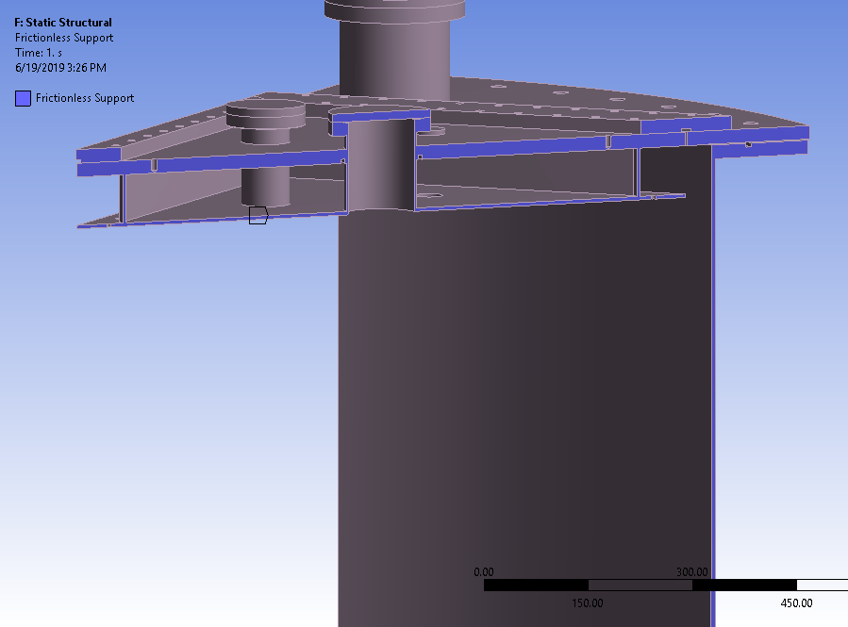
Boundary Conditions

Slide 5
Load
20 PSI
20 PSI
5 PSI

Slide 6
Total Deflection
Equivalent Stress
3 mm 8 mm 25 mm 28 mm
58 MPa 175 MPa 460 MPa

Slide 7
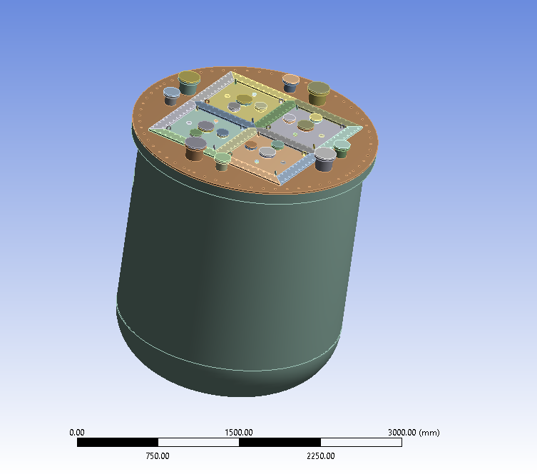
Full Model

Slide 8
Boundary Condition

Slide 9
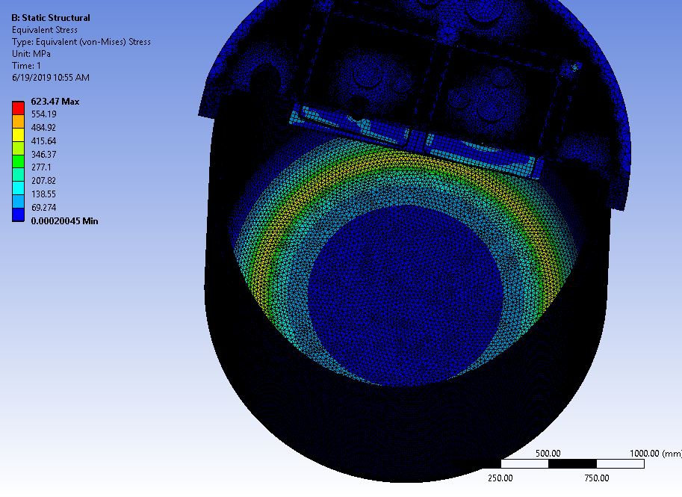
Deformation
Stress

Slide 11
TOP FLANGE ONLY

Slide 12
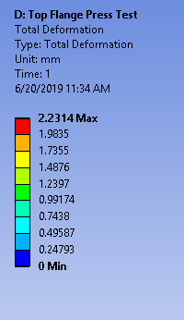
Deformation

Slide 13
Deformation

Slide 14
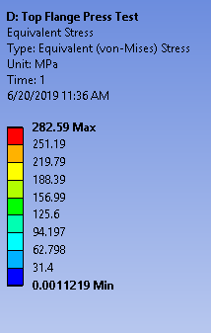
Stress Plot
63 MPa 130 MPa

Slide 15
Stress plot

Slide 16
Stress Plot

Slide 17
16.7 ksi Max. allowable stress of 304SS for temp not exceeding 100 F. Table 1A Pg. 84 BPVC II_D_C
16.7 ksi = 115 MPa

Slide 18
Revision 1 :
Apply loads on sides of vacuum pockets, underneath blind flanges. Symmetry BC to 1/8th model.

Slide 19
1/8th Model Deflection:
Comparison
New

Slide 20
1/8th Model Stress:
Comparison
New

Slide 21
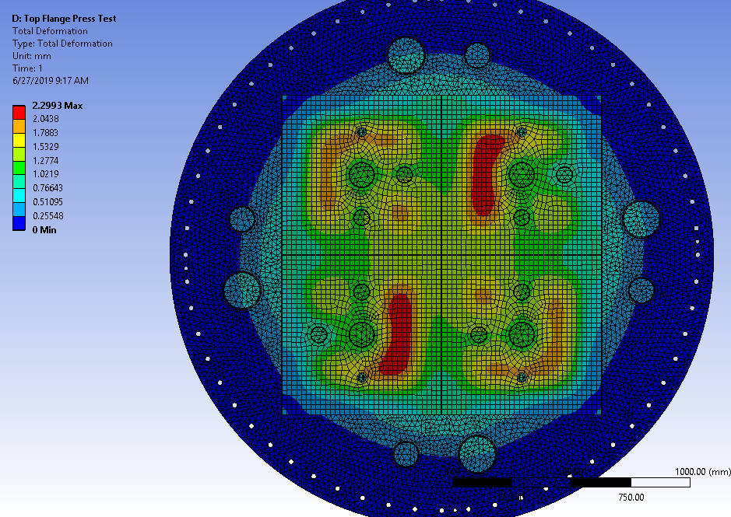
Top Flange Deflection:
Comparison
New

Slide 22
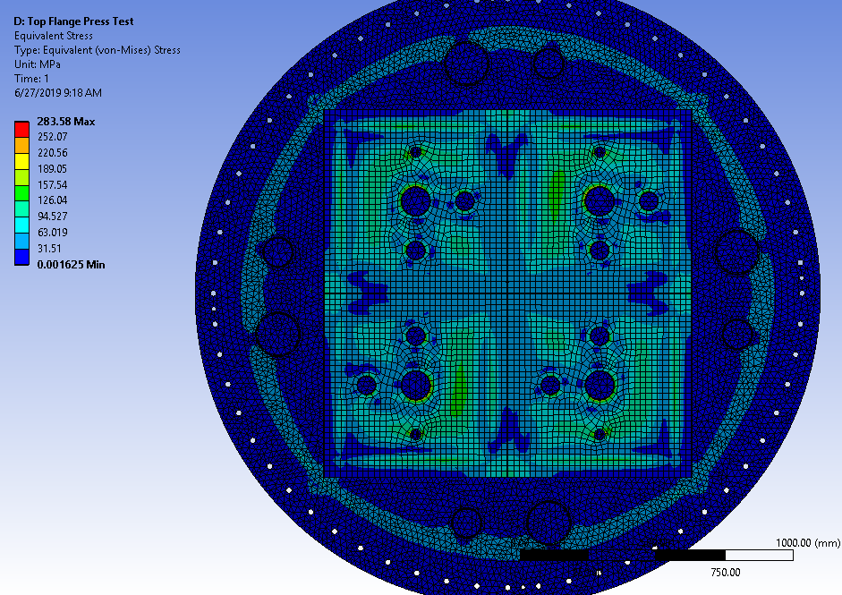
Top Flange Stress:
Comparison
New

