Slide 1
MQXFA03 Coil Review Coil QXFA204
Henry M. Hocker, Jr.
June 27, 2019

Slide 2
Outline
Notes / photos
Reaction plots
Electrical Data
CMM
DRs

Slide 3
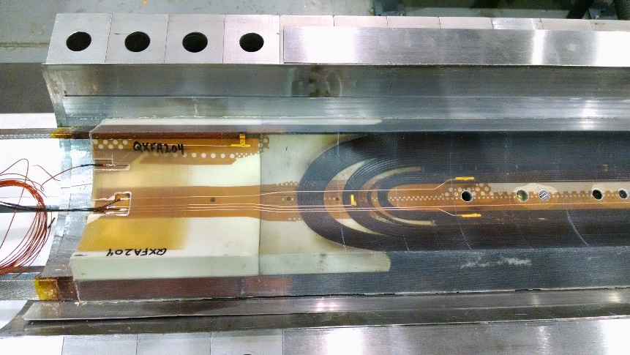
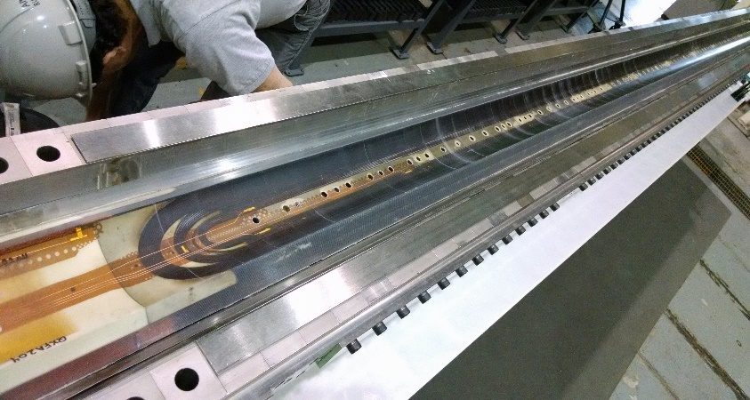
QXFA204
Prior to change for B6 adjustment
4 layers glass on pole
10 mil G11 shims on midplane
Pole gaps
1.8 mm after reaction
Lead / Wire length
2.6 m coil leads
1 m coil tap wires
4.5 m splice tap wires
1 m quench heater wires
Coil length
4525.1 mm overall length
Tap Wires A01 & B01 are attached to the leads (not connected in the wiring pocket, as they will be from now on

Slide 4
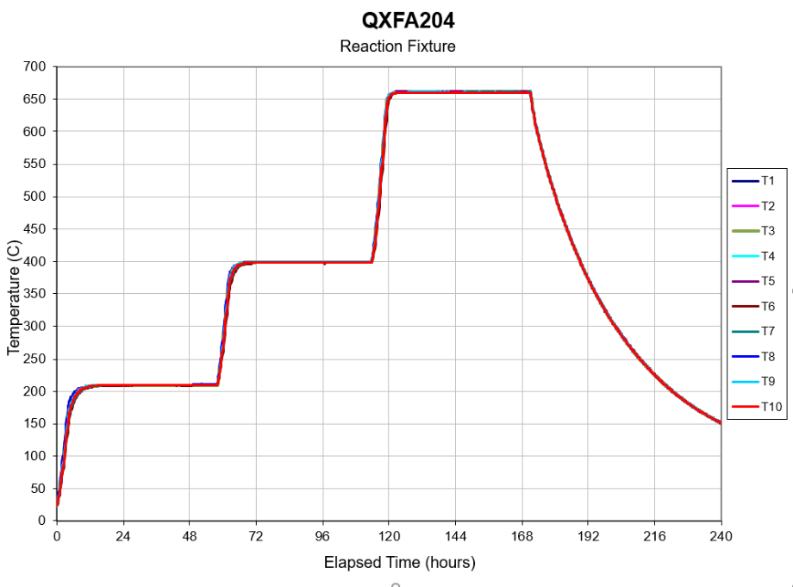
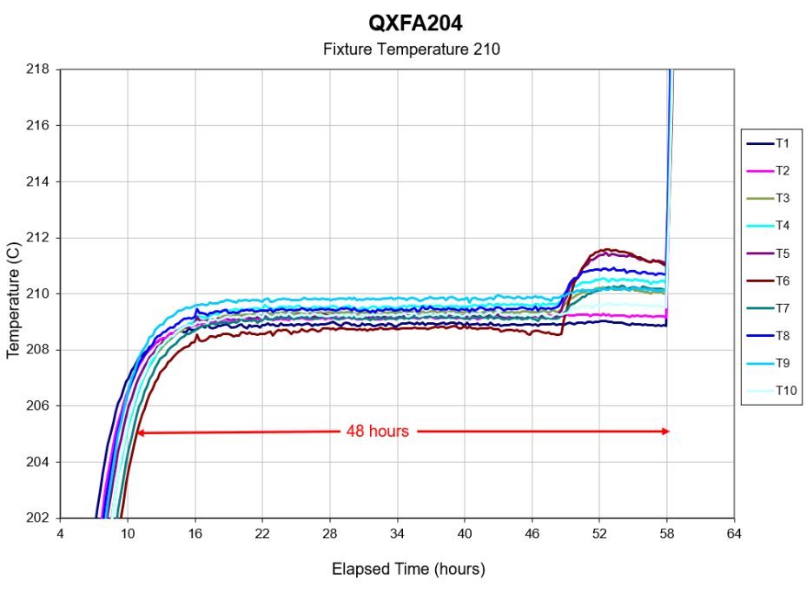
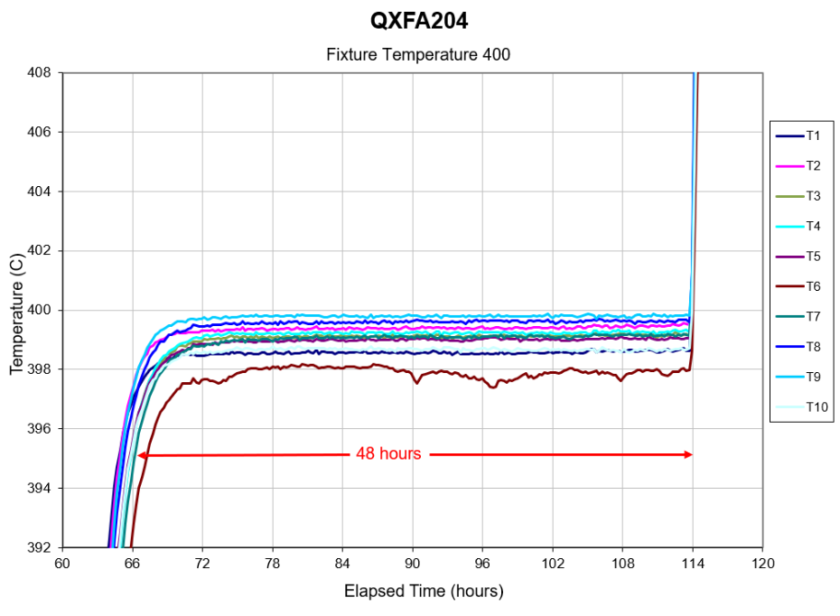
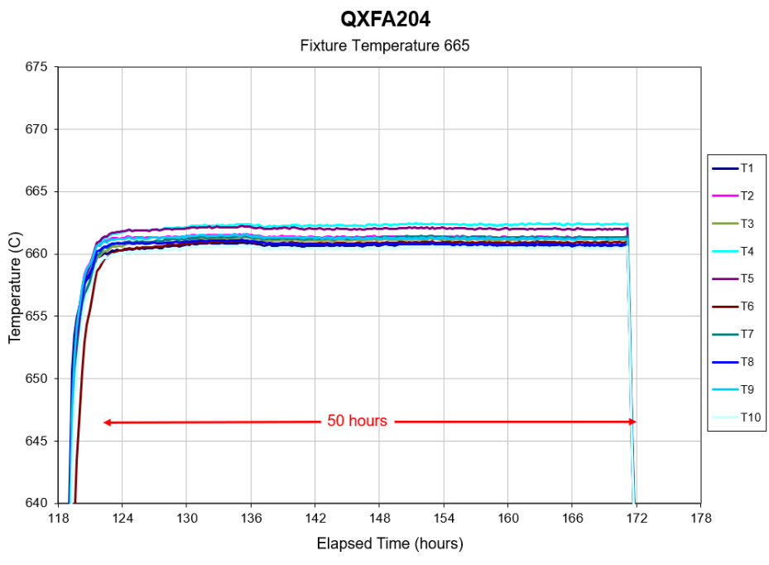
QXFA204
Reaction Cycle:
48 Hours at 210 C
48 hours at 400 C
50 hours at 665 C

Slide 5
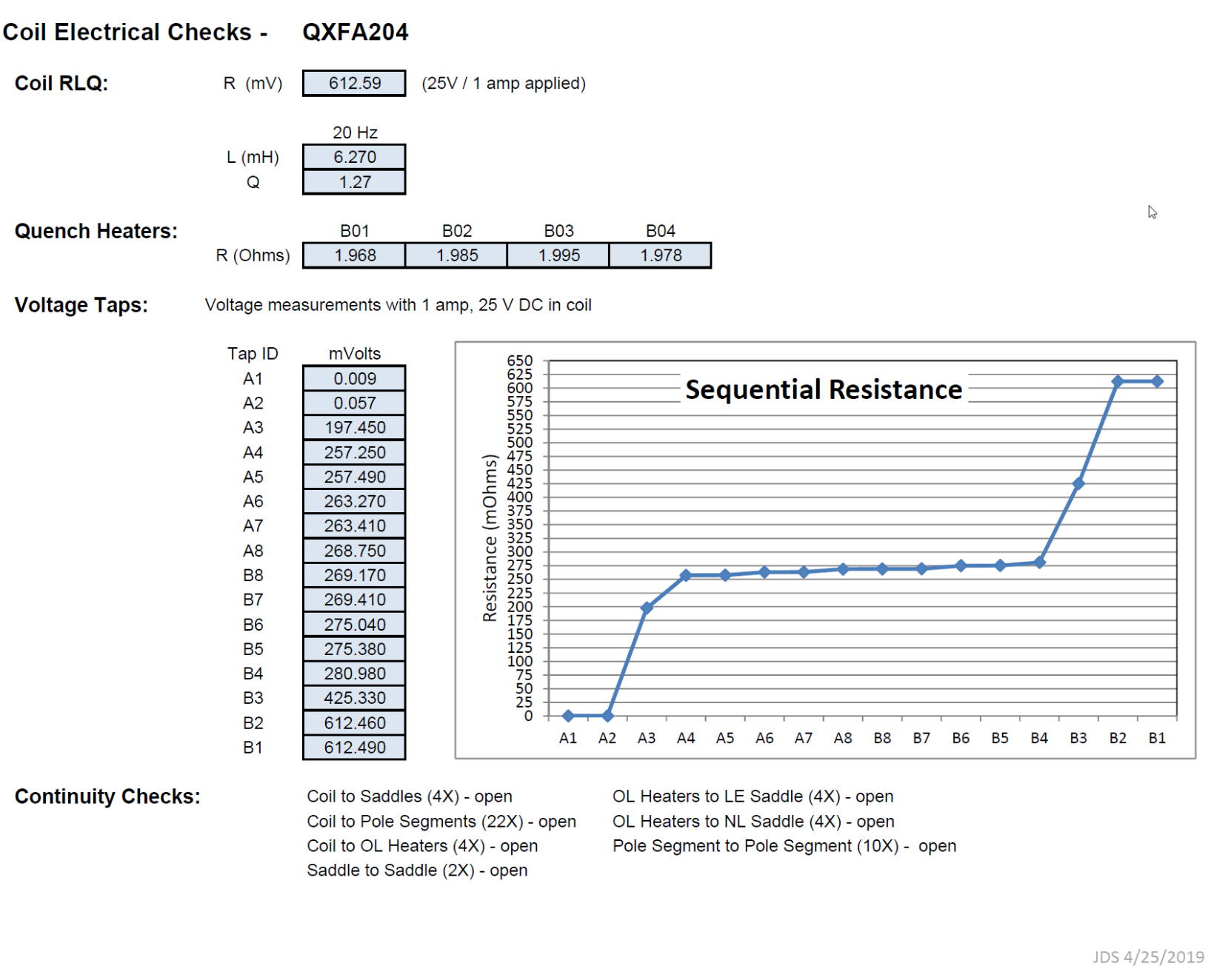
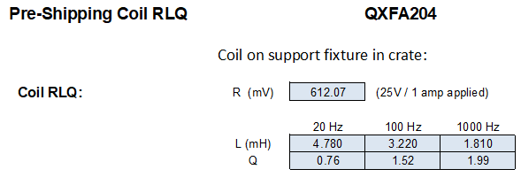
QXFA204

Slide 6
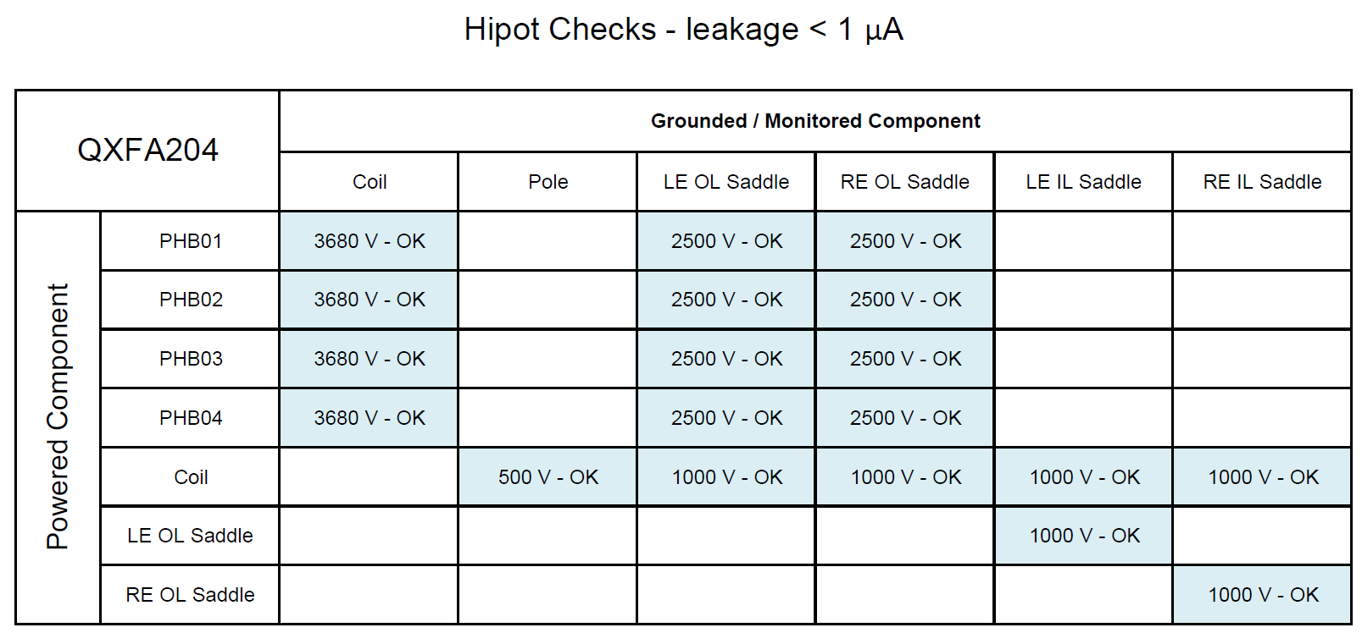
QXFA204

Slide 7
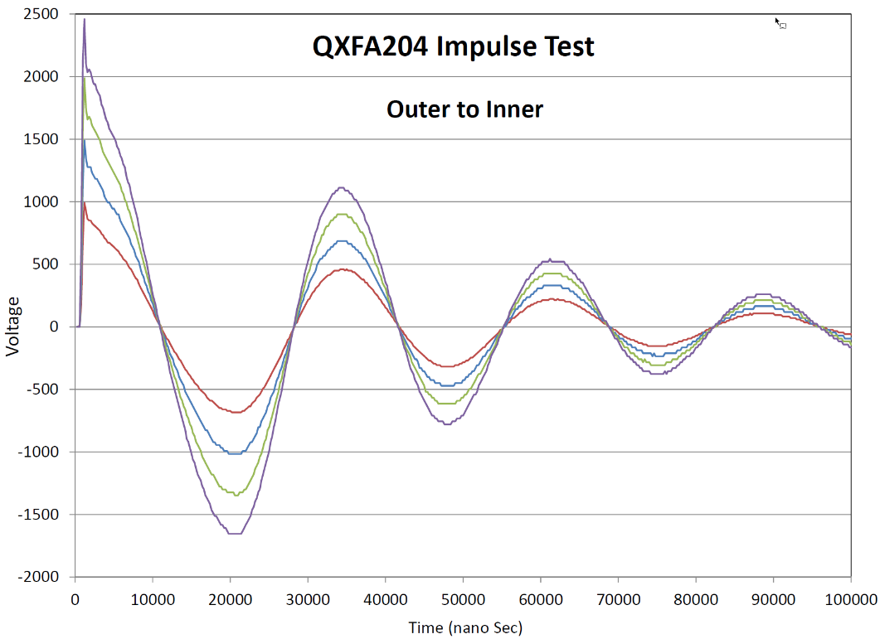
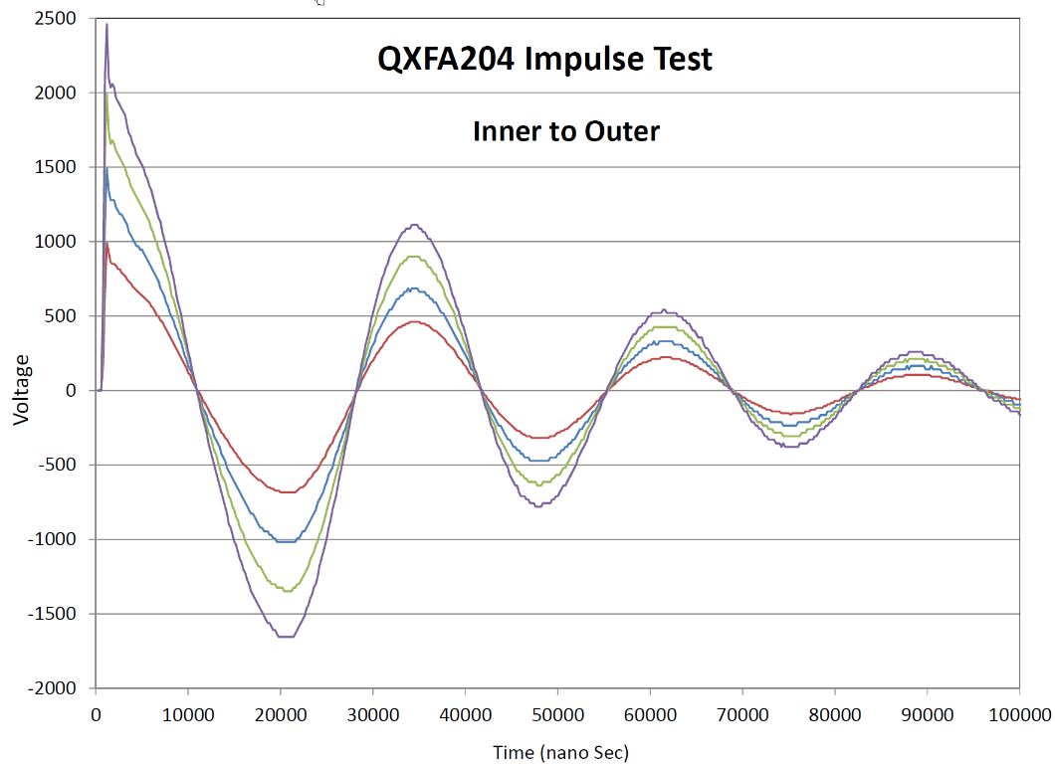
QXFA204

Slide 8
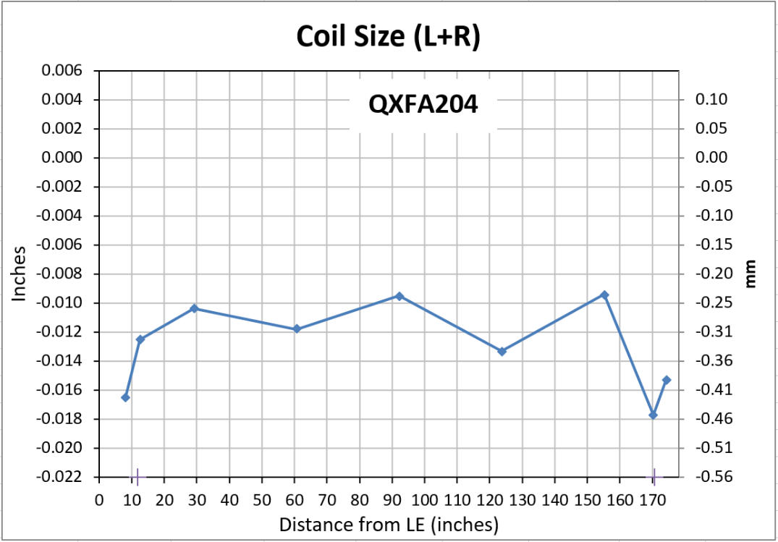
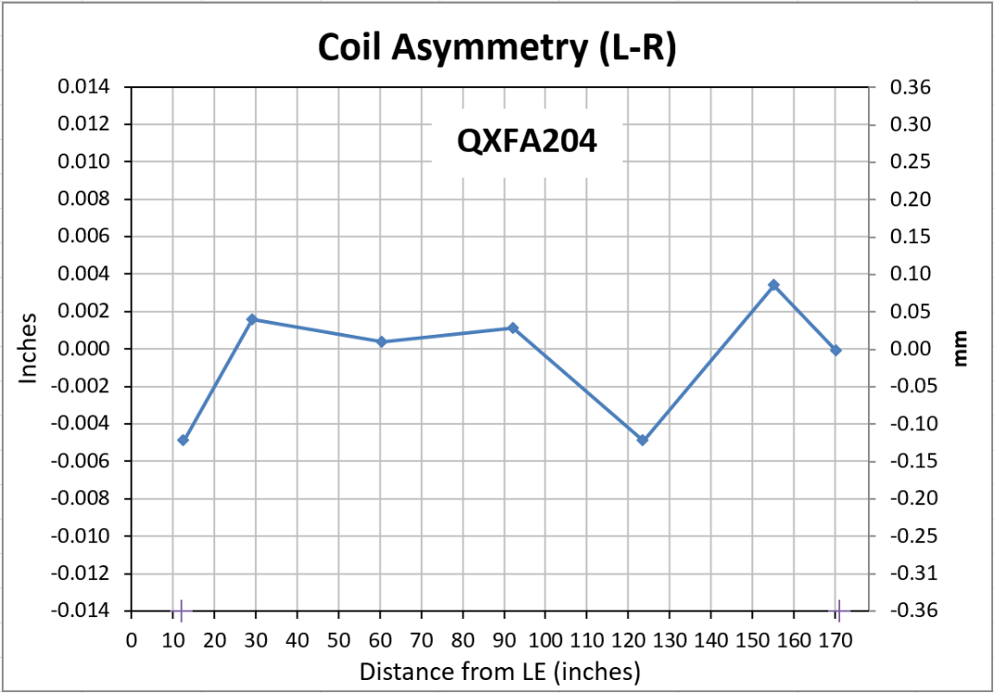
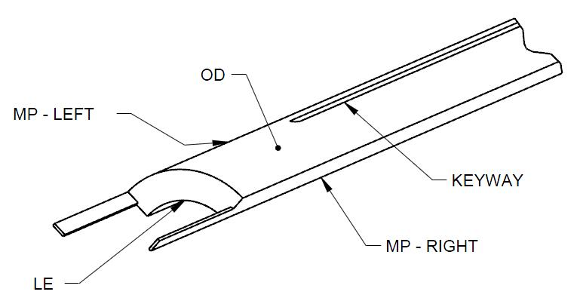
QXFA204
Faro arm coil size measurements:
Primary best fit to coil OD, secondary to keyway (midplane where no keyway).
Nominal Coil Dimensions:
Outer Radius = 113.376 mm
Midplane offset = .125 mm
Keyway Width = 14.00 mm

Slide 9
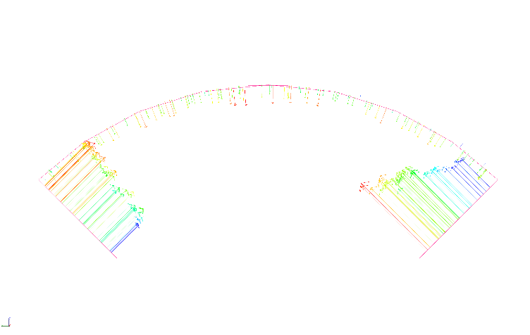
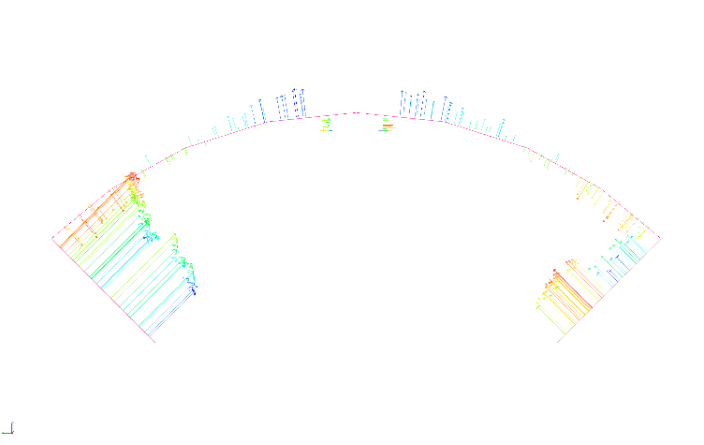
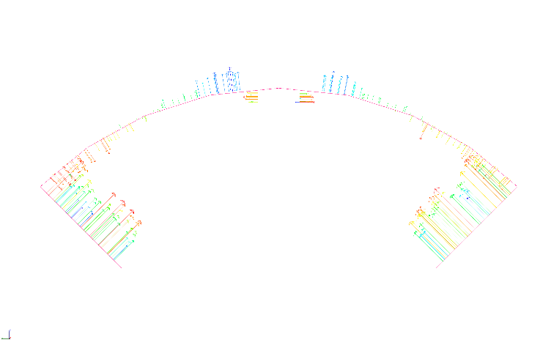
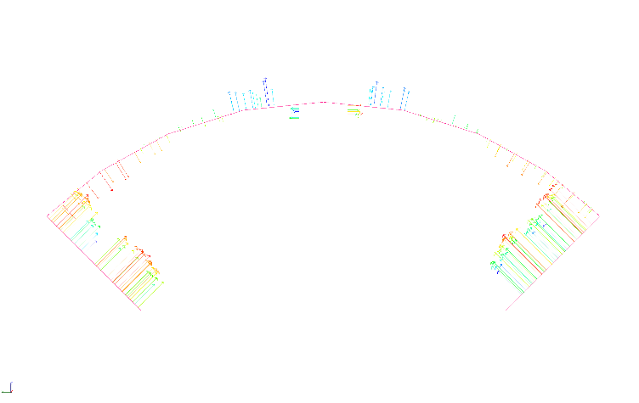
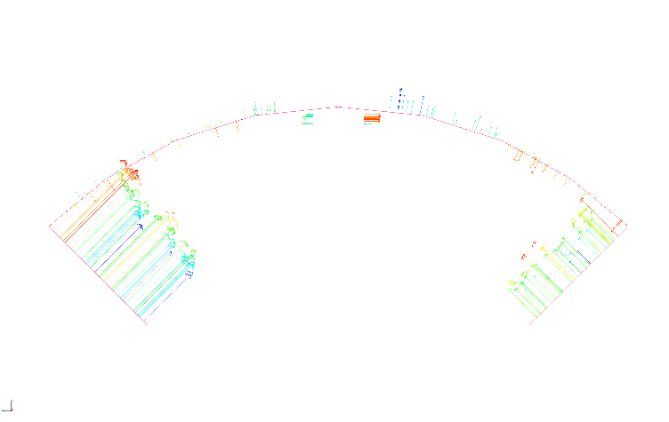
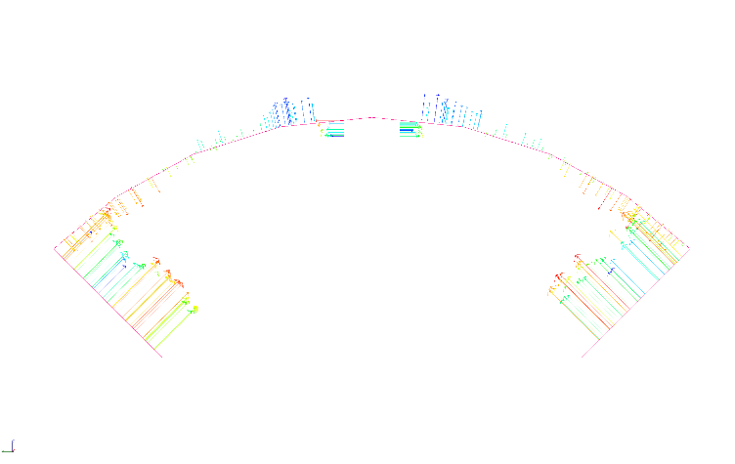
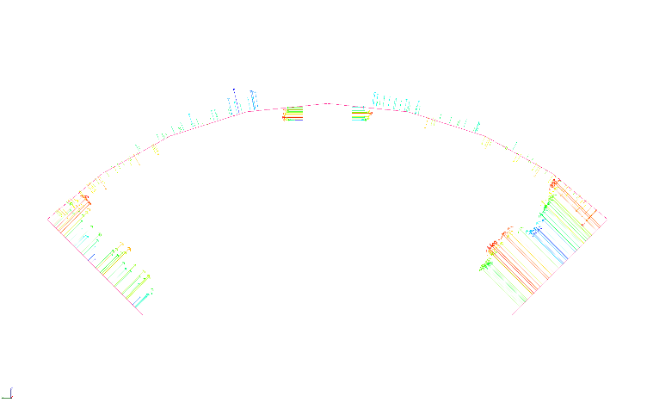
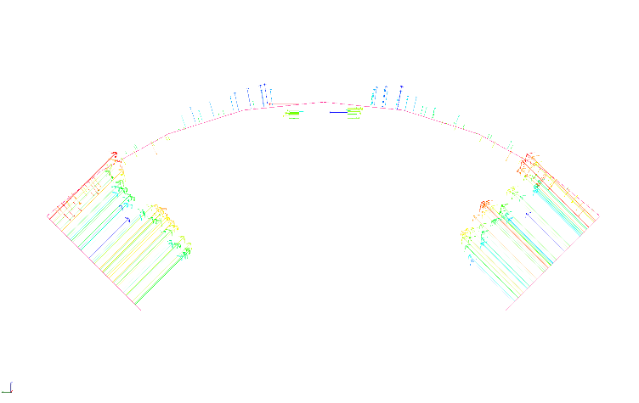
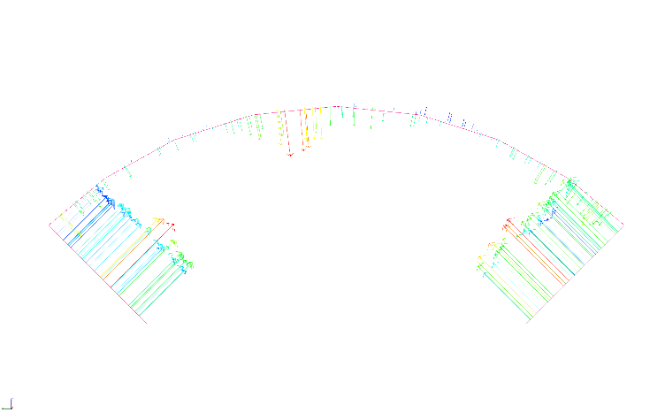
QXFA204
8 (207)
13 (320)
29 (740)
61 (1540)
92 (2340)
124 (3140)
155 (3940)
170 (4323)
174 (4426)

Slide 10
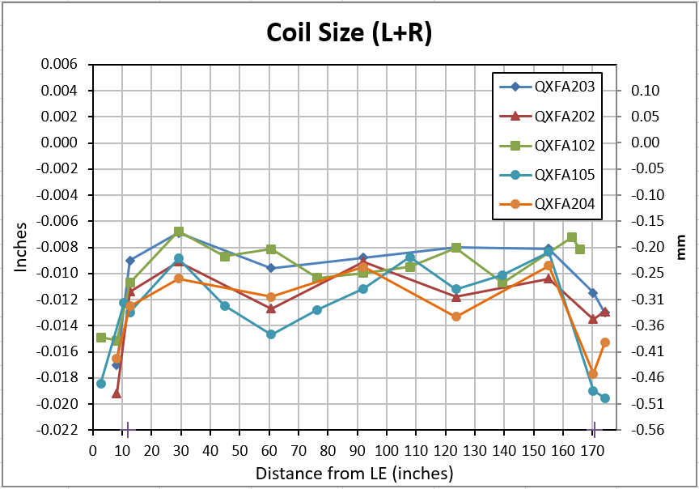
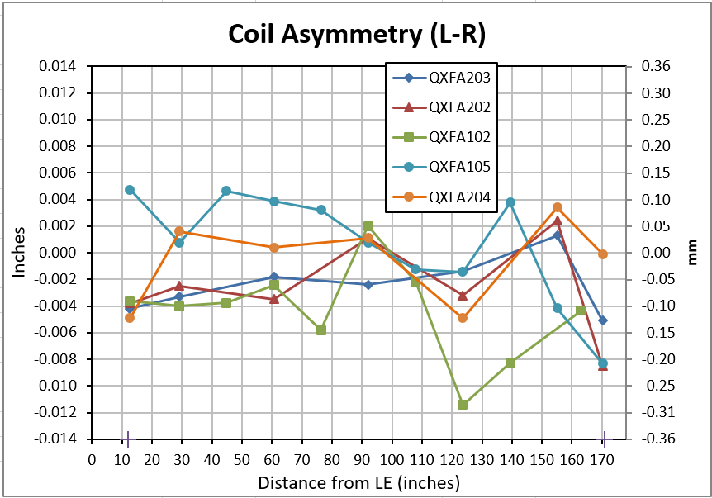
QXFA Coils
Coil size comparison:

Slide 11
QXFA204
DRs
Small number of issues with supplied parts – Addressed via replacement.
Conductor abrasions noted in a number of places during cable inspection
Overall coil length out of range (low side)
R value slightly outside range listed in doc 521 v12.

