Slide 1
MQXFA03 Coil Replacement Options for Coil 109 (Coils 112 and 204 only)
Dan Cheng, et al.
6/20/2019
LBNL

Slide 2
Outline
Coil 109 Issue Timeline
Options for replacement
Measurements of Coils 112 and 204
Proposed Coil Pack
Coil Pack schedule
Shell fabrication schedule
Summary

Slide 3
Coil 109 Issues Timeline
All coils passed Acceptance Testing after receipt at LBNL
See MQXFA03 Readiness Review material, May 22, 2019
https://indico.fnal.gov/event/20781
After assembly in coil pack
Impulse tests showed HF artifacts on impulse test (both Direct and Reversed polarities)
Removing connectors did not change result
Removing VT twist in wiring also did not change
Hipot testing (not normally performed at this stage of Coil Pack assembly) was performed
Test parameters with Chroma 10973 hipot unit
5 V/sec ramp, 10 µA threshold
Resulted in a breakdown from Coil to ILRE end shoe at 114 V
Resistive short then became present, at about 3 kOhm
Decided to replace Coil 109
Upon disassembly of coils (but still “paired”), short in Coil 109 now shows ~198 kOhm --evidence of change
Evaluating options for replacement coil

Slide 4
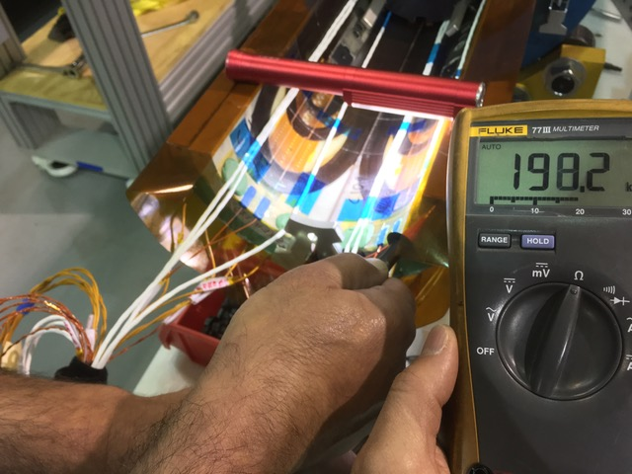
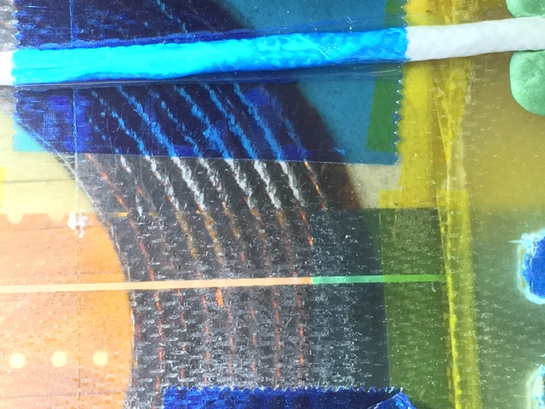
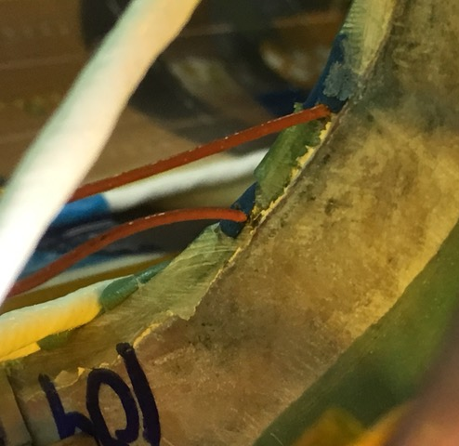
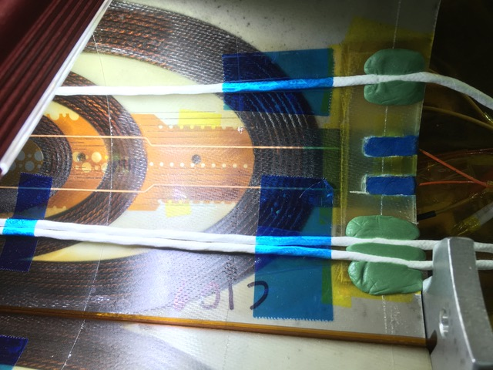
Coil 109 RE Pics
Pictures of the RE have been taken, though examination is not complete yet
Nothing particular was observed yet, but to be discussed at a later date

Slide 5
Coils at LBNL Slated for MQXFA04
Four coils already at Berkeley for next magnet, MQXFA04
112, 113 (Fabricated at FNAL)
203, 204 (Fabricated at BNL)
Coils were already CMM’d upon receipt
EQC acceptance tests had not been performed prior to Coil 109 issue
Technician timing and availability only allowed for two of the four coils in the near term to be tested
Prioritized Coils 112 and 204 to be tested for replacement, results shown here

Slide 6
Possible Replacement Coils
Both Coils 112 and 204 passed all EQC tests
See next slides
CMM measurements are compared with that of 109
If the coil size is close to that seen in 109 another Fuji coil pack build may not be necessary (savings of ~4 days)
Data shown in next slides

Slide 7
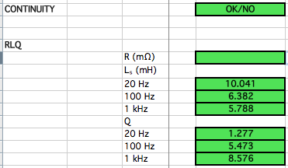
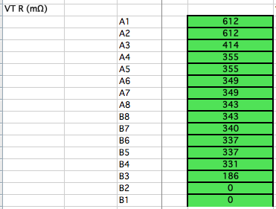
Coil 112 EQC (Post-ship, Pre-Coil Pack)

Slide 8
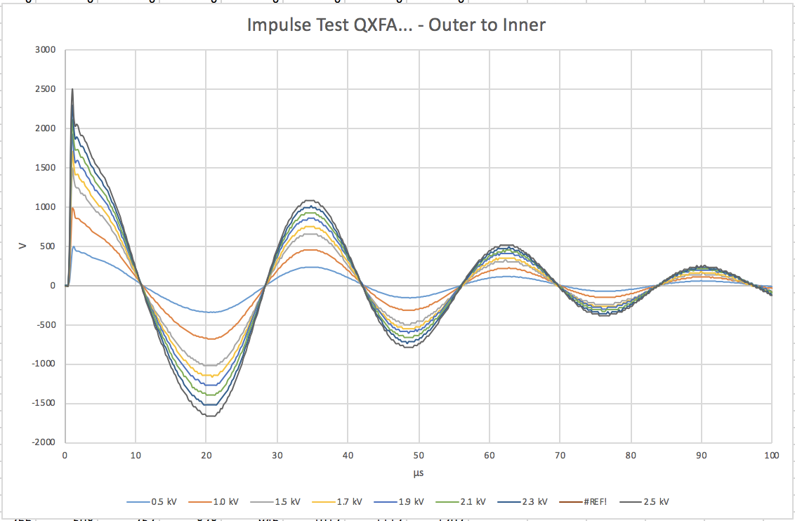
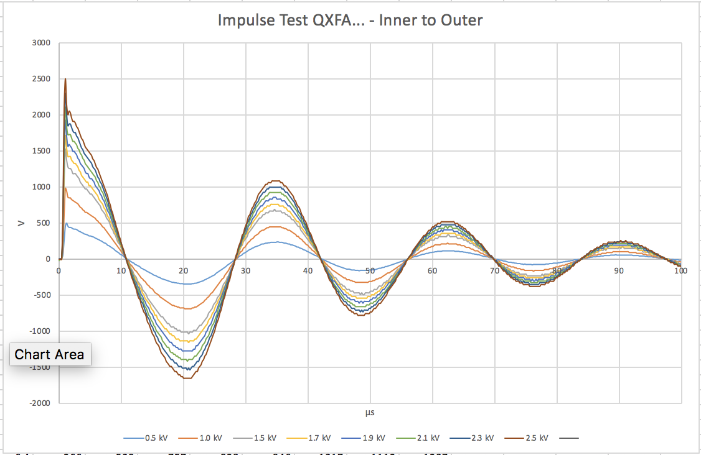
Coil 112 EQC (Post-Ship Impulse)
Direct
Reverse

Slide 9
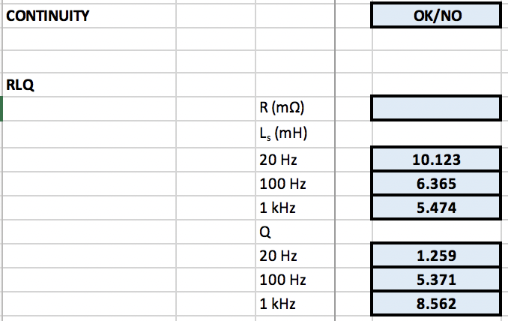
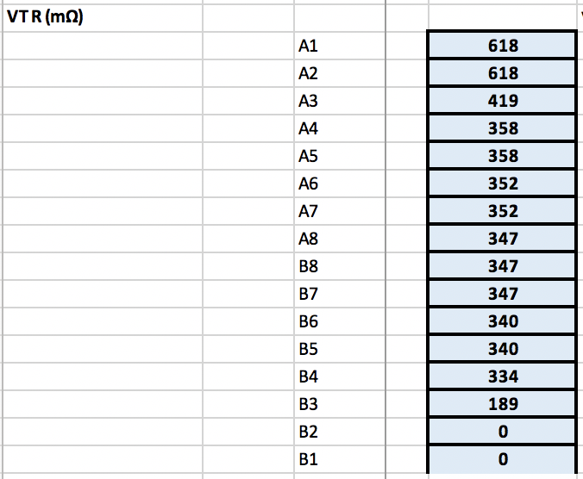
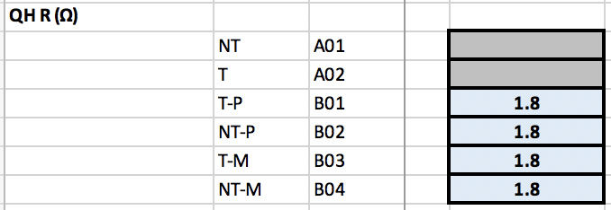
Coil 204 EQC (Post-ship)

Slide 10
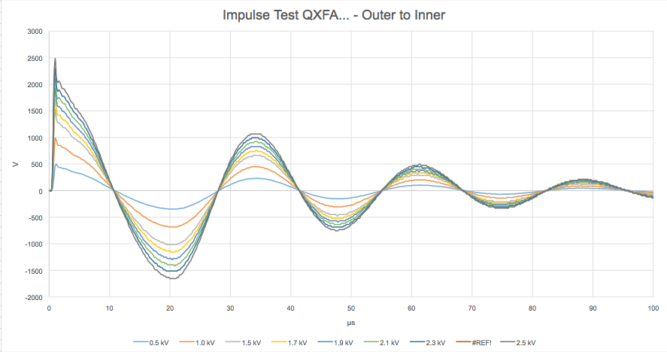
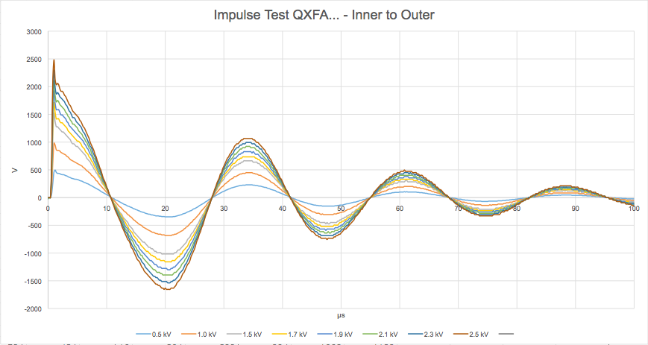
Coil 204 EQC (Post-Ship Impulse)
Direct
Reverse

Slide 11
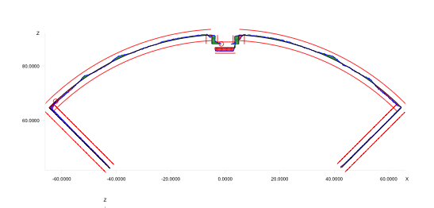
CMM Measurements
All LBNL data was taken using a Zeiss Accura for CMM
Calypso software post-processed data
All surfaces were “best-fit” to reference geometry with equal weighting
The alignment key was not included in coil 109 measurements
ID was not measured (will be with new LBNL CMM system)
New Leica tracker system will be utilized for later coils, along with Spatial Analyzer (weighted fit will be possible)

Slide 12
CMM Measurements
Coils are measured after receipt
Cross Section Data was collected in three sections
LE Section (2 points)
10 straight section locations (10 points)
RE Section (1 point)
For MQXFA03 SG is only at ~3940 mm location
Prior three locations no longer used
2 LE Points
RE Point
3140 mm
3940 mm
740 mm
1940 mm
CMM Model Standard:
Inner Radius: 74.75 mm
Outer Radius: 113.376 mm
Midplane offset: 0.125 mm

Slide 13
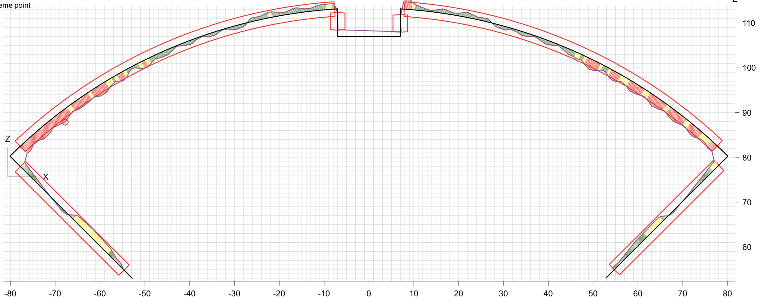
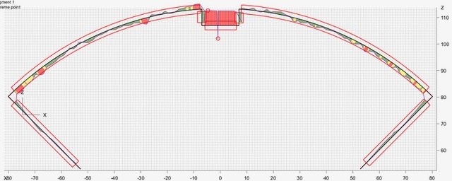
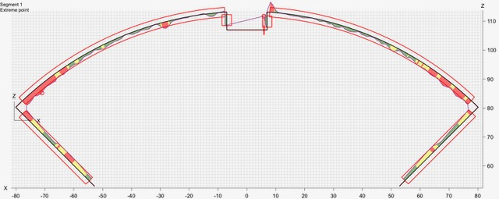
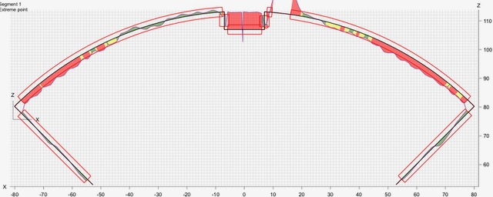
(S. Sec) Graphical Profiles at 740 mm from LE
Profile: ± .002”
Coil 204
Radial: -0.001”
Midplane: -0.001”
Coil 110
Radial: -0.0005”
Midplane: -0.0005”
Coil 111
Radial: 0.001”
Midplane: -0.0015”
Coil 202
Radial: -0.002”
Midplane: 0.0005”

Slide 14
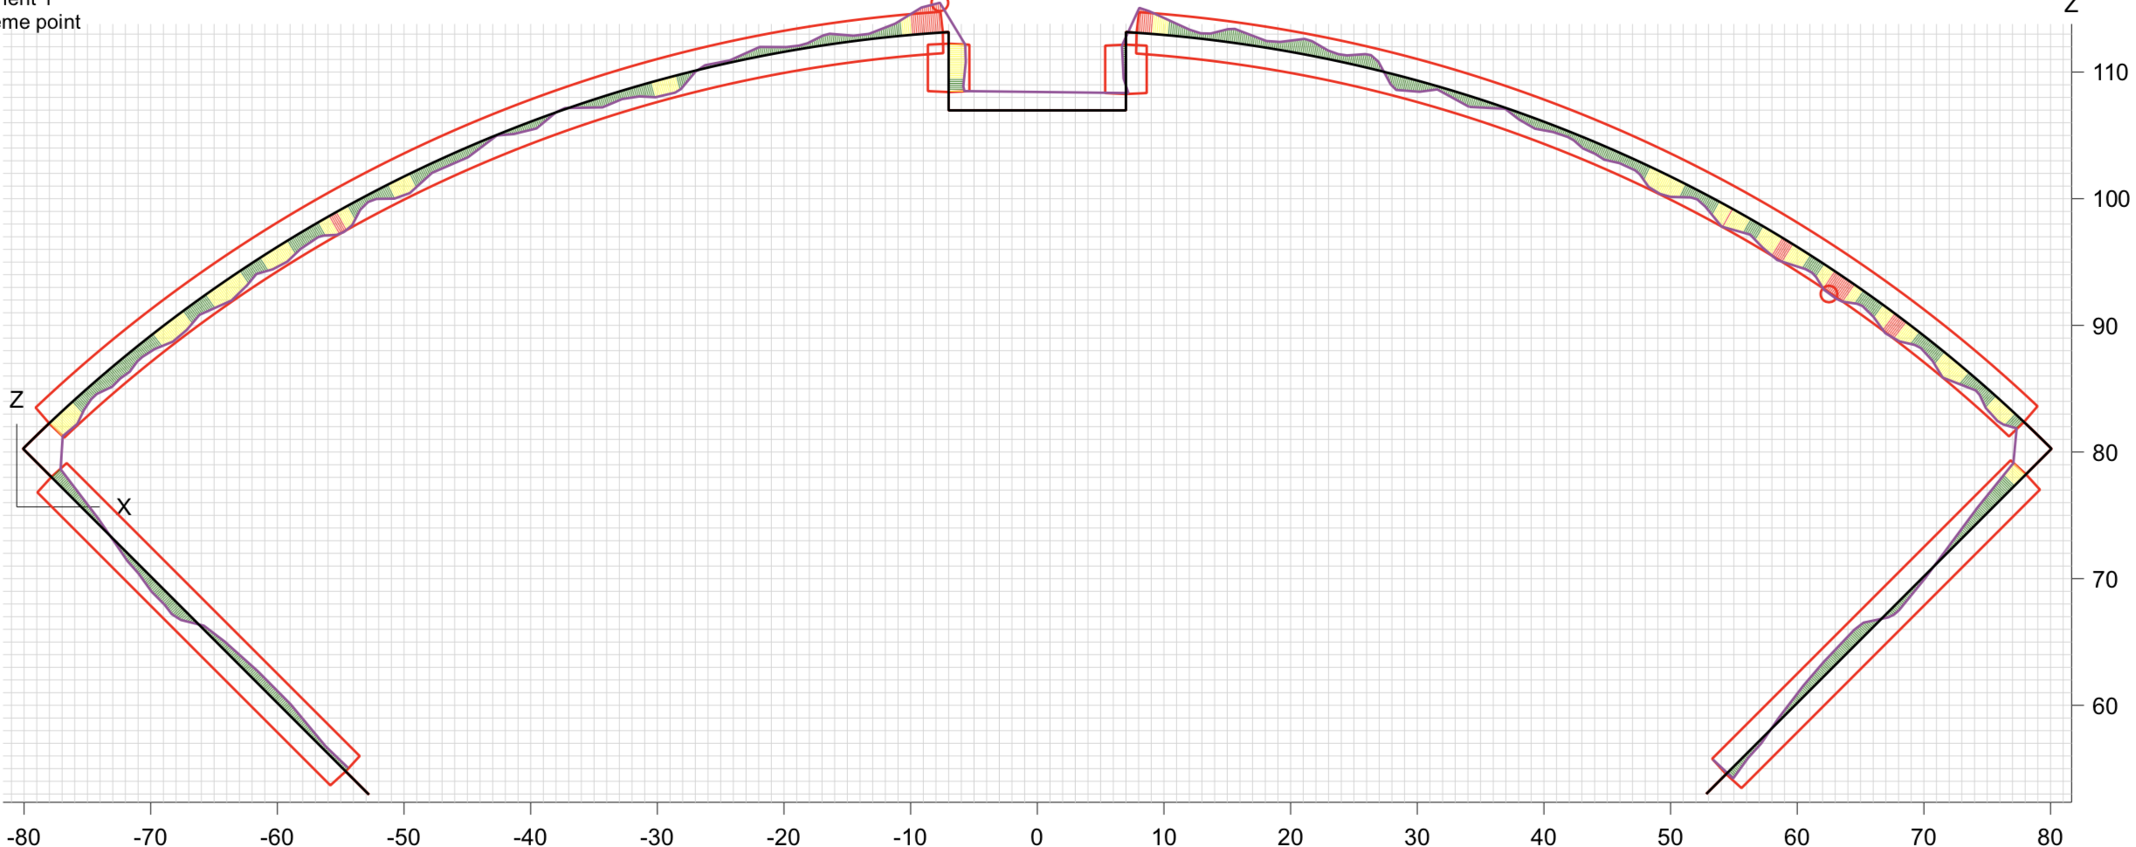
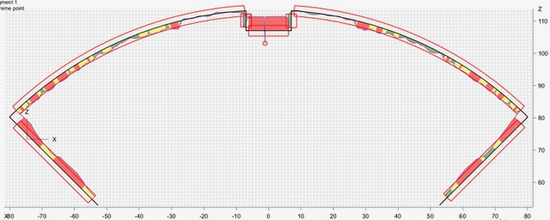
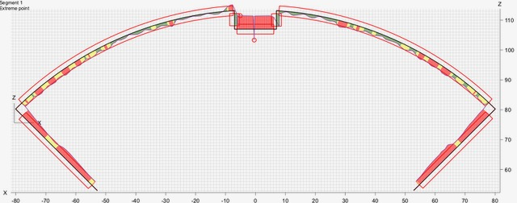
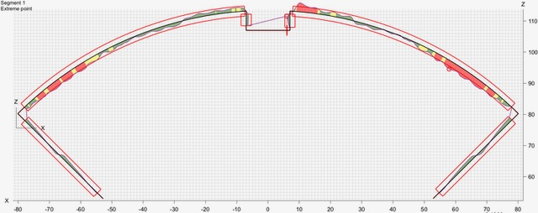
(S. Sec) Graphical Profiles at 1940 mm from LE
Profile: ± .002”
Coil 204
Radial: -0.0015”
Midplane: -0.0005”
Coil 110
Radial: -0.0015”
Midplane: -0.002”
Coil 111
Radial: -.0015”
Midplane: -0.0025”
Coil 202
Radial: -0.001”
Midplane: -0.0005”

Slide 15
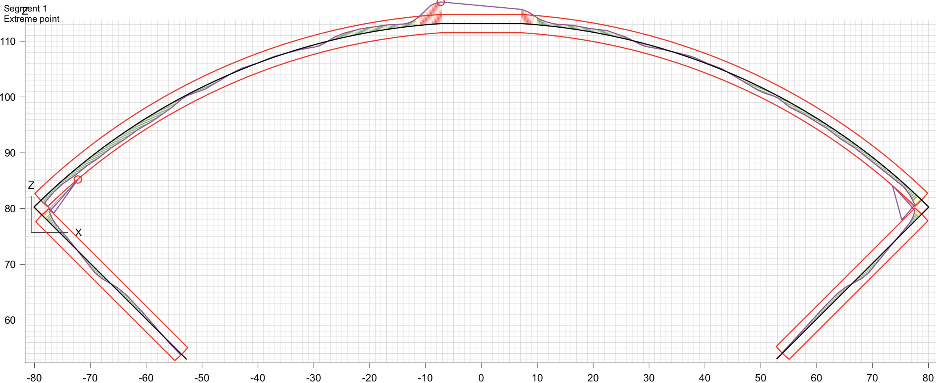
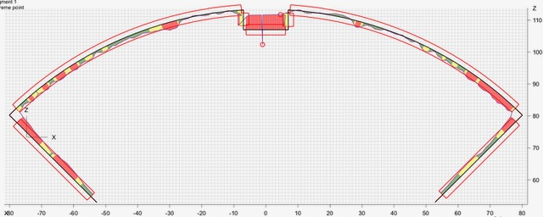
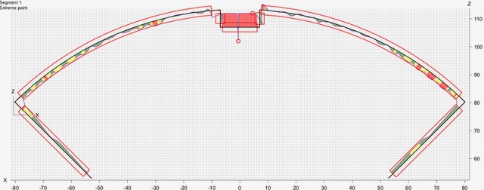
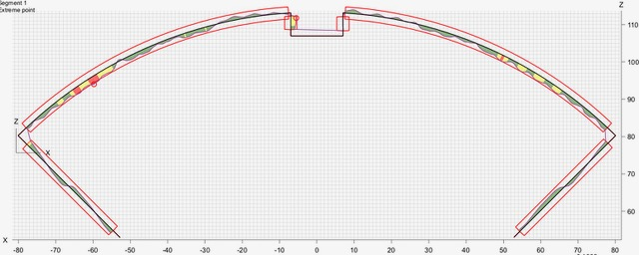
(S. Sec) Graphical Profiles at 3540 mm from LE
Profile: ± .002”
Coil 204
Radial: -0.0005”
Midplane: +0.00”
Coil 110
Radial: -0.001”
Midplane: -0.0015”
Coil 111
Radial: -0.0007”
Midplane: -0.001”
Coil 202
Radial: -0.001”
Midplane: -0.0005”

Slide 16
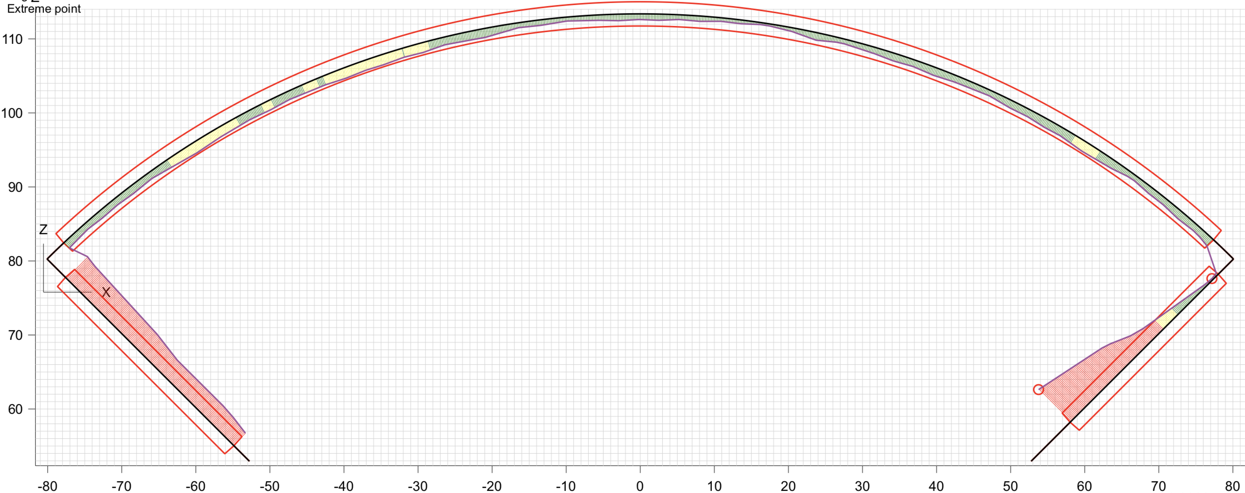
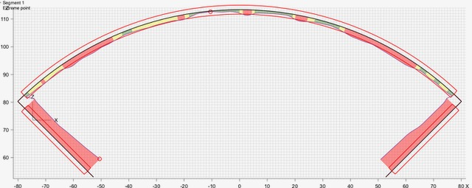
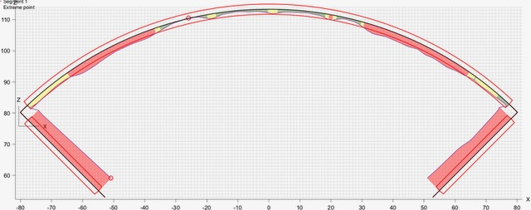
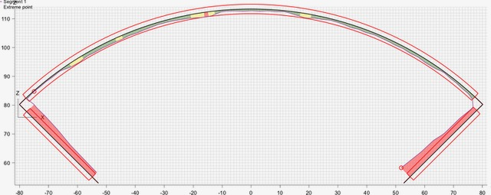
(LE) Graphical Profiles at 207 mm from LE
Profile: ± .002”
Coil 204
Radial: -0.001”
Midplane: -0.0035”
Coil 110
Radial: -0.002”
Midplane: -0.007”
Coil 111
Radial: -0.002”
Midplane: -0.007”
Coil 202
Radial: -0.001”
Midplane: -0.0035”

Slide 17
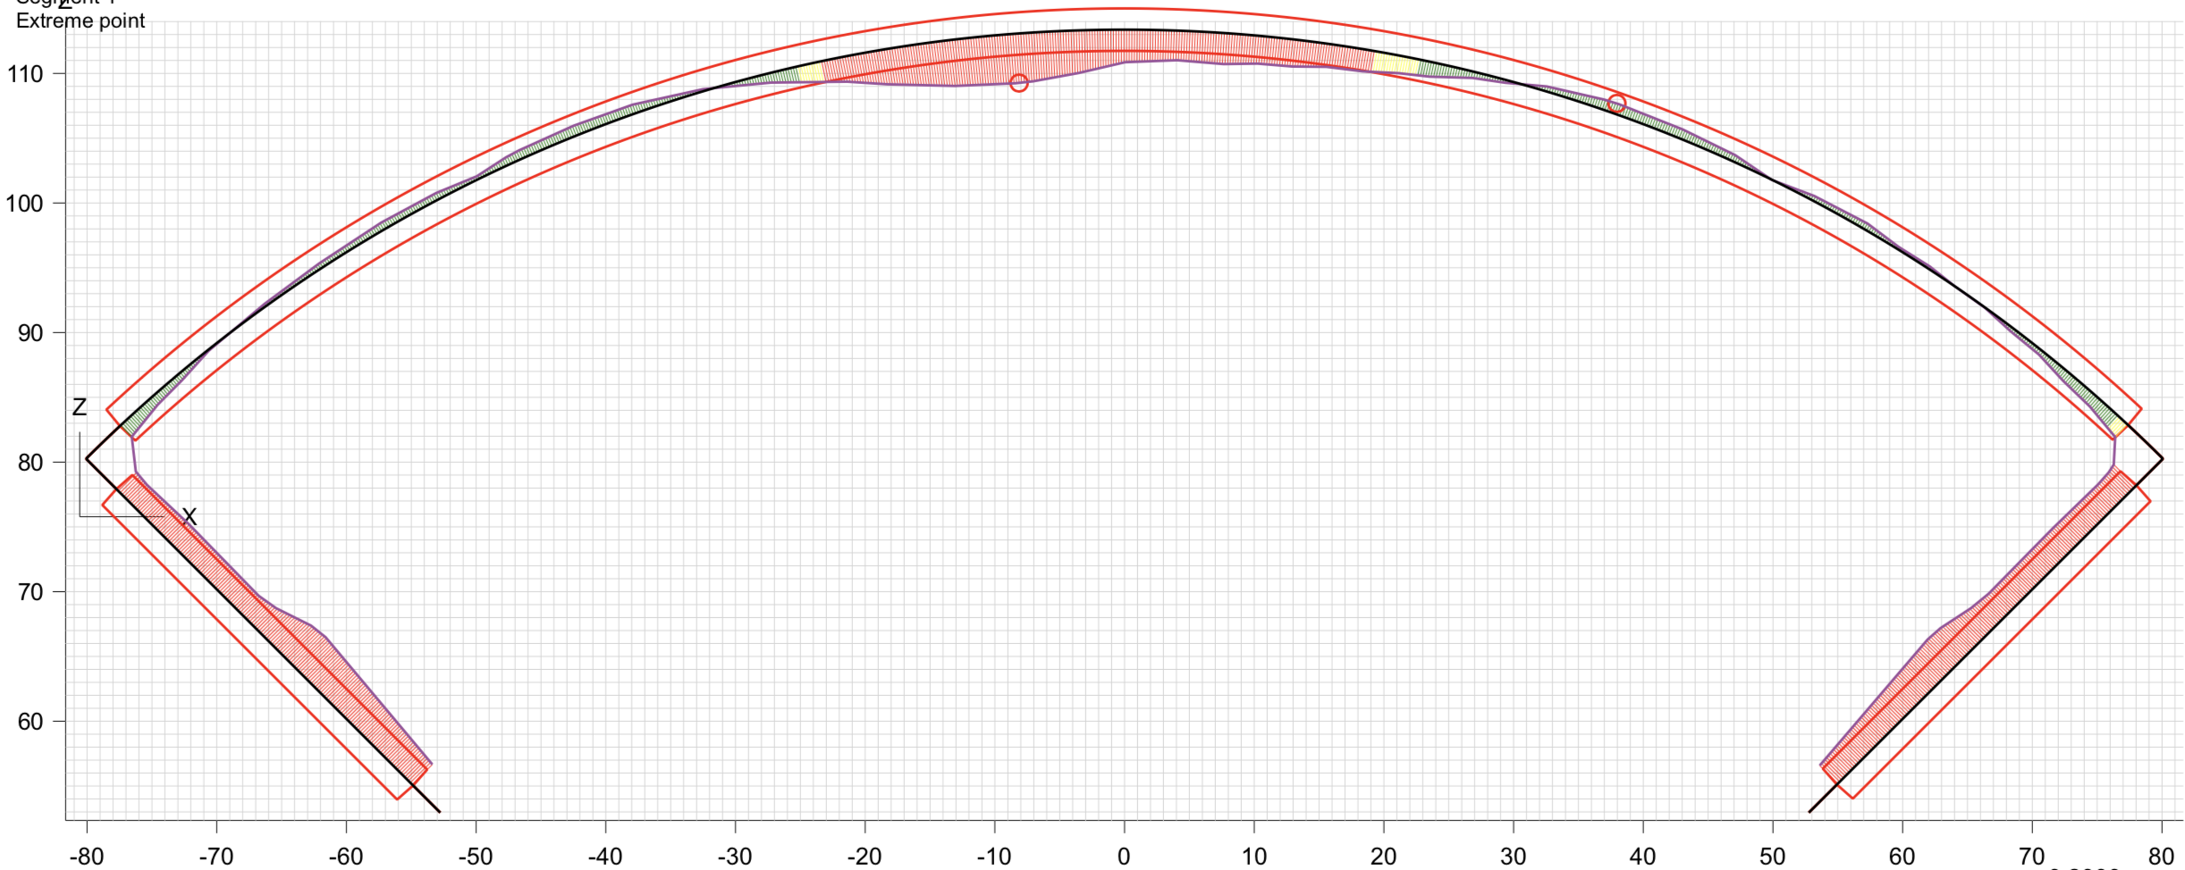
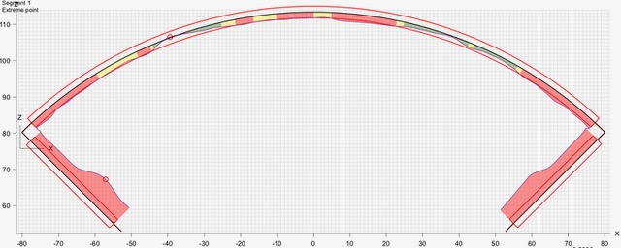
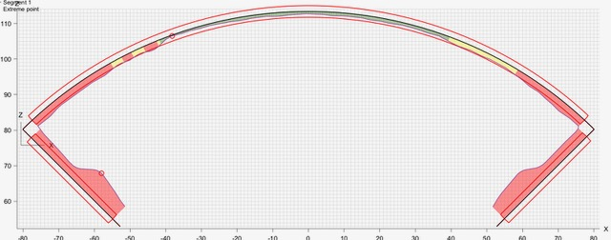
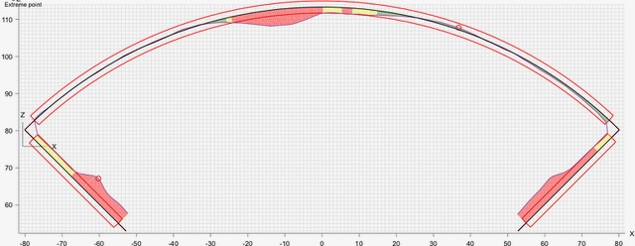
(RE) Graphical Profiles at 4426 mm from LE
Profile: ± .002”
Coil 204
Radial: 0.0005”
Midplane: -0.0025
Coil 110
Radial: -0.0018”
Midplane: -0.0055”
Coil 111
Radial: -0.0015”
Midplane: -0.006”
Coil 202
Radial: -0.0005”
Midplane: -0.003”

Slide 18
MQXFA03 Coil CMM Summary, 204 replace 109
Radial Size deviations (inches)
Loc (mm) | A204* | A110 | A111 | A202
70 | 0.002 | -0.002 | -0.003 | -0.002
207 | -0.001 | -0.002 | -0.002 | -0.001
320 | -0.001 | 0 | -0.005 | -0.0005
740 | -0.001 | -0.0005 | -0.001 | -0.002
1140 | -0.0015 | -0.0015 | -0.002 | -0.002
1540 | -0.0015 | -0.0015 | -0.0017 | -0.001
1940 | -0.0015 | -0.0015 | -0.0015 | -0.001
2340 | -0.0015 | -0.0015 | -0.001 | -0.001
2740 | -0.0015 | -0.0015 | -0.0015 | -0.001
3140 | 0 | -0.0015 | -0.001 | -0.0005
3540 | -0.0005 | -0.001 | -0.0007 | -0.001
4110 | -0.001 | -0.001 | -0.0008 | -0.0005
4323 | -0.0015 | -0.001 | -0.001 | -0.0005
4426 | 0.0005 | -0.0018 | -0.0015 | -0.0005
Avg 320-4323 | -0.0011 | -0.0011 | -0.0016 | -0.0010
RMS | 0.00120 | 0.00125 | 0.00201 | 0.00117
St. Dev. | 0.00052 | 0.00053 | 0.00126 | 0.00055
Max | 0 | 0 | -0.0007 | -0.0005
Min | -0.0015 | -0.0015 | -0.005 | -0.002
Avg LE | *0.0005 | -0.0020 | -0.0025 | -0.0015
RE | 0.0005 | -0.0018 | -0.0015 | -0.0005
Midplane Size Deviations (inches)
Loc (mm) | A204* | A110 | A111 | A202
70 | -0.005 | -0.008 | -0.007 | -0.004
207 | -0.0035 | -0.007 | -0.007 | -0.0035
320 | -0.0005 | 0.001 | 0.001 | 0.0005
740 | -0.001 | -0.0005 | -0.0015 | 0
1140 | -0.001 | -0.002 | -0.0035 | -0.001
1540 | -0.001 | -0.002 | -0.0025 | -0.001
1940 | -0.0005 | -0.002 | -0.0025 | -0.0005
2340 | 0 | -0.002 | -0.002 | 0.0005
2740 | -0.001 | -0.0025 | -0.002 | 0
3140 | 0 | -0.002 | -0.002 | 0.0005
3540 | 0 | -0.0015 | -0.001 | -0.0005
4110 | -0.001 | -0.001 | -0.0015 | 0
4323 | -0.0015 | -0.002 | -0.0018 | -0.0018
4213 | -0.0025 | -0.0055 | -0.006 | -0.003
Avg 320-4323 | -0.0007 | -0.0015 | -0.0018 | -0.0003
RMS | 0.00074 | 0.00175 | 0.00208 | 0.00057
St. Dev. | 0.00046 | 0.00104 | 0.00118 | 0.00058
Max | 0 | 0.001 | 0.001 | 0.0005
Min | -0.001 | -0.0025 | -0.0035 | -0.001
Avg LE | *-0.0043 | -0.0075 | -0.0070 | -0.0038
RE | -0.0025 | -0.0055 | -0.0060 | -0.0030
*see next slide for LE

Slide 19
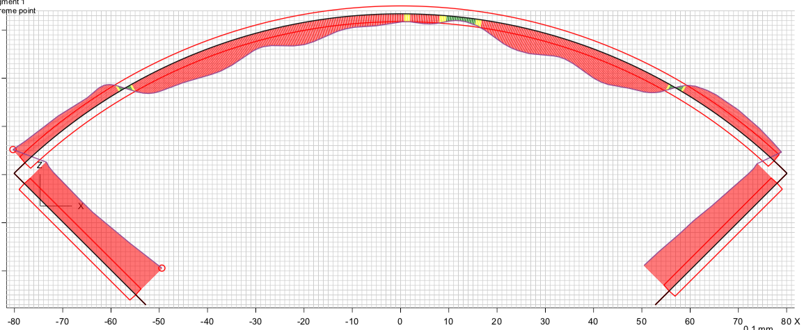
Note on CMM Measurements on end
Profile at 70
There is a pocket in the end shoe for the solder connections to be made
“Global Fit” of the profile may overstate profile deviations of the OD
Net radial and midplane deviations are much smaller than what is depicted
New Leica system and Spatial Analyzer software may be utilized to minimize this “global fit” error
Past Fuji paper results showed good exposure even on the ends
End-specific shimming likely is not required

Slide 20
MQXFA03 Coil CMM Meas. Summary w/204
Based on “global fit” visual CMM data after testing:
“Straight section” (averaged profiles between 320 mm and 4323 mm)
Radial deviations from ~-0.001” to ~-0.0016”
Midplane deviations from ~-0.002” to ~0”
Lead End (averaged 2 points on LE)
Radial: ~-0.002 / Midplane: ~-0.006
Return End
Radial: ~-0.0015 / Midplane: ~-0.005
Coils are mostly “undersized” by 0.001”-0.002” from nominal, except in the ends
Shim plan in the next pages assumes no electrical issues affecting coil order

Slide 21
MQXFA03 Coil Pack Build 5 (with 204)
Based on observed size variations, no Fuji Paper build will be necessary.
Same build up (as MQXFAP1b, MQXFAP2) will be utilized
First Coil Pack Shim Plan
Indico page link: https://indico.fnal.gov/event/20110/
Based on experience from MQFXAP1b, MQXFAP2
Final Coil Pack Shim used the same stack as the MQXFAP1b and MQXFAP2 magnets
Recent coils appear to be fairly uniform in size (though MQXFAP1 coils utilized additional midplane shims)

Slide 22
Updated Coil Arrangement with 204
8 x δ_{midplane} = 2 π x δR_{OR}
.0011” Undersized R
Neglected
0.0015” Undersized Midpl.
neglected
0.0011” Undersized R
Neglected
0.0007” Undersized Midpl.
neglected
110
204 (replacing 109)
202
111
0.001” Undersized R
Neglected
0.0003” Undersized Midpl.
neglected
0.0016” Undersized R
neglected
.0018” Undersized Midpl.

Slide 23
MQXFA03 Coil Pack Builds 1 & 2 (both were the same)
Nominal Collar R: 114 mm
Nominal Coil R: 113.376 mm
Nominal Radial shim = 0.025” (0.624 mm)
Plan to still aim for ~0.020”
Target MQXFA03 radial stack up is ~0.021” (~0.54 mm)
0.0045” Coil GPI + 0.007” (Fuji) + 0.005” & 0.005” G11
 | 109 | 110 | 202 | 111
Kapton Ground plane insulation | 0.0045” (0.114 mm)
Coil Specific Radial Shim | 0 | 0 | 0 | 0
Coil-specific midplane shim (None) | 0.000” 0.0 mm | 0.000” 0.0 mm | 0.000” 0.0 mm | 0.000” 0.0 mm
Fuji paper | 0.007” (0.175 mm)
Radial Shim | 0.005” Polyimide + 0.005” G11 (~0.25 mm)

Slide 24
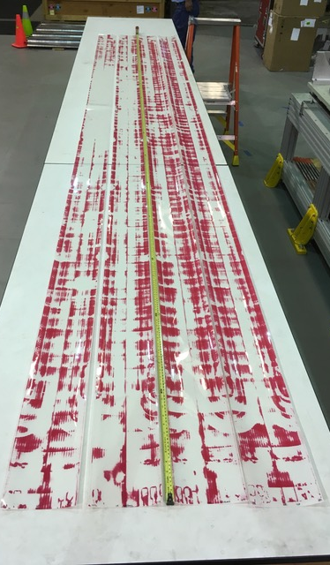
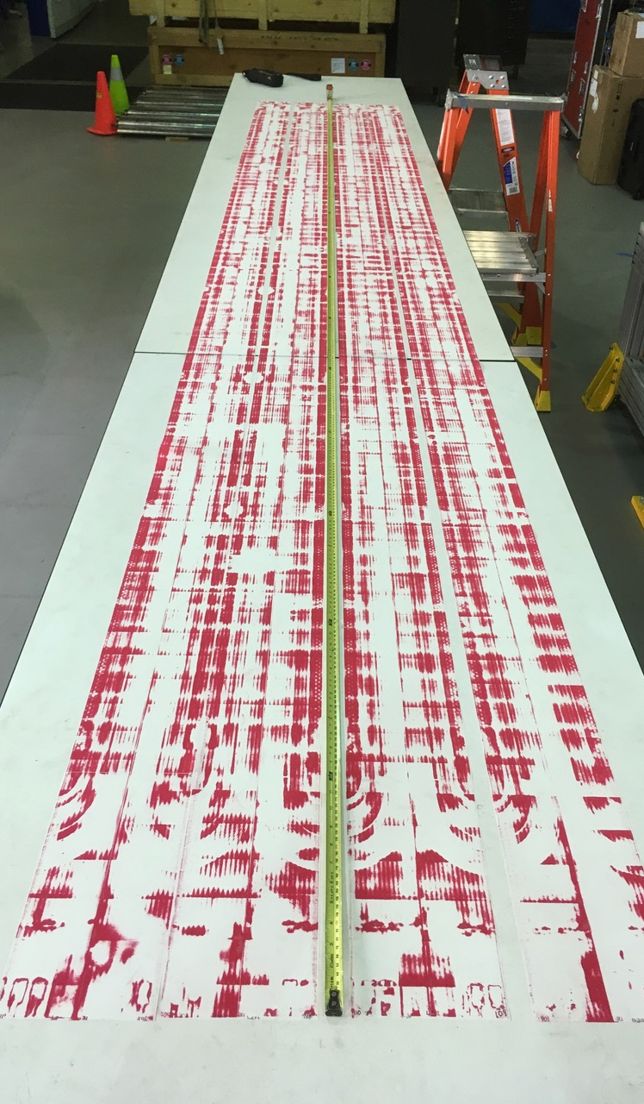
MQXFA03 Coil Pack Builds 1 & 2
Fuji Build 1 Fuji Build 2
Technicians noted loose bolts around the unexposed quadrant after each torqueing pass
Based on one quadrant’s good exposure, shimming was thought be be correct
Possible bending effects in one pad-collar assembly may have been the cause of loose bolts after a torqueing pass
Decision to build the second Fuji with no change to shimming was made, only making sure bolts were retorqued after each step up
Second Fuji exposure looked good

Slide 25
MQXFA03 Coil Pack Build 3 & 4 and Proposed #5 (Final with 204)
Nominal Collar R: 114 mm
Nominal Coil R: 113.376 mm
Nominal Radial shim = 0.025” (0.624 mm)
Plan to still aim for ~0.020”
Target MQXFA03 radial stack up is ~0.021” (~0.54 mm)
0.0045” Coil GPI + 0.005” + 0.005” & 0.005” G11
Note: This is the same radial shim stackup used in both MQXFAP1b and MQXFAP2.
 | 109 | 110 | 202 | 111
Kapton Ground plane insulation | 0.0045” (0.114 mm)
Coil Specific Radial Shim | 0 | 0 | 0 | 0
Coil-specific midplane shim (no different end shimming) | 0.000” 0.0 mm | 0.000” 0.0 mm | 0.000” 0.0 mm | 0.000” 0.0 mm
Fuji paper | 0.000” (0.0 mm)
Radial Shim | 0.005” Polyimide + 0.005” Polyimide + 0.005” G11 (~0.38 mm)

Slide 26
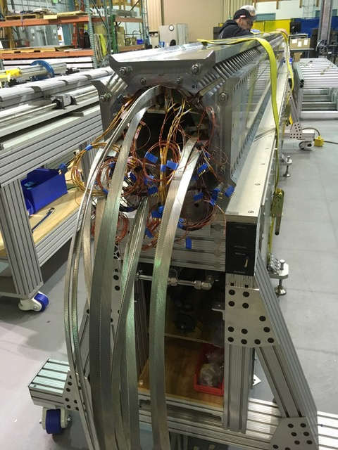
MQXFA03 Updated (working) Schedule
Coil pack build schedule
Coil pack disassembled
Coils 112 and 204 are being instrumented
Dressed Coil (Pions and GPI) to be completed by 6/27
Coil pack assembly complete week of July 4
Magnetic measurements to be performed during week of July 8
Shell-yoke assembly will take place in parallel
Minimal delay from original 9/16 ready for ship date--likely ~1-2 week delay

Slide 27
Summary
Coils 112 and 204 were shown
E-tech availability was only able to measure two coils in time allowed
CMM measurements shown
Coil 204 was chosen for the new build
Pending selection approval, both Coils 112 and 204 are being instrumented “just in case”
Final Coil pack measurements (mechanical and magnetic) to be completed the week of July 8
Work on coil pack will happen in parallel with Shell-yoke assembly activities
Magnet may be delayed by a maximum of 2 weeks from original “ready-to-ship” date of 9/16

Slide 28
Additional Slides

Slide 29
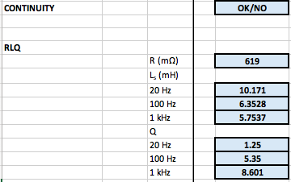
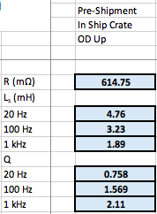
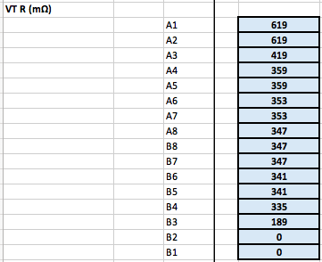
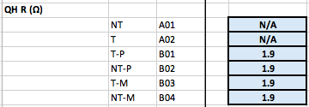
Coil 110 EQC (Post-ship)

Slide 30
Coil 110 EQC (Post-Ship Impulse)

Slide 31
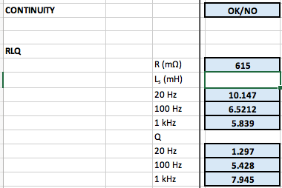
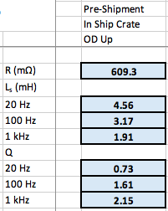
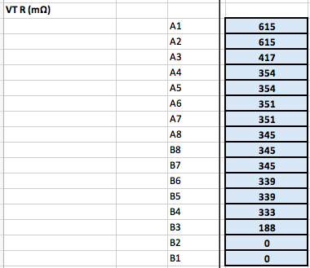
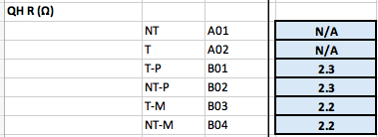
Coil 111 EQC (Post-ship)

Slide 32
Coil 111 EQC (Post-ship Impulse)

