Slide 1
Welcome to Fermilab
T.I. Meyer | Deputy Director for Administration
Internat’l Conference on Neutrino Beams & Instrumentation (NBI2019)
22 October 2019

Slide 2
Fermilab at a glance
America’s Particle Physics and Accelerator Laboratory
As the United States’ premier particle physics laboratory, we do science that matters.
6,800 acres
including restored, tall-grass prairie
Celebrating 50 years of science & technology

Slide 3
Fermilab Program
Make the best use of lab core capabilities + people + infrastructure to strengthen the field of particle physics in the U.S. and host the world to advance scientific discovery and innovation

Slide 4
Lab strategic plan is aligned with the P5 Plan
Fermilab’s primary 10-year goal: a world-leading neutrino science program
Anchored by the Long-Baseline Neutrino Facility (LBNF) and Deep Underground Neutrino Experiment (DUNE)
Powered by megawatt beams from an upgraded and modernized accelerator complex made possible by the Proton Improvement Plan II (PIP-II)
First international mega-science project based at a DOE national laboratory
DUNE & LBNF & PIP-II

Slide 5
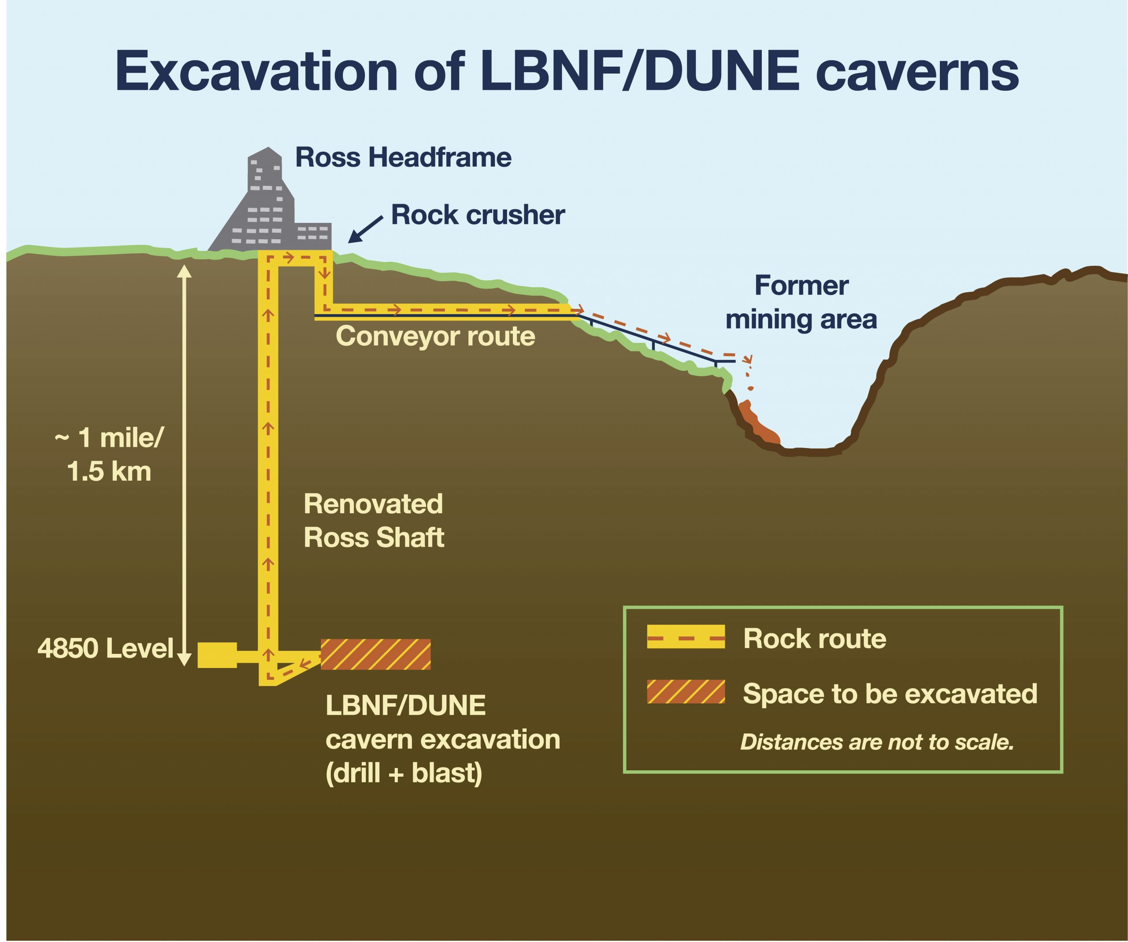
LBNF
Far Site:
Pre-excavation work in progress
Excavation design complete; contracting in progress
Near Site:
Neutrino beamline preliminary design underway
Site Prep contract awarded; ground-breaking next month
Far Site at Sanford Underground Research Facility, Lead SD

Slide 6
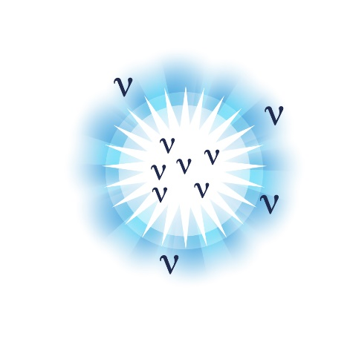
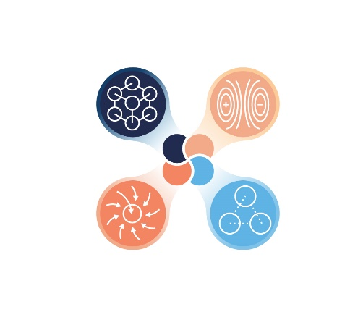
DUNE Science Goals
Origin of matter Discover what happened after the big bang: Are neutrinos the reason the universe is made of matter?
Black hole formation Use neutrinos to look into the cosmos and watch the formation of neutron stars and black holes in real time
Unification of forces Move closer to realizing Einstein’s dream of a unified theory of matter and energy

Slide 7
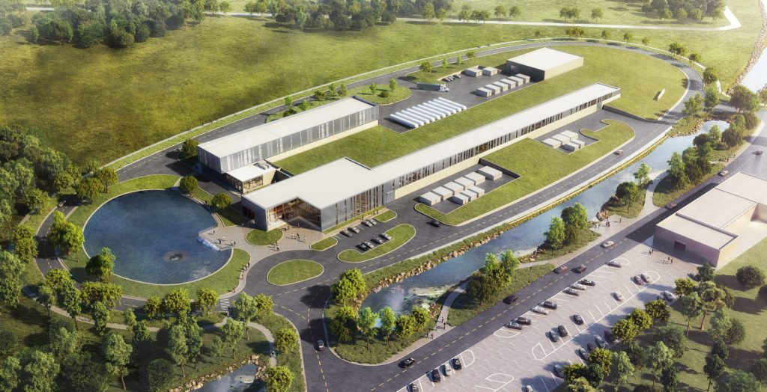
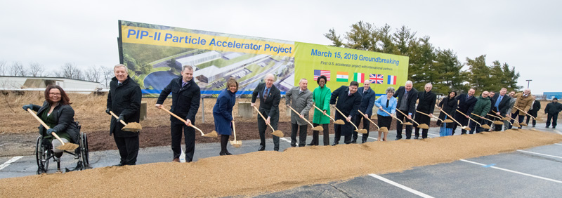
Proton-Improvement Plan II (PIP-II) Accelerator
First accelerator to be built with significant international involvement
Unique technology (SRF CW with protons) to generate world’s most intense neutrino beam and power new discoveries

Slide 8
Thank you for participating
The future of Fermilab is based on high-power beams, neutrinos, targets, international collaboration, …
i.e., NBI !
Hosting this conference is an honor and an opportunity for us
Thank you for coming…and please enjoy your visit!

Slide 9
