Slide 1
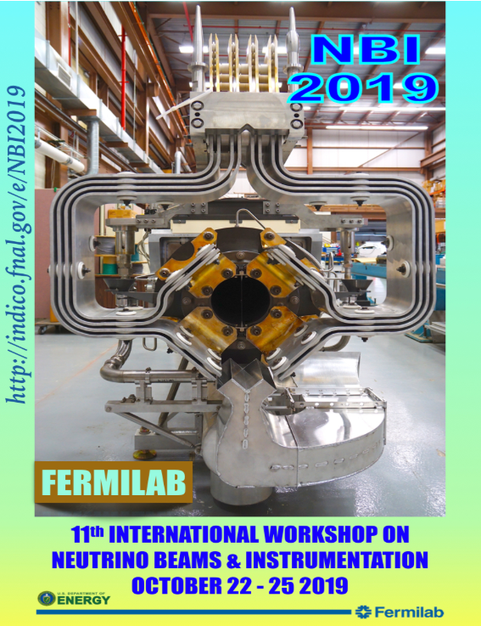
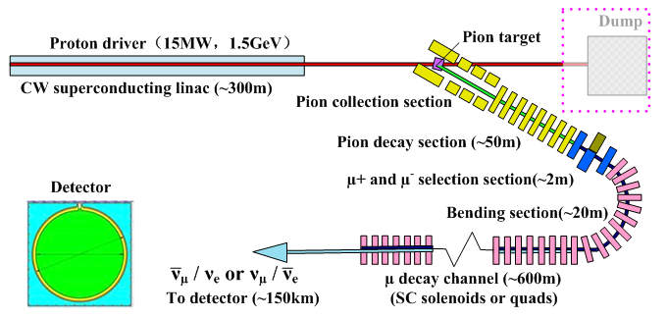
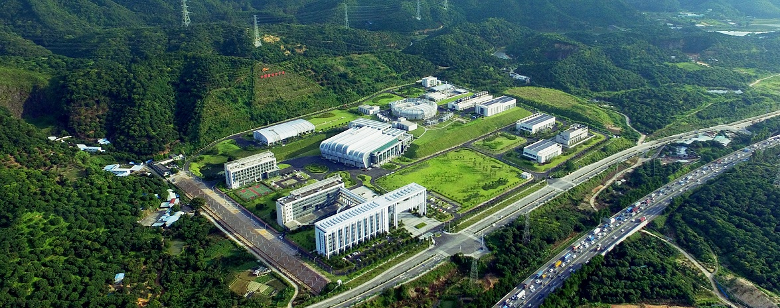
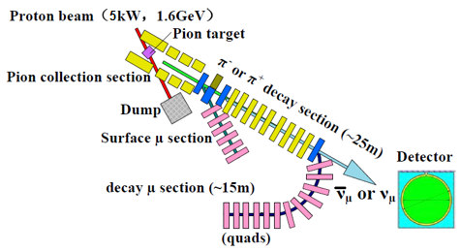
EMuS & MOMENT Target Studies
Nikos Vassilopoulos, IHEP, CAS
on behalf of Target Group

Slide 2
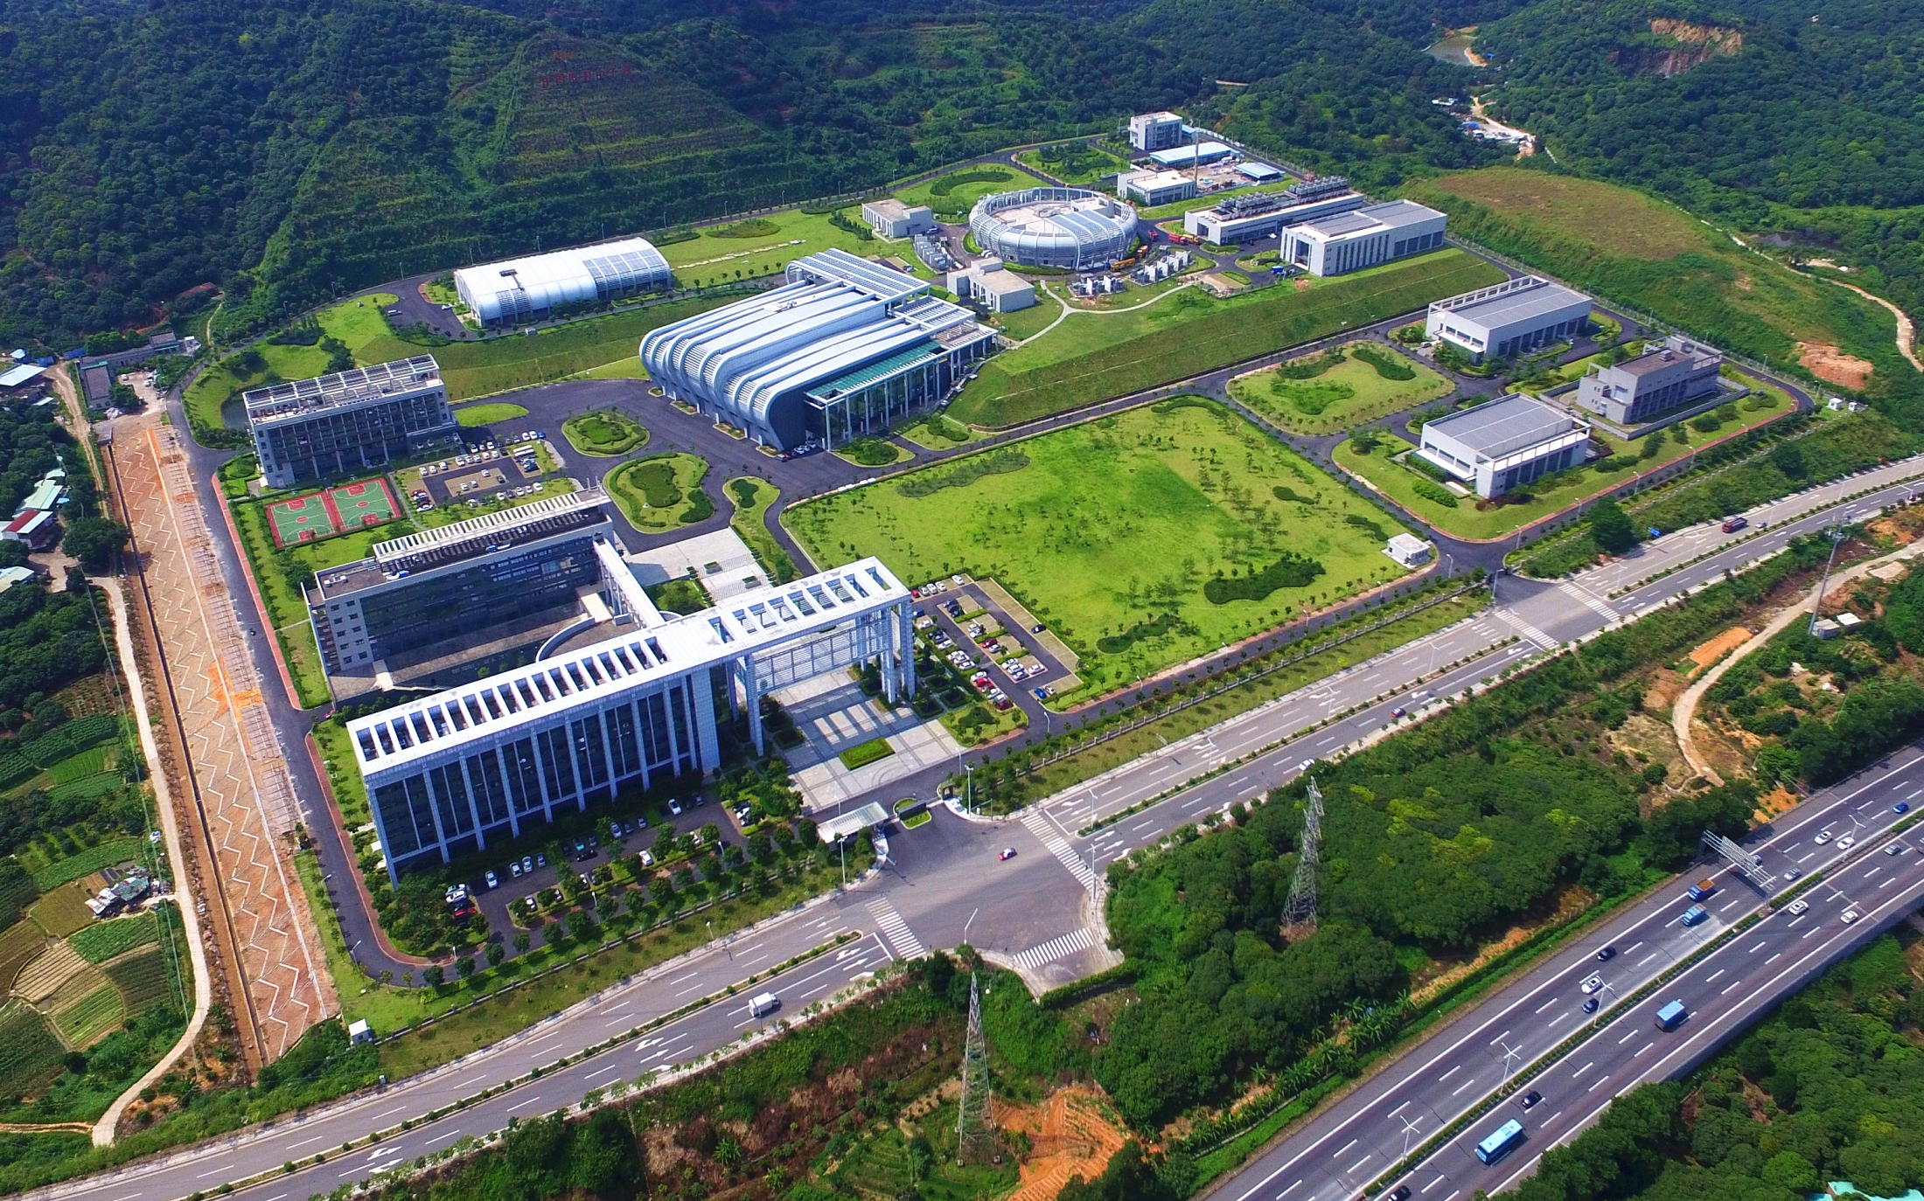
CSNS facility as today
IHEP Dongguan Branch
First beam on target: Aug.28, 2017
Accelerator-target-instruments joint commissioning: November 1-9, 2017
Accelerator reached the acceptance beam power of 10 kW: Nov. 9, 2017
Instrument tuning and Day-one experiments: from January to March, 2018
Initial operation: Since April 2018
First physics paper including CSNS neutron scattering experiment published: April 17, 2018
Open to general users: from September 2018
Present beam power: ~80 kW
EMuS
The site for CSNS is in Dongguan, Guangdong Province
CSNS is the first large scientific facility in southeastern China, jointly invested by the central government and local government. It will promote advanced researches in the economic developed zone of Guangdong-Hong Kong. Total budget: ~2.3B CNY (or 350M USD)

Slide 3
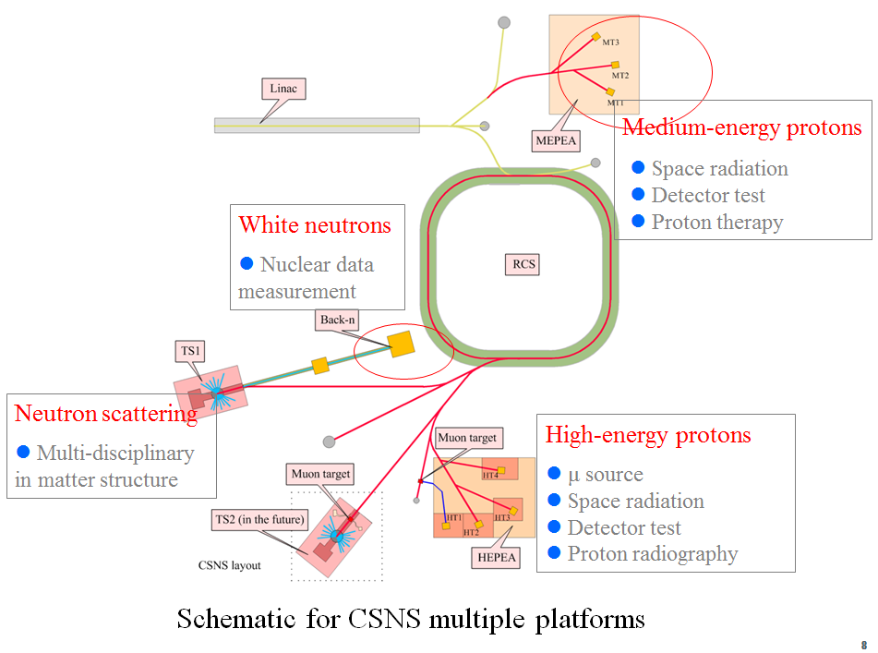
CSNS and EMuS
CSNS is the only large-scale proton accelerator in China today
Strong needs from other fields than neutron scattering
Excellent capability to support multiple platforms
Phased development from 100 kW (I) -> 500 KW (II)
Parameters | CSNS-I | CSNS-II
Beam power (kW) | 100 | 500
RCS Energy (GeV) | 1.6 | 1.6
Beam current (μA) | 62.5 | 312.5
Repetition rate (Hz) | 25 | 25
Linac Energy [MeV] | 80 | 250
EMuS power (kW) | 5 | 25
EMuS repletion rate (Hz) | 2.5 | 2.5
Schematics for CSNS
protons 80 MeV
1.6 GeV, 62.5 /312.5 μA, 25 Hz
EMuS will be located at the High Energy Proton Application hall
EMuS

Slide 4
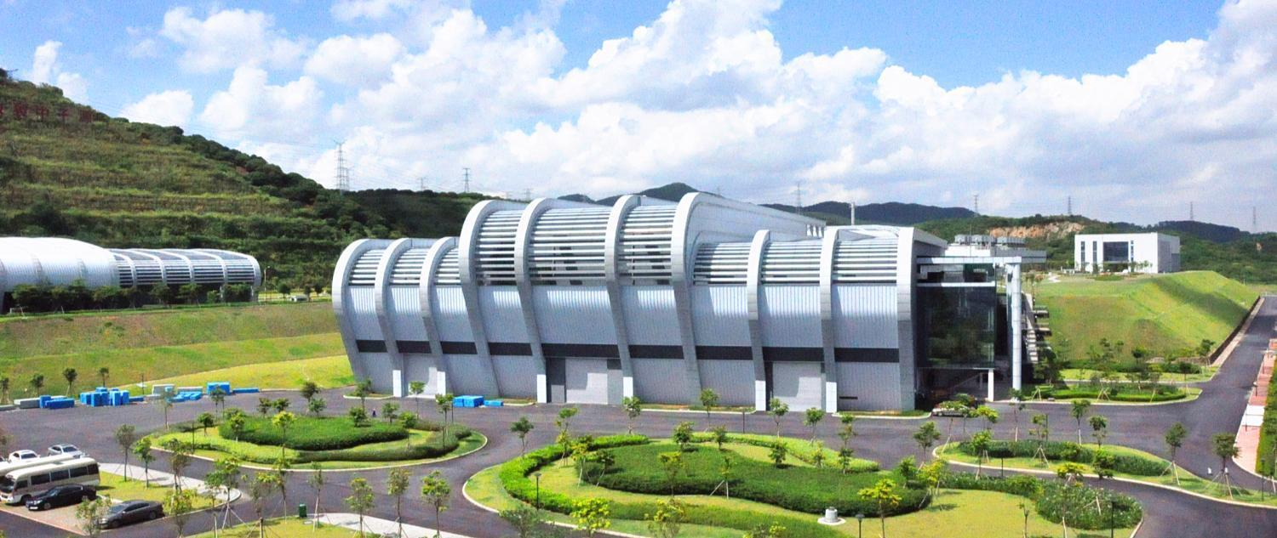
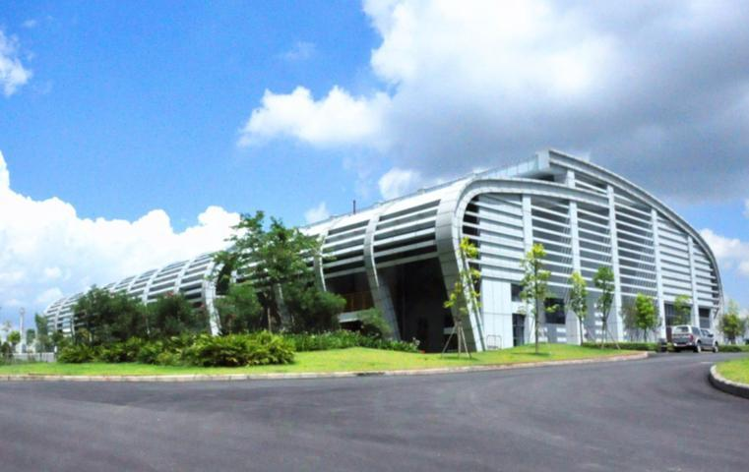
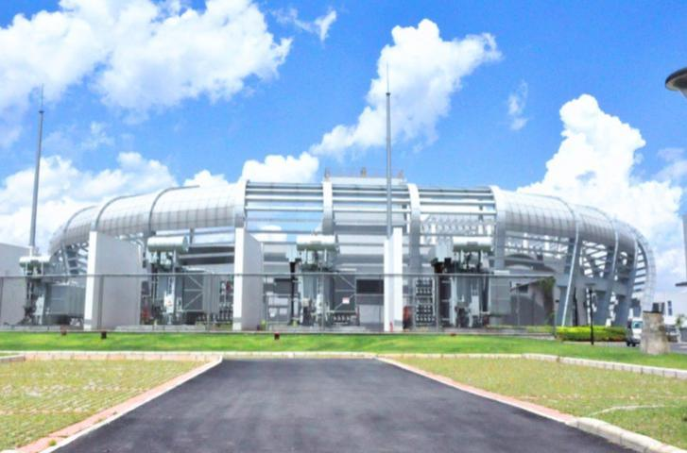
Target and experiment hall
LINAC service building
RCS service building

Slide 5
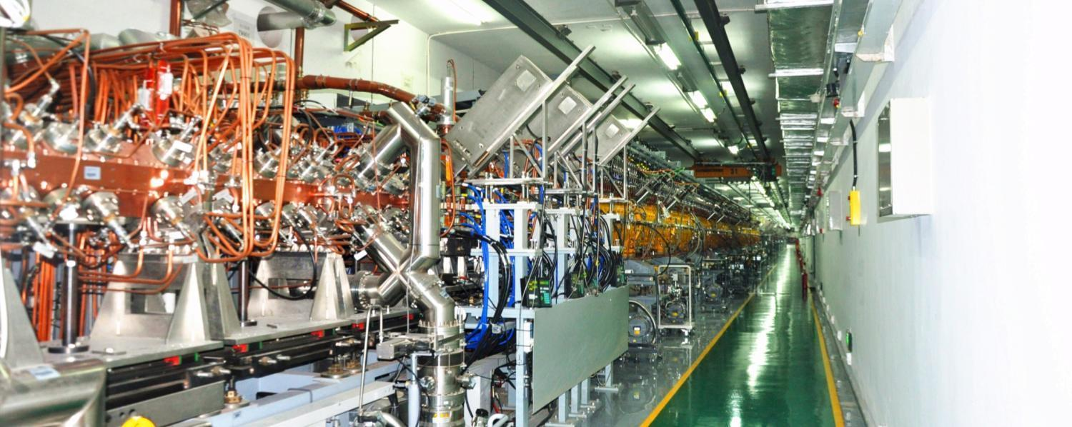
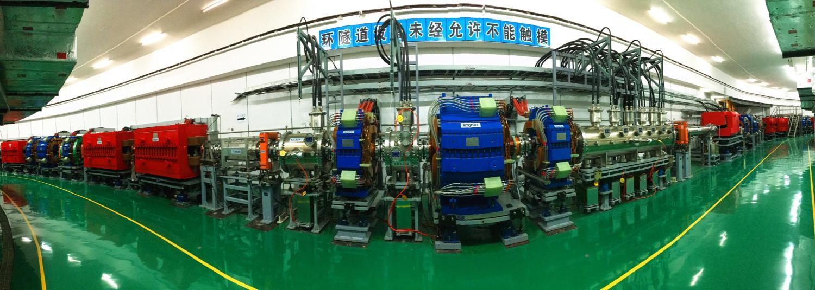
Linac Tunnel
RCS Tunnel

Slide 6
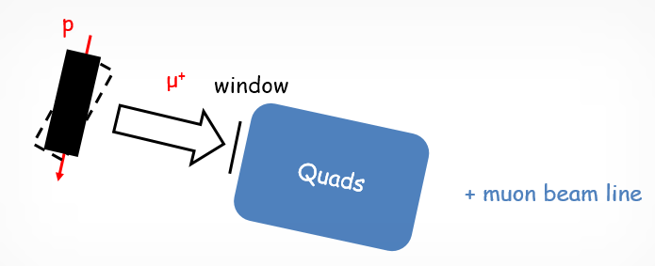
EMuS “Baby” scheme schematics
Sideway μSR collection at 90⁰ with respect to the primary proton beam direction
Quadrupole system, low acceptance collector
Main line
It consists of 4 groups of triplets. Using symmetric achromatic design.
Green: quadrupole
Red: Wien Filter
Electrostatic deflection separator
The beam is divided into 2 parts here
ES line
Half of the beam passes through the deflector
Total angle (ES separator + dipole): 41°
No positron, so both quadrupole-scheme and solenoid-scheme are under development
Straight line
Half of the beam is unaffected and straight ahead

Slide 7
Tests of smaller configurations than 12x12 cm2: 12->8 x 4 cm2, 25 kW
Singlet slab best case
Proton’s Gaussian peak is displaced by 0.5 cm = 1 σ_{p} from side (collection) surface
collection surface
(z,y), r= 16cm
Thickness (z) = 12, 10, 8, 6 cm
Width (x) = 3 cm
25 kW
protons
μ+
Target | Gr slab – Width = 3 cm
emittance (π mm mrad) | 4500
momentum | μSR - μ⁺ 25 < P < 29.8 MeV/c
Thickness x Height (cm2) | 6x4 | 8x4 | 10x4 | 12x4 | 12x12
intensity (x10⁶) μ/sec | 14 | 15.5 | 16 | 17 | 17.5
polarization | -0.96 | -0.95 | -0.95 | -0.96 | -0.96
surface muon purity (%) | 97 | 97 | 96 | 97 | 97
stat. error ~ 3% for intensity, < 1% for polarization
Height (y) = 4 cm
π+
μ+
protons
μ+
x-axis, 60 cm
proton beam spot
σx = σy = 5 mm
Also 8x4 cm2 could be chosen if not matter the -10% in rates

Slide 8
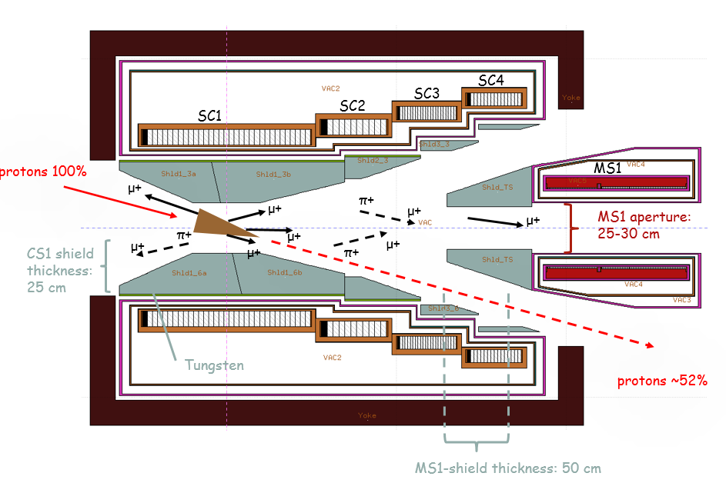
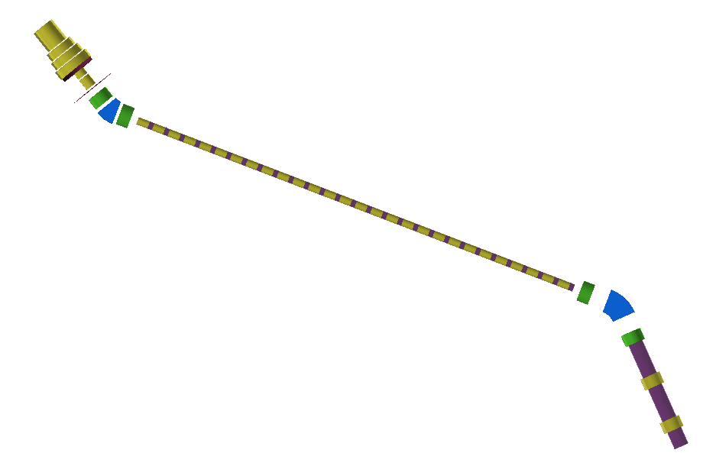
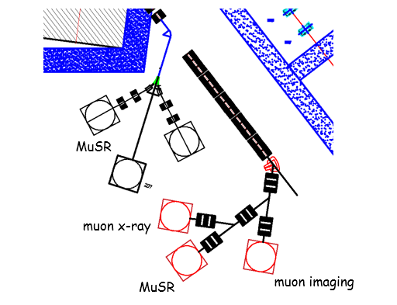
“Baseline” Scheme: surface and decay muons
Superconducting Capture Solenoid
Charge/momentum selection for surface muons/pions
25 m superconducting transport solenoids
pion decay section -> muons
“surface” muon section
2nd selection,
decay muons
Decay muon section
Working modes (independent):
Surface μ mode
Δp/p: <±5%
Ref. Pμ=29 MeV/c
Decay μSR mode
Δp/p: <± 10%
Ref. Pμ =40-150 MeV/c <-> Ref. Pπ = 100-260 MeV/c
High-momentum μ mode
μ imaging, neutrinos
Ref. Pπ=200-450 MeV/c
detectors

Slide 9
capture using superconducting capture adiabatic solenoid
Forward spent-proton extraction, proton beam & target tilted in respect to magnetic axis, θp = 15º
4-coils/3-steps design, NbTi-Al coils, adiabatic taper
5 kW shielding
15⁰ tilt of protons/target with respect to magnetic field lines:
Facilitate the extraction of spent-protons with a moderate length of 2.5 m of the CS through the Matching Solenoid and capture coils
Lower tilts as 10⁰ make the length of CS excessive and costly

Slide 10
primary protons and conical target
target parameters - conical target
material | radius r1 large / r2 small (cm2) | length (cm) | Z | λ_{I} (cm)
C (1.82 gr/cm³) | 5-4.5 / 0.25 | 25 - 30 / ~0.65 λ_{I} | 6 | 47
Use only one target for surface muon and π+ collection
For surface muons
Better surface muon collection than cylindrical shape
Lower power deposition on the SC
For π+ collection at MS1
Similar collection to cylindrical shape
r1 = 5-4.5 cm
r2 = 0.25 cm
Graphite

Slide 11
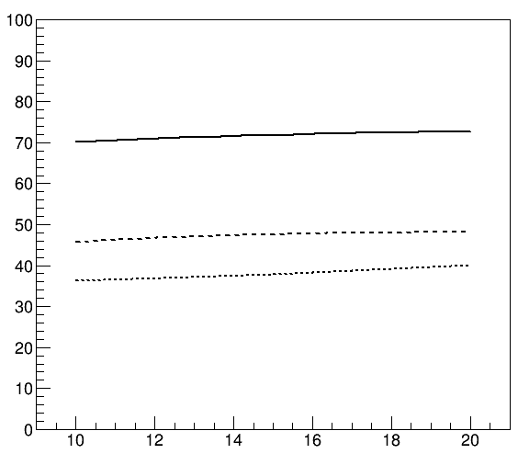
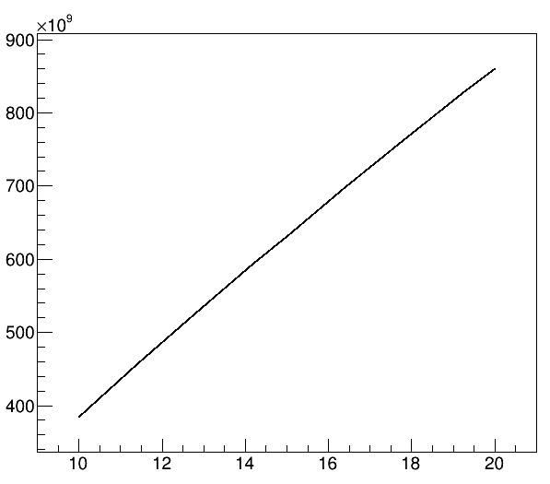
Polarization and rates as function of fields and proton/target tilts 1st coil exit, 5 kW shielding
Surface muons: best polarization at 1 T
Tilt benefits surface muons & π+ rates
p
surface muons polarization
π+ rates
π+ / s
5 T -> 3 T
polarization (%)
1 T -> 0.5 T
2.5 T -> 0.5 T
5 T -> 3 T
baseline tilt 15⁰
baseline tilt 15⁰
proton/target tilt angle
proton/target tilt angle
1st coil study – no shielding
no emittance selection

Slide 12
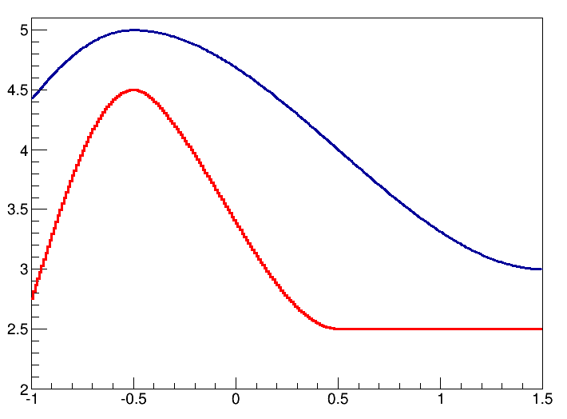
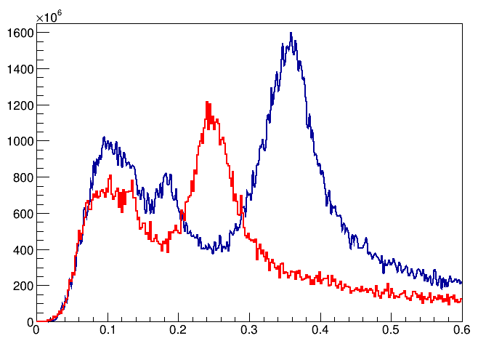
Field tuning for π+ collection at MS1 for decay muons, 5 kW shielding
Final 5 T and 4.5 T used for π+ collection:
5 T, 4.5 T taper variations
π+ entering MS1 as function for different taper
100 MeV/c
-> μ+ 45 MeV/c
260 MeV/c
-> μ+ 150 MeV/c
450 MeV/c
-> μ+ 450 MeV/c
Bz(r=0) T
π⁺ / 2 MeV / s
100000 π mm mrad
Z in m
P GeV/c
emittance (π mm mrad) | 100000
P (MeV/c) ± 10% | 100 | 260 | 450
intensity π+ (x10¹⁰) μ/sec | 1 | 2.8 | 2.4
stat. error ~ 1%

Slide 13
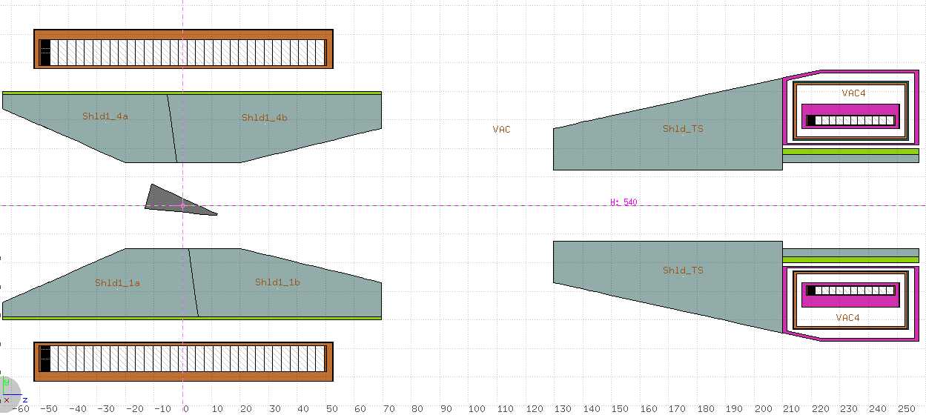
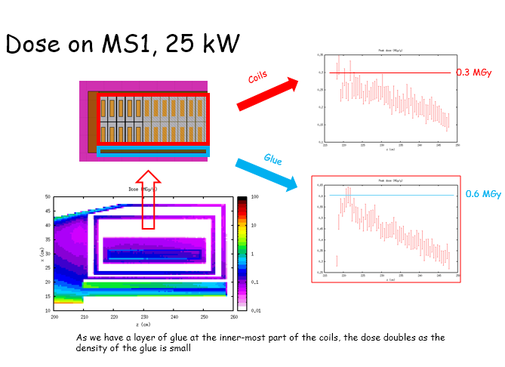
5 kW -> 25 kW “baseline” scheme: increased shielding is needed
z = 0 cm
z = 209.8 cm
1st coil
1st Matching Solenoid
Tungsten, or hybrid shield
Tungsten
t^{(25kW)} = 40-50 cm
aperture^{(5, 25 KW)} = 25 cm
aperture^{(5, 25 KW)} = 30 cm
t^{(5kW)} = 25 cm
t^{(5, 25kW)} = 50 cm, 80 cm
Aim of the shielding design, , neutron radiation < 10²¹ n/m2/year, epoxy damage < 10 MGy :
25 kW and up to 30 years operation

Slide 14
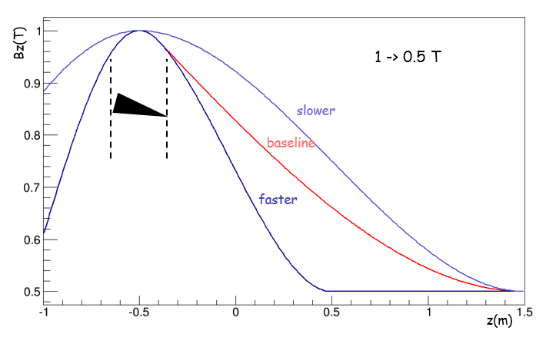
μSR: surface muon collection at MS1, 1 T, 25 kW studies
MS1 shielding
aperture 25 cm
t = 90 cm from 50 cm
surface muons collection
Bz(r=0) T
1 -> 0.5 T
emittance (π mm mrad) | 10000
momentum (MeV/c) | μSR - μ⁺ 25 < P < 29.8
collection | MS1 - entrance
field | baseline | baseline | faster
power-shielding case | 5 kW | 25 kW | 25 kW
intensity (x10⁶) μ/sec | 7 | 37 | 26
polarization | -0.83 | -0.80 | -0.86
surface muon purity (%) | 86 | 83 | 85
stat. errors for both intensity and polarization ~ 5%
z(m)
Rates are increased with same factor of 5 as primary proton beam power
Faster fields increase polarization but decrease rates

Slide 15
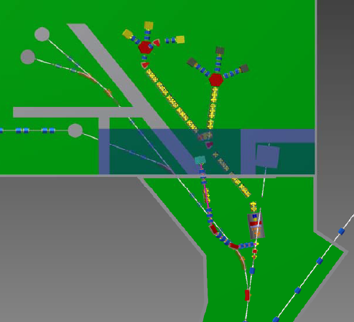
Vertical μSR beam line with thin target before superconducting solenoid at “baseline scheme” (under study, 25 kW)
interaction length | 1 cm
beam size | σ_{x} = 6 mm, σ_{y} = 12 mm
emittance (π mm mrad) | 4500
momentum | μSR - μ⁺ 25 < P < 29.8 MeV/c
tilt (degree) | 45
length x height (cm2) | 12x12 | 10x10 | 8x8 | 6x6 | 5x5
intensity (x10⁶) μ/sec | 3.55 | 3.6 | 3.55 | 3.4 | 3.05
polarization | -0.96 | -0.95 | -0.97 | -0.94 | -0.94
surface muon purity (%) | 97 | 97 | 98 | 96 | 96
statistical error | ~ 5% / 2% on intensity / polarization
3.9 m
Beam core Emittance:
80 π mm·mrad
1.05 m
Beam spot at thin target
σx = 6 mm
σy = 12 mm
Beam spot at center of main target
σx = σy = ~5 mm

Slide 16
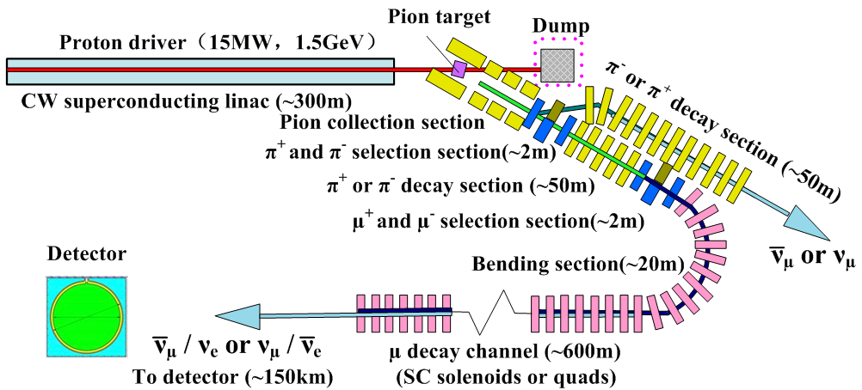
Other applications for EMuS
EMuS could act as a high power targetry and accelerator R&D platform for MOMENT, a future muon-decay medium-baseline neutrino beam facility in China
MOMENT in future
Leptonic CP-violation
Decay at rest source
Pions decays neutrino beam
Exotic NSI, neutrino decays
Target
Hg liquid jet:
Granular Waterfall: Comparison with Hg-jet, R&D project

Slide 17
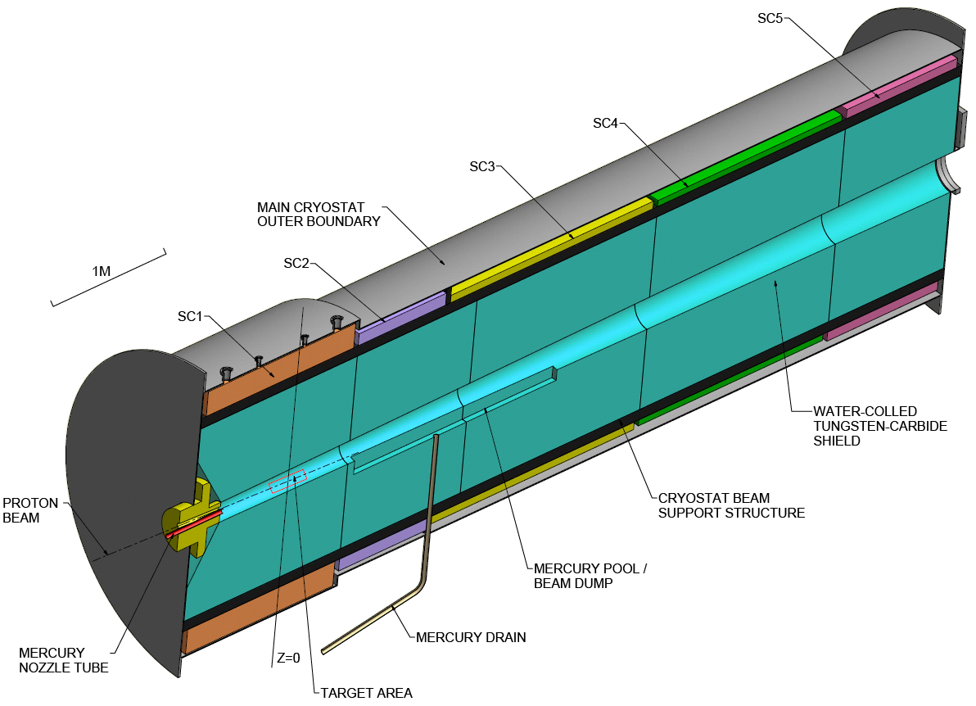
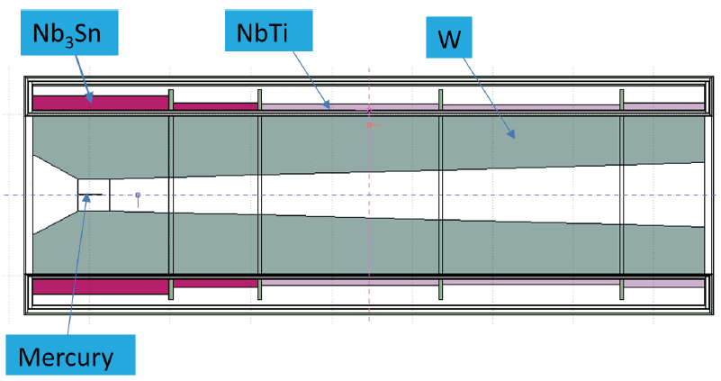
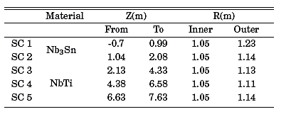
MOMENT’s high-field superconducting solenoid
Baseline design: super conductive solenoid from ~ 14 T -> 3 T
2 first Nb₃Sn coils, 3 last NbTi coils
80 -> 60 cm thick W-shielding <-> 15 MW proton beam

Slide 18
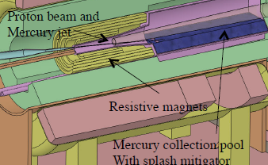
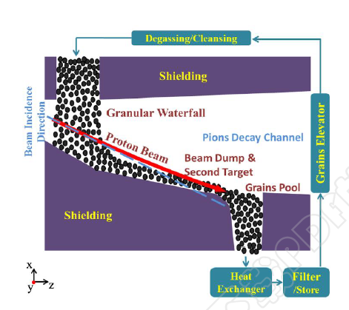
Granular waterfall as alternative flowing target @ 15 MW
Why using an alternative flowing target other than Hg-jet
toxicity -> recirculation circuit, Hg-pool
Possible technical limitations with jet velocity: needs 70 m/s to accommodate 15 MW and questionable jet stability
Neutrino Factory and Muon Collider studies (US) considered Gr target for up to 1.5 MW (from 2000, nuFact15-16)
What are the advantages of a granular waterfall target over a liquid one
High mass flow rate, large stream cross section -> higher power absorbed and removed
Reliable, circuit simplicity -> gravity driven flow of granules
Material is already broken – intrinsically damage proof
No cavitation, splashing or jets as for liquids
Shock waves constrained within material grains
If the new target produces similar meson yields then is considerable.
Are the reduced and variable (effective) density and the geometry of the waterfall an obstacle to pion’s generation ?

Slide 19
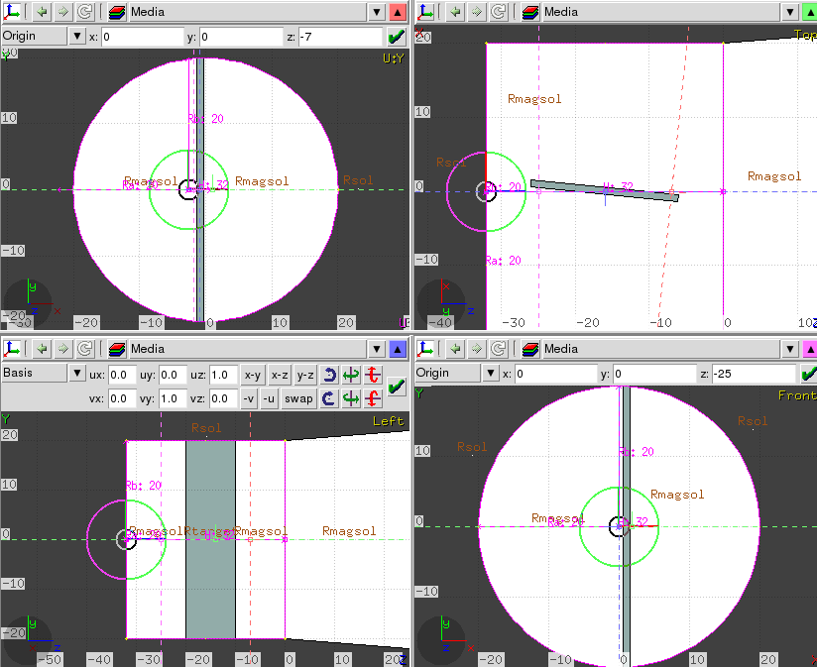
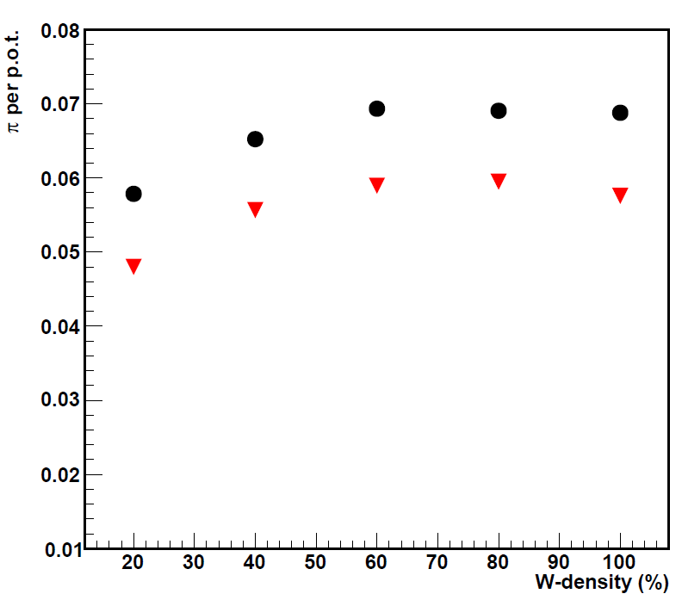
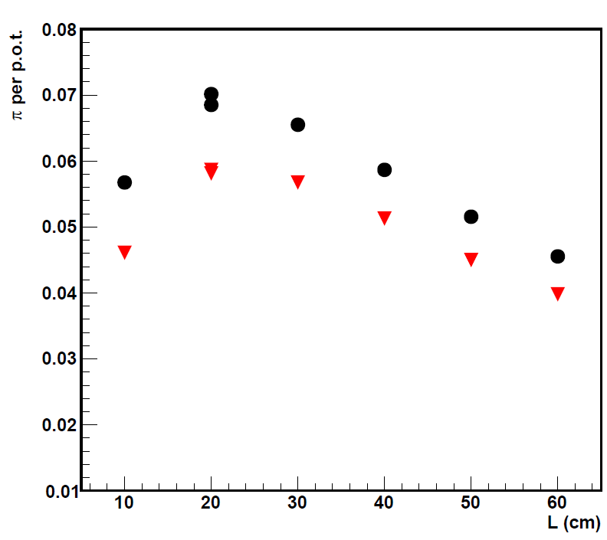
Initial proof of efficient pion capture with FLUKA does the waterfall acts an absorber for pions ?
Toy FLUKA model (2015, NuFact16)
shows -10 % captured pions
Granular waterfall target: best π-capture and length of as function of constant effective density
π-yields as function of length for effective d_{W} = 56 %
100 mrad turn
π⁺/π⁻ = 1.86/1
L = 2λ_{W}
L = 2λ_{W}
L = λ_{W}
L = 3λ_{W}
Granular waterfall / Hg-jet capture
0.07/ 0.077 π per p.o.t.
0.06 / 0.063 π per p.o.t.
L = 4λ_{W}
all momenta in black
selection in red
pions 0.222 < P (GeV/c) < 0.776
statistical error < 1 %
λ_{W(d= 100%)} = 10 cm
- 10% total pions than Hg-jet target

Slide 20
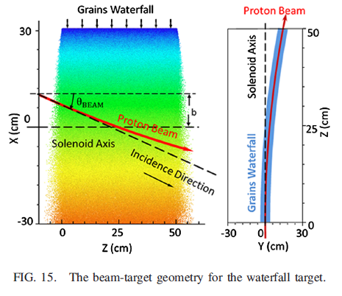
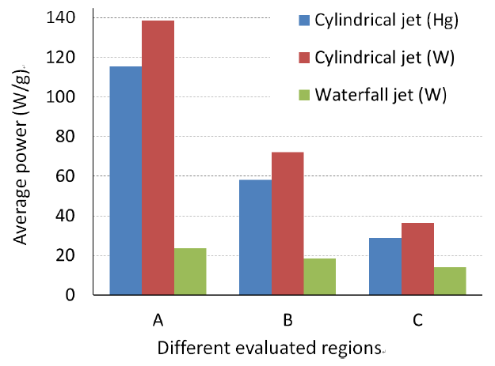
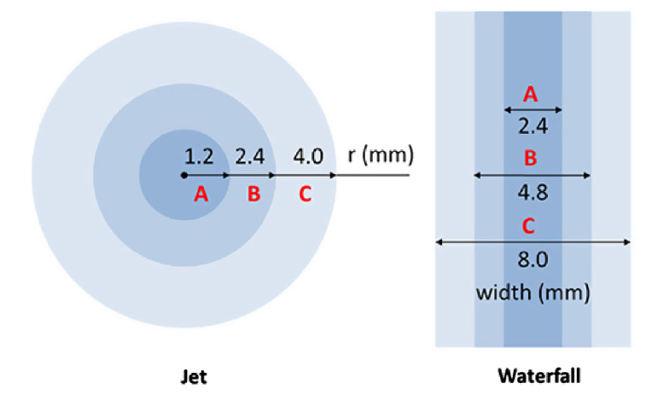
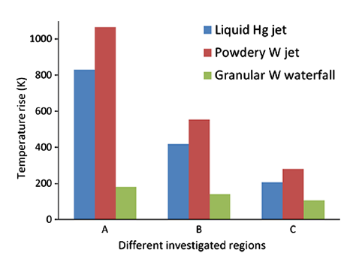
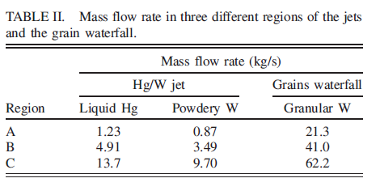
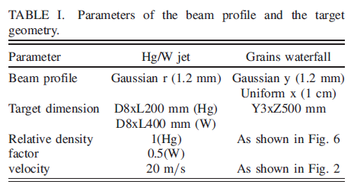
Faster mass flow rate and lower temperatures for heat exchange
for the granular waterfall target (analysis for 4 MW)
Discrete Element Model MC at IMP, ADS & MOMENT target groups (NuFact16, “Phys.Rev.Accel.Beams 20 (2017) no.2, 023401”)
Hanjie Cai, IMP/CAS

Slide 21
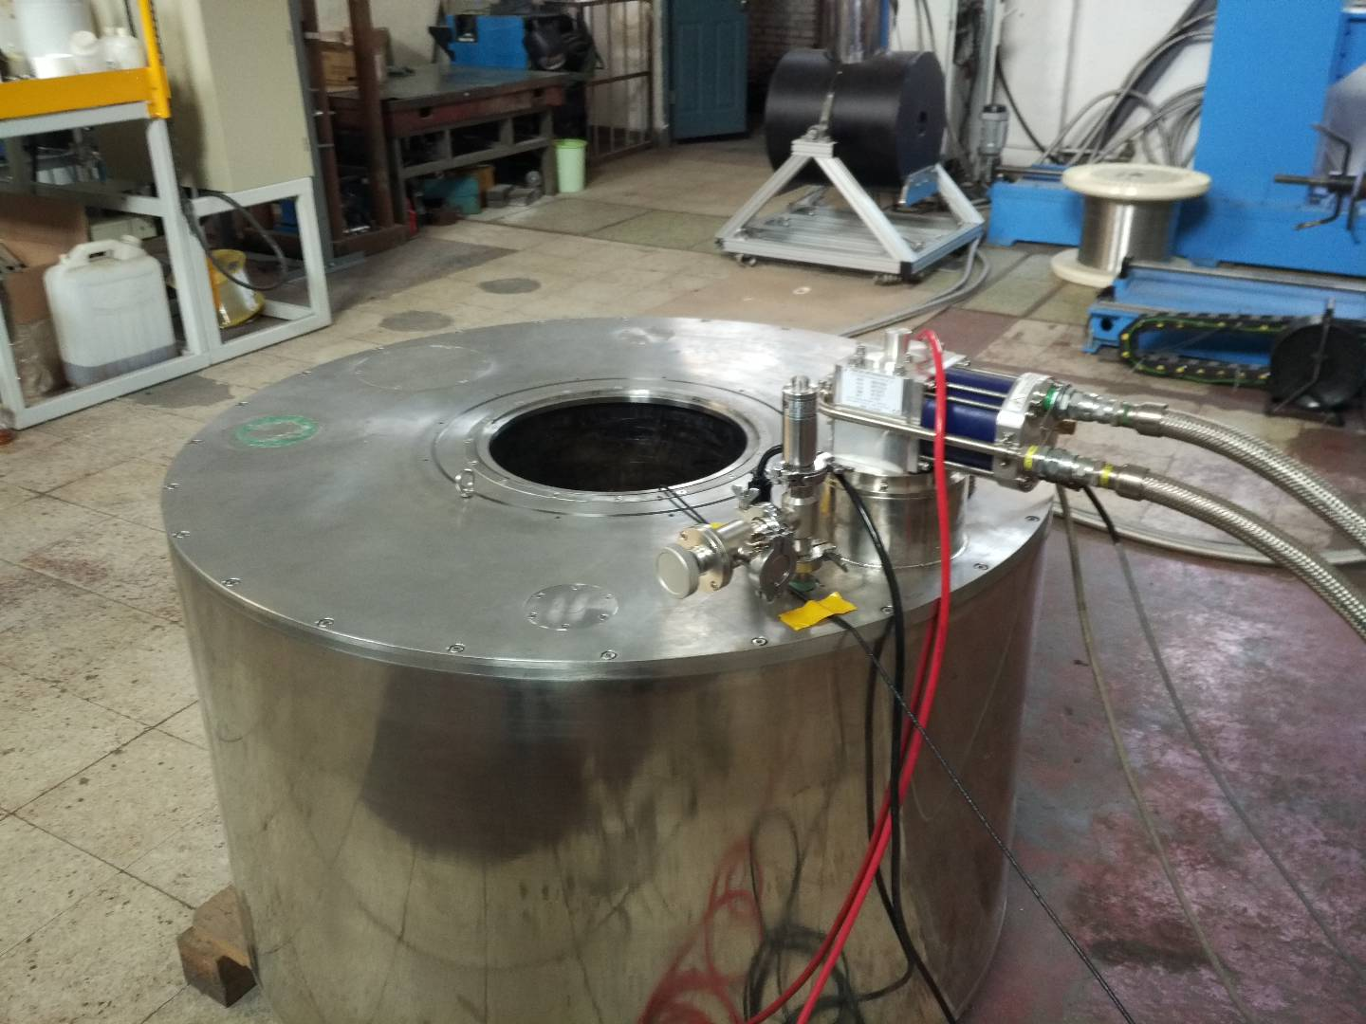
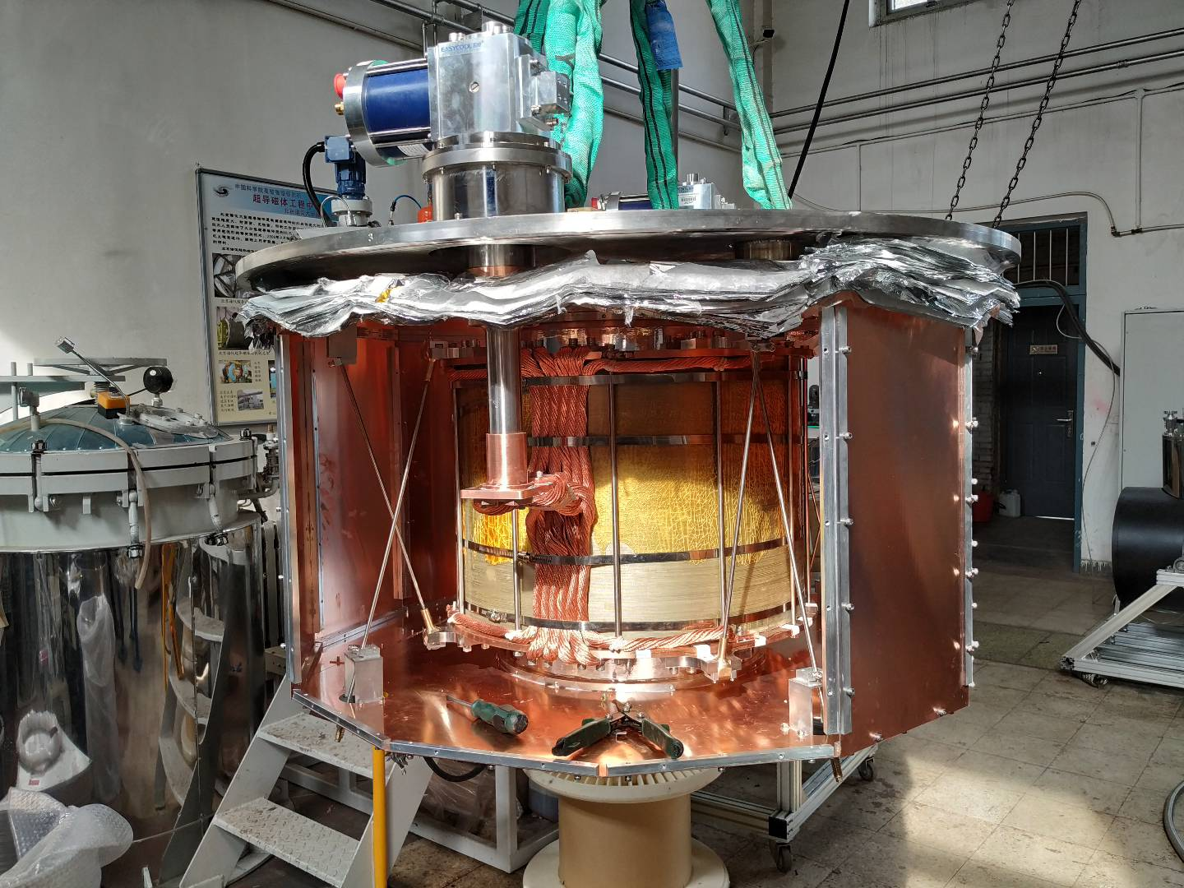
WC granules: instabilities and shape transformations/magnetic field tests
IHEP’s magnet group superconducting solenoid
6 T
40 cm bore
42 cm coil-length
Total length 70 cm
MOMENT’s 14 T superconducting capture solenoid

Slide 22
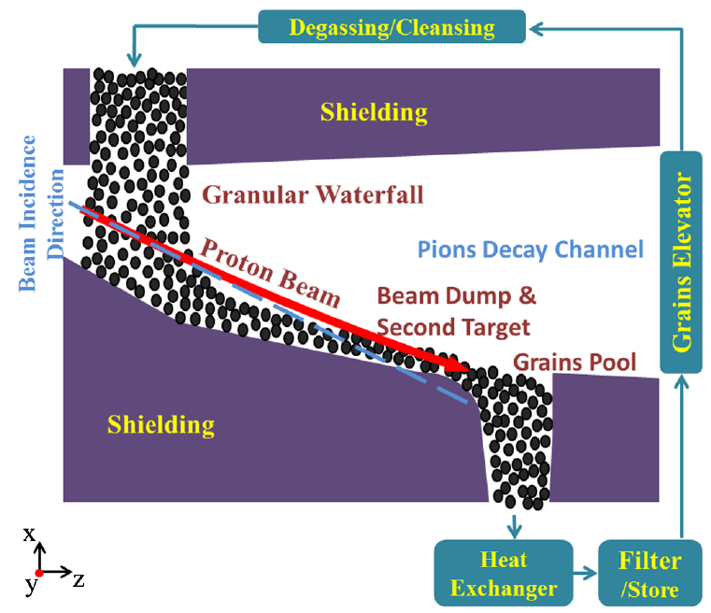
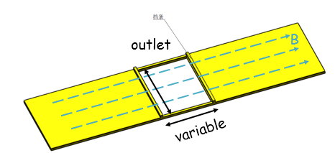
Waterfall granular target will be represented by a box in the solenoid
preliminary designs

Slide 23
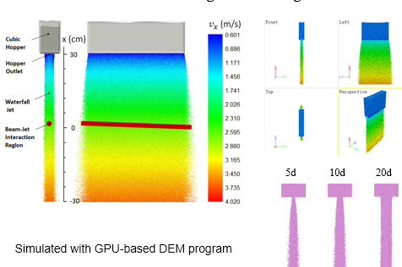
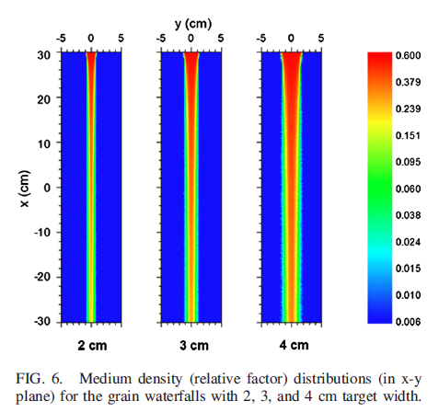
The higher part of the waterfall will be tested with the box due to solenoid’s bore size limitations -> restriction on effective densities and velocities values
waterfall height ~ 13 cm
~13 cm

Slide 24
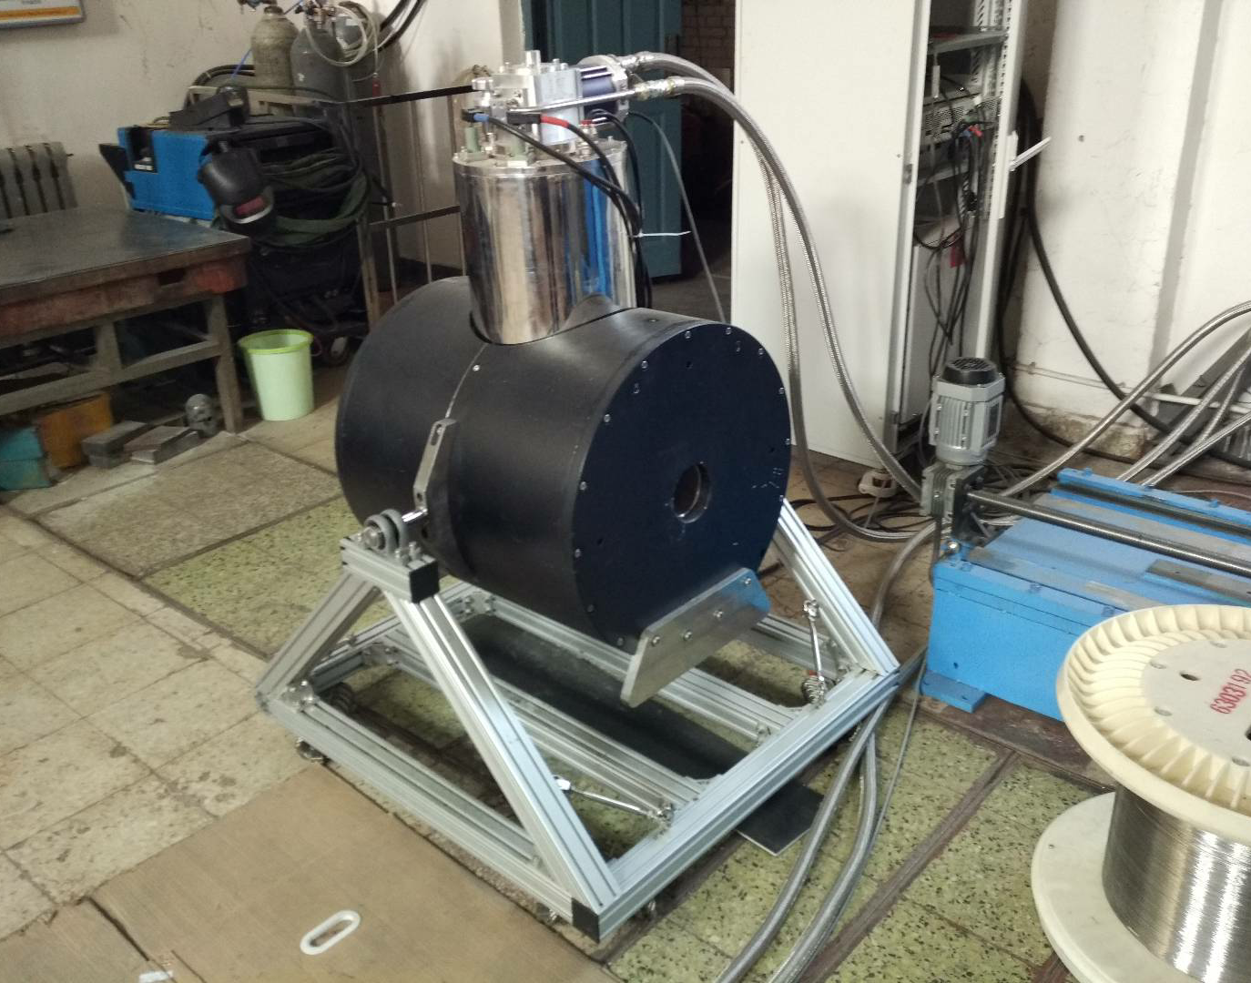
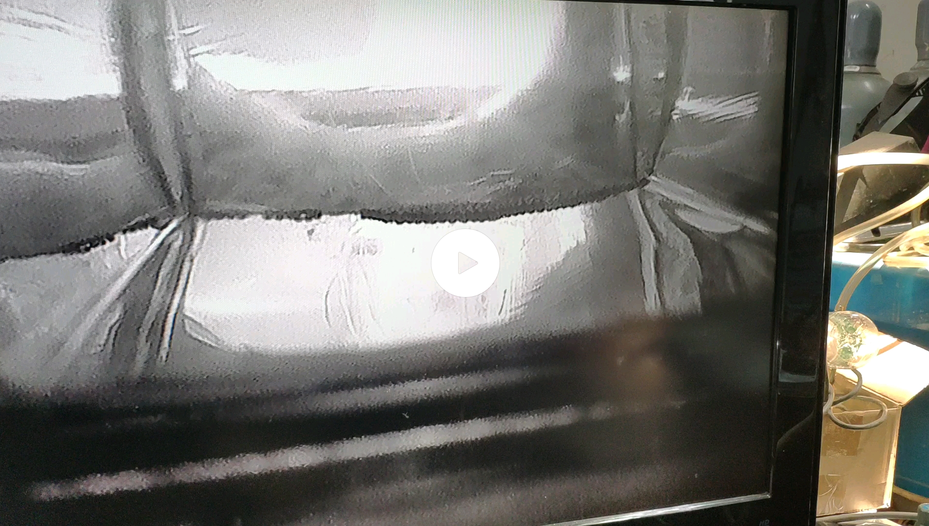
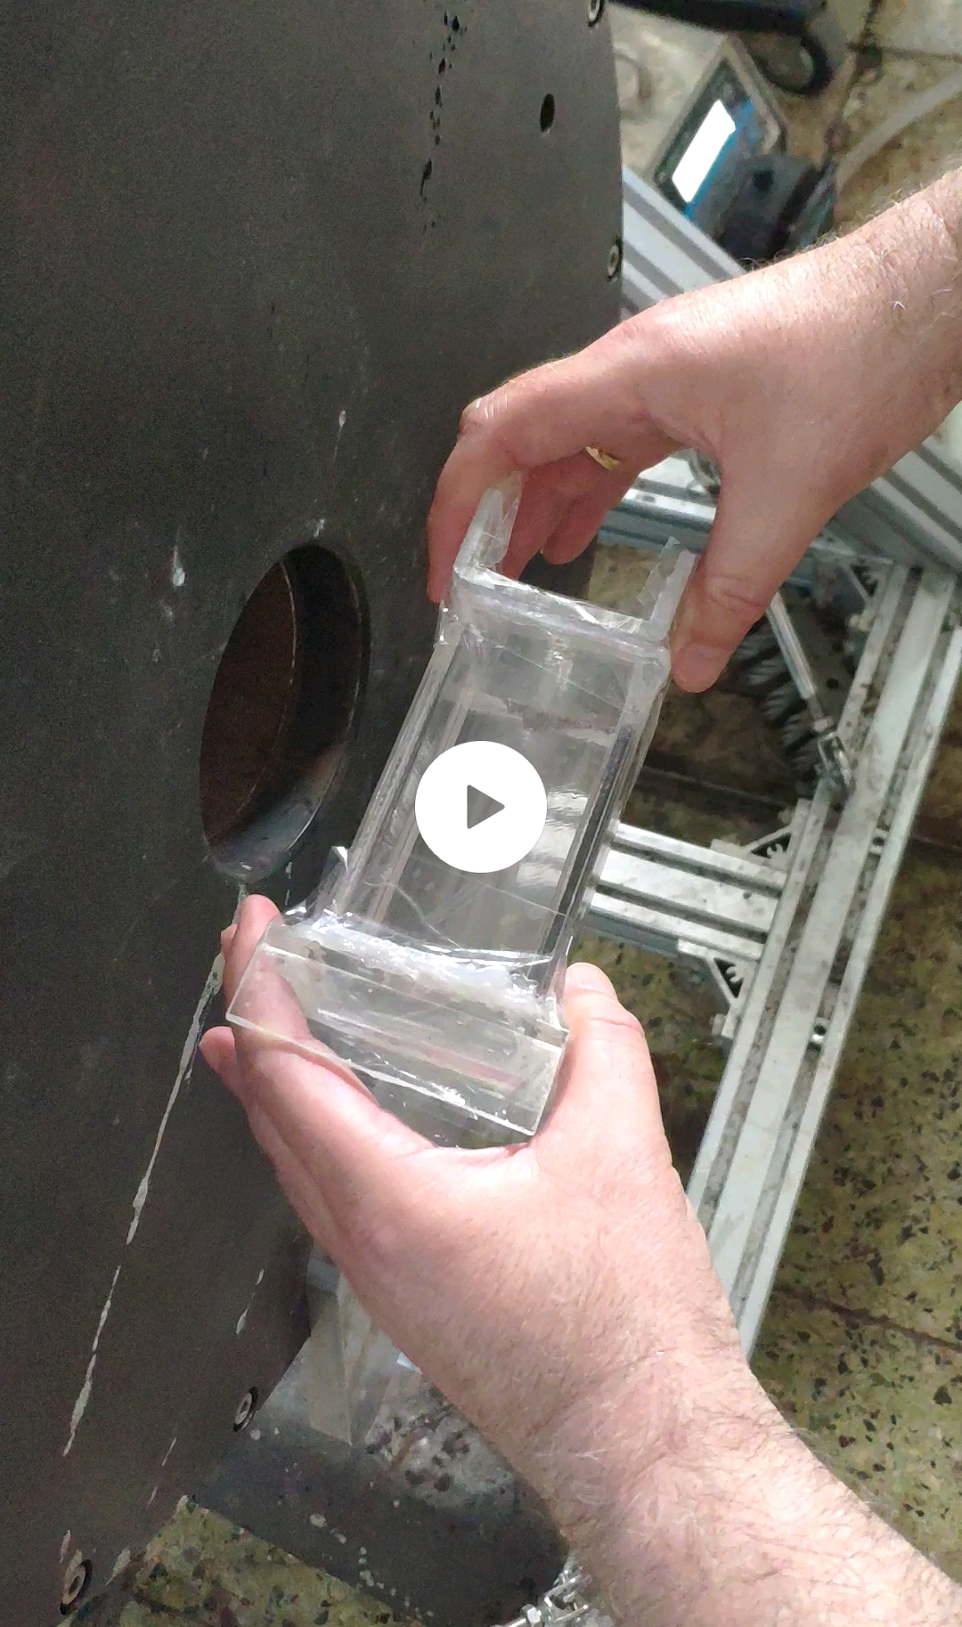
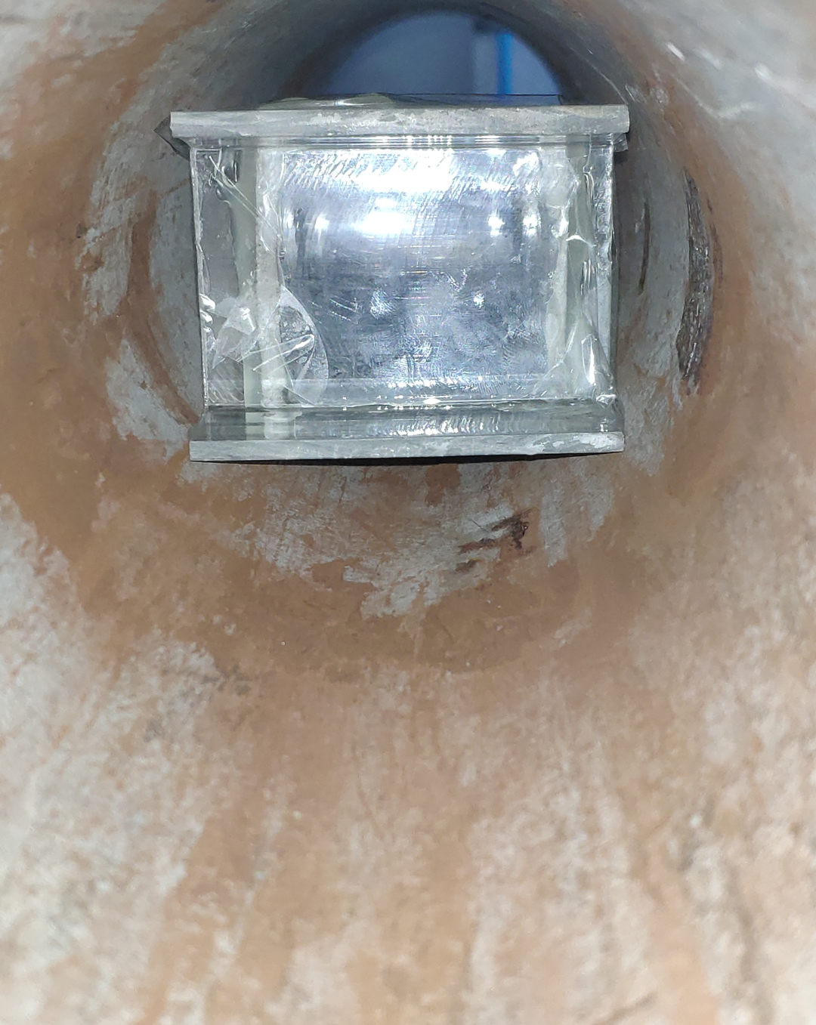
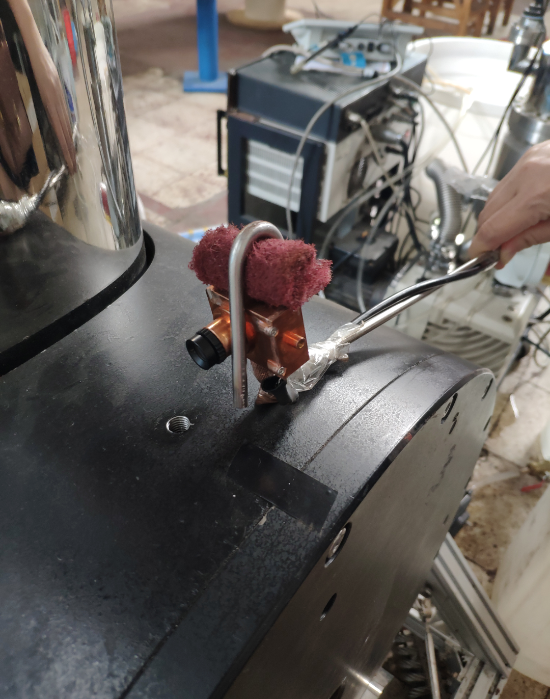
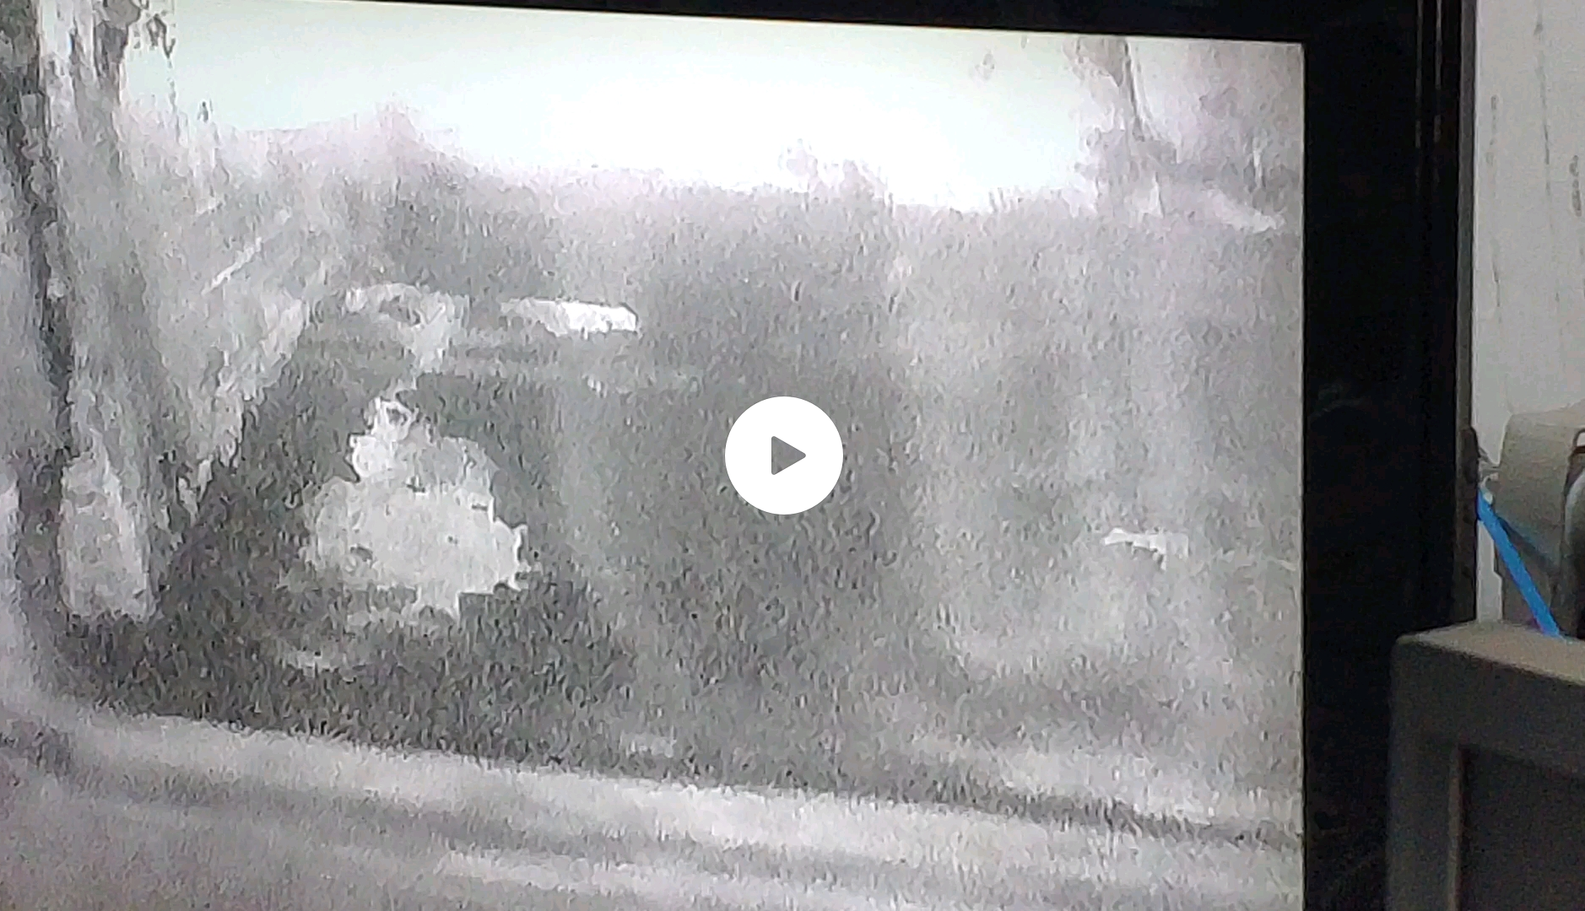
Tests of waterfall granules and powder: look for induction in granules
from 0 T -> 5 T at IHEP’s magnet laboratory
primary small bore 5 T solenoid for granules’ qualification
moving the box
at the edge of solenoid
in varying magnetic field
0 T -> 5 T in 20 minutes
boxes of
tungsten carbide granules and powder
box in solenoid
camera
No repulsion from induction among the granules or powder observed
with box at center of solenoid
by moving the box at the borders of solenoid

Slide 25
Next test for granules: Fall one by one inside a 6 T solenoid, test any deflection from straight trajectory
magnetic field lines and granules fall trajectories
6 T solenoid
F =q B x u
top plate with holes along the radius
prototype for collection
bottom cylindrical collection transparent straws for granules collection

Slide 26
Foreseen tests for granular waterfall system, no field
1. Stability and consistency
2. Flowing parameters (effective density, velocity, flow rate)
3. Mechanical properties of the grains (breakage/wear rate)
4. DEM program
Important for pion capture and heat exchange
cubic hopper with a narrow outlet
detecting instruments
shunt funnel
collection funnels

Slide 27
conclusions
EMuS
Aim has been achieved at up to 25 kW at target level and under emittance criteria
produce a competitive number of muons for μSR applications
a rate of 10⁶ – 10⁷ for surface muons per second and higher rates for decay muons under certain emittance selection criteria
the design of EMuS target station had been optimized for 5 kW
working to deliver it for 25 kW and a lifetime up to 30 years
MOMENT
Granular waterfall:
similar yields than Hg-liquid jet using DEM analysis parameters
target solution of multi-MW neutrino and muon beams
initial tests for the waterfall granules and their magnetic properties have been started
foreseen tests for its stability, velocities, mass flow and effective density
Thank you

Slide 28
extra

Slide 29
μSR muons for EMuS, the first muon source in China
The high intensity muon source project EMuS is foreseen at CSNS and is being optimized for both muon and neutrino experiments
It is primarily intended for muon science related to μSR techniques in matter physics and chemistry concerning μSR muons:
surface muons: μ+ from π+ decaying at rest inside target or at its surface, P ≤ 29.8 MeV/c, 100% polarization
cloud muons that are background by causing beam depolarization: any μ+ with P ≤ 29.8 MeV/c produced from π+ decaying in flight in the target station
decay muons that are also signal, μ+ from π+ decaying in flight, which can be used also for material science
μSR muons from DAR, produced only at target
Asymmetrical decay
due to week interaction
100 % polarisation
due to DAR pions

Slide 30
singlet-tilt case and doublets, triplets, 5 kW
total proton – target interaction always 12 cm
Target | Gr slab
Selection | μSR - μ⁺ 25 < P < 29.8 MeV/c
target | BEST singlet | singlet-tilt |  | doublet | triplet
total intensity (x10⁶) μ/sec | 24 | 31 |  | 28 | 31
emittance (π mm mrad) | 4500
intensity (x10⁶) μ/sec | 3.5 |  | 3.2 | 2.6 | 2.2
polarization | -0.95 |  | -0.96 | -0.95 | -0.97
surface muon purity (%) | 97 |  | 96 | 97 | 98
stat. error ~ 1.5% for intensity / polarization

Slide 31
zz‘ phase space is split into two with doublets (three with triplet)
zz’ at the collection surface
yy’ at the collection surface
zy vertex at of selected surface muons
z‘ (mrad)
y‘ (mrad)
y (mm)
proton beam @ z-axis
only surface muons from
the first target due to
the emittance selection
z (mm)
y (mm)
z (mm)
doublet underperformance:
selected μSR μ⁺ from only one ellipse at zz’ e_{z} .and. e_{y} @ 4500 π mm mrad

Slide 32
CSNS and EMuS
CSNS is the only large-scale proton accelerator in China today
Strong needs from other fields than neutron scattering
Excellent capability to support multiple platforms
Phased development from 100 kW (I) -> 500 KW (II)
Schematics for CSNS
EMuS with 1.6 GeV / 5 kW to 25 kW primary protons will be located at the High Energy Proton Application hall
protons 80 MeV
“baby” scheme
“baseline” scheme
1.6 GeV, 62.5 /312.5 μA, 25 Hz
EMuS

Slide 33
Commissioning and initial operation
First beam on target: Aug.28, 2017
Accelerator-target-instruments joint commissioning: November 1-9, 2017
Accelerator reached the acceptance beam power of 10 kW: Nov. 9, 2017
Instrument tuning and Day-one experiments: from January to March, 2018
Initial operation: Since April 2018
First physics paper including CSNS neutron scattering experiment published: April 17, 2018
Open to general users: from September 2018
Present beam power: ~80 kW

Slide 34
conical target
better surface muon collection than cylinder
lower power deposition on the SC
μ+ with 25 ≤ P (MeV/c) ≤ 29.8
similar polarization
r1 = 4.5 cm
r2 = 0.25 cm
r1
rate and polarization as function of radius r1 (in σ_{b} = 0.5 cm)
10000 π mm mrad selection
μ+ / s
no emittance selection
stat. error ~ 1%
Polarization (%)
cone
cylinder
10000 π mm mrad
stat. error ~ 5%
no selection
baseline
r1 (σ_{b} )
r1 (σ_{b} )

Slide 35
屏蔽与防护——baby-scheme方案
垃圾桶下部和右侧需要2m混凝土，缪子源隧道和实验大厅之间需要4m混凝土，其中垃圾桶左侧厚3m铁,右侧厚3.6m铁。
1.6GeV-25kW质子打长方体碳靶瞬发辐射剂量（mSv/h）
1.6GeV-25kW质子打长方体靶运行100天停机4小时剩余辐射剂量（mSv/h）

Slide 36
屏蔽与防护——baseline方案
屏蔽需求为：缪子源控制区和实验区墙普通混凝土厚为1.5m，垃圾桶铁屏蔽体外下侧为1m，缪子输运线1(非平行束流方向)为侧向最厚为3m，最薄为1m，前向为3.5m, 缪子输运线2(平行束流方向)为侧向为0.5m前向为1m。其中，碳靶中心距离垃圾桶靶为9m。
1.6GeV-25kW质子打锥形靶瞬发辐射剂量（mSv/h）
1.6GeV-25kW质子打锥形靶运行100天停机4小时剩余辐射剂量（mSv/h）

Slide 37
Thermal analysis of Baby target
material:C
Heat deposition
Given for Gaussian distribution in phase space
(Max 0.32W/cm³,integral 126W for t-100mm,σ_{x}=5mm,σ_{y}=5mm)
Temperature rise curve
Max temperature 318℃

Slide 38
radiation studies, 5 kW shielding
target vacuum vessel
water inlet
water outlet
water jacket
temperatures on conical target
temperatures on target’s vessel
Max temperature 407℃
Max temperature 44.5℃

Slide 39
π+ momentum selection for decay muons
muon momentum MeV/c
Charge/momentum selection for pion/decay muons
pion decay section
decay muons require pion capture momentum at 100, 260 and 450 MeV/c
2nd selection,
decay muons
μSR muon section
Decay muon section
pion momentum MeV/c
+ or – reflects spin direction of “forward” and “backward” muon

Slide 40
p 100%
~52%
Conductor —Aluminum stabilized NbTi Rutherford cable by Chinese industry:
Hou Zhilong/IHEP
Aluminum
Rutherford cable
Cross section of Rutherford cable
Rutherford cable
Superconducting Capture Adiabatic Solenoid:
Forward spent-proton extraction, proton beam & target tilted in respect to magnetic axis, θp = 15º
4-coils/3-steps design, NbTi-Al coils, adiabatic taper
Graphite target with conical shape
Adiabatic 1 -> 0.5 T for surface muon capture, 5 -> 3 T for pions

Slide 41
different adiabatic tapers <-> different momentum selection
5T case
polynomial representation of tapers
π+ entering MS1 as function
of different taper shapes at 5T
5T taper variations
100
260
450 MeV/c
~100 MeV/c
Bz(r=0) T
π⁺ / 2 MeV / s
Slower taper
Baseline
Faster
5 ->3 T
z(m)
P GeV/c
EMuS Review
NV - Target Studies

Slide 42
different momentum selection
4.5, 4 T cases
polynomial representation of tapers
260 MeV/c
4.5 -> 2.5 T
π⁺ / 2 MeV / s
4.5T taper variations
Bz(r=0) T
P GeV/c
260 MeV/c
4 -> 2.5 T
π⁺ / 2 MeV / s
z(m)
EMuS Review
NV - Target Studies
P GeV/c

Slide 43
conical target π+ collection at MS1, 5 kW shielding
similar collection to cylindrical best
r1 = 4.5 cm
r2 = 0.25 cm
r1
rates as function of radius r1 (in σ_{b} = 0.5 cm) and momentum distributions
π+ / s
π⁺ / 2 MeV / s
conical baseline
cylinder best
baseline for conical
no emittance selection
stat. error ~ 0.2%
r1 (σ_{b} )
P GeV/c

Slide 44
Systematics from monte-carlos: μ+ and μ- with FLUKA and G4 (BERTINI) at MS1, 1 Τ
μ+, 1 T
μ⁺ / 2 MeV / s
FLUKA = 2.2x10⁹
G4 = 2.9x10⁹
P GeV/c
Ratio μ+/μ-
FL = 2
G4 = 3.6
Same baseline 1T taper used on both
μ-, 1 Τ
μ⁻ / 2 MeV / s
FLUKA = 1.1x10⁹
G4 = 0.8x10⁹
For surface muons
FLUKA -25%
FLUKA predicts again a ratio μ+/μ- = 2
Momenta distribution similar
Both codex could be used keeping in mind the difference
G4: Song Yingpeng
P GeV/c

Slide 45
Systematics from monte-carlos: π+ and π- with FLUKA and G4 (BERTINI, INCL) at MS1, 5 Τ
π+, 5 T
π⁺ / 2 MeV / s
G4 bert
FLUKA = 1.7x10¹¹
G4 (bert) = 2x10¹¹
G4 (incl) = 2x10¹¹
G4incl
Ratio π+/π-:
FL = 1.9
G4 (bert) = 2.9
G4 (incl) = 2.2
Same baseline 5T taper used on both
P GeV/c
π-, 5 T
π⁻ / 2 MeV / s
FLUKA = 0.9x10¹¹
G4 (bert) = 0.7x10¹¹
G4 (incl) = 0.9x10¹¹
Total pions are similar with FLUKA and G4 (BERTINI)
G4(INCL) produces more pions
The distribution at the high momentum peak is similar
FLUKA predicts a ratio π+/π- = 2
G4: Song Yingpeng
P GeV/c

Slide 46
FLUKA vs MARS vs HARP
FLUKA is in agreement with MARS and HARP data @ E_{k} = 2.2 GeV

Slide 47
Decay muon beam parameters
 | μSR |  | X-ray analysis |  | Muon imaging
Ref. mom. | 45MeV/c | 150MeV/c | 45MeV/c | 150MeV/c | 450MeV/c
Intensity (1E6/s) | 0.6 | 11 | 0.44 | 25 | 13000
PolZ | 0.82 | 0.81 | − | − | −
Spot_{FWHM} (mm) | 27×30 | 20×30 | 30×30 | 35×37 | 20×51
dp/p_{FWHM} | 6.7% | 8.0% | 4.4% | 9.2% | 5%
All data is based on the proton beam power of 25kW.
The momentum spread for imaging beam is done manually, the intensity usually One order of magnitude higher than done by collimators.

Slide 48
Design of the capture solenoid for 5 kW beam power
Layout of coils and iron yoke
Yoke
CS4
CS1
CS2
CS3
MS1
MS2
Coils parameters
coil | Rmin (m) | Rmax (m) | Zmin(m) | Zmax (m)
CS1 | 0.50 | 0.5918 | 0 | 0.986
CS2 | 0.56 | 0.6518 | 1.05 | 1.436
CS3 | 0.64 | 0.7165 | 1.5 | 1.846
CS4 | 0.72 | 0.8118 | 1.91 | 2.23
MS1 | 0.23 | 0.2912 | 2.38 | 2.68
MS2 | 0.30 | 0.368 | 3.207 | 3.707

Slide 49
Design of the capture solenoid for 25 kW beam power
CS1
CS2
CS3
CS4
MS1
MS2
coil | Rmin (m) | Rmax (m) | Zmin(m) | Zmax (m) | Layer | Je（A/mm²）
CS1 | 0.65 | 0.7724 | 0 | 0.986 | 8 | 44.8
CS2 | 0.68 | 0.7718 | 1.05 | 1.436 | 6 | 44.8
CS3 | 0.7 | 0.7612 | 1.5 | 1.846 | 4 | 44.8
CS4 | 0.72 | 0.8118 | 1.91 | 2.23 | 6 | 44.8
MS1 | 0.23 | 0.3065 | 2.68 | 2.98 | 4 | 18
MS2 | 0.30 | 0.368 | 3.507 | 4.007 | 68 | 50

Slide 50
MW targets for neutrinos and muons
Hg-jet target (similar to NF design, MERIT) as baseline
Higher beam power: heat load, radioactivity <-> 15 MW
On the other hand, easier to some extent due to CW proton beam (no shock-wave problem)
More interest in developing fluidized granular target
collaborating with C-ADS target team
MERIT @ CERN (2007), Hg-jet & p-24 GeV @ 5, 10, 15 T:
MERIT: Proof-of-principle for generating intense muon and neutrino beams from liquid Hg-jet and protons

Slide 51
Other applications for EMuS
EMuS could act as a high power targetry and accelerator R&D platform for MOMENT, a future muon-decay medium-baseline neutrino beam facility in China
MOMENT
Novel waterfall granular target
WC granules of 0.9 mm diameter

Slide 52
Tests of waterfall granules
Before applying any test for the waterfall target, magnetic tests of the granules are being performed
tungsten carbide granules are firstly considered
magnetic susceptibility expected to be ≤ 10⁻⁸
measurements foreseen for future samples
Samples of the granular WC alloy (diameter = 0.9 mm)
the content of Co !!!

Slide 53
made a mini-version of the box in order to test the granules’ deflection in a horizontal solenoid/IHEP
6 T solenoid
machining of a short straight aligned track line at the start f for granules
box, and straw collection
it did not work in the table experiment because the plate was not fabricated flat

Slide 54
Schematics and GUI plots of the granular waterfall target
Differences from C-ADS target
Compact dimensions, like an A3 size paper with few centimeters width
Suitable for pion capture and not neutron spallation sources
Functioning inside a 14 T solenoidal field
Variable density due to the granular waterfall

