Slide 1
Development of
J-PARC New Muon Monitor
Takashi Honjo
Osaka City University
on behalf of the T2K muon monitor group
October 25, 2019
Notes:
Hello, Iʼm Takashi Honjo.
Iʼm going to talk about “Development of J-Parc New Muon monitor”.

Slide 2
Contents
Current muon monitor
Issue of current monitor for higher beam power
Candidates for the new monitor
(PMT & EMT)
EMT beam test
Summary
Notes:
2. These are contents of my talk.
First, I explain the current muon monitor.
Next, I mention some issues of the current monitor for higher beam power.
Then, I talk about the candidate for the new monitor, PMT and EMT,
preparation status of EMT beam test, and summary.

Slide 3
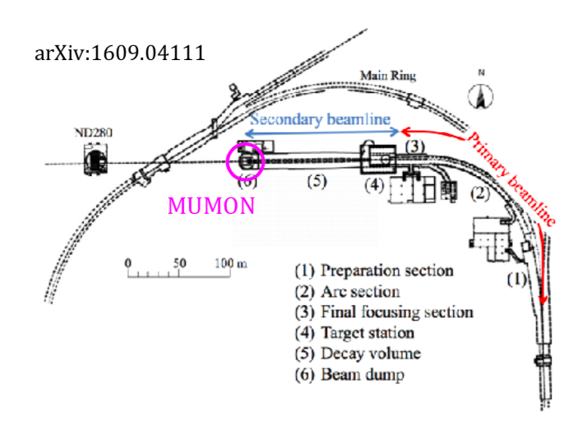
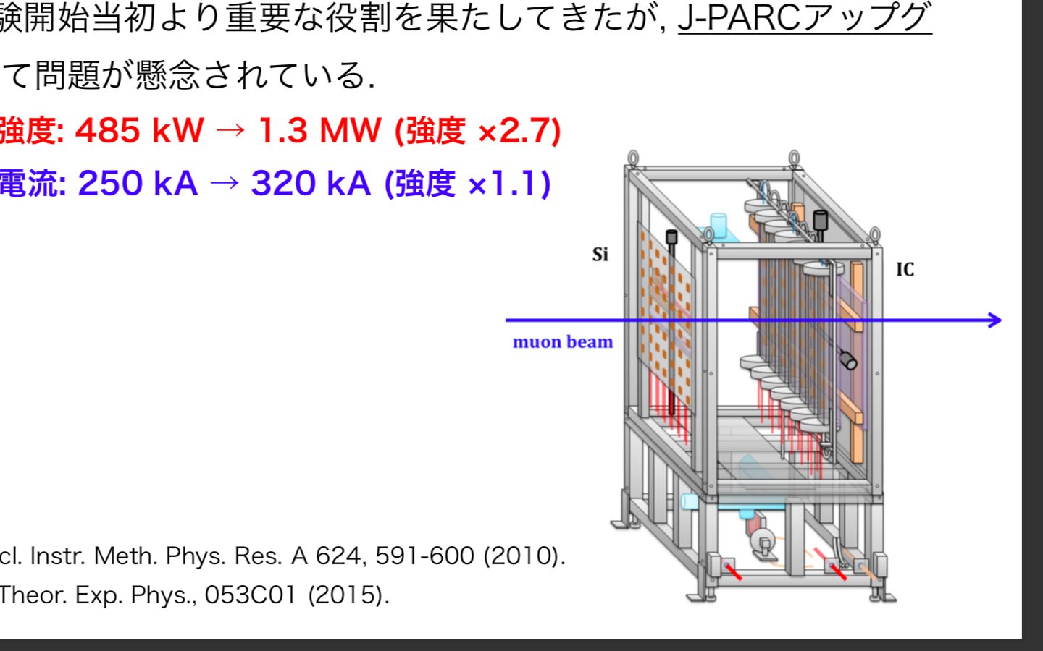
What is Muon Monitor (MUMON)
Ion
Chamber
Si
Array
μ
Monitor the direction and intensity of muons from pion/kaon decays.
This is only detector that can monitor the beam bunch-by-bunch after the hadron production target.
→It’s essential for T2K.
Composed of Si & ion chamber (IC) array.
Notes:
3. Let me start from the current muon monitor, MUMON.
This detector monitors the direction and intensity of muons produced along with the neutrino.
It is located 118 m away from the target.
This is the only detector that can monitor the beam bunch-by-bunch after the hadron production target.
So, MUMON is essential for the beam operation.
MUMON is composed of two arrays of sensors, one is the silicon PIN photodiodes and another is the ionization(アイニゼイション) chambers.

Slide 4
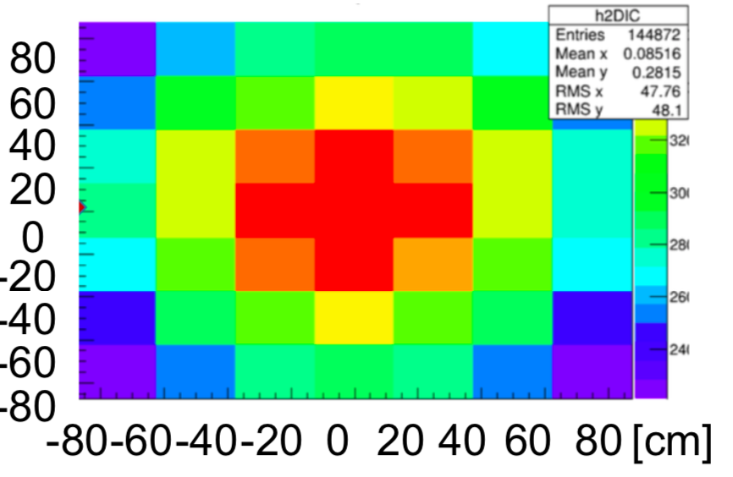
Current Monitor (Si, IC)
Working since 2009.
Each Si & IC has 7 × 7 channels and covers 150 ×150 cm².
Get the beam intensity and position by fitting 2D distribution of collected charges.
The intrinsic detector resolution (RMS).
  Beam center<0.3 mm
  Beam intensity<0.1%
[cm]
yield
[mrad]
0.5
0
-0.5
y direction
1
0.5
0
-0.5
x direction
-1
total 45 months
Notes:
4. This detector is working since 2009.
Each array covers a 150(one fifty)×150 cm2 region.
And there are 7×7 channels with a 25 cm pitch.
And, get the beam intensity and center position by fitting 2D distributions of collected charges.
Resolution is less than 0.3 mmfor the beam center, and less than 0.1% for the intensity measurement.
Si & IC has shown excellent performance since the T2K started.

Slide 5
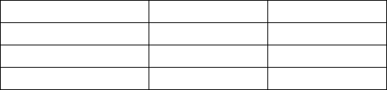
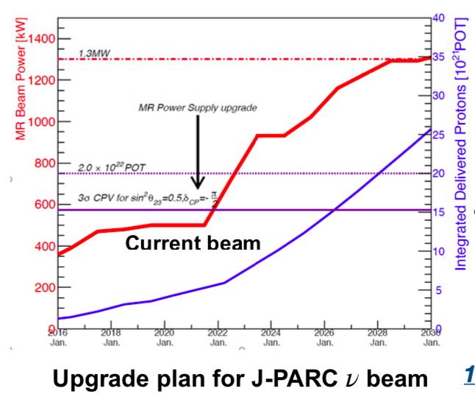
J-PARC Upgrade
In the future, J-PARC will increase the beam power.
Now (485 kW)
Future (1.3 MW)
Operation cycle
2.48 s
1.16 s
Horn current
250 kA
320 kA
# of muons / cm² / beam bunch
3.5 × 10⁶
4.9 × 10⁶
40
-> Concerning some issue
as the beam power is increasing
1400
35
1200
MR Beam Power [kW]
MR Power Supply upgrade
30
1000
25
Candidates for new detector
800
20
Integrated Delivered Protons [10²¹POT]
PMT
EMT
->Replace photocathode of PMT with Al (detail later)
->Higher radiation hardness
600
15
400
10
200
5
0
0
2016
2018
2020
2022
2024
2026
2028
2030
Notes:
5. We are planning to increase the T2K beam power in the future.
The bunch cycle will be doubled.
the T2K horn current will be increased to 320 kA from 250 kA.
The muon flux per bunch will increase by a factor of 1.4.
We are concerning some issues as the beam power is increasing.
So, we are considering new detectors.
There are the two candidates PMT and EMT.
I will explain them in detail later.

Slide 6
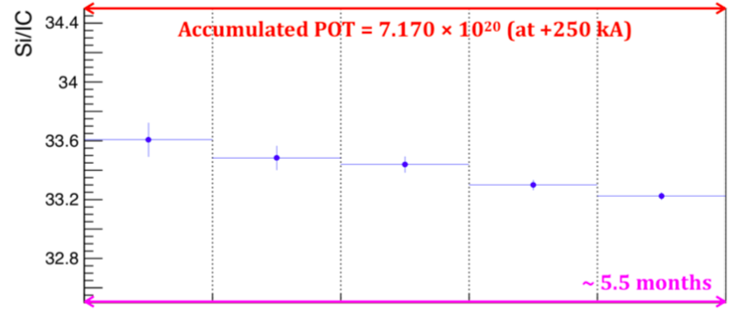
Issue of Current Detector (Si)
Response degradation of the Si Detector.
Signal decrease due to radiation damage
is seen (~1% / 5×10²⁰P.O.T).
The requested value from T2K is within 3%
-> Replace the Si detector every half a year in the future
1%
Notes:
6. We have concern for using the current detector in the future.
The first issue is response degradation of the silicon detectors.
This figure shows the result of the last physics run at T2K.
The signal from the silicon decreased by 1% during about 5 months for the current beam power.
The requested value from T2K is within 3%.
So, we would have to replace the Si detector every half a year for the higher beam intensity expected in the near future.

Slide 7
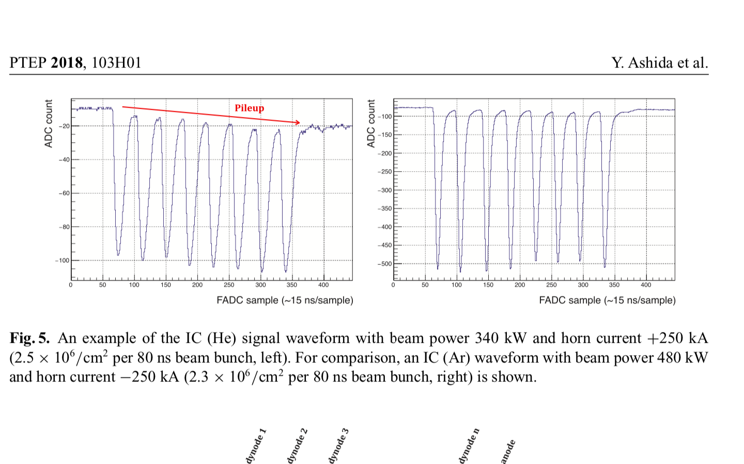
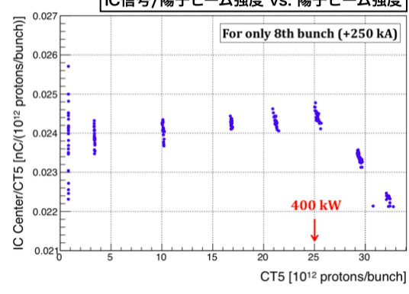
Issue of Current Detector (Ion Chamber)
IC-Ar
Signal response of IC
for higher beam power
ADC count
IC-Ar yield/proton beam power
vs. proton beam power
5 μs
FADC sample (~15 ns/sample)
IC-He
IC Center/Reference
[nC/(10¹² protons/bunch)]
~8%
ADC count
400 kW
[10¹² protons/bunch]
5 μs
FADC sample (~15 ns/sample)
Non-linearities, at high intensity.
Using of He gas instead of Ar.
-> Pileup is due to faster ion drift speed.
Notes:
7. The second issue is the signal response of the ion chambers for higher beam powers.
The left figure shows the normalized response of the IC using the Ar gas for eight bunches at various beam powers.
We see non-linearities here from 400 kW.
One solution of this would be to use a lighter gas, such as He,
in which the number of generated electron/ion pairs is much smaller than Ar.
However, as shown in the right figure,
He suffers from signal pileup caused by the fast drift speed of the lighter ion.
So, this affects bunch-by-bunch monitoring.

Slide 8
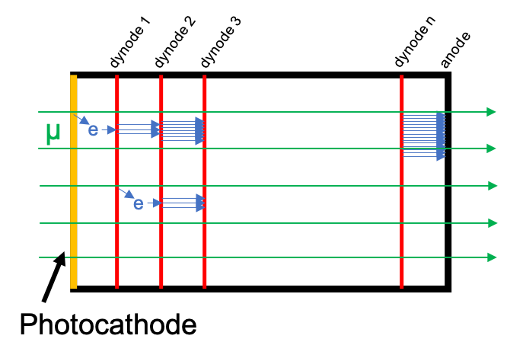
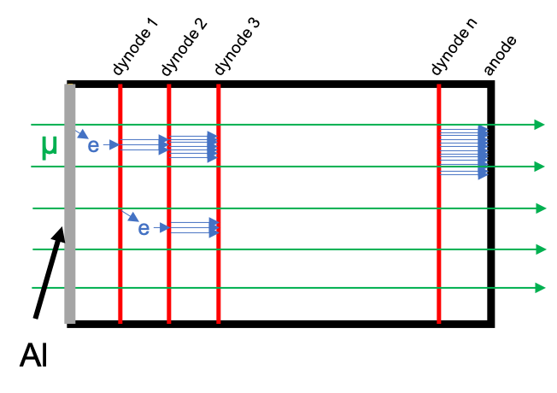
What is the Electron–Multiplier Tube (EMT)?
The Development of Prototype Detectors
-PMT&EMT-
The components of EMT are the same as the standard PMT except the photocathode.
Photocathode material is replaced with Al for EMT
-> Expect higher radiation hardness
(low signal gains though).
We have some options for EMT.
PMT
EMT
Notes:
8. I’m going to talk about the development of prototype detectors
Let me explain the EMT.
This is candidate of new detector.
These figures are the schematic views of PMT & EMT.
Components of the EMT are the same as the standard PMT except the photocathode.
Photocathode material is replaced with Al(アル-ミナル) which we expect has higher radiation hardness.
The electron emission rate of Al is smaller than standard photocathode but sufficient signal is expected for the high intensity beam.
In addition to this, we prepare some EMTs.
These are different options.

Slide 9
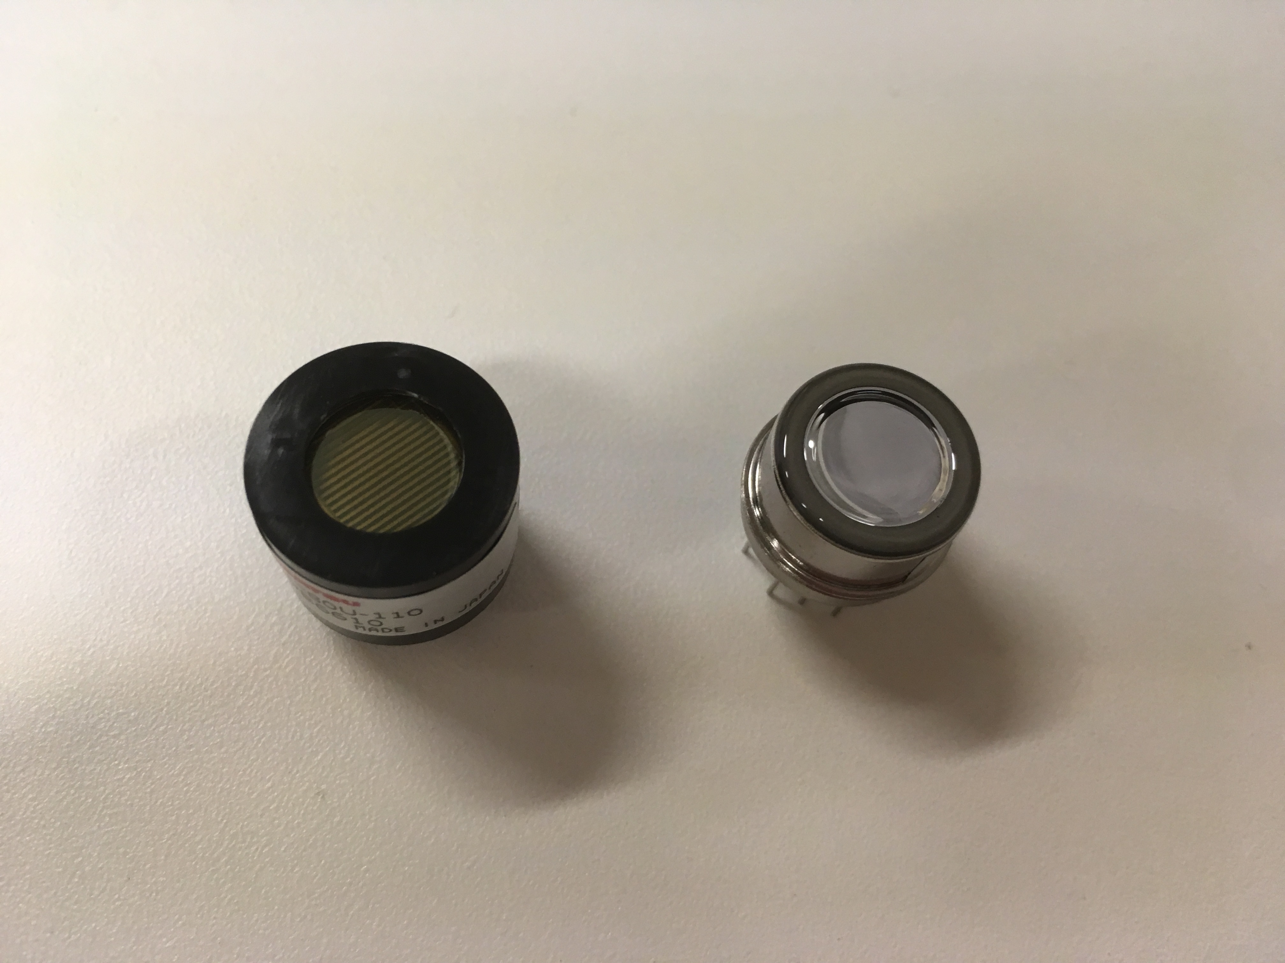
The Development of Prototype Detectors
-PMT&EMT-
16 mm
14.6 mm
PMT
EMT
Notes:
This is the picture of PMT and EMT. the diameter of effective area is 8 mm.

Slide 10
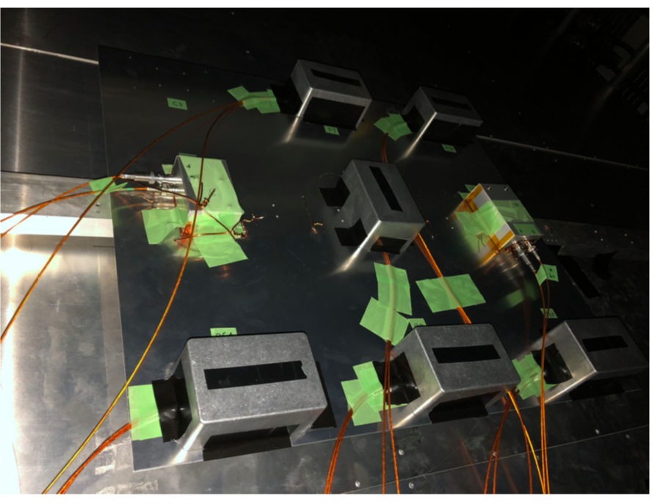
The Development of Prototype Detectors
-PMT&EMT-
μ
Some candidate detectors were tested.
Installed behind the MUMON.
Notes:
10. The performance of some prototype detectors was studied with the T2K muon beam.
There are 2 PMTs and 6 EMTs like this picture. These were installed behind the MUMON.

Slide 11
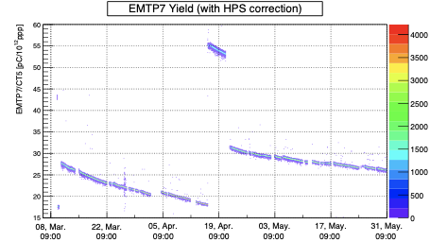

PMT’s Stability
We tested two PMTs.
PMT #1
Change HV
PMT #2
Change HV
60
60
55
55
PMT #1/CT
type B/CT
50
50
45
45
40
40
35
35
30
30
25
25
20
20
15
15
10
about 3 months
about 3 months
The signal continued to drop for about 3 months.
Tried different voltage.
Stability is worse than the current detectors.
Notes:
11. First, let me talk about the PMT.
We installed two standard PMTs.
We checked the linearity and stability.
The PMT signal continued to drift for three months.
So, the stability is worse than the current detector.
The cause is thought to be damage of the photocathode.

Slide 12
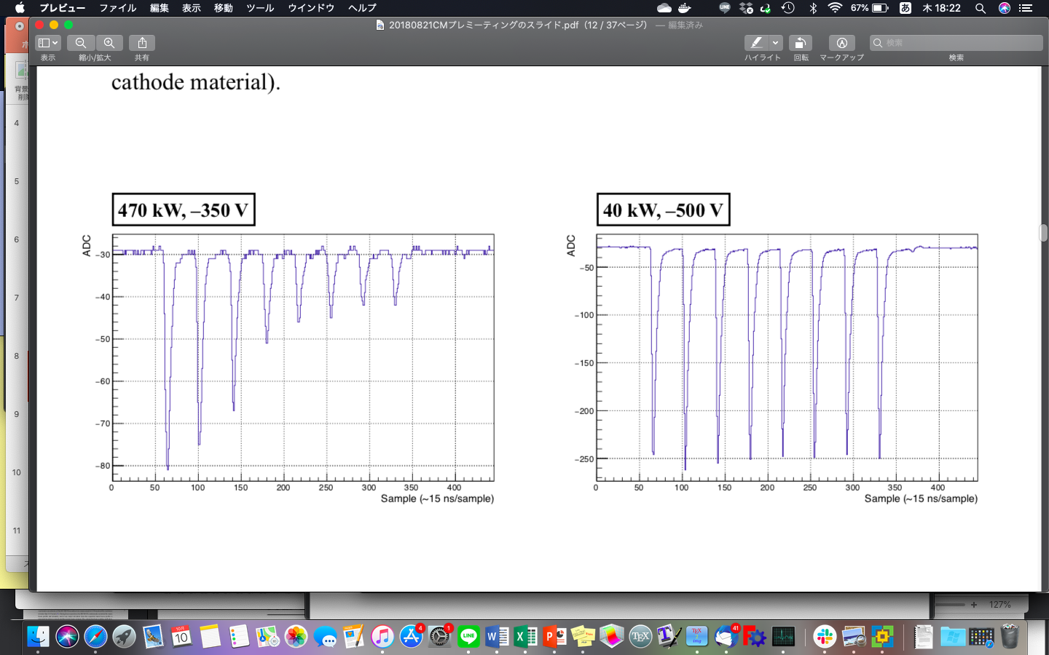
PMT’s Signal for 8 bunches
Measured the signal of PMT for different Intensities and HV.
ADC count
ADC count
220
50
40 kW, -500V
470 kW, -350V
FADC samples (~15 ns/sample)
FADC samples (~15 ns/sample)
Expect the same magnitude
of response
gain at -500 V is ten times at -350 V
Signal was OK at 40 kW, but saturated at 470kW.
->Voltage drop by photocathode resistance.
PMT does not seem to be a good candidate.
Notes:
12. We measured the signal of PMT for different Intensities and HV.
Under those two conditions, the signal is considered(d) to have the same magnitude.
However, the waveform is strange at high intensity.
PMT shows clear non-linearity due to voltage drop by photocathode resistance.
So, PMT does not seem to be a good candidate.

Slide 13
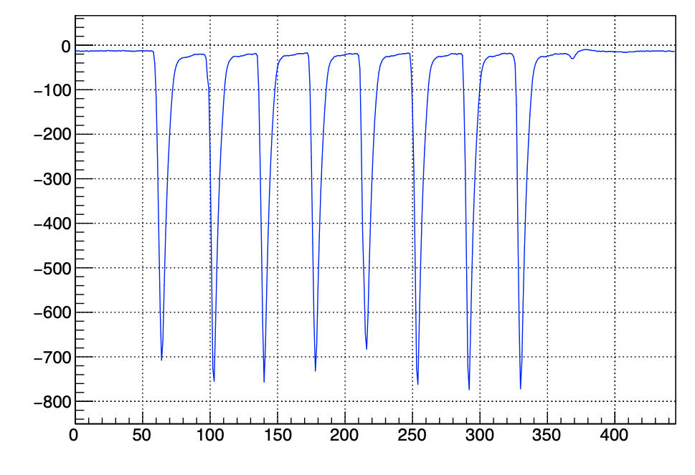
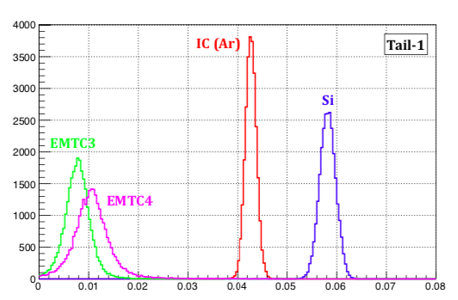
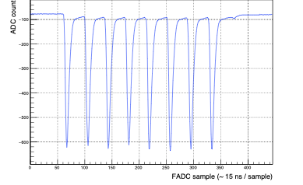
Time Response of EMT
Smaller tail contribution is better.
-> Affects bunch-by-bunch monitoring for T2K.
EMT #1
Tail
ADC count
EMT #1
Si
EMT #2
ADC count
Ratio (Tail/1st bunch)
EMT performs better than Si and IC
FADC sample (~15ns / sample)
Notes:
13. This is a result of time response of EMT.
Smaller tail contribution is better because it affects (a) bunch-by-bunch monitoring.
The upper left figure shows EMT
The lower left figure shows Si.
The right figure shows the tail contribution obtained from the regions shown here.
EMTs perform better than Si and IC for bunch-by-bunch beam monitoring.

Slide 14
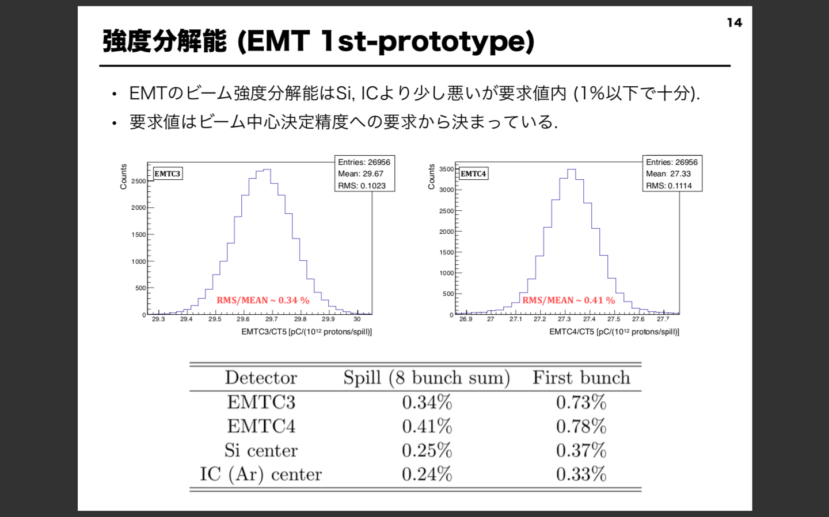
Intensity Resolution of EMT
Intensity resolution of the EMT is better than a required value of ~1% .
for beam position measurement with an accuracy < 0.3 mrad.
Counts
EMT #1
EMT/Reference[pC/(10¹² protons/spill)]
EMT #1
EMT #2
Notes:
14. Next, Intensity resolution about EMT
Intensity resolution of the EMT is worse than that of Si nor IC,
but better than a required value of
about 1% for beam position measurement with an accuracy <(less than) 0.3 mrad

Slide 15
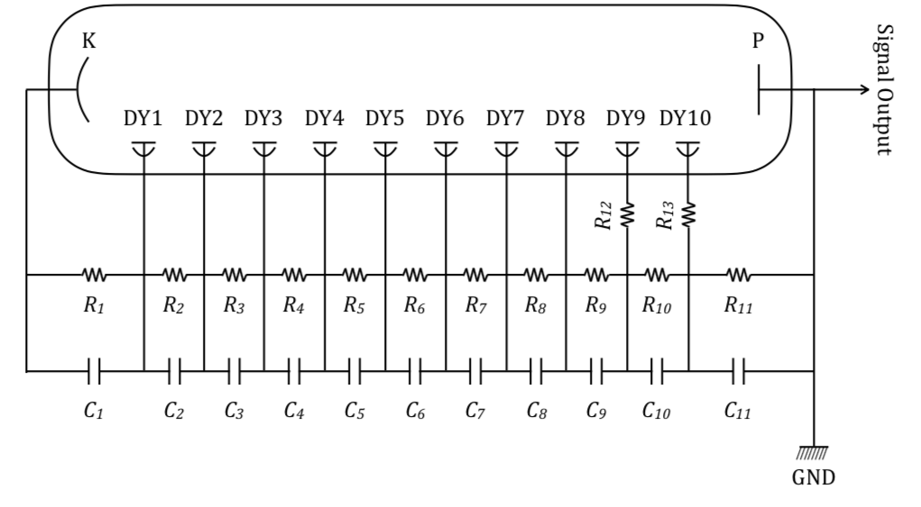
Linearity of EMT
Measured with two EMTs with different capacitances in divider circuit.
Large capacitance may give better response at higher intensity.
R₁ – R₁₀ : 330 kΩ
R₁₁ : 160 kΩ
small capacitance
10
10
10
15
large capacitance
100
100
100
330
330
330
(nF)
Notes:
15. We measured linearity for two EMTs with different capacitances in divider circuit.
This is the divider circuit.
Large capacitance may give better response at higher intensity.

Slide 16
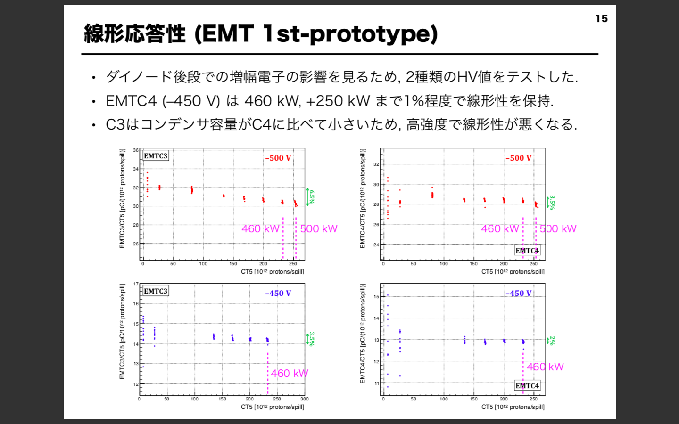
Linearity of EMT
Large capacitance EMT shows better linearity as expected.
small capacitance
Type 1B
Type 1A
- 500 V
large capacitance
- 500 V
EMT #1/Reference
[pC/(10¹² protons/spill)]
6.5 %
EMT #2/Reference
[pC/(10¹² protons/spill)]
3.5 %
Type 1A
500 kW
Type 1B
500 kW
[10¹² protons/spill]
[10¹² protons/spill]
Notes:
16. These are the results.
The left figure for small capacitance, and right one for the large capacitance.
At the high intensity, the signal decreased by about 5 %.
Large capacitance EMT shows better linearity as expected.

Slide 17
Linearity of EMT
EMT with the same capacitance was compared for different HV.
-> Low HV is better (less electric field distortion).
small capacitance
- 500 V
small capacitance
- 450 V
EMT #1/Reference
[pC/(10¹² protons/spill)]
EMT #1/Reference
[pC/(10¹² protons/spill)]
6.5 %
3.5 %
[10² protons/spill]
[10² protons/spill]
Notes:
17. EMT with the same capacitance was compared for different HV.
The linearity is better for small voltage.
Higher voltages degrade the linearity due to electric field distortion.

Slide 18
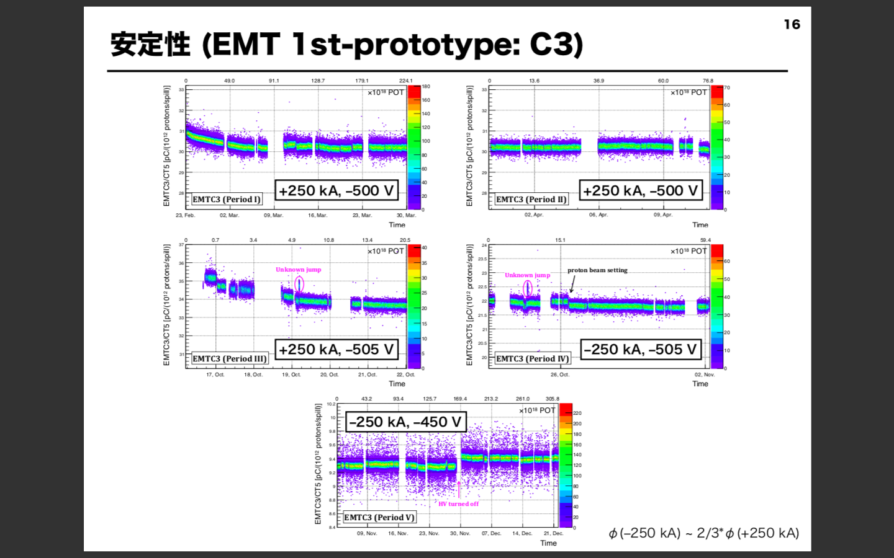
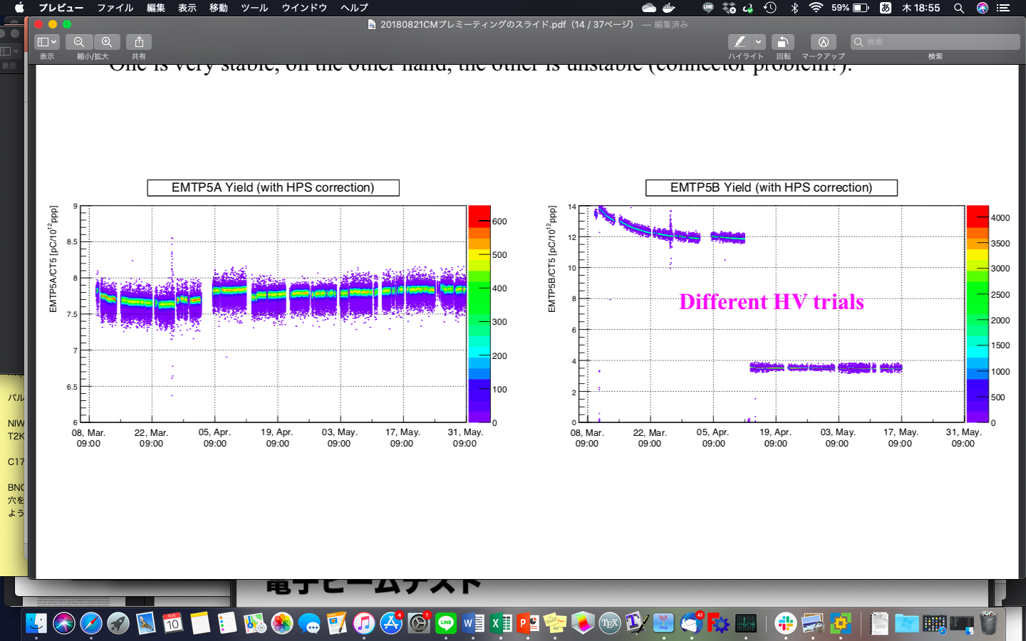
Stability of EMT
We see ~3% drift for the first 10 days since installation.
-> After the drift, both the EMTs show good stability (~1%).
One of the four EMTs showed a large and long drift.
-> Tube-to-tube variation large?
EMT yield
drift
3 %
2/23
1 month
3/30
4/1
11 days
4/11
drift
15 %
3 months
Notes:
18. This is the result of stability.
We measured the stability for four EMTs.
The results for one EMT are shown in the figure above.
We see about 3% drift for the first 10 days since installation.
After the drift, the EMTs show good stability.
However, One of the four EMTs showed(d) a large and long drift
So, Tube-to-tube variation could be large?

Slide 19
Summary so far and future research
PMT is worse than current detectors.
EMT is a good candidate for new muon monitor.
However…
  As intensity increases, linearity deteriorates.
  -> Change the voltage ratio of the divider circuit.
  One of the four EMTs showed a large and long drift.
  -> We are going to measure many EMTs.
  Large drift at the beginning due to alkali metal on dynode.
  -> Test EMTs without alkali.
Notes:
19. This slide is summary so far and future research
PMT is worse than current detectors.
On the other hand, EMT is a good candidate for the new muon monitor
However, There are something to study more.
First, linearity gets worse at high intensity.
We will Optimize the divider circuit
One of the four EMTs showed a large and long drift.
So, we are going to measure many EMTs.
The signal drifts(s) are rather large due to alkali metal.
We will test EMT removing alkali metal from dynodes.

Slide 20
EMT beam test
We study more details EMT by a beam test.
at Research Center for Electron Photon Science (ELPH)
at Tohoku University in Japan
at the end of Nov. 2019
We are planning to measure the followings …
Linearity up to 1.4 times current intensity
(4.9×10⁶ muons/cm²/100 ns)
Stability corresponding to 10-years beam exposure
with the planned intensity.
3. Others
Without alkali metal
EMT with different circuits
Notes:
20. The EMT could be a good candidate for the new muon monitor.
We study more details by a beam test at Research Center for Electron Photon Science (ELPH) at Tohoku University in Japan.
In particular, performance tests at future intensity are required.
We will measure linearity up to the future intensity,
and stability corresponding to 10 years beam exposure with the planned intensity.
In addition, using EMT without alkali metal,
And, different divider circuits.

Slide 21
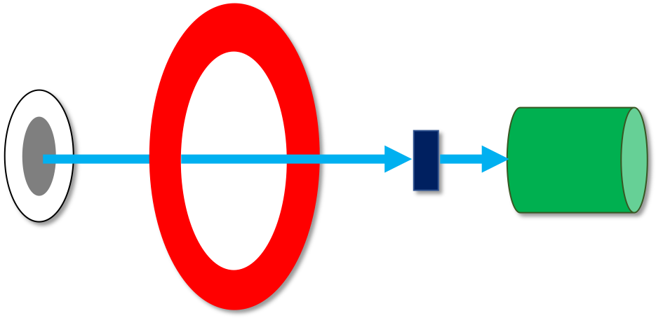
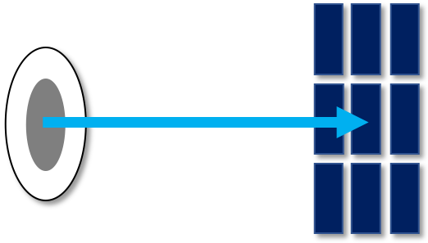
Setup of beam test
Measure the beam profile with Si array.
Measure the beam intensity with CT.
Compare EMT with the current detector of Si.
e⁻
e⁻
beam
window
beam
window
Si
EMT
Si array
CT
Setup1
Setup2
Notes:
21. This is the beam test setup.
Setup 1 is used(ユーズド) to measure the profile of electron beam by using Si array.
In the setup2, measuring EMTs performances compare with the current detector of Si.
CT is put in the upstream to calibrate the beam intensity.

Slide 22
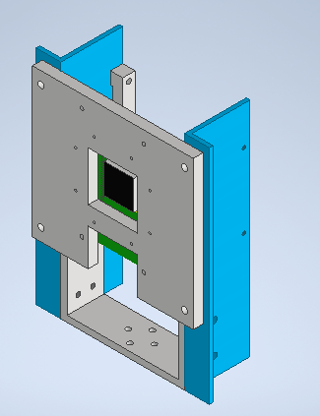
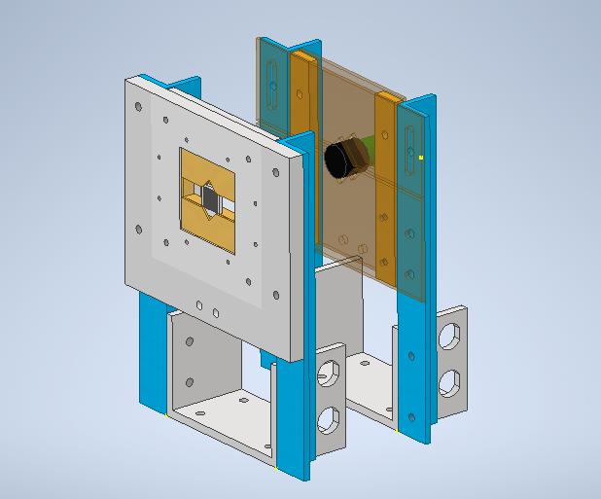
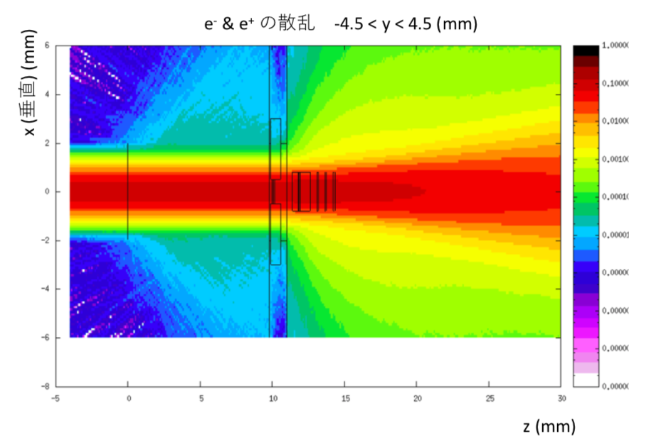
Preparation for EMT beam test
Si array
EMT
270 mm
180 mm
change
e⁻
Si
beam window
200 mm
160 mm
Setup 2
Setup 1
Supporting structure
for sensors have been designed.
Scattering effect is checked
by FLUKA simulation.
-> less than 1%
e & e⁻
beam window
supported Si
EMT
Notes:
22. Supporting structure for sensors have been designed.
These are the supporting structure for sensors for the beam test.
Scattering effect(イ) is checked by FLUKA simulation.
The support was designed to produce as little scattering as possible.
And confirmed that scattering by the support is less than 1%.

Slide 23
Summary
MUMON is essential for the T2K experiment to ensure good neutrino beam quality.
We are developing a new MUMON detector for higher intensity beam operation.
EMT is a good candidate.
-> However, we need to study more about linearity, large drift …
We are planning a beam test at the end of Nov. 2019.
Looking forward to EMT test results !!
Notes:
23.
This is summary.
MUMON is essential for the T2K experiment to ensure good neutrino beam quality.
We are developing a new MUMON detector for higher intensity beam operation.
EMT is a good candidate. However, there are some little problems.
We are planning to do a beam test at the end of Nov. 2019.

Slide 24
backup

Slide 25
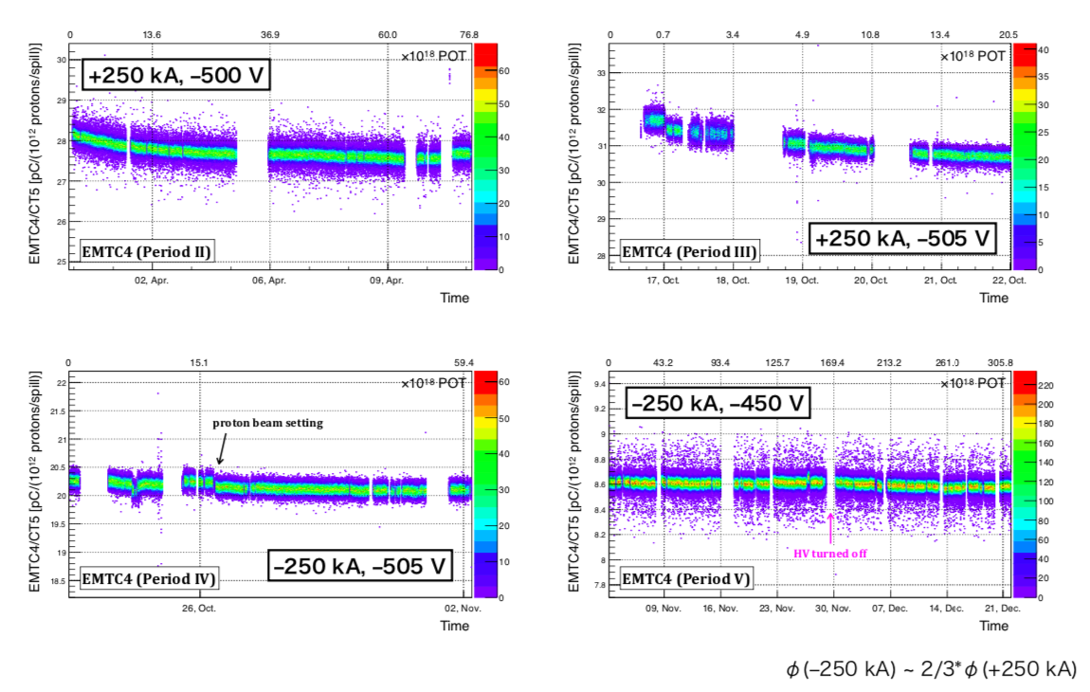
Stability EMT Type 2B

Slide 26
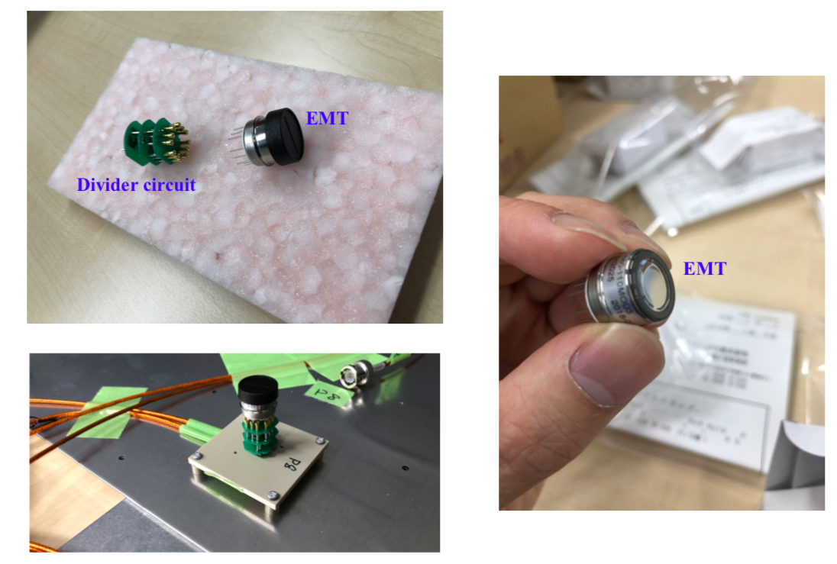

Slide 27
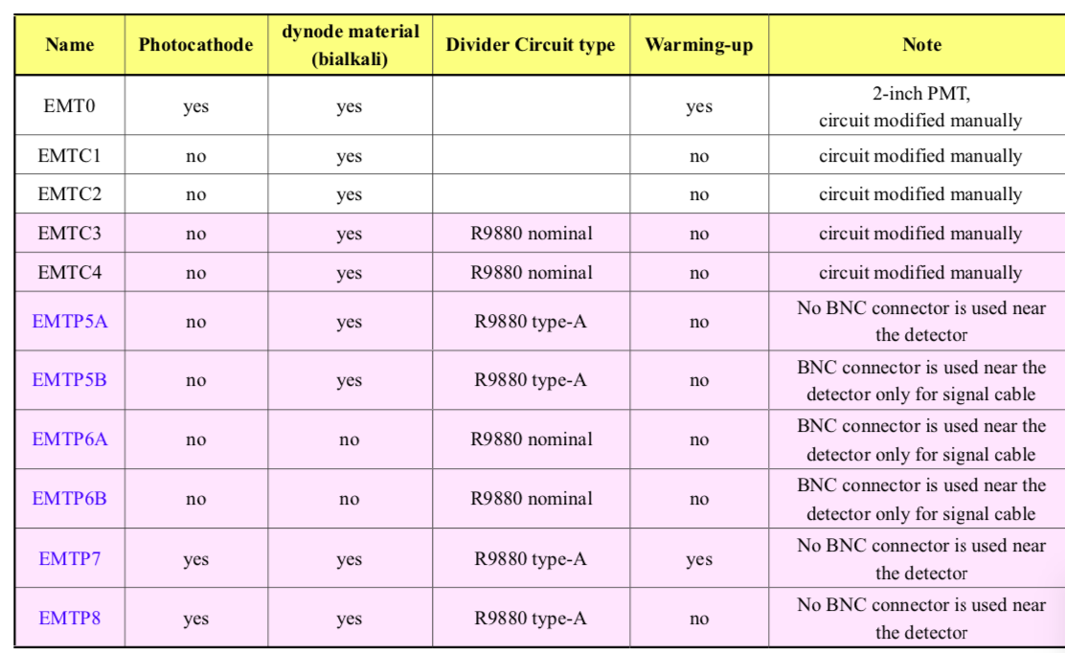

Slide 28
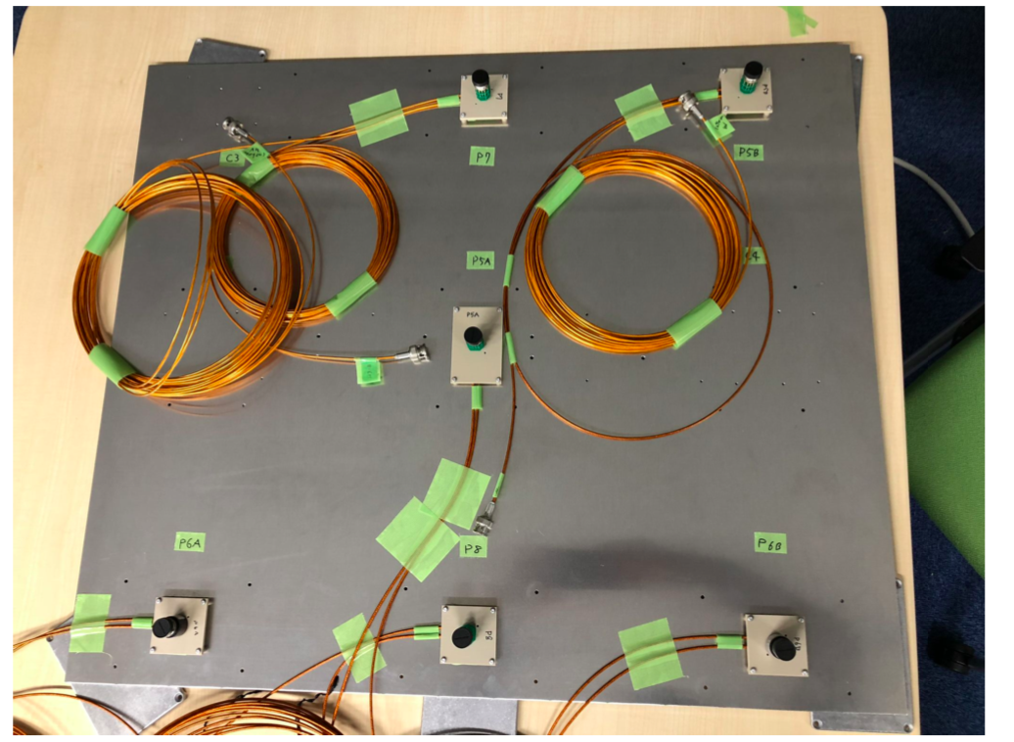

Slide 29
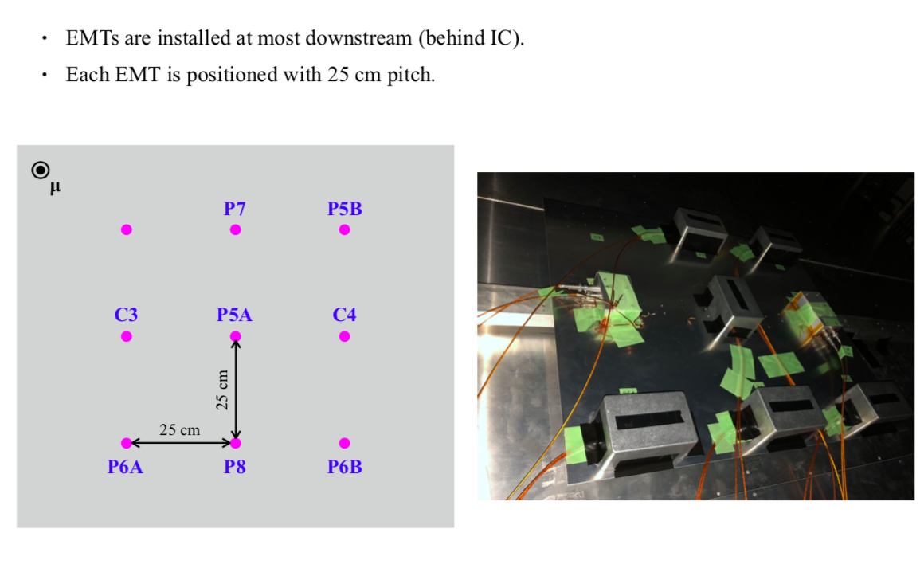

Slide 30
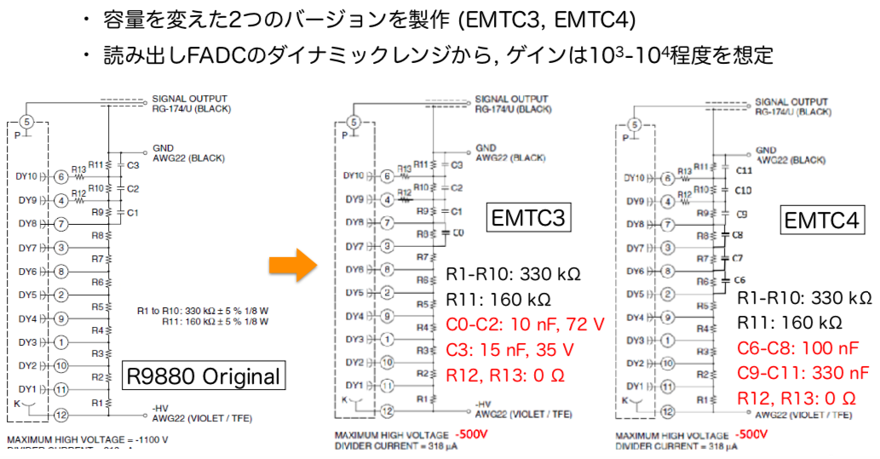
Prototype EMT
prototype detector that improved the circuit of Hamamatsu R9880
capacitance of decoupling capacitor change for corresponding 8 bunchs during 5 μs

Slide 31
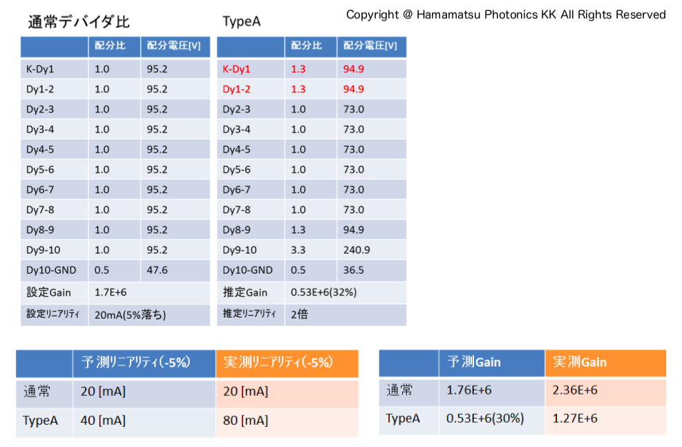

Slide 32
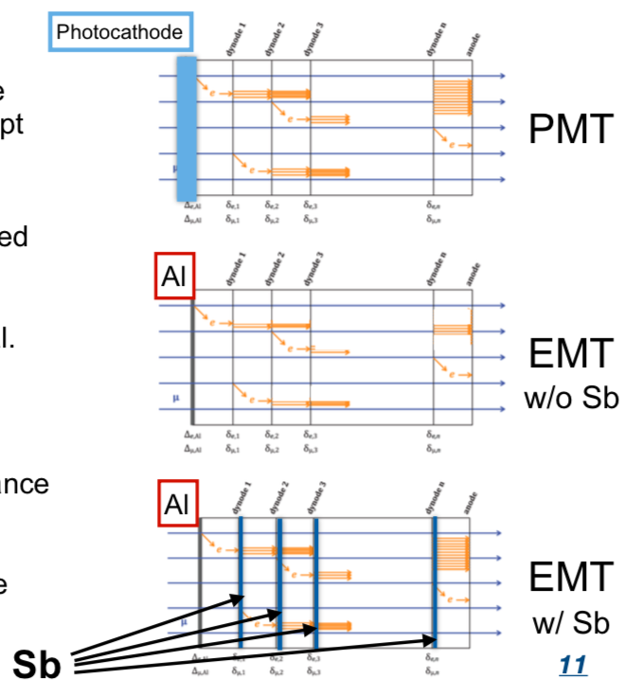
What is the EMT?
The component of EMT are the same as the standard PMT except the photocathode.
Photocathode material is replaced with Al for EMT
→expect higher radiation hardness (low signal gains though).
Current option
 | Dynode material (Sb) | Divider circuit | Expected gain
Type 1 | yes | nominal | 〜6×10⁶
Type2 | yes | Type-A | 32% of Type 1
Type3 | no | nominal | 10〜10³
Type of the divider circuit is difference of distribution ratio
expect Increase efficiency of secondary electron emission for include Sb
Notes:
radiation –resistant

Slide 33
Setup of EMT Type-1
PMT
Type A
EMT
Type 1A
EMT
Type 1B
μ
PMT
Type B
Two custom-made prototype detectors based on HAMAMATSU R9880.
Dynode decoupling capacitors between the types.
Readout : 65 MHz Flash-ADC (the same as the Si and IC)
Notes:
ダイノード後段での増幅電子の影響を見るため、2種類のHV値でテストした

Slide 34
Setup of EMT Type-2
EMT
Type 2B
PMT
Type A
EMT
Type 2A
μ
PMT
Type B
To improve linearity, we change the voltage ratio of the divider circuit.
-> By reducing the potential difference between some dynodes in the first half, the space charge effect at the later stage was suppressed.
Notes:
ディバイダー回路の電圧比を調整した。線型性を改善するために
前半のダイノード間の電位差を小さくして後段で空間電荷効果を抑制させる。

Slide 35
Result of EMT Type-2
Type-2A is stable within 1%, after drifting 3%.
Type-2B drifted 15% in a month, then became stable.
We did not measure linearity.
-> The linearity is to be measured in the next beam test.
Type-2A Yield (with HPS correction)
Type-2B Yield (with HPS correction)
2.5 month
2.5 month
Notes:
Type-2Aは始め数%減衰した後は、1%程度で安定
Type-2Bは1ヶ月かけて15%信号が減少したが、その後安定

Slide 36
Setup of EMT Type-3
PMT
Type A
μ
EMT
Type 3B
EMT
Type 3A
PMT
Type B
EMT Type-3 has no alkali-Sb on dynodes (expected gain is 10~10³) →We expect higher radiation hardness than the Type1.
Unfortunately, we could not see any signal for 450V.

Slide 37
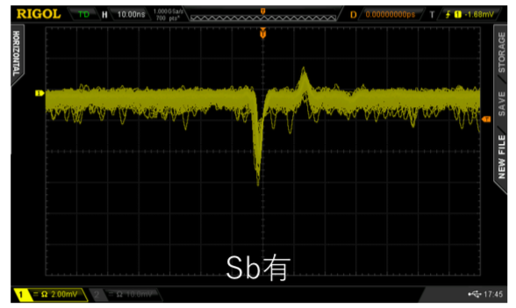
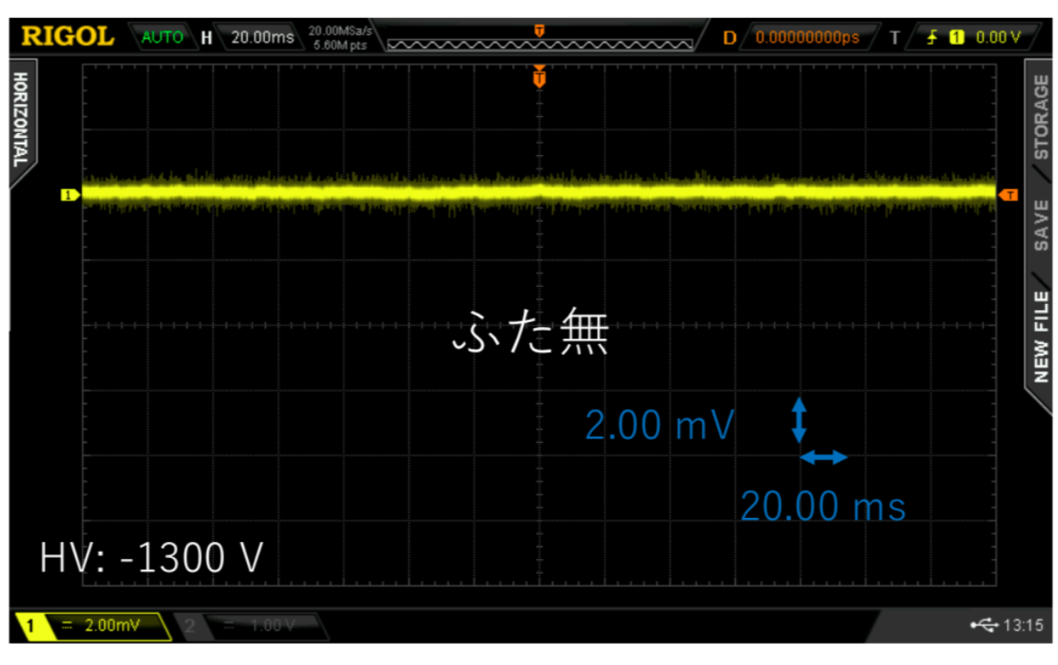
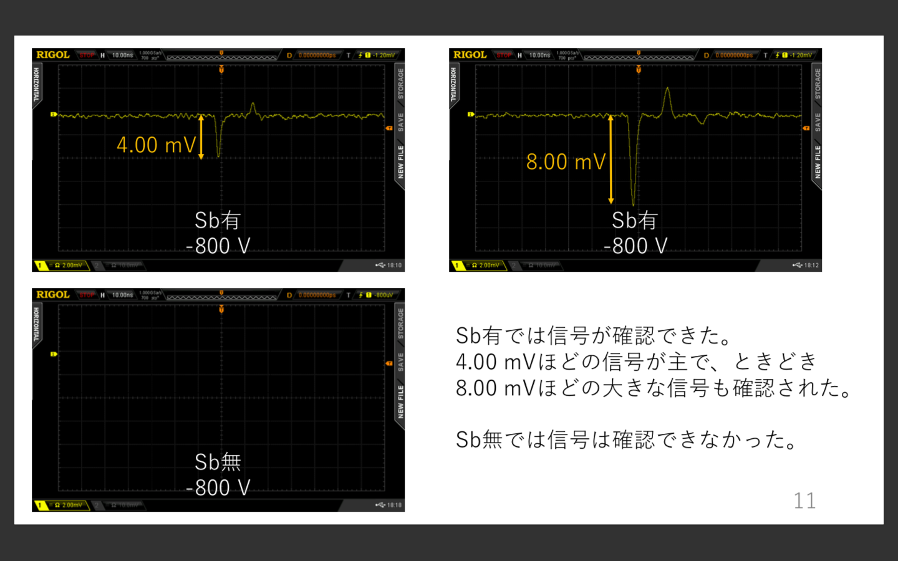
Measurement of EMT Type-3
We tried other signal sources such as fluorescent light and a radioactive source(¹⁵²Eu: gamma rays at ? eV)” .
Recommended voltage value is 500 V, but no signal even higher voltages.
fluorescent light
HV -800 V
with alkali-Sb
HV -1300 V
without alkali-Sb
radioactive source
HV -800 V
with alkali-Sb
HV -800 V
without alkali-Sb
We will check if we see signal in the beam test using higher beam intensities.
Notes:
電圧の適正値は500 Vだがそれよりも高い電圧をかけても信号が見れなかった

Slide 38
dynode 1
dynode 2
dynode 3
dynode n
anode
dynode 1
dynode 2
dynode 3
dynode n
anode
μ
e
μ
e
e
e
Al
Photocathode
dynode 1
dynode 2
dynode 3
dynode n
anode
dynode 1
dynode 2
dynode 3
dynode n
anode
μ
e
μ
e
e
e
Al
w/o alkali-Sb
Al
w/ alkali-Sb

