Slide 1
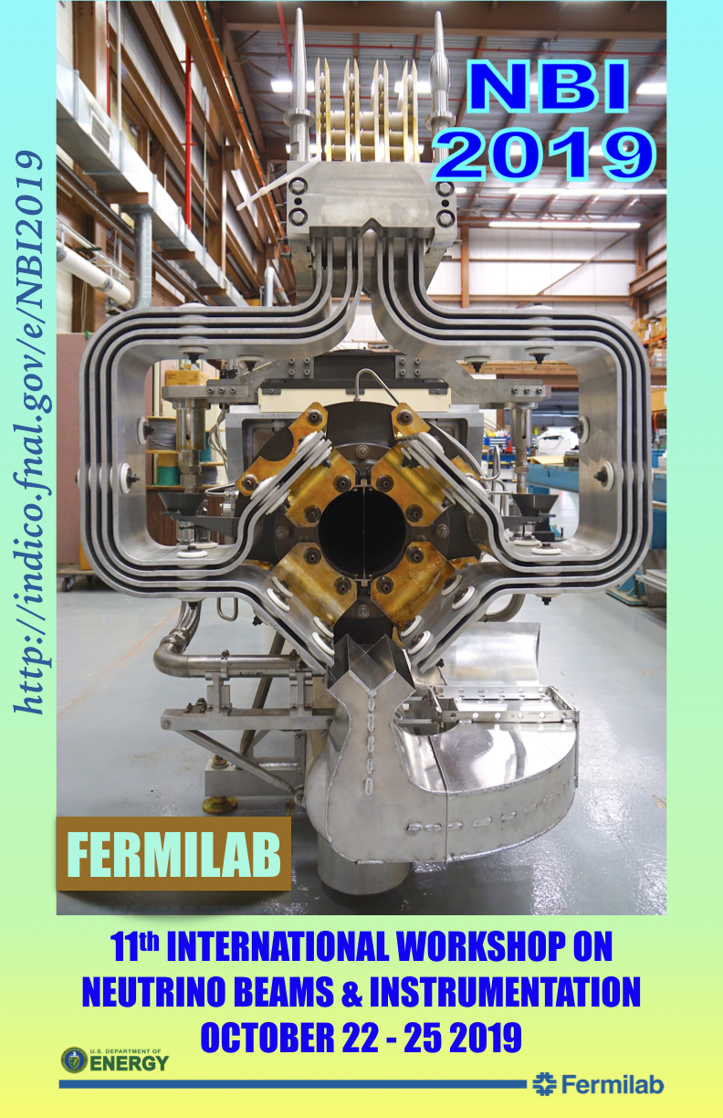
Farewell NBI!
25 October 2019

Slide 2
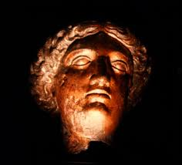
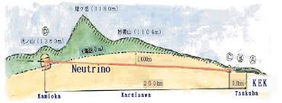
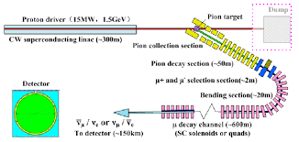
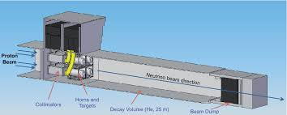
The Golden Age of Neutrino Beams
3 operating neutrino beams
2 “MW Class” beams
New & upgraded beams
Several new experiments
2 proposed multi-MW beams
Nobels, Breakthroughs, …
What is next?
Our real experience determines this

Slide 3
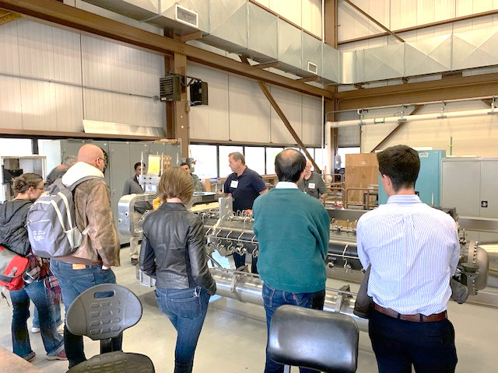
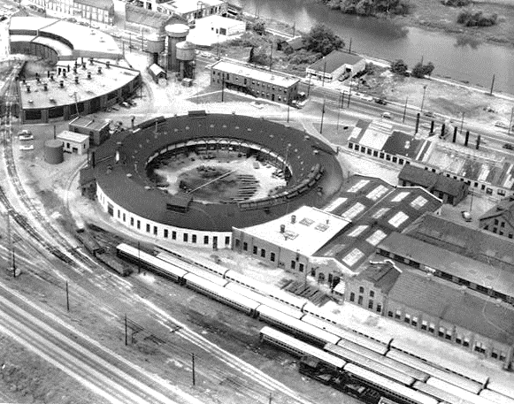
Recap
3-slides to summarize each talk
No more than 3 minutes per slide
3 ½ days of workshop
48 talks
53 registered participants
1 extended tour
15th floor reception courtesy of Fermi Research Alliance
Casual dinner in a historic railroad maintenance facility
Adjacent to many other meetings: Joint T2K-NOvA, MicroBooNE, Emphatic, LBNF satellites, …
MINERvA Wine & Cheese seminar today (3:30/4).

Slide 4
Thanks!
Local Organizing Committee:
Keith Gollwitzer
Kavin Ammigan
Patrick Hurh
Cara Kachel
Matt Slabaugh
Athula Wickremasinghe
Katsuya Yonehara
Tour guides
Katsuya Yonehara, James Hylen, Cory F. Crowley, Kris E Anderson, Kavin Ammigan, Georgi Lolov, David R. Pushka, Sujit Bidhar, Yun He, Michael Campbell, David W Peterson, Thomas R Kobilarcik, Keith E Gollwitzer, Frankie C Kelly, Robert Zwaska, Don A. Wickremasinghe, Martin Murphy,
Lab/Project management and Fermi Research Alliance
All of you! Presenters – audience - questioners

