Slide 1
Thermal Shock Studies at CERN’s HiRadMat Facility
Kavin Ammigan
11th International Workshop on Neutrino Beams and Instrumentation
24 October 2019

Slide 2
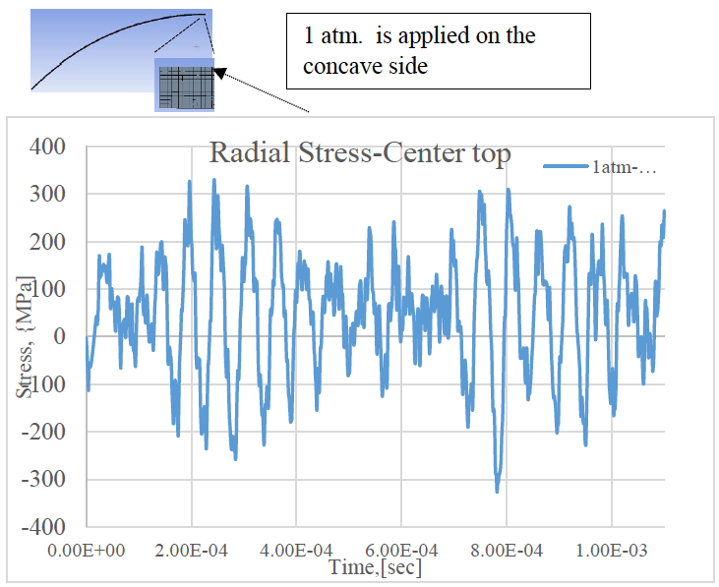
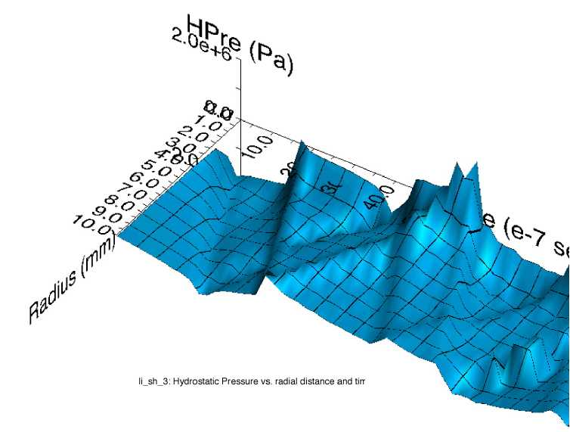
Beam-induced thermal shock
Rapid expansion of material surrounded by cooler material creates a sudden localized area of high compressive stress
  Stress waves are generated and propagate through the material
Dynamic stresses may induce plastic deformation, cracking and fatigue failure of the material
Thermal shock response dependent on:
  Energy deposition rate
  Specific heat capacity
  Coefficient of thermal expansion
  Modulus of elasticity
S. Bidhar, Dynamic stresses in T2K Ti beam window
P. Hurh, Stress wave propagation in FNAL pbar source Li lens

Slide 3
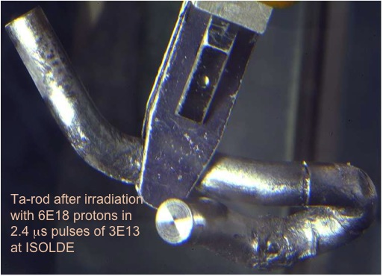
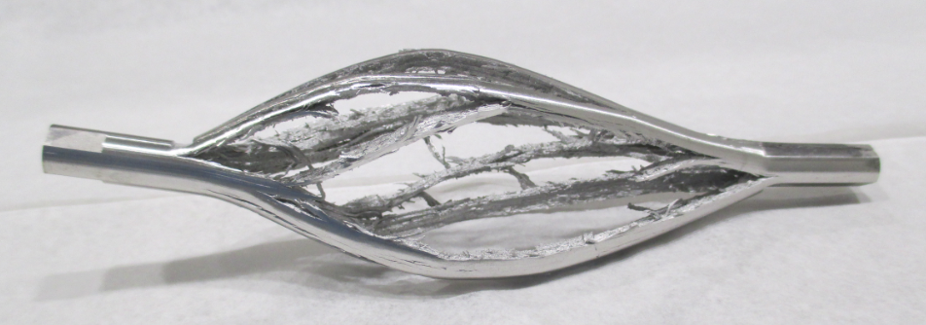
Motivation for in-beam thermal shock experiments
Address the thermal shock challenge in future multi-MW target facilities to avoid compromising particle production efficiency by limiting beam power on target
What are the material thermal shock limits?
Onset of material yielding and failure modes?
Validity of strength models used in highly non-linear numerical simulations?
Photo courtesy of J. Lettry
Objectives
Iridium rod in HRMT27 exploded
with single shot 1.27x10¹² protons
In-beam tests to induce thermal shock in beam-intercepting device materials under controlled conditions at very high localized strain rates and temperatures
Post-Irradiation-Examination and analysis of real-time measurements to quantify thermal shock effects

Slide 4
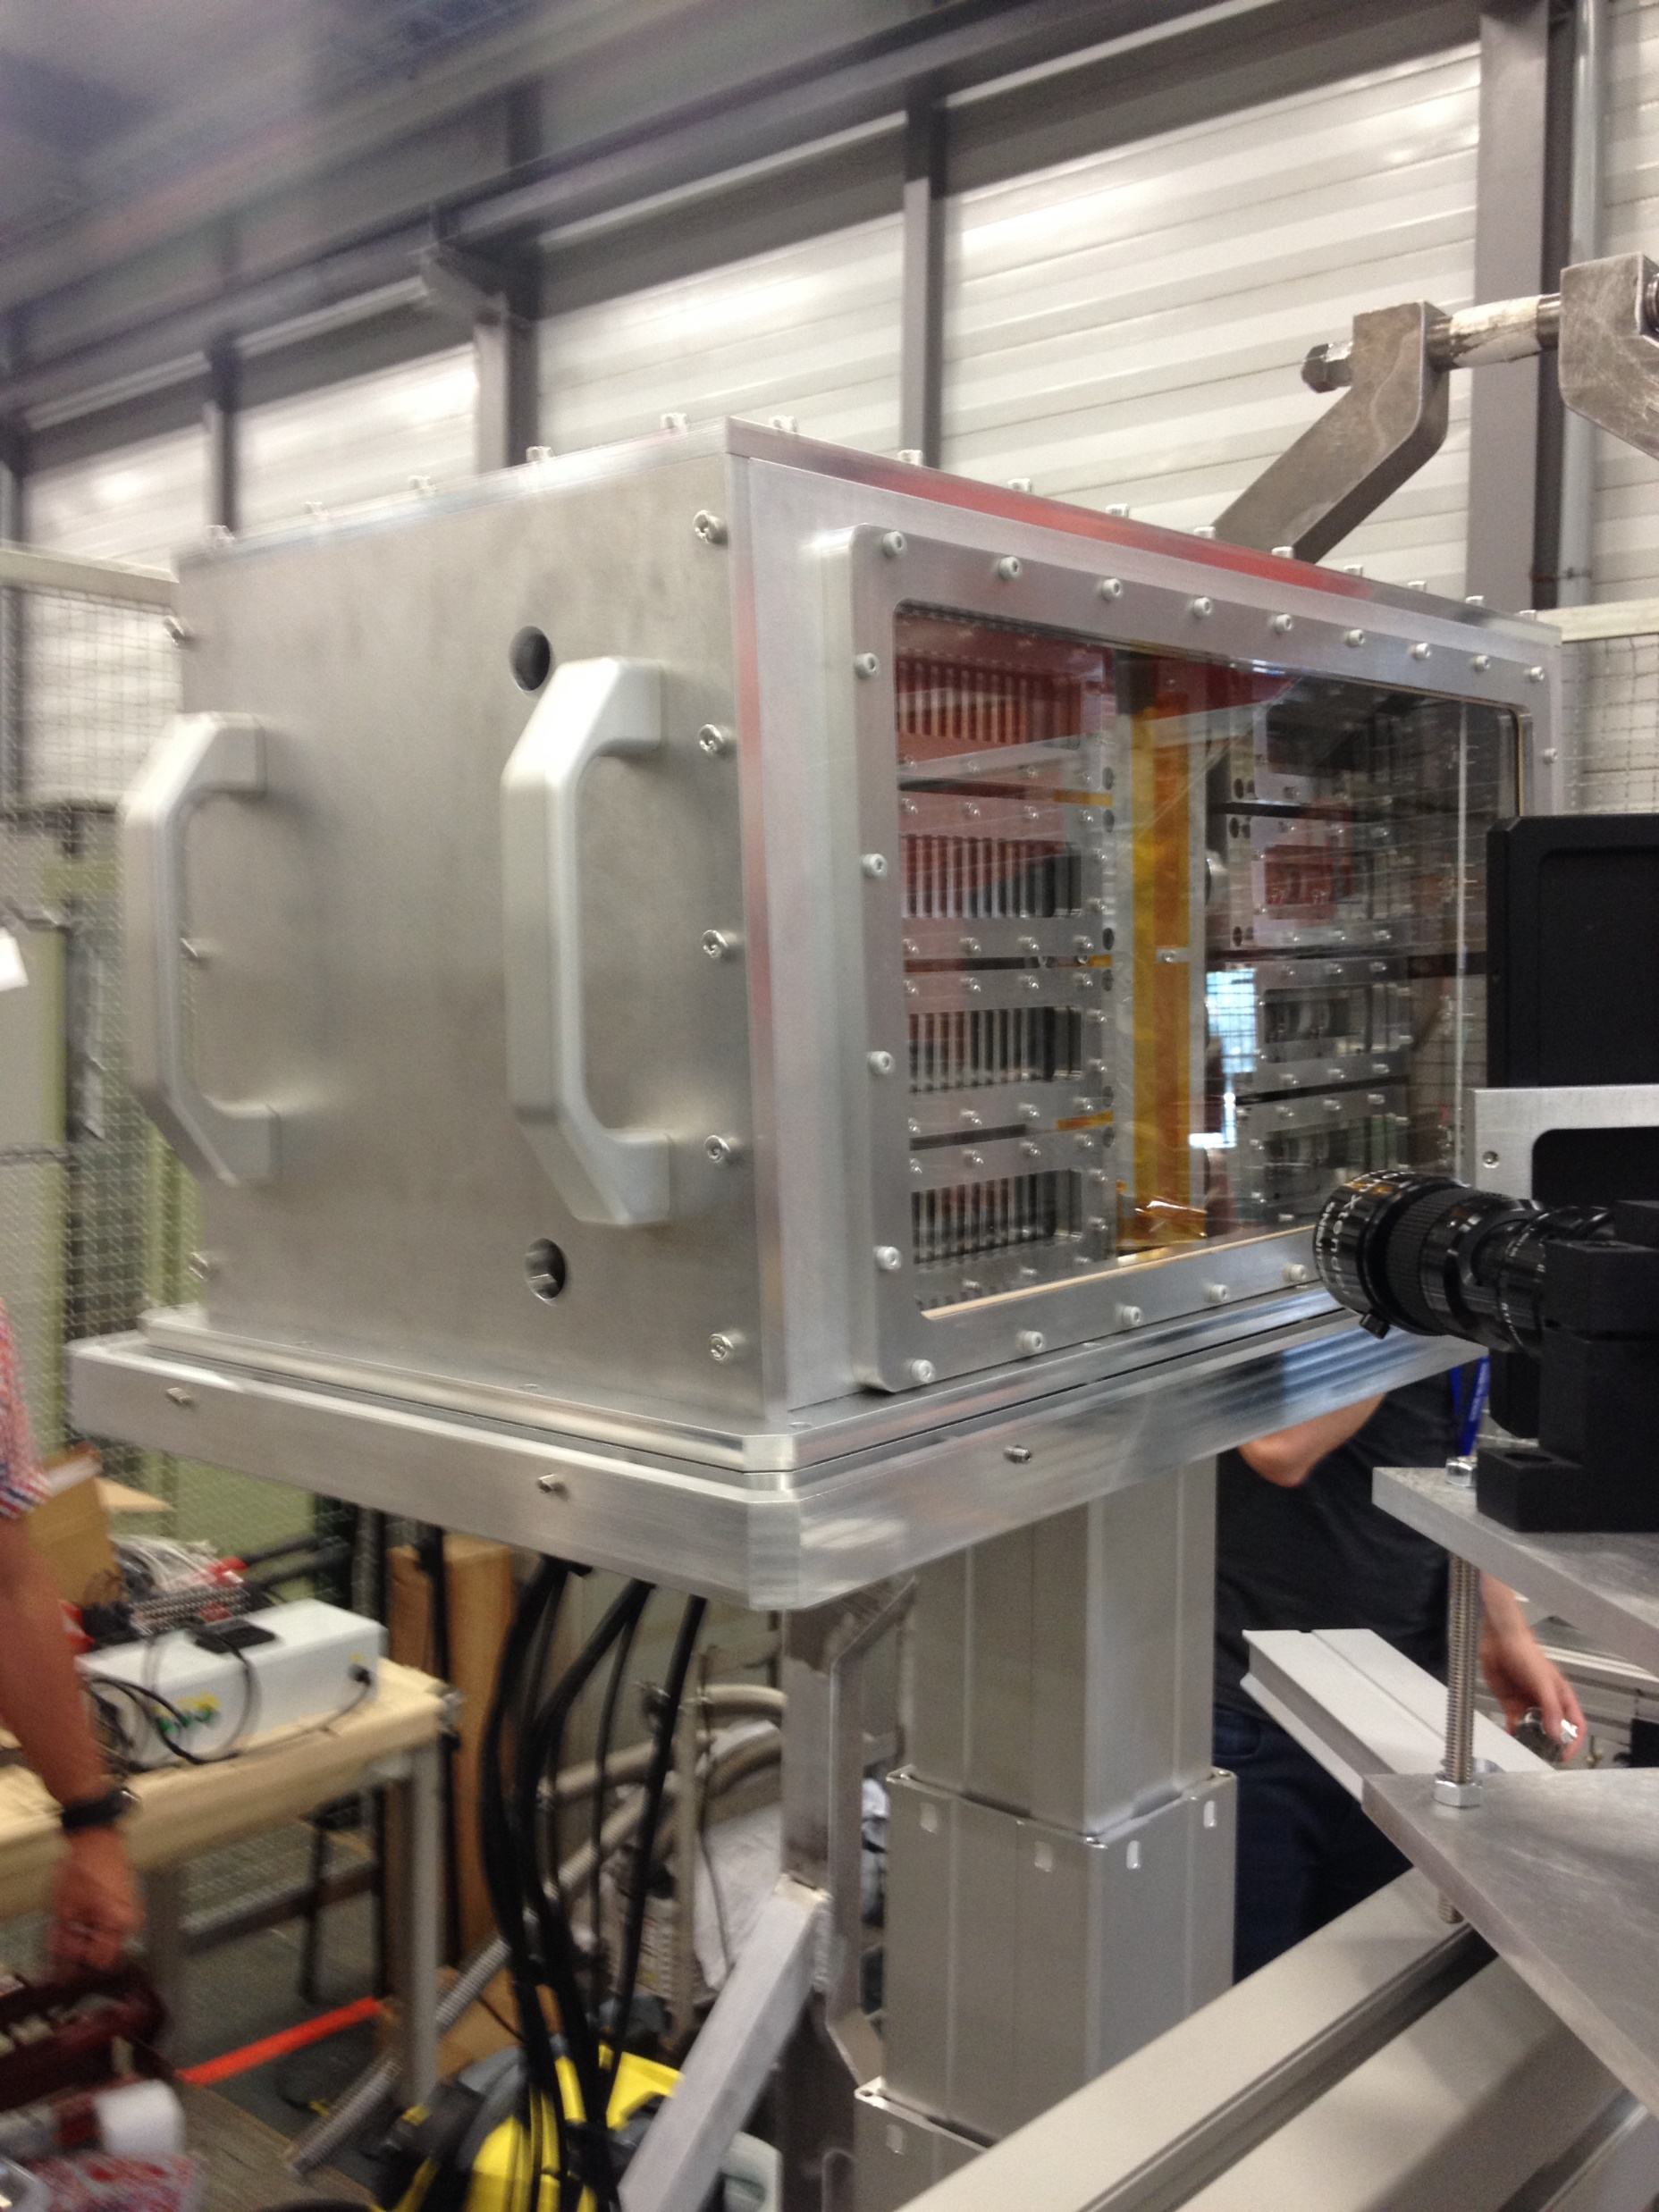
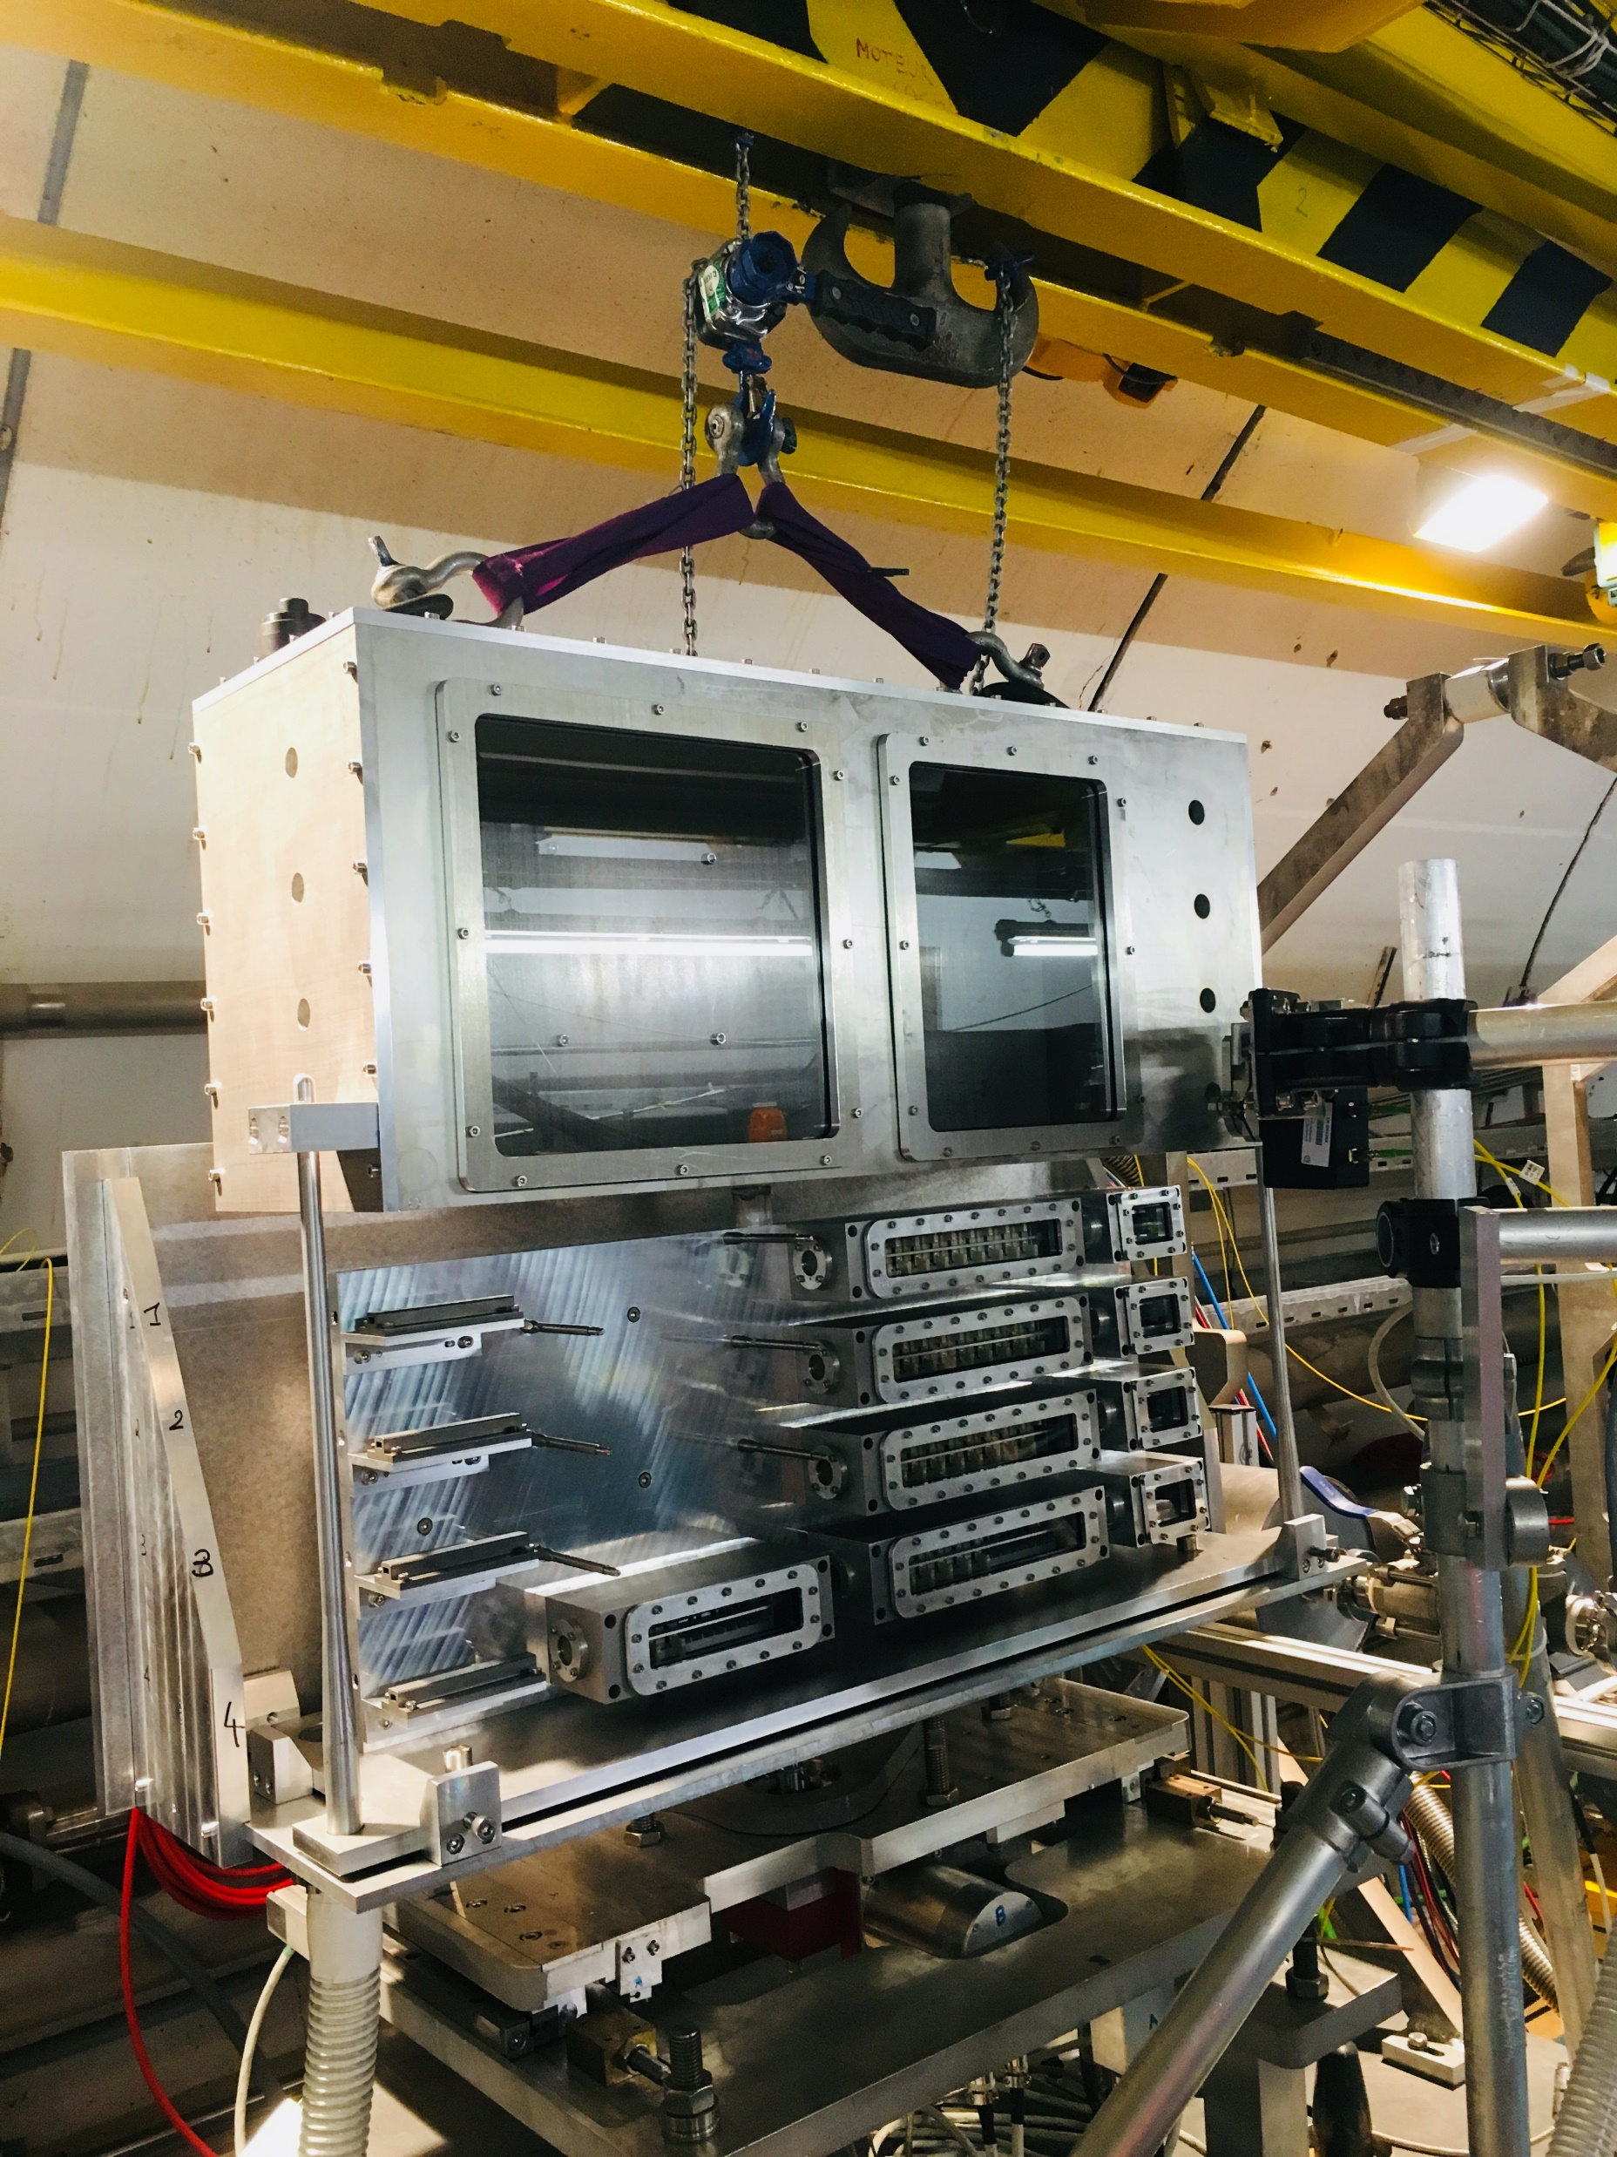









RaDIATE thermal shock experiments
HRMT24 (BeGrid1) – completed in 2015
  Various grades of beryllium: beam window and target material
  PIE results, Johnson-Cook model development, benchmarking of numerical simulations complete
HRMT43 (BeGrid2) – completed in 2018
  Beryllium: beam window and target material
  Graphite: target material
  Si-coated graphite: KEK muon target material
  Silicon: CERN SPS internal dump
  Titanium: KEK beam window
  Novel materials (foam/electrospun): candidate material for targets
  Experiment disassembled, PIE work starting soon, numerical simulation validation
Including pre-irradiated specimens from BLIP

Slide 5
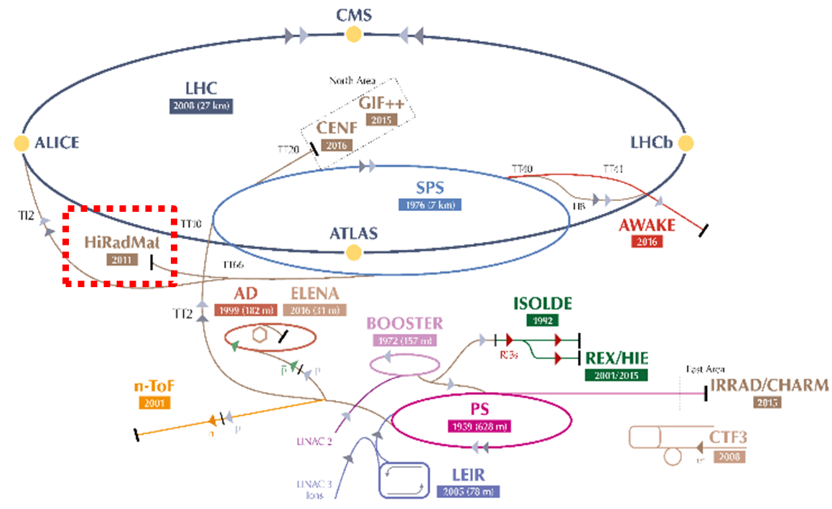
CERN’s HiRadMat facility
High Radiation to Materials (HiRadMat) facility at CERN for material testing
Testing facility for single shots experiments
  Total allocated protons/year: 1.0 x 10¹⁶ (~10 experiments/yr)
Beam Parameters
Beam energy | 440 GeV
Max. pulse energy | 2.4 MJ
Max. bunch intensity | 1.2 x 10¹¹
No. of bunches | 1 – 288
Max. pulse intensity | 3.5 x 10¹³ ppp
Max. pulse length | 7.95 µs
Gaussian beam size | 1σ rms: 0.25 – 4 mm

Slide 6
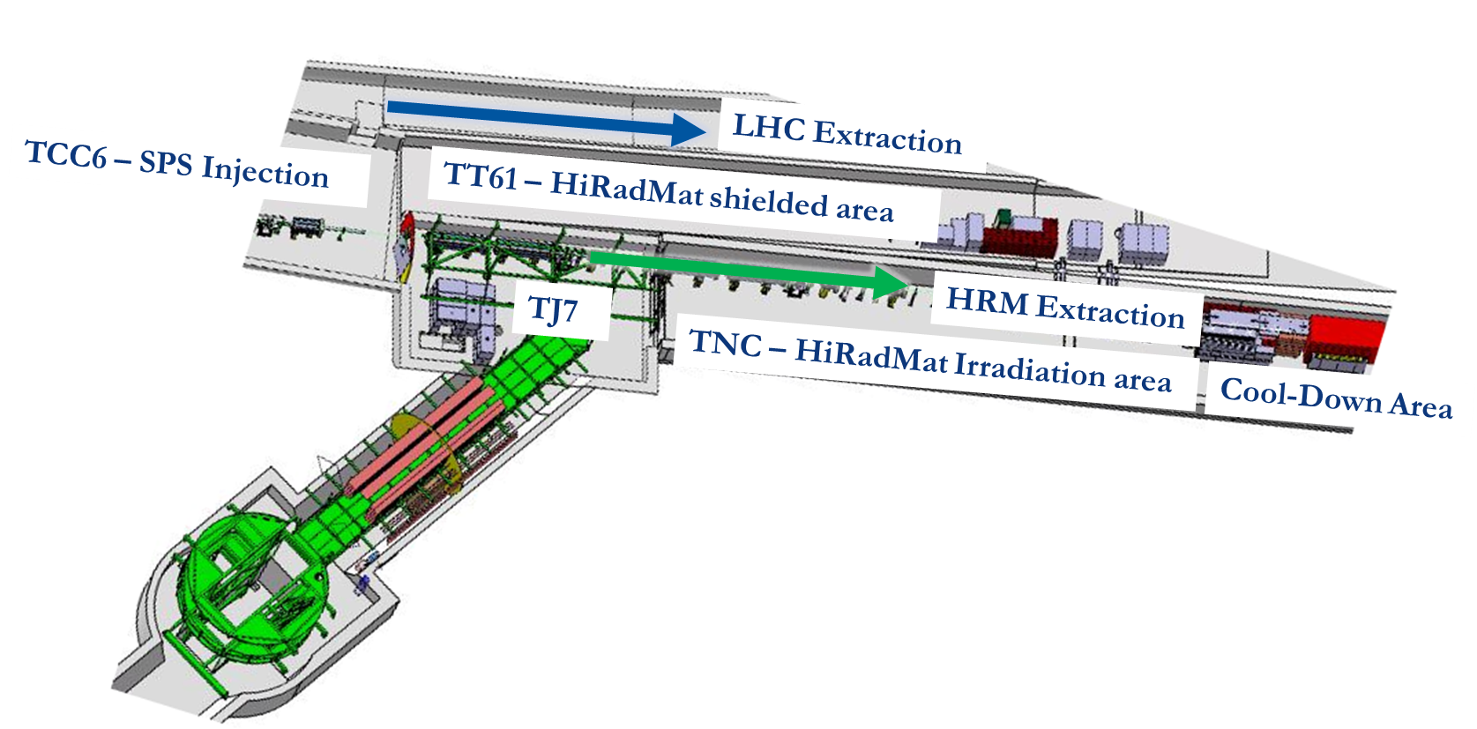
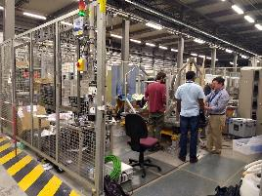
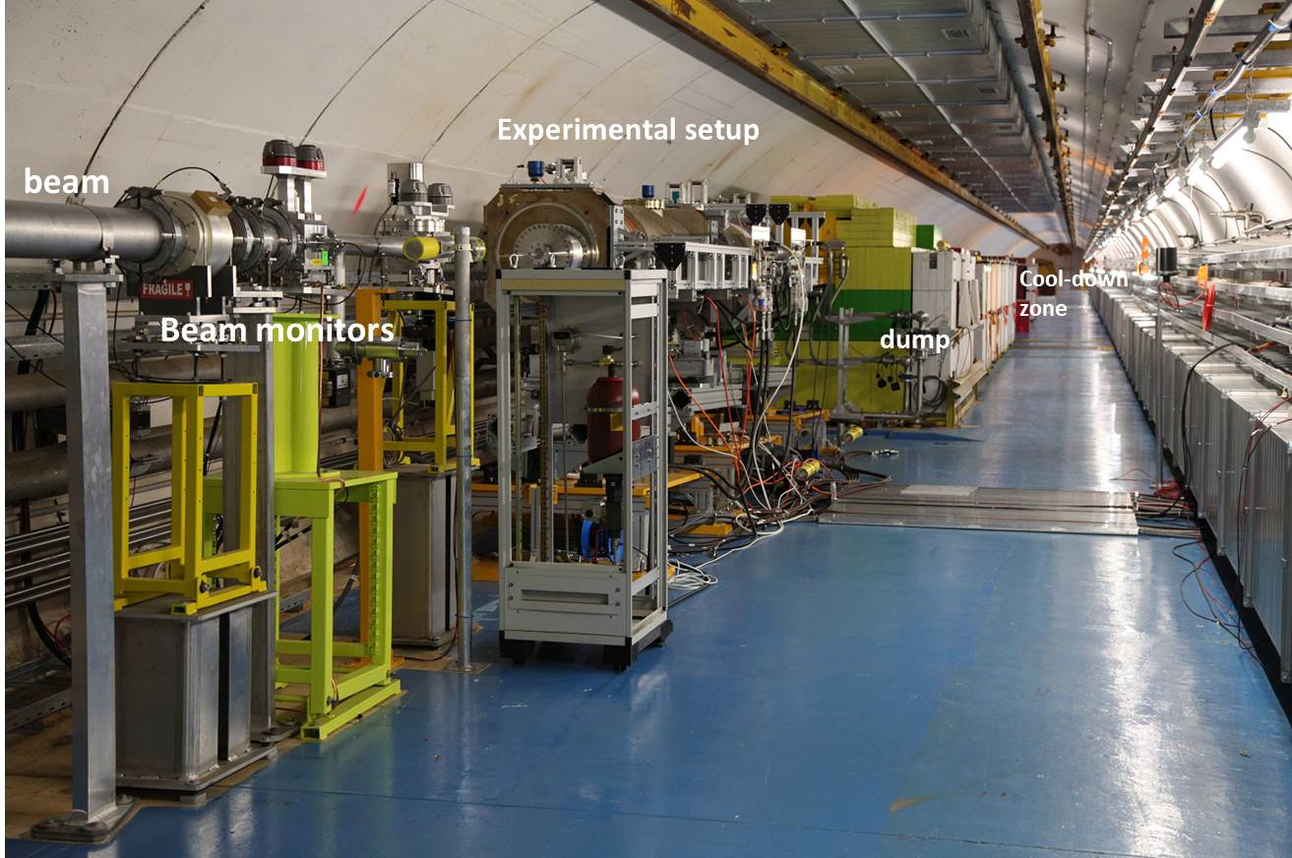
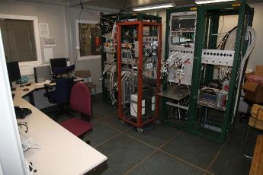
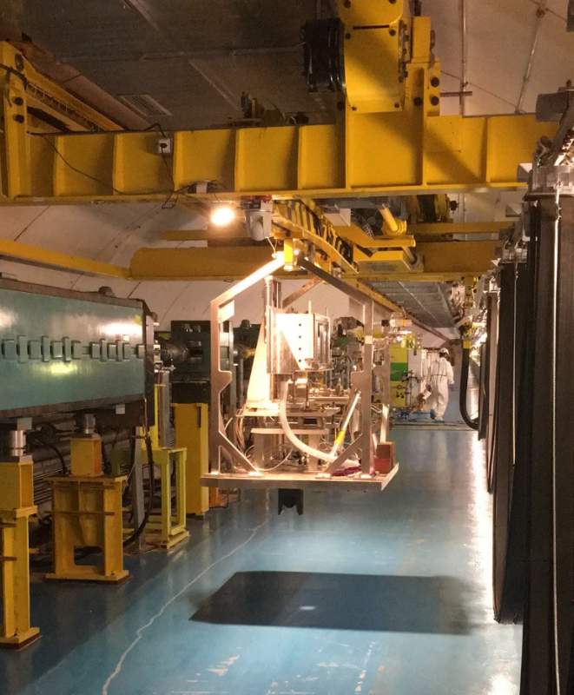
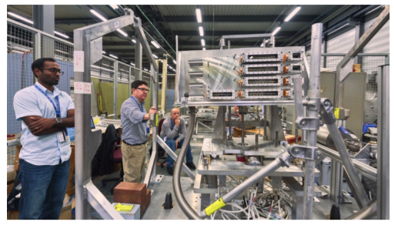
HiRadMat infrastructure and tunnel
HiRadMat tunnel
HiRadMat surface lab (BA-7)
Assembly and pre-commissioning tests before installation in tunnel
Control room for DAQ and offline monitoring systems
Installation area with dummy experimental tables

Slide 7
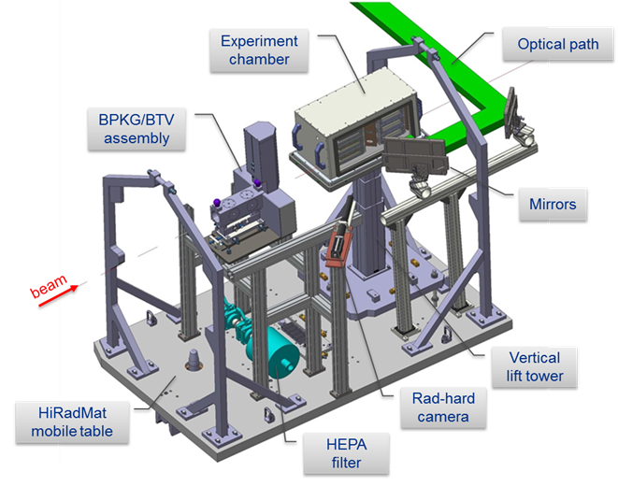

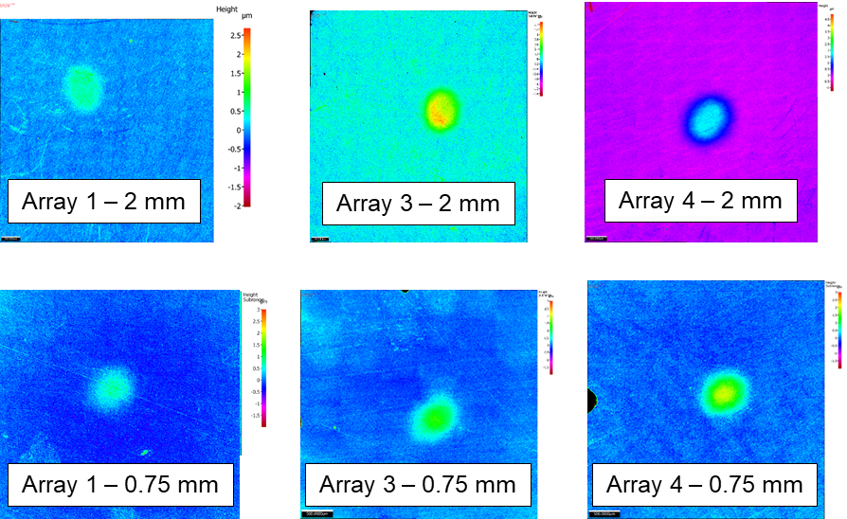
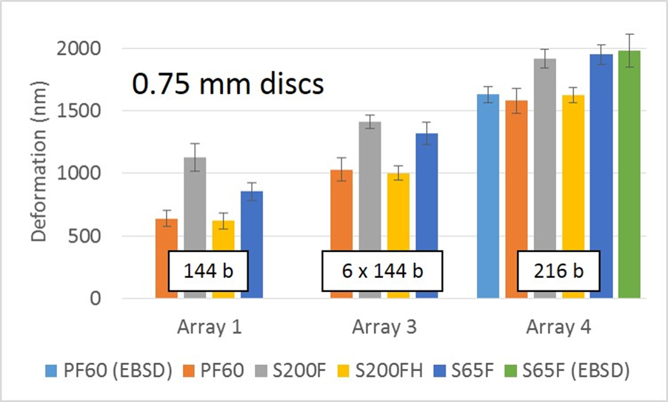
HRMT24 – BeGrid1 experiment
Completed in 2015
Thermal shock response of various commercially available beryllium grades
Real time dynamic measurements of temperature, strain and displacement
PIE of thin disc specimens performed at Oxford University
Profilometry to measure plastic out-of-plane deformations
V. Kuksenko, Oxford
Distinctive strain responses for each Be grade (PF60, S65F, S200F, S200FH)
  S200FH grade showed least amount of plastic deformation
Plastic strain ratcheting observed with multiple pulses
Glassy carbon windows survived with no signs of degradation

Slide 8
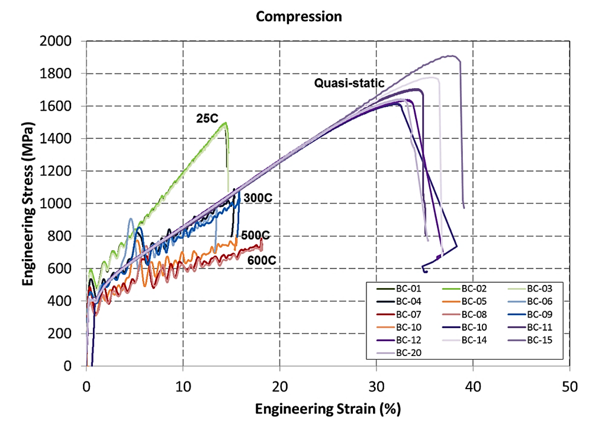
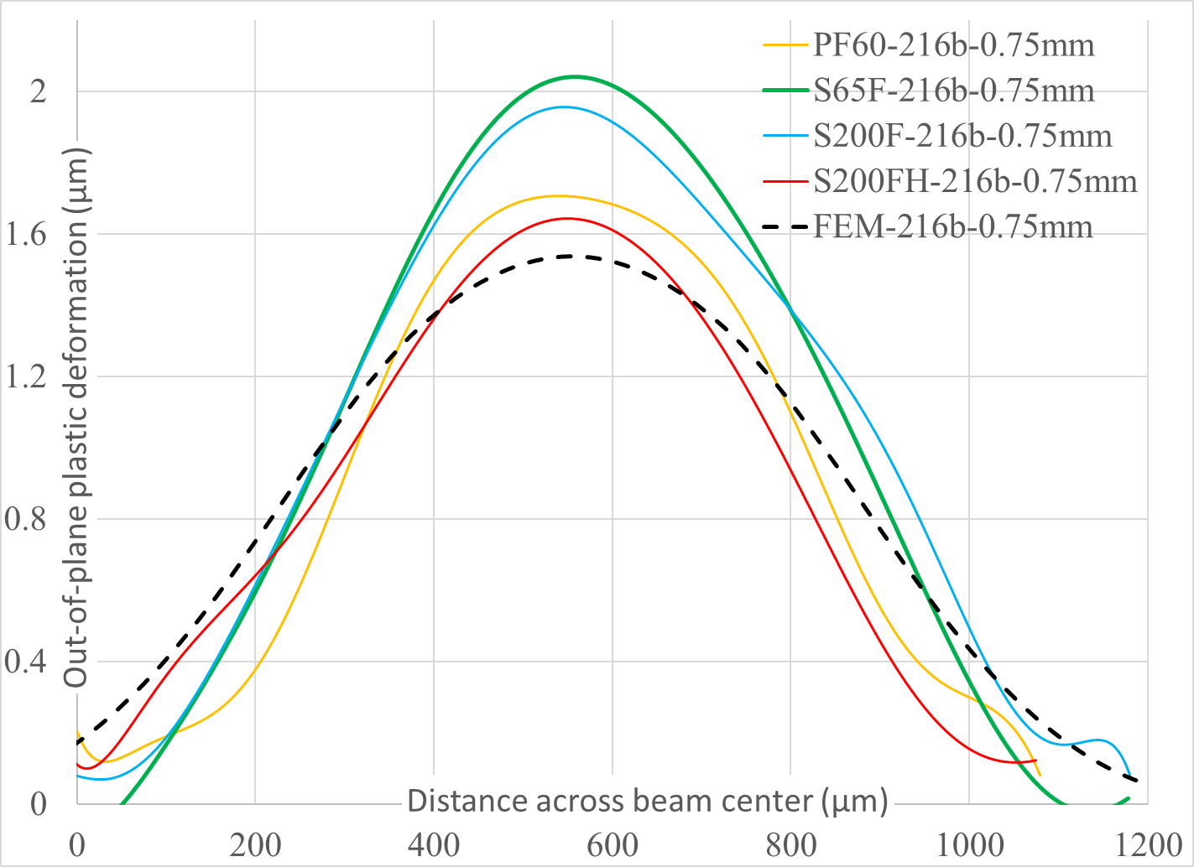
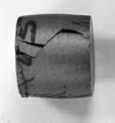
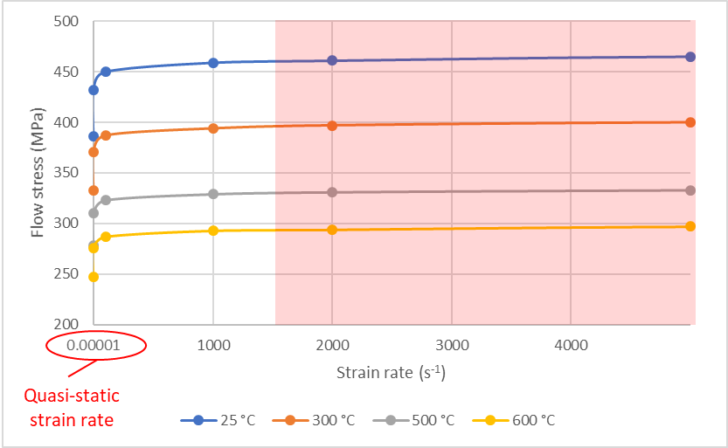

HRMT24 – BeGrid1 experiment
Completed in 2015
Successful validation of beryllium S200FH Johnson-Cook strength model developed at SwRI
$$σ_{Y}=\left[A+B(ε_{eff}^{p})^{n}\right]\left[1+Cln{\dot{ε}}^{∗}\right]\left[1−T_{H}^{m}\right]$$
K. Ammigan et al., “Thermal shock experiment of beryllium exposed to intense high energy proton beam pulses”, Phys. Rev. Accel. Beams 22, 044501.
Flow stress (σ_{y}) dependency on strain rate and temperature
Model parameters A, B, C, m, n empirically determined
YS from JC model
25 °C
Good agreement
600 °C
SwRI
S. Bidhar, FNAL

Slide 9
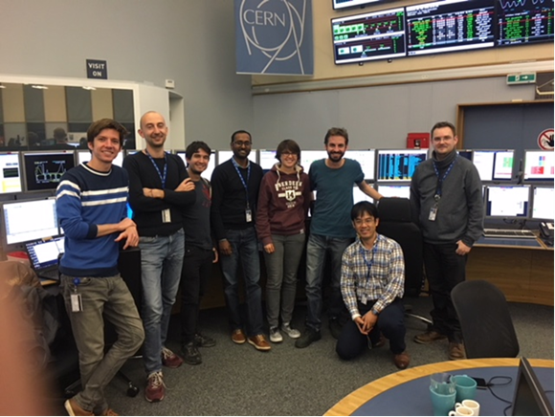
HRMT43 – BeGrid2 experiment
Completed in 2018
Experimental objectives
Identify thermal shock response differences between non-irradiated and previously irradiated specimens from BLIP
  First and unique test with activated materials at HiRadMat
Explore novel materials such a metal foams (C, SiC) and electrospun fiber mats (SiO2, ZrO2) to evaluate their resistance to thermal shock and suitability as target materials
HRMT43 BeGrid2 beam time completed on Oct. 2, 2018, 4 am
Follow-up of HRMT24 (BeGrid1) to expose beryllium to even higher beam intensities
Real-time measurement of dynamic thermomechanical response of graphite slugs to help benchmark numerical simulations

Slide 10
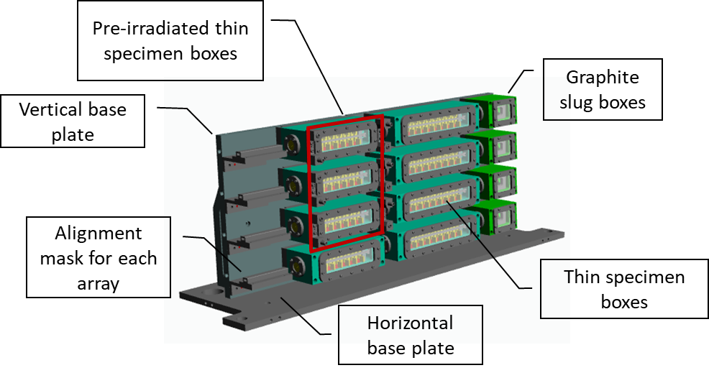
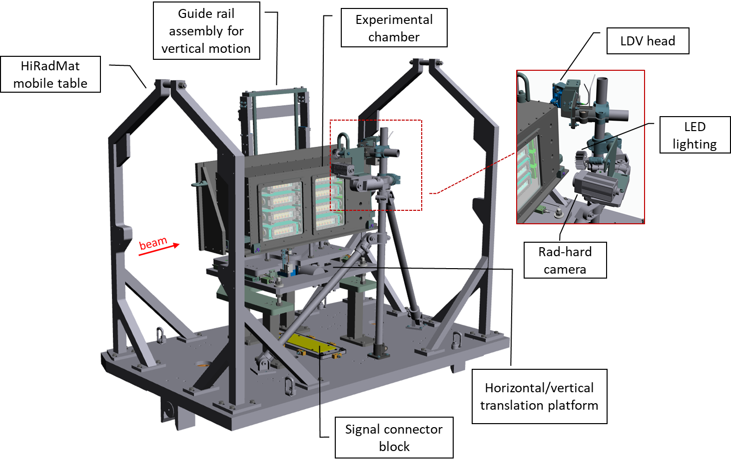

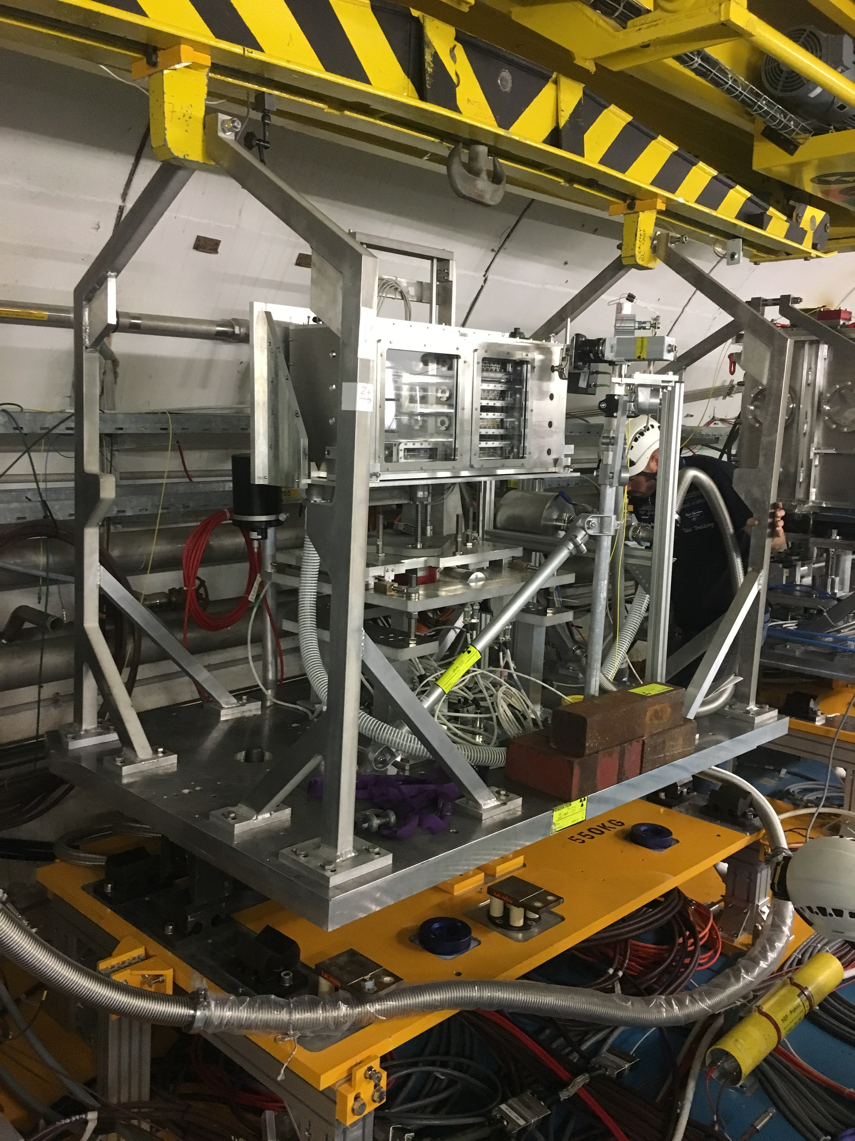
HRMT43 experimental set-up
Double containment design with outer chamber as a dynamic secondary containment
Four arrays separated vertically (92 specimens in total)

Slide 11
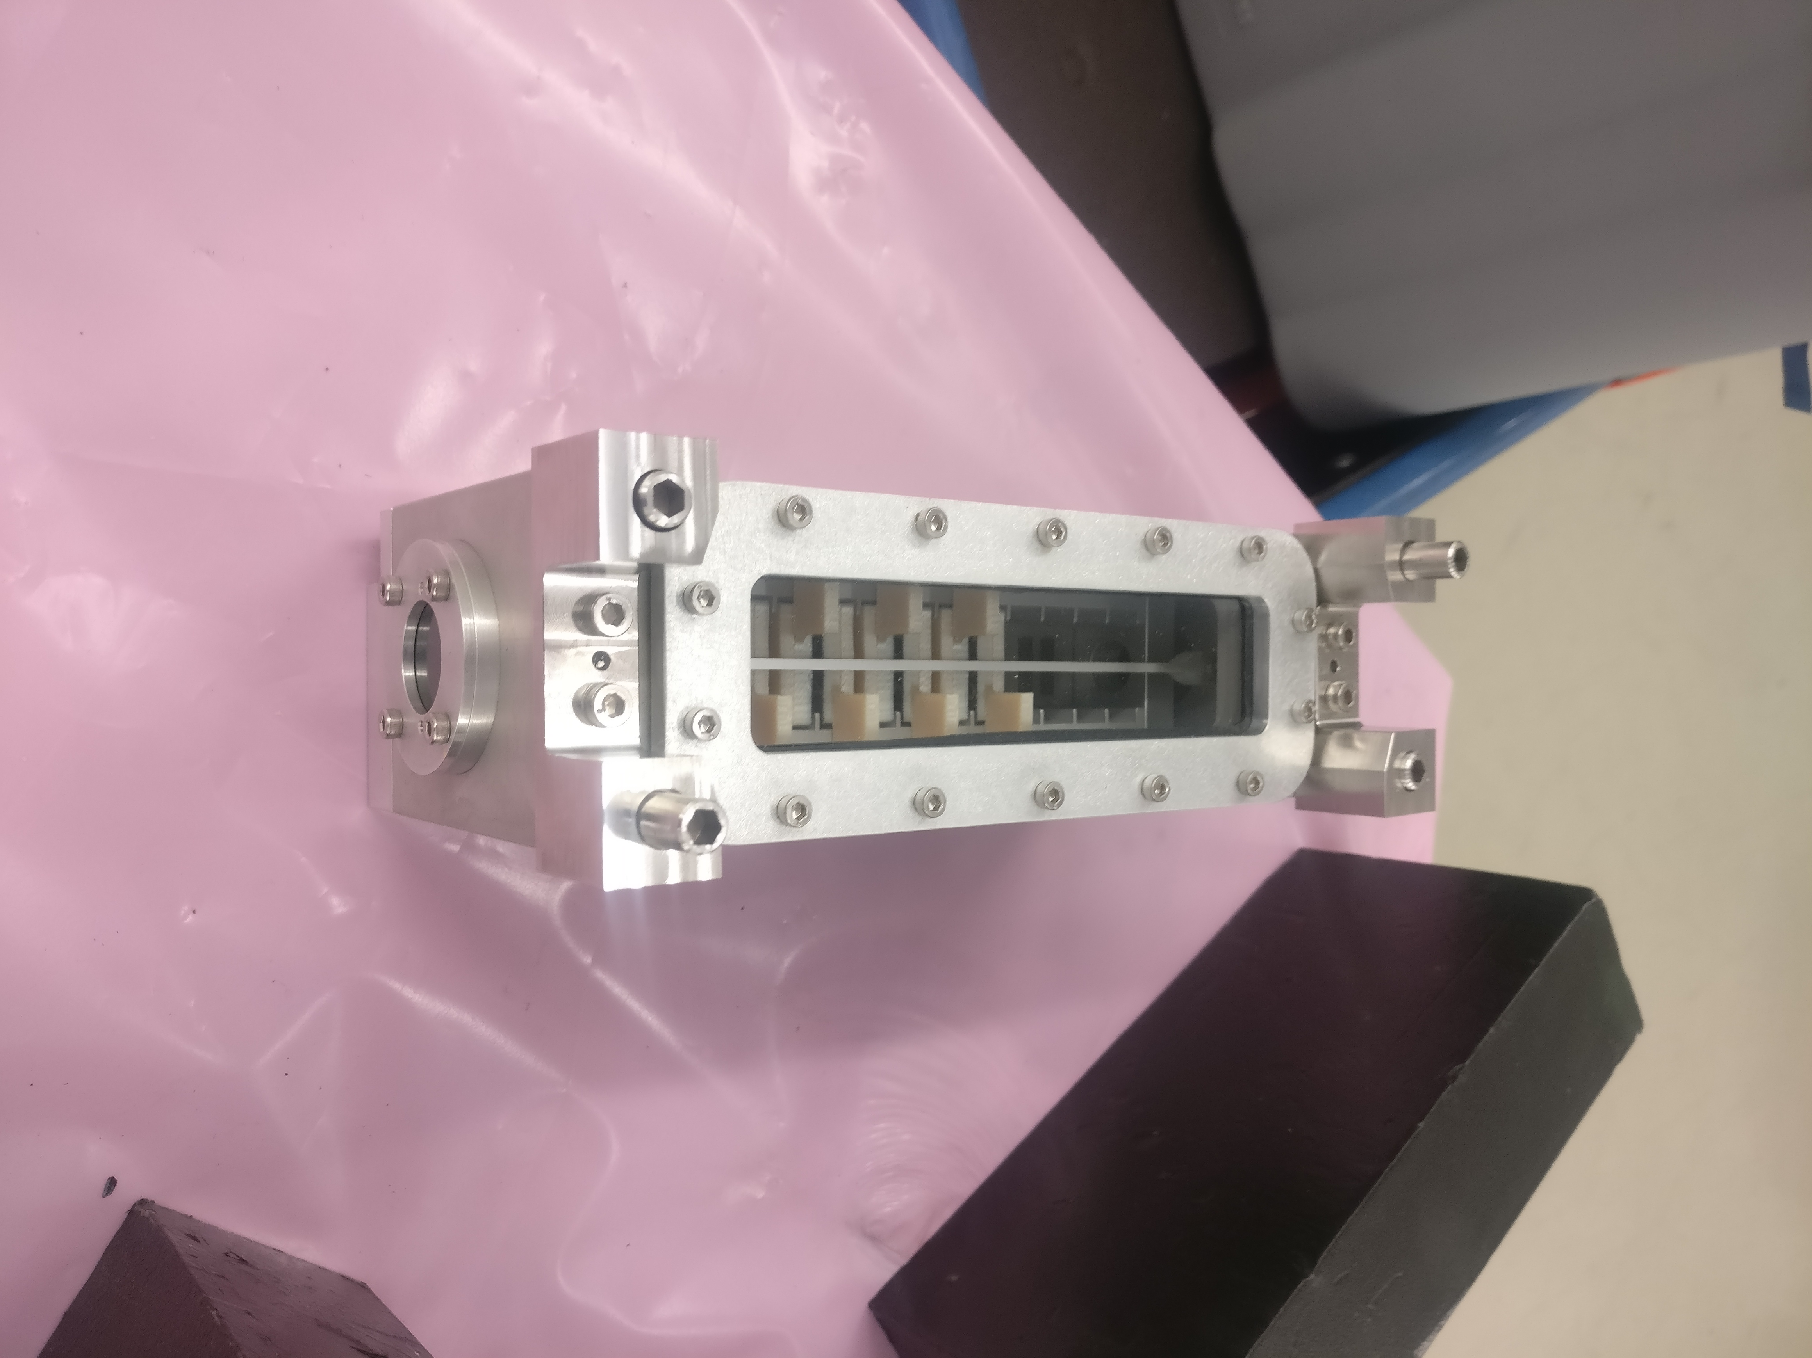
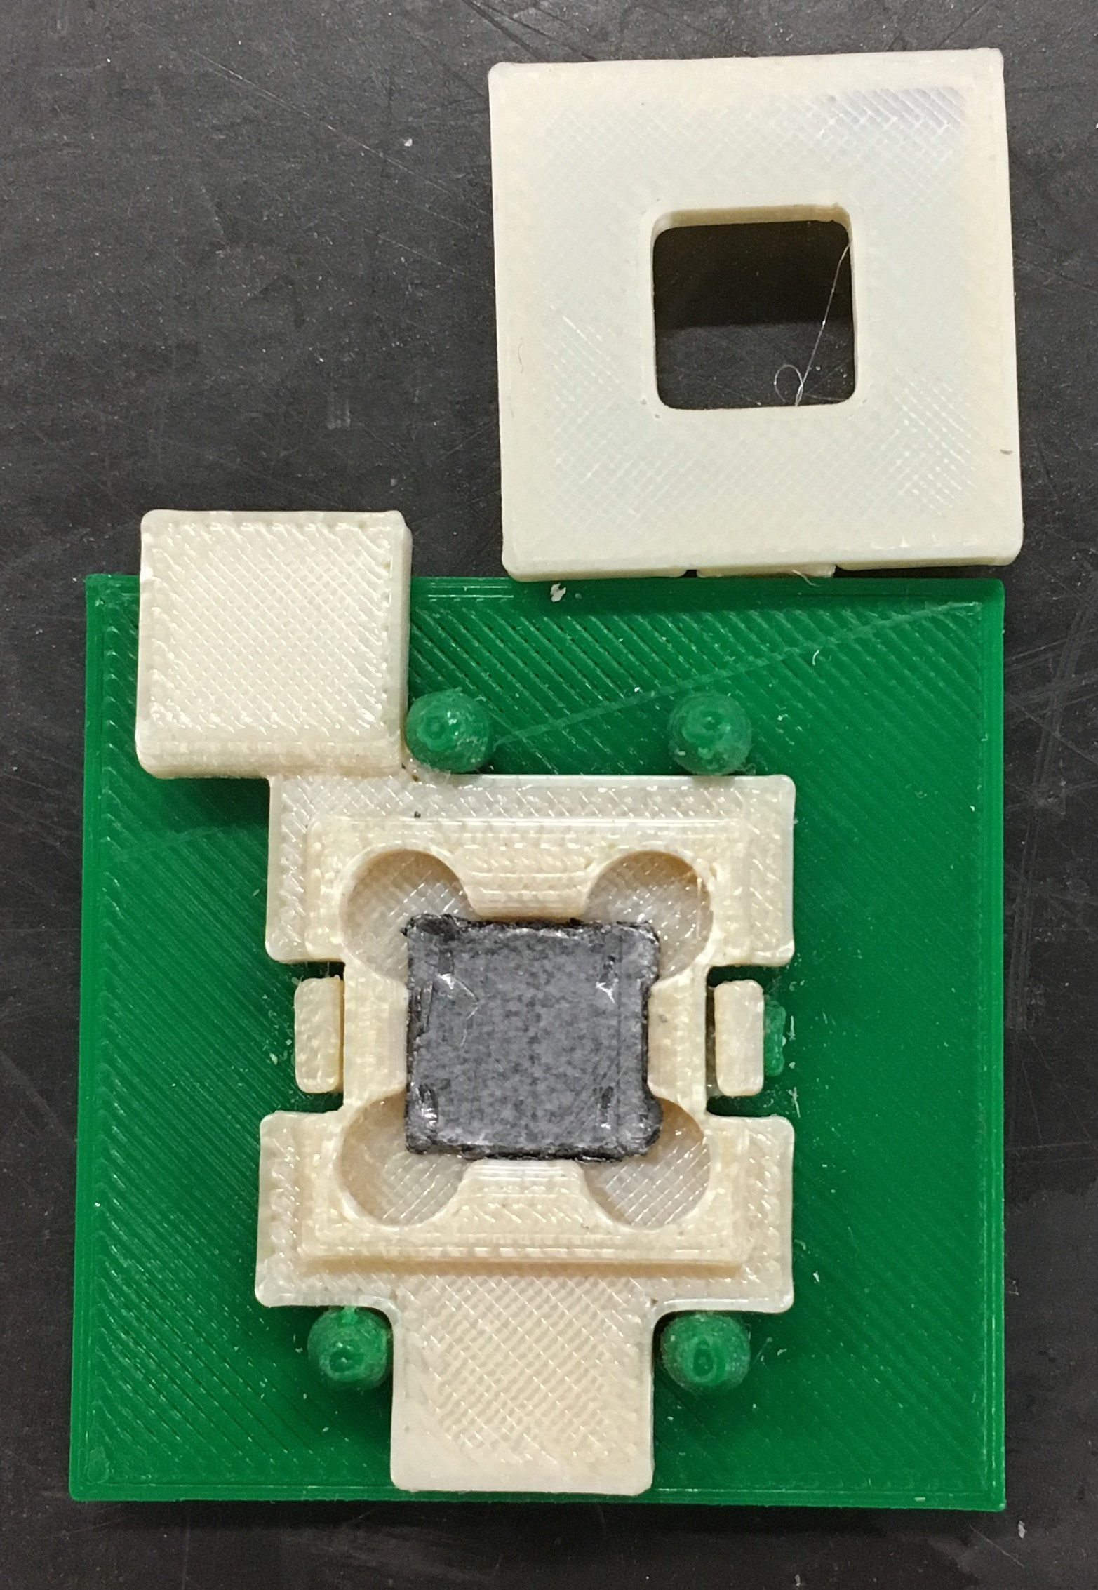
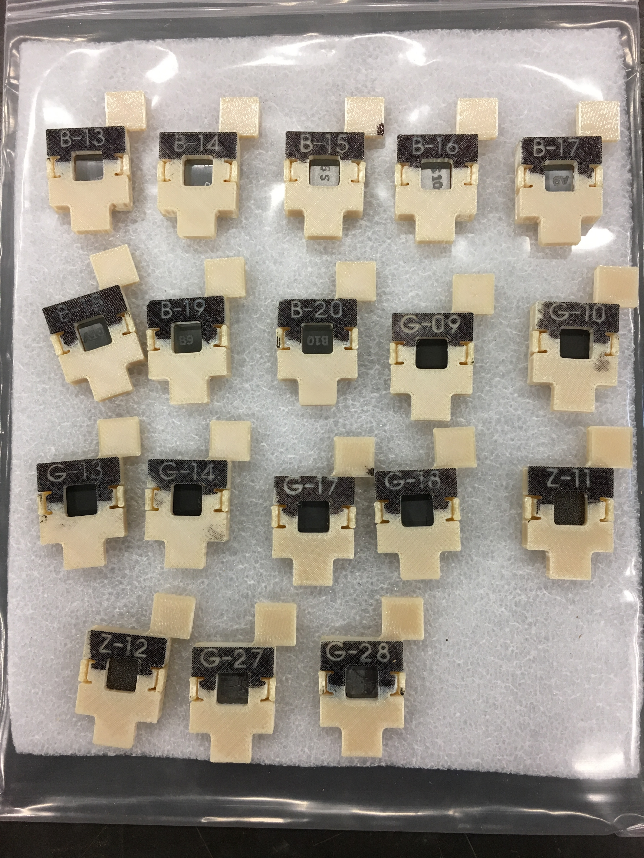
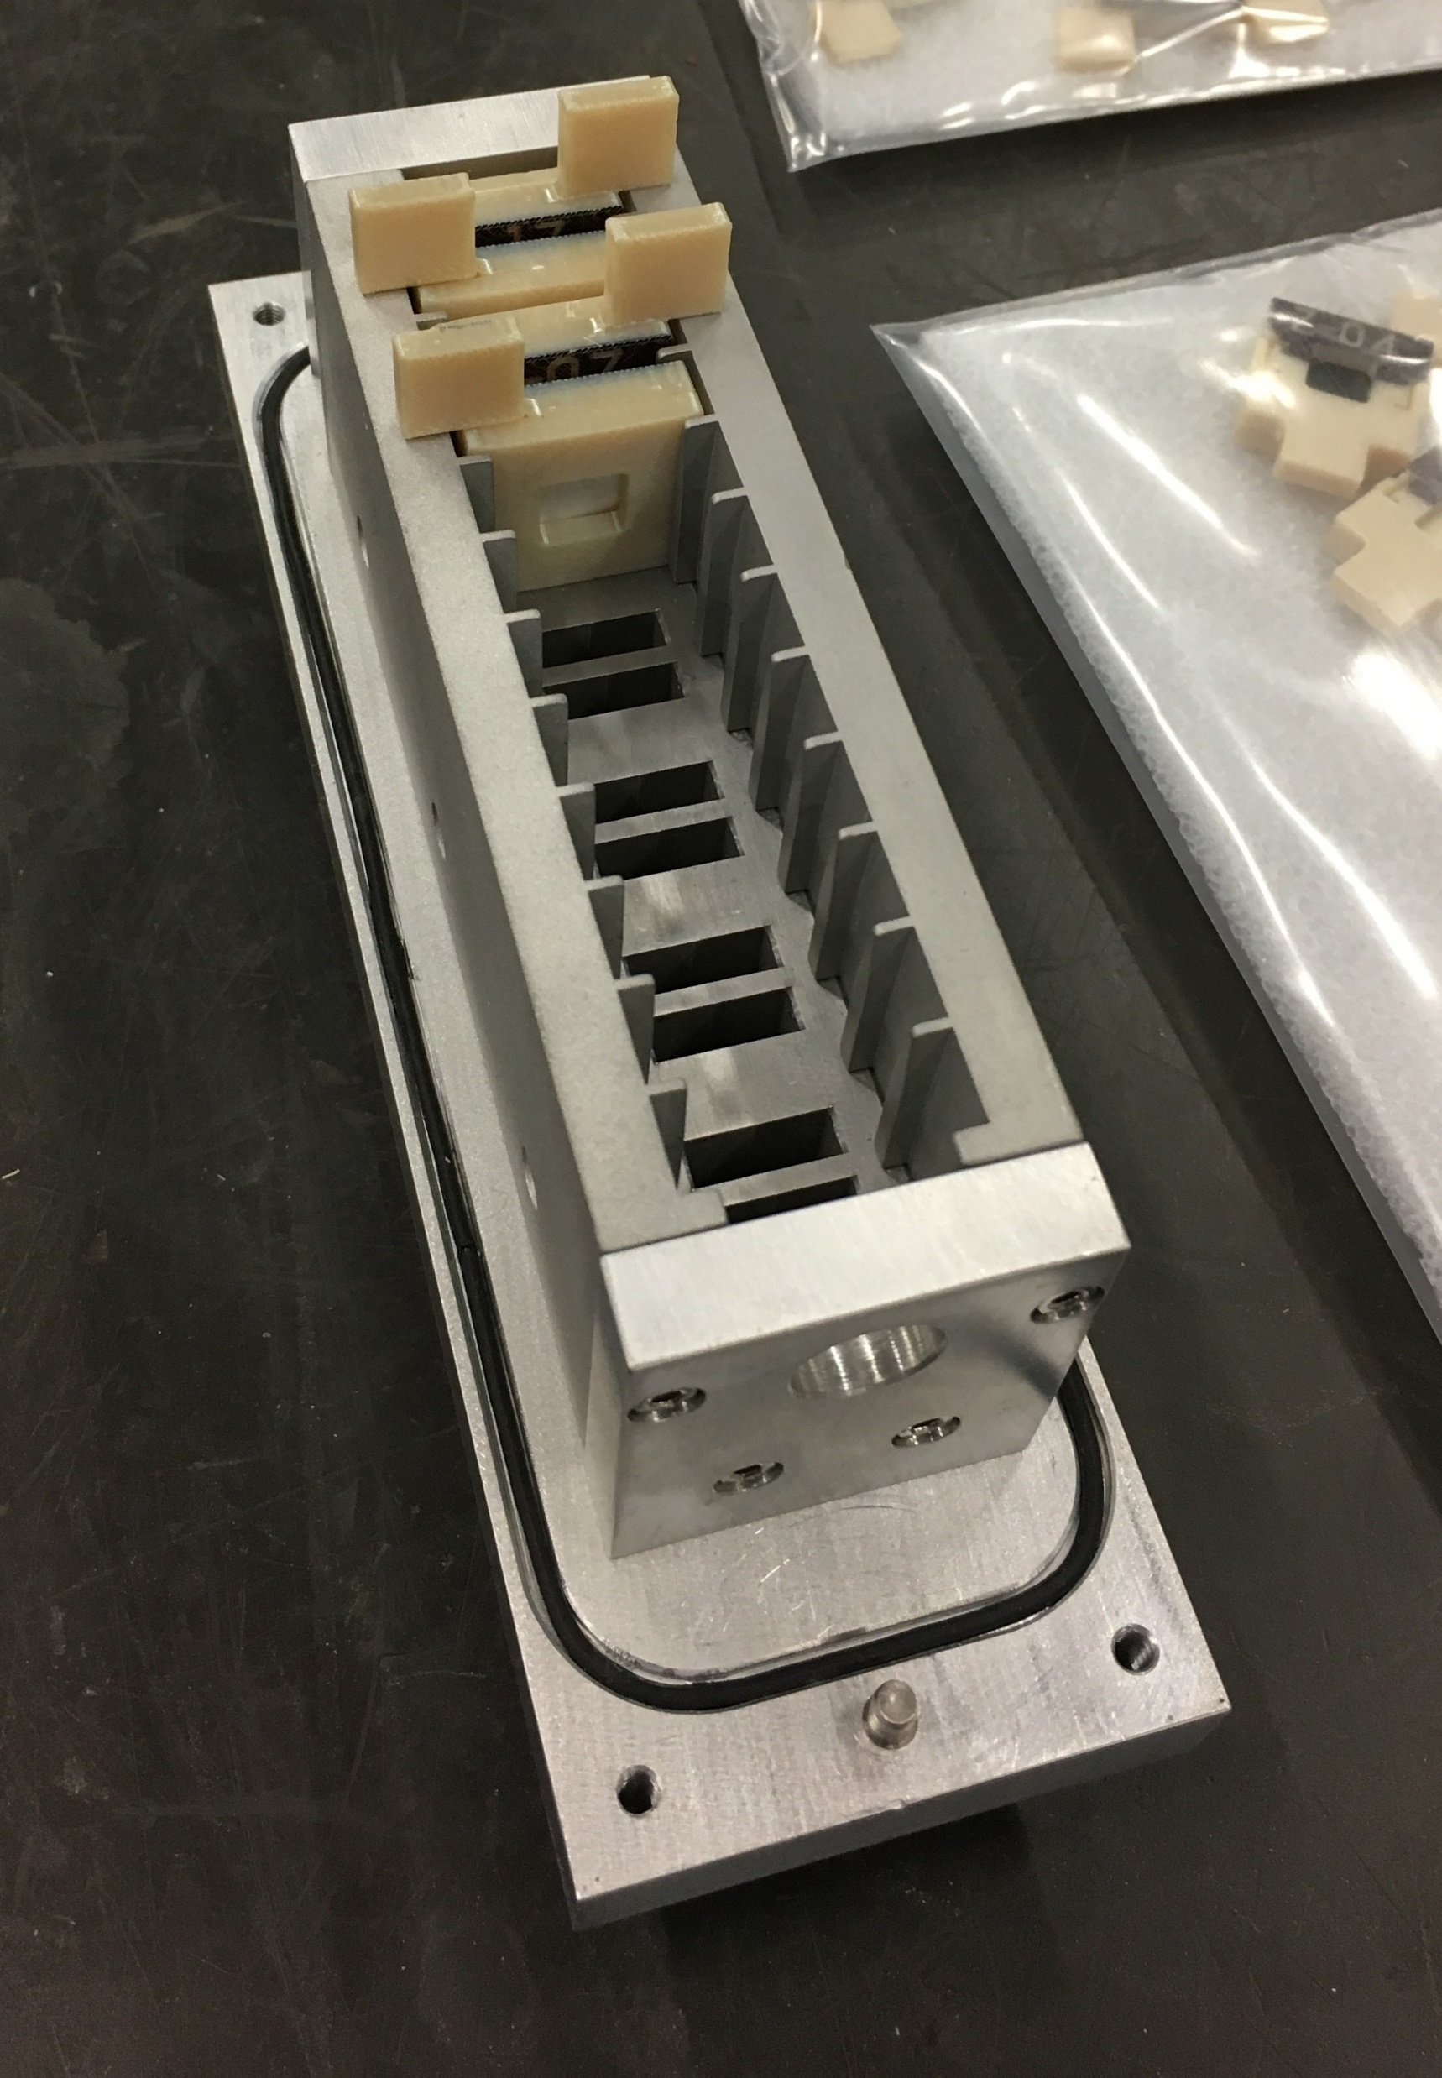
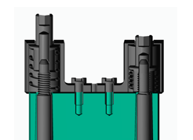
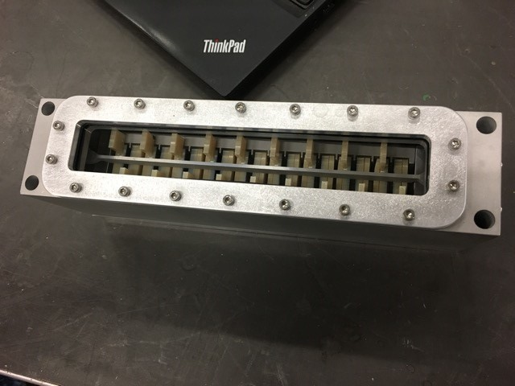
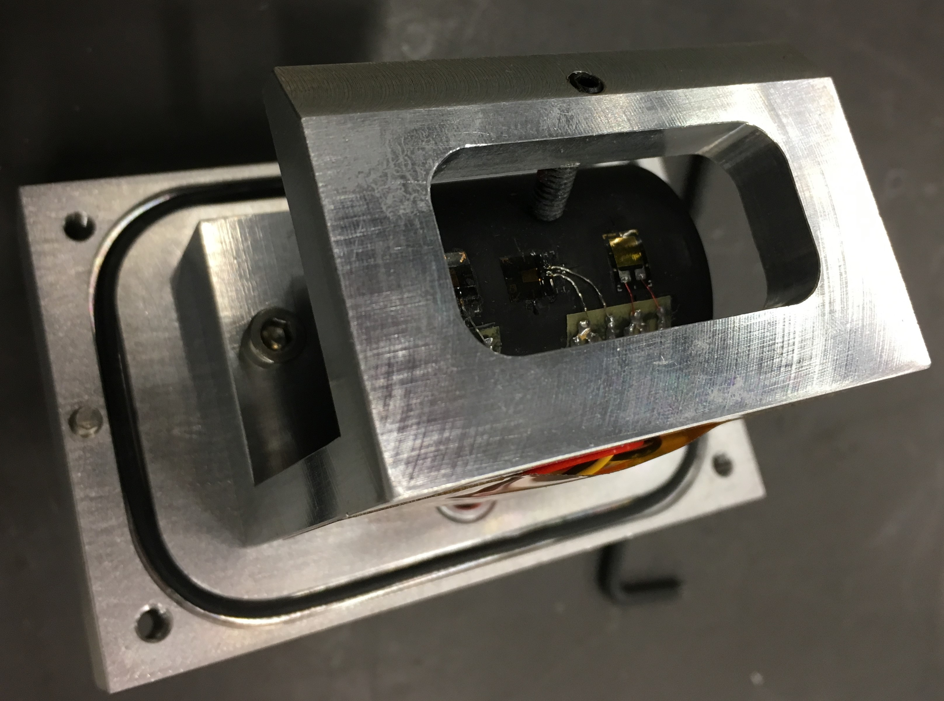
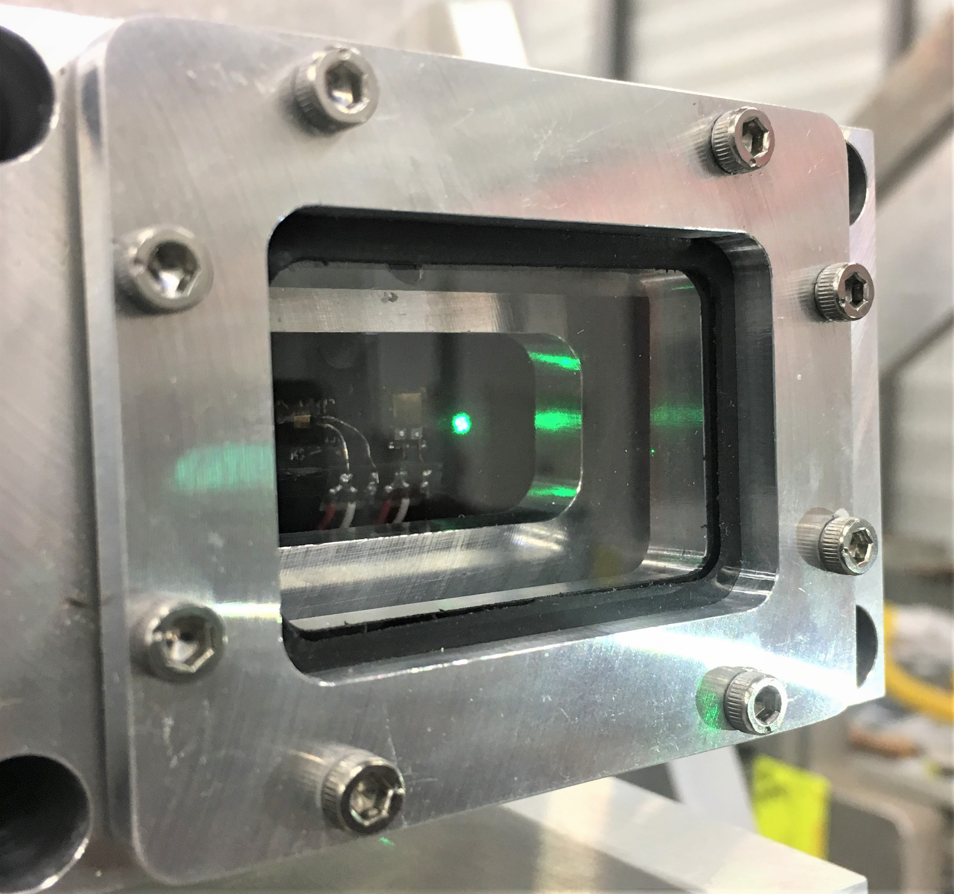
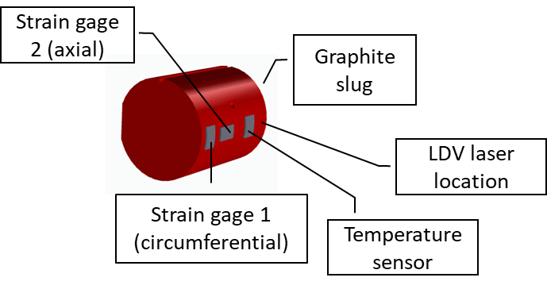
HRMT43 specimen assembly
BLIP irradiated specimen box equipped with captive nut assembly
Thin specimens assembled in 3D printed snap-fit holders (ULTEM)
Graphite slug box for online measurements

Slide 12
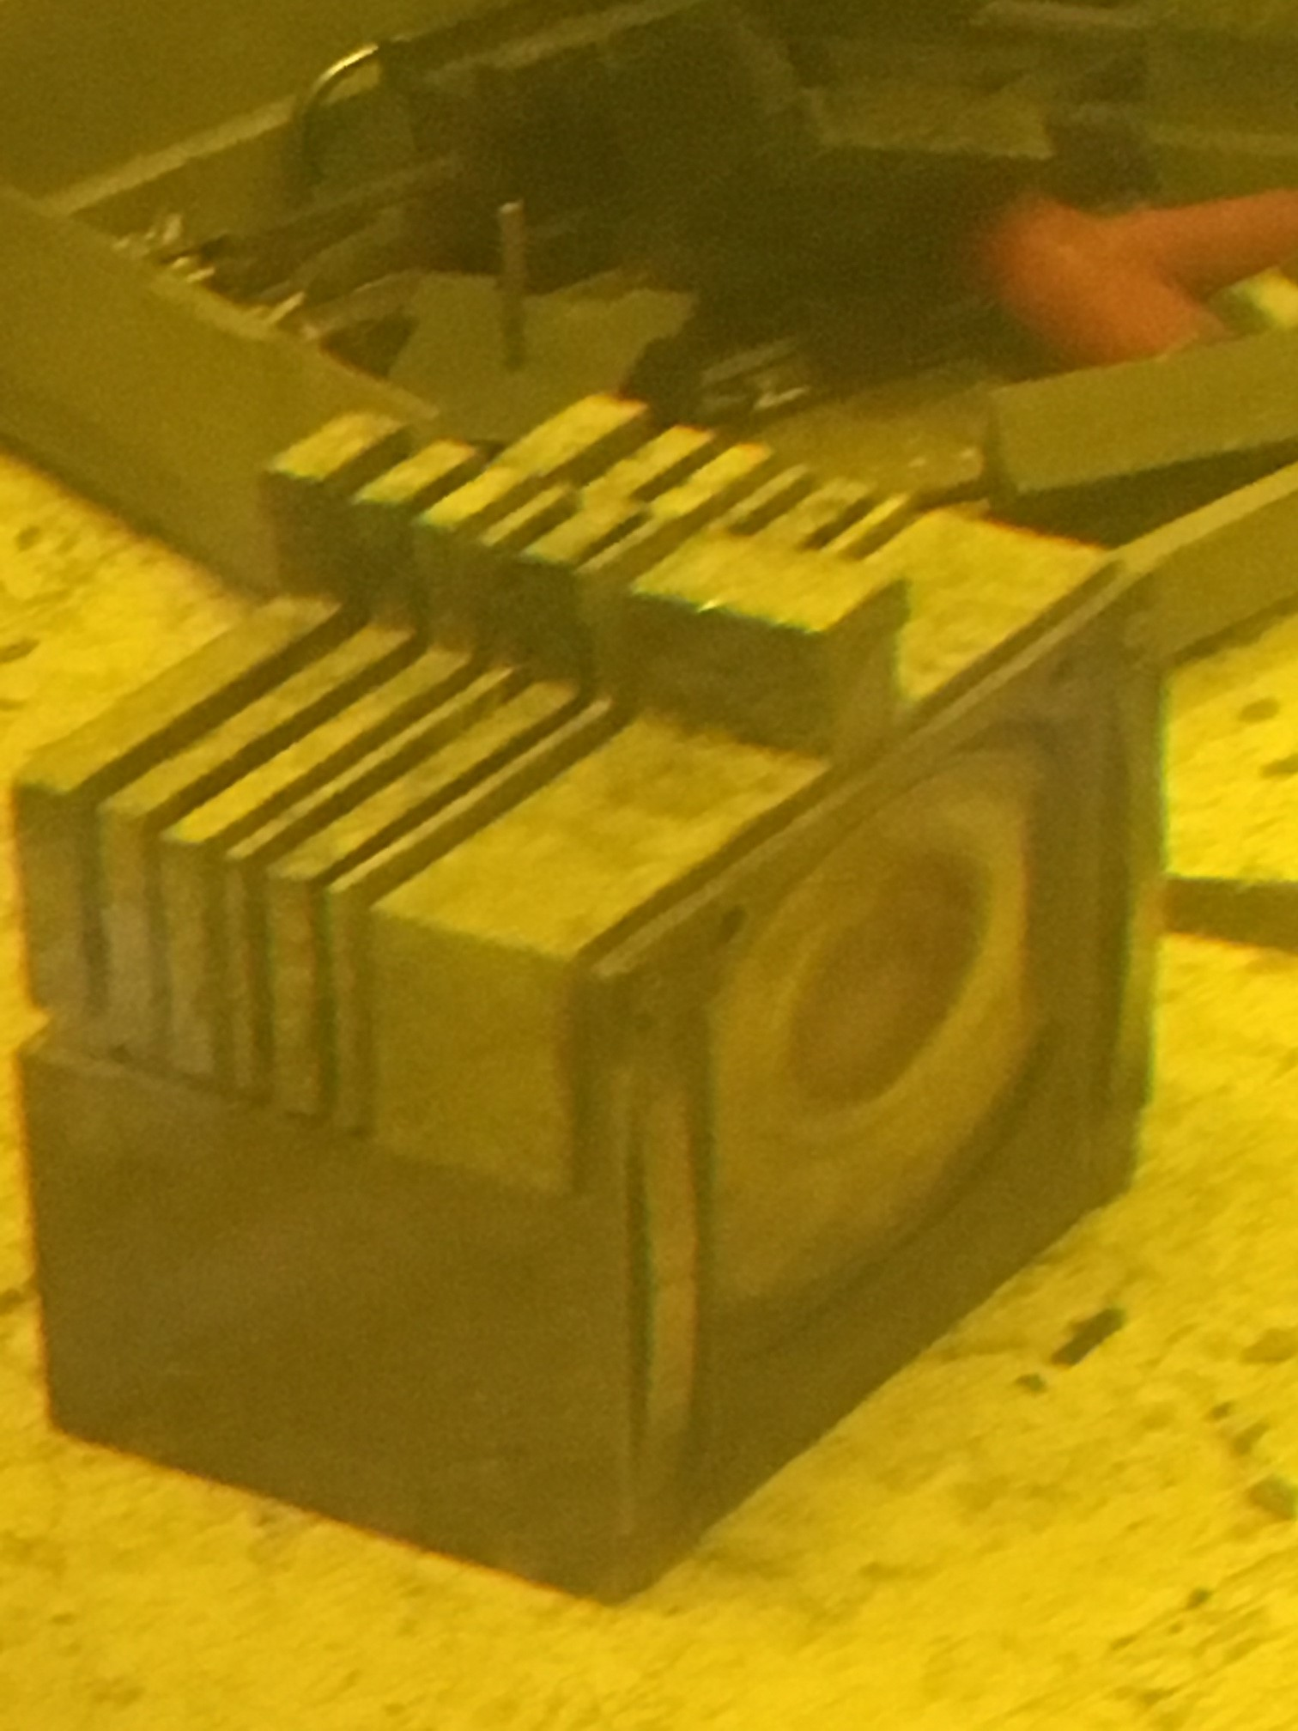
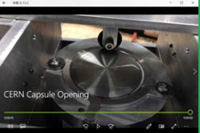
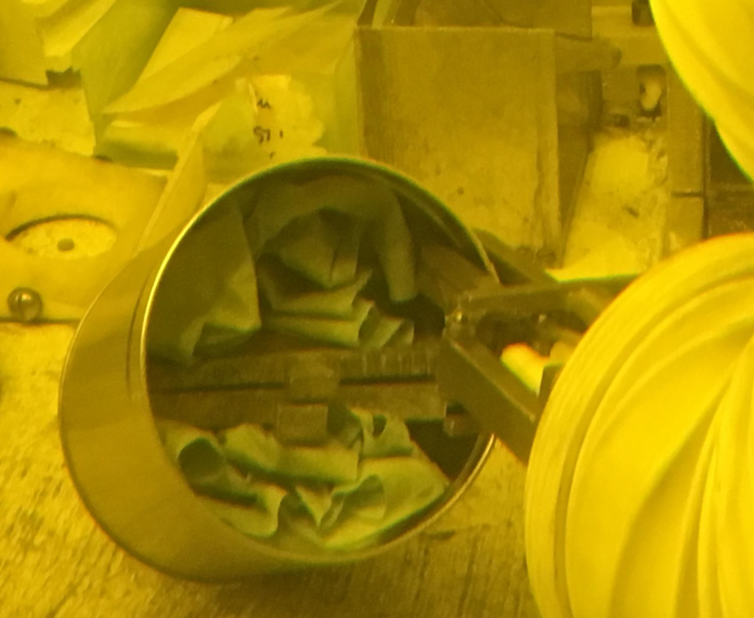
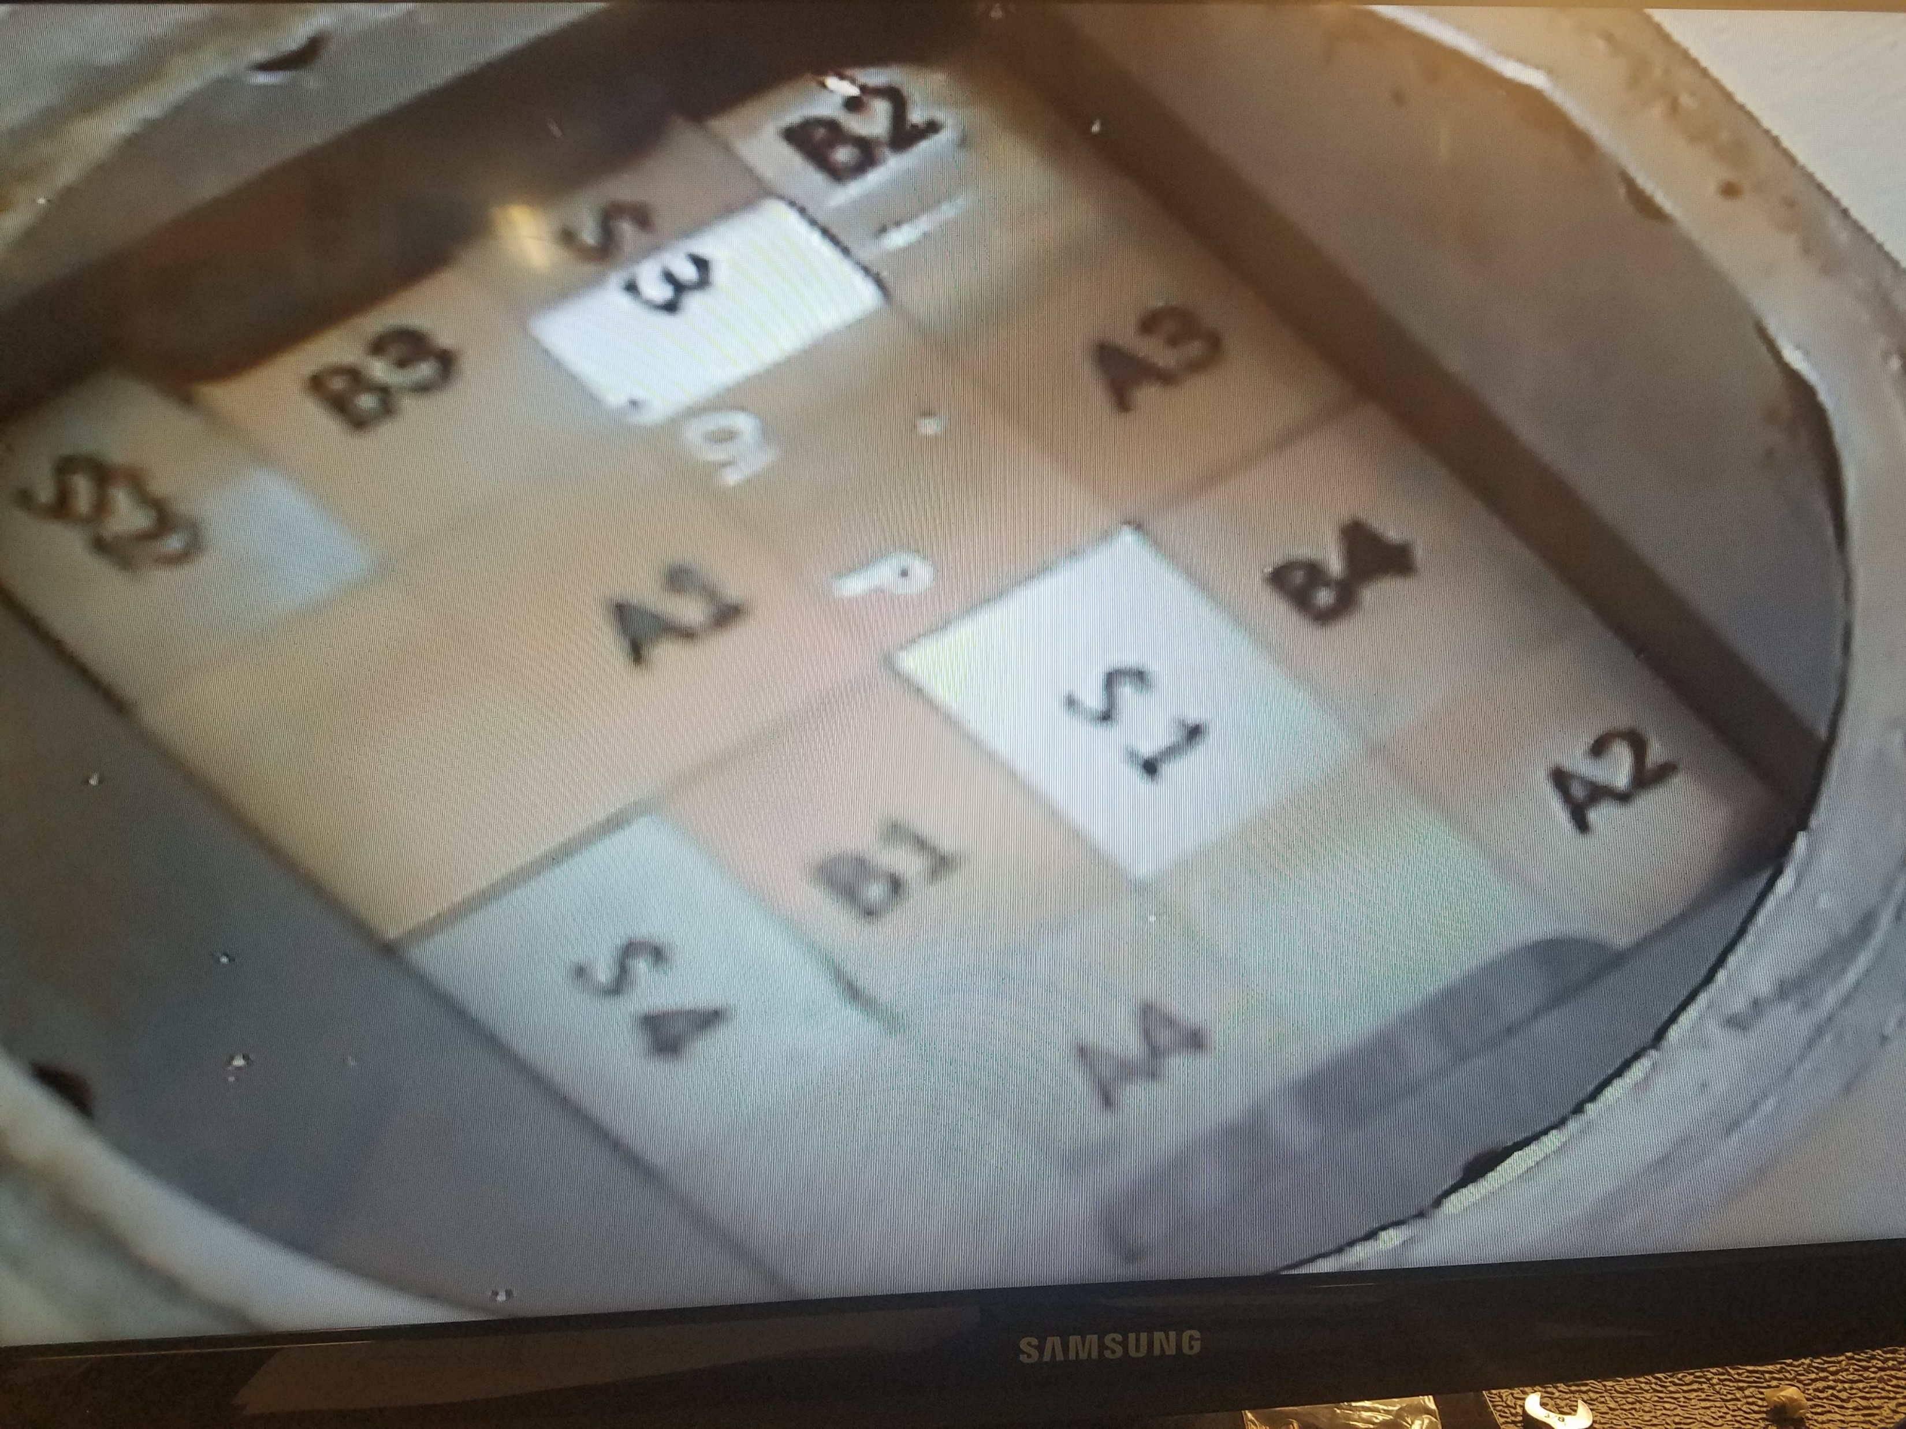
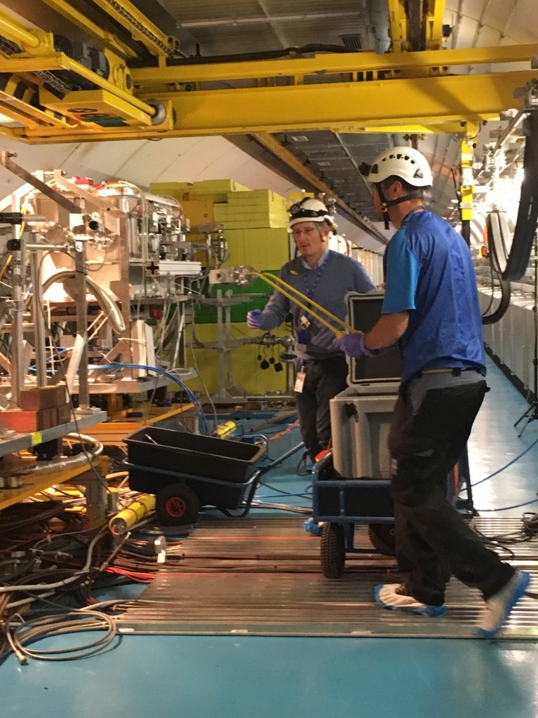
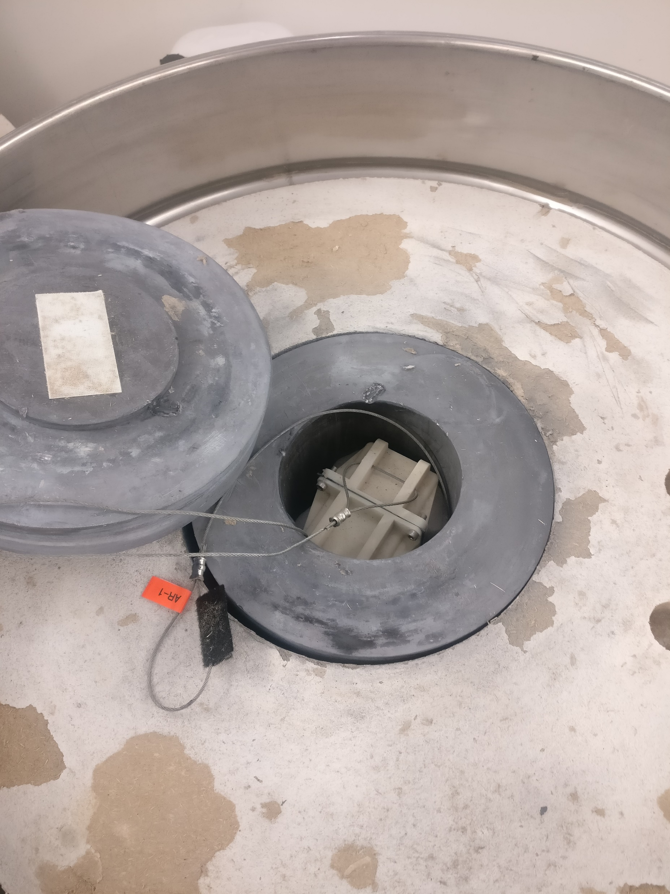
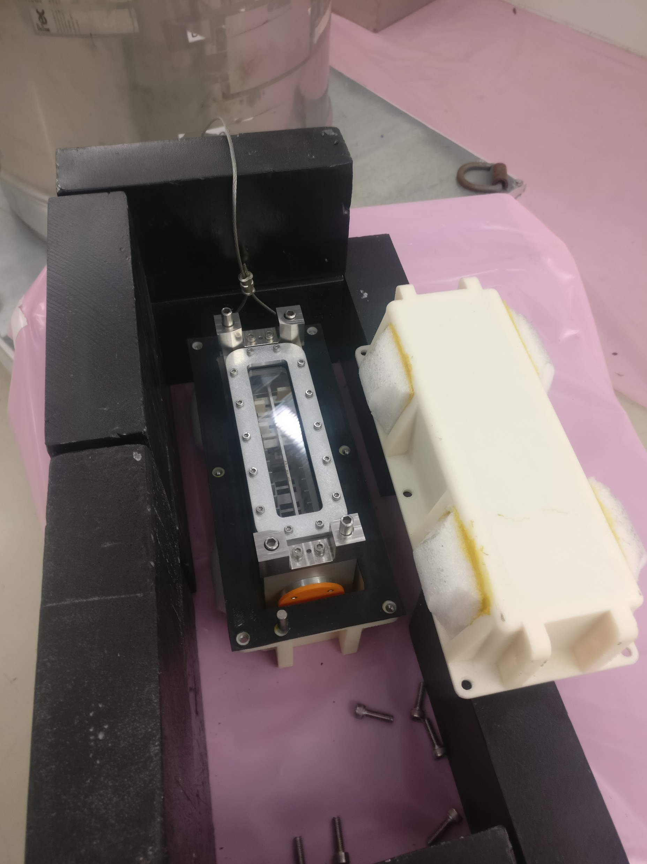
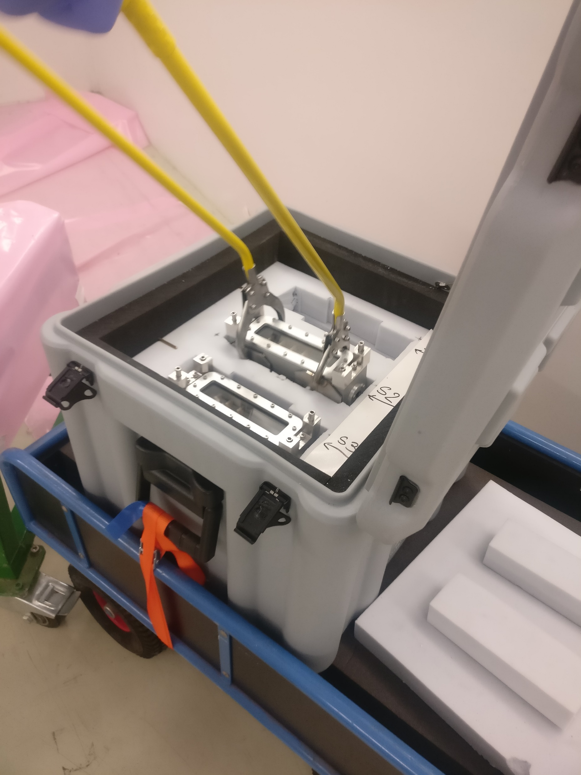
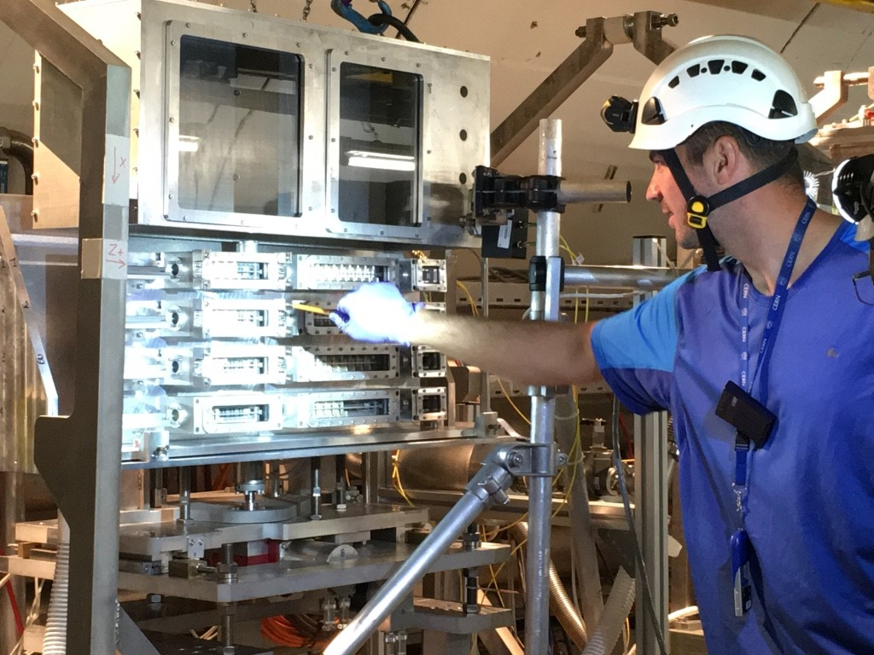
Irradiated specimen installation logistics
Complex coordination between BNL, FNAL, PNNL and CERN
8-week irradiation at BNL BLIP
Capsule shipment from BNL and opening at PNNL
Specimen sorting and assembly in HRMT43 inner box at PNNL
Packaging and shipment of inner boxes to CERN in Type A container
Inner boxes transported to TNC tunnel for direct installation in test rig
Opening of Type A container at CERN
Bldg. 867 (3 boxes: 0.85 mSv/hr at 30 cm)

Slide 13
HRMT43 test matrix

Slide 14
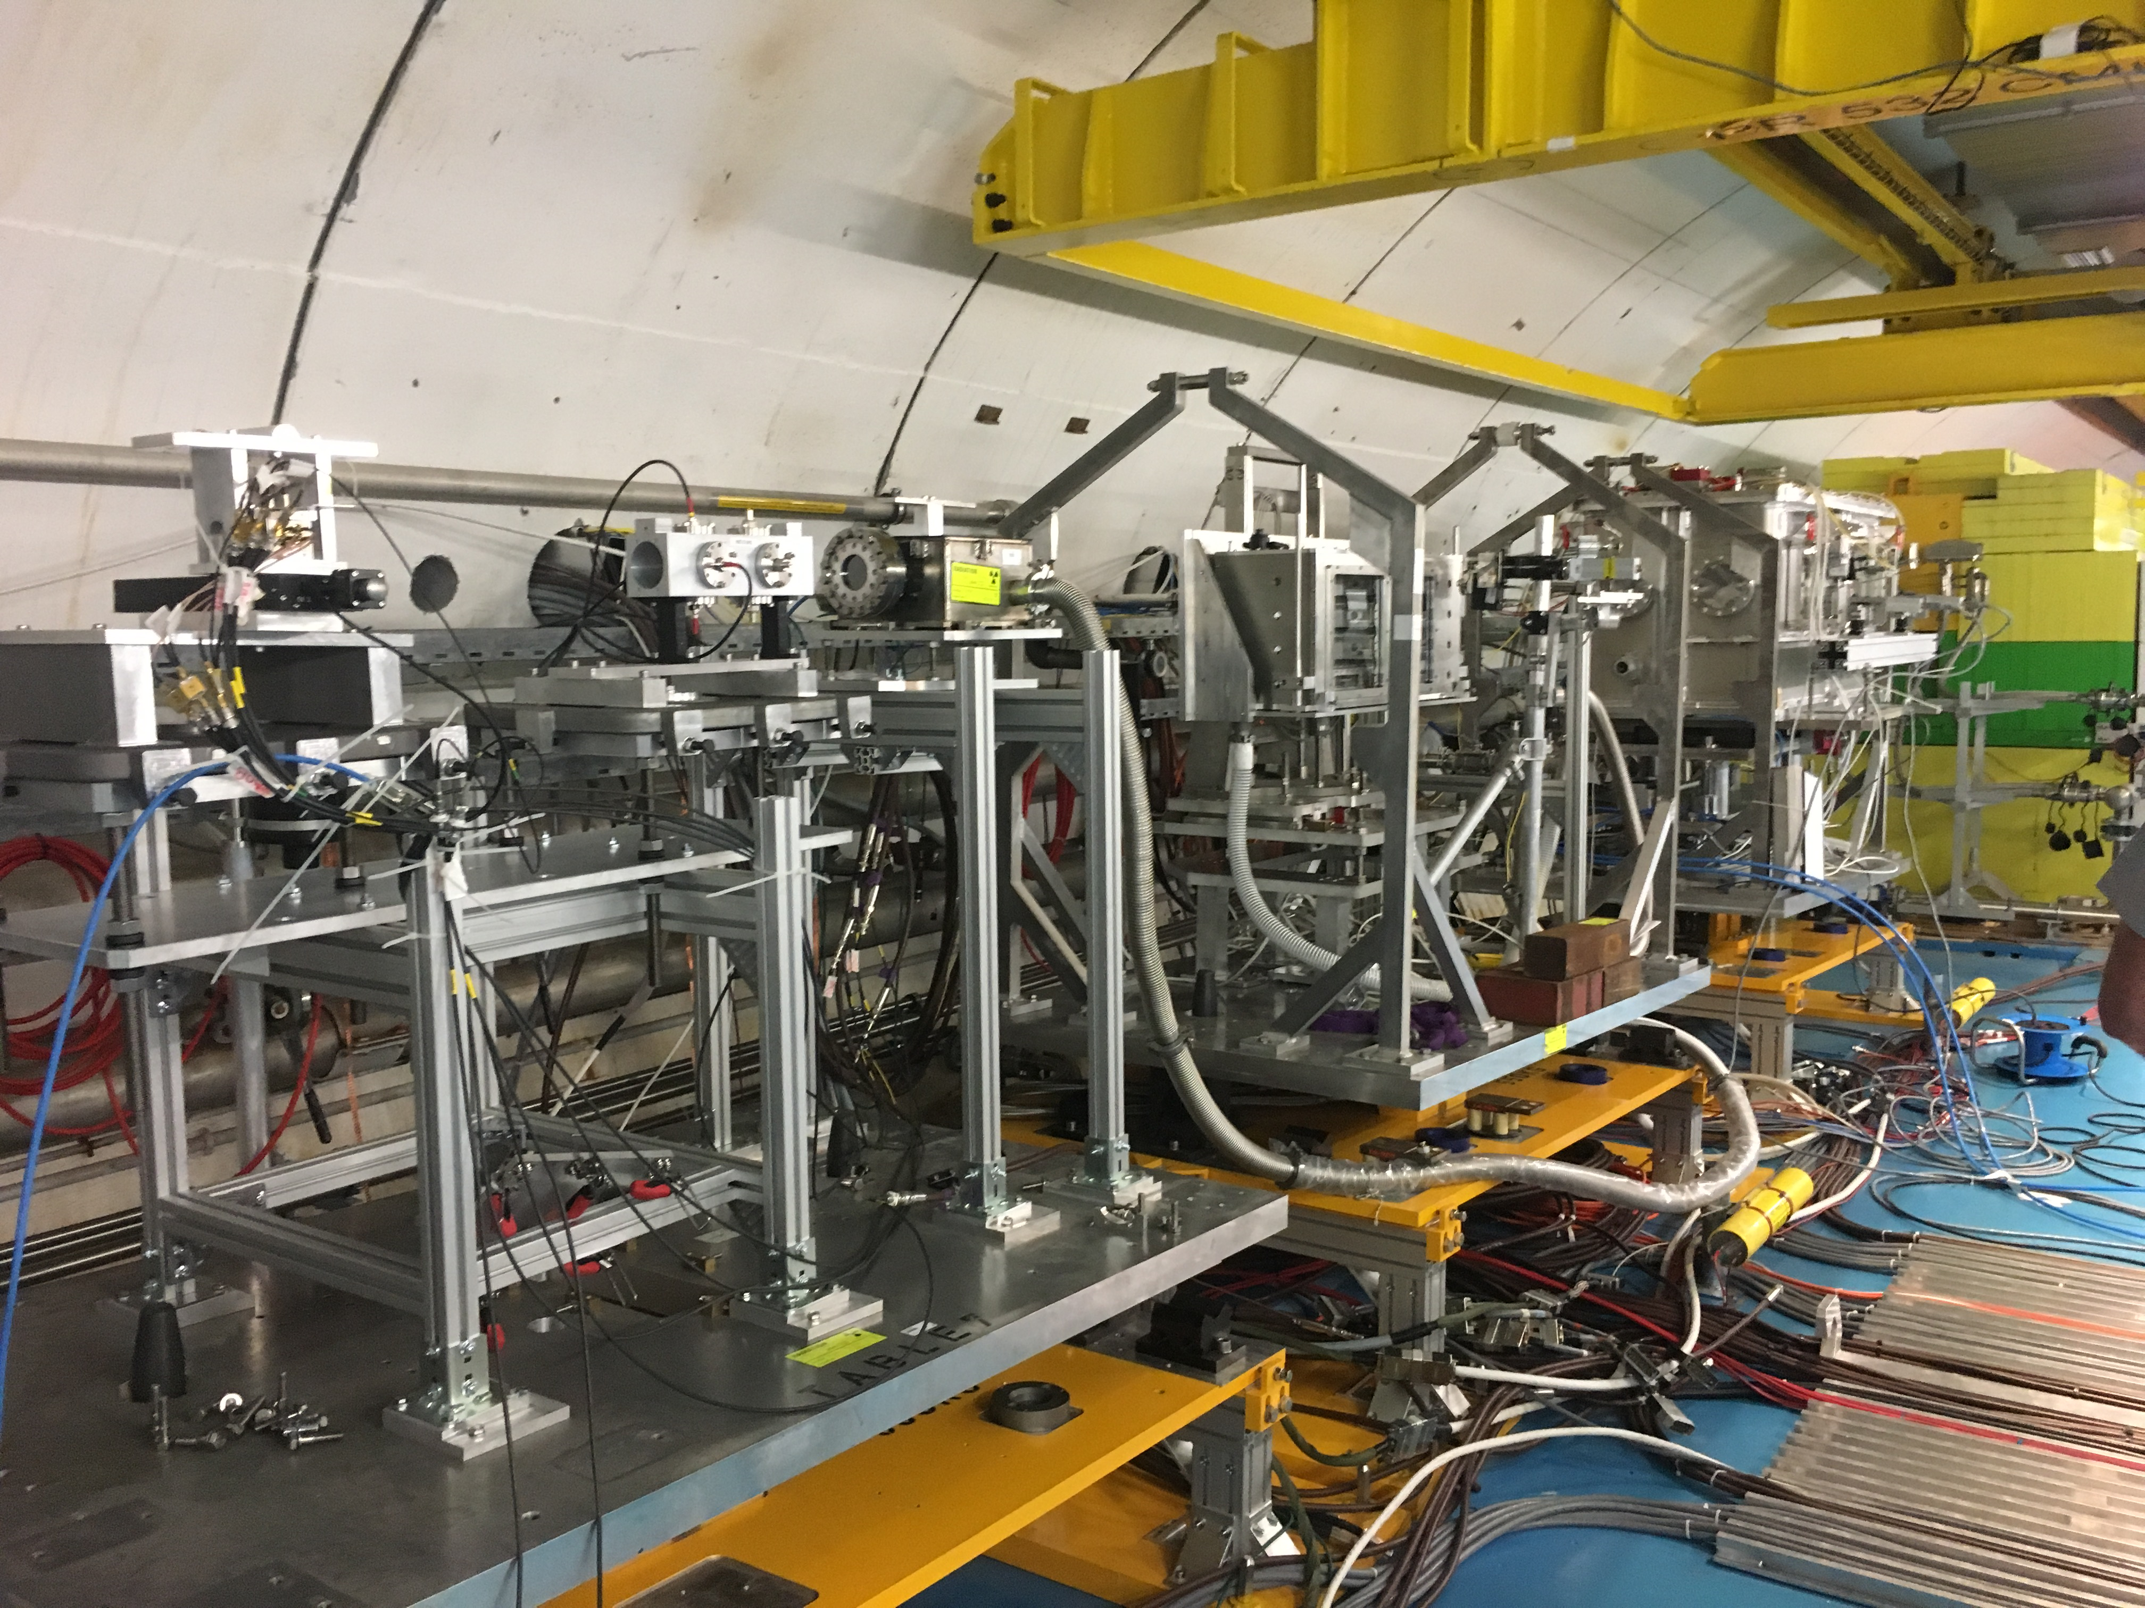
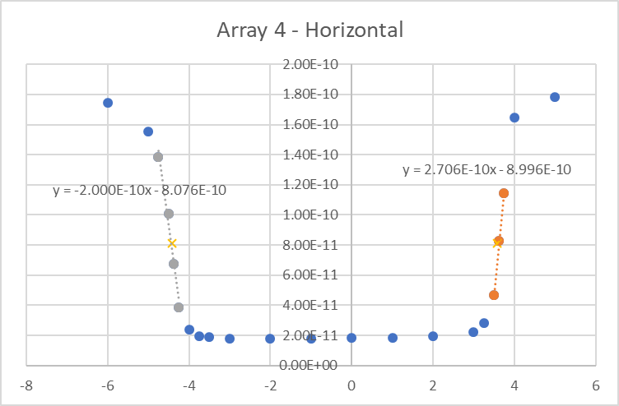
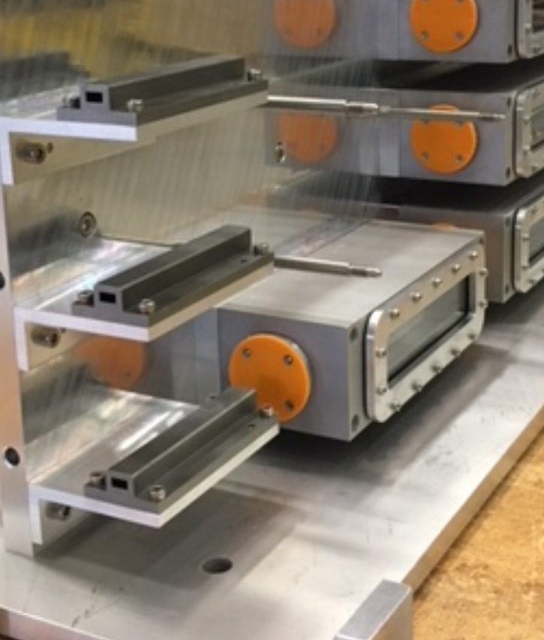
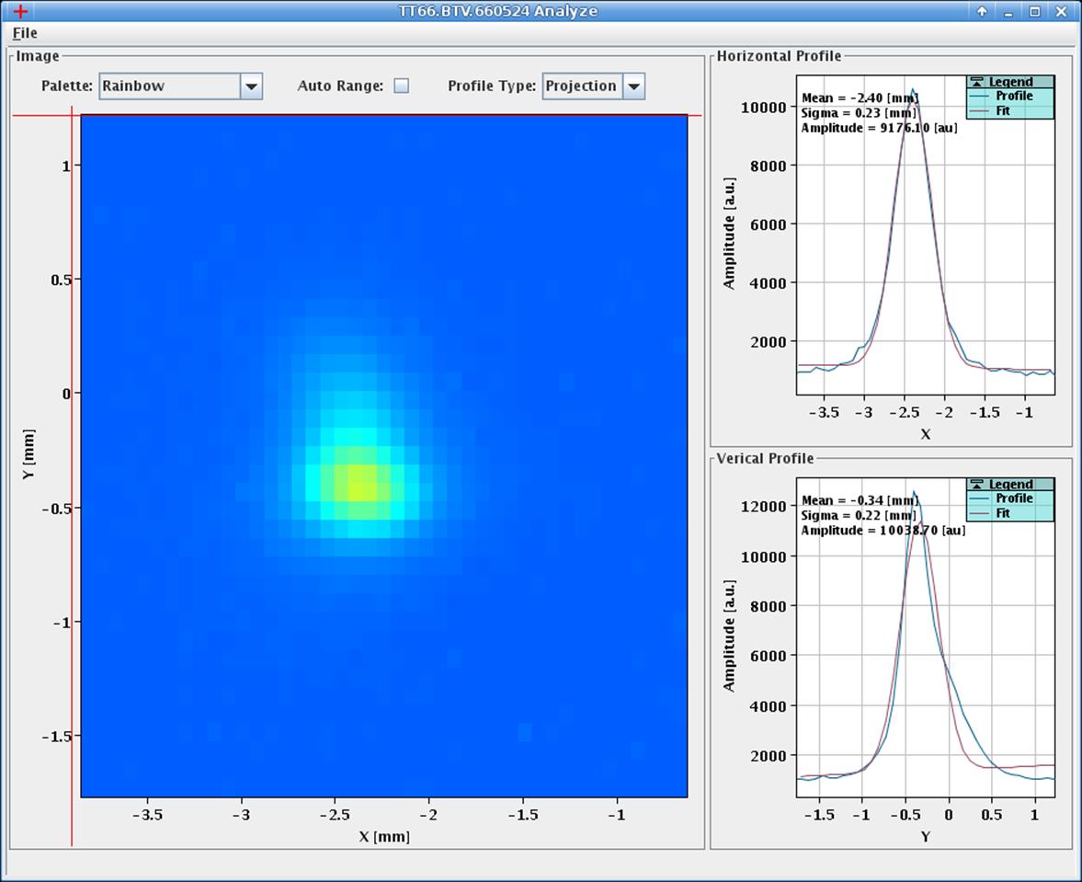
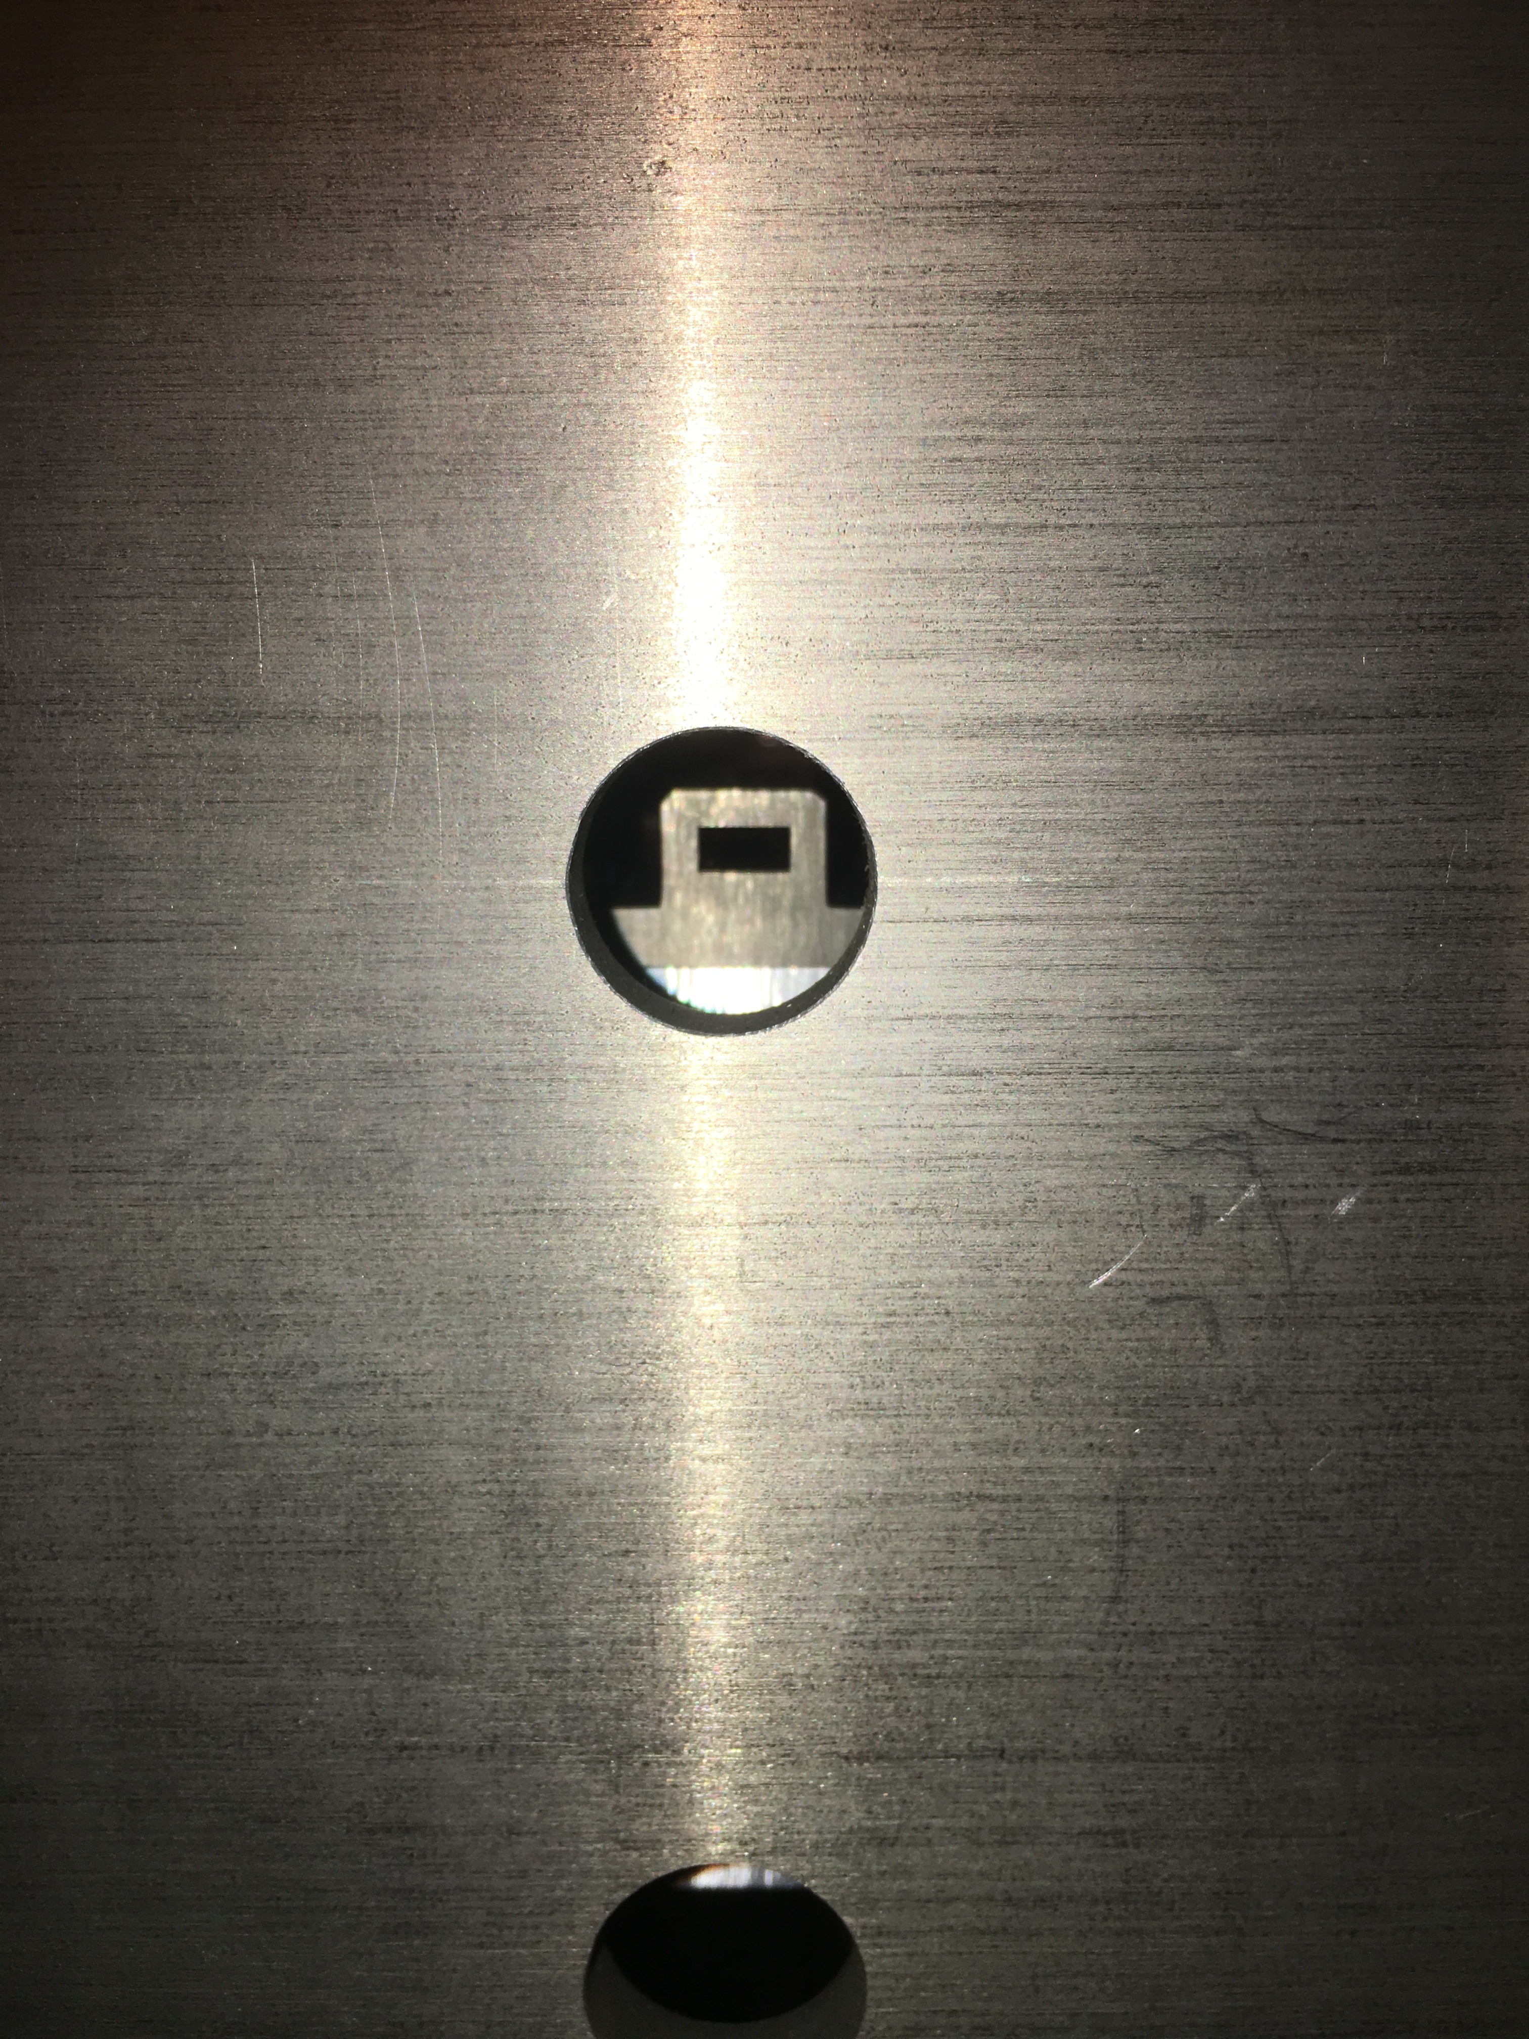
Beam-based alignment
BPKG/BTV
HRMT43
Alignment mask positioned upstream of each array
Beam scan across 4 mm x 8 mm mask aperture
BLM
Beam location and size info from BTV image
TZM mask
BLM data normalized by pulse intensity
Test rig position adjusted accordingly to center beam on mask and downstream targets

Slide 15
Experimental beam parameters
Pulse | Array | No. of bunches | Bunch intensity | Pulse intensity | σ_{x} (mm) | σ_{y} (mm)
1 | 3 | 144 | 8.40E+10 | 1.21E+13 | 0.26 | 0.19
2 | 4.1 | 144 | 8.47E+10 | 1.22E+13 | 0.25 | 0.19
3 | 4.2 | 144 | 8.54E+10 | 1.23E+13 | 0.26 | 0.20
4 | 4.3 | 144 | 8.33E+10 | 1.20E+13 | 0.26 | 0.19
5 | 4.4 | 144 | 8.26E+10 | 1.19E+13 | 0.25 | 0.19
6 | 4.5 | 144 | 8.30E+10 | 1.21E+13 | 0.25 | 0.19
7 | 2 | 216 | 1.17E+11 | 2.53E+13 | 0.28 | 0.21
8 | 1 | 288 | 1.22E+11 | 3.51E+13 | 0.27 | 0.22
Total protons on target: 1.33E14

Slide 16
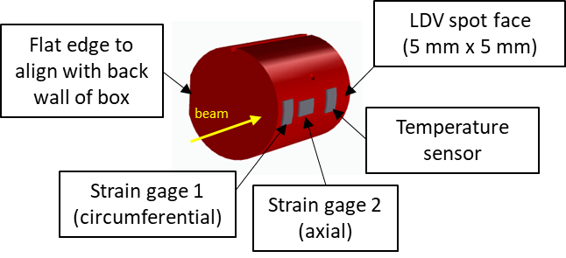
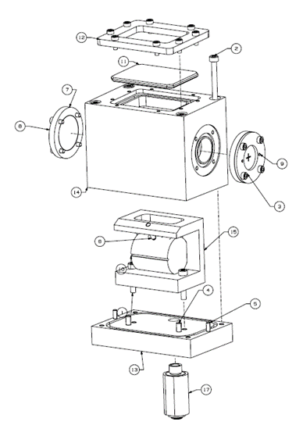
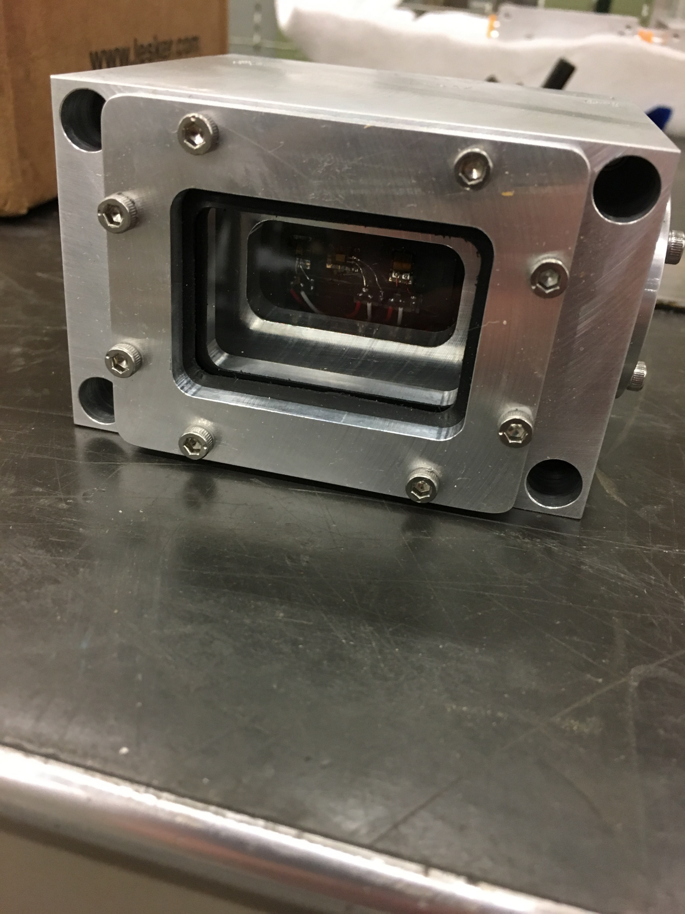


Online real-time measurements
Dynamic response measurements to help benchmark and validate highly non-linear numerical simulations
POCO ZXF-5Q cylinder: 35 mm long, 30 mm OD
Beam impact 5 mm from cylindrical edge
A. Miller, FNAL

Slide 17



Temperature and strain measurements
Temperature data acquired at 4 kHz
Array 1 – 288 bunches
Array 2 – 216 bunches
Circumferential and axial strains acquired at 4 MHz to capture dynamic effects
Arrays 3,4 – 144 bunches
Simulations prior to experiment

Slide 18





Laser Doppler Vibrometer: velocity
Optomet fiber head located ~100 mm from surface of graphite
Radial velocity logged at 4 MHz
Array 1 – 288 bunches
Simulations prior to experiment

Slide 19


Laser Doppler Vibrometer: displacement
Radial displacement data appear to reveal beam pulse structure
Pulse consists of batches of 72 bunches, separated by 250 ns
  Avg. bunch length ~16 ns, bunch spacing ~25 ns
144b (2 batches)
216b (3 batches)
Each batch ~ 1.9 µs
288b (4 batches)

Slide 20




Numerical simulation validation
Goal is to compare numerical simulation results with experimental results to validate graphite strength model
  Temperature, dynamic axial/circumferential strain and radial velocity/displacement
Data analysis ongoing - FEA model is being updated with experimental beam parameters
  MARS heat generation data with actual beam spot size and intensity
  Beam spot location from BTV and BA-7 alignment info
Array 1: Temperature distribution after 1s
Radial velocity
R. Campos, FNAL

Slide 21





Experimental chamber disassembly
Experimental table was removed from TNC tunnel and transported to Bldg. 867 for disassembly in May 2019
Inner boxes retrieved and packaged in Type A containers for shipment to CCFE, UK
980 µSv/hr on contact
0.5 µSv/hr on contact
0.8 µSv/hr on contact
R. Seidenbinder, CERN

Slide 22




Post-Irradiation-Examination plans
Type A containers eventually shipped and received by CCFE in September 2019 after FNAL-CCFE PIE work contract was placed
CCFE currently unpacking/sorting specimens. PIE work expected to begin in November 2019
  Profilometry to measure beam-induced out-of-plane plastic deformation
  Optical and Scanning Electron Microscopy (SEM) to look for potential surface cracks
Type A containers in storage at MRF facility, CCFE
Out-of-plane deformation in Ti specimen
Peak temperature jump ~1000 °C in Be
S. Bidhar, FNAL

Slide 23
Summary
Both HRMT24 and HRMT43 experiments completed successfully
HRMT24 provided valuable information on the thermal shock response of various grades of beryllium, as well as the successful validation of S200FH JC strength model
PIE work and data analysis from HRMT43 experiment will provide
  Direct comparison of thermal shock response between irradiated and non-irradiated materials
  Evaluate novel materials and their suitability as target materials
  Validate graphite strength model and numerical simulations
  Beryllium response to even higher pulse intensities
Acknowledgement
K. Ammigan¹, K. Anderson¹, S. Bidhar¹, R. Campos¹, P. Hurh¹, A. Miller¹, G. Waver¹, K. Yonehara¹, R. Zwaska¹, M. Calviani², R. Losito², C. Torregrosa², R. Seidenbinder², K. Kershaw², F. Harden², Y. Kadi², A. Bouvard², C. Saury², M. Butcher², V. Kuksenko³, D. Senor⁴, A. Casella⁴, C. Densham⁵, A. Atherton⁵, G. Burton⁵, O. Caretta⁵, T. Davenne⁵, P. Loveridge⁵, J. O’Dell⁵, M. Fitton⁵, T. Ishida⁶, S. Makimura⁶, E. Wakai⁶, S. Roberts⁷
¹Fermi National Accelerator Laboratory (FNAL), ²European Organization for Nuclear Research (CERN), ³Culham Center for Fusion Energy (CCFE), ⁴Pacific Northwest National Laboratory (PNNL), ⁵STFC Rutherford Appleton Laboratory (RAL), ⁶High Energy Accelerator Research Organization (KEK), ⁷University of Oxford

