Slide 1
NuMI Target Construction & Megawatt Modifications
George Lolov
NBI 2019
10/23/2019

Slide 2
Outline
NuMI Overview
Target Assembly Overview
Target Fins
Overview
1 MW Modifications
FEA Results
Downstream Beryllium Window
Overview
Preliminary FEA
1 MW Modifications
Final FEA
Baffle
Overview
1 MW Modification
FEA
Manufacturing
NBI 2019 / NuMI Target Construction and Megawatt Modifications
10/23/19

Slide 3
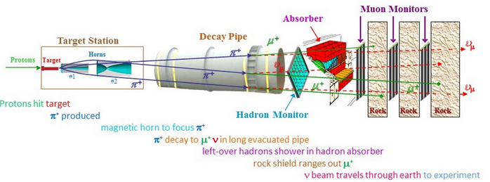
NuMI Overview and Challenges of 1 MW Upgrade
Current Experiment Metrics
Beam Power: 700-750 kW
Beam Energy: 120 GeV
Beam Intensity: 5e13 Protons/Pulse
Beam Bunches: 588 Bunches/Pulse
Pulse Length: 11 µs
Duty cycle: 1.33 seconds
2020/2021 Beam Upgrades
Beam Power: 1 MW
Beam Intensity: 6.5e13 Protons/Pulse
Duty cycle: 1.2 seconds
MET-05 designed for 1 MW use
1 MW Upgrade Challenges
Temp. and Stress Increase from Beam Heating | Increased Radioactivation | Aging Infrastructure
Pre-target beam window Target core and baffle Target DS window Horn stripline cooling Radioactive water (RAW) systems, target chase air handling, chiller Hadron absorber temperature monitoring | Additional shielding to the RAW room and target chase Review NuMI shielding and tritium production assessment for 1MW Retrofit or expand existing tritium mitigation systems New radiation-hard hadron monitors | Decay pipe window repair plan​ Target/horn module positioning drives Chase cooling retrofits and expansion
TA-02 | TA-03 | TA-05 | TA-06, 07, 08, 09
7/15/19: Transferred to C0 hot cell | 8/9/19: Transferred to MI-65 Morgue for cooldown | 8/12/19: Fabrication + Assembly 100% complete | Part procurement has begun
NBI 2019 / NuMI Target Construction and Megawatt Modifications
10/23/19

Slide 4
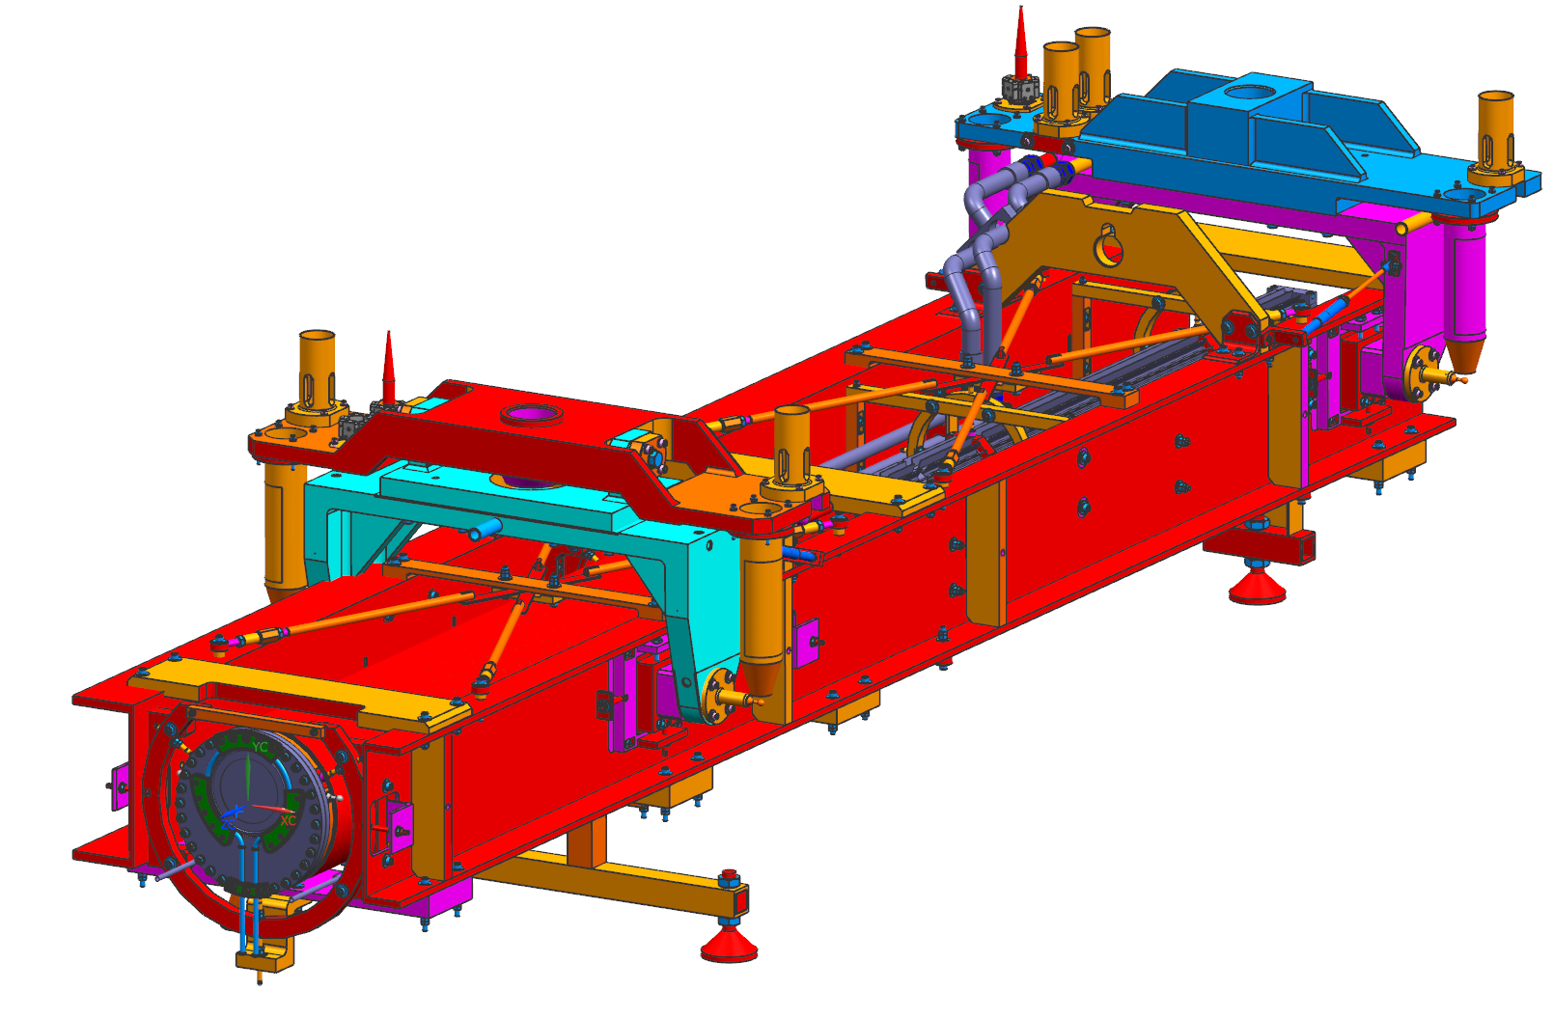
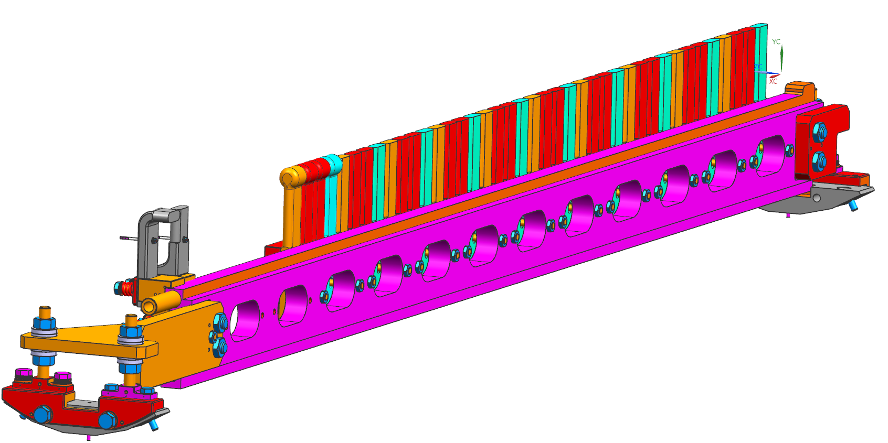
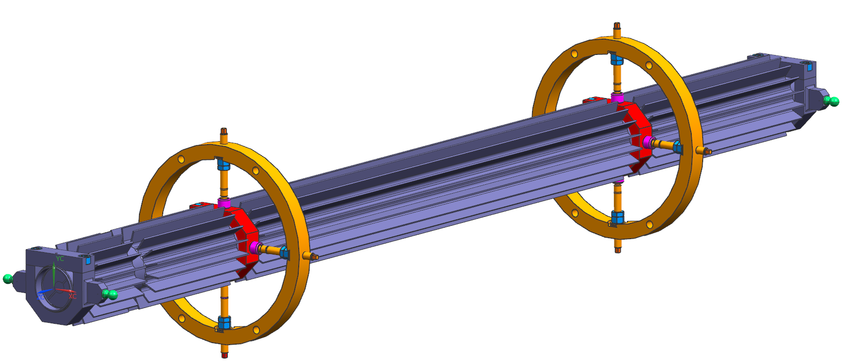
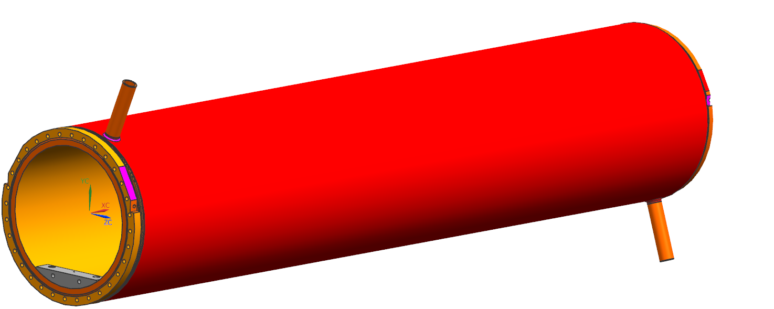
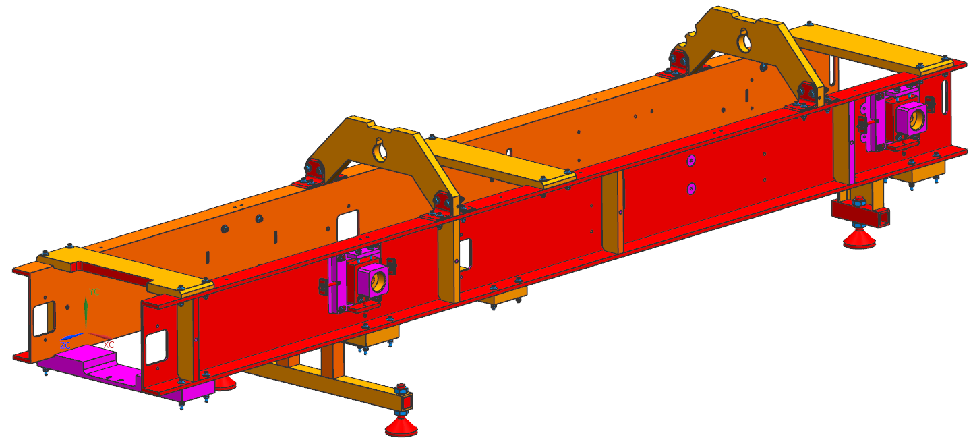
Target Assembly Overview
Upstream (Beam Enters)
Downstream (Beam Exits)
Target Assembly 05
Hylen Device
Baffle
Target Rail Assembly
Target Canister
Target Carrier
Graphite Slug Shield
Beam Heat Dissipation
Graphite Target Fins
Cooling Rail
Fin Enclosure
Helium Environment
Frame
NBI 2019 / NuMI Target Construction and Megawatt Modifications
10/23/19

Slide 5
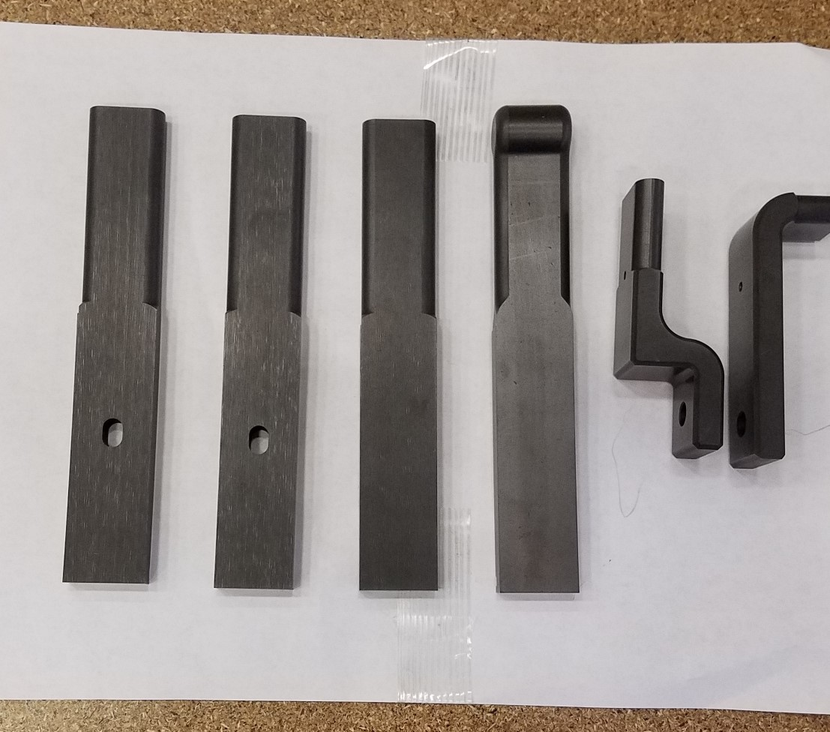
Target Fins
Graphite Grade: POCO ZXF-5Q
NBI 2019 / NuMI Target Construction and Megawatt Modifications
10/23/19

Slide 6
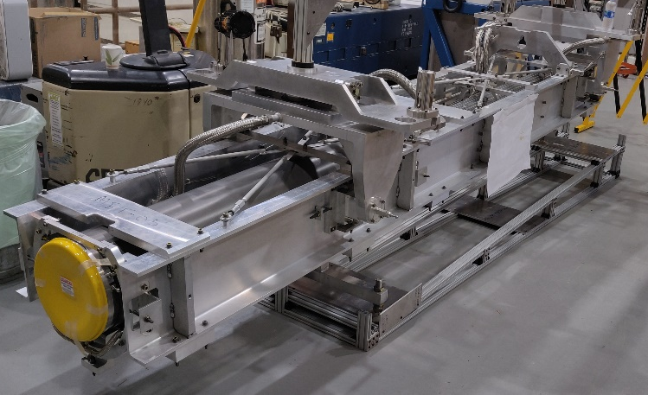
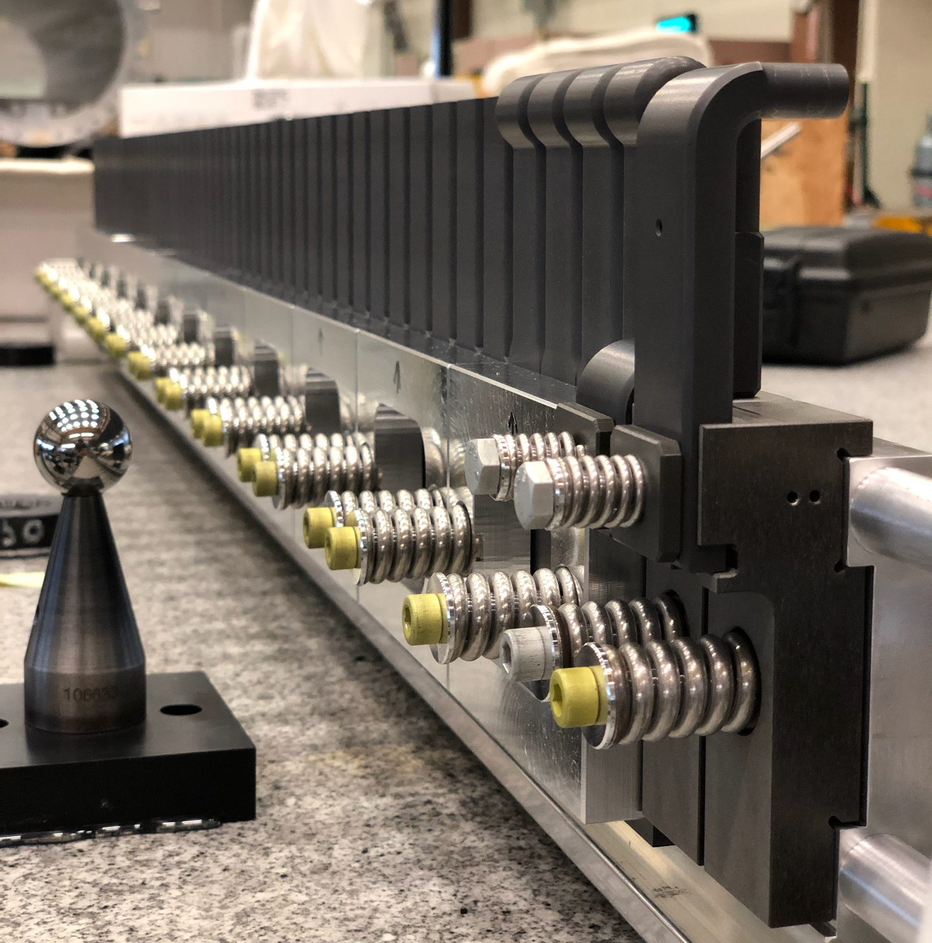
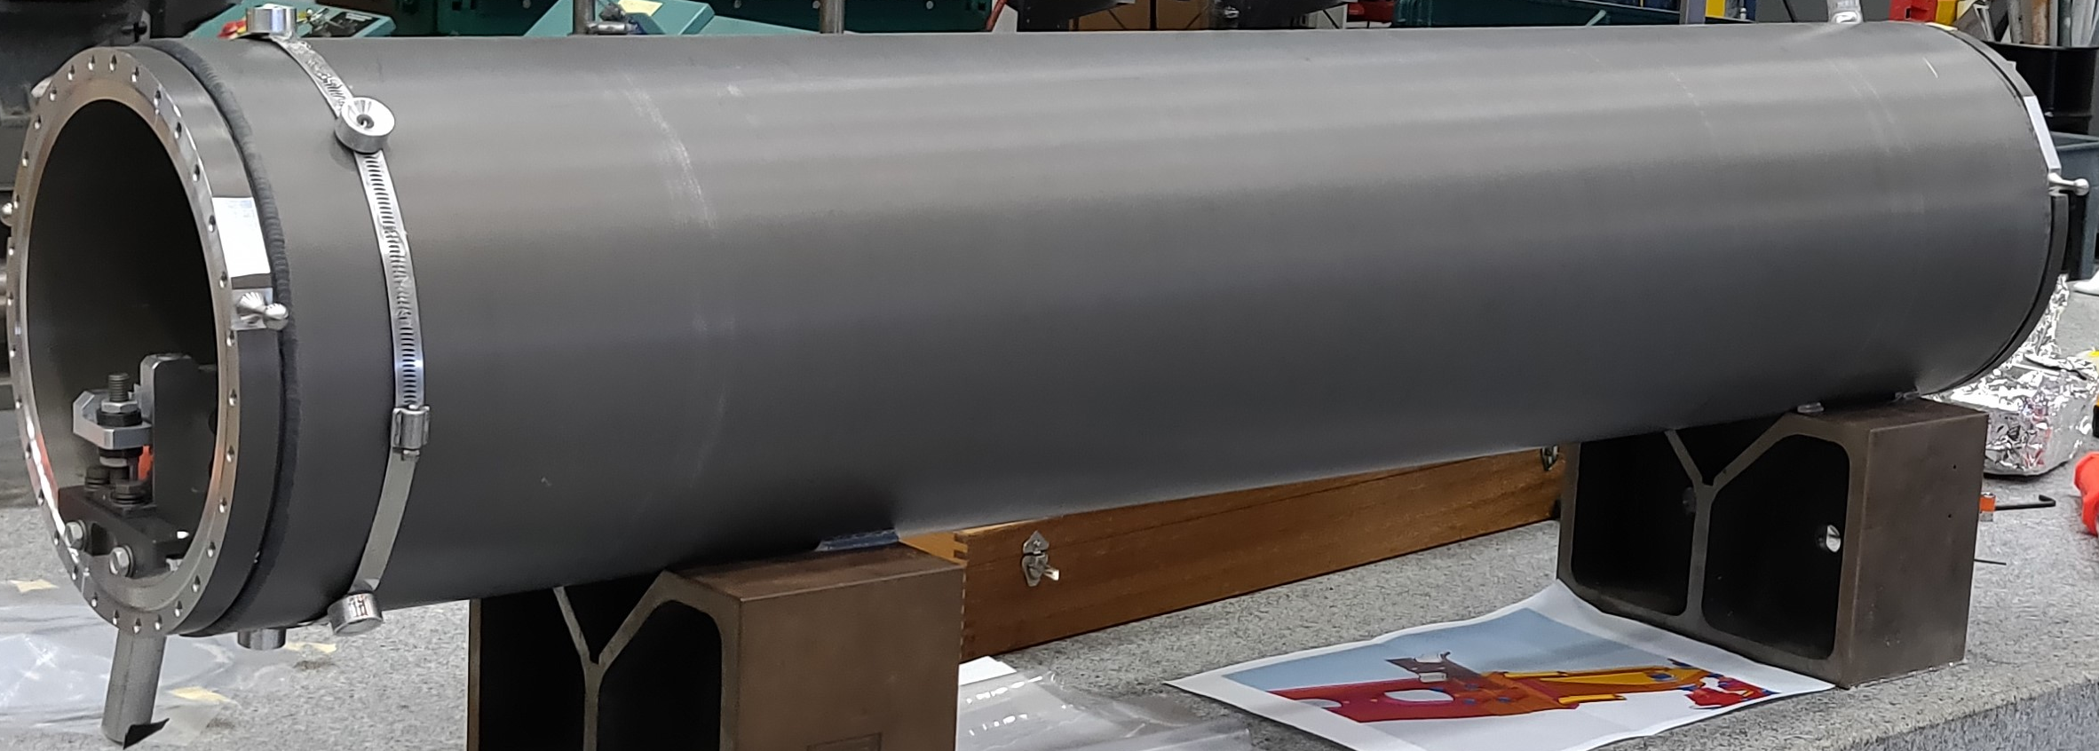
Location of Target Fins
MET-05 Graphite Fins
TA-05 Target Carrier
MET-05 Target Canister
NBI 2019 / NuMI Target Construction and Megawatt Modifications
10/23/19

Slide 7
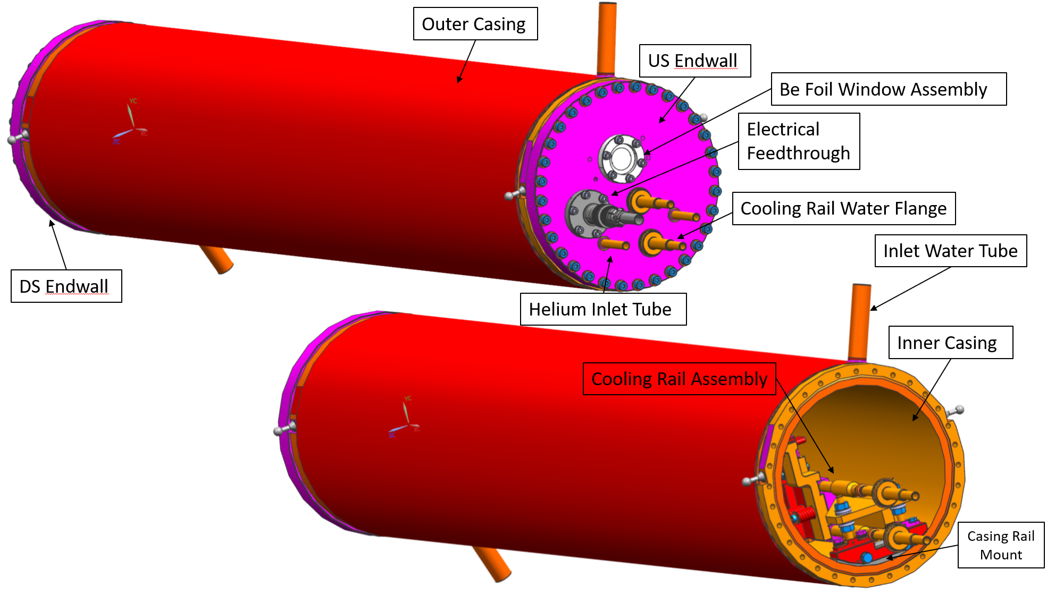
Target Canister Overview
Enclosure for target fins
Helium environment
Water cooled walls
NBI 2019 / NuMI Target Construction and Megawatt Modifications
10/23/19

Slide 8
Target Rail Overview
Back View
Water Supply/Return
Cooling Rail
Target fins
Front View
48 target fins + 2 budal fins
Graphite Grade: POCO ZXF-5Q
Water cooled channel within the rail
Budal Fins
NBI 2019 / NuMI Target Construction and Megawatt Modifications
10/23/19

Slide 9
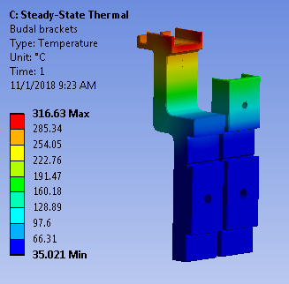
1MW Design Modification 1: Increased Fin Thickness
Steady-state thermal analysis
Fins width updated to 9 mm
Peak graphite fin temperature: 913 °C
Budal brackets peak temperature ~316 °C
NBI 2019 / NuMI Target Construction and Megawatt Modifications
10/23/19

Slide 10
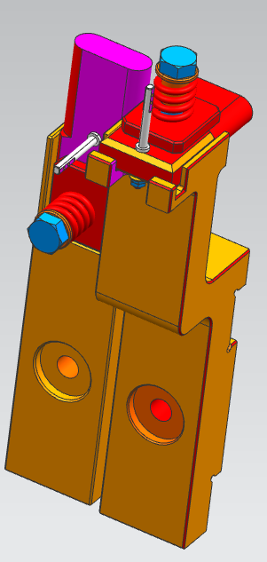
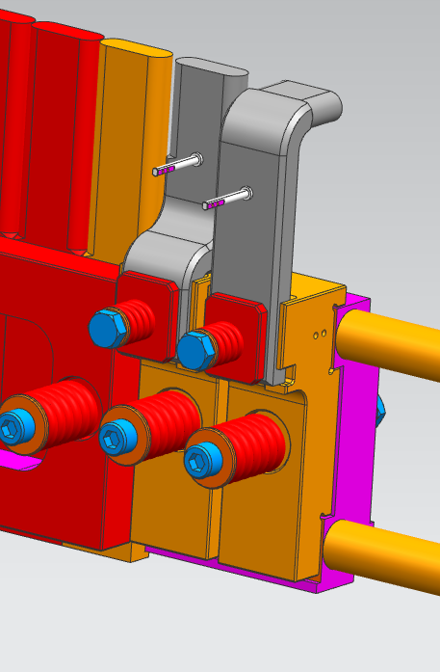
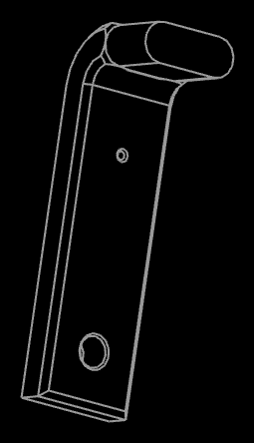
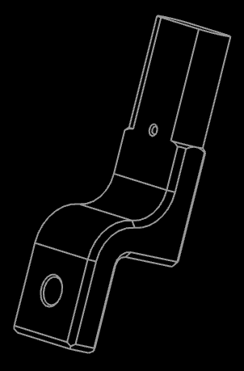
1MW Design Modification 2: Budal Bracket/Fin Redesign
Original Budal fins/brackets design
Reduce conduction path length in Aluminum
Shorten and keep Al brackets closer to cooling rail
Longer graphite fins extending towards cooling rail
Aluminum bracket
US Budal fin
DS Budal fin
NBI 2019 / NuMI Target Construction and Megawatt Modifications
10/23/19

Slide 11
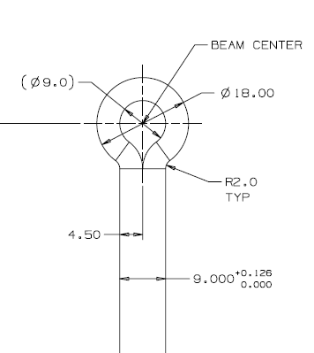
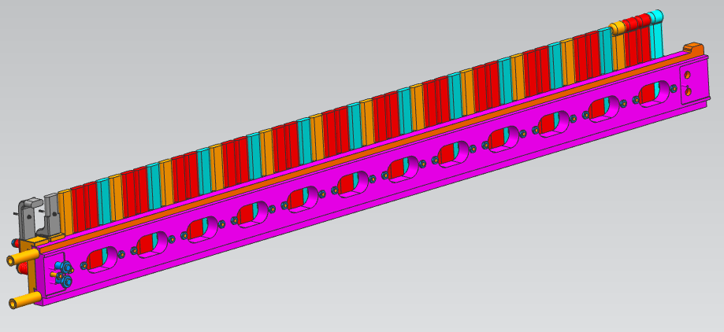
1MW Design Modification 2: Addition of Winged Fins
Addition of four graphite winged fins currently at downstream end of target
Provides protection for decay pipe window as well as Horn 1 neck in the event of completely mis-steered beam
Winged fins
Updated Budal fins/brackets
NBI 2019 / NuMI Target Construction and Megawatt Modifications
10/23/19

Slide 12
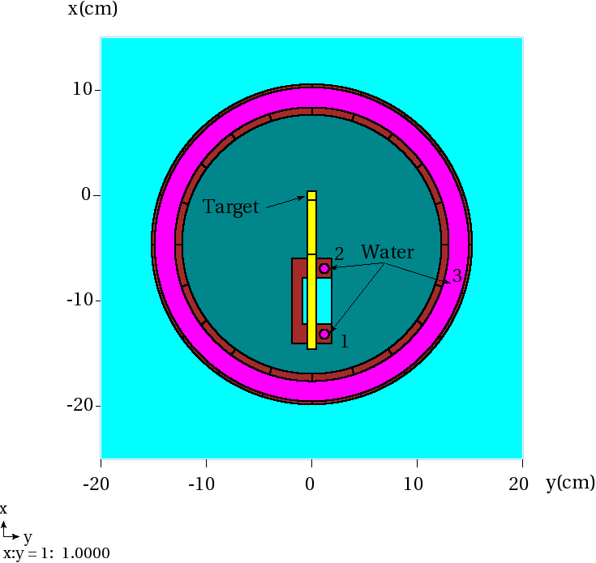
MARS Energy Deposition Data
(I. Rakhno)
NuMI AIP 1 MW beam parameters
Energy: 120 GeV
Power: 1 MW
σ = 1.5 mm
Repetition rate: 1.2 s
Pulse length: 10 µs
Protons/pulse = 6.25e13
Protons/s = 5.21e13
MARS geometry and binning
48 fins: 24 mm x 9 mm x 150 mm
x-y direction:
18 x 18 bins: x from 4.25 mm to -4.25 mm, y from -4.25 mm to 4.25 mm (0.5 mm x 0.5 mm bins)
6 x 6 bins: x from 3.75 mm to -3.75 mm, y from -51.7083 mm to -8.79167 mm (1.5 mm x 8.6 mm bins)
6 x 6 bins: x from 3.75 mm to -3.75 mm, y from -138.042 mm to -63.4583 mm (1.5 mm x 14.9 mm bins)
z-direction:
4 x-y data sets per fin for 48 fins
[(18 x 18 x 4) + (6 x 6 x 4) + (6 x 6 x 4)] x 48 = 76032 data points
NBI 2019 / NuMI Target Construction and Megawatt Modifications
10/23/19

Slide 13
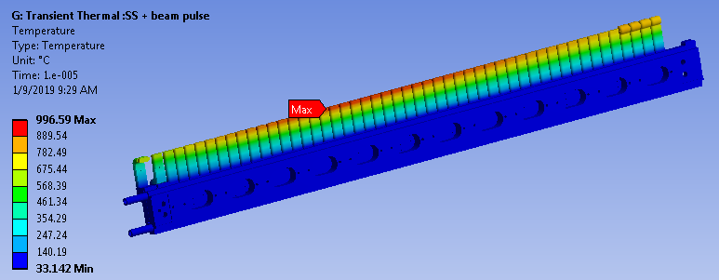
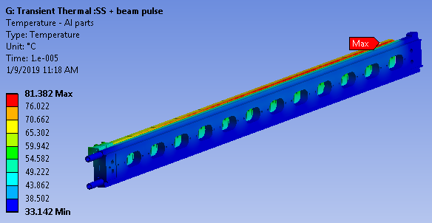
Thermal Analysis: Steady State + Beam Pulse
TARGET RAIL ASSEMBLY
T_{graphite, max}: 997 °C
ΔT ~ 107 °C from SS temperature
Cooling Water
Al COOLING RAIL & PRESSING PLATES
Negligible change in temperature of Al cooling rail and pressing plate from beam pulse
NBI 2019 / NuMI Target Construction and Megawatt Modifications
10/23/19

Slide 14
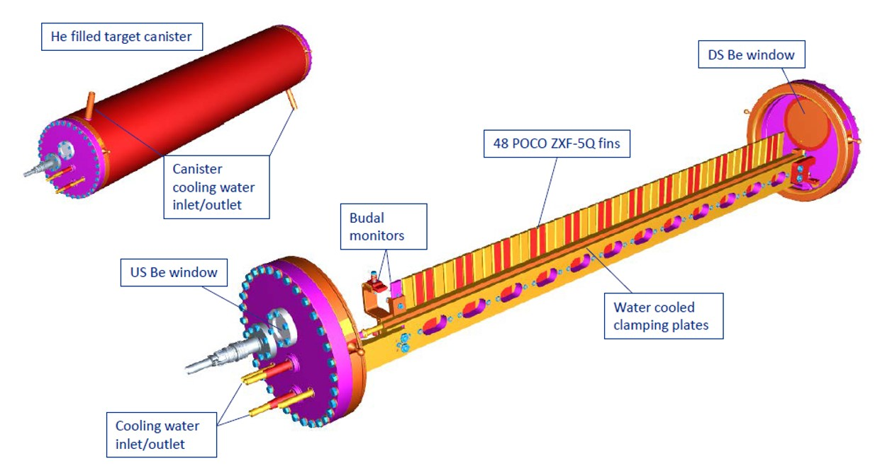
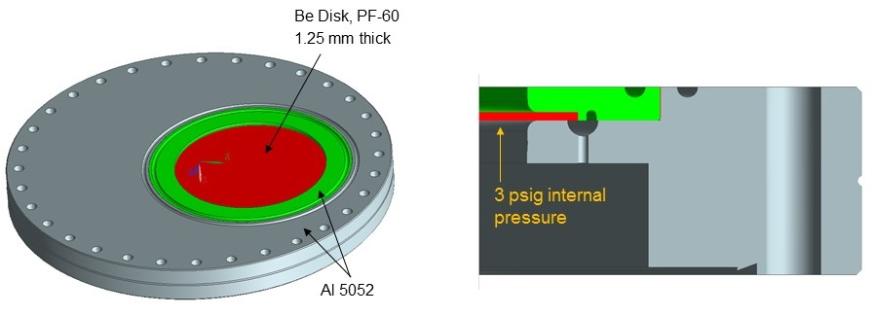
Downstream Beryllium Window
Target Rail Assembly
PF-60 Be disk e-beam welded to Al ring
Be disk and Al ring weldment then e-beam welded to Al flange
NBI 2019 / NuMI Target Construction and Megawatt Modifications
10/23/19

Slide 15
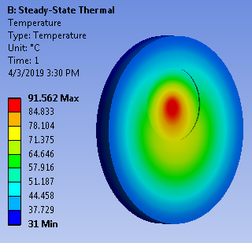
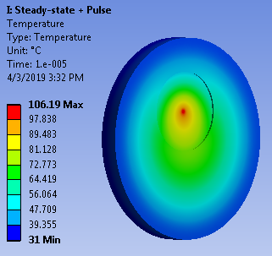
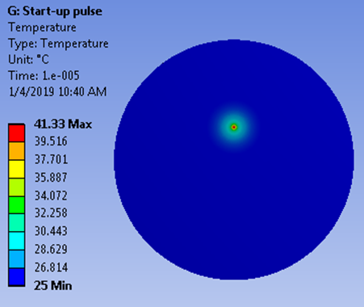
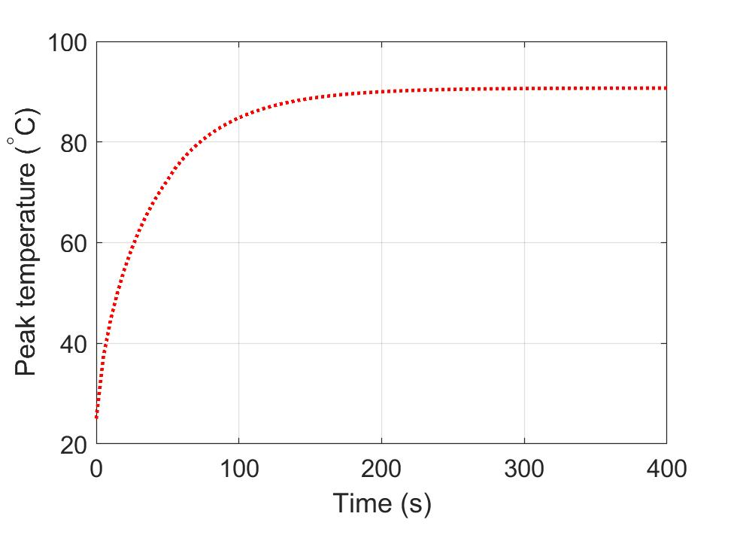
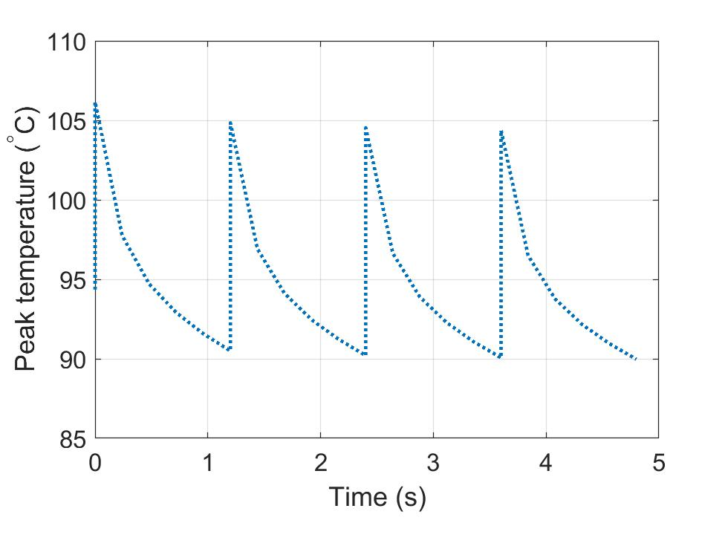
Thermal Analysis Results
K. Ammigan
Steady-state temperature distribution
Temperature immediately after beam spill
Initial temperature: 25 °C
Temperature after first beam pulse: 41 °C
T_{max}: 91.5 °C
T_{max}: 106 °C
NBI 2019 / NuMI Target Construction and Megawatt Modifications
10/23/19

Slide 16
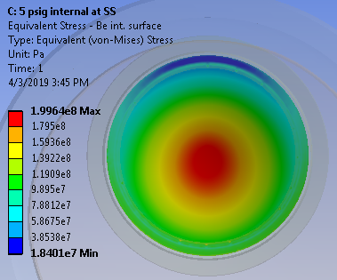
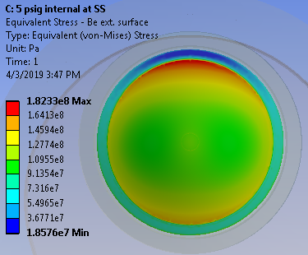
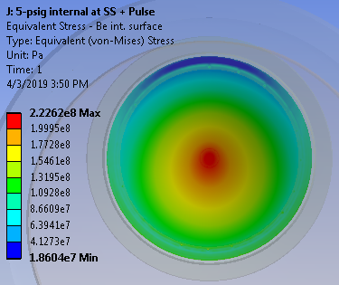
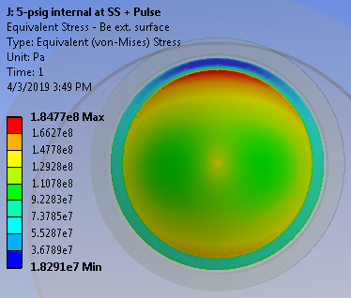
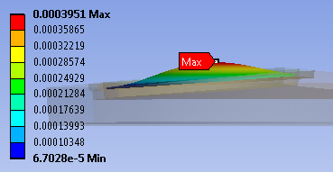
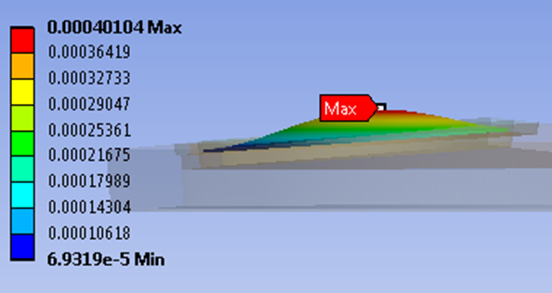
Structural analysis
K. Ammigan
5 psig Helium internal pressure (worst-case condition)
At steady-state, T_{max}: 91 °C
At steady-state immediately after pulse, T_{max}: 106 °C
Internal surface
External surface
Internal surface
External surface
Peak σ_{equiv} = 200 MPa (center)
Peak σ_{equiv} = 182 MPa (edge)
Peak σ_{equiv} = 226 MPa (center)
Peak σ_{equiv} = 185 MPa (edge)
NBI 2019 / NuMI Target Construction and Megawatt Modifications
10/23/19

Slide 17
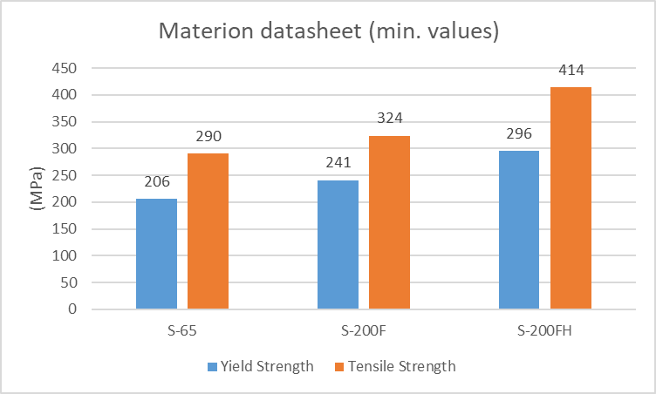
Peak Equivalent Stresses Exceed Be Yield Strength
K. Ammigan
Internal pressure (5 psig) | T_{max} (°C) | Internal surf. σ_{equiv, max} (MPa) | External surf. σ_{equiv, max} (MPa)
Steady-state | 91 | 200 (center) | 182 (edge)
Steady-state + beam | 106 | 226 (center) | 185 (edge)
Beryllium strength properties at room temperature
Lower YS at elevated temperatures
Chemical composition closer to S-65 grade (VHP)
Expect anisotropy in properties due to rolled and textured material
Uncertain long-term effects of radiation damage
NBI 2019 / NuMI Target Construction and Megawatt Modifications
10/23/19

Slide 18
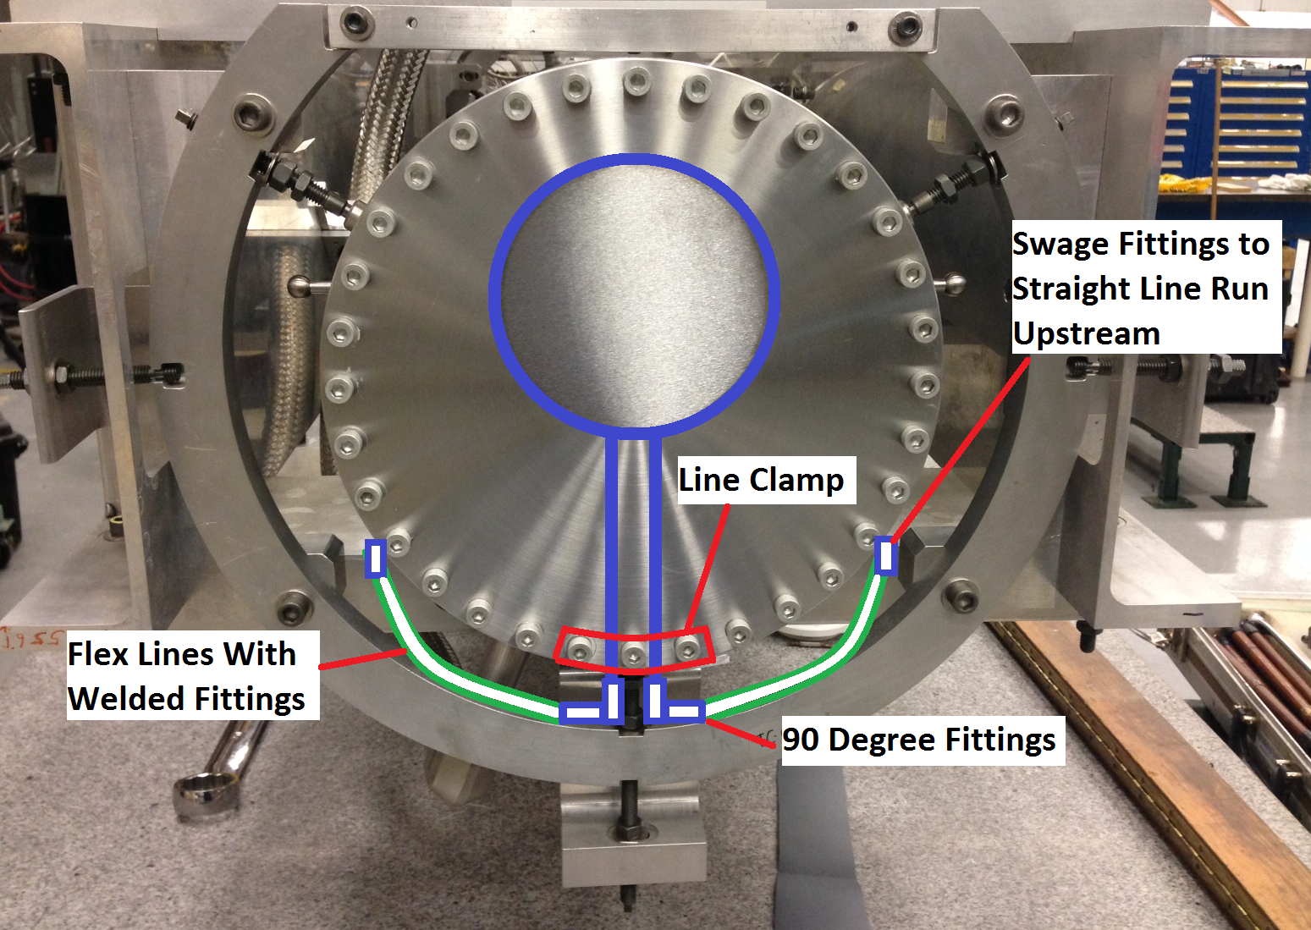
Proposed Cooling Loop
C. Crowley
NBI 2019 / NuMI Target Construction and Megawatt Modifications
10/23/19

Slide 19
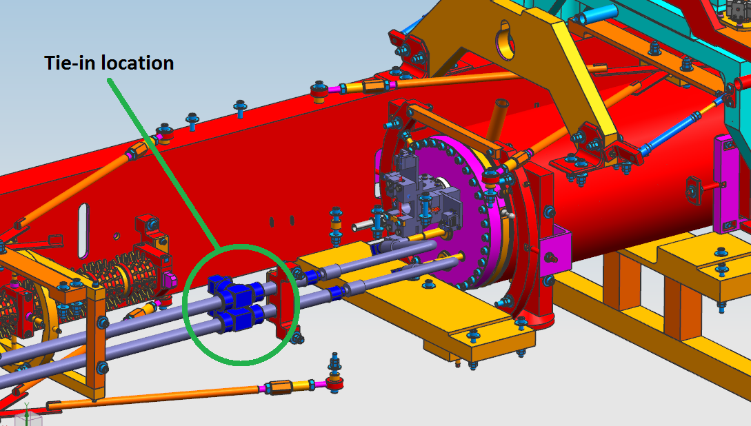
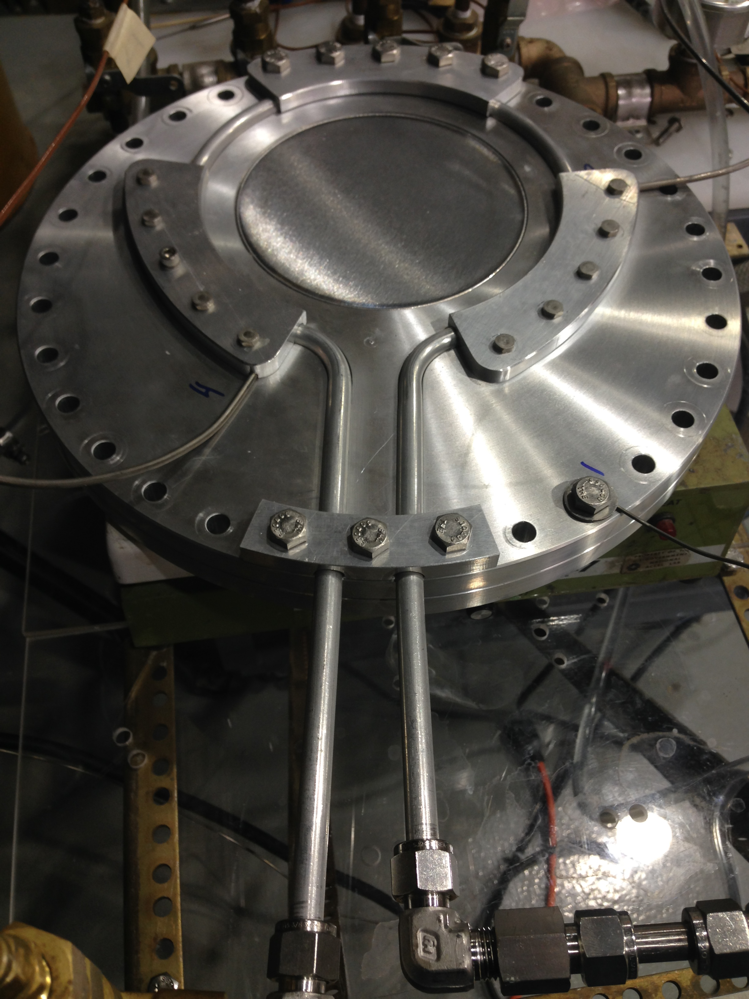
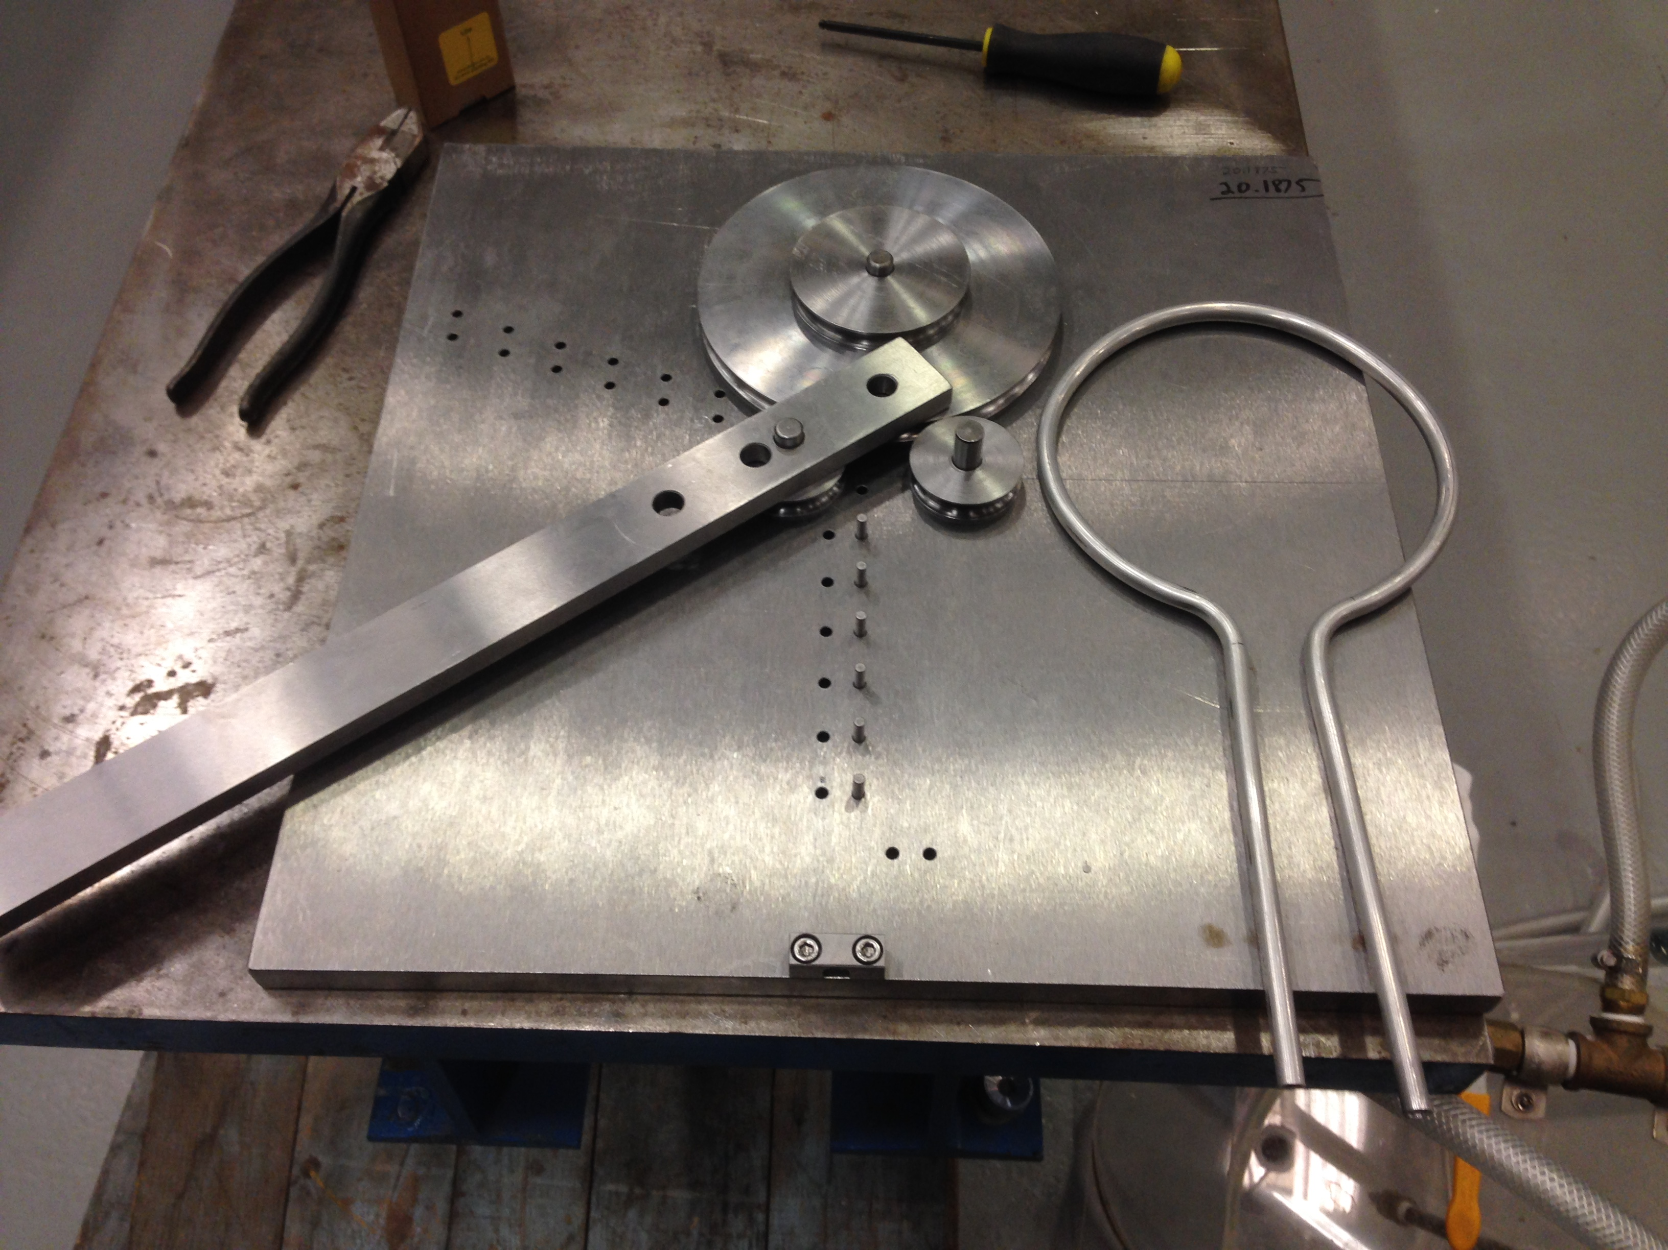
1 MW Modification: Active Cooling Loop
Thermocouple
Custom Bent Tubing
0.5 GPM Water Diverted from Cannister Supply
NBI 2019 / NuMI Target Construction and Megawatt Modifications
10/23/19

Slide 20
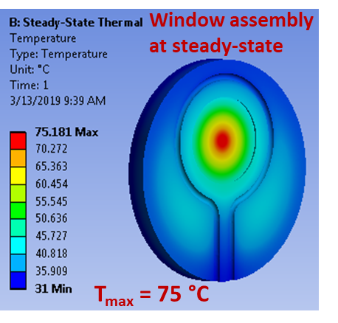
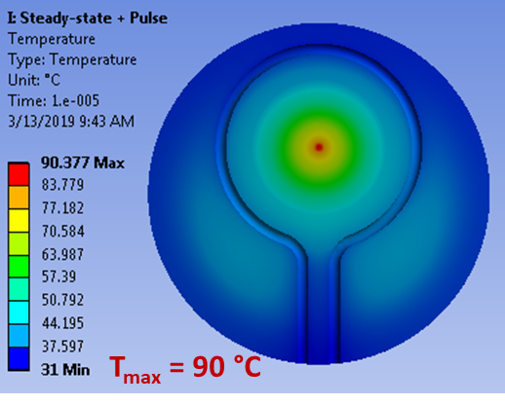
Thermal Analysis – Active Cooling
K. Ammigan
Steady-state temperature distribution
Temperature immediately after beam spill
Peak temperature reduction of about 16 °C
NBI 2019 / NuMI Target Construction and Megawatt Modifications
10/23/19

Slide 21
Peak Equivalent Stresses in Be Disk With Active Cooling
K. Ammigan
Beryllium strength properties (at RT)
Stresses now below YS of other Be grades
NBI 2019 / NuMI Target Construction and Megawatt Modifications
10/23/19

Slide 22
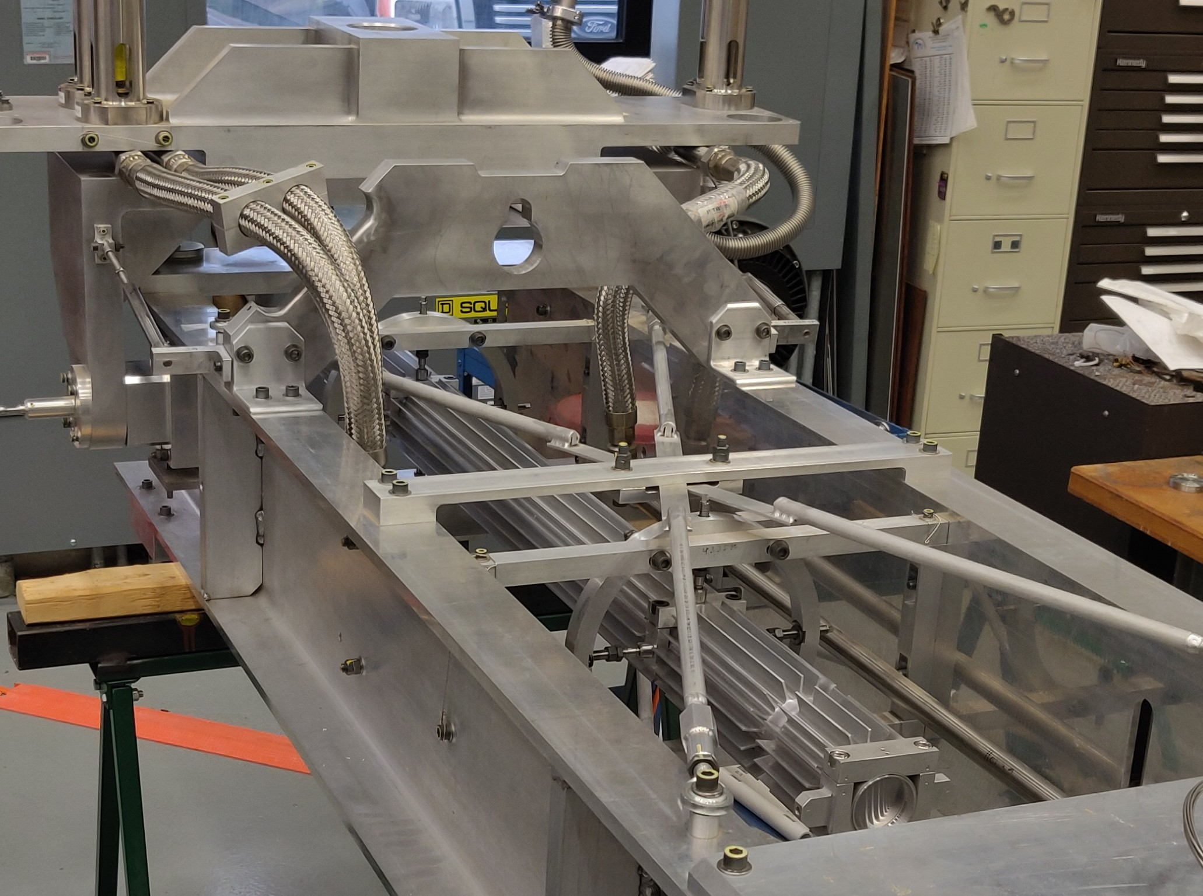
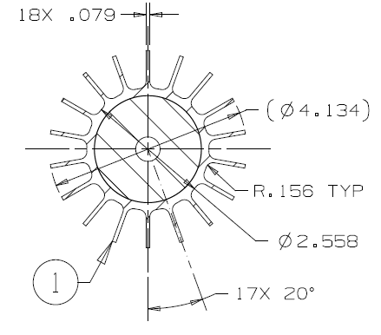
Baffle Overview
Al Casing
13mm Hole
Graphite Slug
0.010” thick beryllium windows at US and DS ends
Graphite core press fit at 150 °C - 160 °C with 0.005” – 0.006” interference fit at RT
NBI 2019 / NuMI Target Construction and Megawatt Modifications
10/23/19

Slide 23
1 MW Modification: Increased Hole Diameter
Since beam spot size increased, baffle hole diameter must also increase proportionally to prevent scraping
Baffle hole diameter enlarged from 13 mm to 15 mm for NuMI Target Systems AIP
NBI 2019 / NuMI Target Construction and Megawatt Modifications
10/23/19

Slide 24
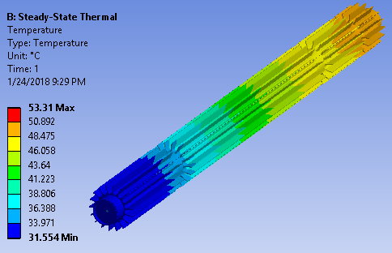
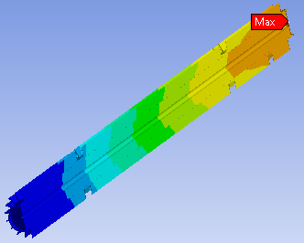
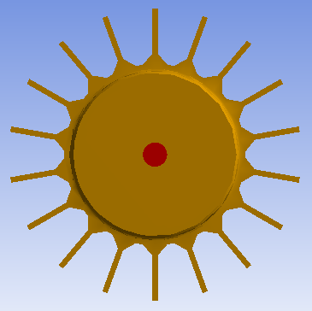
ANSYS Steady-State Thermal Results
K. Ammigan
beam
Peak Graphite and Aluminum temperatures: ~50 °C
Peak Beryllium temperature: 53 °C
NBI 2019 / NuMI Target Construction and Megawatt Modifications
10/23/19

Slide 25
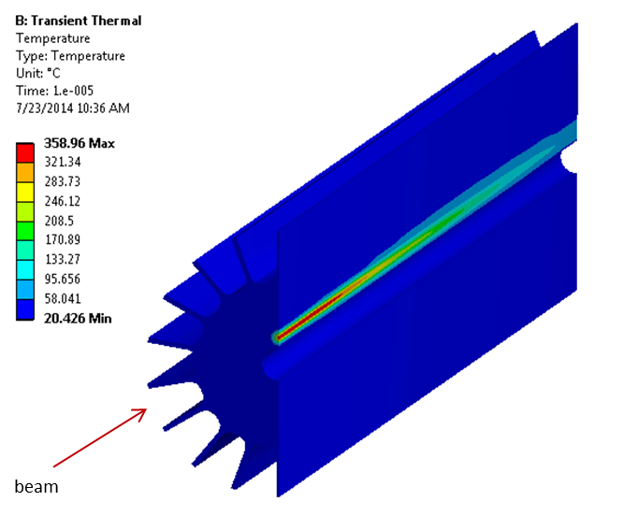
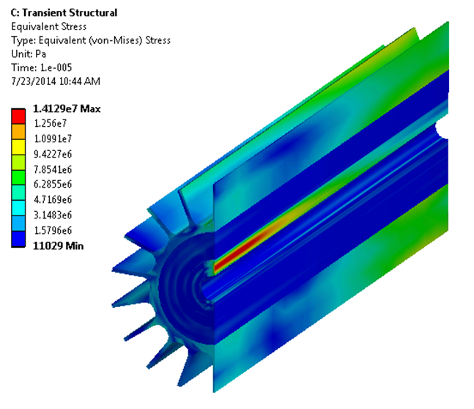
Direct beam interaction - thermal and structural FEA results*
NOvA beam parameters: 120 GeV, 0.7 MW, σ: 1.3 mm, 4.9e13 ppp, 1.33 s rep. rate
K. Ammigan
Baffle expected to survive direct beam interaction
Temperature
Equivalent stress
Peak ΔT in graphite: 339 °C
σ_{equiv, max} in graphite: 14 MPa
σ_{equiv, max} in Al: 13.6 MPa
NBI 2019 / NuMI Target Construction and Megawatt Modifications
10/23/19

Slide 26
Baffle Press Fit Fixture
NBI 2019 / NuMI Target Construction and Megawatt Modifications
10/23/19

Slide 27
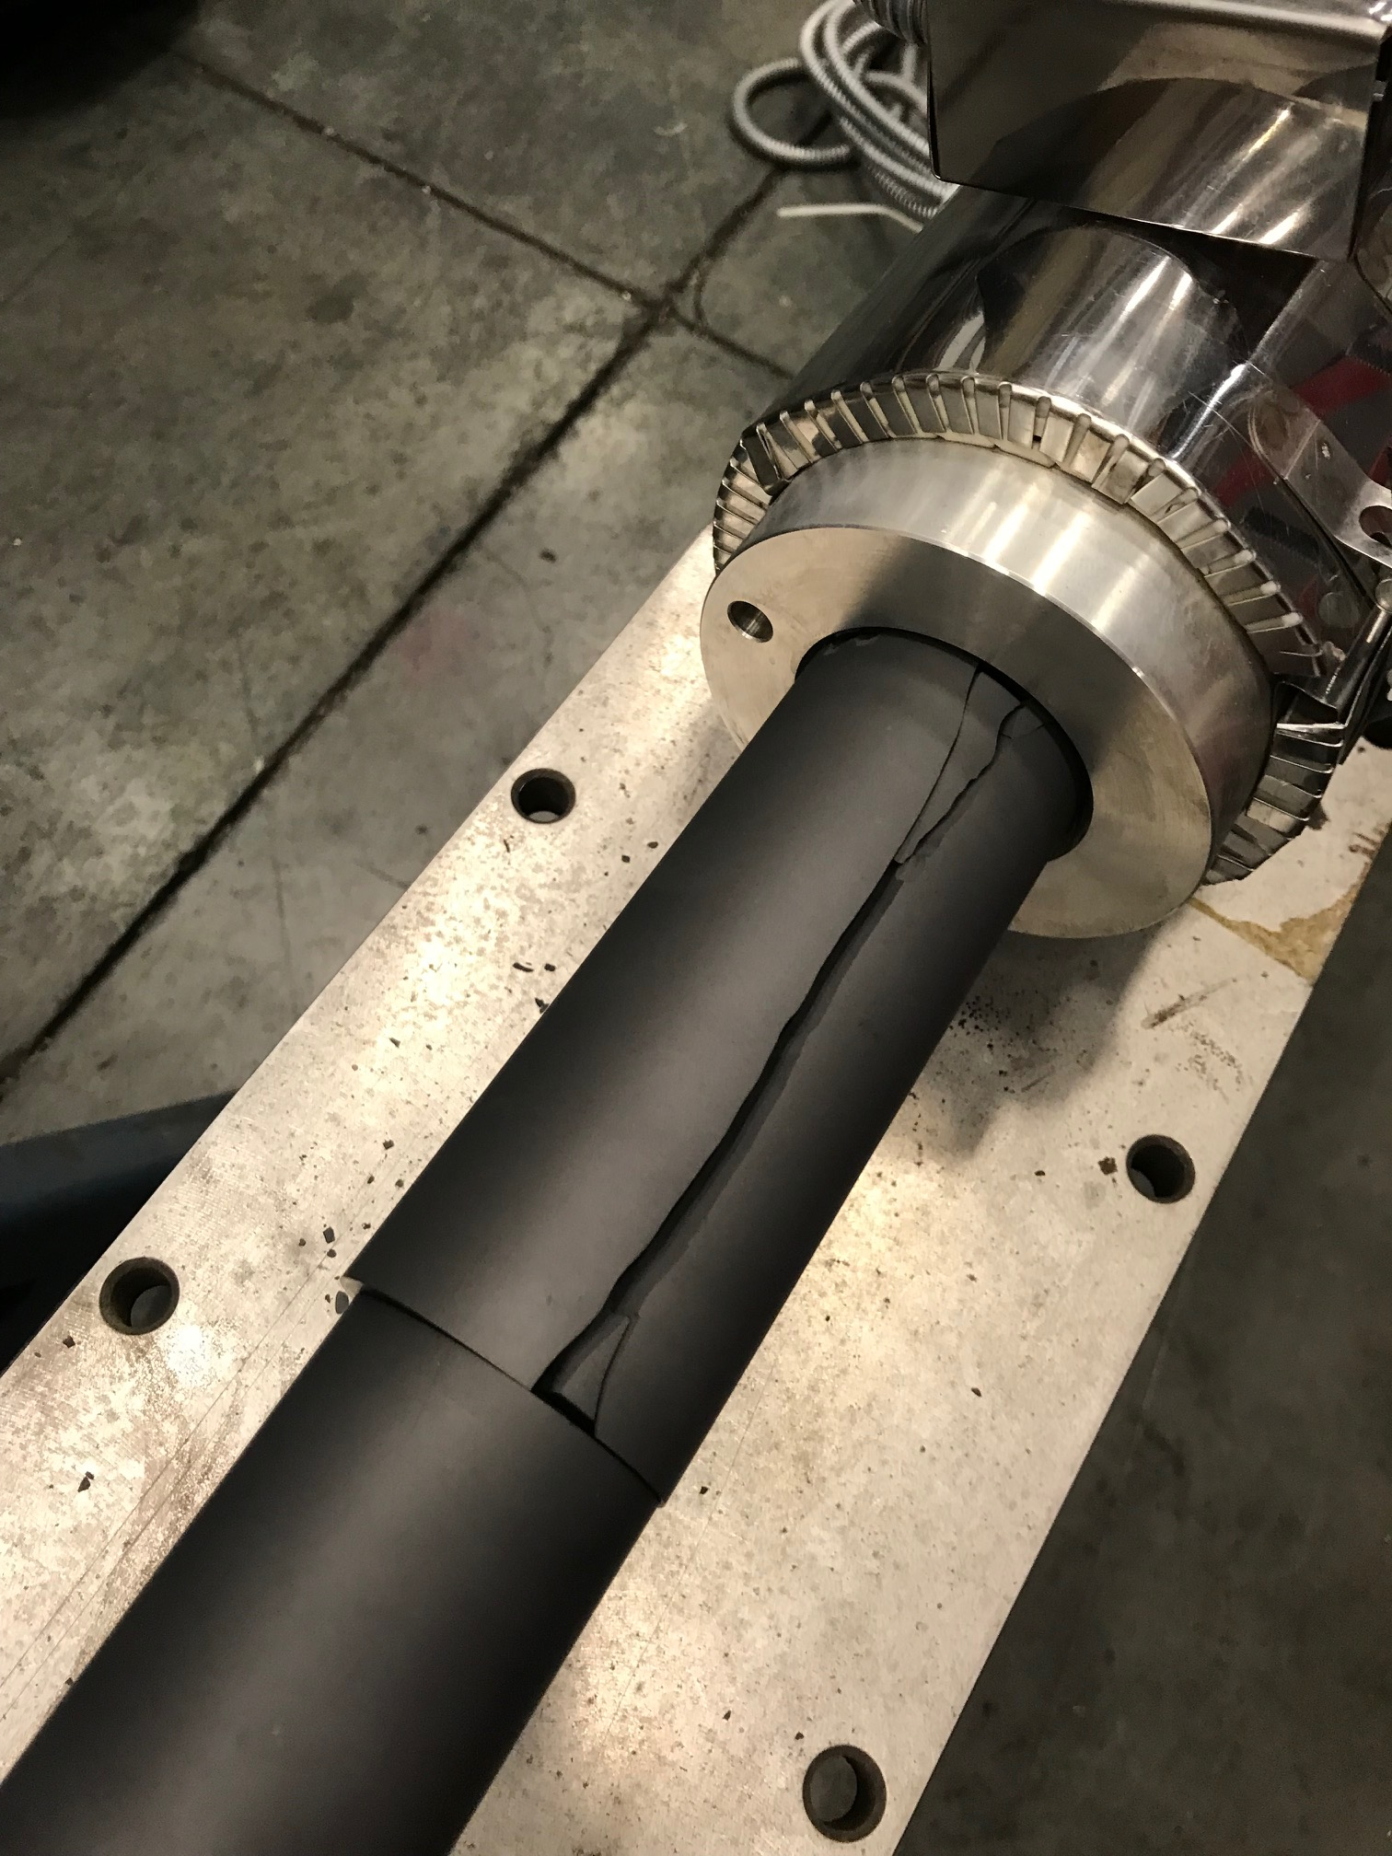
When Things Go Wrong…
Improper shrink fit
Poor temperature monitoring
Improper tooling (tried to use 13mm stacking rod on new 15mm bore 1MW baffle).
NBI 2019 / NuMI Target Construction and Megawatt Modifications
10/23/19

Slide 28
Summary
Temperature, Stress, and Beam Sigma increases due to increased beam power warranted redesigns of:
Target Fins
Downstream Beryllium Window
Baffle
TA-05 ready for 1 MW operation

