Slide 1
LBNF Target Exchange System - Design Progress
Eric Harvey-Fishenden, Chris Densham, Mike Fitton, Joe O’Dell, Peter Loveridge (High Power Targets STFC RAL)
In conjunction with FNAL Target Systems Department
NBI Fermilab 2019

Slide 2
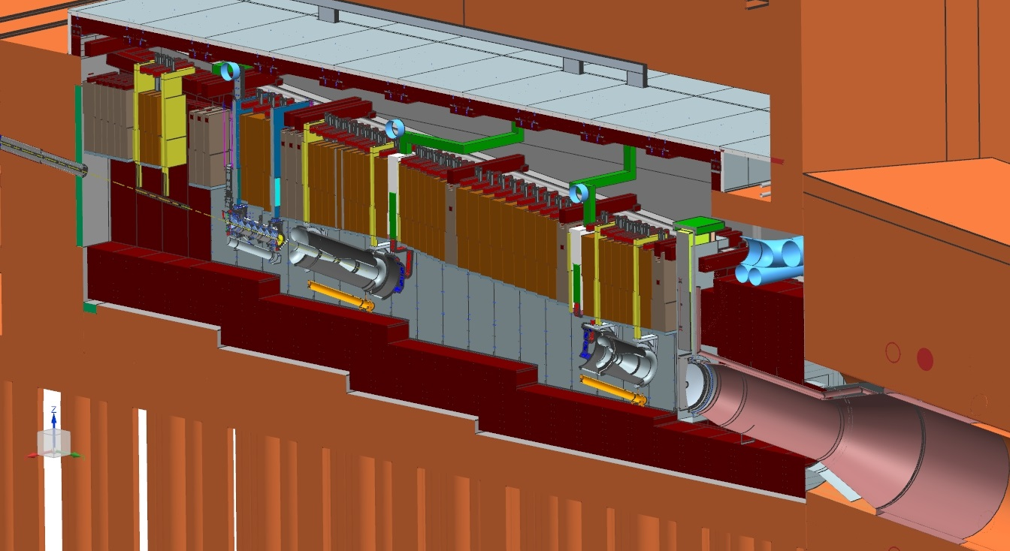
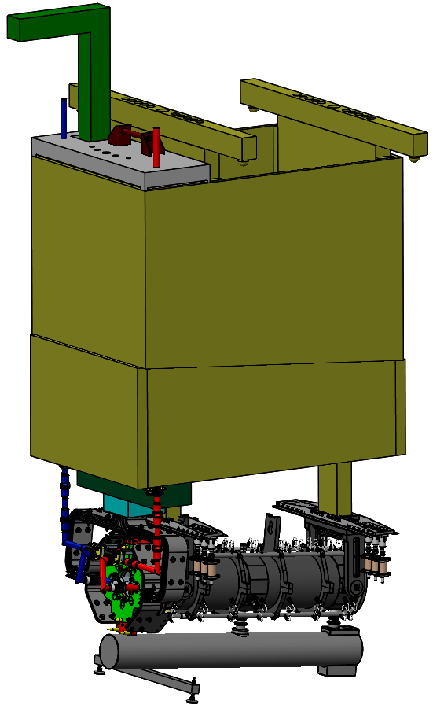
LBNF Neutrino Beamline
LBNF/DUNE Experiment
Horn A & Module
LBNF Target Hall
Horn A & Module: most of the important interfaces between RAL and FNAL

Slide 3
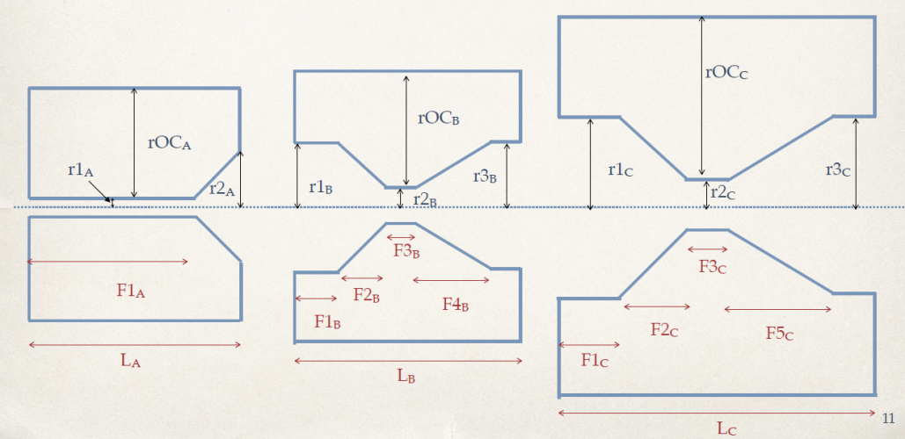
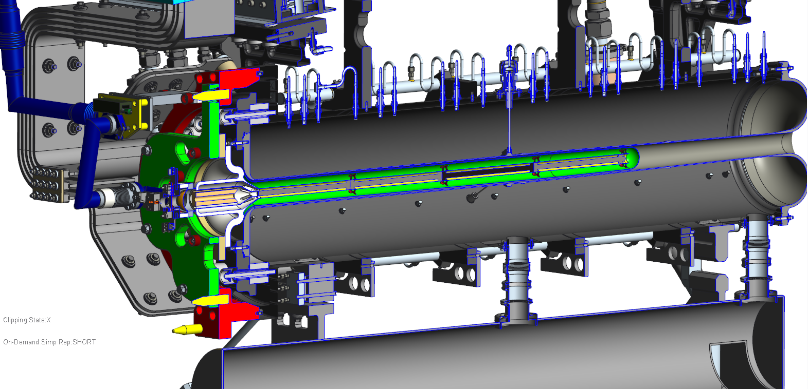
Why Do We Need To Exchange Targets?
Horn & Target configuration for LBNF/DUNE optimised using genetic algorithm (Laura Fields)
Optimum geometry for physics tends towards 4λ length target (≈2m)
Achieving a long target pushes fundamental limits (deflection, natural frequency, manufacturing etc.)
Must be prepared for targets to fail
Horns are inherently complex, costly and take a long time to produce
Target cost ≈1/10th horn cost, and spares can be produced more readily
Hence the need for an independently exchangeable target

Slide 4
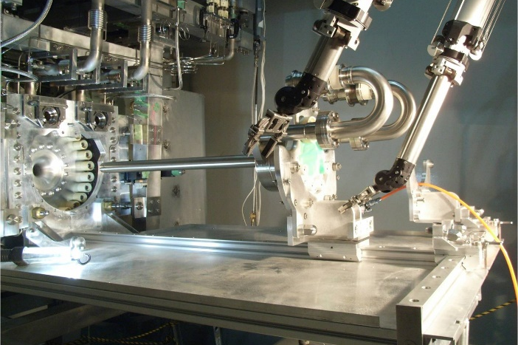
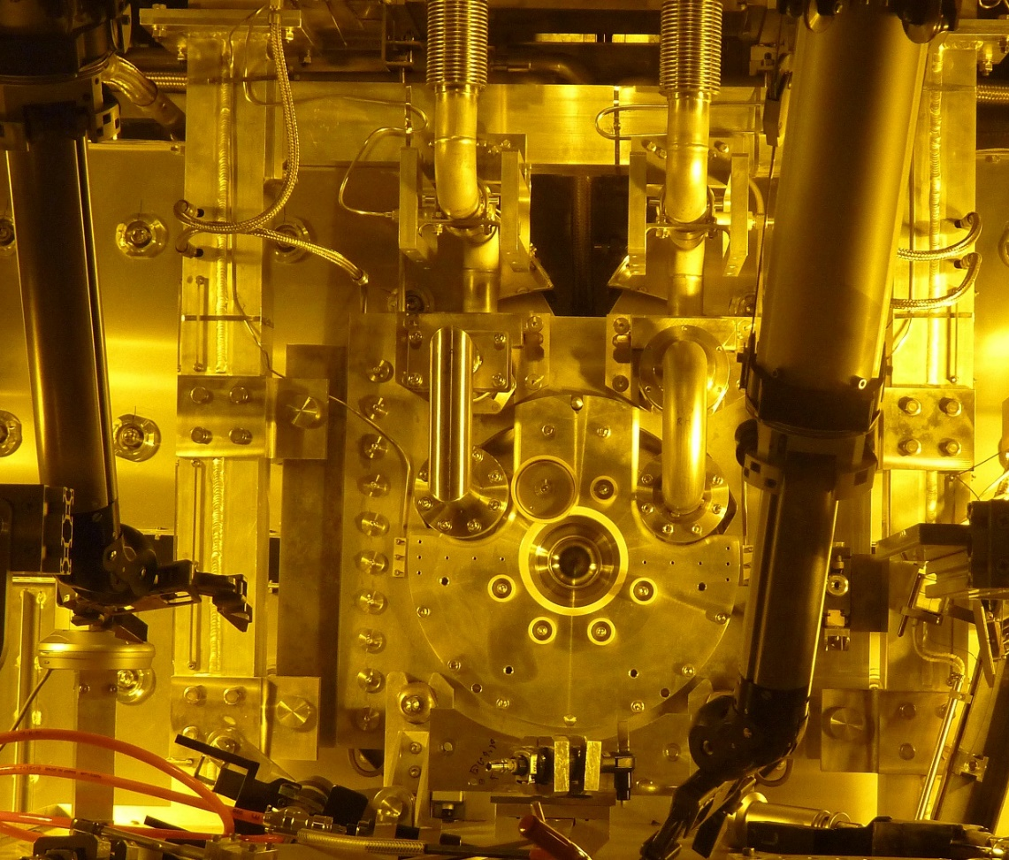
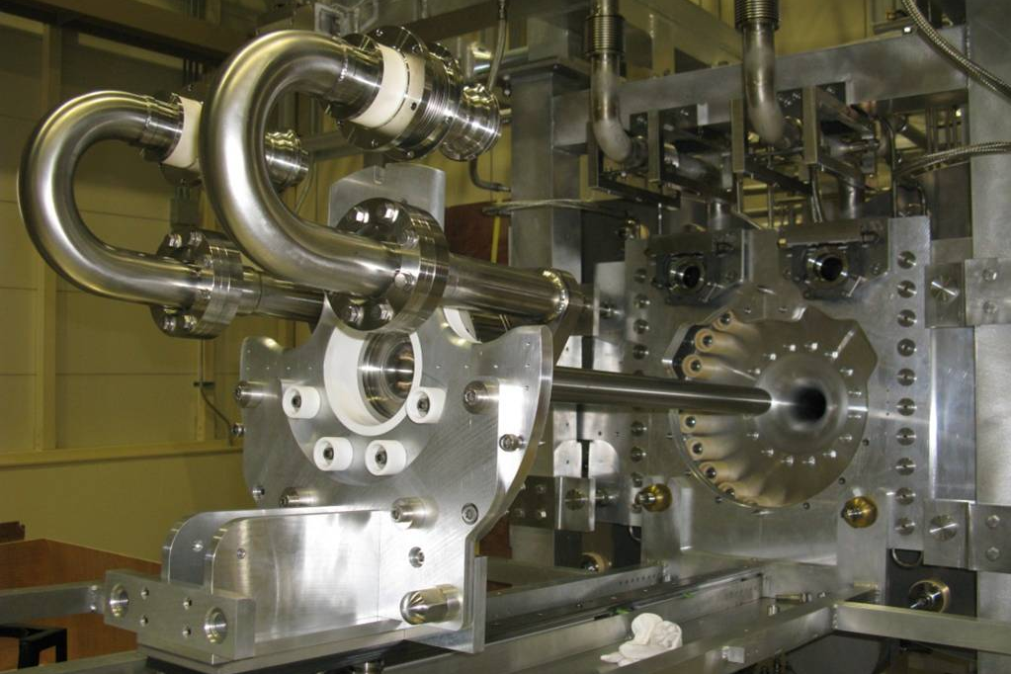
Current Experience – T2K
LBNF target exchange is a similar concept but under different constraints
Longer target, different exchanger interfaces, more horn bore clearance
Experience from T2K will feed into LBNF exchanger design

Slide 5
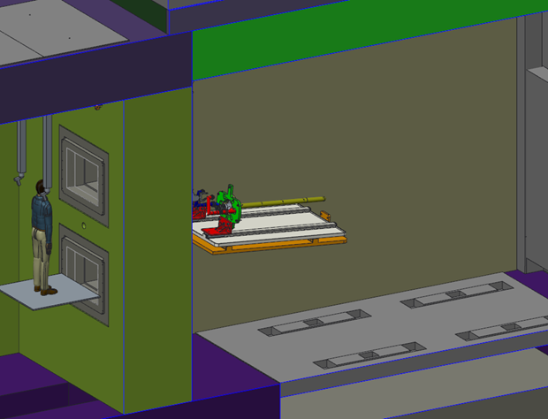
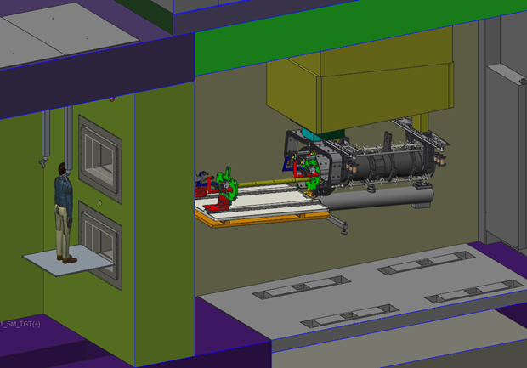
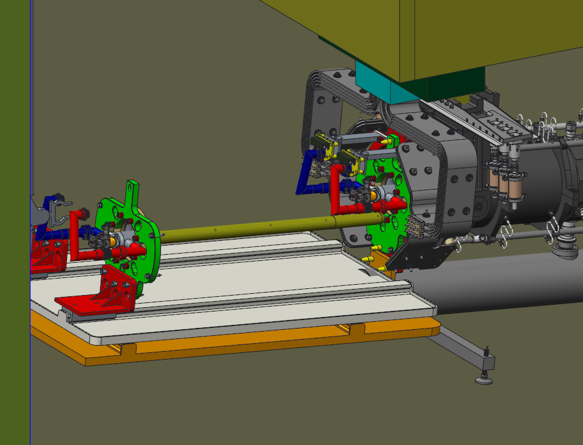
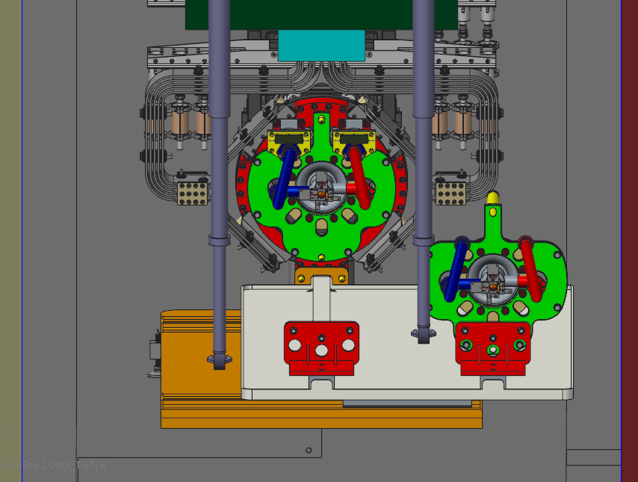
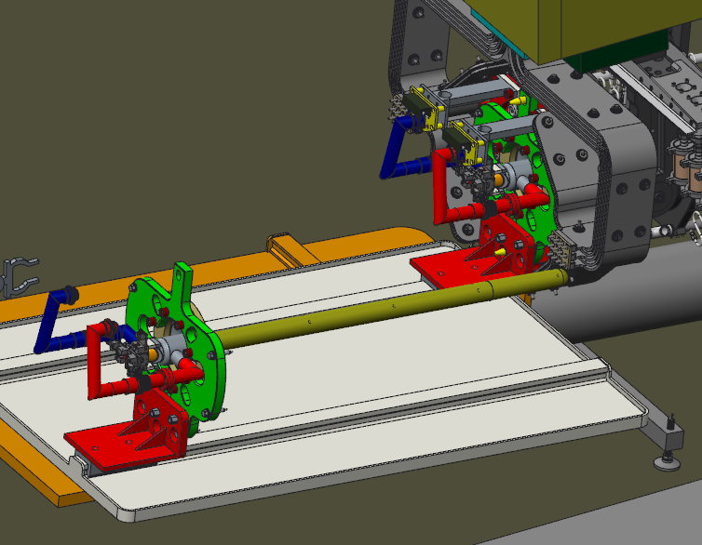
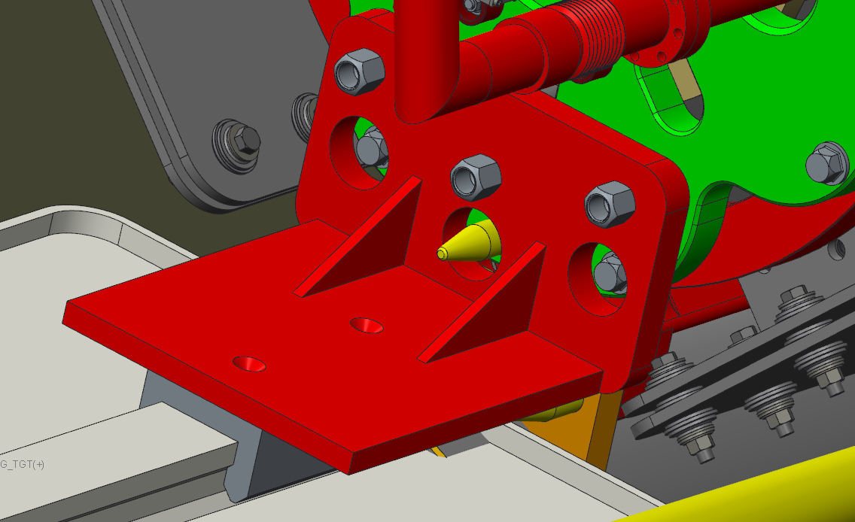
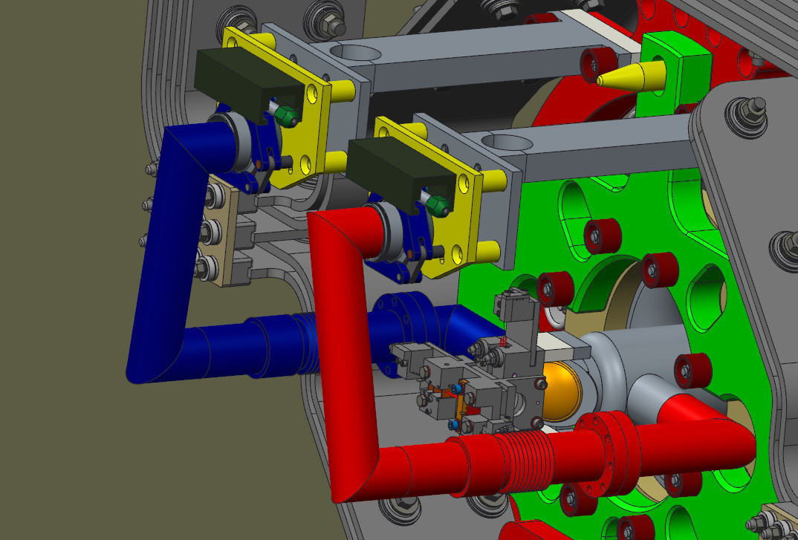
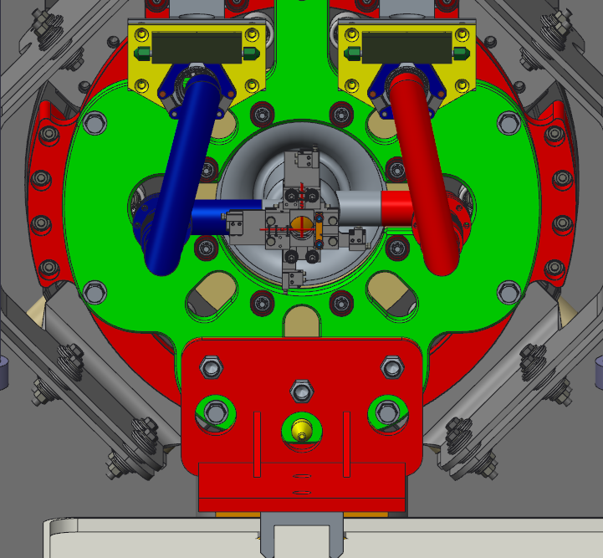
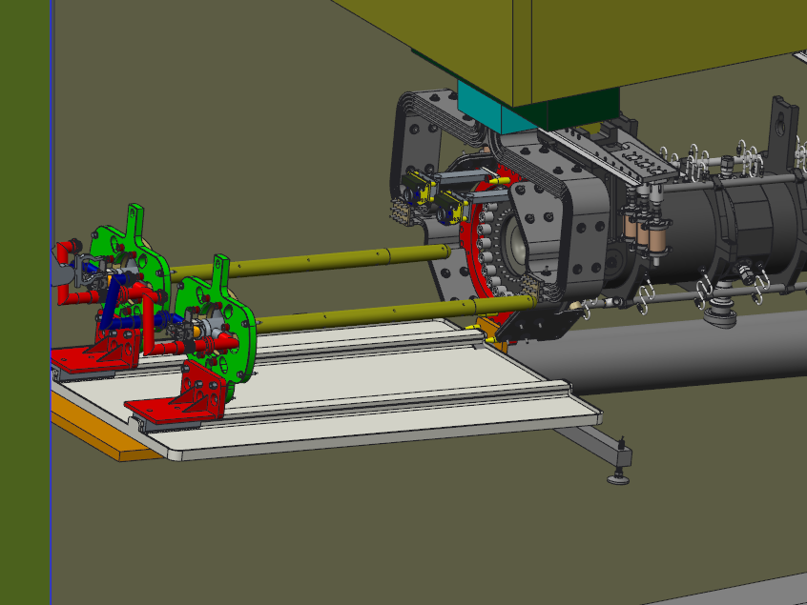
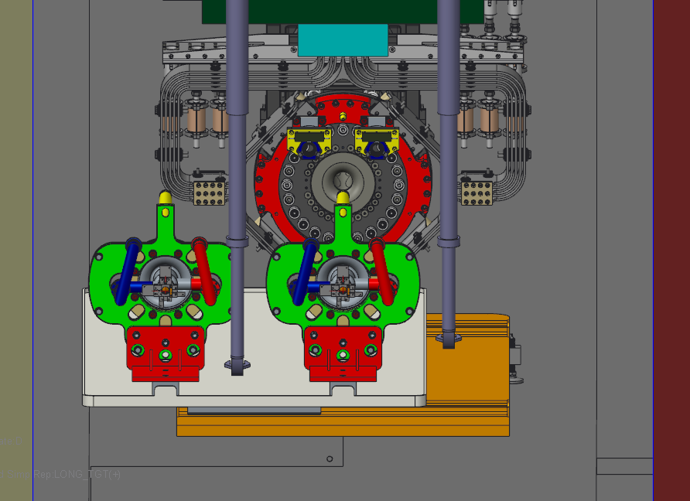
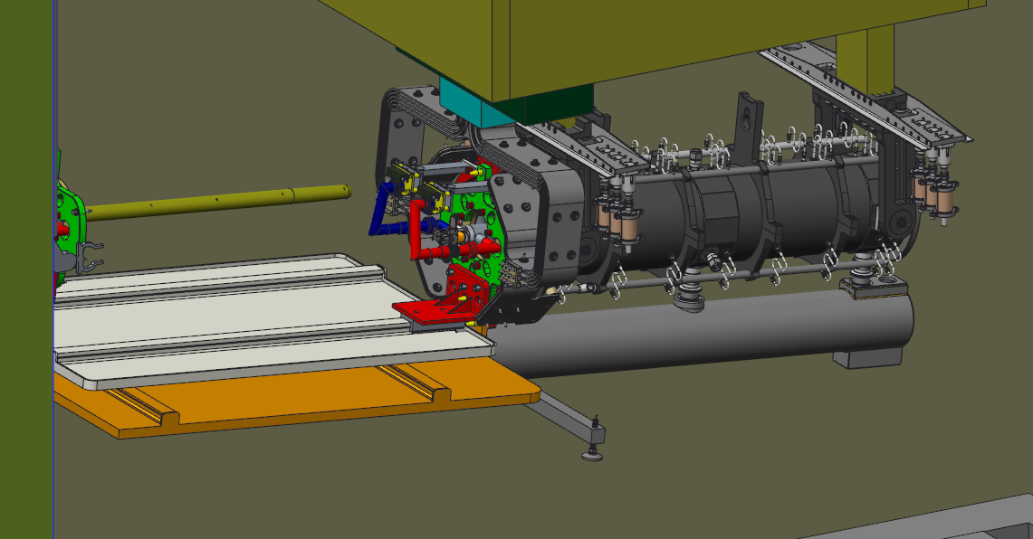
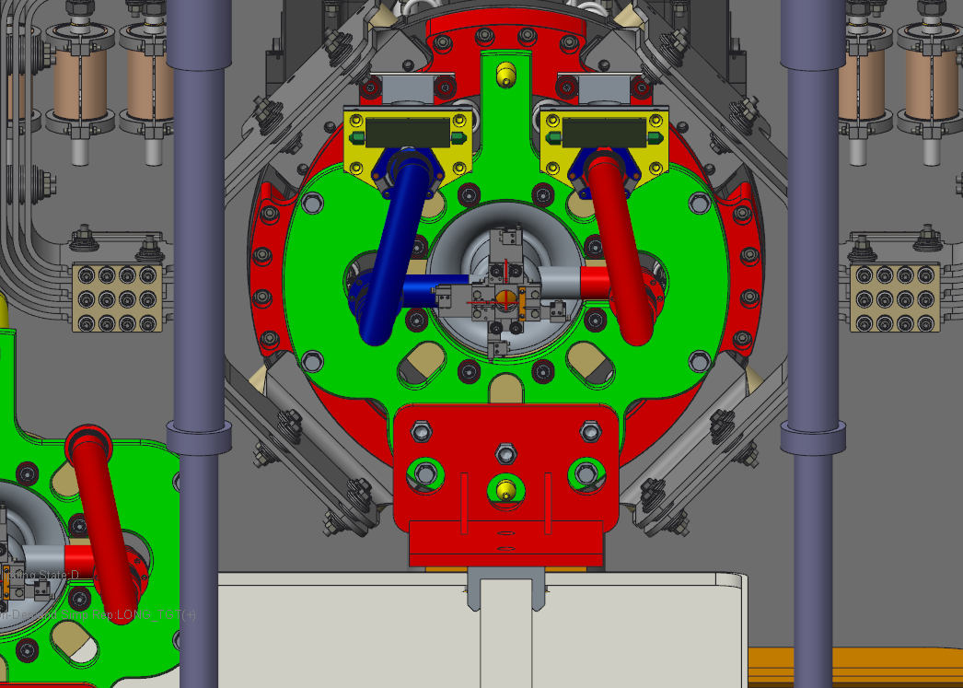
Conceptual Procedures for Target Exchange
1
2
3
4
5
6
7
8
9
10
11
12…

Slide 6
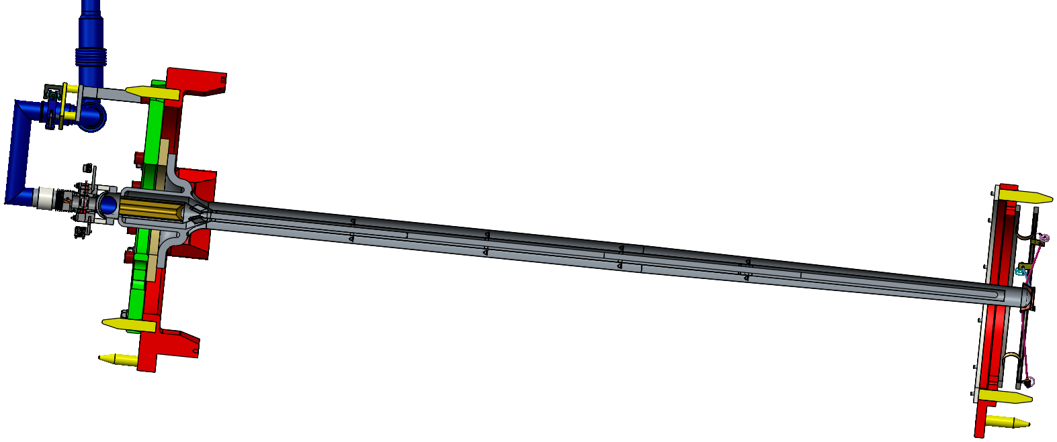
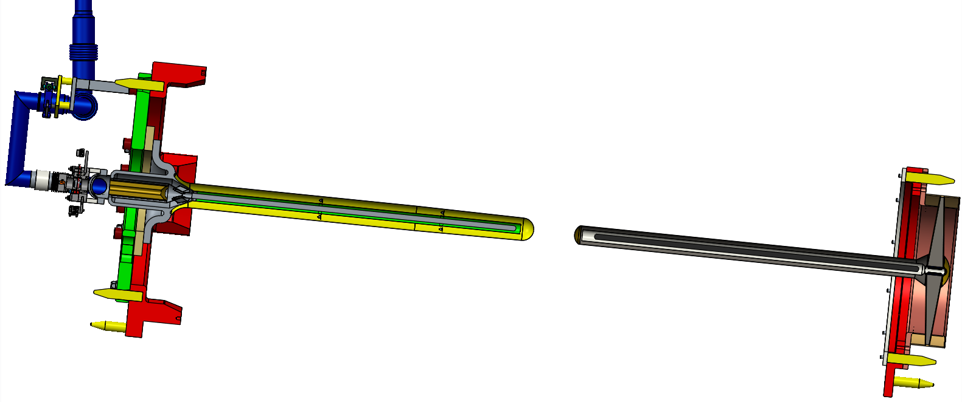
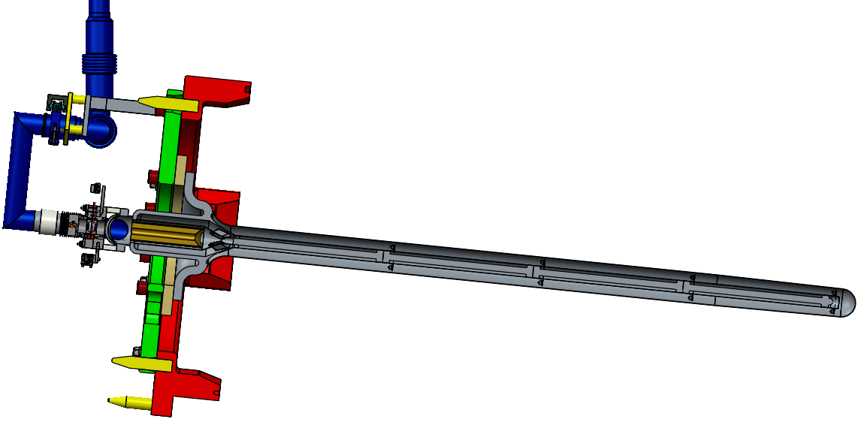
Target Concept Selection
Target exchange impacts were a key consideration in the LBNF target concept selection:
2.2m supported target
Target exchange was considered for each concept including:
Procedures required
Risk associated with target exchange
Time taken to exchange target system
Impacts on the work cell requirements
Double target
Single cantilever target

Slide 7
Target Concept Selection
Option | No. Operations | Target Handling Time (Days)
1) 2.2m Supported Target | 41 | 22
2) Double Target | 35 | 14
3) Cantilever Target | 18 | 5
2.2m supported target
Double target
John Back’s assessment calculates an extra 13-19 days running per year with a single cantilever target to achieve same theoretical physics performance as a 2.2m supported target
A single cantilever target was selected as providing the optimum performance:
Small hit in instantaneous physics versus a longer, downstream supported target, but;
Instantaneous physics hit likely to be made up in integrated performance due to a more robust design
Simpler target is less likely to fail in operation
Takes less time to replace outside of a planned maintenance schedule
Single cantilever target

Slide 8
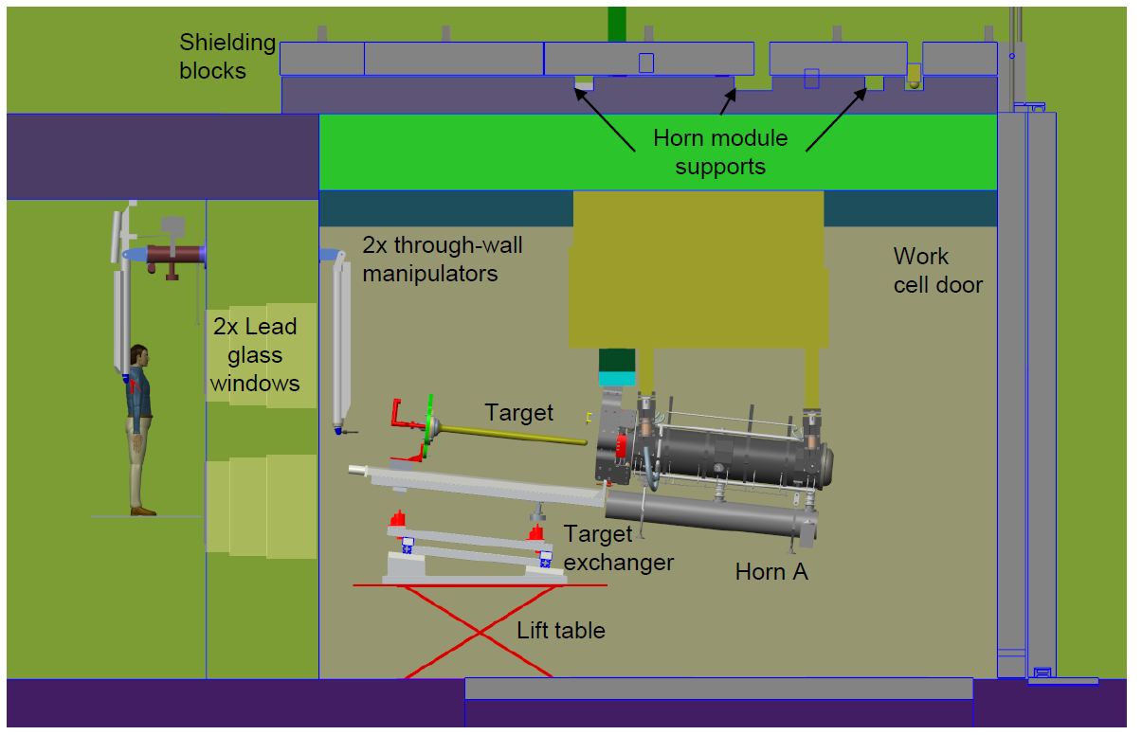
LBNF Work Cell During Target Exchange
Horn module supported from the top of the work cell
Target exchanger located on lift table on work cell floor
Persons using through-wall manipulators are approximately 4m away from the front face of the horn

Slide 9
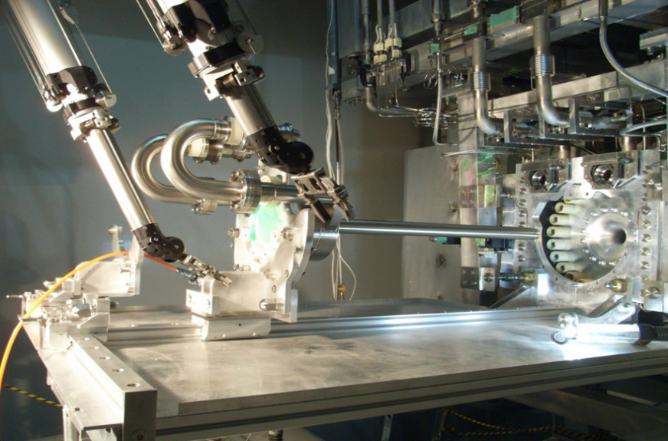
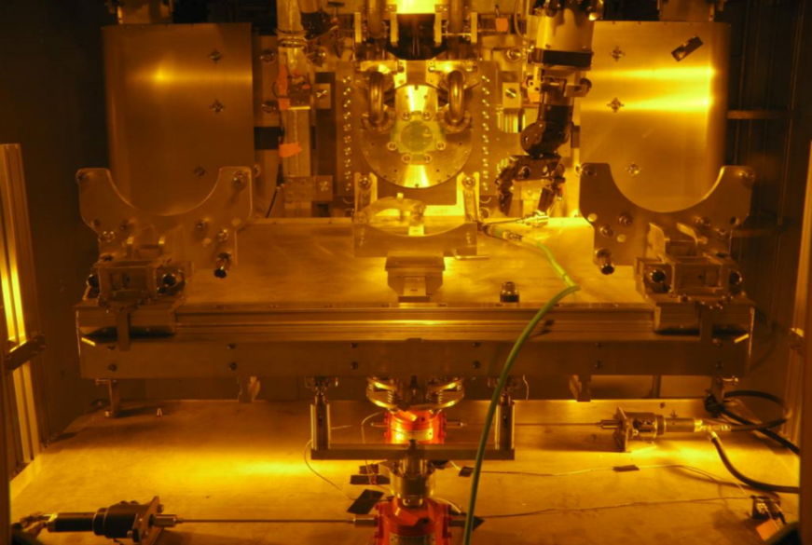
T2K Target Exchange System
Target exchange set-up in remote maintenance area (RMA)
Target exchanger and through-wall manipulators
View through from human side of RMA

Slide 10
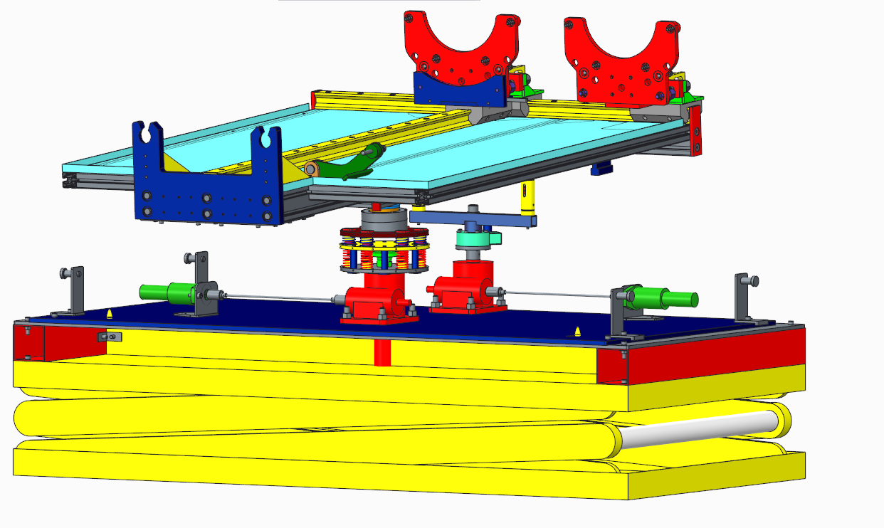
T2K Target Exchanger
Passive linear rails
Target carriers
Catch tray
Docking interface
Floating table
Limited movement gimbal
Load cells
Air motors
Screw jacks
Spring overload protection
Lift table

Slide 11
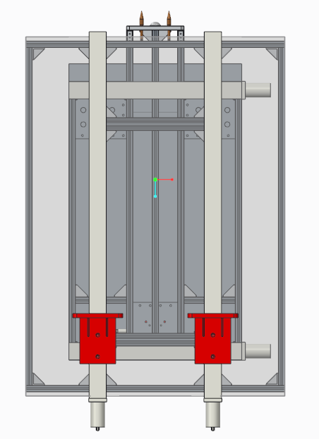
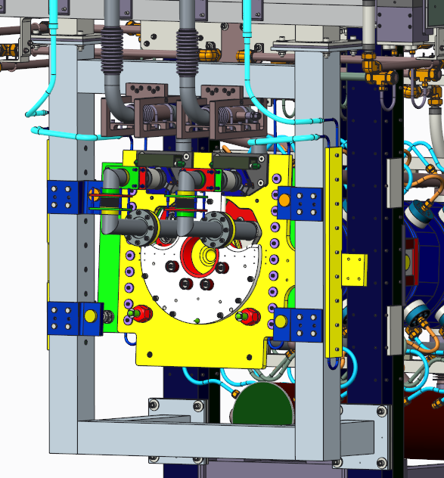
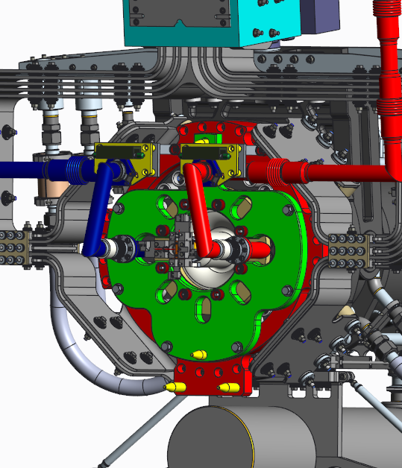
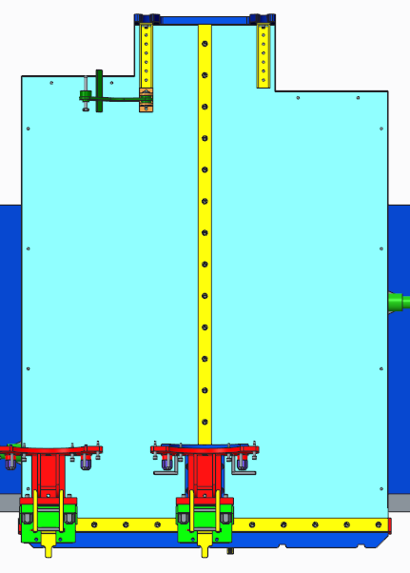
Some Differences for LBNF
Length of target exchanger
T2K Target 0.9m (1.7m exchanger)
LBNF Target 1.5m+ (2.8m exchanger)
Docking interface
T2K relies on perpendicularity of several interfaces
Limited “real estate” on LBNF
LBNF supports are not a robust datum for alignment
Potential for large moments to be applied to horn A
Cross rail system
Moving target from “x” rail to “z” rail is fiddly and time consuming
Passive rails
Range of motion required to push or pull target carriers along rails would be excessive for LBNF
T2K
LBNF
T2K
LBNF
Docking interfaces on horn front end
→ Use motorised linear rails for LBNF target exchanger
→ “Hard” mechanical docking/alignment likely not possible for LBNF

Slide 12
LBNF Target Exchange System Concept
Target supports
Horn
Target
Target Carrier
Linear rail
Docking
interface
Exchanger support and adjustment
Exchanger
Dock exchanger @ target supports to accurately fix position at front end of exchanger
Allow some rotation about that position to align the exchanger axis to the horn bore axis
Alignment diagnostics may be challenging – investigating triple beam interferometers/autocollimators for laser alignment
Sensitivity/accuracy of these systems may be no better than a “hard” mechanical alignment but the risk of damaging other systems is reduced

Slide 13
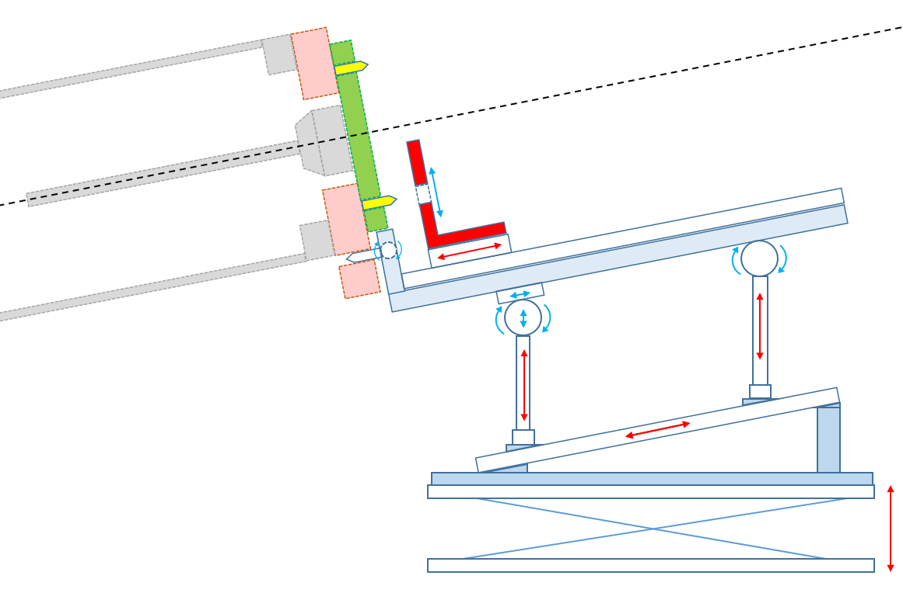
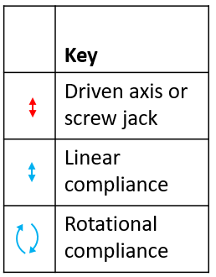
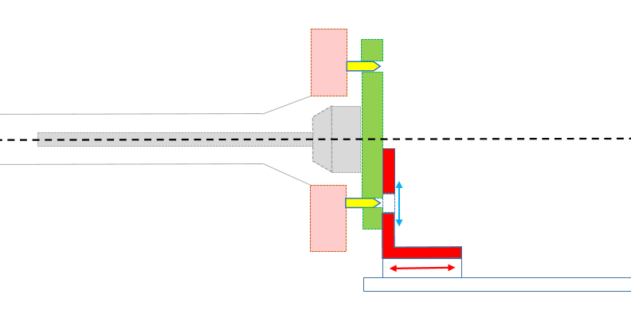
LBNF Target Exchange System Requirements
Horn module suspended from the top of the work cell
Exchanger located on lift table on work cell floor
Relative positions not well defined
Horn tilted at approximately 6° from horizontal
Exchanger must have sufficient compliance to allow location pins at front end to align
Compliance must be well controlled such that the exchanger is not unstable
Driven jacks/linear stages must allow fine adjustment to align the exchanger slides to the horn bore
Target carrier must have some small in-plane compliance to allow target to locate on its alignment pins, but must not allow angular rotation
Target must clear horn bore without touching

Slide 14
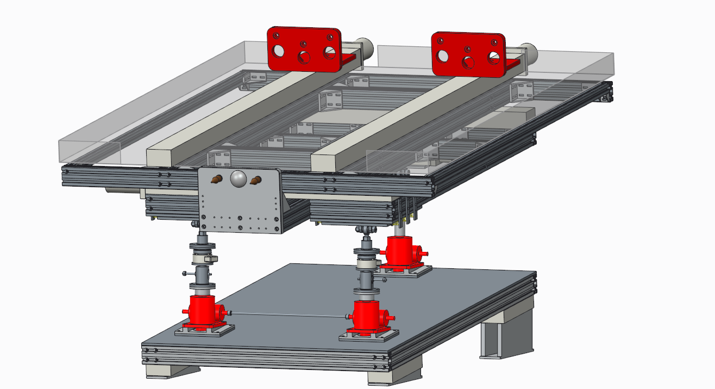
Potential Layout
Actuated linear rails
Target carriers
Catch tray
Floating table
Docking interface
Load cells
Spring overload protection
Screw jacks
Challenges:
Stiffness/mass trade-off
Minimising complexity

Slide 15
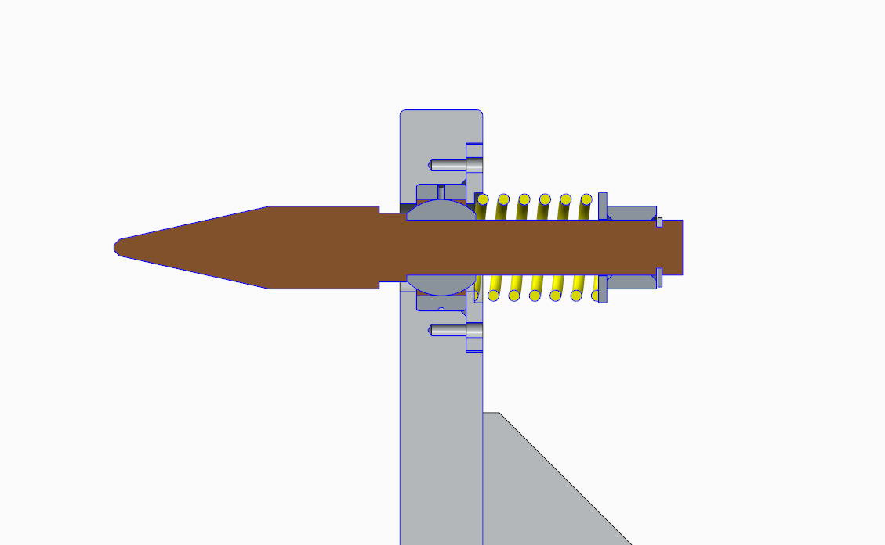
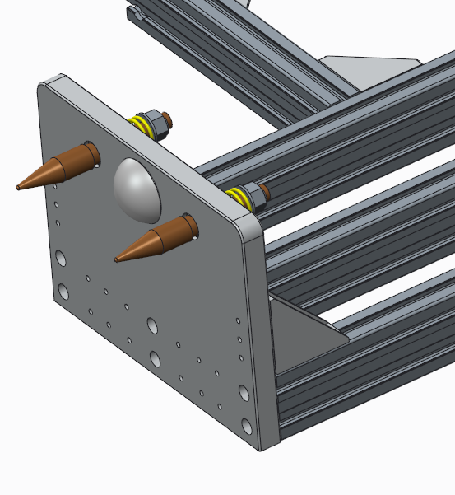
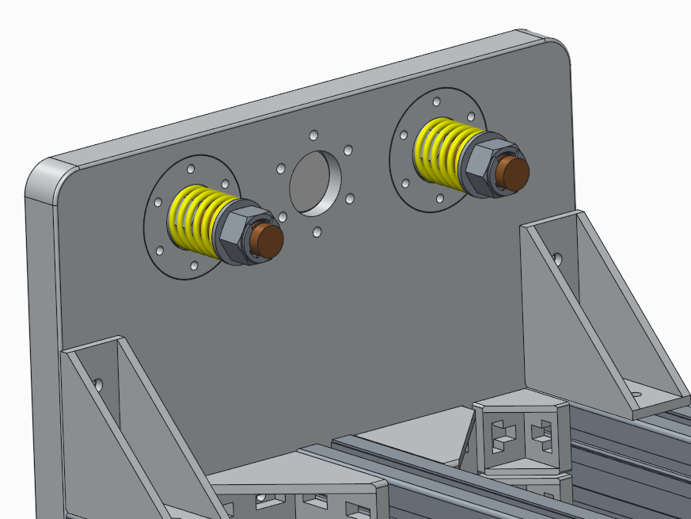
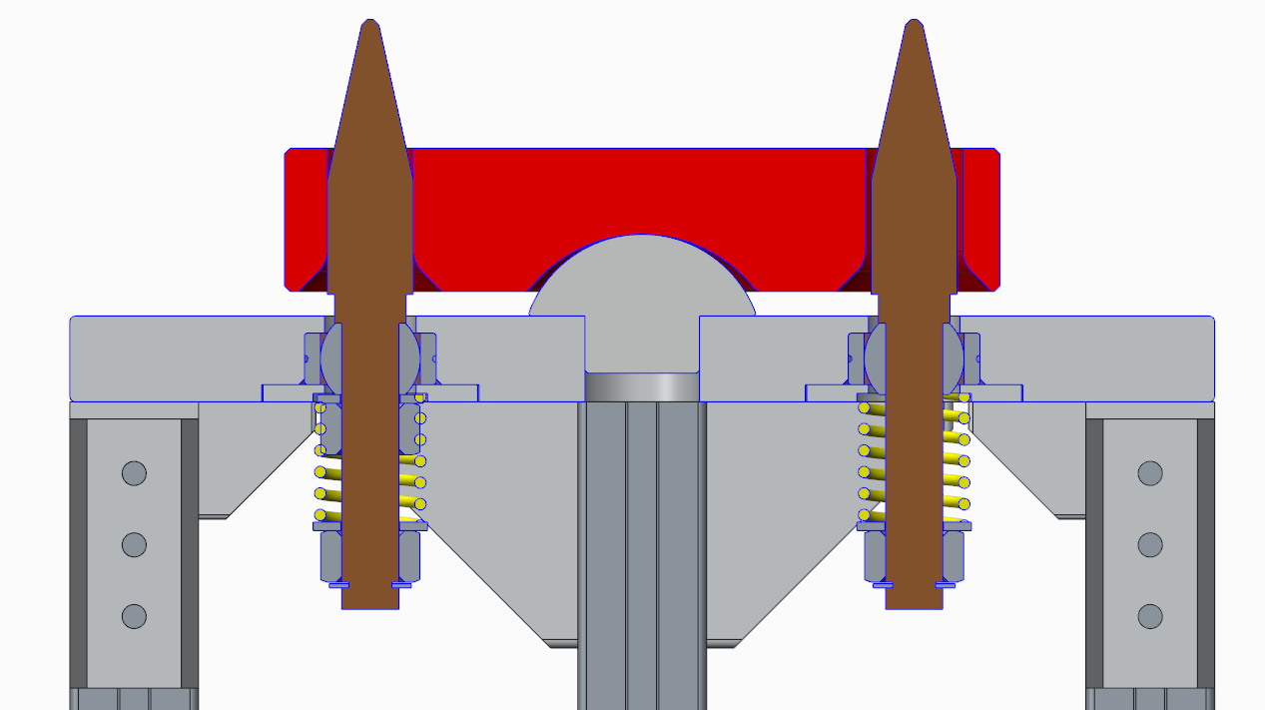
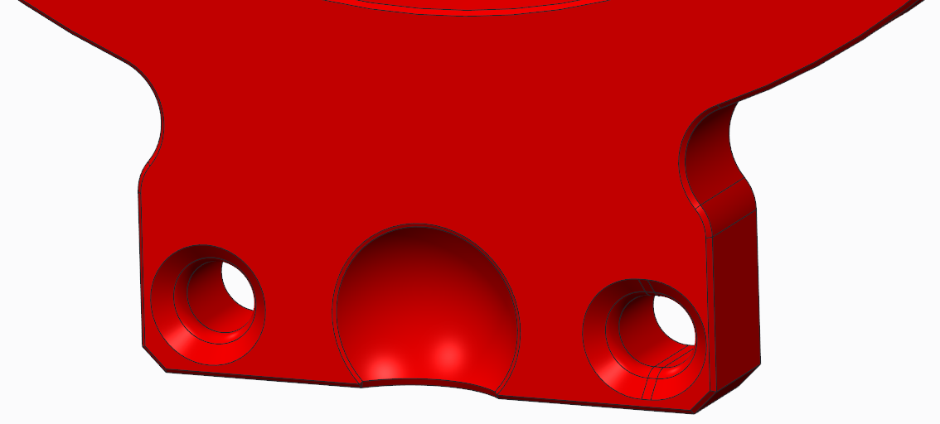
Docking Interface Ideas
Target support
Exchanger
Spring centred location pin on spherical bush
Tapered hole/slot in target supports
Spherical stop to fix separation between exchanger and target supports but also permit small rotational adjustments after docking
Still need a method of securing the exchanger to the target supports
Layout of pins/holes may change
- Prototyping of interface will be necessary

Slide 16
Summary
The LBNF secondary beamline will use a remotely exchangeable target
The procedures for exchanging targets have been developed and documented
The concept for an LBNF target exchanger is being developed into preliminary design ideas
Plenty of R&D still to be done
Lessons learnt from the target exchange system for T2K are being implemented in to the LBNF design
Based on T2K experience we expect to go through a few iterations before we have an exchanger suitable for “on-line” target exchange
Current schedules show that this will be possible

Slide 18
Backup - Schedule
RAL Schedule currently has exchanger testing during summer 2024
Approx. 6 months allocated to redesign prior to delivery to FNAL
Feb 2025 earliest possible date for actual integration and exchange testing with Horn A on test stand at FNAL
Assuming this schedule is correct, there are several years available to iterate and potentially improve exchanger prior to an “on-line” target exchange
This will also allow scope for FNAL RH technicians to develop and become familiar with procedures

Slide 19
Backup - Exchanger Table Supports
X-adjustment stage
Rose joint
Spring centered floating stage (ball transfer units)
Rose joint
Load cell
Thrust tapered roller bearing
Load cell
Spring support (lockable)
Screw jack
Screw jack
Challenges:
Flexibility/stability compromise
Maintaining simplicity

