Slide 1
Muon Target Replacement
N. Kawamura, Muon Sci. Sec.,
MLF (Materials and Life Science Facility), J-PARC
NBI2019, 25/Oct/2019

Slide 2
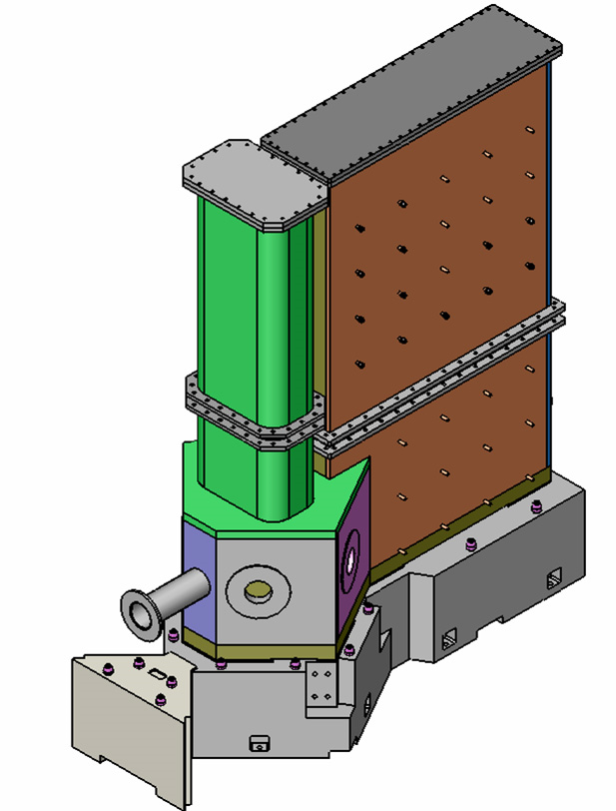
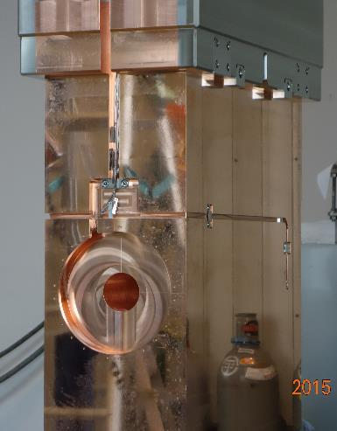
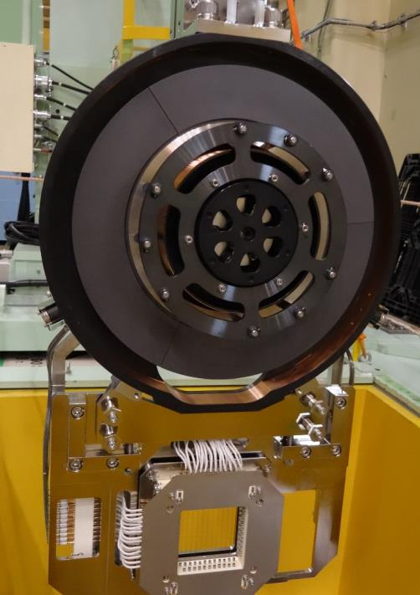
Muon production target system
Rotating target
To prolong the lifetime of the target against DPA, operation started.
#1: 2014-2019
#2: 2019-
Heat deposit：4 kW
Graphite disk: rad. cooling
Bearing, jacket: water cooling
Monitors: motor torque, vacuum level, Q-mass for outgas. IR-Radiation thermometer is going to be operated.
Scraper (proton collimator)
Scrape the scattered protons by the target
Renewed in 2015.
Heat deposit：20 kW＠No1
Water cooling
Thermocouple thermometers
μ
p
μ
Vacuum vessel
In service since 2008
Hea deposit：10 kW
Water (>90%) and air cooling
Thermocouple thermoeters

Slide 3
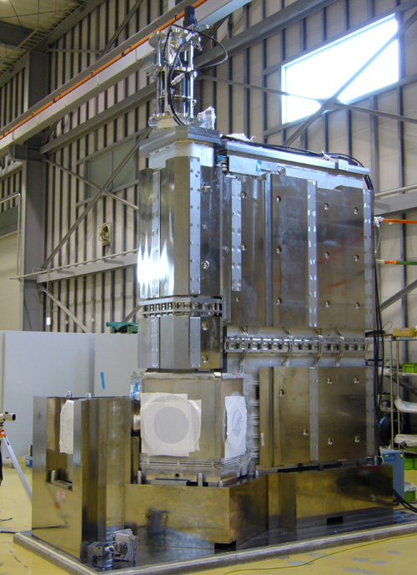
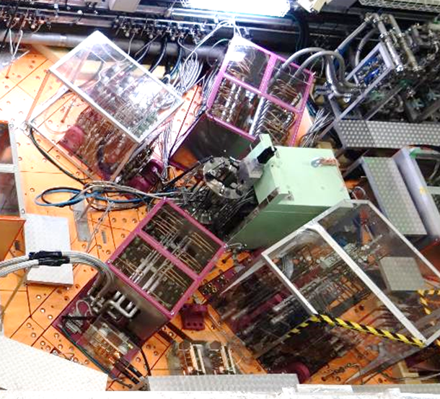
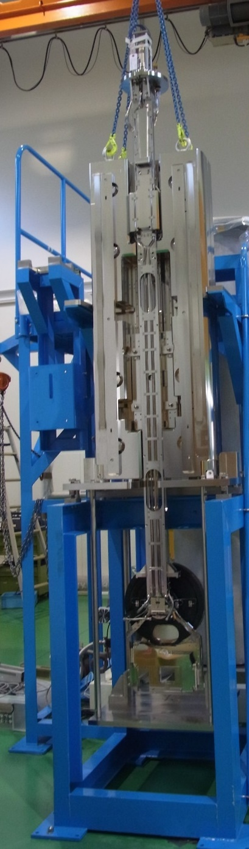
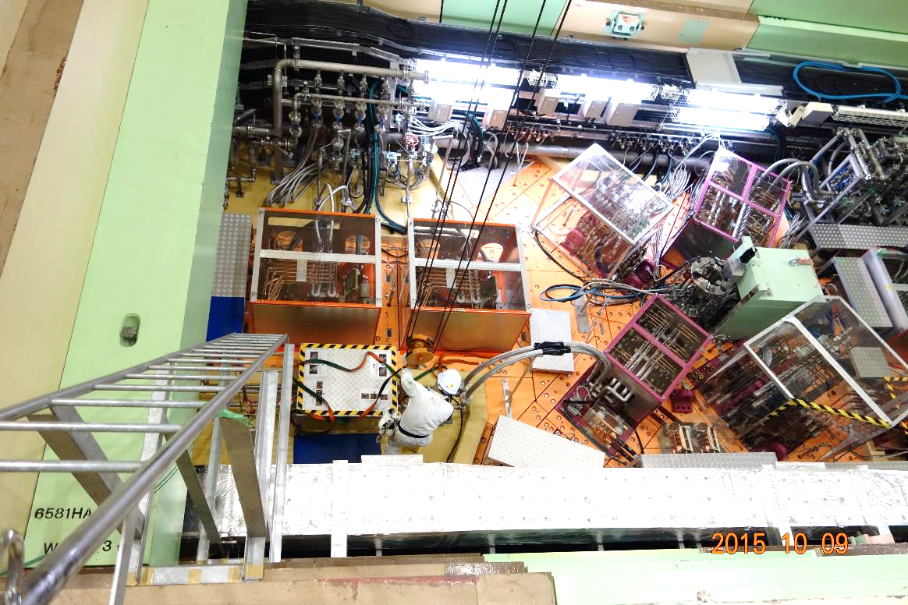
Muon target assembly
Maintenance floor in M2 tunnel
plug shield
2.4 m
3.5 m
The top flange, 2.4 m from BL, is accessible for hands-on work.
(Maintenance floor)
The dose rate is not so low, but one can stay for several hours.
target rod
3.5 m

Slide 4
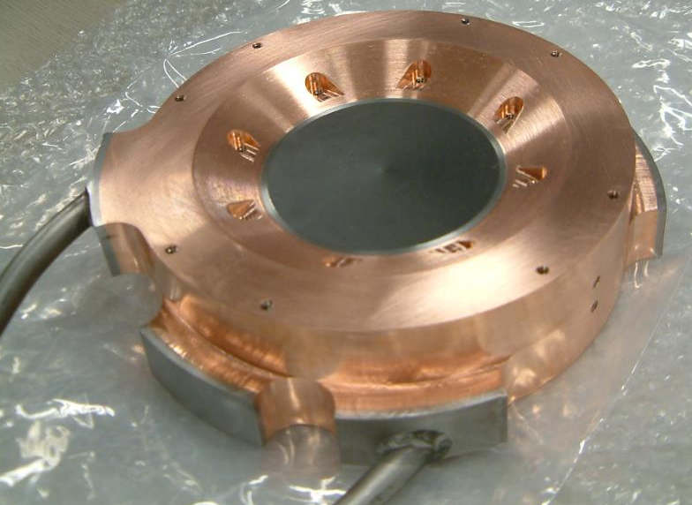
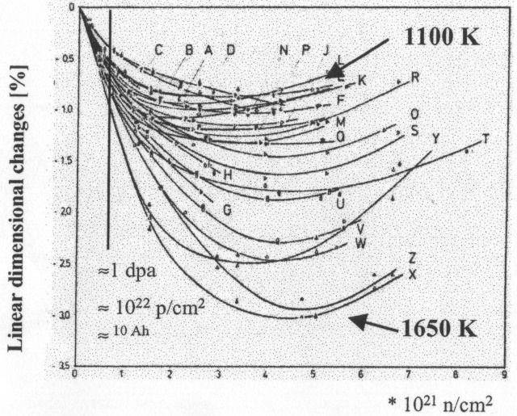

Muon production target
Rotating target #1: ’14-’19
Num. of P.: 5800 MW×hr.
Fixed target: ’08-’14
Num. of P.: 2500 MW×hr.
To disperse the radiation damage, 1% shrinkage / 1DPA (~0.5 year irradiation under 1 MW), and to prolong its life time, rotating target has been applied since 2014.
Common property
  2-cm thick IG-430U from Toyo Tanso Inc., consuming 5% of protons
Different property
  direct water cooling (fixed) vs. radiation cooling (rotating)
  Max temp.: 1500 deg C (fixed) vs. 700 deg C (rotating)

Slide 5
Target Replacement
We performed the target replacement work only twice.
In 2014: Fixed target → Rotating target
  The duration time of the fixed target reached at the estimated life time corresponding to 1 DPA, 0.5 years × 1MW.
  We didn’t mind about tritium contamination seriously.
  We just placed a local IC monitor, but didn’t use any special equipment.
In 2019: Rotating target #1 → Rotating target #2
  An valuable joint was found to be used in a rotating rod in 2018.
  In ’18, we decided to use a bad one until the next maintenance period of ’19 to construct a fixing/replacing scenario and to prepare special equipment like a local exhaust ventilator, an airline mask, an anorak suit etc.
  According to experiences in these years, the air in the working area was expected to be highly contaminated by tritium above the permissible level in Japanese low of 0.8 Bq/cc.

Slide 6
Fixed target → Rotating target
Maintenance work in ’14

Slide 7
Issues
In principle, the scenario of target replacement was constructed at the construction phase of MLF, and this work was a part of that.
  All the maintenance/replacement scenario was commissioned before the first beam in 2008.
Suppressing/controlling external exposure during transporting the highly activated target assy. from the beamline to the storage pit.
  By using of cask, the main work could be performed remotely.
  Hands-on works were minimized.
In ’14, the main concerns were
  the scenario could really be performed against highly activated devices
  the first rotating target could work properly.

Slide 8
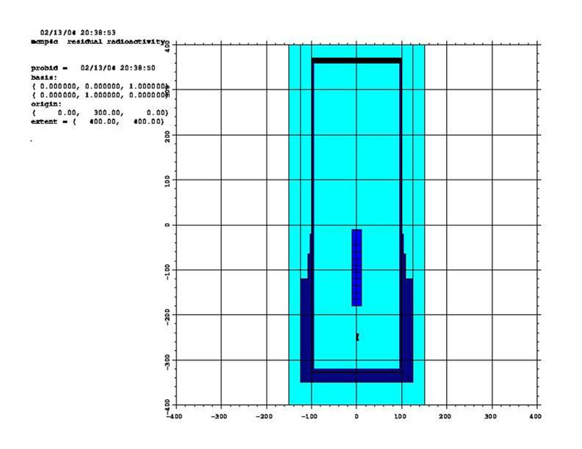
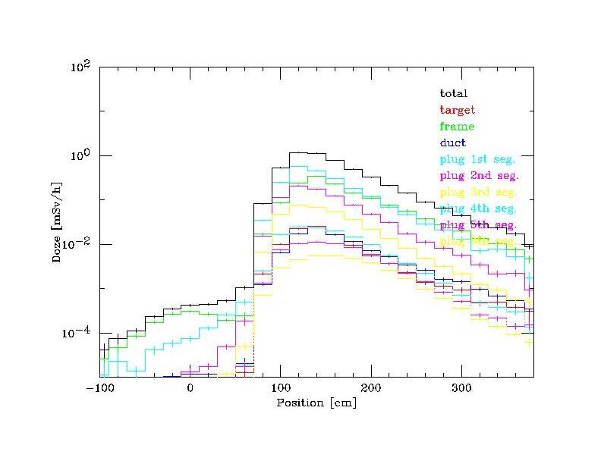
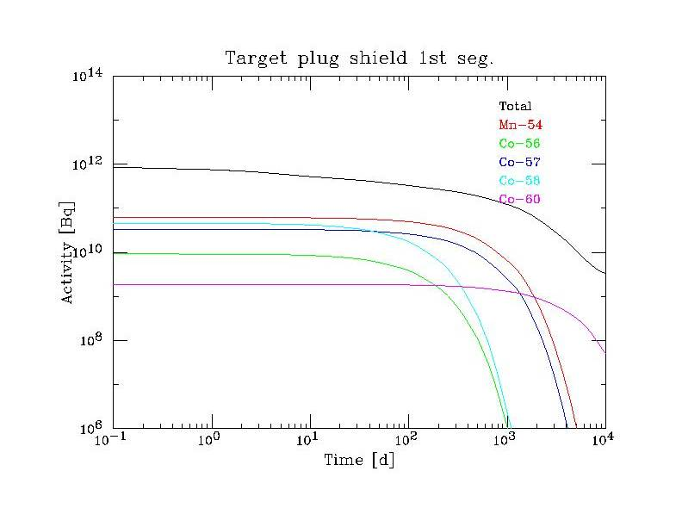
Conceptual design of cask in ’04
x
Dose on the cask surface
10-year irradiation and 1-day cooling
Cask
Target assy.
Plug shield
Target
Reality of the maintenance scenario is examined.
Residual activity in the 1st segment of the target plug

Slide 9
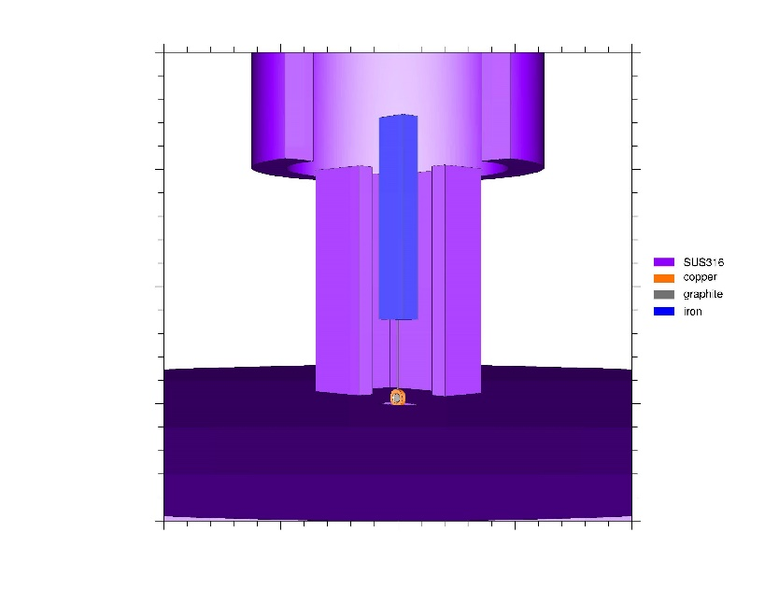
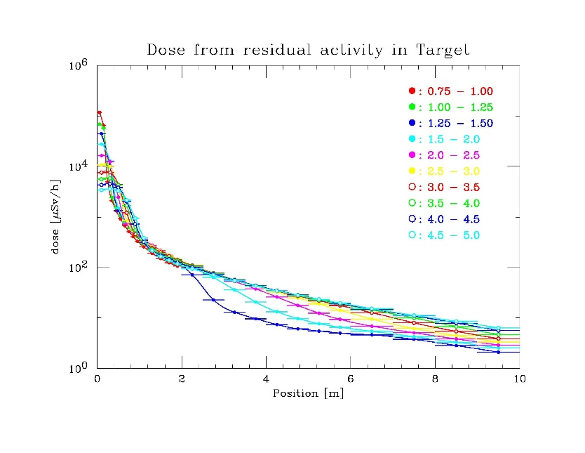
Dose during target maintenance
x
In principle, target maintenance can be controlled remotely.
  Accumulated dose is negligible.
In trouble, one can work
  for several hours at FL+6m
  for a few minutes at FL+4m
A ring structure (a cover) is necessary in the service area.
FL+6m
service area
10cm gap
FL+4m
Ring structure

Slide 10
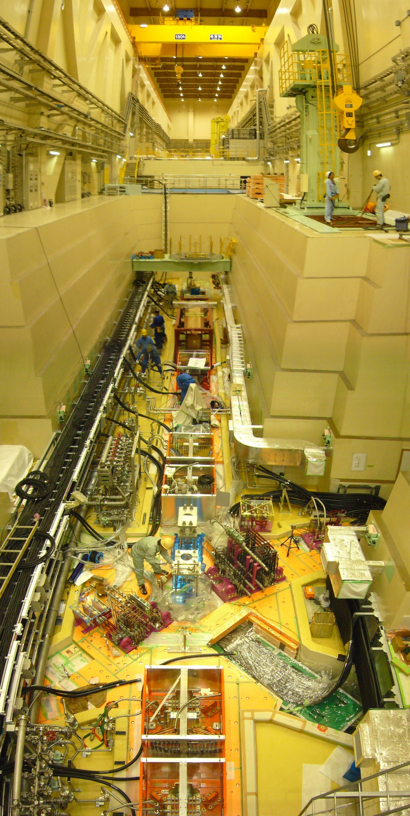
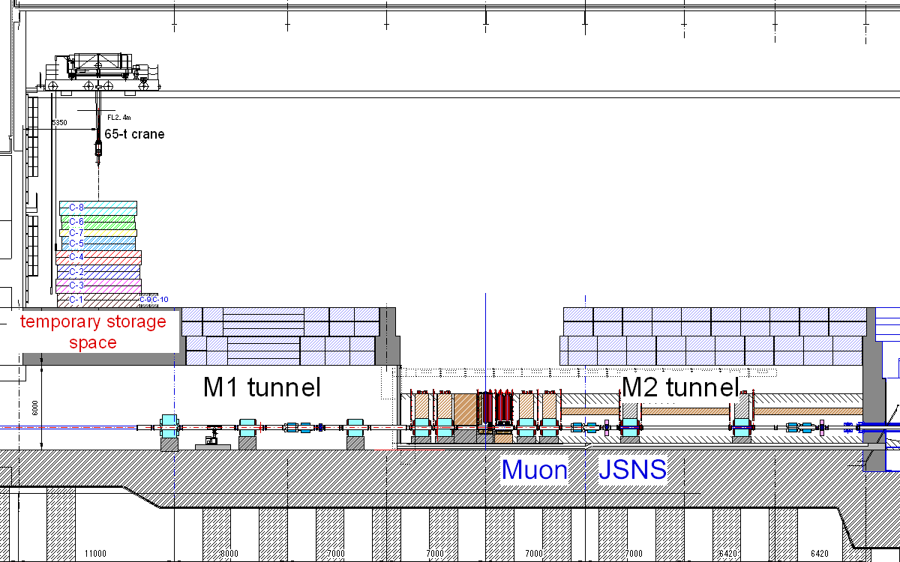
Maintenance of muon target
Drying room
Hot cell
Removal of ceiling shield
Temporary storage in storage pod
Drying of cooling water in Drying room
Target exchange in Hot cell
Off-beam commissioning
Storage
pit
Temporary storage space
Ceiling shields transportation
Chamber

Slide 11
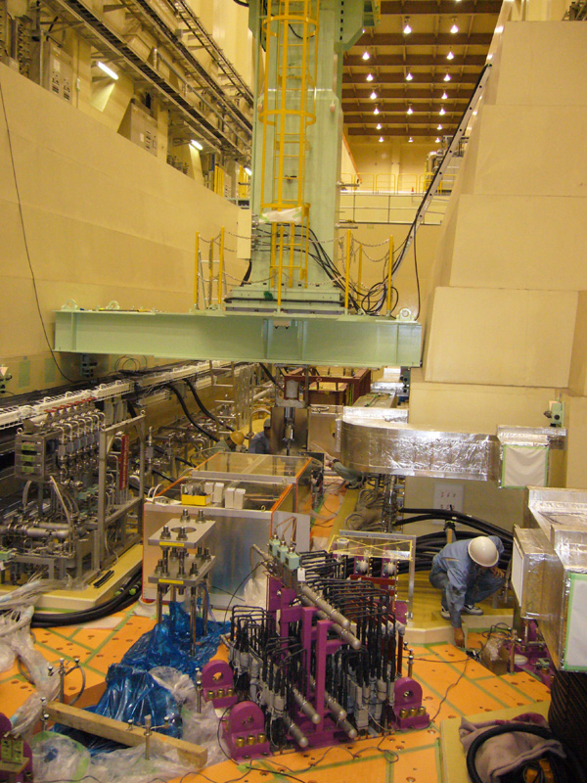
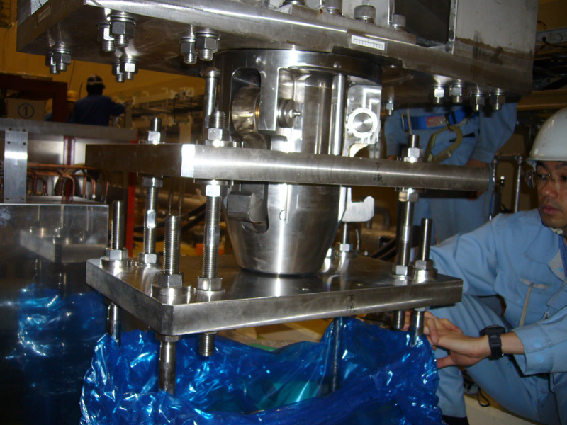
Muon Cask
Up-down speed; 0.5m/min
Total weight; 23t
Handled apparatuses ；maximum weight; 6t
target, monitor, scraper, pillowseal
Shielding thickness; 150mm
Reproducibility of location; ±5mm
Remote controlled gripper
Off-beam commissioning

Slide 12
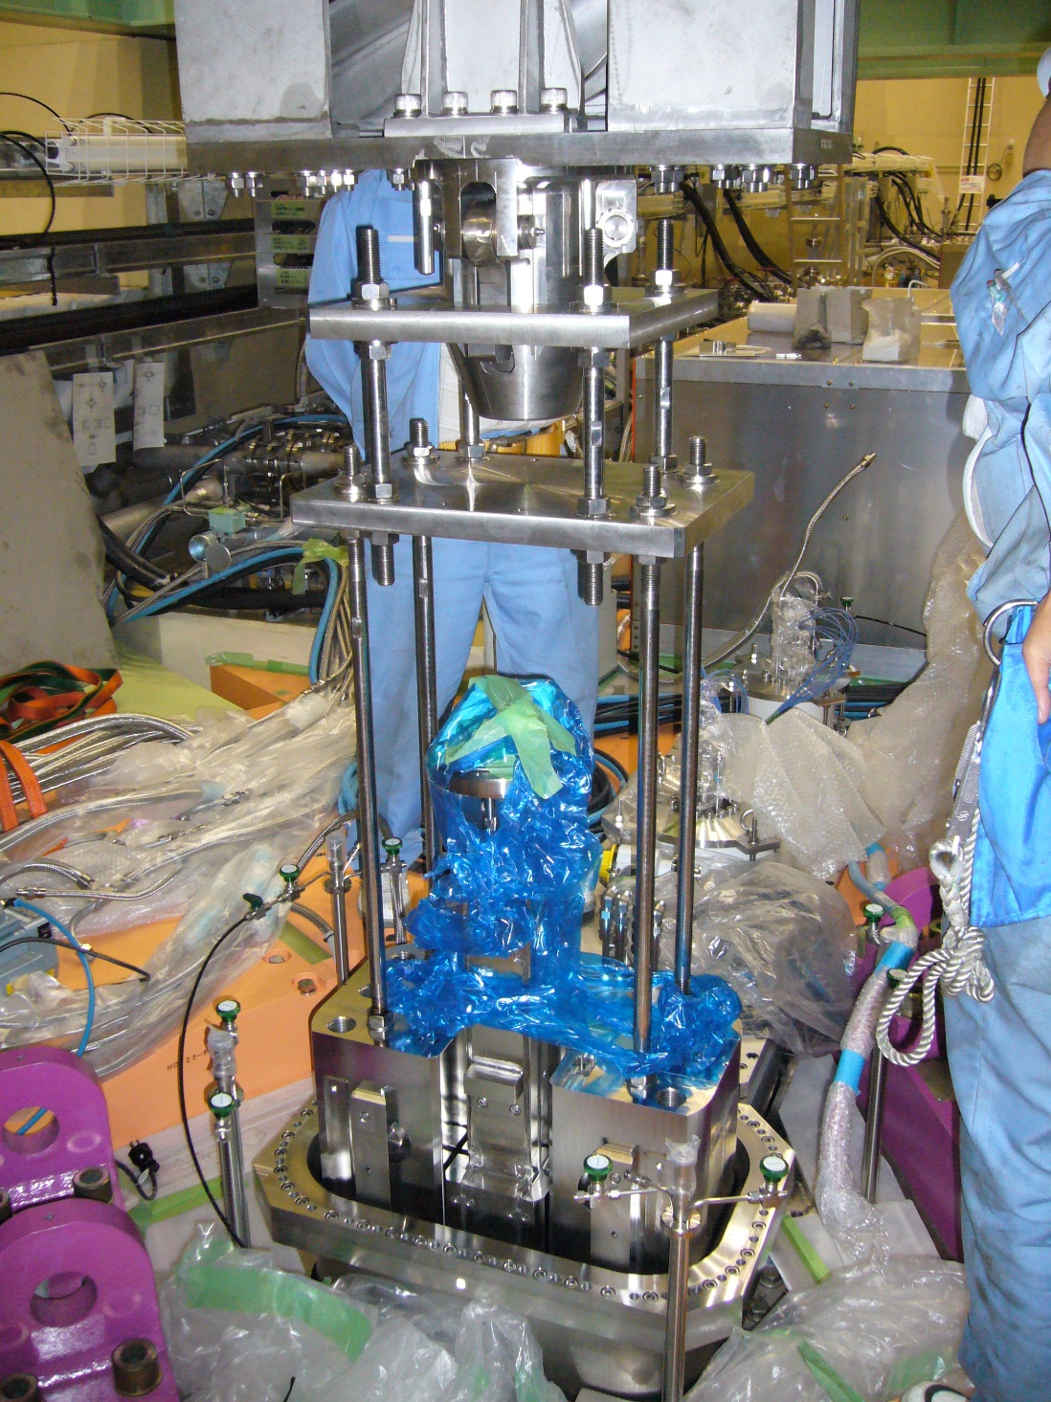
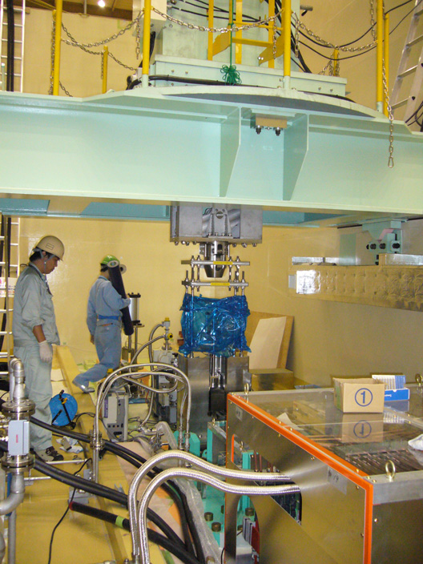
Commissioning by Muon cask
Target
  Beam line, storage pit –completed
  Drying room, hot cell – this March
Monitor (M22, M23)
  Beam line –completed
  Storage pod, hot cell –this March
Pillowseal, scraper (#1, #2)
  Beam line -completed
Off-beam commissioning

Slide 13
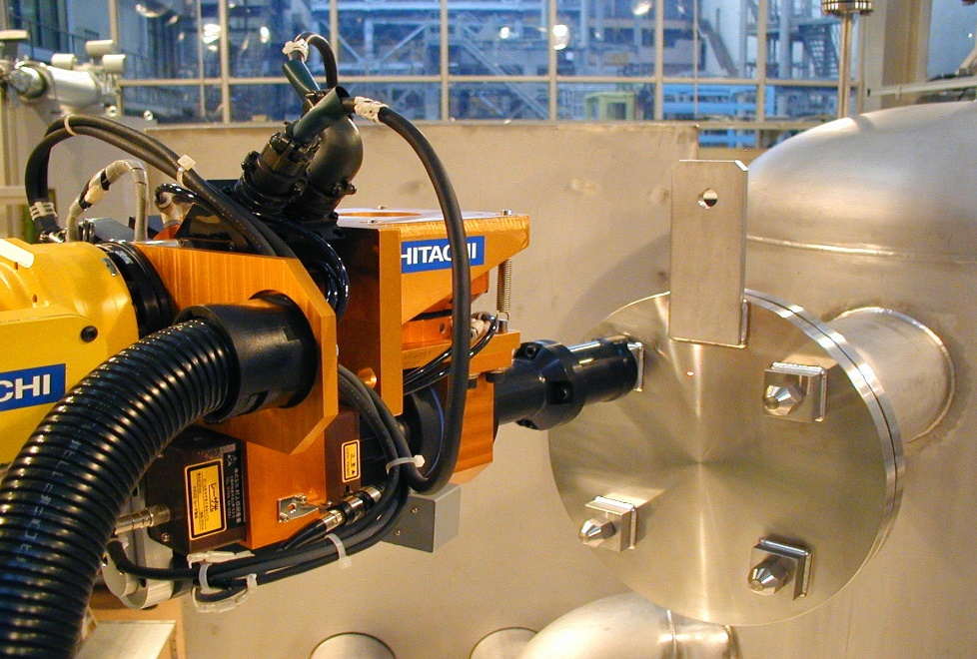
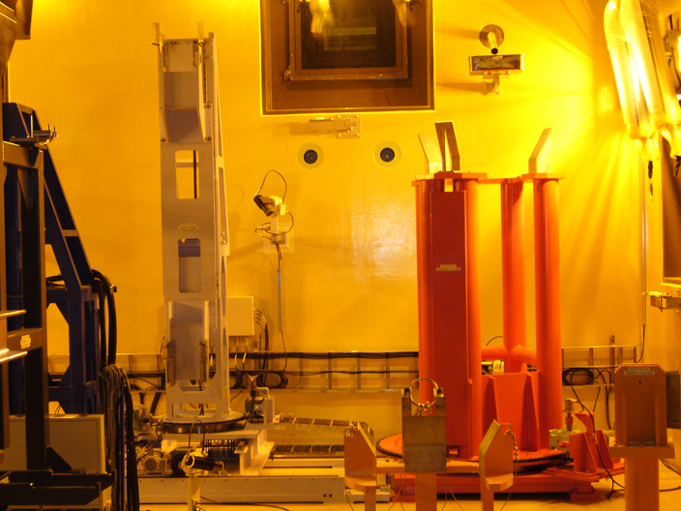
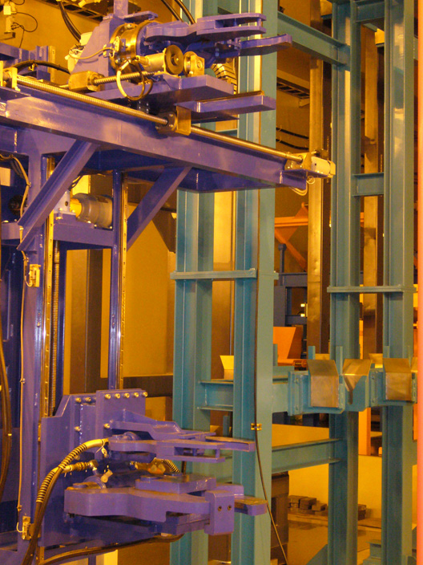
Target exchange in hot cell
Manipulators
Plug stand
Exchange device
Cutting device
Power manipulator
Off-beam commissioning
Master slave manipulator
Exchange device
Plug stand
Cutting device

Slide 14
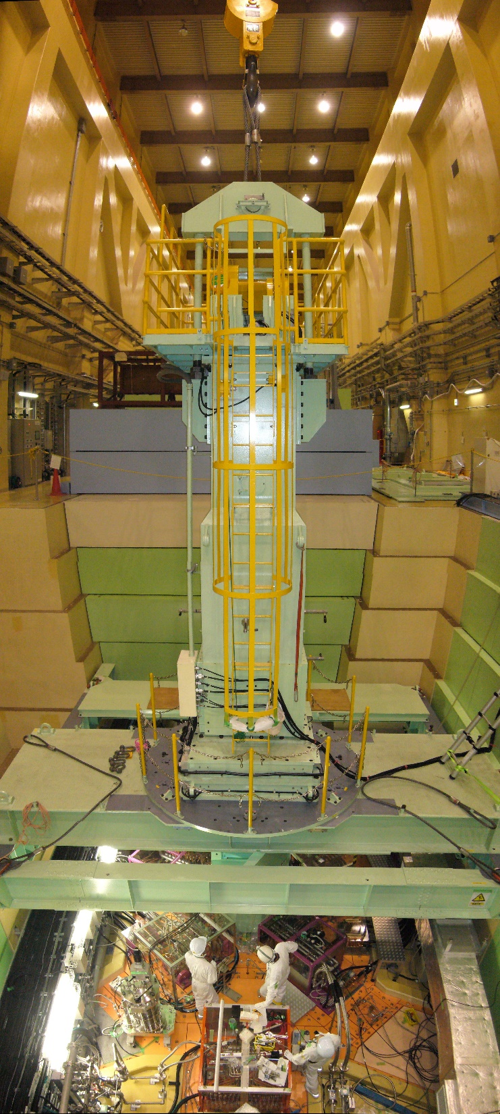
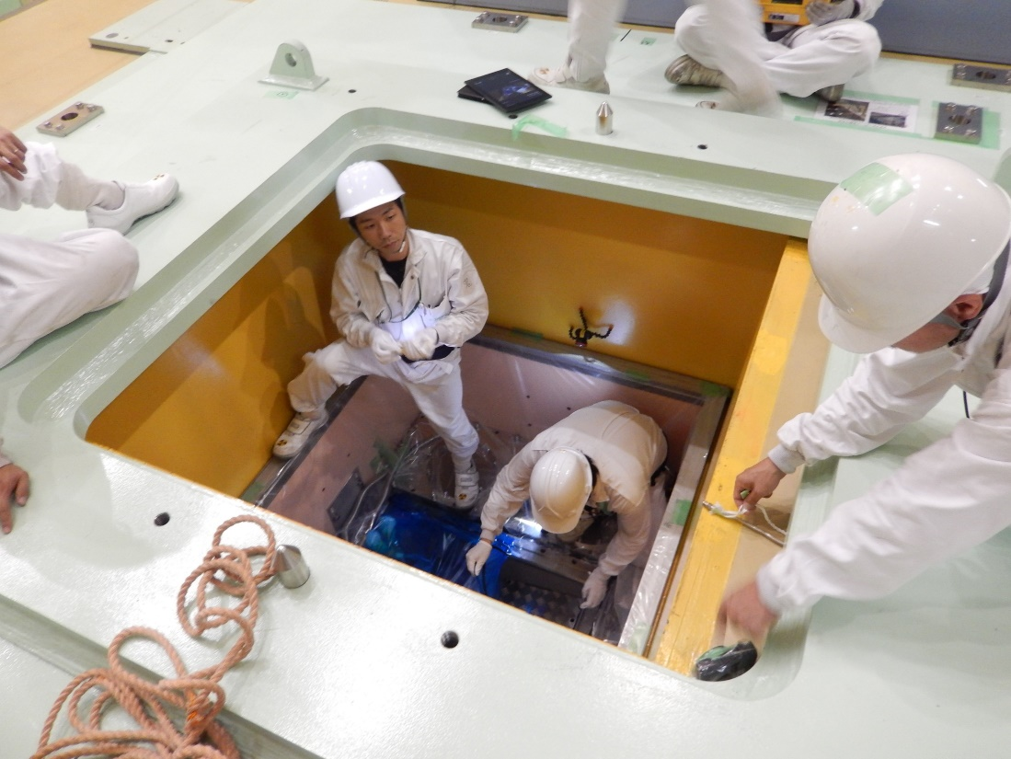
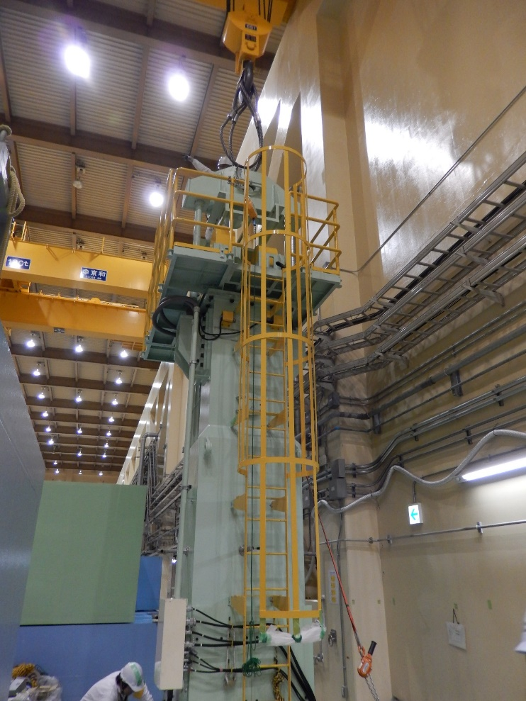
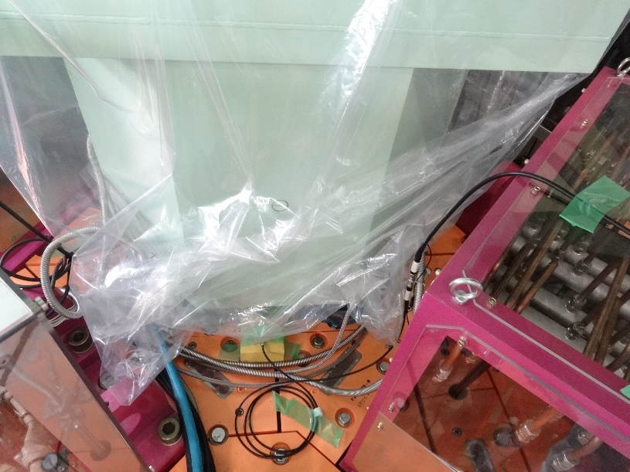
Replacement work in ’14
Preparation of the storage pit
The cask on the pit
Vinyl sheets for a counter measure against radio isotopes on the target assy.
Meaningless? “Better than do not”?

Slide 15
Rotating target #1 → #2
Maintenance work in ’19

Slide 16
Issues
In principle, the replacement work itself is almost the same as that in ’14 (fixed target → rotating target).
However, in these years, it was reported the tritium contamination in the target chamber and the vacuum components becomes serious; ~ a few kB/cm².
Treatment of tritium wasn’t considered in the original target exchange scenario.
We refurbish the scenario, adding the use of green-house that is a small chamber covered with air-tight vinyl sheets, local exhaust ventilator, an airline mask and an anorak suit to control the internal exposure of the working staff enough low.

Slide 17
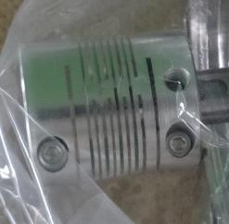
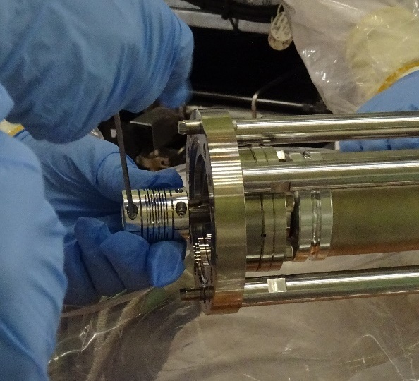
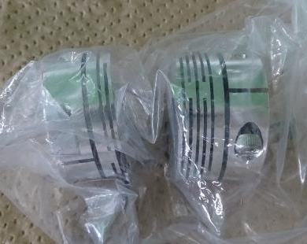
Trouble on the shaft-joint in ’18
During the annual rotating-machine maintenance in ’18, we found the damaged shaft-joint, and then one of two was replaced with an appropriate one. But, the other one was left as it was.
Rotating machine
joints
A Shaft-joint is used to absorb misalignment btw the shafts.
A through-ditch by
processing mistake
P8GVで封止
Due to cyclic stress and processing mistake, the upside shaft was broken after 5 years use.
P7ポンプ位置
M1トンネル
The lower side joint was located inside of the shield, and we don’t have enough time to prepare the replacement work, we decided to keep using it, after confirming the target rotation at least.

Slide 18


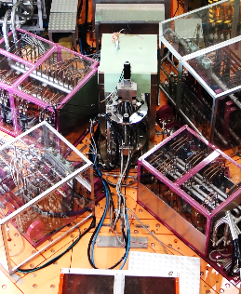
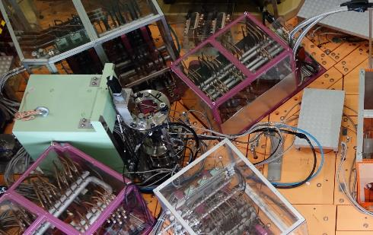
Target assy. removal procedure
Disconnect cables, pipes and misc.
Vacuum purge
Assemble the green-house
Remove up-down motion system
Mount cask attachment
Mount cask rack and ext. shield
Mount cask
遮蔽付きキャスク
Material for investigative commission
GH
上下駆動機構
矩形フランジ
遮蔽
ミュオン標的
M2 tunnel

Slide 19
Target assy. removal procedure
Disconnect cables, pipes and misc.
Vacuum purge
Assemble the green-house
Remove up-down motion system
Mount cask attachment
Mount cask rack and ext. shield
Mount cask
Winch up the target assy.
Transport the cask on the pit.
Store the used target in the pit.
遮蔽付きキャスク
Material for investigative commission
GH
遮蔽
ミュオン標的
M2 tunnel

Slide 20
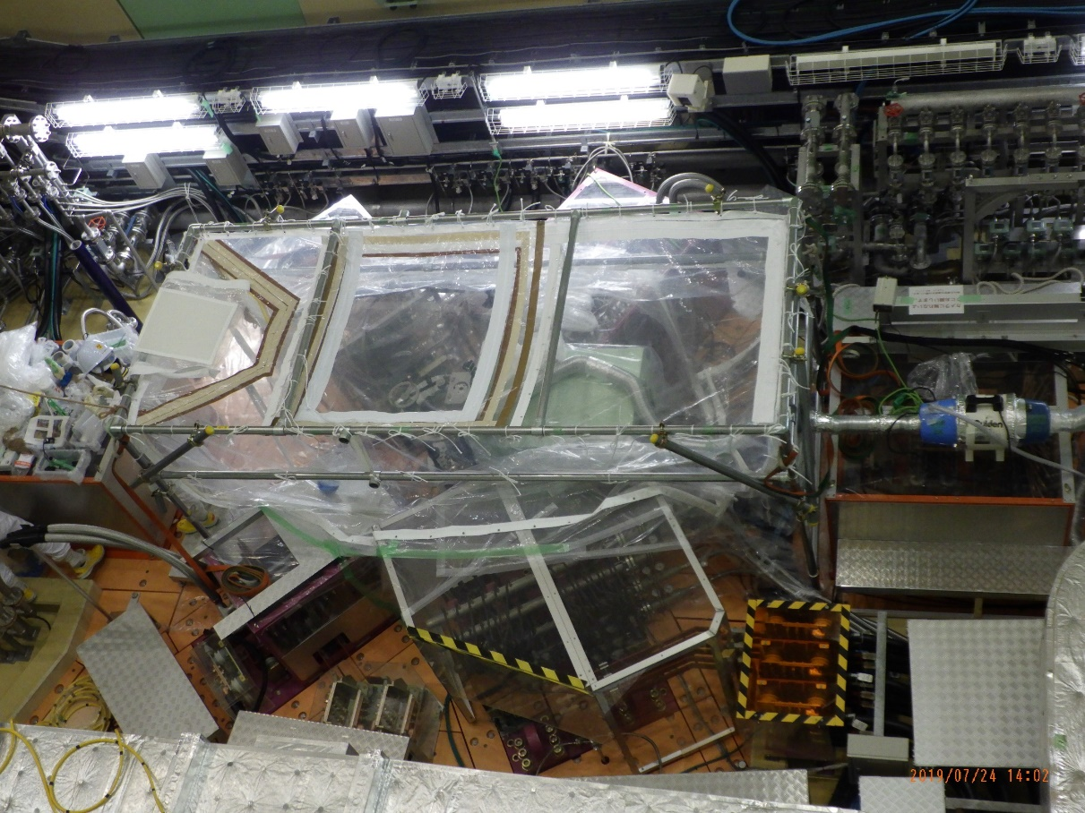
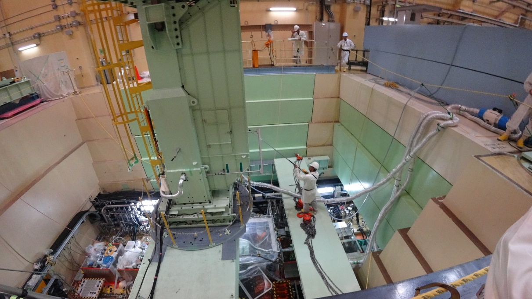
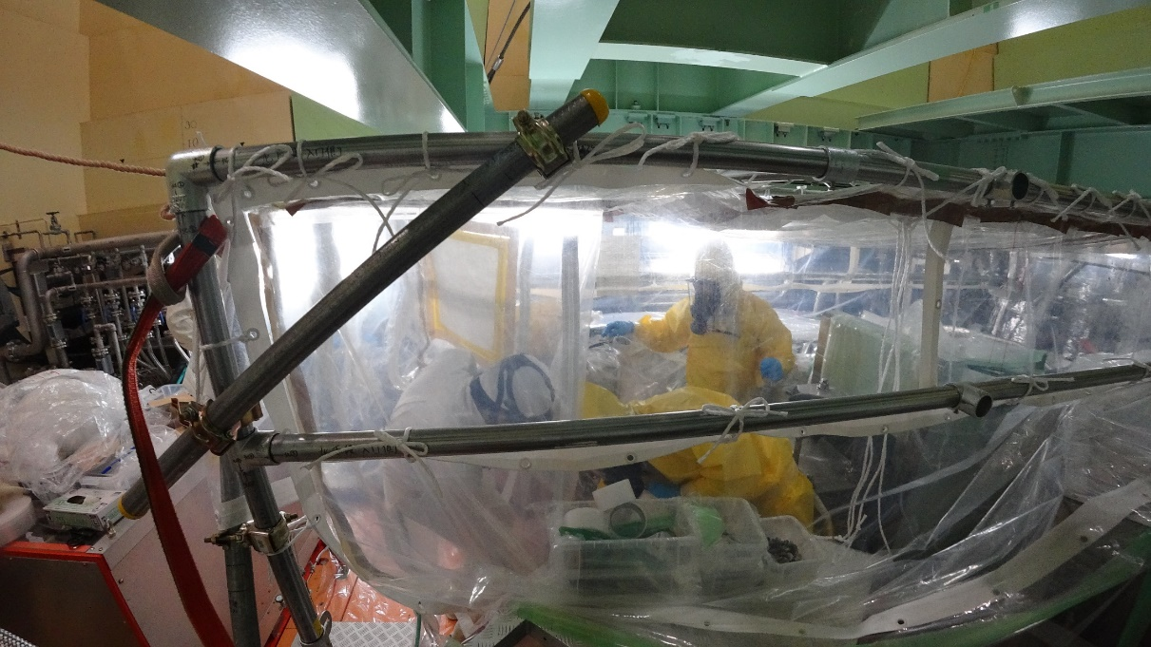
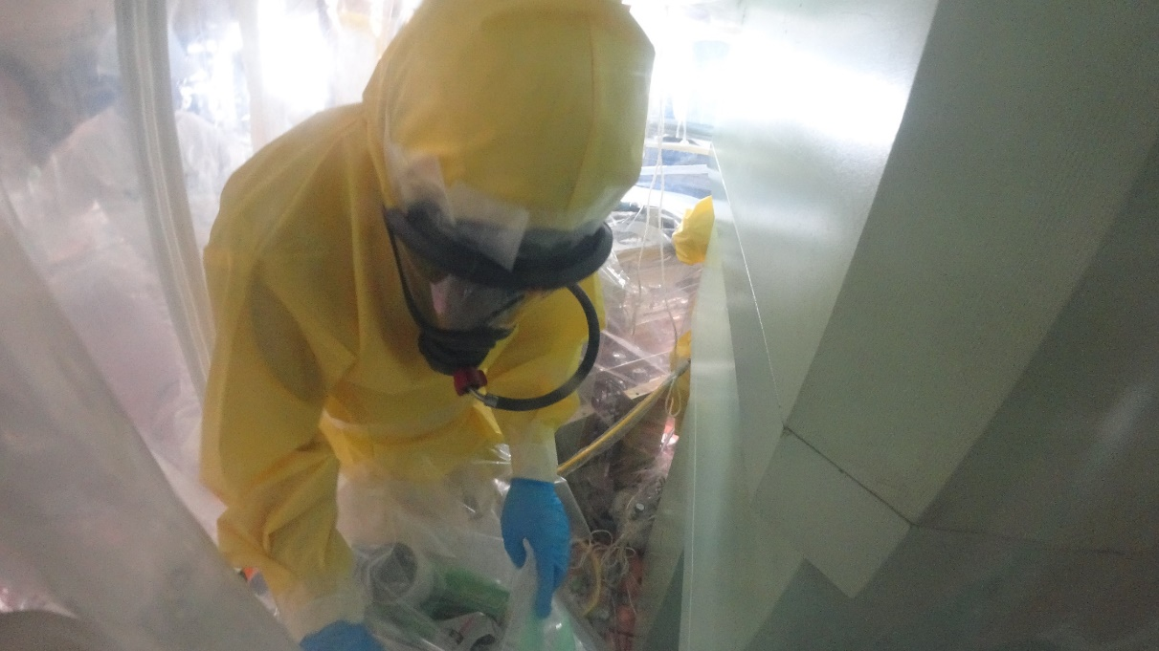
Replacement work in ’19
GH
local exhaust
local exhaust
The work wearing airline mask and anorak suit is hot and extremely tough.
2-hour is the upper limit for one work.
airline mask
anorak suit
air supply line

Slide 21
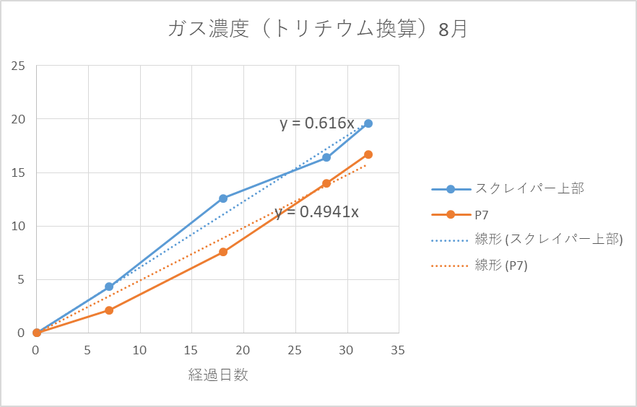
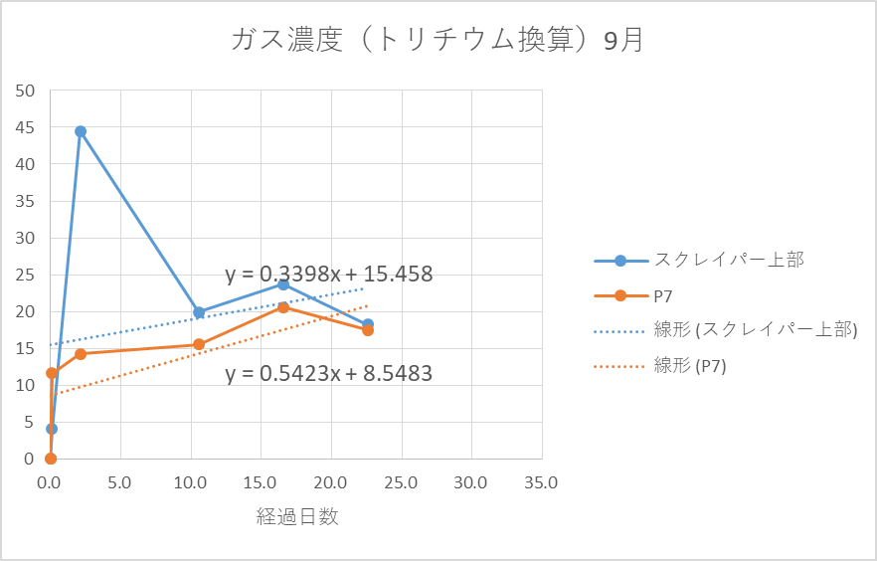
Tritium release to the beamline in ’18
Tritium concentration in the purge gas ’18
Isotope exchange on surface:
H₂O → HTO
Even dry N₂ contains a small fraction of water as an impurity. (~10 ppm)
H₂O is useful for tritium decontamination.
Dry N₂ only
flange open
Elapsed time [days]
Dry N₂ + air(10%)
Manipulation like opening a flange must be done carefully because the air is drawn into the chamber rapidly.
Humidity is bad for vacuum.
We need a longer time to achieve good vac. level again.
Elapsed time [days]

Slide 22
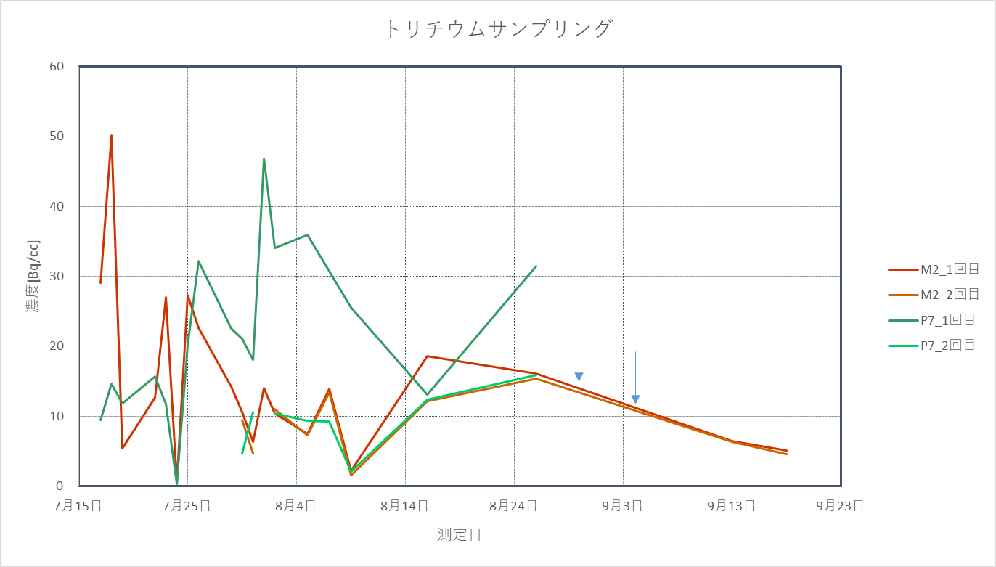
Tritium decontamination by air in ’19
purge
Tritium concentration in the purge gas
evac+purge
evac+purge
Vacuum sealing
Target assy. removal
flange open
We did tritium decontamination procedure by the humidity-controlled gas (dry N₂ + air(10%)), quantitative explanation is difficult, but this was obviously efficient to reduce the tritium level.

Slide 23
Summary
Originally, the used muon target assy. was designed to be replaced with new one. In the hot-cell, the used assy. would be disassembled by the manipulator, and then the rod be cut by the cutting device to reduce its volume. But the situation has been changed due to
  Treatment of the tritium becomes more serious
  → use of green-house, local exhaust ventilator, airline mask, anorak suit
  The life time of the target assy. is successfully prolonged to 10 years.
    Only several target assemblies will be used during the designed life time of MLF facility of 40 years.
    Original scenario was constructed to deal with a fixed target that would be spent every half a year under 1 MW beam.
    Two targets would be spent every year.
  Changing the human resources → simple scenario
We just started reconstructing the maintenance scenario, minimizing the consumption of time, money and human resources.

Slide 24
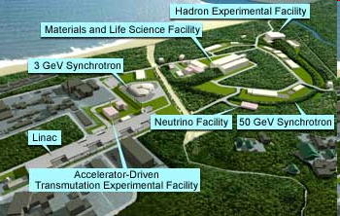
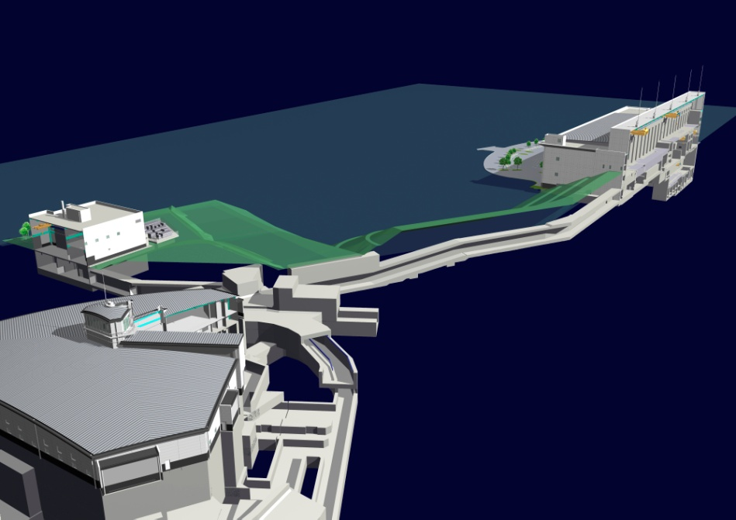
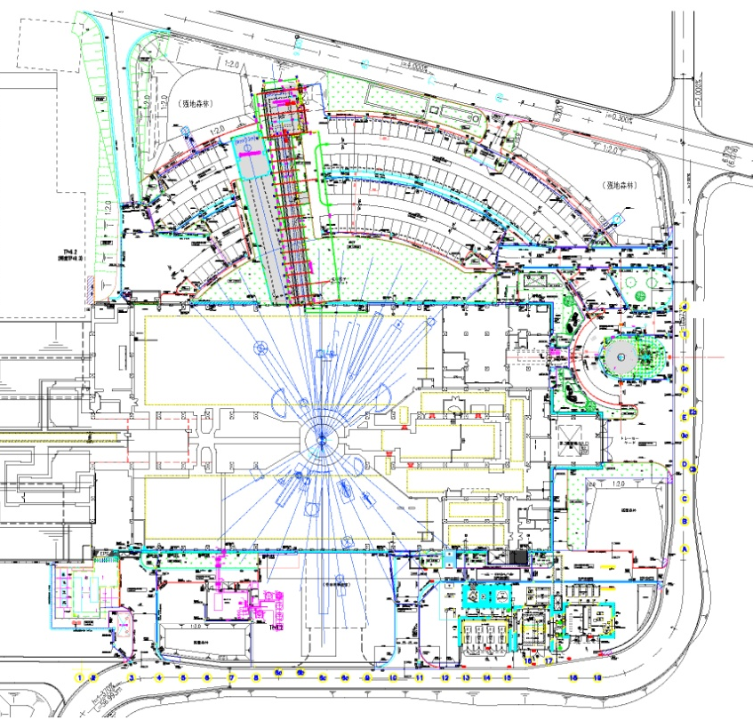
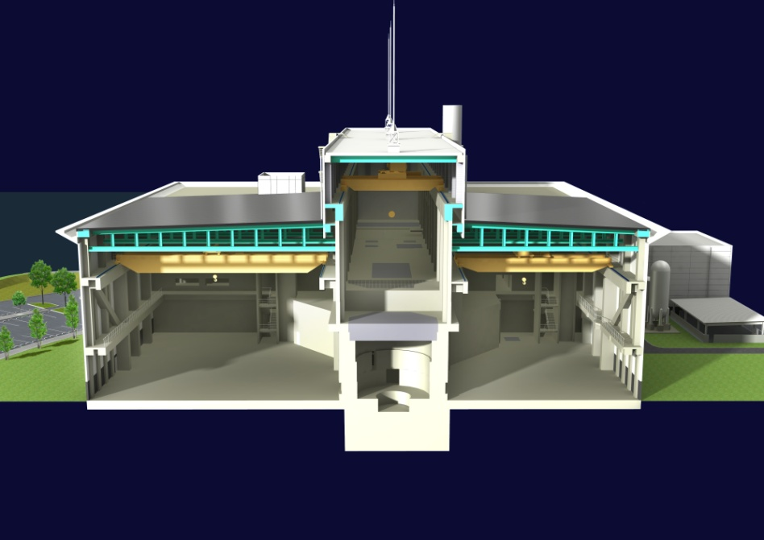
Materials and Life Science Facility
MLF
RCS (3GeV333μA)
Muon target
Spallation neutron target
Exp. Hall #1
Exp. Hall #2
Exp. Hall #1
Cascade target
μ
n
Exp. Hall #2
100%
>90%
graphite
mercury
Beam transport tunnel

Slide 25
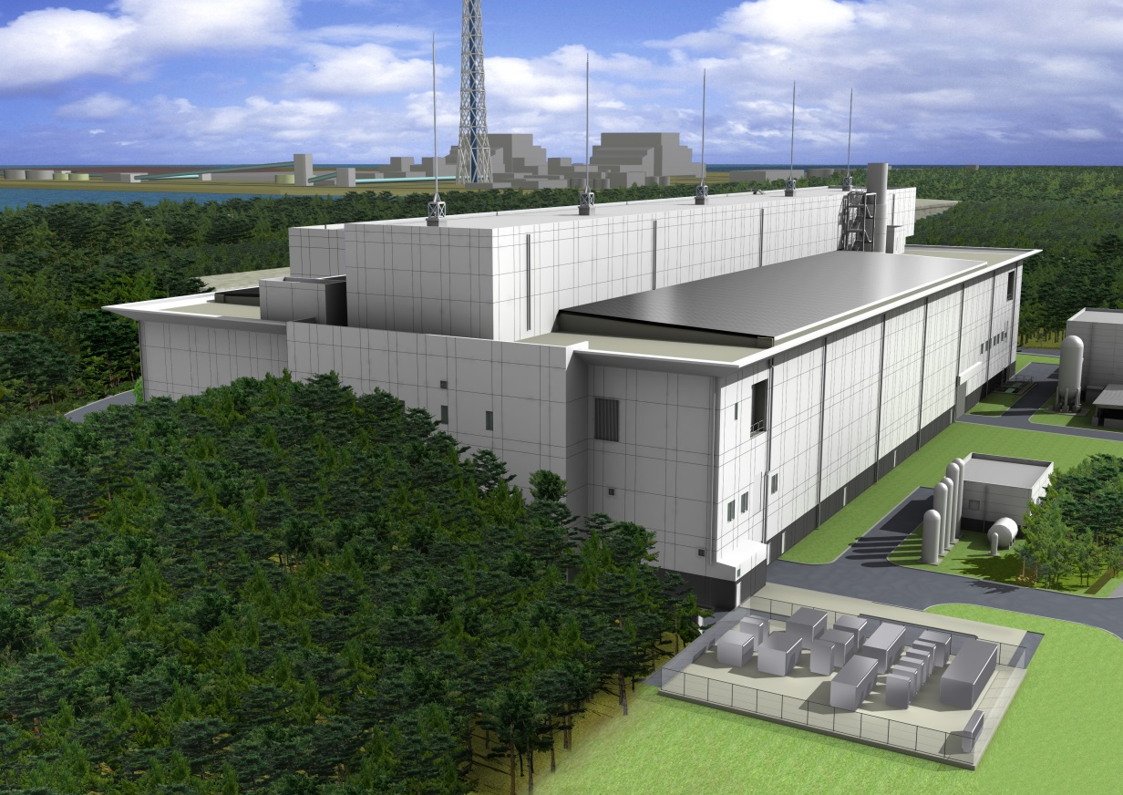
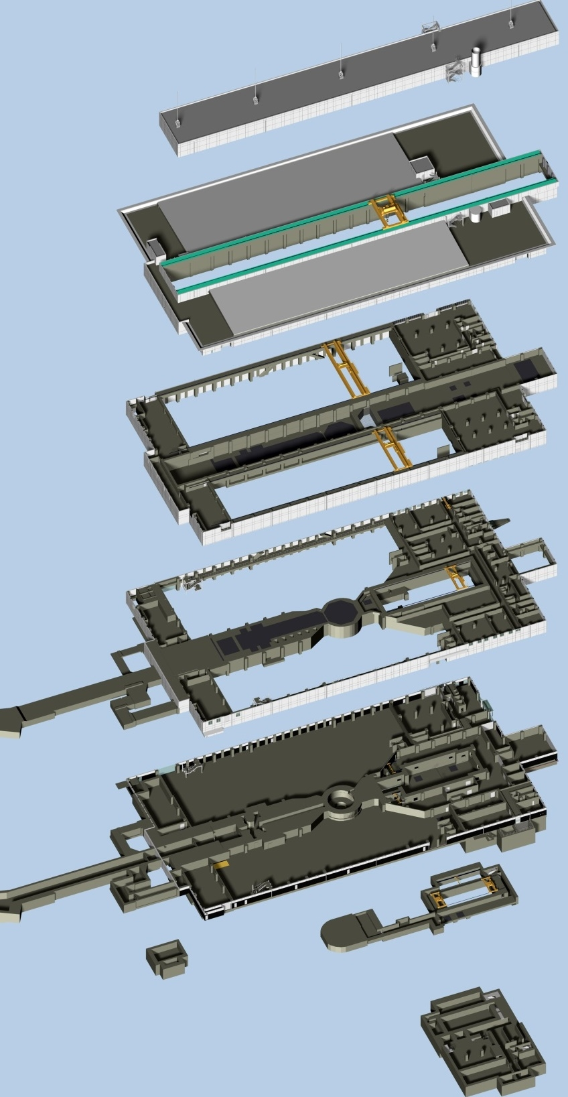

30m
146m
70m
22m
Exp. Hall #1
Exp. Hall #2
Exp. Hall #1
proton
Exp. Hall #2
M1 & M2 tunnel
Proton beam transport tunnel

Slide 26
Muon Facility in MLF
S-line
µ⁺
H-line
µ±
Slow beam （4 MeV）,
dedicated to bulk µSR ultralow tem-perature/high magnetic field/ pulsed excitations.
Slow（4 MeV）-fast（50 MeV）beam, for particle physics, atomic physics (“precision frontier”)
µ⁺
U-line
µ±
D-line
Ultra slow beam （0.1-30 keV）, near-surface, sub-micron scale condensed matter physics, chemistry, etc.
Slow（4 MeV）-fast（50 MeV）, general-purpose beamline with 2 exp. areas.

Slide 27
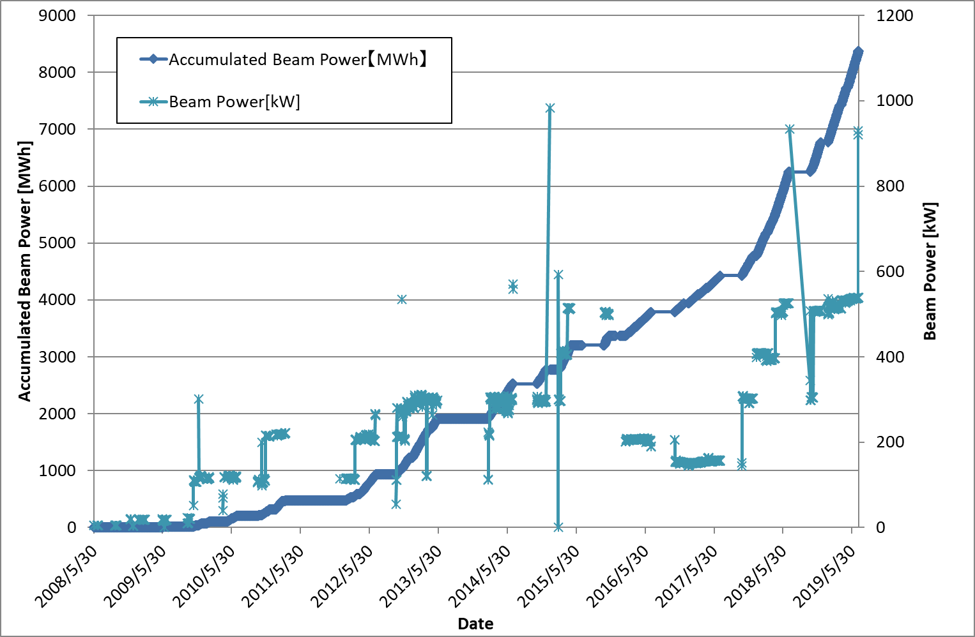
History of the target operation
Oct. 2014
1 MW test beam operation
Rotating target #1
Fixed target
Rot. system trouble
Users’ runs were canceled for 2 weeks.
Rotating Target #1
Operation time: 17000 hours
Nov. 2014 ~ July. 2019
6000 MWh
Rotation : ~16 M revolutions
4.5 M revolutions /year @ 15 rpm
Stable 500 kW operation in 1 year
27

Slide 28
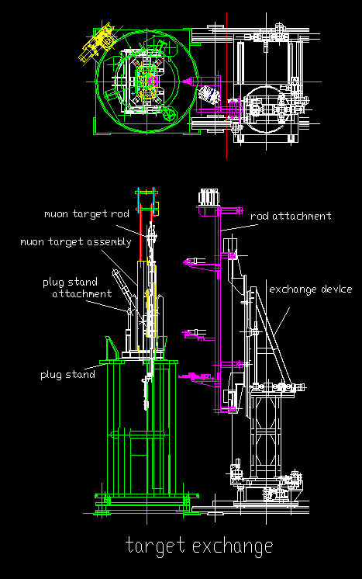
Remote handling attachments
for muon components
Target rod, Profile monitor rod, and CT rod are exchanged in Hot cell.
Plug stand attachment is equipped on Plug stand.
Each assemblies are put down on Plug stand attachment by Muon cask.
Rod attachment is equipped on Exchange device.
Each used rods are hooked and removed by rod attachment.
Both attachments are common for three components.
Off-beam commissioning
Attachment will be delivered this February.
Commissioning of target exchange will be completed this April.

Slide 29
Muon target assembly
replaced
Muon target assy
To be replaced
M2 tunnel
Rotation speed: 15 rpm
Duration time: 5 years
Accumulated beam power:
Rotating target: 5850 MWh

Slide 30
Shaft-joint / Target assy. replacement
The old shaft-joint has the greatest risk for the stable operation, and thus we decided to replace it in this summer maintenance period.
The lower side joint was not designed to be replaced originally, and thus the replacement work was expected to be a fight against time under the high radiation field.
Replacement work in M2 tunnel → impossible
The target assy. is moved to the pit that is originally for temporary storage of a new/old target assy.
We prepared the special scaffold on the pit.
We prepared 2 options: fix the 1st target/install the 2nd target
Plan A: If the dose from the assy. is enough low, joint would be replaced.
Plan B: If not, new target assy. (Rot. Target #2) would be installed.
Finally, we found that the upper part of assy. was highly activated than we expected. We took plan B.

