Slide 1
Managed by Fermi Research Alliance, LLC for the U.S. Department of Energy Office of Science
C-Zero Radioactive Component Storage Facility
NBI2019: 11th International Workshop on Neutrino Beams and Instrumentation
By: Mike Campbell
October 25, 2019

Slide 2
Contents:
Brief History of Czero and the Project Team
The Design and Build
Civil Construction
Bridge Crane w/ Vertical Sliding Shield Wall
Sliding Shield Door w/ Railcar Pass-Thru
Cameras & Remote Viewing Station
Moving In Our First Hot Component
C-zero Radioactive Component Storage Facility – Mike Campbell 10-25-2019

Slide 3
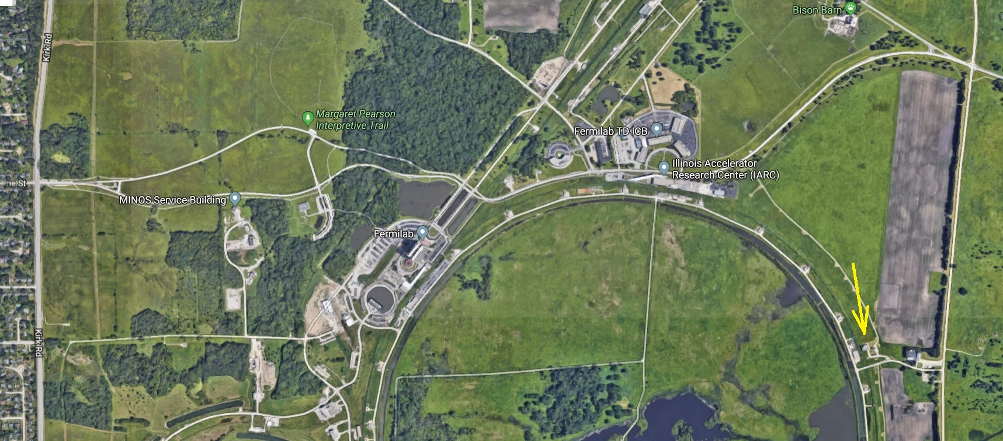
Brief History of Czero
Czero building originally completed in 2004 for the BTEV Project (was cancelled)
Had Tevatron magnet ring passing thru otherwise empty 30’ x 80’ detector hall
Had 3 hot-storage bays and a hot cell w/ telemanipulators added 2012 (Czero RHF)
C-zero Radioactive Component Storage Facility – Mike Campbell 10-25-2019

Slide 4
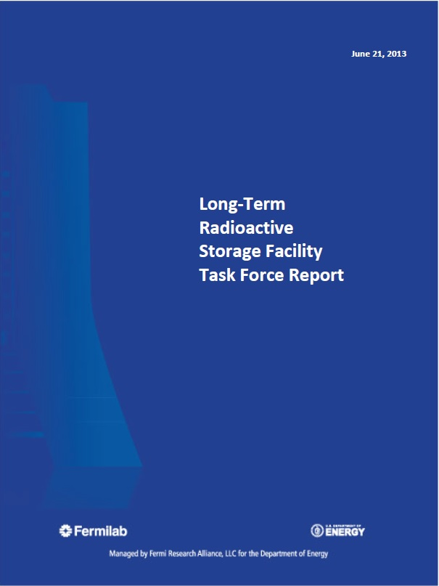
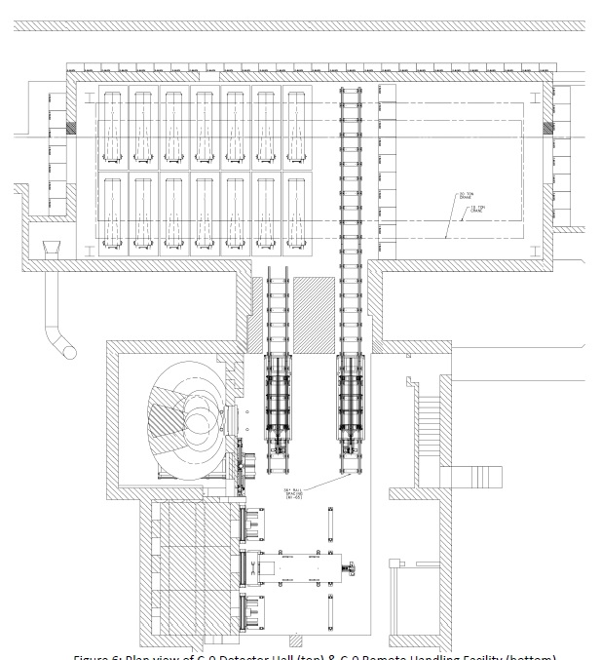
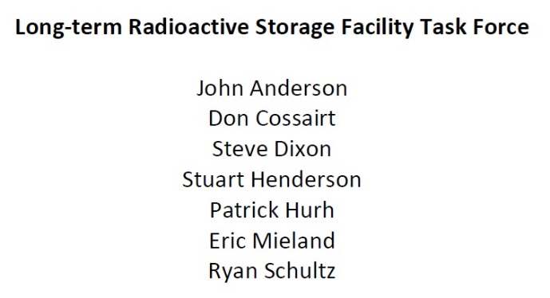
Brief History of Czero
Summer, 2013: Long-Term Radioactive Storage Facility Task Force Report
C-zero Radioactive Component Storage Facility – Mike Campbell 10-25-2019

Slide 5
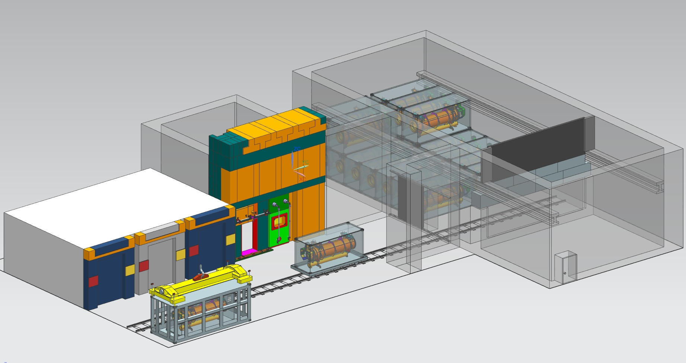
Brief History of Czero
Design concept later modified to:
C-zero Radioactive Component Storage Facility – Mike Campbell 10-25-2019

Slide 6
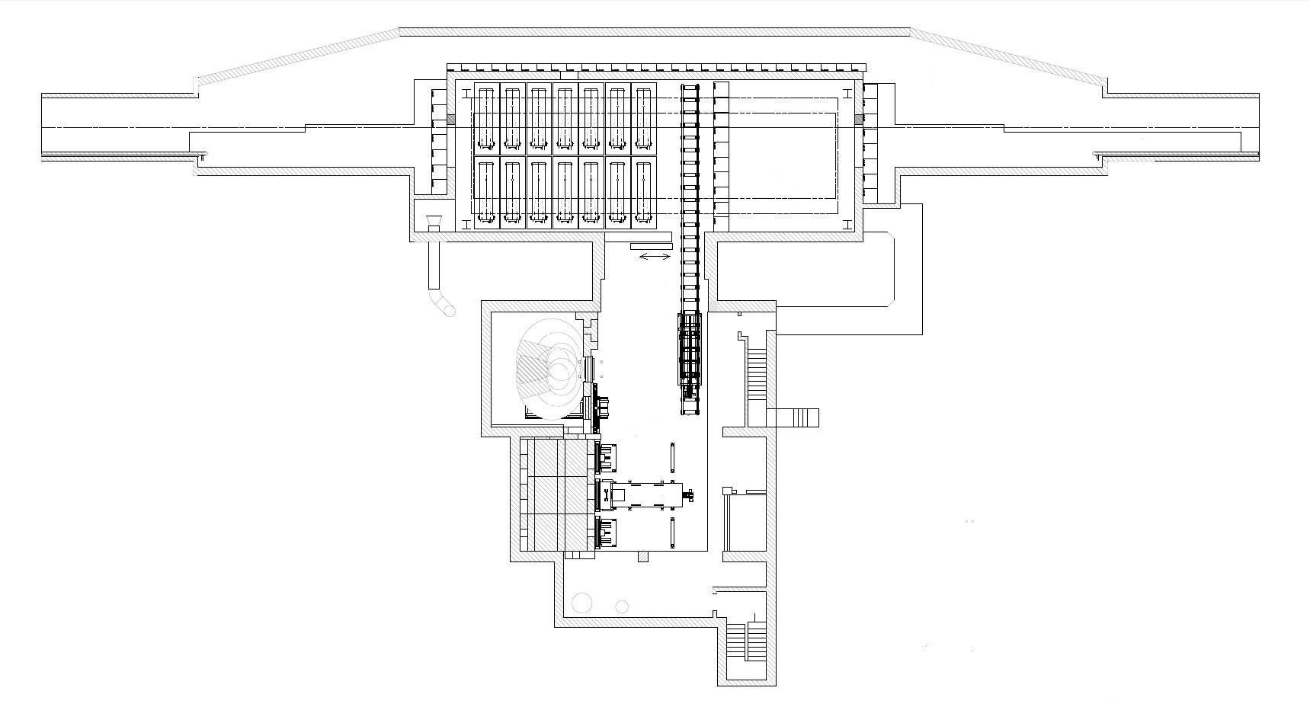
Brief History of Czero
Design concept later modified to:
Access/Service area
New radioactive storage area
Lead-glass window
New crane inside w/ vertical sliding shield wall
New wall being added
New sliding shield door
No crane coverage in this area
New rail car and track
C-zero Radioactive Component Storage Facility – Mike Campbell 10-25-2019

Slide 7
Brief History of Czero
Project began 2014
Project Team:
Pat Hurh, Ryan Schultz, Cory Crowley – Engineers AD/TSD – Project oversight
Jonathan Hunt – Engineer, FESS – Civil construction
Cory Crowley – Engineer AD/TSD – Bridge-crane w/ vertical sliding shield wall
Mike Campbell – Engineer AD/TSD – Sliding shield door w/ railcar pass-thru
Keith Anderson – ME Build Tech AD/TSD – Cameras and remote viewing Station
Cervando Castro – ME Build Tech AD/TSD – Lead builder (also Bob A., others)
Budget: $ 3M
C-zero Radioactive Component Storage Facility – Mike Campbell 10-25-2019

Slide 8
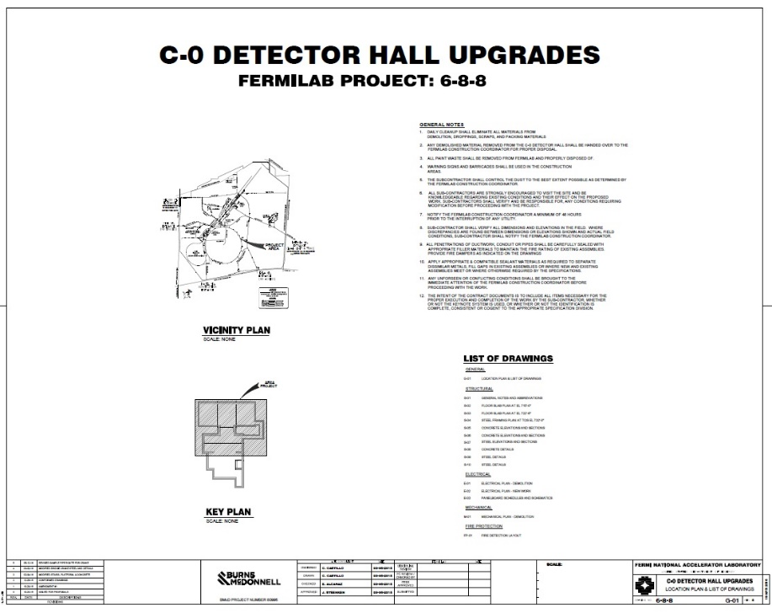
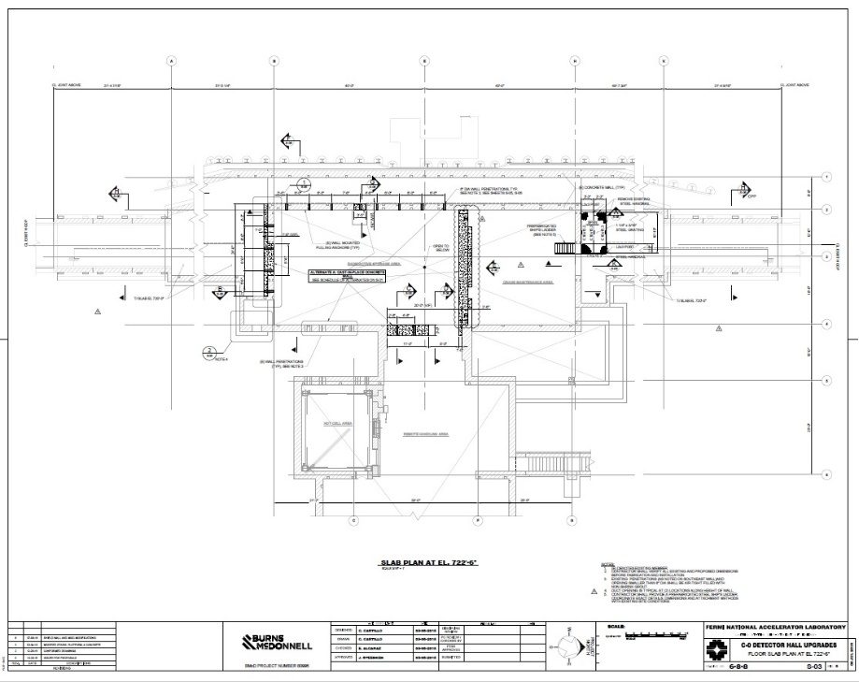
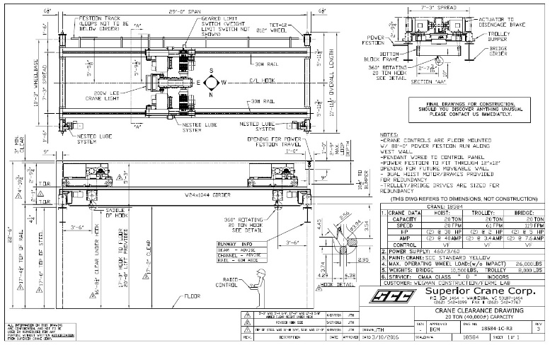
Civil Construction
Civil construction included:
Demolition of existing concrete shield plug and other structures
Two new concrete walls – one w/ large opening, other w/ lead glass window
Install structural steel for crane (columns & rails)
Install hot-side bridge crane w/ redundant / relocated motion controls
Electrical infrastructure build-out (lighting, crane & door control panels, etc)
C-zero Radioactive Component Storage Facility – Mike Campbell 10-25-2019

Slide 9
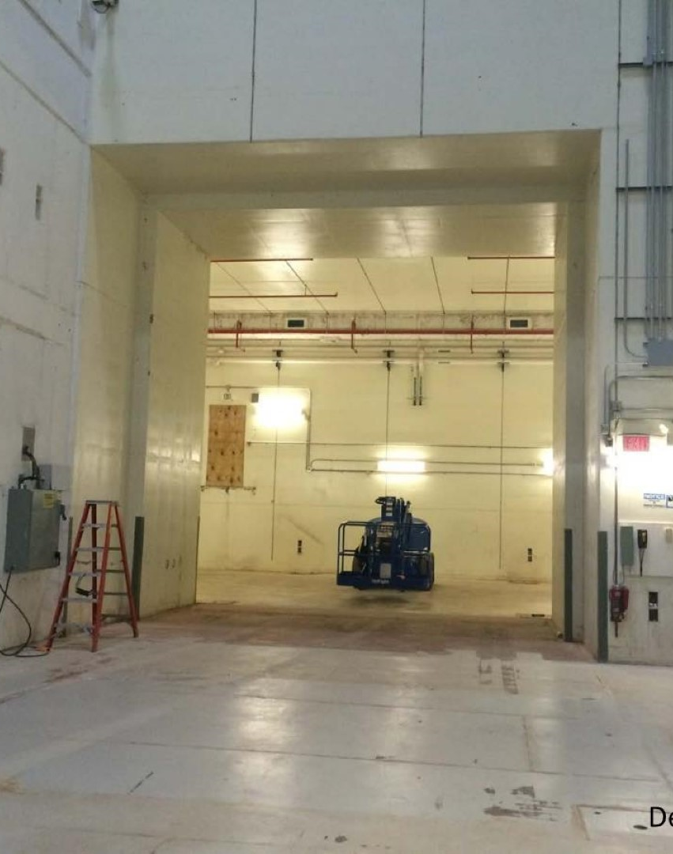
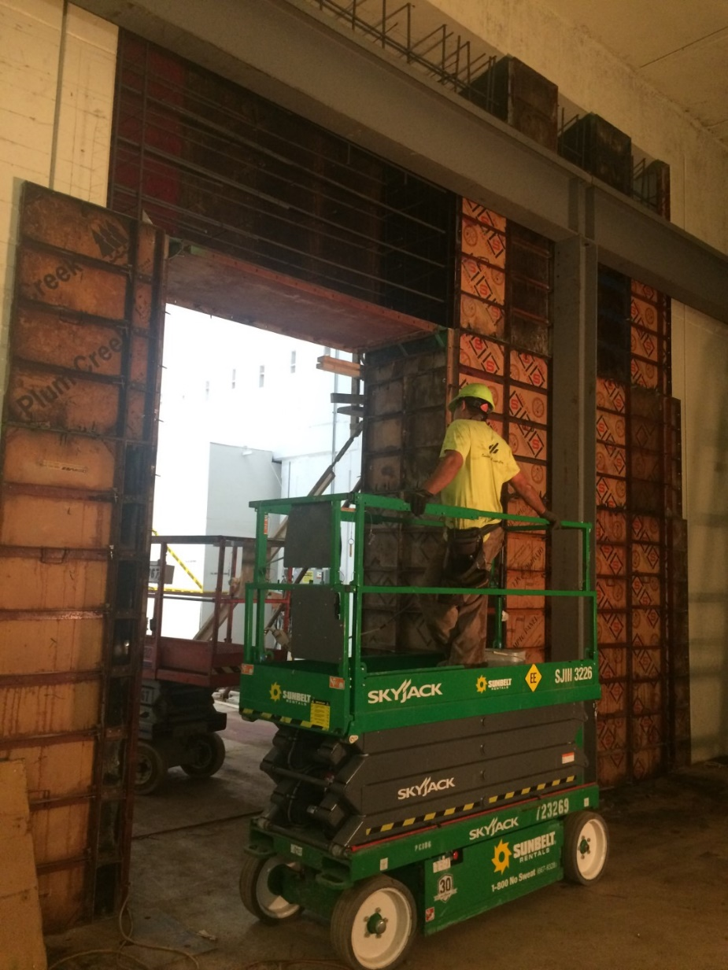
Civil Construction
C-zero Radioactive Component Storage Facility – Mike Campbell 10-25-2019

Slide 10
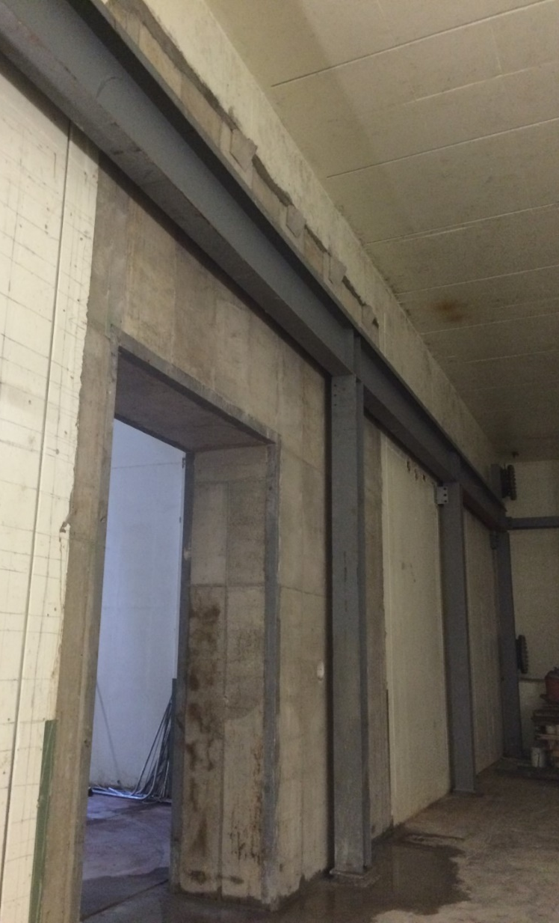
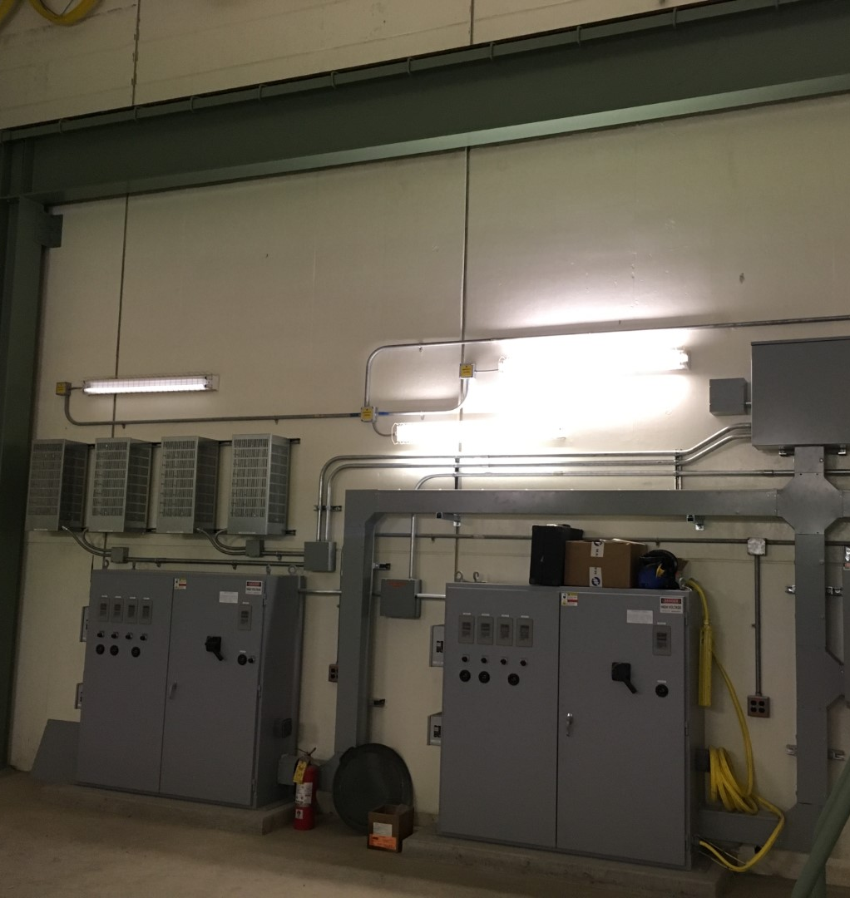
Civil Construction
C-zero Radioactive Component Storage Facility – Mike Campbell 10-25-2019

Slide 11
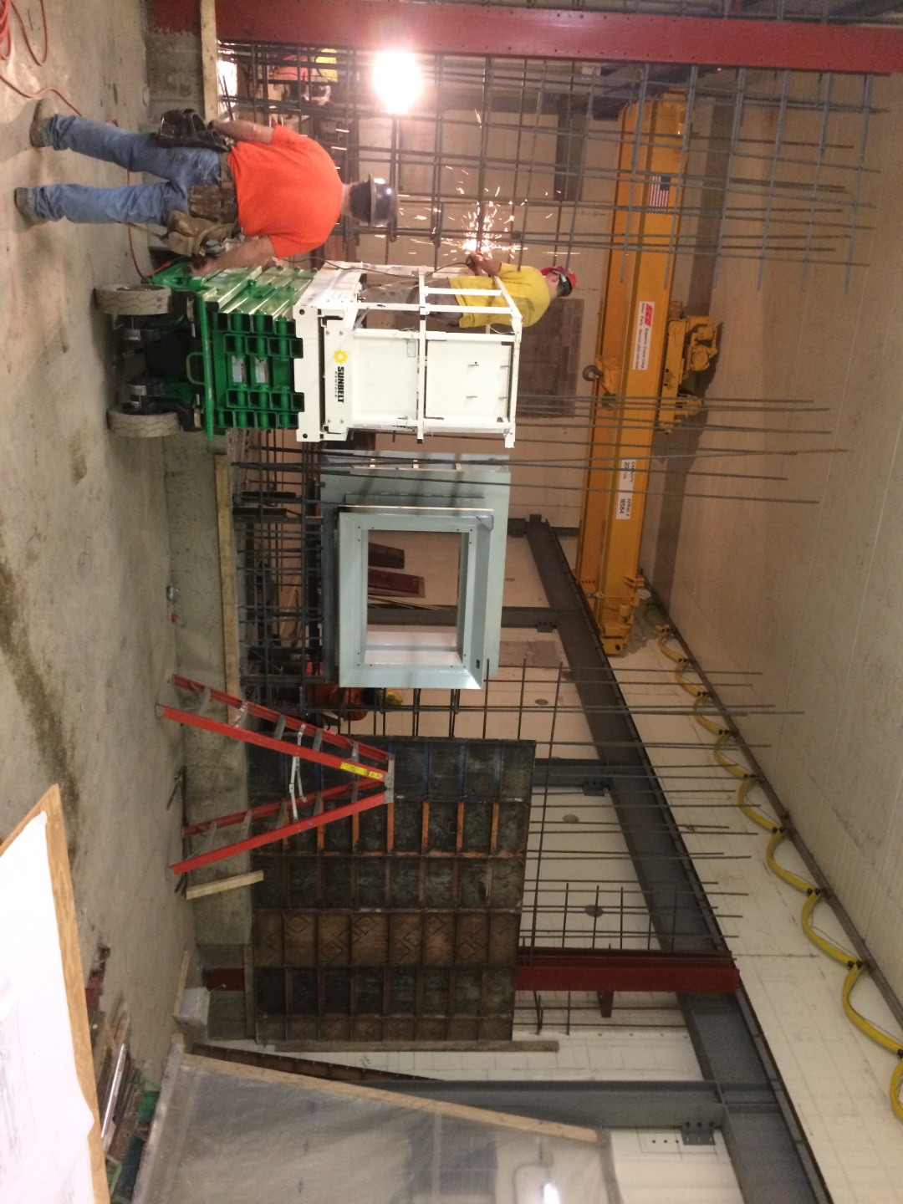
Civil Construction
C-zero Radioactive Component Storage Facility – Mike Campbell 10-25-2019

Slide 12
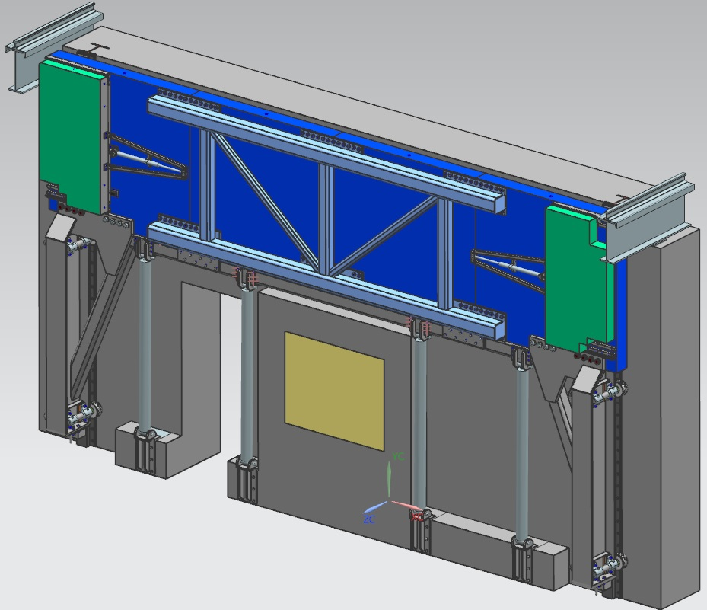
Bridge Crane w/ Vertical Sliding Shield Wall
Crane rail
Horizontal actuating panel
Horizontal actuating panel
Rising shield wall
Crane rail
Lead-glass window
4X hydraulic lifting cylinders
C-zero Radioactive Component Storage Facility – Mike Campbell 10-25-2019

Slide 13
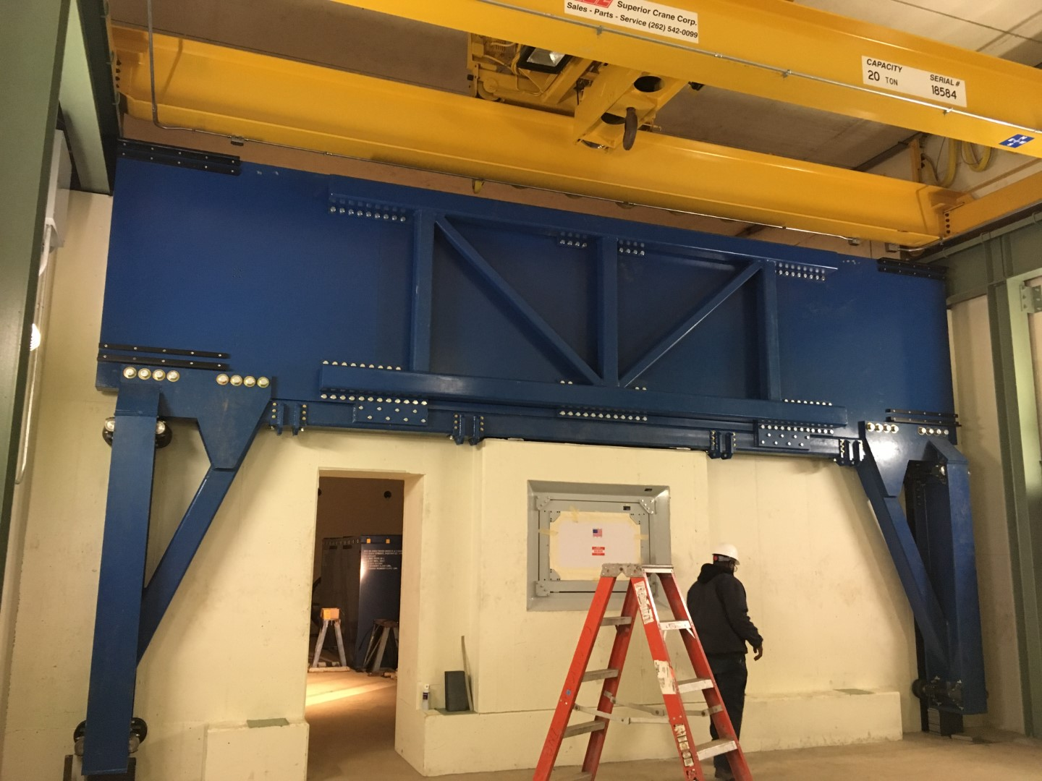
Bridge Crane w/ Vertical Sliding Shield Wall
C-zero Radioactive Component Storage Facility – Mike Campbell 10-25-2019

Slide 14
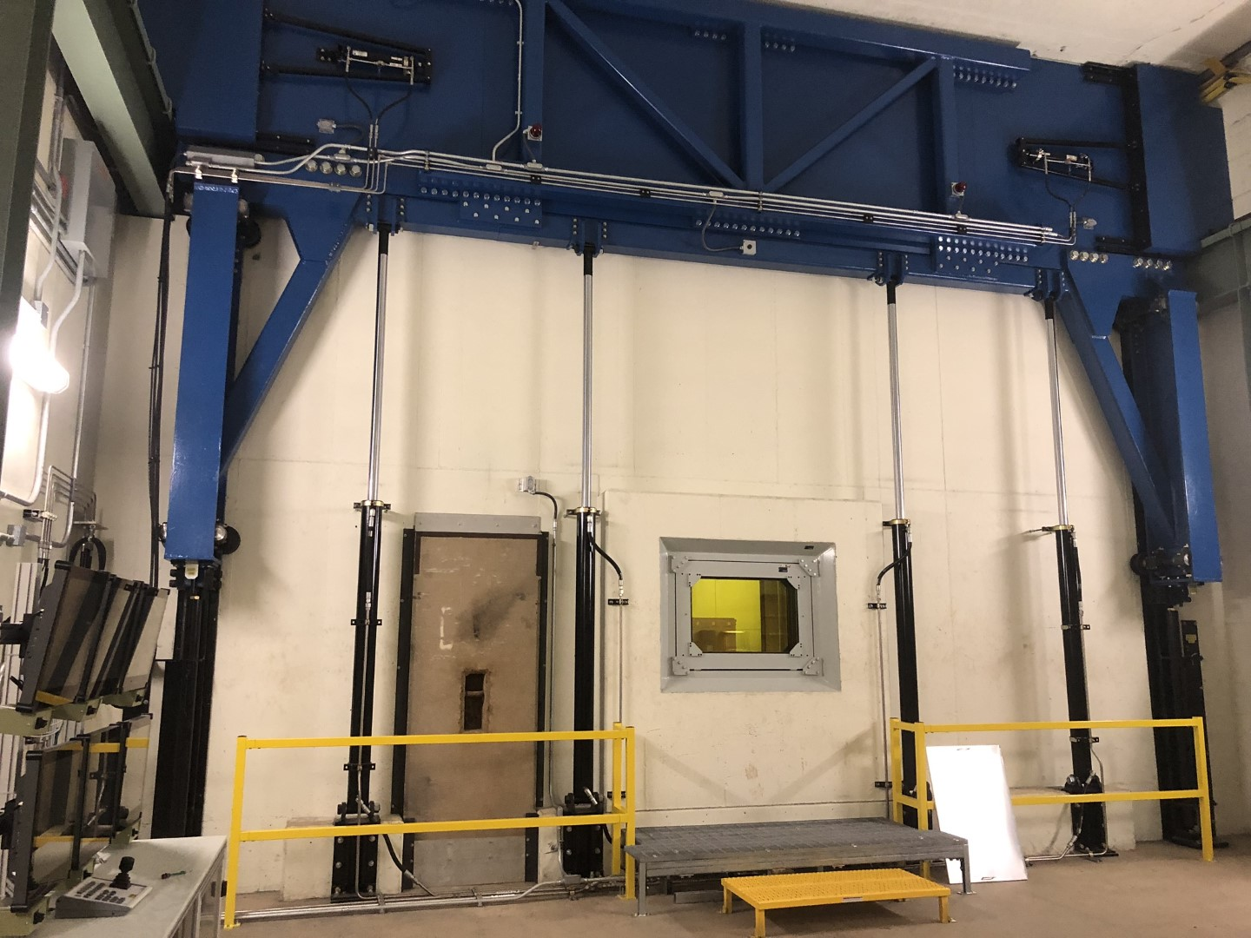
Bridge Crane w/ Vertical Sliding Shield Wall
C-zero Radioactive Component Storage Facility – Mike Campbell 10-25-2019

Slide 15
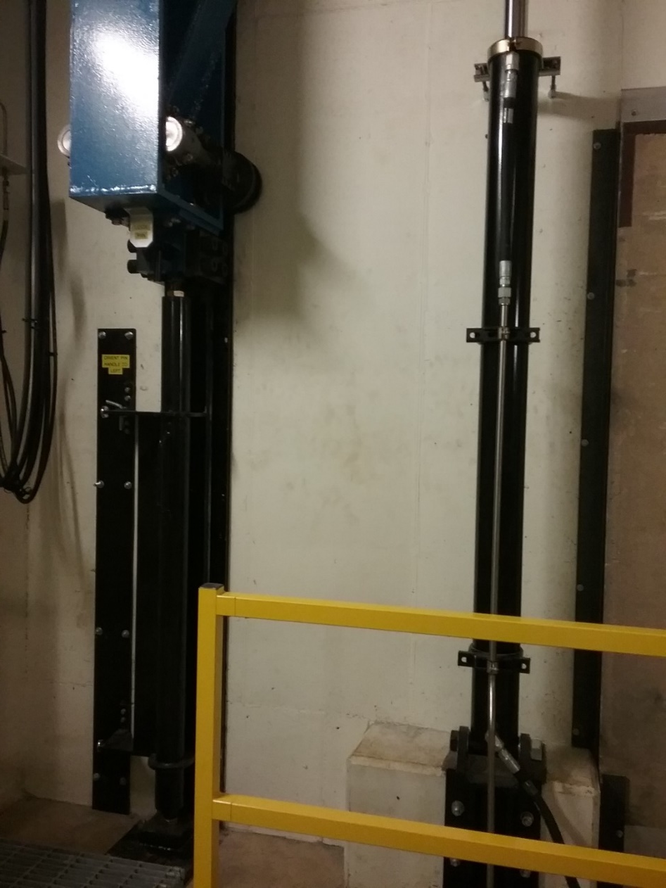
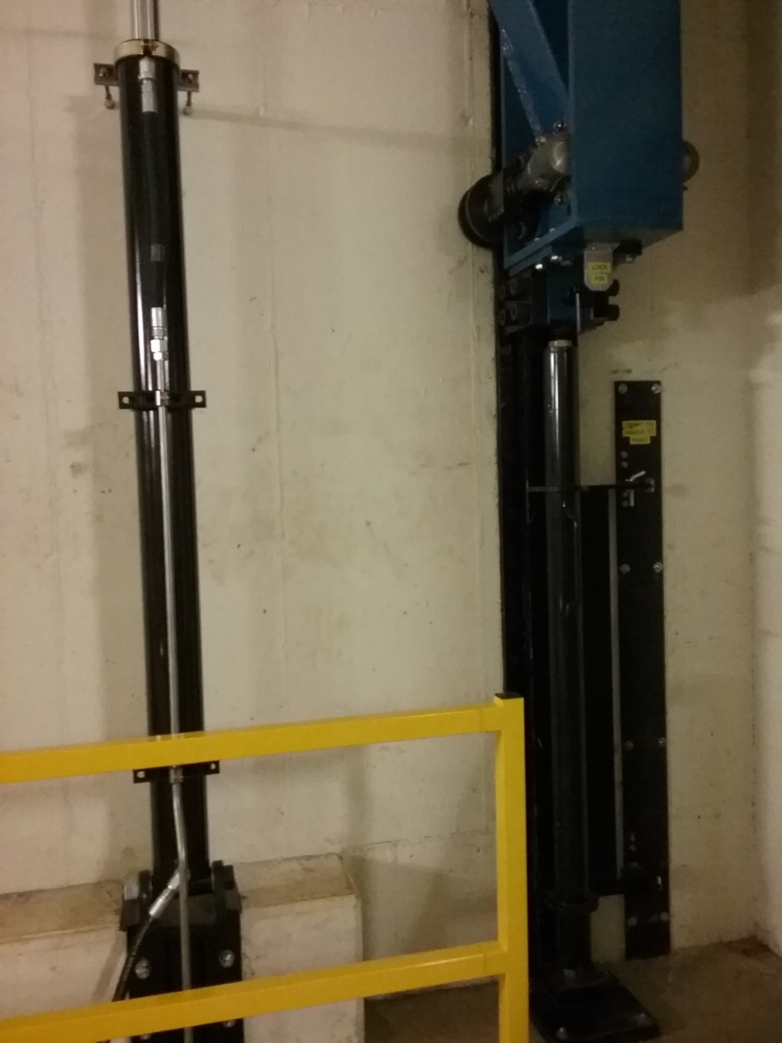
Bridge Crane w/ Vertical Sliding Shield Wall
C-zero Radioactive Component Storage Facility – Mike Campbell 10-25-2019

Slide 16
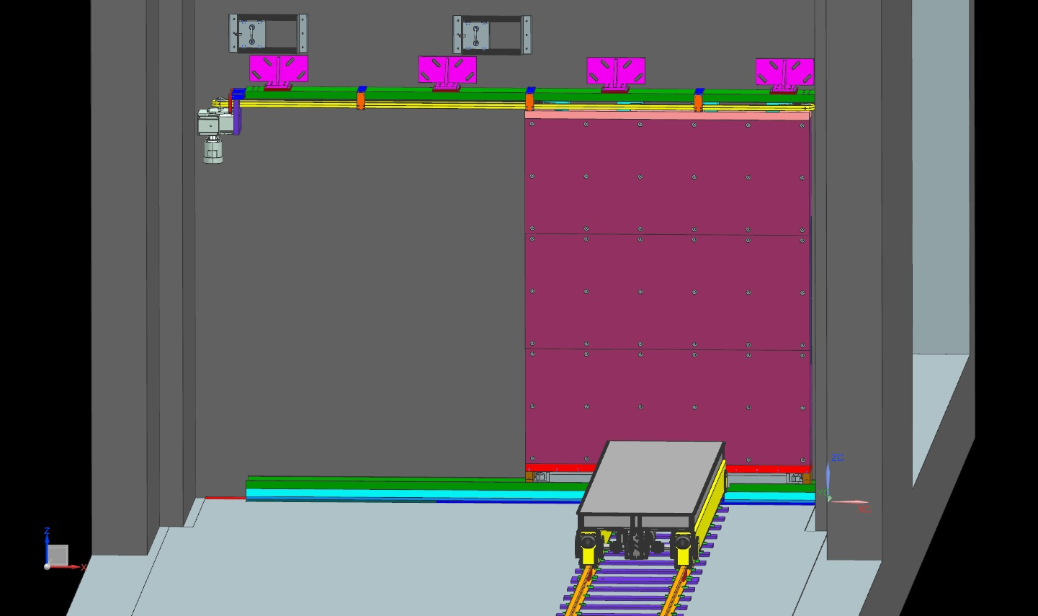
Sliding Shield Door with Railcar Pass-Thru
Upper guide
track and drive
Camera access holes w/ sliding covers (Keith A)
Sliding shield door
Lower guide track
New rail car and tracks
C-zero Radioactive Component Storage Facility – Mike Campbell 10-25-2019

Slide 17
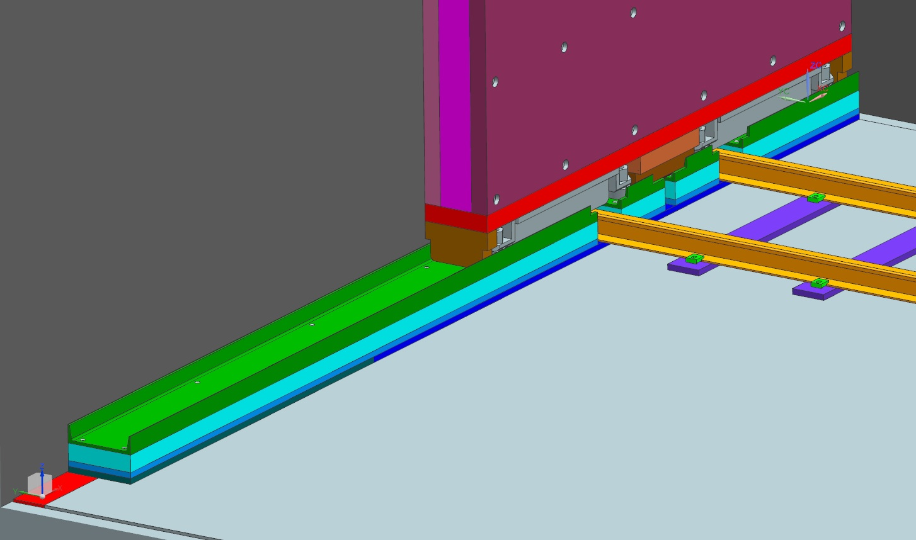
Sliding Shield Door with Railcar Pass-Thru
2X long standard Hilman rollers
Small shield blocks fill in the gaps at both ends and in between the rollers
2X gaps for rail car tracks plus center gap for motor power cable
C-zero Radioactive Component Storage Facility – Mike Campbell 10-25-2019

Slide 18
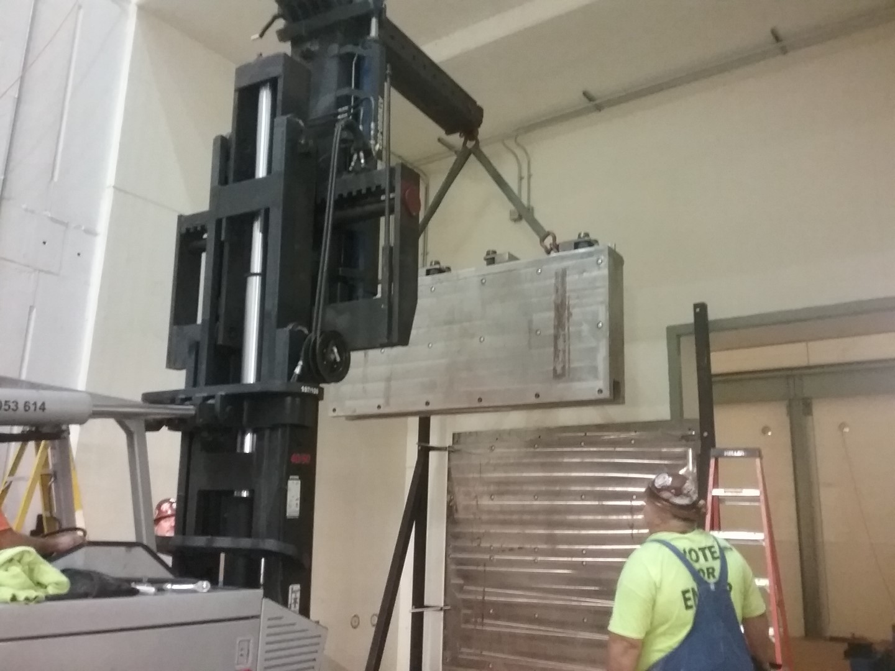
Sliding Shield Door with Railcar Pass-Thru
C-zero Radioactive Component Storage Facility – Mike Campbell 10-25-2019

Slide 19
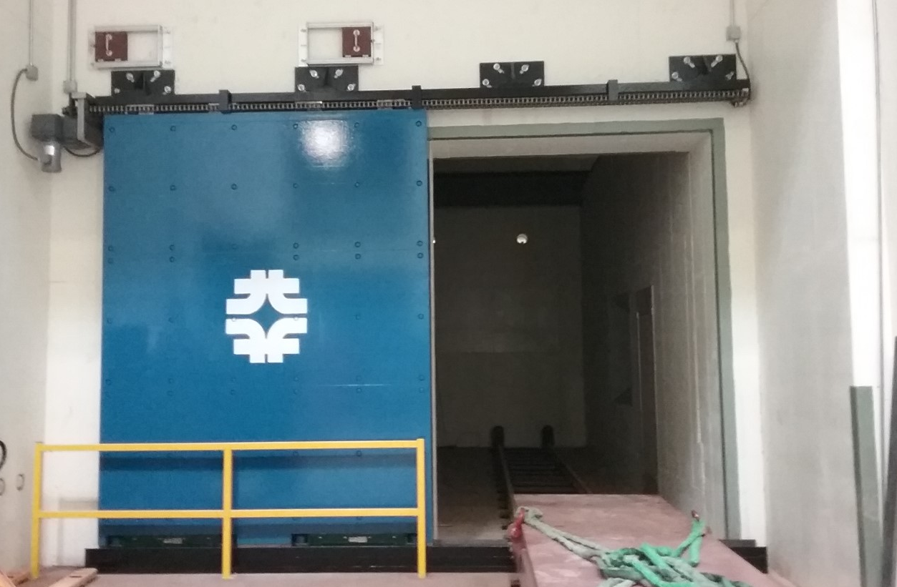
Sliding Shield Door with Railcar Pass-Thru
C-zero Radioactive Component Storage Facility – Mike Campbell 10-25-2019

Slide 20
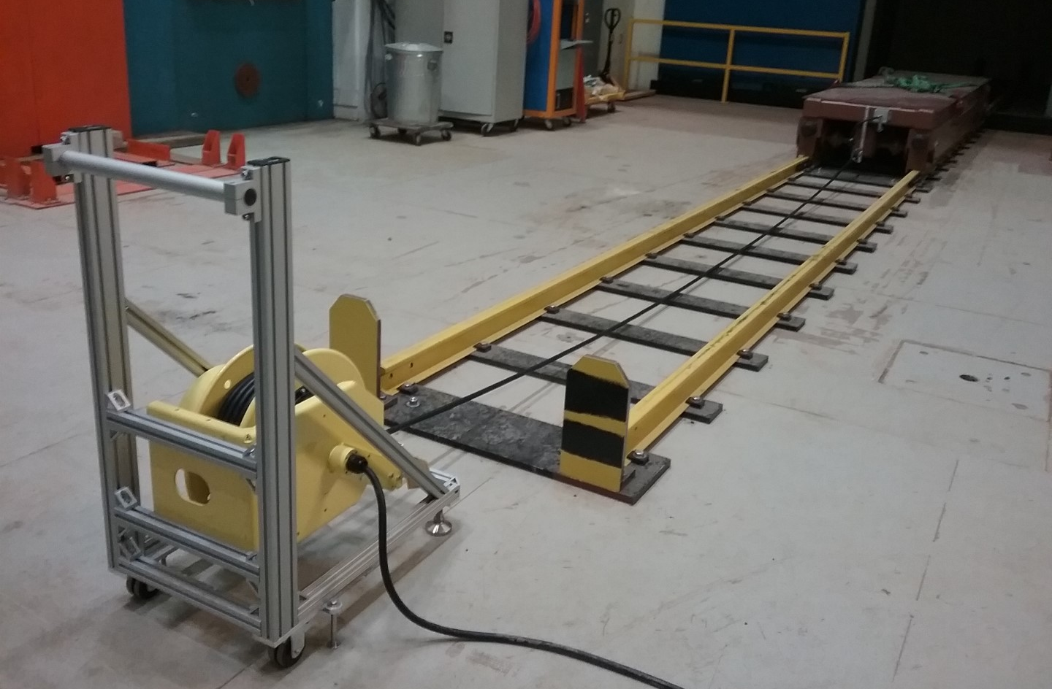
Sliding Shield Door with Railcar Pass-Thru
C-zero Radioactive Component Storage Facility – Mike Campbell 10-25-2019

Slide 21
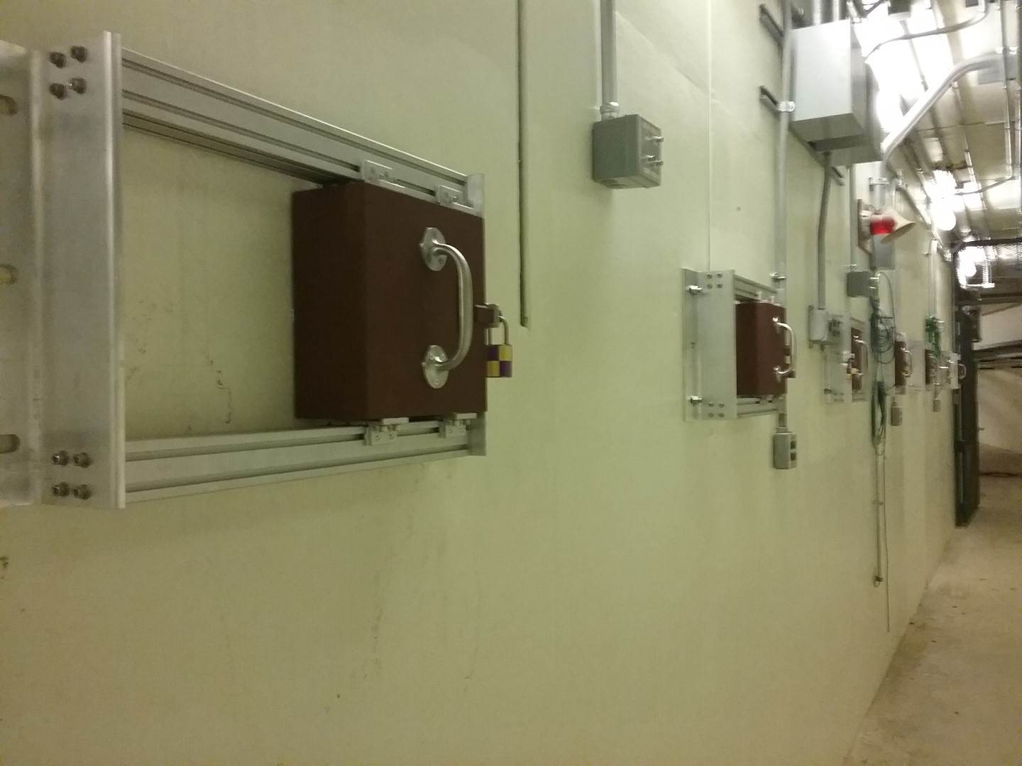
Cameras and Remote Viewing Station
C-zero Radioactive Component Storage Facility – Mike Campbell 10-25-2019

Slide 22
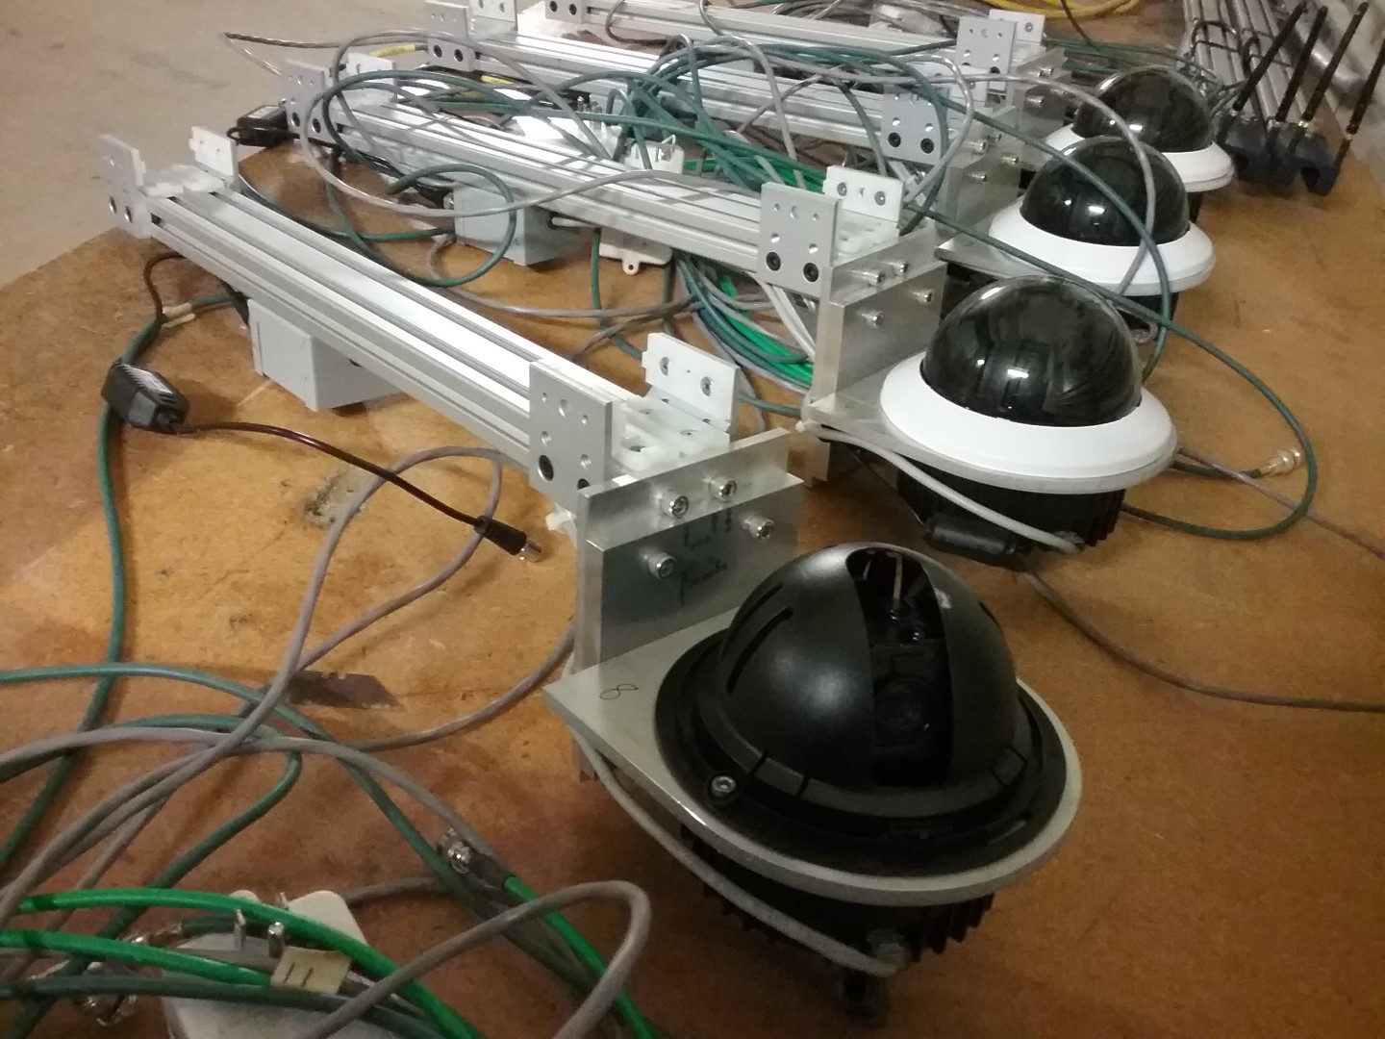
Cameras and Remote Viewing Station
C-zero Radioactive Component Storage Facility – Mike Campbell 10-25-2019

Slide 23
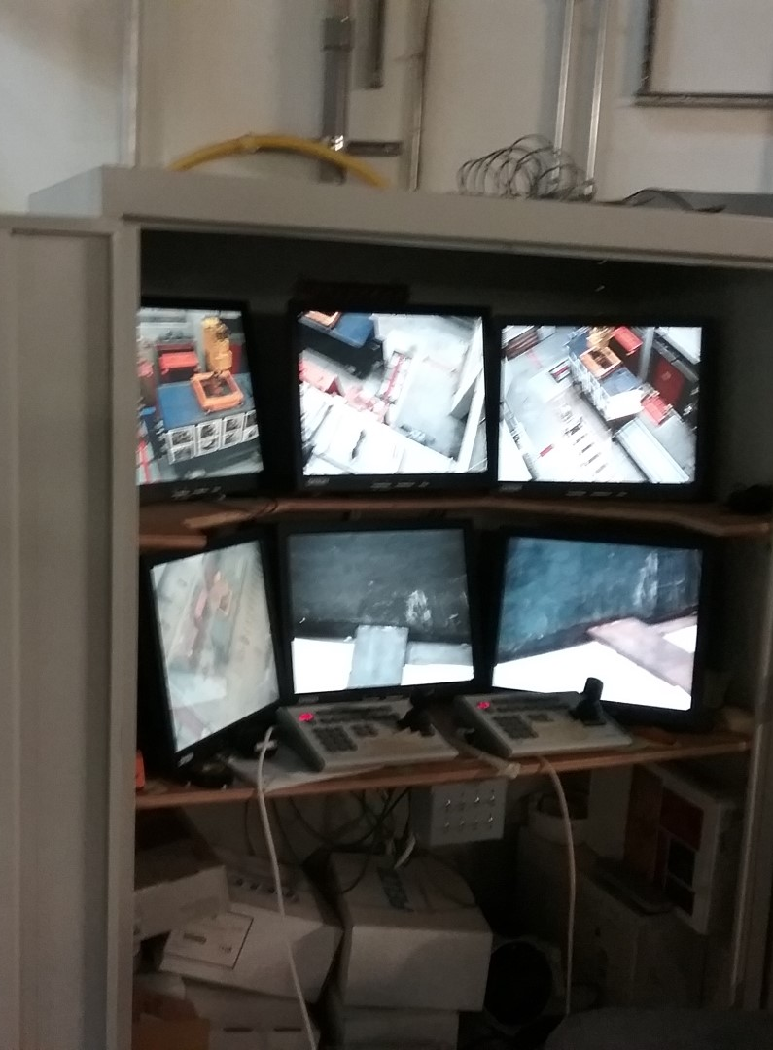
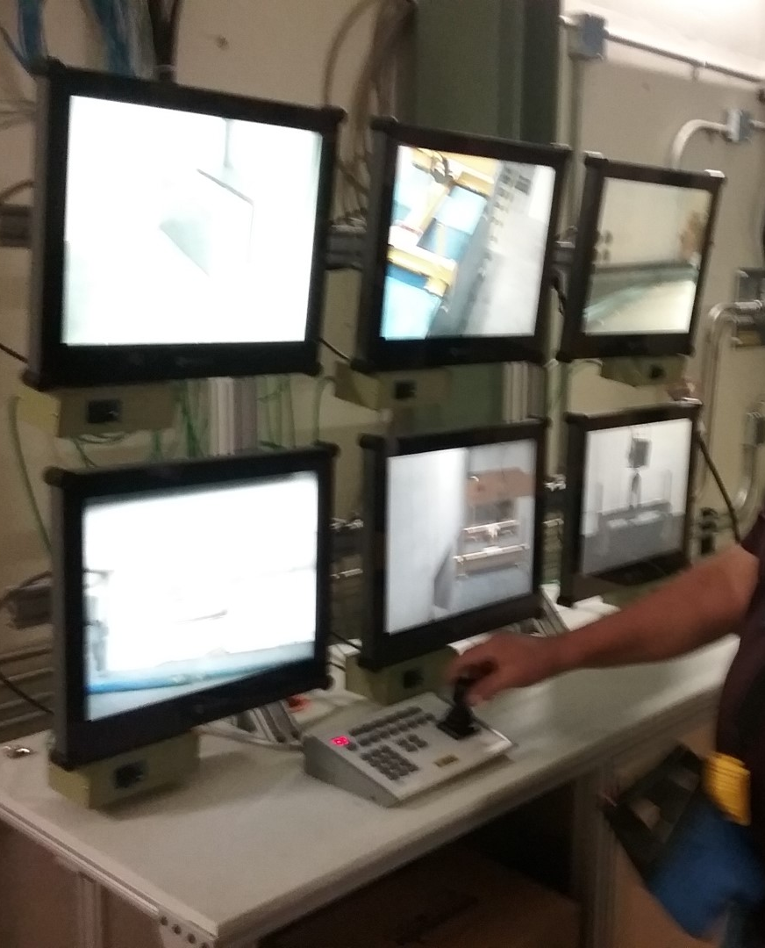
Cameras and Remote Viewing Station
C-zero Radioactive Component Storage Facility – Mike Campbell 10-25-2019

Slide 24
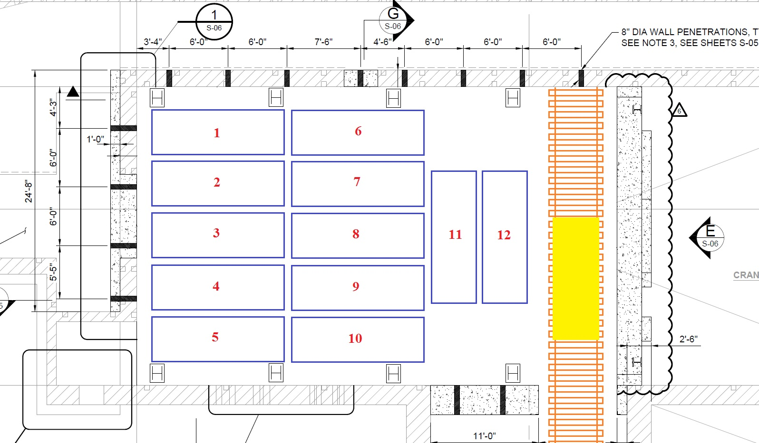
Moving In Our First Hot Component – The Planned Layout
NuMI / Nova Components
Mu2e Components
1
2
3
4
5
6
7
8
9
C-zero Radioactive Component Storage Facility – Mike Campbell 10-25-2019

Slide 25
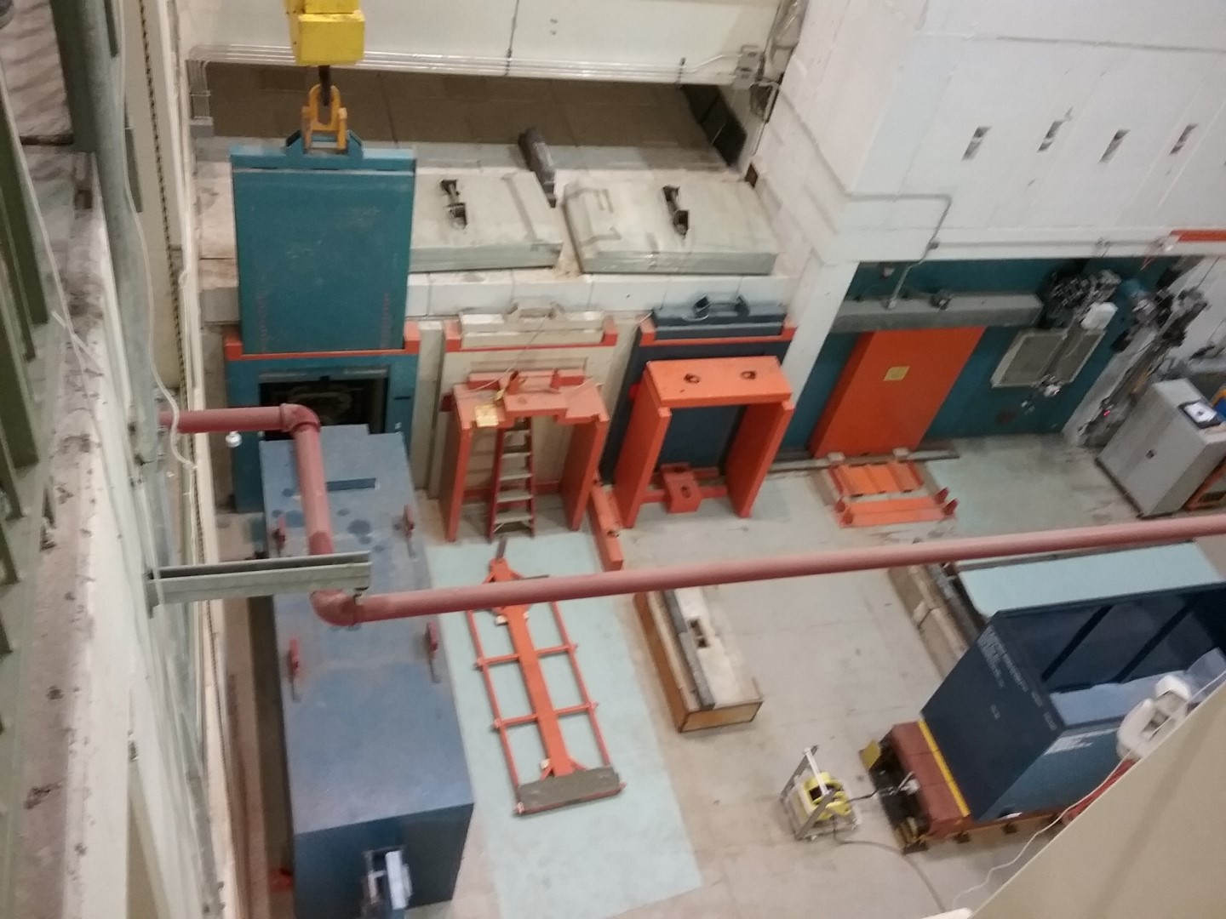
Moving In Our First Hot Component
June 27, 2019
NuMI Horn #PH1-02
C-zero Radioactive Component Storage Facility – Mike Campbell 10-25-2019

Slide 26
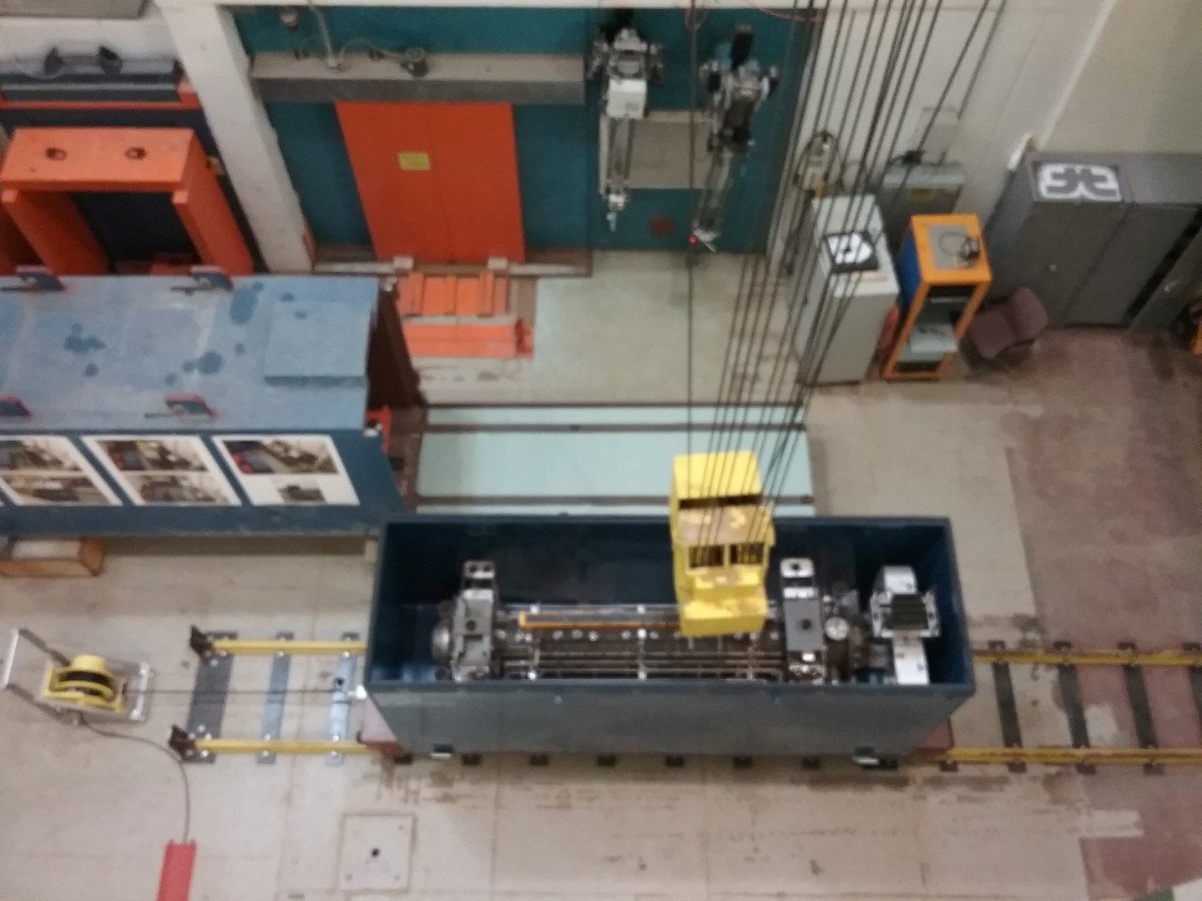
Moving In Our First Hot Component
C-zero Radioactive Component Storage Facility – Mike Campbell 10-25-2019

Slide 27
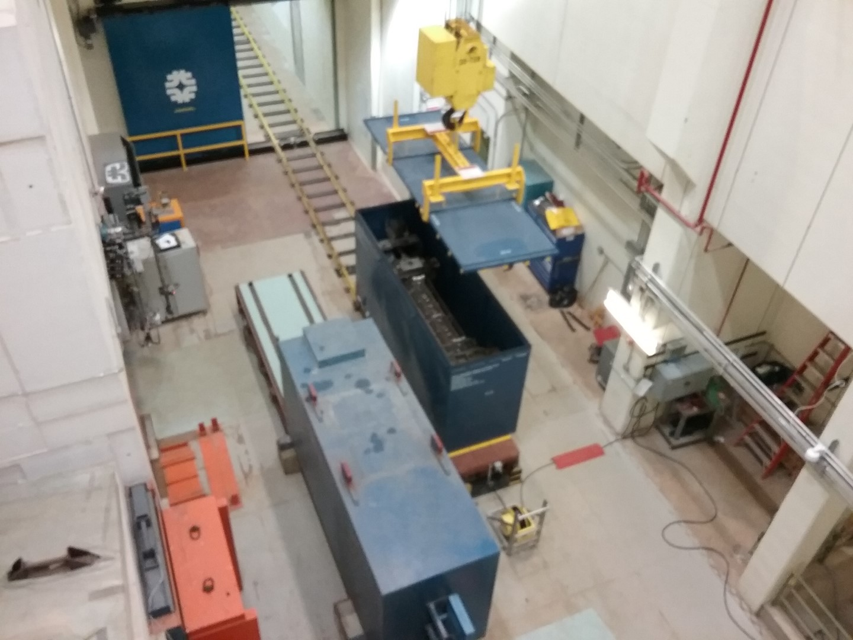
Moving In Our First Hot Component
C-zero Radioactive Component Storage Facility – Mike Campbell 10-25-2019

Slide 28
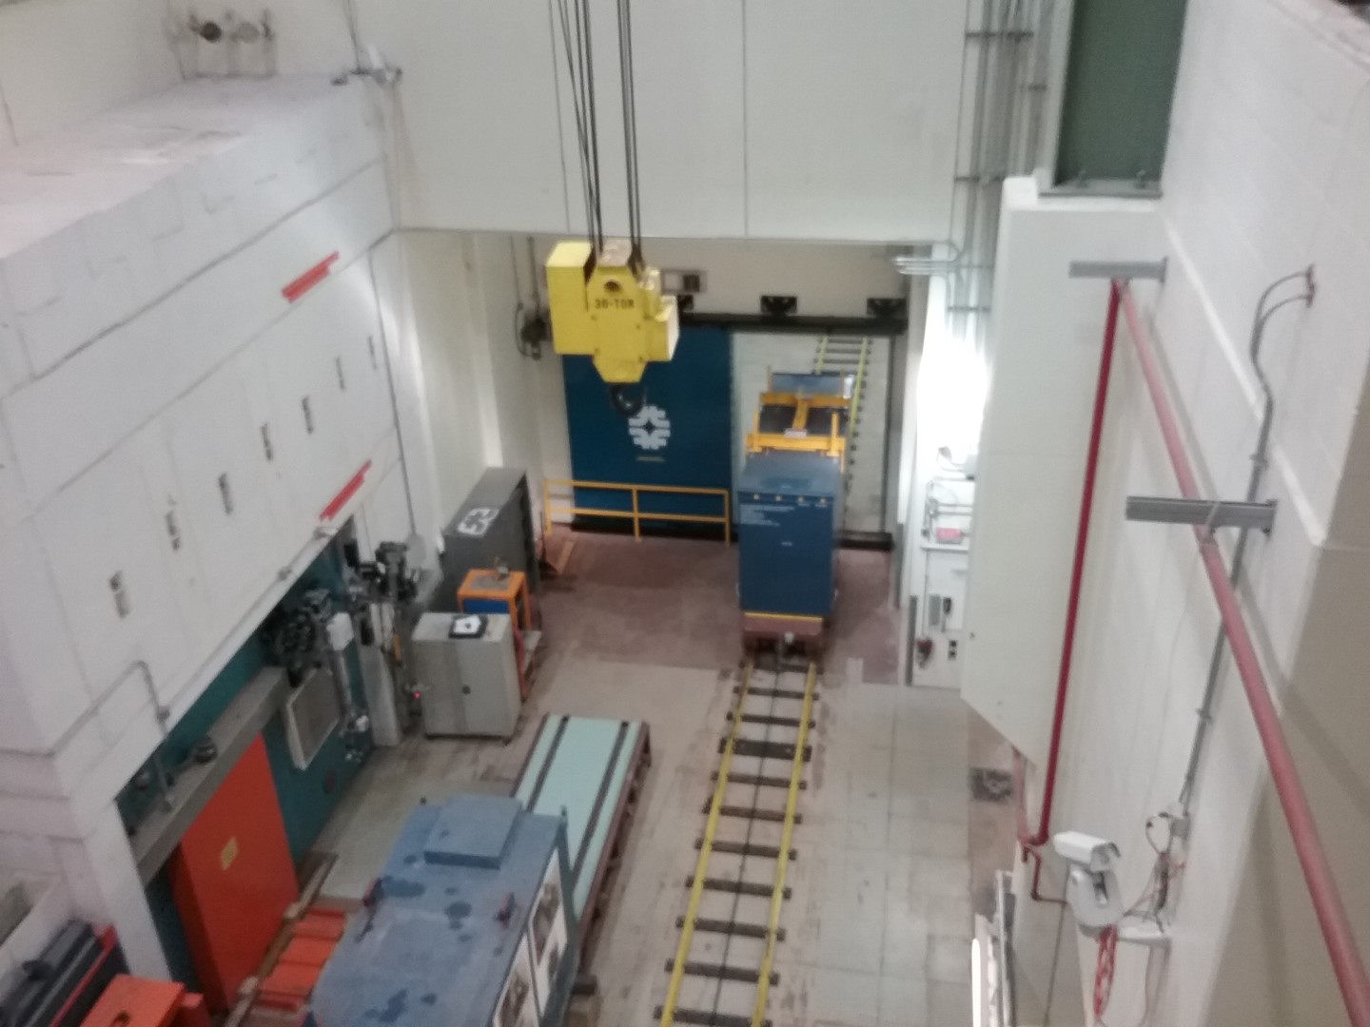
Moving In Our First Hot Component
C-zero Radioactive Component Storage Facility – Mike Campbell 10-25-2019

Slide 29
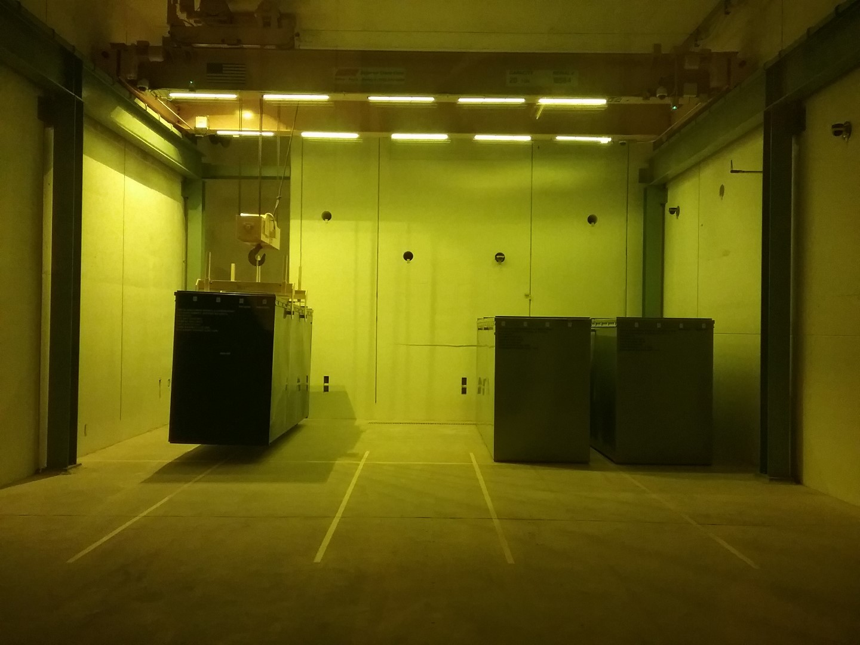
Moving In Our First Hot Component
C-zero Radioactive Component Storage Facility – Mike Campbell 10-25-2019

Slide 30
Moving In Our First Hot Component
Questions ?
C-zero Radioactive Component Storage Facility – Mike Campbell 10-25-2019

