Slide 1
Air Diverter for Cooling 1MW Horn Stripline
George Lolov
NBI 2019
10/24/2019

Slide 2
Outline
Horn 1 Overview
Environment
Stripline Design
Motivation for Testing and Requirements
Testing and Design Goals
T-Block Air Diverter
Testing
Pressure
Convection Coefficient
Air Diverter Redesign
Test Results
Air Diverter for Cooling 1MW Horn Stripline
10/24/19

Slide 3
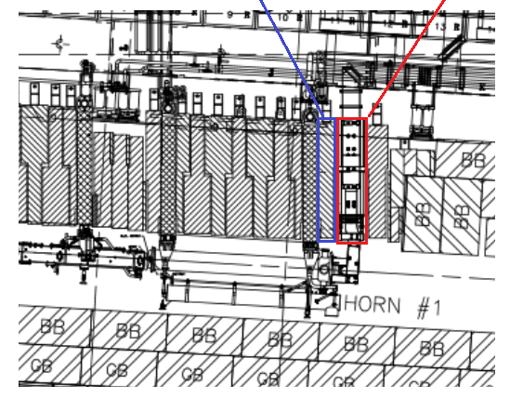
Horn 1 Layout and Environment
Chase
Horn Stripline
Airflow
Chase is kept cool with a large fan delivering ~ 25,000 CFM
Will be increased to ~ 28,000 for 1MW operation
Air Diverter
Air Diverter for Cooling 1MW Horn Stripline
10/24/19

Slide 4
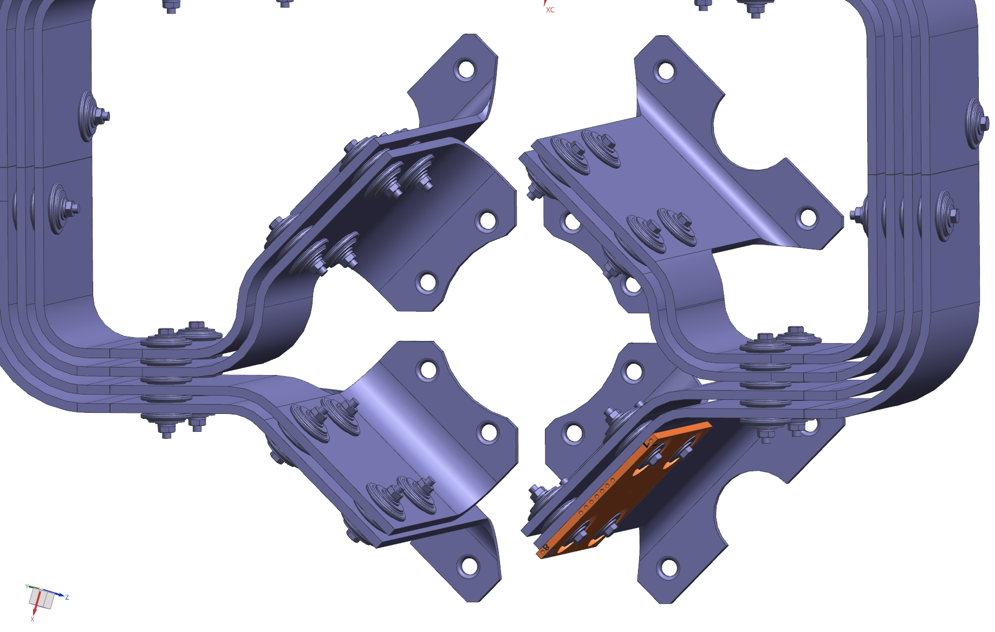
Horn 1 Stripline Overview
2 Main Stripline Areas
8 flags where majority of testing/analysis focused on
Inner stripline
Upper Flags
Stripline Span
Inner Flags
Outer Flags
Lower Flags
Air Diverter for Cooling 1MW Horn Stripline
10/24/19

Slide 5
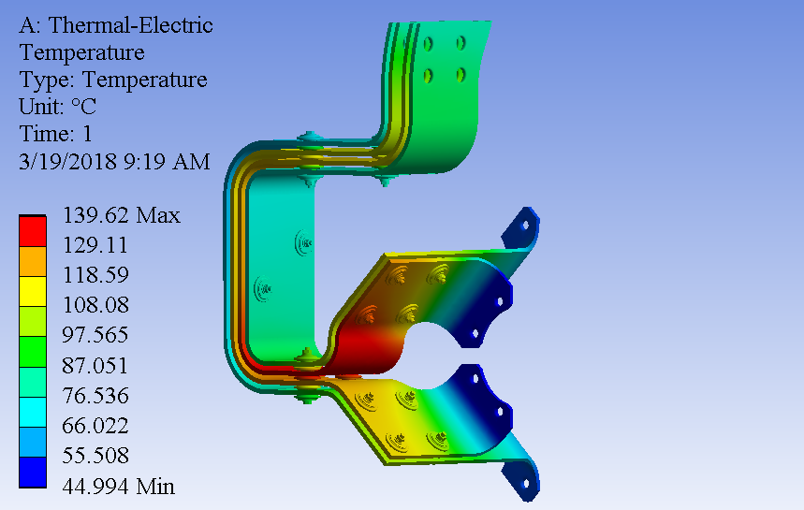
1MW Stripline Motivation & Requirements
Existing 700kW stripline & air diverter system is not a viable solution at 1MW.
Max stripline temperature desired to be less than 100C at any point.
Must maintain 100,000,000 pulse lifetime requirement. Temperature & resultant material creep makes pulse life determination impossible.
Goal:
Improve air cooling to stripline structure and reduce stripline temperature < 100C
Analysis Credit: Zhijing Tang
Air Diverter for Cooling 1MW Horn Stripline
10/24/19

Slide 6
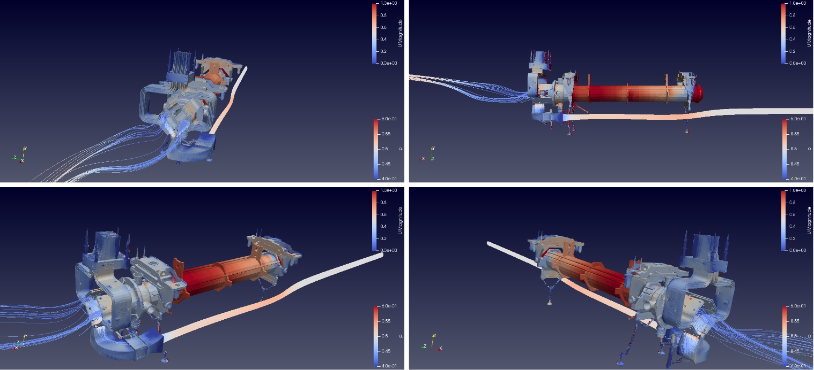
Testing & Design Goals
Understand existing air flow characteristics & heat transfer.
Identify improvements to existing structures & verify through iterative theoretical & experimental testing.
Verify conclusions and final production design with repeat wind tunnel & heat transfer test.
Analysis Credit: Lionel Pittman
Air Diverter for Cooling 1MW Horn Stripline
10/24/19

Slide 7
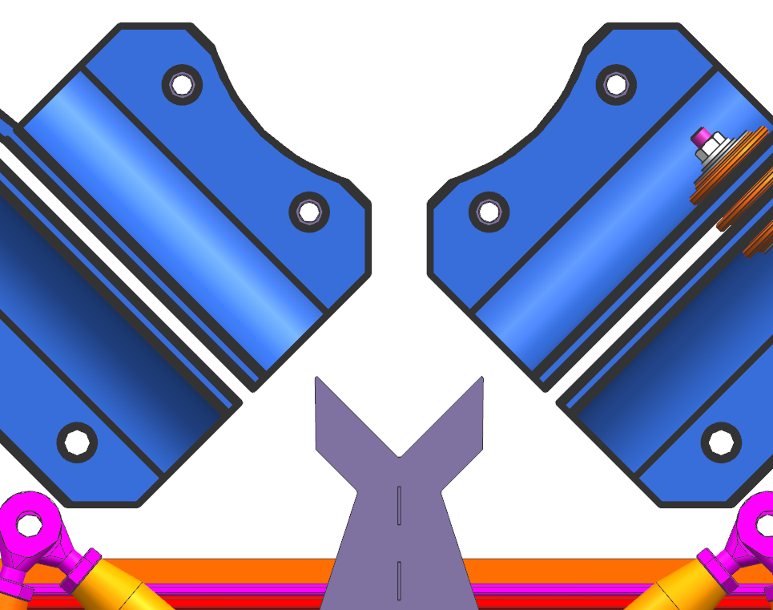
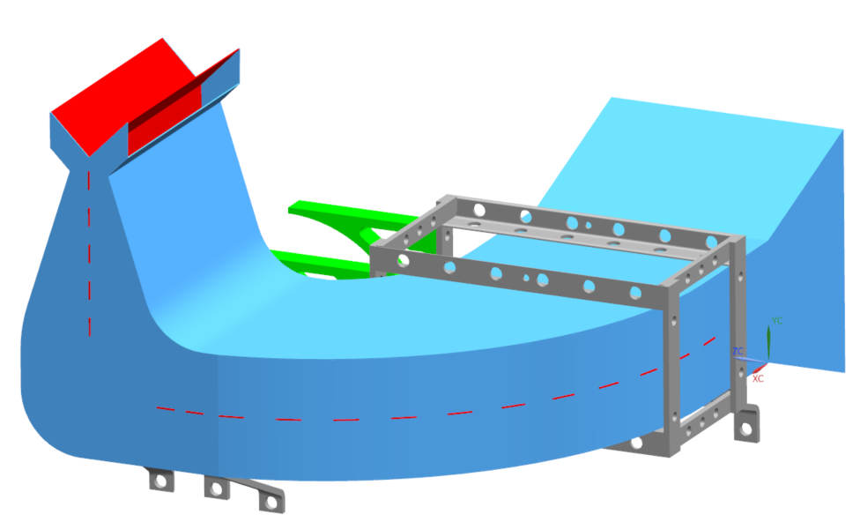
CFD Conclusions of Existing Diverter
Provides good flow for inner lower flags; moderate flow for inner upper flags.
Sharp edges and pinch points appear to impeded air velocity.
Initial thoughts were that they created eddy currents to improve flow.
Theoretical simulations show these can be improved.
Sharp Edges
Outlet Duct
Middle Duct
Mounting Bracket
Inlet Duct
Low Airflow
Low Airflow
Divider
Air Diverter for Cooling 1MW Horn Stripline
10/24/19

Slide 8
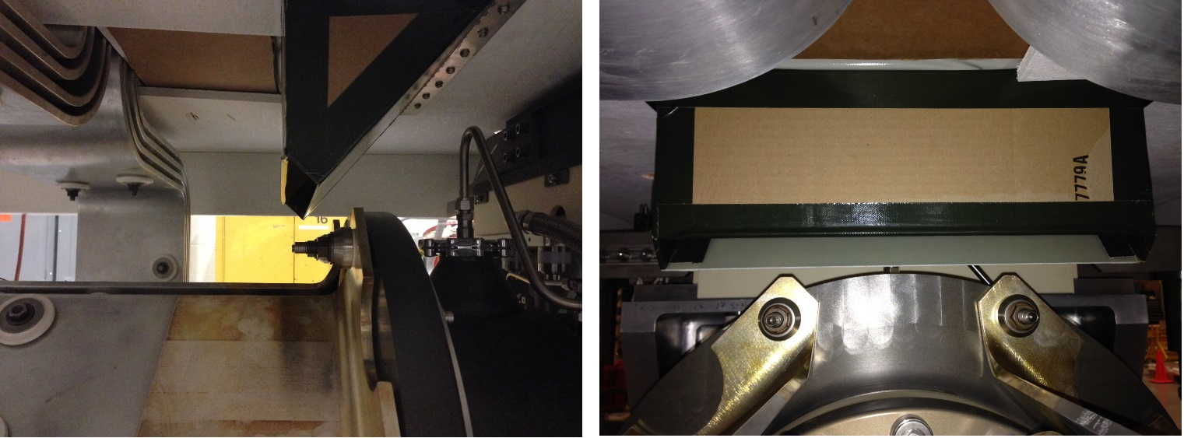
T-Block Air Diverter
Upper Flags
Solution needed to address stripline upper flags and vertical side spans.
Solution:
Dedicate T-block with internal duct (direct access to upper flags)
Air deflection from T-block appears to greatly help vertical side spans as well.
Multiple diverter angles tested; winner is 45 degrees at ~600 CFM.
Air Diverter for Cooling 1MW Horn Stripline
10/24/19

Slide 9
T-Block Air Diverter Location
T-Block to be Redesigned
Stripline Route
Air Diverter for Cooling 1MW Horn Stripline
10/24/19

Slide 10
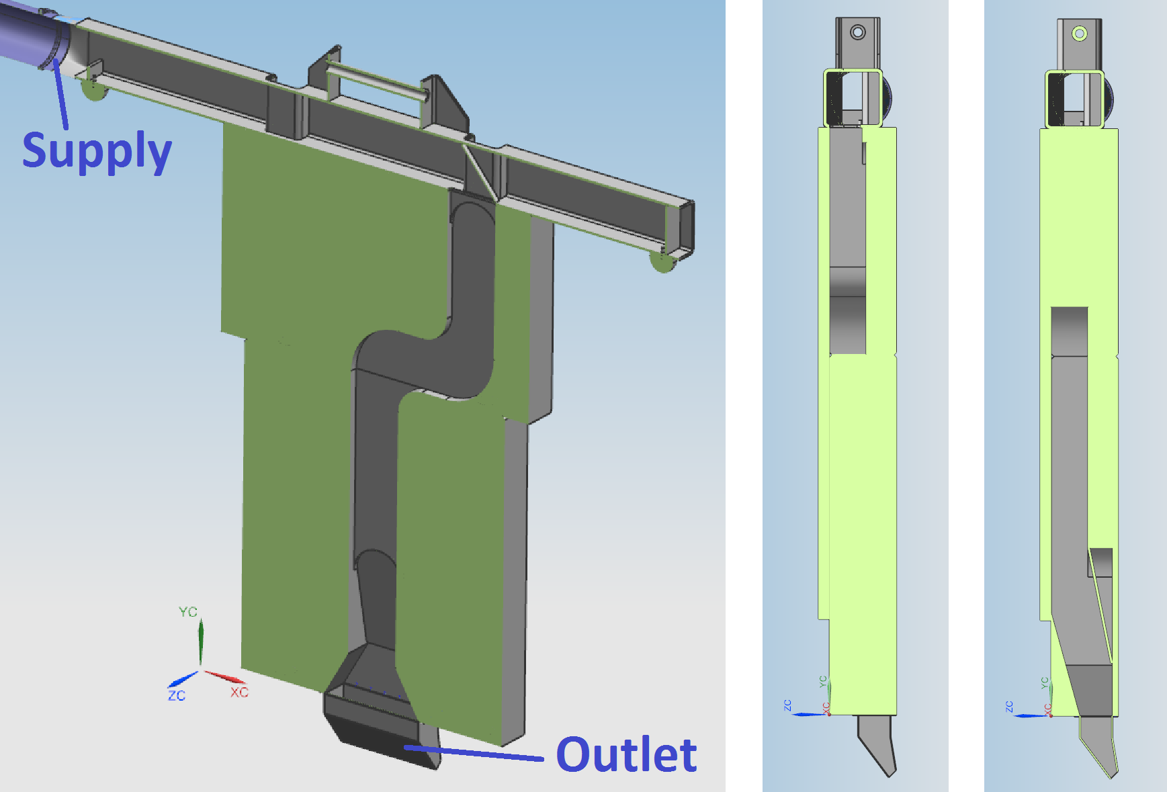
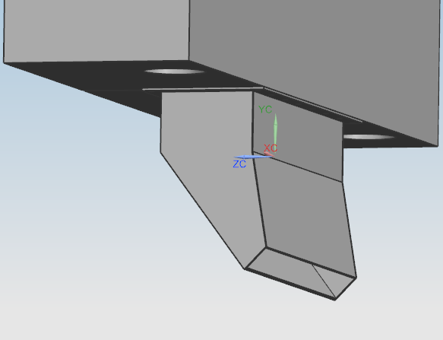
T-Block Air Diverter
C. Crowley
Drop in replacement T-block.
Channel dimensions minimized (8” wide X 4” deep).
Supply will employ quick disconnect coupling.
Outlet
Air Diverter for Cooling 1MW Horn Stripline
10/24/19

Slide 11
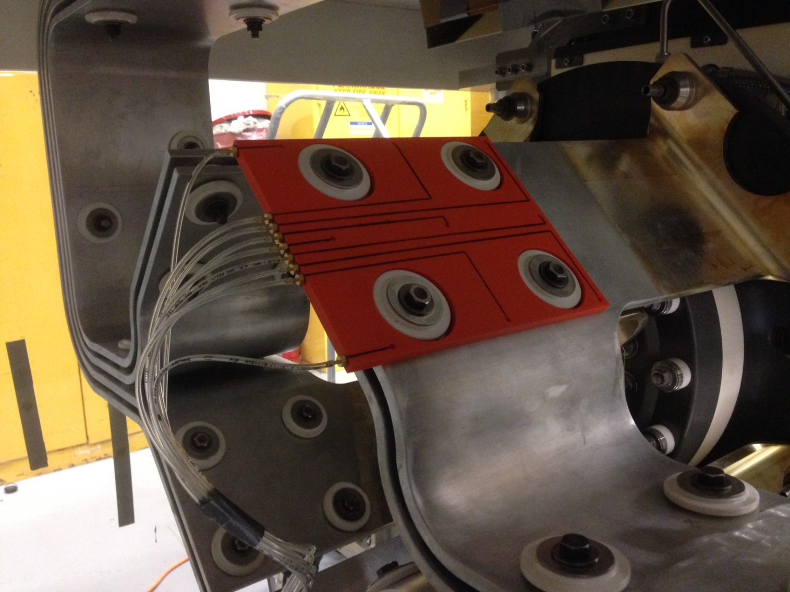
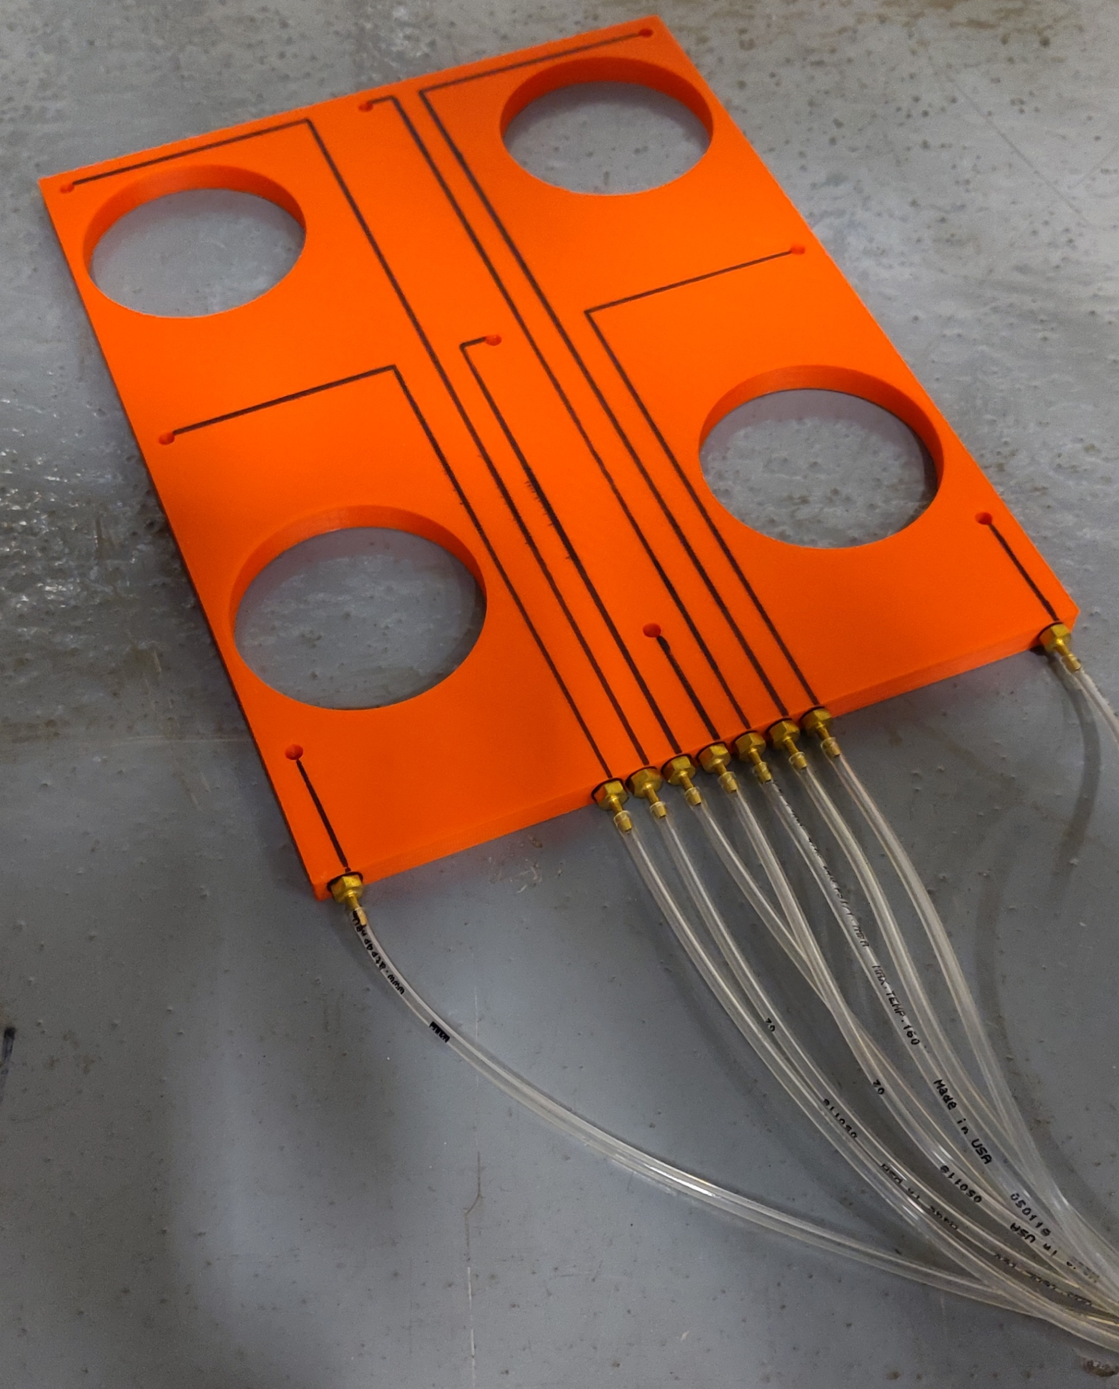
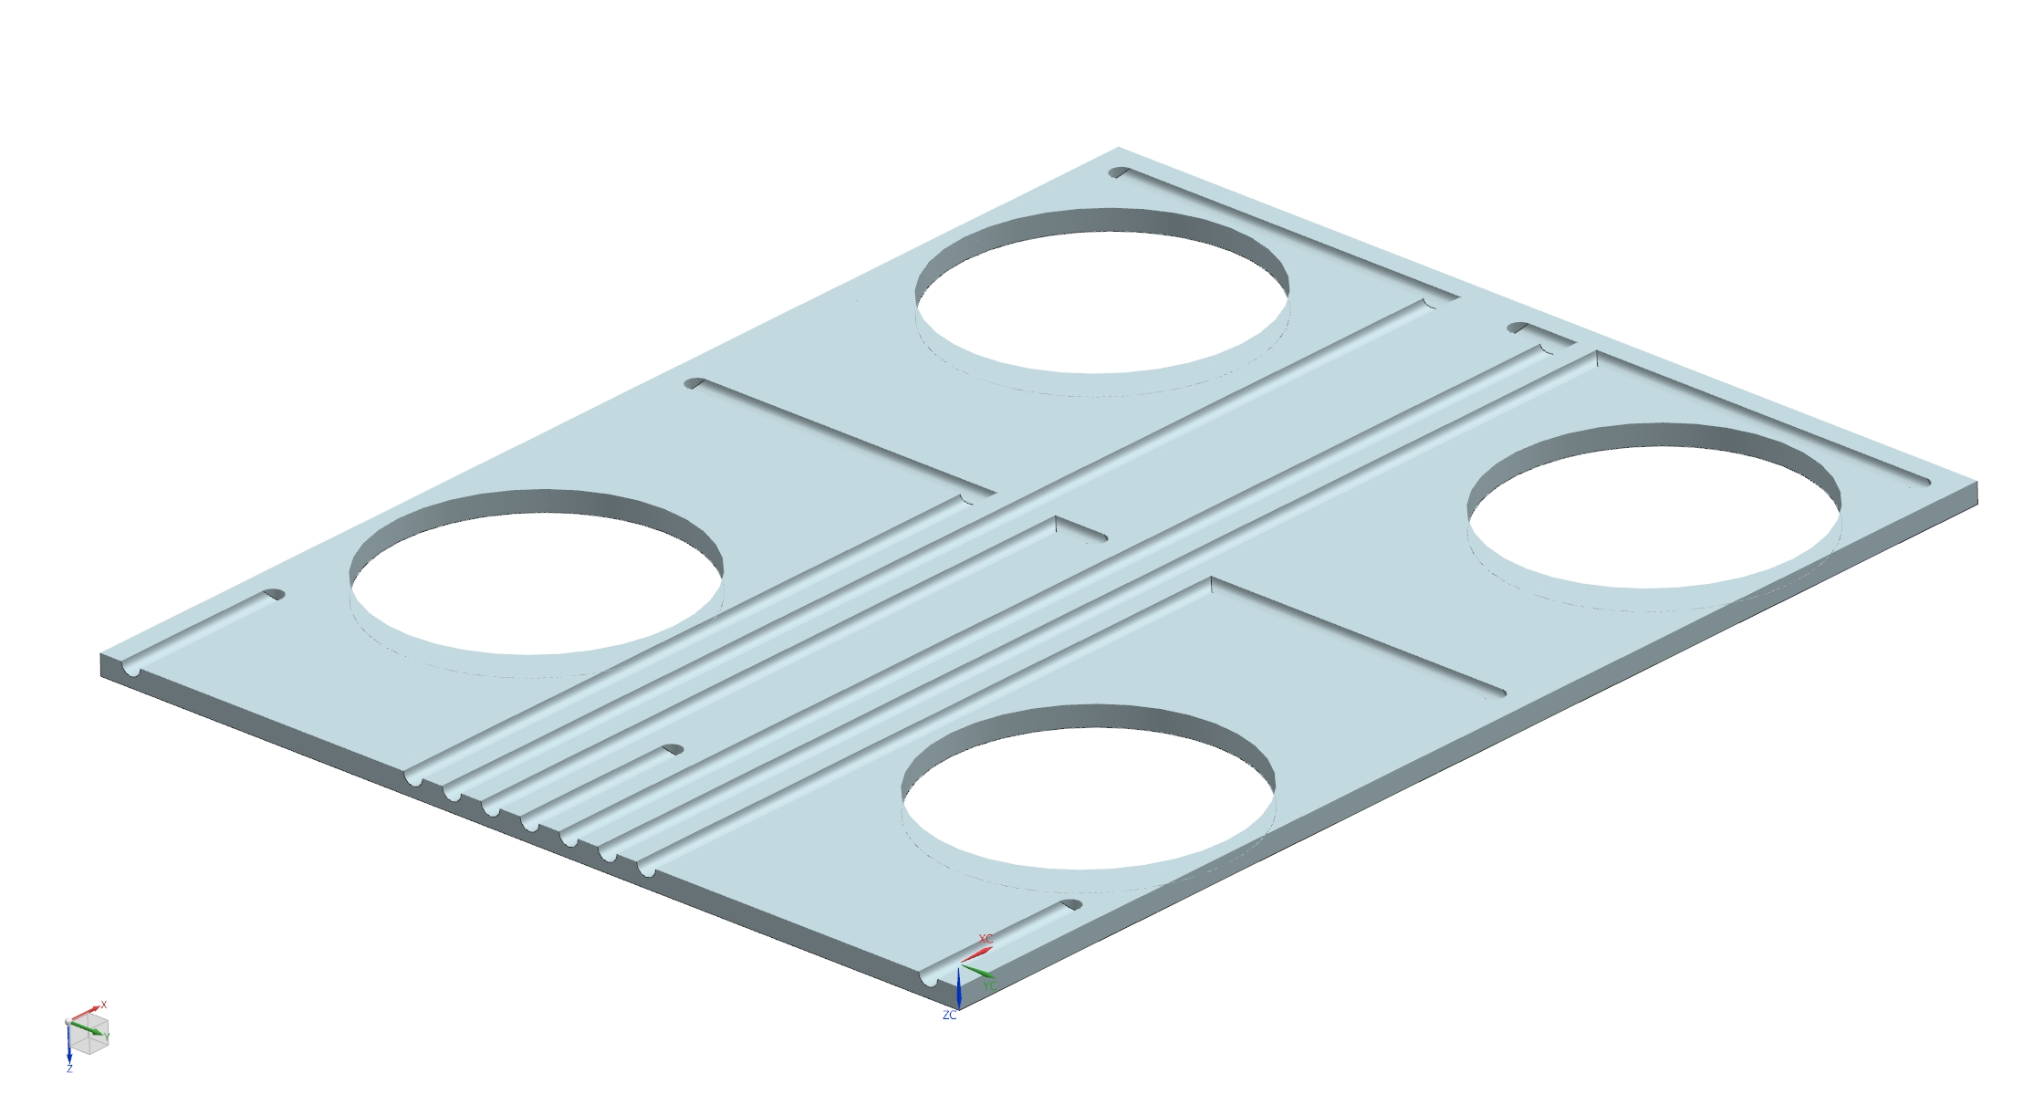
Test Setup - Pressure Testing Trials
Fixed on each of the 8 flag faces and measured airflow pressure at 9 locations on the flag surfaces
Air Diverter for Cooling 1MW Horn Stripline
10/24/19

Slide 12
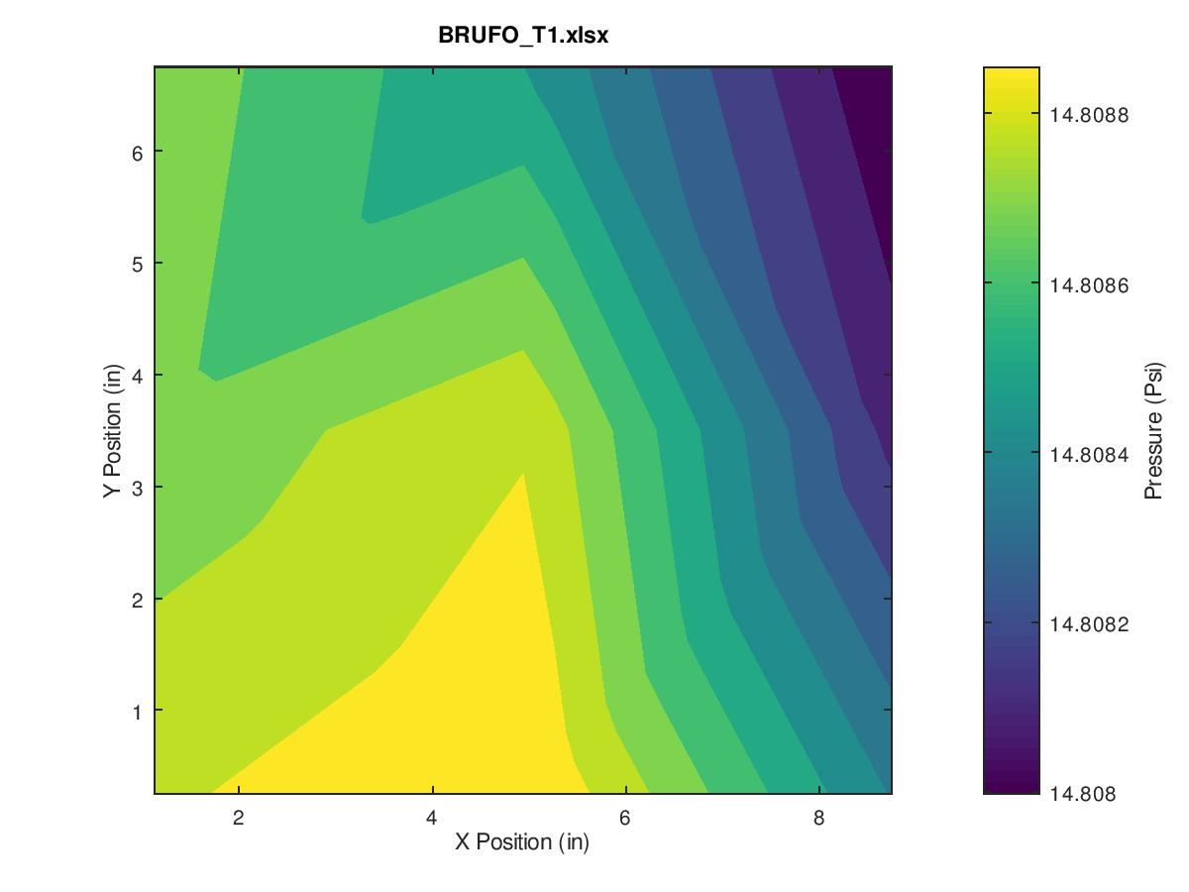
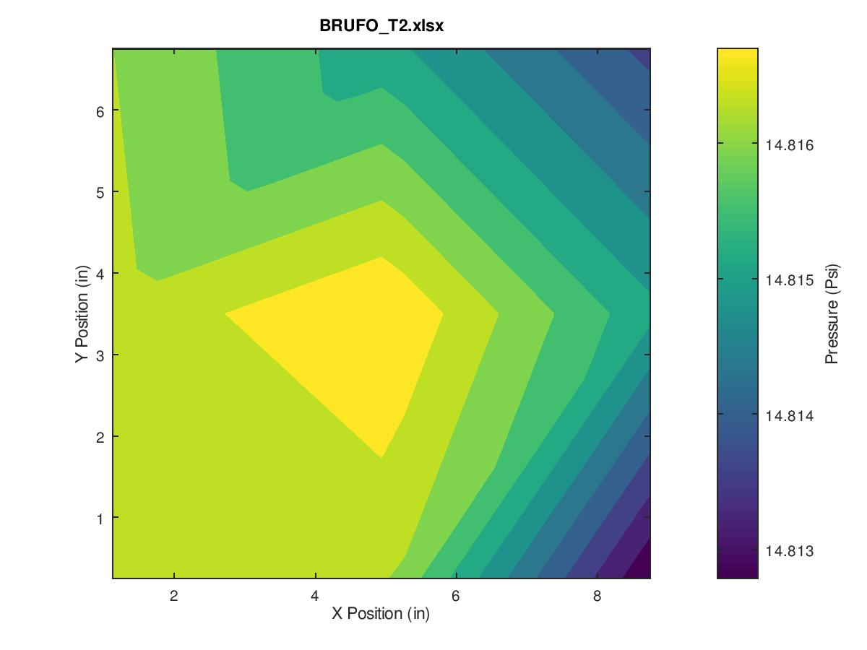
Pressure Testing
Ran pressure tests for each iteration of the top and bottom diverters.
Results mostly inconclusive. Pressure drop not large enough to provide reliable data.
Air Diverter for Cooling 1MW Horn Stripline
10/24/19

Slide 13
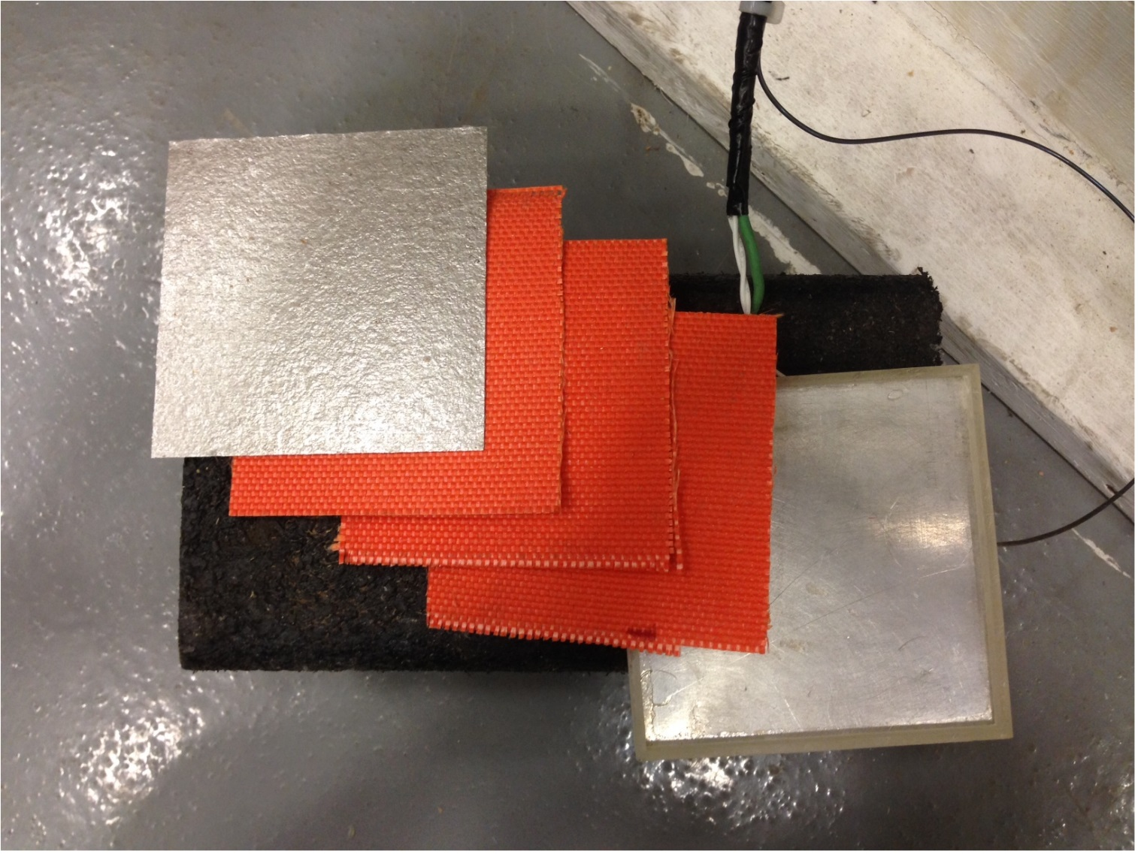
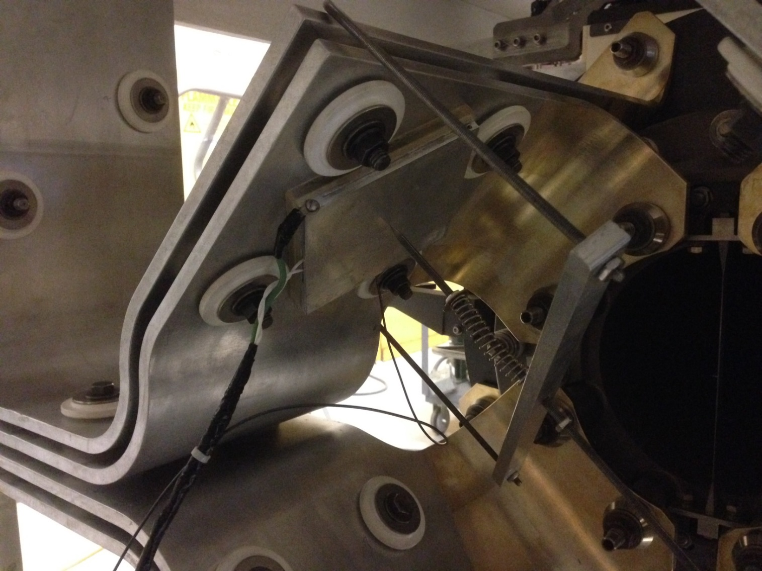
Convection Coefficient Testing
Al coupon with heating pad and thermocouple inside.
Set on each of the flag faces
Set heater to 80W
Turned on the airflow
Observed cooling curve until SS temperature was reached
Air Diverter for Cooling 1MW Horn Stripline
10/24/19

Slide 14
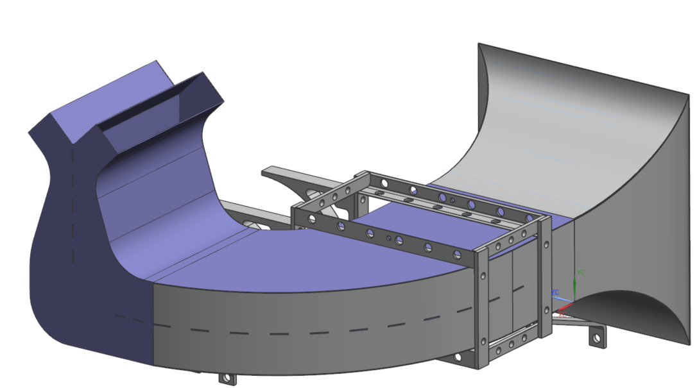
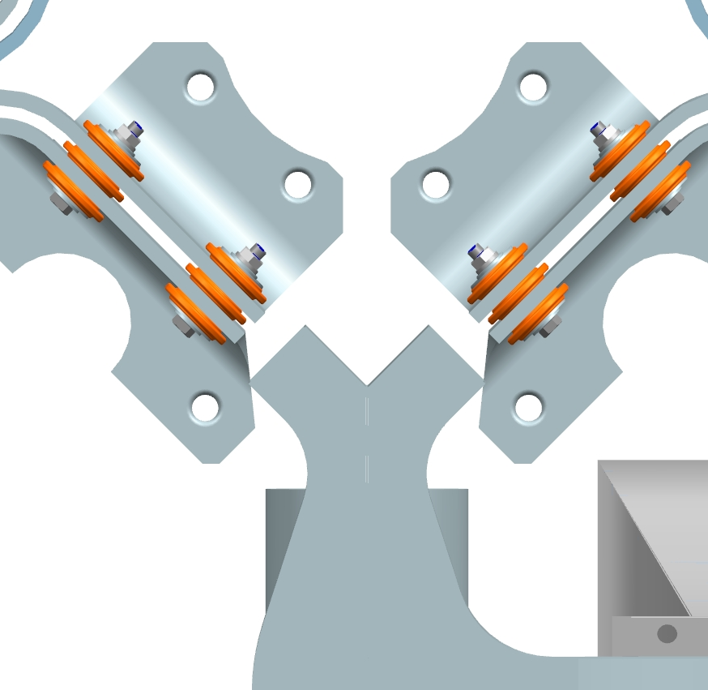
Old / New Diverter Comparison
Sharp Edges
Low Airflow
Low Airflow
Outlet Duct
Middle Duct
Divider
Mounting Bracket
Inlet Duct
Smooth Edges
Balanced Airflow
Outlet Duct
Middle Duct
Divider
Mounting Bracket
Inlet Duct
Air Diverter for Cooling 1MW Horn Stripline
10/24/19

Slide 15
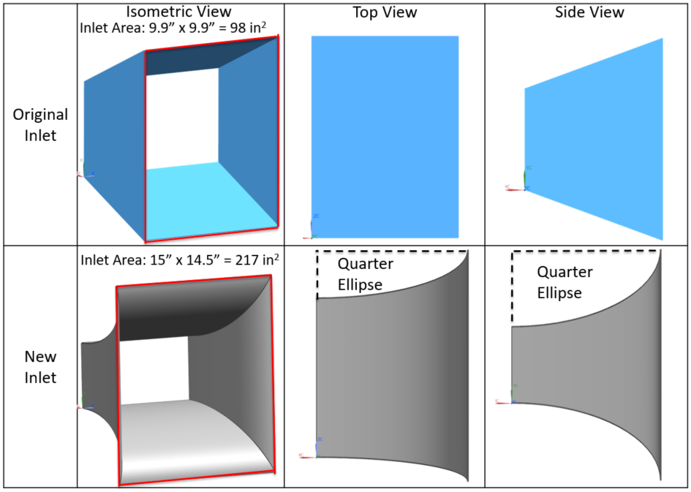
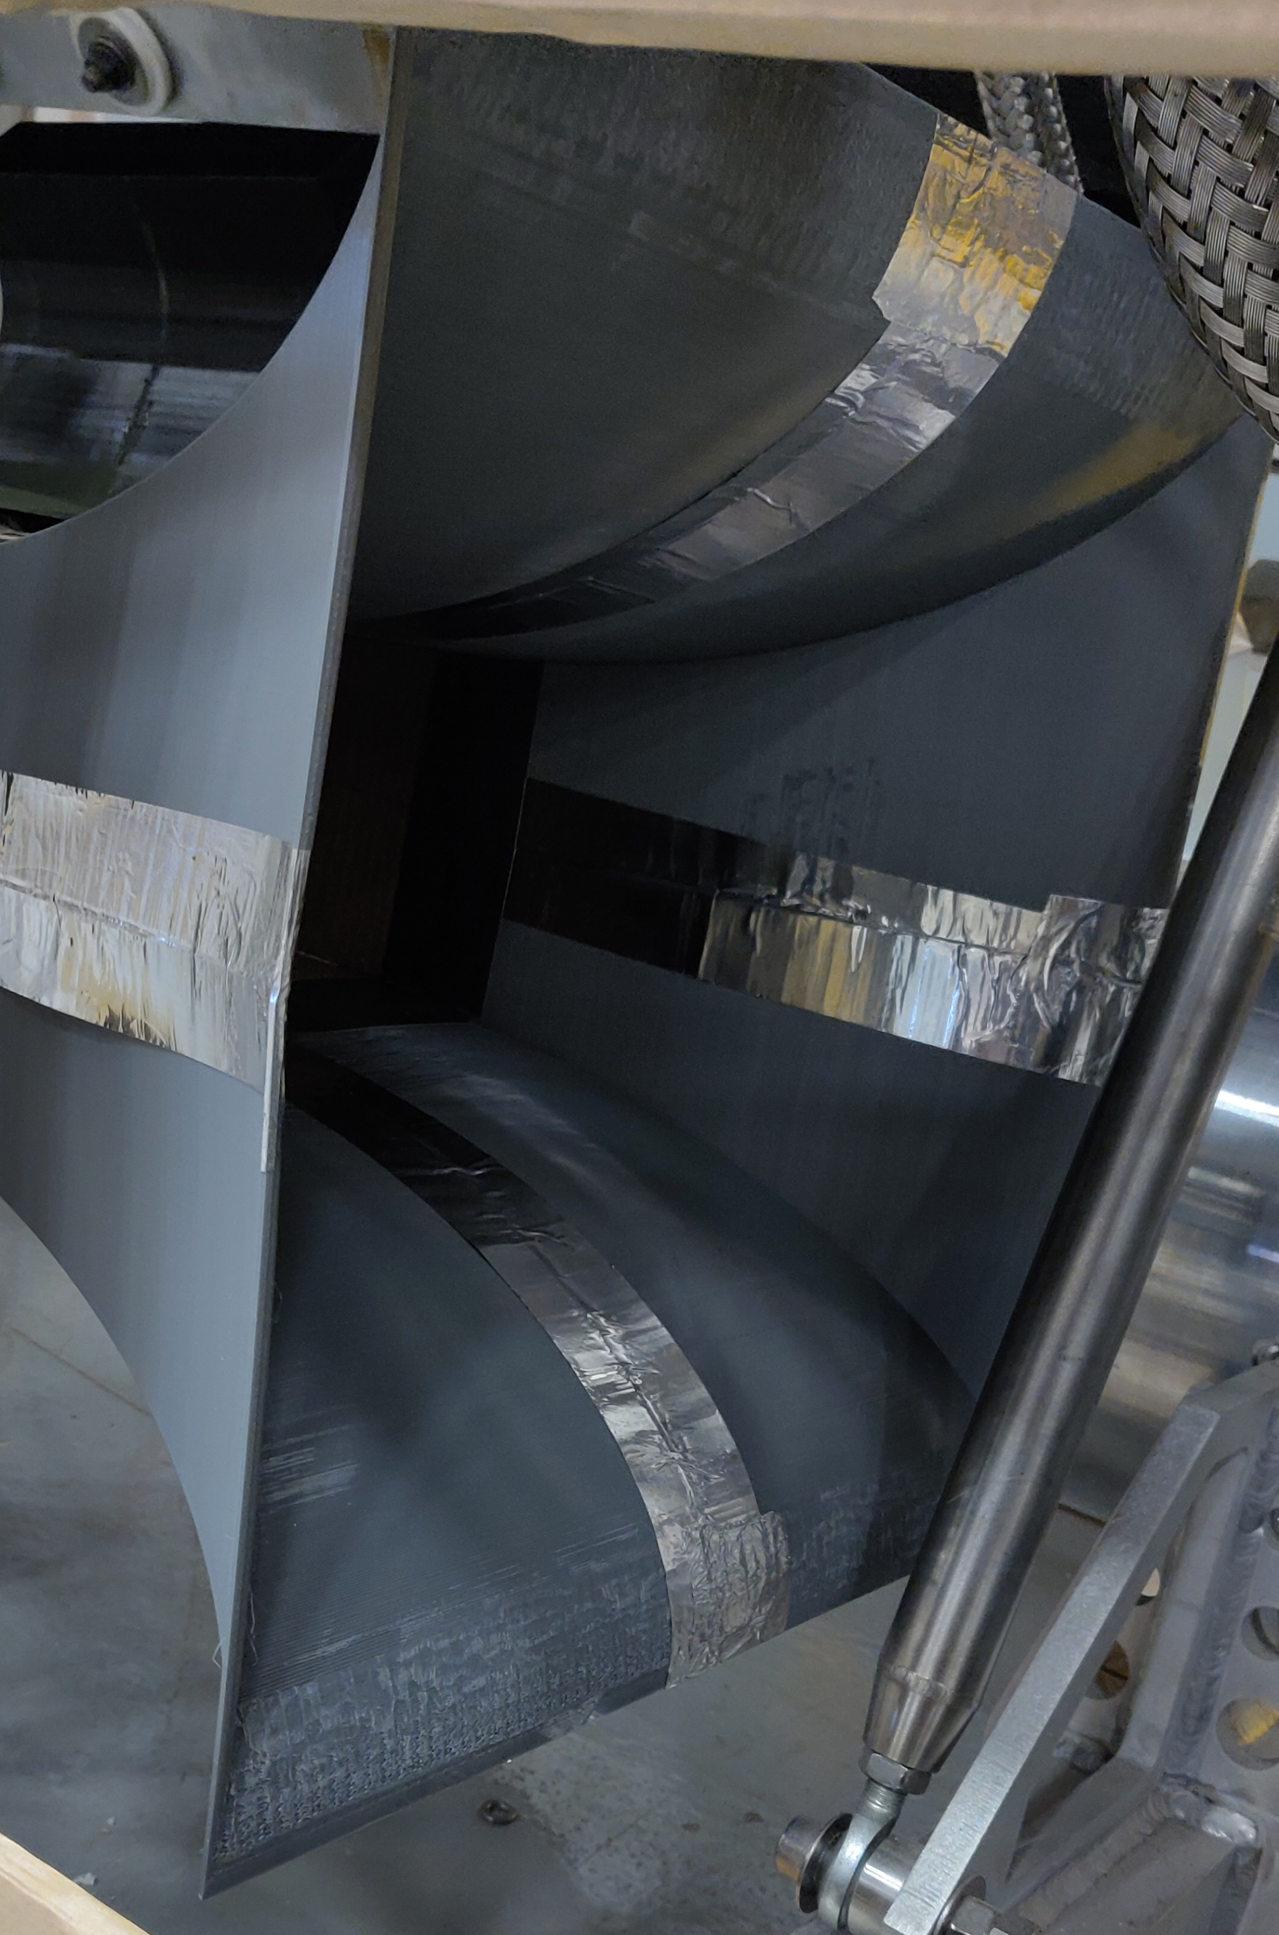
New Diverter Design: Inlet
New Inlet features 4 sheets curved into elliptical geometry.
Initially tried creating from cardboard- didn’t turn out so well.
Split into 4 sections and 3D printed (K. Anderson)
Air Diverter for Cooling 1MW Horn Stripline
10/24/19

Slide 16
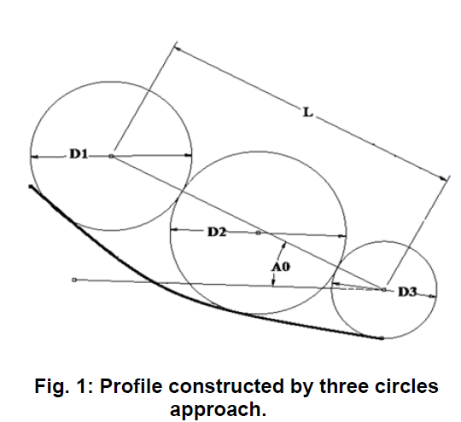
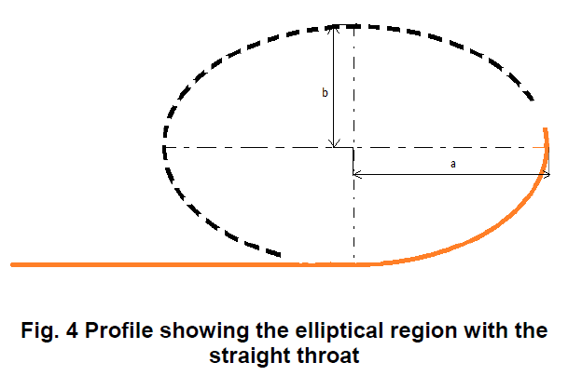
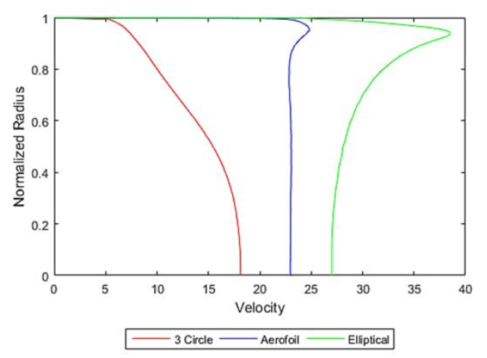
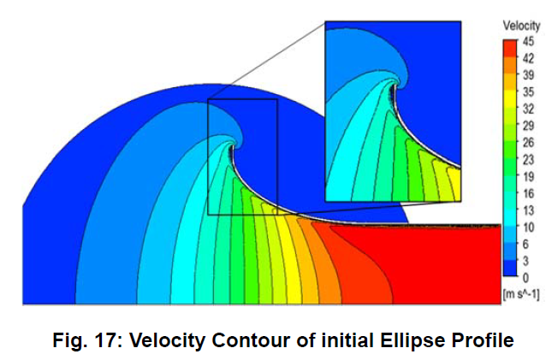
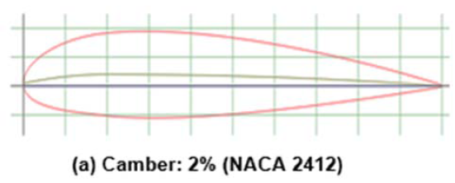
New Diverter Design: Inlet
DEVELOPMENT OF BELL MOUTH FOR LOW SPEED AXIAL FLOW
COMPRESSOR TESTING FACILITY
Apurva Tiwari Et al.
Air Diverter for Cooling 1MW Horn Stripline
10/24/19

Slide 17
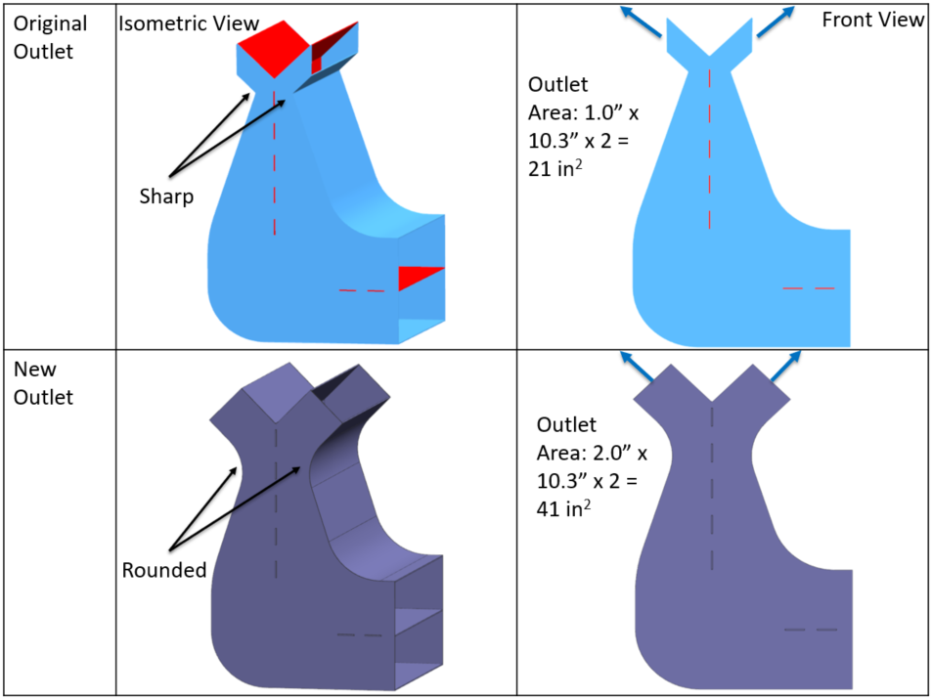
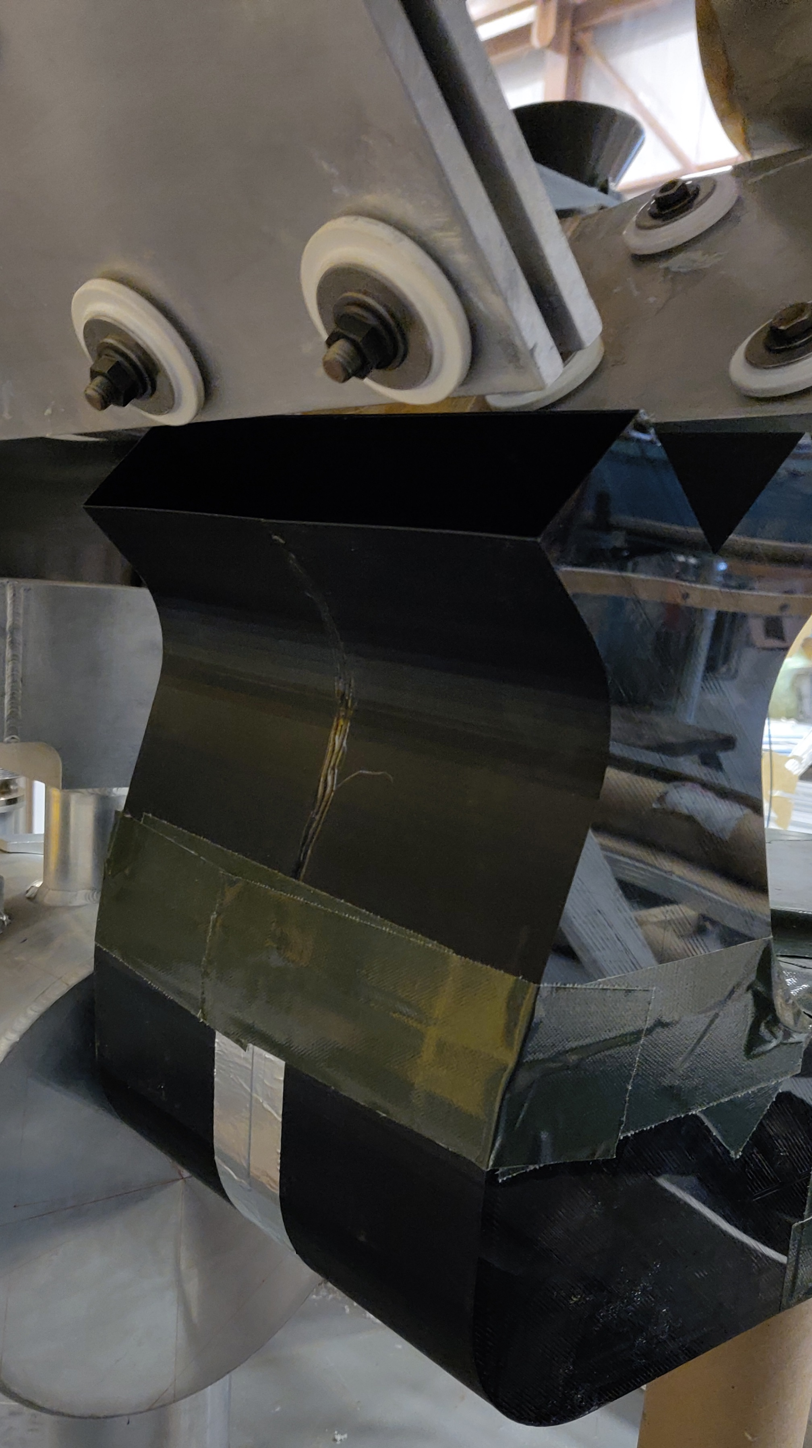
New Diverter Design: Outlet
Because we doubled the inlet area, we also doubled the outlet area – airflow covers more flag surface area.
Didn’t bother with cardboard, split up into 4 pieces and 3D printed.
Air Diverter for Cooling 1MW Horn Stripline
10/24/19

Slide 18
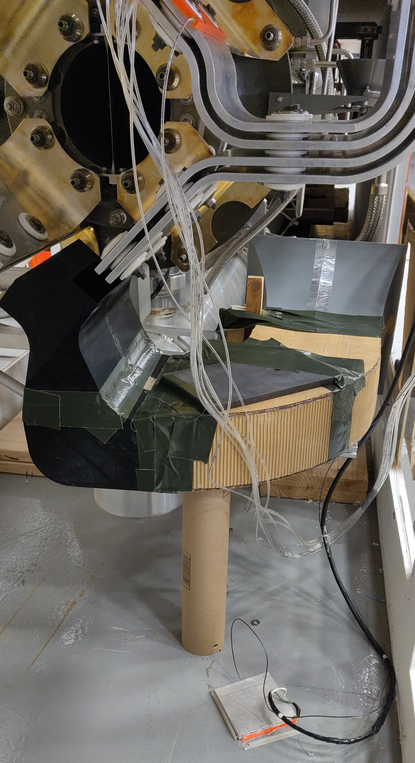
Diverter Prototype
3D Printed Inlet
Cardboard Middle Section with Cardboard Divider
3D Printed Outlet
Air Diverter for Cooling 1MW Horn Stripline
10/24/19

Slide 19
Stripline Problematic Areas: Between Striplines
Segment # | External (W/m2∙K) | Internal (W/m2∙K)
1 | 5 | 2
2 | 15 | 5
3 | 36 | 5
4 | 36 | 5
5 | 36 | 5
6 | 36 | 5
7 | 36 | 5
8 | 15 | 5
Air Diverter for Cooling 1MW Horn Stripline
10/24/19

Slide 20
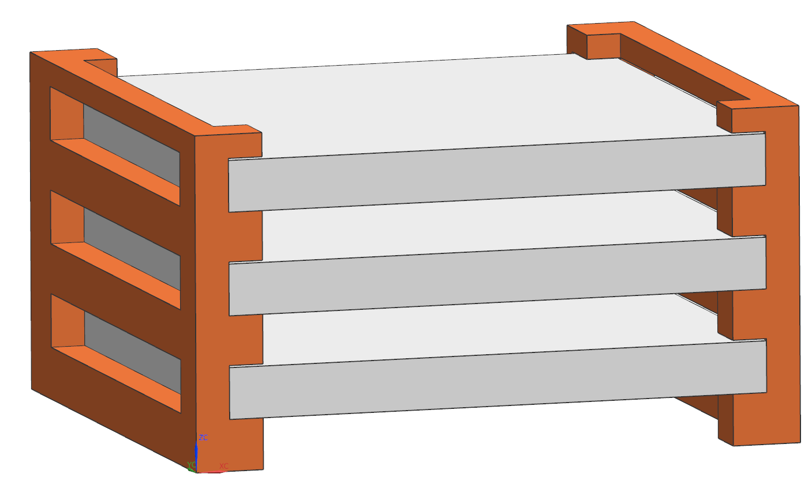
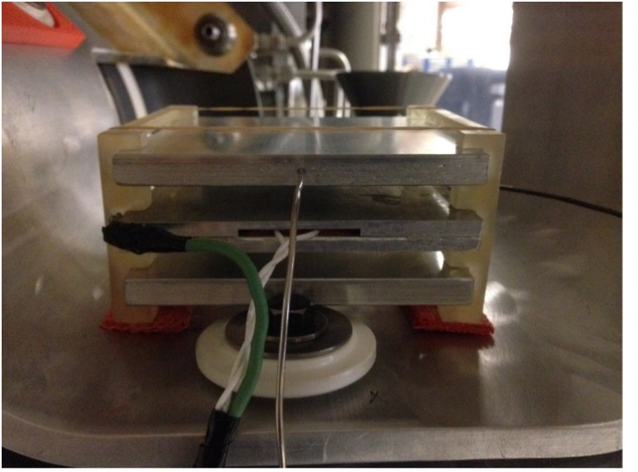
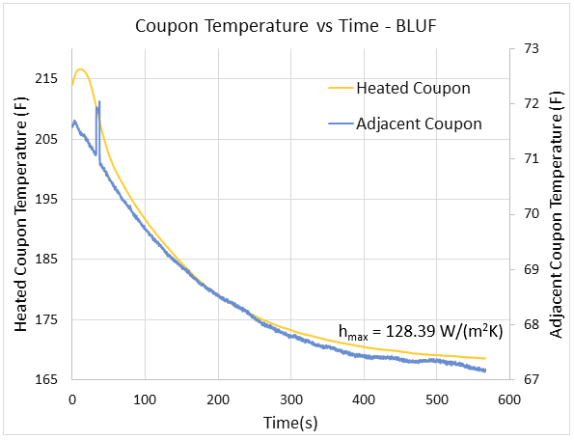
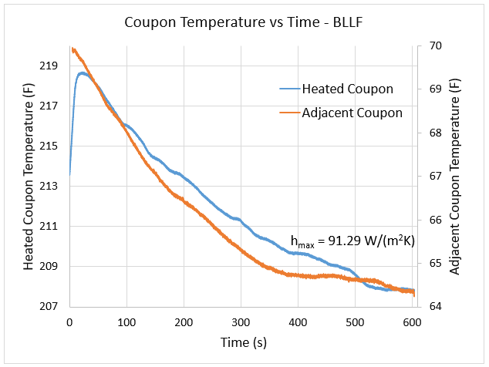
Convection Coefficient Testing
Assumed stagnant air convection coefficient between the striplines unless proven otherwise.
Simulations showed inner stripline temps to be too high.
Experimentally determined convection coefficient for most problematic areas.
4.25”
J-Type Thermocouple
4.25”
T
Adjacent Coupon
3/8”
T
3/8”
Heating Pad
3/8”
3/8”
3/8”
Air Diverter for Cooling 1MW Horn Stripline
10/24/19

Slide 21
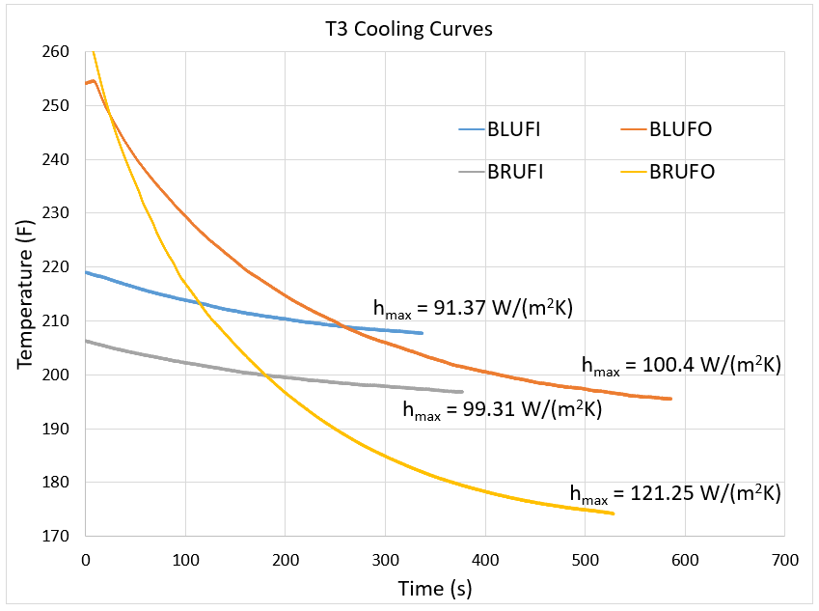
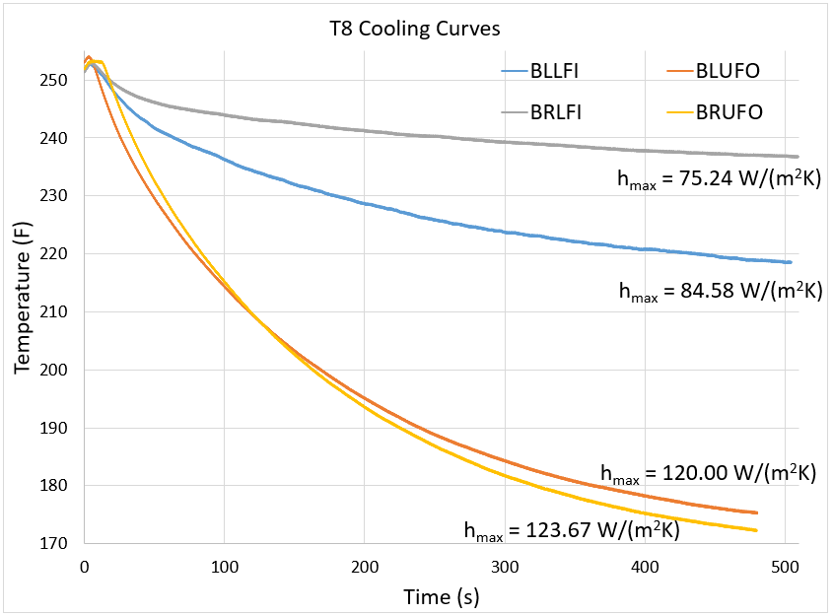
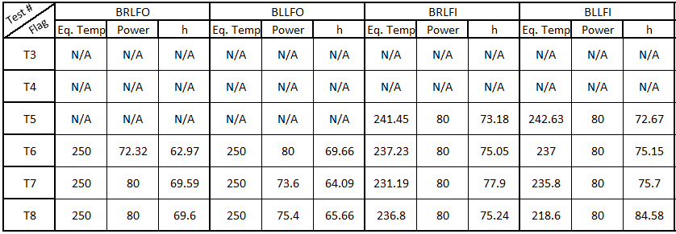
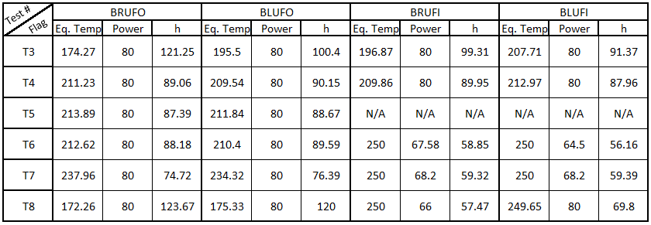
Convection Coefficient Test Results
6 Total Tests – changed top/bottom diverter designs, added insulation.
Not all flags showed cooling at 80W, Wattage had to be adjusted to equilibrium.
$$\dot{Q}=hA\left(T_{S}−T_{Surr}\right) h=\frac{\dot{Q}}{A{(T}_{S}−T_{Surr})}$$
Final Top/Bottom Diverter Designs
Air Diverter for Cooling 1MW Horn Stripline
10/24/19

Slide 22
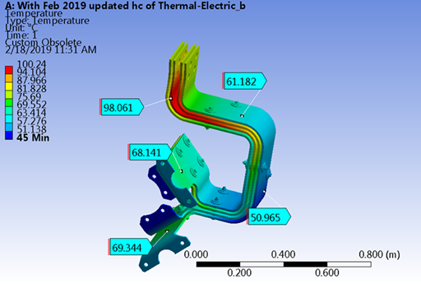
Updated Analysis Results
Steady state temperatures @ 1MW appear to meet requirements of <100C.
Hot spots are result of remaining conservative cooling coefficients. Further testing could reduce further but design goals are met.
Air Diverter for Cooling 1MW Horn Stripline
10/24/19

Slide 23
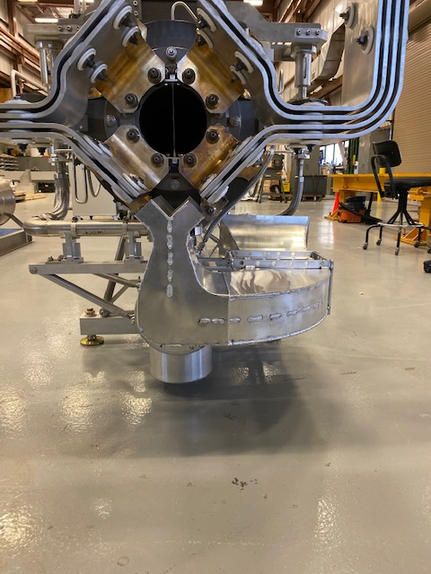
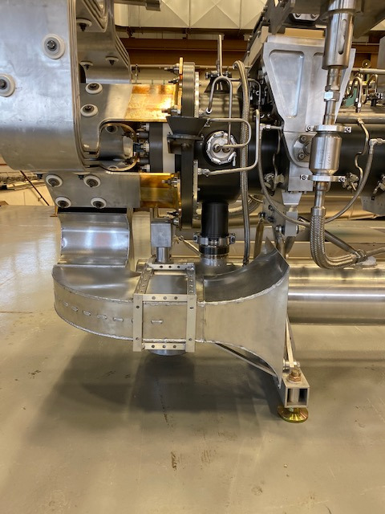
Final Diverter Design
6061 Aluminum Sheets
Welded at seams
Mounting Bracket
Air Diverter for Cooling 1MW Horn Stripline
10/24/19

Slide 24
Summary
Updated air diverter design(s) needed to maintain acceptable Horn 1 stripline temperatures during 1 MW operation
Convection coefficient testing was conducted to identify problematic areas and areas for improvement
Testing led to design revisions until final designs for the top/bottom diverters were selected
Stripline temperatures were verified with final FEA and experimental test
Air Diverter for Cooling 1MW Horn Stripline
10/24/19

