Slide 1
J-PARC Secondary Beamline Status & Upgrade Plan
2019.10.25
KEK IPNS
Tada

Slide 2
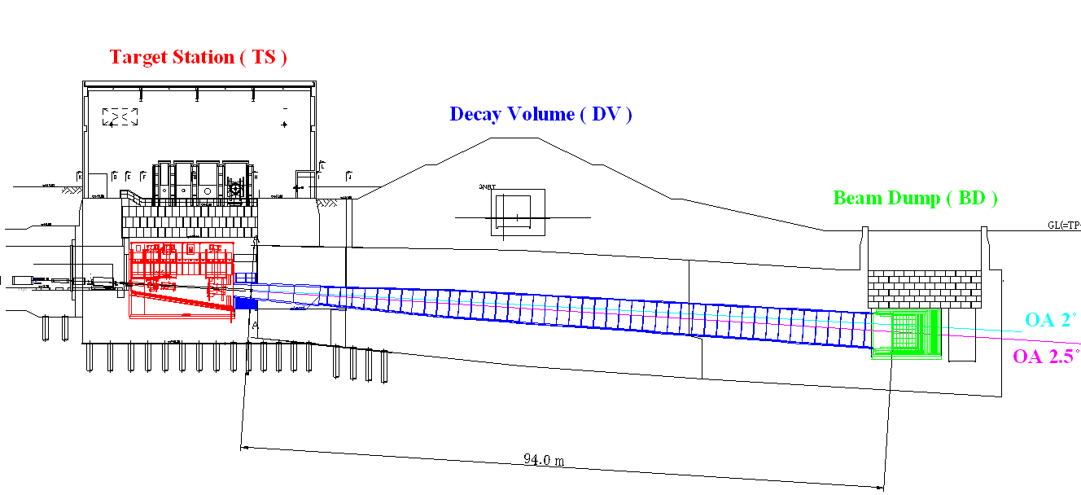
Secondary beam line in T2K beam line
Target Station
Secondary beam line
Beam dump
Decay Volume
Helium 1atm
100m
The components of the secondary beam line are in an integrated helium-tight vessel of the huge volume of 1500m³.
There are two service buildings in the secondary beam line, the Target Station for the target, the horns and the upstream of the decay volume, and the Neutrino Utility Building No.3 (NU3) for the beam dump and the downstream of the decay volume.

Slide 3
Target station
Service pit
Helium
Vessel
Horns
Beam
Decay Volume
Target

Slide 4
Helium vessel
4m
15m
11m

Slide 5
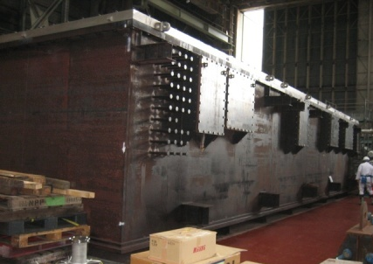
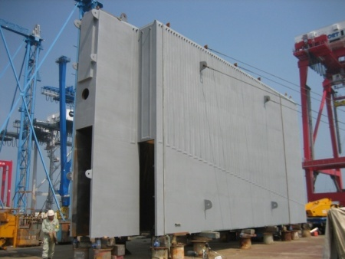
Helium vessel
Upper part
50mm steel
4m
15m
Lower part
100mm steel
Water cooled
11m
Helium vessel consists of 50mm / 100mm thickness carbon steel plates and serves both as a vessel and a support structure for the horns.

Slide 6
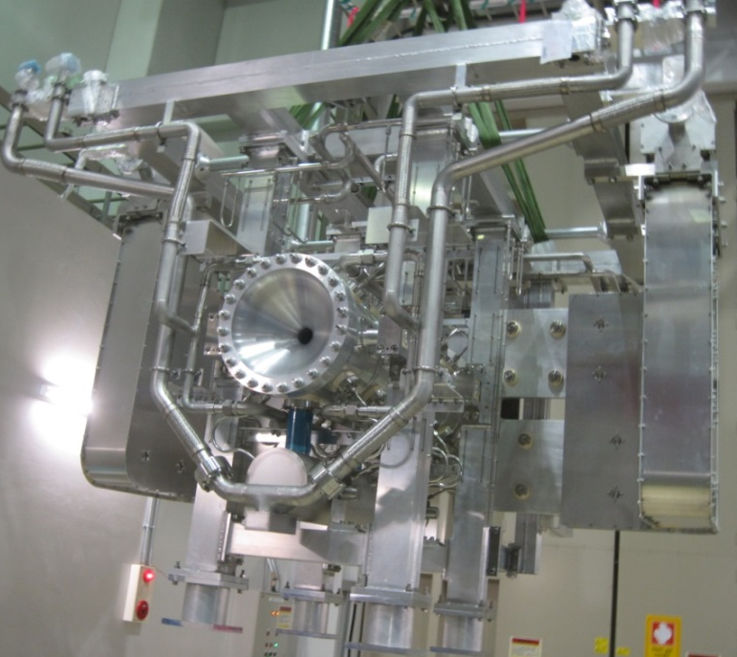
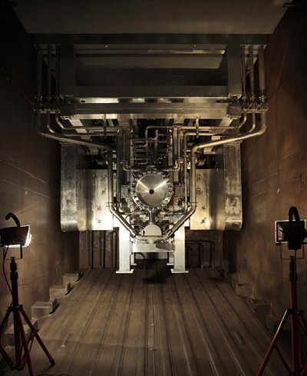
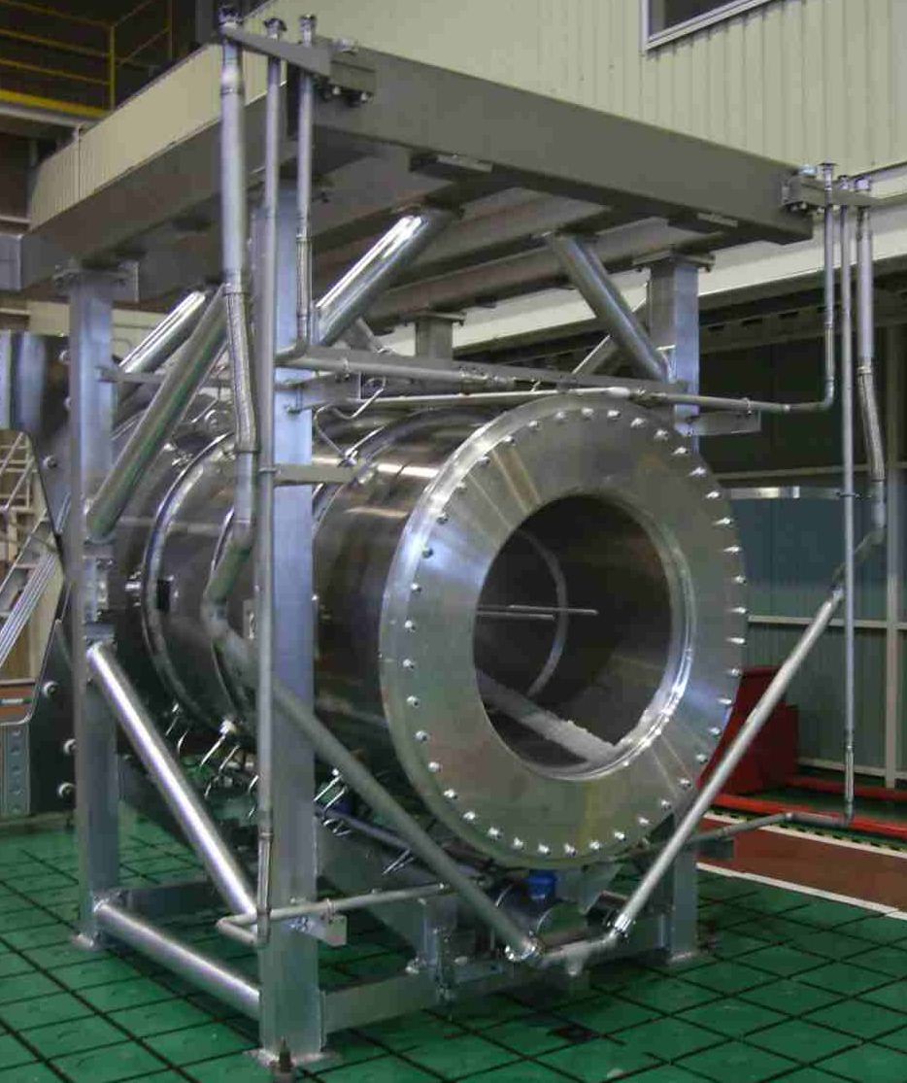
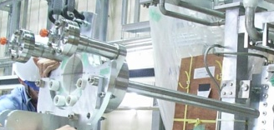
Horn 1 in helium vessel
Helium vessel
4m
15m
Horn 1
Horn 3
11m
Target

Slide 7
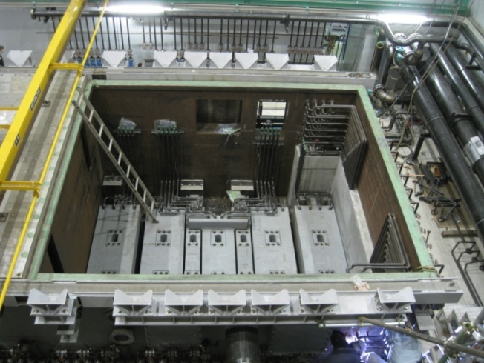
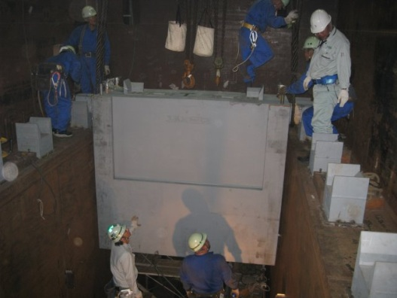
Helium vessel
4m
15m
Iron shields above horns
19 blocks, Water cooled
11m

Slide 8
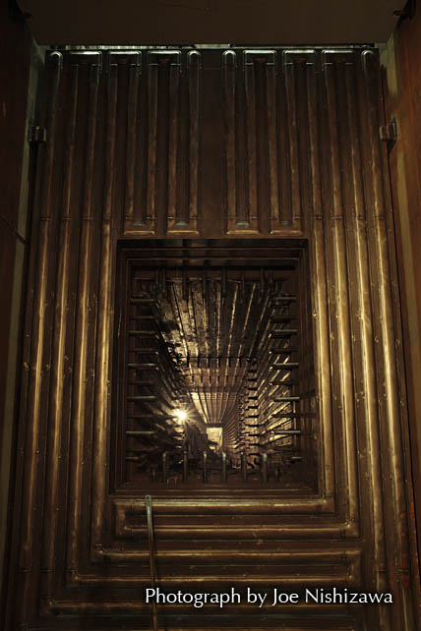
Helium vessel
4m
Collimator for decay volume
(DV collimator)
3 steel plate (180mm × 3)
Water cooled
15m
11m
Water cooling channels
(Plate coils)

Slide 9
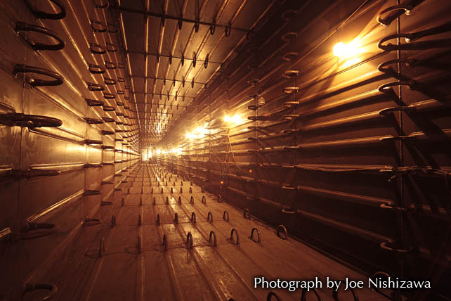
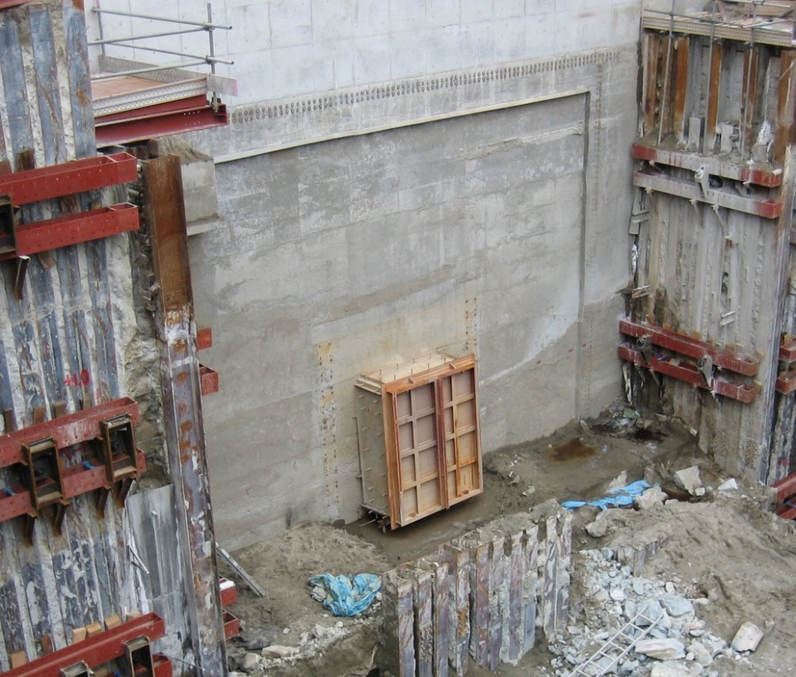
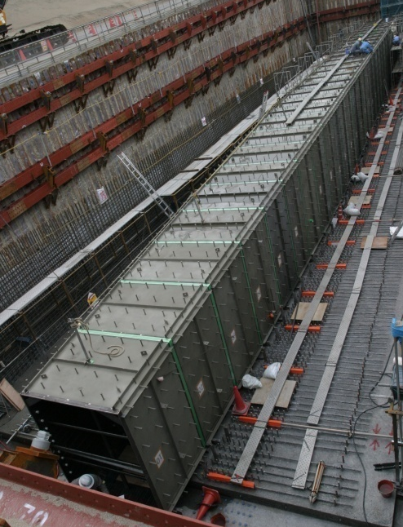
Decay volume
Concrete
6m
16mm steel box
Water cooling channels
(Plate coils)
Decay volume consists of a water cooled carbon steel rectangular box surrounded by concrete.
100m length

Slide 10
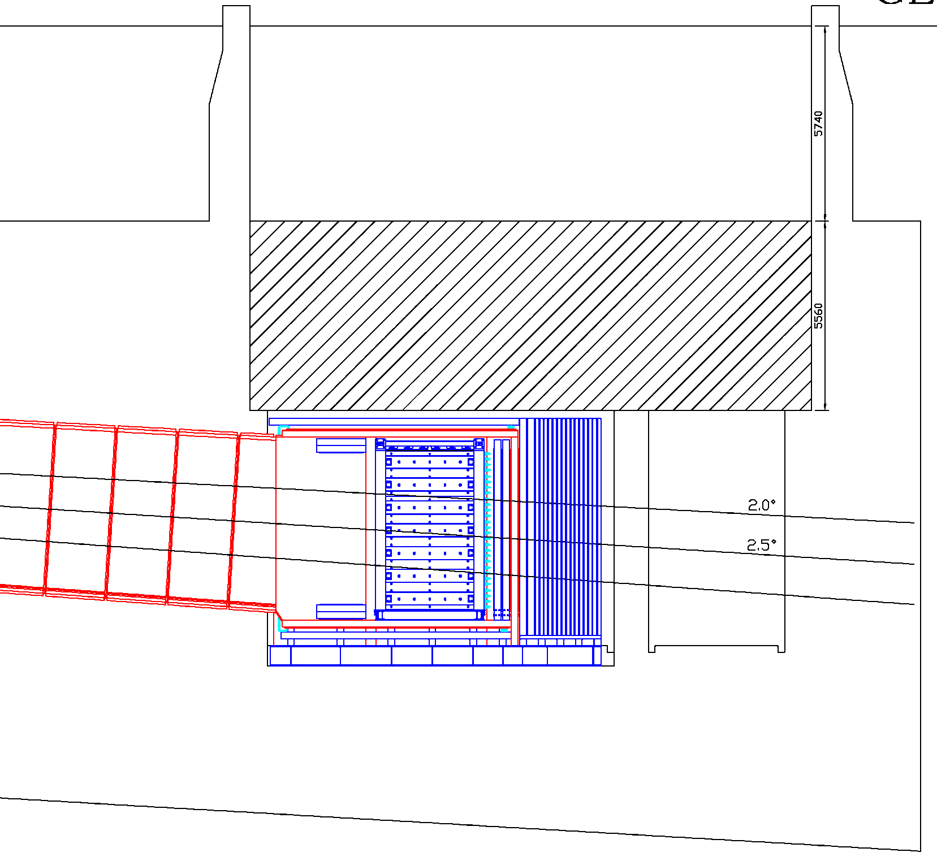
Beam dump

Slide 11
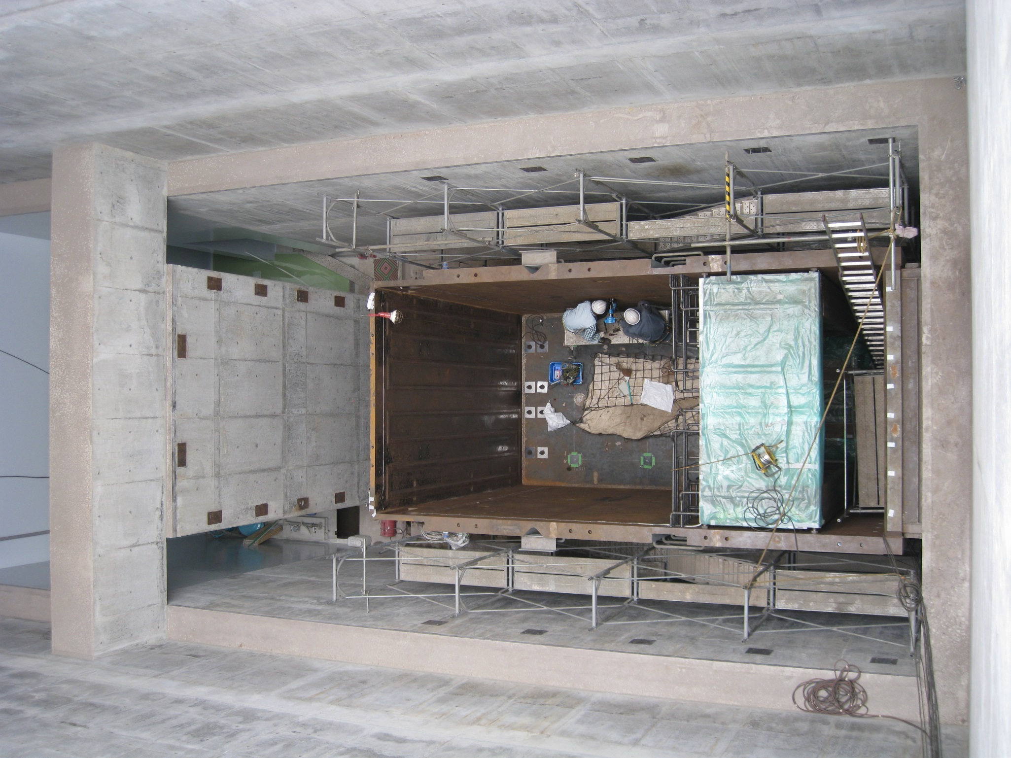
Beam dump
Helium vessel
for beam dump
200mm steel
Water cooled

Slide 12
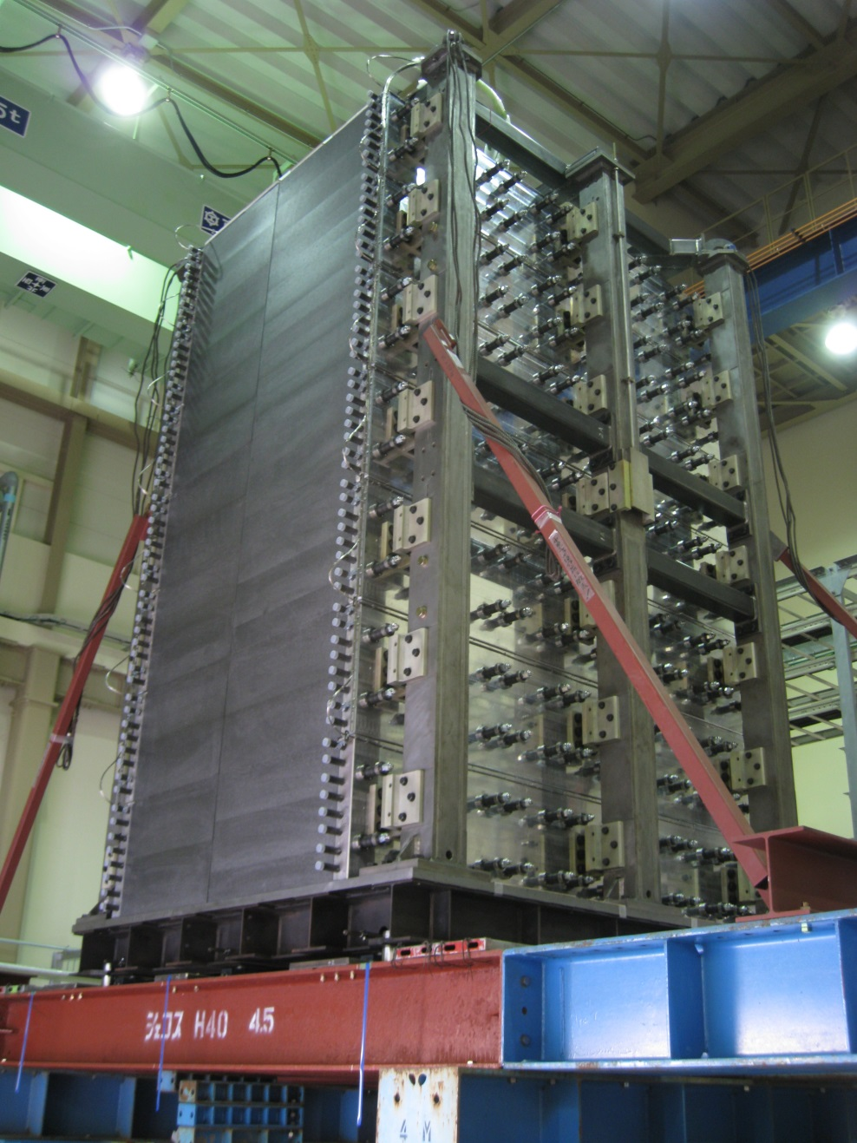
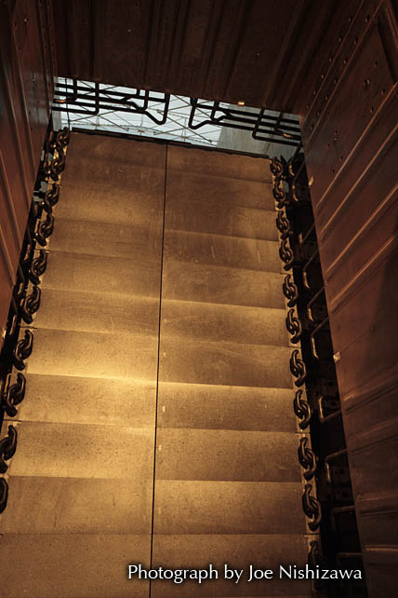
Beam dump
Beam dump core
Beam dump core
in helium vessel

Slide 13
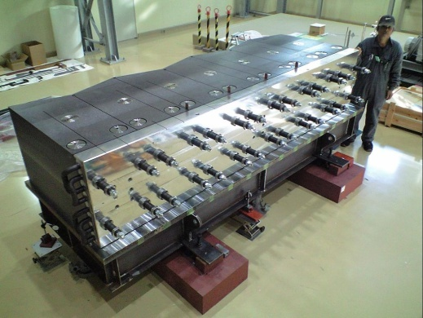
Beam dump
Core module
Graphite block
Beam dump core
Cooling panel
Water cooling pipes are
cast into aluminum panels

Slide 14
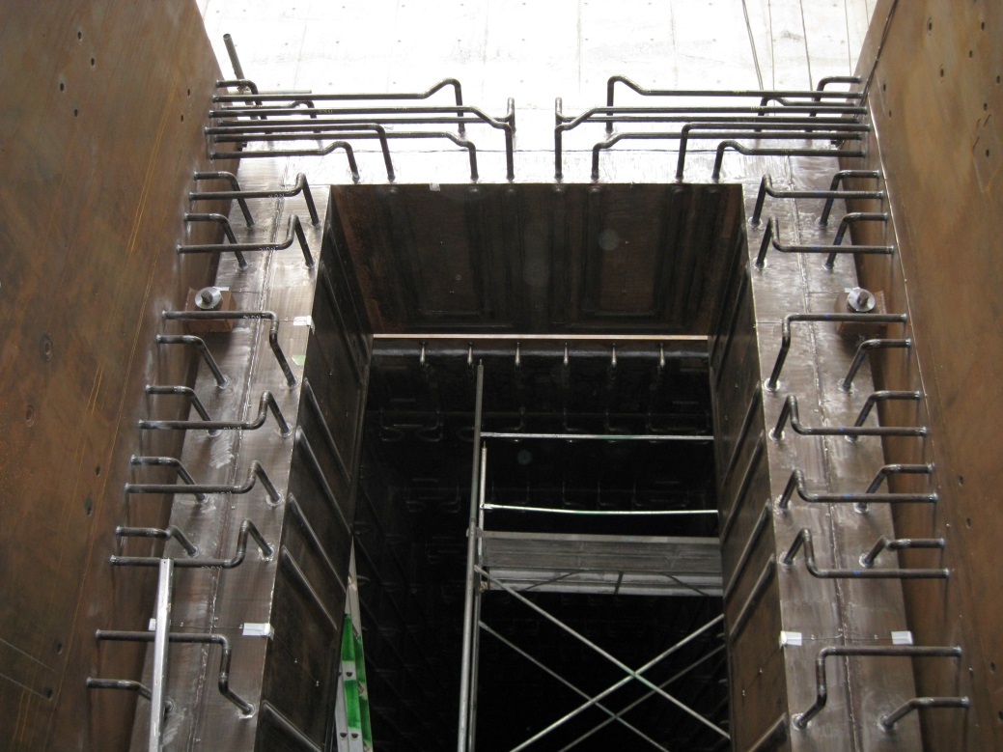
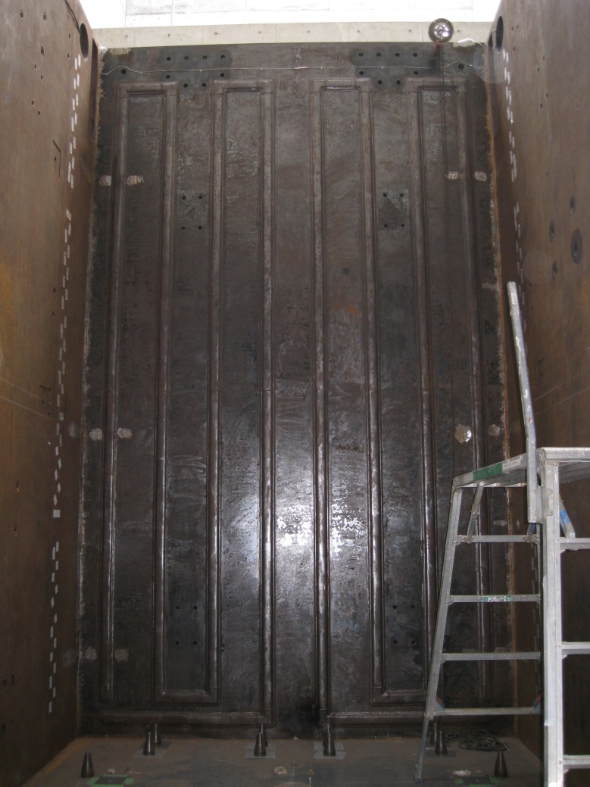
Front shields
Beam dump
Rear shields
Water cooling channels
(Plate coils)

Slide 15
Summary of current acceptable values for beam operation
(1)
Component | Limiting factor | Current acceptable value
Beam window | Thermal shock | 3.3×10¹⁴ proton/pulse
 | Cooling capacity | 0.75 MW
Target | Thermal shock | 3.3×10¹⁴ proton/pulse
 | Cooling capacity | 0.9 MW
Magnetic horns | Conductor cooling | 2 MW
 | Stripline cooling | 0.75 MW
 | Cooling capacity | 0.98 MW
 | Hydrogen removal | 1 MW
 | Operation current and cycle | 250 kA , 2.48 sec

Slide 16
Summary of current acceptable values for beam operation
(2)
Component | Limiting factor | Current acceptable value
Helium vessel in target station | Thermal stress / expansion | 4 MW
 | Cooling capacity | 1 MW
Decay volume | Thermal stress | 4 MW
 | Cooling capacity | 1 MW
Beam dump | Oxidization of graphite block | 3 MW
 | Cooling capacity | 1 MW
Radiation | Shielding ( TS upper shield ) | 0.75 MW
 | Shielding ( Others ) | 4 MW
 | Radioactive water disposal | 8.4×10²⁰ POT/year

Slide 17
Summary of current acceptable values for beam operation
(1)
Component | Limiting factor | Current acceptable value
Beam window | Thermal shock | 3.3×10¹⁴ proton/pulse
 | Cooling capacity | 0.75 MW
Target | Thermal shock | 3.3×10¹⁴ proton/pulse
 | Cooling capacity | 0.9 MW
Magnetic horns | Conductor cooling | 2 MW
 | Stripline cooling | 0.75 MW
 | Cooling capacity | 0.98 MW
 | Hydrogen removal | 1 MW
 | Operation current and cycle | 250 kA , 2.48 sec
Ishida-san talked

Slide 18
Summary of current acceptable values for beam operation
(1)
Component | Limiting factor | Current acceptable value
Beam window | Thermal shock | 3.3×10¹⁴ proton/pulse
 | Cooling capacity | 0.75 MW
Target | Thermal shock | 3.3×10¹⁴ proton/pulse
 | Cooling capacity | 0.9 MW
Magnetic horns | Conductor cooling | 2 MW
 | Stripline cooling | 0.75 MW
 | Cooling capacity | 0.98 MW
 | Hydrogen removal | 1 MW
 | Operation current and cycle | 250 kA , 2.48 sec
Ishida-san talked
Eric-san and Matsubara-san talked

Slide 19
Summary of current acceptable values for beam operation
(1)
Component | Limiting factor | Current acceptable value
Beam window | Thermal shock | 3.3×10¹⁴ proton/pulse
 | Cooling capacity | 0.75 MW
Target | Thermal shock | 3.3×10¹⁴ proton/pulse
 | Cooling capacity | 0.9 MW
Magnetic horns | Conductor cooling | 2 MW
 | Stripline cooling | 0.75 MW
 | Cooling capacity | 0.98 MW
 | Hydrogen removal | 1 MW
 | Operation current and cycle | 250 kA , 2.48 sec
Ishida-san talked
Eric-san and Matsubara-san talked
Sekiguchi-san talked

Slide 20
Summary of current acceptable values for beam operation
(2)
Component | Limiting factor | Current acceptable value
Helium vessel in target station | Thermal stress / expansion | 4 MW
 | Cooling capacity | 1 MW
Decay volume | Thermal stress | 4 MW
 | Cooling capacity | 1 MW
Beam dump | Oxidization of graphite block | 3 MW
 | Cooling capacity | 1 MW
Radiation | Shielding ( TS upper shield ) | 0.75 MW
 | Shielding ( Others ) | 4 MW
 | Radioactive water disposal | 8.4×10²⁰ POT/year
Oyama-san talked

Slide 21
Contents of my talk
Water cooling system
Helium vessel
Decay volume
Beam dump
Radiation shielding
Upper shields in Target Station
Remote maintenance

Slide 22
Water cooling system

Slide 23
Water cooling system for the secondary beam line
Target Station
Secondary beam line
Beam dump
Decay Volume
Cooling system
in target station
for upstream part
Cooling system
in neutrino utility building No.3
( NU3 )
for downstream part

Slide 24
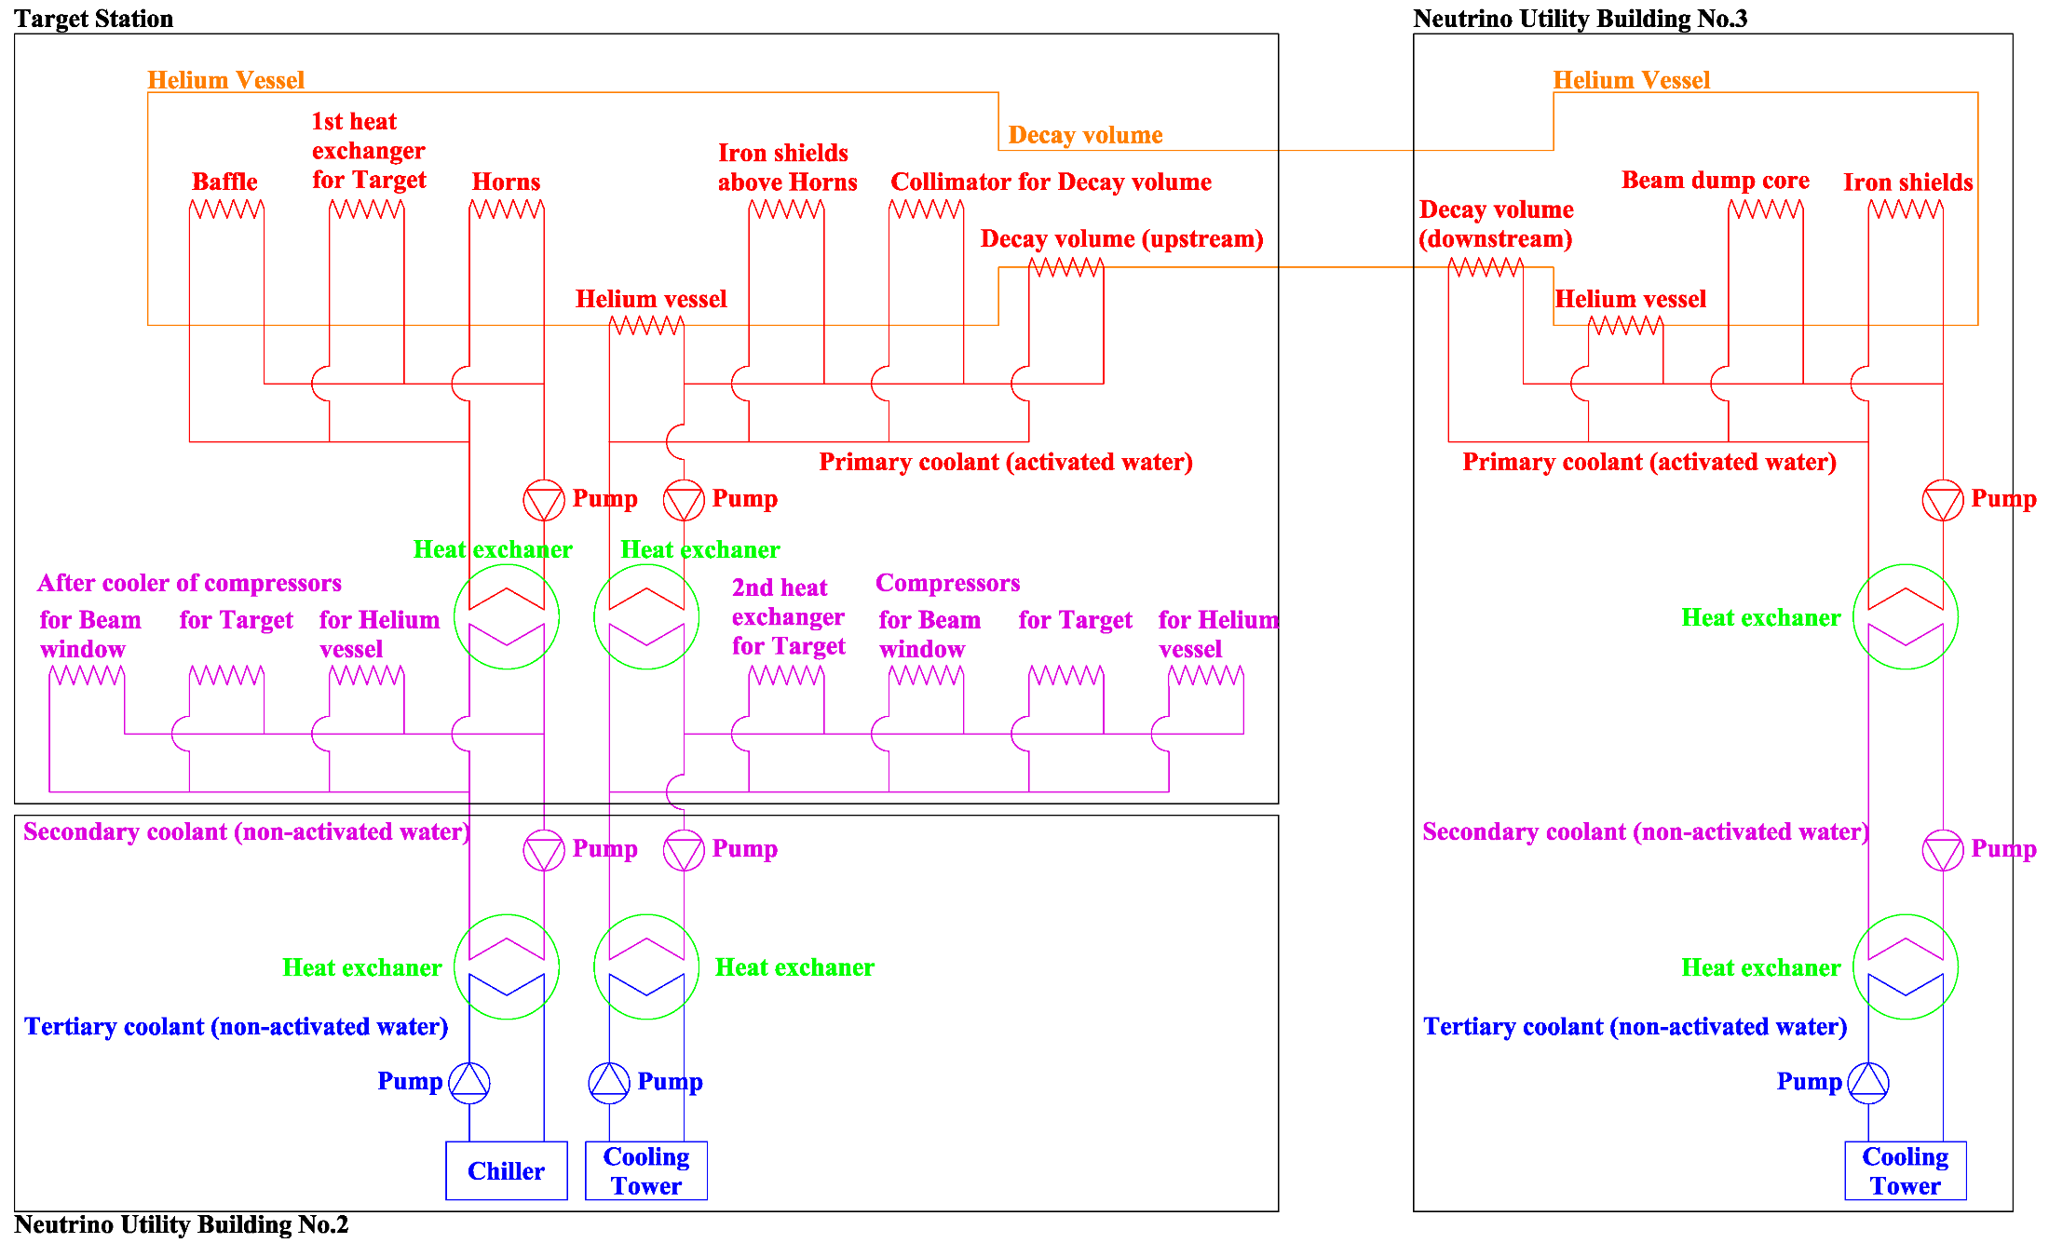
Schematic diagram of water cooling system
Both systems consist of three stages and the stages are coupled by the heat exchangers, so that the activated water does not mix into the tertiary coolant if one of the heat exchanger breaks.

Slide 25
Policy for water cooling system
(except target and horns)
For carbon steel structure
Thermal stress is to be suppressed < 1/3 of tensile strength (133MPa)
In particular, for side wall of TS helium vessel,
Thermal expansion < 1mm : for horn position accuracy
Because the horns are mounted on the side wall of the helium vessel.
-> Temperature rise is kept below 30 degree.
For beam dump core
Prevent oxidization of graphite block

Slide 26
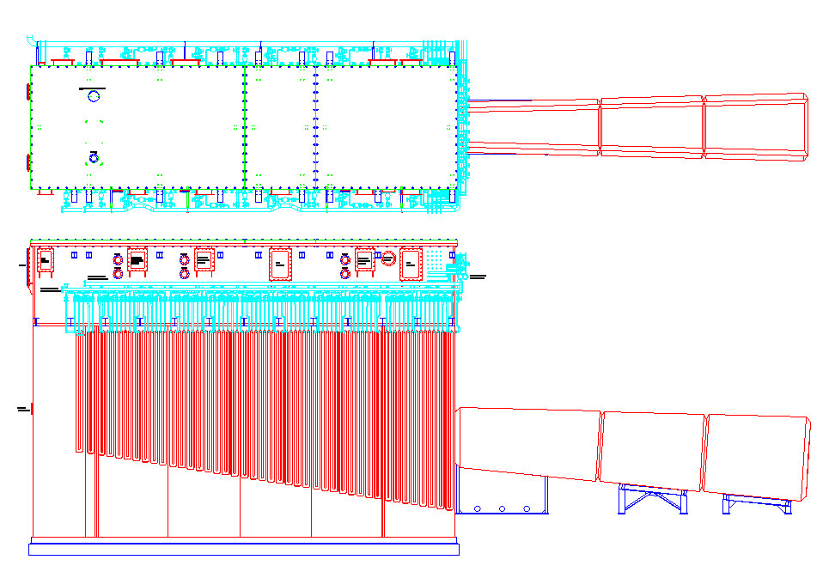
Cooling channels of helium vessel ( outside )
Top flange ( made of Aluminum )
OTR window
4.4 m
Helium vessel
Decay volume
Outside view
Flanges for the busbar of the horns
Valves for the plate coils
Plate coils of the helium vessel
( side plates and back plate )
10.6 m
15.0 m

Slide 27
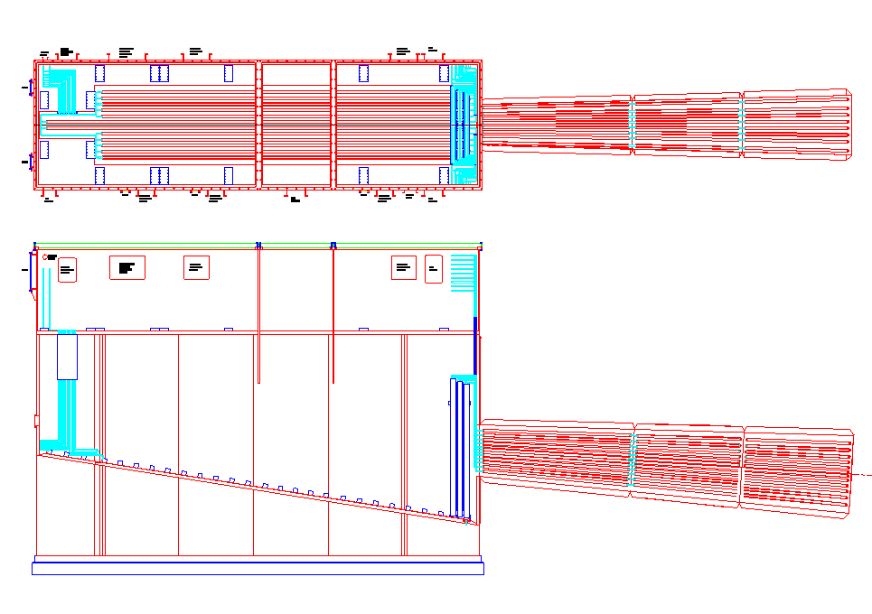
Cooling channels of helium vessel and DV ( inside )
Plate coils on the bottom plate of the vessel
DV collimator
( inner )
Base plates of the support modules for the horns
Plate coils on the
inside of decay volume

Slide 28
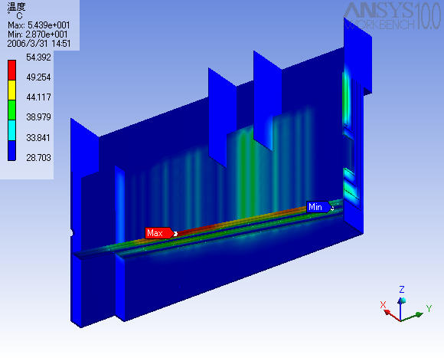
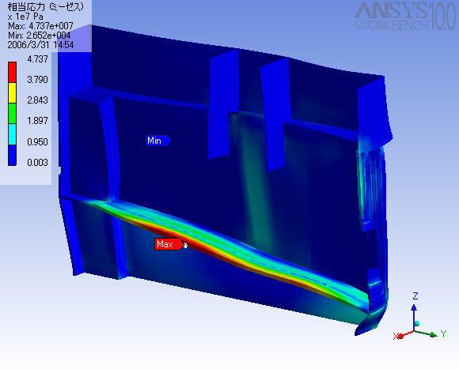
Thermal analysis for TS helium vessel
750kW ν operation
( Water flows in every other plate coil line. )
Thermal Stress
Maximum 47 MPa
Maximum 54 ℃
Temperature
The design criteria for the vessel are
less than 60 degree in temperature
and less than 133 MPa in stress.

Slide 29
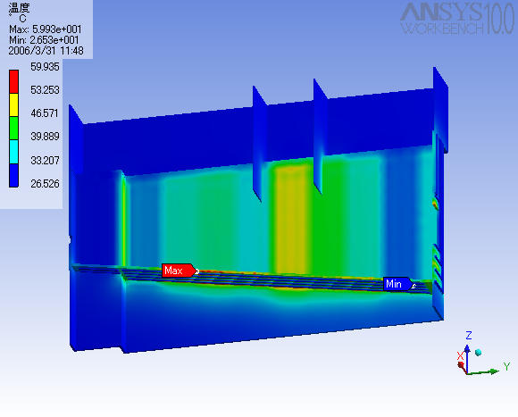
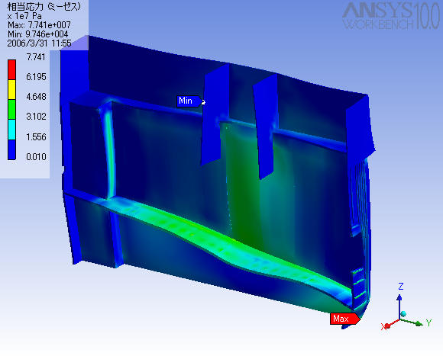
Thermal analysis for TS helium vessel
4MW ν operation
Total cooling water flow rate in 4MW simulation is doubled compared with 750kW simulation.
Thermal Stress
Maximum 77 MPa
Maximum 60 ℃
Temperature
These analyses give satisfactory results!

Slide 30
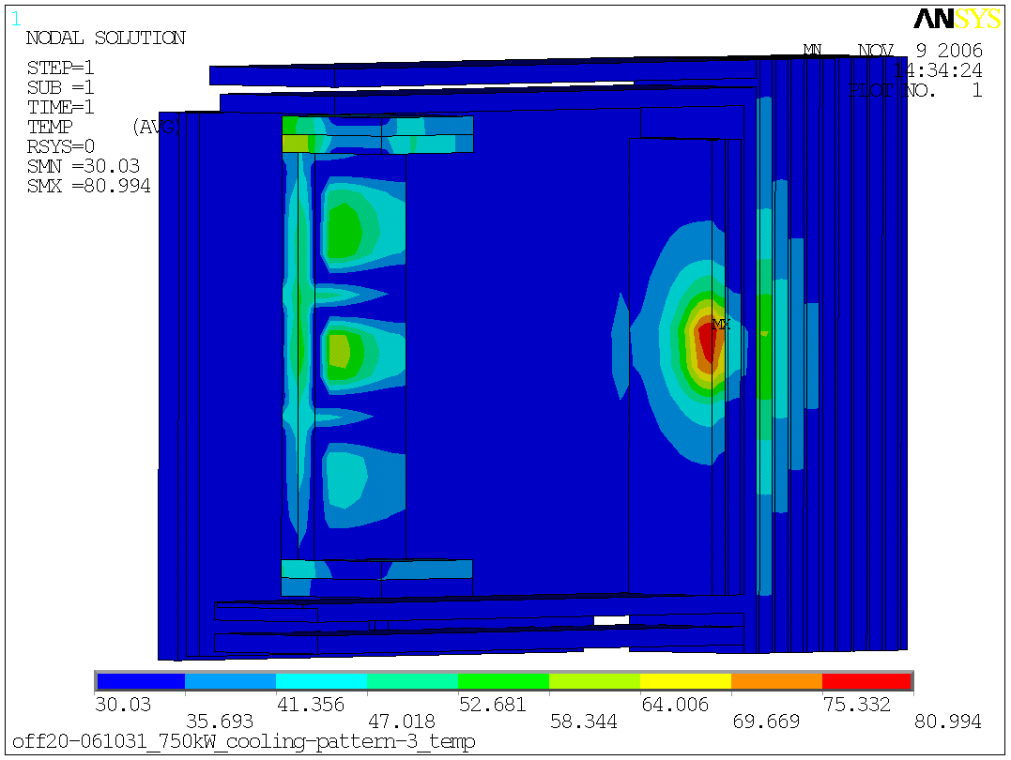
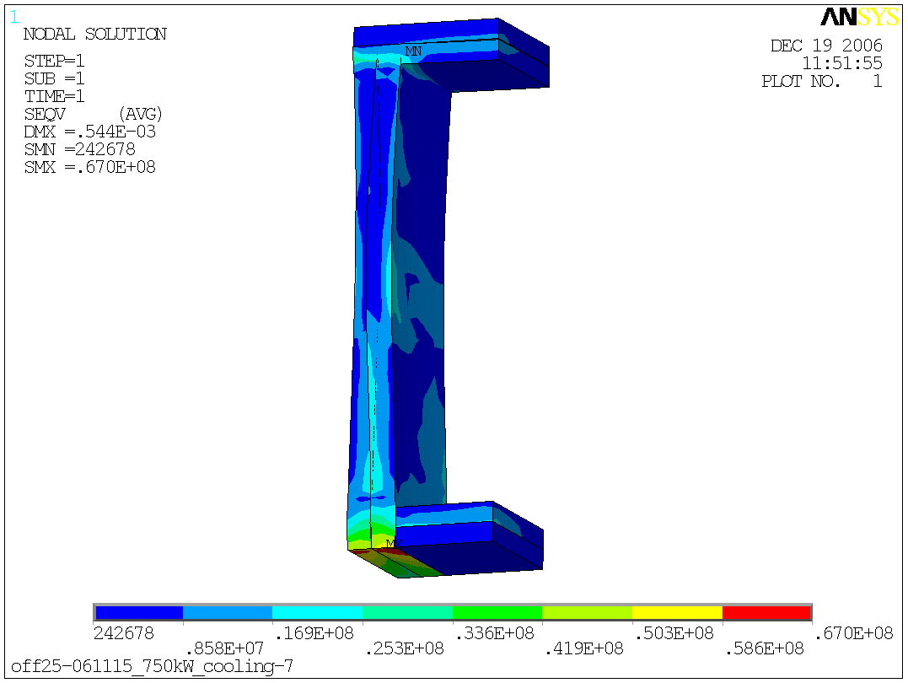
Thermal analysis for BD helium vessel
750kW ν operation
max
49℃
20MPa
Vessel
Rear shield
Front shield
max 51℃
max
67MPa
max 81℃

Slide 31
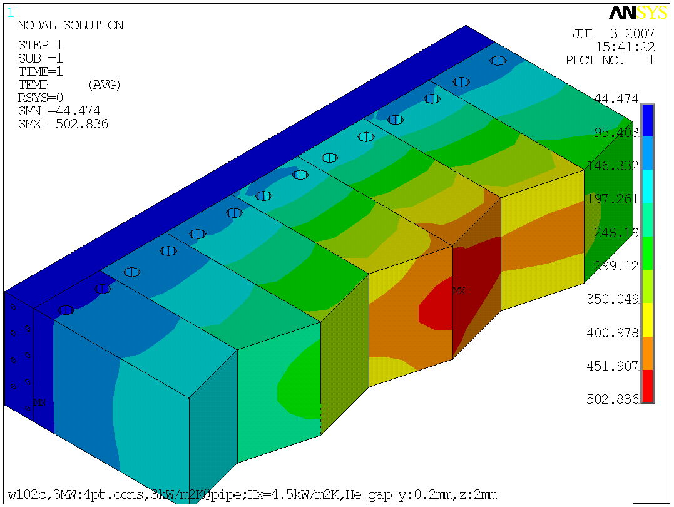
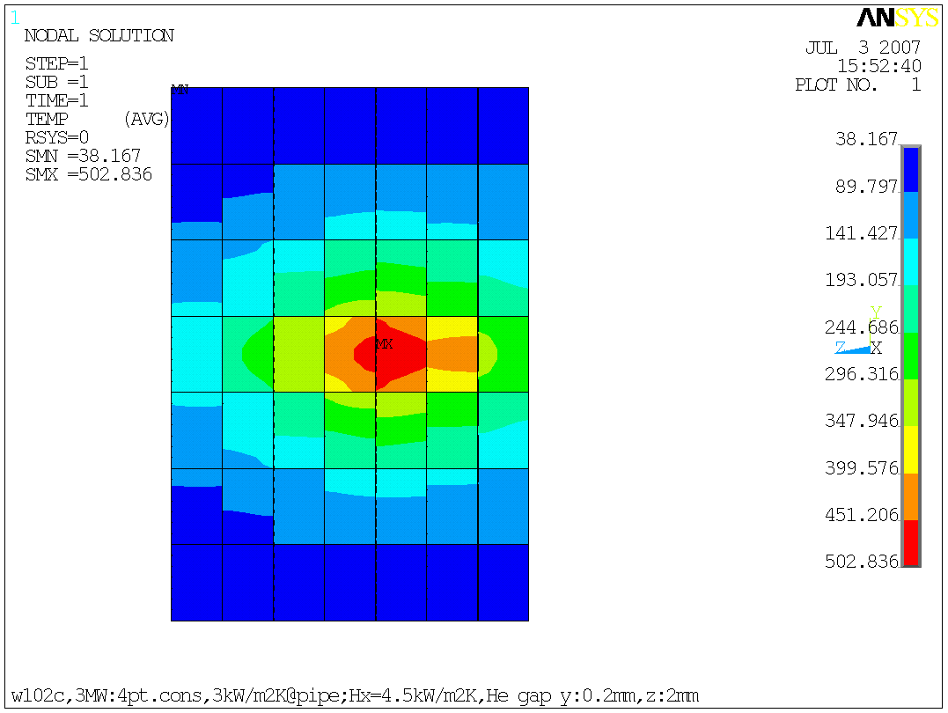
Thermal analysis for BD core
Assuming heat transfer coefficient between the graphite block and the cooling module
4.5kW/m²K
3MW ν operation
Gap ΔＹ 0.2mm
~ 500 deg.

Slide 32
Measured maximum temperature rise (ν operation)
 | Measured 410 kW, ν | Extrapolation 750 kW, ν | Simulated value 750 kW, ν
Helium vessel (side wall) | 7.1 deg. | 13 deg. | 22 deg.
Iron shields above horns | 8.7 deg. | 16 deg. | 22 deg.
Decay volume | 7.3 deg. | 13 deg. | 34 deg.
DV collimator | 11.0 deg. | 20 deg. | 38 deg.
Beam dump core | 36.9 deg. | 68 deg. | 118 deg.
Vessel for BD core | 7.5 deg. | 14 deg. | 19 deg.
Iron shields behind BD | 20.1 deg. | 37 deg. | 51 deg.
Extrapolation from 3MW simulation
Measured values are generally lower than simulated values, because there are tolerances in the simulation parameters.

Slide 33
Measured maximum temperature rise (anti-ν operation)
 | Measured 450 kW, anti-ν | Extrapolation 750 kW, anti-ν | Simulated value 750 kW, ν
Helium vessel (side wall) | 7.8 deg. | 13 deg. | 22 deg.
Iron shields above horns | 7.5 deg. | 12 deg. | 22 deg.
Decay volume | 11.9 deg. | 20 deg. | 34 deg.
DV collimator | 13.3 deg. | 22 deg. | 38 deg.
Beam dump core | 20.5 deg. | 34 deg. | 118 deg.
Vessel for BD core | 6.0 deg. | 10 deg. | 19 deg.
Iron shields behind BD | 18.0 deg. | 30 deg. | 51 deg.
Extrapolation from 3MW simulation
Measured values are generally lower than simulated values, because there are tolerances in the simulation parameters.

Slide 34
Measured heat removal (ν operation)
 | Measured 410 kW, ν | Extrapolation 750 kW, ν | Design value 750 kW, ν
Helium vessel | 40 kW | 73 kW | 158 kW
Iron shields | 11 kW | 20 kW | 29 kW
Decay volume | 42 kW | 77 kW | 85 kW
DV collimator | 40 kW | 73 kW | 105 kW
TS total | 133 kW | 243 kW | 377 kW
NU3 total | 129 kW | 236 kW | 332 kW

Slide 35
Measured heat removal (anti-ν operation)
 | Measured 450 kW, anti-ν | Extrapolation 750 kW, anti-ν | Design value 750 kW, ν
Helium vessel | 54 kW | 90 kW | 158 kW
Iron shields | 19 kW | 32 kW | 29 kW
Decay volume | 52 kW | 87 kW | 85 kW
DV collimator | 55 kW | 92 kW | 105 kW
TS total | 179 kW | 298 kW | 377 kW
NU3 total | 101 kW | 168 kW | 332 kW

Slide 36
Measured heat removal (anti-ν operation)
 | Measured 450 kW, anti-ν | Extrapolation 750 kW, anti-ν | Design value 750 kW, ν
Helium vessel | 54 kW | 90 kW | 158 kW
Iron shields | 19 kW | 32 kW | 29 kW
Decay volume | 52 kW | 87 kW | 85 kW
DV collimator | 55 kW | 92 kW | 105 kW
TS total | 179 kW | 298 kW | 377 kW
NU3 total | 101 kW | 168 kW | 332 kW
× 1.3
When this extrapolation is correct,
the cooling system in TS is available to beam power of 950kW.

Slide 37
Measured heat removal (ν operation)
 | Measured 410 kW, ν | Extrapolation 750 kW, ν | Design value 750 kW, ν
Helium vessel | 40 kW | 73 kW | 158 kW
Iron shields | 11 kW | 20 kW | 29 kW
Decay volume | 42 kW | 77 kW | 85 kW
DV collimator | 40 kW | 73 kW | 105 kW
TS total | 133 kW | 243 kW | 377 kW
NU3 total | 129 kW | 236 kW | 332 kW
× 1.4
When this extrapolation is correct,
the cooling system in NU3 is available to beam power of 1,060kW.

Slide 38
Present water cooling system ( < 1MW )

Slide 39
Upgraded water cooling system ( > 1MW )
The circulation pumps and the heat exchangers will be replaced to more large capacity ones
Chillers and cooling towers will be added.

Slide 40
Summary of upgrade for water cooling system
The present water cooling system of the secondary beam line is available blow 1MW beam operation, and we will upgrade the system as follows before over 1MW beam operation.
- Replacement the circulation pumps and the heat exchangers to more large capacity ones
- Adding chillers and cooling towers
We are designing with a design company to determine the parameters and to select circulation pumps, heat exchangers, chillers and cooling towers.

Slide 41
Radiation shielding

Slide 42
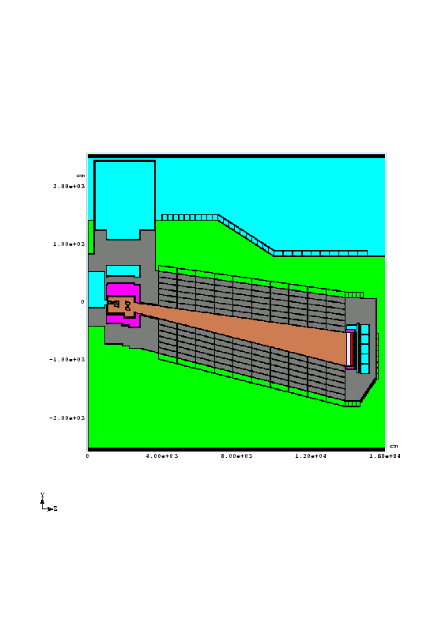
Simulation for radiation shielding
We calculated the radiation level to determine the thickness of the radiation shield.
MARS simulation
TS
DV
BD
We determined the thickness of the shield as the calculated radiation level is below the half of the legal limit.
Operation condition in the simulation
Upper shields in target station : 750kW beam operation
Other shields : 4MW beam operation

Slide 43
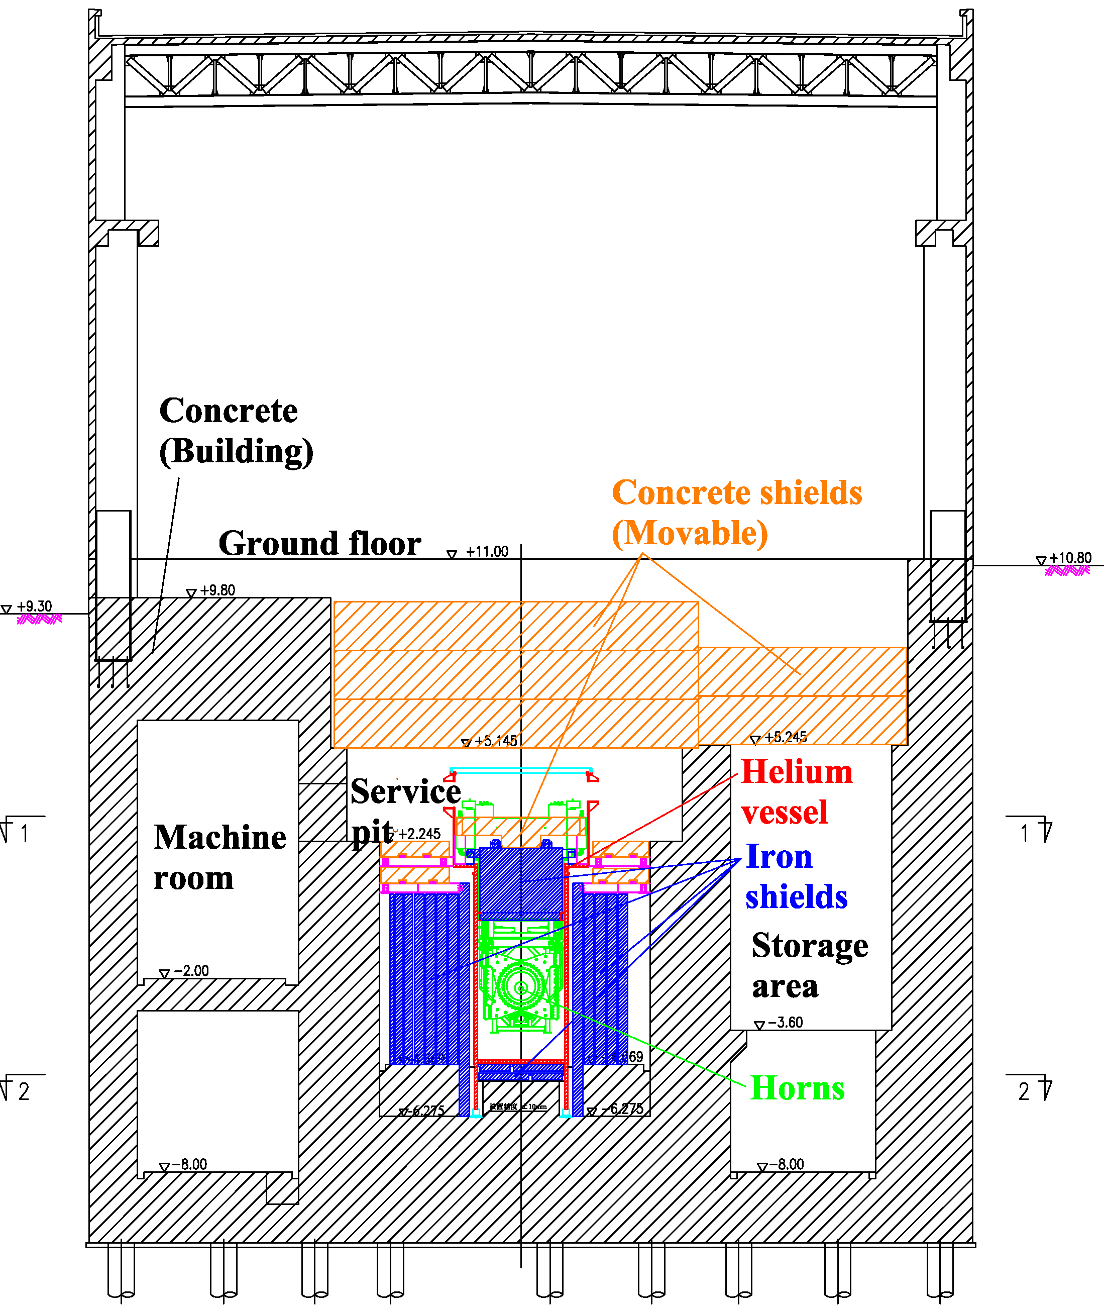
Shields in target station ( cross section )
Radiation measured point
legal limit :
< 25 μSv/h
design value :
< 12.5 μSv/h
940 mm
4,500 mm
2,250 mm
2,200 mm
1,600 mm
500 mm
4,000 mm
5,000 mm
4,770 ~ 7,190 mm

Slide 44
Measured radiation level on ground floor of target station
 | Present (measured value) 460 kW | Extrapolation 750 kW | Extrapolation 1.3 MW
neutrino operation
γ | 0.7 μSv/h | 1.1 μSv/h | 2.0 μSv/h
neutron | 1.3 μSv/h | 2.1 μSv/h | 3.7 μSv/h
total | 2.0 μSv/h | 3.3 μSv/h | 5.7 μSv/h
anti-neutrino operation
γ | 0.7 μSv/h | 1.1 μSv/h | 2.0 μSv/h
neutron | 1.2 μSv/h | 2.0 μSv/h | 3.4 μSv/h
total | 1.9 μSv/h | 3.1 μSv/h | 5.4 μSv/h
The extrapolation values indicate that the radiation level is below the specified value (12.5μSv/h) even at 1.3MW beam operation, in other words that it is not necessary to add more shields.
However, we have to determine whether we add more shields based on the calculation, because the application to Nuclear Regulation Authority in Japan is based on calculation.
So we have to redo radiation calculation at 1.3MW beam operation.

Slide 45
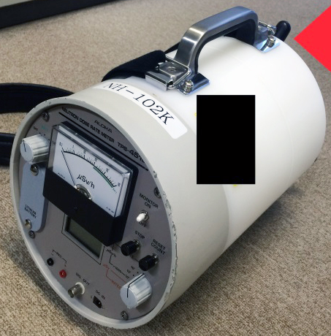
Recommendation by technical design report committee
The committee on the technical design report for T2K beam line upgrade pointed out that the radiation monitor we used (moderated neutron dose equivalent meter) is low sensitivity to fast neutrons.
And they recommended to measure the radiation level again with another detector, for example, a film badge.
moderated neutron dose equivalent meter

Slide 46
Summary of upgrade for radiation shields
The radiation shields except the upper concrete shields in TS have enough ability for 1.3 MW beam operation.
So it is not necessary to upgrade them.
The upper concrete shields in TS have enough ability for 1.3 MW beam operation, too, when the measurement and the extrapolation are correct.
But we will measure again with another detector at the next beam operation from November and decide whether to add the concrete shields finally based on the measurement result.
And we will redo radiation calculation at 1.3MW beam operation.

Slide 47
Remote maintenance

Slide 48
Components maintained remotely in target station
 | Presence of remote handling system | Experience of actual remote handling
Beam monitors | Under development | No
Beam window | Yes | Yes
Baffle | No | No
Target | Yes | No
Magnetic horns | Yes | Yes

Slide 49
Remote maintenance history
 | 2009 | 2010 | 2011 | 2012 | 2013 | 2014 | 2015 | 2016 | 2017 | 2018
Beam window
Target
Horn 1
Horn 2
Horn 3
1st generation
2nd generation
Replacement
1st generation
2nd generation
Replacement ( with horn 1 )
1st generation
2nd generation
Replacement
1st generation
2nd generation
Replacement
1st generation
2nd generation
Replacement

Slide 50
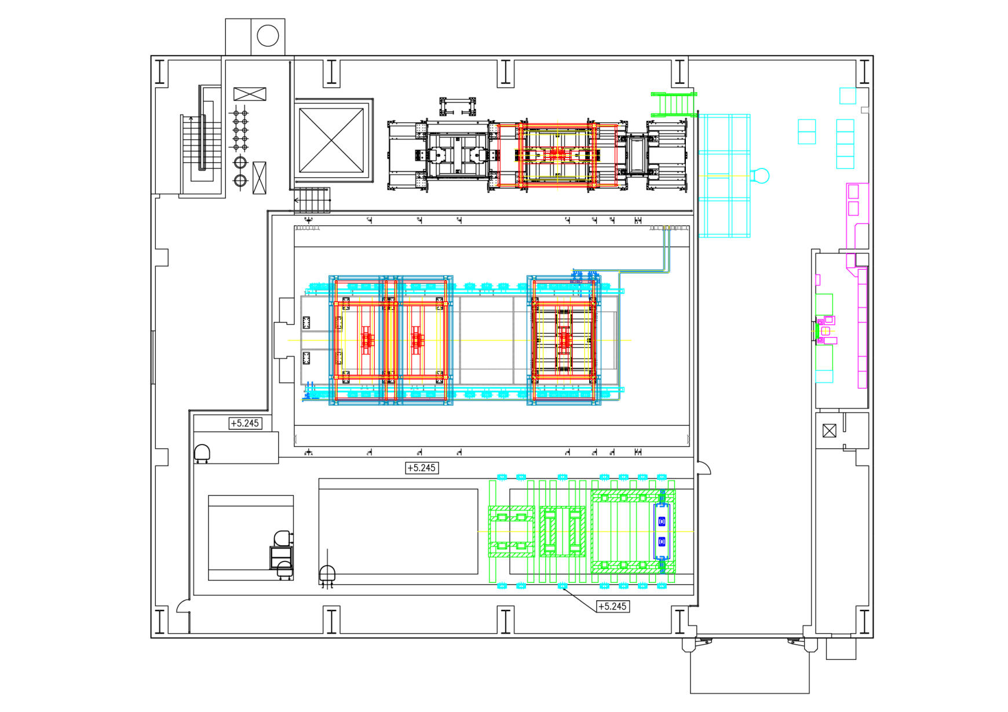
Top view of target station
Helium vessel
Beam window
Service pit
Crane control room
Manipulator operation room
Carry-in
area
Hot area
Storage area
Maintenance area
All components can be accessed only from the top.

Slide 51
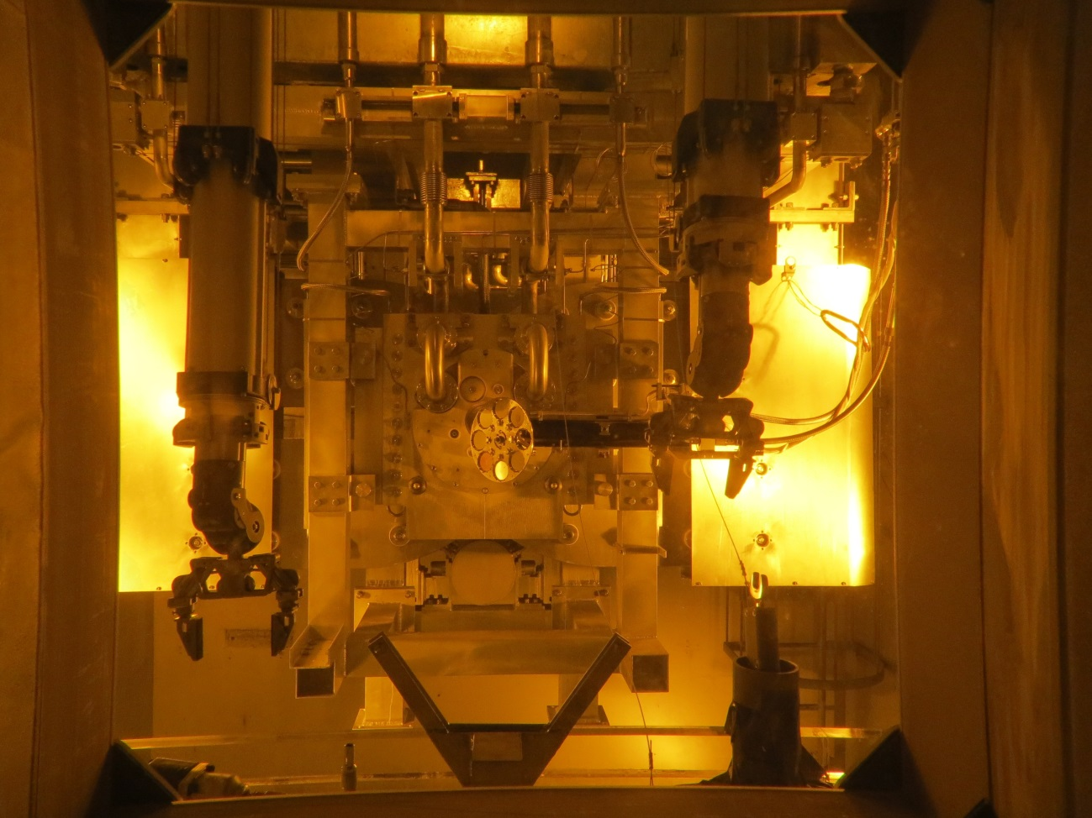
Top view of target station
View of hot area from operation room through lead glass
Beam window
Crane control room
Manipulator operation room
manipulator
Carry-in
area
Hot area
Storage area
Maintenance area
hand tools
manipulator
air tools

Slide 52
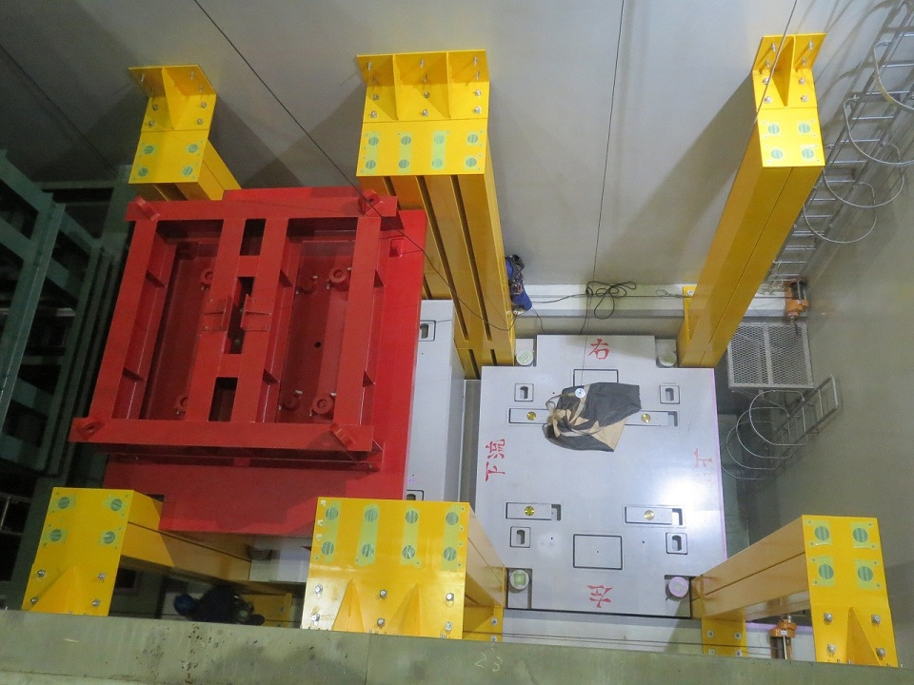
Top view of target station
Helium vessel
Beam window
Service pit
Storage area
Manipulator operation room
Carry-in
area
Hot area
Storage area
Maintenance area
Casket for horn

Slide 53
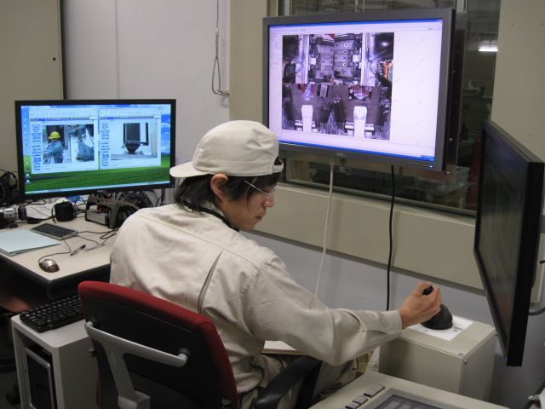
Top view of target station
Helium vessel
Service pit
Crane control room
Service pit
Displays for cameras
Crane control room
Carry-in
area
Hot area
Storage area
Maintenance area
Controller / Sensor display

Slide 54
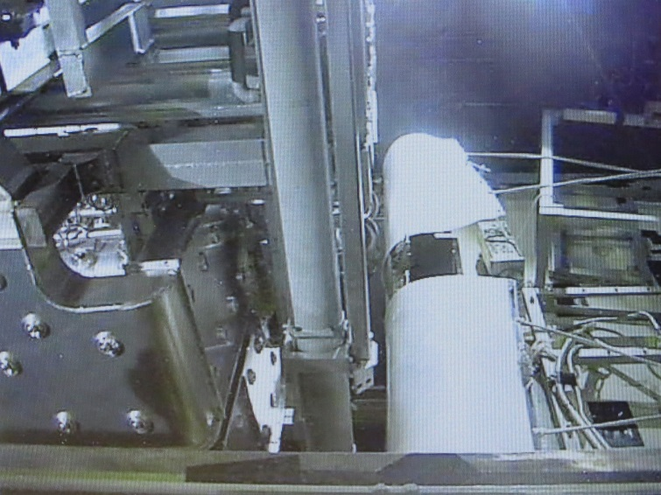
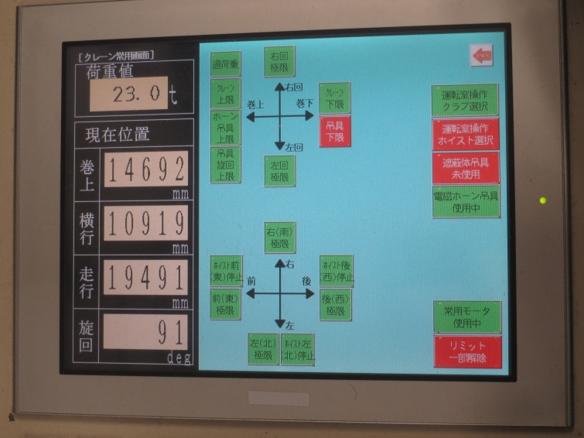
Top view of target station
Camera view
Sensor view
Helium vessel
Service pit
Crane control room
Service pit
Displays for cameras
Crane control room
Carry-in
area
Hot area
Storage area
Maintenance area
Controller / Sensor display

Slide 55
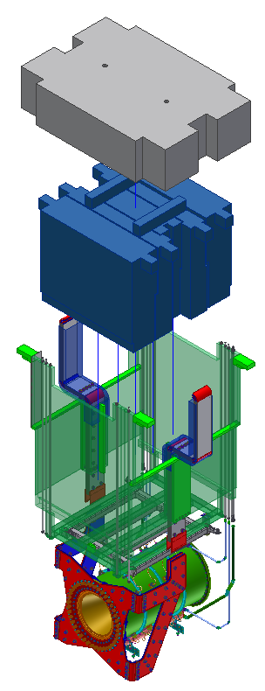
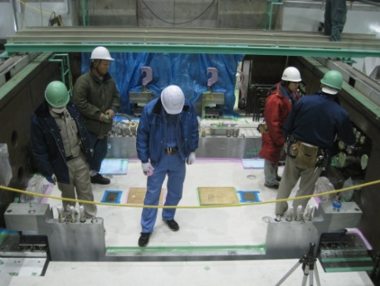
Remote maintenance for horns
Horns are suspended by the horn support modules.
Horns are treated with the support modules at remote maintenance work.
Horns are shielded by iron and concrete shields and the workers can access only above the these shields.
Concrete
Shield
0.9m
Iron
Shield
2.3m
Support
Module
for Horn
Concrete shield
Horn
Horns and shields are handled by the remote controlled handling machines when they are taken out of the beam line, because of the high radioactivation of them.
Notes:
55

Slide 56
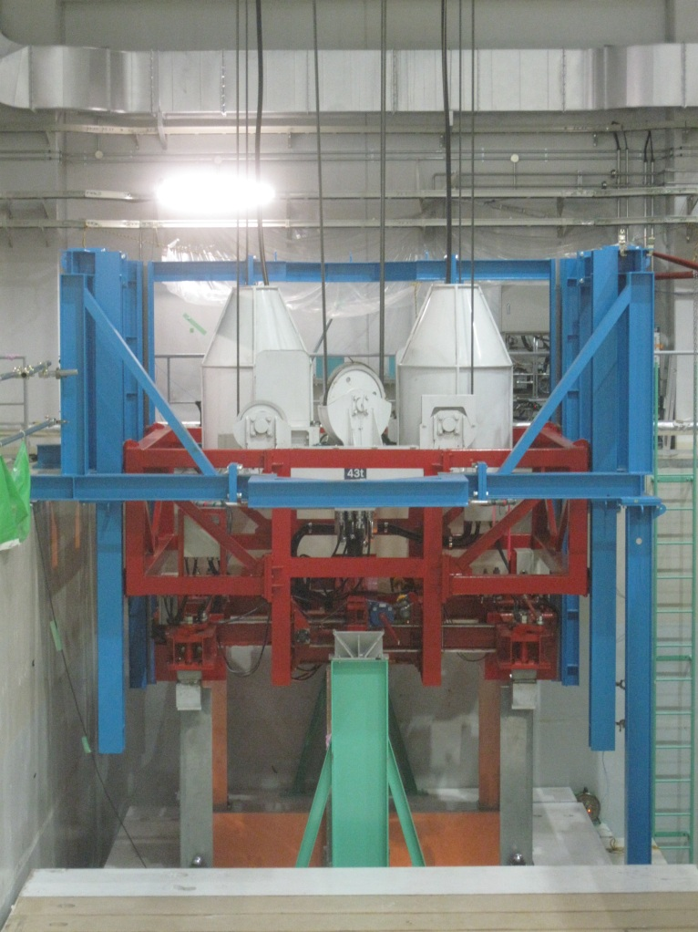
Concept of remote handling for horns
There is a numerical controlled crane in the target station.
We use the remote handling machine attached to this crane.
Crane
Guide cell
We need a few mm in x, y, z direction and 0.5 degree in rotation for the position accuracy.
To secure such accuracies, we use this numerical controlled crane in a few cm and the mechanical guide in a few mm.
(Finally, we fine-tune the horn position manually in the helium vessel.)
This crane has a spare system.
If the crane stops while at work (for example, while it suspends an radioactive device), the main system is cut off, and the spare one runs and keeps on the work.
Handling machine for horns
Horn support module

Slide 57
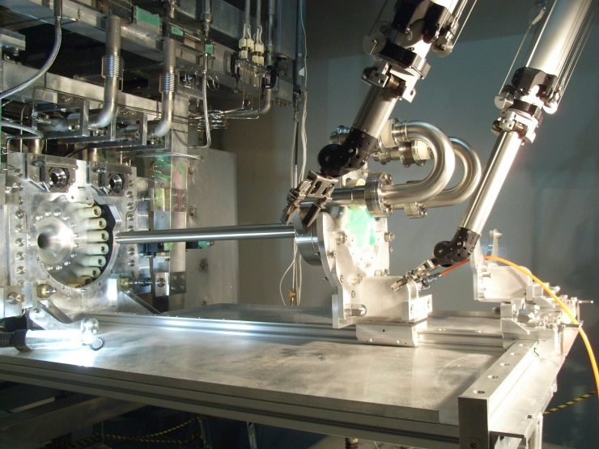
Remote maintenance for target
Manipulator
The target is attached the horn 1.
When the target is replaced, the horn 1 is taken into the maintenance area with target and the target is replaced with the target exchanger and the manipulators.
Horn 1
Target
Target exchanger
The target exchanger is developed and completed by RAL.
But there is no experience to replace the actual target in KEK.
We have to practice before actual replacement work.

Slide 58
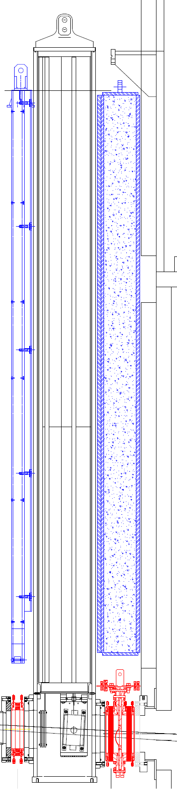
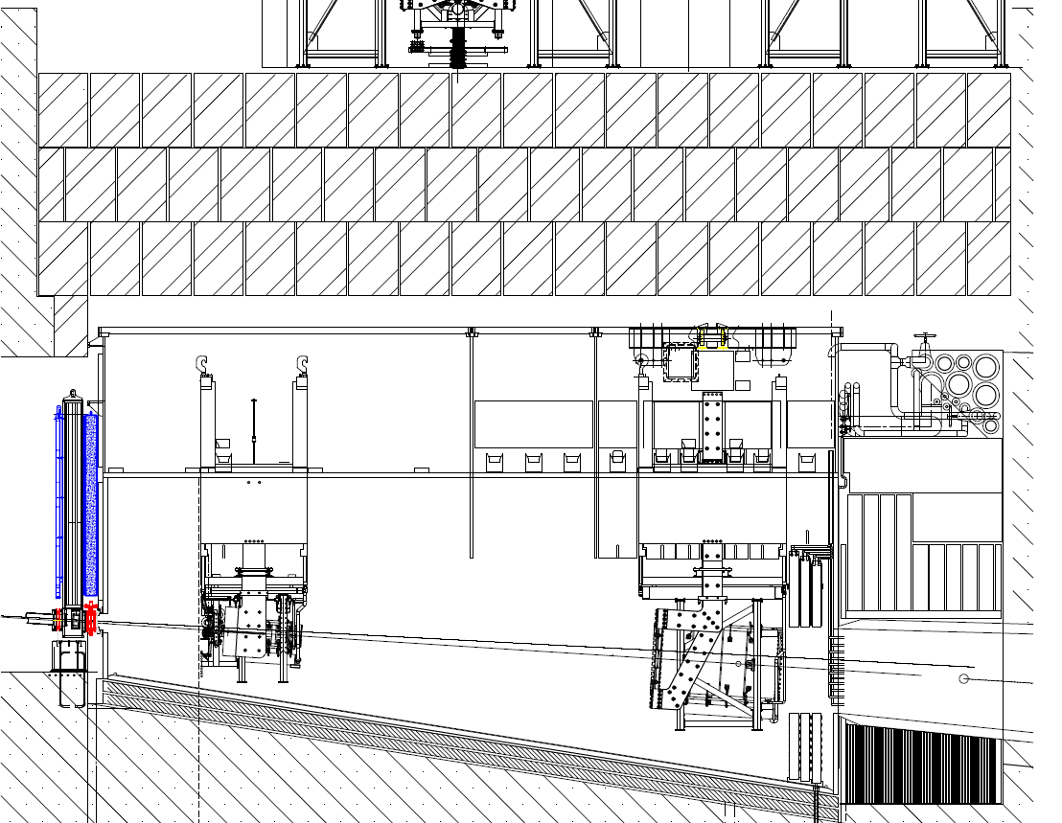
Remote maintenance for beam window and beam monitors
Monitor Stack
( in vacuum )
Shield
Shield
Beam
Monitor
Helium Vessel
( Helium 1atm )
Pillow seal
without
window
Pillow seal
with window

Slide 59
Remote maintenance for beam window and beam monitors
The pillow seal keeps a vacuum by metal touch between the pillow and the mirror flange.
The pillow is pushed to the mirror flange by gas pressure inside the bellows.
Shield
Shield
Monitor Stack
( in vacuum )
Pillow seal
with window
SSEM19
Pillow seal
without
window
Primary beam line
( in vacuum )
Helium Vessel
( Helium 1atm )
ESM21

Slide 60
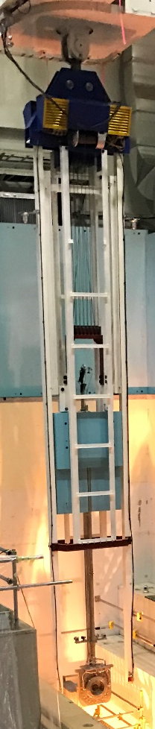
Remote handling for beam window
Crane
The handling machine is attached to crane,
and it moves by crane horizontally.
In vertical direction, it moves by crane before
the guides touch down on the service-pit side,
and it moves by winch built in the handling
machine after touchdown.
The handling point moves along inside of
the guide by the winch.
Winch
Guide
9 m
Handling point
The pick-up shaft for the beam window is
hung on the top of the shield.
And a worker rotates the shaft to lock or
unlock the beam window over the shield.
Shield
Pick-up shaft

Slide 61
Remote handling for beam monitor
Proton beam monitors in the target station
SSEM19 : mounted in the vacuum chamber (called monitor stack)
ESM21 : mounted in monitor stack
OTR : attached to the frame of the horn 1
SSEM 19 and ESM 21 are attached to the bottom of the plug of the monitor stack and carried to the maintenance area with the plug.
They are removed from the plug by manipulators there.
The handling machine serves both for the plug and the beam window.
The exchanger for SSEM 19 and ESM 21 is under development.
OTR is carried to the maintenance area with the horn 1 and exchanged by manipulators there.
OTR No.1 was removed by manipulators from the horn 1 at the replacement work of the horn in 2014.
But there is no experience in which we attached OTR to the horn 1 by manipulators.

Slide 62
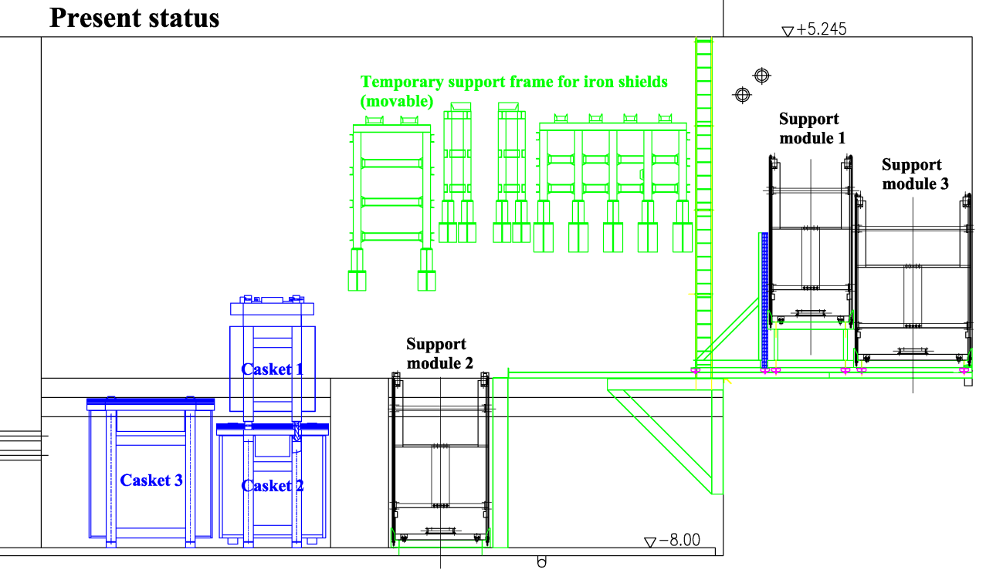
Status of storage area
Caskets for 1st generation horns
Support module for 1st generation horns

Slide 63
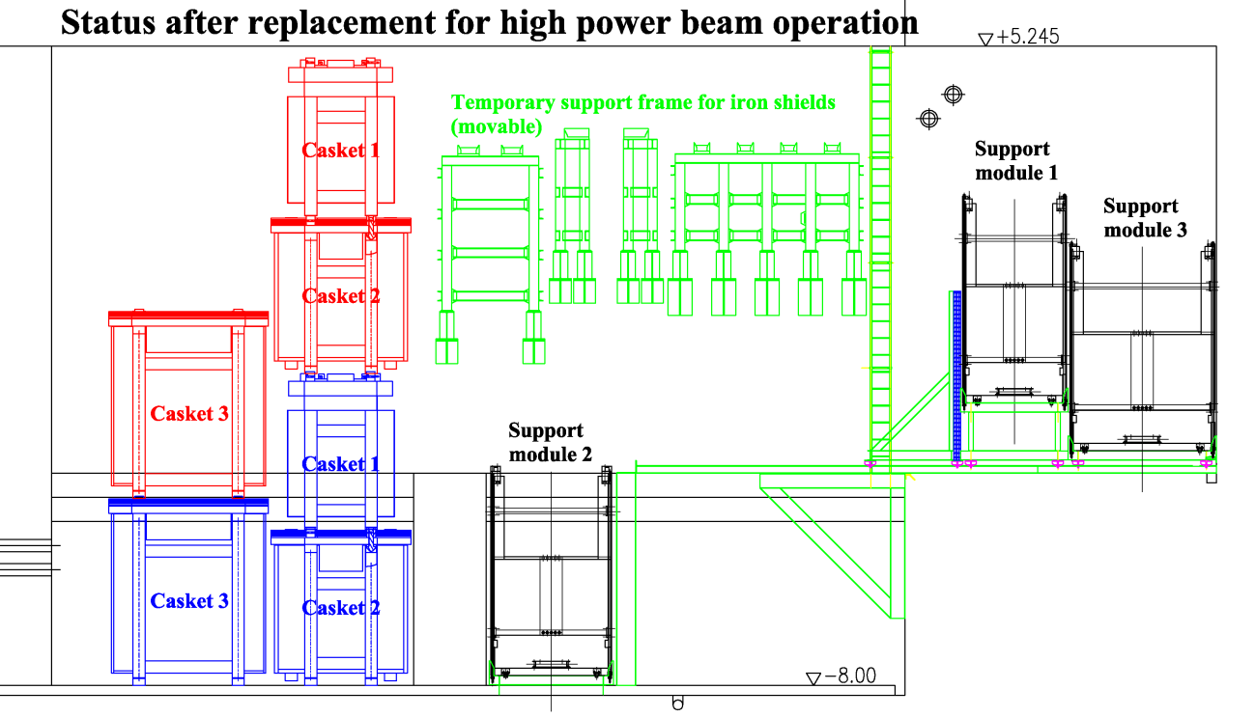
Status of storage area
our plan : 2021
Caskets for 2nd generation horns
Support module for 1st generation horns
When the storage area is filled with the caskets …

Slide 64
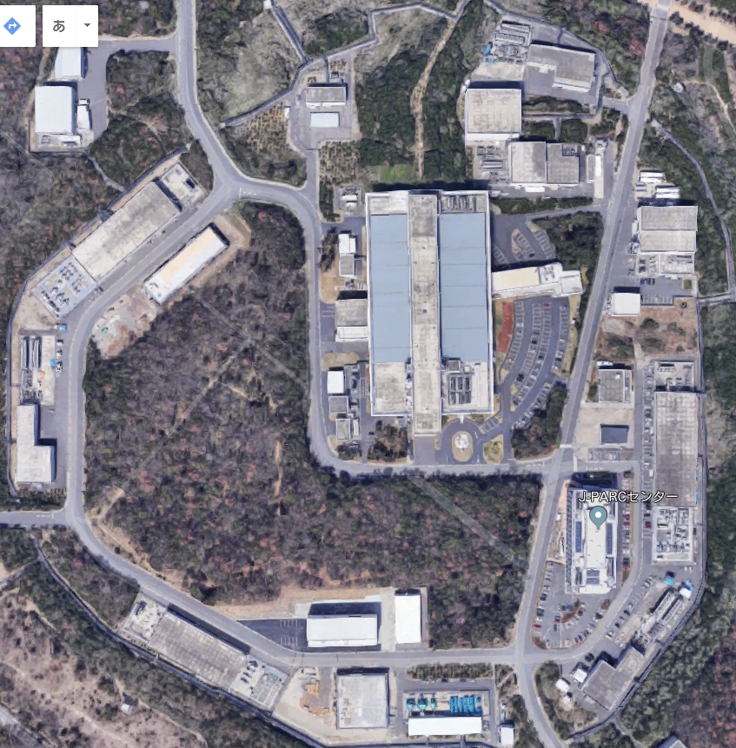
Storage building in J-PARC
Target station
We will transport the caskets from TS to the storage building in the J-PARC site.
100 m
Storage building

Slide 65
Summary of remote maintenance
For beam window
All methods are established.
There is a experience of actual replacement work.
For SSEM19 and ESM21
The exchanger is under development.
For OTR
There is a experience of remove work.
There is no experience of attachment work.
For target
The exchanger is completed.
We have tested and practiced the procedures of replacement individually.
There is no experience of actual replacement work.
For horn
All methods are established.
There are several experiences of actual replacement work.

Slide 67





Black layer problem in carbon steel water cooling pipes
Ion Exchanger
(Not used: it will erode
Carbon steel)
Pre-filter + Degasifier
  Hollow fiber membrane
Strainer coated by black color
Irradiation
By Be7(53d) + Mn54(1yr)
3~4mSv/h on contact
Decrease of flow rate
Clogging by colloidal Be7 (+ black skin) by 1~2month
Open Bypass
Need to reinforce pre-filter system
Need to investigate how to stop clogging by colloidal Be7
Need to estimate total amount of black skin powder/solution in the system
** Flowrate recovers when beam is off: 7Be ?

Slide 68


Cooling pipes of iron shield above horns
Top view
2562 mm
Side view
Water cooling pipes
Water in
Water out
Beam
2200 mm
Helium vessel
Cast iron blocks
Cooled by water
300 ~ 900 mm

Slide 69


Cooling channels of collimator for decay volume
DV collimator is set to prevent the excessive energy deposit into DV concrete.
Helium vessel
Inner DV collimator
Top view
180 mm x 3
2600 mm
Beam
DV
4600 mm
3rd horn
DV collimator
( inner )
DV collimator
( outer )
Water cooling
Air cooling
Cooling channel
( Plate coil, both side )

