Slide 1
NuMI Target System
Katsuya Yonehara
NBI Workshop
10/22/2019

Slide 2
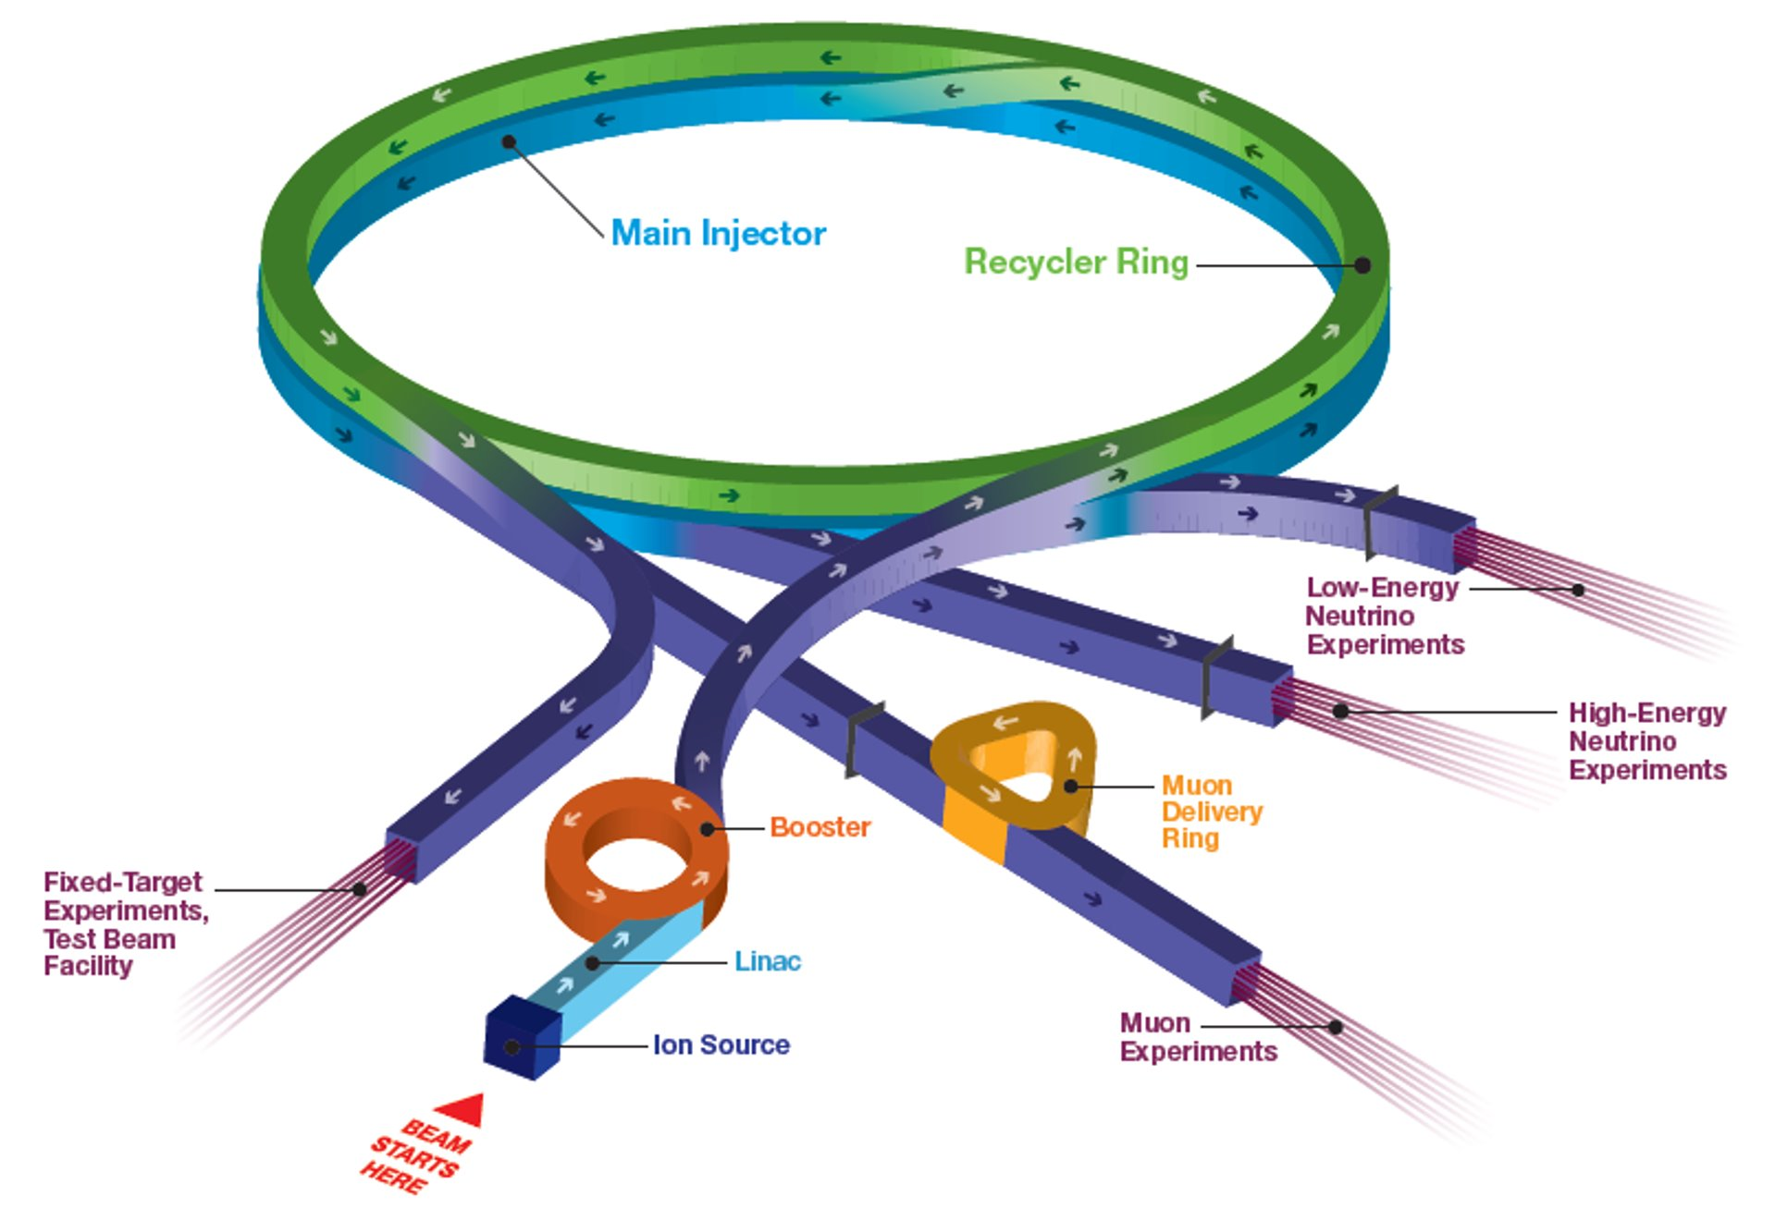
Neutrinos at the Main Injector (NuMI)
Produce intense neutrino beam for oscillation experiment
Deliver beam to MINOS, MINERVA, and NOvA
Deliver neutrino beam to
NOvA FD in Ash River
BNB
NuMI beam line
FTBF/NOvA test
SpinQuest
g-2/Mu2e

Slide 3
Neutrino Physics by using NuMI beam

Slide 4
Publication of physics result in Major Journal
MINOS (2005 - 2016)
  4 PRD and 3 PRL in 2016 - 2019
MINERvA (2010 - 2019)
  5 PRD and 2 PRL in 2018 - 2019
NOvA (2014 - now)
  2 PRD and 1 PRL in 2018 - 2019

Slide 5
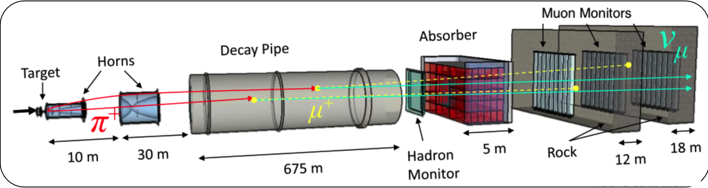
NuMI target system
NuMI Target system
Horn 2
Horn 2
Horn 1
Target carrier

Slide 6
Proton beam into NuMI target
Achieved in Spring 2019
FY20 Plan
Start from November 2019 to May 2020
Maximum beam power 777 kW
Run 1.2 sec duty cycle and 1.4 sec rep rate with g-2/BNB/SY beam operation

Slide 7
Beam exposure of NuMI target system
J. Hylen
MET-03 target just used for one year operation
Total accumulation of MET-03 is 5.5e20 POT
MET-04 is a spare for 700 kW operation
Beryllium (S-65) fins
MET-02 target
10-year operation

Slide 8
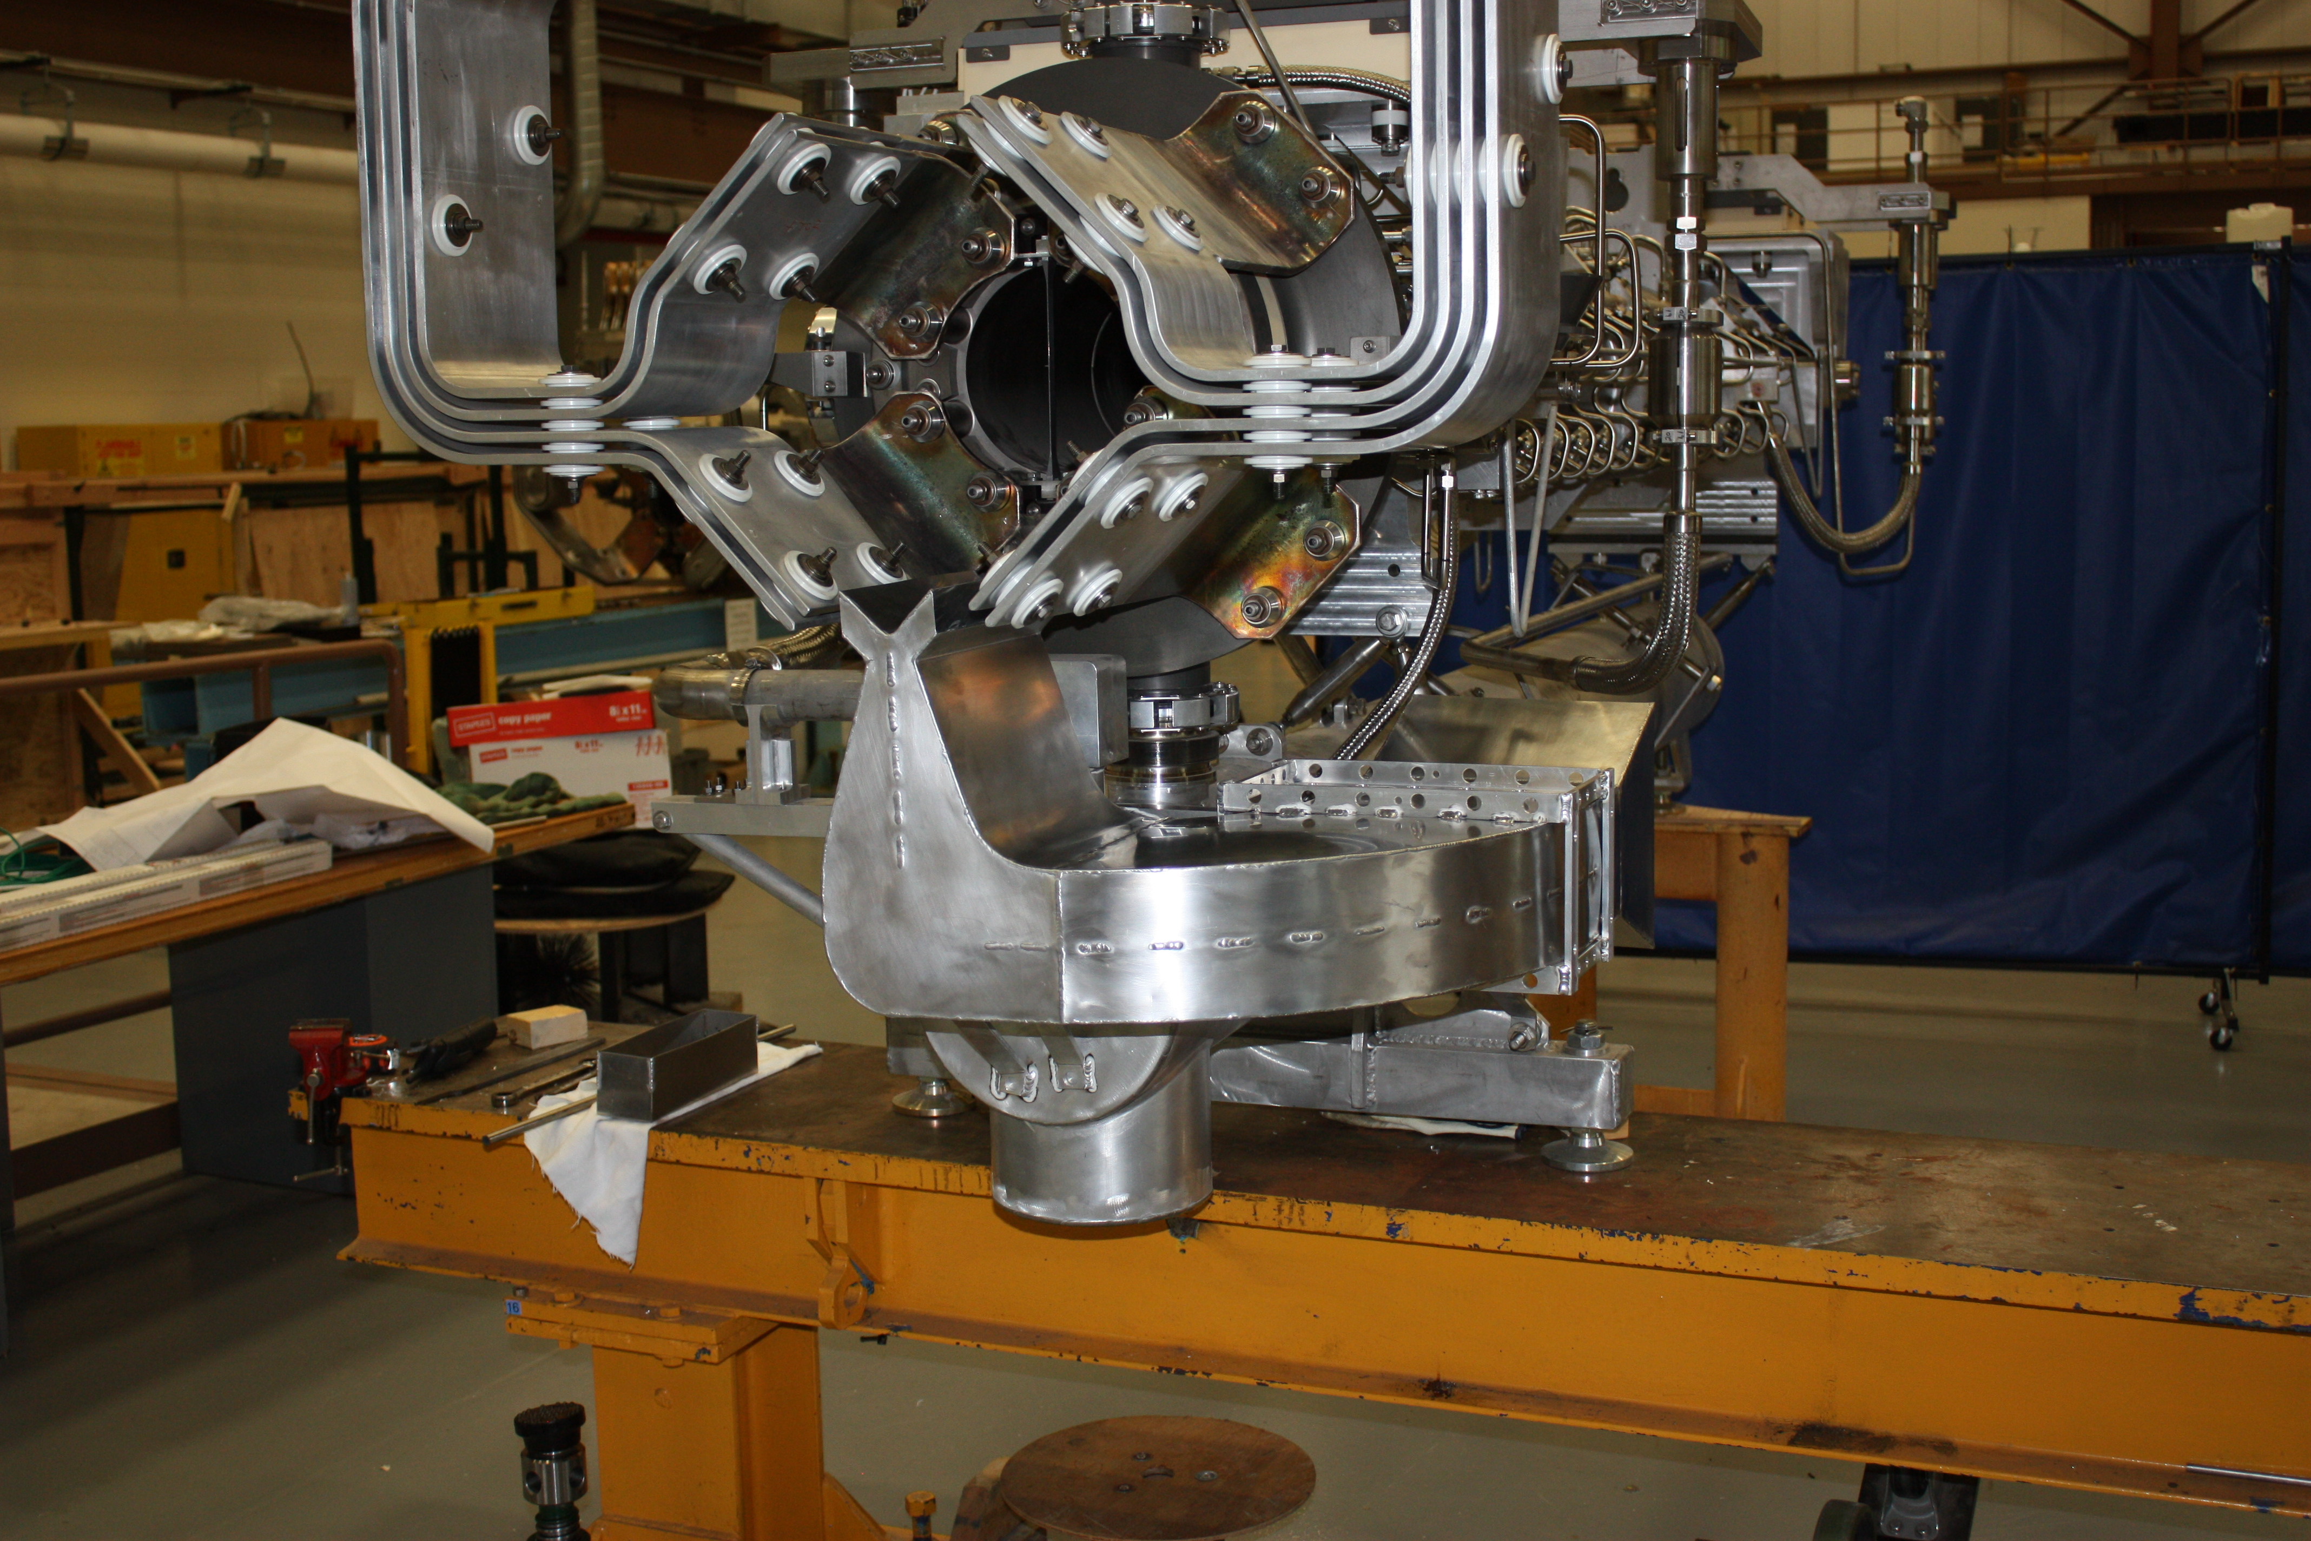

NuMI AIP Upgrade
Upgrade Target system for 1-MW operation
Construction start from 2018 and complete in Summer Shutdown 2020
  MET-05 target capable to accept 1-MW beam
  Modify horn stripline and air diverter
  Yun He and Kris Anderson will show more detail
K. E. Anderson
Free Air Stream
From Beamline
Chase Lower
Beam Left
Quadrant
Air Diverter

Slide 9
Summary of Tasks in Summer Shutdown 2019
M. Murphy
Job/Week | 1 | 2 | 3 | 4 | 5 | 6 | 7 | 8 | 9 | 10 | 11 | 12
Tar/H1 RAW skid work - Des
Horn-1 Target Pile RAW Fitters. - Des
Mez fitting work. Lee Hammond
Mez SCHW HX Replacement Lee Hammond
Mez Chiller PM - Prism Lee Hammond
Chase Cooling HVAC/Fitting Lee Hammond
Transfer MET-02 to C0
Install MET-05 Crowley & Lolov |  |  |  |  | MET-03 to Morgue |  |  |  |  |  | Install MET-05 | Install MET-05
Replace Stipline Hardware
12-week plan, started from 7/09/19
Major activities are for upgrading to the NuMI-AIP 1-MW target system
MET-05 target has been installed in the target chase
  Ready for beam based alignment
  Neutrino beam operation after the alignment

Slide 10
NuMI-AIP Team in Summer 2019
One for all, all for one
Thank you all for your hard works and tremendous supports to accomplish the summer project!

Slide 11
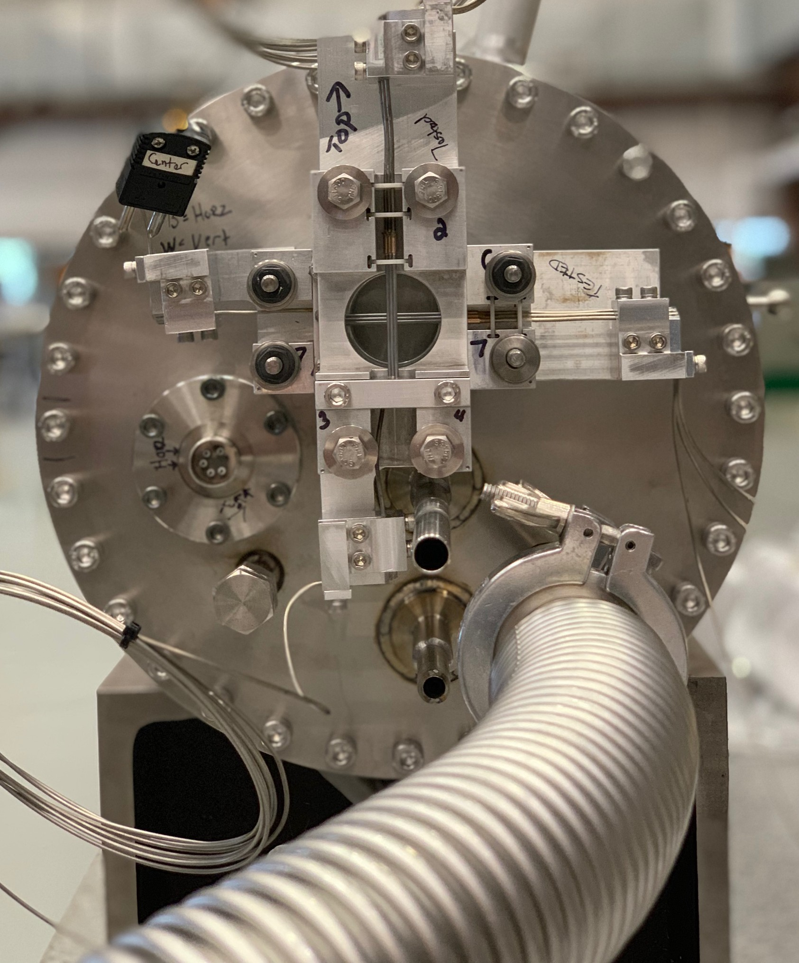
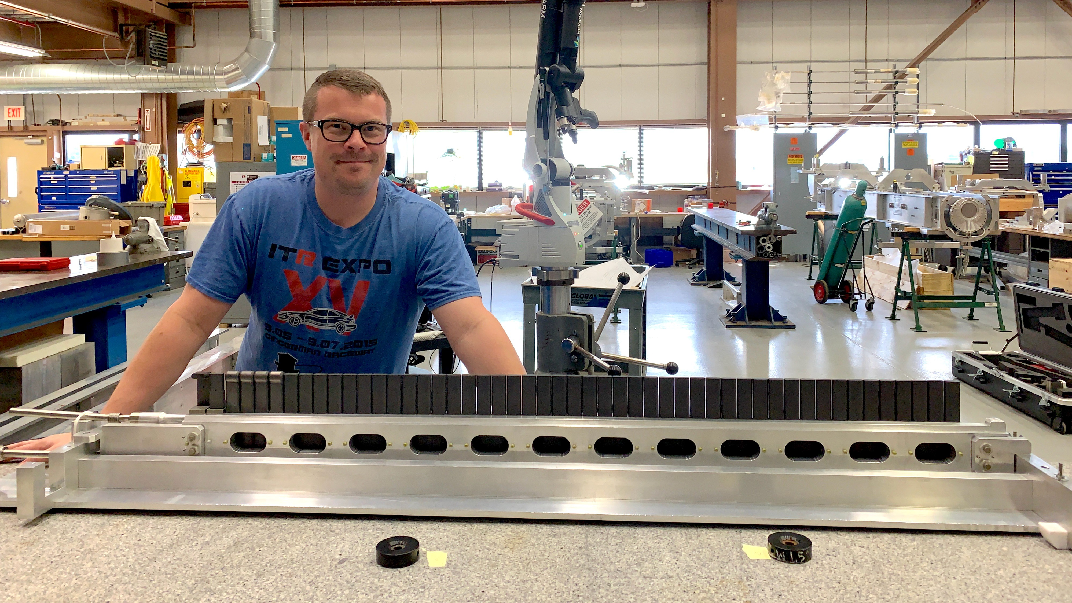
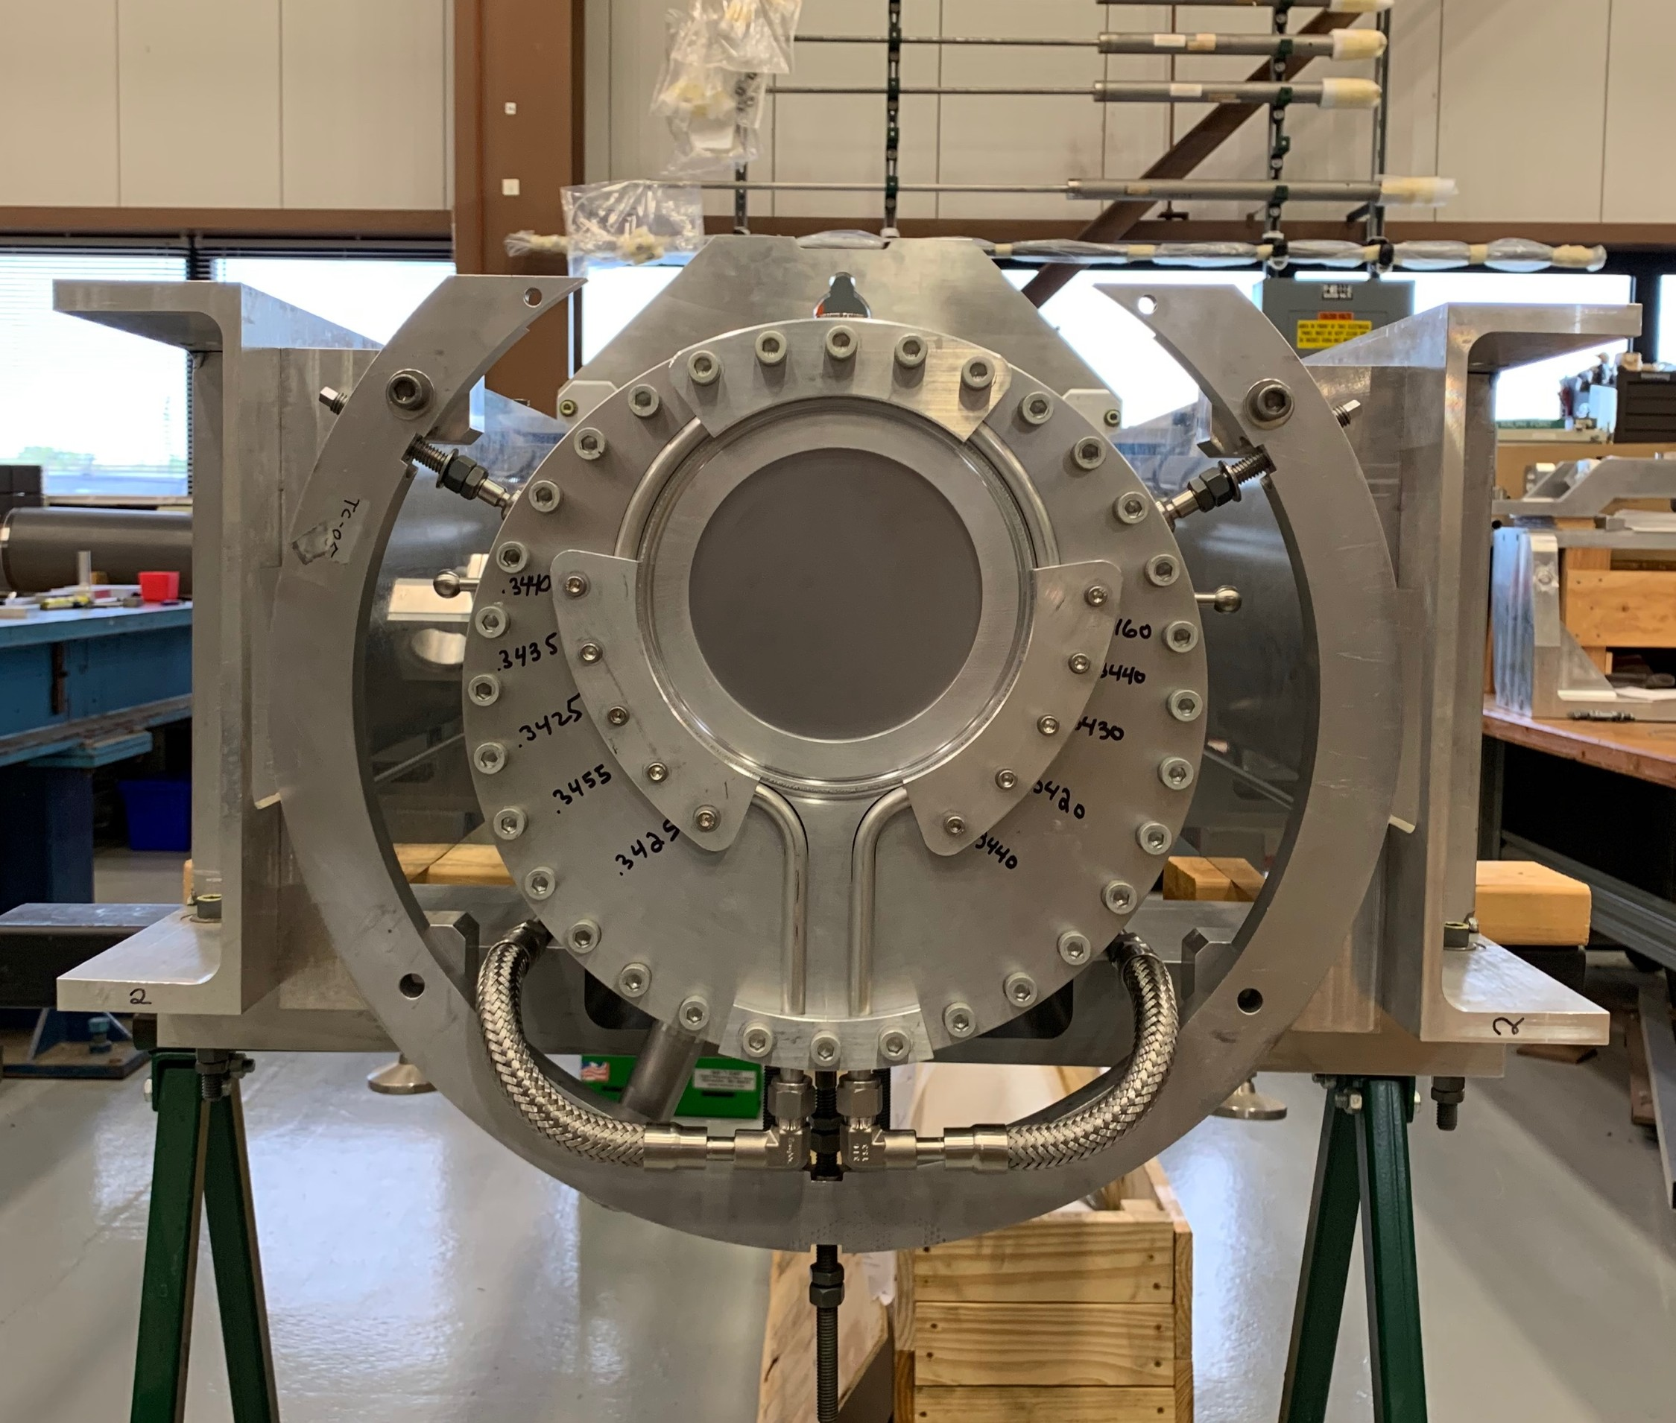
MET-05
G. Lolov
Front-end view of
target can
Fabricate target fin on cooling rail
Back-end view of
target can
Target carrier

Slide 12
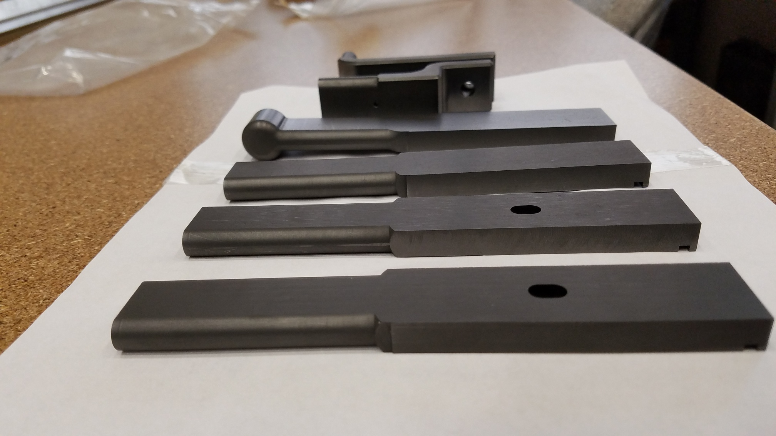
Major modification which can impact on ν beam parameter
Increase target fin width to reduce thermal shock
  7.4 mm to 9.0 mm
  RMS beam size change from 1.3 mm to 1.5 mm
Add winged fin
  First four fins are replaced to the winged fin
Increase inner diameter of baffle
  13 mm to 15 mm
Add water cool on the downstream Be window
Fins, Winged fin, and Budal Monitor fins
New baffle
New DS Be window
& water line

Slide 13
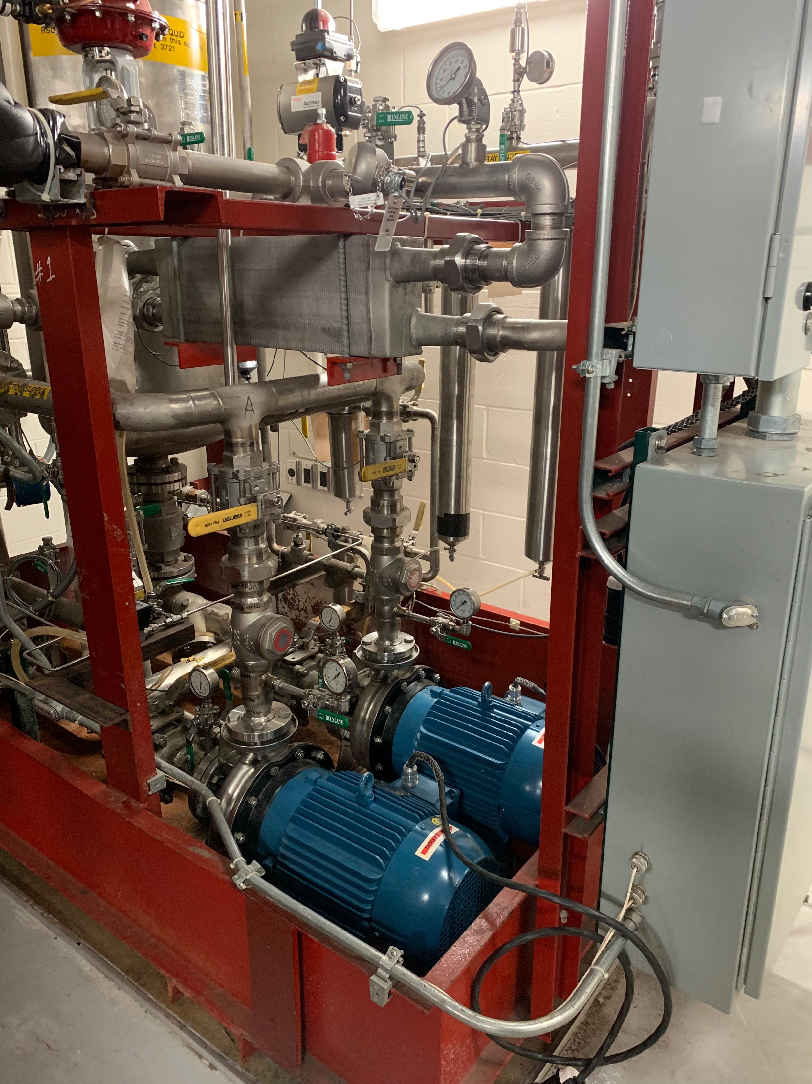
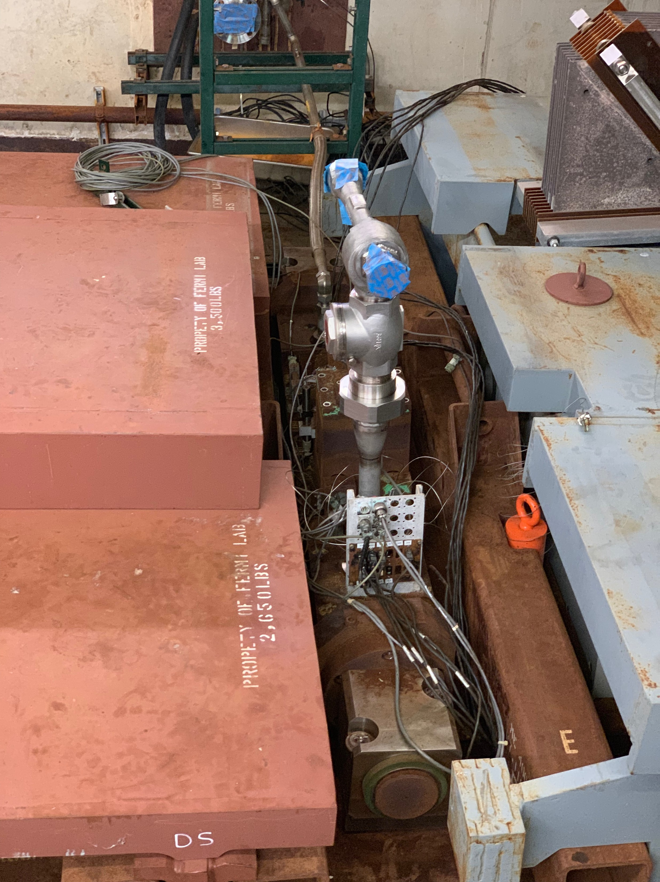
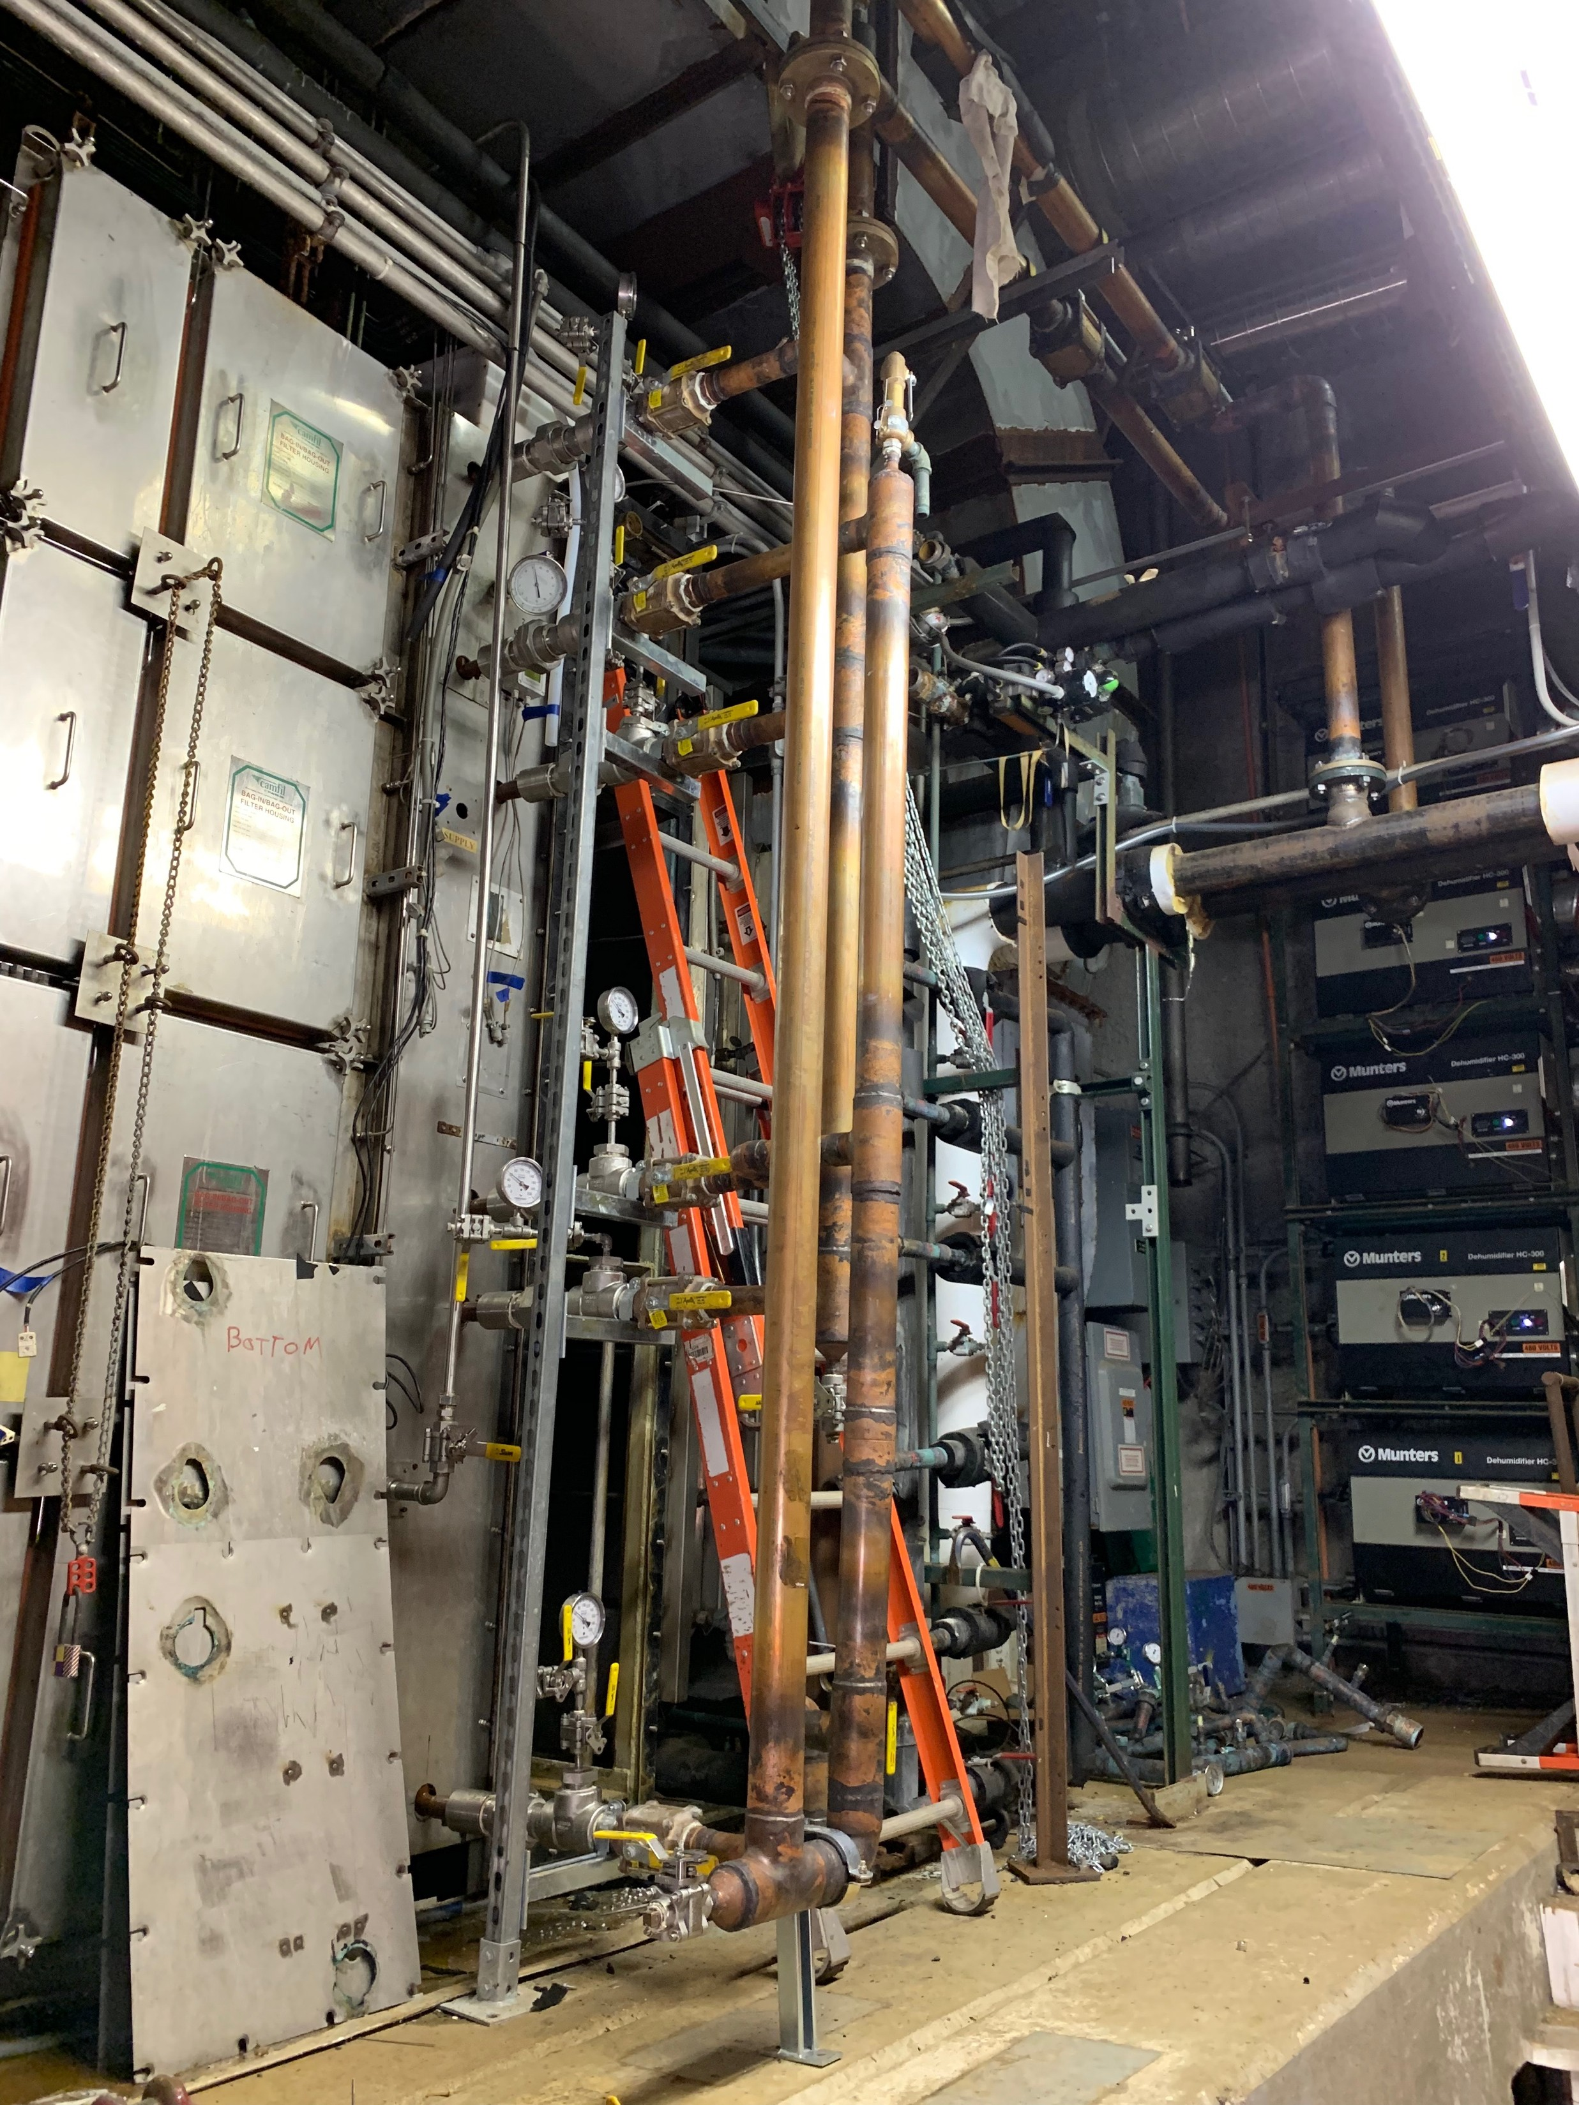
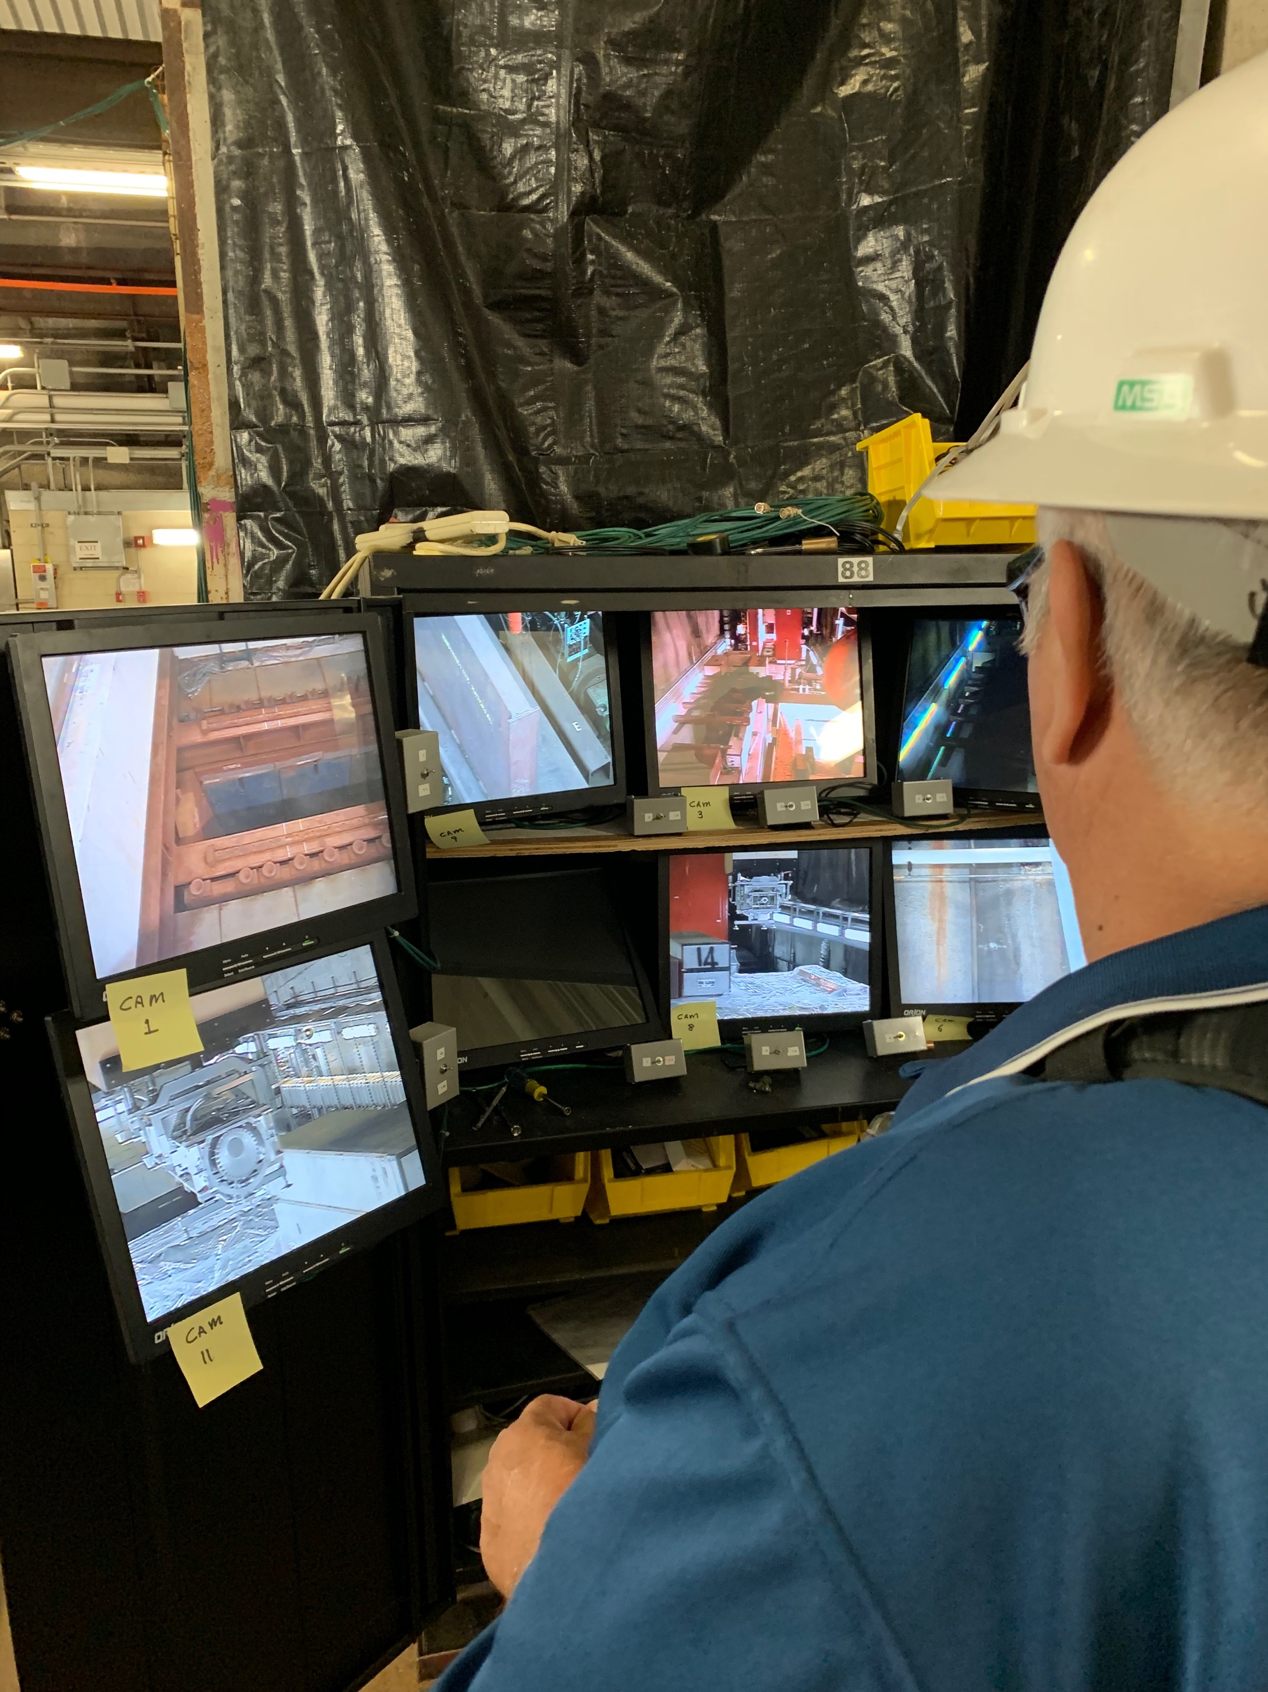
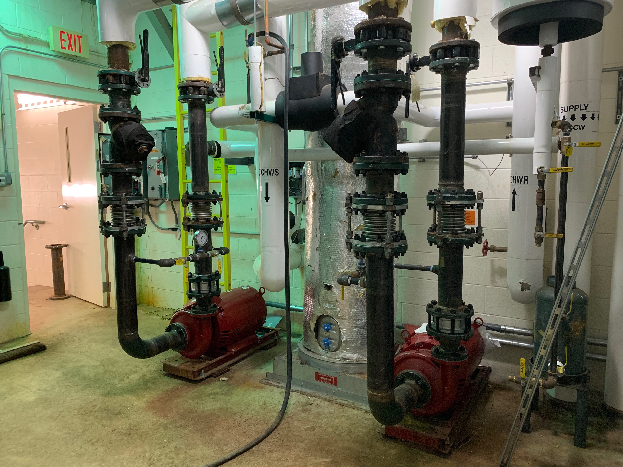
Upgrade cooling system
& Remove old target
RAW skid
Horn 1 suction line
Mez chiller
Add/new cooling coil in TH
MET-02 to C0, MET-03 to Morgue
  Plan to autopsy MET-02 and MET-03
New pumps & HX
New suction line
Operate crane to move MET-03
New multistack chiller
Two new coils are added to the three existing coils

Slide 14
MINOS ND terminated
Since MINERvA completed operation in 2019, the MINOS ND operation is terminated
We lost the most convenient neutrino detector to quickly check the quality of neutrino beam
We investigate the function of muon monitor to diagnose the condition of NuMI target system
Search for Sterile Neutrinos with the MINOS
Long-Baseline Experiment pp 135-152

Slide 15
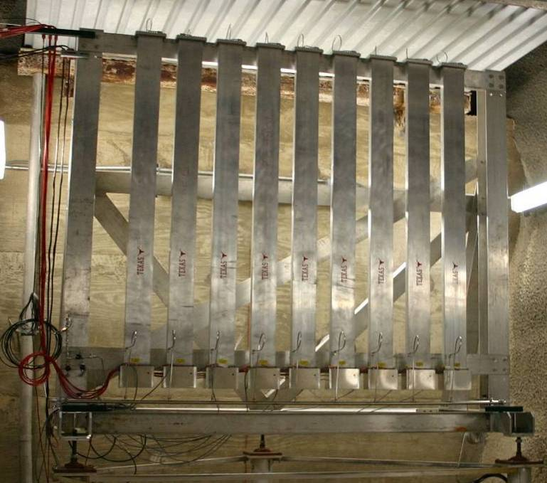
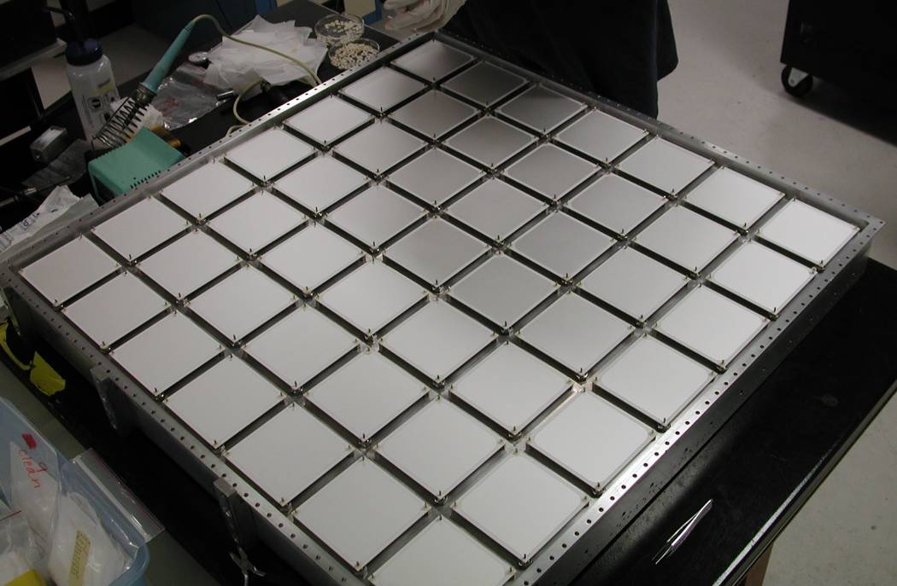
Study beam monitor system
NuMI Target system
Horn 2
Can we reconstruct the neutrino flux at
NOvA ND/FD from beam monitor signal?
Hadron monitor
(0.8x0.8 m², 7x7 pixels)
Hlyen detector
(3+3 Thermocouple
wires)
Muon monitor
(2x2 m², 9x9 pixels)

Slide 16





Study Muon Monitor Signal
Characterize the horn focusing power by using muon monitors at various horn currents (Horn current scan)
$\vec{r_{2,π}}=\hat{M}∙\vec{r_{1,p}}$ and $\hat{M}$ can be a beam transfer matrix
Analytical model reproduces $\vec{r_{2}}=\left(x_{2},θ_{x_{2}},y_{2},θ_{y_{2}}\right)$
Beam centroid on Muon Monitor 1
Beam centroid on Muon Monitor 1
$$x_{2}$$
$$y_{2}$$
Horizontal beam scan
$$x_{1}$$
Vertical beam scan
$$y_{1}$$
E_{π} = 8 GeV
16 GeV
18.6 GeV
30 GeV
Higher E_{π} diverge more
Horizontal (x) track is symmetry while vertical (y) one is asymmetry due to the NuMI target geometry
The model predicts that the observed slope and offset in the beam scan should be unique
x
Ray trace of pions in decay pipe
(Analytical pion production angular distribution estimated by Geant4 + analytical horn field)
Horn 2
y

Slide 17
Machine Learning in NuMI Target system
A. Wickremasinghe
Linear correlation suggests to utilize the Muon Monitor to diagnose the healthiness of target system by using ML system
Introduce Machine Learning to
daily-base monitor MM signal
Accuracy +/-0.5 mm

Slide 18
Summary
Upgrade NuMI Target system
  Install MET-05 target
  New cooling system ready to operate
  Work on horn stripline and air diverter
FY20 run will start next week
  Beam power up to 777 kW
  Or > 680 kW with synergistic operation
Study beam monitor system
  Capability of reconstruct neutrino flux at NOvA ND/FD

