Slide 1
LBNF Target Hall Remote Handling Facilities and Horns exchange procedure
Vladimir Sidorov
NBI 2019
25 October 2019

Slide 2
Remote Handling Equipment Requirements
Remote Handling Facilities and Equipment must provide methods to support radioactive component replacement and short-term storage
The remote handling shall be integrated into the infrastructure of the complex both underground and above ground. (This indicates that Remote Handling Facilities shall be designed for 2.4 MW operations since it is not upgradeable)
The remote handling shall incorporate ALARA (As Low As Reasonably Achievable) principles into facilities, equipment and procedures

Slide 3
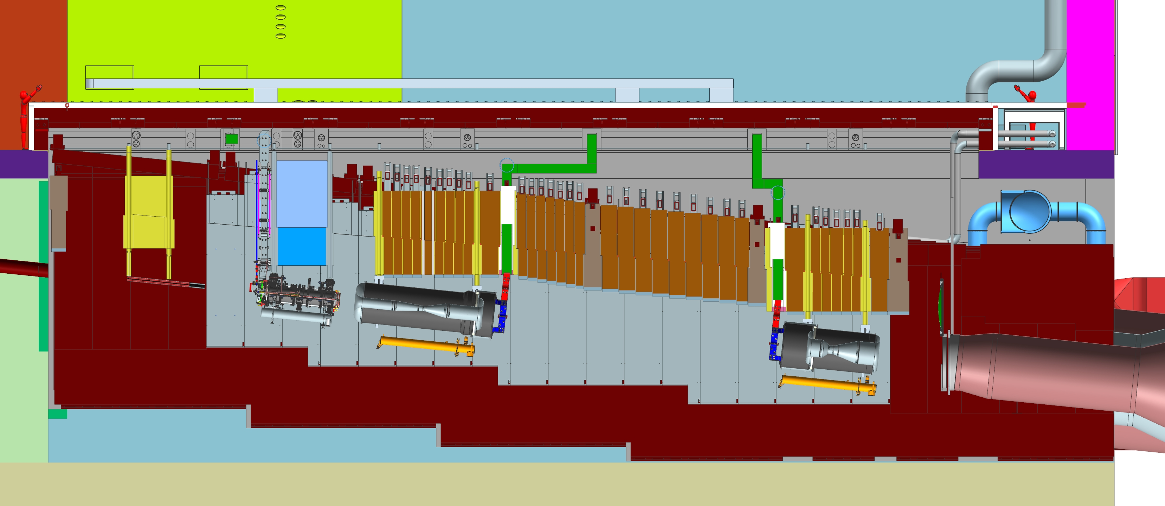
Target Chase
The Target Hall enclosure contains the components, Baffle , Target and Horns, for generating neutrinos and focusing them toward the near and far detectors.
All components have the life limits and have to be replaced with new ones.
Baffle
Target/Horn-A
Horn-B
Horn-C
Decay pipe

Slide 4
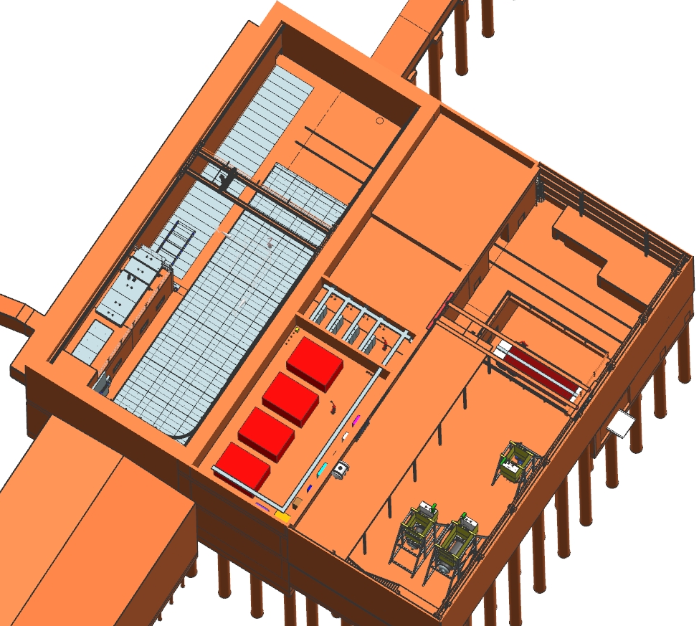
LBNF Target Hall Remote-Handling Facilities
Beam line
All components are replaced remotely in the Work Cell and stored in the morgue located inside the target hall. The morgue location inside the Target Hall simplifies the remote handling operation. The radioactive components are transported to the permanent storage place after the cool down in the Target Hall morgue.
All Remote-Handling operations are provided by using the bridge
crane 60 ton capacity with redundant motions in the Target Hall and 60 ton crane in the service building.
T-blocks pit
Rails
Crane
Shielding door
Morgue
Target Chase
Transfer
Cart
Work
Cell
Truck
bay
Horns
Assembly
stands
Service
building

Slide 5
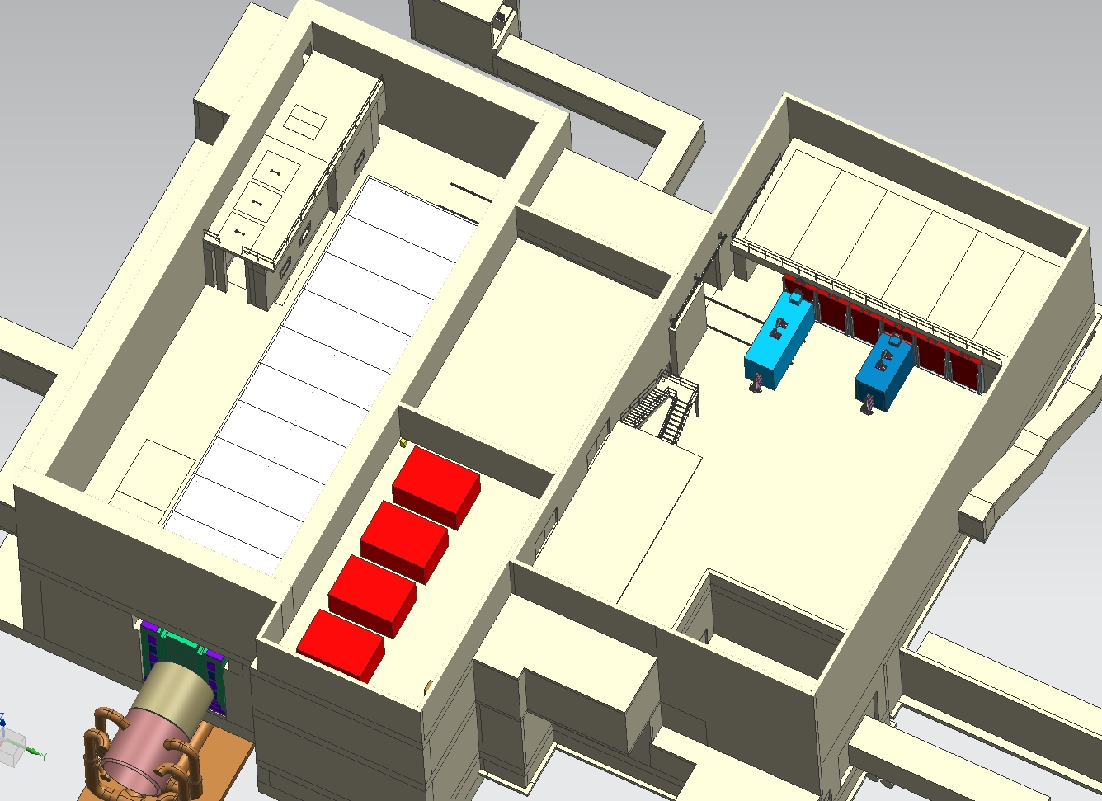
Target Complex Remote-Handling Facilities, Old design
Work Cell
Door
Rails
Casks
Target Pile
T-blocks storage pit
Morgue
60
Maintenance
area

Slide 6
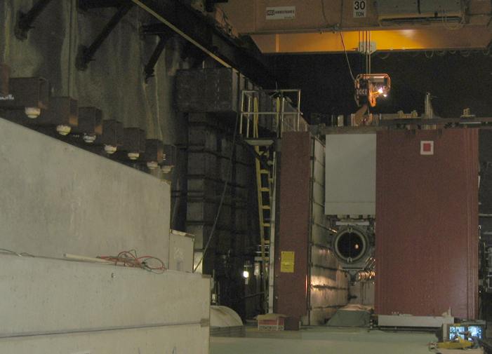
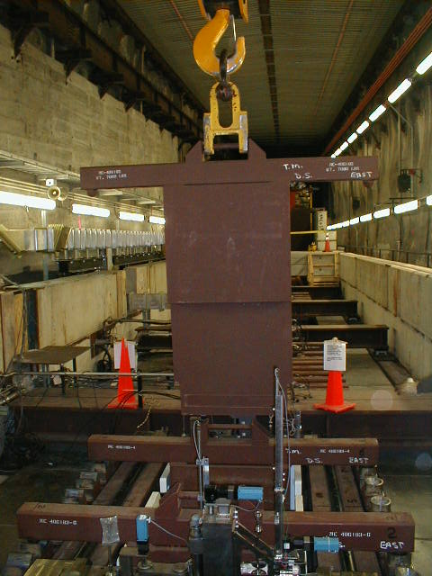
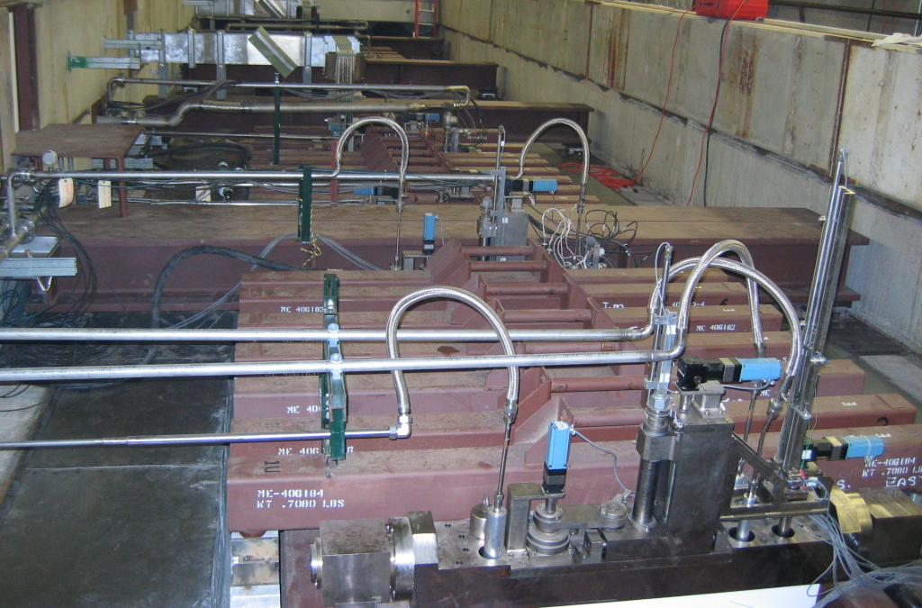
Real life examples from NUMI Target Hall
T-block
storage
T-block
Work
Cell
Horn with module
Target Chase

Slide 7
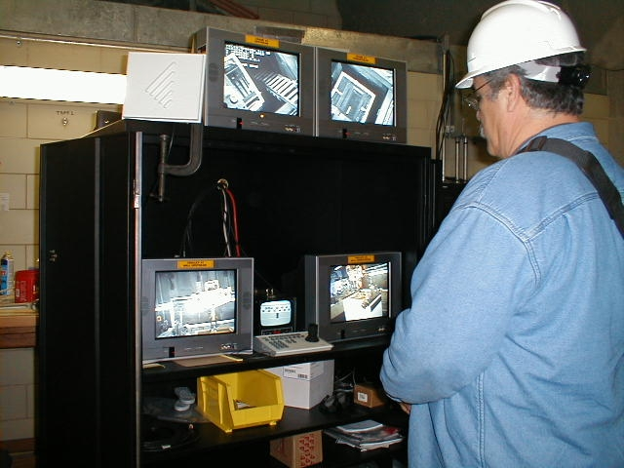
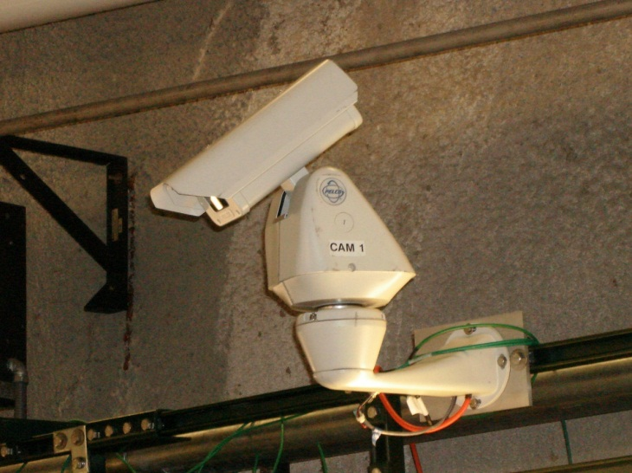
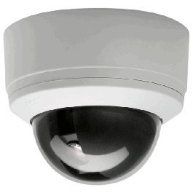
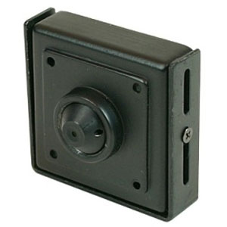
Operations remote viewing system
The video system is integral to all remote handling steps.
Video Center
Video cameras
Target Hall
Crane
Work cell
PELCO SD4-W0 SPECTRA SD4-W0

Slide 8
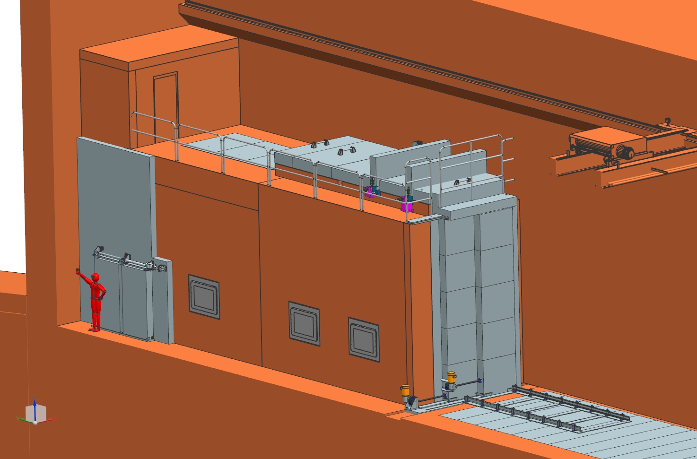
Work Cell and Operation Center
The Work Cell and Operation Center are located in the right corner of the downstream end of the Target Hall. The top shielding covers ( 14” thick steel blocks) are installed and removed by crane remotely.
Top covers
Work Cell
door
Operation
Center door
Carts rails

Slide 9
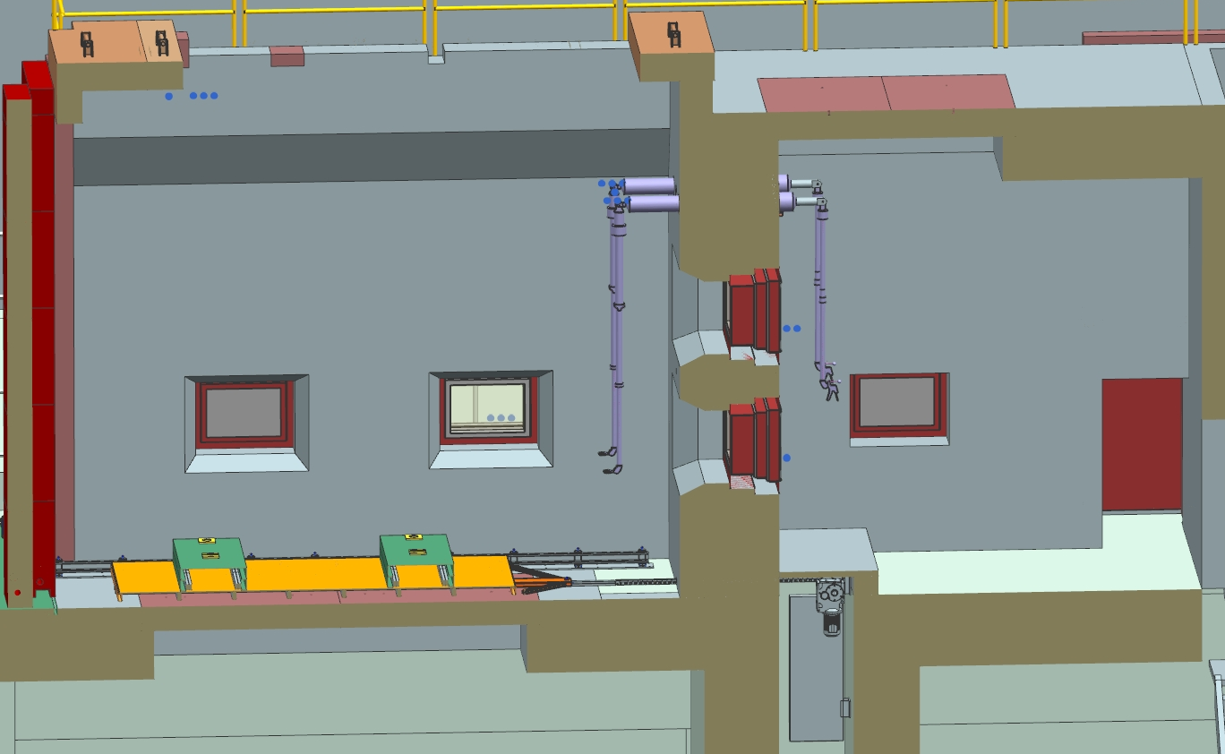
Work Cell and Operation Center
The Work Cell is equipped with remotely operated transfer cart with lifting tables, remotely operated door, Lead-Glass windows and video cameras.
Door
Work Cell
Operation Center
256”
Tele-manipulator
300”
Led-Glass window
Chain drive
mechanism
Transfer cart
with lifting tables
Shielding plate
Guide rails

Slide 10
Work Cell Door
Two doors 12” thick and 20’ tall are installed on the base plate in the front
of the Work cell. Both doors are guided at the bottom and top. Doors are moved with
independent motorized screw jacks. Doors weight 44,000lb –right; 47,000lb left.
240”
Screw jack
90”
Both door closed
One door opened
Both doors opened

Slide 11
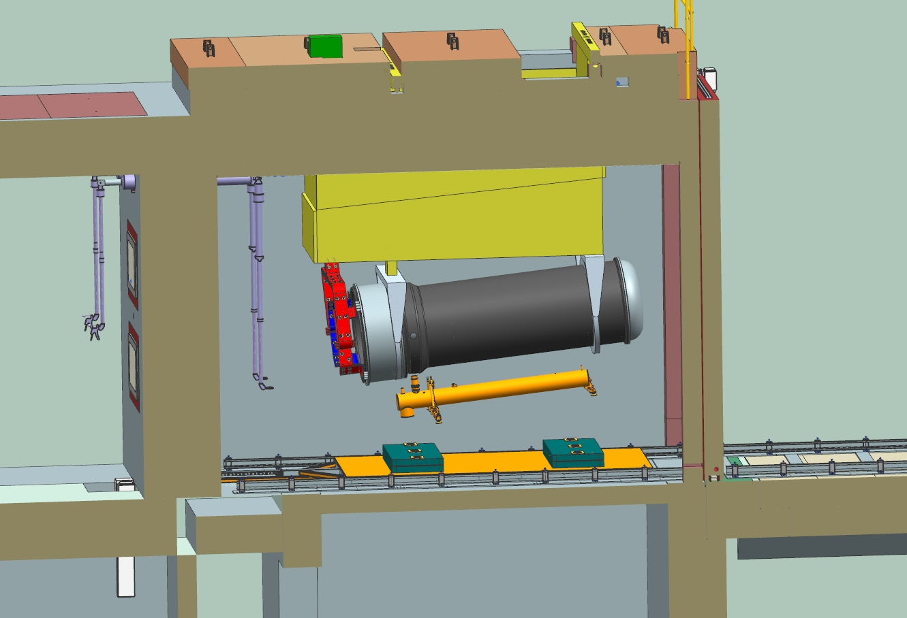
Target Hall Work Cell Horns replacing system
The module with horn is delivered into the Work cell from the Target chase by crane.
Work cell
Module
Horn-B
Transfer cart
Rails
Operation
Center
Chain
Drive
Rails inside WC
Lifting tables

Slide 12
The lifting tables are raised up and touching the horn support legs.
The horn is disconnected from module and lowered down by lifting tables.
The work cell door is opened.
The cart with Horn is moved out from the Work cell.
Chain type: CH60PS2000; Stroke 10meters ( 397in);Push-pull force 2,810 lbf; Speed 7 fpm

Slide 13
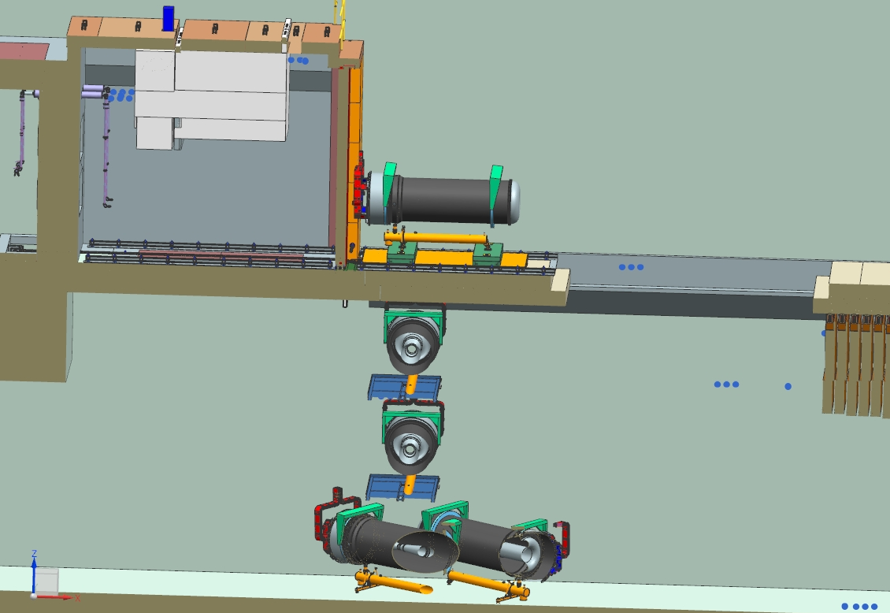
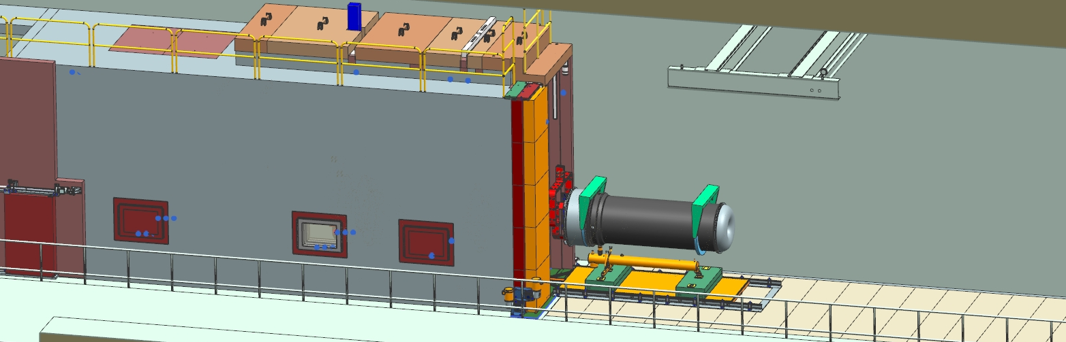
The Horn is picked up by crane using horns lifting fixture and dropped into the morgue through the opened concrete shielding hole . The concrete shielding blocks are installed. New Horn is arrived , delivered to the Work Cell and attached to the module.

Slide 14
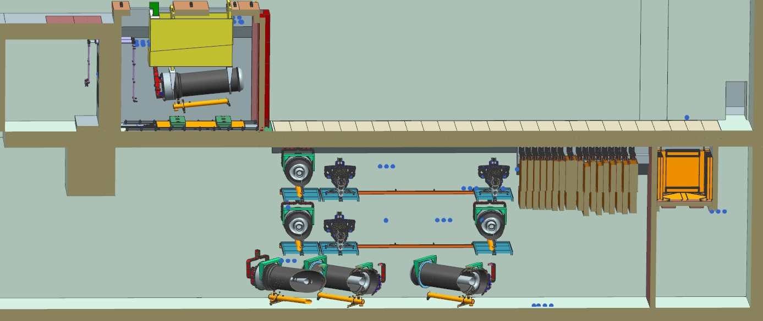
Target Hall morgue and T-blocks pit design
The shielding between morgue and T-blocks pit is removed. Concrete blocks and T-blocks
support lips are modified. The storage box is redesigned.
Work Cell
Morgue
T-blocks pit
Storage
box

Slide 15
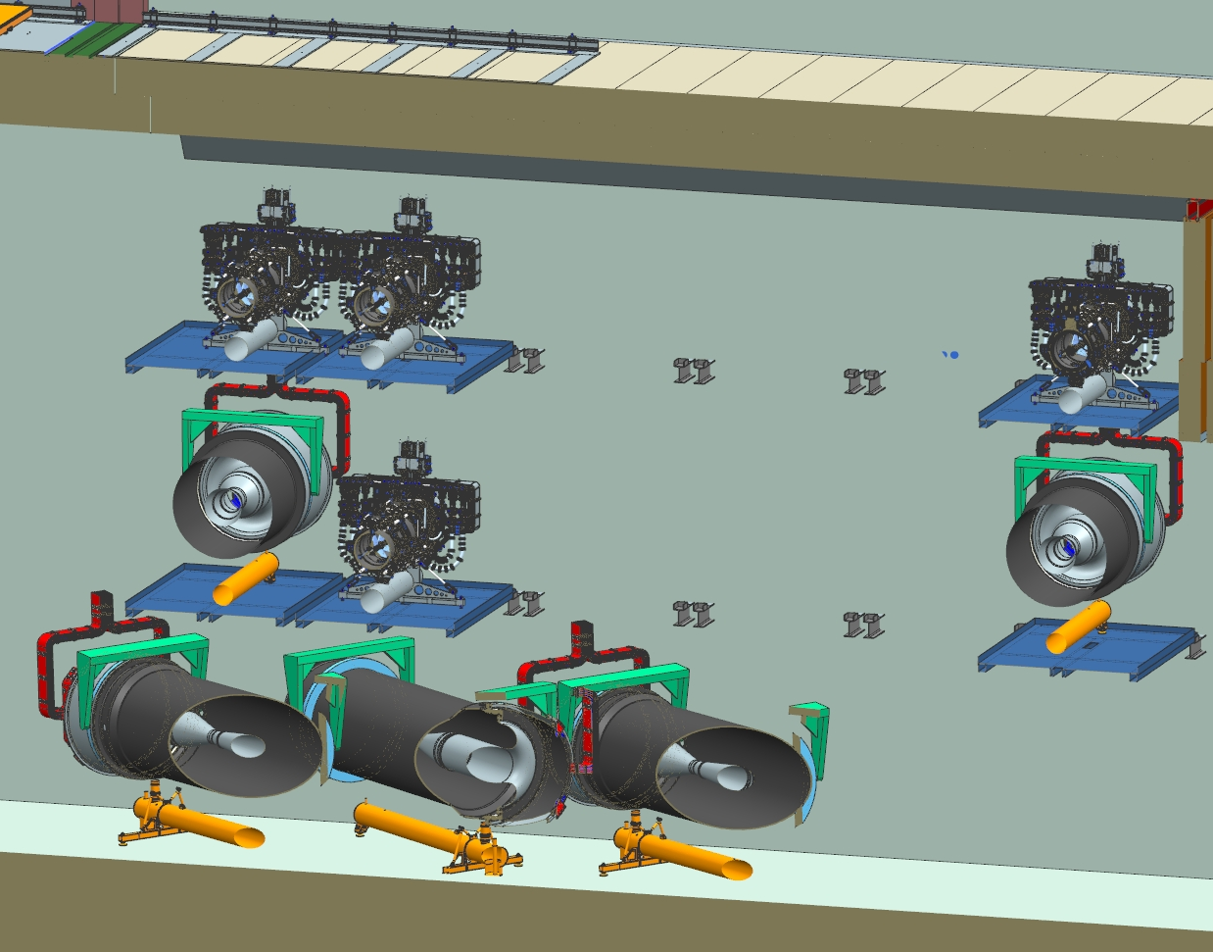
Morgue design
The platform support I-beams are mounted into the wall.
The same size platforms can be installed on middle and upper levels.
The corbel is made from 8” I-beam.
Platform weight-1,757lb.
Platform
80”
155”

Slide 16
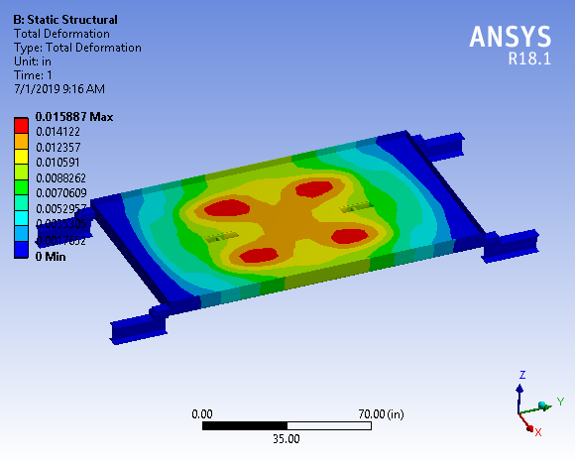
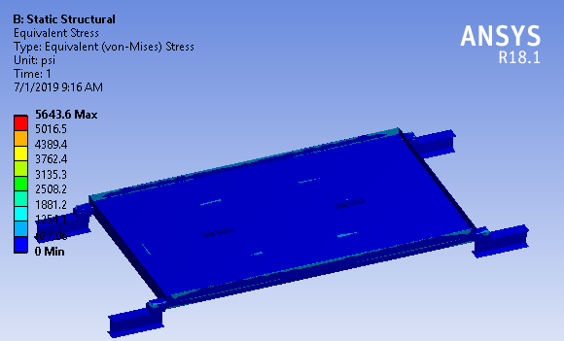
Horn A and Horn C Platform FEA calculation
Deformation and stress are low

Slide 17
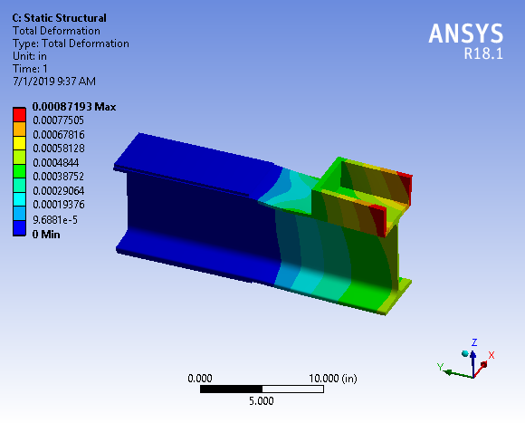
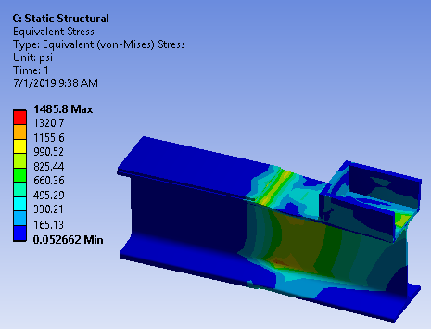
Corbel FEA calculation
Deformation and stress are low

Slide 18
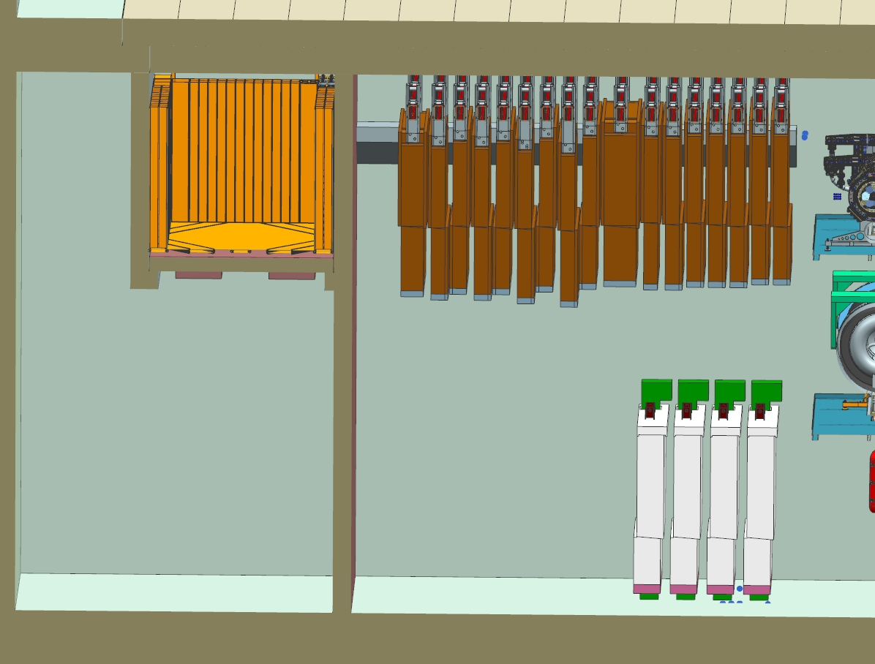
T-Blocks pit
There is no shielding between the morgue and T-blocks pit.
T-Blocks
Concrete blocks
120”
Storage box
Shielding plate
Stripline block
Shielding wall
174”

Slide 19
Work cell hatch
The hatch is located in the middle of the work cell between two transfer cart rails.
The hatch is covered by two shielding plates, 12” thick.
TH Cooling panels can be stored under the Work Cell. The panel is delivered into the storage place through the hatch. The special lifting fixture and the panel support stand are required for the cooling panel storage.
Work Cell
hatch
180”
48”
WC Hatch
Shielding
plates
48”
Cooling
panel

Slide 20
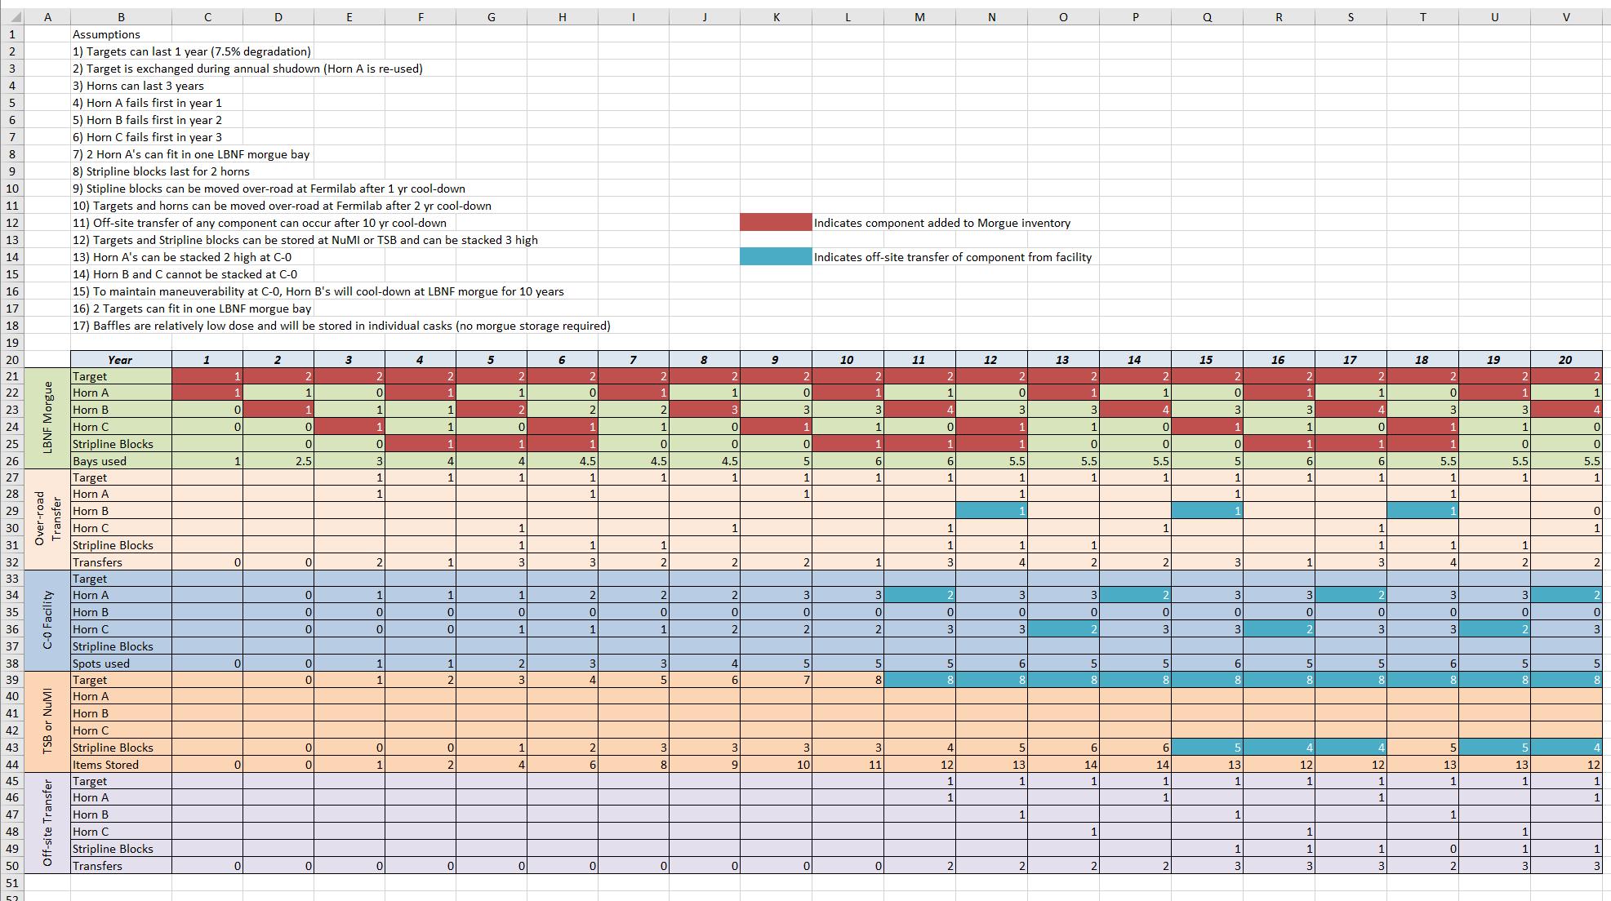
Morgue usage LBNF
P.Hurh

Slide 21
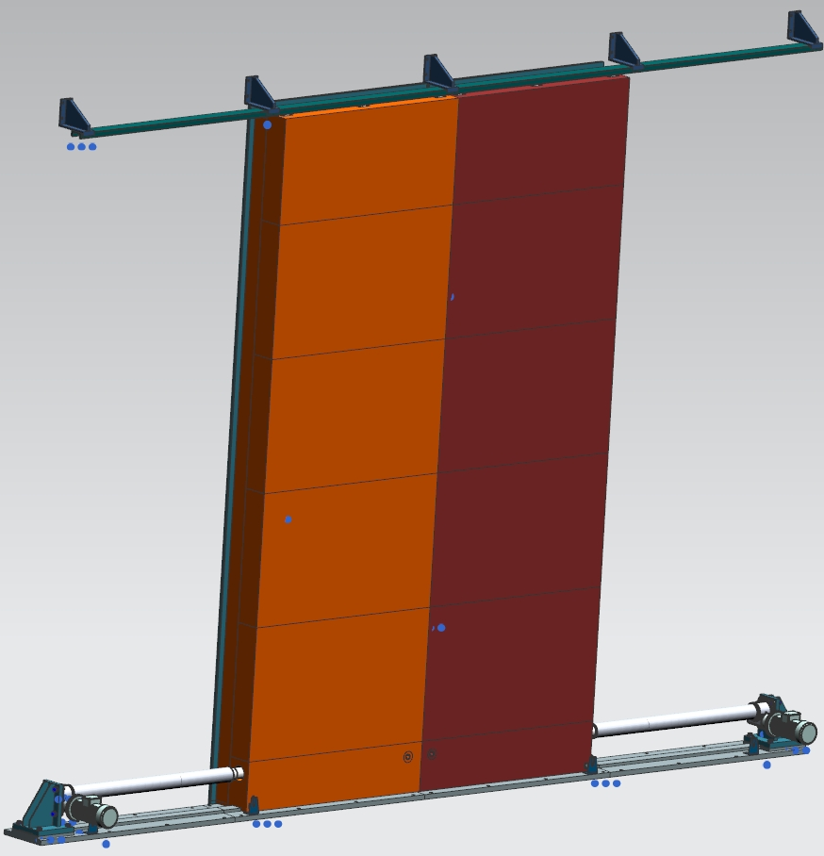
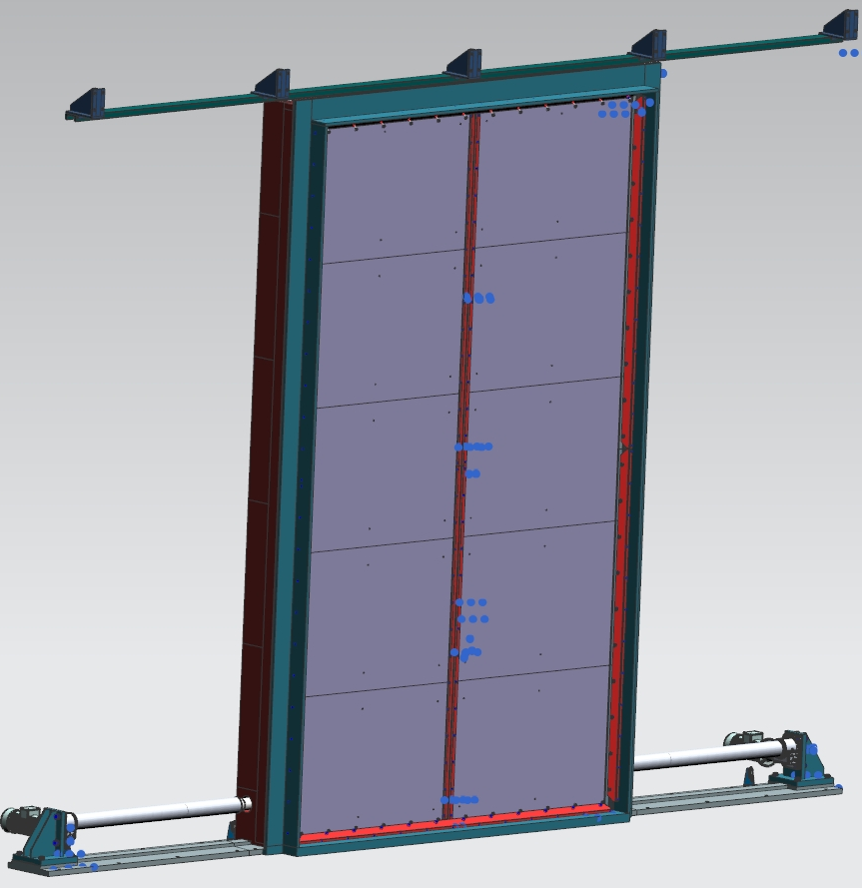
Target hall main entrance door
Two halves of the sliding target hall main door are made of 6 inches of poly and 10 inches of steel. Both doors are running on the base plate by push-pull electrical cylinders. Doors are guided by the guide rail and rollers on the top and rollers on the bottom. Limit switches are controlled the doors position. The door has double air sealing.
Guide rail
Door frame
Steel
door
Borated
Polyethylene
Electrical
cylinder
Seal
clamp
Limit switch
Base plate

Slide 22
The door is mounted on the outside 5 ft long wall the polyethylene facing to the Target Hall and the steel facing to the Rail Corridor.
The door must be providing the shielding of the service areas from the Target Hall.
Target
Hall
Service building
Air sealed
roll door
Rails Corridor
Air sealed
roll door
Shielding
Door
Poly
Steel

Slide 23
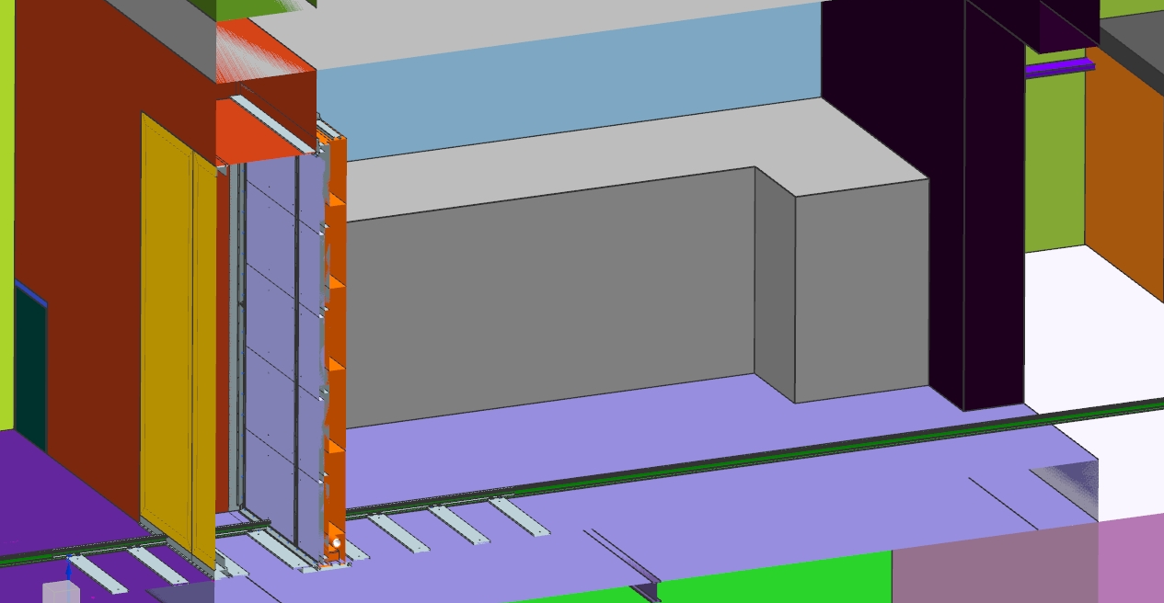
The shield door will incorporate an air seal to separate the radioactive
air volume of the Target Hall enclosure from the air volume of the neighboring
service areas.
Air sealed door
Shielding Door
Roll door
Target Hall
Rails Corridor
Service
Building

Slide 24
Horn transportation
The cask with closed door is placed on the transfer cart by crane and moved from the target hall to the Service building through the Rails Corridor, where the horn is uploaded on the truck and moved to the permanent storage place.
Rails Corridor
NUMI Target Hall

Slide 25
Summary
The Remote Handling Facilities and equipment are designed for 2.4 MW operations and providing the support of the radioactive components replacement and short-term storage.

Slide 26
Back up slides

Slide 27
Work cell doors details
Top guide rail
Top linear bearing
Screw jack
Nut
Left door
drive
Right door
drive
Bottom guide rollers
Hilman rollers

Slide 28
Shielding door air seal
Air seal
Door closed
Air seal
Door open
Gap
Seal
Gap

Slide 29
Shielding door double seal
Top seal
Clamp
Seal
angle
Seal
angle
Door seal
Seal clamps
Clamp
Middle seal

Slide 30
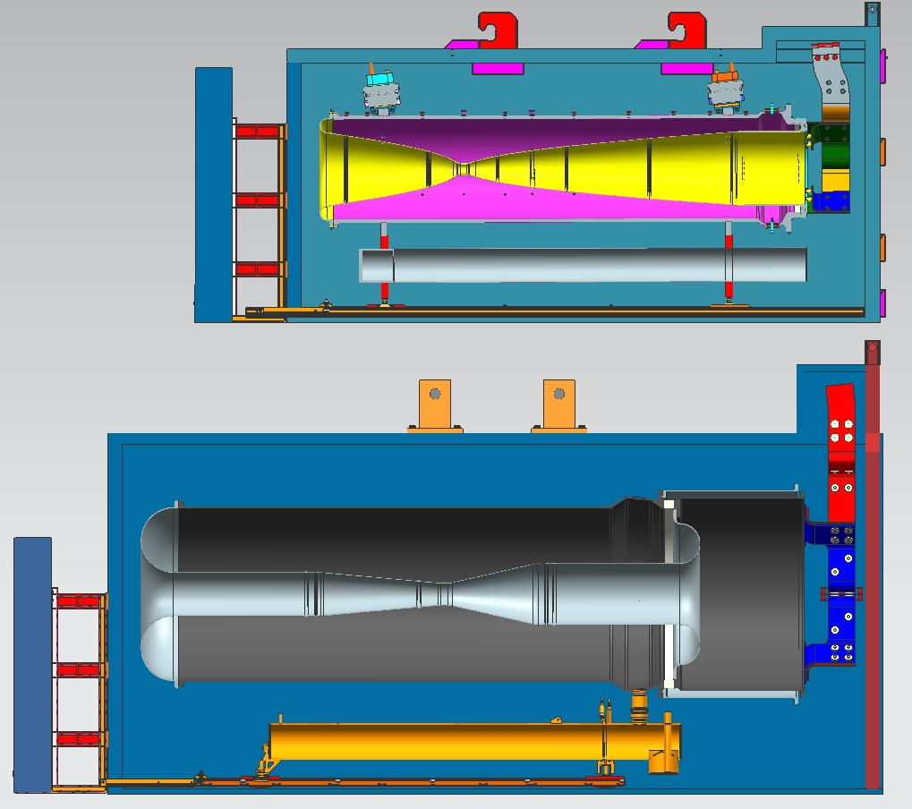
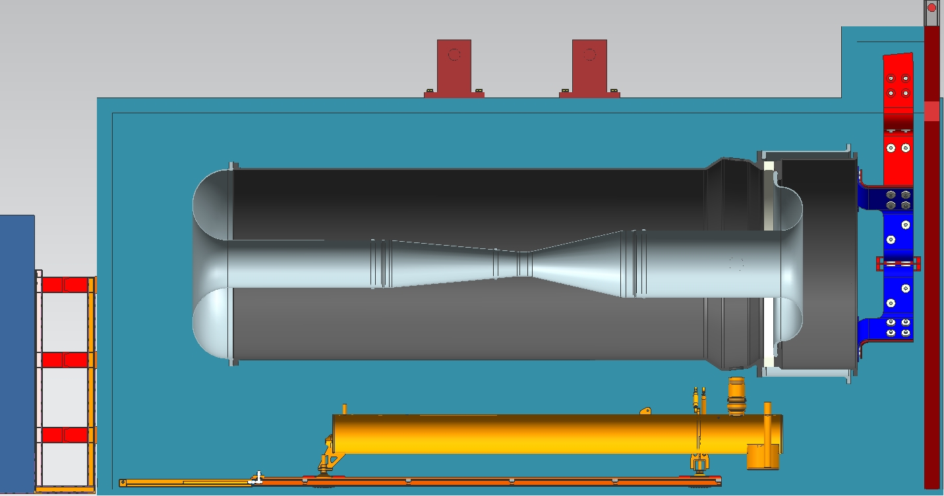
Horns Casks
The LBNF Horn cask is 53” longer,27” wider and 34.75” taller then NUMI Horn cask. The NUMI cask with horn weight is 30 ton, the LBNF cask with horn weight is about 52 ton.
NUMI Horn Cask
90”
75 5/8”
27.3”
172”
57”
4”
3”
4”
4”
127.75”
108.75”
4”
LBNF Horn B Cask
1.5”
27.3”
225”
84”

Slide 31
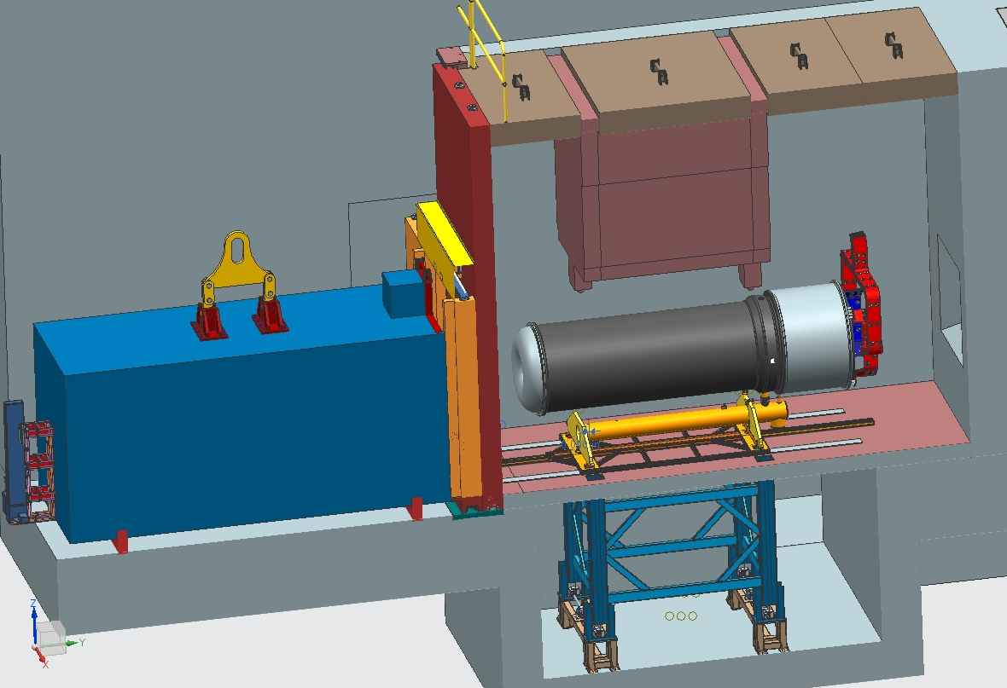
Horn exchange , old version
The horn is disconnected from the module ,lowered down by the structure and placed on the cart.
The cart with the horn is pulled into the cask by a chain drive mechanism. The small door of the work cell is open. The cask door open.
Chain Drive

Slide 32
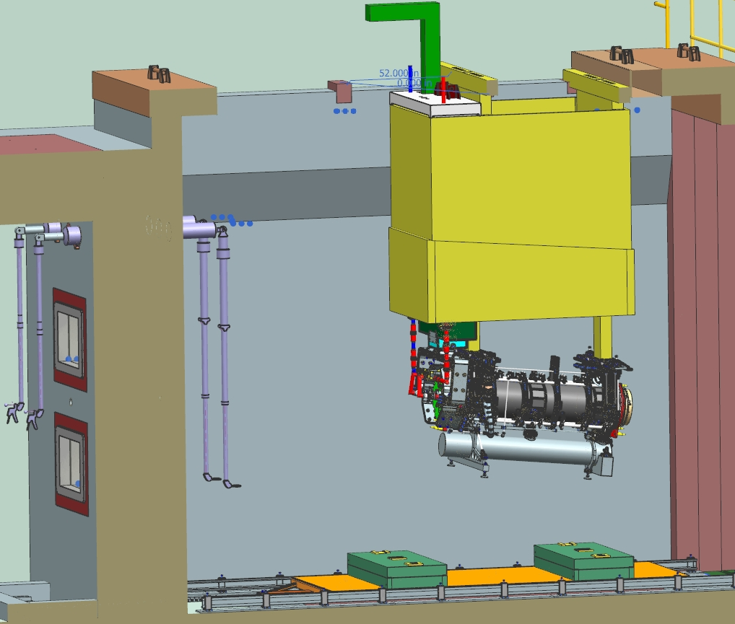
Horn-A Module in Work Cell
Horn-A

Slide 33
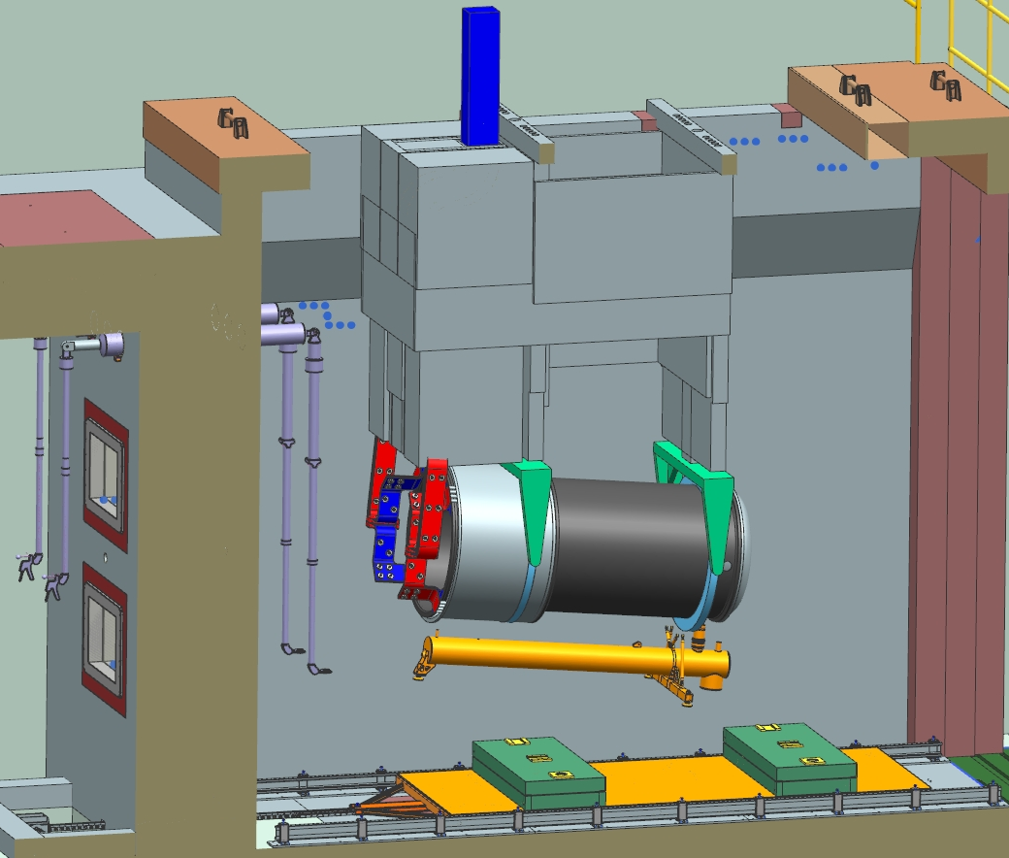
Horn-C Module in Work cell
Horn-C

