Slide 1
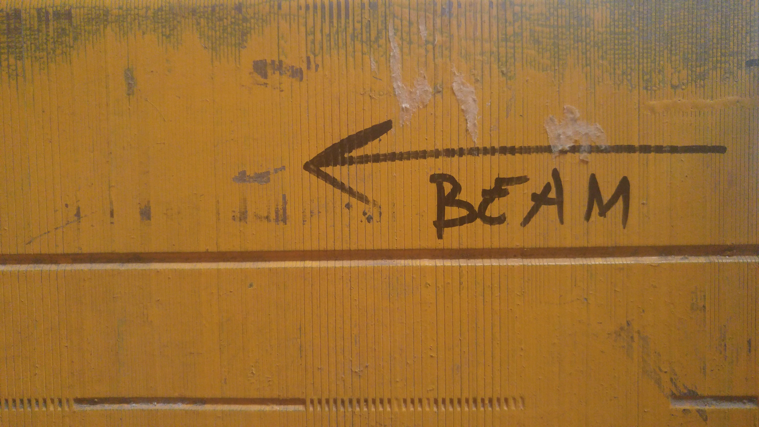
BNB Target Beam Scans
Alyssa R Miller
Fermilab Accelerator Division, External Beams Department
NBI 2019

Slide 2
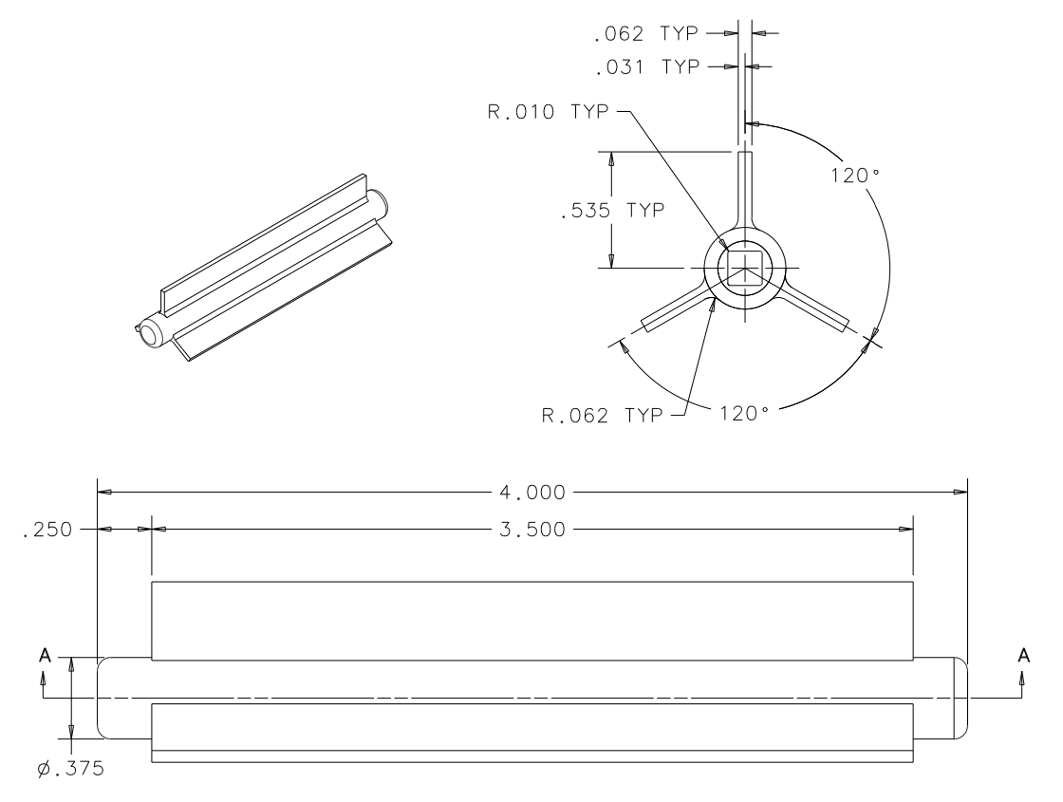
Purpose
1.6mm
Maximize target lifetime
Ensure symmetric energy deposition of beam on target
Autotune calibration check
BPM electrical center can drift
Multiwires give mechanical center wrt target alignment
How can we improve beam quality?
How can we learn more about BNB beam dynamics with instrumentation?
8.8mm
9.5mm

Slide 3
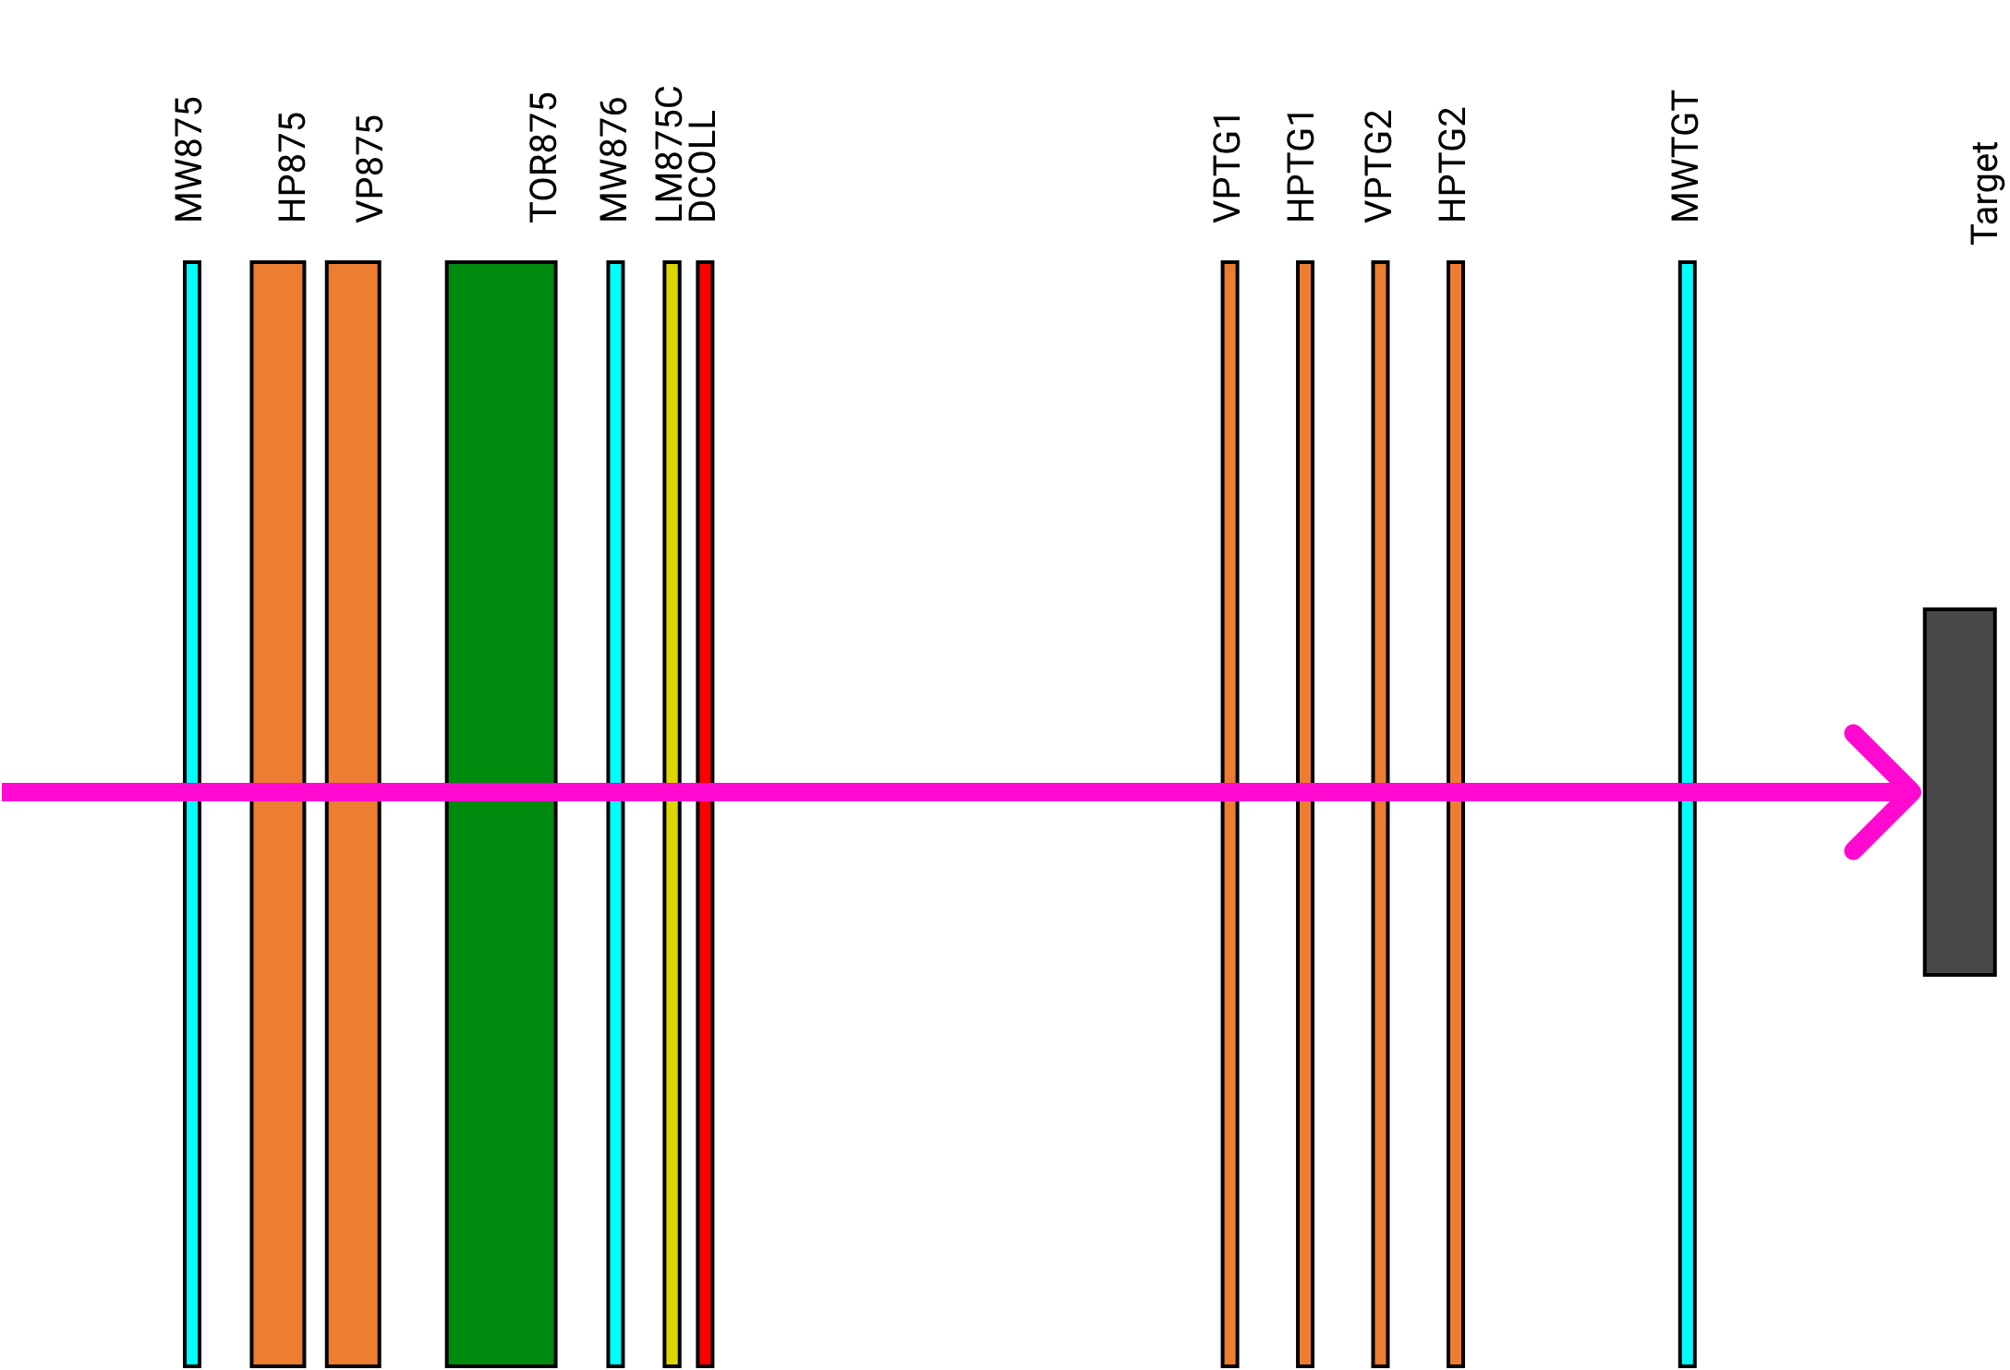
Pre-target Instrumentation

Slide 4
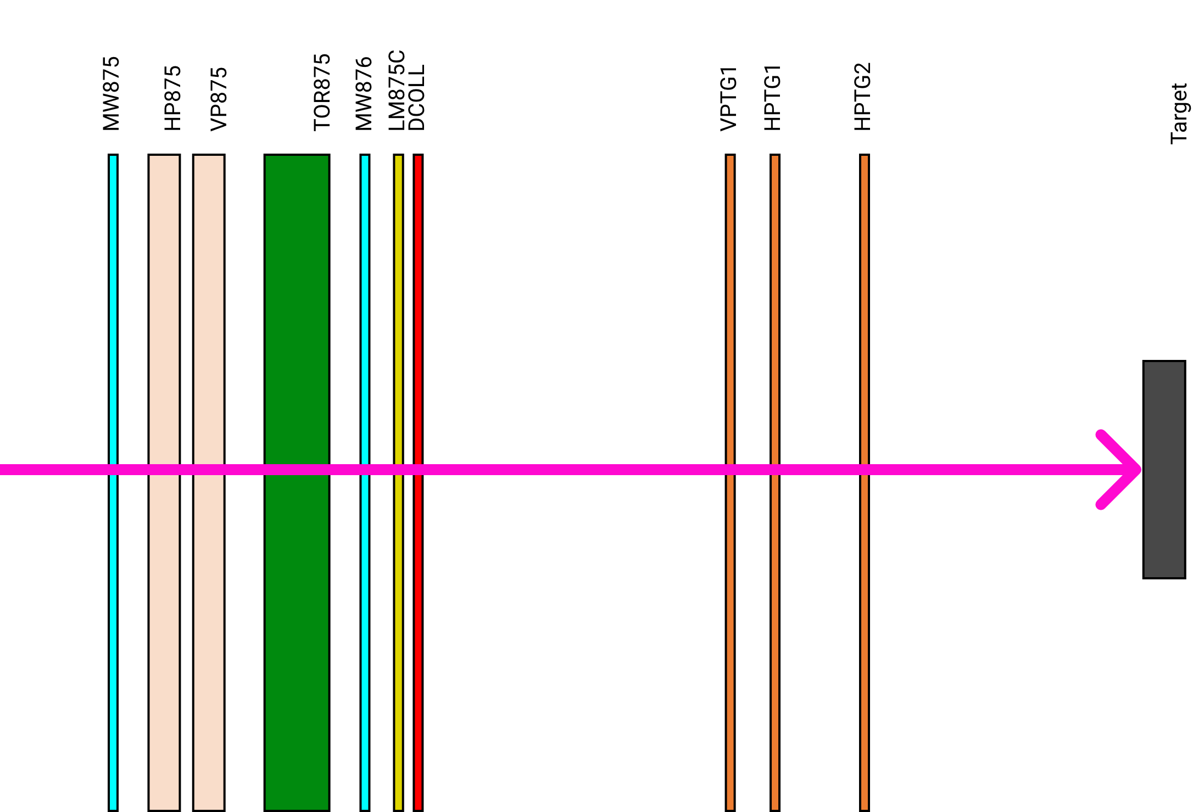
Functional Pre-target Instrumentation

Slide 5
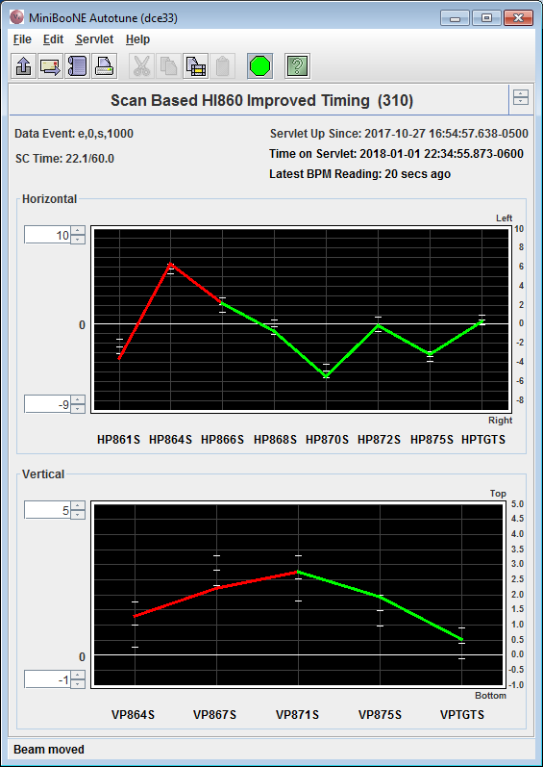
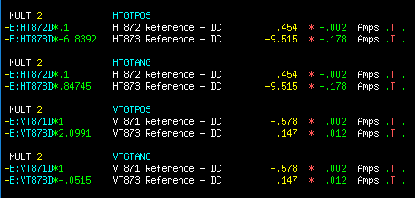
Target Scan Procedure
Autotune program
BPM feedback tells trims how to move beam to center
Determined by previous target scans
Turn off for target scan
Change downstream trim settings to move beam across target
2-bump to move position horizontally and vertically
2-bump to move angle horizontally and vertically

Slide 6
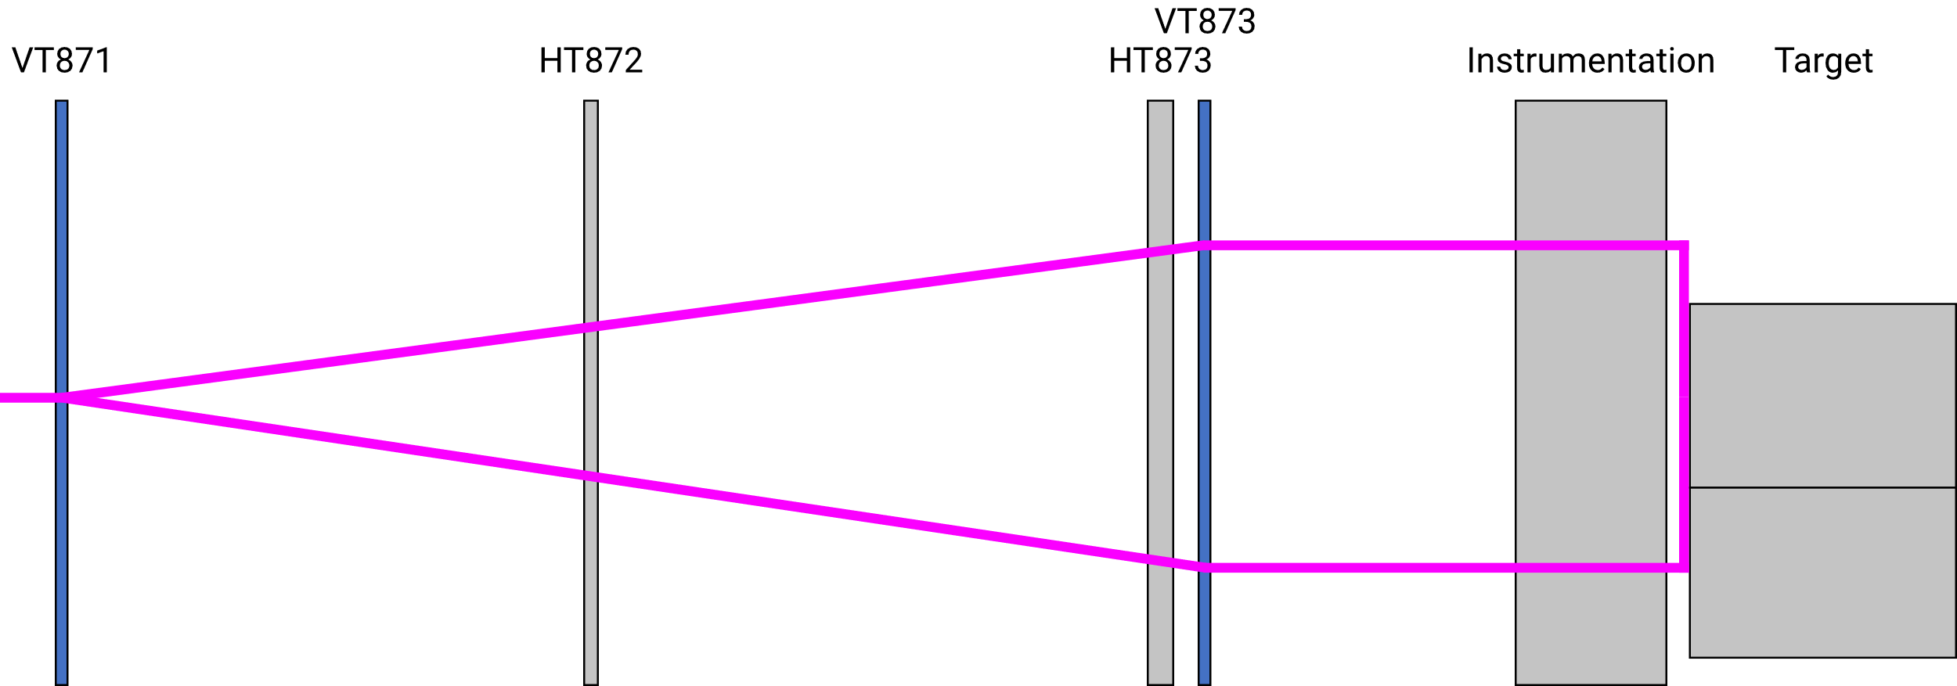
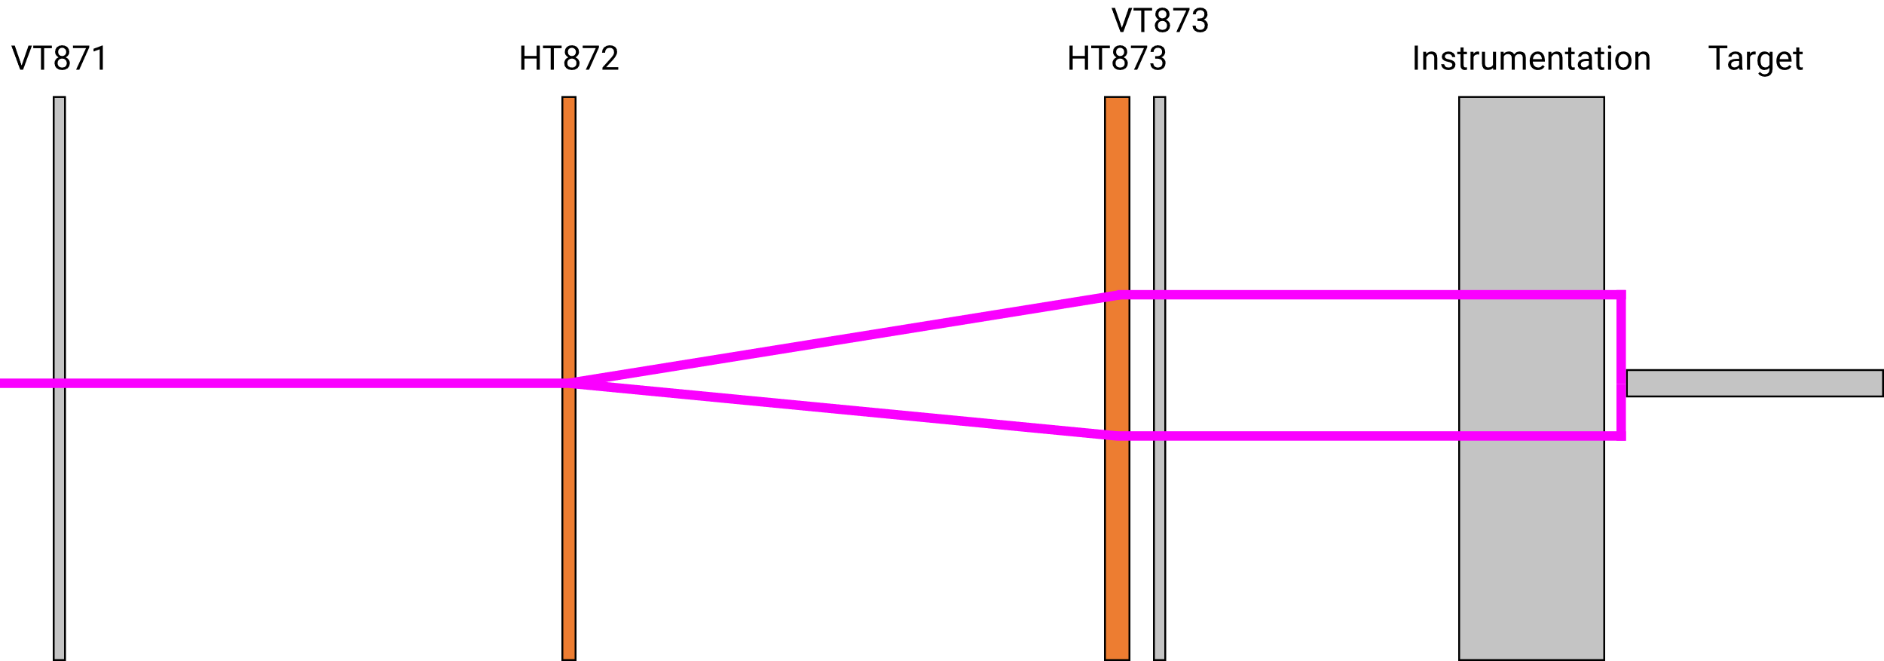

Slide 7
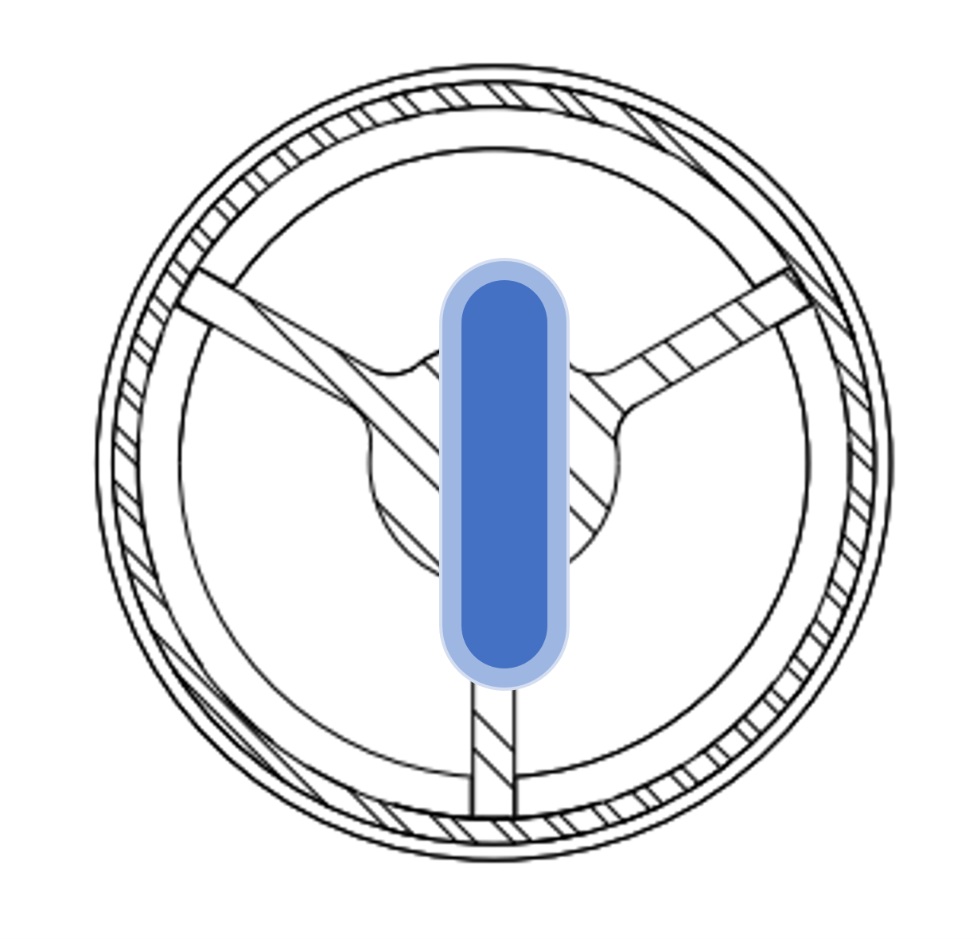
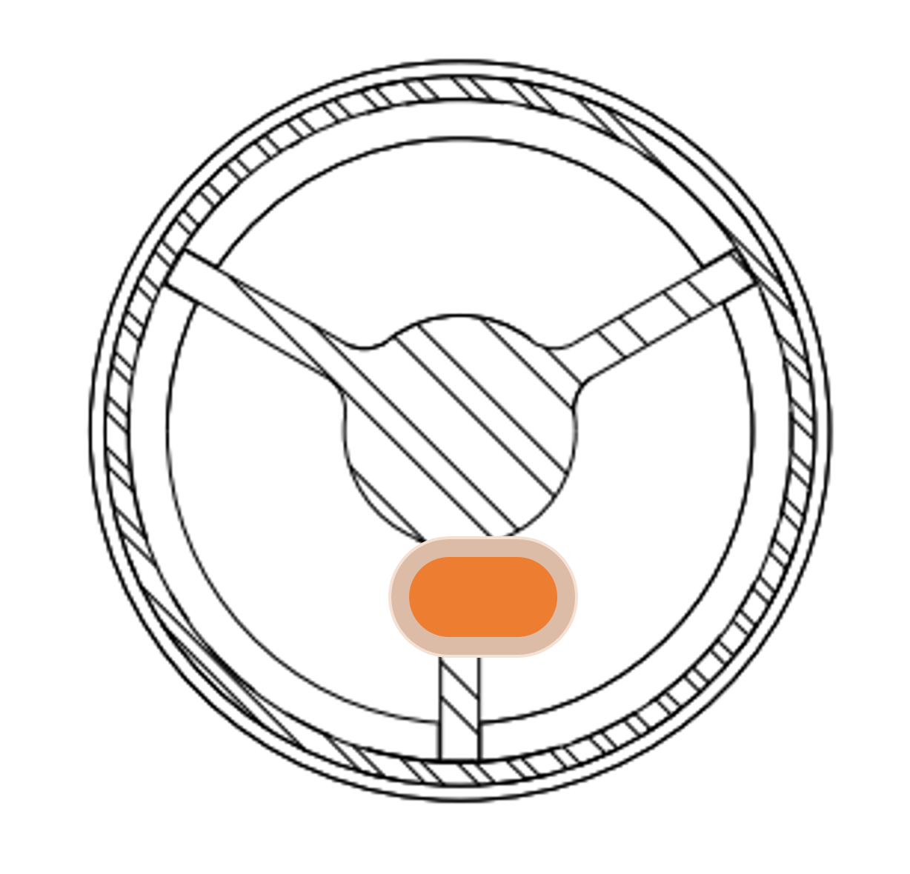
Vertical scan over target face, horizontal beam position isn’t moved from zero
1
2
Horizontal scan over lower target fin, vertical position isn’t moved from fin (~ -8mm)

Slide 8
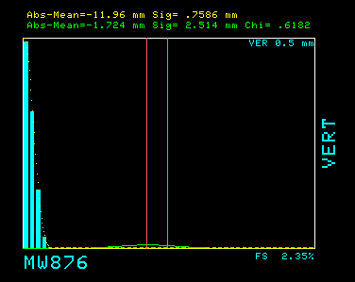
Beam on lower fin
Beam between lower fin and target face
Beam on target face
Beam moving off target face into air cooling gap
Beam in air cooling gap
3
2
1
4
5

Slide 9
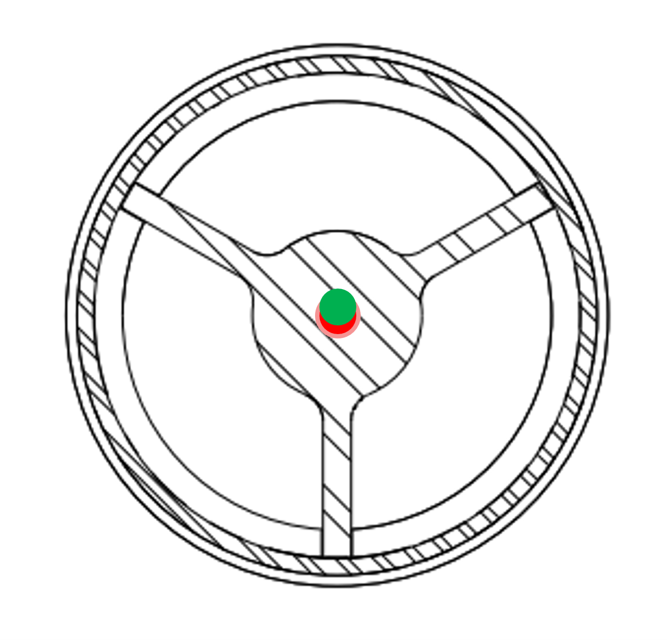
Beam center determined by BPM linear estimates in target scan data -0.19mm
Autotune center and tolerance from previous scan 0.39 +/- 0.5mm Off by 0.53mm
Notes:
When beam is actually on the center of the target, the BPM is -0.19. This is the instrument’s offset.
BPMs will drift

Slide 10
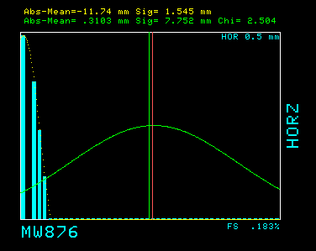
Beam moving off lower target fin into air cooling gap
Beam on target fin
Beam moving off lower target fin into air cooling gap
Beam in air cooling gap
2
1
3
4

Slide 11
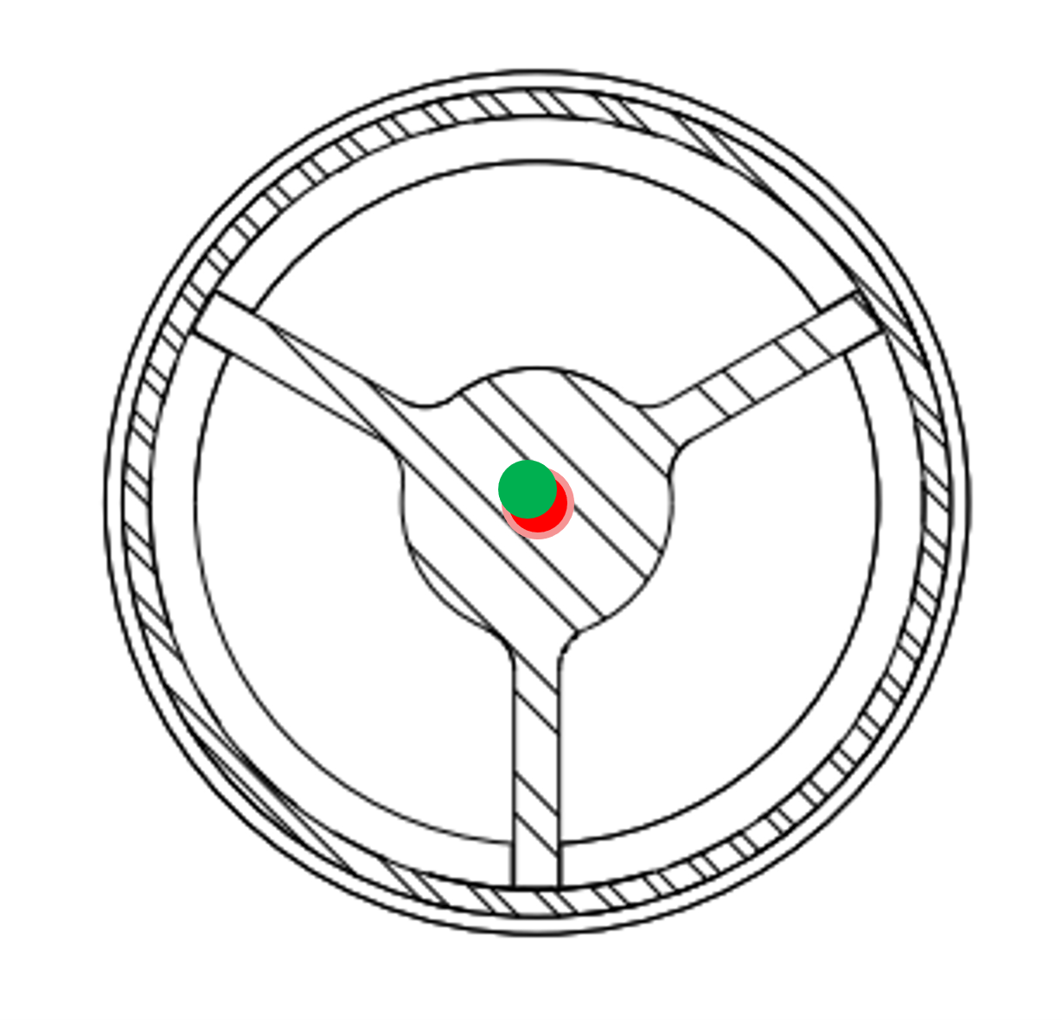
Beam center determined by BPM linear estimates in target scan data -0.31
Autotune center and tolerance from previous scan 0.46 +/- 0.5mm Off by 0.31mm
2
1

Slide 12
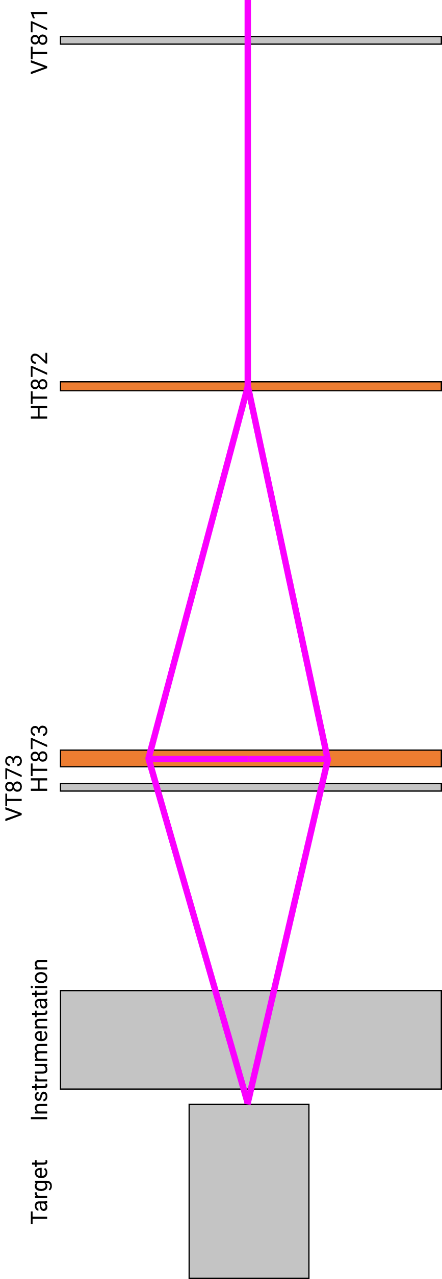

Slide 13
Expect to see symmetric losses
2
Losses lowering = POT lowering? Scraping upstream of loss monitor
Scraping closer to loss monitor
1

Slide 14
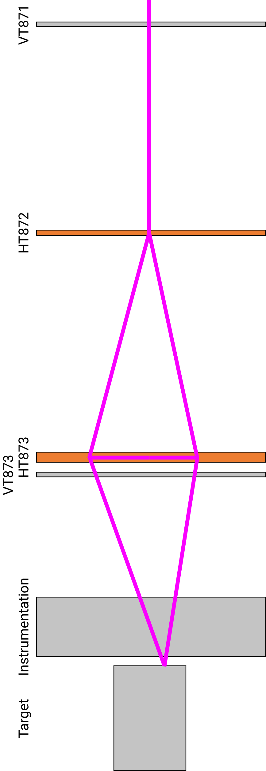
Expect to see symmetric losses
2
Losses lowering = POT lowering? Scraping upstream of loss monitor
Scraping closer to loss monitor
1

Slide 15
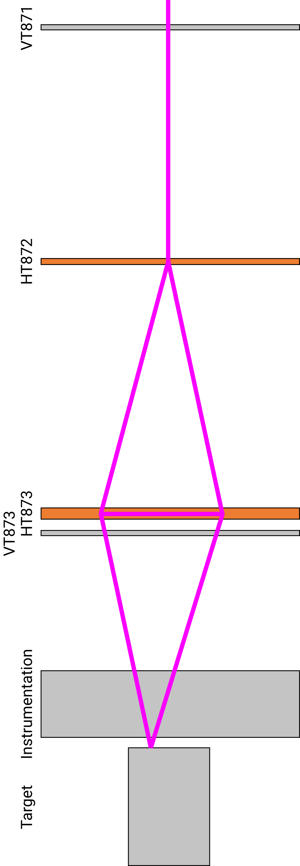
Expect to see symmetric losses
2
No scraping?
Scraping closer to loss monitor
1

Slide 16
How well do we know our pivot point?
What could beam be scraping on upstream?
How can we understand the beam shape better?
Is there a quicker, easier way to import these data and get analyses done more efficiently and more frequently?

