Slide 1





R&D Towards a 1.3MW T2K Target
Eric Harvey-Fishenden, Chris Densham, Mike Fitton, Geoff Burton, (High Power Targets STFC RAL)
In conjunction with the KEK Neutrino Beam Group
NBI 2019 Fermilab

Slide 2
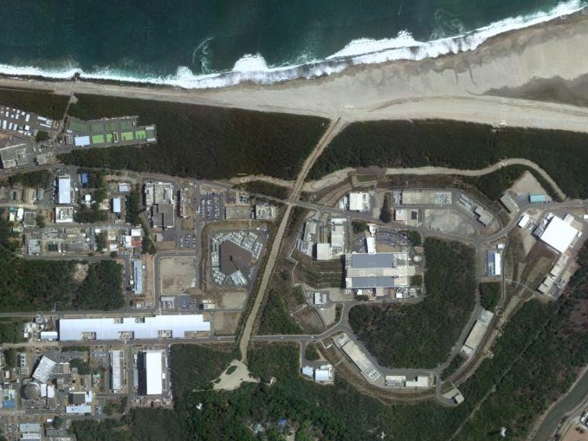
T2K neutrino facility
J-PARC, Tokai, Japan
Beam Power:
Current: 480kW
Design: 750kW
Upgrade (HK): 1.3MW
30 GeV Main Ring (MR)
3 GeV Rapid Cycling Synchrotron (RCS)
T2K Target Station
J-SNS
400 MeV LINAC
Beam dump
Near detector (ND280)
295 km to Super-Kamiokande

Slide 3
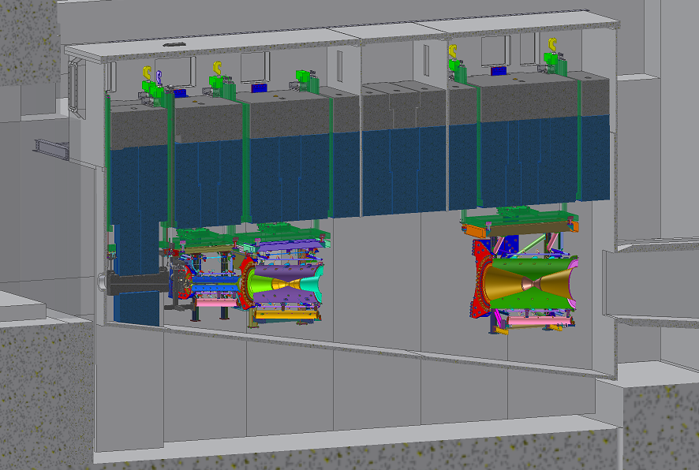
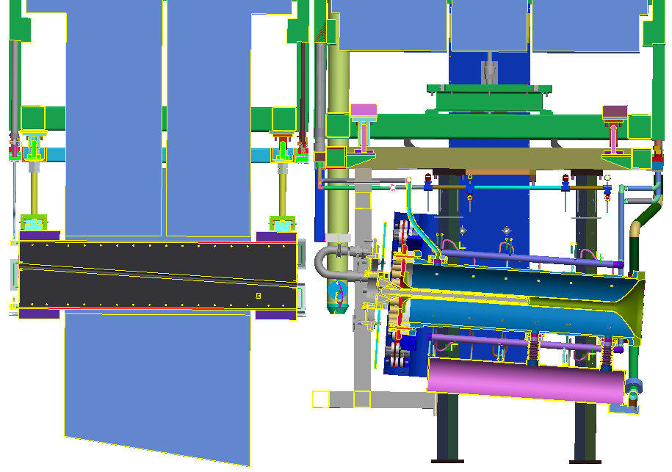
Secondary Beam-line & Target Station
Target station
Helium Vessel
To ND280 (280m)
SuperK (295km)
Concrete Blocks
Iron shield (2.2m)
BEAM
2nd horn
Baffle
Target
3rd horn
1st horn

Slide 4
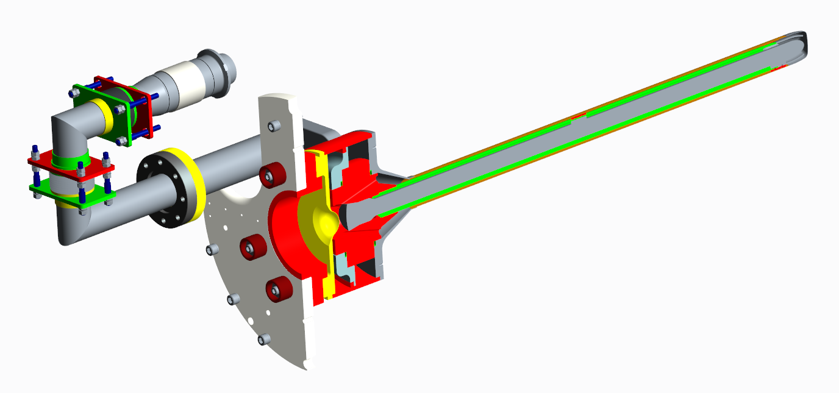
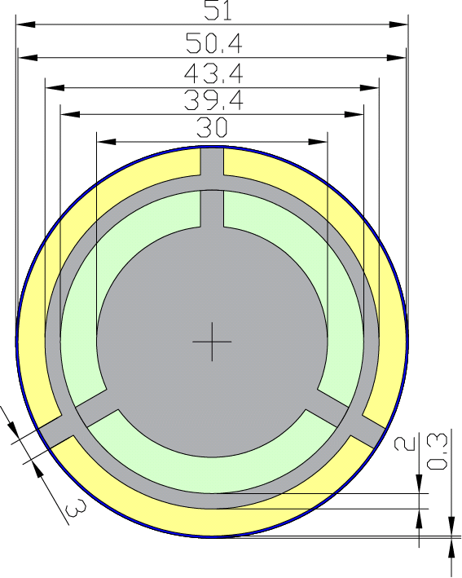
T2K Target
Remote connector + bellows + isolator (Al₂O₃)
Ti-6Al-4V tube and windows (0.5 mm thick)
Titanium pipe + flange
Titanium target body
Graphite (purified)
(Toyo Tanso IG-430)
47.0
46.4
39.6
Graphite
(Toyo Tanso IG-43)
35.6
Stainless tubes + flange
26.0
Al₂O₃ Isolators
Bolted Titanium-Graphite joint (metal seals)
Latest version produced at RAL and shipped to JPARC late 2018, suitable for beam operation up to 750kW

Slide 5
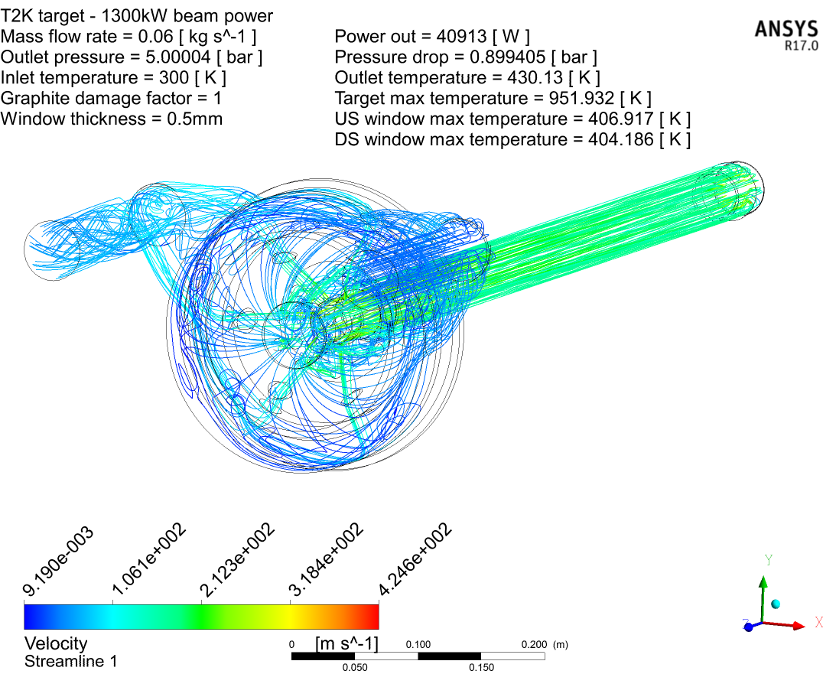
Upgrade to 1.3MW (overview)
Current operational experience up to 480kW (0.48MW)
Beam power 0.75→1.3MW will increase the integrated heat load on the target
Can’t just increase flowrate
  Pressure drop
  Helium velocity
Increase operating pressure:
  Allows higher mass flow rate without big increase in dP or velocities
  Compressor will be smaller, and cheaper to purchase and operate (less power consumed)
60g/s @ 5.9bar (5barG outlet) – 1.3MW beam power (Scaled MARS heat input from c. 2006)
M. Fitton
Target components must be:
re-designed/optimised for operation at 5 bar, and pressure tested at 7.5 bar
With outlet pressure @5 barG the pressure drop of the system become comparable to the 750kW design (32g/s @1.6bar/0.9barG outlet)

Slide 6

Target Upgrades for Higher Pressure
Uprated edge-welded bellows suitable for 5 bar operation
Full penetration EB weld at downstream target window
Re-optimise downstream target window to reduce pressure stress & maintain good cooling
Re-optimise upstream target window to reduce pressure stress & maintain good cooling

Slide 7
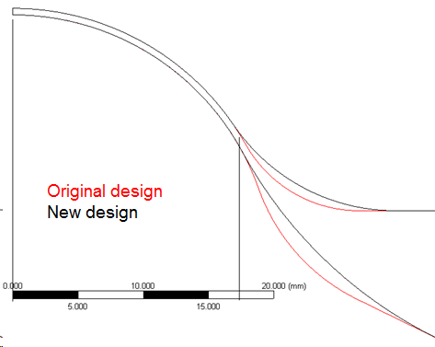
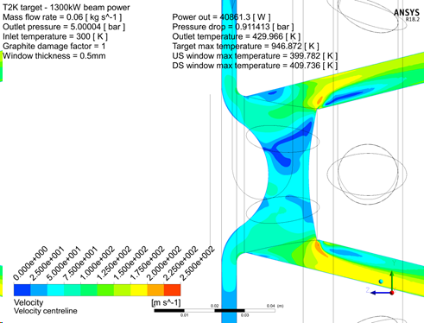
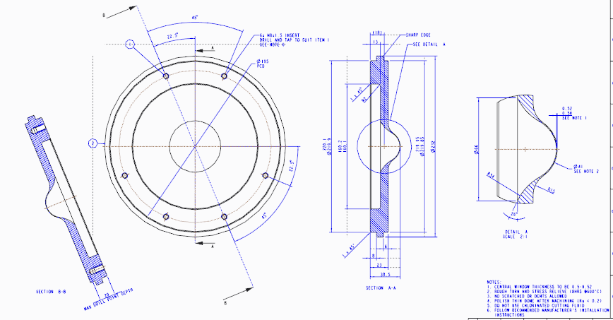
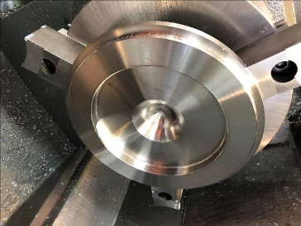
Target Windows Optimisation
Upstream Window:
Plate thickness increased
Window profile maintained the same up to R18mm – off centre beams
Blend radii increased
Stress reduced from 74MPa →38MPa
CFD shows modifications have little effect on flow/cooling
ANSYS plots: Mike Fitton
Prototype currently in manufacture

Slide 8
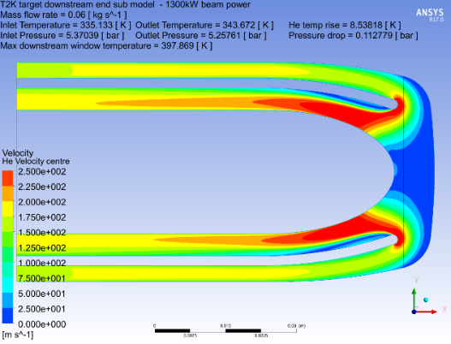
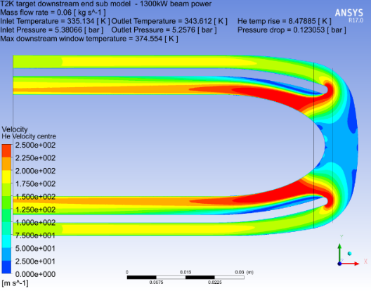
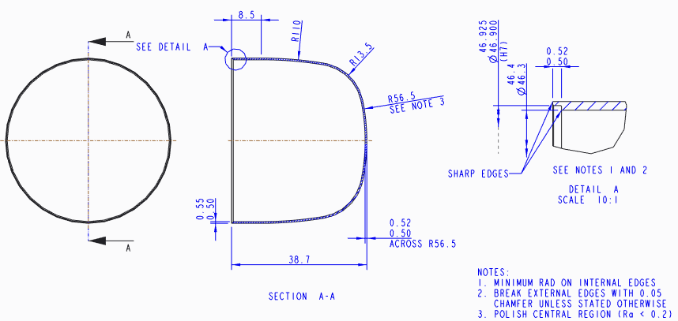
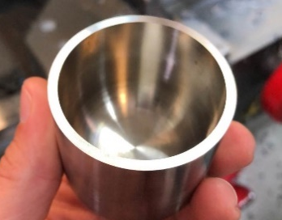
Target Windows Optimisation
Downstream Window:
Curvature of window increased
(both at edges and on beam centre)
Pressure stress reduced by a factor of 3
Small (0.01bar) increase in pressure drop but small increase in cooling
(6% temperature reduction)
750kW design
1.3MW design
ANSYS plots: Mike Fitton
Prototype currently in manufacture

Slide 9
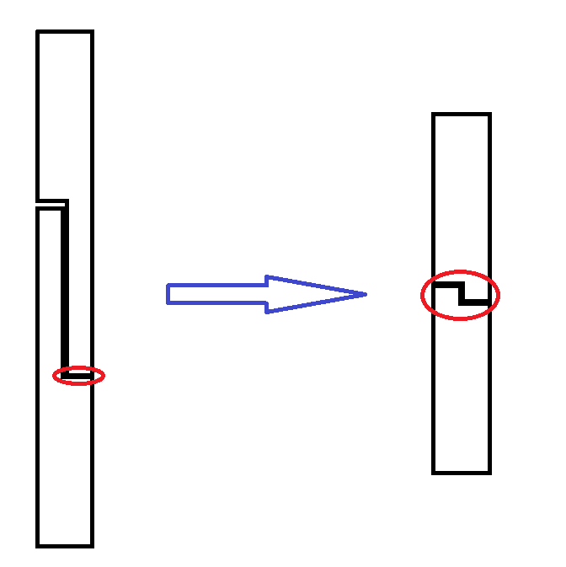
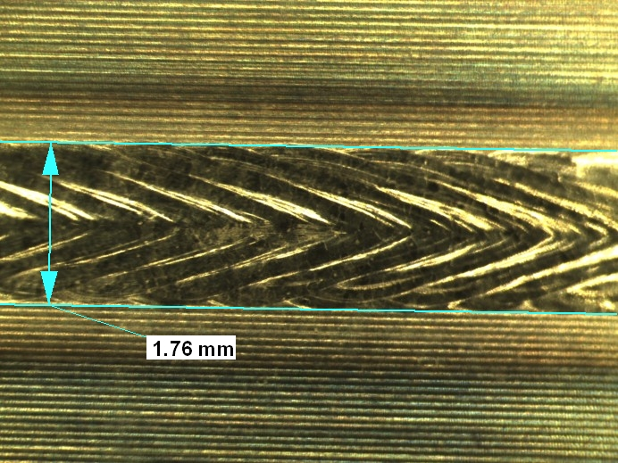
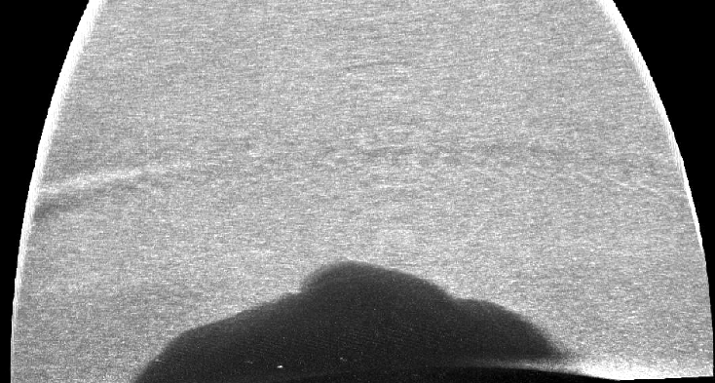
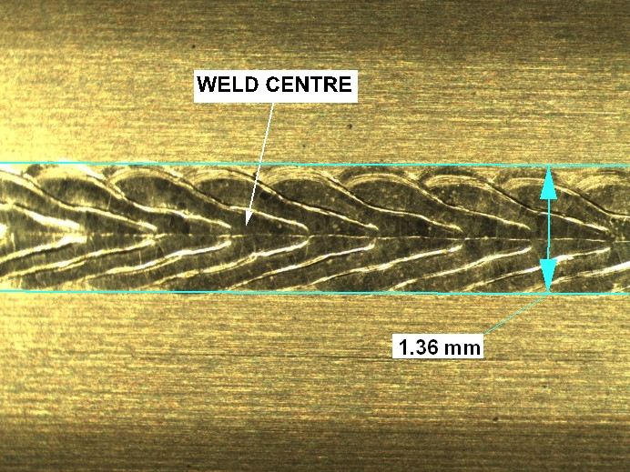
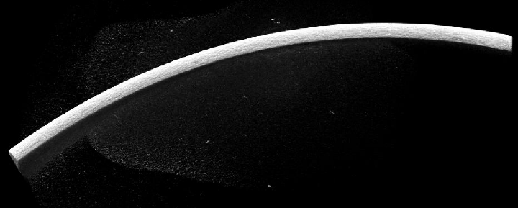
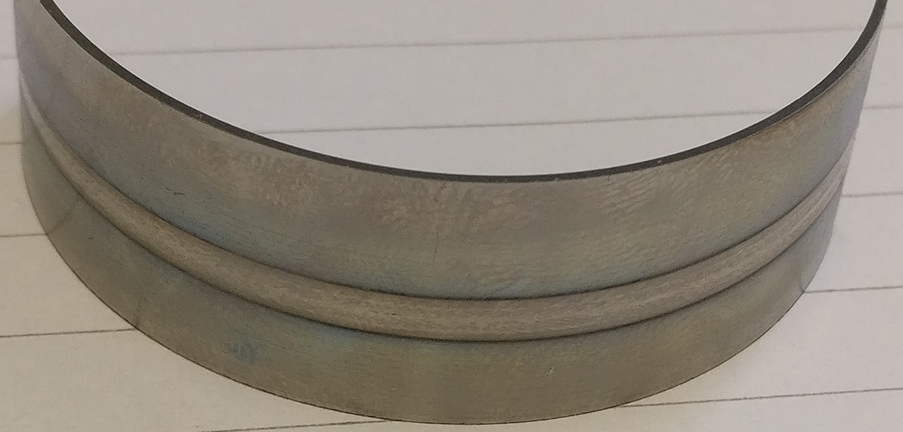
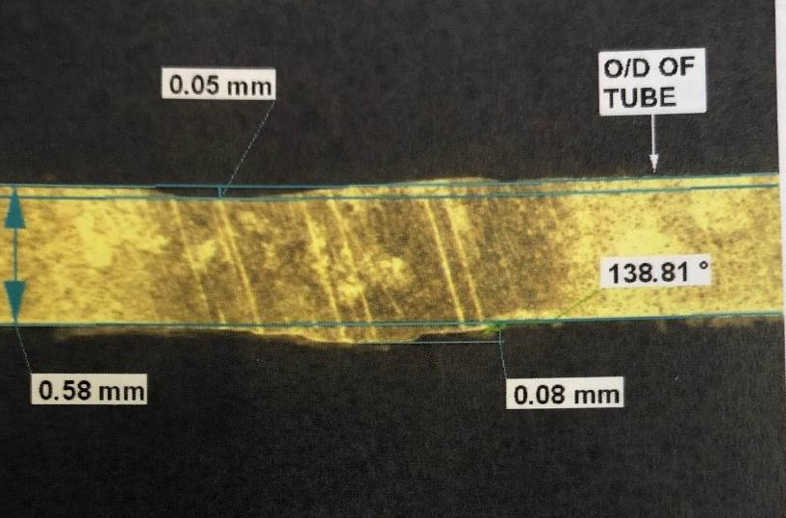
Downstream Window EB Weld Development
Current design has just 0.25mm penetration – for higher pressure we would like a full penetration weld
Joint prep is consumed in the weld – if the fit is not very good, the weld will contain voids or lack fill – QA is very important
Current
design
New
design
Top bead
Re-slice through weld
0.25mm penetration weld
Full penetration EB weld (joint prep is consumed)
Under bead
0.5mm
Visual inspection, cut section, dye pen & CT scan all look good
– no visible pores or defects
Section

Slide 10
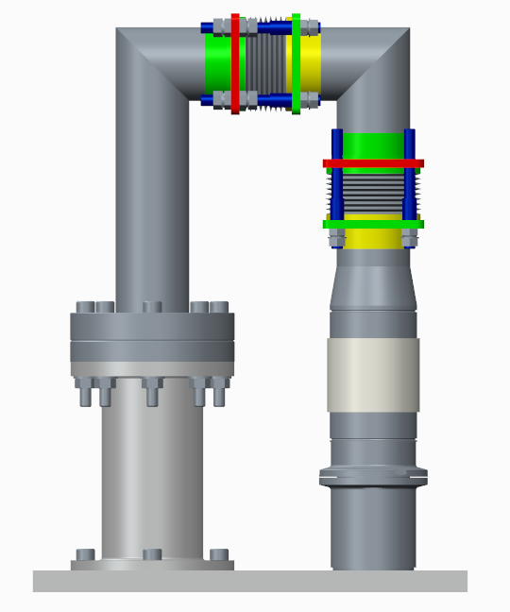
High Pressure Target Pipes
5 Bar capable edge-welded bellows have been sourced and a prototype target He pipe produced
Bellows protect fragile ceramic (more on this later)
Low pressure testing revealed that a re-design is
required
  Expansion of free bellows “1” under pressure is
  excessive
1.3mm
@ 2Bar
0.6mm
@2 Bar
2
Large moment transferred to target
1
Integration of a pressure balanced bellows
system is necessary
  Allow compliance for thermal expansion
  Prevent length growth under internal pressure
Space is limited and mass/complexity must be kept low
  Currently in discussion with bellows companies
Ceramic
isolator
Pressure testing set up of prototype 5 bar pipes

Slide 11
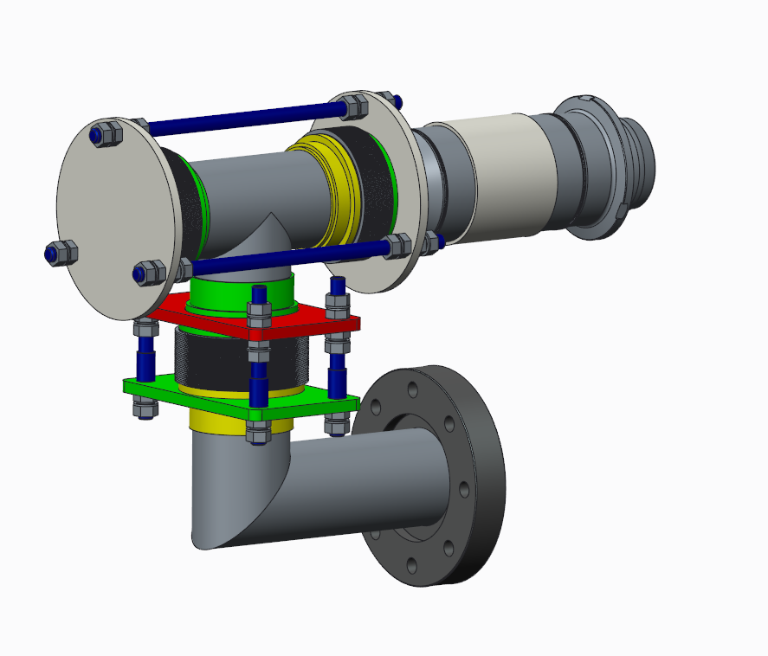
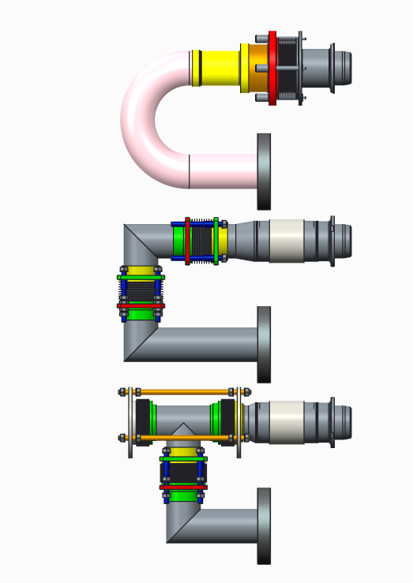
High Pressure Target Pipes
Potential pressure balanced pipe design:
Target Pipe Evolution
Time→
Active bellows
Balancing bellows
Adjustment bellows
Just one reason that target helium pipes are challenging to design and manufacture

Slide 12
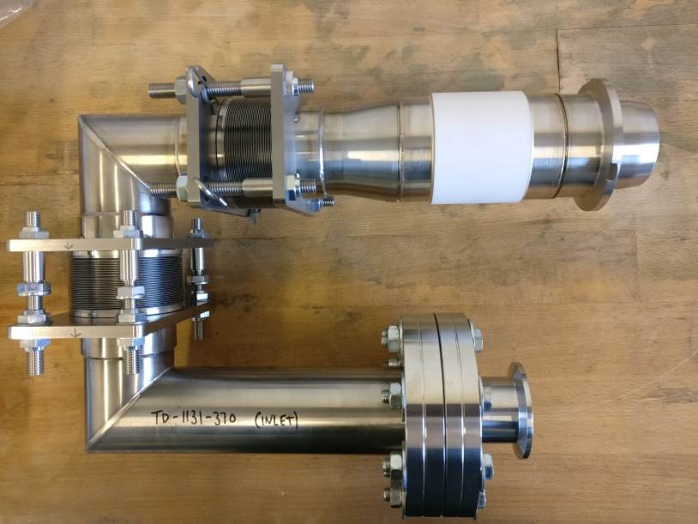
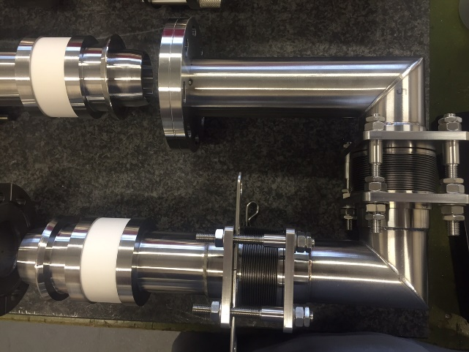
Target Ceramics
Ceramic breaks are a necessity for electrical isolation in all Neutrino facilities (used in target, horn, striplines etc.)
  Typically Alumina (Al₂O₃) in purities between 90-99.5%
  They are brittle, fragile and easily broken if loaded in any manner except axial compression
They feature in several areas for the T2K target:
  Target mounting
  Helium cooling pipes
Ceramic breaks are a potential limiting factor for all Neutrino facilities
  Commonly see water leaks, gas leaks etc. at joints containing ceramic isolation
RAL HPT group has investigated several types of isolator for T2K with varying degrees of success
  Diffusion bonded
  Bolted
  Brazed
Target helium pipes with brazed alumina isolator for 750kW operation
Target helium pipes with diffusion bonded alumina isolator for 750kW operation
Notes:
Ceramic breaks are a real weak point for Neutrino facilities everywhere.

Slide 13
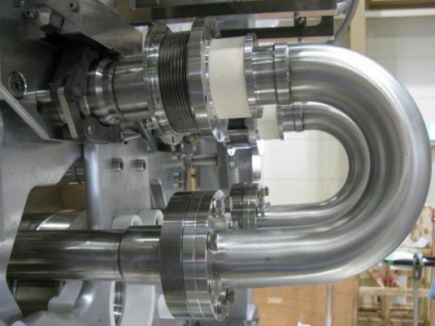
Target Helium Leak
June 2015: Helium leak detected in target cooling system
September 2015: Leak investigations in remote maintenance area (RMA) identify leak at ceramic isolator in target helium outlet pipe
Leaking pipe was replaced remotely with help of TRIUMF in December 2015
Possible causes:
  Stress relieving of cold bent stainless pipes?
  Thermal shock/fatigue due to rapid thermal cycling?
Leak location

Slide 14
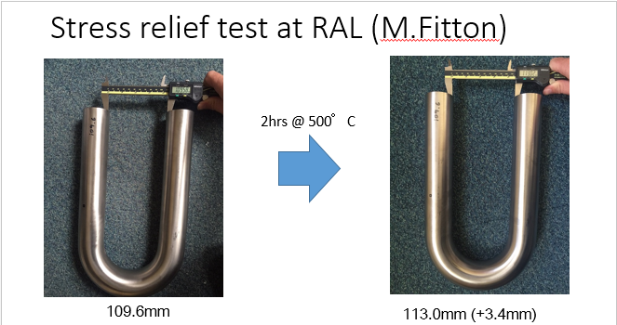
Stress Relieving of Bent Pipes
Pipes tested at RAL opened up by >3mm after furnace run @500°C/2hrs and 200°C/64hrs
(M. Fitton)
3mm lateral movement greater than tolerable by bellows
Shear/bending put on the ceramic isolator potentially caused failure → gas leak
Outcome:
Welded, mitred pipes (relieved for dimensional stability during manufacture)

Slide 15
Beam Trips – Thermal Shock/Fatigue?
Beam trips are an inevitability during operation
Data from operations at JPARC suggest approximately hourly beam trips whilst running
Heat load is removed from target when the beam trips, but helium flow continues
Rapid cooling of target helium causes outlet pipes to see rapid thermal cycling during beam trips:
Target helium outlet temperature data from a beam trip at 480kW beam power operation (provided by KEK Neutrino group)
Outlet He temperature:
  Drops at a cooling rate of 80°C/minute
  Rises at a similar rate when the beam goes back on → thermal shock and thermal cycling on the brittle ceramic isolators
Hourly trips, 24hr operation, 180 days/year = 5000 thermal cycles per year
Offline testing?

Slide 16
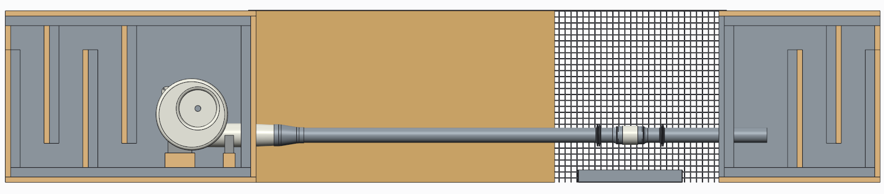
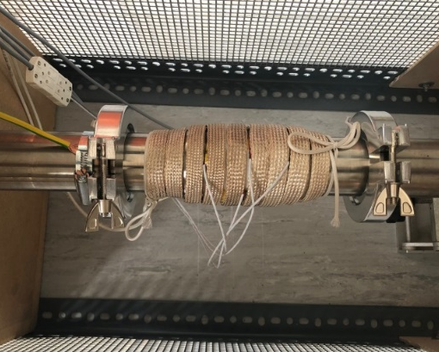

Testing – Thermal Cycling
A test-bed was created at RAL to address the issue of thermal shock/fatigue on target ceramics
Acoustic enclosure (air inlet)
Centrifugal blower (${600 m}^{3}/hr$)
Ceramic test section
Acoustic enclosure (air exhaust)
Test section is heated by a 600W heater tape:
HEATING - PID controlled ramp to set point temperature: 200°C @ 36°C/min
SOAK – Soak at 200°C for 3 minutes to eliminate thermal gradients in test section
COOL - Rapid cool w/ blower @ 70°C/min initial rate

Slide 17
Testing – Thermal Cycling
A test-bed was created at RAL to address the issue of thermal shock/fatigue on target ceramics
 | Temperature Range (°C) | Max cooling rate (°C/min) | Max heating rate (°C/min) | Number of cycles completed | Failure detected
Testing Phase 1 | 40-140 | 50 | 36 | 5120 | No
Testing Phase 2 | 40-160 | 55 | 36 | 5200 | No
Testing Phase 3 | 40-180 | 60 | 36 | 5160 | No
Testing Phase 4 | 40-200 | 70 | 36 | 16118 | No
Acoustic enclosure (air inlet)
Centrifugal blower (${600 m}^{3}/hr$)
Ceramic test section
Acoustic enclosure (air exhaust)
Test section is heated by a 600W heater tape:
HEATING - PID controlled ramp to set point temperature: 200°C @ 36°C/min
SOAK – Soak at 200°C for 3 minutes to eliminate thermal gradients in test section
COOL - Rapid cool w/ blower @ 70°C/min initial rate
Are test conditions as harsh as operating conditions?
Use operational data (485kW) and extrapolated simulations for higher power

Slide 18
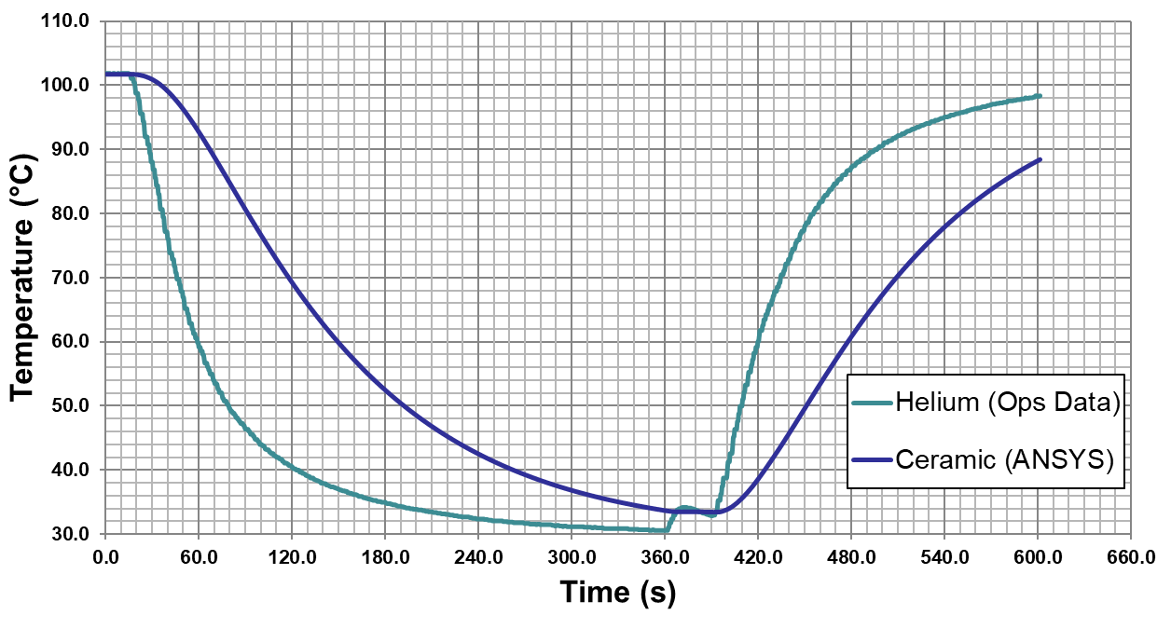
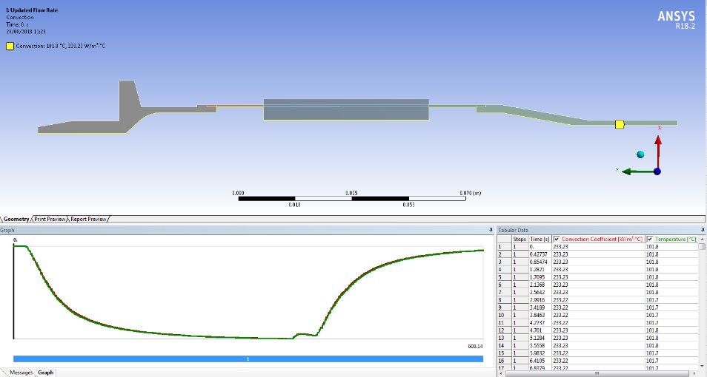
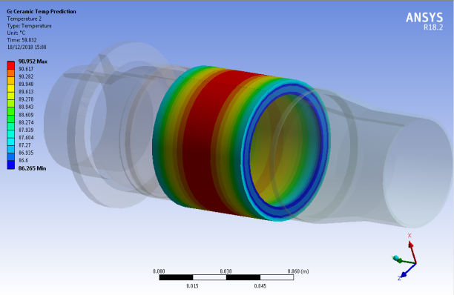
Beam Trips - Thermal Analysis
480kW helium beam data used as an input to ANSYS transient thermal analysis
Temperature at outer surface extracted
  We can compare this with PT100 location on lab tested ceramics
Ceramic temperature lags behind helium temperature significantly
Cooling rates:
Helium = 80°C/min
Ceramic = 25°C/min
PT100 position
What about cooling rates at higher beam power/helium pressure?
Conjugate heat transfer simulations

Slide 19
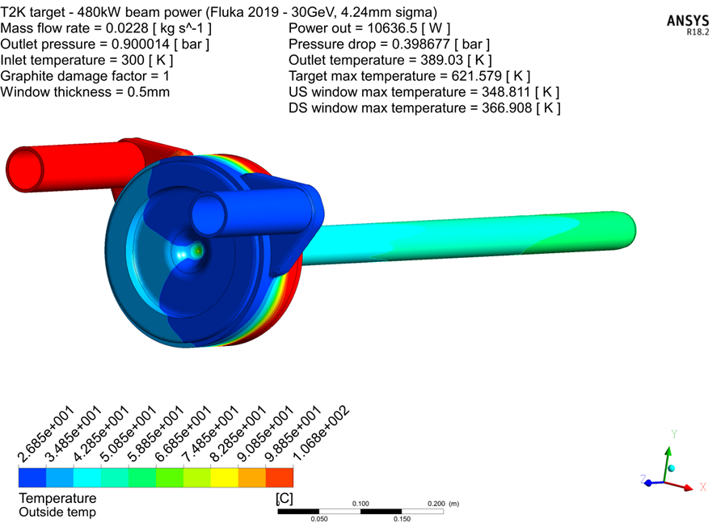
Beam Trip Simulation
Run steady state conjugate heat transfer model (CFX) of target
  MARS/Fluka heat inputs
Import steady state temperatures as input to transient simulation with heat load removed
Extract helium outlet temperature as a function of time and compare with operational data
This can be used as:
  An input to ceramic thermal analyses
  Verification of heat deposition calculations using Monte Carlo codes
Target model includes all material such as outer cover, ears and pipes - thermal mass is important for transient simulation.

Slide 20
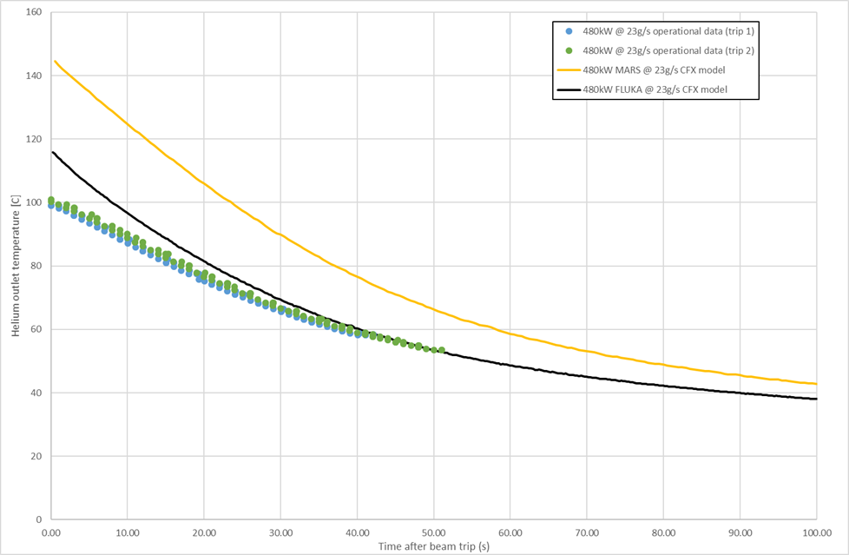
Beam Trips - Operational Data vs Simulations
Operational data from 29/04/2018
Beam power = 480kW
Helium flow rate = 22.9g/s
Target helium outlet temperature (°C)
To match the operational data:
Old (2006) MARS heat load needs to be scaled back to approximately 300kW
Fluka heat load needs to be scaled back to approximately 400kW
Time after beam trip (seconds)

Slide 21
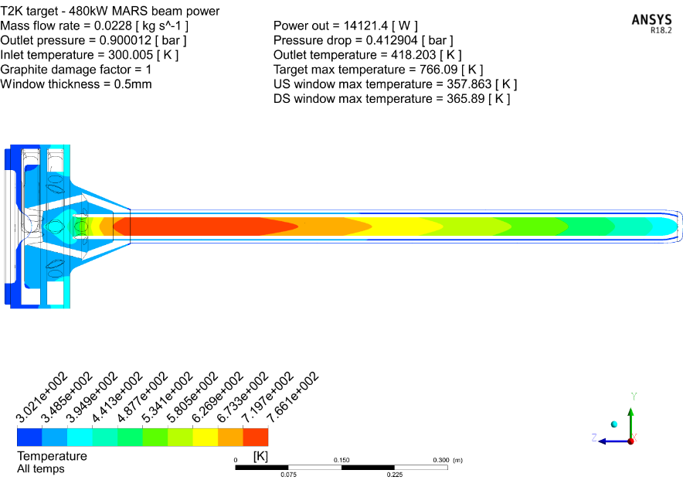

Heat Load Discrepancy
These simulations have highlighted some significant differences between operational data and the engineering analysis using heat loads from Monte Carlo codes
480kW operational data, temp. rise of He = 73.4°C @ 22.9g/s → 8716W
480kW MARS (2006), temp. rise of He = 145.2°C @ 22.9g/s → 14,121W (x1.6)
480kW FLUKA (2019), temp. rise of He = 89.0°C @ 22.9g/s → 10,636W (x1.2)
MARS (2006)
FLUKA (2019)
M. Fitton
M. Fitton
This is good news for us as flow rate & pressure for 1.3MW could be reduced
  4 BarG outlet pressure looks feasible, reduced flow rate study is underway
We are aware that older versions of MARS can predict significantly more heat load
than newer versions of MARS and Fluka

Slide 22
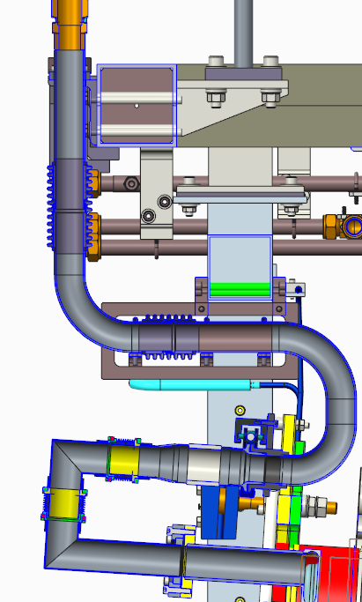
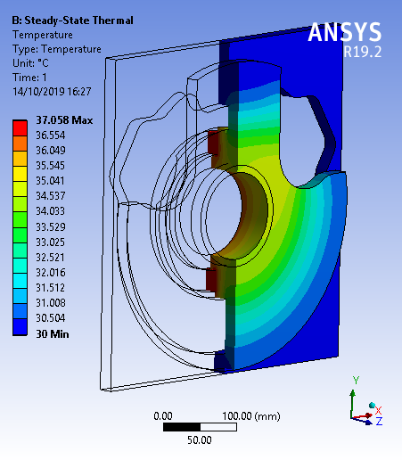
Other Heat Losses
Heat loss from between target outlet and thermocouple position:
  Ø50.8mm pipe
  HTC ~ 10W/m².K
  Ambient helium temperature = 40°C
  Helium pipe @ target outlet temp = 100°C
  Pipe surface area/meter = 0.159m²
  Power loss = 10 x 0.159m² x (100-40) = 63.6W/meter
  Not significant over the approx. 1.5m between target outlet and
  thermocouple location (100W)
Conduction from target head to target support plates:
  Target head mounting face is at 37°C
  TS ambient helium @40°C (negligible heat transfer)
  Target support plates water cooled, water temperature expected
  to vary with ambient conditions
  ANSYS thermal analysis, assuming perfect contact at interfaces:
  200W heat removed with 20°C cooling water
  35W heat flow into the target if cooling water is at 40°C
Max unaccounted for loss ~300W (<4% target heat load)

Slide 23
Comparison – Ceramic Thermal Testing
 | Temperature Range (°C) | Max cooling rate (°C/min) | Max heating rate (°C/min) | Number of cycles completed | Failure detected
480kW @23g/s (Op data - ANSYS) | 33-100 | 25 | 23 | - | -
1.3MW @32g/s (CFX-ANSYS) | 30-167 | 61 | - | - | -
1.3MW @60g/s (CFX-ANSYS) | 30-101 | 53 | - | - | -
Testing Phase 4 | 40-200 | 70 | 36 | 16118 | No
Beam data
Linear extrapolation of beam data
Latest testing phase exceeds estimated operating conditions at 1.3MW for 3+ years operation
We have good reason to believe that the brazed isolator is suitable for 1.3MW operation

Slide 24
Summary
Most R&D in order to achieve an operational 1.3MW T2K Target has been completed
A brazed Alumina isolator has been thermally tested at the equivalent of approximately 3 years running @1.3MW beam power
Heat loads from MARS and FLUKA codes have been compared to operational data highlighting approximately 40% and 10% respective overestimations of energy deposition in the T2K target
Key target components have been redesigned for a higher target helium operating pressure of approximately 5 bar
Prototyping of key components is currently underway

Slide 26
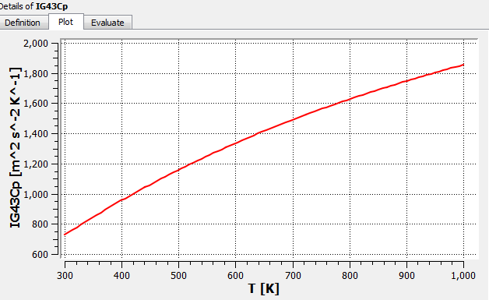

Backup - Simulation Conditions
Inlet Temperature = 300K
Fluid = Helium (Ideal Gas)
Turbulence model = Shear Stress Turbulence (SST)
Reference pressure = 1atm (Gauge P)
Target container and window material = Ti-6Al-4V (Gr. 5 Titanium)
    Specific heat capacity = 526.3 J/kg.K
    Thermal conductivity = 6.7 W/m.K
Target material = Toyo Tanso IG-43 (non-linear properties as below)
Conjugate heat transfer model (coupled CFD-Thermal model)

Slide 27
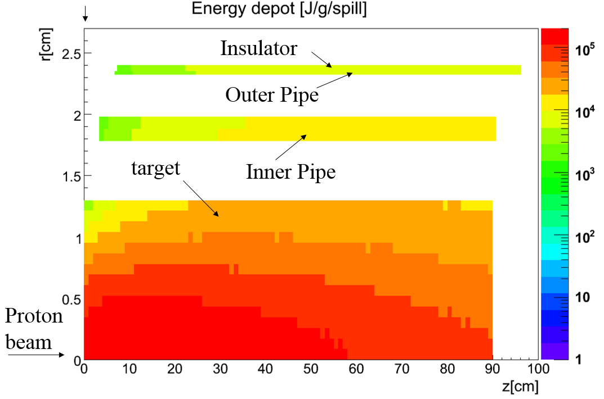
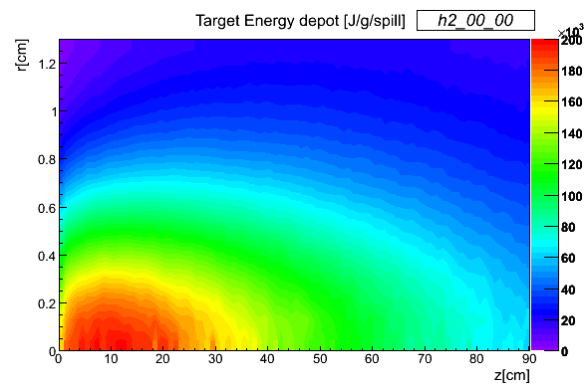
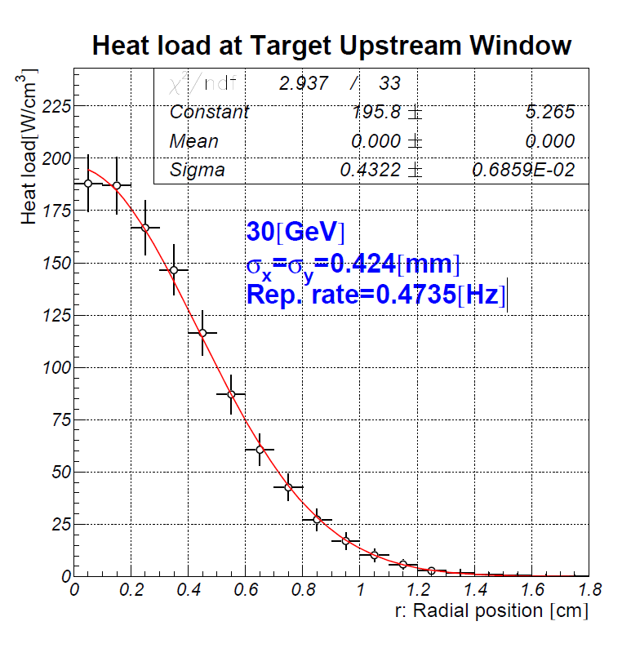
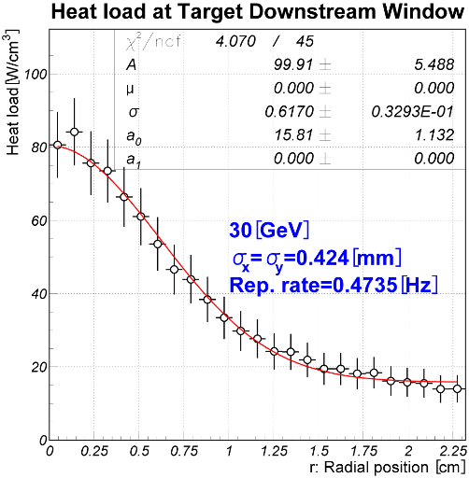
Backup - MARS (2006) heat deposition for target
750kW, 3.3e14ppp , 2.11sec
Target core
Peak energy density = 200J/g
Integrated energy = 39,262J/spill

Slide 28
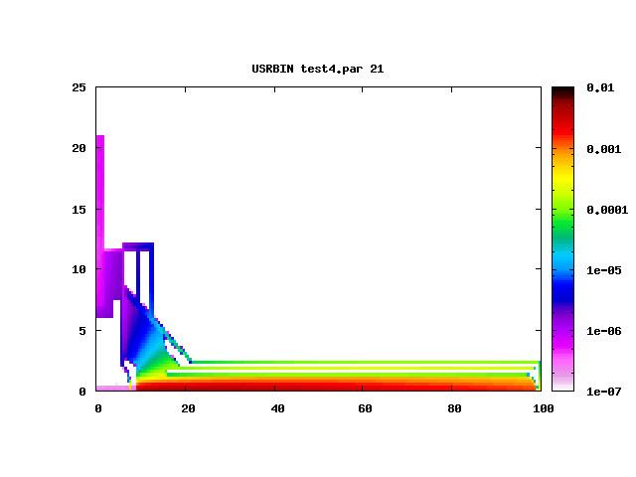
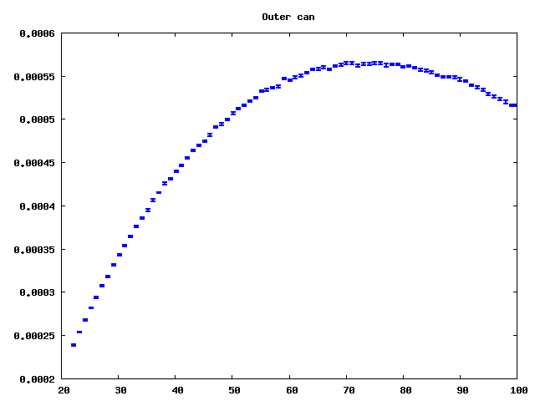
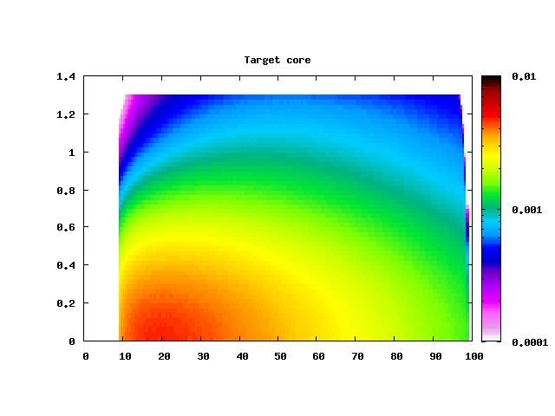
Backup - FLUKA (2019) heat deposition for target
Fluka Flair version: 2.3-0
Beam energy: 30GeV
Particle: Proton
Beam shape: 0.999cm FWHM Gaussian
→ 4.24mm Sigma
Number of primaries: 4,000,000
Geometry updated to be more representative of target

Slide 29
Backup - FLUKA (2019) heat summary
T2K achieved operation
480kW @ 30GeV
2.48x10¹⁴ppp @ 2.48s
750kW proposed
750kW @ 30GeV
2.0x10¹⁴ppp @ 1.32s
HK proposed upgrade
1.3MW @ 30GeV
3.2x10¹⁴ppp @ 1.16s

Slide 30
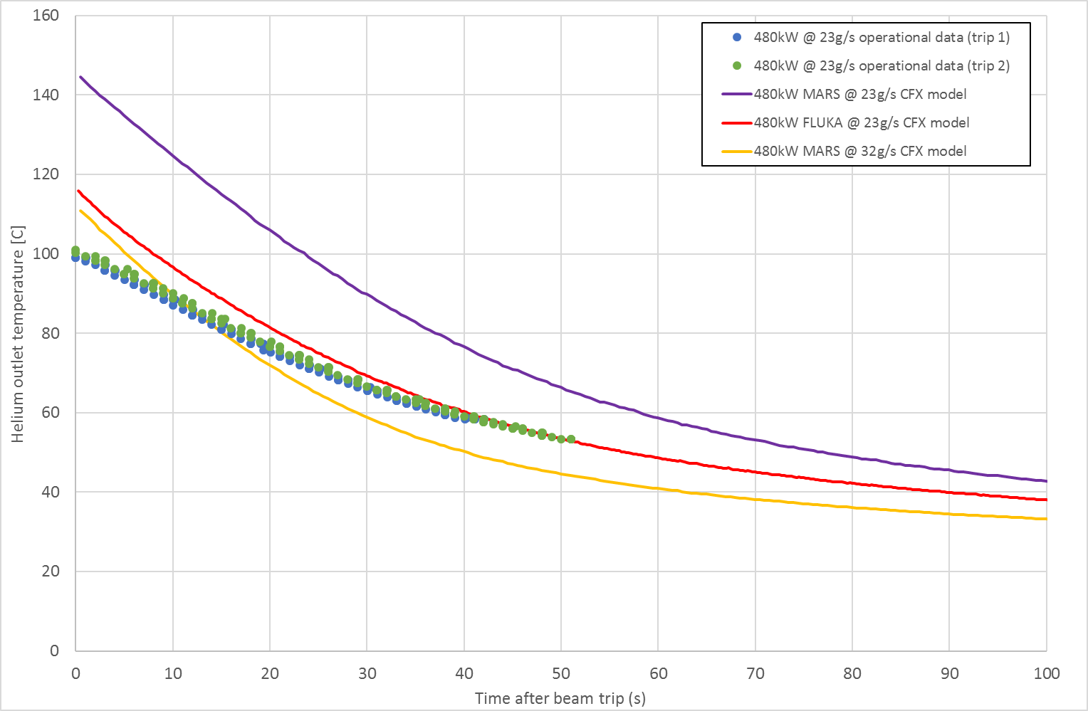
Backup – Mars/Fluka vs Ops Data
Operational data from 29/04/2018
Beam power = 480kW
Helium flow rate = 22.9g/s
Yellow line – MARS 480kW @ 32g/s excludes the possibility that the flow rate was higher than measured – TOut is a closer match to operational data but cooling rate is much faster

