Slide 1
Minerva plane installation and initial Argon Cube Layout
Jim Kilmer, Gary Smith, Min Jeong Kim
Argon Cube
8 July 2019

Slide 2
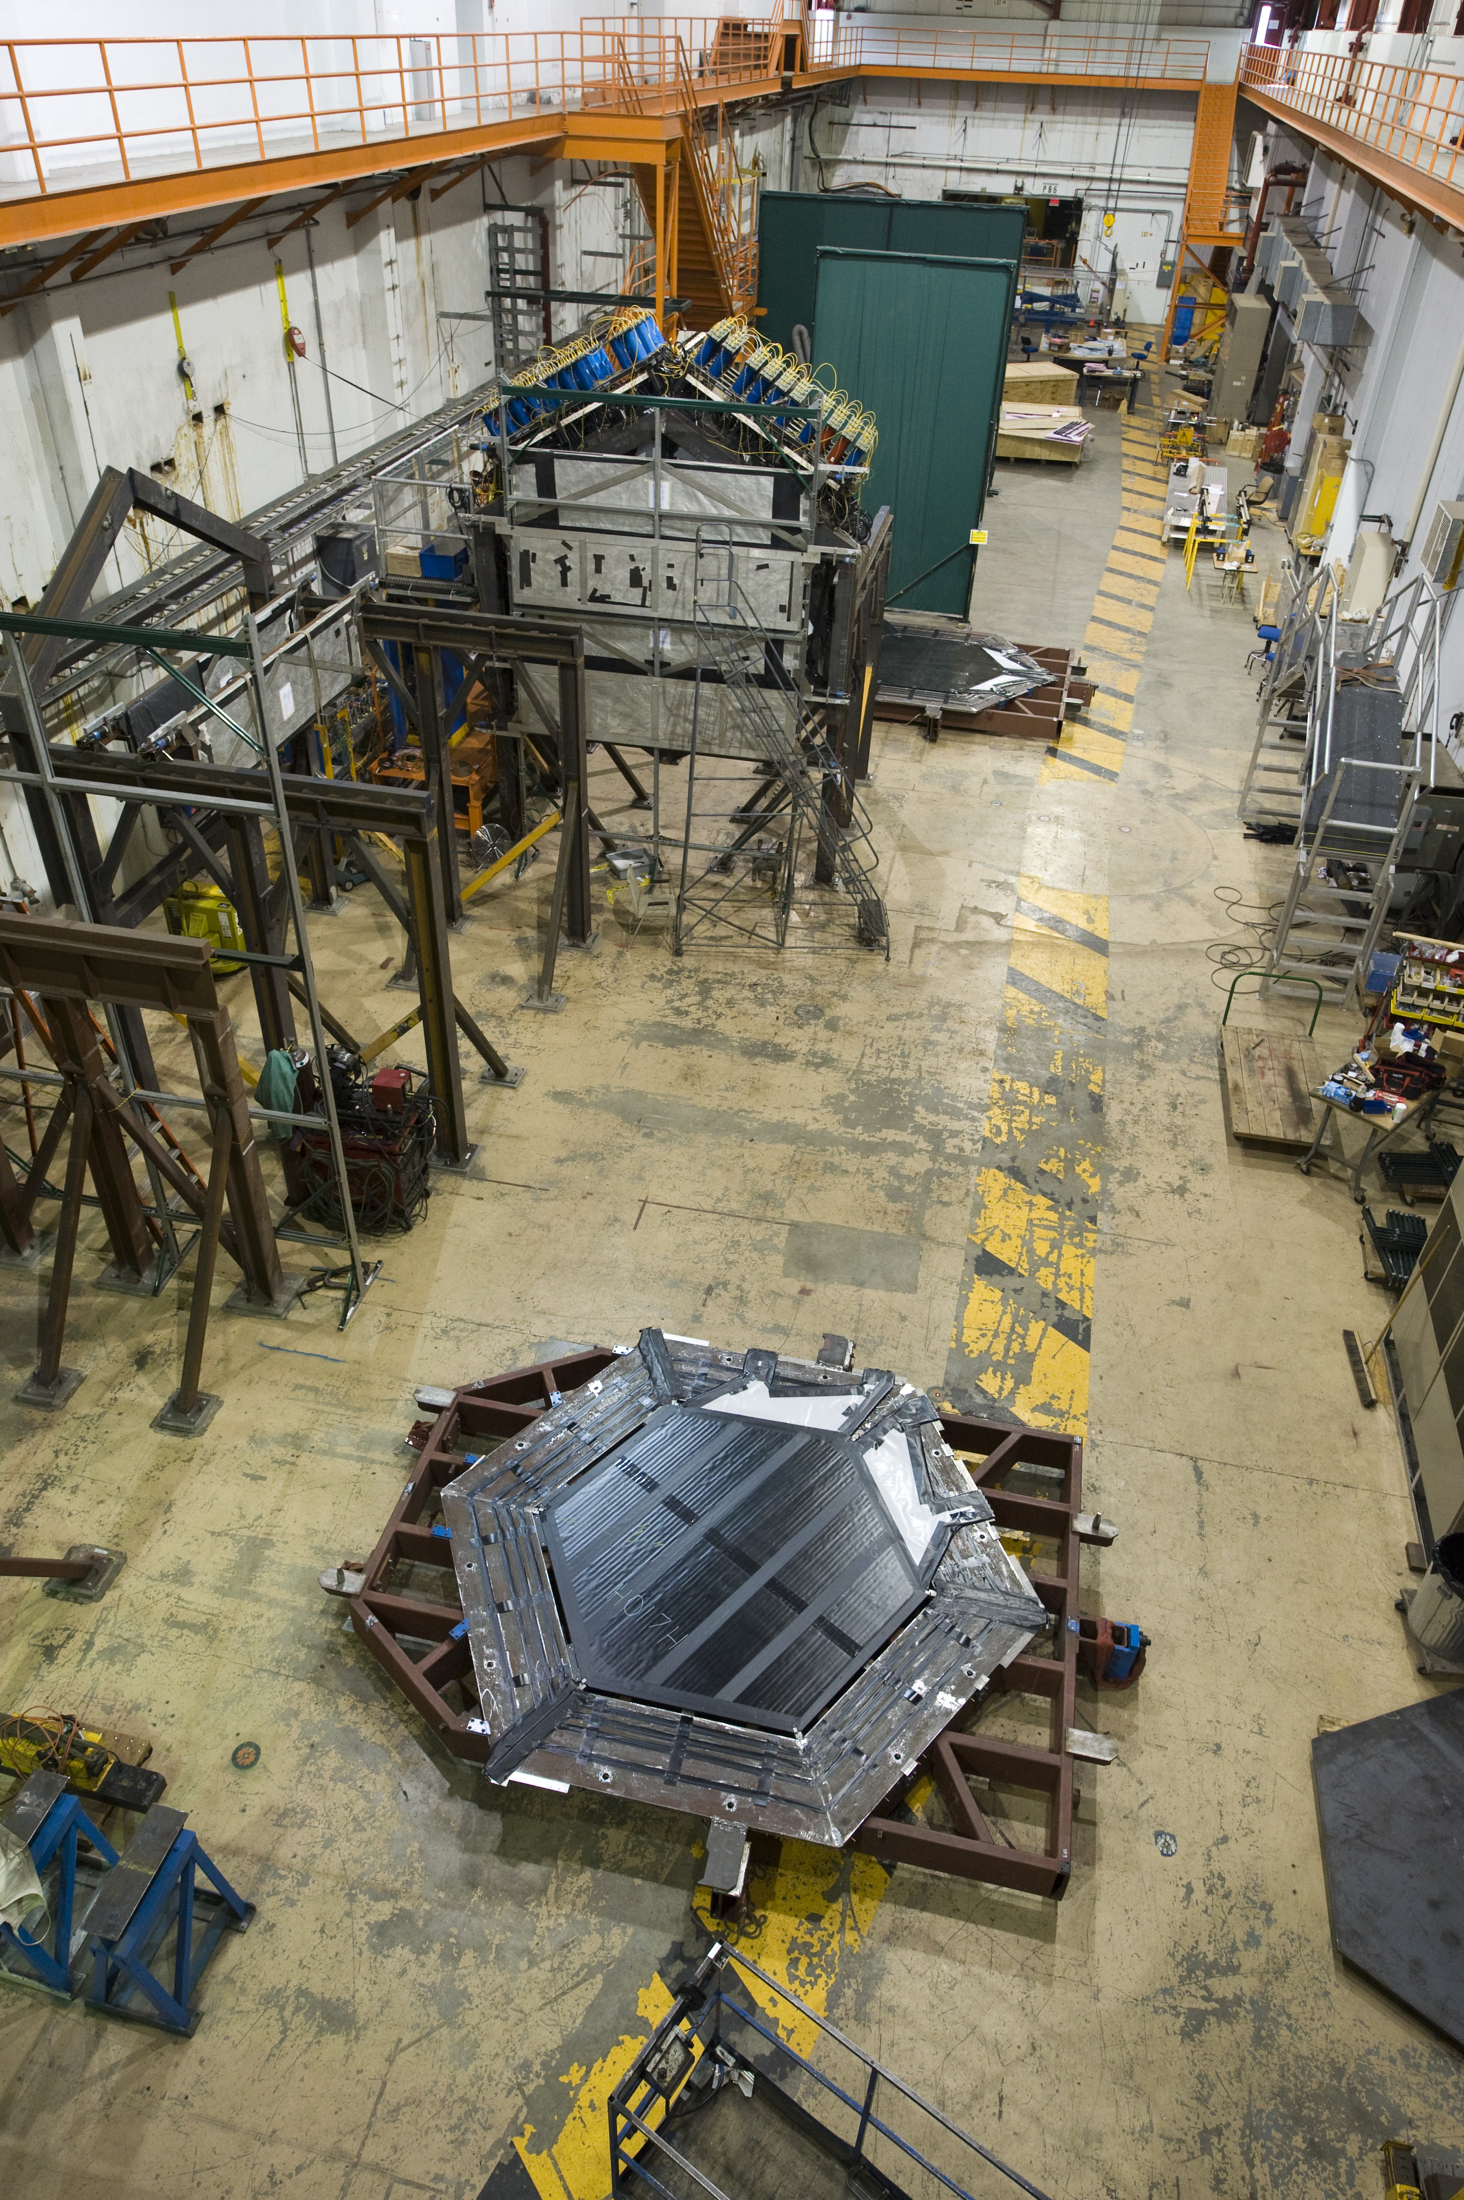
Minerva plane on strongback
Bottom clips support
weight
Rollers
Hoist ring

Slide 3
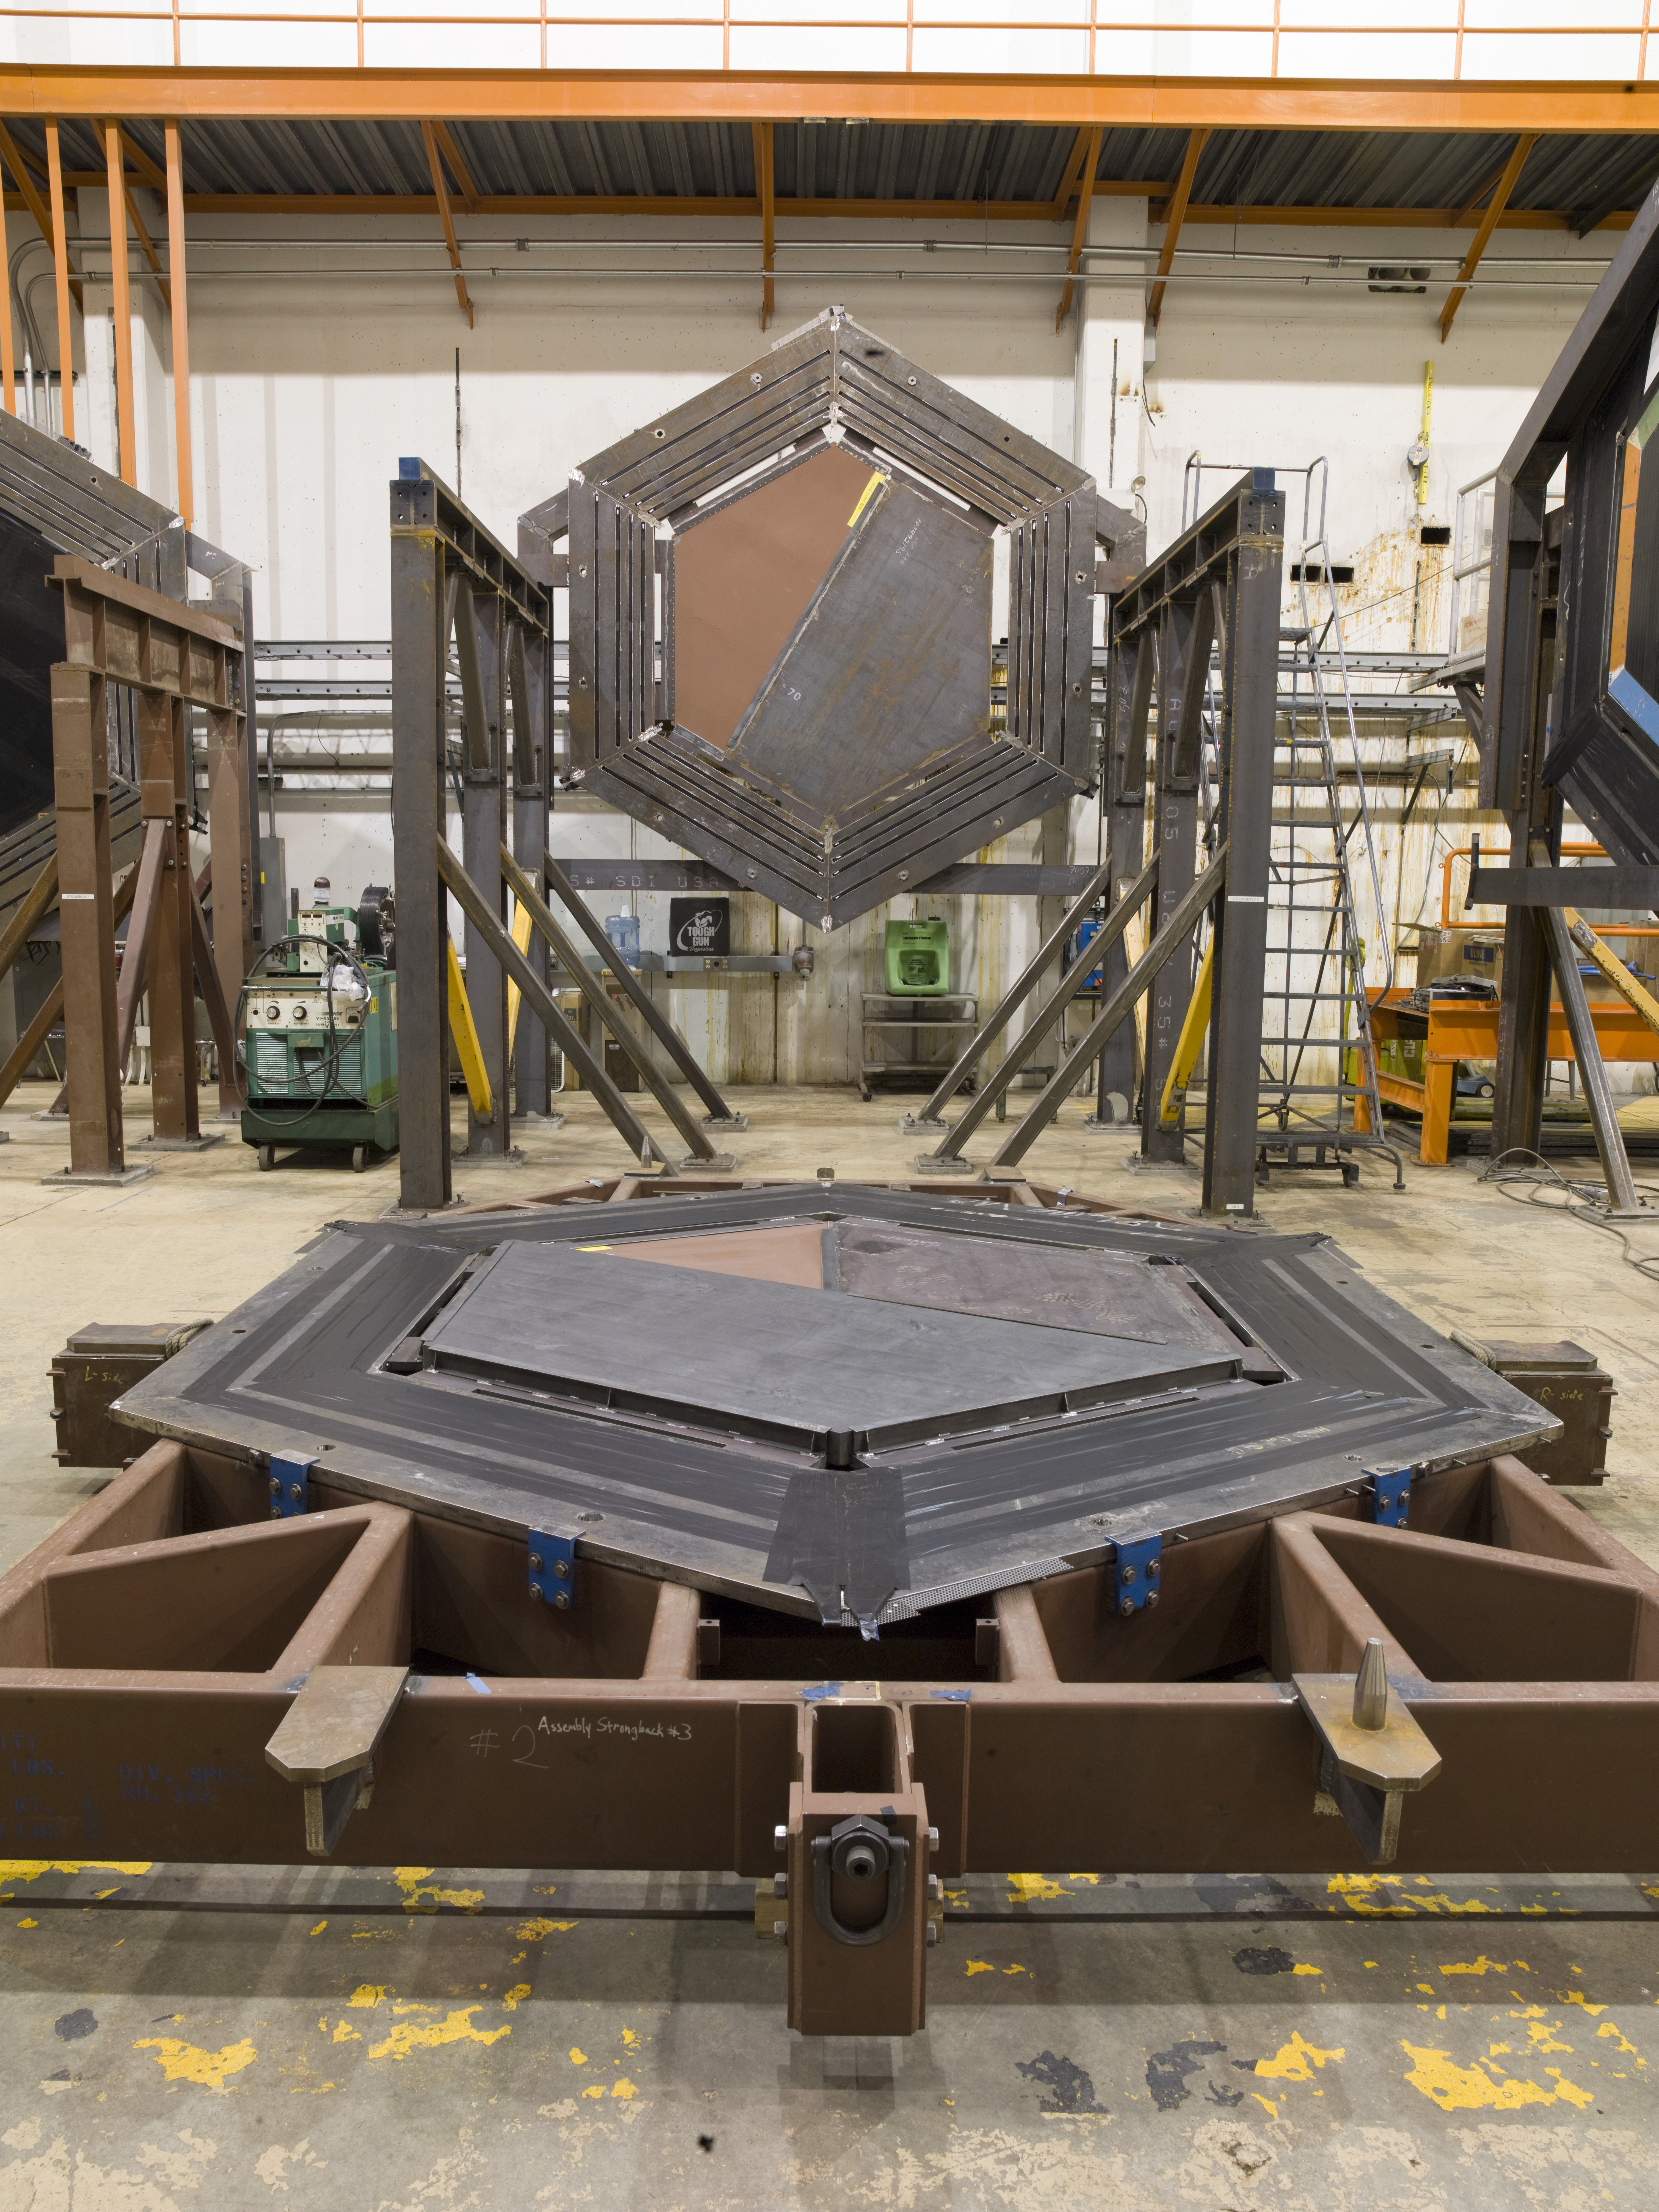
Top clips on the strongback
Top clip

Slide 4
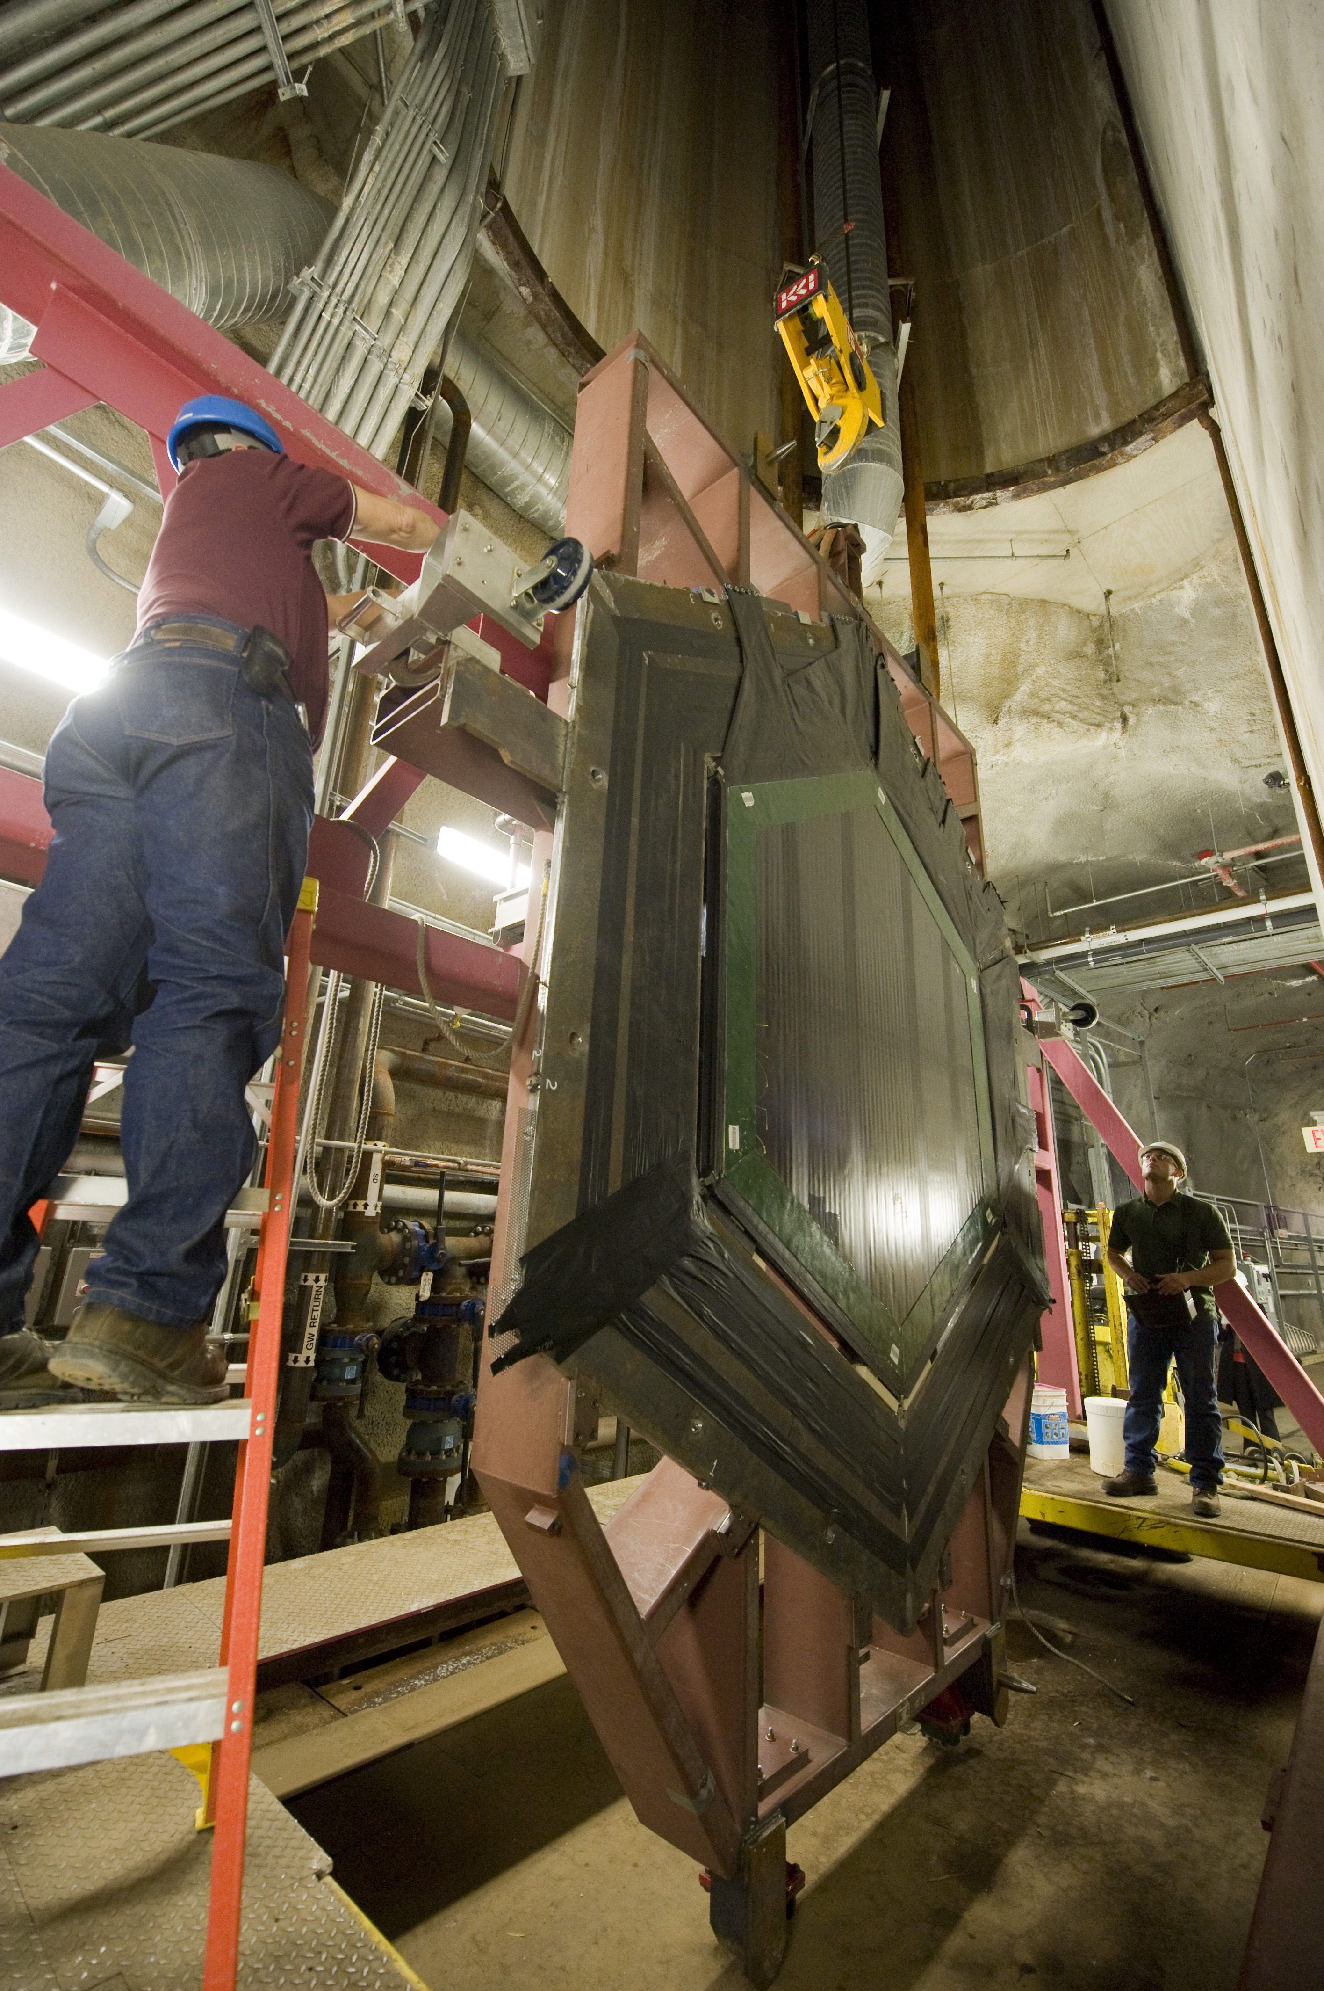
Attaching the strongback to the cart

Slide 5
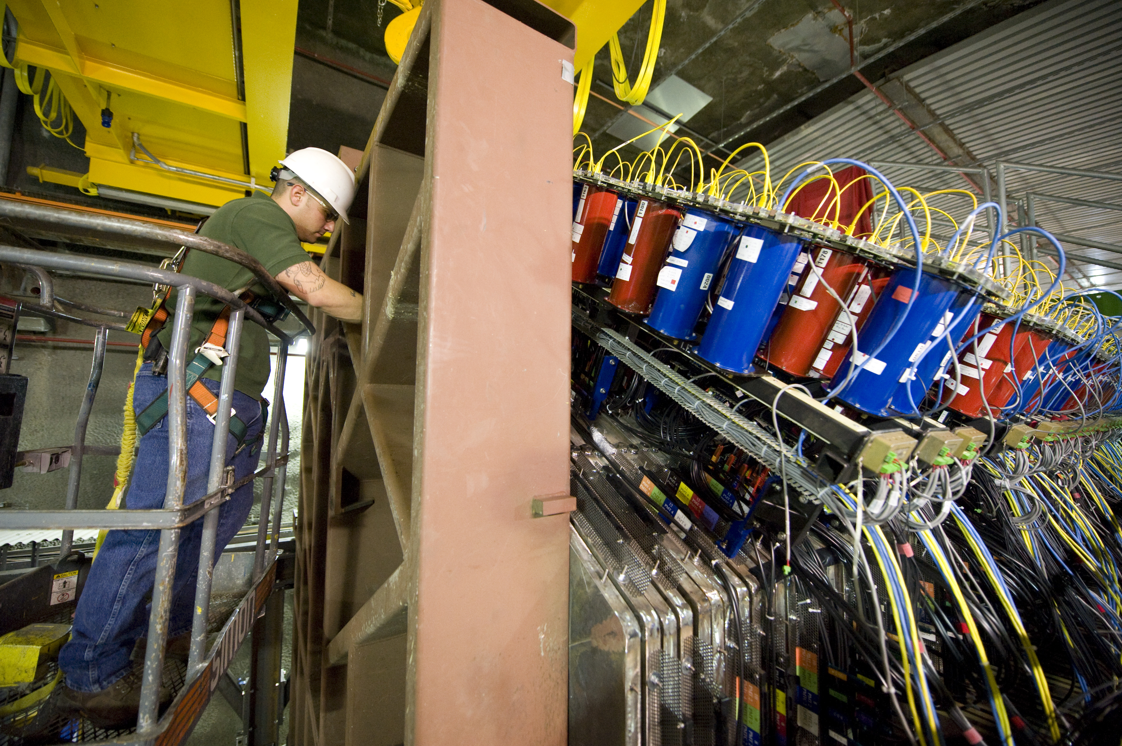
Frame mounted to rail

Slide 6
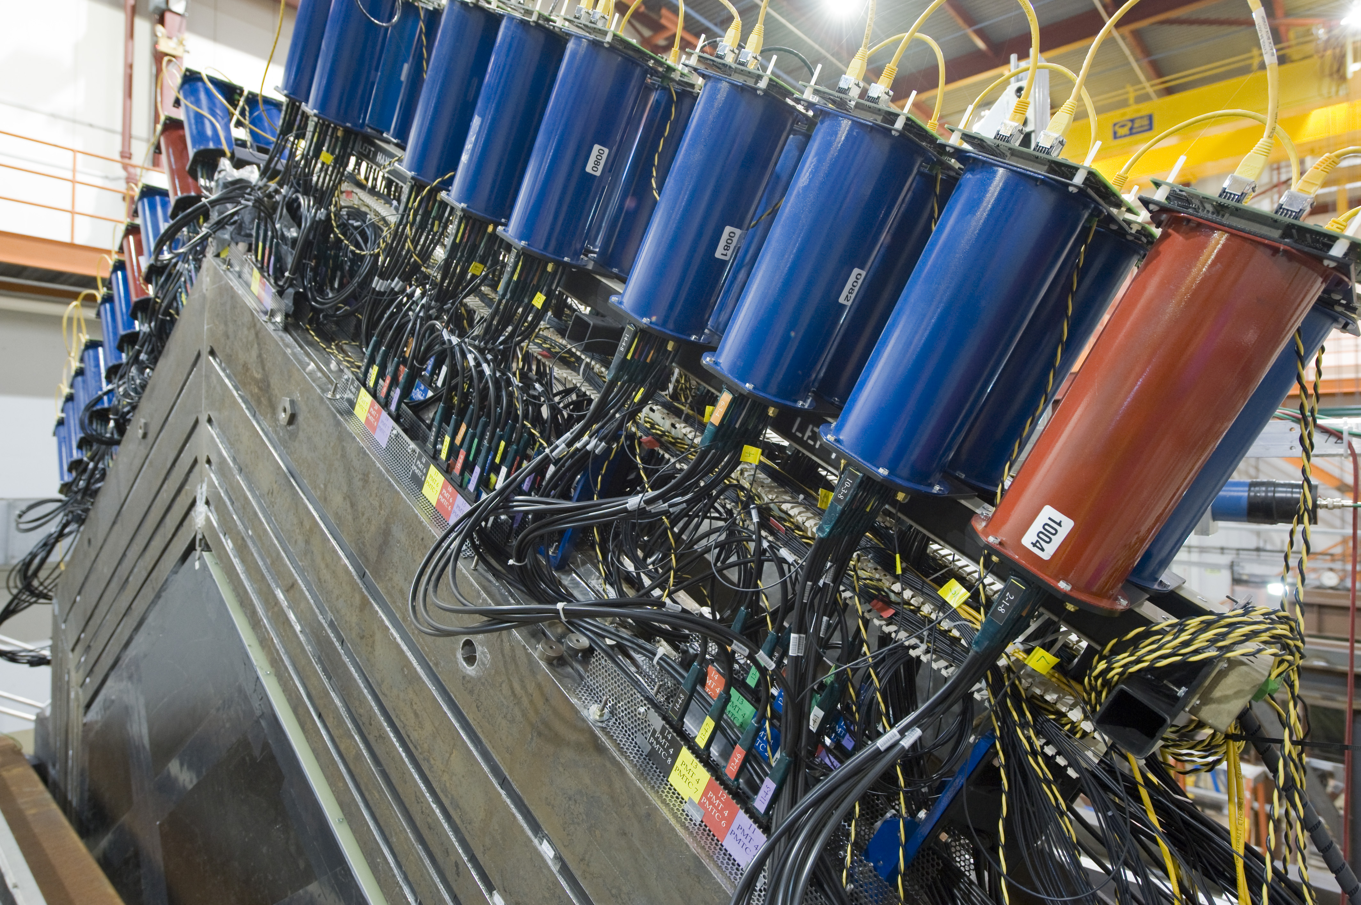
Four frames cables with light fiber cables
Axial bolts

Slide 7
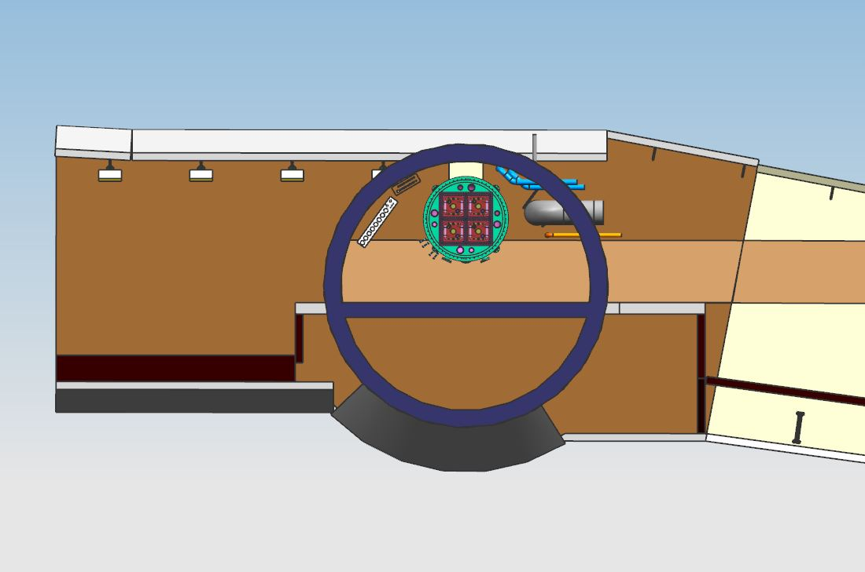
Shaft cross section with argon cube

Slide 8
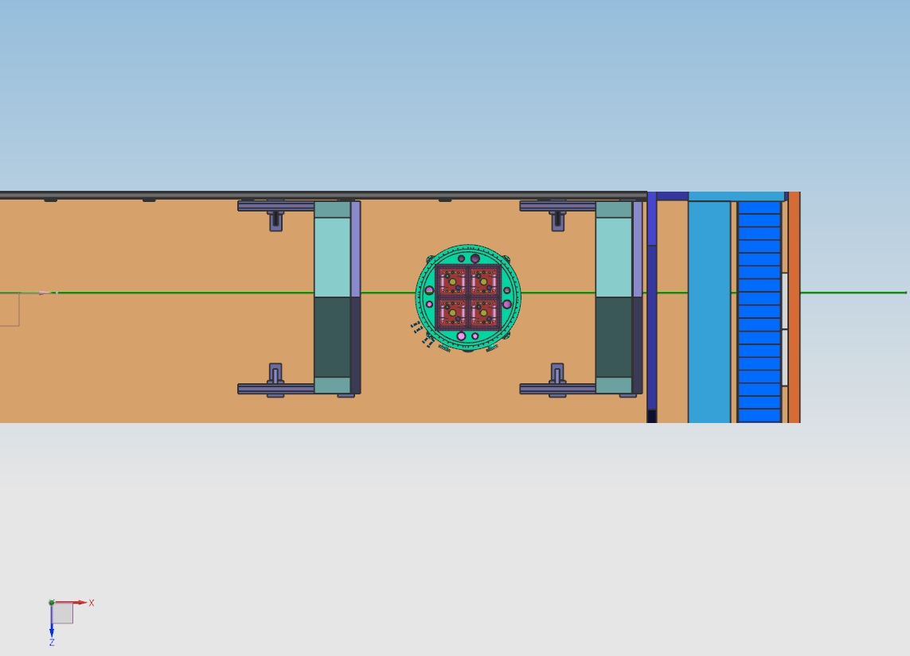
Plan view of Argon Cube
Nu beam central axis

Slide 9
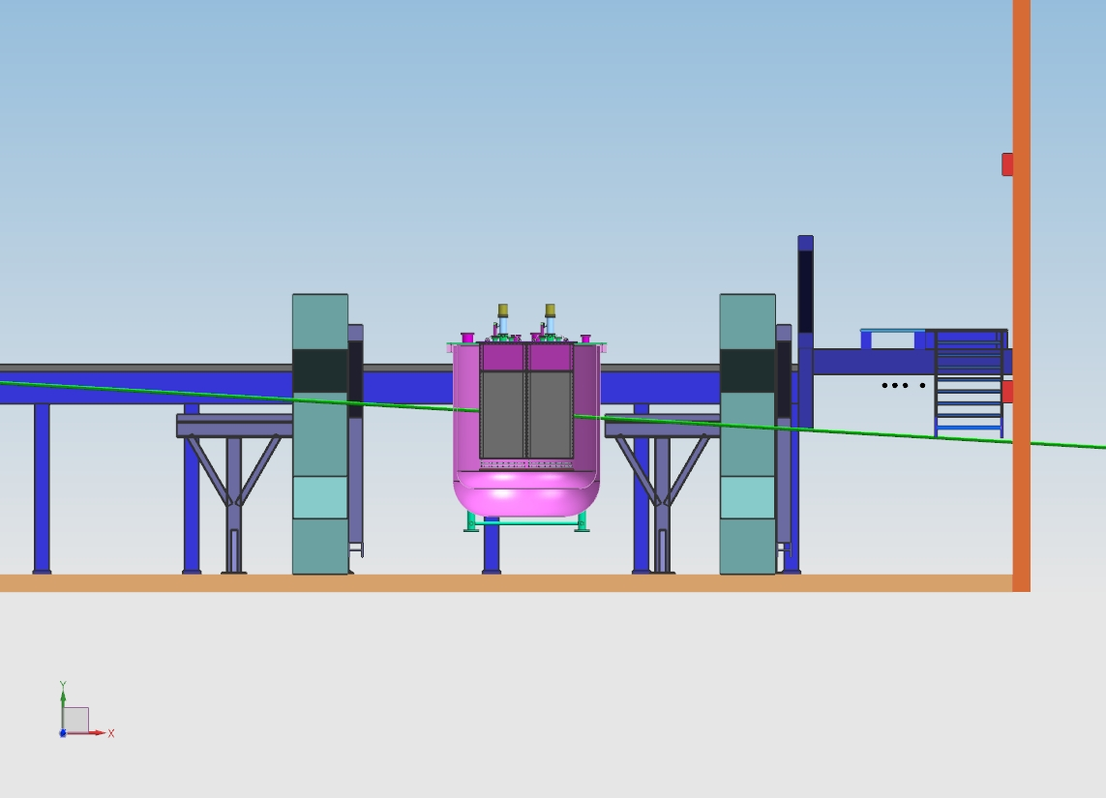
Section view of Argon Cube

Slide 10
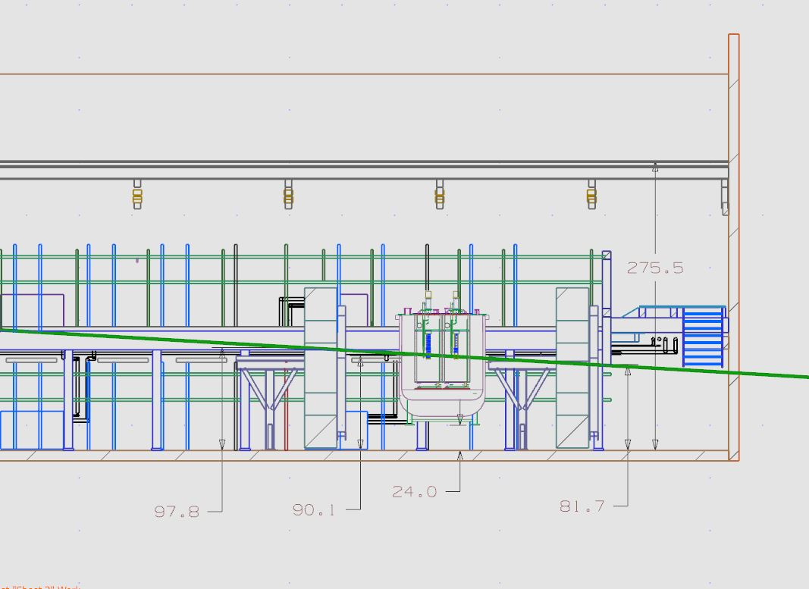
Dimensions of the proposed layout

Slide 11
How to modify strongback
Still need ~2” above
Floor to disengage
strongback

