Slide 1
Linac Installation and Commissioning
WBS 121.04.01-06
Fernanda G. Garcia
PIP-II Director’s CD-2/3a Review
30 July – August 1, 2019

Slide 2
Scope/Deliverables
Charge #3
The scope of the PIP-II Installation and Commissioning WBS includes the work related to
  the installation of the machine components and building utilities
  setting up dedicated test stands for cavity and cryomodule testing with full cryogenic load at the final operating temperature and with full RF power
  warm-front end design, fabrication and procurement
  commissioning: technical check-out and with beam
  accelerator physics lattice design and beam physics simulations
This system is organized in 7 WBS elements
  121.04.01 Project Management
  121.04.02 Warm Front End
  121.04.03 Test Infrastructure
  121.04.04 Building Infrastructure
  121.04.05 Linac Installation
  121.04 06 Beam Commissioning
  121.04.07 Accelerator Physics
span over the entire
project life cycle

Slide 3
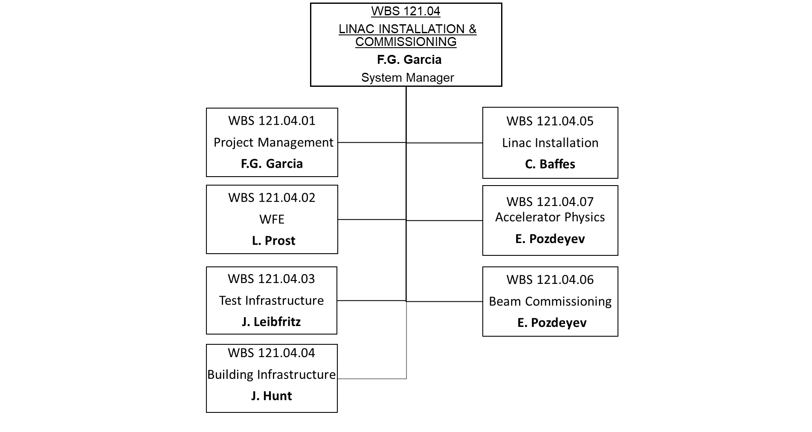
Organization/Team
Charge #6
Sub-systems fully staffed
  Experienced L3 Managers with substantial experience in the type of work related to their respective WBS element
  Stable team since inception of the work breakdown structure

Slide 4
Performance Requirements
Charge #1
Performance requirements are documented in “Functional Requirements Specifications” documents
  Approved by the L2 and Technical Integration representative
  Under document control in Teamcenter (TC)
Discussed in detail in SC2 break-out sessions
121.04.02 Warm Front-End FRS:ED0008004
  Prepare and deliver H⁻ beam to the first SRF cryomodule (HWR)
121.04.03 Test Infrastructure FRS:ED0008064
  Support for cavities & CMs test areas
    PIP-II Injector Test (PIP2IT)
    Spoke Test Cryostat (STC)
121.04.04 Building Infrastructure FRS: ED0008083
  Provides cooling and electrical infrastructure in gallery and tunnel for machine components

Slide 5
Performance Requirements (cont.)
Charge #1
121.04.05 Linac Installation FRS: ED007996
  Maintain the top-level PIP-II CAD model
  Design work
    cryomodule stands
    transport system to be used during installation
    design and build stands and align the warm unit structures
    design and install tunnel alignment network
  Planning and execution work
    develop and execute the Linac installation plan
    checkout of the machine components and storage of accepted cryomodules awaiting to be installed, including transportation from the storage area to the linac complex area
121.04.06 Beam Commissioning FRS: ED0008026
  Deliver beam with appropriate properties to Booster and integrate the superconducting linac to the Fermilab accelerator complex
121.04.07 Accelerator Physics FRS: ED0008103
  Development and evaluation of the linac lattice design
  Support for Shielding Assessment – Cryoplant Building, Linac and Booster

Slide 6
Technical Summary
Excellent technical progress on several fronts
  Installation of infrastructure at PIP2IT cave progressing well
  PIP2IT cryotransfer line installed and ready to tie-in to the Cryoplant at CMTF
  Prototype cryomodule stand assembly process underway
  On track to complete milestone, Ready for beam at PIP2IT, by April’20
  STC test stand cryostat modification complete and fully cold tested
  Mechanical and electrical system designs advancing well
  3-D CAD model continues to evolve as design matures
  Extensive efforts have been made on beam lattice design and relevant beam optics studies such as fault analysis

Slide 7
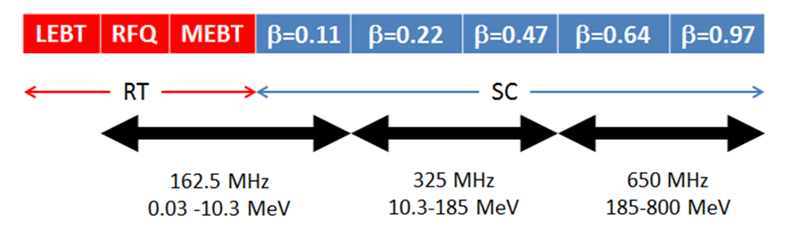
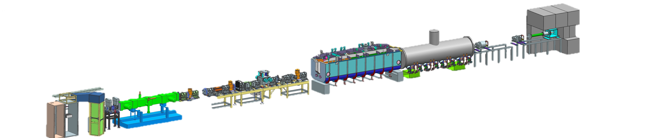
PIP-II Injector Test – PIP2IT
A test accelerator representing a nearly full-scale of the PIP-II front-end
HEBT
SSR1
Warm front-end tested
HWR
MEBT
25 MeV
RFQ
10 MeV
to be installed and tested in FY19/20
2.1 MeV
30 keV
Related WBS
WFE, Test Infrastructure, Beam Comm. AP

Slide 8
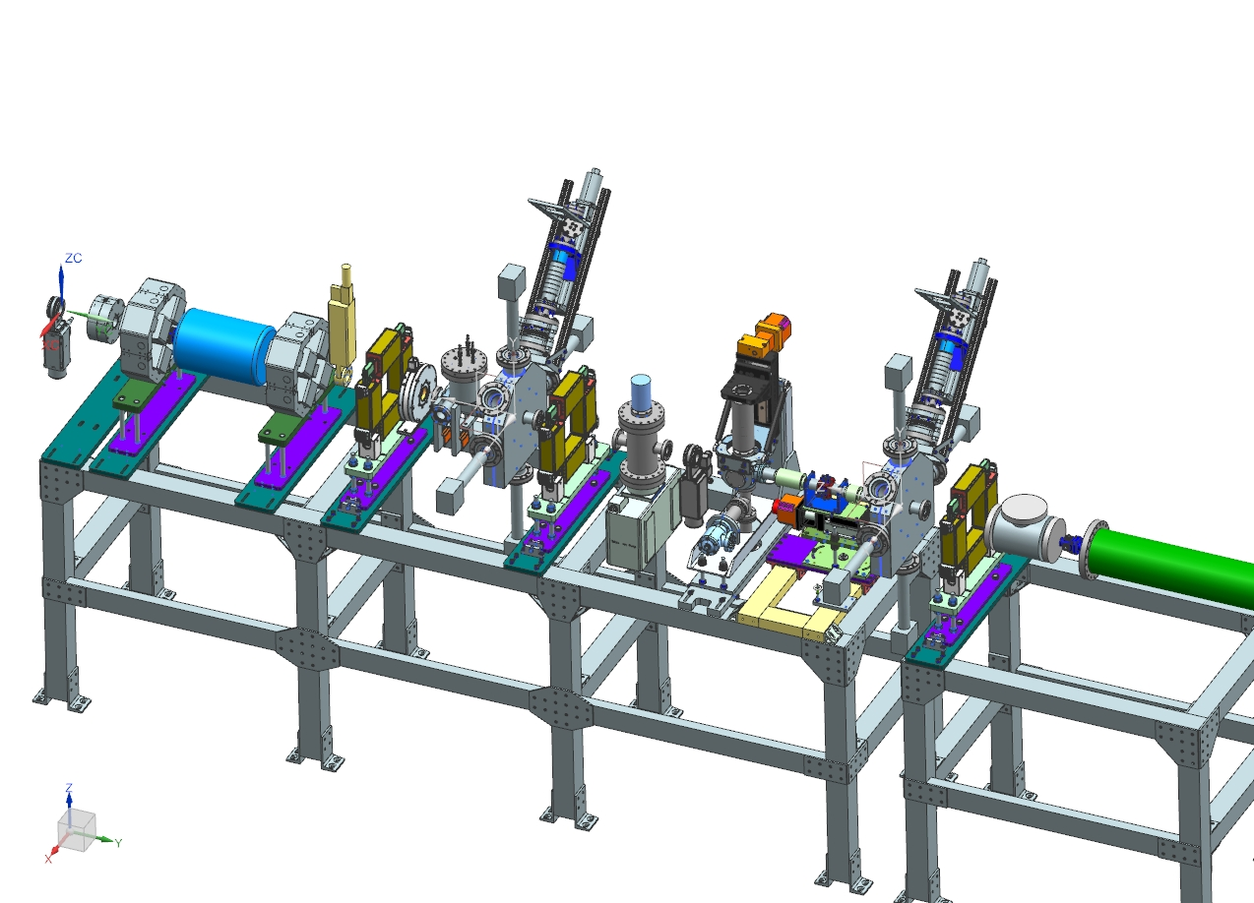
Progress – Warm Front-End
Charge #1
SC2-Prost
  Recent activities have been on
    Design of HEBT section of PIP2IT in order to support HWR/SSR1 beam commissioning
      Design completed and reviewed in Feb’19
        proceeding with procurement/assembly
HEBT 3D model
(T. Hamerla, S. Wesseln)
    Fabrication of the final design of the MEBT beam absorber
    Final Design Review of the MEBT Kickers (Aug’18)
      Construction of 2 production kicker structures underway
      Recommendation to increase the kicker driver output margin for operation -> improved design and starting fabrication

Slide 9
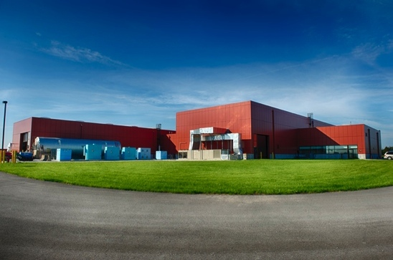
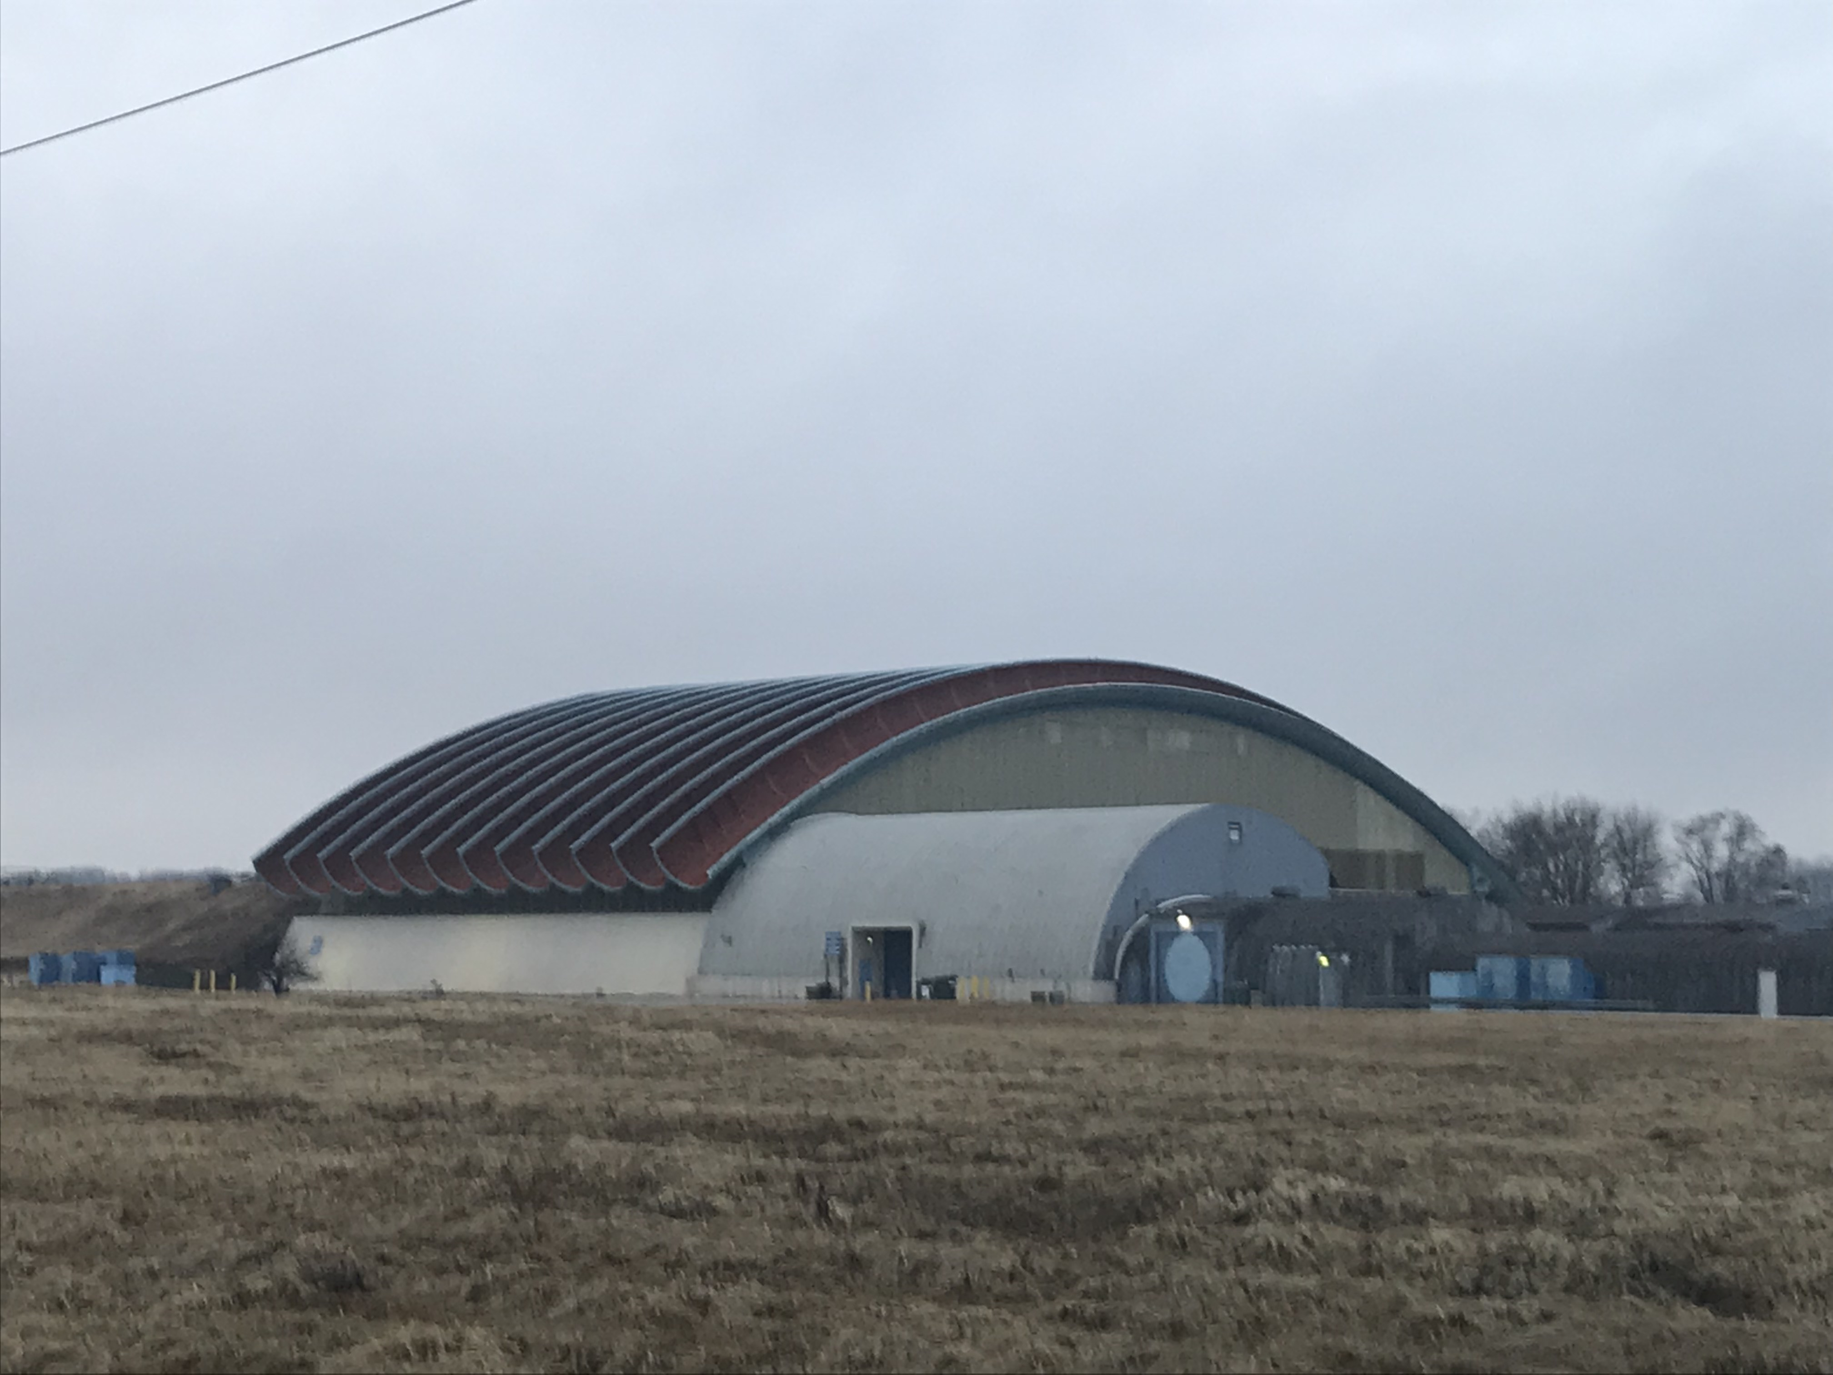
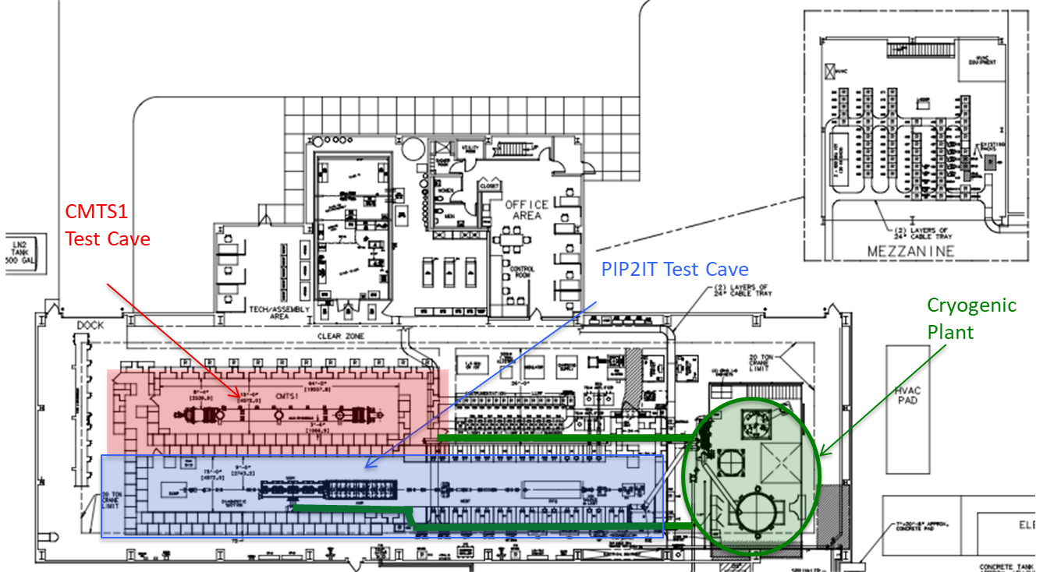
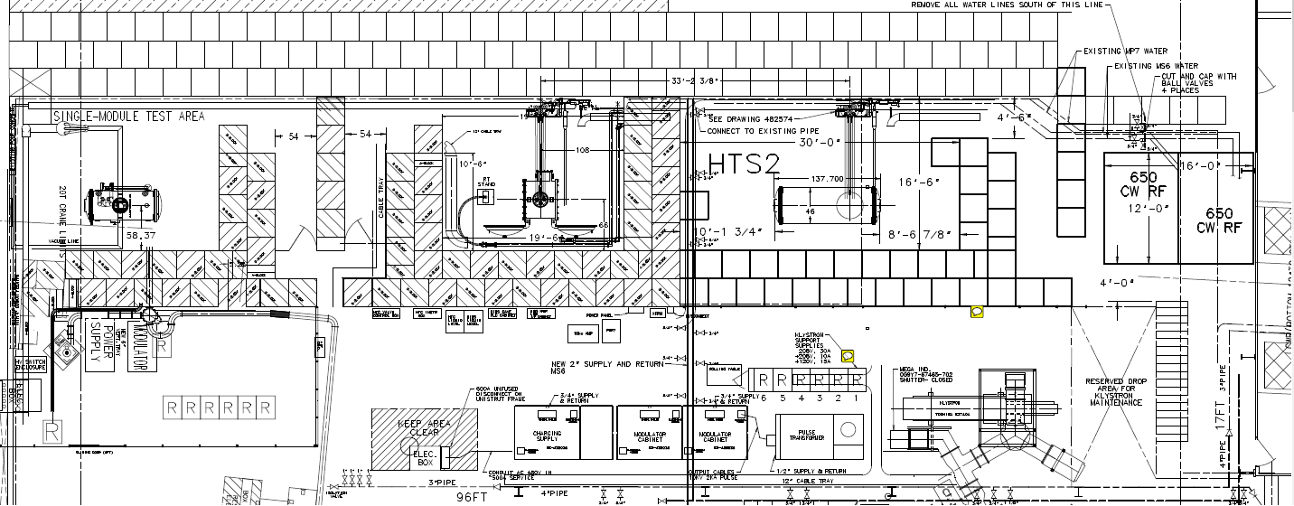
Test Infrastructure
Charge #1
SC2-Leibfritz
  PIP2IT @ CMTF
  (PIP2IT @ Cryomodule Test Facility)
  CMTF has two test stands (CMTS1 & PIP2IT)
  STC @ MDB
  (Spoke Test Cryostat @ Meson Detector Building)
  MDB has three test stands (HTS-1/2 & STC)
CMTS1 Cave
PIP2IT Cave
Cryogenic Plant
HTS-1
STC
HTS-2

Slide 10
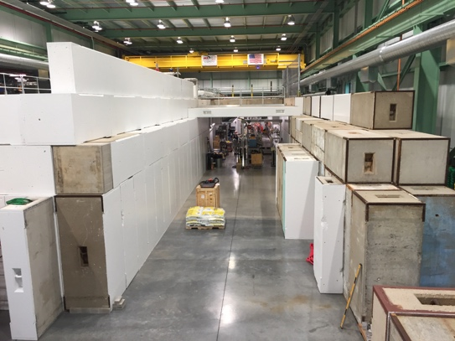
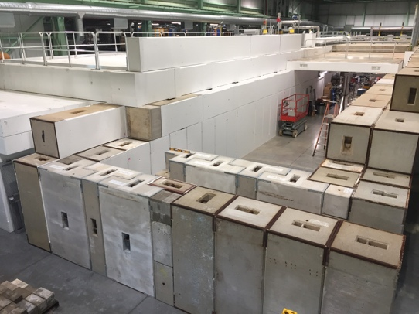
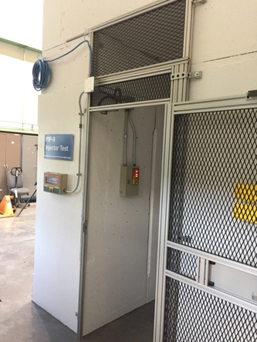
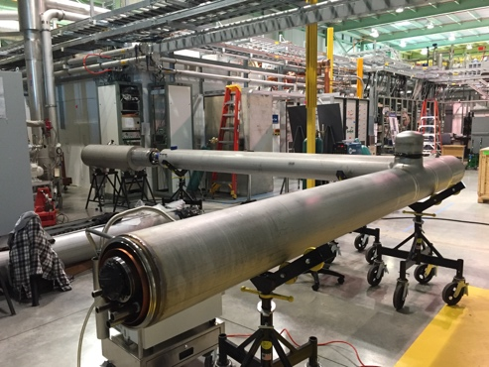
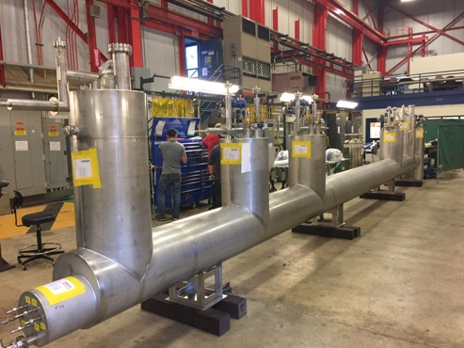
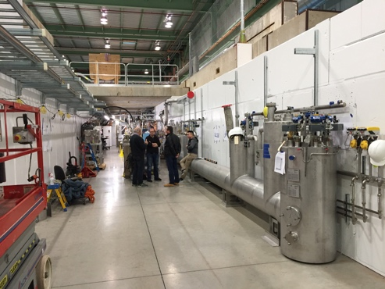
Progress: Test Infrastructure (II)
Charge #1
SC2-Leibfritz
  PIP2IT @ CMTF
  Cave extension complete to receive HWR/protoSSR1 Cryomodules
  Ongoing installation of the cryogenic transfer line (CTL)
interlocks
cave extension
CTL installation

Slide 11
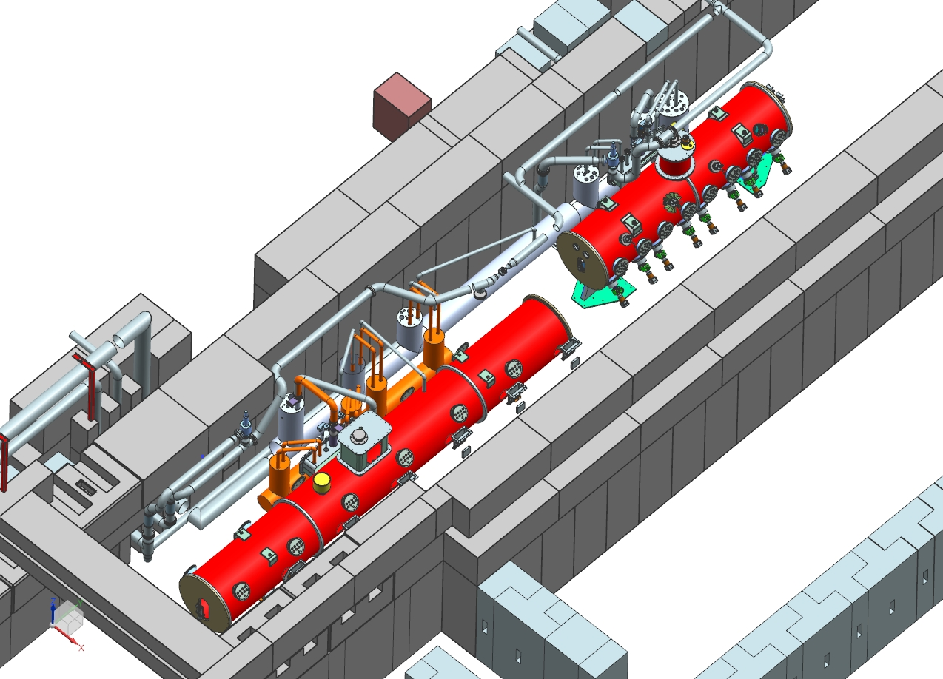
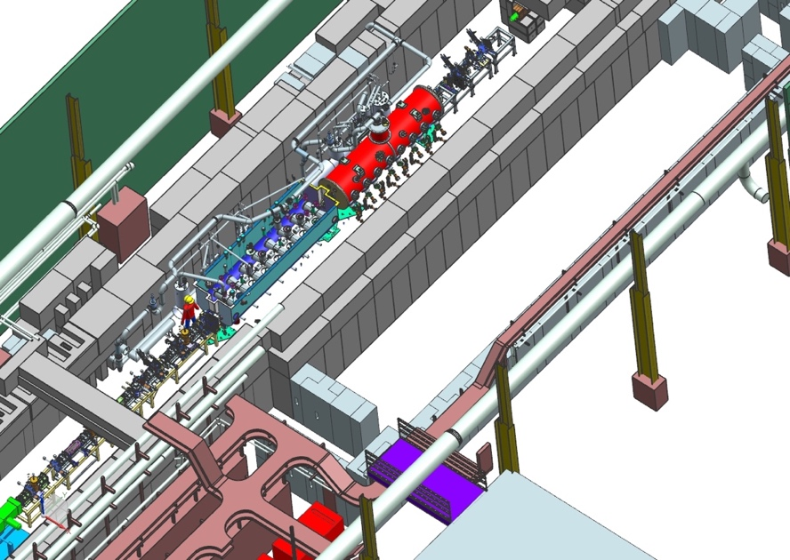
Progress: Test Infrastructure (III)
Charge #1
SC2-Leibfritz
  Future Plans: PIP2IT will be converted to two test stands for cold RF testing PIP-II cryomodules w/o beam
    Decouples PIP-II and LCLS-II HE schedules
    SSR1 test stand will require minimum modifications
    HWR slot will be converted to 650 MHz cryomodules test area
HWR/SSR1
HB650/SSR1

Slide 12
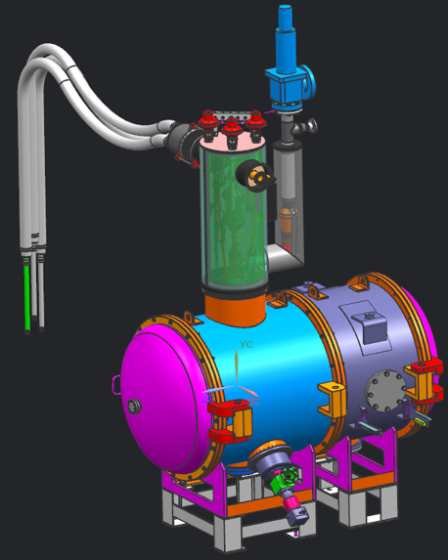
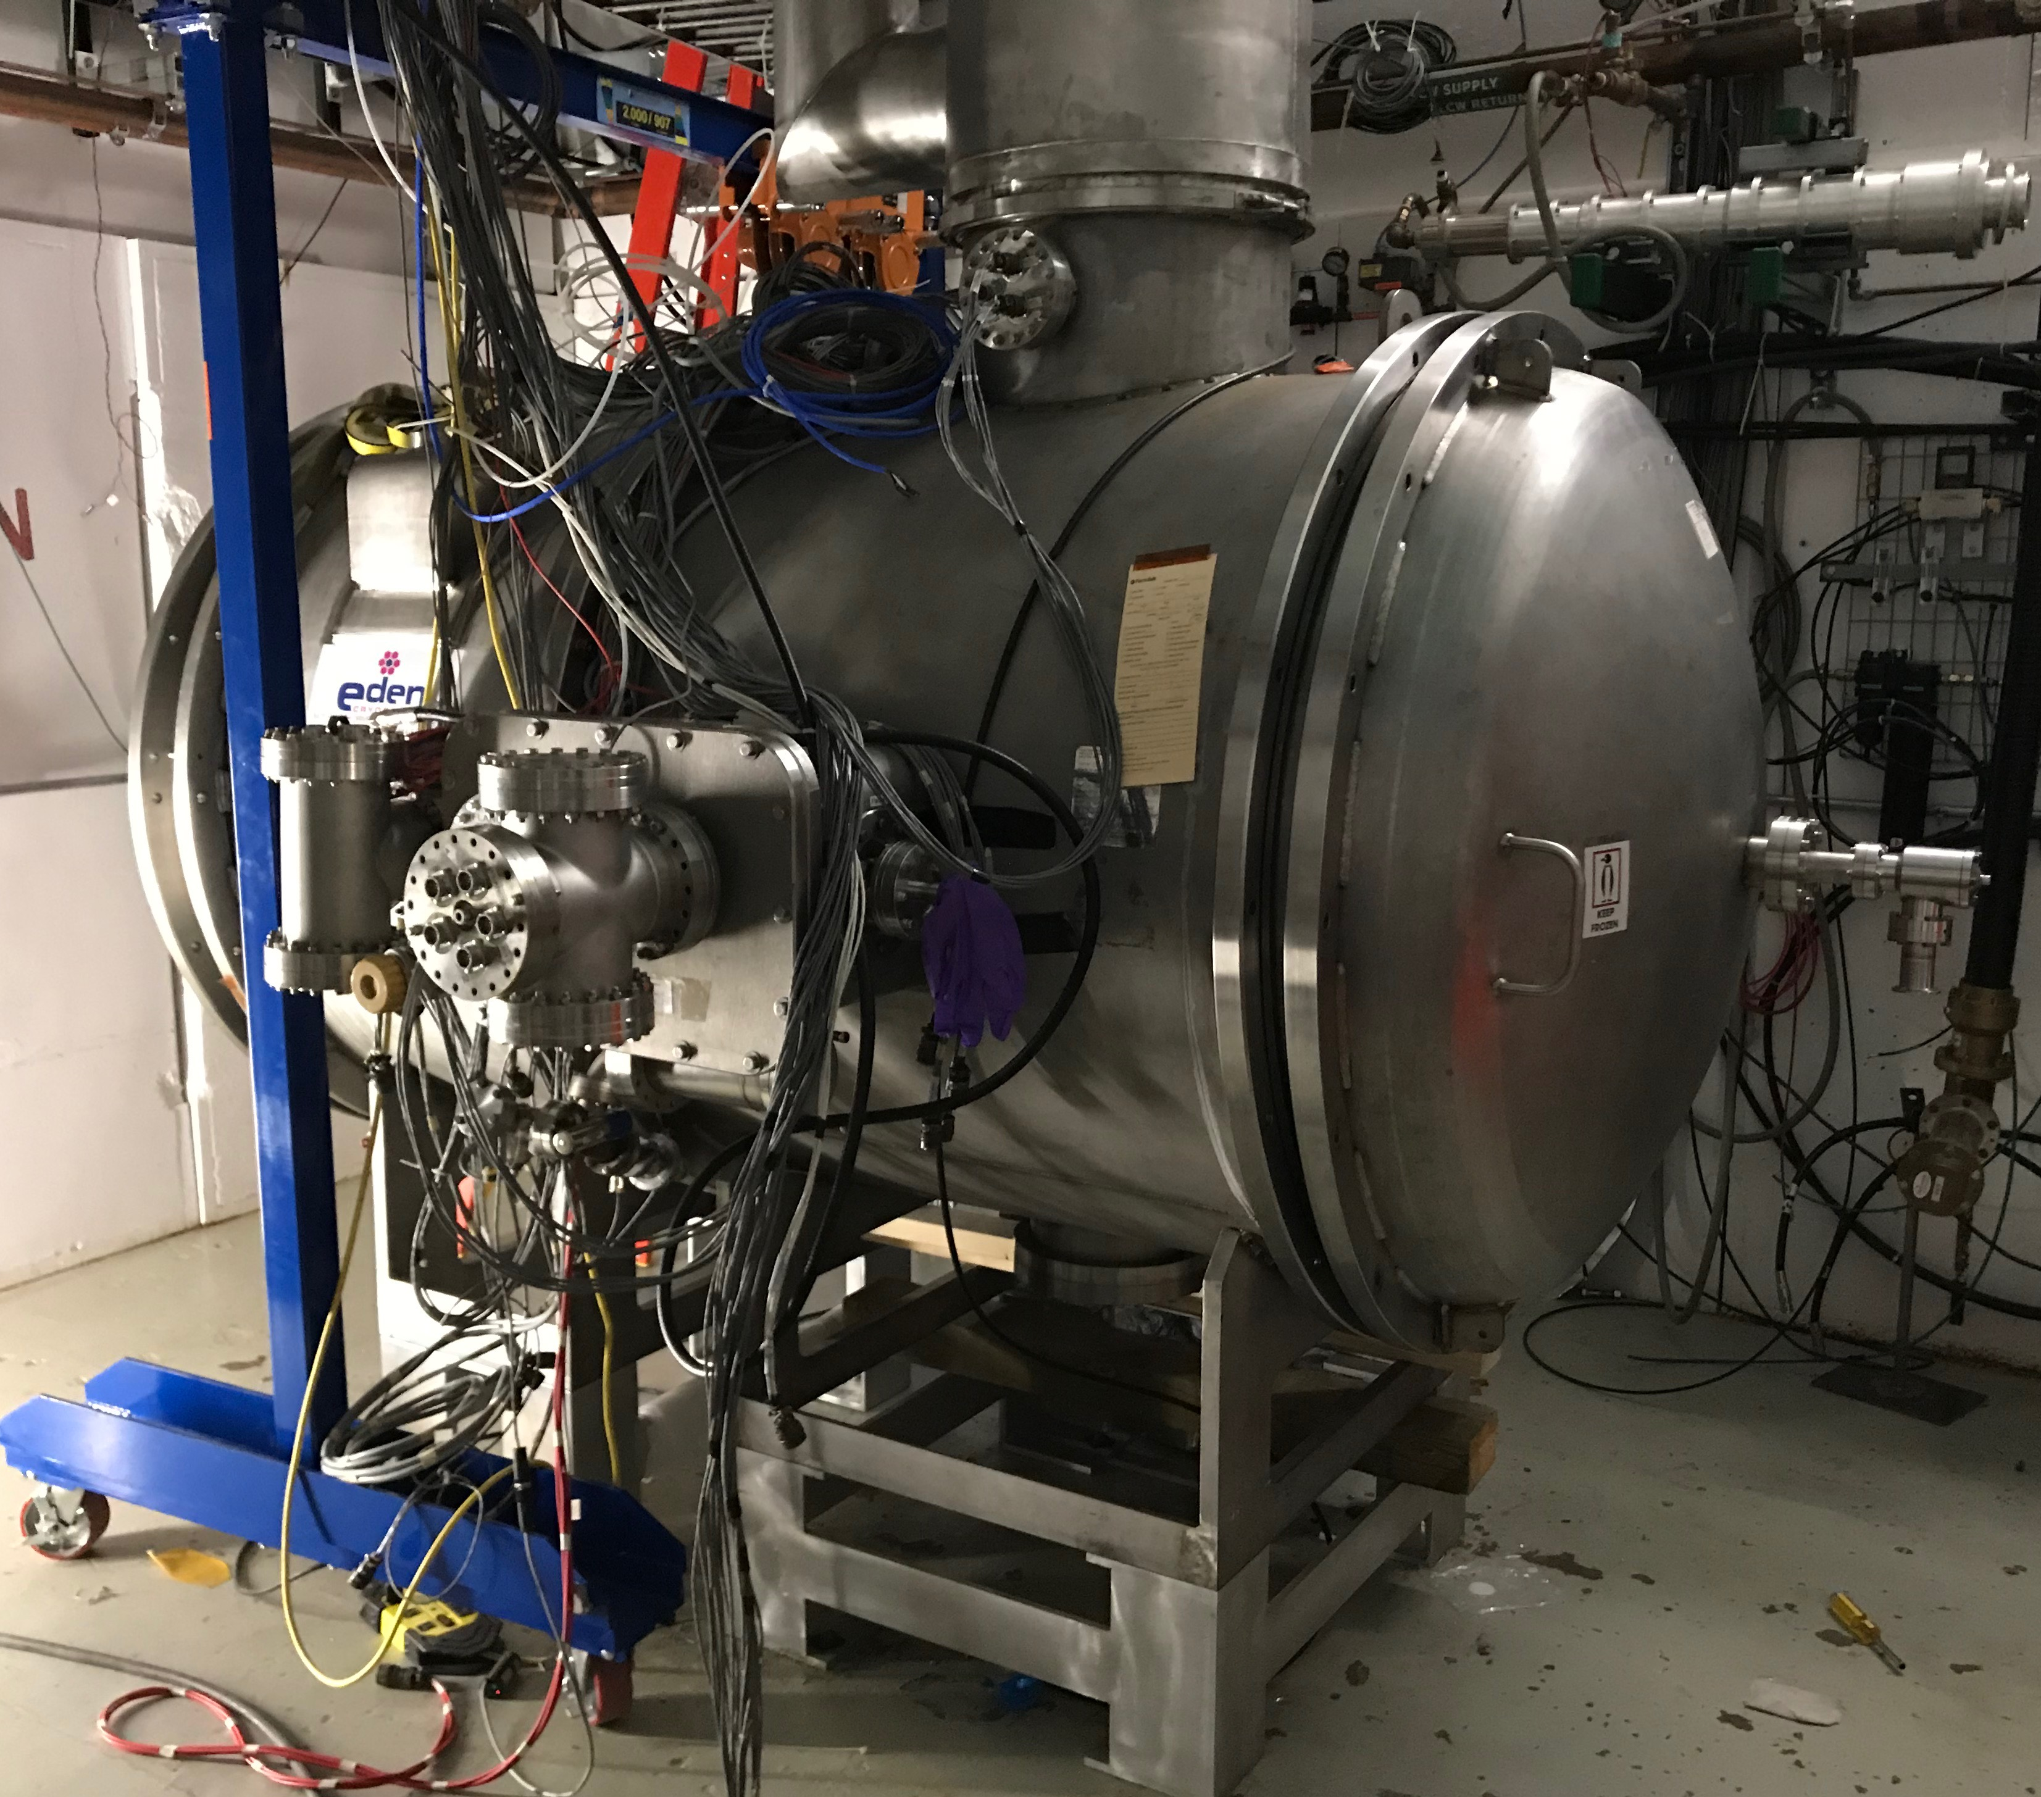
Progress: Test Infrastructure (IV)
Charge #1
SC2-Leibfritz
  STC: MDB
  (Spoke Test Cryostat @ Meson Detector Building)
  Demonstrate dressed cavity performance
    used for testing pSSR1 cavities (Nov’18)
  Mechanical modifications to the cryostat to allow for cavity testing for SSR2 and 650 cavities
  Completed July’19
STC cryostat modified with extension to accommodate 650MHz cavities

Slide 13
Progress: Building Infrastructure
Charge #1
SC2-Hunt
Developed the Room Data Sheet (RDS)
  Collect information of equipment infrastructure needs from other L3Ms
  Validation of the entries with participation of all L2Ms/L3Ms
    First release in Jan’19
    6-months revision/2nd check - complete Jun’19
Tailoring the Accelerator Division cable database for PIP-II
  Key features
    Add zone configuration
    Add links of cables -> zones -> batches -> ready for procurement
    Add a Quality Check (QC) step
      Verification process includes checks for data completion, location discrepancies, cable types in line with the PIP-II cable catalogue
    Add lockout periods prior to initiating final procurement package for a specific batch
  Apply Lessons Learned from using the AD Cable Database at PIP2IT

Slide 14
Progress: Mechanical System
Charge #1
SC2-Hunt
Preliminary low-conductivity water (LCW) cooling system
  One primary water-cooling circuit and two secondaries close loop circuits
  Pumping station located at the Utility Plant (CPB)
    Operation in cooperation with the cooling towers situated outside the building
    4 pumps for the supply line with automatic adjustment for system balancing
    2 plate-type heat exchangers
    Water treatment system
      Deionizing and Deoxygen systems
      Filtration system
To Beam Dump area
Linac Complex
HB650
LB650
SSR2
SSR1
FRONT END
PIP-II LCW System Design Specification:
Delta P: 106 PSID
Heat Load: 8,200 KW
Flow: 7,600 GPM
Set Supply Temperature: 86⁰F
Average Temperature Rise: 7.2F⁰
Utility Bridge
Cooling Towers
PIP-II LCW System
Ion Source Cooling Skid
RFQ Cooling Skids (3)
RAW Absorber Skid
45°F Chilled Water Supply from CUB (CHW)
Cryoplant Building
Utility Plant

Slide 15
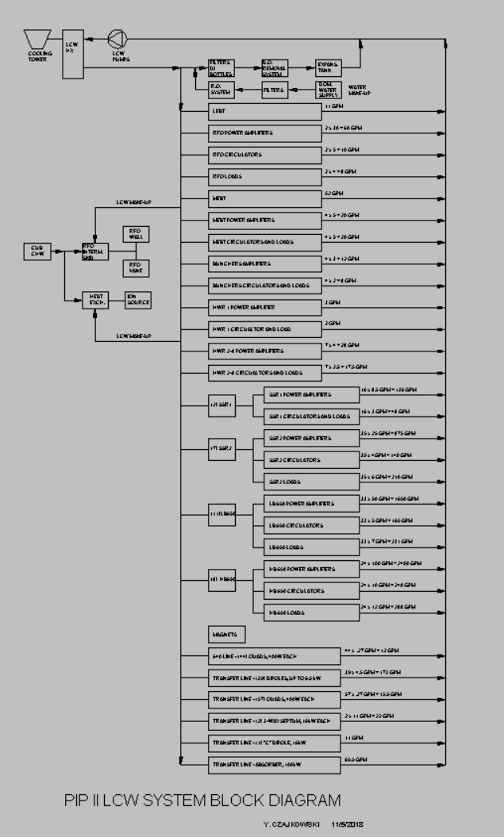
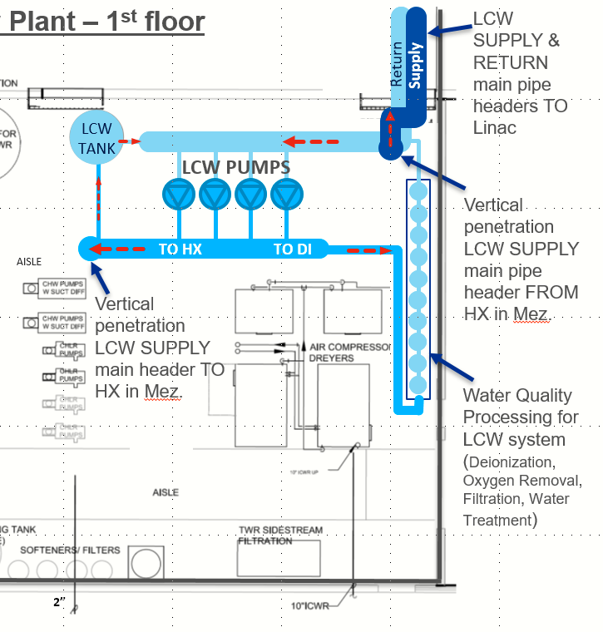
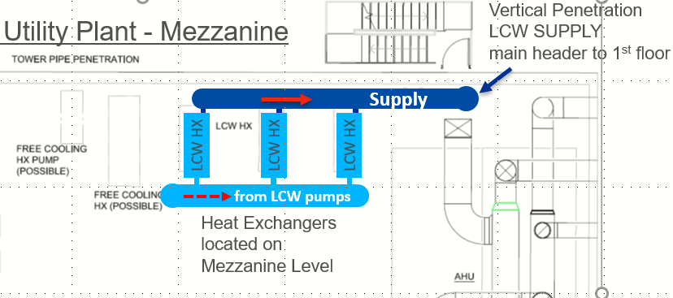
Progress: Mechanical System (II)
Charge #1
Primary circuit
LCW Primary circuit
Provides cooling water to equipment in the linac gallery and tunnel
  heat exchange with cooling tower
LCW Secondary circuits
Provides makeup water for RFQ/IS water cooling skids
  heat exchange with chiller water
2nd circuits
Utility plant
LCW floor plan

Slide 16
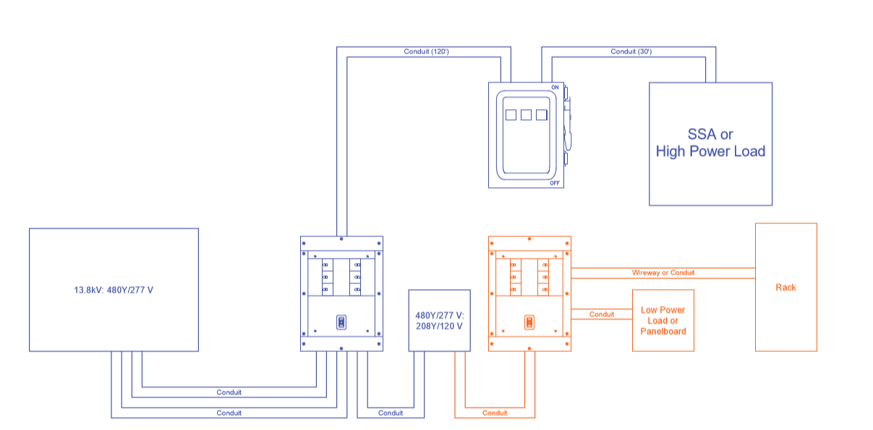
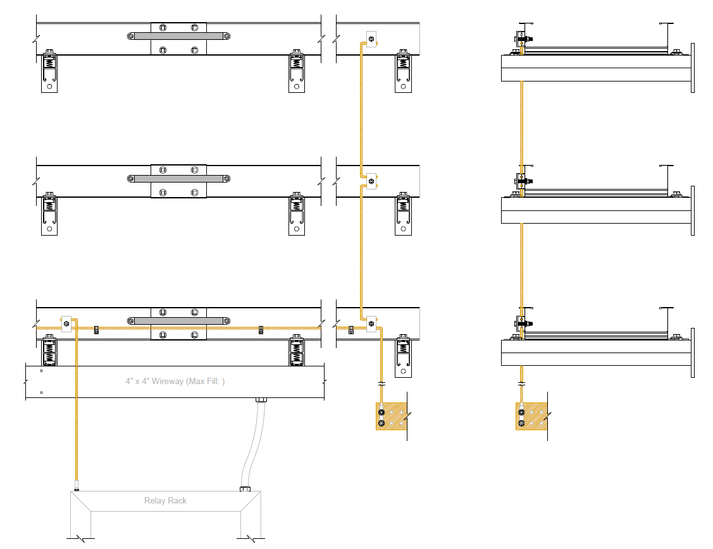
Progress: Electrical System
Charge #1
SC2-Hunt
Preliminary electrical distribution design
  AC Distribution designed to provide power to machine components
    Power distribution into the building is 480V
      Accelerator components require 480/208 and 120V control power
      Conduits and wireways distributions
      Safety switches
Power distribution layout
Cable Tray / Grounding scheme
Bounding jumper
2 AWG Ground
4” x 4” Wireway
Relay Rack
Building ground

Slide 17
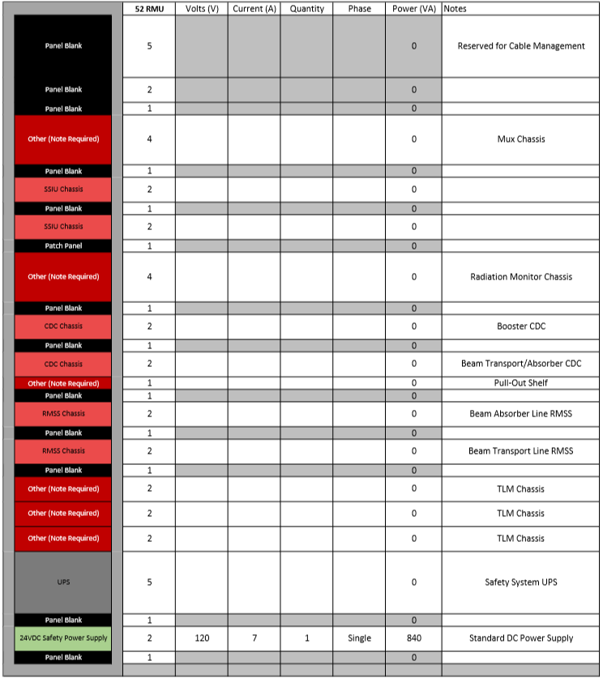
Progress: Electrical System (II)
Charge #1
SC2-Hunt
Cables/Connectors/Racks
  Developed guidelines for standard cables and connectors
  Initiated detail individual rack layout with other L3Ms
    Validate rack count, location and power draws
    Graphical interface
      Forethought on maintainability
      Provision for cable management and equipment distribution

Slide 18
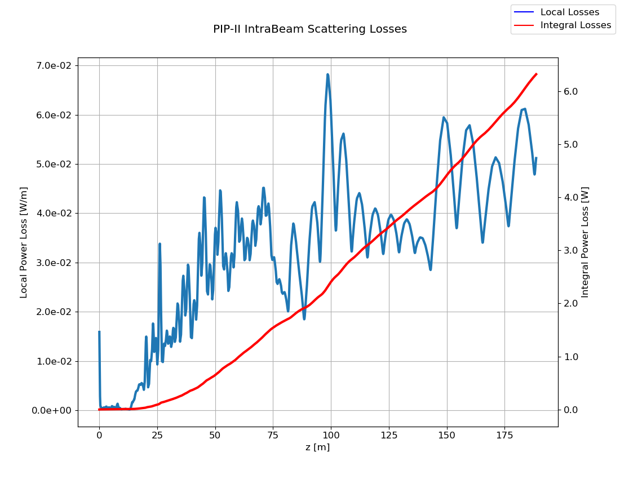
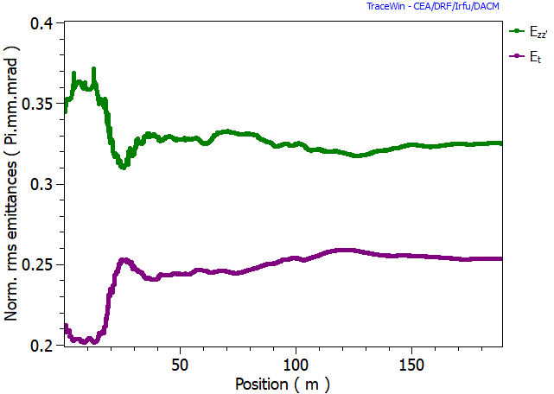
Progress: Accelerator Physics
Charge #1
SC2-Posdeyev
Progress on the PIP-II baseline beam lattice
  New layout of MEBT defined
  Space allocation for collimators between SSRs cryomodules
  Increase space allocation for magnet package in LB650 region
  Increase space between cavities in SSR1
  Reconfiguring 11x3LB650 to 9x4LB650 cryomodule
  Implementing field map for quadrupoles
Nominal beam dynamics studies and lattice design performance evaluation
  intra-beam stripping studies < 0.1 W/m
  Misalignment tolerances of beam line components
  Ongoing study to understand fault scenario

Slide 19
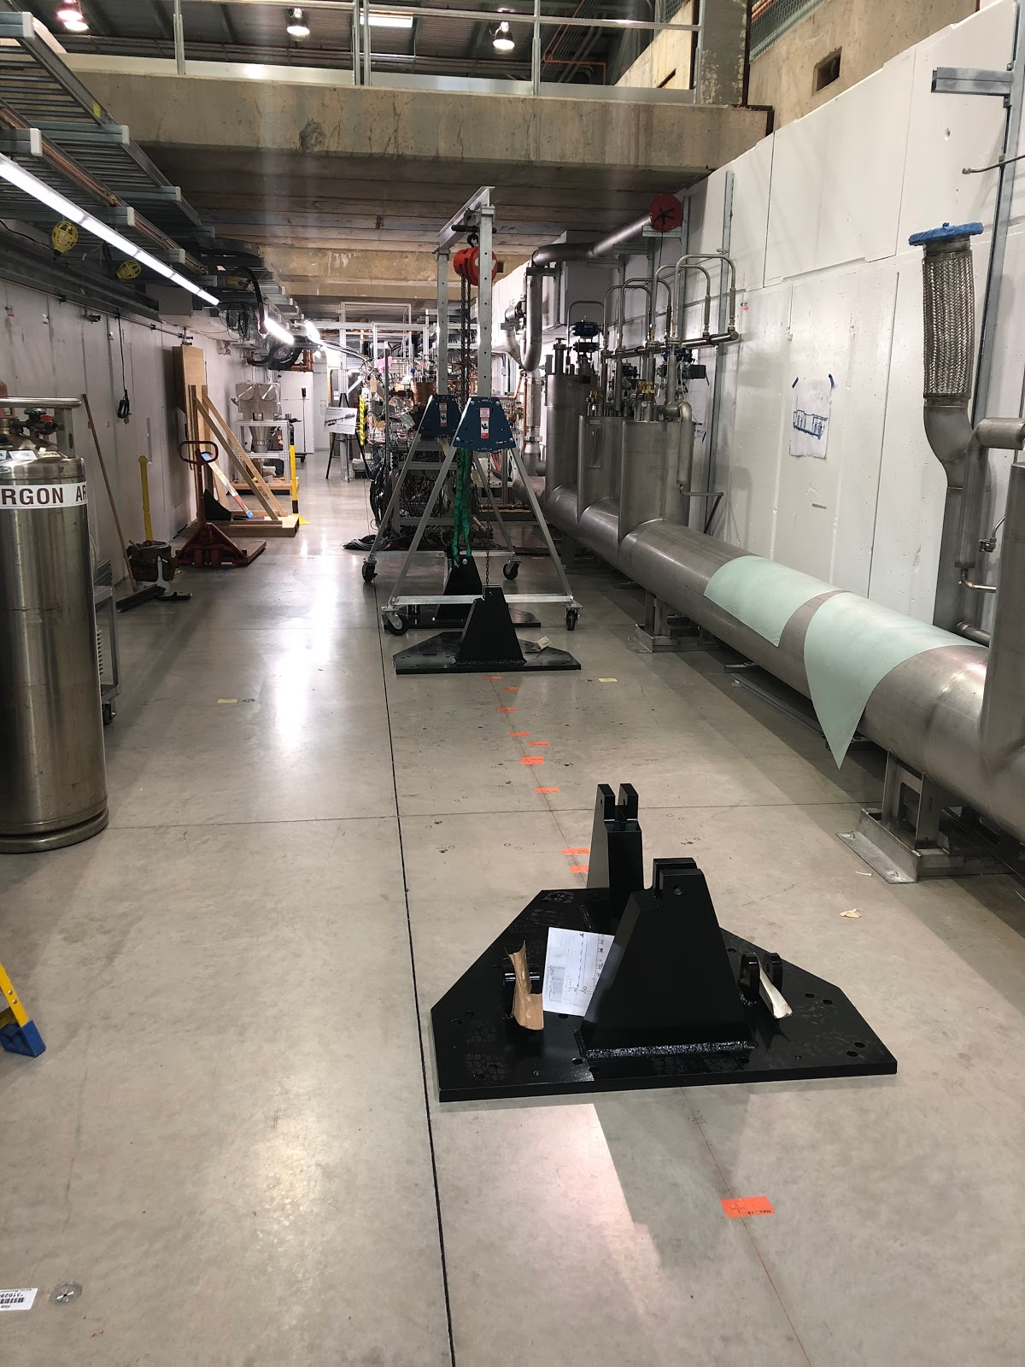
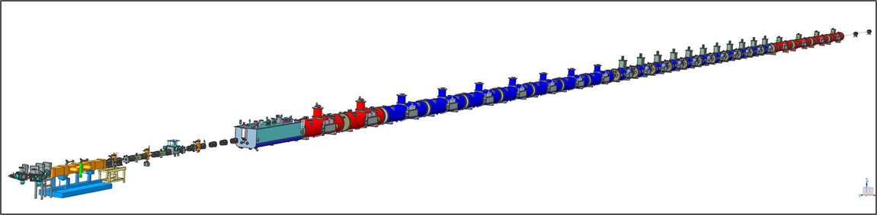
Progress: Linac Installation
Charge #1
SC2-Baffes
  Cryomodule stands
      Comparable design with HWR, SSRs, and 650 cryomodules, with minimal modification between cryomodule types
      Successful PDR conducted Nov’18
        Prototypes placed on the floor at PIP2IT – May’18
    Warm Unit
      Conceptual design and interfaces defined
    Integrated 3D CAD Model
      Automated lattice import implemented
      Date exchange procedure with lattice and Conventional Facility defined
PIP2IT:
HWR/protoSSR1 stands plate placed on the floor of the PIP2IT cave as marked by the alignment group following the beam lattice

Slide 20
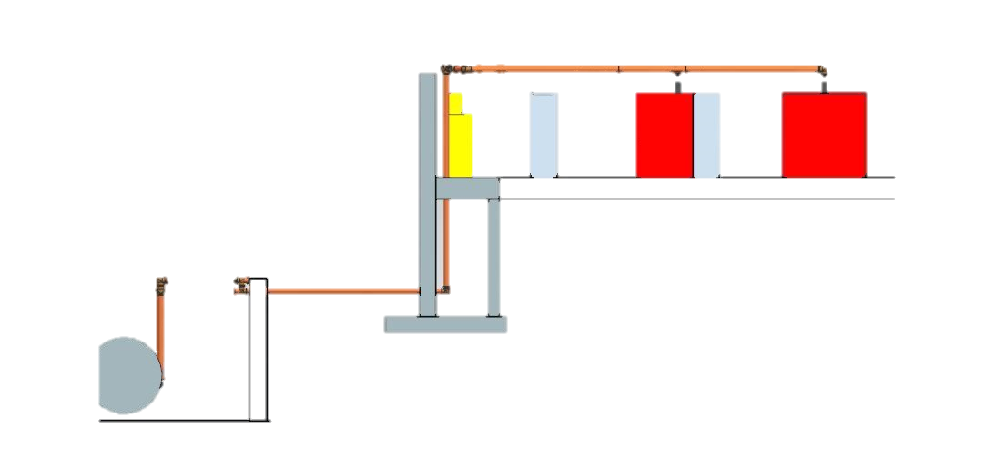
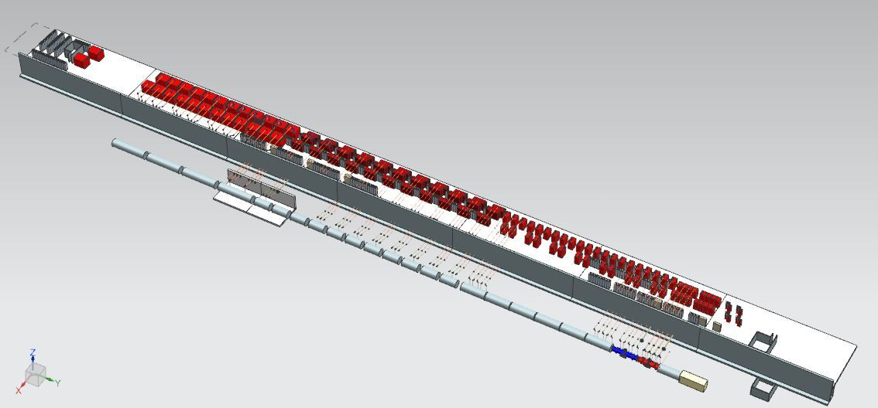
PIP-II: 800 MeV linac surface building cross section
The PIP-II linac will be located in a ~230 m long tunnel ~ 7 m underground
Surface building will house radio frequency amplifier and other equipment
Overall floor surface installation = ~ 5,500 m² over 2 levels
A 300 m long transfer line connects to the Booster
6,6m
3m
800 MeV
HB650
500 MeV
4m
LB650
185 MeV
35 MeV
SSR2
10 MeV
~230 m
SSR1
HWR
2.1 MeV
WFE
Personnel access building on both ends connect the two levels and provides access to the underground installations

Slide 21
Progress: Linac Installation (II)
Charge #1
SC2-Baffes
Linac Installation Process Design
  Installation must be strategically designed for flexibility and tight integration with Conventional Facility work, hardware delivery schedule, and incremental commissioning
  After receiving Beneficial Occupancy (BO) of each area, installation starts
    Alignment network creation
    Installation of cryo transfer line (partially subcontracted)
    Installation of machine component stands
  Followed by accelerator components installation in sections
    WFE
    Superconducting Linac (SCL) - several stages
    Hardware commissioning

Slide 22
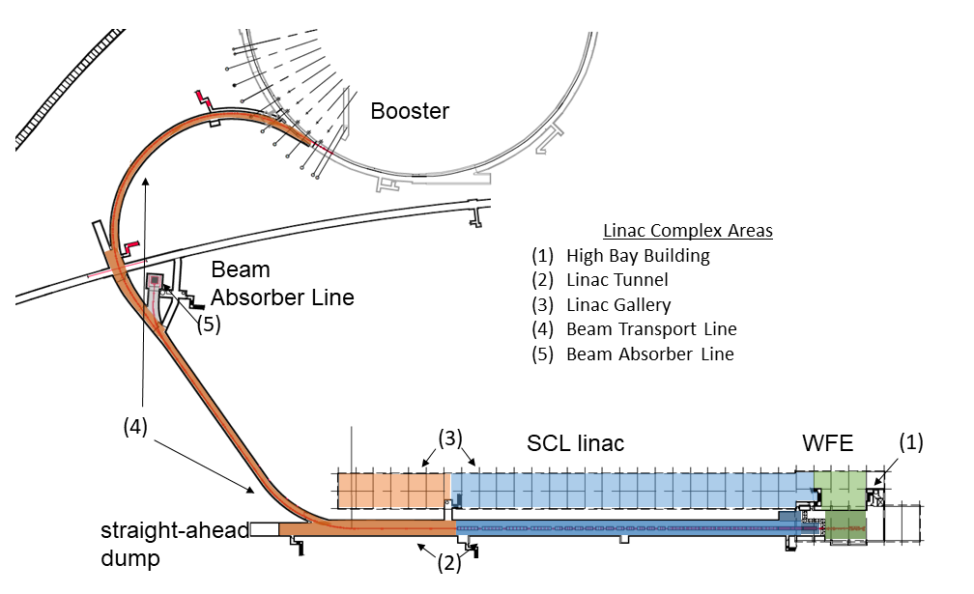
Progress: Beam Commissioning
Charge #1
SC2-Pozdeyev
  Preliminary PIP-II beam commissioning strategy and methodology
    One of the most appealing characteristic of the PIP-II design is that most of the civil engineering work, infrastructure installation and installation of machine components can coexist with ongoing scientific program
    Foreseen staged beam commissioning with installation activities
does not require
program shutdown
      Warm front end (WFE) (2.1 MeV)
      Superconducting Linac – Phase1&2
      Beam transmitted to the straight-ahead dump
      Beam transmitted to the main absorber (BAL)
      Beam transmitted to the Booster injection region
  A concept of how to transition from commissioning to operation has been developed

Slide 23
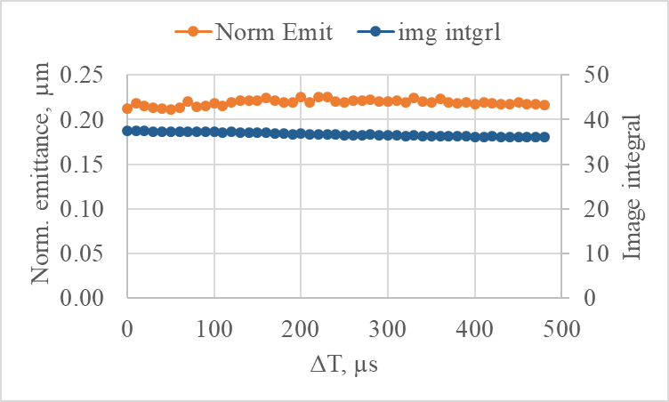
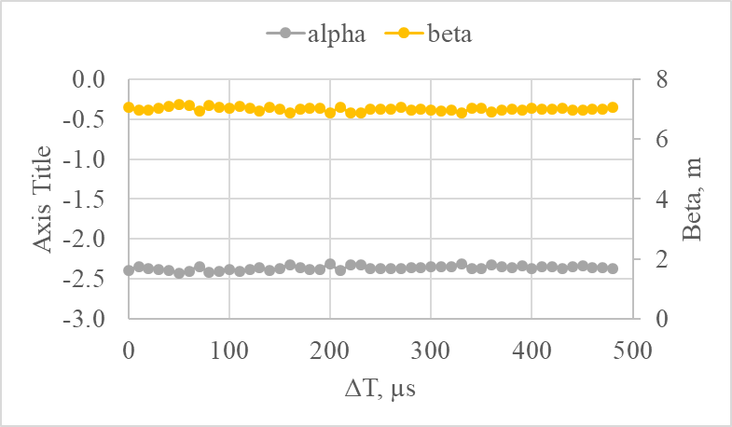
Progress: Beam Commissioning (II)
Charge #1
SC2-Pozdeyev
Preparation for PIP-II Commissioning at PIP2IT
  PIP2IT beam is the precursor for PIP-II beam commissioning plan
    WFE prepares the beam with the proper characteristics
    Goal: accelerate beam through the HWR and protoSSR1 (FY20)
      gain experience accelerating proton beam through superconducting cavities
      understand the beam loss at frequency transition (longitudinal tails)
      develop/optimize LLRF resonance control loops algorithms
      test the MPS compatibility with SRF tolerance
  Apply lessons learned post PIP2IT to further develop PIP-II commissioning
    Review beam commissioning experience
    Review the tools/app./simulations/monitoring required for the commissioning phase
Beam parameters at 10 µs and at the end of a 0.55 ms pulse are the same to within several %
Left – norm. vertical emittance and image integral (proportional to the beam current)
Right – Twiss parameters

Slide 24
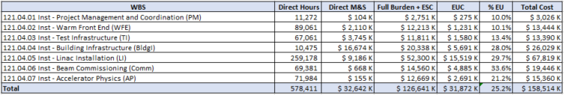
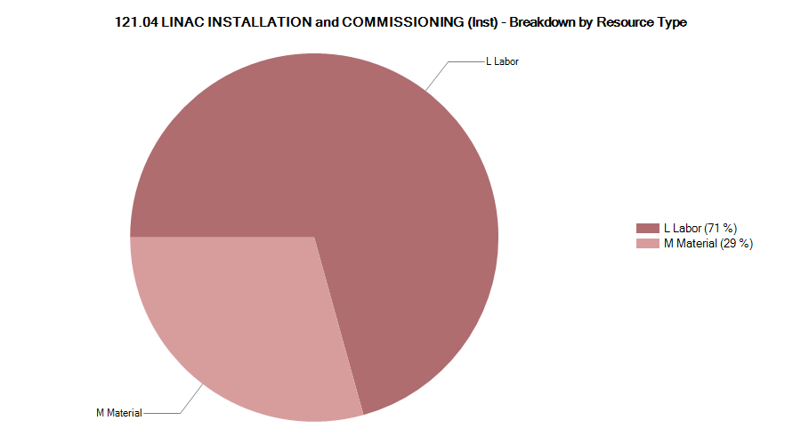
Cost Estimate
121.04 Total
P6 based cost - Managed Amount
Resource Type | Value | %
L Labor | $89,527,669 | 71%
M Material | $37,113,734 | 29%
Notes:
This is an excel format that PIP-II used for a May workshop.

Slide 25
Estimate Quality
Notes:
This is an excel format that PIP-II used for a May workshop.

Slide 26
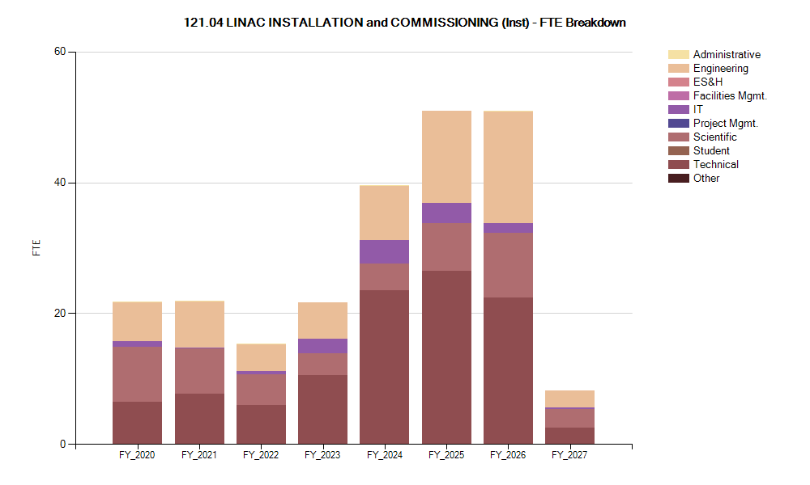
FTE Breakdown
Labor peaks after FY24 associated with installation & commissioning activities
Labor is dominated by engineer, technical skills and scientists
Notes:
This is an excel format that PIP-II used for a May workshop.

Slide 27
Risks and Mitigations
Charge #2,3
Risks reviewed every 3-4 months - formal discussion with risk management team on June’19
9 remaining risks in the risk register
  9 retired risks
Three risks retired on the past year, including 7 medium rank ones
  RT-121-04-004 MEBT scrapers are unable to absorb amount of beam loss – scrapers tested at PIP2IT under conditions well beyond what is needed for PIP-II operations
  RT-121-04-008 MEBT absorber does not meet performance requirement – current design well beyond what is needed for PIP-II operations
  RT-121-04-009 LCW system does not achieve temperature stability requirements – similar LCW system design at CMTF
Remaining Medium rank risks (technical):
  RT-121-04-002 Inst: Machine has performance problems during commissioning
  RT-121-04-003 Inst: Unable to maintain vacuum between MEBT absorber and SRF
  RT-121-04-006 Inst: Late subsystem delivery makes installation less efficient
  RT-121-04-012 Inst: Subsystem or component problem discovered after installation
  RT-121-04-013 Inst: MEBT kickers performance is unsatisfactory

Slide 28
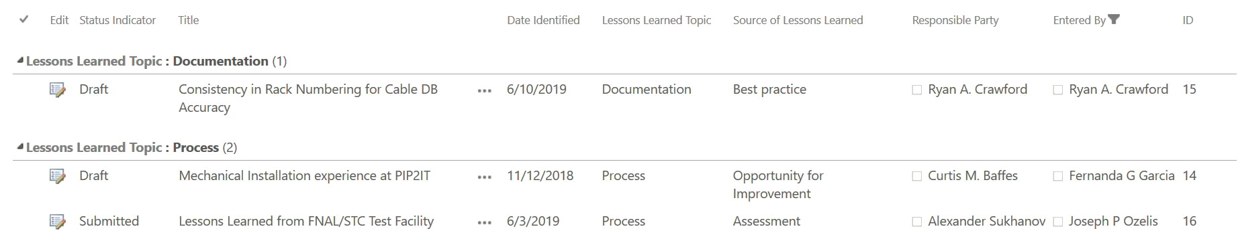
Planning for Quality Assurance/Control (QA/QC)
L2M - QA responsibilities and expectations
  System-specific QA Plan developed
Every L3 sub-systems responsible for creating QC Plans for their deliverables in their scope
  QC will be performed on deliverables from Partners and Vendors
Actively identify, document, and analyze lessons learned related to the System per the PIP-II Project Lessons Learned Procedure
pip2-docdb#2611
pip2-docdb#2964

Slide 29
Planning for Quality Control (QC)
Ensure nonconformances identified within the system are adequately captured and addressed in compliance with the PIP-II Nonconformance Procedure pip2-docdb#3100
Fermilab QC procedures will be developed by L3 Managers in collaboration with SMEs
  The procedures and results are documented in TC
  Assure comparability of results at different stages of QC
QC is a great opportunity to prepare for a smooth transition from design -> fabrication and assembly process -> testing -> installation -> commissioning

Slide 30
Summary
PIP2IT reconfiguration is in progress to receive HWR/protoSSR1 cryomodules
HEBT of PIP2IT design is complete and proceeding to procurement/assembly phase
Advancing design to preliminary stage for both Mechanical and Electrical systems
IC Scope, Cost and Schedule developed and under EVMS control

