Slide 1
Improving Beam Tomography With Deep Neural Networks and Machine Learning
Waltteri Leinonen Supervisor: Kyle Hazelwood
Helen Edwards Intern Meeting
10.7.2019
Notes:
My talk today will cover the basic aspects of my project:
I’ll give a run-down of some background knowledge
I’ll describe what problem I’m trying to solve,
what methods already exist to solve it and
how we intend to improve upon this technology with machine learning

Slide 2
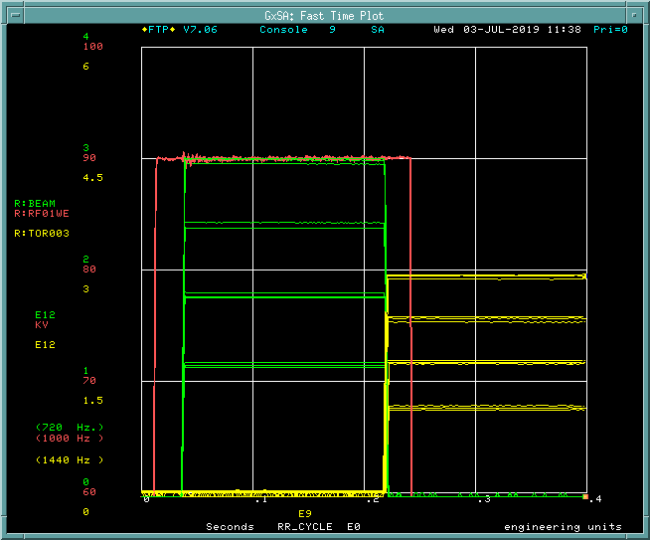
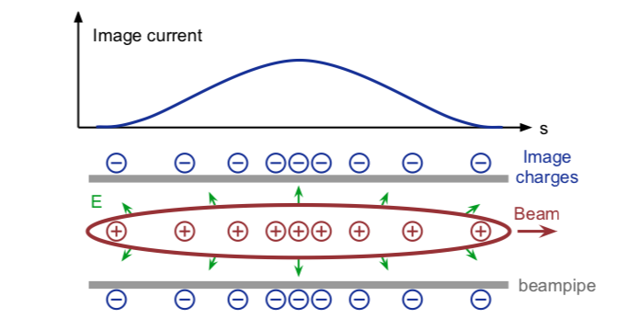
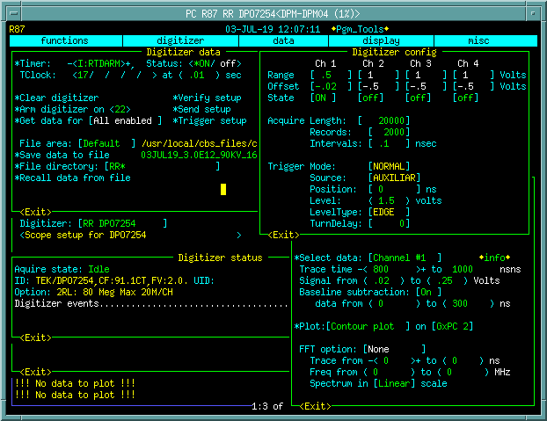
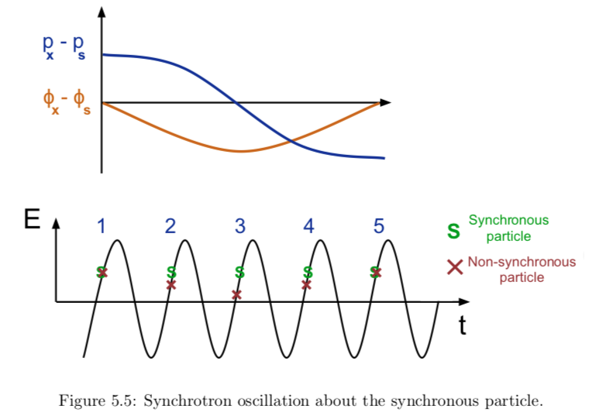
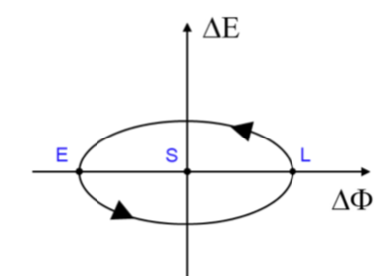
Longitudinal Beam Dynamics
Notes:
1.5 minutes
how bunches form in Booster into RR/MI
RF systems (too early, too late, you get synchrotron oscillation!)
How does this map onto a phase-space diagram?
What happens to this when the bunch is accelerated?
Mention the use of RWCM for longitudinal charge profiles
Bunches from RF Cavity Systems and Injection losses
When we make beam with the Source, LINAC into Booster, and finally Booster into Recycler/Main Injector, they use many RF systems to shape and accelerate these so-called “bunches”.
The Booster is capable of making 88 bunches at 8 GeV that gets injected into RR as a so-called ”batch” of bunches. The process isn’t perfect, in fact it’s a bit messy and a little lossy too, so even after synchronizing and hand-shaking between accelerators, there’s still loss and the bunches don’t all make it in one piece. Bunches can either arrive too early or too late or off-axis, or any combination of these!
What results (longitudinally) is synchrotron oscillation.
Longitudinal beam dynamics refers to the motions of the particles that compose a single bunch. These bunches are rather complicated, consisting of up to 5E12 protons, with a space charge affecting it’s internal dynamics, with a spread of different momenta and positions throughout.
When the bunches get accelerated, this actually corresponds to a ramping of RF voltage and frequency. When this occurs, particles arriving to a RF Cavity early or a little late get accelerated and decelerated respectively. Do it smoothly enough and you won’t lose many.
We measure these bunches shapes and positions using RWCM (resistive wall current monitors)

Slide 3
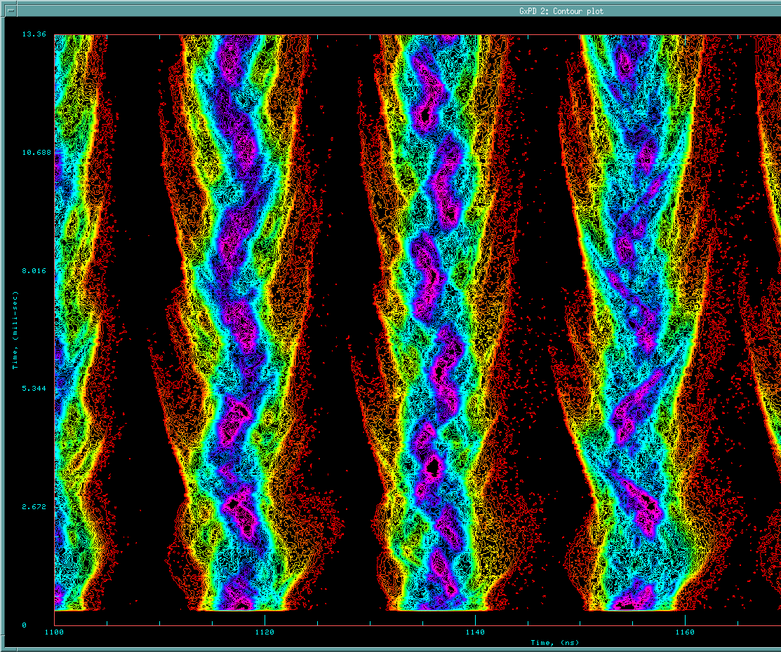
TaRDIS
Longitudinal charge profiles after RR injection
Tomography and Related Diagnostics In Synchrotrons
Tool made in 2014 by Duncan Scott
An application that uses tomography to reconstruct longitudinal phase space distributions from longitudinal charge profiles, provided by RWCM (resistive wall current monitors)
Works slowly, and only for simple cases
Difficult and convoluted procedure!
TaRDIS phase space reconstruction
Notes:
Talk about TARDIS
It was made to use the RWCM data and reconstruct phase-space from tomography algorithm
Slow
Not general
Not proven
This image is a longitudinal charge profile taken by the RWCM. It measures the charge profile after an offset interval of some tens of nanoseconds after a TCLOCK event, capturing the bunches as they pass the same location.
Both axes are in units of time, but you can multiply the bottom axis with the beam velocity to get a displacement in space. Each row of pixels going upward represents a snapshot of the beam charge profile after many many rotations around the Recycler ring.
TARDIS is a tool written by Duncan Scott in 2014. It works by taking the same data that this image captures, preprocessing it, and performing tomography to recreate a phase-space reconstruction.
This problem with TARDIS is that:
It works very slowly, as it is very methodical and programmatic
The algorithm doesn’t work in all cases, and is sometimes inaccurate
The algorithm was made by someone who had an intuition with how Booster/MI/RR worked, and isn’t a generalizable methodology that can easily port over to other accelerators.

Slide 4
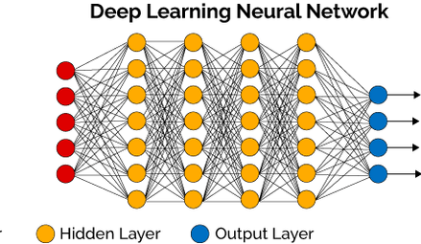
The (nonlinear regression) Problem
?
Above: TaRDIS reconstruction of longitudinal charge profiles
Left: charge profile data of two bunches
Below: matching bunch
Notes:
TARDIS works by taking the data, zooming in on one bunch and analyzing a half of a synchrotron oscillation.
We can do that same thing with the same data, and try another method of constructing the phase-space diagram. Deep Learning Neural Networks.
My supervisor recognized that a neural network would be invaluable in this context, and created a working prototype using a basic NN that he trained using simulated and experimental data. Even with a basic Perceptron, he was able to reconstruct a somewhat blocky phase-space diagram in Java.
I’ll be mainly using Python with Tensorflow, Keras, and perhaps in conjunction with Scikit-Learn to train a NN with at least 1 or 2 hidden layers, as we need the added nonlinearity to work with this problem

Slide 5
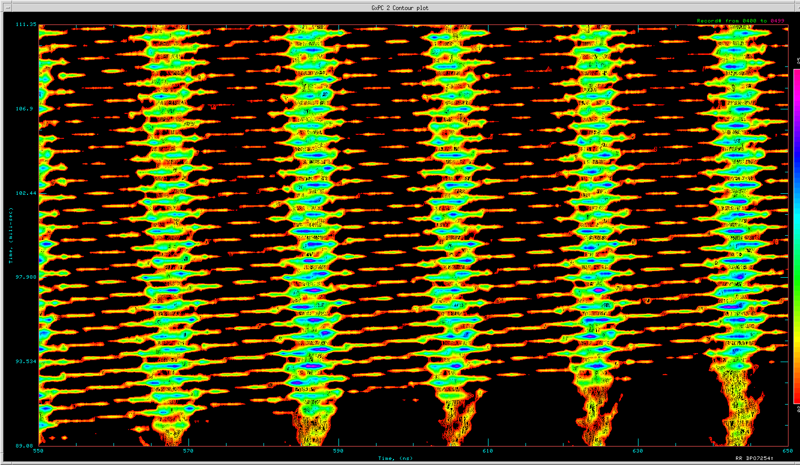
Deep Neural Network (NN) Challenges
The end goal is to create a generalized neural network model (unique to Booster/MI/RR) that is:
Accurate enough to diagnose Booster/MI/RR issues
Fast enough to do this in almost real-time
Capable of more than simple cases
NN
Pssst… Your bunch rotation is off…
Slip stacking in Recycler
Notes:
The end goal is to create a generalized NN, which means that we will train a model that can be plugged into any other program that will be able to accurately predict the phase-space representation of any number scenarios.
Some challenges that still lay ahead:
Creating enough training data to train our NN
Implementing the NN such that it is generalizable
Making a model that can recognize multiple bunches or singular bunches
Making a model that can work in cases with slip-stacking (TARDIS is not able to do this!!!)
We already took multiple GB of test data from Recycler before they powered off last weekend, and are working now to create many different scenarios with BLonD simulation code. Once the training data is in the proper format, the implementation of the NN and training thereof will come next. Finally testing will use the data we collected to test whether it works or not!
No matter what the accuracy, this is an accurate short-cut to the same end result that TARDIS take us to, but potentially generalizable to multiple different scenarios!

