Slide 1

DUNE Project Status
Janet Bishop
DUNE PMG Meeting
July 2019

Slide 2
Outline
ES&H Update
QA Update
PM Update
Schedule & Budget Status
DUNE Update
  FD Engineering
  FD Installation
  FD APA
  FD TPC Electronics
  Near Detector
Upcoming Events

Slide 3
ES&H Update
Completed a site visit of the DUNE APA Assembly area at the Ash River Facility
  Reviewed ESH training and work planning documentation
  Met with the University of Minnesota ESH representative
  Facility inspection of tower, APA & cabling assembly fixtures
Participating in the Operational Readiness Clearance (ORC) for test of the ALICE gaseous TPC readout chamber at the PAB facility
Continue to support the development of the DUNE TDR
DUNE ESH Coordinator integrating with the SP Technical Leads

Slide 4
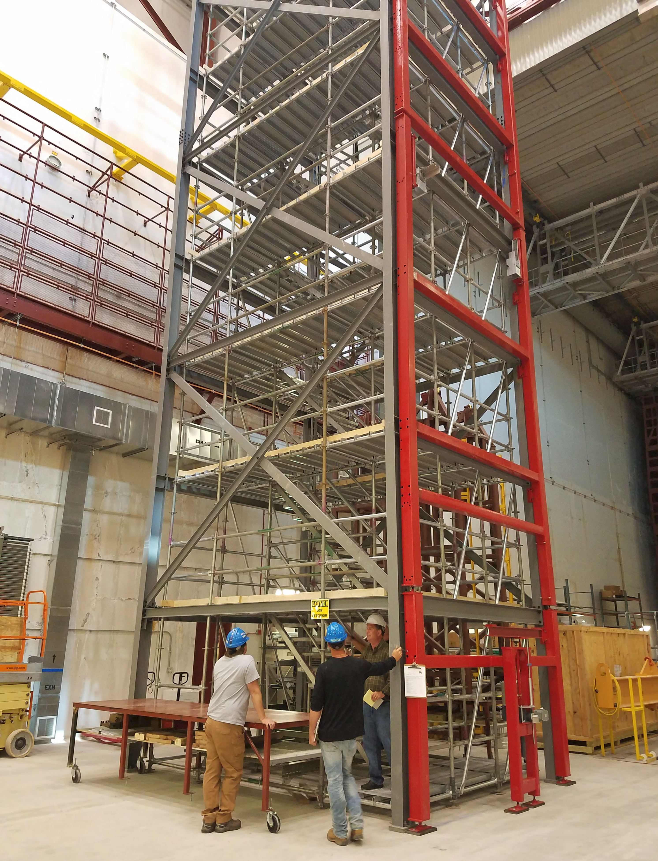
Quality Assurance
  QA Input
  QA Procedures are being uploaded to EDMS for use by the Consortia.
  Provided a response to a comment on the QA/QC Section of the HV TDR.
Participated in the following DUNE Meetings/Reviews
  Performed an assessment of the Ash River APA Assembly Tower regarding design, safety, process control and quality control.
  Weekly Consortia meetings.
  Safety and Quality at the Universities – Discussed QA resources in EDMS, QA Representative responsibilities.

Slide 5

Project Management Highlights
Staffing Update
  Close to assigning a Lead Mechanical Engineer for Far Detector.
Technical Design Report on target for July completion
  Reviewer feedback on the Single Phase and Technical Coordination volumes received later than expected.
  Four of the five volumes (including the Single Phase volume) will be submitted on time; Dual Phase volume will be submitted on Nov 1 to allow data collection from ProtoDUNE-DP.
IPR Preparation & Postponement
  Prepared presentations and did practice talks.
  IPR was scaled back to only Plenary talks.
  IPR was postponed until October 29-31.
Visit to Ash River facility to review Safety & QA of the APA Assembly area prior to Phase I of Prototype testing

Slide 6
Project Management Highlights
Technical Workshops at CERN – June 17-20
  Background Mitigation - reviewed knowledge of sources of radioactivity that may influence low energy physics of DUNE. Further studies and measurements will be done before deciding on a mitigation method.
  Calibration - reviewed possible techniques for calibration on the detector including laser calibration system, pulsed source, and radioactive system. Further analysis and testing during the second run of ProtoDUNE will be done.
  Cryogenic Instrumentation - Discussion around the appropriate level of instrumentation for DUNE-SP as well as plans for ProtoDUNE-2 and ProtoDUNE-DP.
  Double Drift Task Force - presented the risk and possible cost savings for increasing the single phase drift length in ProtoDUNE-SP and DUNE-SP.

Slide 7
DUNE Milestones
T2: Federal Project Director
T3: Fermilab Directorate
T4: Project Director
T5: L2 Manager
T6: CAM
 | May 2019 P6 Update | June 2019 P6 Update | Variance | Comments
Completed In June 2019
None
Planned for Completion July – September 2019
T4 MS - Stakeholders Written Approval of 100% FSCF Final Design Documents | 7/26/2019 | 7/26/2019 | - | On track
T4 MS - Interface Agreement with all Detector Subgroups Complete | 8/20/2019 | 8/20/2019 | - | On track

Slide 8
DUNE Stop Light Report
Overall, the performance is within acceptable range however, issues being masked are:
Underspend on CPA/HV & ND tasks (mostly labor) and technical coordination activities under-earned in May were corrected in June.
Overspend and schedule delay on TPC Electronics due to delays in ASIC design and testing followed by delays in FEMBs, lifetime tests for ASICs, and system tests.

Slide 9
Far Detector Engineering
DUNE General
  Working with Consortia to complete Consortia-to-Consortia and Consortia-to-Facility Interface Control Documents (ICDs). All documents are placed in the CERN Engineering & Equipment Data Management Service (EDMS). Mandate is to have versioned document set released by end of July along with TDR.
  Responding to LBNC comments regarding the DUNE Technical Coordination TDR volume.
DUNE Detector component integration and mechanics
  Continue to develop drawings for Consortia-to-Consortia interfaces; Vic Guarino (ANL) is helping to lead this effort along with Kyle Zeug (PSL), Manhong Zhao (BNL) and others.
DUNE Detector Electrical/Electronics
  Continued a series of meetings with the new DAQ Consortia leaders on issues relating to the Surface Computer Room, Underground DAQ Room and main fiber trunk runs. Some new requirements have been identified and we continue to work through implementation details.
  Working with LBNF and SURF to refine and agree to final implementation of production fiber optic trunk runs through both the Ross and Yates shafts and the surface termination points.
  Continue working with Calibration Consortia leads to understand new calibration systems being proposed (laser, neutron source and radioactive source).

Slide 10
Far Detector Installation
Interface Control Documents
  The ICDs between the consortium and installation are being revised.
  An action item list is being generated with an interface drawing list.
TDR
  Comments from the internal reviewers and Mont have been received. No comments from the other LBNC reviewers are available. The TDR chapter is being revised based on the comments in hand.
Cost Estimating
  Work on revising the cost estimates to reflect the changes in underground configuration and WBS are beginning. An initial update is expected in August.
IPR preparation
  The installation talk for the IPR was prepared and the practice talk given.
Inventory Management system
  On track to deliver ahead of fabrication.

Slide 11
Trial Assembly at Ash River
Installation Prototyping Phase 1 – Focus on the development of the APA assembly and cabling process including handling and transport of the APAs
Two APAs, APA assembly frame, associated hardware arrived at Ash River in June. APA assembly frame installed. Final components will arrive by end of July.
Mechanical and electrical reviews of engineering drawings and notes are underway
  Most review documentation is posted on EDMS
  Missing documentation for review will be posted soon
Electrical wiring for the actuator is being contracted.
Minor design change to the assembly tower to add a few diagonal braces to minimize movement in the North/South direction.
Start of testing targeted for early August.

Slide 12
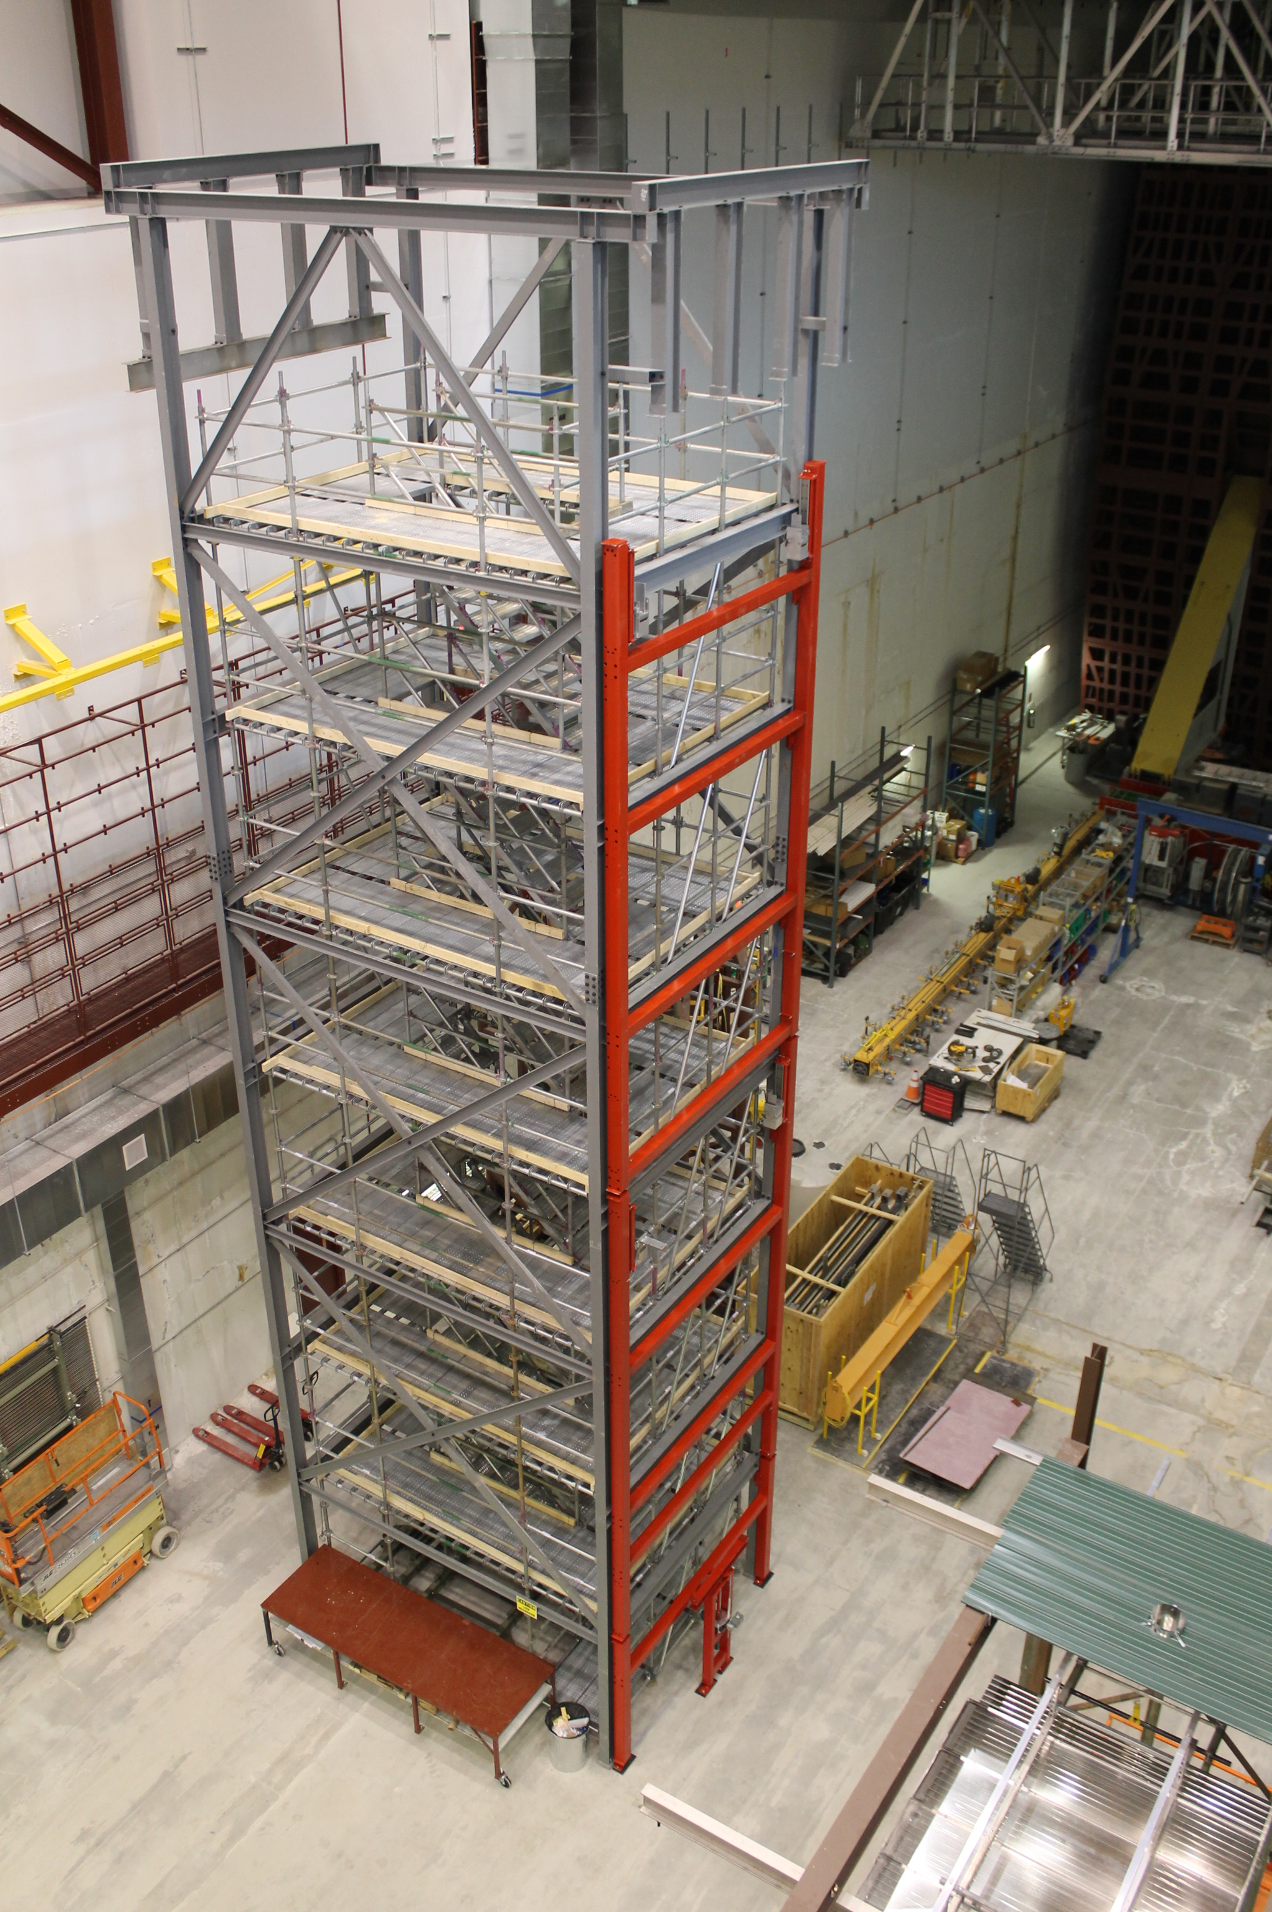
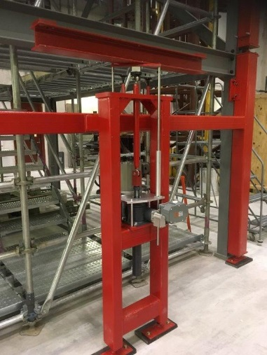
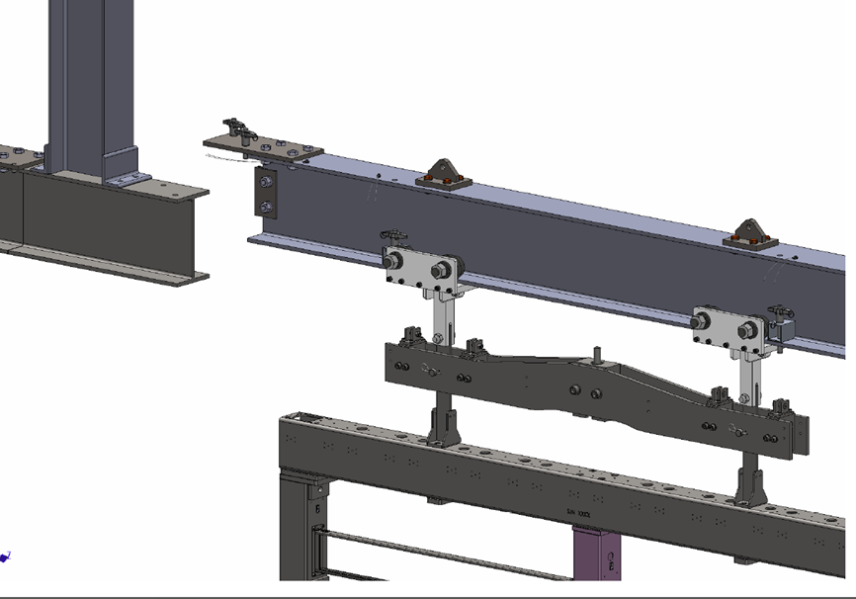
FD APA
PSL- Ash River test of APA Doublet
  APA assembly fixture successfully installed
  Yoke, APA link, and modified cable conduits and stabilizer pins to be shipped to Ash River by end of July
  New lifting beam design has been completed, built at Ash River
  Need to complete electrical wiring for actuator
  DUNE ES&H group visit at Ash River on July 8-10
  Engineering notes being completed and under review
Ladder frame
Actuator stand
Lifting beam

Slide 13
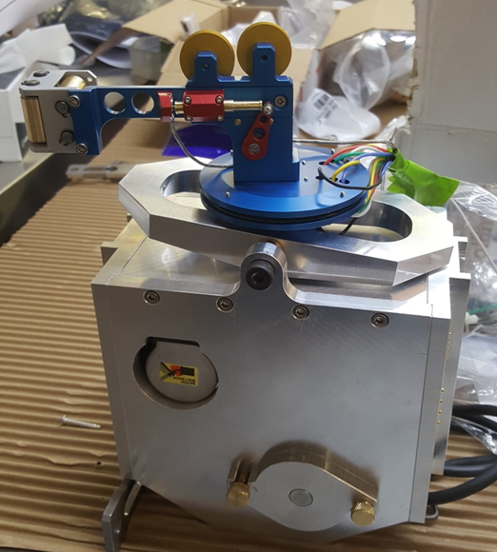
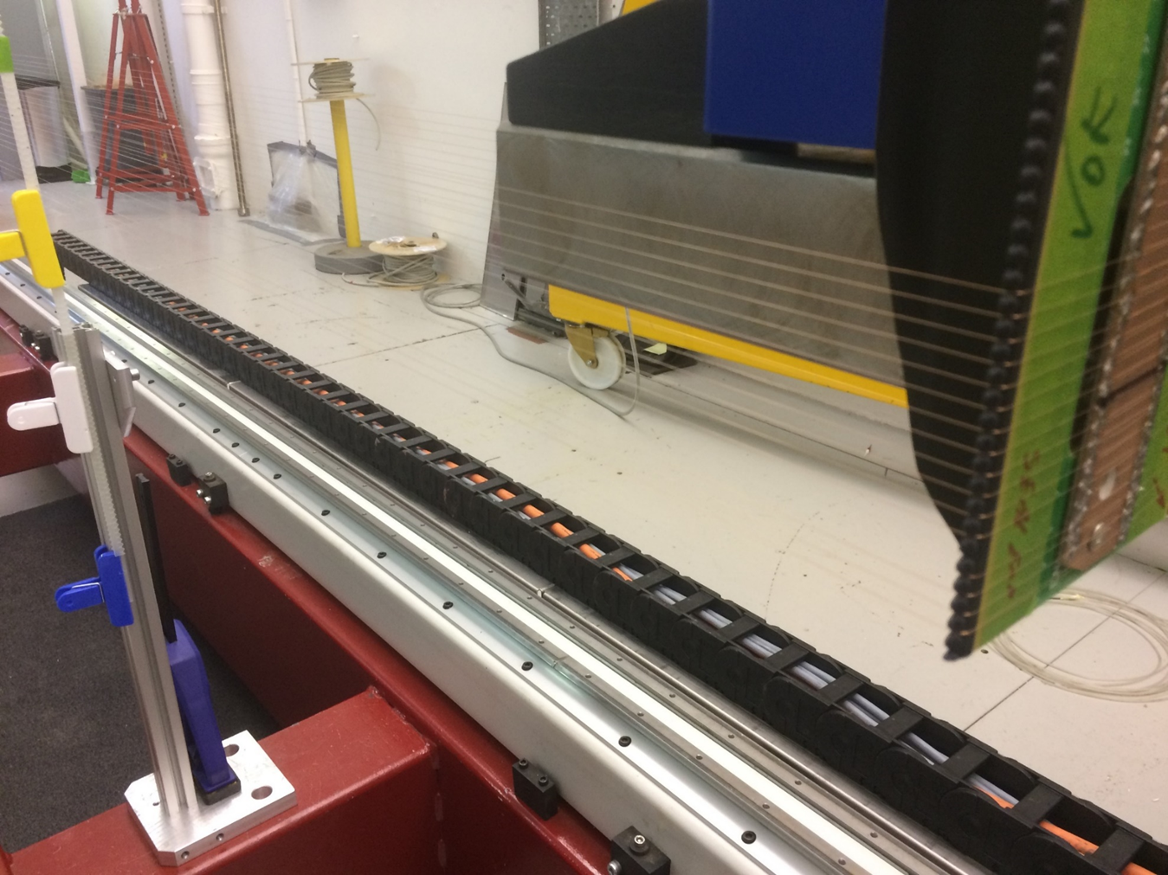
FD APA
TDR preparation
  Consortium wide effort for the final TDR release.
Analysis and simulation
  Electron diverters task force reports on July 1 and 8.
  Final report being completed.
Activities at Daresbury
  Production site: ready for installation of jib cranes
  (on order, ~4 weeks delivery time)
  First winding tests with the updated winding head,
  with wire wrapping around
  Seen problems with maintaining wire tension
  at low motor speed (AC motor)
  Next step: test a DC motor (motor and drive
  system on order) or introduce gearbox

Slide 14
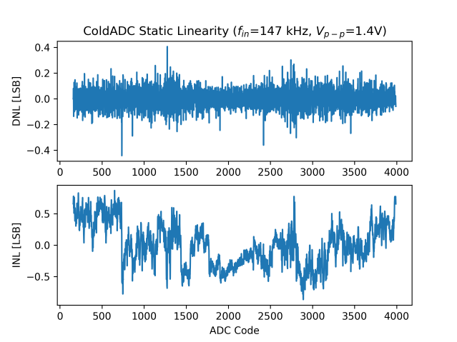
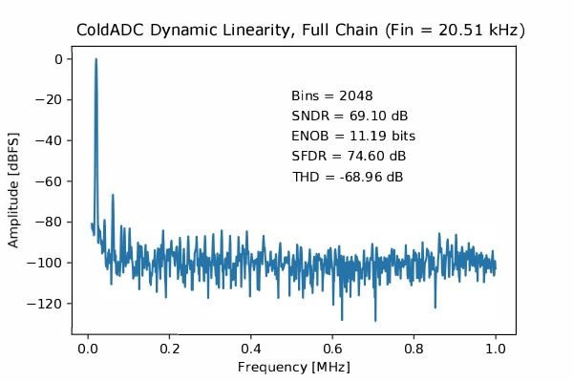
TPC Electronics – ASICs (i)
Testing of ColdADC completed
  Packaged chips have been received, will calibrate ~140 ADCs for installation on FEMBs (120 required)
  Identified (but not yet fixed) reason for malfunctioning of calibration engine
  Demonstrated that insufficient open-loop gain of operational amplifier in the pipeline engine is reason for residual non-linearities
  Excellent performance (ENOB over 11 bits)

Slide 15
TPC Electronics – ASICs (ii)
Testing of CRYO continues
  Static linearity measured (ENOB 10.6 bits), but when moving to measurements of dynamic linearity and to characterization of front-end observe extra noise in the chip
  Noise does not disappear completely when additional capacitors are applied on LDOs and input 2.5V supply, ENOB reduced to 10 bits
  Observe common-mode noise between different channels
  When common-mode noise is subtracted the residual noise is factor 2 larger than expected
Noise Floor
DC input @ middle range (~1.25V)
Spurs are visible even w/o signal (supply, Vref, pickup?)

Slide 16
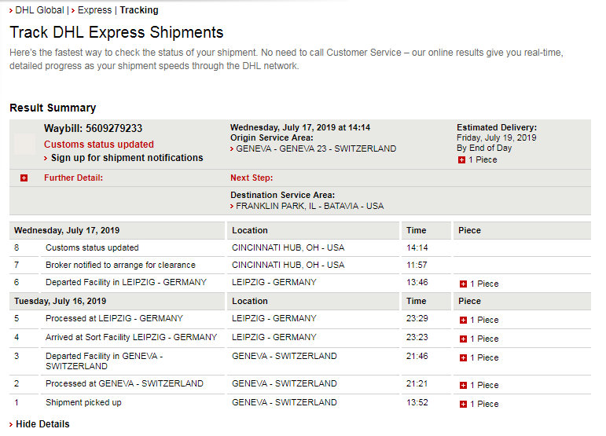
TPC Electronics – ASICs (iii) / FEMBs
COLDATA is coming
  Will be delivered at the beginning of next week
We are getting ready for testing
  Test PCBs in fabrication
  Have National Instruments tool on loan, should consider purchasing one
FEMB design for ColdADC+FPGA
  Almost ready to fabricate first boards, will then proceed with order for 15-20
  Will move onto design of FEMB with ColdADC + COLDATA
FEMB design for CRYO
  Design exist, will use nEXO version of chip (may be delayed due to noise issues)

Slide 17
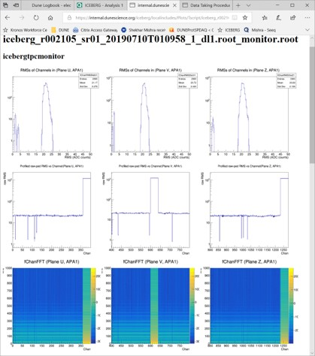
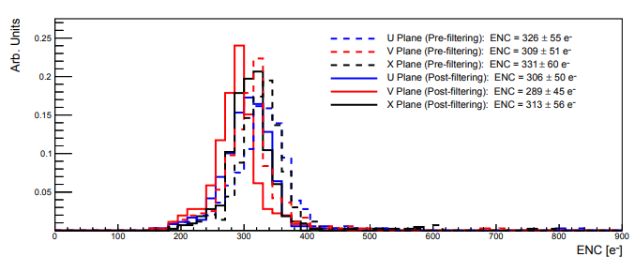
TPC Electronics – ICEBERG
Small TPC in ICEBERG cryostat operated without problems for 1 week
  Pressure regulation still requires work, still managed to avoid bubbling over periods of ~ 1 day
  Unattended operation overnight
  No sparking
  9/10 FEMBs operational
  Solved noise cross-talk between TPC electronics and photon detector
  Purification system still needs to be upgraded, poor lifetime (still we manage to observe tracks in first day)
  Cryostat has been emptied, will work on pressure regulation, purification system before next run

Slide 18
TPC Electronics – Other
TDR
  Almost complete, need to update a few figures
Interface documents
  Continuing to develop these
Other design activities
  Forming a working group for the Warm Interface Board, have preliminary design of new WIB, will be needed for system tests with CRYO / COLDATA (late Fall, mostly firmware work required)
Preparation for the next review
  Need to update all BoEs and schedule

Slide 19
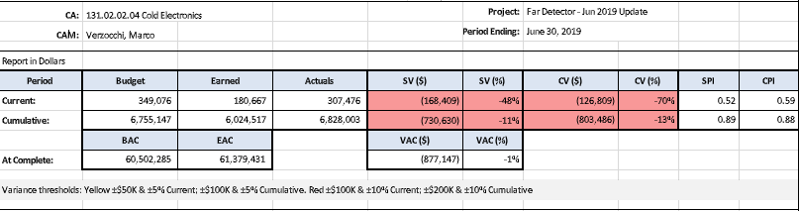
TPC Electronics – VAR (i)
TPC Electronics has spent $803k more than planned and has a delay of $731k
  Roughly 4 months delay
Cascade effect of delays in ASIC design and testing followed by
  Delay in FEMBs
  Delay in lifetime tests for ASICs
  Delay in system tests (also external reasons, cold box at CERN not available because personnel working on Dual Phase, problems with ICEBERG and small TPC)

Slide 20
TPC Electronics – VAR (ii)
Lessons learned
  First design iteration of ASICs requires at least factor 2 more resources
  Will not increase resources for 2nd iteration (part of the ColdADC redesign already done during testing)
  CTC structure not optimal for understanding cost differences (will become more complicated when more institutions are active, discuss whether to restructure again)
Impact
  Delay does not have impact on project due to large float, may impact ProtoDUNE Run 2
  Not expecting ASICs costs to grow further
Corrective actions
  Some corrective actions taken in past months (additional ASIC design resources, postponed some system testing)
  Some delay of system & lifetime tests, FEMB should have been inserted in a schedule via BCR prior to the beginning of EVMS

Slide 21
Near Detector
Recent Activities:
  ND LArTPC:
    Revising WBS Dictionary based on discussions with contributing institutions
    Elaborating resource estimates for expected US Project scope
    ArgonCube 2x2 Demonstrator:
      Working with partners to refine plan for detector deployment in NuMI near hall
      Submitting procurement for mid-scale (~11k parts) LArPix-v2 pixel ASIC production
  MPD:
    Working with NDDG, others to establish staging concept within US Project Plan
    Exploring interim muon spectrometer options: magnetized range stack, KTeV magnet
    Next ND Workshop: Week of Oct. 21 @ DESY (Hamburg), emphasis on MPD
  Beam Monitor:
    Adapting design to accommodate Italian contribution of KLOE superconducting magnet and calorimeter
Next steps:
  Elaborate US Project roles in staged Near Detector plan
  Complete ‘bottom-up’ resource estimate based on detailed WBS activity breakdown
Issues:
  Clarify scope/interfaces of ‘Near Detector’ with ‘Installation and Integration’
    Understand implications for planning process

Slide 22
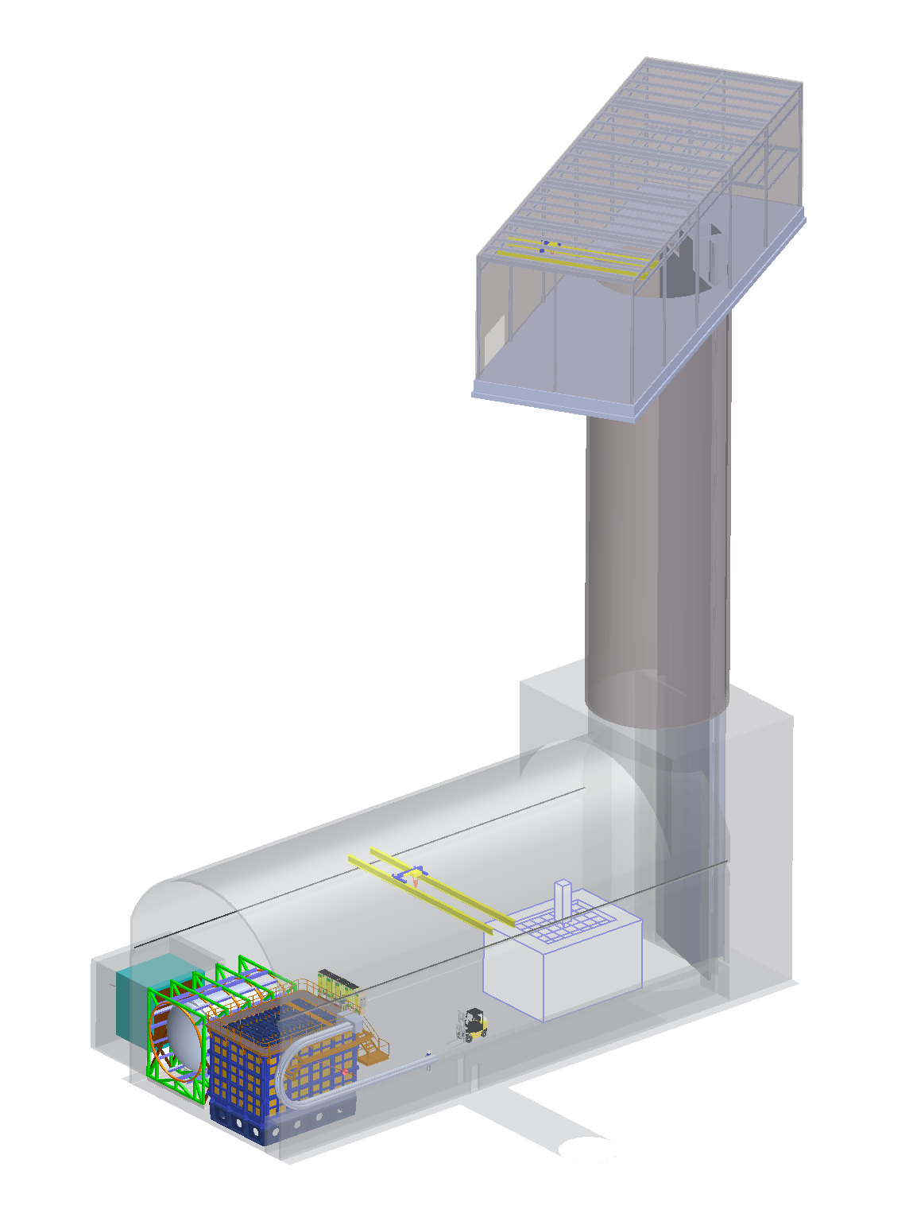
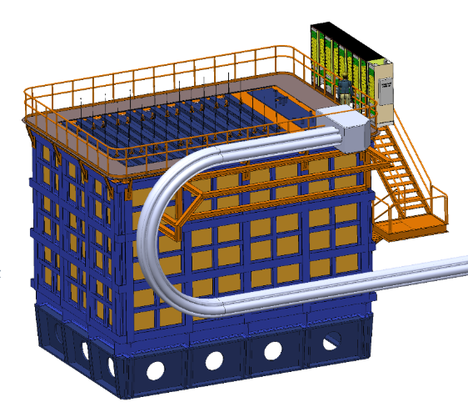
Near Detector
Design Updates (M. Leitner, et. al.)
  Near Site:
    Upper hall reconfigured and realigned
    Next steps: defining utilities, refinement of shaft-side of cavern
  ND LArTPC:
    Many refinements, including PRISM support frame, mezzanine, racks, cryogenic ducts, stairs
    Next steps: space allocation for cyrogenic equipment, further cavern integration
ND LArTPC
Near Site

Slide 23
Upcoming Events
LBNF/DUNE Meetings with DOE – July 23-24 at Fermilab
LBNC Meeting – July 31 – August 2 at Fermilab
Installation/Integration Workshop – August 19-21 at SURF
DUNE Collaboration Meeting – September 23-27
LBNF/DUNE IPR – October 29-31

