Slide 1
Core Campus Revitalization Project (CCRP)
Mission Validation Independent Review
Overview: Fermilab Campus Infrastructure Planning, CCRP Context
Karen Kosky
Head, Facilities Engineering Services Section

Slide 2
Presenter Introduction
Karen Kosky
Head, Facilities Engineering Services Section
20+ years experience managing facilities, environmental, sustainability programs
3 years Fermilab, 6 years Federal Government
Part of team revitalizing Fermailab’s infrastructure planning processes
Section includes Engineers, Project Managers, Facilities Operators, Utilities Managers, Service Contract Managers, Roads & Grounds, Personal Property Managers

Slide 3
Agenda - Today
Fermilab Campus Infrastructure Planning, CCRP Context K. Kosky
CCRP: Accelerator Controls Modernization D. Nicklaus
CCRP: Technology Campus Modernization A. Grassellino
CCRP: Wilson Hall Restoration K. Kosky

Slide 4
Presentation Outline
Fermilab Campus Infrastructure Planning, CCRP Context K. Kosky
Mission Need
  Campus Information
  Mission, Strategy, Capabilities, Gaps
Program Requirements
  Infrastructure Planning
Cost Range & Schedule
  Path Forward

Slide 5
Charge Questions
Mission Need
Is the documentation adequate to confirm that a specific capability gap, risk, and/or impediment exists to the execution of Office of Science mission?
Program Requirements
Are high-level requirements sufficiently defined to identify preliminary alternatives to address the capability gap, risk, and/or impediment? Are the preliminary alternatives reasonable for this stage?
Cost Range and Schedule
Are the preliminary cost range and preliminary schedule reasonable for this stage of the project? Does the cost range bound the preliminary alternatives deemed to be viable? Is planning for this project being appropriately coordinated to ensure that it does not interfere with ongoing operations or projects?

Slide 6
Mission Need
Mission Need
Fermilab will demonstrate adequate documentation to confirm that a specific capability gap, risk, and/or impediment exists to the execution of Office of Science mission
The mission of SC is to deliver the scientific discoveries and major scientific tools that transform our understanding of nature and advance the energy, economic, and national security of the United States.
SC accomplishes this mission through direct support of research, construction and operation of national scientific user facilities, and the stewardship of ten world-class national laboratories.

Slide 7
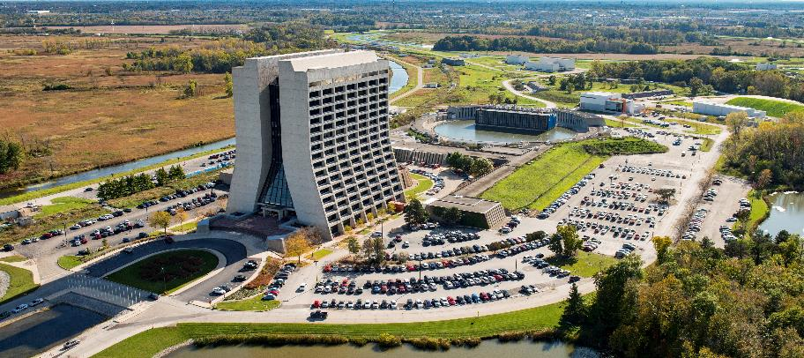
Fermilab at-a-glance
Basics
  Location
  Batavia, Illinois
  Type
  Single-program laboratory
  Contractor
  Fermi Research Alliance LLC
  Responsible Site Office
  Fermi Site Office
  http://www.fnal.gov
Physical Assets
  6,800 acres (10 mi²)
  366 Buildings
  2.4M GSF
  $2.21B Replacement Plant Value
  22,155 GSF in Leased Facilities
  15-30 Bison
Human Capital
  1,782 FTE
  21 Joint Faculty
  95 Postdoctoral Researchers
  73 Undergraduate Students
  30 Graduate Students
  3,635 Facility Users
FY 2018 Costs ($M)
  Lab Operating
  $437.41
  DOE
  $435.55
  SPP (Non-DOE/Non-DHS)
  $1.87
  SPP as % Total Lab Operating Costs
  0.4%

Slide 8
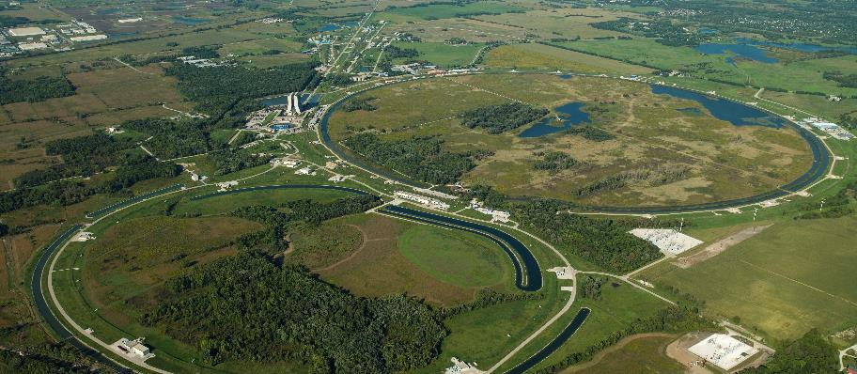
Fermilab – International Hub for Particle Physics
Fermilab’s employees and users drive discovery in particle physics by building and operating world-leading accelerator and detector facilities, performing pioneering research with national and global partners, and developing new technologies for science that support U.S. industrial competitiveness.

Slide 9

Fermilab Science Strategy Aligned With the P5 Plan
The ten-year goal of Fermilab’s science strategy is a world-leading neutrino science program anchored by the Long-Baseline Neutrino Facility (LBNF) and Deep Underground Neutrino Experiment (DUNE), powered by megawatt beams from an upgraded and modernized accelerator complex made possible by the Proton Improvement Plan II (PIP-II).

Slide 10
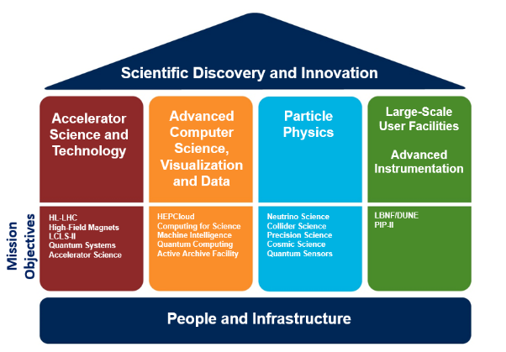
Fermilab Core Capabilities
Mission Need
Combined with expert staff, cutting-edge facilities, reliable infrastructure, and a global network of collaborators, these capabilities help Fermilab discover and innovate.
Core
Capabilities

Slide 11
Infrastructure – Gaps by Core Capability and Mission Objectives
Mission Need
Campus Need / Gap | Top Mission Objectives Affected | Infrastructure Solution
Reliable utility service and capacity for laboratory expansion | All mission objectives; sitewide impacts | Utilities Infrastructure Projects (Central Campus Infrastructure, Utilities Upgrade 2.0)
Accelerator science and technology facilities | Accelerator Science LBNF/DUNE PIP-II LCLS-II, LCLS-II HE | Accelerator Controls Modernization*, Center for Accelerator Science and Technology*, Utility Corridor GPP, Master Substation Feed GPP*, Industrial Building Retrofit GPP*
Sufficient space in the Central Campus to co-locate engineers and technicians from geographically dispersed facilities | Quantum Systems, Quantum Computing, Quantum Sensors Collider Science LBNF/DUNE | Technology Campus Modernization*, Integrated Engineering Research Center, Core Campus Parking GPP*
Office, meeting and collaboration space for staff, users and collaborating institutions | All mission objectives | Wilson Hall Restoration*, Wilson Hall Modernization
Detector science and technology facilities | Neutrino Science, Precision Science Collider Science, Cosmic Science LBNF/DUNE | Technology Campus Modernization*, Utilities Upgrade 2.0*
High bay assembly and production facility | HL-LHC AUP | Technology Campus Modernization*, Industrial Center Building Addition GPP
Overnight accommodations for short-term visitors | All mission objectives | Hostel*
*Proposed
Core Capabilities: Accelerator Science & Technology | Advanced Computer Science | Particle Physics | Large-Scale User Facilities
Notes:
In second example, include technology campus scope of work
Say that this includes both proposed and existing projects

Slide 12
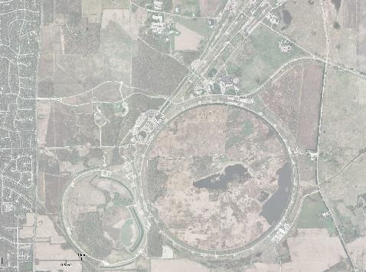

Fermilab Campus Infrastructure Investments
“Building for Science”
Mission Need
Infrastructure Investments
Neutrino Detector Buildings (GPP)
Muon Detector Buildings (GPP)
UUP 1.0 (SLI)
Wilson Hall Floor 13 & Ground Floor Modernization (SLI GPP)
Industrial Center Building-Addition (GPP)
Integrated Engineering Research Center (IERC) (SLI)
PIP II (HEP)
Utility Corridor to Accelerator Campus (GPP)
IB-4 Retrofit and Cleanroom (GPP)
Core Campus Parking – East (GPP)
11. Master Substation Electrical Feed to Accelerator Campus (GPP)
12. Long Baseline Neutrino Facility (HEP)
Key
Completed
In-Process
Proposed
3
9
5
4
6
11
1
10
2
7, 8
12

Slide 13
Program Requirements
Program Requirements
Fermilab will demonstrate definition of high-level requirements with preliminary alternatives which address the capability gaps and risks; Fermilab will explain that preliminary alternatives are reasonable for this stage.
Alternatives Identified at CD-0:
Alternative 1 - Maintain status quo. This approach would continue operations without providing additional investment and the impact to the SC mission will be assessed.
Alternative 2 - Recapitalize and modernize existing infrastructure. This approach would recapitalize sitewide controls infrastructure and modernize facilities and infrastructure to meet mission need.
Alternative 3 – Recapitalize and construct a new facility(ies) to replace existing infrastructure. This approach would recapitalize sitewide controls and recapitalize select site facility infrastructure while also constructing new building(s) to meet the mission need.
Alternative 4 – Recapitalize infrastructure including exploring funding partnership options. This approach would recapitalize controls and site infrastructure and would evaluate potential funding partnerships to subsidize specific elements of the project.

Slide 14
Alternatives Identification – Infrastructure Planning Fermilab Campus Master Plan
Campus Master Plan is Fermilab’s plan to support SC’s future science mission though the built environment
Sets a vision from which specific infrastructure initiatives are developed and executed

Slide 15
Fermilab Campus Infrastructure Planning
Program Requirements
Campus Facility Planning Board
Wilson Hall
Technology Campus
Site Utility & Central Plant Infrastructure
Lab-Executed Tasks
General Plant Projects
Accelerator Controls
Condition Assessment Surveys
Resilience, Energy Planning
ESH Assessments
Regulatory Requirements
New Mission Requirements
Lab Initiatives
Risk-Based, Prioritized List of Laboratory Needs
Projects Integration
Campus Master Plan ● Sustainability Plan ● Parking Plan ● Facility Annual Plans ●
Infrastructure Prioritization
Space Management
Parking

Slide 16
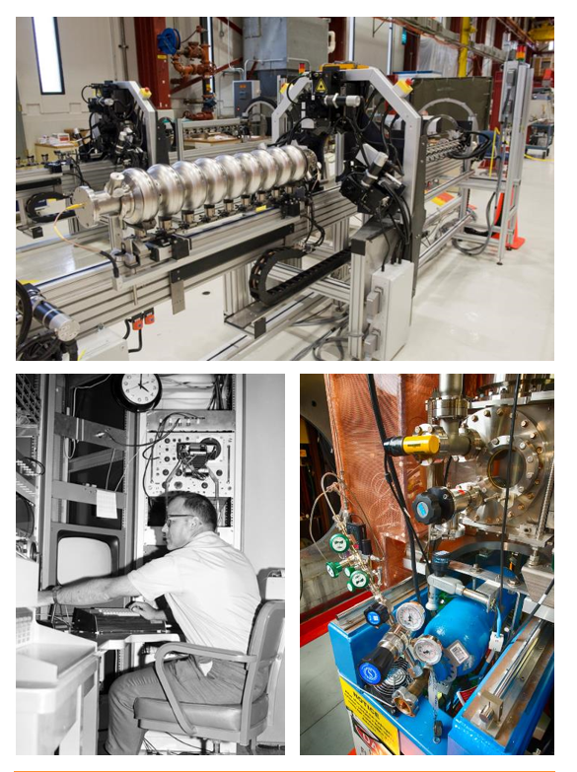
CCRP - Accelerator Controls Modernization
Fermilab Accelerator Controls Modernization supports the future of Fermilab's accelerator capability by recapitalizing critical accelerator support systems and controls-supporting infrastructure.
Key Points
Replace Sitewide Accelerator Controls System Consistent with PIP II Controls Technology
Modernize Radiofrequency Systems, Instrumentation, Power Supplies and Other Supporting Infrastructure
Core Capability |  | Mission Objectives Supported
Accelerator Science & Technology |  | High-Field Magnets; Accelerator Science
Advanced Computer Science
Particle Physics |  | Neutrino Science; Collider Science; Precision Science; Cosmic Science
Large-Scale User Facilities / Advanced Instrumentation |  | LBNF-DUNE; PIP-II

Slide 17
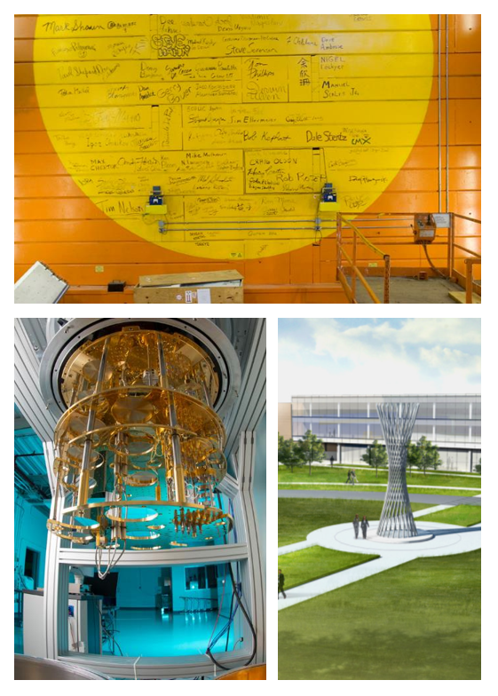
CCRP - Technology Campus Modernization
Fermilab Technology Campus Modernization supports the future of Fermilab's technological, computing, and detector development processes and production capability by developing and recapitalizing critical support infrastructure.
Key Points
Develop Superconducting Quantum Technology Center
Revitalize Existing Industrial, Detector and Computing Buildings
Streamline Technology and Detector Research Development Processes
Consolidate and Modernize Superconducting Technology Facilities
Core Capability |  | Mission Objectives Supported
Accelerator Science & Technology |  | HL-LHC; High-Field Magnets; LCLS-II; Quantum Systems; Accelerator Science
Advanced Computer Science |  | HEPCloud; Computing for Science; Machine Intelligence; Quantum Computing; Active Archive
Particle Physics |  | Neutrino Science; Collider Science; Precision Science; Cosmic Science; Quantum Sensors
Large-Scale User Facilities / Advanced Instrumentation |  | LBNF-DUNE; PIP-II

Slide 18
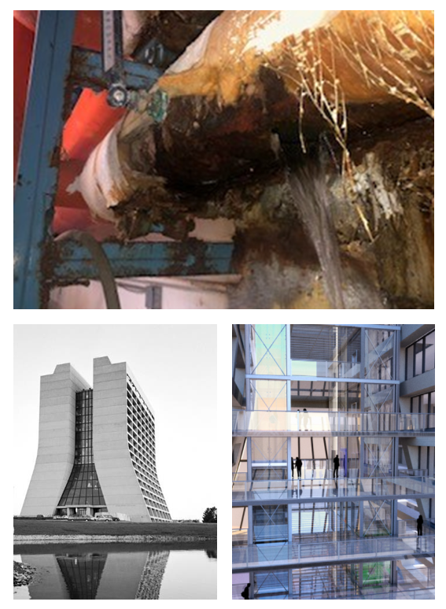
CCRP - Wilson Hall Restoration
Wilson Hall is an iconic 45 year old DOE facility and home to 40% of Fermilab's staff. The facility, constructed using unique and frugal techniques, requires significant recapitalization to make relevant for another fifty years of science discovery and innovation.
Key Points
Recapitalize Utilities – HVAC, Water, Wastewater, Electric
Mitigate Envelope Deficiencies – Windows, Concrete
Improve Life Safety - Elevators, Fire Protection
Modernize Floors
Improve Campus Entrance/ Wilson Hall Approach
Core Campus Parking West
Interface with Adjacent Core Campus Projects
Failed hot water pipe in 2019 caused near shutdown of Wilson Hall
Core Capability |  | Mission Objectives Supported
Accelerator Science & Technology | 
Advanced Computer Science | 
Particle Physics | 
Large-Scale User Facilities / Advanced Instrumentation | 
All Capabilities Supported

Slide 19
Cost Range and Schedule
Cost Range and Schedule
Fermilab will demonstrate that the preliminary cost range and schedule are reasonable for this stage of the project and that the cost range bounds the viable preliminary alternatives; Fermilab will additionally describe the coordination efforts for this project which will ensure that it does not interfere with ongoing operations or projects.
Rough order of magnitude estimates consistent with 413.3 DOE Cost Estimating Guide
Parametric, expert opinion, trend based estimates
DOE Cost Estimating Guide, 413.3, Table 4.4
DOE Cost Estimating Guide, 413.3, Table 4.2
Notes:
This overall funding profile includes potential
Is flexibility which will be presented in future presentations; some project elements are tied to campus dependencies, some are flexible with start & cadence

Slide 20
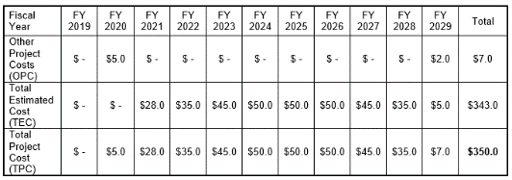
Cost Range and Schedule
Cost Range and Schedule
Fermilab will demonstrate that the preliminary cost range and schedule are reasonable for this stage of the project and that the cost range bounds the viable preliminary alternatives; Fermilab will additionally describe the coordination efforts for this project which will ensure that it does not interfere with ongoing operations or projects.
Funding Profile ($M)
Profile for single CCRP project moving forward
10-year profile accounts for staged scope starts & long-range infrastructure needs
Notes:
This overall funding profile includes potential
Is flexibility which will be presented in future presentations; some project elements are tied to campus dependencies, some are flexible with start & cadence

Slide 21
Next Steps
Infrastructure Projects Advisory Group
Staffing
Interim Project Director: Kate Gregory
Interim Project Manager: Karen Kosky
Developed a staffing resource outlook
Submitted requisitions to recruit project staff
Prepared for CD0 to CD1 A/E staffing augmentation using existing subcontract vehicles
Programming
Programming from CD0 to CD1 to include
  Condition Assessments
  Analysis of Alternatives
  Conceptual Designs
Develop acquisition strategy for A/E for post-CD1 work

Slide 22
Conclusion
Building for Science: 21st Century Facilities for 21st Century Science
Questions?
Executing goals of P5 Plan
Building for Science; preparing for the next decade of innovation
Infrastructure planning processes yield comprehensive, risk-based, prioritized initiatives with flexible execution schedules
Aggressive next-steps: planning to prepare for CD-1 opportunity based on HEP guidance
NEXT UP
3 CCRP Initiatives
Accelerator Controls • Technology Campus • Wilson Hall
Notes:
Technically Limited Schedule

