Slide 1
TPC electronics:
update on the next short term activity
ICARUS WA104 Meeting July 17th 2019
Notes:
1

Slide 2
Next short term activity at FNAL
Starting from July 24th an intense 10 days intervention on the TPC electronics is planned to install cables on the top of the detector and to refurbish some defective module.
At the same time an intense activity is planned finalized to better understand the origin of the limited excess of noise measured on mini-crates.
In addition a working station, will be assembled (at D0?) in order to test anomalous CAEN board if/when required.

Slide 3
Installation activities
In the first couple of days, some repair action will be performed on the spare mini-crates and PS modules in order to allow an easy replacement if required:
One PS: a missing 5V module will be installed.
One PS: one defective 12V module will be replaced.
On the two mini-crates backplanes need to be replaced.
Moreover some missing dummy front panels will be installed to close some mini-crates already installed on the T600 top.
A fully equipped test station of flange feed-through, cables, mini-crate, DBB boards will be installed (at D0 ?) for the check the CAEN boards functionality.
According to the foreseen cable delivery on July 26th, the following cables will be connected to each mini-crate:
Two SHV-SMA cables for wire biasing on the standard mini-crate;
One SHV-SMA cable with one splitter for each mini-crate on the corners.
One Lemo cable for TTLink to each mini-crate.

Slide 4
Tests on the problematic crates
Since beginning of June, different tests have been performed to understand/solve the evident excess of noise visible in :
4 “standard” mini-crates EE08, EE12, EE18 and WW18
5 “corner” mini-crates EW20Top, WW20Top, EE01Middle, EW20Middle, EE20Middle where the RMS exceed 10 #ADCs in few boards;
Main focus was on the “corner” chimneys, where the replacement of ~10 boards allowed to solve the most noisy crates, avoiding the flange opening.
Besides the more comfortable situation, some extra noise is still present in few flanges requiring additional studies and tests:
Tests have to be performed with the latest on-line DAQ working version;
The online TPC signals monitoring while we collect the data is required to directly access in "real time" wire signal waveforms and then measure noise and pedestals per board or per crate.
Slide# : 4

Slide 5
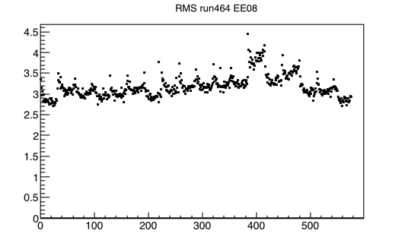
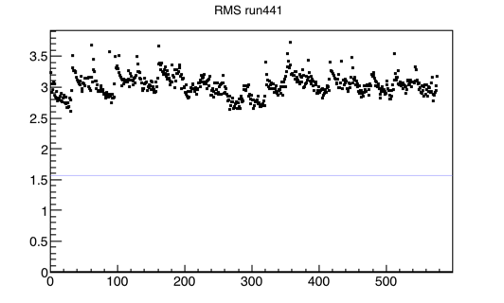
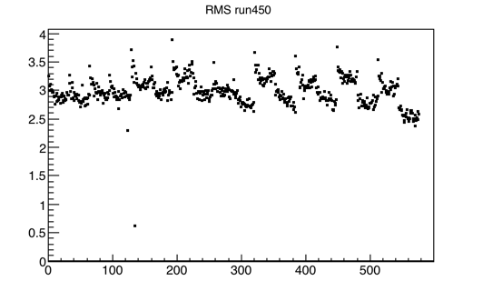
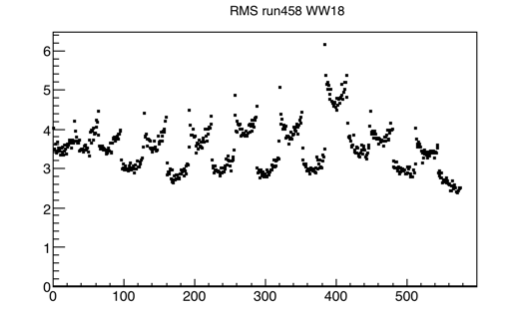
Standard mini-crates: remaining issues
RMS (#ADC)
RMS (#ADC)
Crate EE12
Crate EE08
channel
channel
RMS (#ADC)
RMS (#ADC)
Crate EE18
Crate WW18
channel
channel
Slide# : 5

Slide 6
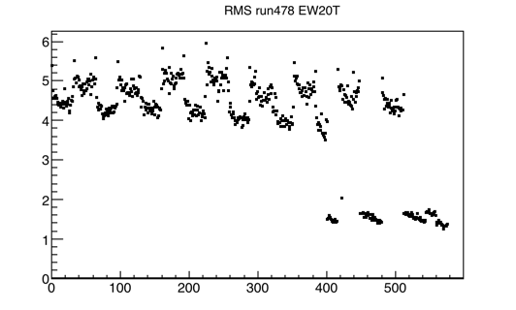
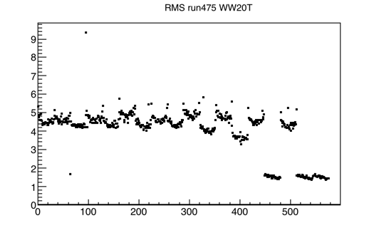
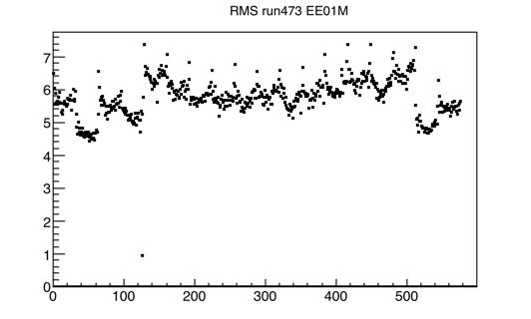
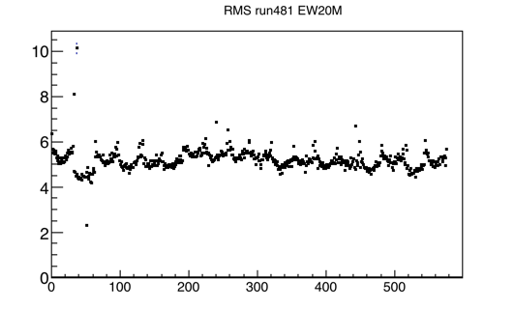
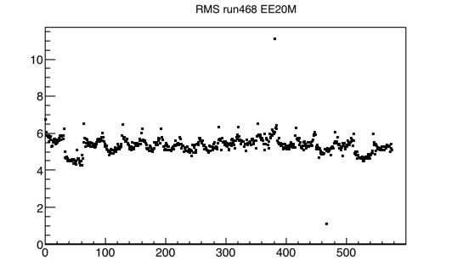
Corner chimneys: to be further investigated
RMS (#ADC)
WW20Top
RMS (#ADC)
EW20Top
not used channels +15 chs flat cable cut
not used channels
channel
channel
EW20Middle
RMS (#ADC)
RMS (#ADC)
RMS (#ADC)
EE20Middle
EE01Middle
channel
channel
channel
Slide# : 6

Slide 7
Correlated noise
The average noise level in the corner chimneys results ~ 5 #ADC, higher with respect to the “standard” chimneys (~3÷3.5 #ADC).
In all flanges (standard and corner chimneys) is also evident a correlated noise that is enhanced in the corner flanges. This problem must be cured working on fine tuning on grounding.
This might be an issue given to the permanent mixing of building and detector grounding.
channels
channels
ticks
ticks
Top
Middle
Slide# : 7

