Slide 1
Simulating Qubit Interactions Using Multimode Cavity-QED
Soumya Shreeram
Helen Edwards Summer Intern
Week 4 meeting: Project Overview (18 July 2019)
Supervisors: Yu-Chiu Chao, Alexander Romanenko

Slide 2
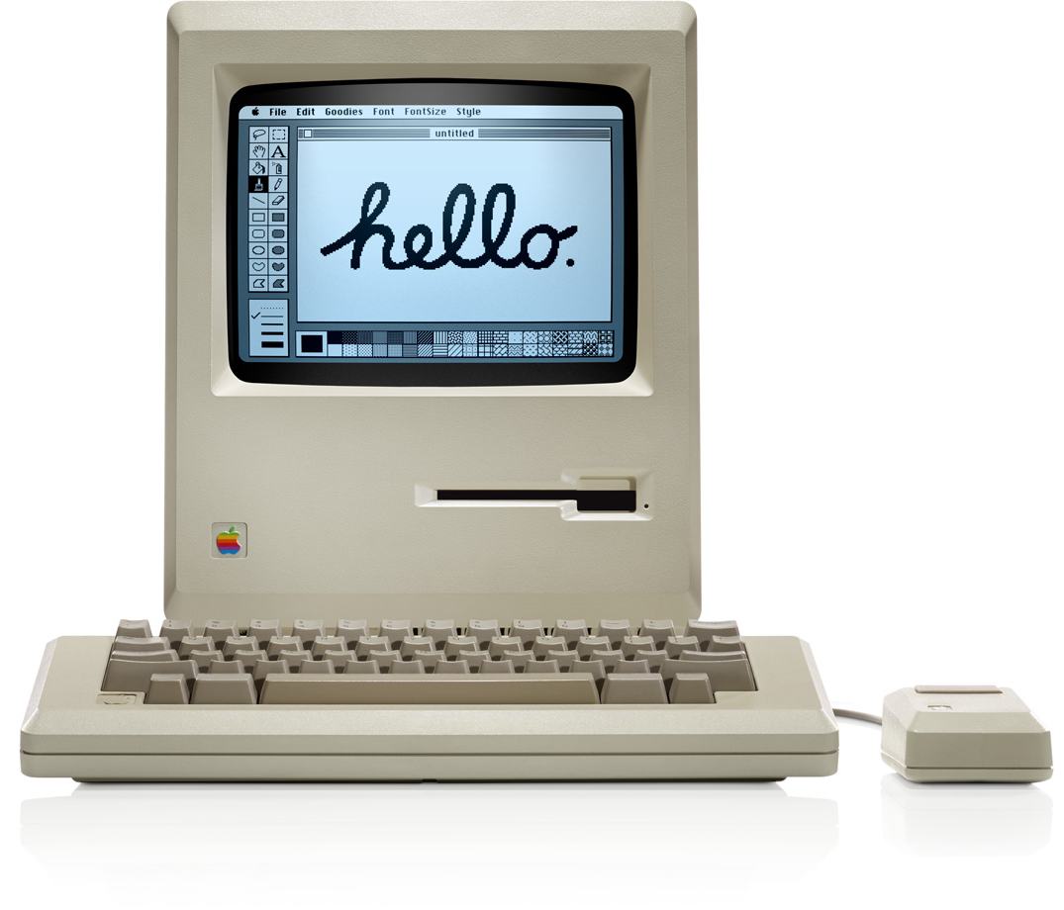
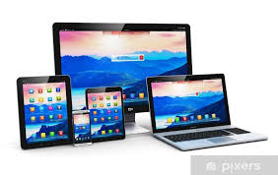
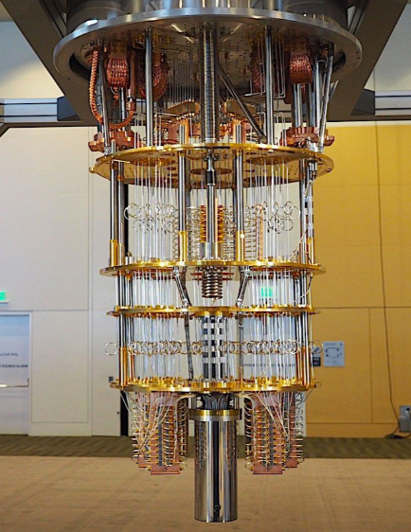
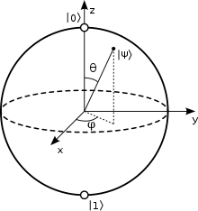
Quantum Computing
Bit
0
1
0
1
Qubit
$$|\left.1\right\rangle$$
Photons,
Quantum dots…
$$|\left.0\right\rangle$$
Ion traps E.g. Be atoms
$e^{−}$, atoms
Superconducting circuits
Photon courtesy: IBM
Notes:
Classical computers -> “Brain” are transistors. Information stored in bits.
Quantum computers :
Benefits: machine learning, quantum mechanics understanding, faster – but also larger and not very compactible atm.
Qubits:
Spin Up-Down: electrons, nuclear spins, neutral atoms
Superconducting circuits:
Ion traps
Photons, Quantum dots, etc,

Slide 3
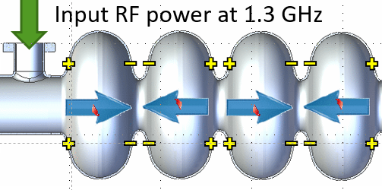
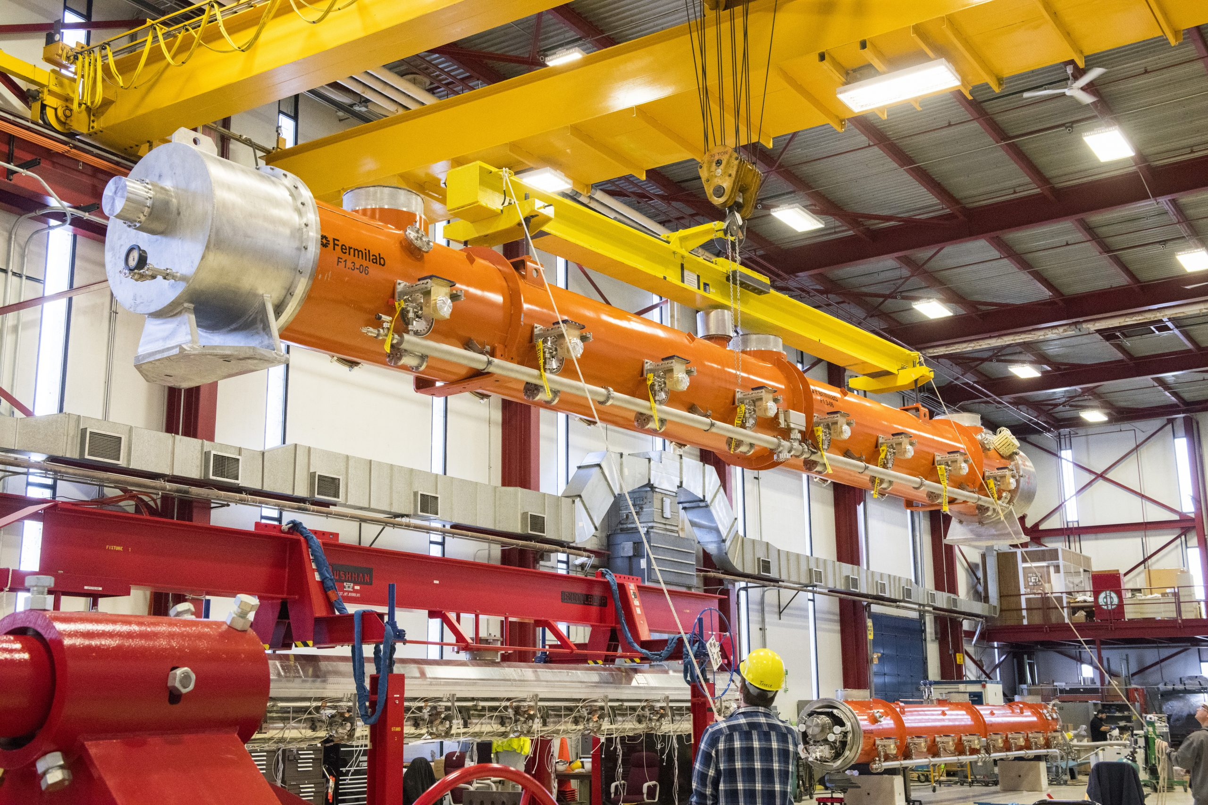
Limitations:
Decoherence $(τ)$: System decays with time due to external environment
Spontaneous emission
Scattering/collisions (dephasing)
Prospective solutions:
Multi-mode Superconducting RF (SRF) cavities:
Particle physics: High $Q>{10}^{10}$
Quantum computing: $τ≈2$s at $T<20$mK
Cryomodule testing at Fermilab (APS-TD)

Slide 4
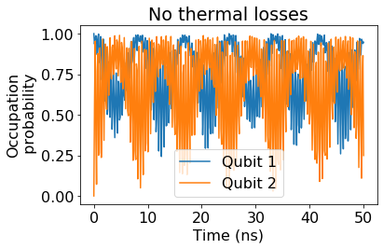
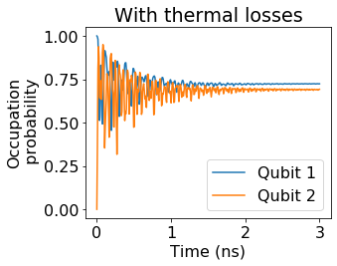
Aims of the project:
Setting up QuTip environment for quantum information studies.
Simulate multimode cavity-qubit system for the 2D and 3D case:
Explore the effect of controlled gates on the above 2 systems
Notes:
Quantum logic gates are a quantum circuit operating on a small number of qubits.
They are reversible
Building blocks of quantum circuits

Slide 5
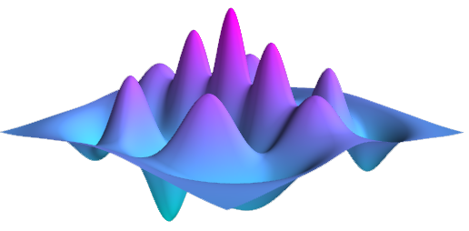
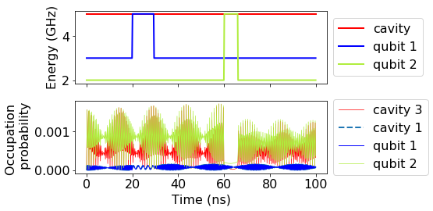
Objectives and Timeline
Setting up QuTip, Learning C-QED…
Coded the Hamiltonian for a 2 qubit – 3 cavity system
Evolve such a system with time
Explore other Quantum control gates (McKay et al 2017)
Find physical solutions
Expand the code to even more cavities (Leung et Ial. 2018)
Wk 1 | Wk 2 | Wk 3 | Wk 4 | Wk 5 | Wk 6 | Wk 7 | Wk 8 | Wk 9 | Wk 10
Simulating the effect of transformation (gate) on the system
Using to simulate system coupling
Modelling parameters for 3D cavities

