Slide 1
TSD Update
Robert Zwaska
TSD Topical Meeting
25 July 2019

Slide 2
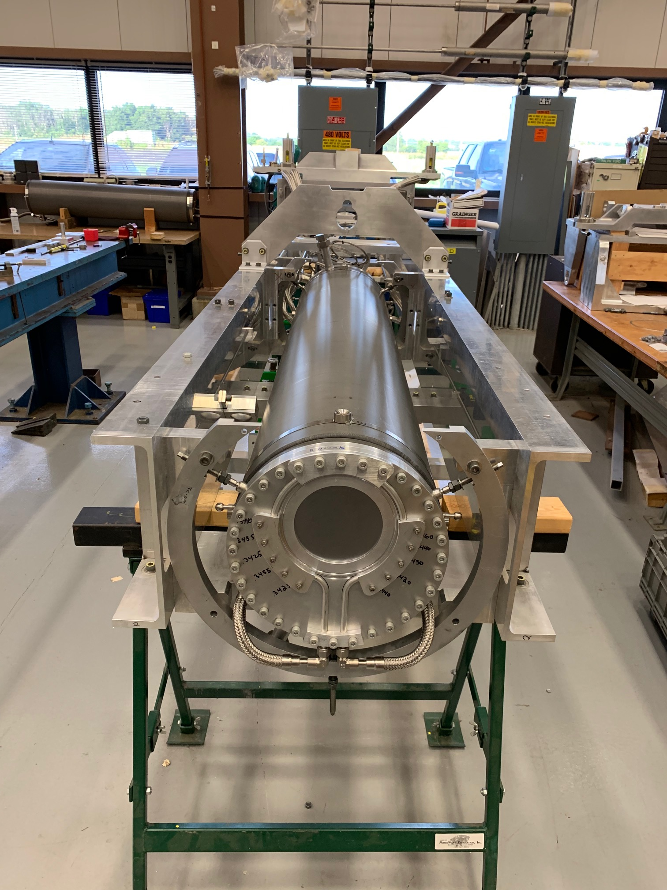
A busy Summer
Guests from RAL here
Middle of shutdown
TA-02 moved to C0!
Megawatt target to be installed to NuMI
And many other jobs
Target investigations at AP0
Projects grinding ahead

Slide 3
AD Budget Info
AD Operations has been short in FY19
Not going to receive any further supplements
Division/Lab actions
Supply more project labor
Continue to squeeze M&S
Modified run plan – beam off for 9 days / on for 5
Near Hiring Freeze
End of year will be interesting
FY20 is looking better, but the pressure won’t relent until it is a sure thing

Slide 4
Performance Reviews
The 2019 Performance Review cycle is underway
June 3rd – July 5th
Self-evaluations open in FermiWorks
Workday Demos and goals assistance by HR Partner
Mid-July
Job change info must be completed in FermiWorks by July 19th
Manager evaluation due by July 31
Goal setting discussions begin for 2020
August 9th
Performance reviews submitted for final approval
September 24th – November 1st, 2019
Performance reviews are finalized and ready to be viewed by employees and managers for discussion
Overall laboratory payscale increase determined early September

Slide 5
TSD Activities
LDRD (Laboratory-Directed Research & Development)
Proposals are encouraged
ldrd.fnal.gov/
TSD LDRD Workshop August 8, 1:30 pm, Penthouse
One-page Preproposals due Aug 30
TSD All-Hands Meeting
August 20, 1pm, Location TBD
Department has grown – reintroduce our people and work
All employees, full-time contractors should attend!
Affiliates, visitors are welcome

Slide 6
Laboratory Climate Survey
Initial evaluation survey a few months
Thanks for participating!
Now lab has collected suggestions and has groups to recommend actions to manage
Thanks to those who volunteered for these groups!
Expect to be asked for more input
This process may affect the way the lab works
Expect this process to iterate – there will be more surveys, on about an annual basis

