Slide 1
Hall Reference Design
Near Detector Integration & Installation
Matthaeus Leitner
6th DUNE Near Detector Workshop at DESY
Oct. 20-23, 2019

Slide 2
Outline
Near Detector Integration and Installation Scope ^{(*)}
Detector Details
Cavern Requirements
Cavern Size Discussion
Schedule
Next Steps
Summary
^{(*)} LAr US-scope as well as Near Site LBNF scope details are not discussed

Slide 3
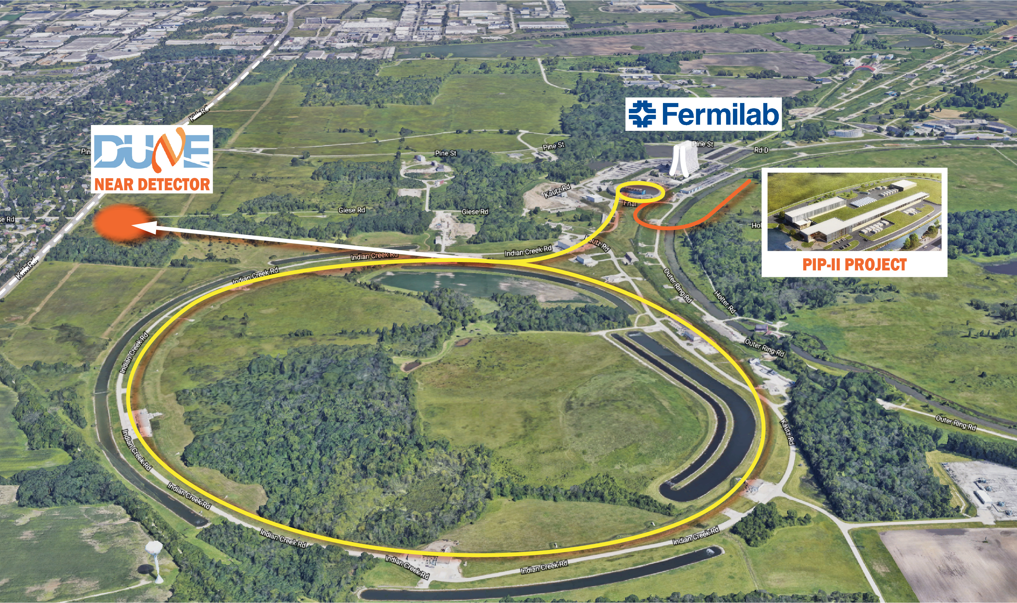
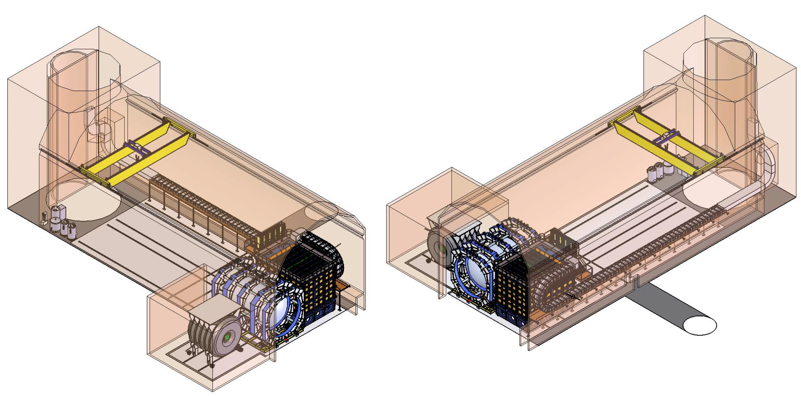
DUNE Near Detector (ND) Scope And Reference Design
LAr Detector
300 t High Purity Liquid Argon
Pixelated Readout Electronics
Removable Detector Segments
MPD Detector
Superconducting Magnet (0.5-0.7 T)
425 t Calorimeter
Pressurized Argon Gas TPC
KLOE-3DST Detector
Superconducting Magnet (0.6 T)
100 t Calorimeter
3DST, TPC or Straw Tubes
PRISM
Up To 30 m Detector Travel
Off-Axis Beam Measurement

Slide 4
US Is Strongly Committed To DUNE Near Detector:
Budgeted Cost ~$150M Plus Contingency
LBNF
  Cavern large enough to accommodate full ND reference design
  Surface building
  Main power distribution infrastructure
  LHe cryoplant procurement
LAr US Scope
  Cathode and Field Cage, Charge Readout, Module Integration
DUNE Near Site Integration & Installation
  LAr cryostat procurement cost
  LAr cryogenics procurement cost
  PRISM movement system and cable chain (incl. prototypes)
  KLOE cryogenic distribution system procurement cost
  Support for detector installations
  Surface cryogenics (LAr and LHe)
  Cavern preparation plus installation tooling and equipment
  Cavern infrastructure (local power distribution, cable ways, cabling)

Slide 5


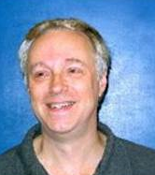

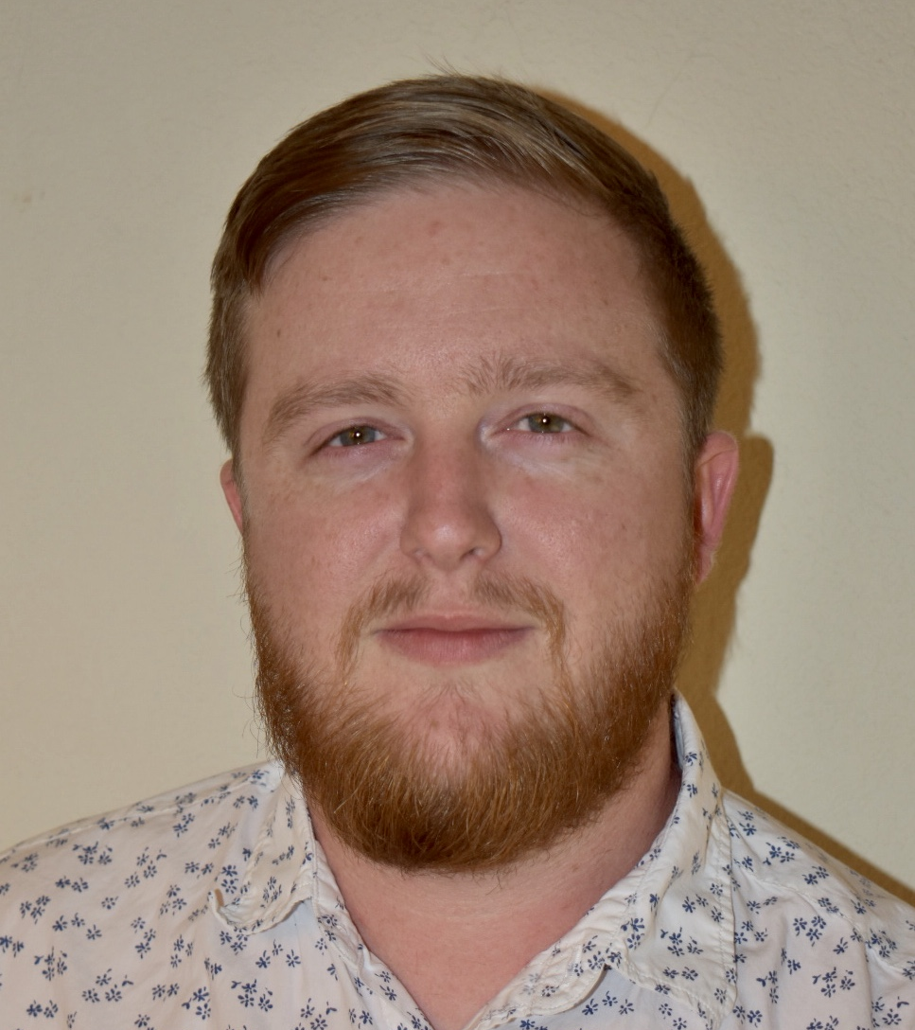
WBS 131.4.2 Technical Coordination Office
Near Detector Engineering Base Team In Place – Integration Matures Rapidly
ND Integration Office: FY 2020 to FY 2025
  Lead Engineer
  Detector Integration Engineer
  Installation Engineer
  Designer
  Cryo Engineer and Electrical Engineer (shared with Far Site)
  Travel and M&S
ND Installation Office: beyond FY 2025
  Lead Engineer
  Detector Integration Engineer
  Installation Engineer
  Junior Planning Engineer
  Cryo Engineer and Electrical Engineer (shared with Far Site)
  Technician Lead
  Four Core Technicians (Consortia must provide additional installation technicians)
  Travel and M&S
M. Leitner
R. Flight
A. Lambert
A. Lawrence
supported primarily through off-project DUNE Support Funds (DOE)

Slide 6
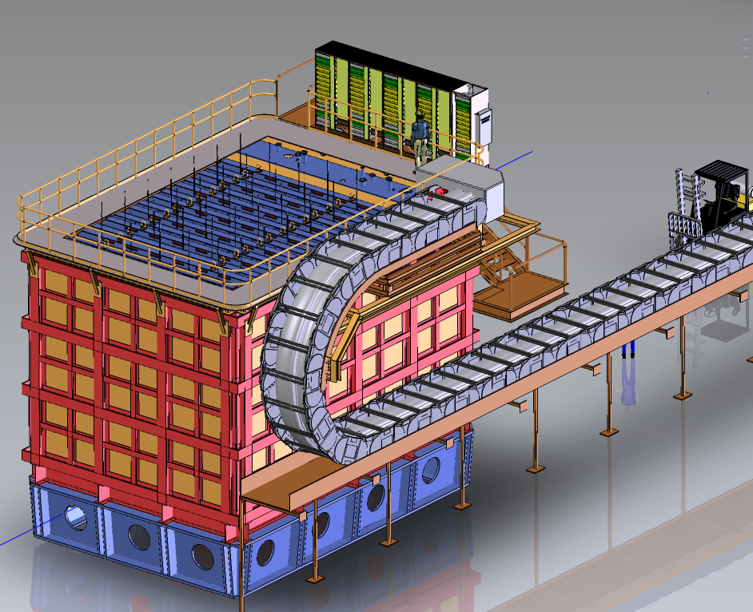
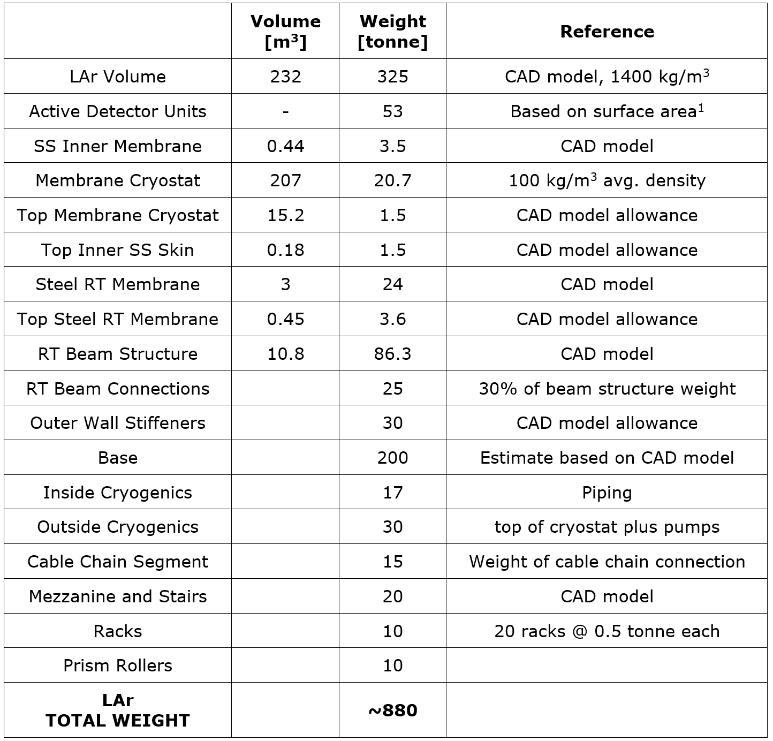
LAr Detector Main Structure Parameters:
Movable Membrane Cryostat With Segmented Detector Modules
Width = 11.34 m
Depth = 8.34 m
Height = 7.04 m

Slide 7
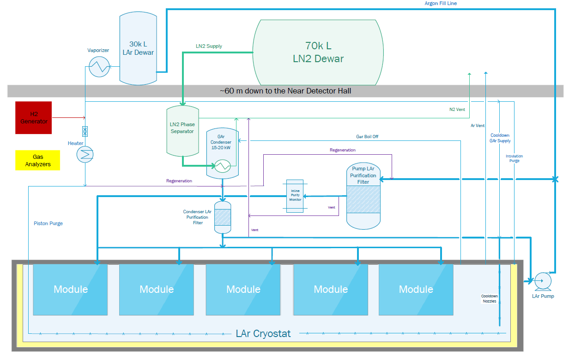
LAr Detector Simplified Flow Diagram:
Large Diameter Cryogenic Piping Needs To Move With Detector
3” pipe
6” jacket
24” pipe
3” pipe
6” jacket
Above
Ground
2” pipe
6” pipe
12” jacket
Below
Ground
Cryogenics
Moves With
Detector
Graphic: Min Jeong Kim

Slide 8
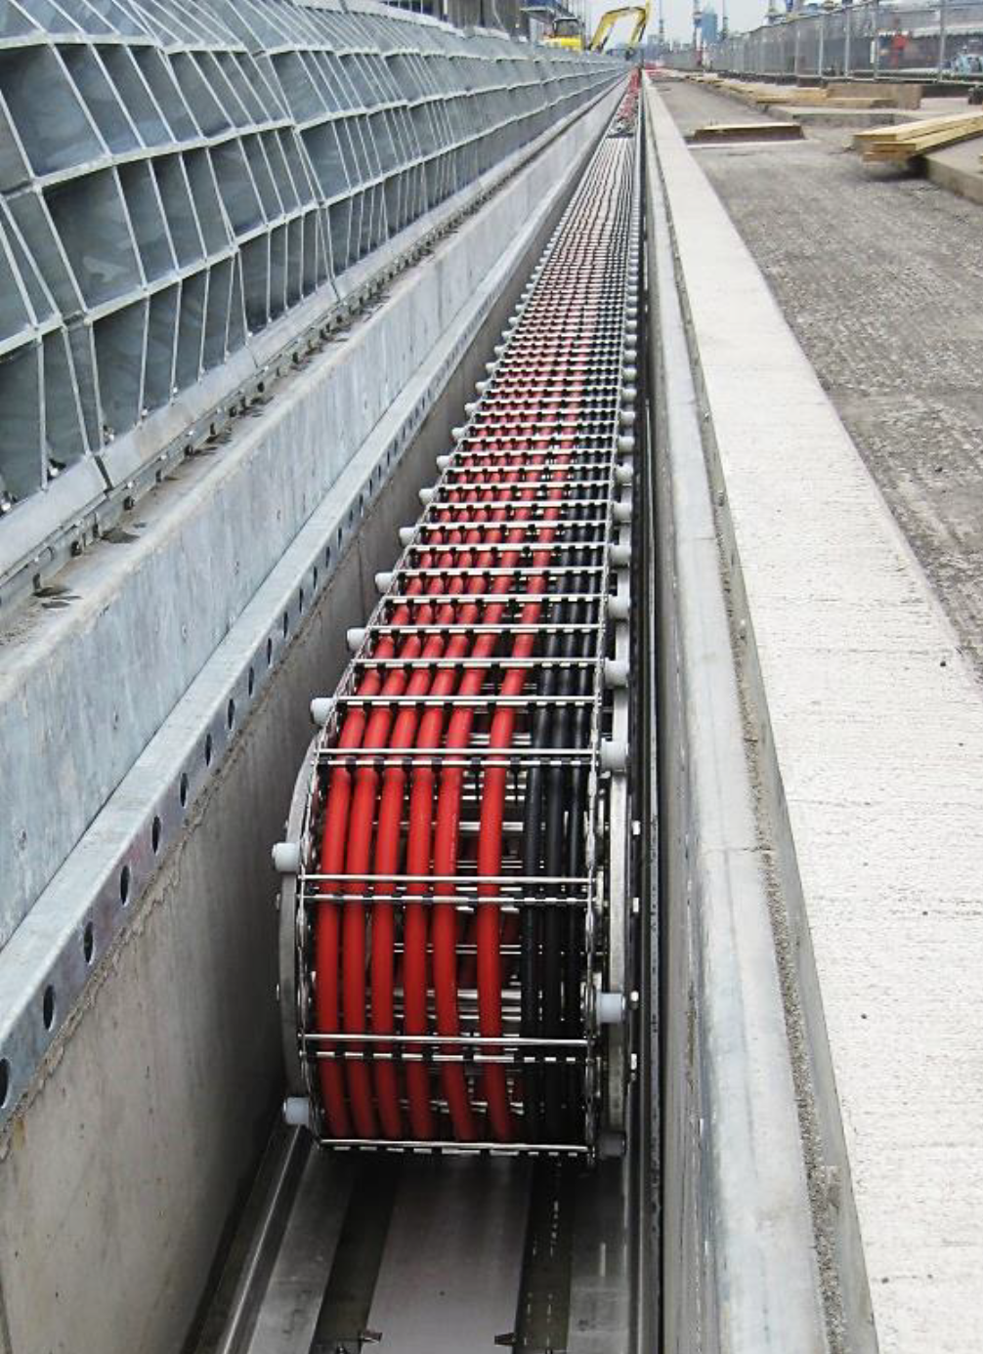
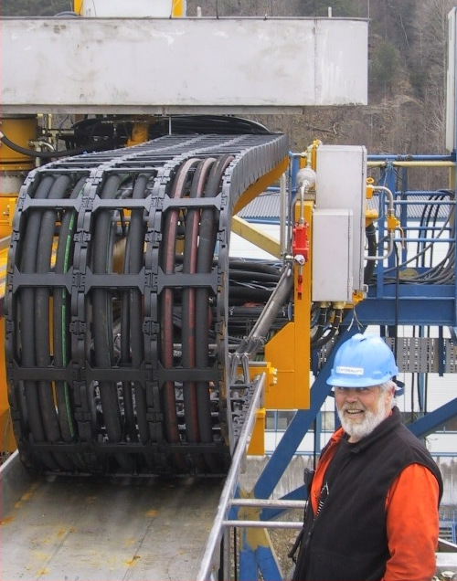
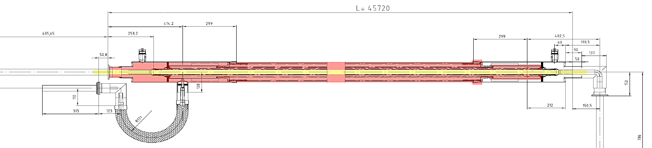
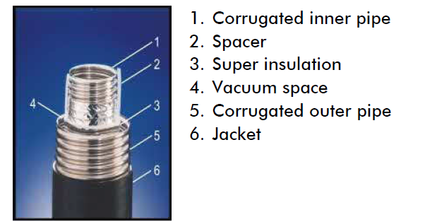
Cryogenic Line Guides Require Novel Design Solution
Metal Guide Option
Plastic Guide Option
Vacuum Jacketed Lines
Commercially Available
Guide Designs Needs To Resist “Coil-Up” Under Vacuum Load

Slide 9
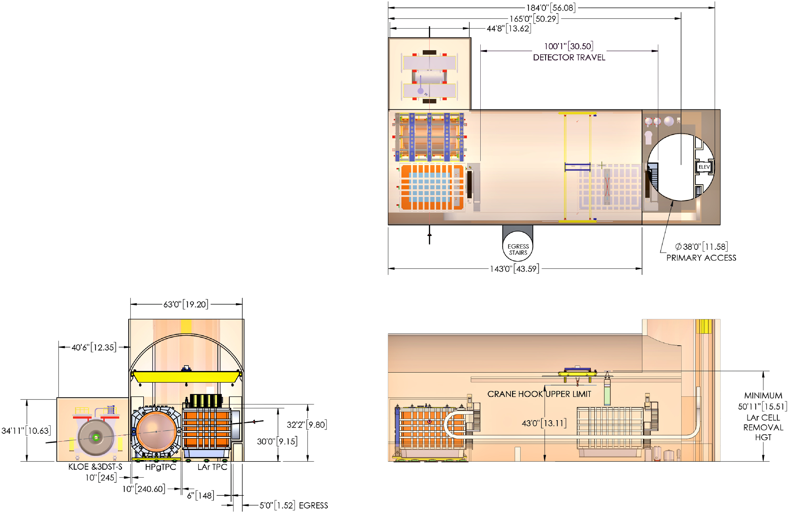
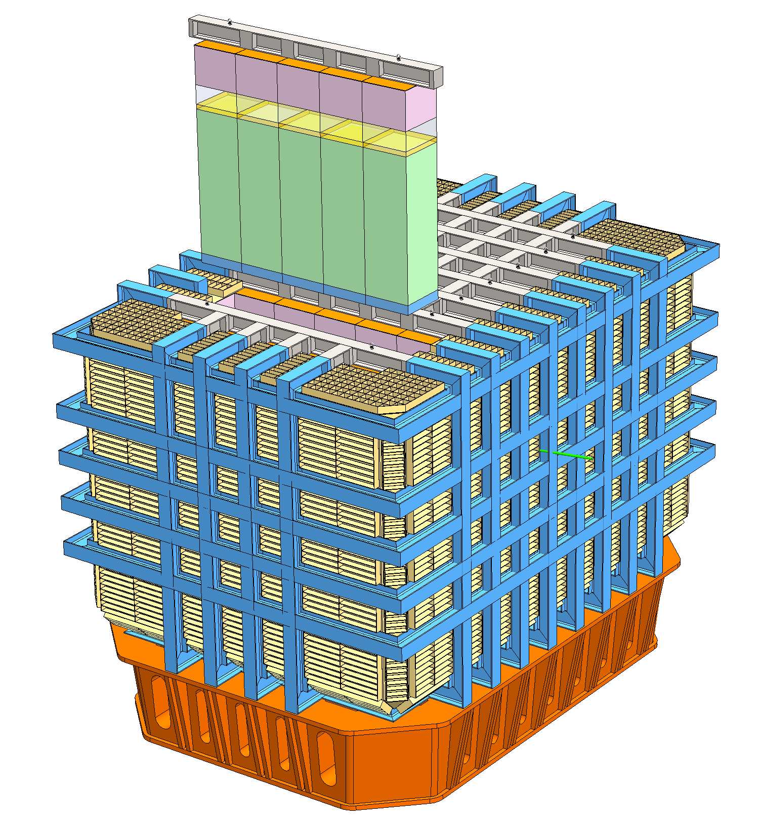
LAr Cryostat Concept Based on SBND Design:
Framing Aligns With Detector Modules And Permits Extraction
LAr Detector Rows
Can Be Extracted
Cavern Layout
Permits Servicing
LAr detector cryostat conceptual design

Slide 10
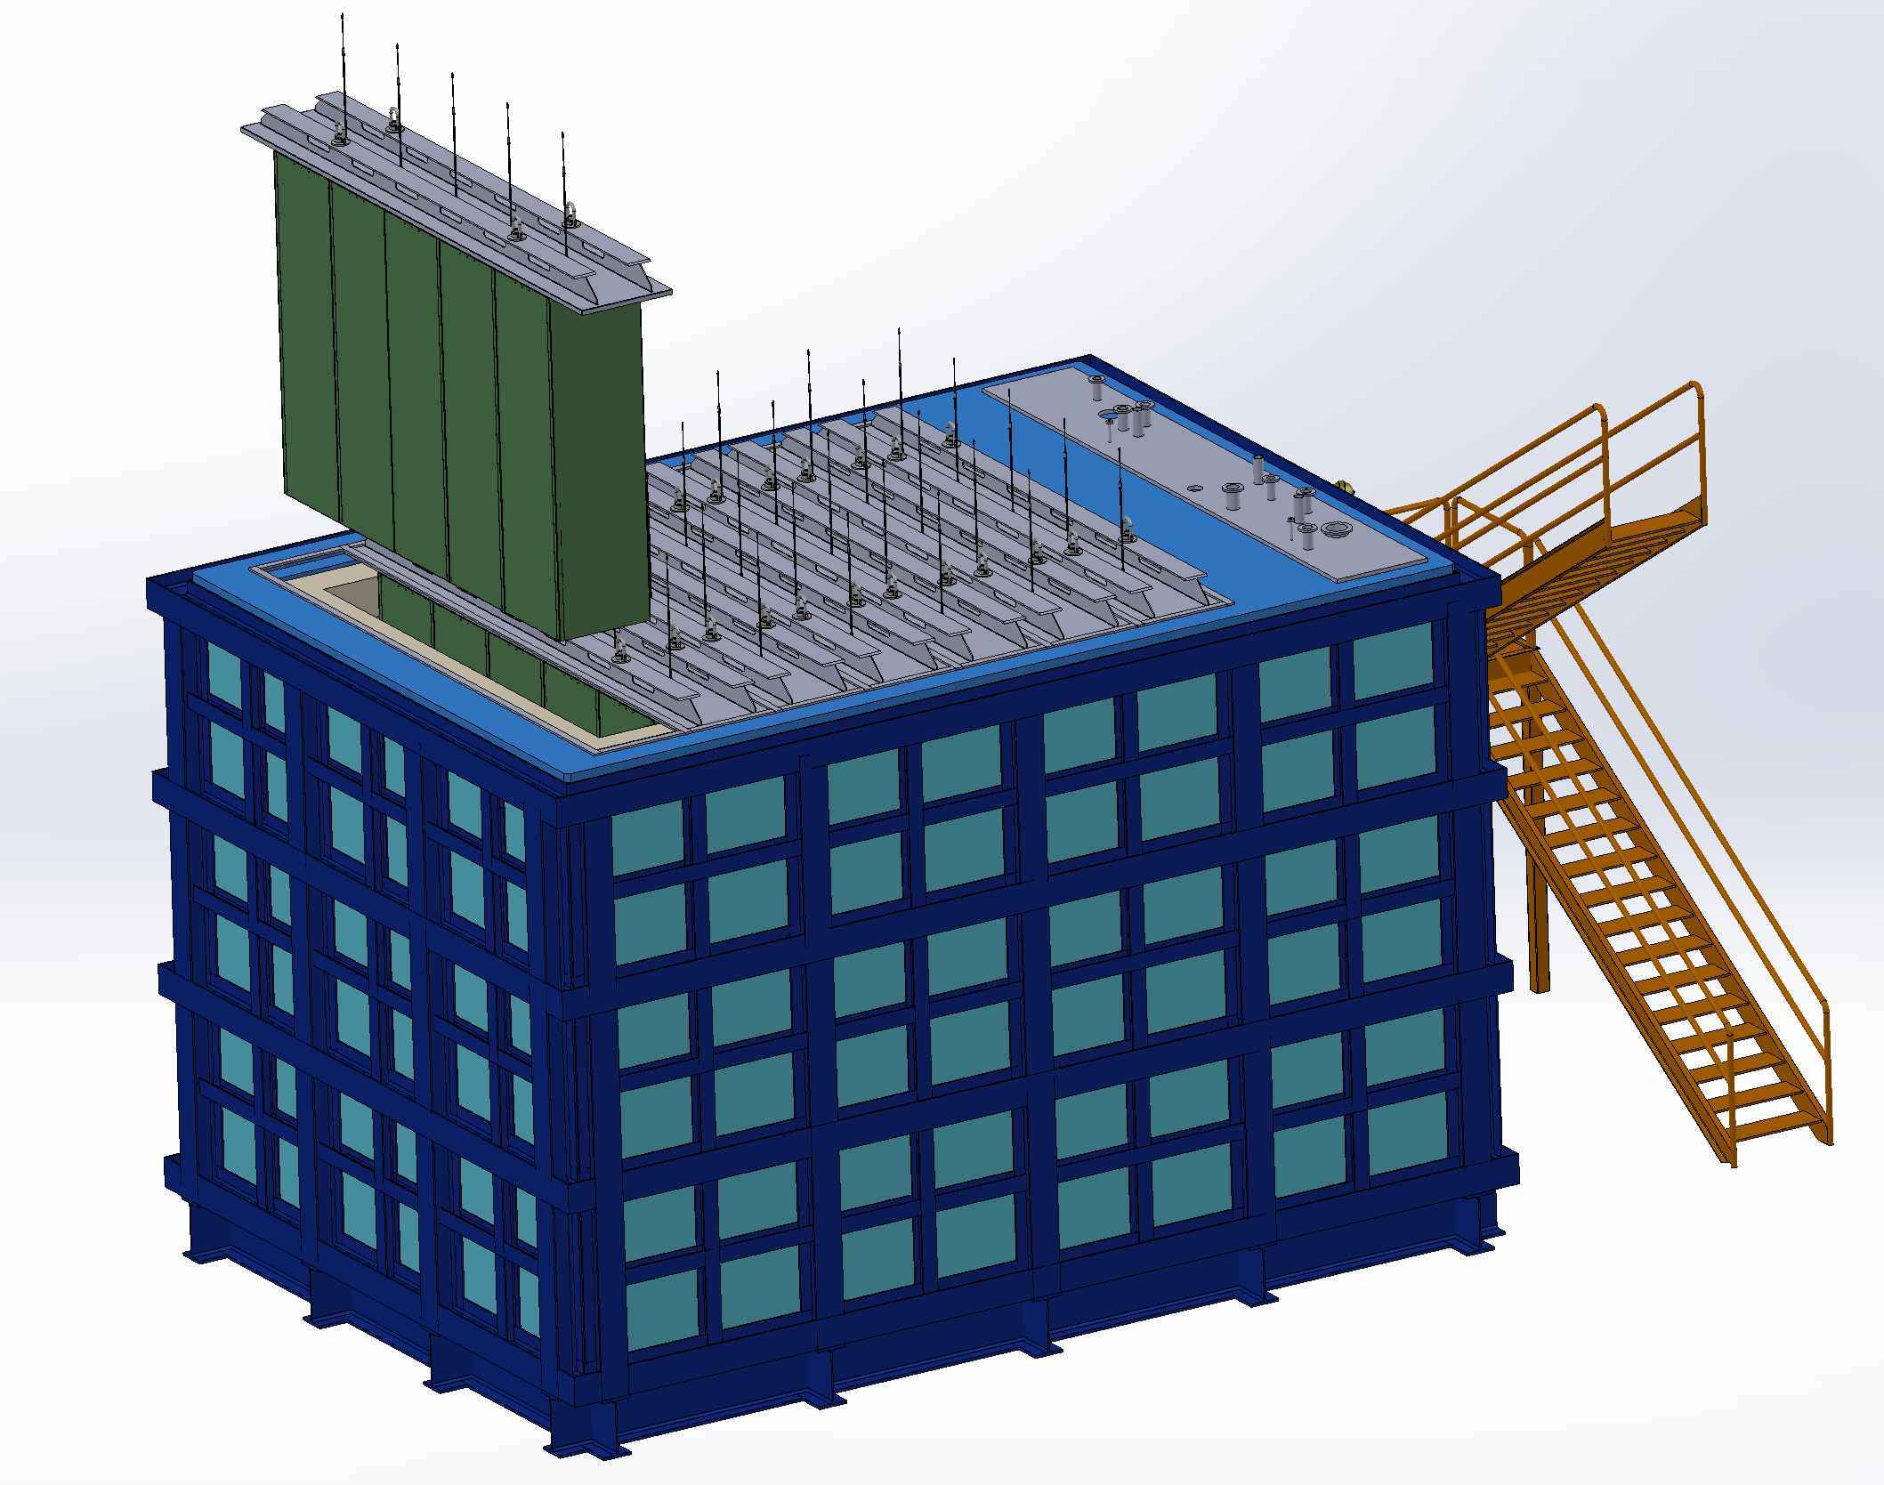
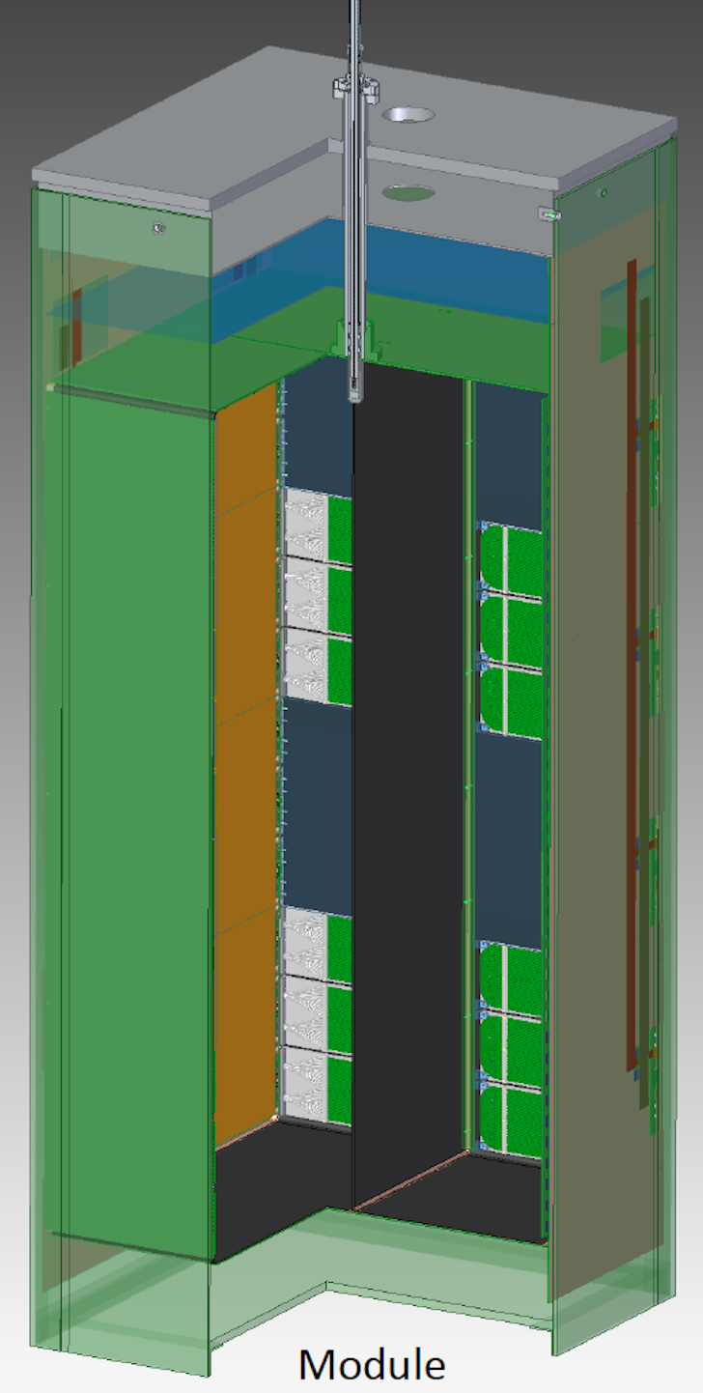
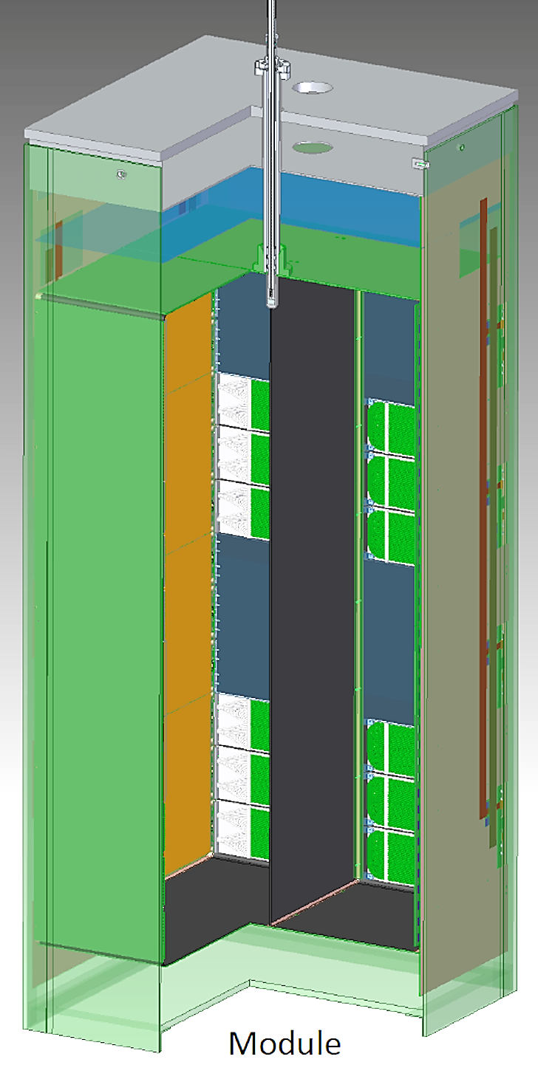
LAr Module Design Will Be Validated In Phases:
Captured In Detector And Installation Project Schedules
D. Dwyer
2019-2021
ArgonCube 2x2
Demonstrator
2022-2023
Pre-production
Demonstrator
2024-2026
DUNE Production
Institutions:
Bern, LBNL, SLAC, CSU, UTA, +others
WBS 131.02.03.03.10.3
(US Detector Scope)
WBS 131.04.02
(I&I Scope)
4 (+1) modules
Operated in existing cryostat
at Bern, then FNAL (NuMI)
Technical demonstrator
1 (+1) Full-scale ND module
Operated in single-module cryostat
DUNE ND Installation
One Production ‘First Article’
35 (+5) Production Modules
300 cm
140 cm
70 cm
70 cm
100 cm
100 cm
each fully tested in single-module cryostat

Slide 11
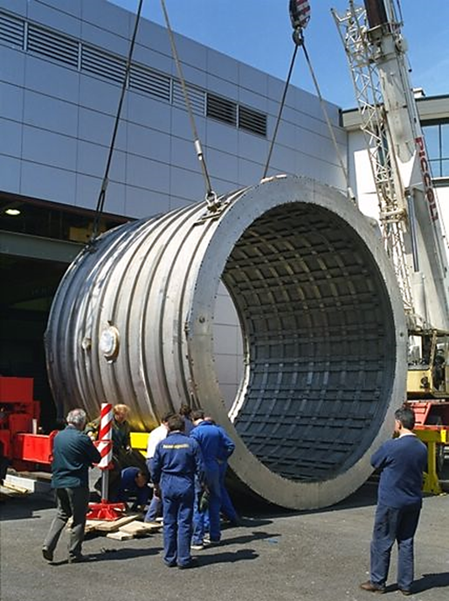
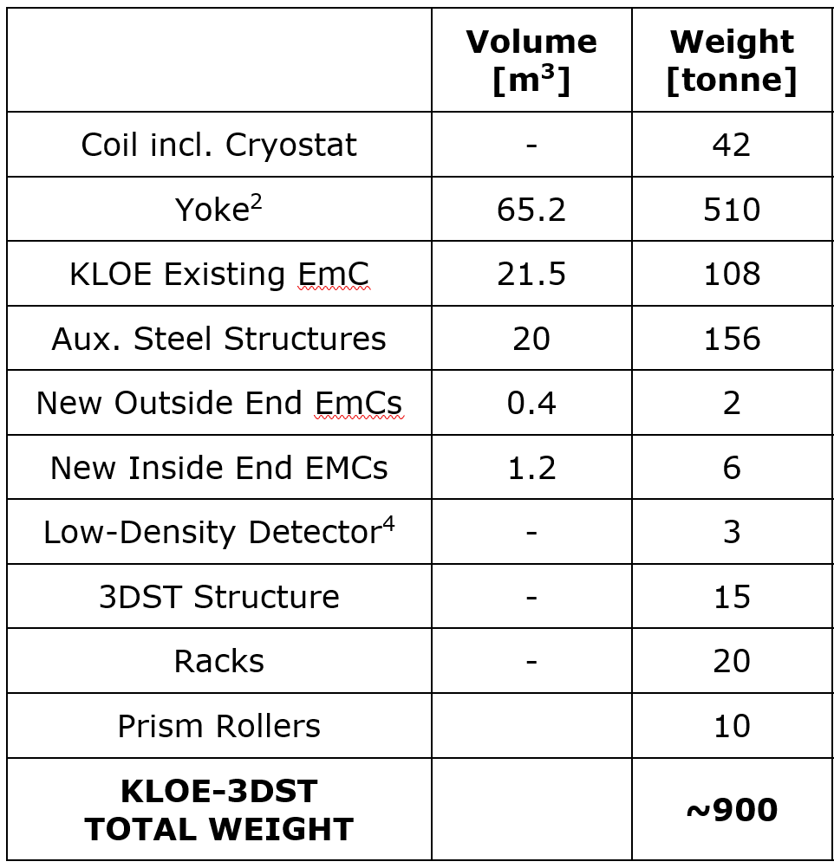
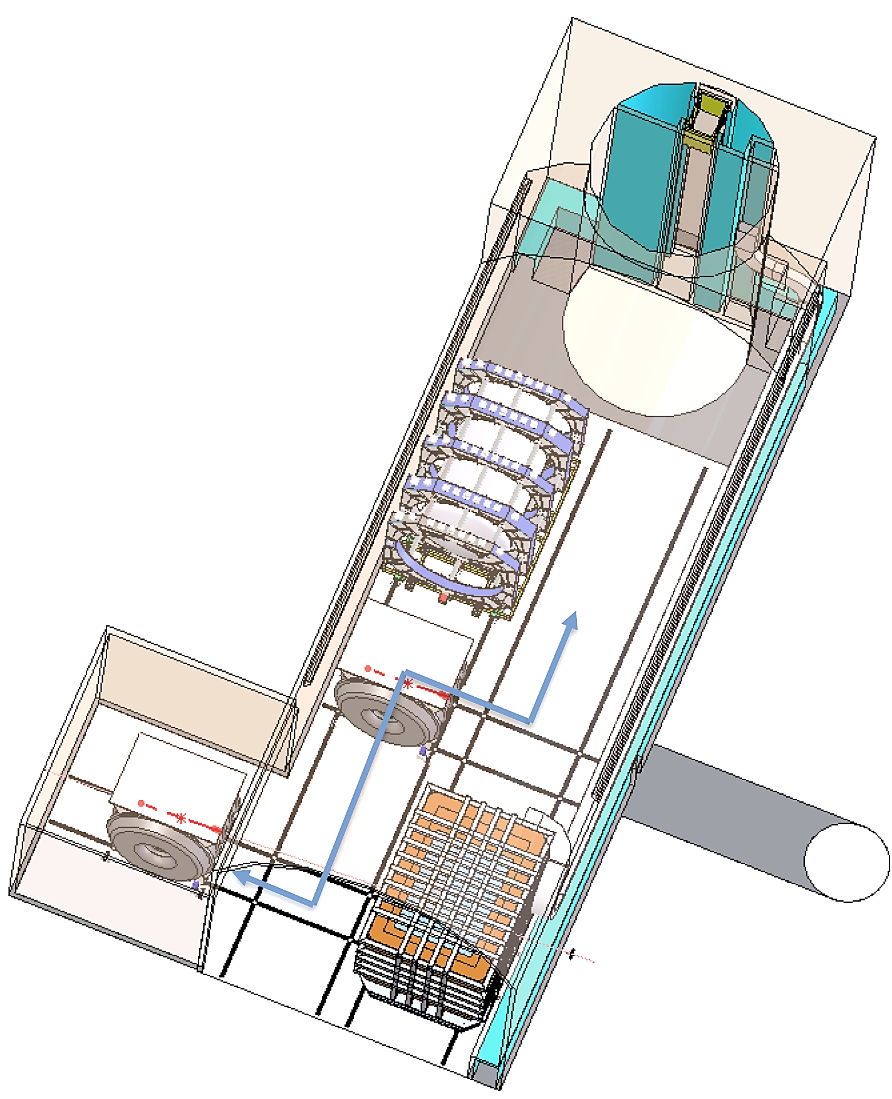
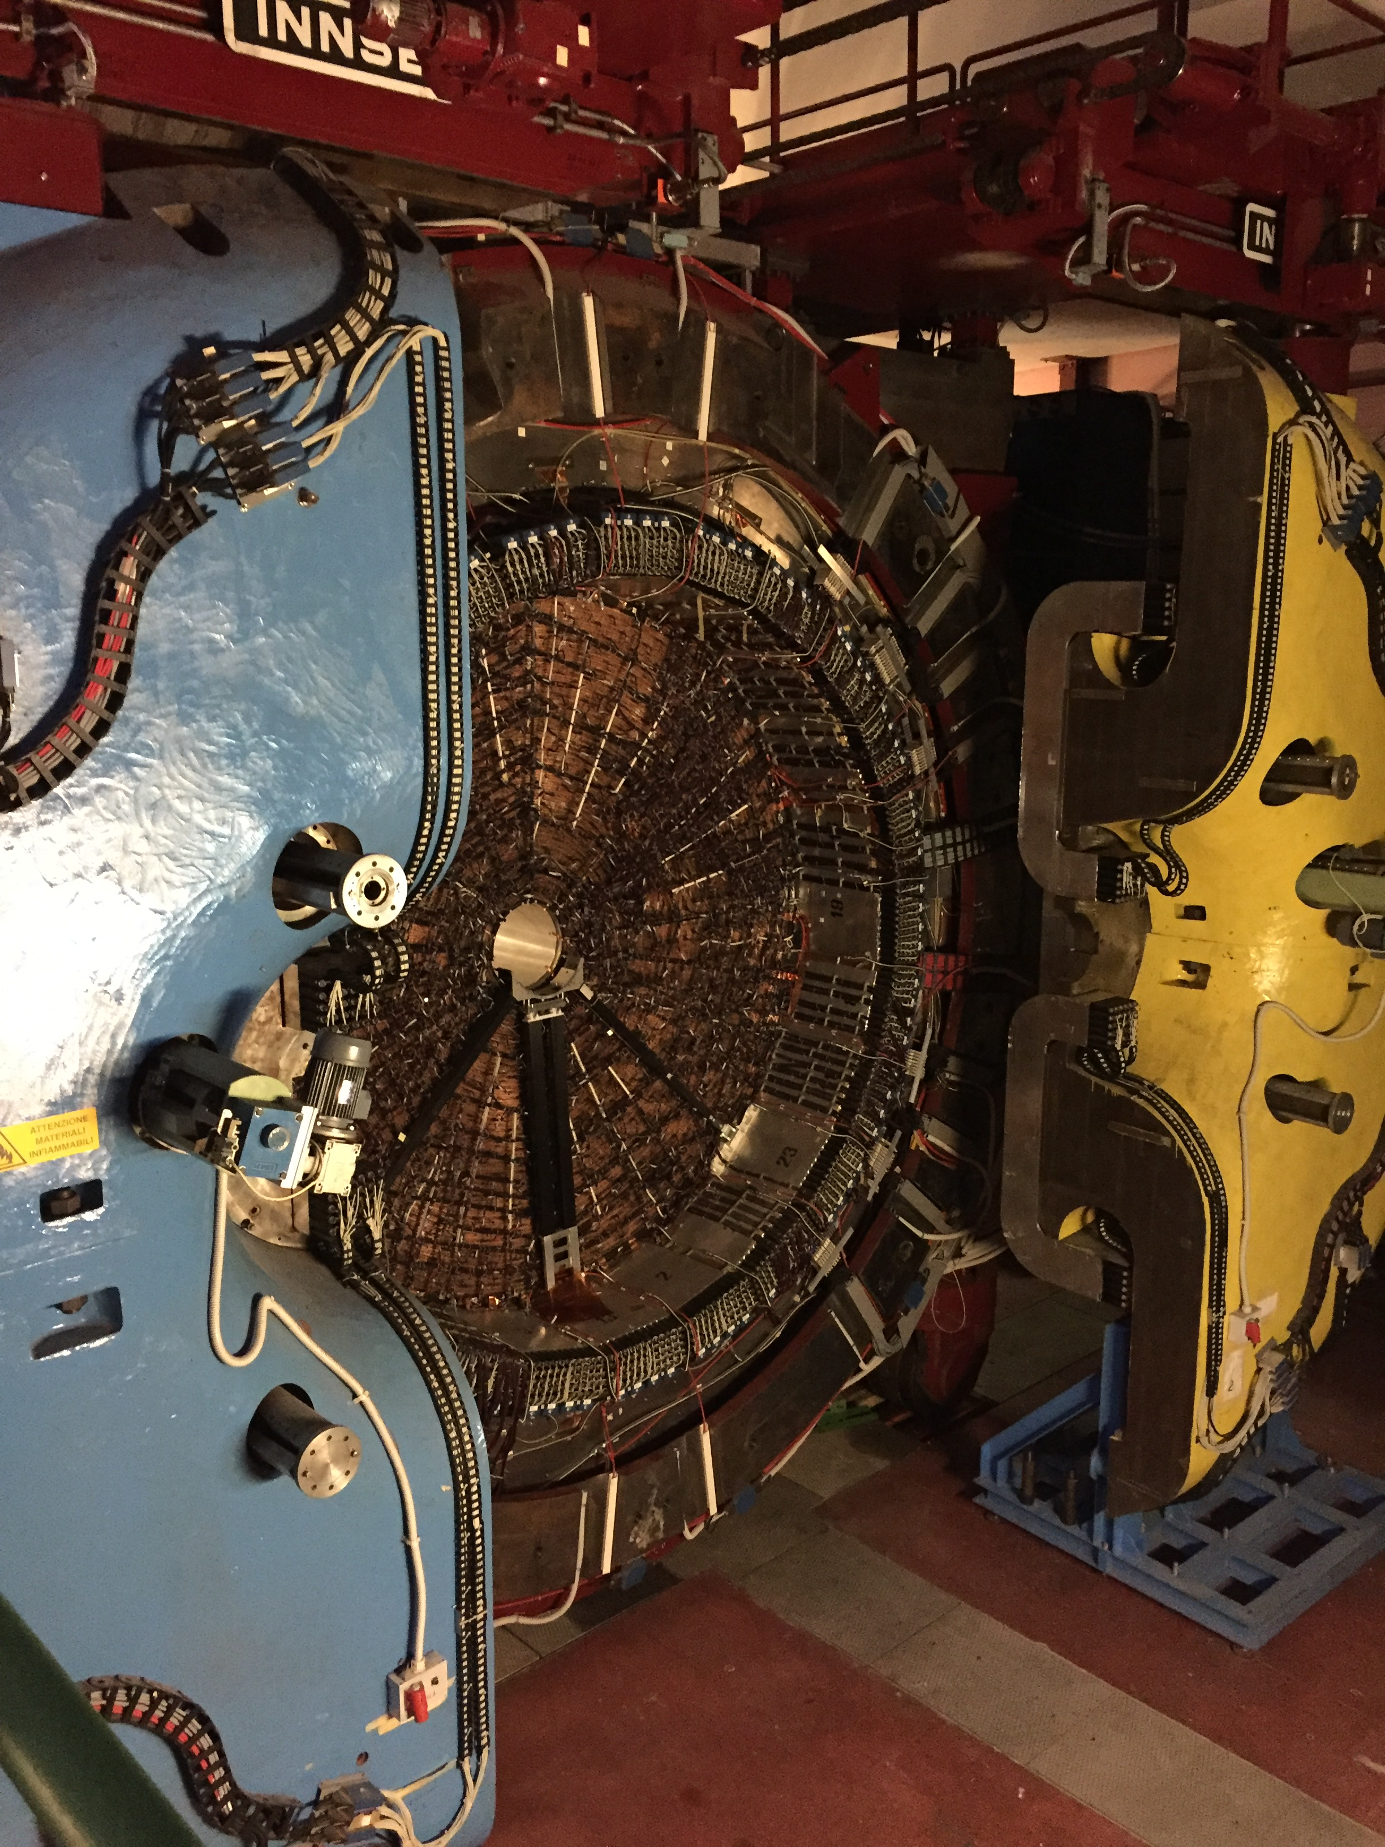
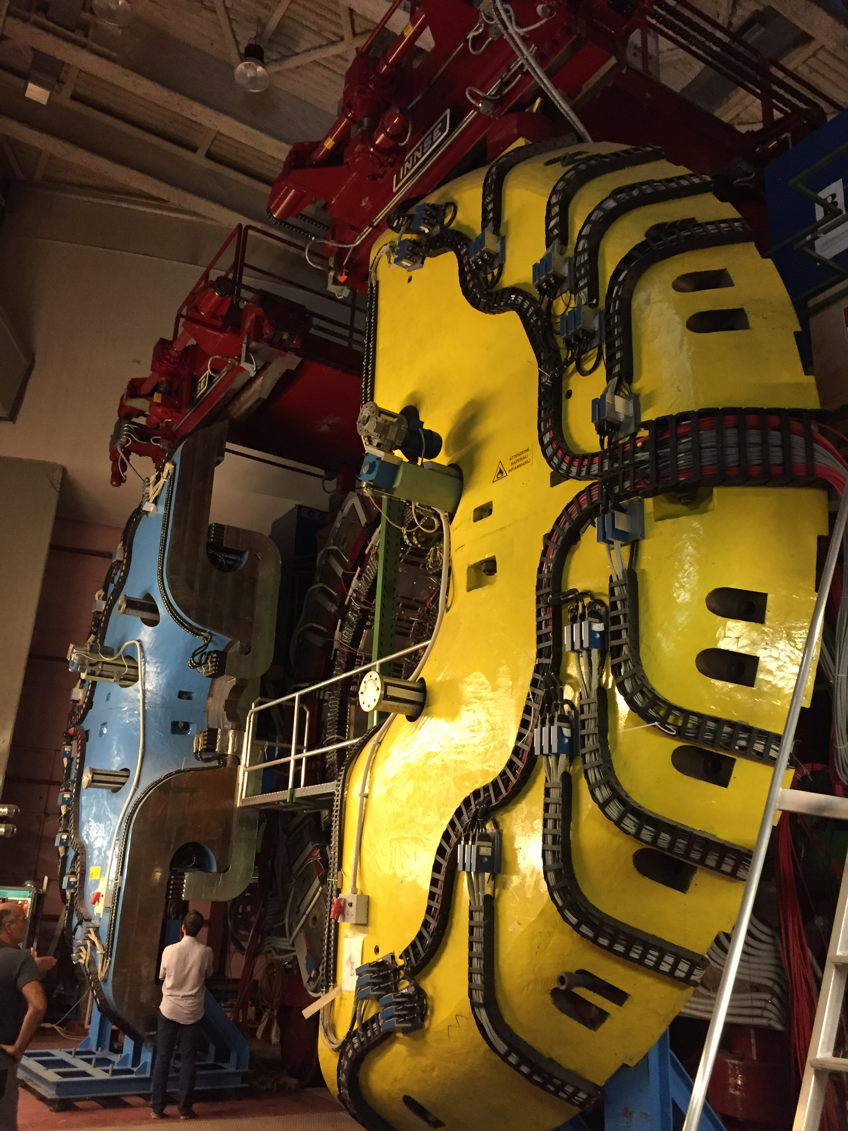
KLOE-3DST Detector Main Structure Parameters
Stationary Detector Will Primarily Serve As Beam Monitor
KLOE-3DST
Stationary Detector
Inside Alcove
Floor Guides
To Assembly
And Servicing
Station
Yoke:
Length = 6 m
Diameter = 7 m
Full Detector Size:
Length ≈ 10 m
Height ≈ 11 m

Slide 12
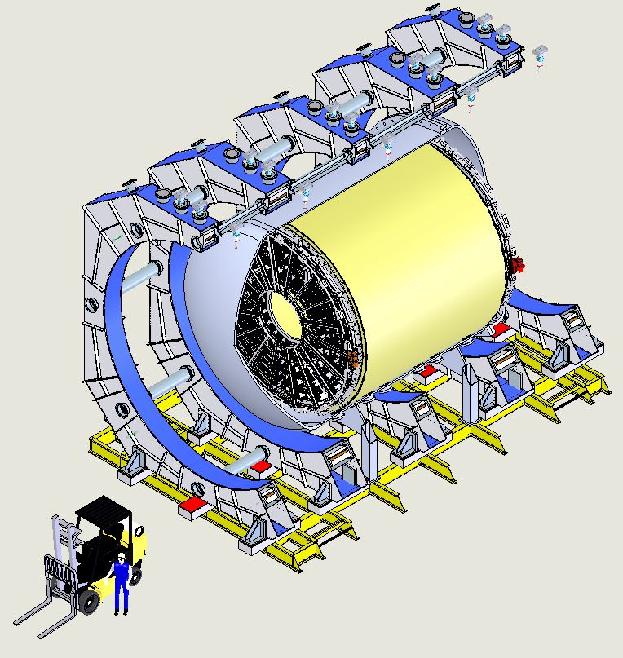
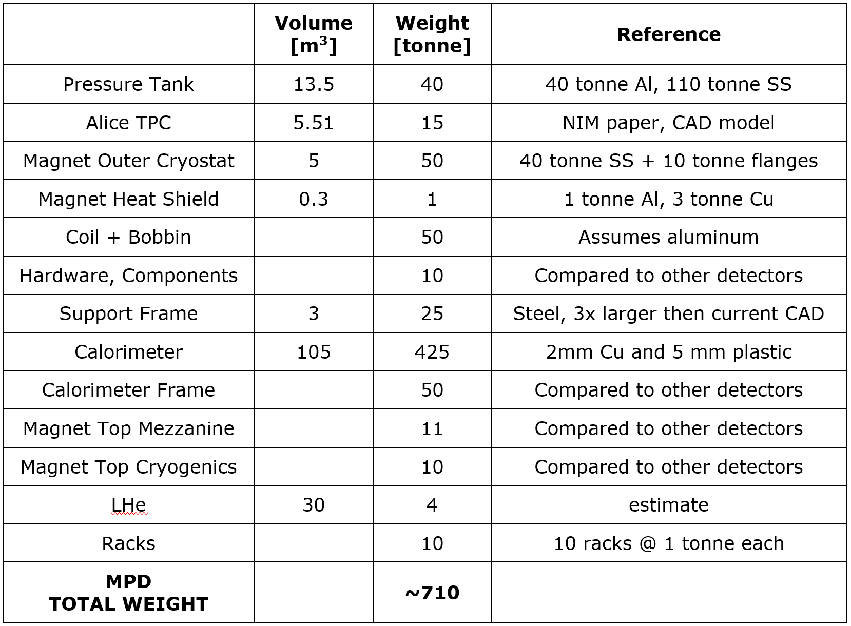
MPD Main Structure Parameters
MPD Design Matured: Achieved Fully Integrated Design
Detector Size:
Length = 12.8 m
Height = ~10 m
Width = 8.5 m

Slide 13
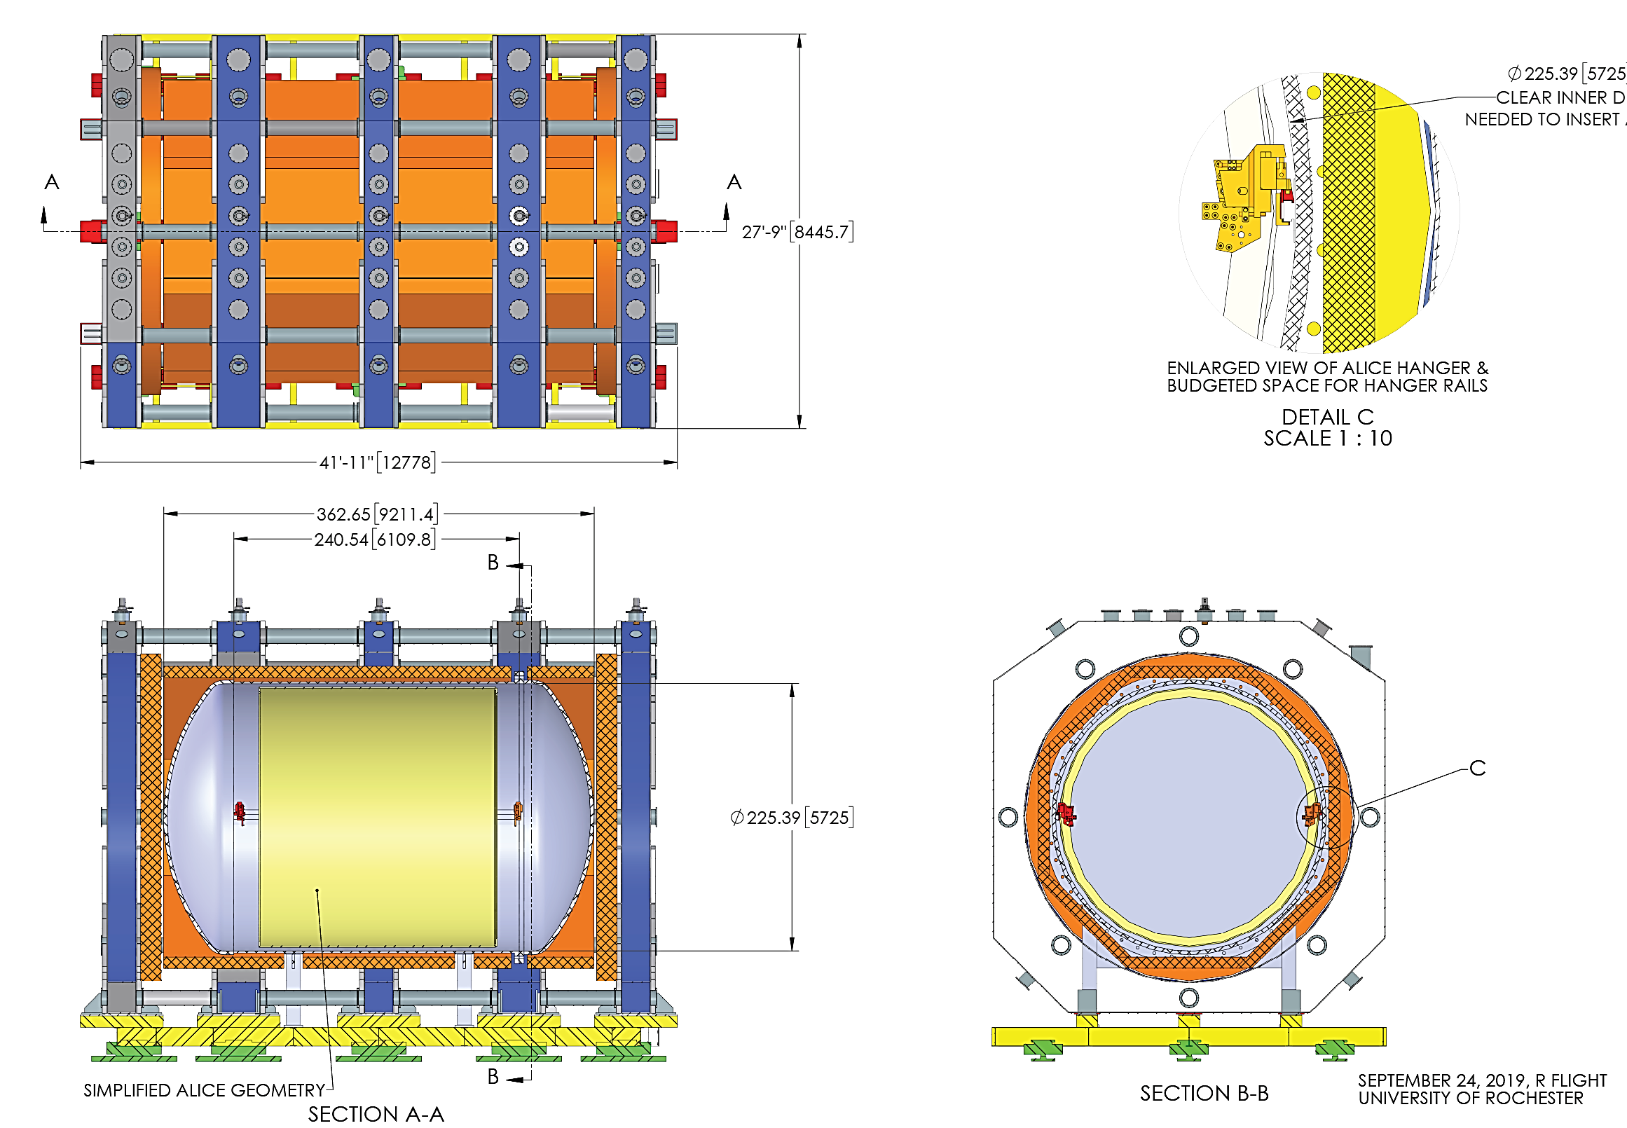
MPD Design Matured: Achieved Fully Integrated Design
Coil and Cryostat Structure
Calorimeter
Pressure Vessel
Detector Size:
Length = 12.8 m
Height = ~10 m
Width = 8.5 m
TPC

Slide 14
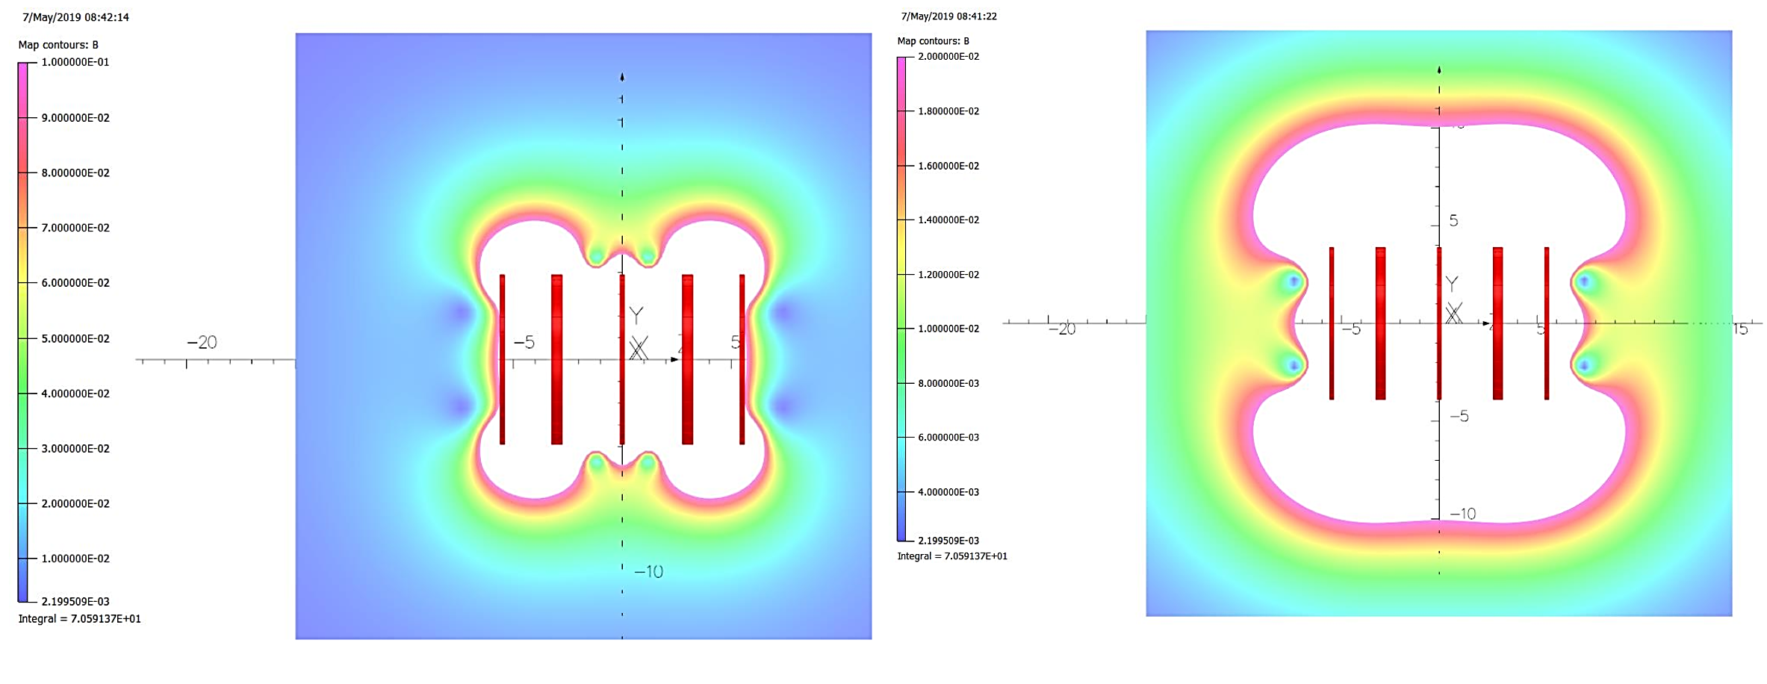
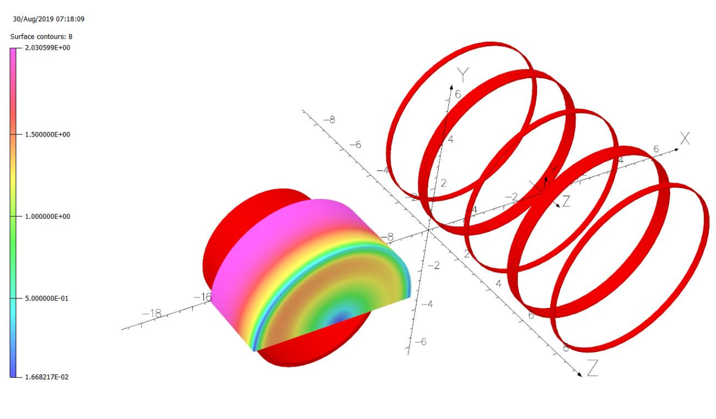
MPD Superconducting Coils Could Expose Adjacent Structures To Significant Magnetic Stray Fields
1000 G Contour
200 G Contour
20 tonne-force between MPD and KLOE Plus Added Interaction Between Both Detector Coils
MPD field may require LAr cryostat room-temperature structure to be fabricated out of stainless steel or aluminum
More effort will be required to ensure magnetic interactions are fully understood
Simulations by Vladimir Kashikhin

Slide 15
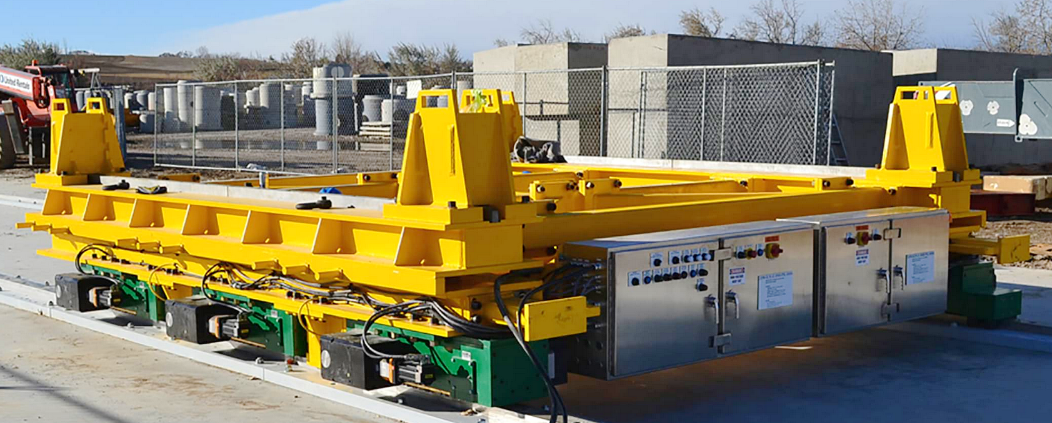
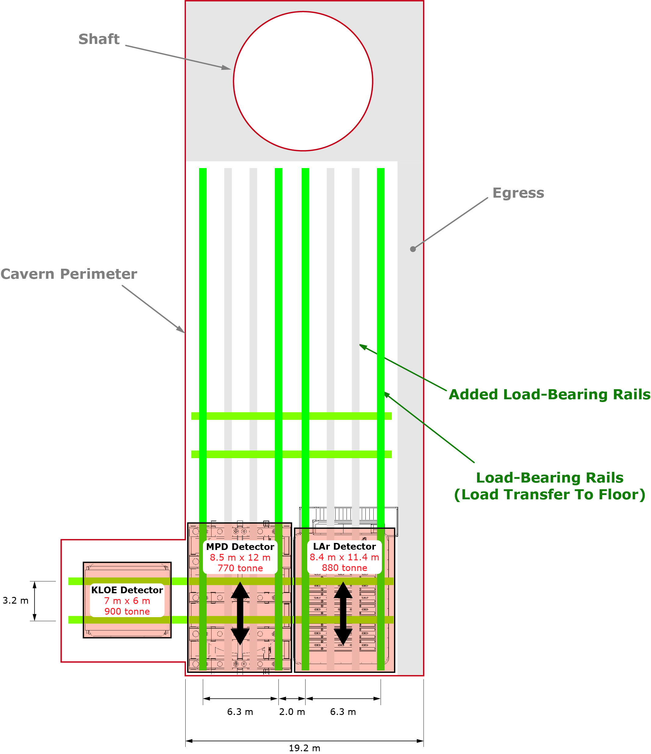
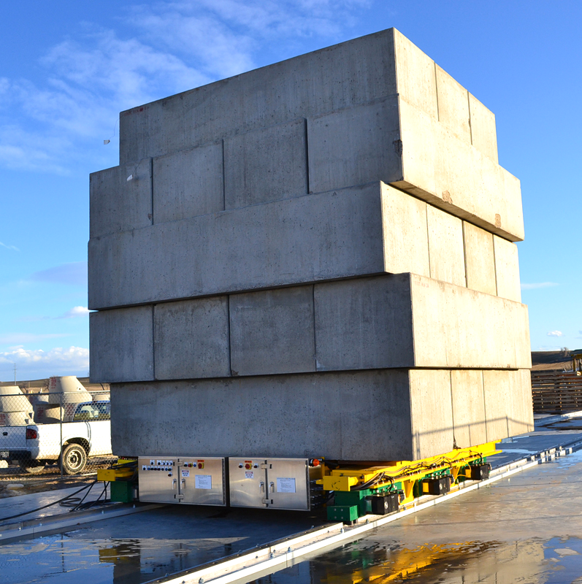
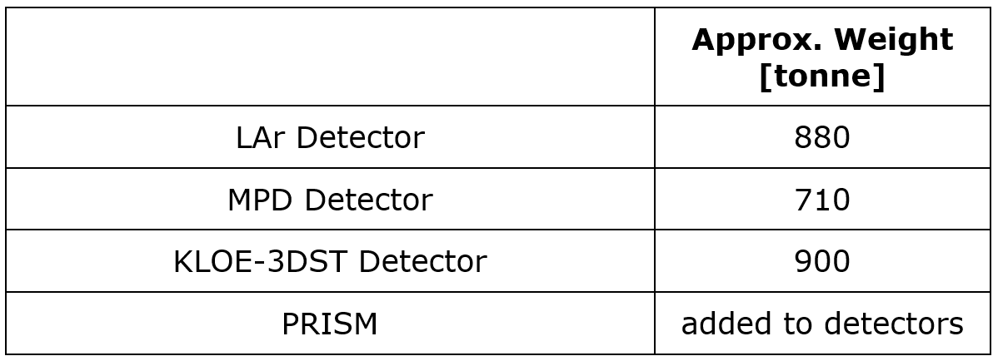
DUNE ND Prism Design Utilizes Commercially Proven Roller Drives Which Distribute Significant Detector Weights
Control system can synchronize several rows of rollers to distribute weight
Guide rail design optimized together with cavern structural design
System Permits Smooth Movement

Slide 16
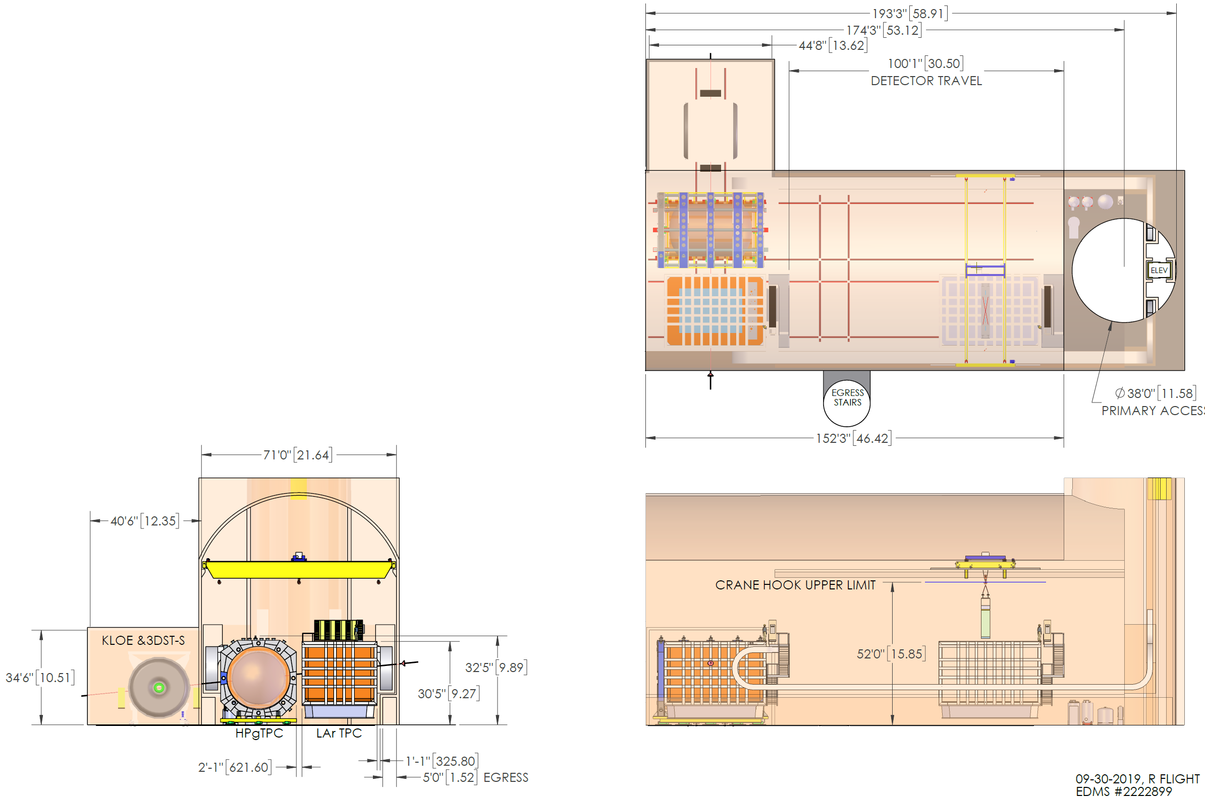
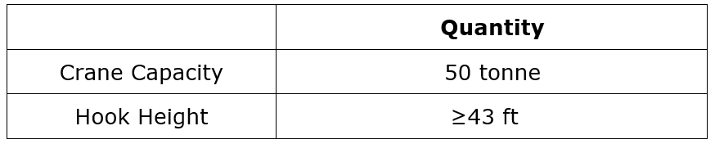
Crane Load Requirements
Largest Weights:
KLOE Magnet (~42 tonne)
MPD Pressure Vessel (~40 tonne)
Largest Hook Height Needs:
LAr Detector Module Removal
Bridge crane will not permit full module extraction. A special lifting setup in the maintenance position will be implemented
LIMITED ROCK QUALITY REQUIRES
EFFORT REDUCING CAVERN HEIGHT

Slide 17
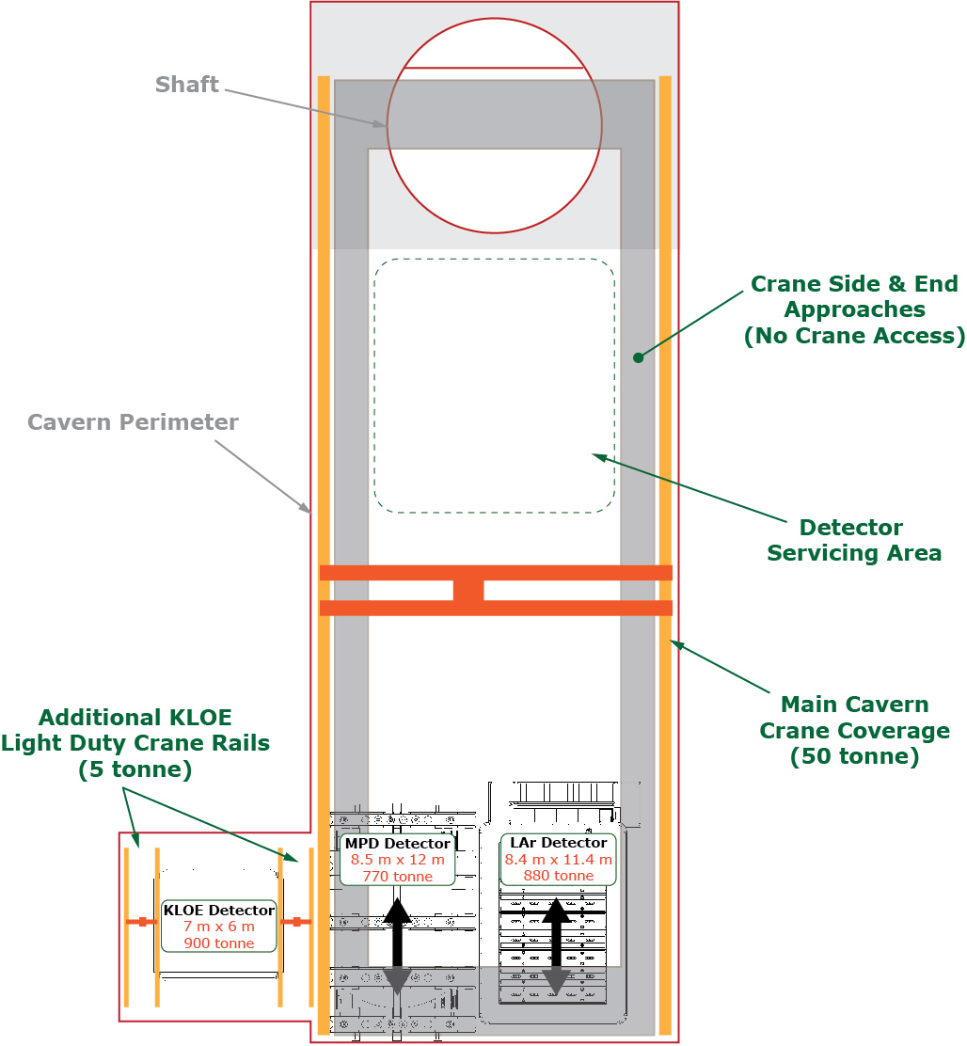
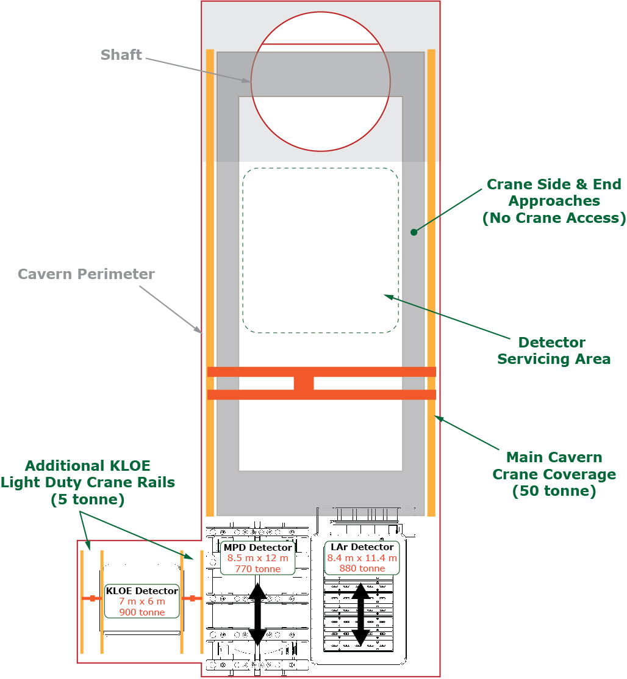
Crane Coverage Area May Be Limited Due To
KLOE Alcove Impacting Cavern Structure Design

Slide 18
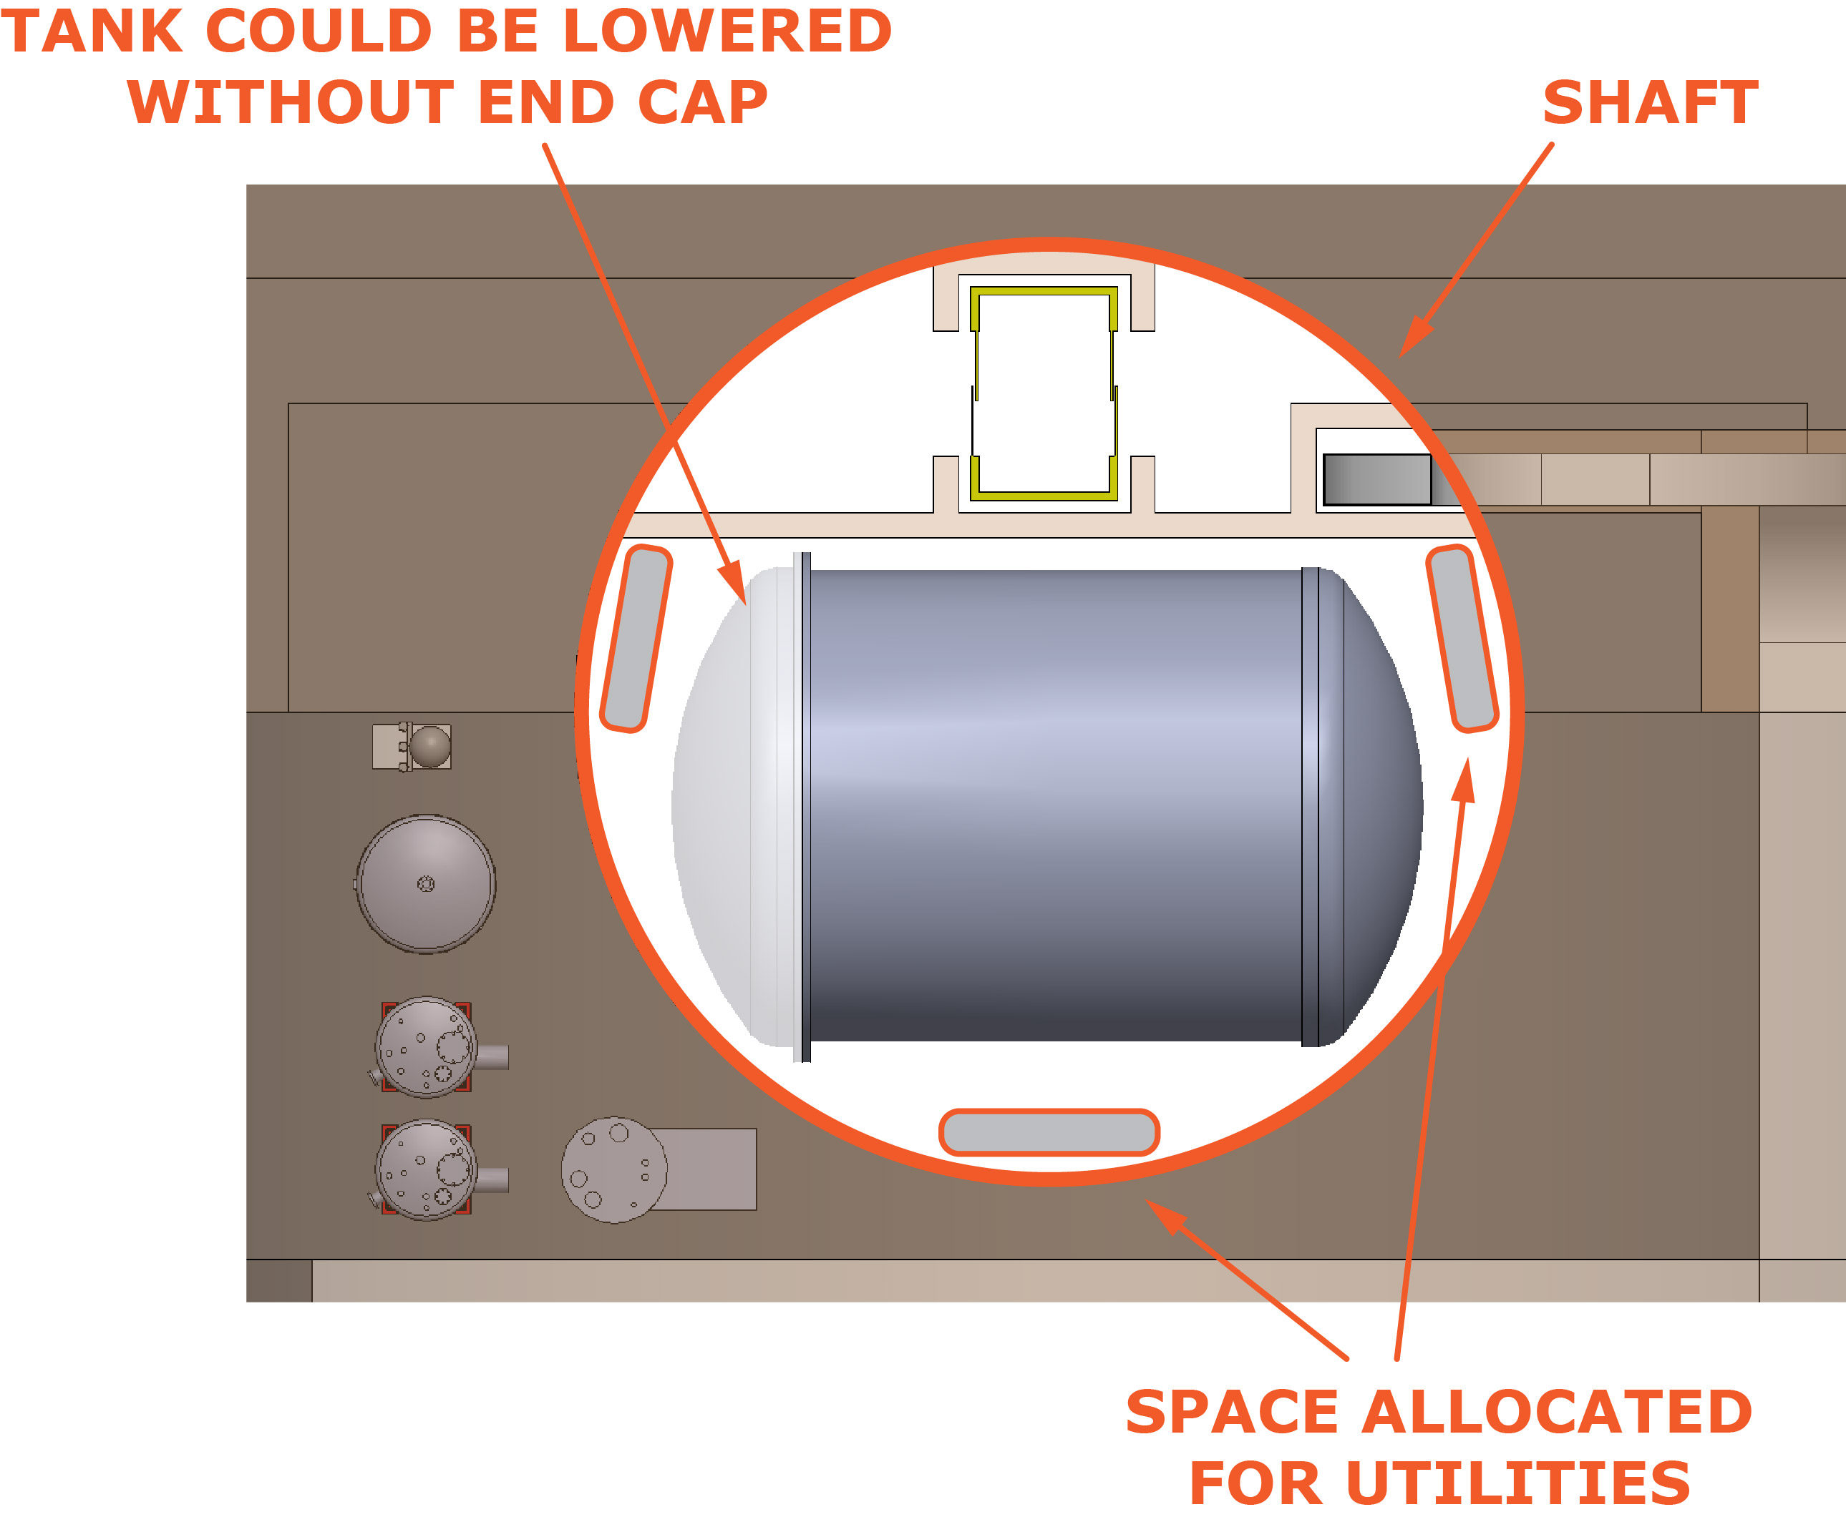
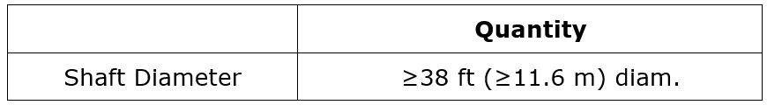
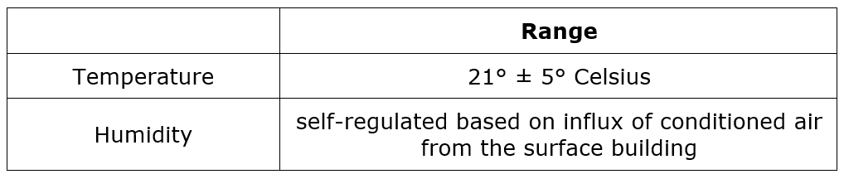
Shaft Size And Cavern Climate Control
Shaft:
The cavern shaft must be of large enough diameter to permit lowering the largest detector components
Largest component is MPD gas tank, a welded pressure vessel which must be lowered into the cavern as a complete unit
The large shaft diameter will also allow inserting pre-welded LAr warm cryostat support panels
Shaft will also provide space for utilities routing
Cavern Climate:
Conditioned (dried) air will be generated at the surface building and blown into the cavern.
This approach can control temperature and would significantly reduce cavern humidity. However, such approach cannot actively control or guarantee cavern humidity which will depend on water presence in the cavern or weather conditions on the surface.
Cavern Air Conditioning Requirements

Slide 19
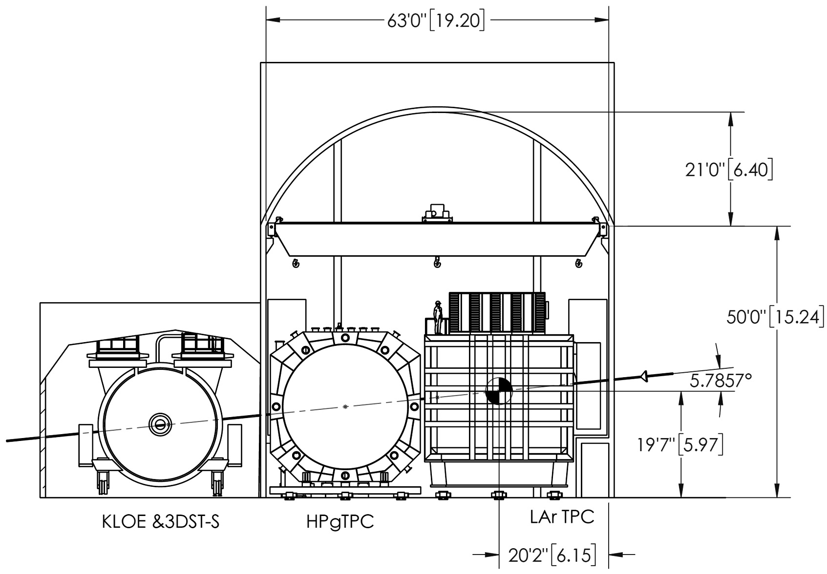
Overall Cavern Size
MPD and LAr detectors can fit into the smaller “BCR” cavern if they are reduced in size along the beamline by at least a combined 6 to 7 feet (shared between the two detectors).

Slide 20
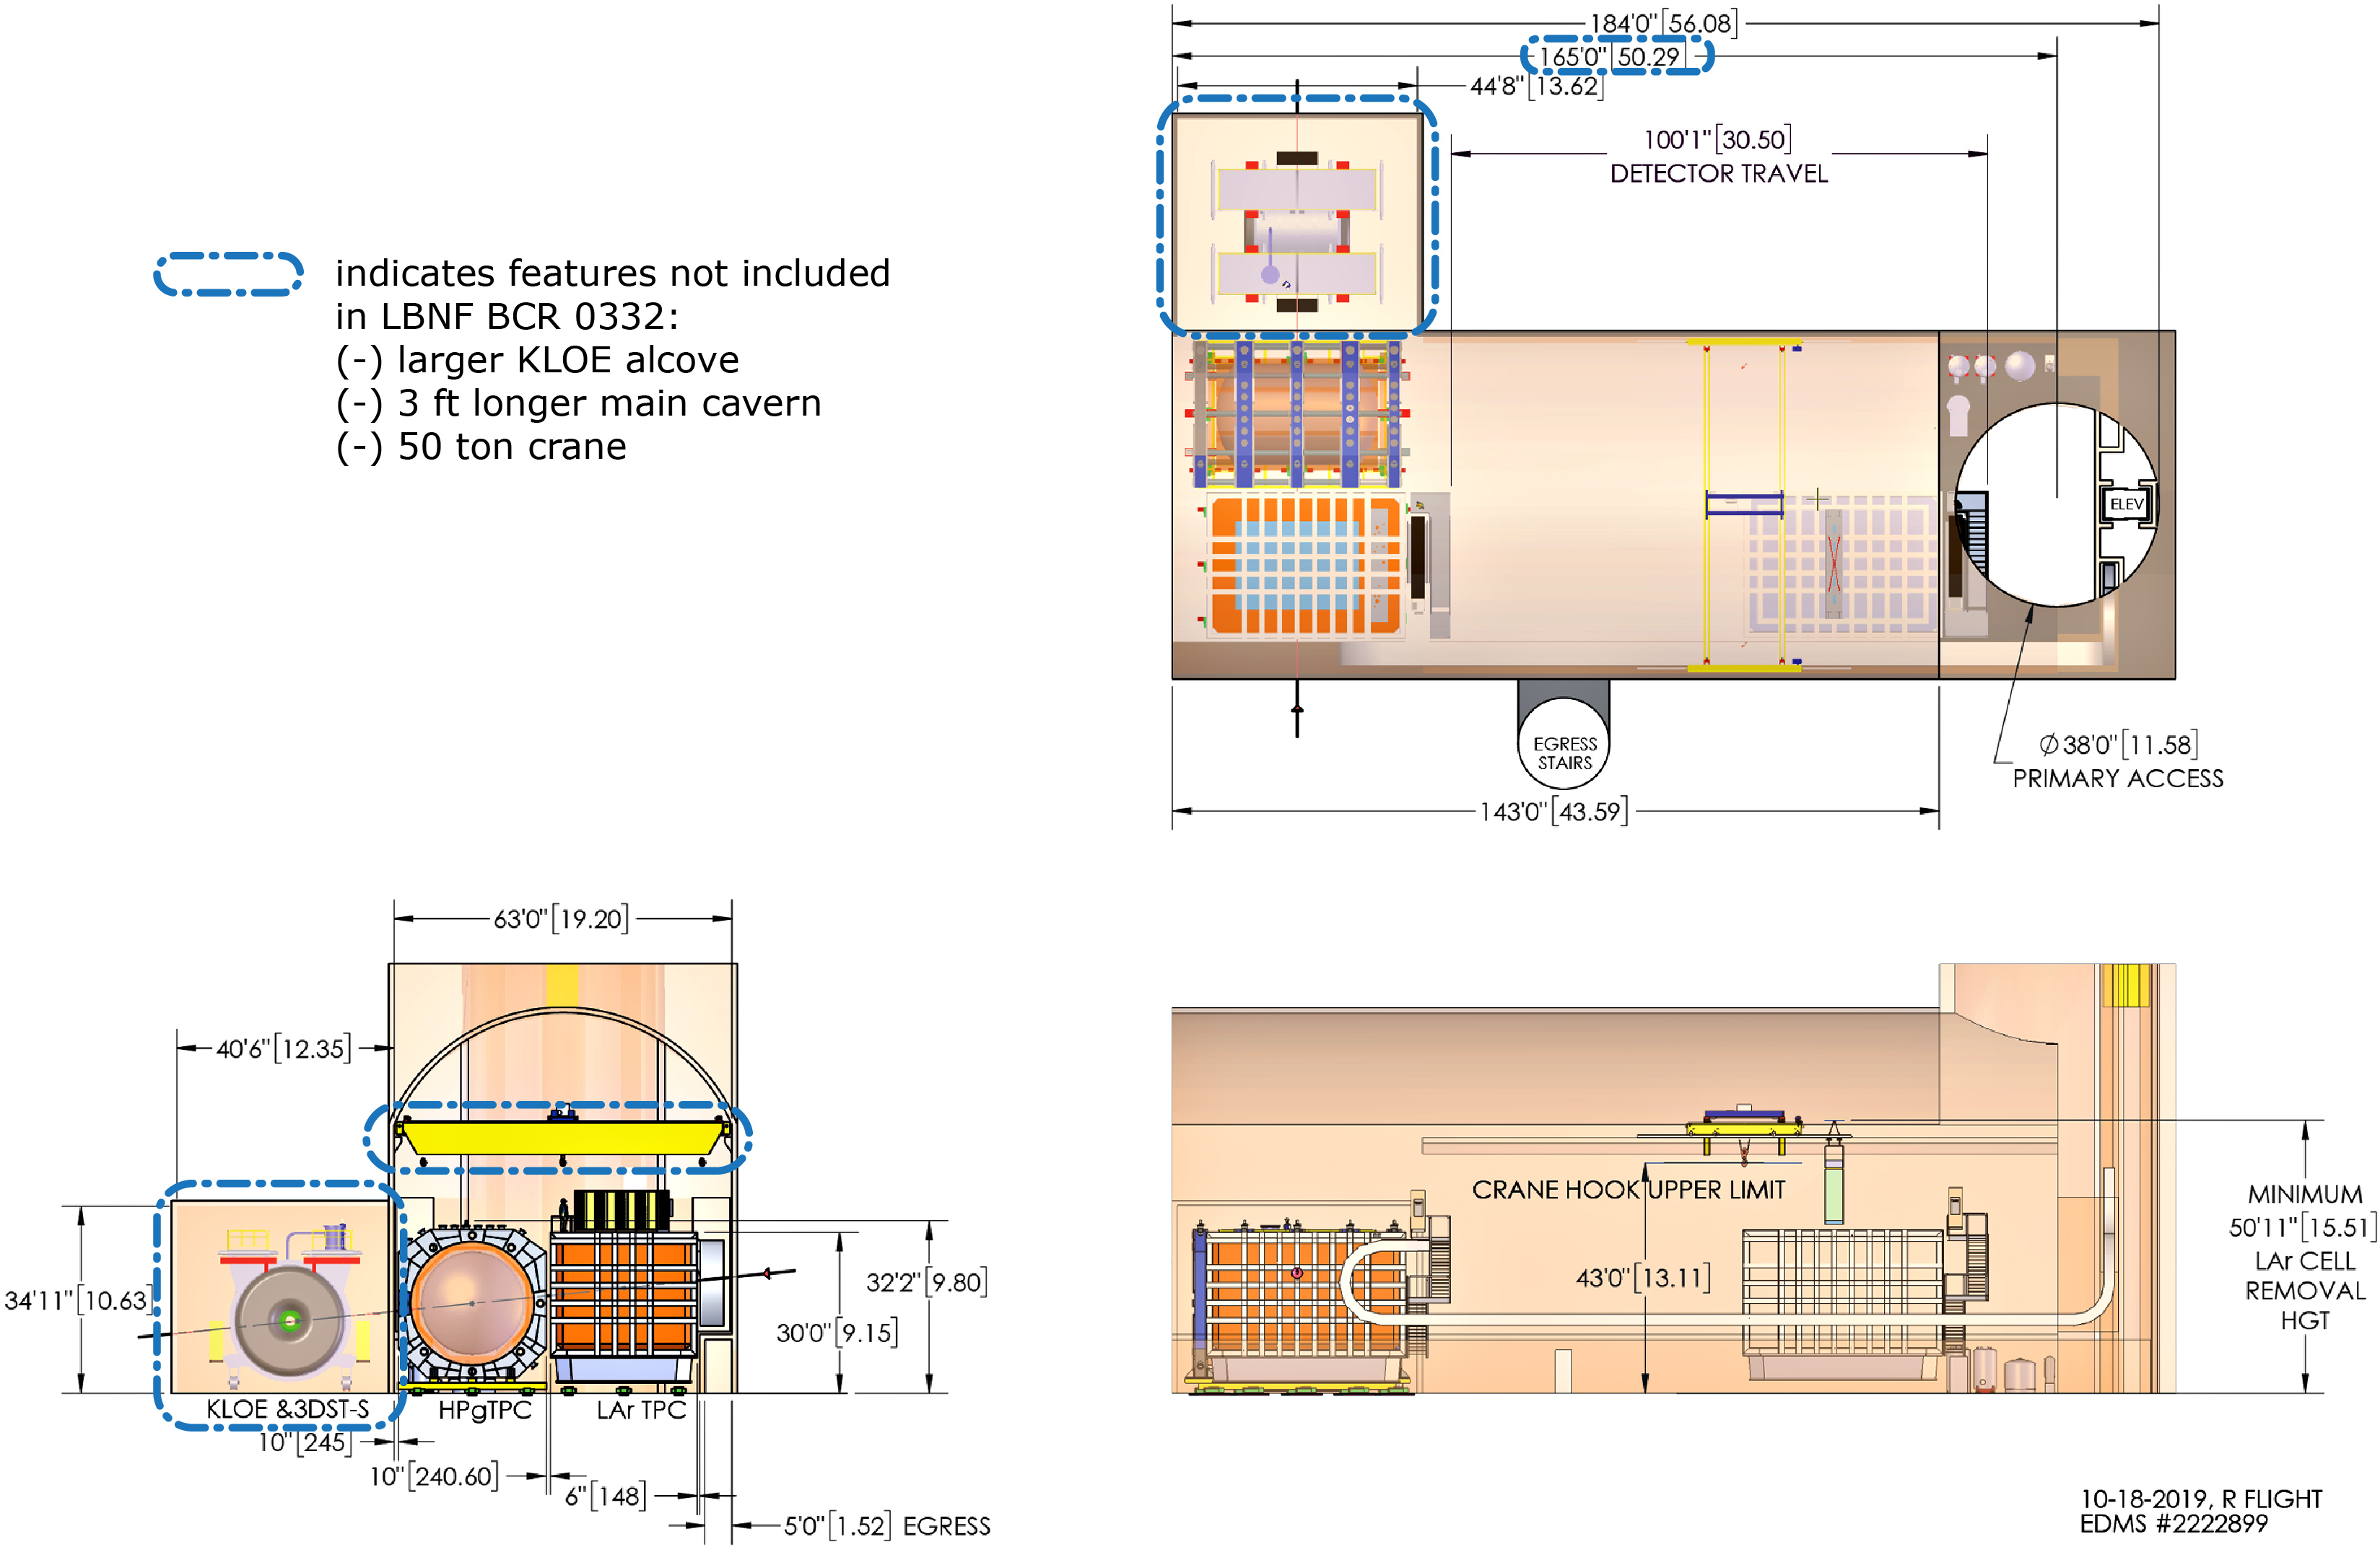
KLOE Alcove
Current Size Request

Slide 21
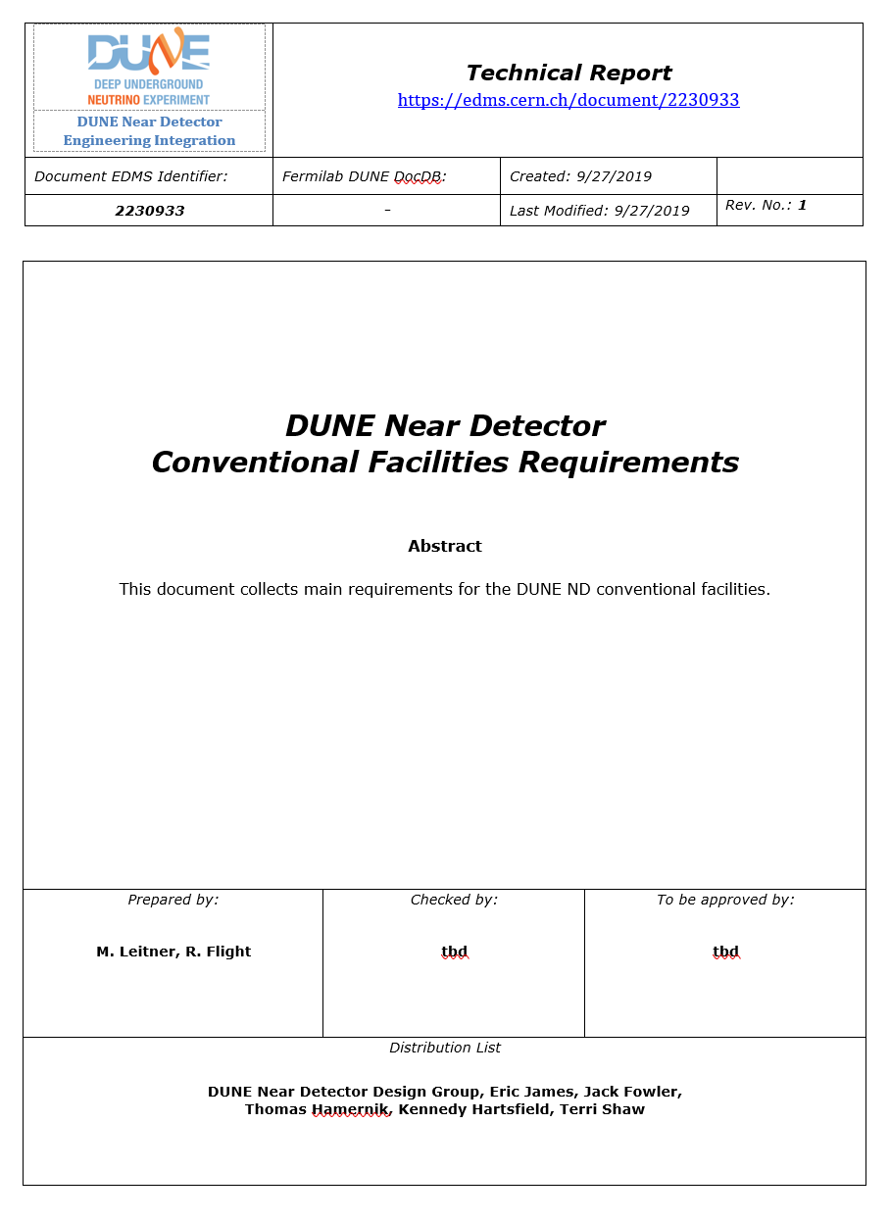
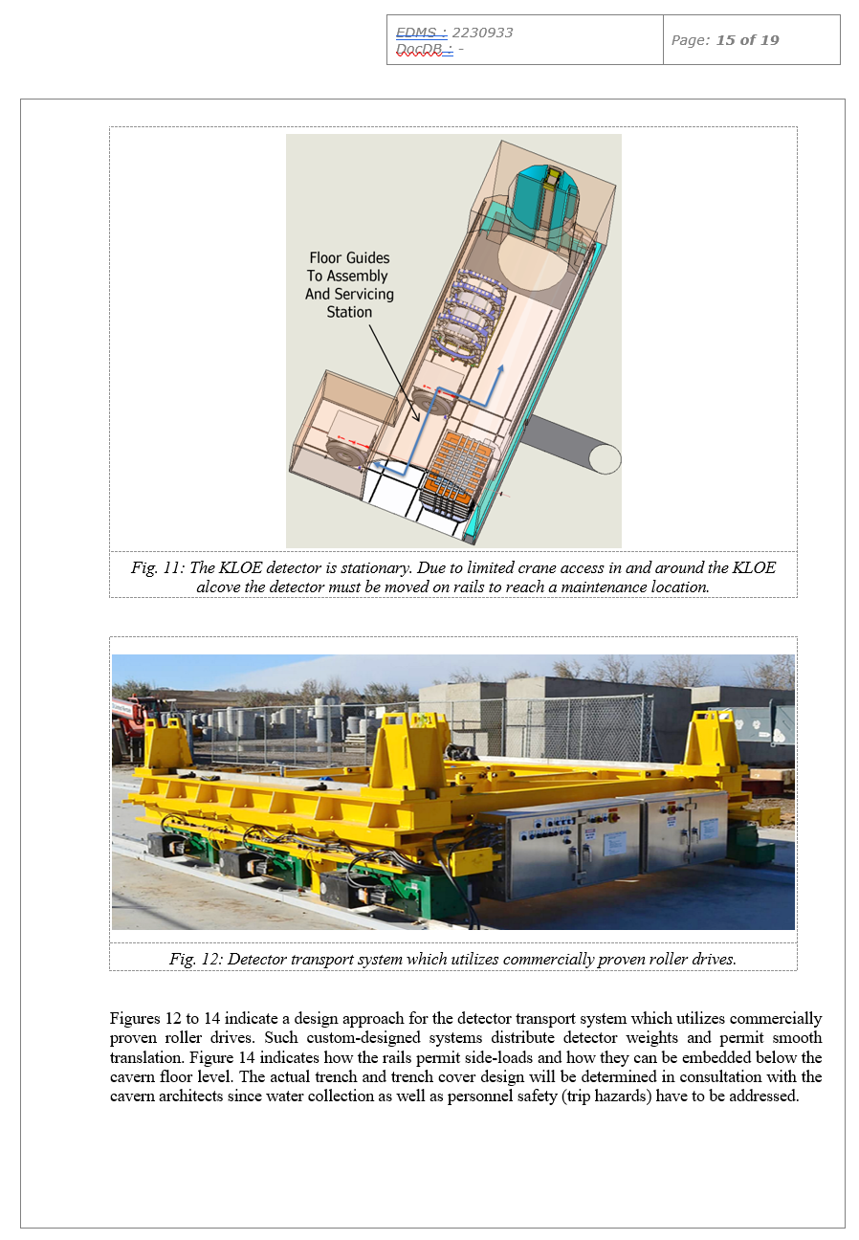
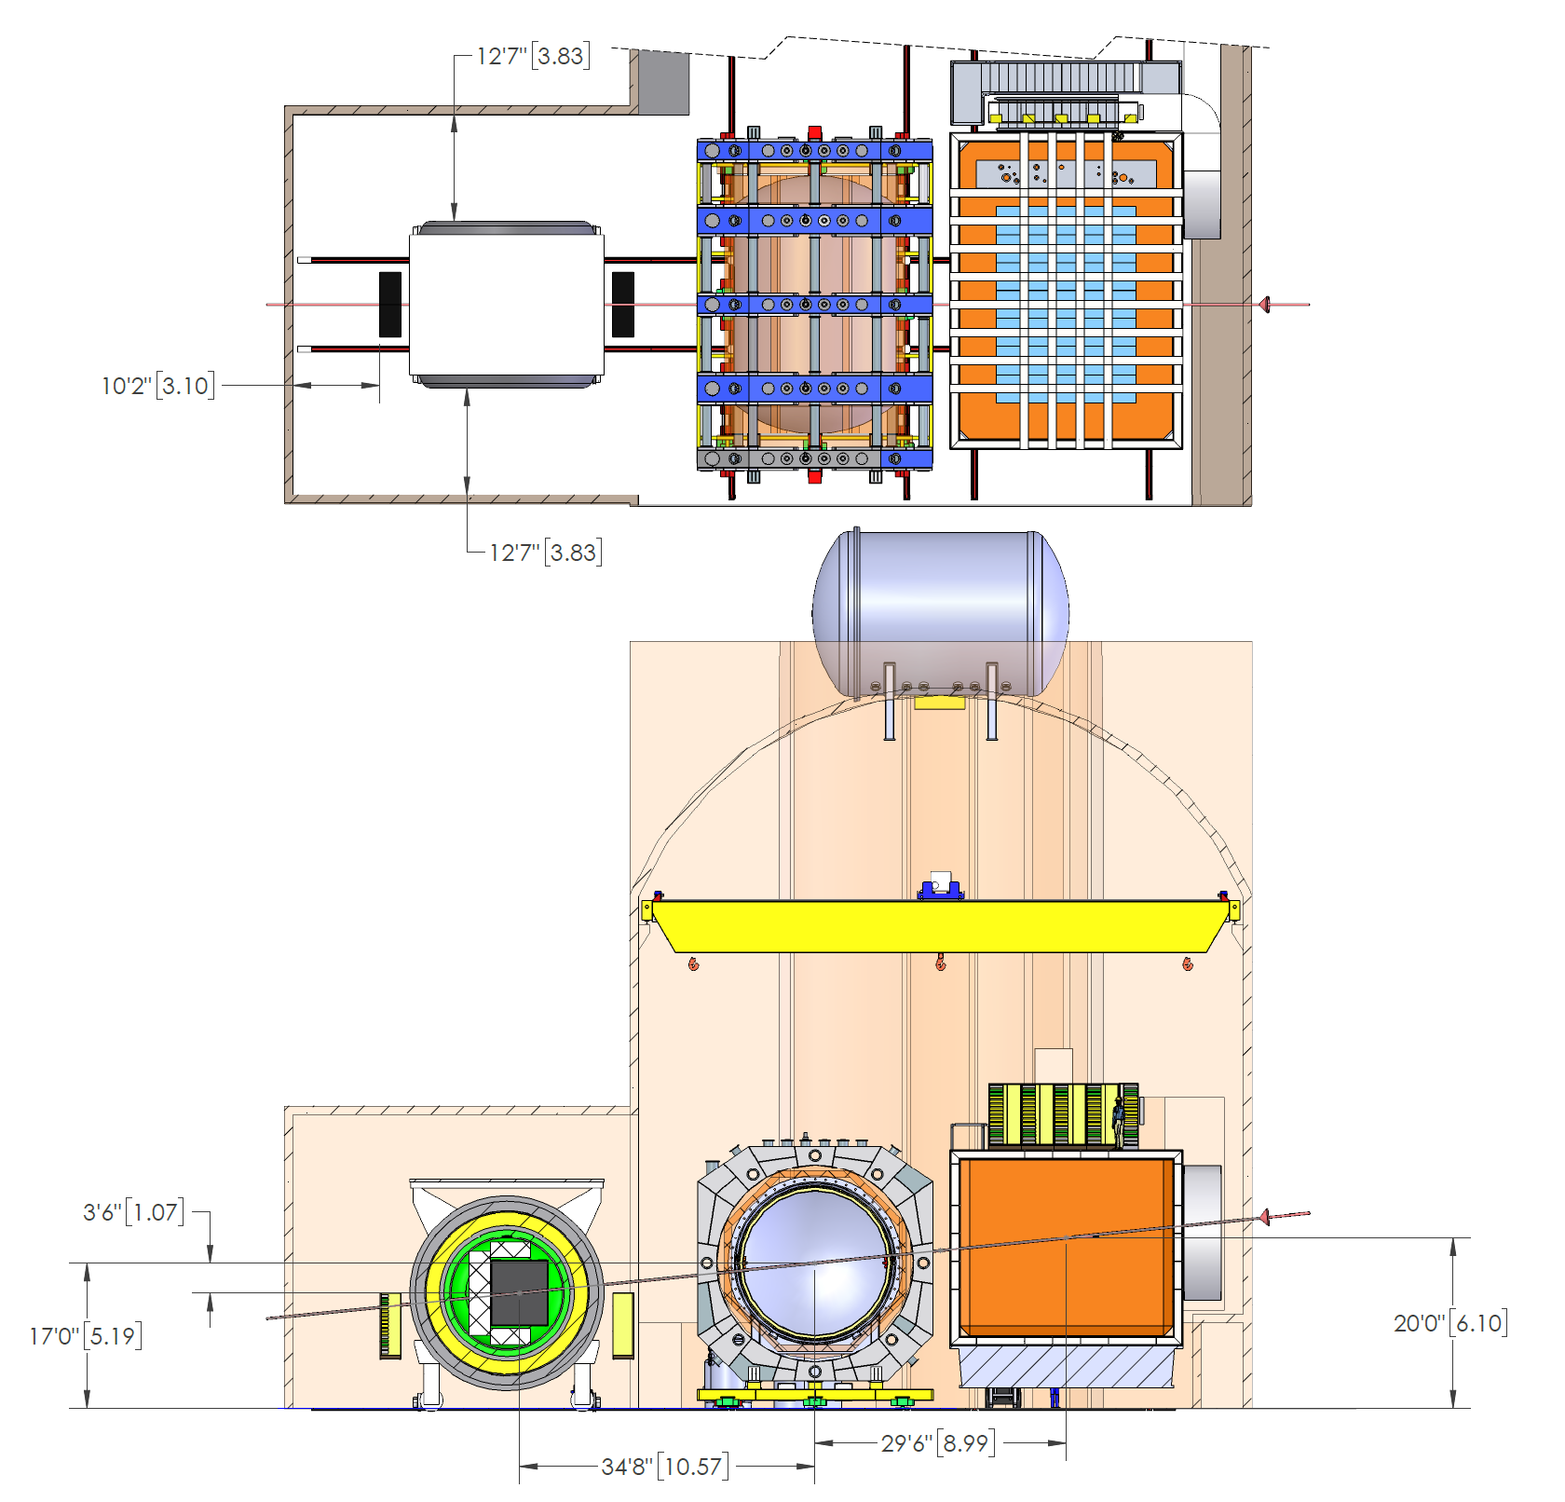
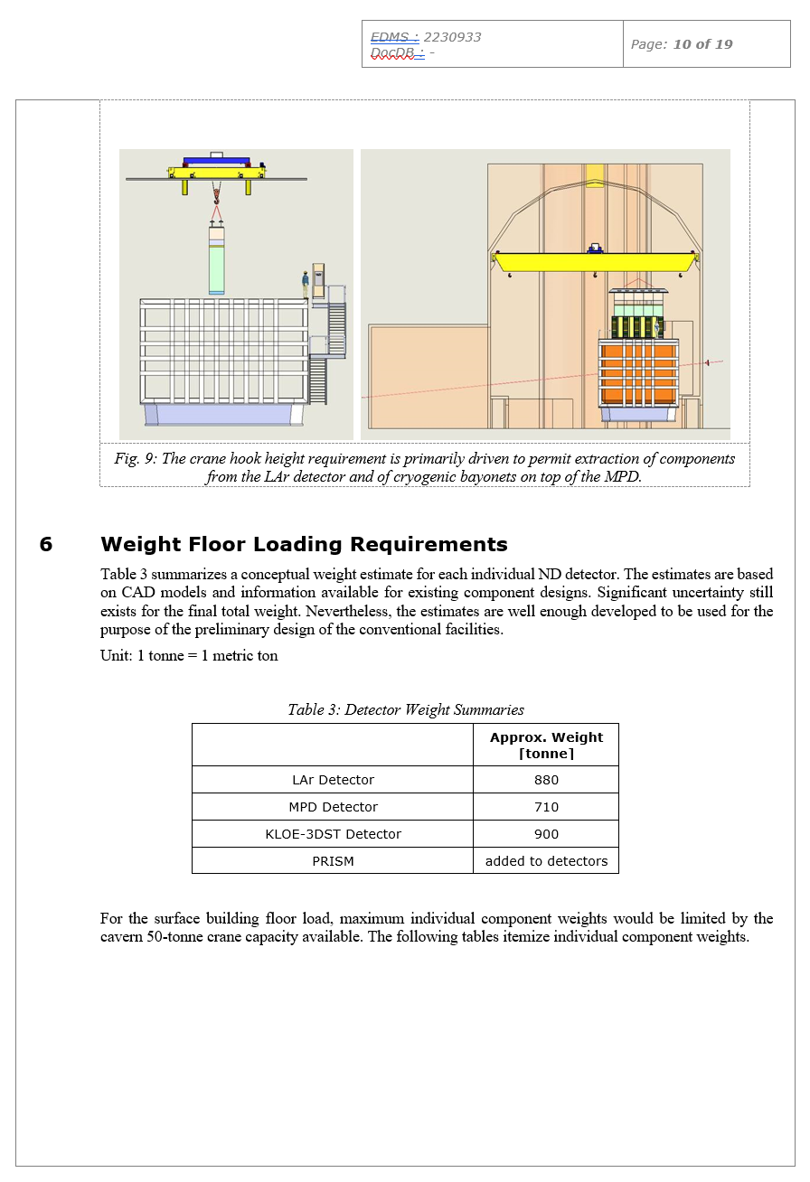
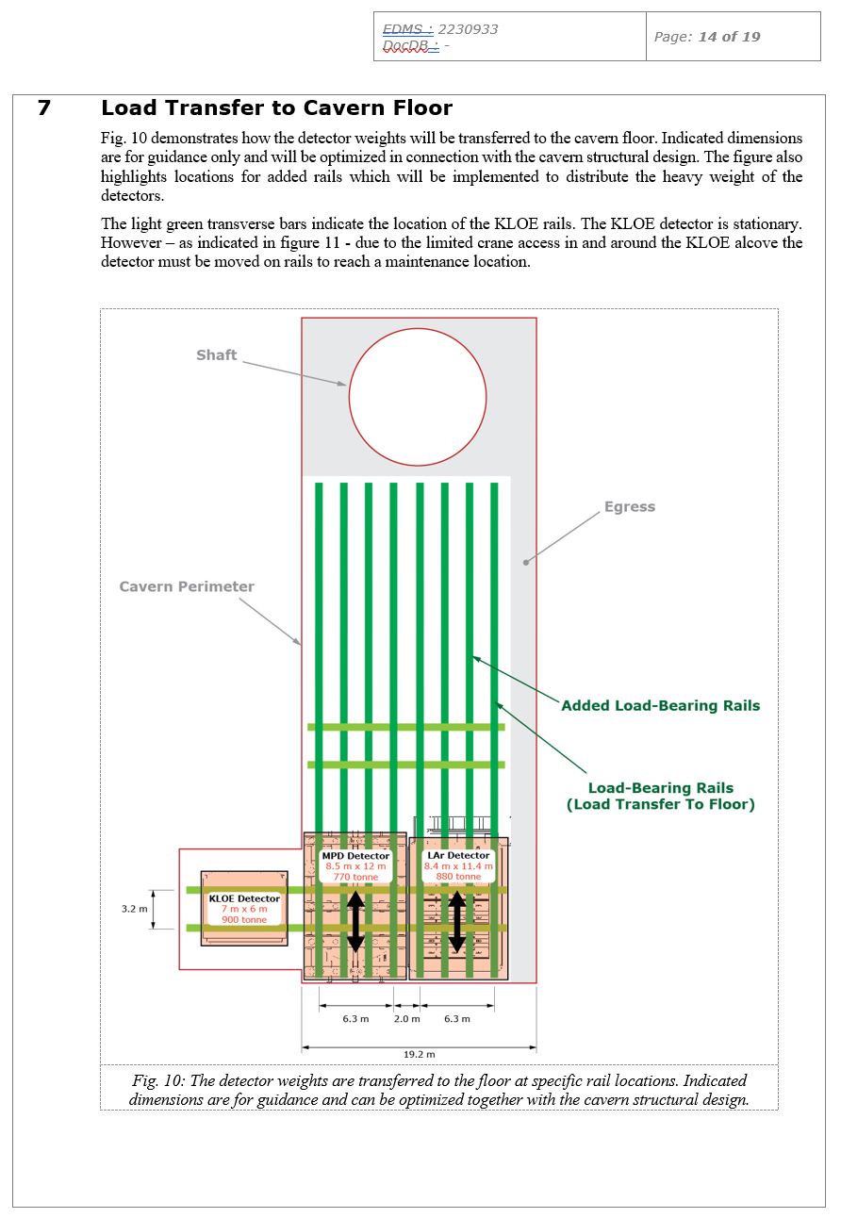
Detector Designs Matured:
ND Requirements Document Defines Facility Interfaces
COMMON 3D CAD MODEL INTEGRATES ALL DETECTOR DESIGNS
INTERFACES ARE CENTRALLY MANAGED
INTERFACE DRAWING
EDMS# 2222899
INTERFACE DOCUMENT
EDMS# 2230933
A frozen document is provided for the Oct DOE IPR on Doc-DB #16604

Slide 22
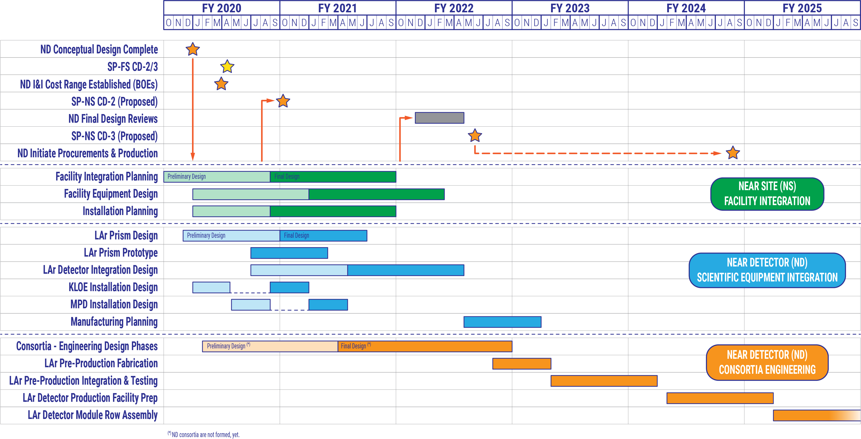
WBS 131.4.2 Integration & Installation
Design, Prototyping, and Pre-Production Schedule
DUNE-ND installation schedule matches US-project P6 schedule

Slide 23
DUNE-ND Integration Design Scope Definition Matures:
Top-Level Schedule Built From Bottom-Up Activities
Facility Integration Planning
(WBS 131.04.02.01)
    Systems Engineering
    Engineering Analysis
    Safety Engineering
    Procurement Planning
    Final Checkout and Energization Plan
          Facility Checkout and Energization Plan
          Prism Checkout and Energization Plan
          LAr Detector Checkout and Energization Plan
          MPD Checkout and Energization Plan
          KLOE Checkout and Energization Plan
    LOE Activities
    M&S
    Travel
Facility Equipment Design
(WBS 131.04.02.01)
    Integrated Facility Layout
    Facility Interface Drawings and Document
    Shaft Utilities
    Cavern Power Routing
    Cavern Water Routing
    Cavern Additional Utilities Routing
    Top Building Power Routing
    Top Building Water Routing
    Top Building Additional Utilities Routing
    Top Building Cryogenic Storage
    Top Building Piping Drawings
    Control Room
    Interfaces with Conventional Facility Rooms
    Mezzanine and Support Structures
    Crane and Maintenance Structures
    Structural Engineering: Attachments to Cavern and Top Building
    Electrical Engineering
        Power Spreadsheet
        Grounding
        Power Distribution
        Controls Layout
    Electrical Routing Design - Cable Trays
    Electrical Routing Design – Racks and Servers
    Electrical Routing Design - Safety Systems
Example Activity Breakdowns
~300 schedule activities
Matches US detector scope schedule
Matches US LBNF/DUNE project schedule
Will be incorporated in P6 in November
Labor and procurement cost envelope already captured in P6

Slide 24
Path To SP-FS CD-2/3: April 2020
Detailed near detector schedule in P6
Near detector initial BOEs
Near detector initial risk analysis
Installation plans
Cavern and detector value engineering
Implement formal configuration control

Slide 25
Path To SP-NS CD-2: October 2020
Near detector BOEs
Near detector risk analysis
Start PRISM detail design
Surface and cavern utilities/cryogenics routing design
Continue detector detail design integration
  Detector interface documents
  Design reviews
Enhance engineering support in remaining disciplines
  Electrical engineering
  Cryogenic engineering

Slide 26
Summary
DUNE near detectors have significantly matured in design.
US-scope near detector baseline design needs to be developed within a year. However, cavern size and major interfaces must mature within months.
US-scope (LBNF, LAr US Scope, I&I) represents a substantial project commitment to the near detector reference design and will benefit the international near detector community.
Staff is now in place to oversee ND systems engineering and to organize design integration and interface definitions.
Integration & Installation (I&I) engineering staff also supports detector design activities related to integration and installation. I&I continues to develop a close working relationship with near detector physics and engineering personnel.

