Slide 1
DUNE
Near Detector Overview
Alfons Weber
for the DUNE ND Design Group
DESY, 21-Oct-2019

Slide 2
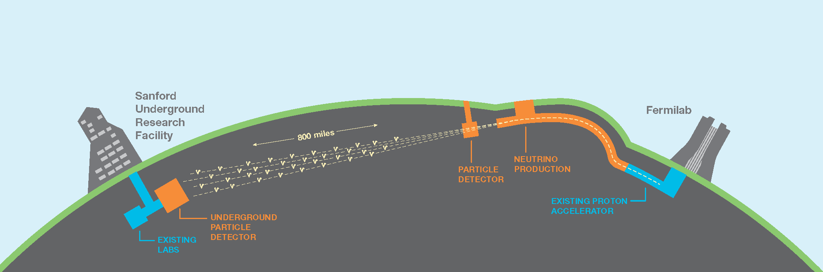
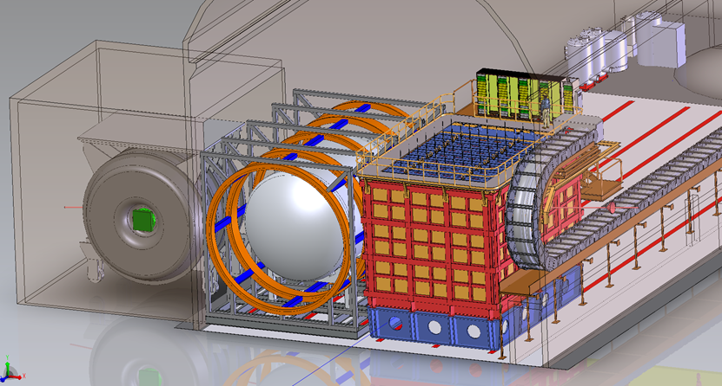
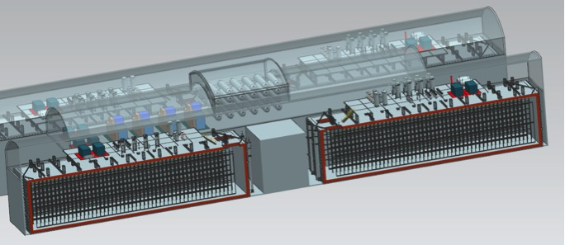
General Setup
LBNF/DUNE will consist of
  An intense 1.2 MW upgradeable 𝜈-beam fired from Fermilab
  A massive 68 kt (40kt instrumented) deep underground LAr detector in South Dakota and a large Near Detector at Fermilab
  A large international collaboration
1300 km
South Dakota
Chicago
ν_{μ}
ν_{μ} & ν_{e}
FD
ND

Slide 3
Physics Program
Neutrino Oscillations
  Search for leptonic CP violation
  Determine neutrino mass ordering
  Precision PMNS measurements
Supernova Physics
  Observation of time and flavour profile provides insight into collapse and evolution of supernova
  Unique sensitivity to electron neutrinos
Baryon number violation
  Predicted by many BSM theories
  LAr TPC technology well-suited to certain proton decay channels (e.g., p→K+𝜈)
  𝛥(B-L) ≠ 0 channels accessible (e.g., n→n)

Slide 4

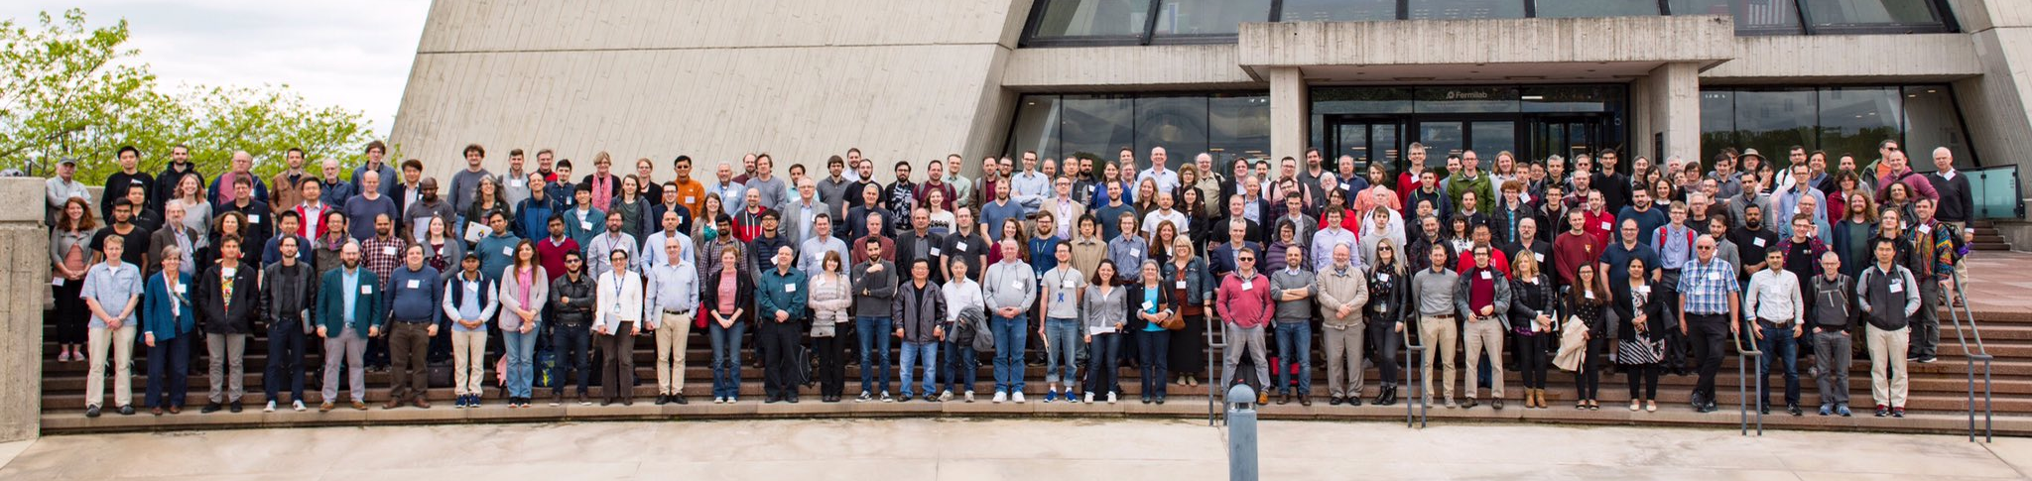
An international science collaboration
1106 collaborators from 184 institutions in 31 countries

Slide 5
Beam
Proton beam energy
60-120 GeV
Power
1.2 MW ➔ 2.4 MW
Neutrinos and anti-neutrinos

Slide 6
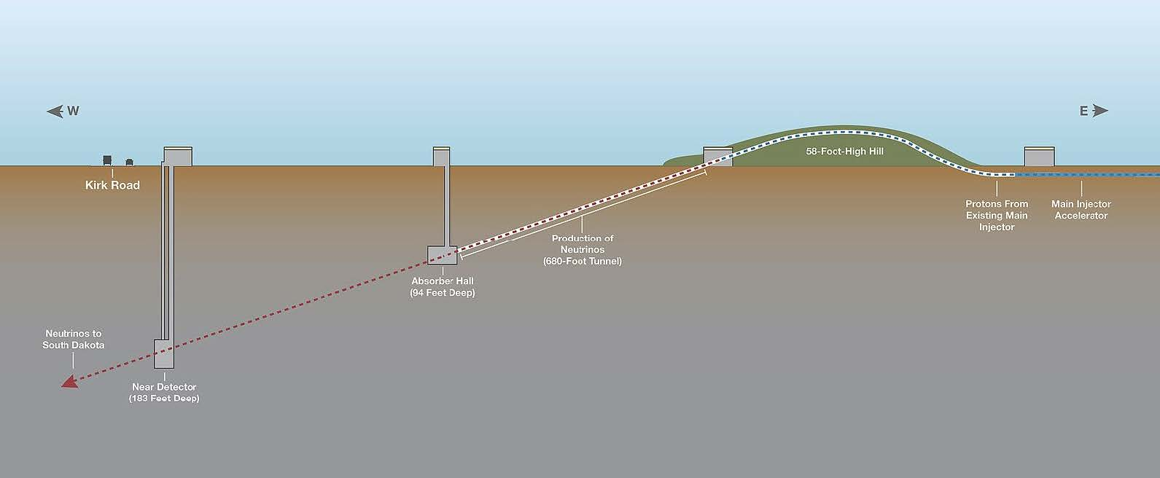
DUNE Near Site
Near detector hall located 574 m from the target and 60 m below the surface

Slide 7
The DUNE Near Detector Complex
Over the past 2 ½ years the DUNE collaboration has developed requirements and a concept design for the near detector complex
Currently, the Near Detector Design Group is tasked with developing a reference design that meets all physics requirements
  Deliver CDR by end of CY 2019
I will present an overview of the requirements and then detail the current reference design

Slide 8

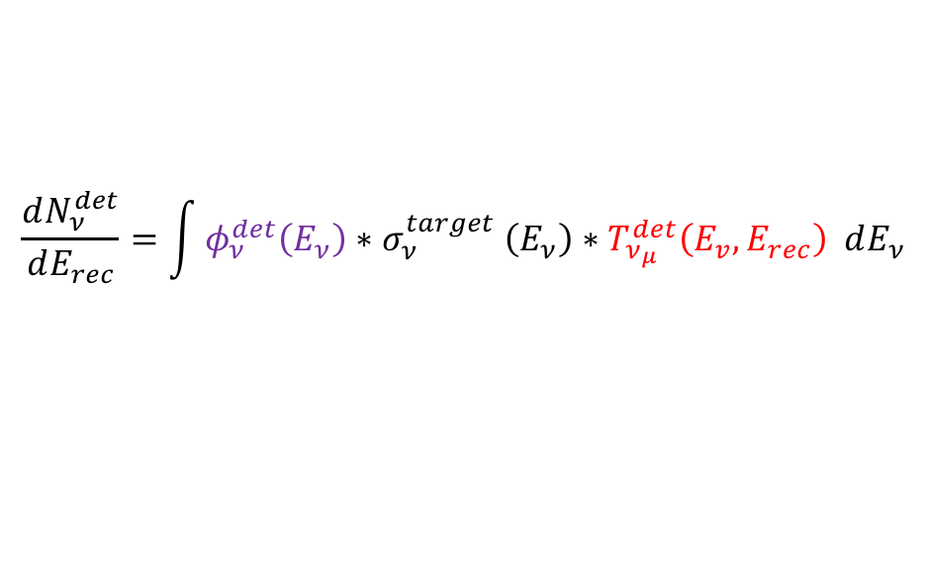
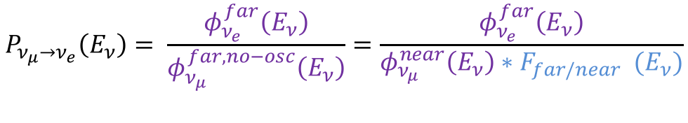
How to Measure Oscillations
Oscillation probabilities
Number of events/energy spectrum
In reality
Folding of detector effects
  Prevents (easy) cancellations of many systematic effects
  Needs unfolding
$$P_{ν_{μ}→ν_{e}}\left(E_{ν}\right)= \frac{φ_{ν_{e}}^{far}\left(E_{ν}\right)}{φ_{ν_{μ}}^{far,no−osc}\left(E_{ν}\right)}=\frac{φ_{ν_{e}}^{far}\left(E_{ν}\right)}{φ_{ν_{μ}}^{near}\left(E_{ν}\right){∗F}_{far/near} (E_{ν})}$$
Well known (1-2%)
$$\frac{dN_{ν}^{det}}{dE_{ν}}=φ_{ν_{μ}}^{det}\left(E_{ν}\right){∗σ}_{ν_{μ}}^{Ar}\left(E_{ν}\right)$$
$$\frac{dN_{ν}^{det}}{dE_{rec}}=\int{φ_{ν}^{det}\left(E_{ν}\right){∗σ}_{ν}^{target}\left(E_{ν}\right)∗T_{ν_{μ}}^{det}\left(E_{v},E_{rec}\right) dE_{ν}}$$

Slide 9
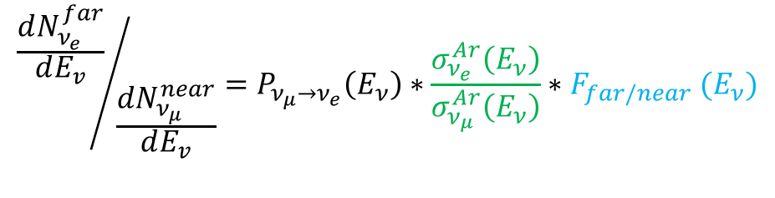
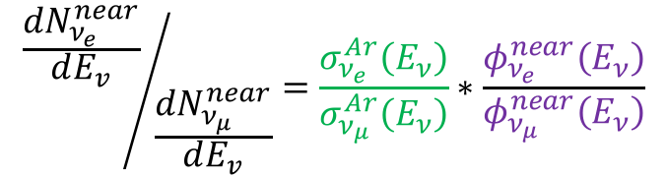
Are there cancellations?
Oscillation signal
Near muon/electron ratio
Need to know
  Flux & cross section ratios
  Far/near extrapolation
Small theo. uncertainty
or measurement
$${\frac{dN_{ν_{e}}^{far}}{dE_{v}}}/{\frac{dN_{ν_{μ}}^{near}}{dE_{v}}}=P_{ν_{μ}→ν_{e}}\left(E_{ν}\right)∗\frac{σ_{ν_{e}}^{Ar}\left(E_{ν}\right)}{σ_{ν_{μ}}^{Ar}\left(E_{ν}\right)}∗F_{far/near} (E_{ν})$$
1-2% uncertainty
$${\frac{dN_{ν_{e}}^{near}}{dE_{v}}}/{\frac{dN_{ν_{μ}}^{near}}{dE_{v}}}=\frac{σ_{ν_{e}}^{Ar}\left(E_{ν}\right)}{σ_{ν_{μ}}^{Ar}\left(E_{ν}\right)}∗\frac{φ_{ν_{e}}^{near}\left(E_{ν}\right)}{φ_{ν_{μ}}^{near}\left(E_{ν}\right)}$$
Not so small uncertainty

Slide 10
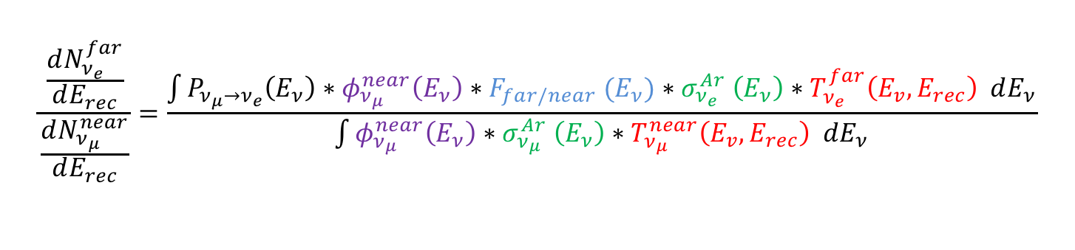
But in Reality
$$\frac{\frac{dN_{ν_{e}}^{far}}{dE_{rec}}}{\frac{dN_{ν_{μ}}^{near}}{dE_{rec}}}=\frac{\int{P_{ν_{μ}→ν_{e}}\left(E_{ν}\right)∗φ_{ν_{μ}}^{near}\left(E_{ν}\right){∗F}_{far/near}(E_{ν}){∗σ}_{ν_{e}}^{Ar}\left(E_{ν}\right)∗T_{ν_{e}}^{far}\left(E_{v},E_{rec}\right) dE_{ν}}}{\int{φ_{ν_{μ}}^{near}\left(E_{ν}\right){∗σ}_{ν_{μ}}^{Ar}\left(E_{ν}\right)∗T_{ν_{μ}}^{near}\left(E_{v},E_{rec}\right) dE_{ν}}}$$
No cancellations
  Unless you unfold
Need to understand especially
  Detector effects in near and far detector
  Relation of visible to neutrino energy
  Cross section ratios
  Near to far flux extrapolation
Flux normalisation cancels
  Shape is more important

Slide 11
Overarching ND Requirements
O0: Predict the neutrino spectrum at the FD: The Near Detector (ND) must measure neutrino events as a function of flavor and neutrino energy. This allows for neutrino cross-section measurements to be made and constrains the beam model and the extrapolation of neutrino energy event spectra from the ND to the FD.
O0.1 | Measure interactions on argon | Measure neutrino interactions on argon, determine the neutrino flavor, and measure the full kinematic range of the interactions that will be seen at the FD.
O0.2 | Measure the neutrino energy | Reconstruct the neutrino energy in CC events and control for any biases in energy scale or resolution.
O0.3 | Constrain the xsec model | Measure neutrino cross-sections in order to constrain the cross section model used in the oscillation analysis.
O0.4 | Measure neutrino flux | Measure neutrino fluxes as a function of flavor and neutrino energy.
O0.5 | Obtain data with different neutrino fluxes | Measure neutrino interactions in different beam fluxes in order to disentangle flux and cross sections and verify the beam model. (PRISM)
O0.6 | Monitor the neutrino beam | Monitor the neutrino beam energy spectrum with sufficient statistics to be sensitive to intentional or accidental changes in the beam on short timescales.

Slide 12
Beyond νSM Physics
The near detector facility will provide a very powerful system to study:
  Boosted dark matter
  Sterile neutrinos
  Neutrino tridents
  Heavy Neutral Leptons
  millicharged particles
  Unknown, unknowns………
More details in Silvia’s talk later
See: POND²
Physics Opportunities in the Near DUNE Detector Hall
https://indico.fnal.gov/event/18430/overview

Slide 13
Near Detector Complex
Four main components, working together:
  Liquid argon detector (ArgonCube)
  Downstream tracker with gaseous argon target
  (MPD)
  LAr and GAr systems can move to off-axis fluxes
  (PRISM concept)
  On-axis neutrino beam monitor with neutron detection capability
  (3DST-S+KLOE)
High statistics constrains
  Cross section & neutrino flux
3DST-S+K
MPD
LAr

Slide 14
Detector Functionality
Multi-pronged approach with complementary integration leading to tremendous robustness:
ν interactions on Ar
  LAr provides ν-Ar interaction as seen by FD
  MPD provides ν-Ar interactions with sign selection, very low thresholds, and minimal secondary interactions
Integration
  MPD is necessary to complete reconstruction of events in LAr detector
    μ spectrometer
  ECAL necessary to complete reconstruction of interactions in the HPgTPC (like collider detector)
  Muon system to help with muon/pion seperation
Beyond interactions on Ar: Extended capability in 3DST-S+KLOE
  provides detailed fixed, on-axis beam monitoring
  provides look at ν-CH interactions with novel neutron detection capabilities

Slide 15
Flux & Event Rates @ ND570
Optimized CPV tune
FHC On-axis
1.25 MW
Events/year in Fiducial volume
Detector | Target (Fid. mass t) | # ν_{μ} CC (X10⁶)
LAr | Ar (50) | 80
HPgTPC | Ar (1) | 1.5
3DST-S | CH (8) | 12

Slide 16
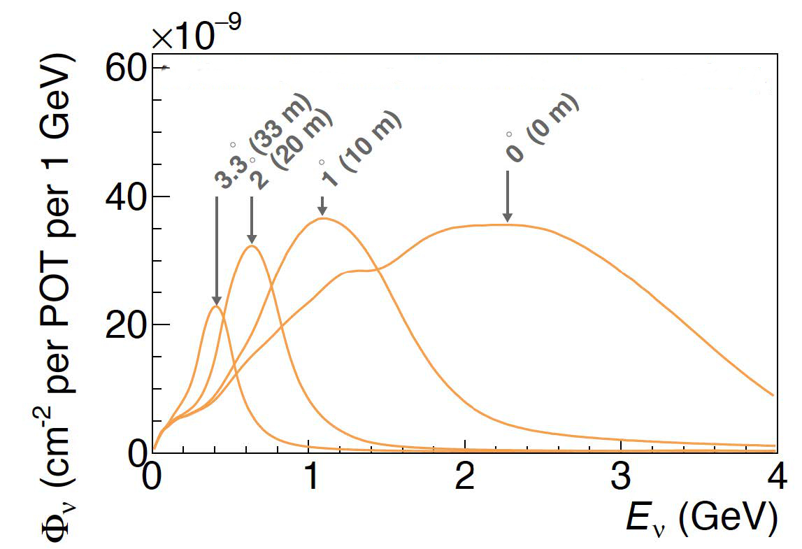
Taking Data Off-axis
The DUNE near detector complex will allow for off-axis running in order to accommodate the PRISM concept
  Precision Reaction Independent Spectrum Measurement
Flux varies as a function of detector transverse position
Pseudo-monochromatic beams can be formed by taking linear combinations of beam data at different off-axis positions
These can help in understanding of relationship between E_{ν} and E_{reco} and thus help deconvolve the flux and cross section uncertainties
Can predict oscillated neutrino event spectra at FD with reduced model dependence

Slide 17
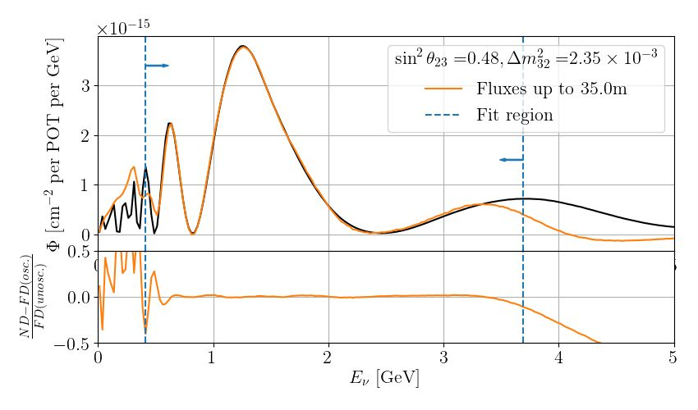
PRISM
Predict oscillated neutrino event spectra at FD with reduced model dependence
  Form “oscillated” flux at near detector with linear combinations of off-axis data
  Extrapolate to Far detector
  Interaction model independent

Slide 18
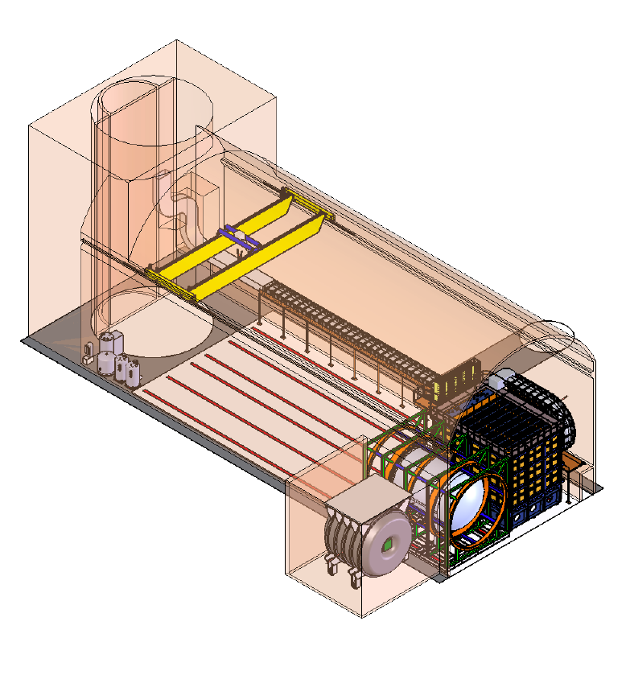
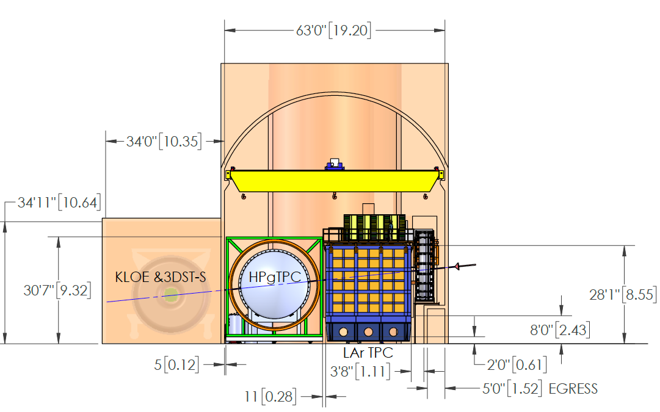
Near Detector Hall
~19m
~40m
~31m (3.3º) travel

Slide 19
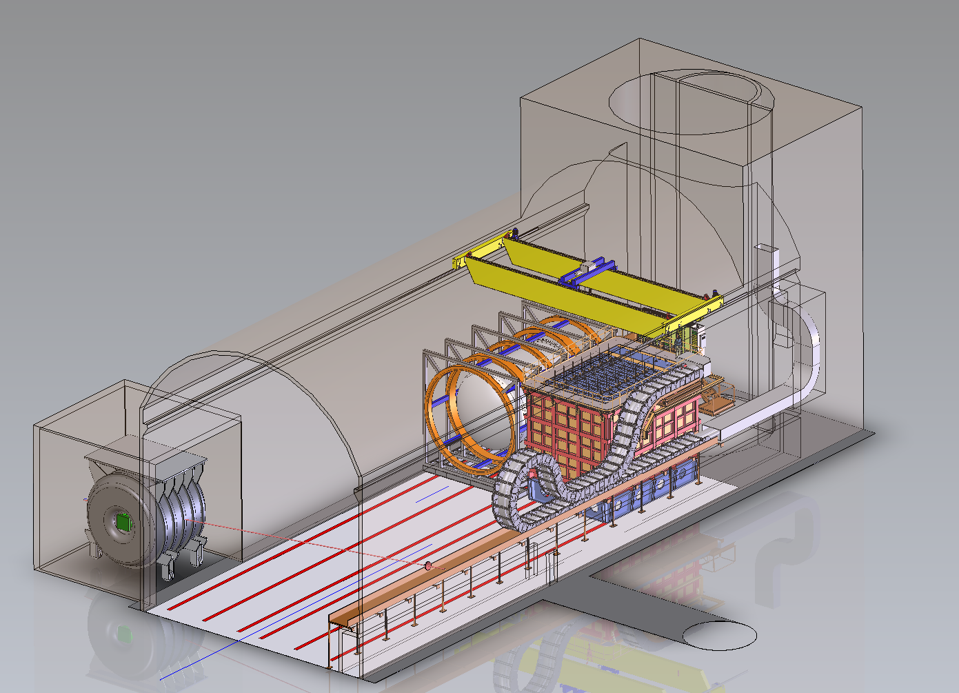
Detectors at Extreme Off-axis Position

Slide 20
Detector Systems

Slide 21
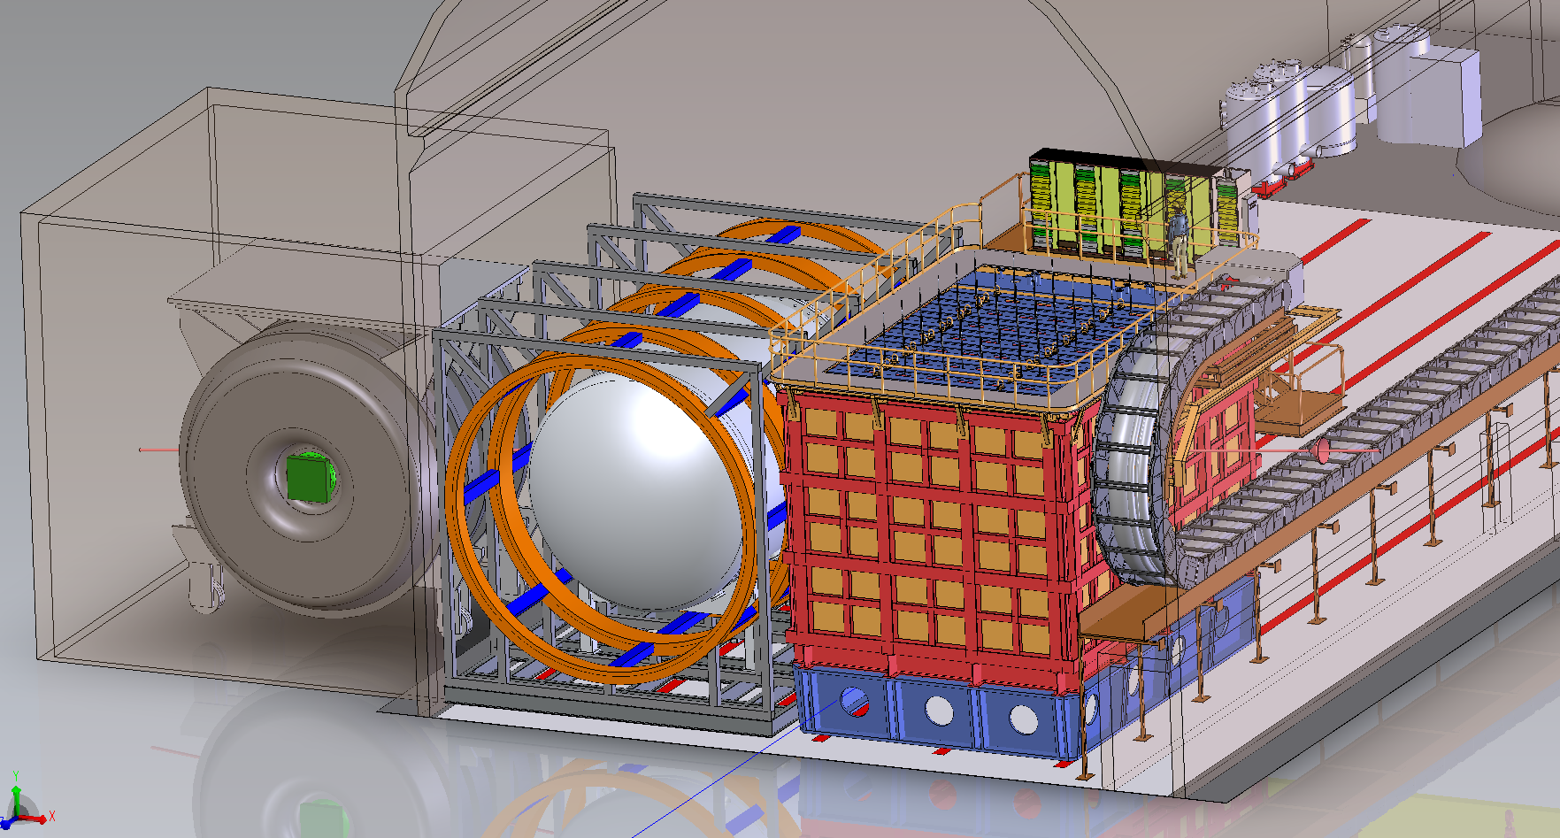
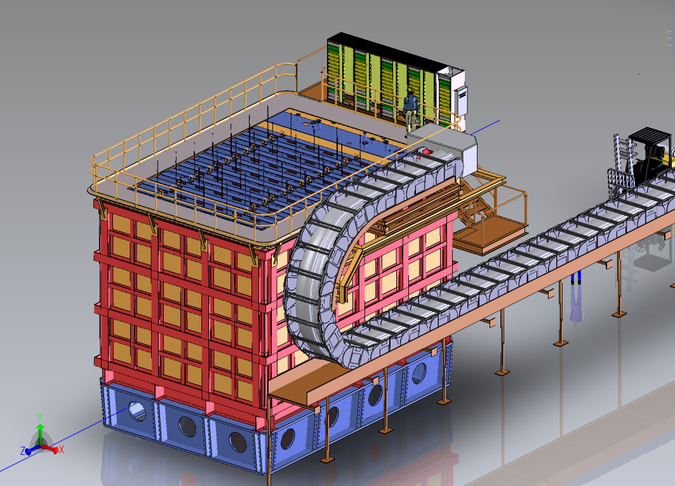
LAr Overview
ArgonCube concept
Pixelated readout to accommodate high rate (>5 evts/spill)
  12 million pads
  ~2 billion voxels
Active volume:
  5 m deep in beam direction and 3 m tall for hadronic shower containment.
  7 m transverse to mitigate side muon spectrometer.
Active mass ~ 150t
  50t fiducial (3m X 2m X 6m)
    Hadronic containment
Divided into 35 modules:
  1 m x 1 m x 3.5 m
  50 cm drift, 50 kV max
Can move off axis

Slide 22
Prototyping Activities
Almost full size module in
2x2 cryostat
Pixel ASIC
Resistive shell TPC

Slide 23
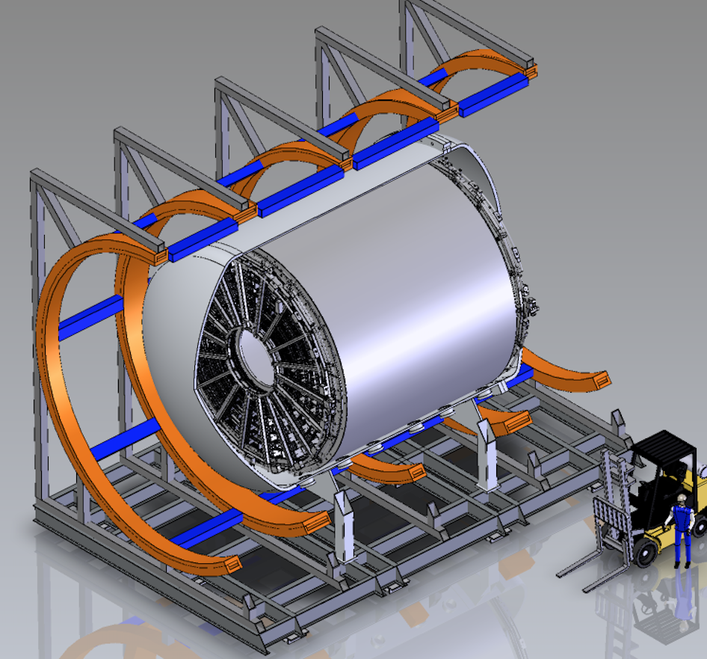
Multi-Purpose Detector Overview
High pressure (10bar) gas TPC + ECAL + SC magnet + μ tag
Provides muon spectrometry for muons leaving LAr
  LAr event containment
Provides an independent, statistically significant event sample on Ar gas
  Sign selection
  Full 4π coverage
  Very-low tracking threshold
  Essentially no secondary interactions
    Low density
Can move off axis

Slide 24
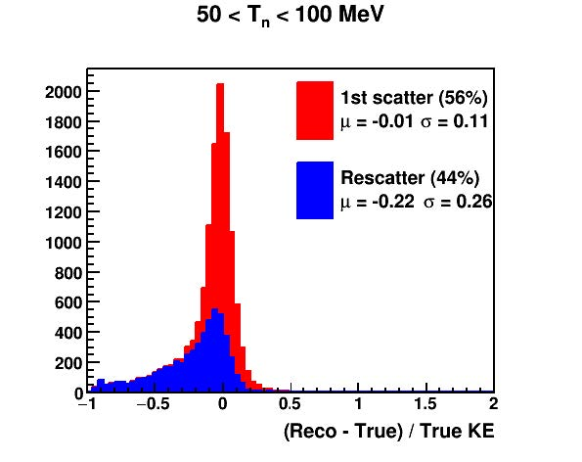
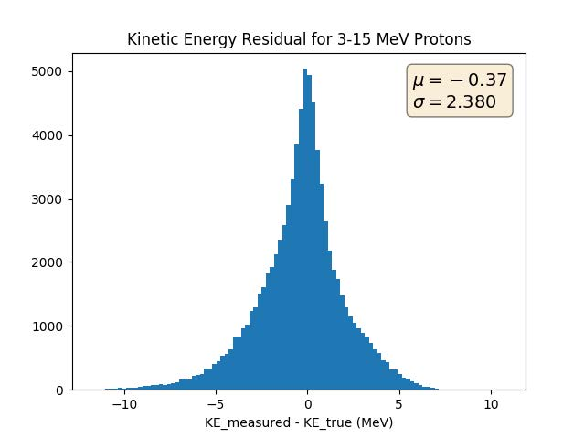
MPD Capabilities
Neutrons
Low-energy protons
GArSoft reconstructs event, outputs TPC hits
TPC hits are assigned to proton candidate sets using RANSAC based algorithm
Each proton candidate set is passed to a neural net trained on single proton events to predict KE
The ECAL has neutron detection capability
With time stamp from charged particle
  Very good energy resolution when reconstructed neutron scatter is the first one
  But due to the high passive fraction, ~50% of the events are re-scatters

Slide 25
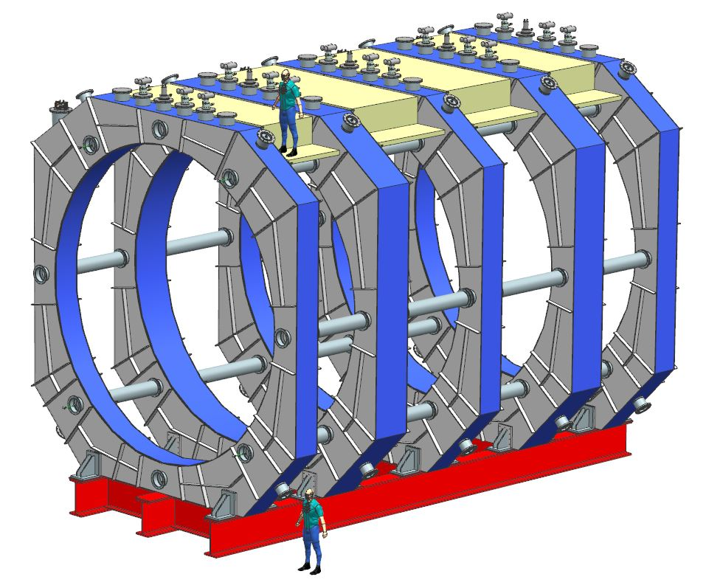
Magnet: Superconducting 3-coil Helmholtz System with 2 Superconducting Bucking Coils
Overarching requirements
  Large acceptance for particles leaving LAr
  Present minimal mass
Central field = 0.5T
Side coils at 2.5 m, shielding coils placed at 5 m from the magnet center in Z.
  All coils have the same inner radius (3.5m)
  Center and shielding coils are identical.
Basic magnetic, cryostat and structural designs complete
Magnet design concept

Slide 26
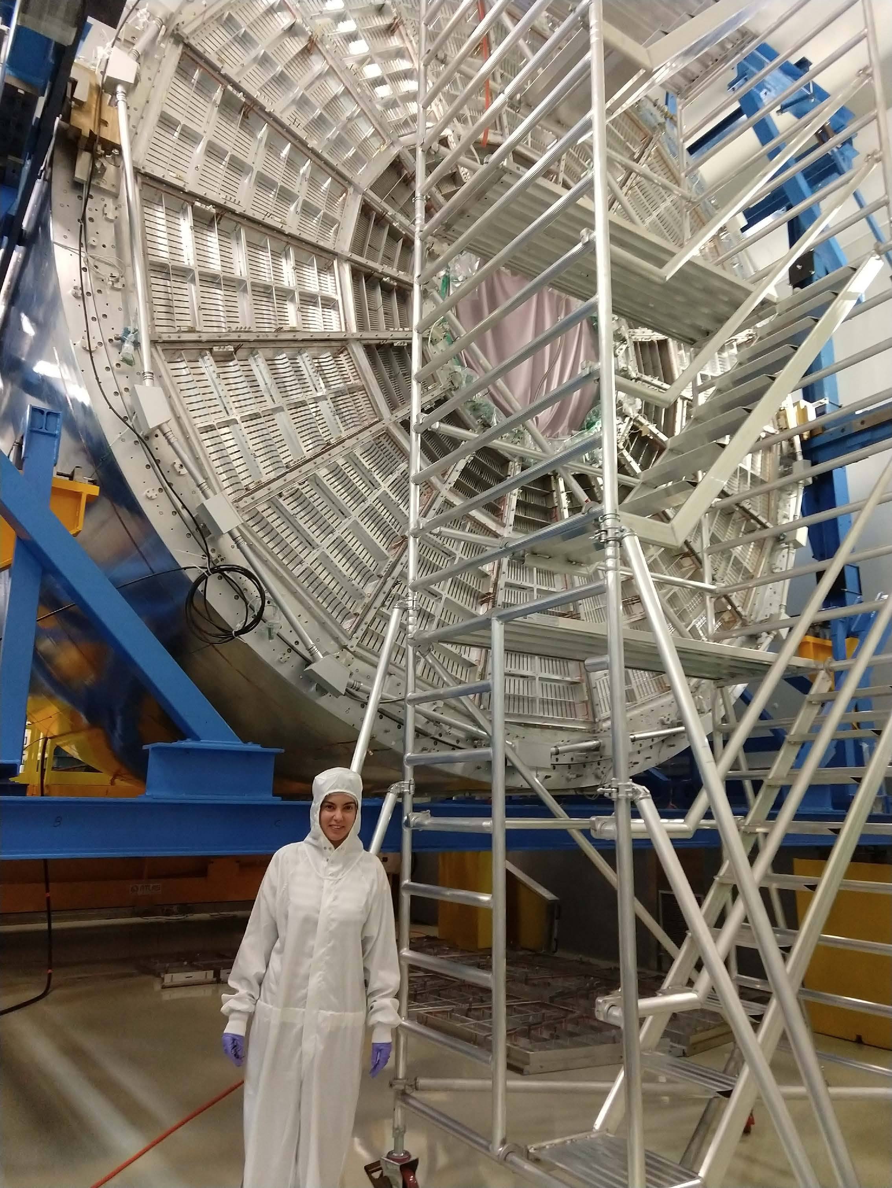
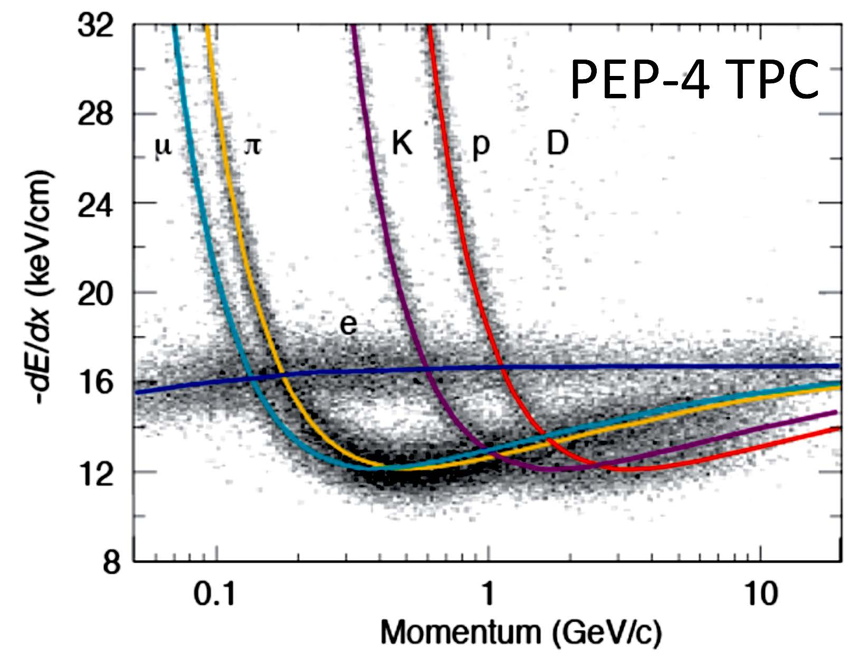
High-Pressure gas TPC (HPgTPC)
Well established technology
Vetted detector design
Build copy of ALICE TPC reusing their
wire chambers
We expect ~ 2% dE/dx resolution based on PEP4
ALICE obtains 5-6%

Slide 27
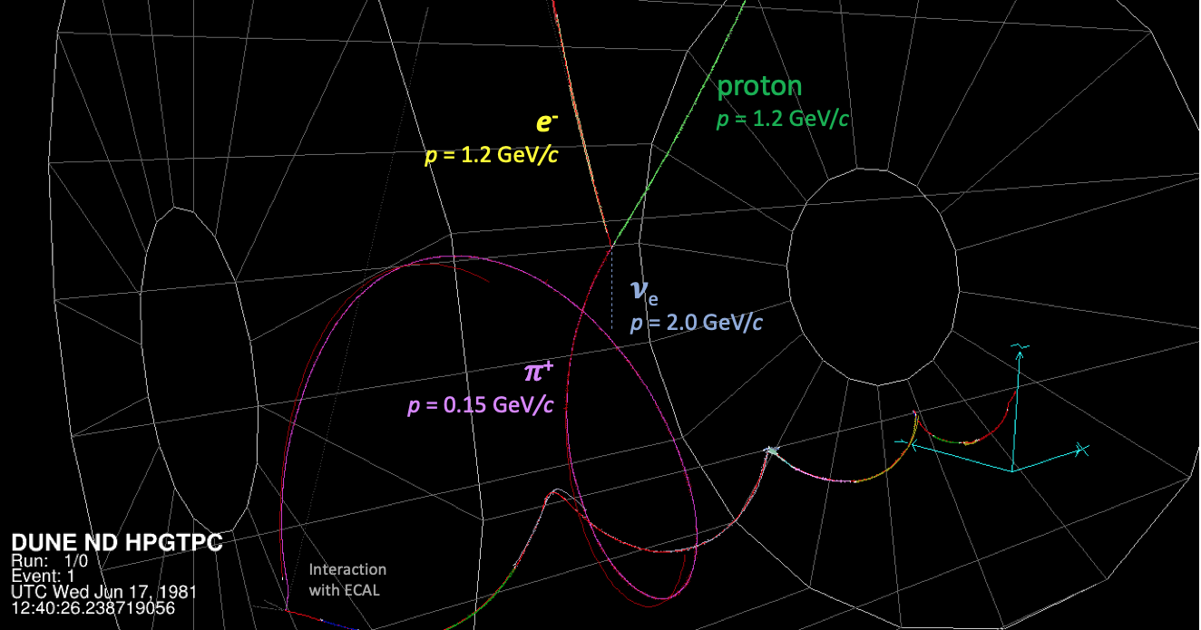
A Simulated and Reconstructed 𝝂_{e} Charged Current Event in the HPgTPC
𝝂_{e} + Ar → e- + 𝜋+ + p + n
Neutron with p = 0.23 GeV/c at the P.V. not shown

Slide 28
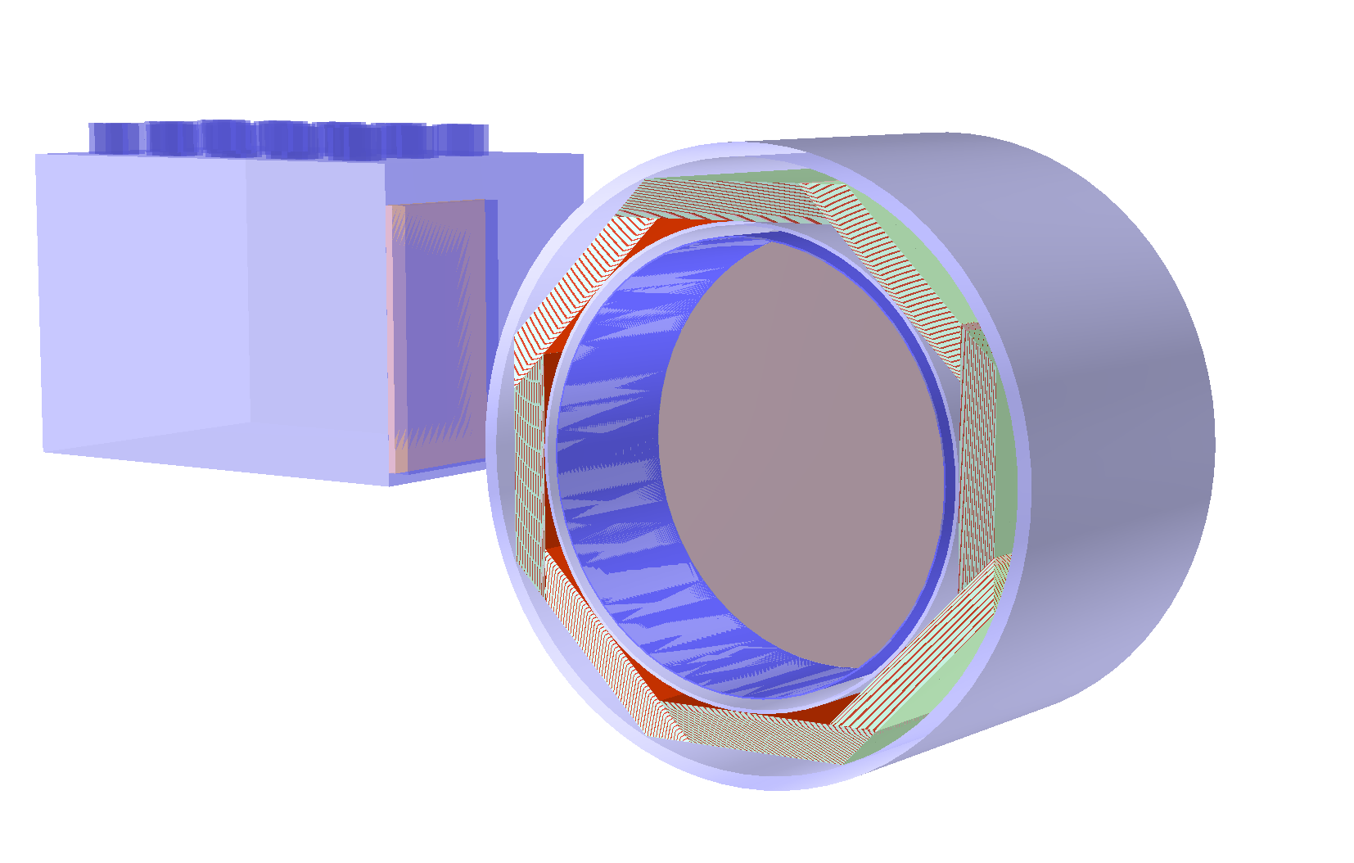
ECAL
Surrounds HPgTPC to detect photons and neutrons
Plastic scintillator tiles & strips – CALICE architecture
SiPM readout now affordable due to recent significant cost reductions
Initiated detailed optimization study

Slide 29
Need for Muon System
ECal thickness ~ 1 𝜆
1/3 of pions don’t interact in ECal
Solution
  additional absorber
  Muon system

Slide 30
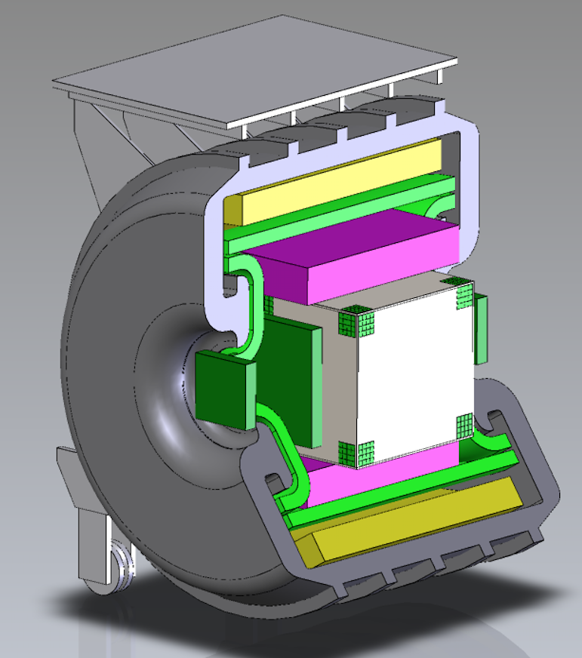
3DST-S+KLOE Overview
Provides precision on-axis monitoring of neutrino beam through rate, profile, and spectrum measurements
Consists of
  Active target (8t) consisting of
  3-dimensional plastic scintillator tracker
  tracking
    Atmospheric pressure TPCs or straws
  KLOE EM calorimeter
    Scintillator fiber + Pb
  KLOE magnet system
    0.6T central field (SC magnet)
    Return Fe
Fixed on-axis position

Slide 31
3DST-S+KLOE Details
Active scintillating target composed of 1x1x1cm³ scintillator cubes
  2.4 x 2.4 x 2 m³ total volume
  fine-grained, isotropic tracking (proton tracking to ~300 MeV/c)
  neutron tagging and spectrometry by time-of-flight
Surrounded by tracking detectors and ECAL in magnetic field
High-performance beam monitor
+
Independent physics program (ν_{μ} + CH)

Slide 32
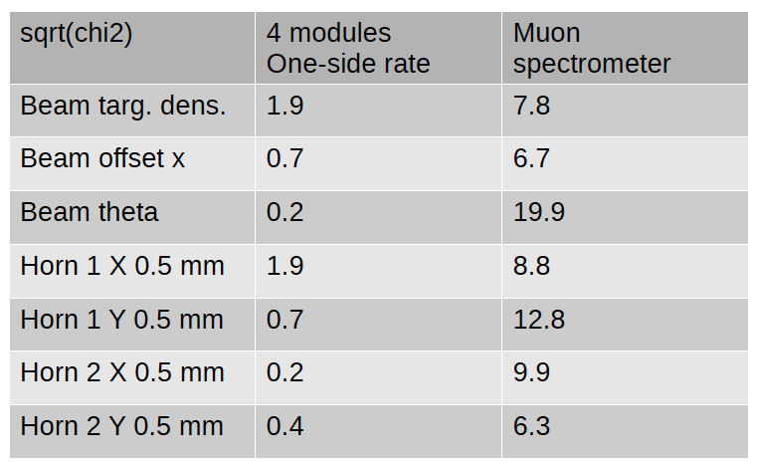
3DST-S+KLOE Capabilities
Precision on-axis flux monitor
  Sufficient rate, spectrometry capabilities, and transverse span
Neutron detection
  New capability in neutrino detectors
  Nascent capabilities in MINERνA show potential
ν-CH sample
  Cross check ν-A modelling across A
  Connect to “historic” data sets
  Provides cross check on flux measurements with very different detector technology and capabilities
Comparison between Ingrid-like
system and spectrometer.
Preliminary

Slide 33
Timeline
May 2018: Conceptual design of ND
May 2018: FD IDR
July 2018: Completion of ProtoDUNE-SP construction
July 2019: Commissioning of ProtoDUNE-DP
Dec 2019: ND CDR
Early 2020: baseline LBNF & DUNE-US (CD2/3a)
Dec 2020: ND TDR, reviews
2021/22: ProtoDUNE running post LS2
Aug 2024: Installation Module 1
Aug 2025: Installation Module 2

Slide 34
Opportunities
We are close to a CDR ➔ Conceptual
  Everything needs more thought, design, work,…
Examples (incomplete)
  Muon system
    Muon/pion separation
    Cosmic trigger
  DAQ
    LAr, MPD, …
  Trigger and timing
    Beam, calibration, cosmic
  Detectors
    Pay attention to the talks!

Slide 35
Conclusions
DUNE has developed a near detector reference design that has wide-ranging capability (calorimetric, spectrometer, PID, multiple target nuclei, off-axis measurements)
  LAr, MPD (HPgTPC+ECAL+Magnet+μ tagger) and 3DST-S+KLOE
    Basic technical/engineering foundations in place for most
With these detectors and the LBNF beam, we will accumulate enormous statistics in all channels, including neutrino-electron elastic scattering
Aggressive 3-pronged approach to CPV
Opportunities to study the νSM, BSM physics and neutrino interaction physics are extensive

Slide 36
Thank You

Slide 37
BACKUPS

