Slide 2
ICARUS 3d Simulations
Diego Zambelli - CERN EN-HE
Julia Laast– CERN EN-CV, CFD team

Slide 3
Scope and CFD study structure
The scope of this project is to determine the Temperature and air Velocity distribution within the 3d geometry of the Icarus building.
The input geometry will be simplified, executing CFD simulations including all heat sources.
Input
Simplified 3d Geometry
Geometrical Model
fluid body
Meshing
Post-processing
and Results
Calculation
Input
Boundary conditions and heat fluxes

Slide 4
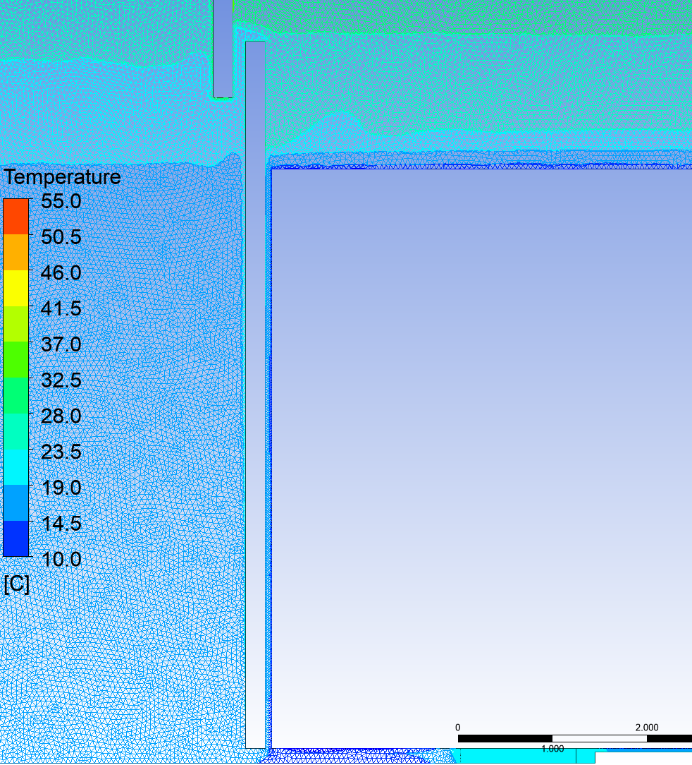
2D Simulation
Negligible thermal effects in small gaps, only global phenomena have been investigated

Slide 5
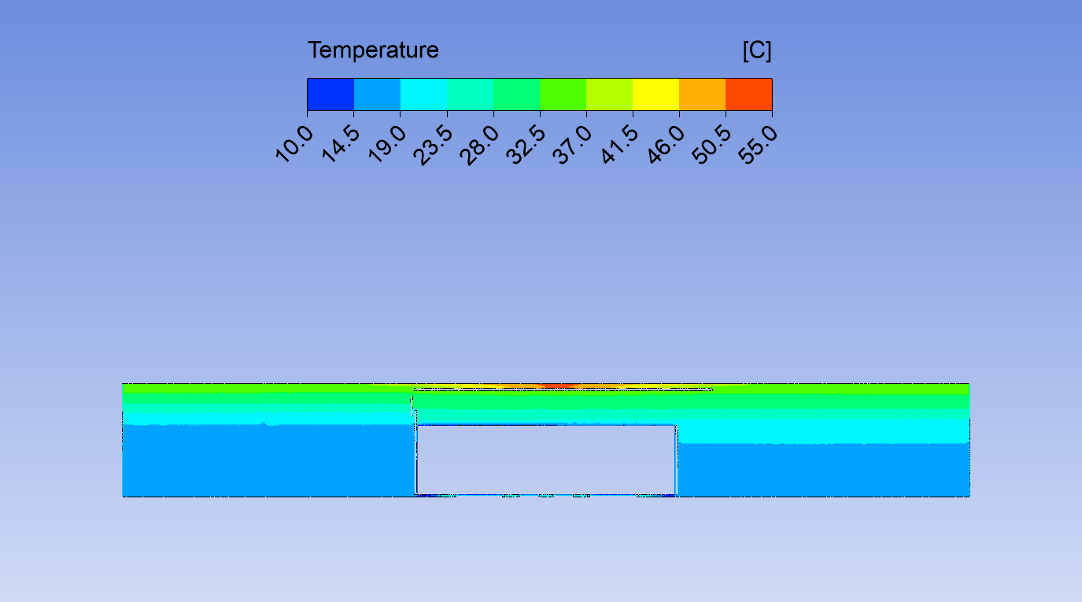
2D Simulation
Based on the 2D results, the global temperature distribution has to be investigated further

Slide 6
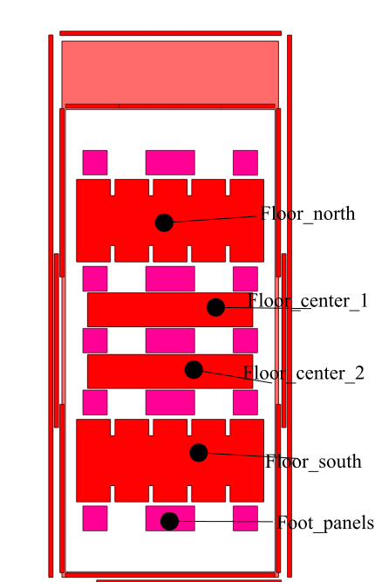
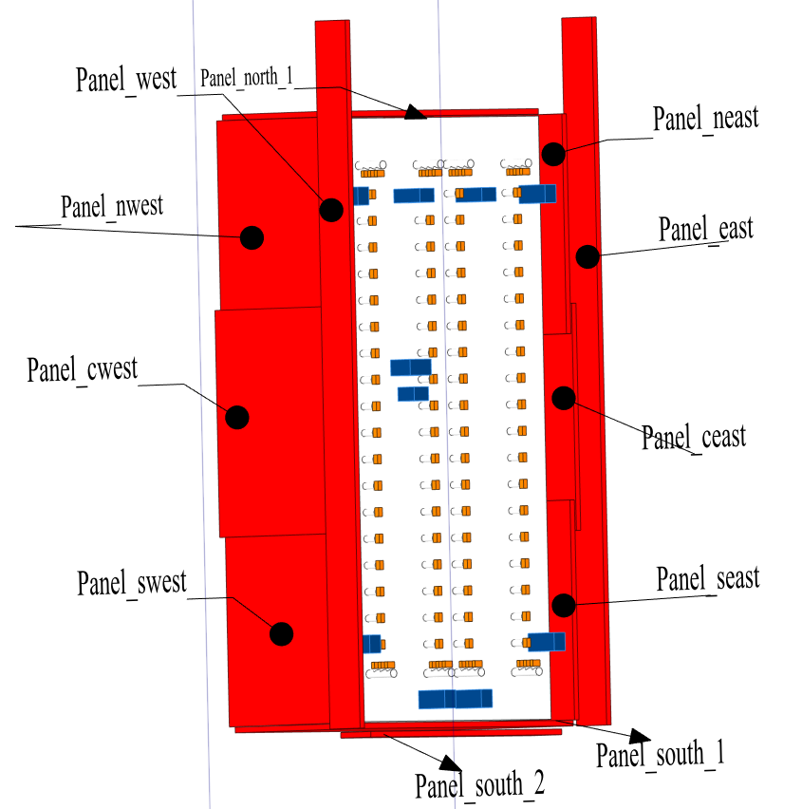
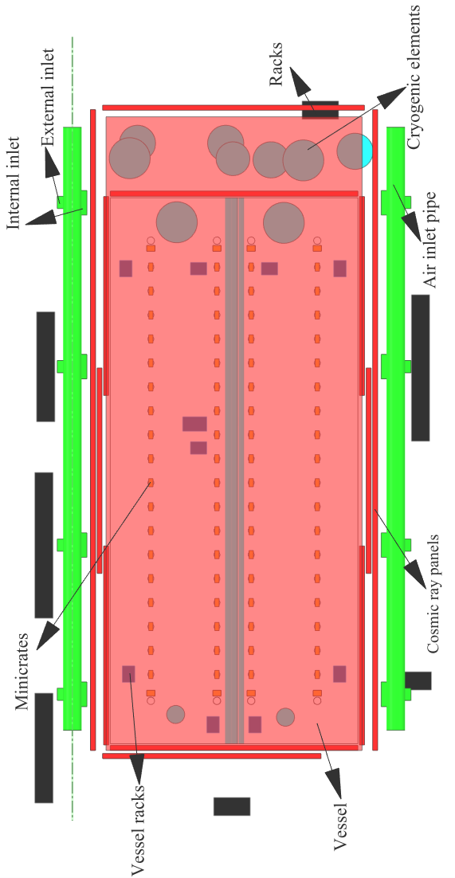
Geometry 3d Geometry
Top view
Paneling system
Bottom view

Slide 7
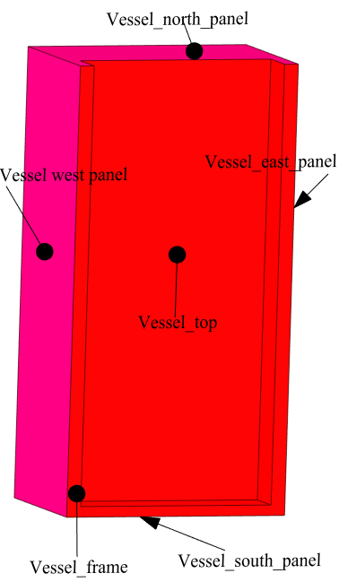
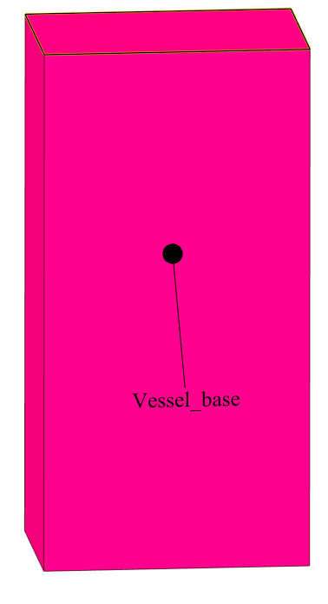
Geometry Simplified 3d Geometry
Main changes:
Merging of minicrates
Elimination of long cryogenic pipes and foot panels
Merging of cosmic ray panels with vessel except upper panels
Top view
Paneling system
Bottom view

Slide 8
Geometrical model

Slide 9
Component heat fluxes (as provided by Fermilab)
Component | Area (m²) | Power (W) | Heat Flux (W/m²)
Minicrates
Minicrates west | 57.7873 | 3750 | 64.89315126
Minicrates east | 57.7873 | 3750 | 64.89315126
Minicrates c_west | 57.7873 | 3750 | 64.89315126
Minicrates c_east | 57.7873 | 3750 | 64.89315126
Cryogenic
Cryogenic 1 | 22.3153 | 0 | 0
Cryogenic 2 | 13.4303 | 0 | 0
Cryogenic 3 | 13.4303 | 0 | 0
Cryogenic 4 | 10.1316 | 0 | 0
Cryogenic 5 | 13.2827 | 0 | 0
Cryogenic 6 | 15.7551 | 0 | 0
Cryogenic 7 | 10.1316 | 0 | 0
Cryogenic 8 | 20.7131 | 0 | 0
Cryogenic 9 | 13.4303 | 0 | 0
Cryogenic 10 | 5.596 | 0 | 0
Cryogenic 11 | 5.596 | 0 | 0
Building | 3160.5182 | 0 | 0
Racks
Racks_south | 10.868 | 0 | 0
Racks_north | 10.868 | 0 | 0
Racks_nwest | 26.129 | 3333.333333 | 127.572174
Racks_west | 33.589 | 3333.333333 | 99.23883811
Racks_swest | 26.129 | 3333.333333 | 127.572174
Racks_neast | 33.759 | 7500 | 222.1629788
Racks_seast | 10.868 | 7500 | 690.0993743
Cosmic Rays panel
Panel 1 | 45.4996 | 227.498 | 5
Panel 2 | 607.8 | 3039 | 5
Air supply pipeline
Pipe_west | 58.8528 | 0 | 0
Pipe_east | 58.8528 | 0 | 0
inlet_ext_north 1 | 0.7222 | 0 | 0
inlet_ext_nwest | 0.7222 | 0 | 0
inlet_ext_west | 0.7222 | 0 | 0
inlet_ext_swest | 0.7222 | 0 | 0
inlet_ext_north 2 | 0.7222 | 0 | 0
inlet_ext_neast | 0.7222 | 0 | 0
inlet_ext_east | 0.7222 | 0 | 0
inlet_ext_east | 0.7222 | 0 | 0
inlet_ext_seast | 0.7222 | 0 | 0
inlet_int_north1 | 1.2333 | 0 | 0
inlet_int_nwest | 1.2333 | 0 | 0
inlet_int_west | 1.2333 | 0 | 0
inlet_int_swest | 1.2333 | 0 | 0
inlet_int_north2 | 1.2333 | 0 | 0
inlet_int_neast | 1.2333 | 0 | 0
inlet_int_east | 1.2333 | 0 | 0
inlet_int_seast | 1.2333 | 0 | 0
Vessel_racks
Vracks_north1 | 4.5472 | 0 | 0
Vracks_north2 | 4.5472 | 0 | 0
Vracks_north3 | 4.5472 | 0 | 0
Vracks_north4 | 4.5472 | 0 | 0
Vracks_center1 | 5.04 | 0 | 0
Vracks_center2 | 3.1072 | 0 | 0
Vracks_south1 | 4.5472 | 0 | 0
Vracks_south2 | 4.5472 | 0 | 0
Vracks_south3 | 4.5472 | 0 | 0
Vracks_south4 | 4.5472 | 0 | 0
Zero heat flux components:
Cryogenic elements
Vessel Racks
Building
Negative Vessel heat flux

Slide 10
Results
Simulations including Vessels, mini-crates, racks and upper panel heat fluxes have been performed.
Temperature and air velocity distribution are represented in the following slides

Slide 11
Global Temperature distribution
43 C
55 C
19 C
39 C

Slide 12
Temperature distribution Side View

Slide 13
Temperature distribution Frontal View

Slide 14
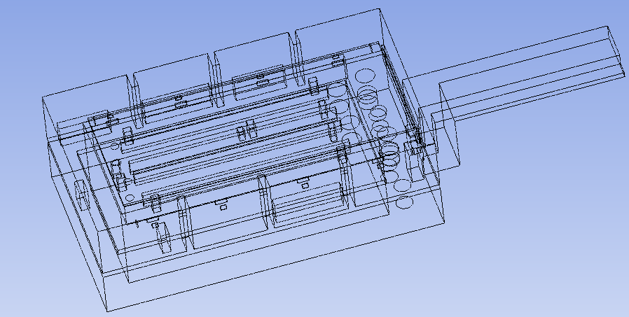
Air velocity distribution

Slide 15
Air velocity distribution Frontal View

Slide 16
Conclusions
Critical points have been identified in which temperatures are exeeding thresholds:
Between tagger and concrete blocks.
Underneath the tagger roof.
Possible mitigation solutions:
Better air velocity distribution.
Local cooling system.
We could calculate in the frame of the present simulation such solutions.

Slide 17
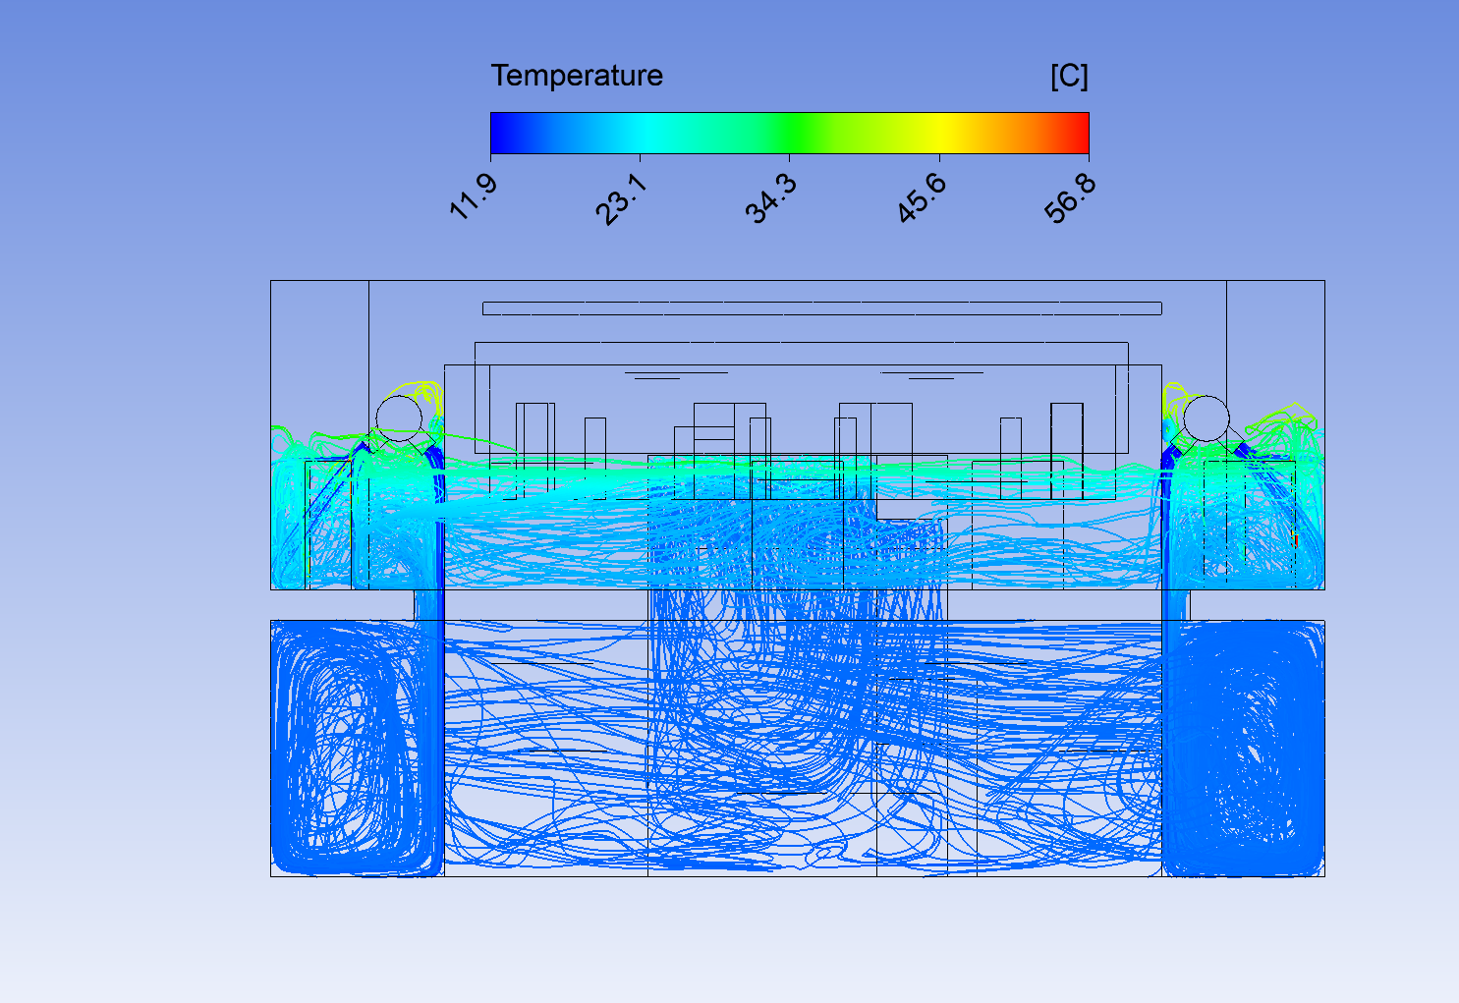
Possible recommendations
Create a more uniform temperature distribution by conveying air into poorly ventilated upper regions
Introduce Cooling units

Slide 18
Thank you for your attention!
Diego Zambelli & Julia Laast, CFD Team, CERN, www.cern.ch/cfd

