Slide 1
SiPM Active Ganging cryogenic test results
Ing. Esteban Cristaldo

Slide 2
Prototype V1
Prototype V2

Slide 3
Prototype V1
Three stage amplifier.
First stage consist in 4 transimpedance amplifiers, each amplifying groups of 12 SiPM’s
Second stage is a single ended summing amplifier.
Third stage is a Differential Low Pass Filter in multiple feedback configuration. It provides single ended to differential conversion.
LMH6629 was used for single ended amplification and LMH6554 for differential amplification.

Slide 4
Prototype V1 test summary
Prototype V1 did not meet operation conditions due to high instability of the single ended stages (LMH6629).
LMH6554 introduces distortion in the signal when operating as Low Pass Filter. Voltage inverter configuration was tested but distortion was still present in high amplitude signals.
Stable operation was achieved when stages were separately tested, but once connected oscillatory condition appeared.

Slide 5
Prototype V2
Two stage amplifier.
First stage consist in 4 transimpedance amplifiers, each amplifying groups of 12 SiPM’s
Second stage of prototype V2 replaced second and third stage of protype V1, providing summing mode and single ended to differential conversion.
OPA847 replaced LMH6629 and THS4131 replaced LMH6554.

Slide 6
Prototype V2 test summary
Prototype V2 meet operation conditions at room and cryogenic temperatures.
Distortion in the signal was not present, even with large signals.
Low amplitude, high frequency oscillatory condition was present. This was mitigated adding compensation networks in between stages.
1 MPPC and 8 MPPC in parallel were tested due to availability of the SiPM’s sensors.

Slide 7
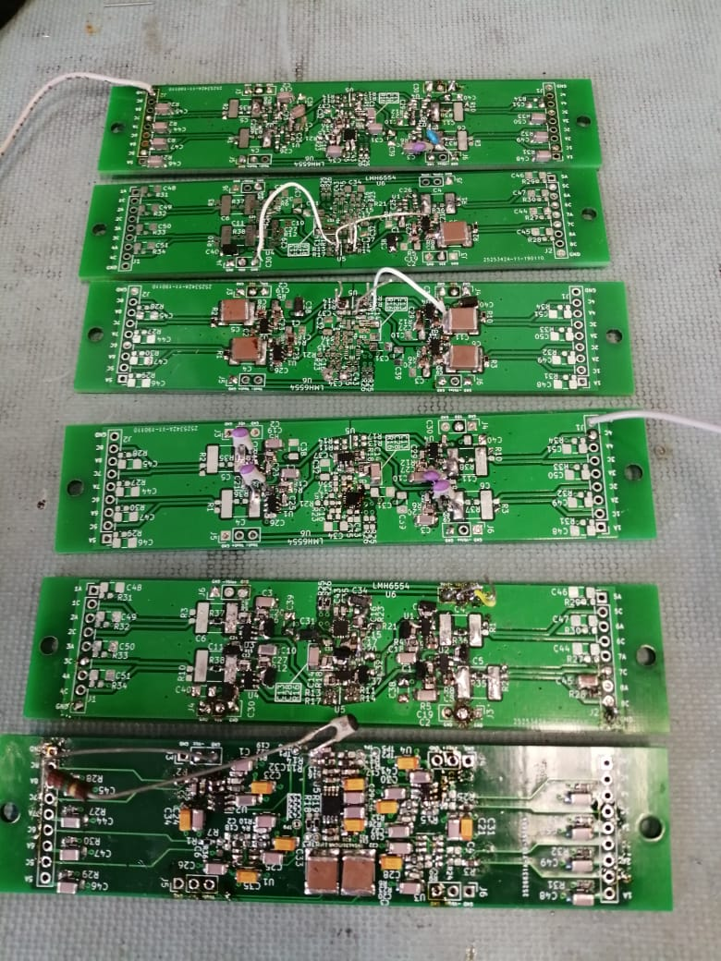
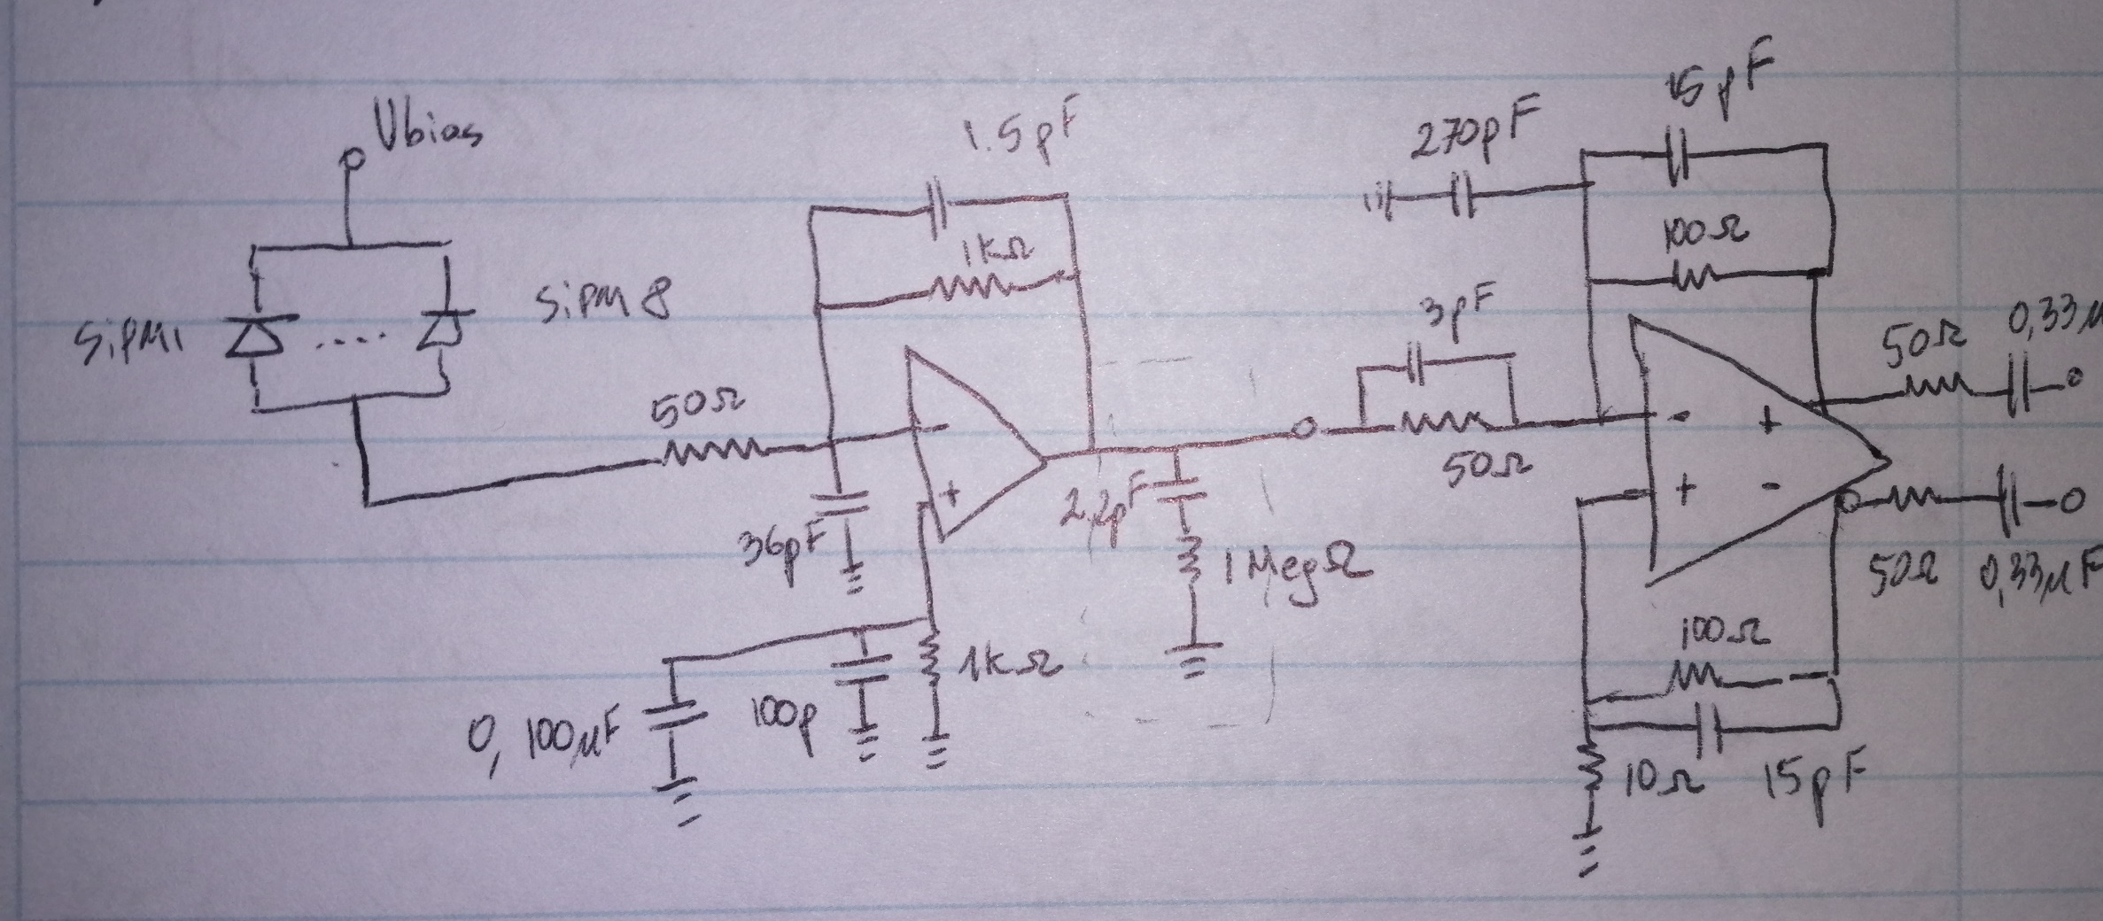
Prototype V1
Prototype V1 was thoroughly tested, but obtaining a
satisfactory operation condition was in vane.
Prototype V2 achieved satisfactory operation
condition.
Prototype V2

Slide 8
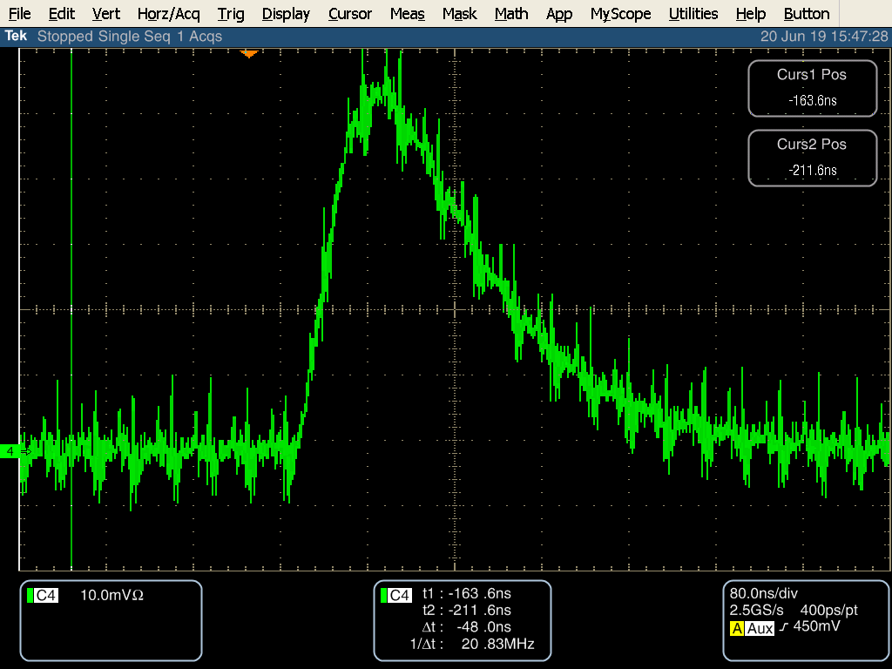
Prototype V2 test @ room temperature
High frequency, low amplitude oscillatory condition was encountered.
Signal shape distortion and high amplitude oscillation that was present in V1 was mitigated.
Nevertheless, this oscillatory condition in V2 prevented the observation of single photoelectron peaks.

Slide 9
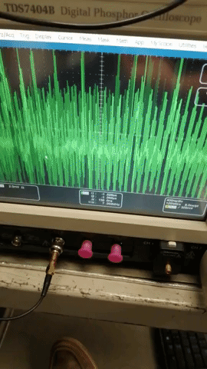
Prototype V2 test @ room temperature
This oscillations where mitigated by adding a compensation network in between stages.
The .gif in the right demostrates in real time the effect of adding this compensation.

Slide 10
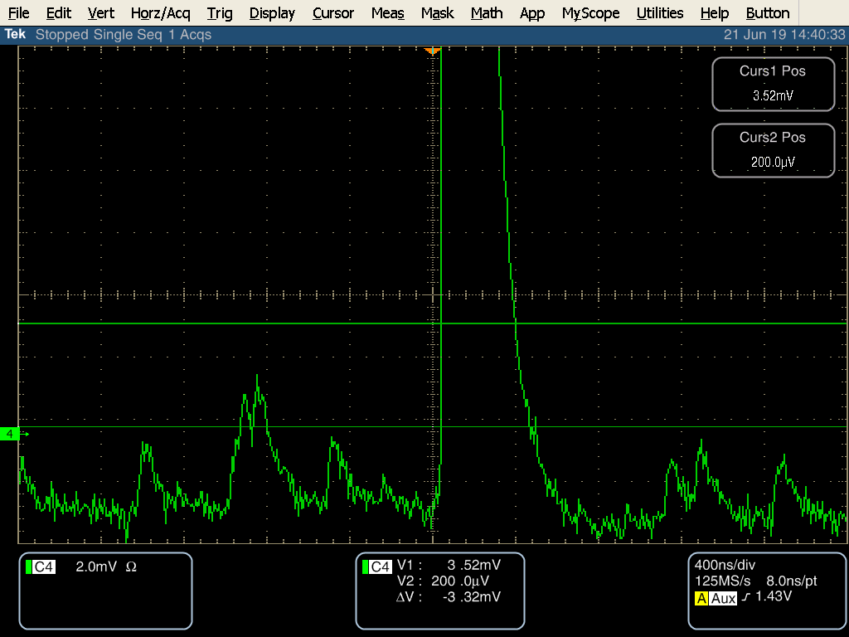
Prototype V2 test @ room temperature
Single PE resolution is achieved at room temperature @ 20 V/V gain.
Signal from LED
Single PE

Slide 11
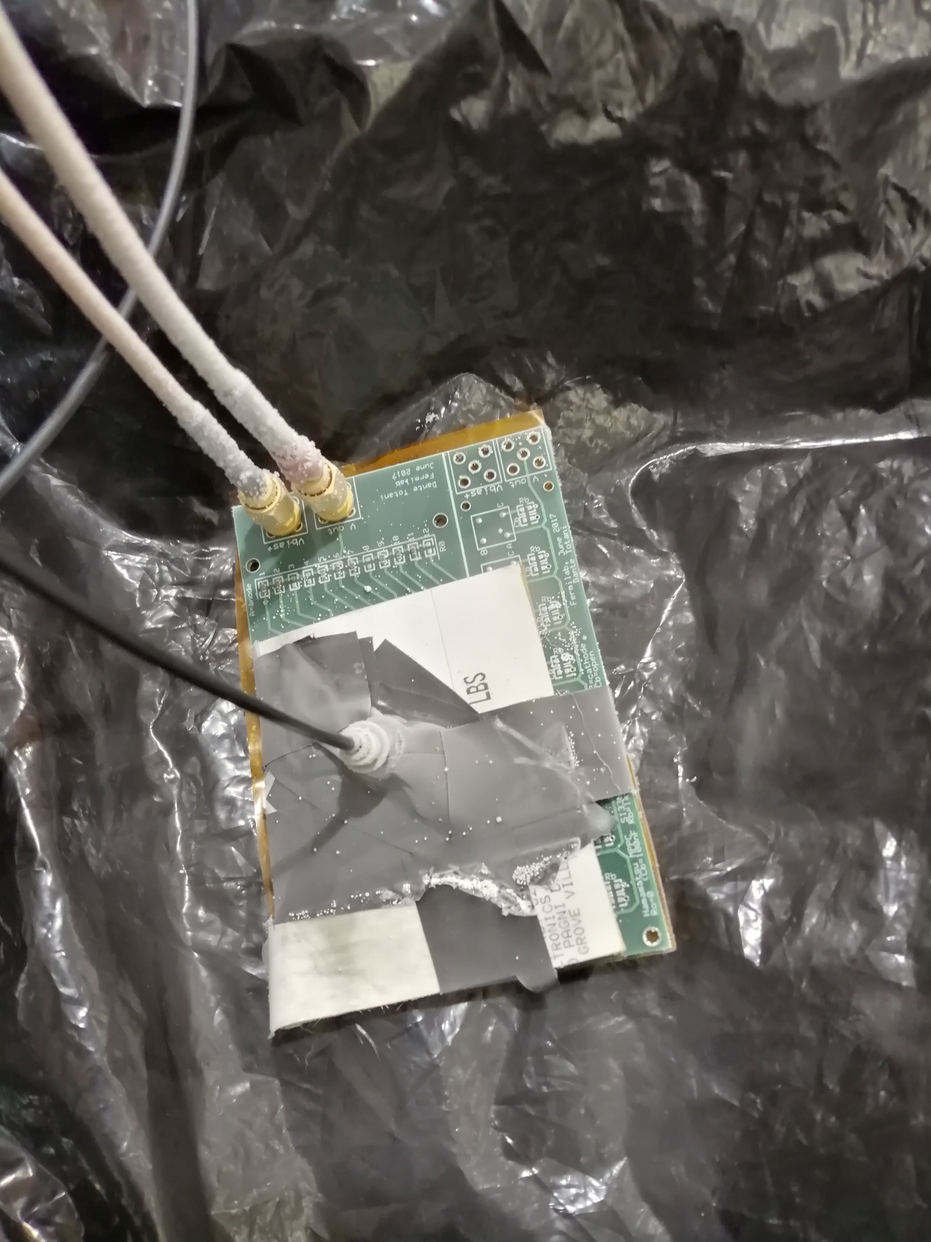
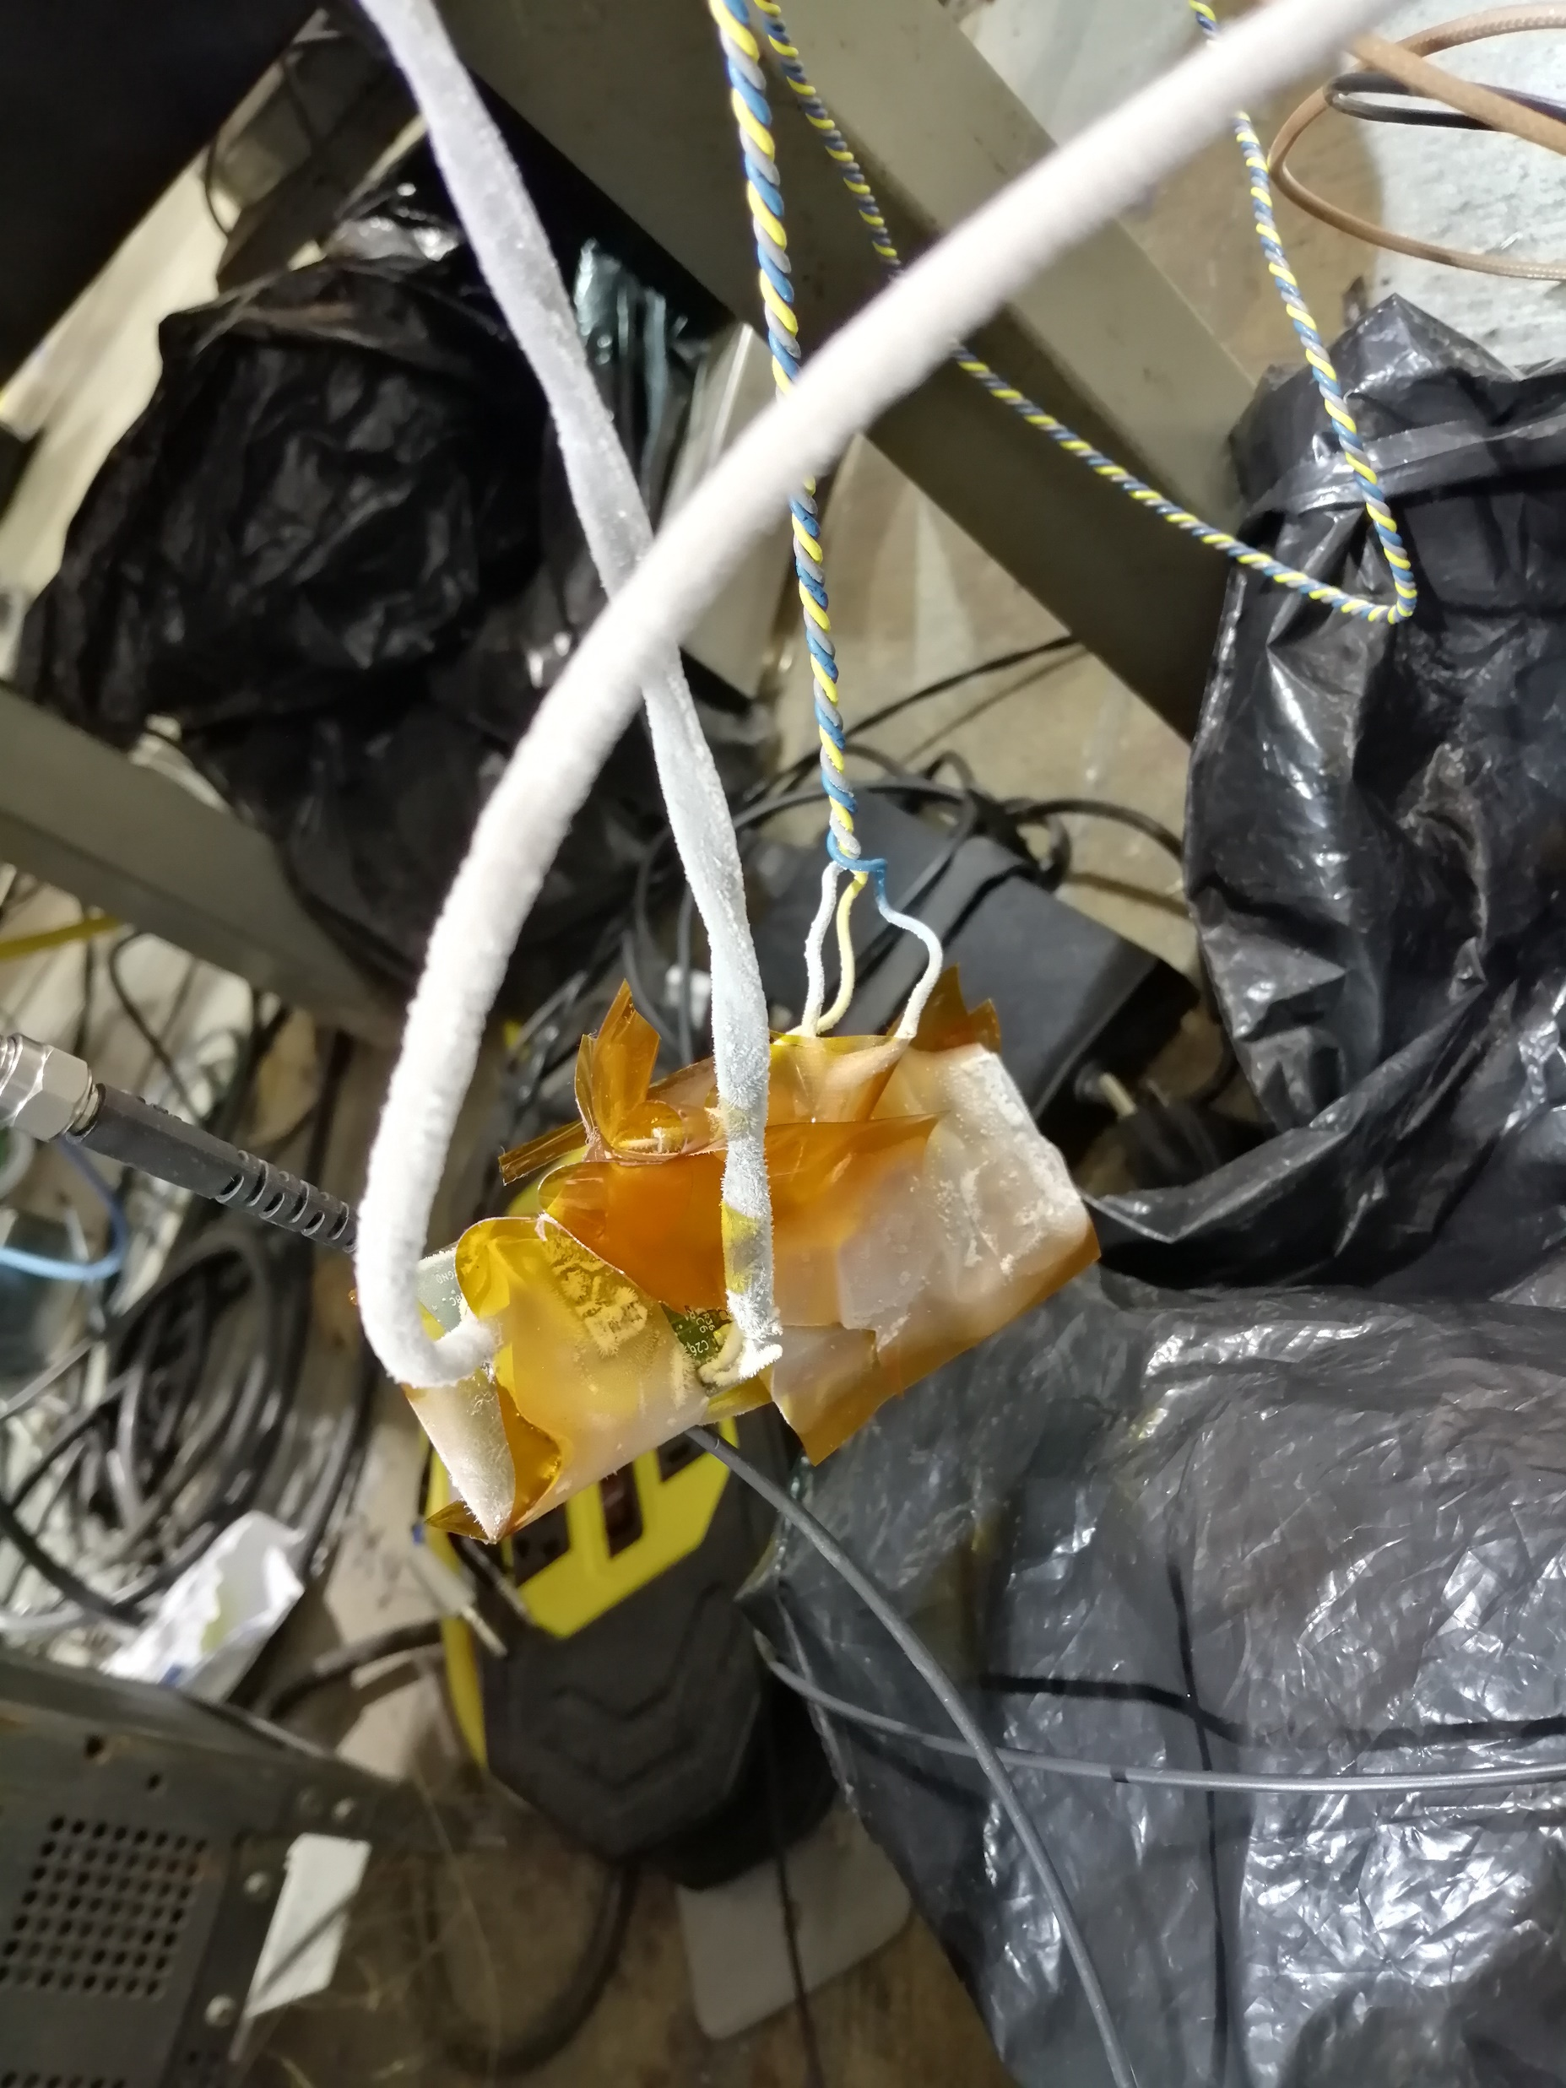
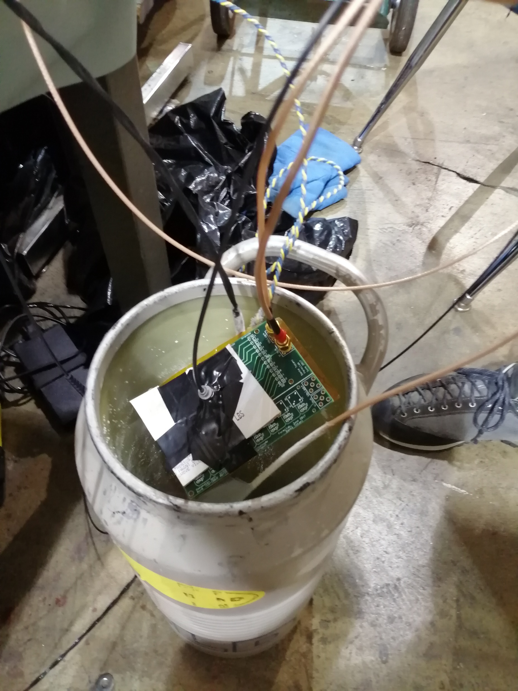
Prototype V2 test @ LN2

Slide 12
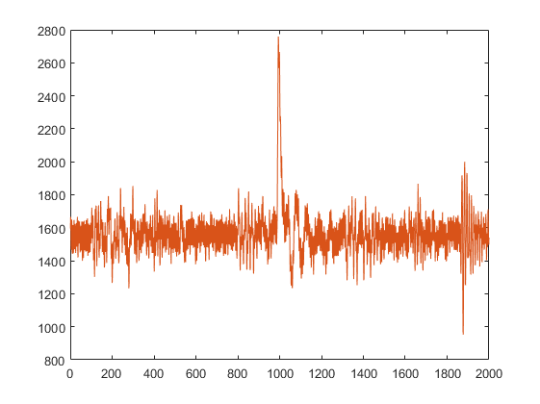
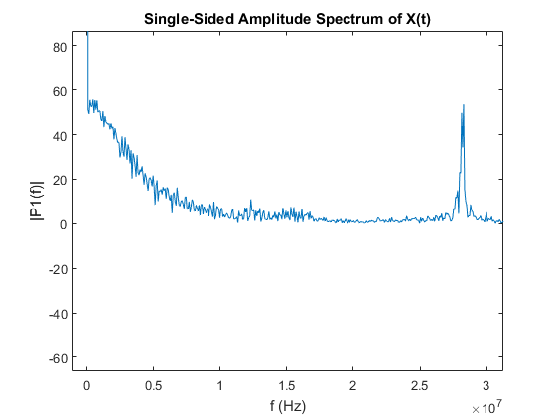
Single PE - 1 MMPC – AMP @ LN2
1 tick = 6.6667 ns

Slide 13
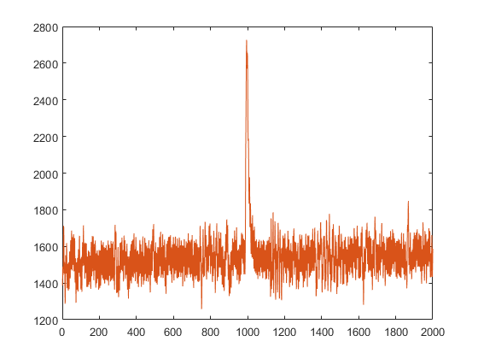
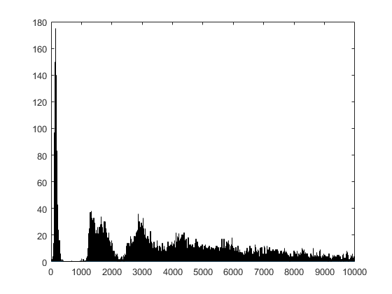
Single PE - 1 MMPC – AMP @ LN2
Histogram of acquired signals
1 tick = 6.6667 ns

Slide 14
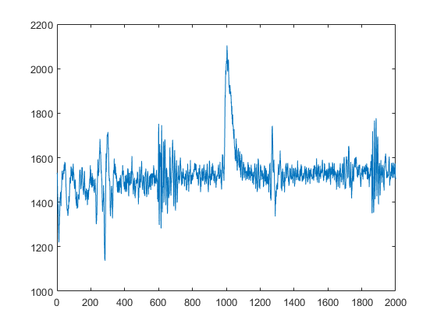
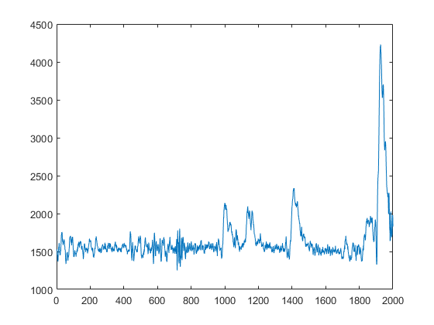
Single PE - 8 MMPC – AMP @ LN2
1 tick = 6.6667 ns

Slide 15
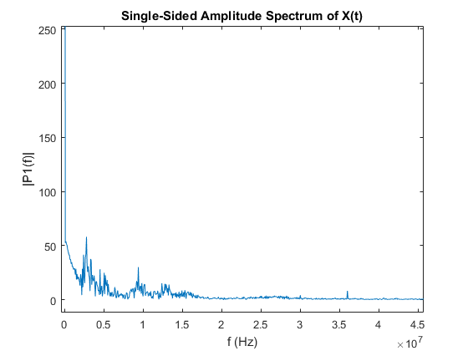
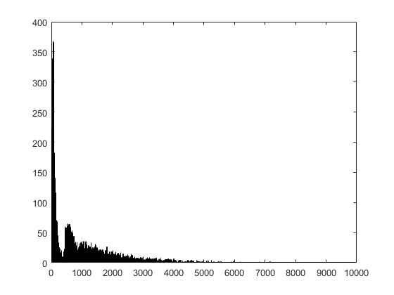
8 MMPC – AMP @ LN2
Histogram of acquired signals

Slide 16
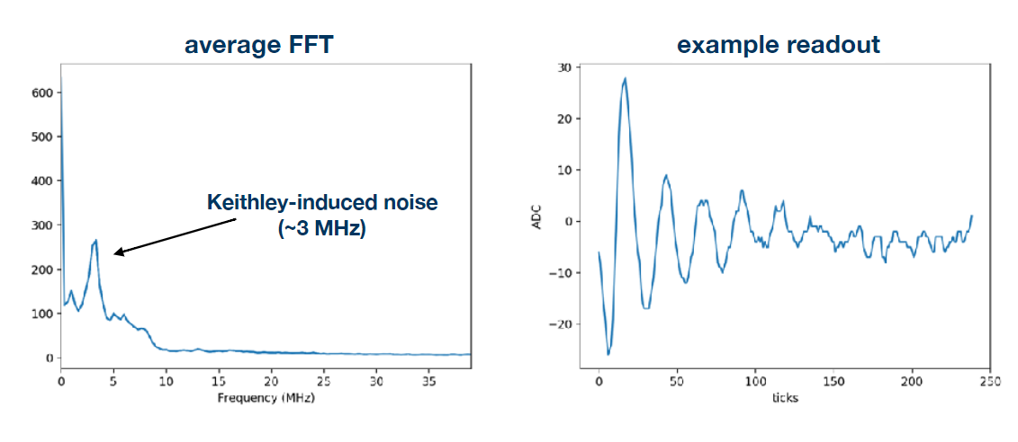
Sources of Noise
Acquired signals
Noise studies in PAB
https://indico.fnal.gov/event/21034/
Rory Fitzpatrick

Slide 17
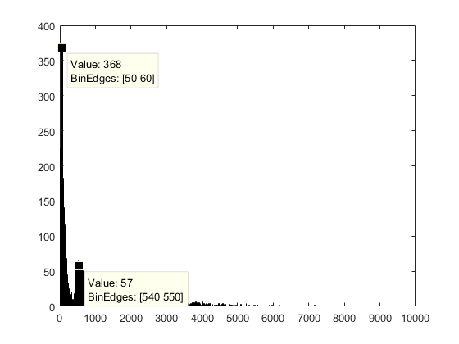
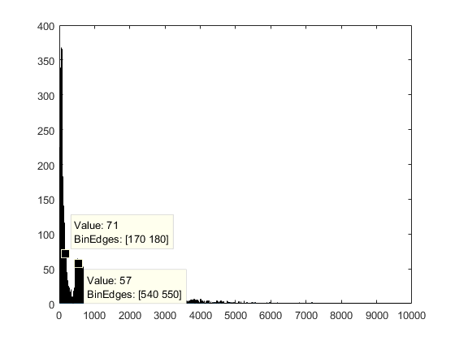
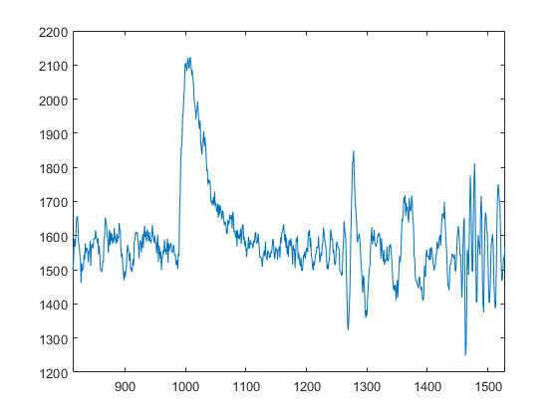
Noise Levels
$SNR=20\log_{10}\left(\frac{540}{60}\right)=$ 19,08 dB
$SNR=20\log_{10}\left(\frac{540}{180}\right)=$ 9,5 dB
As for now, I can say that this the max SNR is about 9,5 dB due to noise introduced by the environment, and can be
optimized to achieve 19 dB.

Slide 18
Dynamic Range
The Dynamic range depends on the first stage
(OPA847)
The OPA847 saturates at around 4V and considering
that a single PE from 1 SiPM connected @ Vbias 55V and
gain of 20 V/V is 2mV peak at room temp.
In this case the dynamic range is about 2000 photons,
but increasing the number ganged SiPM increases the dynamic
range in detriment of SNR.
Of course, at cryo temperatures the SiPM gain changes
and for now I don’t feel confident to throw a number.
Using a good compensation scheme, the gain in the first
stage can be lowered to 4 V/V, which will add more dynamic
range.
Using the second amplification stage or a third passive
attenuator stage, it could be possible to obtain a required
dynamic range.
Signal from LED
Single PE

