Slide 1
Reliability and Availability Study of the PIP-II Linac
Joe Kellenberger
TRAC Intern
27 June 2019

Slide 2
Overview Of my Work at Fermilab
This summer at Fermilab I worked with the PIP-II team to perform reliability analysis for the proposed linear accelerator in preparation for plan finalization.
This work involved analyzing hundreds of components and data points, making calculations and creating graphical models.
I specifically worked this summer on writing a python script manage the complexity of the task.
This presentation will provide a brief overview of Reliability Engineering, PIP-II, the Python script, and the results of my project.

Slide 3
Reliability Engineering Background
Reliability engineering became an established field at the end of World War II and the early 1950s due to the rapid advancement of electronic and mechanical technologies, new component types, and manufacturing processes.
Reliability engineering increases understanding of the function and requirements of new equipment which helps reduce cost and unnecessary failure.
Adds a time based concept to quality control.

Slide 4
Reliability and Availability Overview
Reliability: The probability that an item can perform its intended function for a specified interval under stated conditions.^{[1]}
“What are the odds this machine will work when I need it to?”
Availability: A measure of the degree to which an item is in the operable and committable state at the start of the mission.^{[1]}
“For what percentage of time can I expect this machine to operate nominally?”
Failure Rate (λ): Number of failures over a given period of time
$$λ=\frac{r}{T}$$
Reliability:
$$R\left(t\right)=e^{−λt}$$
Mean Time to Failure (MTTF): The duration of time the machine is fully operational.
- MTTF is the inverse of the failure rate ($λ)$
Mean Time to Repair (MTTR): The duration of time the machine is down during repair and maintenance.
Availability:
$$A=\frac{MTTF}{MTTF+MTTR}$$
Notes:
https://www.reliableplant.com/Read/18693/reliability-engineering-plant

Slide 5
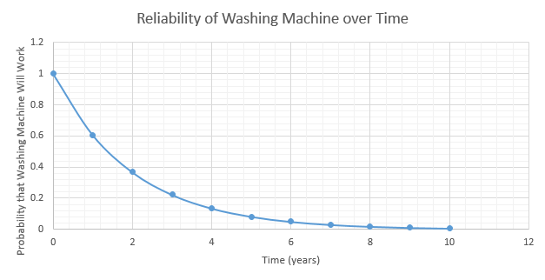
Calculation Method for Reliability
Example: A washing machine in an apartment complex has been working for 10 years and has broken down a total of 5 times during that period.
If the same washing machine as the one in the previous example has a repair time of 8 hours, then its availability can be calculated as:
$$λ=\frac{r}{T}$$
$$λ=\frac{5}{10yrs}$$
$$λ=0.5 failures/yr$$
$$R\left(t\right)=e^{−λt}$$
$$R\left(t\right)=e^{−(0.5)t}$$
$$MTTF=\frac{1}{λ}$$
$$MTTF=\frac{1}{0.5}$$
$$MTTF=2 years$$
$$MTTF=17,520 hrs$$
$$A=\frac{MTTF}{MTTF+MTTR}$$
$$A=\frac{(17,520 hrs)}{(17,520 hrs)+(8 hrs)}$$
$$A=0.9995 or 99.95\%$$

Slide 6
The “BathTub” Curve
Most machines follow a similar pattern of reliability and failure known as a “bathtub” curve
For the analysis of PIP-II we are only considering the Constant Failure Rate of the Linac.
Notes:
By Bathtub_curve.jpg: Wyattsderivative work: McSush (talk) - Bathtub_curve.jpg, Public Domain, https://commons.wikimedia.org/w/index.php?curid=7458336

Slide 7
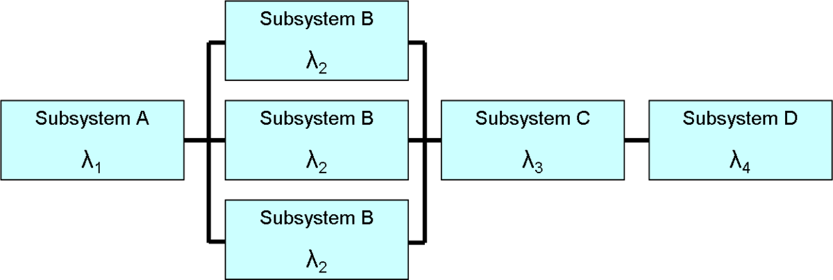
The Block Diagram
Block Diagrams are used in Reliability Engineering to map the relationship between components of complex systems.

Slide 8
Reliability and Availability in a Complex System
Series System: The system fails if one component fails.
Lusser’s Law- the reliability of a series system is equal to the product of the reliability of its component subsystems, if their failure modes are known to be statistically independent.^{[2]}
Reliability
$R_{sys}=\prod_{i=0}^{n}{{R(t)}_{i}}$
$R_{sys}={R(t)}^{n}$ if all components have the same reliability
Availability
$A_{sys}=\prod_{i=0}^{n}{A_{i}}$
$A_{sys}=A^{n}$ if all components have the same availability
Example: The apartment washing machine is paired with an equally reliable dryer. Combining the availability of each gives a total availability of the system as:
$$A_{W}=0.9995 and A_{D}=0.9995 \\ A_{sys}=\prod_{i=0}^{n}{A_{i}}$$
$$A_{sys}=0.9995∗0.9995 \\ A_{sys}=0.9990 or 99.90\%$$
Notes:
https://www.procurious.com/procurement-news/employees-weak-link-cyber-security

Slide 9
Reliability and Availability in a Complex System
Parallel System (Redundant System): The system fails if all components fail
Having back up subsystems increases the overall reliability of the system.
Reliability:
$R_{sys}=1−\prod_{i=0}^{n}{(1−{R(t)}_{i})}$
$R_{sys}=1−{(1−R(t))}^{n}$ if all components have the same reliability
Availability:
$A_{sys}=1−\prod_{i=0}^{n}{(1−A_{i})}$
$A_{sys}=1−{(1−A)}^{n}$ if all components have the same Availability
Example: The apartment complex has three washing machines to choose from and each has the same reliability, so laundry can be done as long as one is operational.
$$A_{sys}=1−{\left(1−A\right)}^{n} where n=3 \\ A_{sys}=1−{(1−(0.9995))}^{3} \\ A_{sys}=0.9999999999 (10 "nines")$$

Slide 10
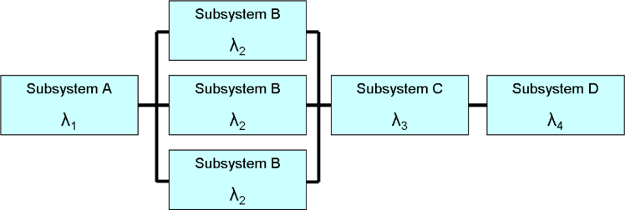
Reliability and Availability in a Complex System
“r out of n” System: the system fails if a certain number of components fail.
As long as the number of failures is below a certain threshold (k), the system remains operational.
Reliability:
$R_{sys (r≤k)}=\sum_{r=0}^{k}{\frac{n!}{r!\left(n−r\right)!}{R(t)}^{n−r}{(1−R\left(t\right))}^{r}}$
Availability:
$A_{sys (r≤k)}=\sum_{r=0}^{k}{\frac{n!}{r!\left(n−r\right)!}A^{n−r}{(1−A)}^{r}}$
Example: Most cars have one spare tire, meaning a car can function as long as four out of five tires are operational. The availability of the car based solely on the reliability of the tires can be calculated as:
Assume A=0.90 for all tires
Where:
r = number of failures
k = maximum number of allowable failures
n = number of units in the system
$$A\left(0\right)=\frac{5!}{0!\left(5−0\right)!}{\left(0.9\right)}^{5−0}{\left(1−\left(0.9\right)\right)}^{0}=0.59$$
$$A\left(1\right)=\frac{5!}{1!\left(5−1\right)!}{\left(0.9\right)}^{5−1}{\left(1−\left(0.9\right)\right)}^{1}=0.33$$
$$A_{sys}=A\left(0\right)+A\left(1\right)=0.59+0.33=0.92$$
r = 0 or 1
k = 1
n = 5

Slide 11
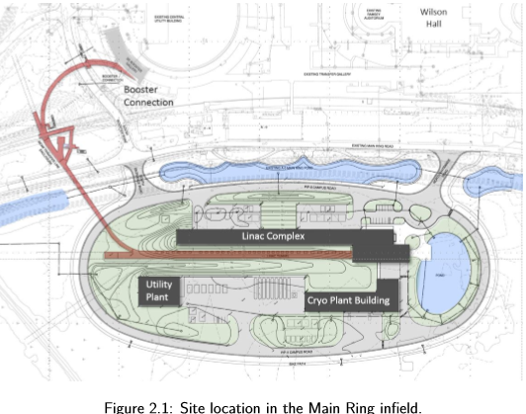
PIP-II Overview
“The PIP-II project at Fermilab is building a superconducting linear accelerator(Linac) to fuel the next generation of intensity frontier experiments. Capitalizing on advances in superconducting radio-frequency (SRF) technology, ﬁve families of superconducting cavities will accelerate H− ions to 800 MeV for injection into the Booster.”^{[3]}

Slide 12
PIP-II Overview
PIP-II has three major sections:
Utility Section- This includes all of the supporting equipment of the main accelerator.
Normal Conducting Section- Kept at room temperature, accelerates the beam to 2.1MeV, forms the beam into bunches and focuses the beam in preparation for acceleration to relativistic velocities. Also includes the transfer line from Linac to booster.
Super Conducting Section- The main part of the Linac, kept at ~2⁰ K, does the heavy lifting and accelerates the beam to 800MeV.
Notes:
http://pip2-docdb.fnal.gov/cgi-bin/RetrieveFile?docid=2261&filename=PIP-II%20Preliminary%20Design%20Report%20Version%206-19-2019.pdf&version=27

Slide 13
PIP-II Block Diagram

Slide 14
Linac Components- Warm Front End
Purpose: Create H⁻ ions, group particles into “bunches”, focus beam for acceleration, take beam measurement
Ion Source: two sources, one in use and one kept on “cold standby”.
LEBT: Transports beam to RFQ, initial focusing and chopping.
RFQ: Groups beams into bunches and accelerates beam to 2.1MeV
MEBT: Transports beam to HWR, has potential to chop any bunch exiting RFQ
Notes:
http://pip2-docdb.fnal.gov/cgi-bin/RetrieveFile?docid=2261&filename=PIP-II%20Preliminary%20Design%20Report%20Version%206-19-2019.pdf&version=27

Slide 15
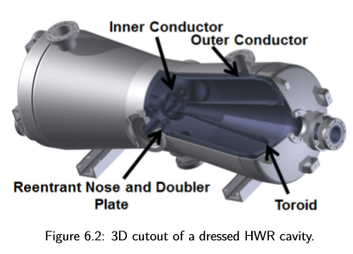
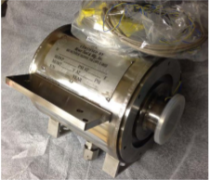
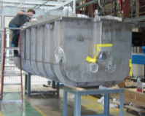
Linac Components- HWR
Half Wave Resonator- accelerates the beam from 2.1MeV to 10.3MeV
1 Cryomodule(CM) containing 8 RF cavities
Operates at 162.5MHz RF

Slide 16
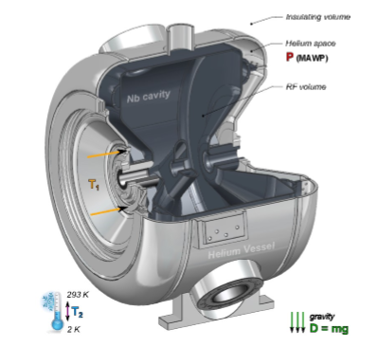
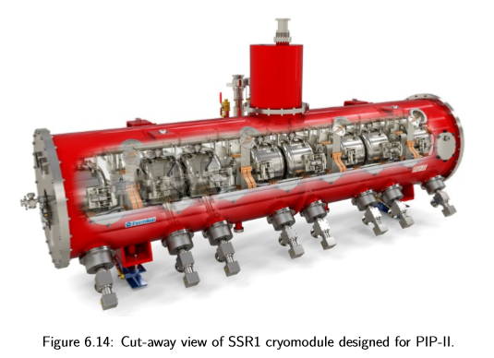
Linac Components-SSR1 and SSR2
Single Spoke Resonator
SSR1- 2 modules with 8 cavities each
Accelerates beam from 10.3MeV to 35MeV
SSR2- 7 modules with 5 cavities each
Accelerates beam from 35MeV to 185MeV
Operates at 325 MHz RF

Slide 17
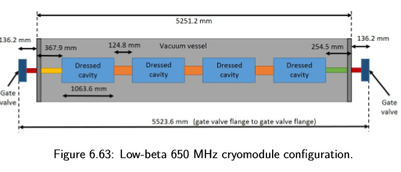
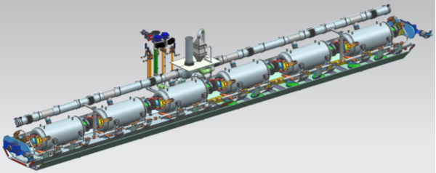
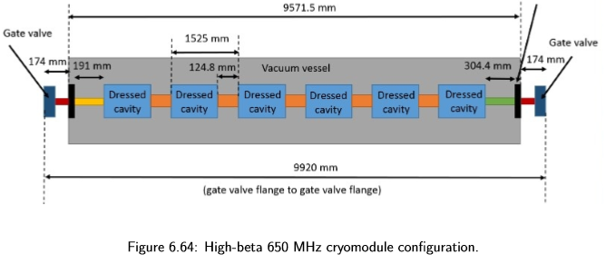
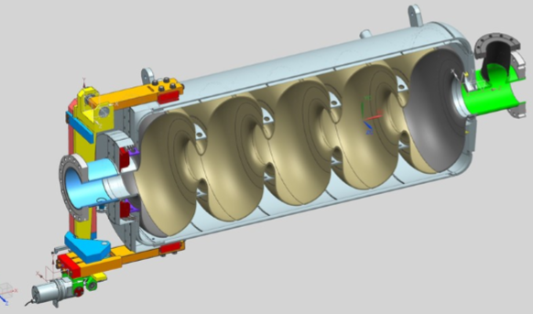
Linac Components- LB650 and HB650
Low Beta- Accelerates beam from 185MeV to 500MeV
9 modules with 4 cavities each
High Beta- Accelerates beam from 500MeV
to 800MeV
4 modules with 6 cavities each
Both operate at 650MHz

Slide 18
The Python Script
MTTF and MTTR data for each component of PIP-II is listed in an excel workbook separated by sheets for each section. (total of over 300 components across 15 sheets)
The script:
Reads the excel file, separating each section into individual data frames.
Calculates the Availability and Reliability of each component.
Calculates Total Availability and Reliability for each section
Accounts for redundant systems in each calculation.
Calculates Total Availability and Reliability of the entire Linac.
Creates graphics for Availability and Reliability.
Exports results to new excel file and saves each graphic as a PDF.

Slide 19
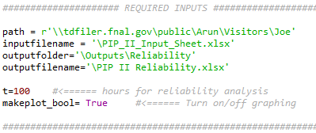
Requirements for Python Script
Python version 3.7
Required inputs: File path to input and output file locations, File names, time for reliability calculations
Can also turn on/off graphing functions as needed

Slide 20
General Composition of Python Script
HWR
Availability
Total Utility Availability
SSR1
Availability
Total
Super Conducting
Availability
Total
Linac
Availability
SSR2
Availability
LB 650
Availability
HB 650
Availability
Total Normal Conducting Availability

Slide 21
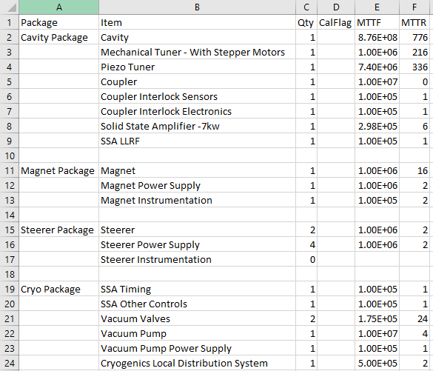
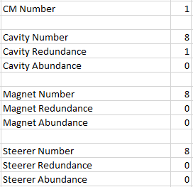
Input Excel File, HWR

Slide 22
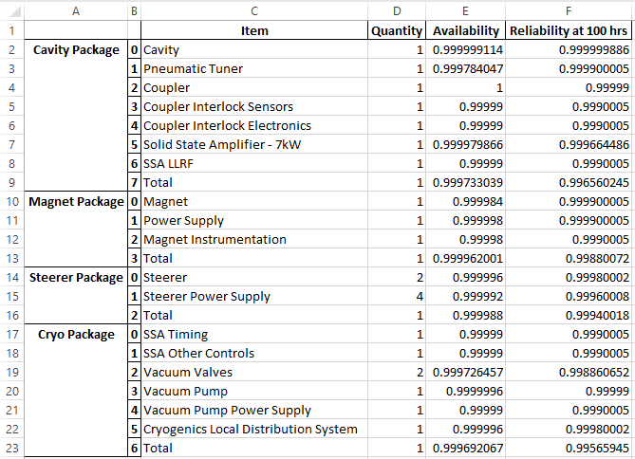
Output Excel File, HWR

Slide 23
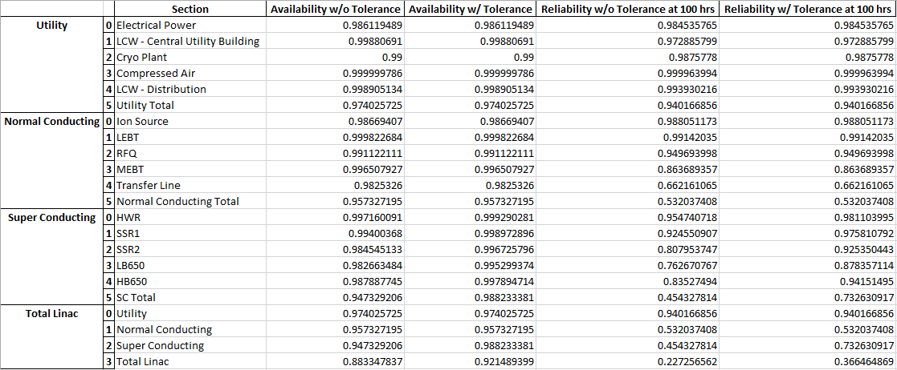
Output Excel File, Totals

Slide 24
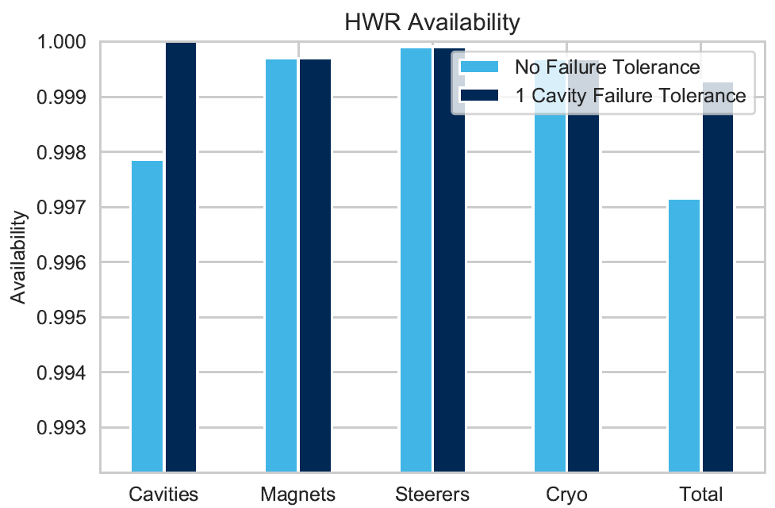
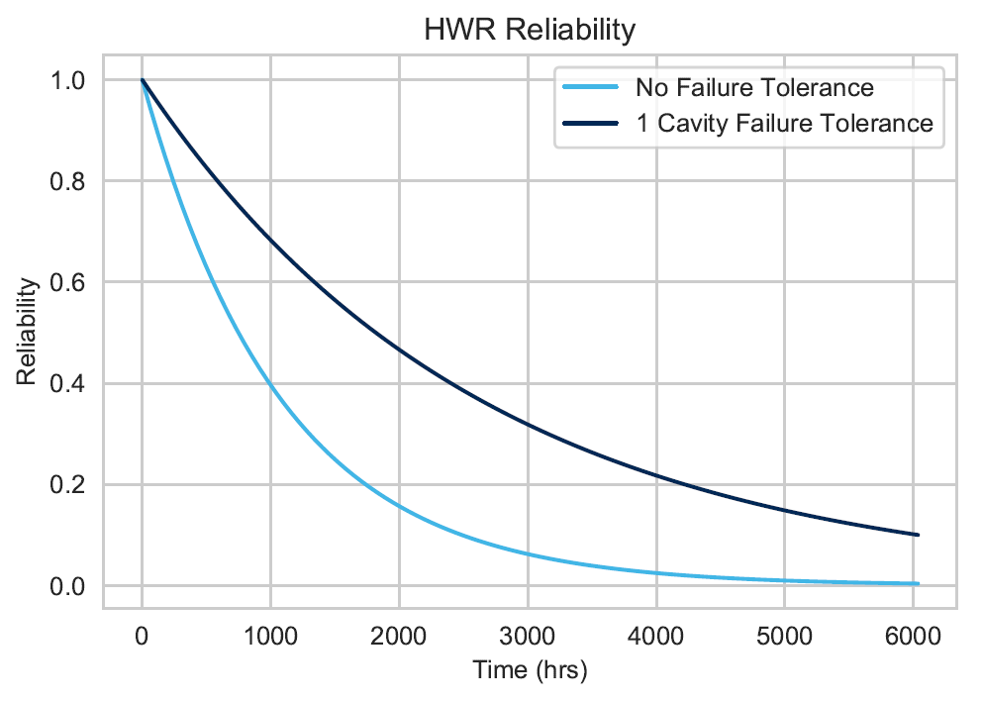
Output Graphs, HWR

Slide 25
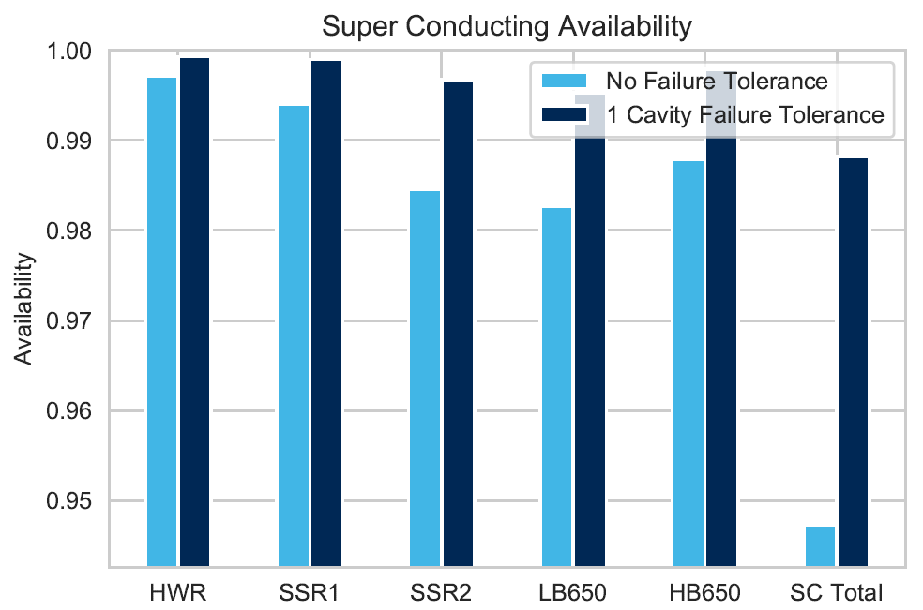
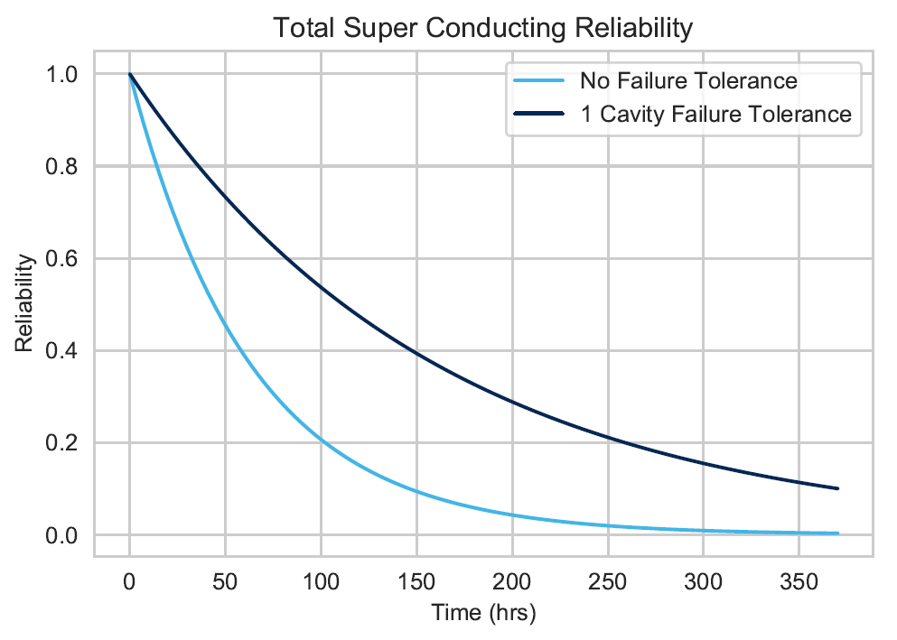
Output Graphs, SC Portion

Slide 26
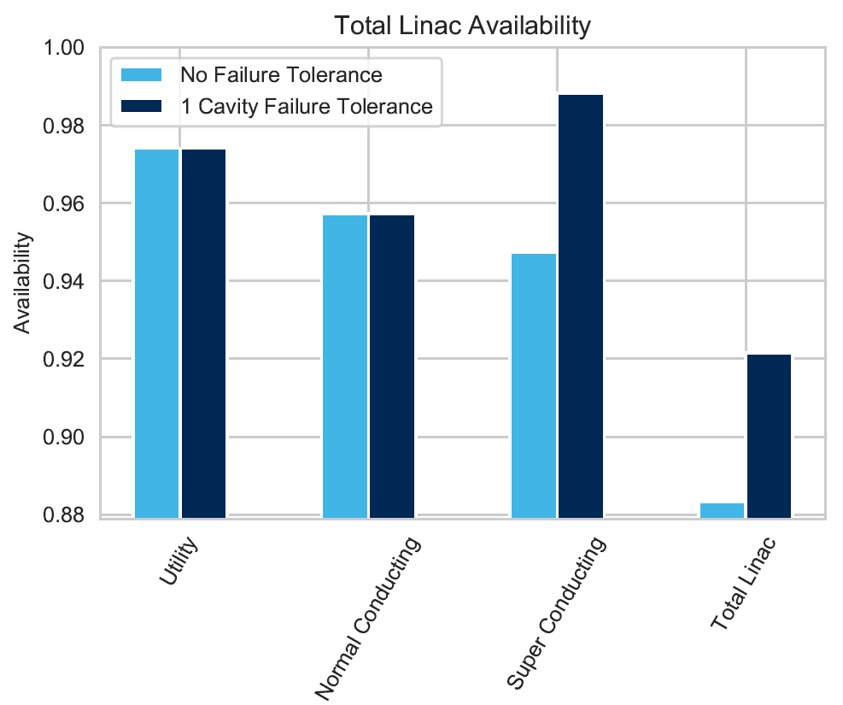
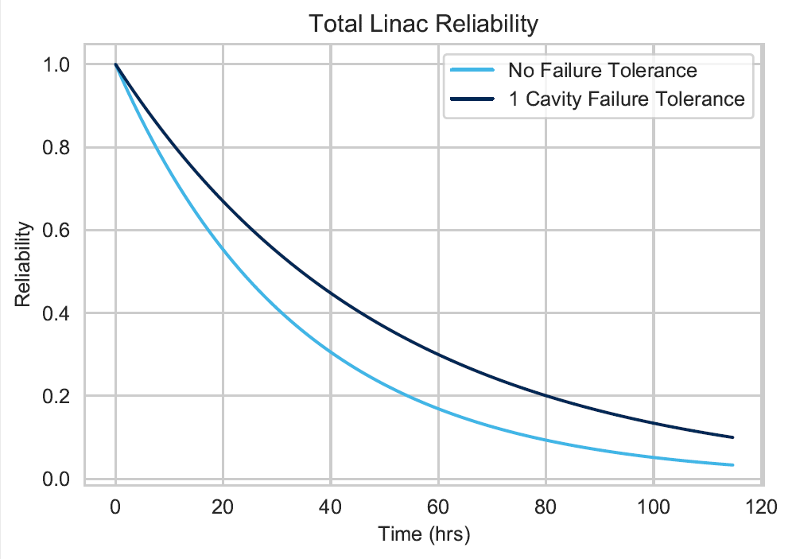
Overall Results

Slide 27
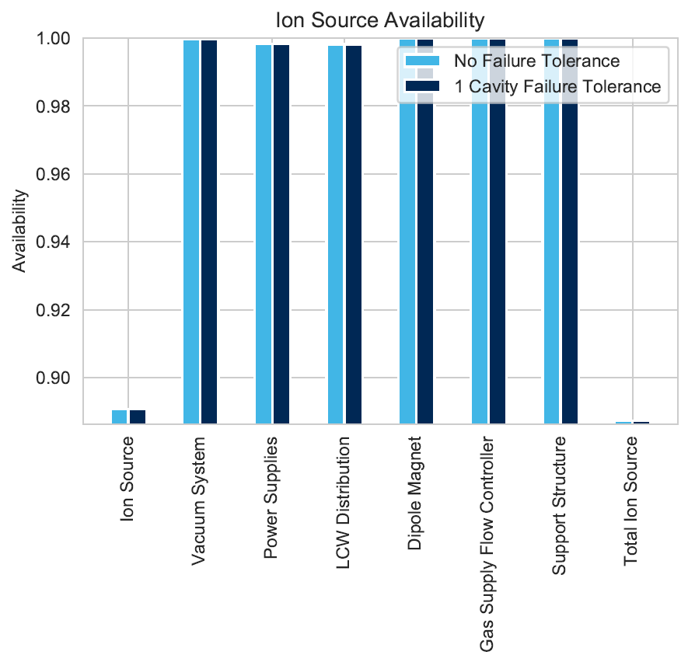
Ion Source and Tolerance
Low Availability of Ion Source shows a need to have a back up.
Availability of one Ion Source: ~0.887

Slide 28
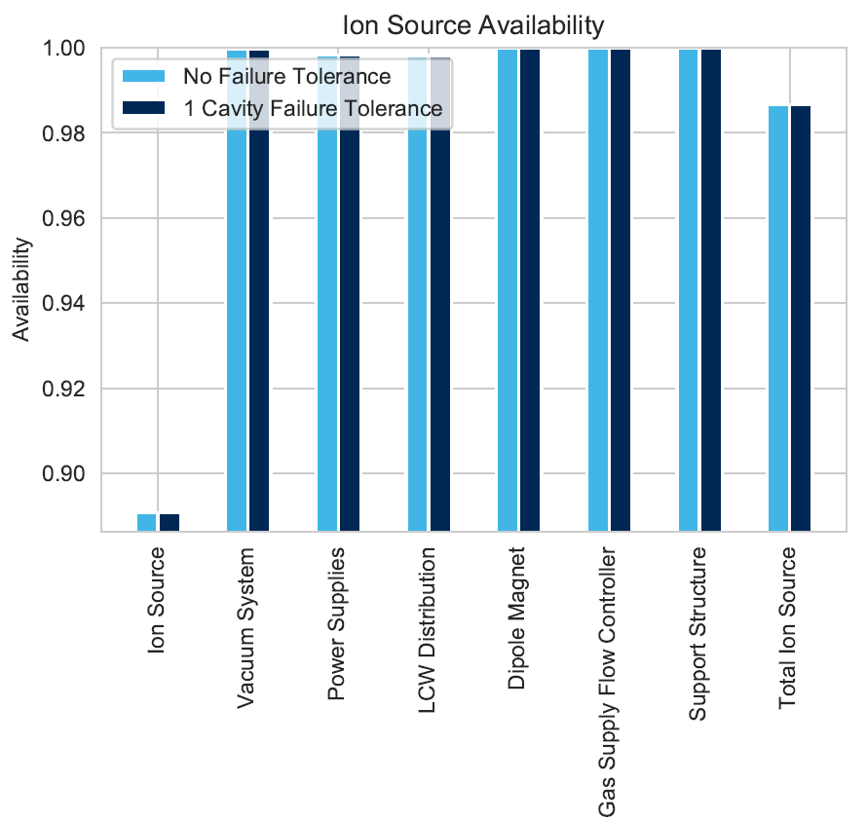
Ion Source and Tolerance
Low Availability of Ion Source shows a need to have a back up.
Availability of two Ion Sources, one kept on cold standby: ~0.987
Note:
Tolerance is calculated for all redundant components of the Linac and utility, but only effects the SC sections due to the difficulty of repairs to those sections

Slide 29
Benefits of Using Python Script
Input
One Excel File
One sheet
~1000 rows of Data
Includes repeated entries
Output
Same Excel File
Limited graphing options
Risk of human error
Formulas contained in cells
Input
One Excel File
One sheet per section
~300 entries
No repeated information
Python Script
Uses functions for calculation/graphing
Easy to adjust code
Output
New Excel Sheet
One sheet per section
Two graphs per section

Slide 30
Challenges of Writing the Python Script
Limited programming experience- One Semester of Python programming in college (circa 2013)
Over 1400 lines of code
Similarities between sections allow the use of loops, however slight differences between sections caused a need for unique parts of each function.
Cold Standby and “k out of n” calculations more intricate than standard series calculations.

Slide 31
Future Improvements to Python Script
Given more experience with python and time to work on the code, the following improvements could be made:
Add Total MTTF calculation
Shorten length of code by 33 to 50 percent.
Create a way to not overwrite the output file after each run.
Add code to create destination folders as needed.
Analyze and report errors in excel file (e.g. missing components or values)

Slide 32
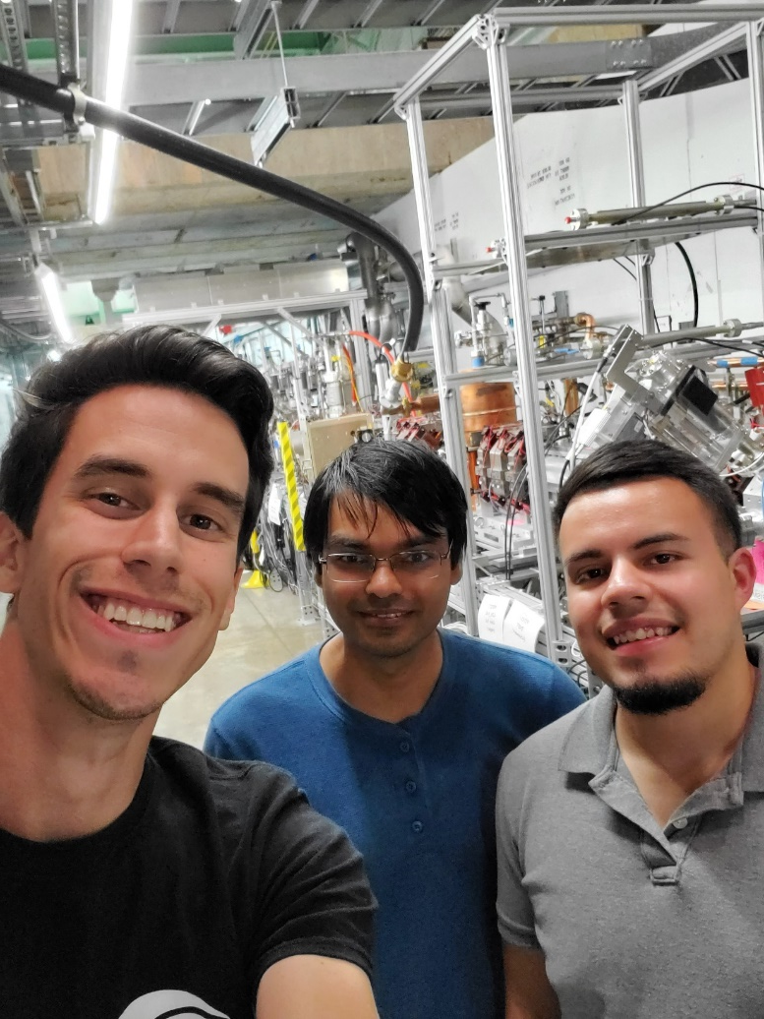
Acknowledgements
I would like to thank the following people for their help this summer:
Arun Saini for mentoring me on all things PIP-II and beyond,
Ram Prakash for helping me work through the calculations and check the results for accuracy,
Brian Martinez for his solidarity in the intern cave, and
Angela Fava and Harry Cheung for running an awesome TRAC program.
This experience has been incredible and I look forward to taking the things I learned this summer back to the classroom with me.

Slide 33
References
[1] https://www.reliableplant.com/Read/18693/reliability-engineering-plant
[2] https://enacademic.com/dic.nsf/enwiki/255262
[3] http://pip2-docdb.fnal.gov/cgi-bin/RetrieveFile?docid=2261&filename=PIP-II%20Preliminary%20Design%20Report%20Version%206-19-2019.pdf&version=27

