Slide 1
Close-out & Path Forward
P. Hurh et al
LBNF Target Conceptual Design Selection Review
26 July 2019

Slide 2
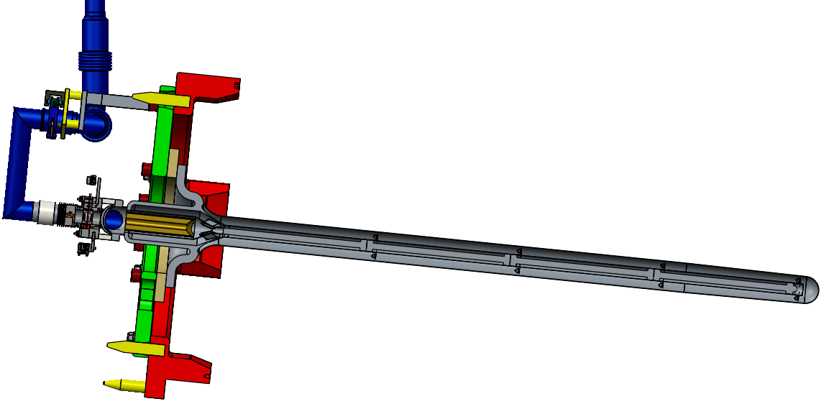
Consensus Reached!
After several well prepared presentations and interesting discussions a design concept and prototyping approach was agreed upon by mutual consensus.
Intermediate length (As Long As Reasonably Achievable) Cantilever Target
End deflection and natural frequency of 1.5 – 1.7 m long target between that of T2K and NuMI-MINOS targets
Physics simulations of CP sensitivity show 1.6 m long target shown to result in the equivalent of 13 days lost of running per year
Other target design options evaluated to be riskier, less robust, and likely to result in lost running time on the same order as 1.6 m long cantilever target
Design and feature prototyping will have working goal of 4 interaction length target
If reliability suffers at longer lengths, then overall operations performance of a 4 interaction length target will be matched with a shorter but more reliable and faster to exchange target
Range of 1.5 to 1.84 m should be considered with a reference length decided at least in time for input into next update of DUNE physics studies (preferably within 6 months)
Prototype Target will be ~1.5 m long
Ensures viable back-up target for initial operation while developing technologies and methods for longer production target

Slide 3
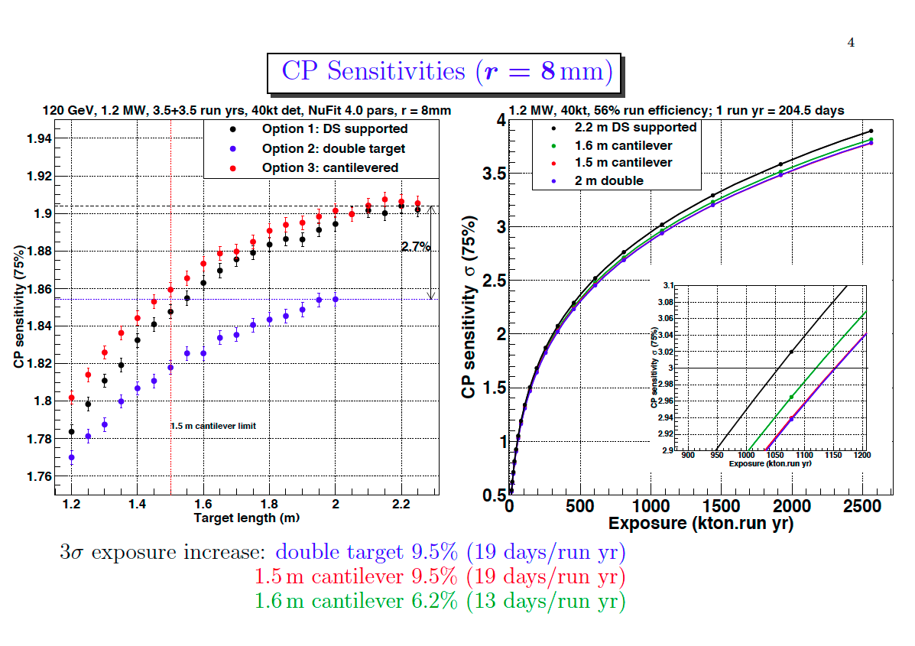
J. Back, Warwick

Slide 4
Remote Handling
Option | No. Operations | Target Handling Time (Days) | Risk
1) 2.2m Supported Target | 41 | 22 | 238
2) Double Target | 35 | 14 | 222
3) Cantilever Target | 18 | 5 | 99
E. Harvey-Fishenden, RAL

Slide 5
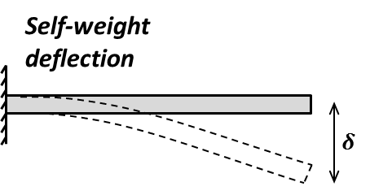
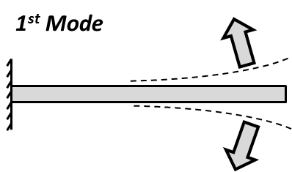
How long can we make a cantilevered LBNF target?
P. Loveridge, RAL
Aiming to achieve similar structural performance to the “two interaction length” T2K and NuMI reference designs.
Given it’s stiffer cross-section, an LBNF cantilever target in the range three to four nuclear interaction lengths could be feasible.
Target | Bending Stiffness $EI_{xx}$(N.m²) | Bending Stiffness $EI_{yy}$(N.m²) | Mass $m$(kg/m) | Unsupported Length $l$ (m) | $$δ=\frac{mgl^{4}}{8EI}$$ | Horizontal mode $f_{1}=\frac{3.52}{2πl^{2}}\sqrt{\frac{EI}{m}}$ | Vertical mode $f_{2}=\frac{3.52}{2πl^{2}}\sqrt{\frac{EI}{m}}$
T2K | 2,780 | 2780 | 1.75 | 0.9 | 0.51 mm | 28 Hz | 28 Hz
NuMI | 637 | 285 | 0.49 | 1.0 | 0.94 mm | 13.5 Hz | 20 Hz
LBNF | 18,517 | 18,517 | 1.64 | *** See below ***
T2K vertical
NuMI vertical
NuMI
NuMI horizontal
T2K

Slide 6
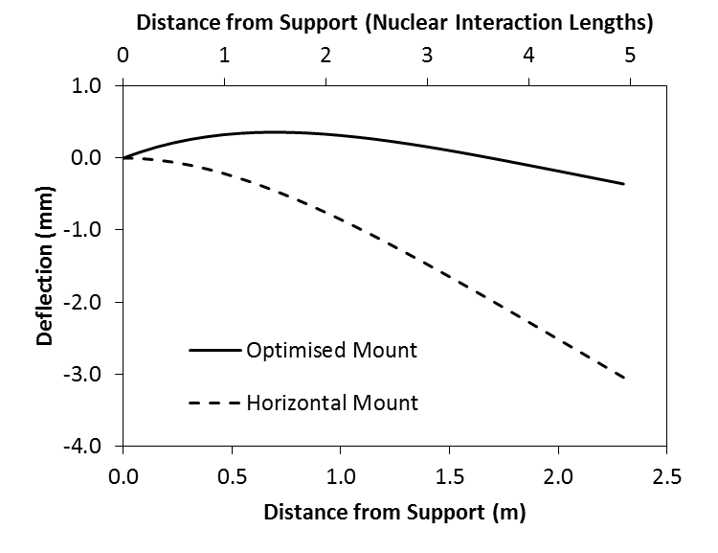
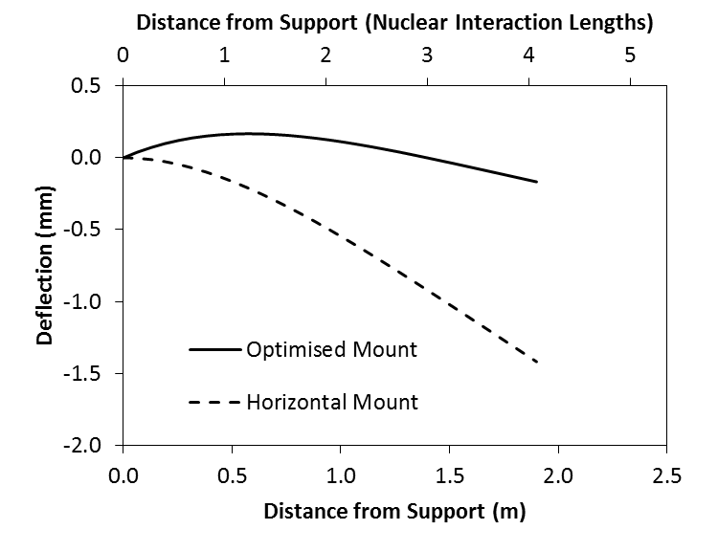
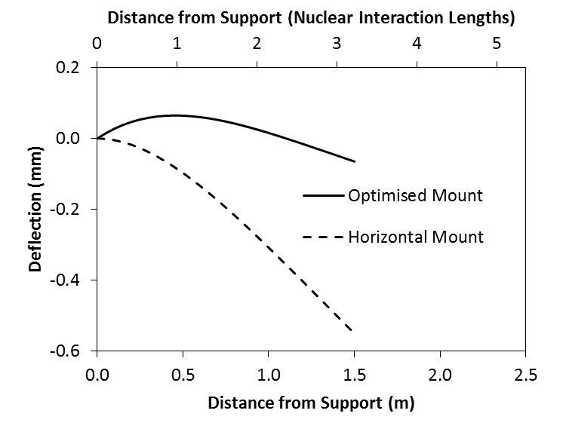
Mounting Optimisation / Sagitta Effect
P. Loveridge, RAL
Can reduce the magnitude of target misalignment from self-weight deformation by “angling up” at the support
2.3m long
Cantilever self-weight deflection as a function of position $x$:
$$δ\left(x\right)=\frac{mgx^{2}}{24EI}\left(x^{2}+6l^{2}−4lx\right)$$
1.9m long
Self-weight deflection for various support configurations
Target Length (m) | Cantilever | Cantilever (optimised mount angle) | Angle | Propped Cantilever
1.5 | 0.55 mm | ±0.07 mm | 0.019° | 0.02 mm
1.9 | 1.42 mm | ±0.17 mm | 0.038° | 0.06 mm
2.3 | 3.05 mm | ±0.36 mm | 0.067° | 0.13 mm
1.5m long

Slide 7
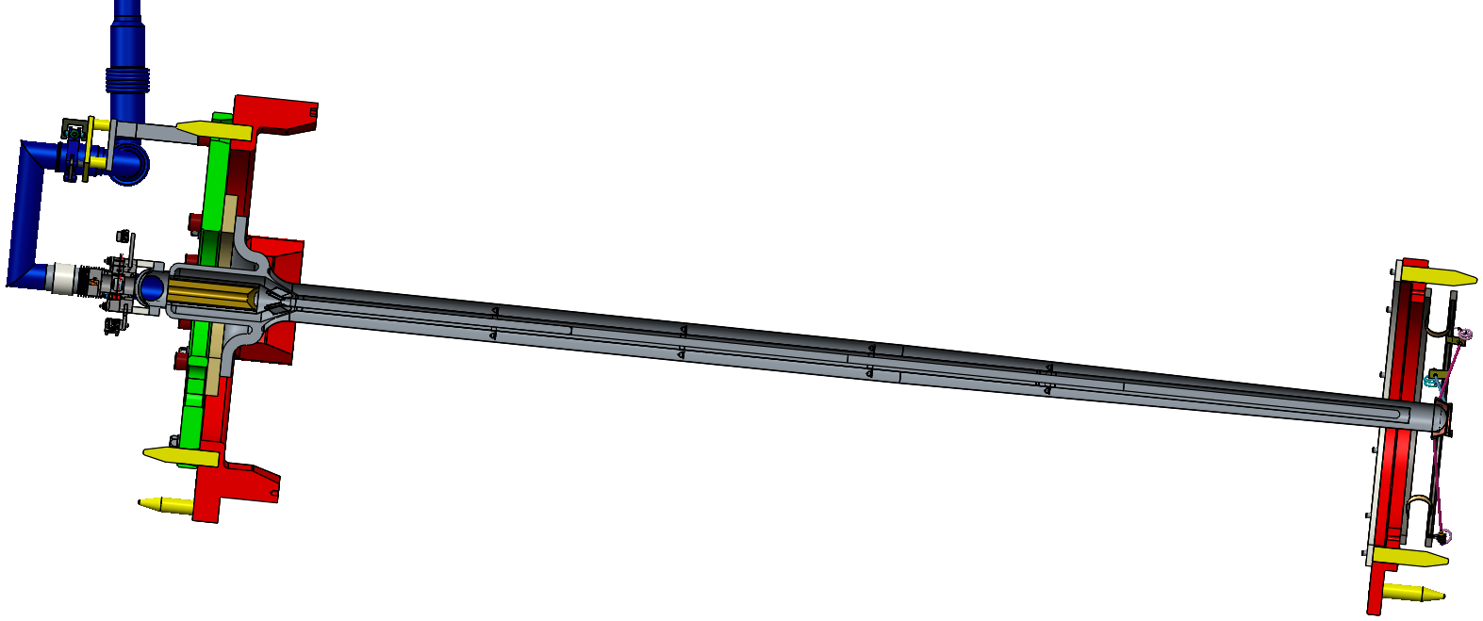
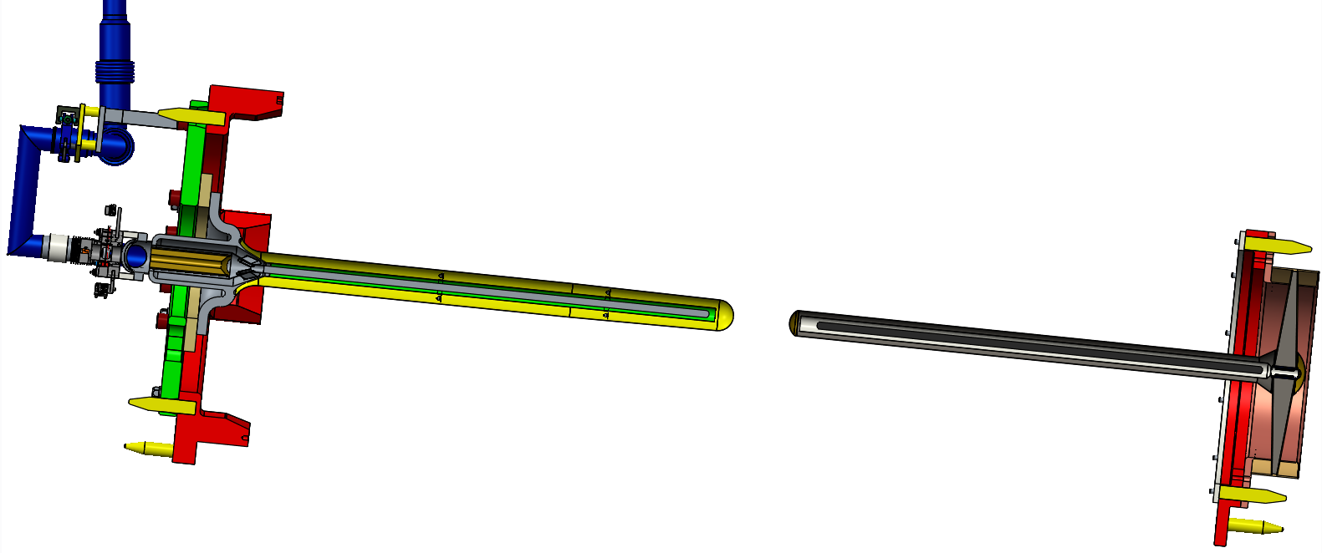
Key Design and Manufacturing Issues
P. Loveridge, RAL
 | Option 1:1x2m long | Option 2: 2x1m long | Option 3: intermediate cantilever
Complexity of horn Interface | Interfaces at both US and DS of horn, plus self interface! Needs Helium services routing to DS end. | Interfaces at both US and DS of horn. Needs Helium services routing to DS end. | Interface to horn US end only
Departure from Proven Technology | Departure from T2K in terms of length / segmentation and Self docking interface. | Closest to two-interaction length T2K target | Departure from T2K in terms of length / segmentation
Design Challenges | DS support design for radial stiffness + longitudinal compliance, requires prototyping. | DS support/manifold design w.r.t. pressure stress and thermal distortion. | Pushing for longest feasible length (re: deflection, violin modes)
Manufacturing Challenges | DS support manufacture is complex. Manufacture of long thin-walled titanium tube to tight dimensional tolerances. | US target most similar to T2K. DS low-mass manifold manufacture is complex. | Manufacture of long thin-walled titanium tube to tight dimensional tolerances.
Cost | Relatively high cost of manufacture and outstanding design tasks | Relatively high cost of manufacture and outstanding design tasks | Relatively low cost of manufacture and outstanding design tasks

Slide 8
Key Operation Issues
P. Loveridge, RAL
 | Option 1:1x2m long | Option 2: 2x1m long | Option 3: intermediate cantilever
Spare Production | Intermediate cost Build two in parallel? | Highest cost Build four (2 US + 2 DS) in parallel? | Lowest cost Build two in parallel?
Thermal Management | Highest heat load, single target cooling loop. Also need to cool DS support. | High heat load but divided between two cooling loops | Lowest total heat load
Mechanical loads | DS prop required to keep self-weight deflection and natural frequency in check | Most “robust” structure as measured by natural frequency and self-weight deflection | Inherently pushing at the limits on cantilever length
Complexity / number of failure points | High complexity due to cooled downstream mount | High complexity due to additional downstream target system | Low Complexity / number of components
Alignment Issues | Relies on DS support for target placement precision | Perceived difficulties with beam based alignment | Single object to align but largest self-weight deflection

Slide 9
Key Remote Maintenance Issues
P. Loveridge, RAL
 | Option 1:1x2m long | Option 2: 2x1m long | Option 3: intermediate cantilever
Time estimate for planned target exchange | 3 weeks | 2 weeks | 1 week
Risk / complexity | High (number of operations) | High (number of operations) | Medium (number of operations)
Work Cell Interfaces | Two sets of exchange tooling with mechanical/services interface | Two sets of exchange tooling with mechanical/services interface | One exchanger tool
Manipulator operations | Ergonomics compromised when module rotated. Long-reach manipulators. | Ergonomics compromised when module rotated | Can optimise reach/view for the single required configuration
Crane operations | Two module rotations, including re-configuration of supports etc | One module rotation, including re-configuration of supports etc | All work achieved with single module configuration

Slide 10
 | Option 1:1x2m long | Option 2: 2x1m long | Option 3: intermediate cantilever
Complexity of horn Interface | Interfaces at both US and DS of horn, plus self interface! Needs Helium services routing to DS end. | Interfaces at both US and DS of horn. Needs Helium services routing to DS end. | Interface to horn US end only
Departure from Proven Technology | Departure from T2K in terms of length / segmentation and Self docking interface. | Closest to two-interaction length T2K target | Departure from T2K in terms of length / segmentation
Design Challenges | DS support design for radial stiffness + longitudinal compliance, requires prototyping. | DS support/manifold design w.r.t. pressure stress and thermal distortion. | Pushing for longest feasible length (re: deflection, violin modes)
Manufacturing Challenges | DS support manufacture is complex. Manufacture of long thin-walled titanium tube to tight dimensional tolerances. | US target most similar to T2K. DS low-mass manifold manufacture is complex. | Manufacture of long thin-walled titanium tube to tight dimensional tolerances.
Cost | Relatively high cost of manufacture and outstanding design tasks | Relatively high cost of manufacture and outstanding design tasks | Relatively low cost of manufacture and outstanding design tasks
Spare Production | Intermediate cost Build two in parallel? | Highest cost Build four (2 US + 2 DS) in parallel? | Lowest cost Build two in parallel?
Thermal Management | Highest heat load, single target cooling loop. Also need to cool DS support. | High heat load but divided between two cooling loops | Lowest total heat load
Mechanical loads | DS prop required to keep self-weight deflection and natural frequency in check | Most “robust” structure as measured by natural frequency and self-weight deflection | Inherently pushing at the limits on cantilever length
Complexity / number of failure points | High complexity due to cooled downstream mount | High complexity due to additional downstream target system | Low Complexity / number of components
Alignment Issues | Relies on DS support for target placement precision | Perceived difficulties with beam based alignment | Single object to align but largest self-weight deflection
Time estimate for planned target exchange | 3 weeks | 2 weeks | 1 week
Risk / complexity | High (number of operations) | High (number of operations) | Medium (number of operations)
Work Cell Interfaces | Two sets of exchange tooling with mechanical/services interface | Two sets of exchange tooling with mechanical/services interface | One exchanger tool
Manipulator operations | Ergonomics compromised when module rotated. Long-reach manipulators. | Ergonomics compromised when module rotated | Can optimise reach/view for the single required configuration
Crane operations | Two module rotations, including re-configuration of supports etc | One module rotation, including re-configuration of supports etc | All work achieved with single module configuration

Slide 11
Impacts to Absorber
2.4 MW operation of shorter 1.2 MW targets results in absorber Al block temperatures approaching allowable temperatures (100 C)
1.2 MW operation of 1.5 m cantilever target looks to first order to be well within allowables
Many ways to address this with upgrades to target, horn, baffle 2.4 MW capability
target to beam sigma ratio > 3
longer bafflette
baffle mask

Slide 12
Path Forward
Continue work on optimization of length for ALARA cantilever target
Identify upgrade path to 2.4 MW
Module, battlement, utility room penetrations
Utilities requirements
BIWG Meeting Presentation (near future)
Back already presented Physics cases
Need to present engineering/reliability considerations
Conceptual Design Review
We have material and confidence, need to have independent reviewers and report to tick the box
Focus on target design
By end of August depending upon Reviewer availability
Technical Advisory Board Review
Arranged by J. Lewis on demand (mid-Sept?)
Focus on impacts to other systems (absorber, utilities, CF)
Inform EFIG
Focus on instantaneous physics performance trade-off with reliability
Requirements say about 4 interaction lengths
Project Planning Document (Define scope of work)
Deliverable Specs (Requirements Definition)
Start Feature Prototyping

