Slide 1
Project News
E McCluskey, LBNF Project Manager
LBNF Target Conceptual Design Selection Review
24 July 2019

Slide 2
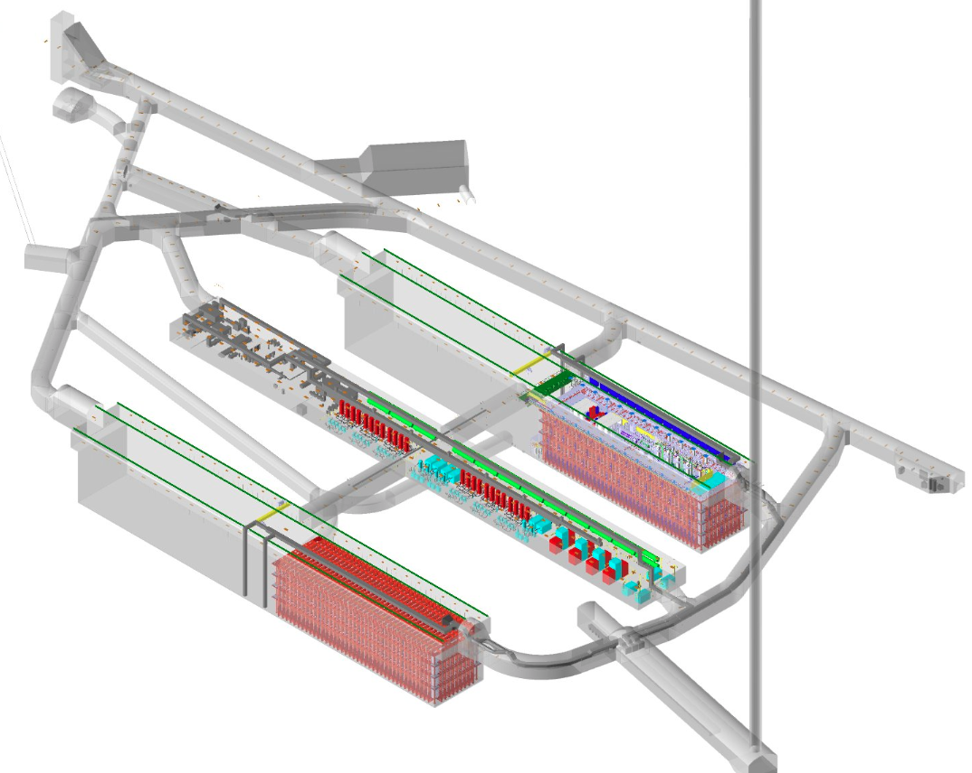
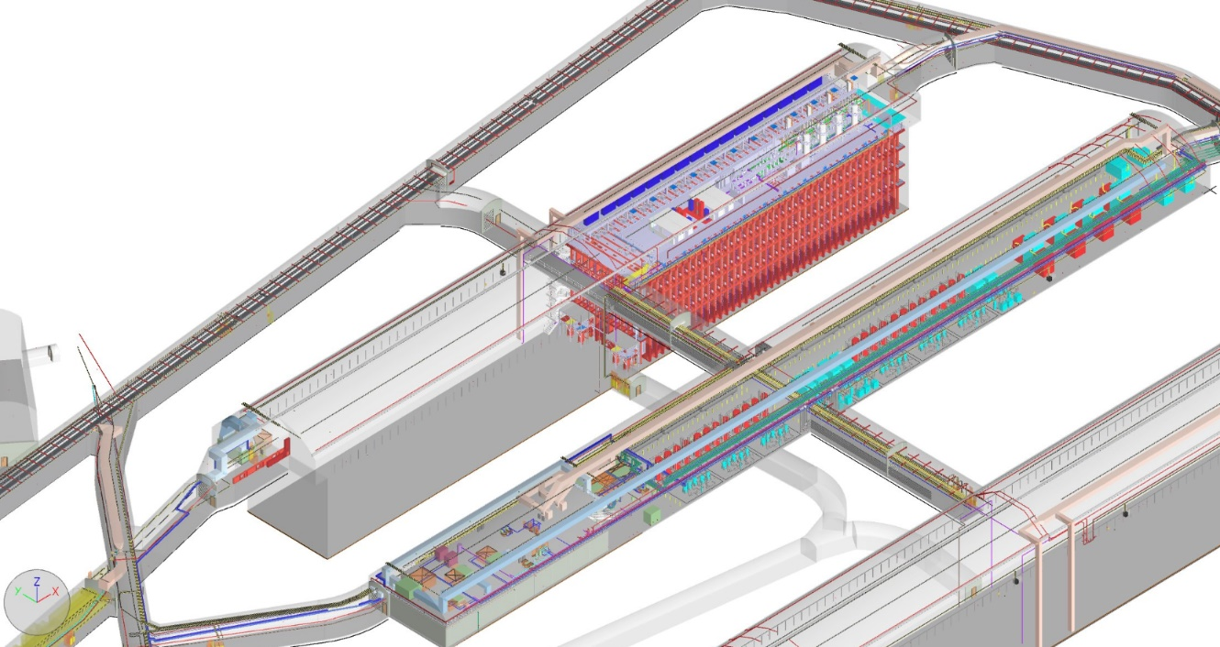
Far Site Update
Conventional Facilities:
Surface and shaft Infrastructure including utilities
Drifts and two caverns for detectors
Central utility cavern for conventional and cryogenic equipment
Cryostats:
Four membrane cryostats supported by external steel frames
Cryogenic Systems:
LN2 refrigeration system for cooling and re-condensing gaseous Argon
Systems for purification and recirculation of LAr
Argon:
70kt LAr
DUNE Detectors
Four LAr TPC detectors
4850L caverns and drift layout
Single cryostat and central utility cavern

Slide 3
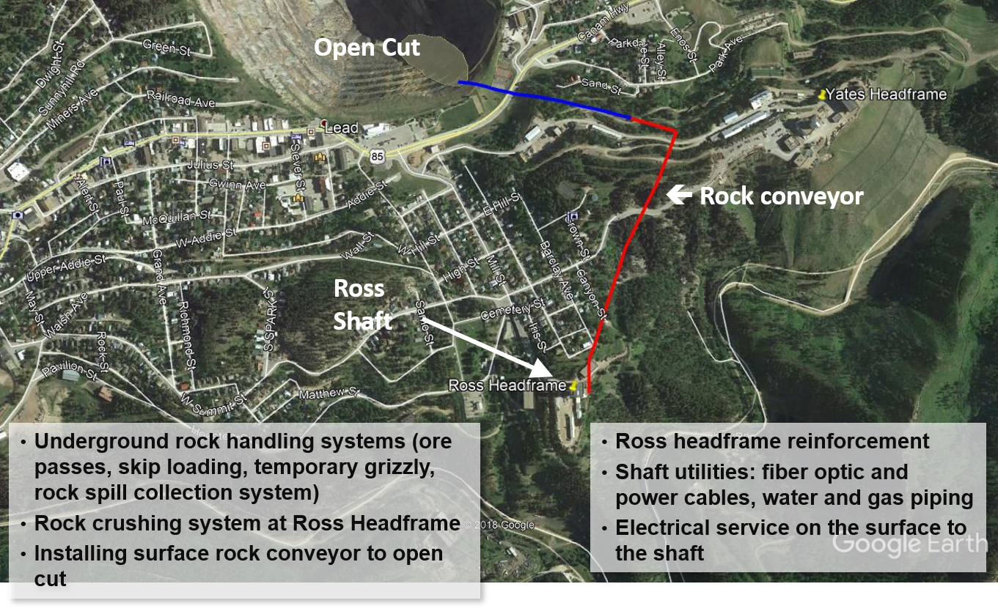
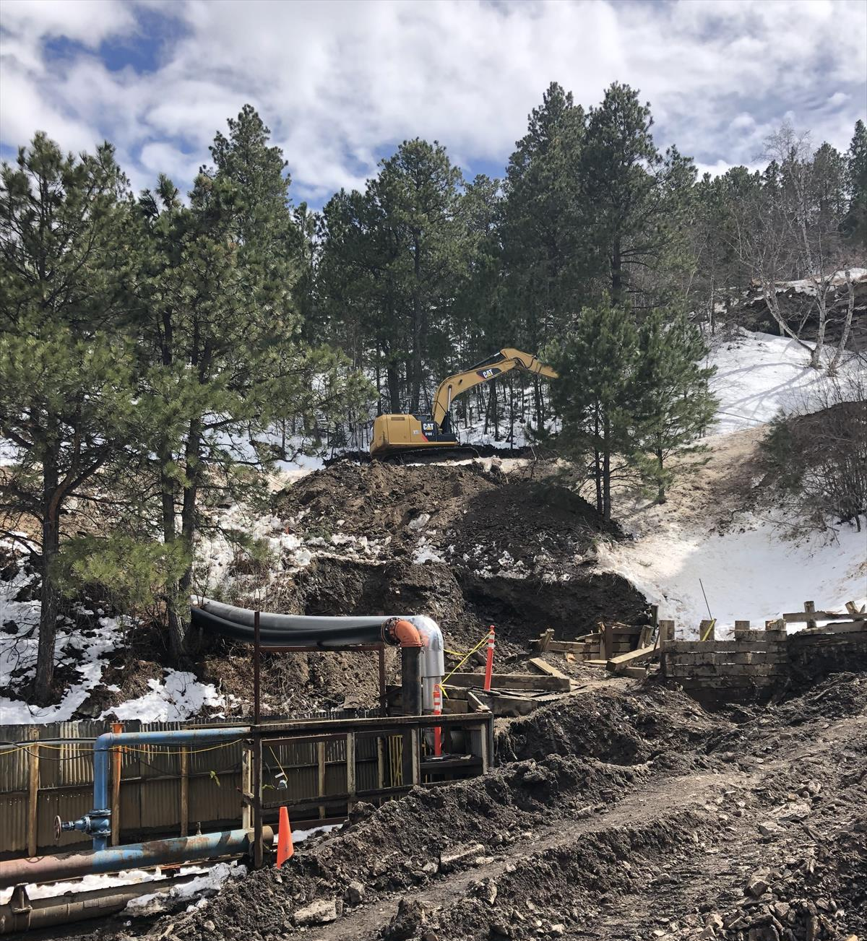
Construction at Far Site
PRE-EXCAVATION
Construct the systems to transport ~800,000 tons of rock from underground blast area to “Open Cut” in downtown Lead, SD.
All work is fully under contract and started early 2019.
Planned completion of this phase of work is November 2020.
Open Cut
⬅ Rock conveyor
Ross
Shaft
EXCAVATION AND BUILDING/SITE INFRASTRUCTURE
Final design completed in May 2019.
Working to issue request for proposals for excavation in fall 2019.

Slide 4
Cryogenic Infrastructure Status – LBNF
Liquid Argon purification/recirculation cryogenic systems: Advancing designs to produce performance specs for partners
Nitrogen Refrigeration System: Working through procurement process for this large industrial-scale system
Process Controls: completing preliminary design.
Cryostat #1 (CERN):
Steel support structure design complete
Internal membrane cryostat design complete
Finalizing cryostat QC document.
Fermilab Directorate leading discussions with partners for LAr cryogenic systems & cryostat #2

Slide 5
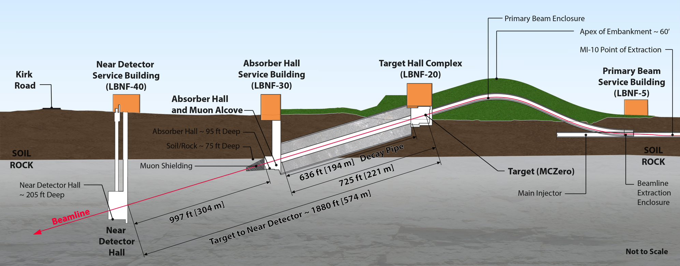
Near Site Update
Primary proton beam @ 60-120GeV extracted from Main Injector
Initial 1.2 MW beam power, upgradable to 2.4 MW
Embankment allows target complex to be at grade and neutrino beam to be aimed to SURF
Decay region followed by absorber
Four surface support buildings
Near Detector facility
DUNE Near Detector

Slide 6
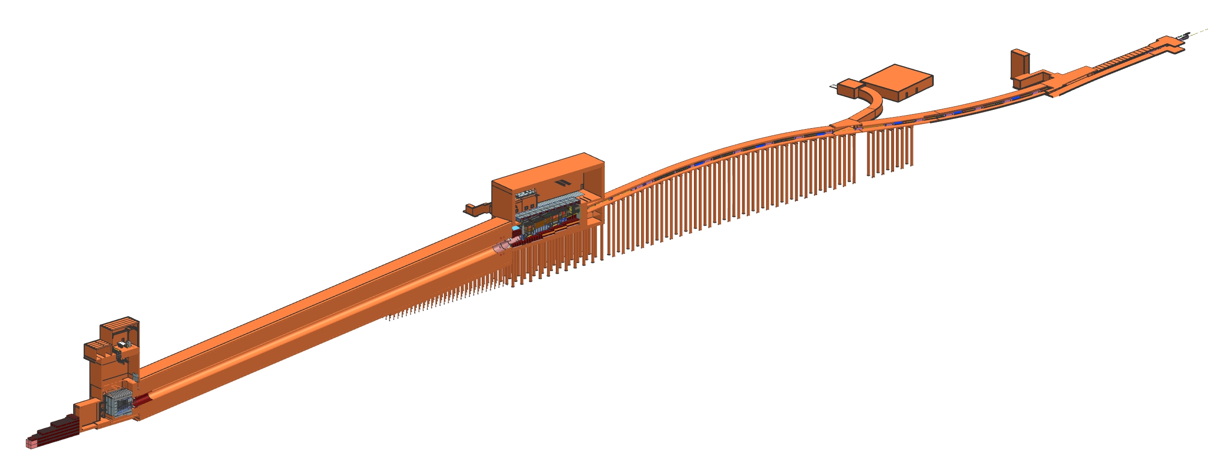
Close integration of NSCF and Beamline
NSCF and Beamline teams have been working through interfaces in last year to resolve scope gaps and be ready for NSCF preliminary design start

Slide 7
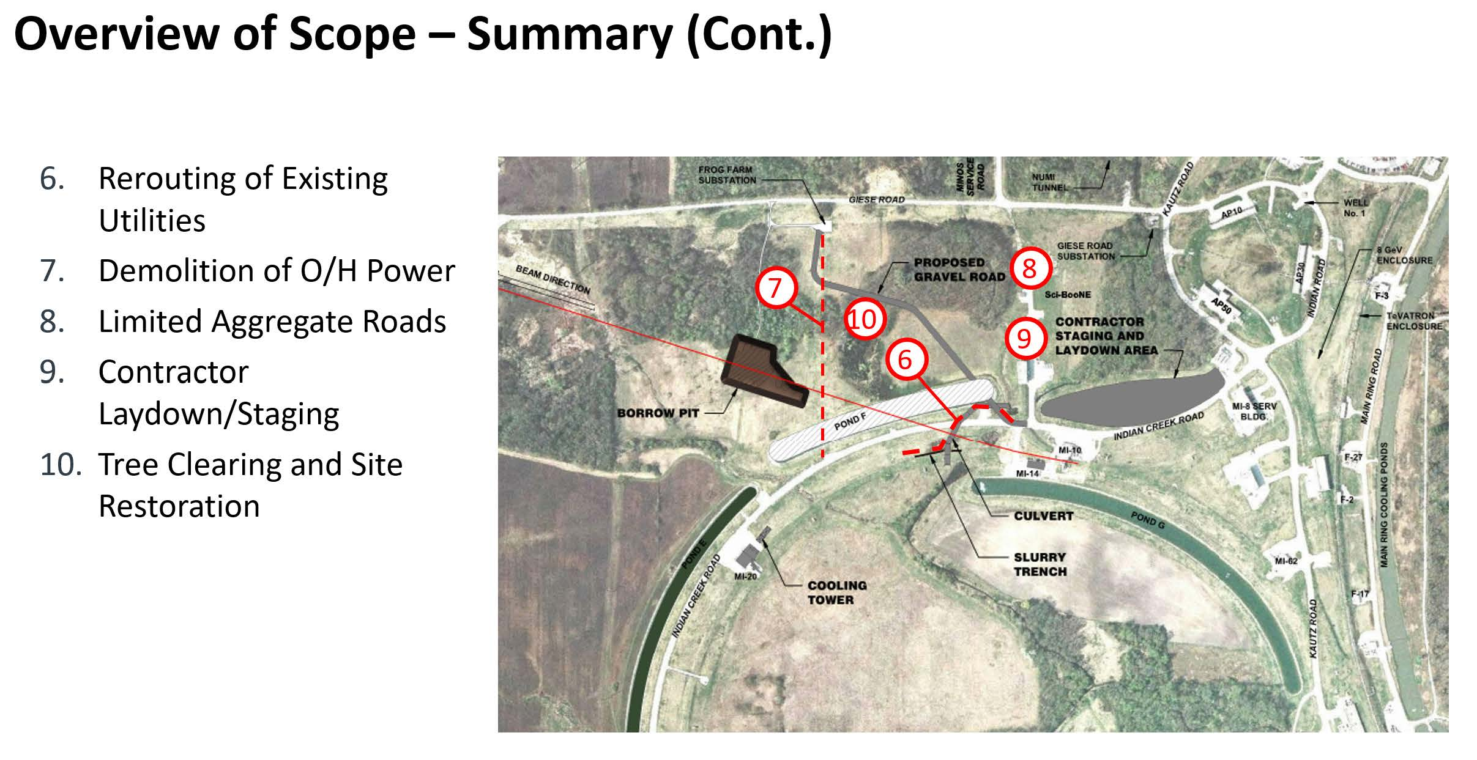
Near Site Conventional Facilities Status
Starting preliminary facilities design later this summer for Beamline & ND Complex
To compress construction schedule, have developed early site prep construction contract, will start FY2020 assuming funds available

Slide 8
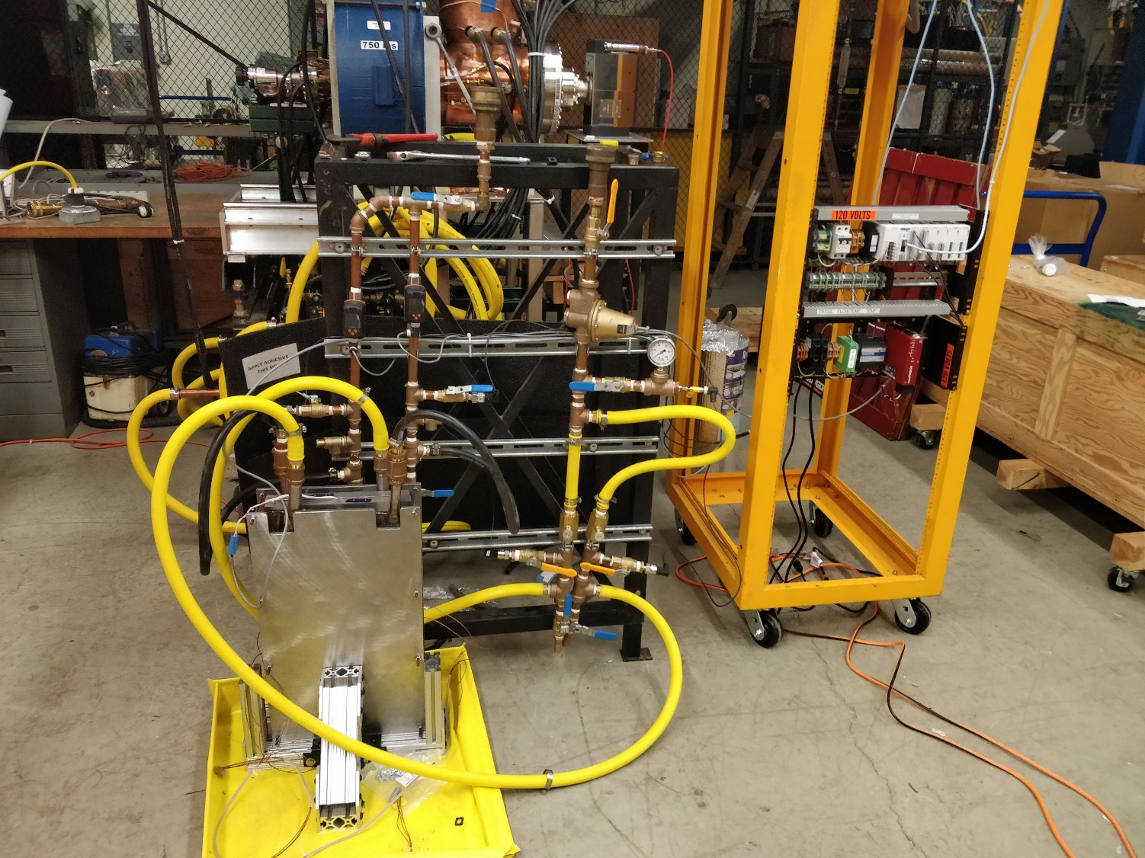
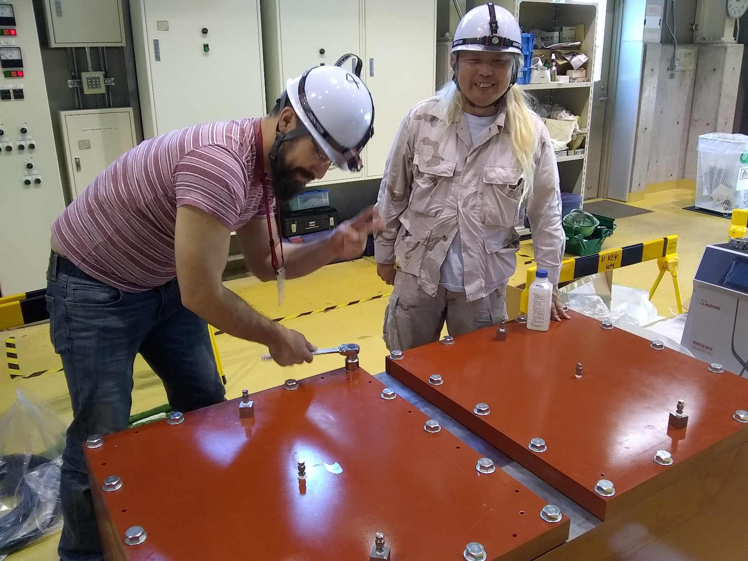
Beamline Update
Preliminary design underway across all systems
Prototype development and testing underway for several sub-systems
Target Shield Pile Cooling Panel prototype being assembled at FNAL
(testing is currently underway)
Target Shield Pile Hatch Cover prototype being vacuum and pressure tested at J-PARC. Initial results look very good.

Slide 9
Experiment-Facilities Interface Group (EFIG) Transition
EFIG forum has been very successful ensuring resolution of high-level integration and interface issues between the facility and the experiment.
Revised EFIG is now a steering and decision-making body:
Co-chaired by Chris Mossey (Deputy Director for LBNF) and Marzio Nessi (Project Integration Director)
Membership includes Co-spokes, TC, RC, LBNF PM and Deputy PM, System Engineering Manager, SDSD Head
New organizational structure shown on next slide
SDSD Head proposed as PM with PID on Exp-Fac Integration scope

Slide 10
LBNF/DUNE Project Organization
LBNF/DUNE
FNAL Director
DUNE
Spokes/TC/RC
EXP-FAC INTEGRATION
PID/ PM
Project Office
Technical Coordination
FD Production
ND Production
Integration Office
Installation
Cryostat
Conventional Facilities
Beamline
Cryogenics
Facility Support & Services
LBNF
PD/PM
EFIG
JOINT PROJECT OFFICE
Experiment/Facilities Interface Group (EFIG) forum has been very successful ensuring resolution of high-level integration and interface issues between the facility and the experiment.
Revised EFIG is now a steering and decision-making body
Co-chaired by Chris Mossey (Deputy Director for LBNF) and Marzio Nessi (Project Integration Director)

Slide 11
Key Milestones – DOE Baseline and Construction Approvals
Project plans to baseline (CD-2) DOE project scope in two steps, starting this year:
Far Site “Sub-Project” (SP-FS) - Baseline all Far Site work (FS conventional facilities, cryogenics, DUNE-US contribution to far detector, & US support of integration) with DOE review in winter 2019.
Near Site “Sub-Project” (SP-NS) – Baseline all Near Site work (NS conventional facilities, beamline, DUNE-US contribution to near detector, & US support of integration) with DOE review ~ Aug 2020.
Approach will allow 65% of U.S. project to baseline as soon as possible, while proceeding with understanding of near site detector requirements and maturing conventional facilities design into 2020.
CD-3 authorization for DOE construction start necessary to maintain schedule
For FSCF and Far Detector - in tandem with SP-FS CD-2
For Cryo, NSCF, Beamline, & Near Detector - up to 2 years after SP-NS CD-2 (presently planned for 2022)

Slide 12
Summary
LBNF continues to receive extraordinary support from DOE leadership, administration, Congress, and international partners.
Far Site construction is underway, Near Site construction will start early next year.
Beamline and cryogenics systems design progressing
DOE and Fermilab continuing to engage international partners to solicit in-kind contributions necessary for project success
Planning for DOE scope baselining reviews in 2020.

