Slide 1
LBNF/DUNE beam & target system
Chris Densham, Peter Loveridge, Tristan Davenne,
Joe O’Dell, Mike Fitton, Phil Jeffery, Geoff Burton, Eric Harvey-Fishenden, Dan Wilcox, Michael Parkin
(STFC Rutherford Appleton Laboratory)
John Back (Warwick University)

Slide 2
LBNF/DUNE US/UK Agreement Hierarchy
Top layer – the US/UK Science and Technology Agreement, signed at Ministerial level, which is legally binding
2nd layer – Implementing Agreement, signed by DOE and UK Ambassador in April 2019
3rd layer – Project Annexe, relates to LBNF/DUNE and is general and non-legally binding (to be signed fall 2019)
CJD expected to be UK Agency Technical Coordinator
4th layer – Project Planning Document (and MoUs)
Technical description of the in-kind-contribution: deliverables, project activities, schedule and key milestones
Sign-off in UK by Geddes (STFC Technology Director of National Laboratories)?

Slide 3
Outline UK In-Kind-Contributions for LBNF target
At least one viable prototype and one 1.2 MW capable helium cooled graphite neutrino target system that meets the requirements of the Beam Interface Working Group specification [ref] as far as is realistically achievable and is compatible with the LBNF magnetic Horn A.
Short baffle collimator (so-called ‘bafflette’) integrated into the upstream of the target that permits beam-based alignment using low intensity horizontal and verical beam scans.
Full Intensity Beam Position monitor (so-called ‘Hylen’ monitor) integrated into the upstream of the target excluding the anticipated beryllium components
Target physical alignment, mounting and interface system with Horn A
Target exchange system to permit failed targets to be replaced in a shielded Work Cell
Design and the specification of the associated helium cooling system for the provided target system (above);
Instrumented baffle/collimator;
Master-slave manipulator system (one pair) that can be installed in the Work Cell to operate the target exchange system
In addition to the above, as the STFC funding envelope permits, STFC may also contribute:
Target helium cooling system key components (e.g. heat exchanger(s))
Ongoing Maintenance and Operations of UK contributions including replacements

Slide 4
LBNF-UK target Project Phases
Structured to maximise what UK can deliver to project within fixed funding envelope (including contingency) and funding profile outlined in UK Business Case.
Phase 0 & Phase 1: April 2018 - March 2022
Preliminary design and specification of UK deliverables for Phase 2
Detailed cost estimates and schedule for supply of UK deliverables
Finalise Scope of Work (via Project Planning Document) for Phase 2 deliverables
Phase 2: April 2022 – March 2026
Detailed design, manufacture, supply, installation and commissioning

Slide 5
LBNF-UK target governance & oversight
1st LBNF target Oversight Committee convened by STFC Programmes Directorate (PD) on 25th June 2019
Documents submitted by LBNF-UK target project team 1 month prior to meeting
“LBNF Targets Assurance Review and Quality Audit” (50 pages) provided after meeting
OsC feedback report received 16th July
UK government department BEIS ‘Gateway 2’ review anticipated fall 2019
Next LBNF target OsC to be scheduled before GW2 review (Sept/Oct)

Slide 6
Summary of Feedback from 1st Oversight Committee ‘OFFICIAL SENSITIVE’
ACTION: The Collaboration is to provide sub-project high-level milestones and deliverables with clearly defined acceptance criteria for the next OsC meeting
ACTION: The collaboration is to review all sub-project milestones and deliverables to establish clearly defined acceptance criteria for the next OsC meeting
ACTION: The Collaboration is to lay out a process through which it is engaging with the US, indicating the degree of engagement and influence
The OsC and PD informed the Collaboration that installation and commissioning costs associated with the sub-project would be funded from the existing BEIS allocation to the sub-project, and that there was no scope for further grant awards to this end. The OsC noted that due to external factors, the proposed 2026 sub-project end date had slipped to 2029. The OsC advised the Collaboration to plan accordingly in preparation for future grant proposals.

Slide 7
Summary of Feedback from 1st Oversight Committee (contd)
The OsC noted that LBNF DUNE sub-projects’ Memorandums of Understanding were yet to be completed but, were in draft and close to being agreed. Whilst financial commitments from PD were anticipated and understood in terms of the sub-project’s costs and a future period of Maintenance and Operations, clarification should be sought regarding the potential assumption that PD fund the annual/regular replacement of targets before formally agreeing to this commitment, as this is not currently budgeted.
ACTION: The Collaboration is to provide clarification regarding future annual/regular costs regarding target replacement/provision before formally agreeing to this commitment

Slide 8
Summary of Feedback from 1st Oversight Committee (contd)
ACTION: The Collaboration is to provide a timeline for the three target options’ design, optimisation, and prototyping period, with decision points, to the next OsC meeting
ACTION: The OsC (via STFC PD) would like to be informed of the outcome of the ‘target selection meeting’ at least one month ahead of the next OsC meeting, in order to understand if a deliverable design has been agreed
ACTION: Following July’s ‘target selection meeting’, the Collaboration is to provide an assessment of resource requirements comparing, at a minimum, (i) the current scenario of design, optimisation, and prototyping of the three target options and, (ii) the pragmatic focussing scenario of design, optimisation, and prototyping of one target option (once known), to the next OsC meeting
ACTION: The collaboration is to elaborate on the rationale for, and extent of, prototyping the target option(s), primarily to comprehend if the timeline allows for it, what the success criteria of the exercise are, and whether or not it would ultimately be a working UK deliverable to the US

Slide 9
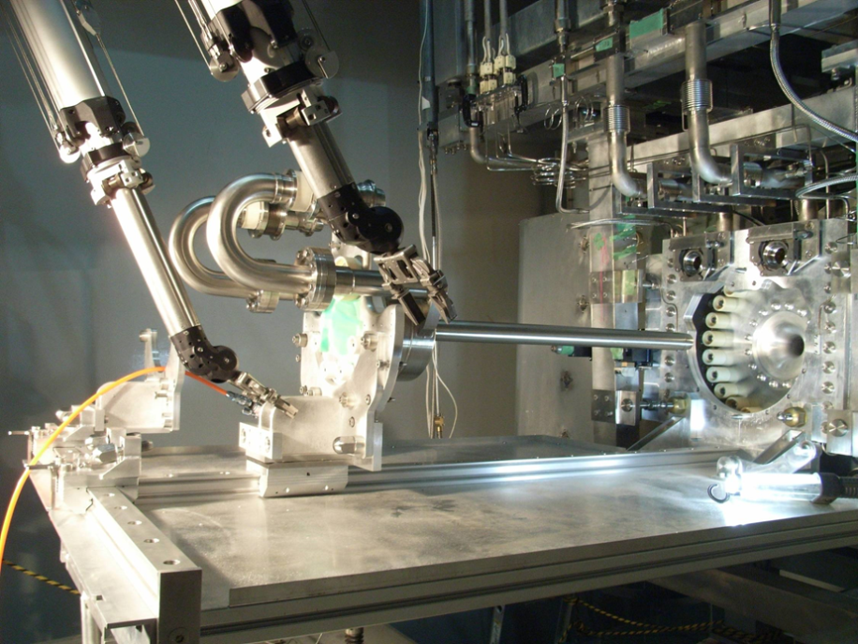
Our starting point: Helium Cooled T2K Target
Target installation in magnetic horn using exchanger and manipulator system
Notes:
Target exchange procedure
Target exchanger platform on gimbal/spring system, positioned by dual jacks, X and Z rails allow carriage cross over for target removal installation.
View of operators through RMA lead glass window.

Slide 10
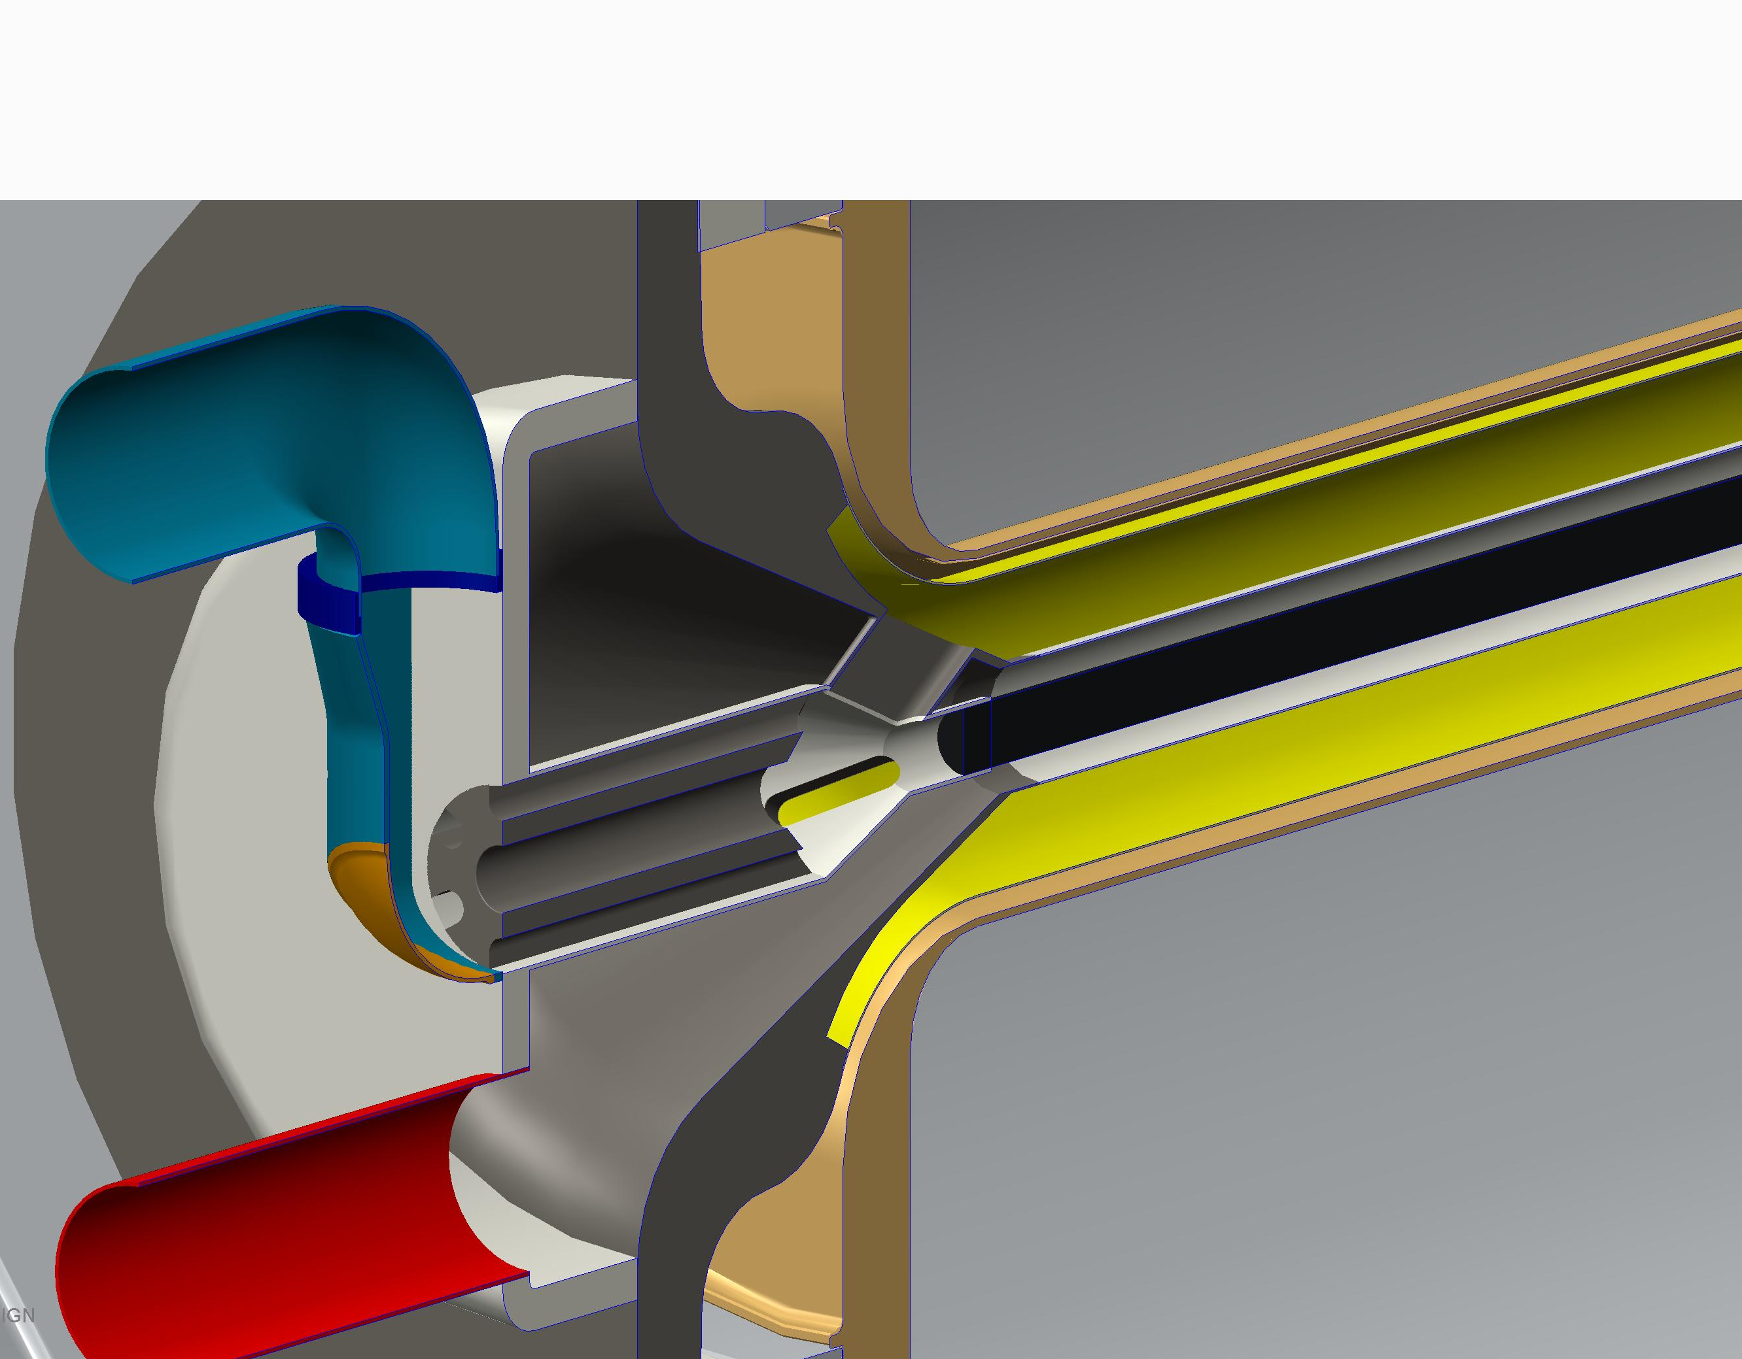
Helium cooled LBNF target schematic
10σ +2mm
‘Bafflette’ to protect downstream elements from halo and miss-steered beam
6σ

Slide 11
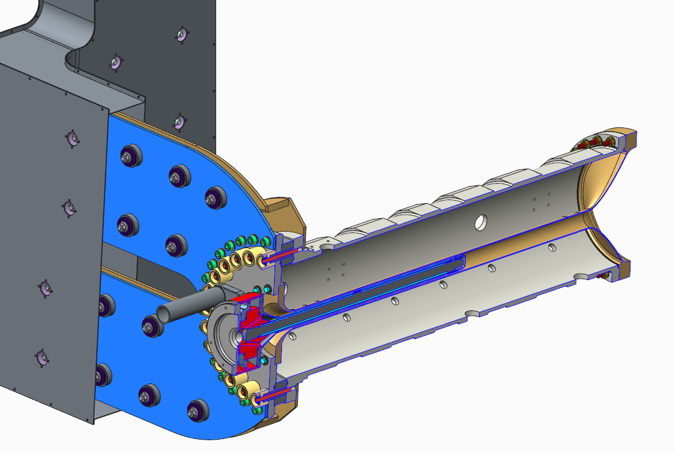
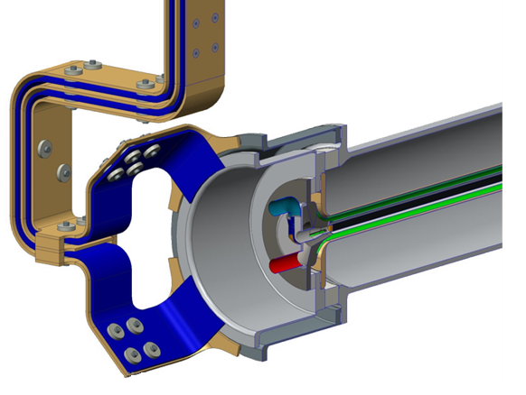
Horn Current Stripline Comparison: T2K vs LBNF
T2K Horn 1
“Radial” current equalisation
LBNF Horn 1 starting point
“Longitudinal” current equalisation
LBNF starting point difficult for target integration & remote handling
Has progressed to more ‘T2K-like’

Slide 12
Screenshot of a bi-weekly Technical Coordination Meeting

Slide 13
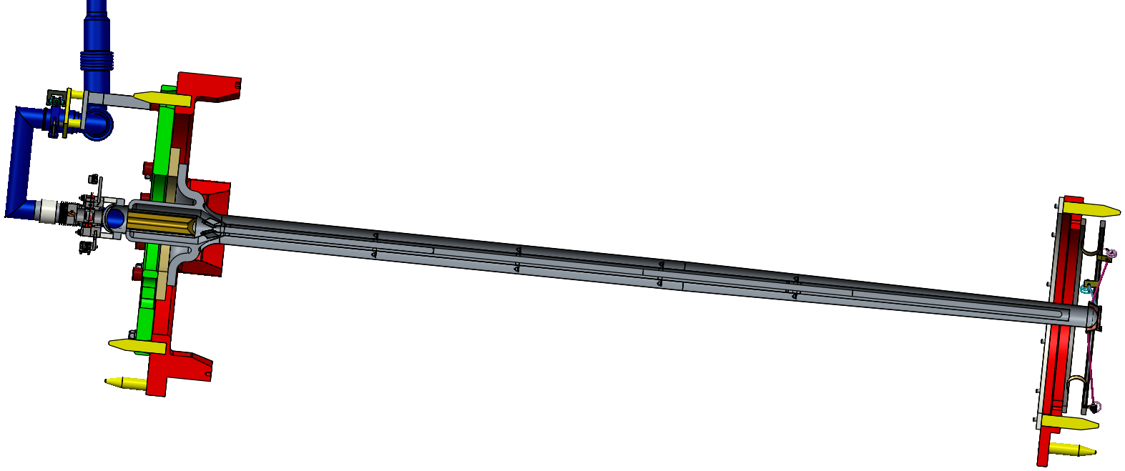
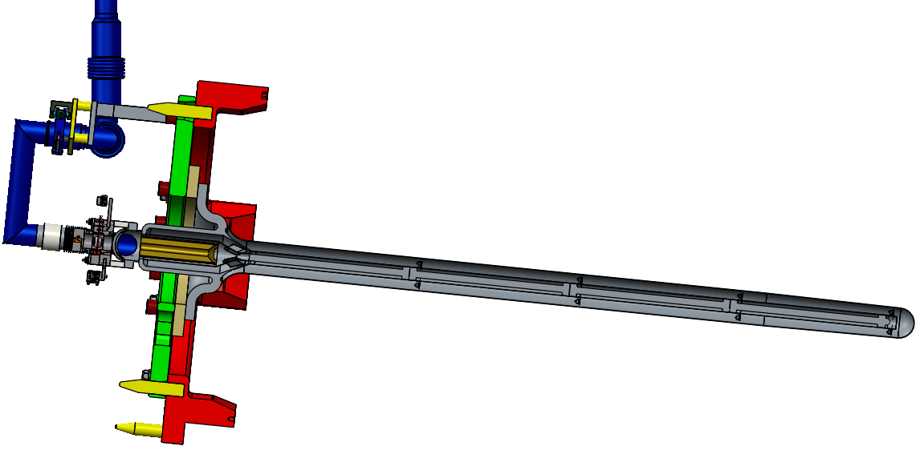
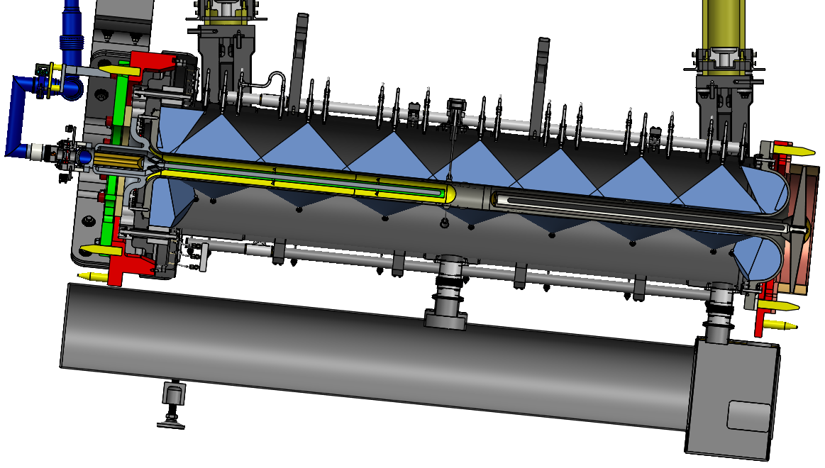
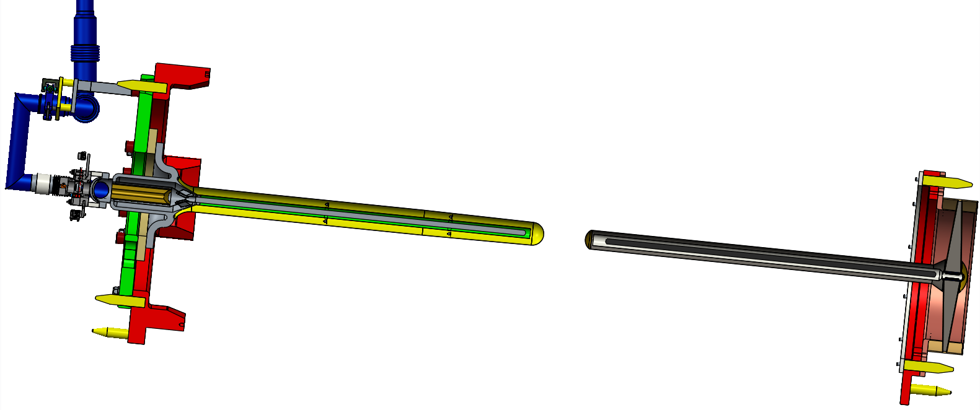
Target concept: proposed options
1: Single 2.2m long target with remote-docking downstream support
3: Single intermediate length target supported as a simple cantilever
2: Two ~1m long cantilever targets, one inserted at either end of horn

Slide 14
Target Concept Selection Criteria (draft from October 2018 meeting)
1 | Physics performance | Instantaneous physics performance
 |  | Upgradeability to 2.4 MW
 |  | Flexibility re optimisation (materials, beam size etc)
 |  | Compatibility with beam alignment (hadron vs muon?)
2 | Engineering performance | Safety factor = f(stress, temperature)
 |  | Lifetime, resilience to radiation damage
 |  | Resilience to off-normal conditions
 |  | Resilience to beam trips
 |  | Potential for diagnostics
3 | Impact on other systems | Impact on horn/stripline design
 |  | Ease of integration with horn
 |  | Ease/reliability of alignment with horn axis
 |  | Impact on services/plant
 |  | Ease of remote handling/disposal
 |  | Impact on TS design
 |  | Impact on absorber design
4 | Cost | Cost & resource for design/prototyping
 |  | Cost & resource for manufacture
 |  | Cost of RH equipment
 |  | Disposal cost
5 | Schedule | Time to design
 |  | Time to prototype
 |  | Time to manufacture
 |  | Schedule impact on other systems
6 | Risk | Design complexity
 |  | Ease of manufacture
 |  | Remote handling complexity
 |  | Departure from known technology
 |  | Schedule risk
 |  | ES&H / ALARA issues

Slide 15
Outline of UK presentations
Weds
10:00 | Physics performance | John Back
11:00 | Target/horn A interface - Outline comparison of design complexity | Joe O’Dell
15:30 | Cantilever target length vs robustness | Peter Loveridge
16:30 | Beam-based alignment issues | Chris Densham/Jim Hylen
Thurs
09:00 | Engineering performance - Heat loads (from FLUKA c/o JB, TD, MDF) - Thermal management (CFX) - Structural assessment (ANSYS…) | Dan Wilcox
10:30 | Remote Handling Comparison of time and risk for operations | Eric Harvey-Fishenden
15:00 | Project and Operations Impacts - Cost and Schedule Implications - Failure Modes Effects Analysis | Peter Loveridge
16:00 | Summary of Challenges - Key Design & Manufacturing Issues - Key Operations issues - Key Remote Maintenance Issues | Peter Loveridge

Slide 16
Extra material

Slide 17
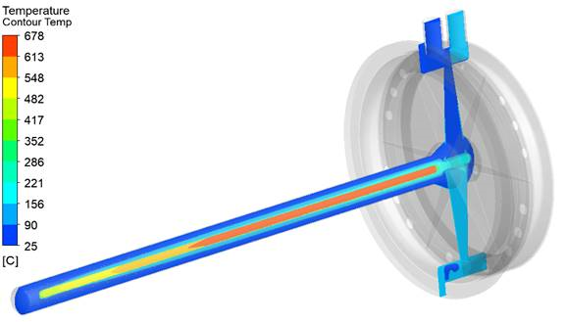
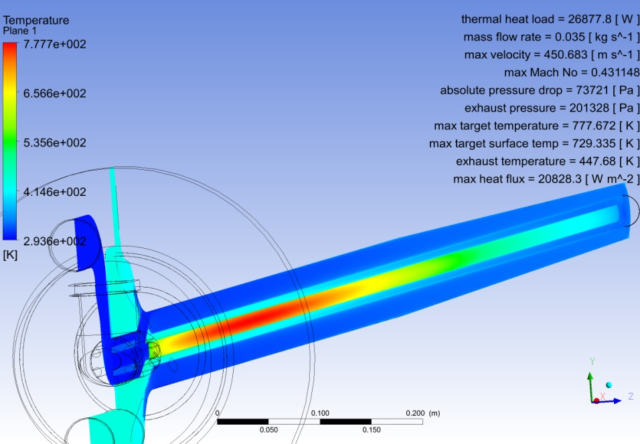
Upstream & downstream target temperatures
Considerable work needed to balance thermal & mechanical requirements of different options
E.g. need sufficient cooling of container walls & windows without excessive helium pressure or pressure drop

Slide 18
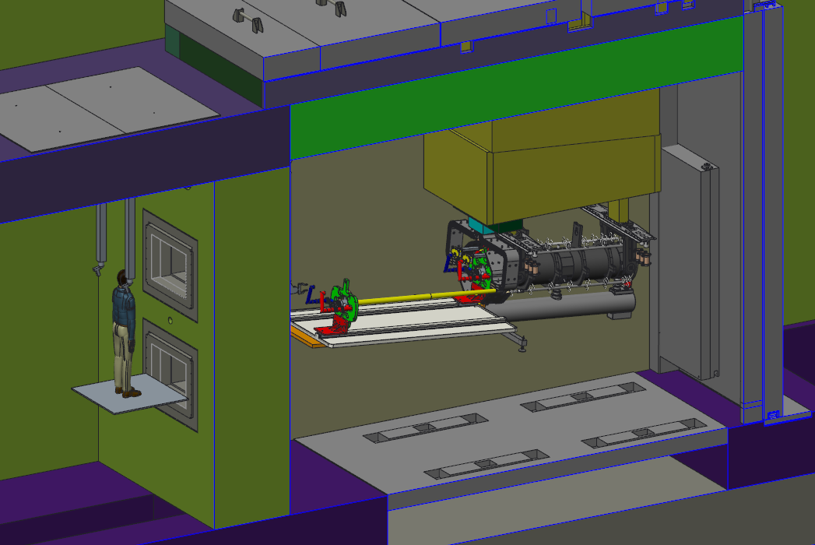
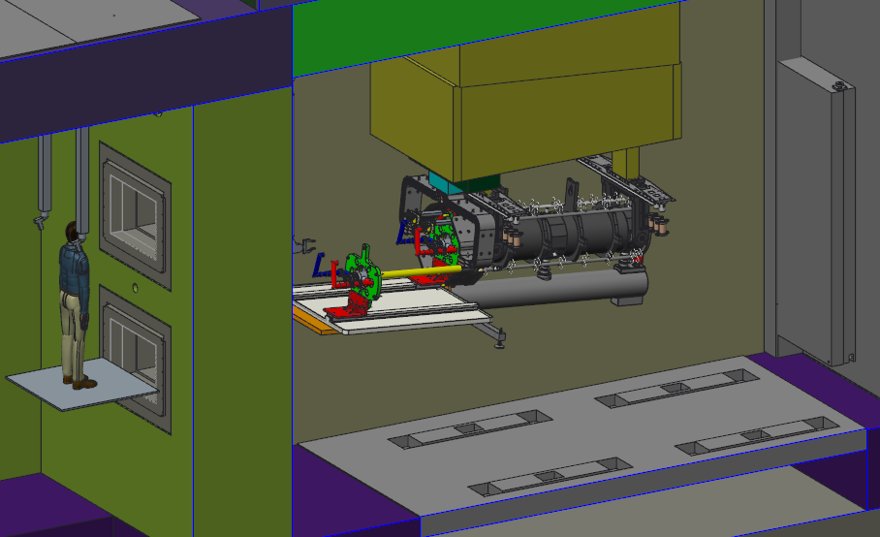
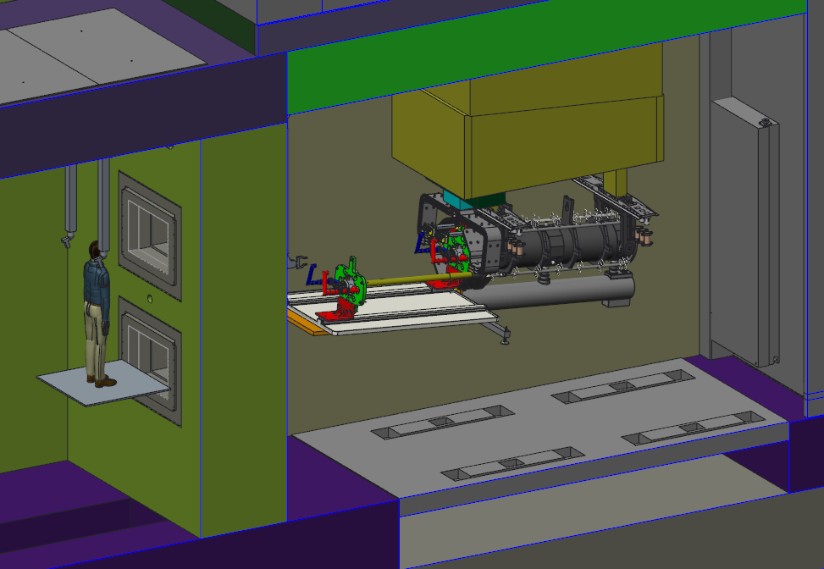
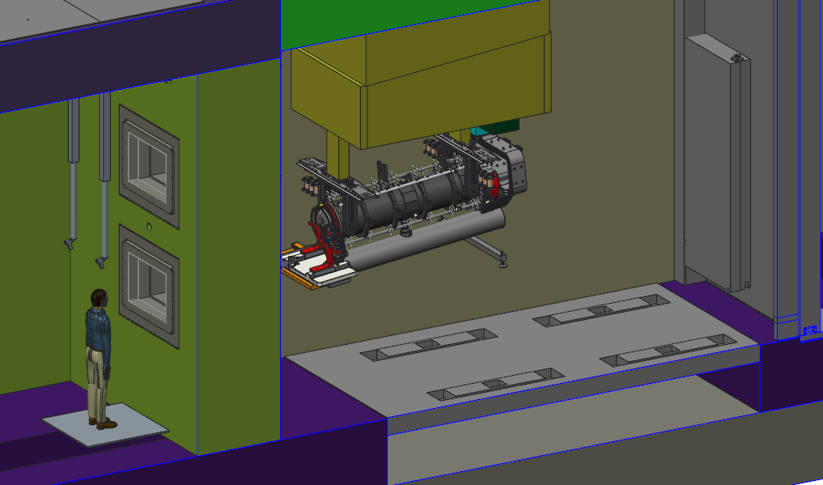
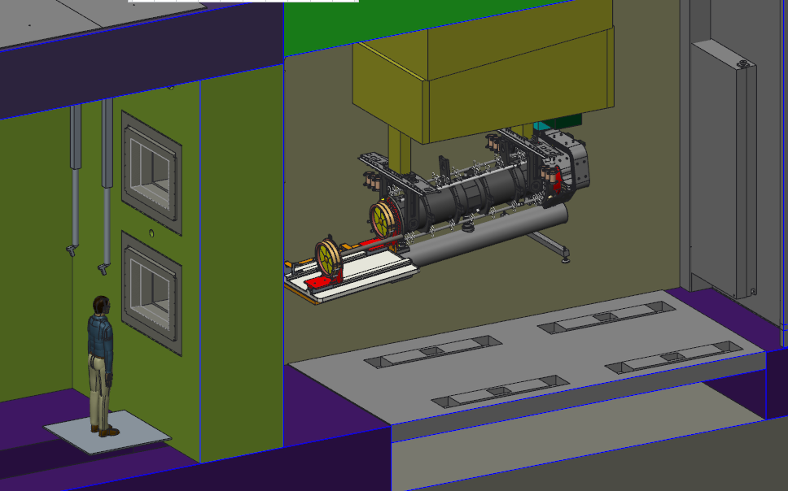
Target Exchange Procedures
2.2m Target 2x 1m Targets 1.5m Target

Slide 19
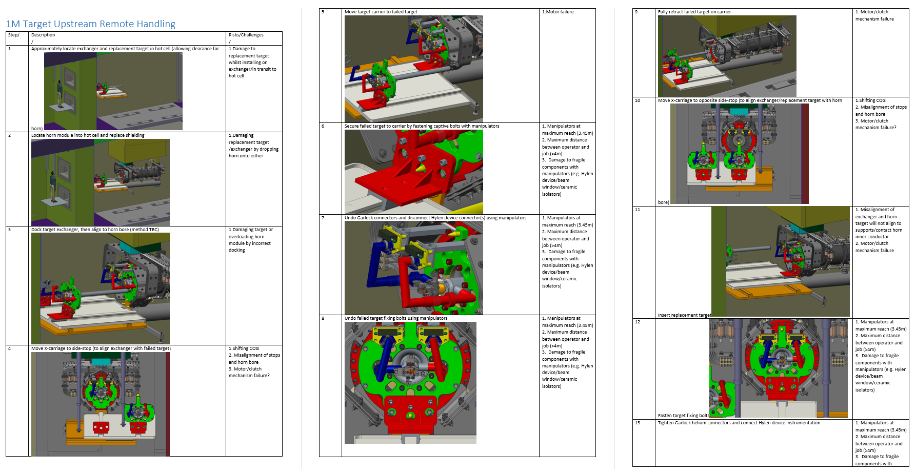
Concept Comparison
Procedures for complete target system exchange have been drafted for each concept
Each operation assigned an estimated time and risk (based on consequence and likelihood)
Comparisons then drawn up – No. operations, combined risk of operations, total time taken for operations
Currently in progress to contribute to target concept selection in July
Option | No. Operations | Risk | Replacement Time (hrs)
2.2m Target
Double Target
1.5m Target

Slide 20
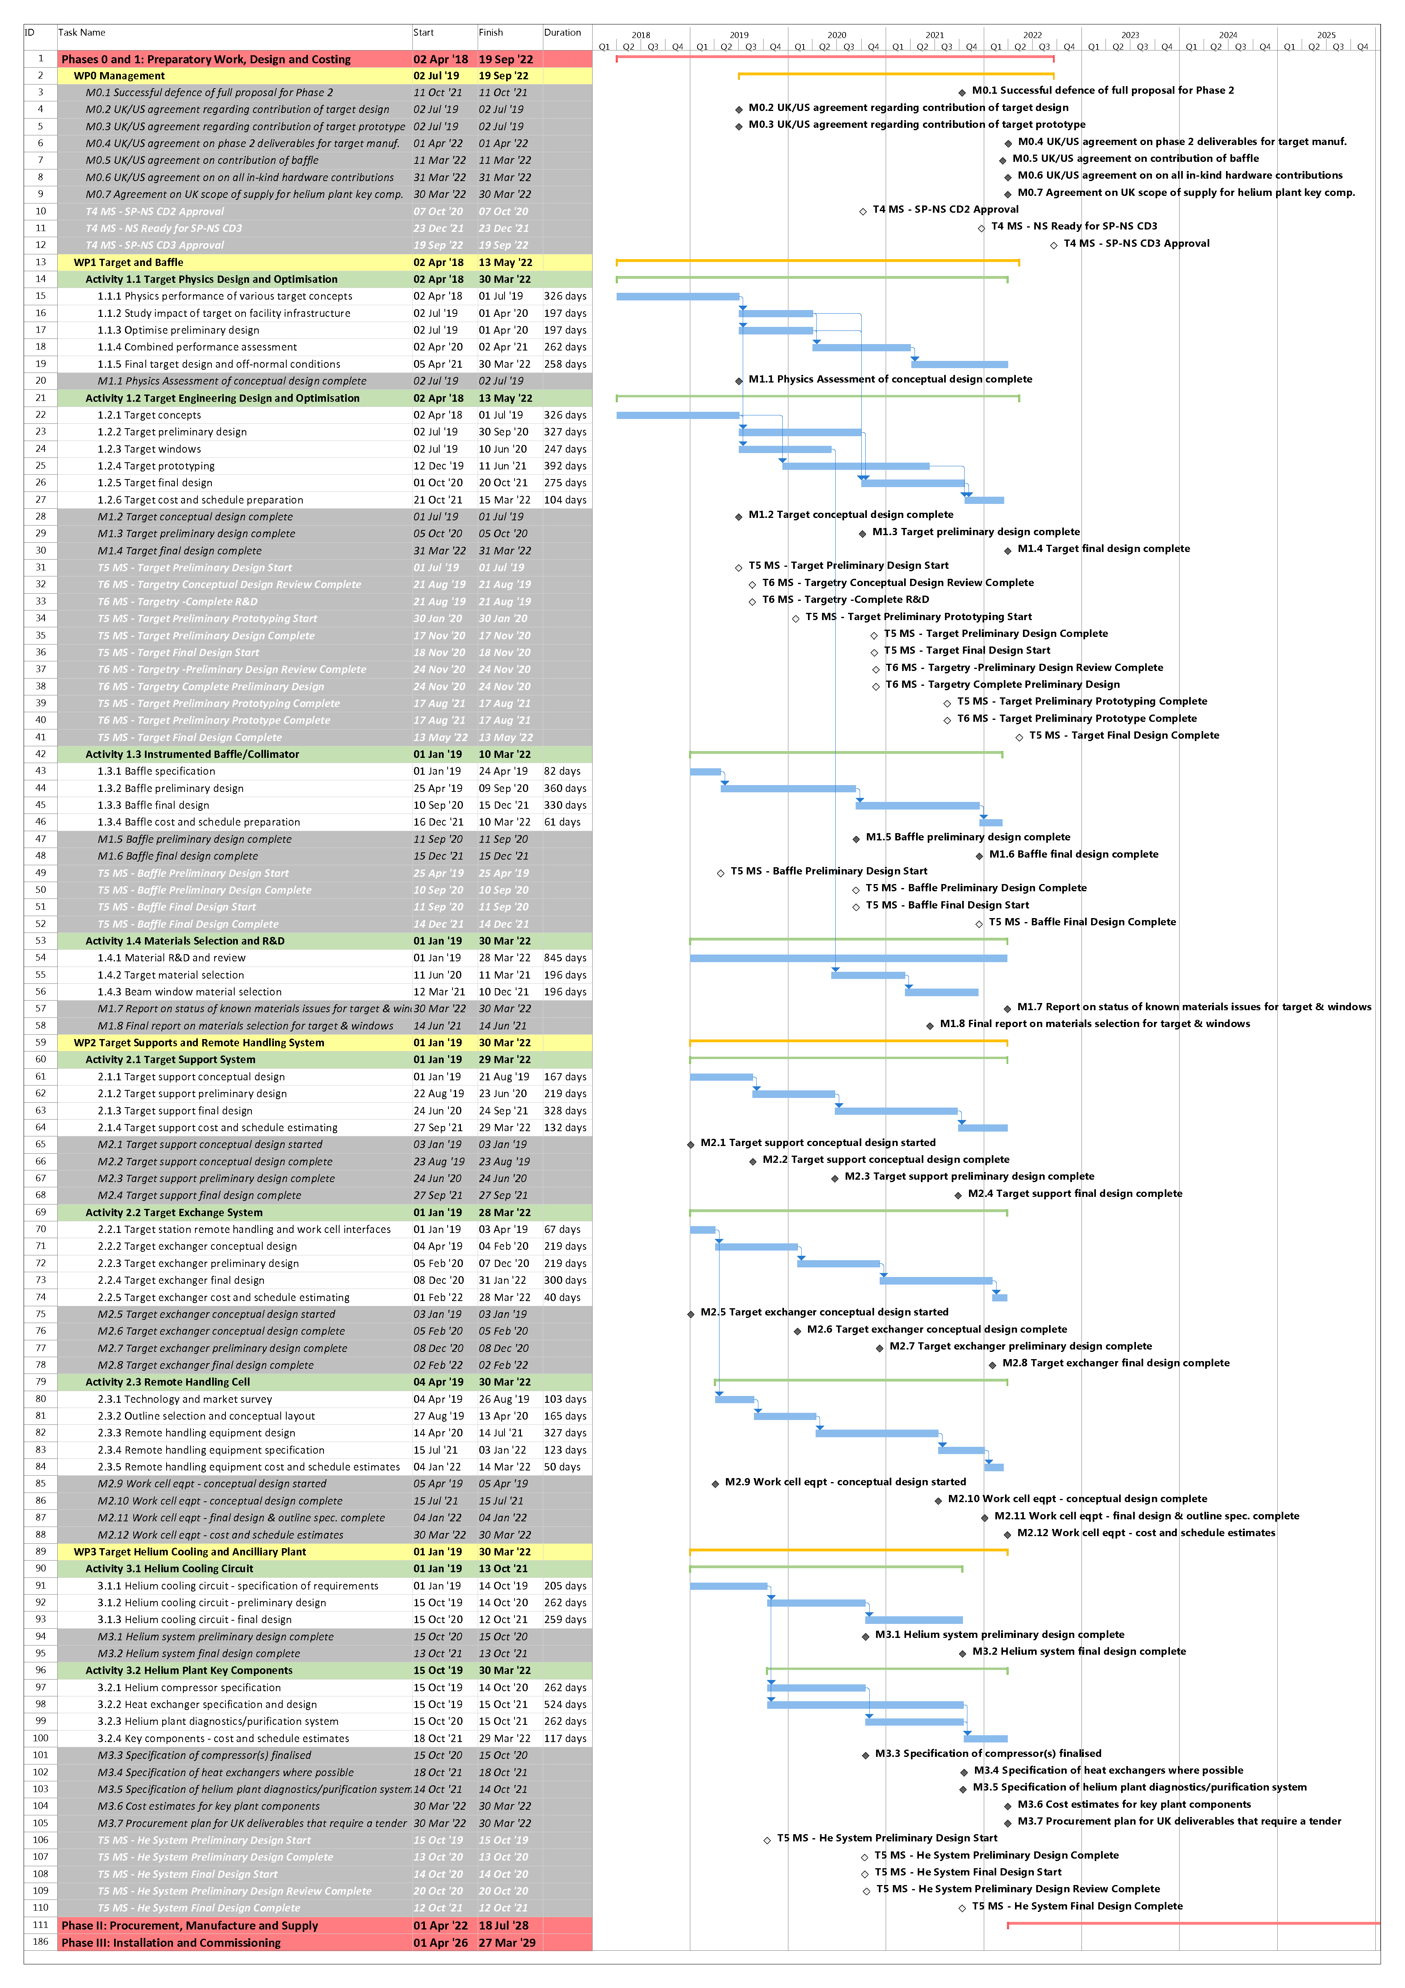
Phase 0 and Phase I (2018-2022)
Phase 0 and Phase I comprise this funded project
Design, prototyping, and costing of Phase II hardware deliverables
UK / US schedule integration efforts progressing well
Have some further freedom to request US milestone adjustments prior to their CD2 baseline (expected Summer 2020).
Target/Baffle/Helium System US milestones now shown in our Gantt (hollow diamonds)
Currently working on schedule integration for remote handling system

Slide 23
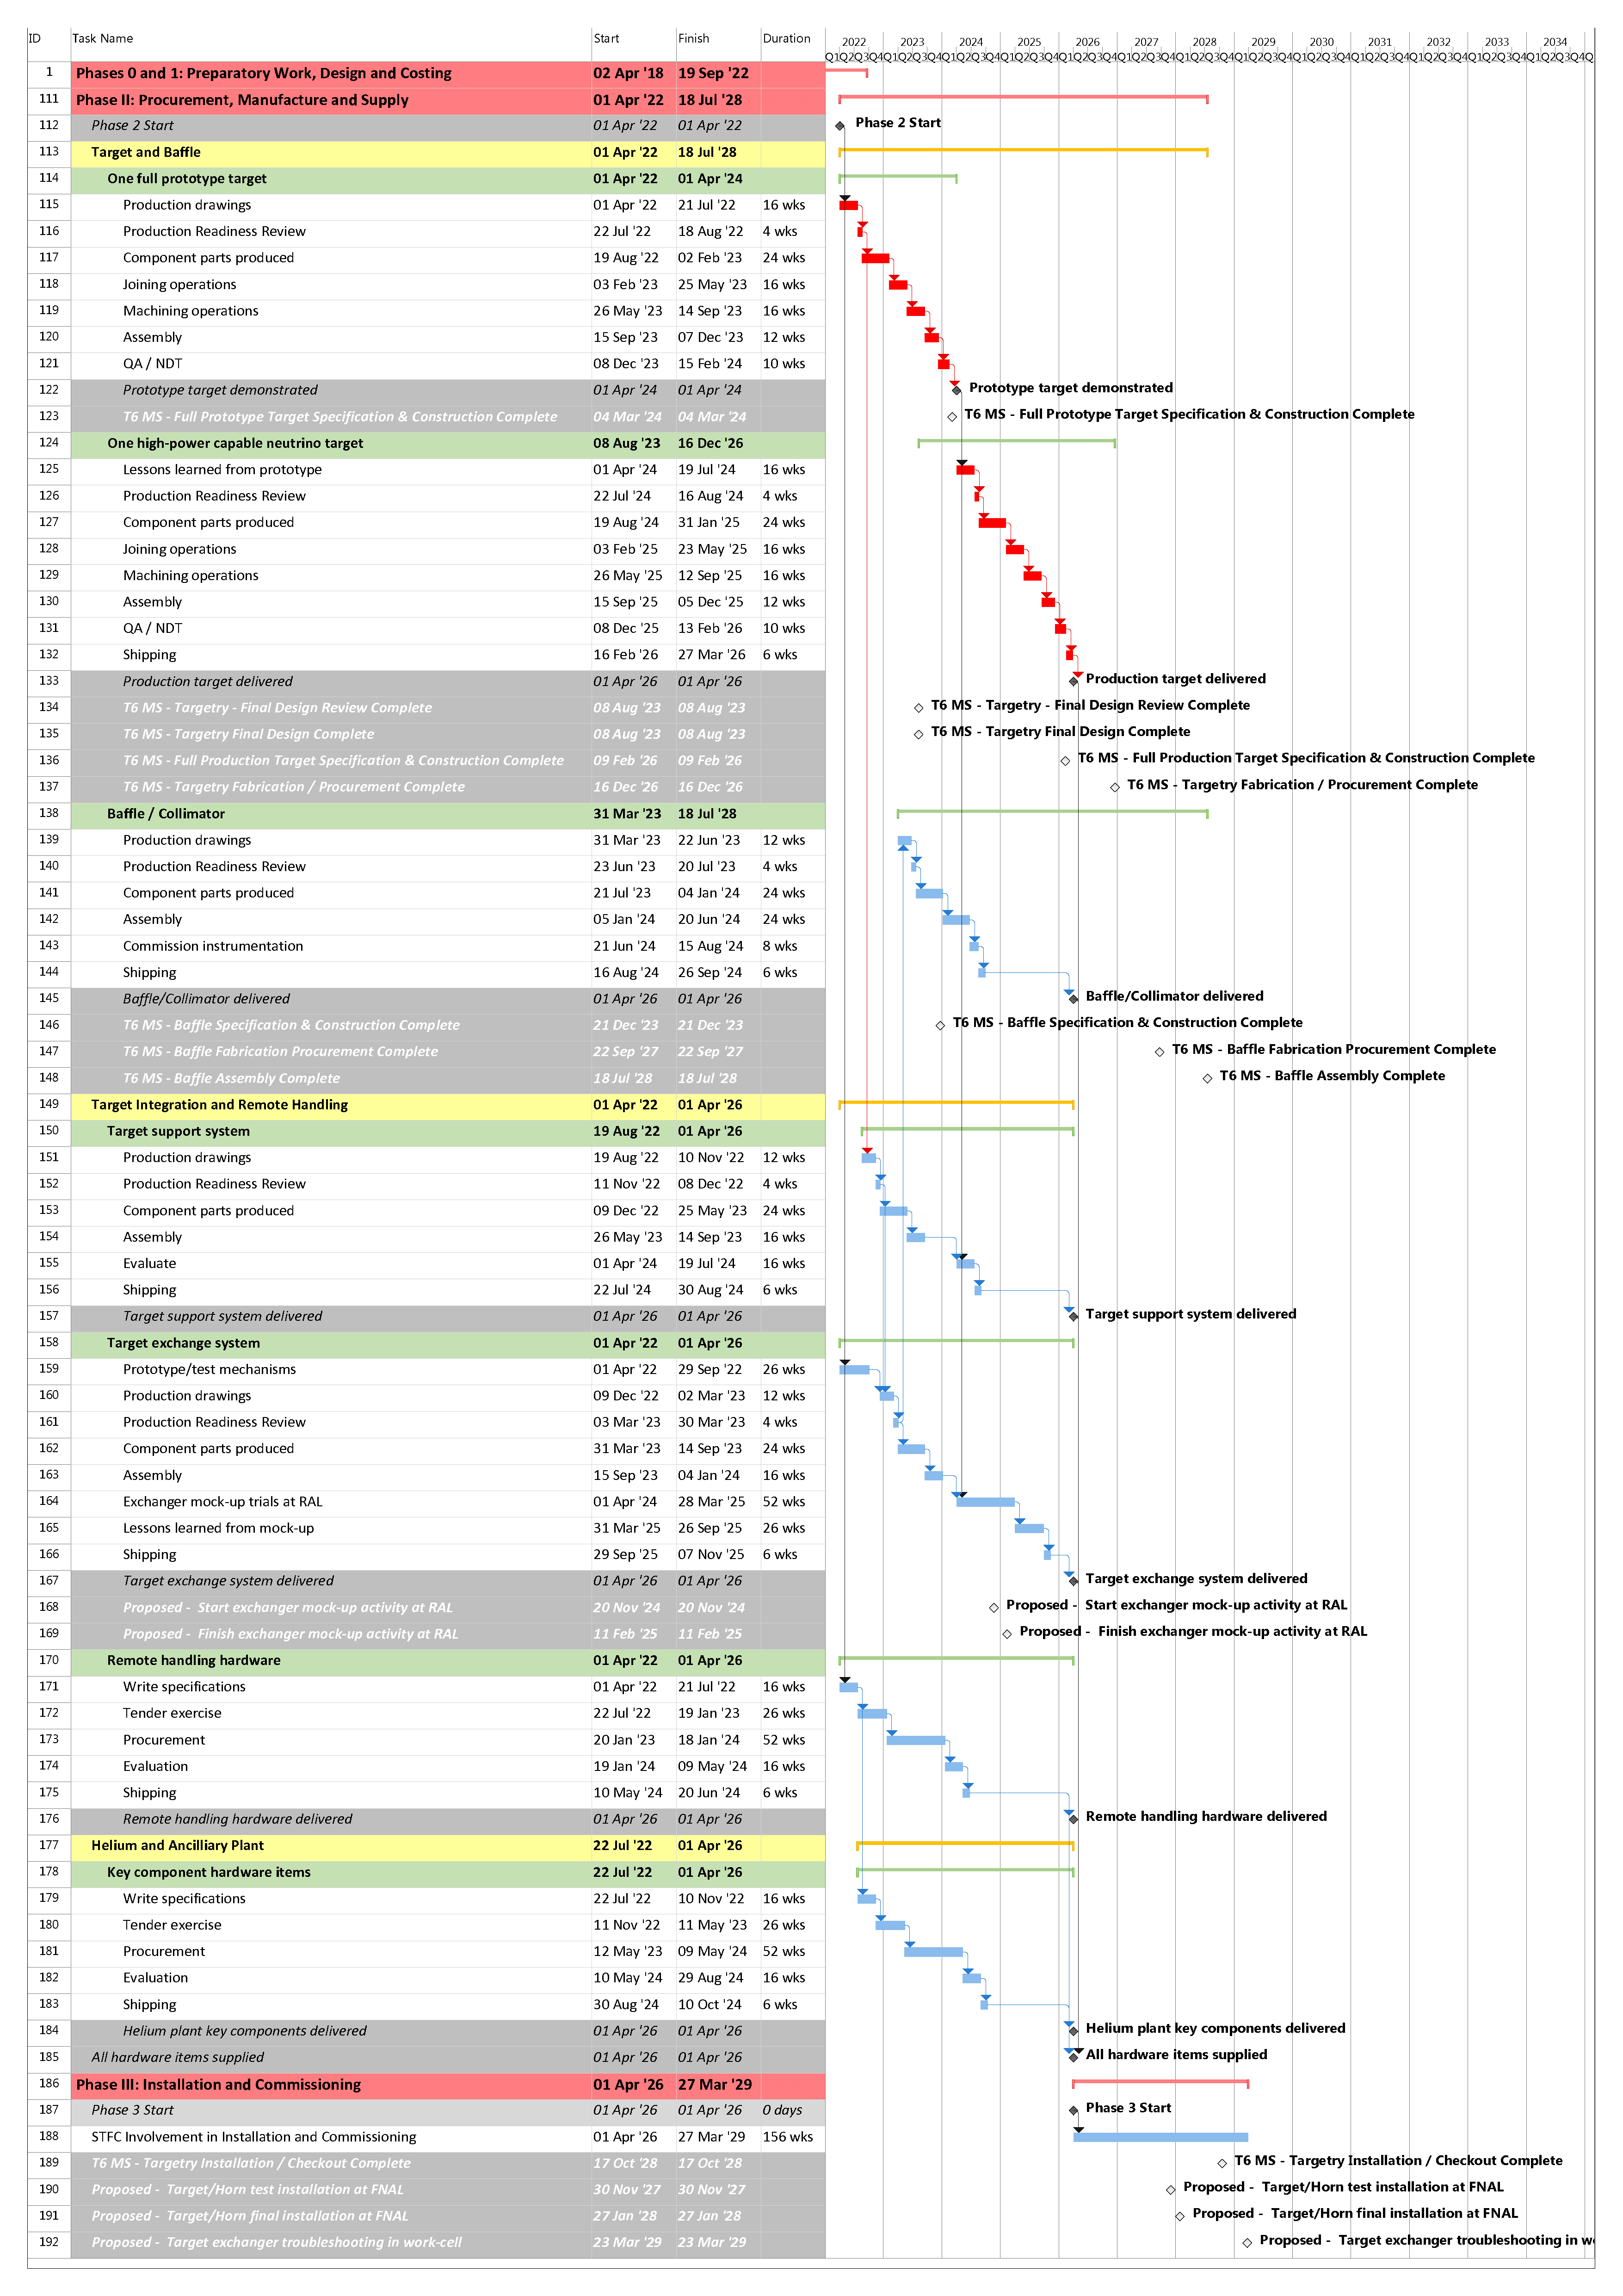
Phase II (2022-2026)
Envisaged to continue on directly from present Phase I project
Procurement, manufacture and supply of all hardware contributions
Target build is on critical path
Working with Fermilab on Phase II milestones in advance of US CD2 project baseline

Slide 26
US ‘Tier 5’ milestones relating to the UK project
T5 Project Integration Milestones
LBNF Project Milestone | Planned Date | Ref. UK Project Plan | Status
Target
Target Preliminary Design Start | 01-Jul-19 | M1.2, Task 1.2.2 | On track
Target Preliminary Prototyping Start | 30-Jan-20 | Task 1.2.4 | On track
Target Preliminary Design Complete | 17-Nov-20 | M1.3 | On track
Target Final Design Start | 18-Nov-20 | Task 1.2.5 | On track
Target Preliminary Prototyping Complete | 17-Aug-21 | Task 1.2.4 | On track
Target Final Design Complete | 13-May-22 | M1.4 | On track
Baffle
Baffle Preliminary Design Start | 25-Apr-19 | Task 1.3.2 | Complete
Baffle Preliminary Design Complete | 10-Sep-20 | M1.5 | On track
Baffle Final Design Start | 11-Sep-20 | Task 1.3.3 | On track
Baffle Final Design Complete | 14-Dec-21 | M1.6 | On track
Helium System
He System Preliminary Design Start | 15-Oct-19 | Task 3.1.2 | On track
He System Preliminary Design Complete | 13-Oct-20 | M3.1 | On track
He System Final Design Start | 14-Oct-20 | Task 3.1.3 | On track
He System Preliminary Design Review Complete | 20-Oct-20 | M3.1 | On track
He System Final Design Complete | 12-Oct-21 | M3.2 | On track

