Slide 1
Data Acquisition System for RF Beam Detector
Kyle Leleux
RF Detector Meeting
25 July 2019

Slide 2
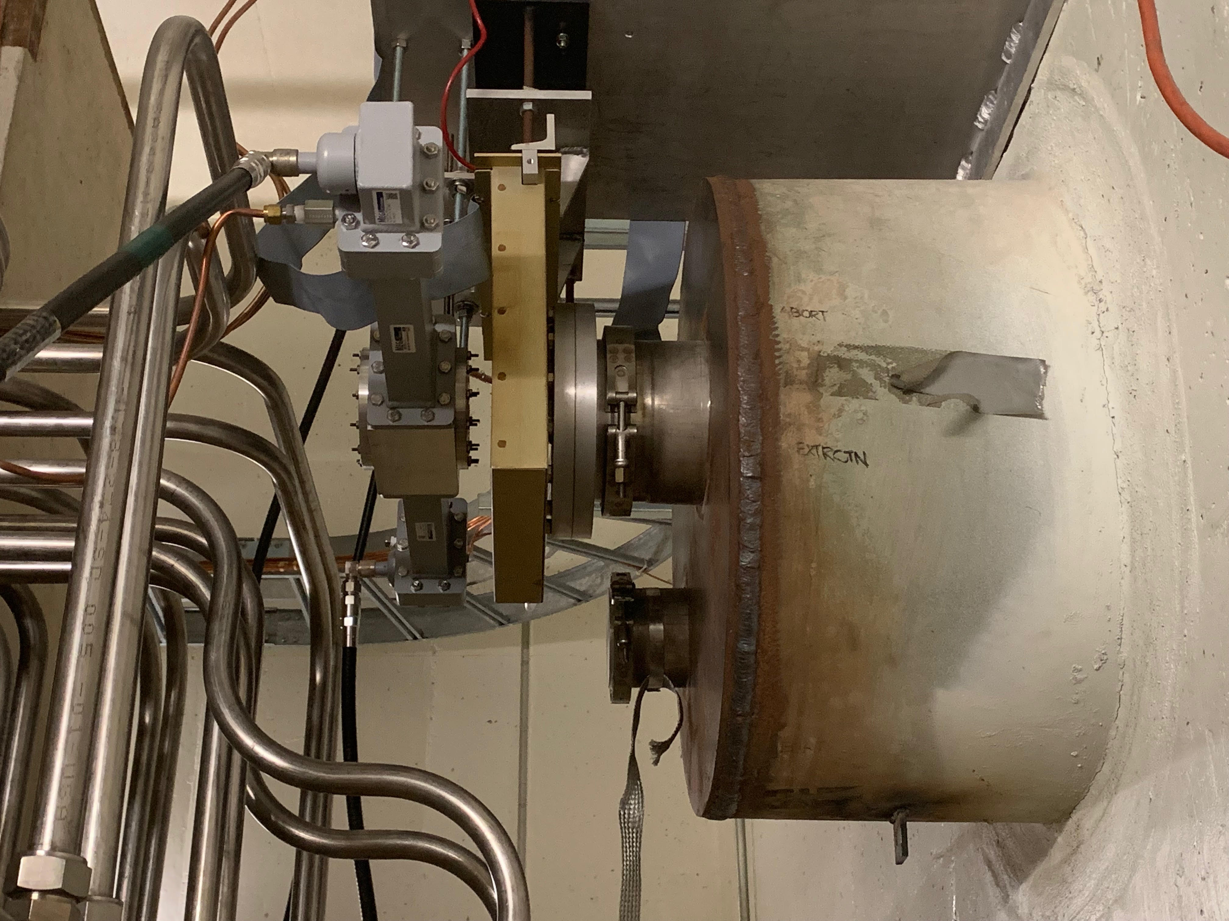
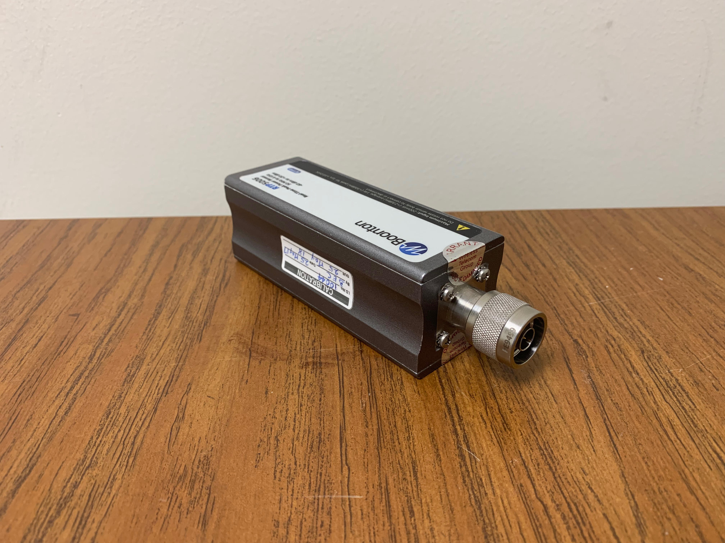
How are we Collecting Data?

Slide 3
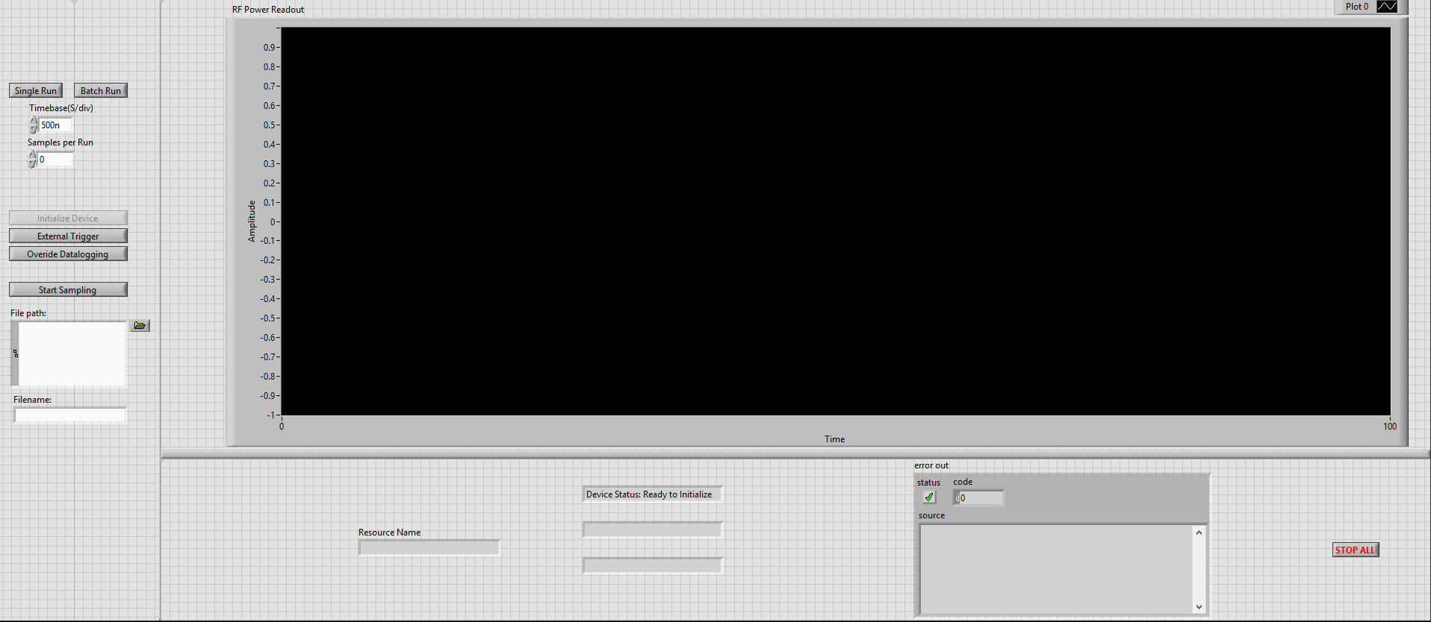
Front-end Display

Slide 4
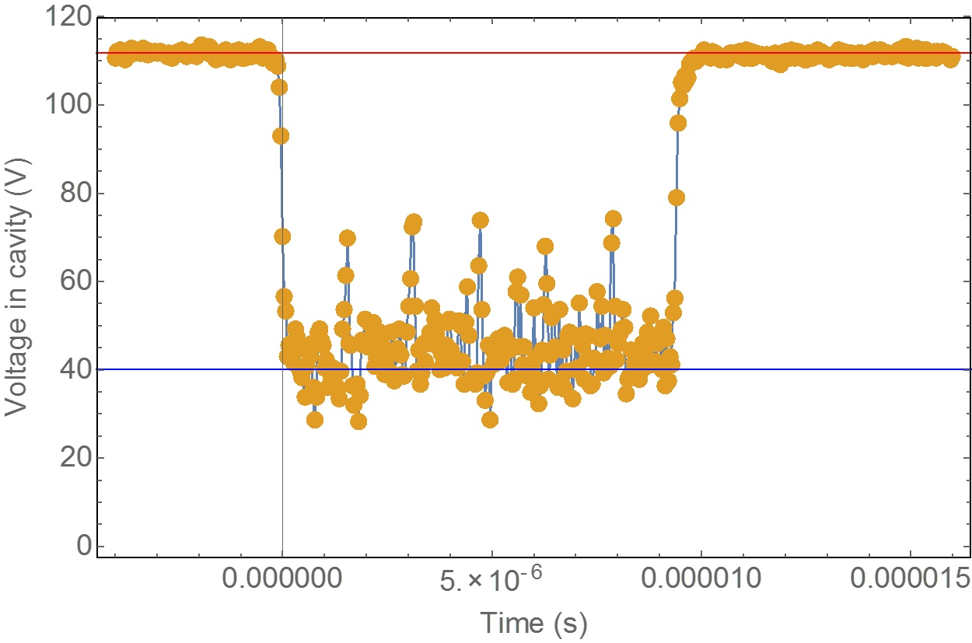
Dataflow Operations
Specify Parameters
Samples
Time base
File path
File name
Initialize Device
Start Sampling
Check trigger
Generate timestamp
Fetch waveform
Save waveform
Plot Waveform
Post Processing
Add headers
Add time column

Slide 5
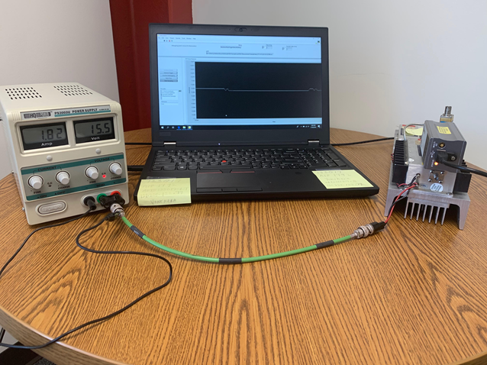
Challenges During the Development Cycle
Reacquainting with LabVIEW
Driver Issues
Different Iterations
Design Optimizations
Benchtop Testing

Slide 6
Future Plans
Benchtop TTL Signal
Implement Data Processing
Implement Safety Measures
Documentation and Comments
Poster and Paper
Implement the DAQ System for the Beam Signal
Not only DAQ, but Control

Slide 7
Questions?

