Slide 1
Implementing Nuisance Parameters in SBNfit
Savannah King
Supervisor: Maya Wospakrik
SIST Final Presentations
7 August 2019

Slide 2
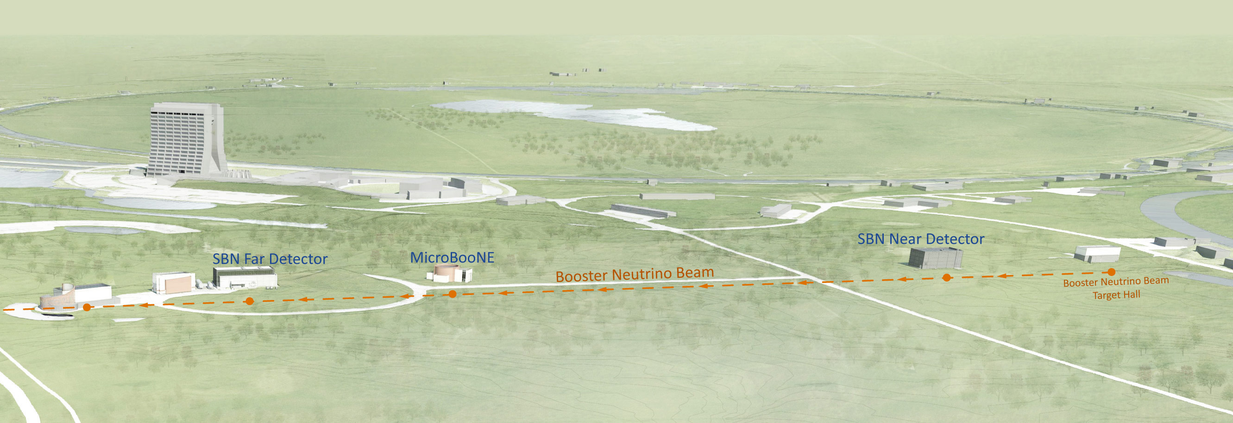
SBN Facilities
Oscillation experiment at Fermilab located on the Booster Neutrino Beam (BNB)
Consists of 3 liquid argon time projection chambers (LArTPC)s: the Short-Baseline Near Detector (SBND), MicroBooNE, and ICARUS
Placing the three detectors at varying distances from the BNB target allows us to observe neutrino flavor oscillations
Notes:
Ref: Fermilab, Short-Baseline Neutrino Program. https://sbn.fnal.gov.

Slide 3
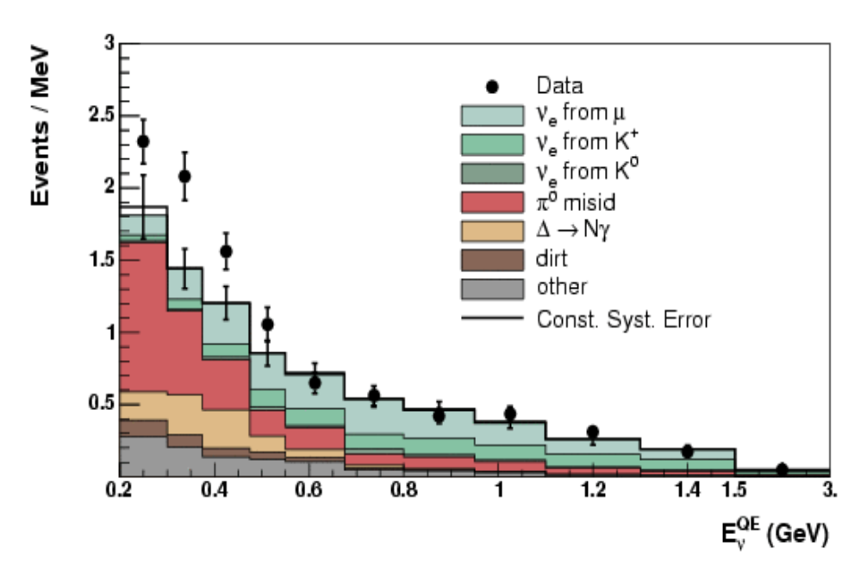
Goals & the LEE
MiniBoone & Liquid Scintillator Neutrino Detector (LSND) experiments observed an excess of electron-like events at low energy, known as the low energy excess (LEE)
Origin of excess is still unknown but possibly due to the presence of a sterile
  neutrino that amplifies the (ν_{μ} → ν_{e}) oscillation or unknown background
Goal of MicroBooNE is to investigate this excess of events by utilizing the ability of liquid argon time projection chambers (LArTPC) to perform electron/photon separation
Notes:
Ref: Fermilab, MicroBooNE. https://microboone.fnal.gov/.
LEE could also be attributed to either single electrons from an increased intrinsic $\nu_e$ charged current event rate or single photons due to neutrino neutral current $\Delta$ production with subsequent radiative decay.
MiniBooNE cannot discriminate between electrons & photons because it is a Cherenkov detector

Slide 4
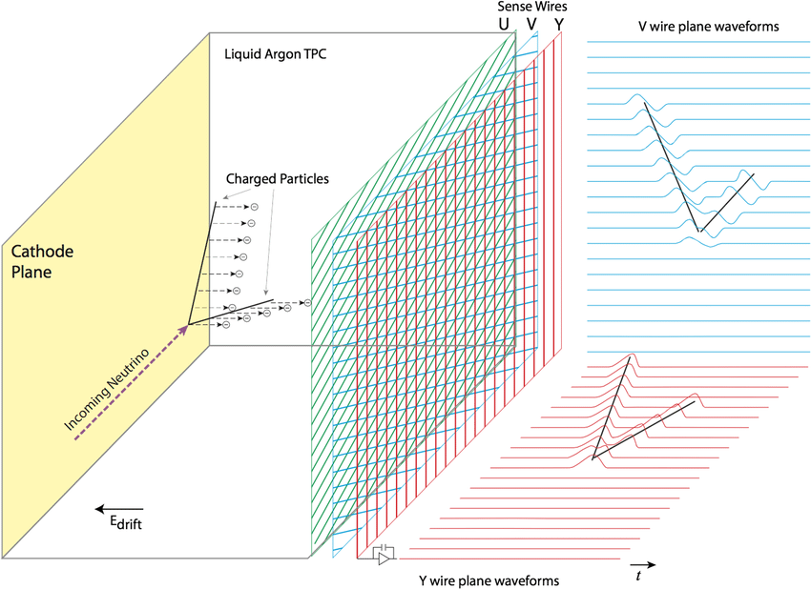
MicroBooNE
Micro Booster Neutrino Experiment
40-ft LArTPC with an active volume of 87 tons
TPC consists of a cathode plane, a field-shaping cage around the drift perimeter, and three wire planes
Charged particles travel through the detector and ionize the liquid argon. The electrons are drifted by a strong electric field towards the three wire planes, where they are detected.
Notes:
Diagram: MicroBooNE collaboration, Deep neural network for pixel-level electromagnetic particle identification
in the MicroBooNE liquid argon time projection chamber. Physical Review D, 7 May 2019.

Slide 5
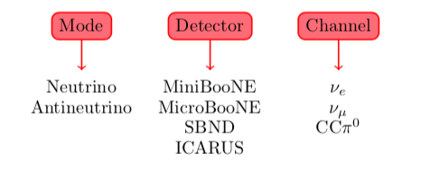
SBNfit
SBNfit is a data fitting framework that allows the fitting of multiple modes, detectors, and channels simultaneously¹
Utilizes the covariance matrix approach used by MinibooNE² to calculate a χ²
Project aims to implement ability to marginalize and extract additional parameters correlated to the spectra that describe the systematic uncertainties (nuisance parameters) within SBNfit
  Allows us to better understand the fit by identifying nuisance parameters with large pull & to represent several systematic errors as nuisance parameters in combination with the covariance matrix
¹M. Ross-Lonergan & the Nevis MicroBooNE group, https://github.com/NevisUB/whipping_star
²D. Cianci, M. Ross-Lonergan, G. Karagiorgi, A. Furmanski, arXiv:1702.01758
Notes:
Expand on 3rd point in following slides (keep wording consistent)

Slide 6
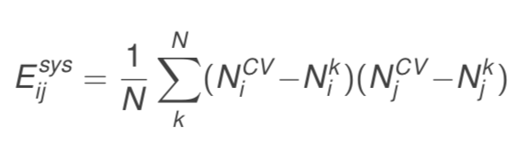
Covariance Matrix Calculation in SBNfit
Equation: Calculating a covariance matrix, where N is the total number of variations, N_{i}^{k} is the value in the i-th bin of the k-th variation and N_{i}^{CV} is that of the central value. 54 sources of uncertainty (variations) were used to build a 37 x 37 covariance matrix.
Notes:
Explain variations-sources of systematic uncertainty related to the neutrino flux and cross section measurements
White: no LEE events above 500 MeV

Slide 7
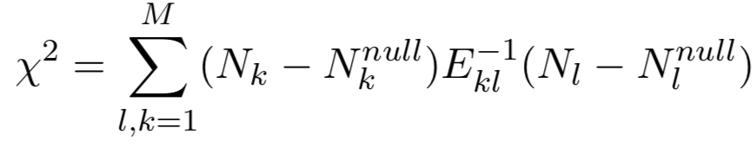
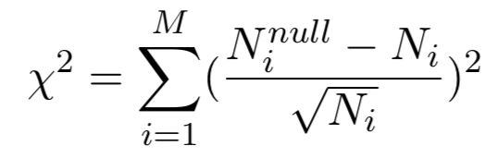
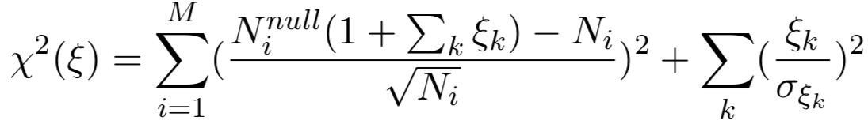
χ² Calculation
χ² for covariance matrix approach:
where M is the total number of bins and E⁻¹ is the inverse of the covariance matrix associated with the null hypothesis
Statistical error only:
where N_{i}^{null} are the theoretical predictions associated with the null hypothesis, N_{i} are the bins of observed data, and √N_{i} is the Gaussian statistical error. When N_{i}^{null} are controlled by systematic uncertainties,
where ξ are nuisance parameters describing systematic uncertainties and σ are the flat (normalization) systematics associated with the nuisance parameters.
Notes:
Minimize equation using MINUIT in ROOT
Both methods should yield the same result

Slide 8
χ² Implementation
Currently, only the weight of each nuisance parameter is accessible in SBNfit and not actual values of the parameters
Using flat normalization values for testing
We have begun implementation
  Created stand-alone toy example code outside the SBNfit framework and validated that the method works
  Implemented the method in SBNfit and validated that it also works
Plans to continue improving and validating the method

Slide 9

Toy Example
Sample a Gaussian distribution to fill a histogram of 10 bins
  First 3 bins are set as the signal spectra and scaled from .1 to 100 in steps of 10^{.025}
  Remaining 7 bins are assigned as background spectra
  We assign δ_{sys}=(10%, 15%, 5%) respectively to sample, signal, and background
  Build the covariance matrix using the systematic errors as follows:
Notes:
Compare the chi^2 between the data and prediction at a linear scaling to make sure that we get consistent results between the two methods + how nuisance parameters behave at large values.
Scaling is noted by the red line

Slide 10
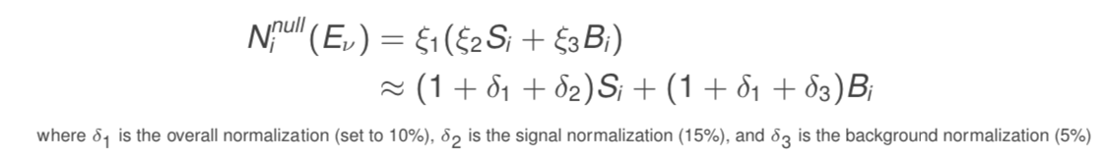
Toy Example

Slide 11
SBNfit Plots

Slide 12
Future Steps
To continue improving the implementation, we will need to validate the nuisance method using the actual parameter values and identify several systematic errors that we can describe as nuisance parameters
  In order to get actual parameter values, we will vary the systematic parameters randomly using their assumed probability distribution, then save these varied parameters to be used in the nuisance parameters approach
Notes:
Unisim Method:
Change the specified parameters by ±σ then save this varied parameter as a branch in the ROOT files.
Multisim method:
Generate many σs for varying the parameter by sampling a standard Gaussian distribution, then multiply the Gaussian number by the σ of the specified parameter. The varied parameters are calculated by adding the generated σs to the central value of the parameter.

Slide 13
Summary
Have started the preliminary study to test the implementation of nuisance parameters in the SBNfit
Need values of the parameter for real analysis
Created a simple toy model for testing
When run in SBNfit, results of the nuisance method agree with the covariance matrix using a flat normalization error

Slide 14
Acknowledgments
Maya Wospakrik
Mark Ross-Lonergan, Georgia Karagiorgi, and the neutrino group at Nevis Labs
SIST Committee

