Slide 1
Exploring the Universe One
Electron at a Time
Judah O’Neil – North Central College
Supervisor: Alex Drlica-Wagner – Fermilab
SIST/GEM Final Presentation
7 August 2019

Slide 2
Outline
Scientific Motivation
Dark Matter
Background
CCD Structure & Operation
Skipper CCDs
My contributions to Astro Skipper
Hardware & Analysis

Slide 3
Motivation & Background

Slide 4
Science Motivation
Dark Matter
Gravitational effect on visible matter
Indirect detection methods
Orbital speeds of stars in spiral galaxies
Radial velocity of galaxies within large clusters
Gravitational lensing by dark matter
Require powerful telescopes and imaging tools
Matter-Energy Density
of the Universe
Notes:
Cosmologists over the years have put in time and effort to determine the matter-energy density of the universe. That effort has uncovered that the majority of the universe is composed of dark energy and dark matter. If we take a specific look at dark matter, we see that it was coined the term ‘dark’ because it is a form of matter that does not interact electromagnetically. This means it does not absorb, reflect or emit light of any kind. However, what we can see is the gravitational effects this form of matter has on visible matter. We see this through observing the orbital speeds of stars within spiral galaxies, the radial velocity of galaxies in large clusters, and the effects of gravitational lensing by these large objects. In the effort to better understand the phenomenon of dark matter cosmologists require powerful telescopes in combination with powerful imaging tools that take accurate image information that can the be studied.

Slide 5
CCD Operation
Charge-coupled device (CCD)
Light-sensitive integrated circuit
Array of light sensitive pixels
Photoelectric effect
Metal-oxide-semiconductor (MOS) capacitor
Voltage manipulation on the capacitor gates controls charge movement
Vertical & Horizontal registers shift charge to output amplifier
Photoelectric Effect
Output Amplifier
Notes:
In comes the CCD or Charge-couple device. A CCD is basically an array of light sensitive areas called pixels that through the photoelectric effect capture electrons produced by incident photons and reads out the voltage stored within each pixel and produces an image. This device is very similar to the imaging device in most smartphones and hand held cameras in use today. Each pixel is composed of a MOS capacitor in which by manipulating the voltage level on the gates of the capacitors, the charge stored in each pixel is shifted through the array to an output amplifier where the voltage is measured and an image is produced.

Slide 6
Skipper CCDs
New generation of Skipper CCD design
Reduces low-frequency readout noise
Repeated measurement of the charge in each pixel
Allows charge measurement at the accuracy of individual electrons
Sensibility for the optical spectral range makes Skipper CCDs optimal for astronomical applications
Silicon CCD package mounted in vacuum dewar
Notes:
Skipper CCDs take the accuracy of this process one step further. Instead of reading the charge on each pixel a single time and producing an image, the Skipper technique repeatedly measures the charge stored within each pixel, granting a much more accurate account of the voltage level in each pixel. This method allows for charge measurement at the accuracy of individual electrons in a pixel. This form of detector is ideal for imaging in the optical range and makes it the best choice for astronomical applications.

Slide 7
My Work This Summer

Slide 8
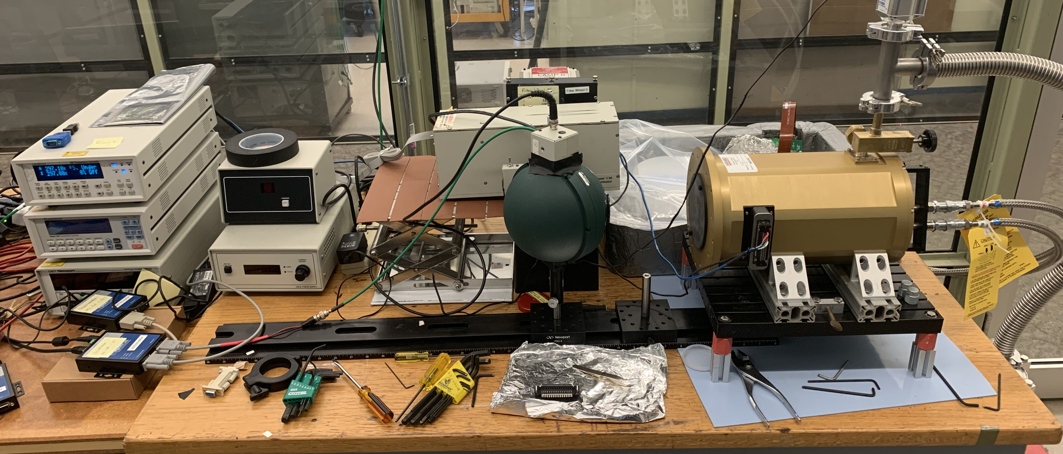
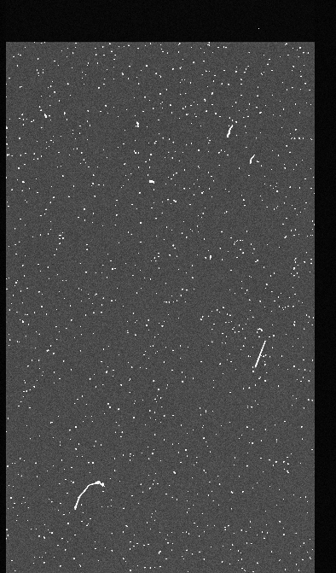
Project Focus
Characterize the response of a Skipper CCD with respect to optical light
1. Experimental Setup
2. Data Analysis
Notes:
The overall focus of my project was to characterize the response of a Skipper CCD with respect to optical light and near infrared light. This focus split the work that I did into two separate categories. First the physical assembly of our testing station, and then developing the scripts (using python) that would be used to characterize the device.

Slide 9
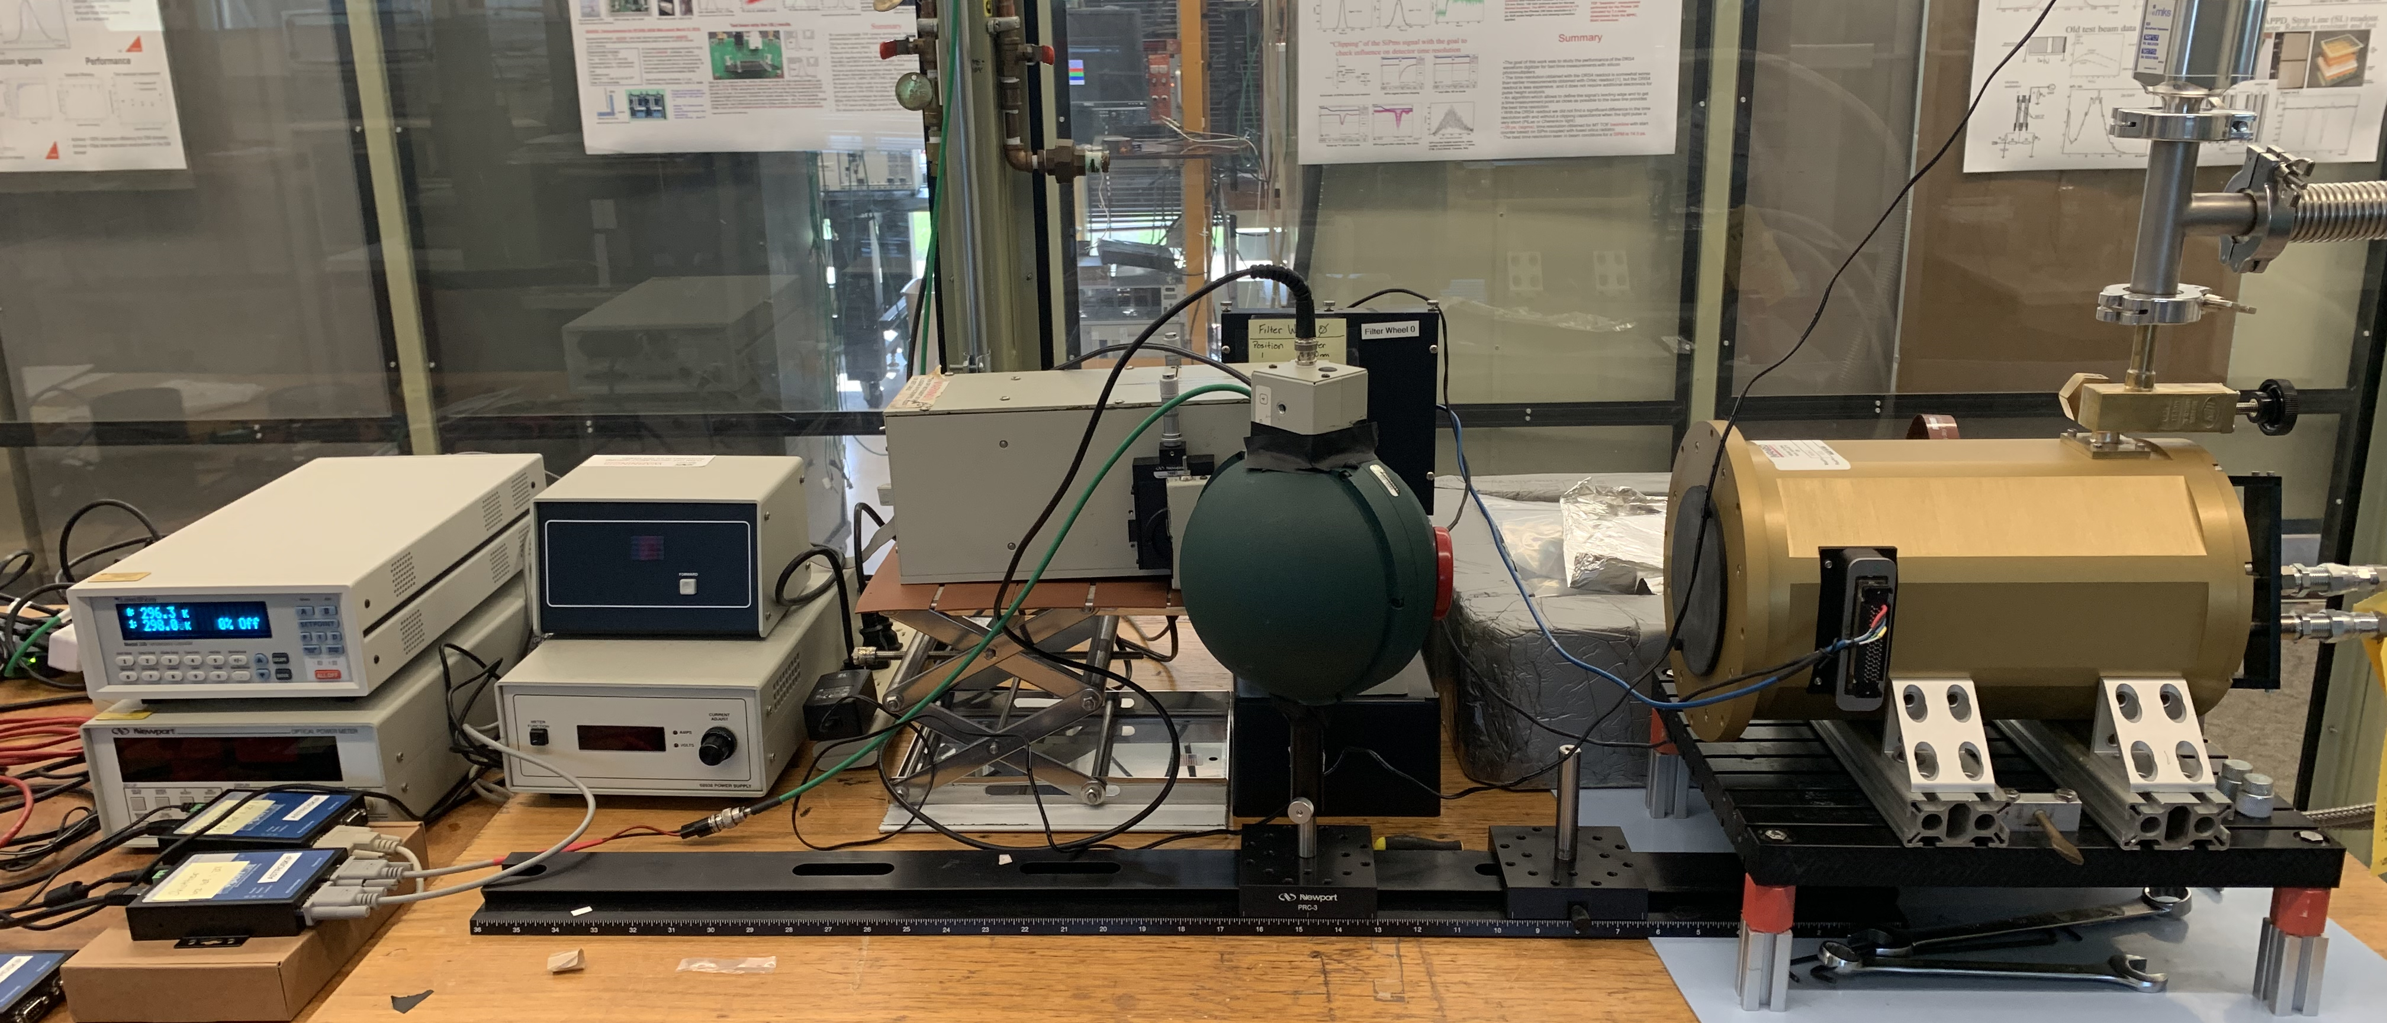
Experimental Setup
Testing station is composed of standard optical equipment
Dewar is specially designed to be mounted on a telescope
First time modern Skipper CCDs are used in this form of application
Photodiode
Vacuum Dewar
Ethernet-to-Serial Ports
Integrating Sphere
Notes:
Pictured here is the testing station for the Astro Skipper CCD located at the SiDet facilty. The station is composed of state-of-the-art optical equipment. The vacuum dewar you see here on the right is specially designed to be mounted on a telescope. Upon completion of this project, this would be the first time modern skipper CCDs are used in astronomical applications.

Slide 10
Station Overview
Photon path is light-tight
Operating temperature ~140 K
Vacuum level ~1 x 10⁻⁵ torr
Notes:
Here you can see in red the path the light takes to the detector. We use a tungsten arc lamp as a source; the light then passes through various filters that isolates a single wavelength. The shutter here controls exposure times. The power level of the light is then measured by a photodiode once it enters the integrating sphere. From here it then enters the vacuum chamber and is then incident on the detector. The vacuum chamber is pumped down to 1x10-5 torr and cooled to an operating temp of 140 K. The temperature and power readings are communicated to the computer interface via Ethernet-to-serial ports; the monochromator, filter settings and shutter are also controlled in the same manner. Each gateway was assigned a unique IP address on the same subnetwork that allows the entire station to be controlled offsite, as long as you are connected to the proper network.

Slide 11
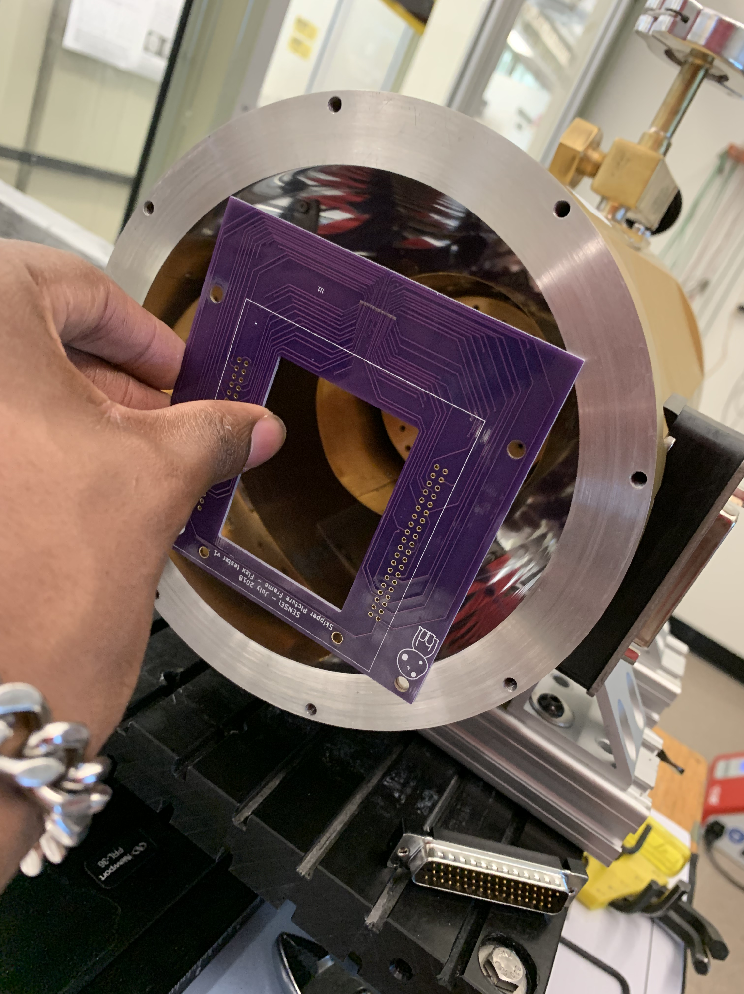
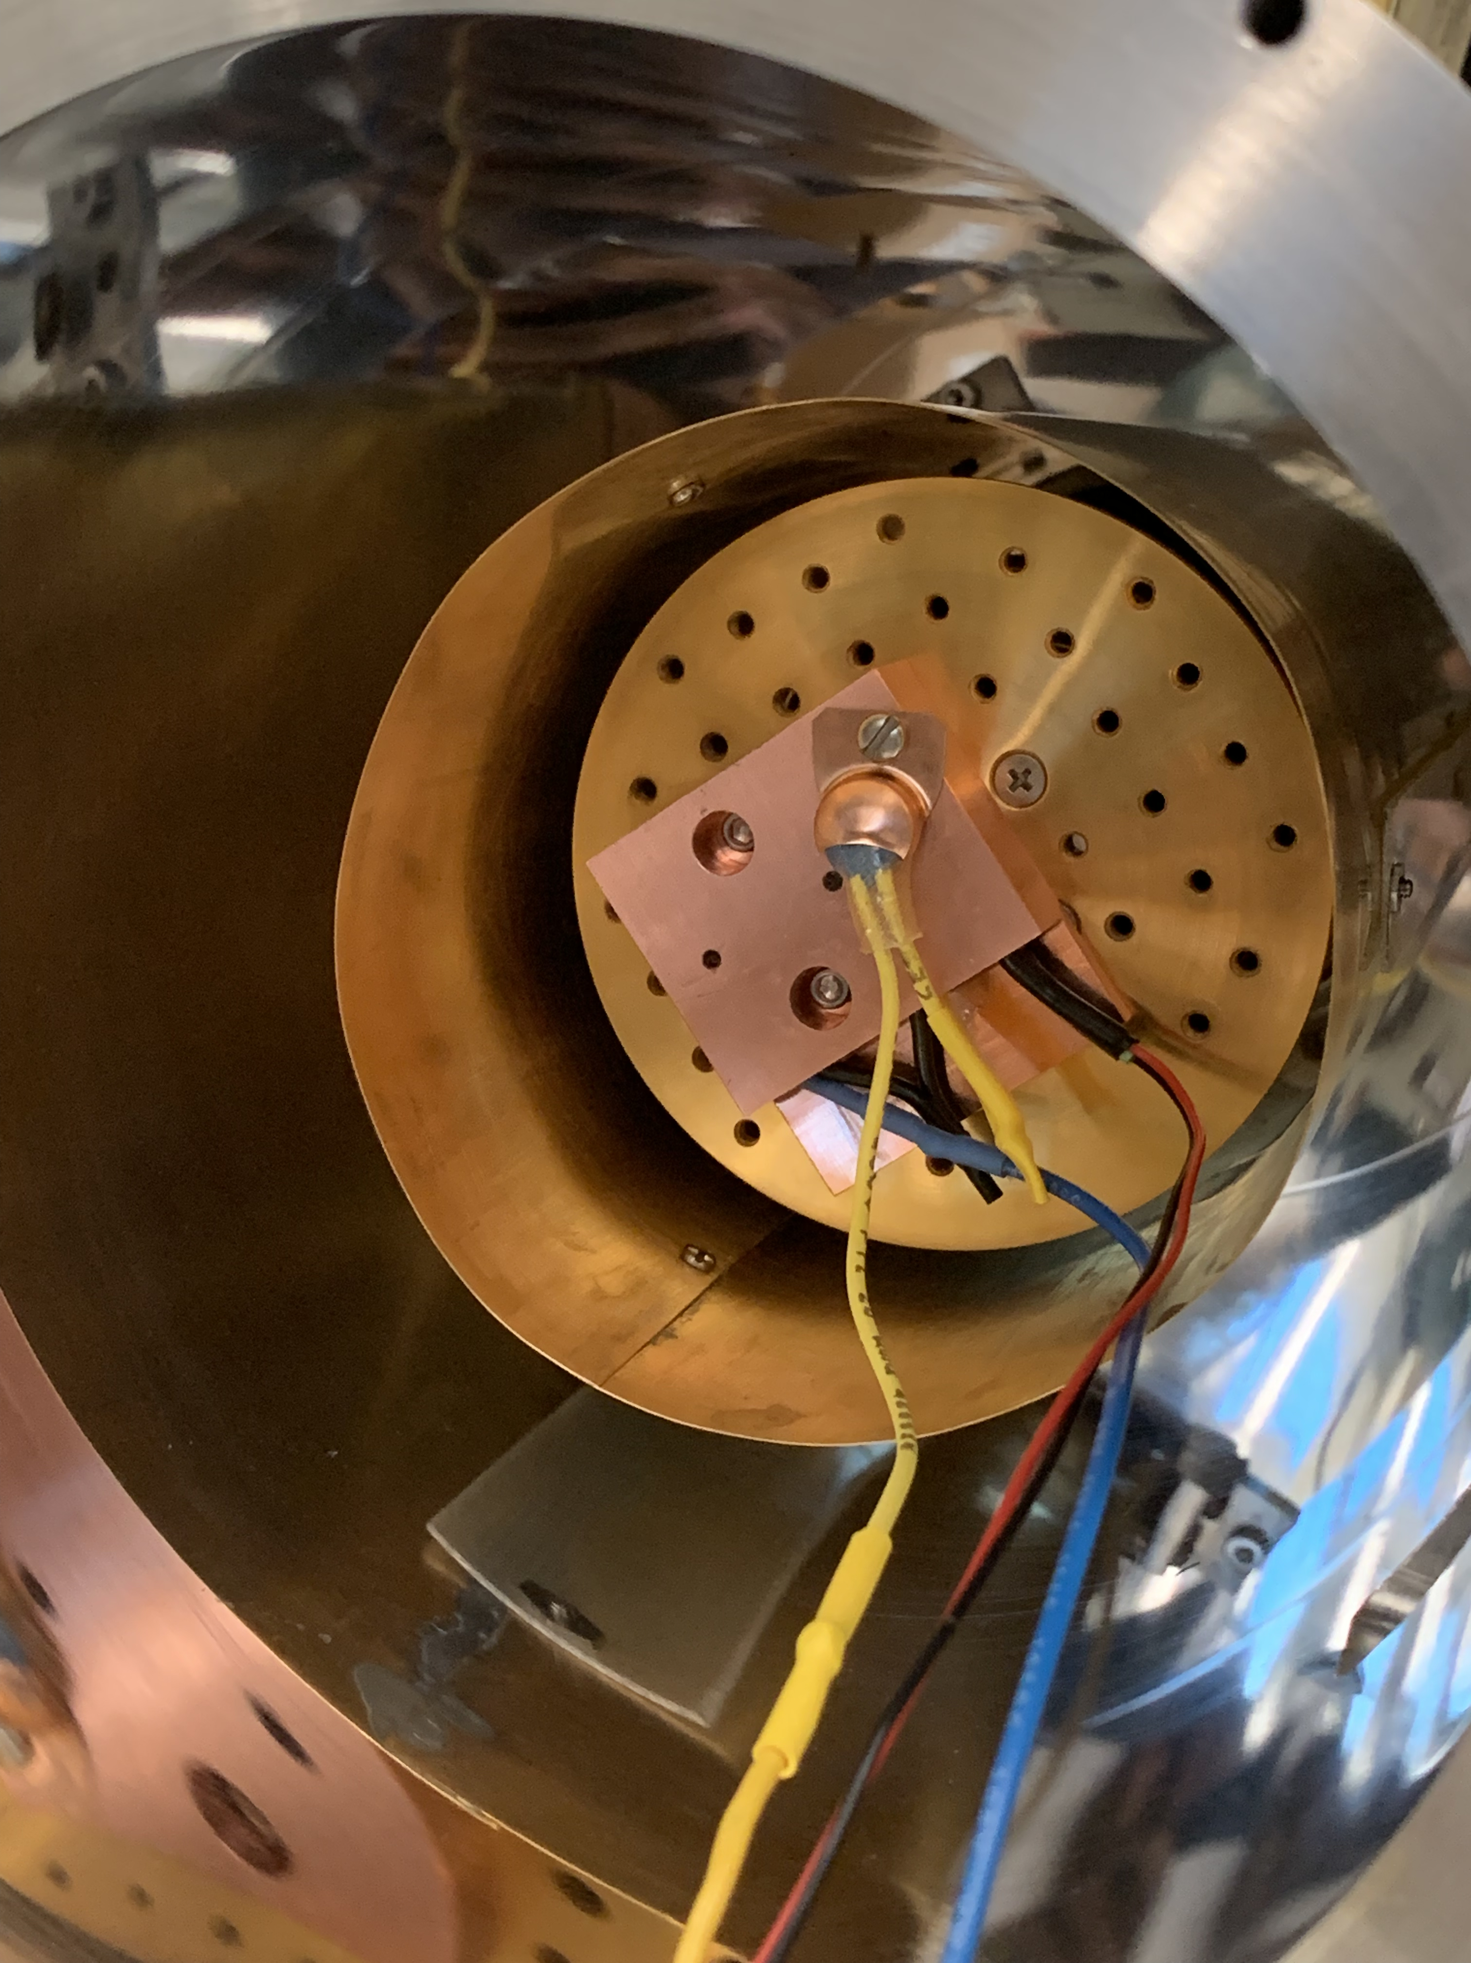
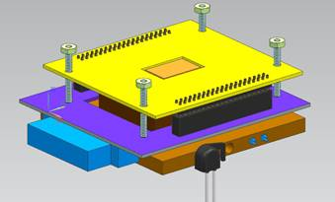
Mounting Package
CCD picture frame (yellow)
PCB board currently too large (purple) – redesign in process
DB-50 output from PCB board (blue)
Copper block (orange)
RTD
Heaters

Slide 12
Data Analysis

Slide 13
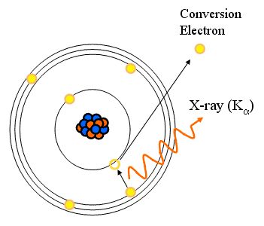
Data Analysis: Gain
Gain – conversion between digital counts and number of electrons captured
Fe⁵⁵ Isotope emits X-rays at known energies
Most intense at 5.9 KeV (K_{α})
1620 electrons produced when K_{α} X-rays are absorbed by silicon

Slide 14
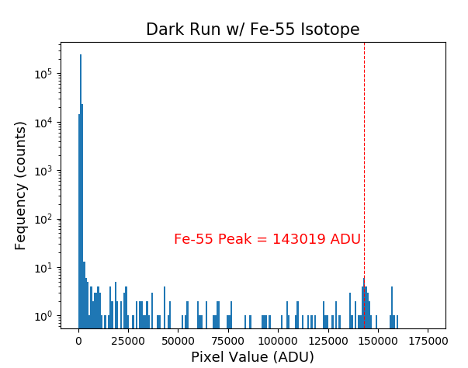
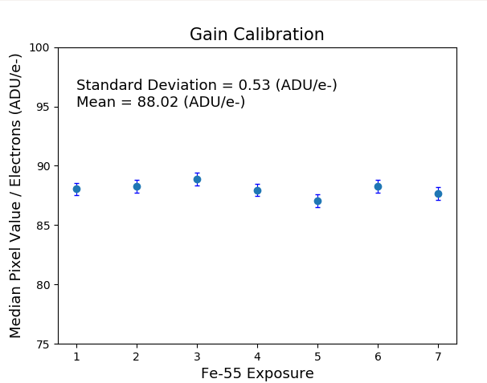
Data Analysis: Gain
Performed multiple Fe⁵⁵ exposures
Histogram of the pixel values
Analog-to-digital unit (ADU)
Average gain calculated to be ~ 88.0 ± 0.5 (ADU/e⁻)
$$Gain=\frac{\left(Median Fe Peak−Noise Bias\right)}{Electrons per Photon Event}$$
$$=\frac{\left(143019−Bias\right)}{1620 e^{−}}=88.05 \frac{ADU}{e^{−}}$$
Judah O’Neil | SIST/GEM Final Presentation
Notes:
Make note of what ADU is

Slide 15
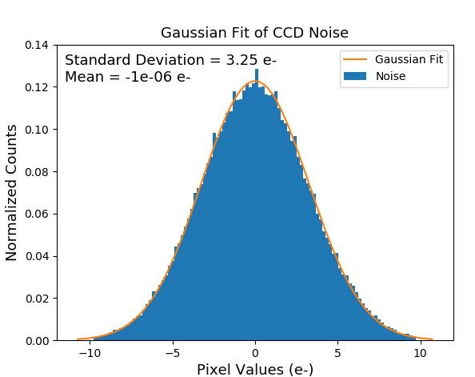
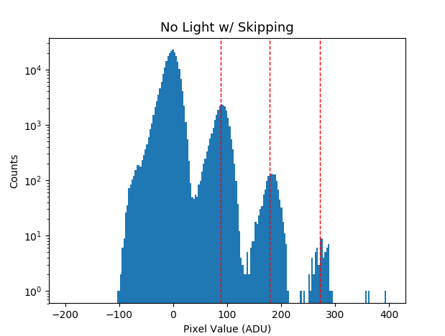
Data Analysis: Readout Noise
Readout noise - random fluctuations in readout electronics
Performed single-sample dark exposure (no light)
Minimizing ambient light as much as possible
Compared to data from multi-sample image
Accuracy down to single electron detection
Notes:
Zoomed version of the red box

Slide 16
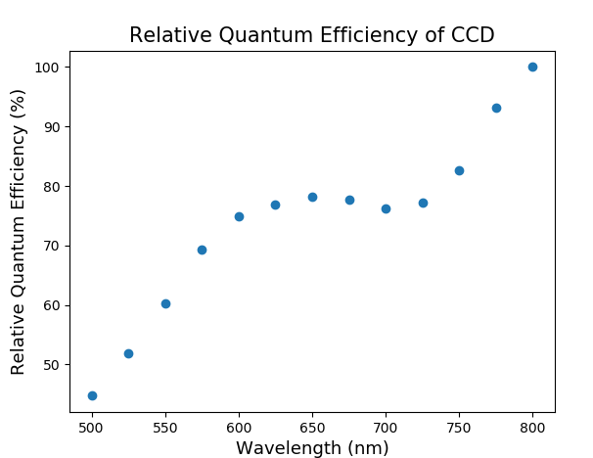
Data Analysis: Quantum Efficiency
QE – measure of the effectiveness of an imager to produce electronic charge from incident photons
(500 – 600 nm) photons vs (700+ nm) photons
Skipper CCDs are 200 μm thick
High efficiencies at longer wavelengths
Term | Variable | Value
Total Photons | N_{ph} | Power / Photon Energy
Total Electrons | N_{e,pix} | Measured by CCD
Power | P | Power meter Reading
Photon Energy | E_{ph} | E = h*c / λ
Exposure Time | t | 30 s
Pixel Area | A_{pix} | 15 μm x 15 μm
Photodiode Area | A_{pd} | 1 cm x 1 cm
$${QE}_{r}=\frac{N_{e}}{N_{ph}}=\frac{\left(\frac{N_{e,pix}}{t×A_{pix}}\right)}{\left(\frac{P}{E_{ph}×A_{pd}}\right)}$$

Slide 17
Conclusion

Slide 18
Conclusion
Next Steps
Completion of testing station assembly
Repeat characterization analysis of multi-sample images with detector in our station
Combine this new generation detector with a high-powered telescope for future cosmological research applications

Slide 19
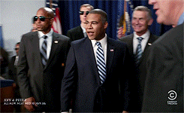
Acknowledgments
I’d like to thank Alex Drlica-Wagner for his oversight and guidance throughout the entirety of my project, as well as my mentors: Carrie McGivern, Charlie Orozco, Mehreen Sultana
Also, I’d like to thank those who assisted in the work I accomplished over the summer: Kevin Kuk, Abhishek Bakshi, Javier Tiffenberg, Guillermo Moroni
Special thanks to the SIST Internship Committee for providing me with this invaluable opportunity
S/O to the Intern Fam

Slide 20
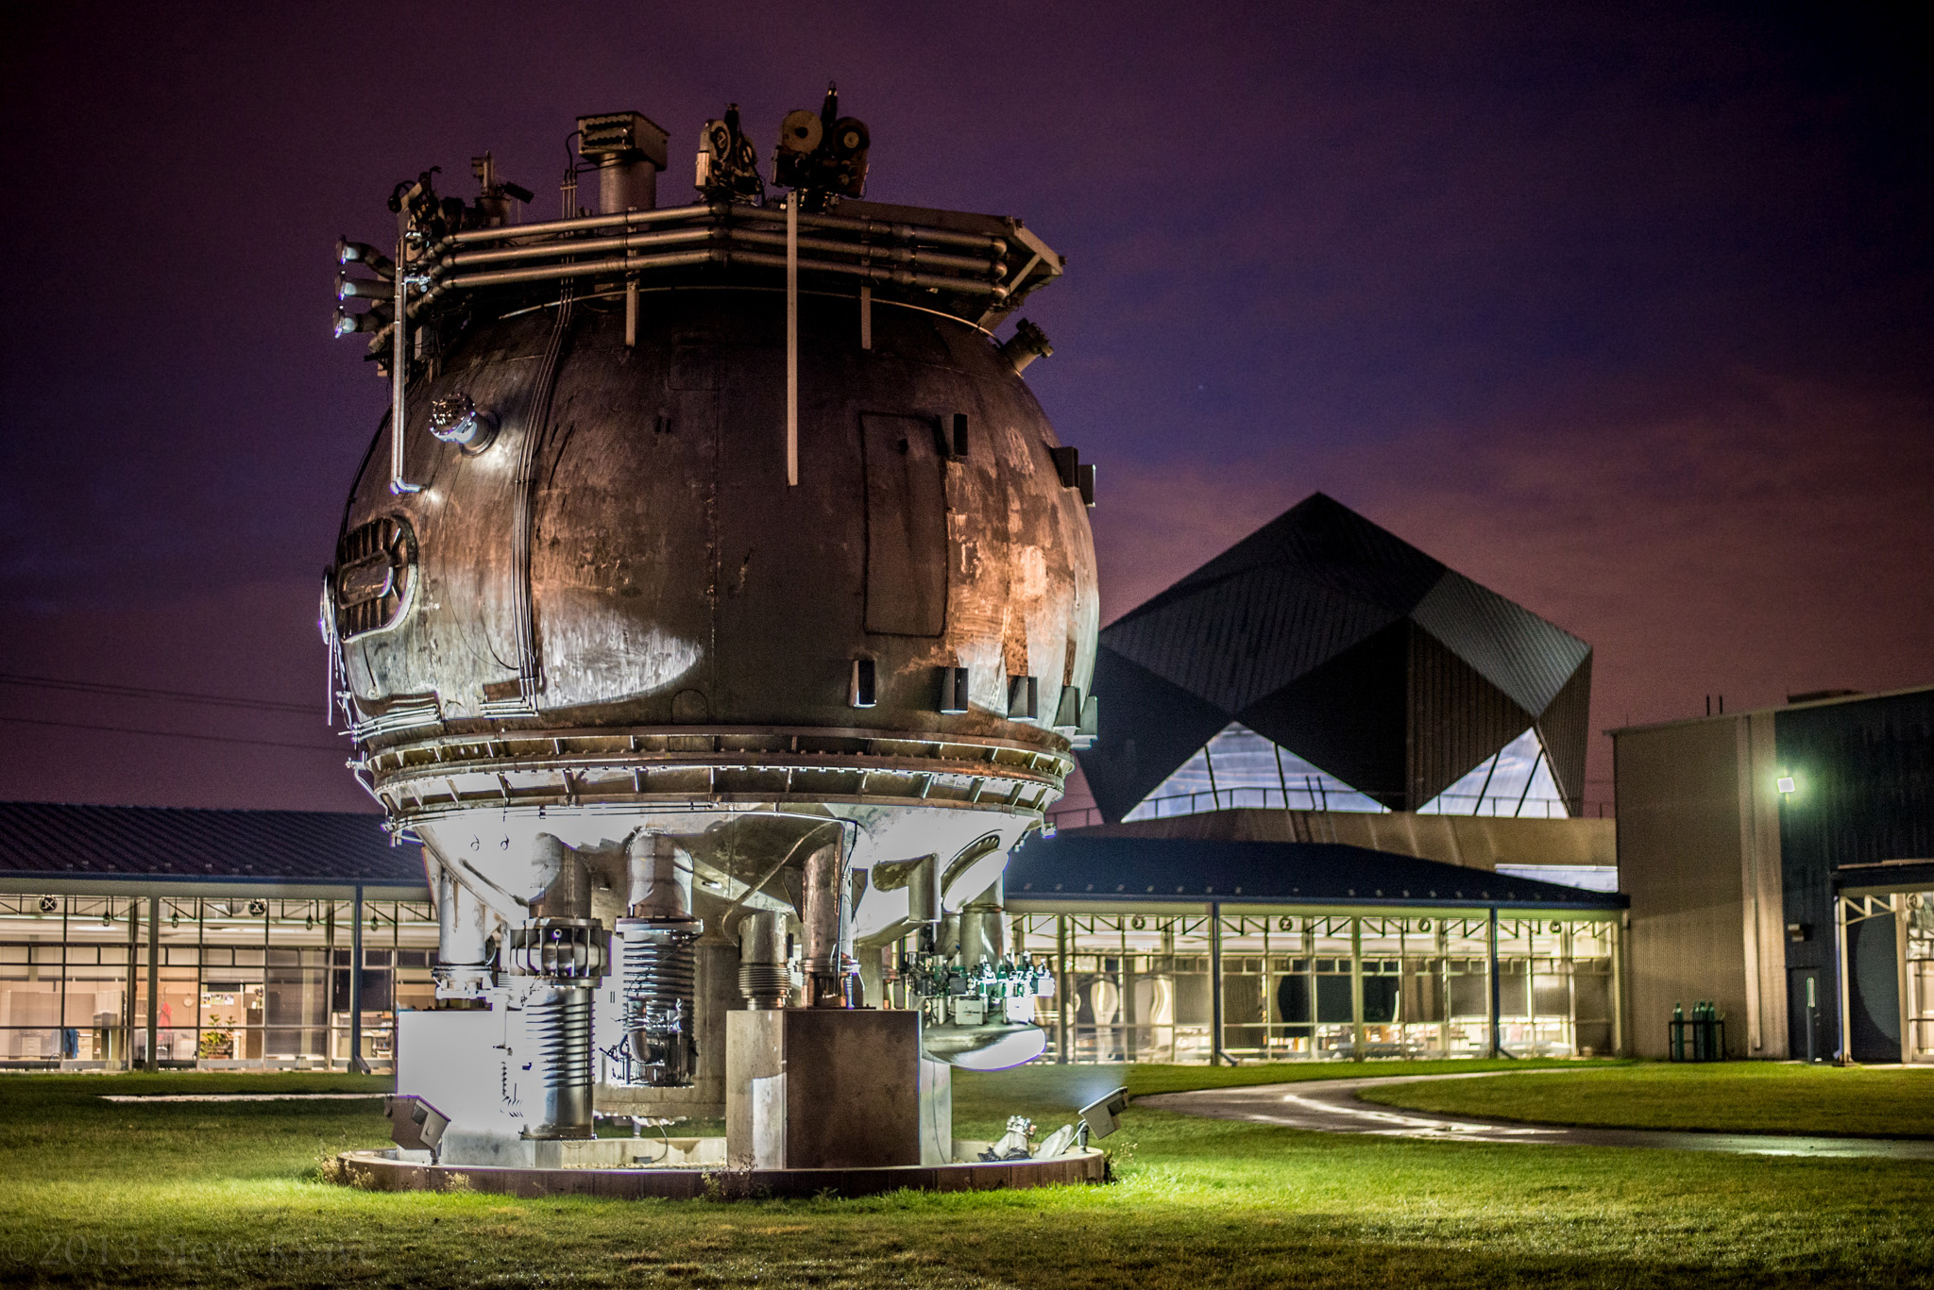
Questions?

