Slide 1
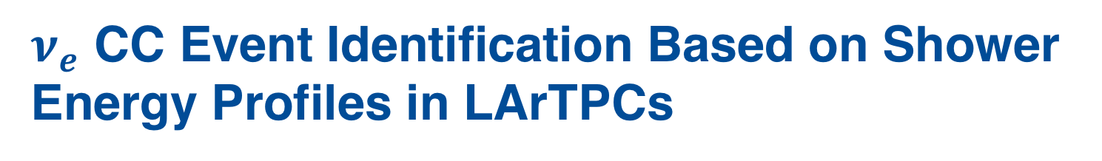
$ν_{e}$ CC Event Identification Based on Shower Energy Profiles in LArTPCs
Diego Lopez Gutierrez
Supervisor: Dr. Wanwei Wu
SIST 2019 Summer Intern
5 August 2019

Slide 2
Why do we care about neutrinos?
Standard Model: Neutrinos have no mass
Super-Kamiokande/SNO: Neutrino oscillations $→$ Neutrinos have mass
Neutrinos could give us insight into physics beyond the SM:
  The matter/antimatter asymmetry in the universe (CP violation)
  The nature of dark matter (sterile neutrinos)

Slide 3

Liquid Argon Time Projection Chambers as Neutrino Detectors
Short-baseline Neutrino LArTPC experiments:
  SBND
  MicroBooNE
  ICARUS
Long-baseline Neutrino LArTPC experiments:
  DUNE
MicroBooNE Detector
$$+z$$

Slide 4
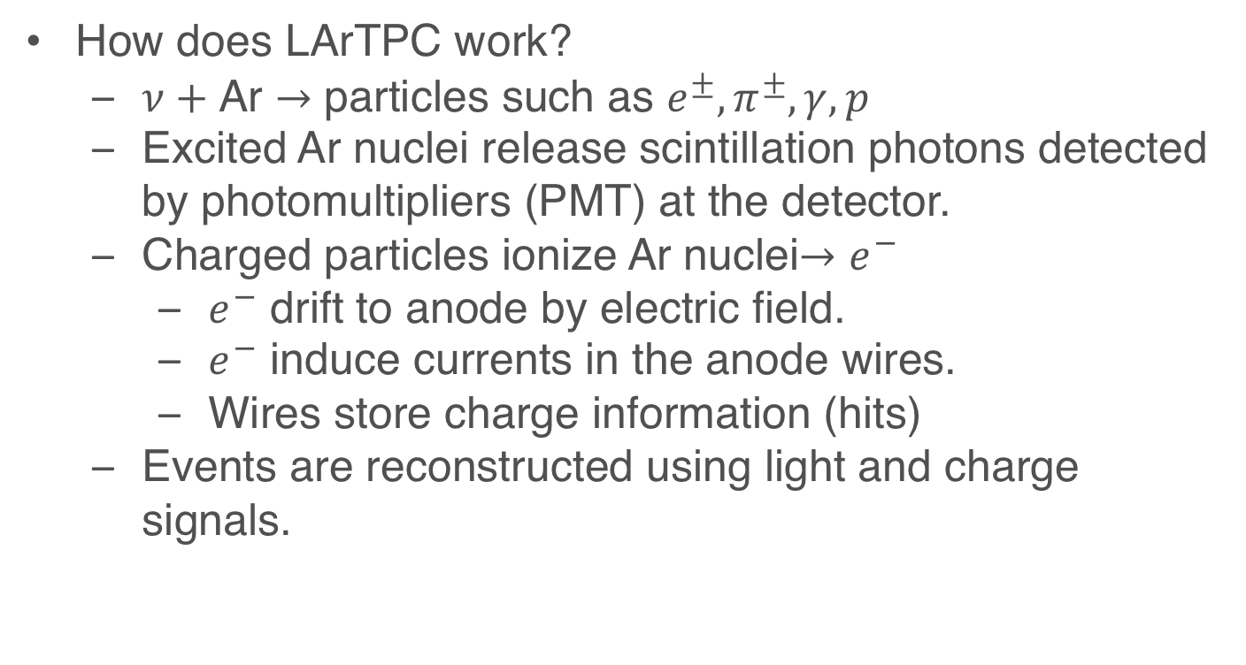
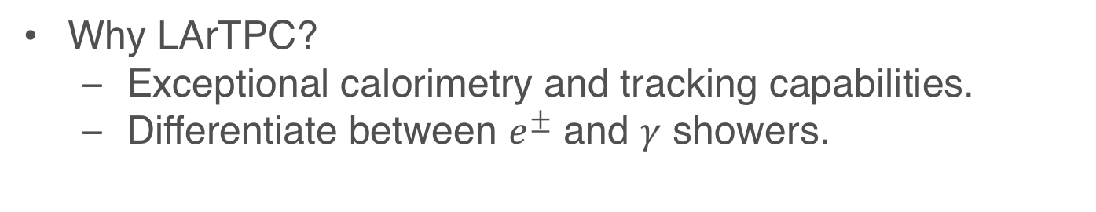
Liquid Argon Time Projection Chamber (LArTPC)
Why LArTPC?
  Exceptional calorimetry and tracking capabilities.
  Differentiate between $e^{±}$ and $γ$ showers.
How does LArTPC work?
  $ν+$ Ar $→$ particles such as $e^{±},π^{±},γ, p$
  Excited Ar nuclei release scintillation photons detected by photomultipliers (PMT) at the detector.
  Charged particles ionize Ar nuclei$→e^{−}$
    $e^{−}$ drift to anode by electric field.
    $e^{−}$ induce currents in the anode wires.
    Wires store charge information (hits)
  Events are reconstructed using light and charge signals.
Notes:
Why LArTPC? We can reconstruct the energy of the shower and the particle tracks to a higher precision.

Slide 5
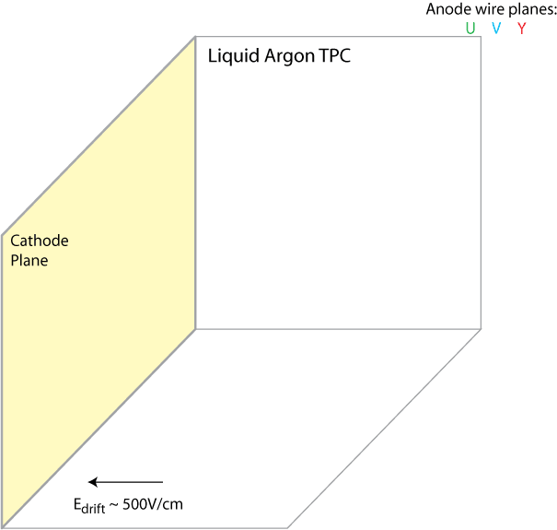
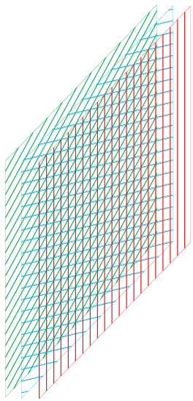

Liquid Argon Time Projection Chamber
Anode Wire Planes
U V Y
V
Charged Particles
U V Y
PMT
Y
t₀

Slide 6
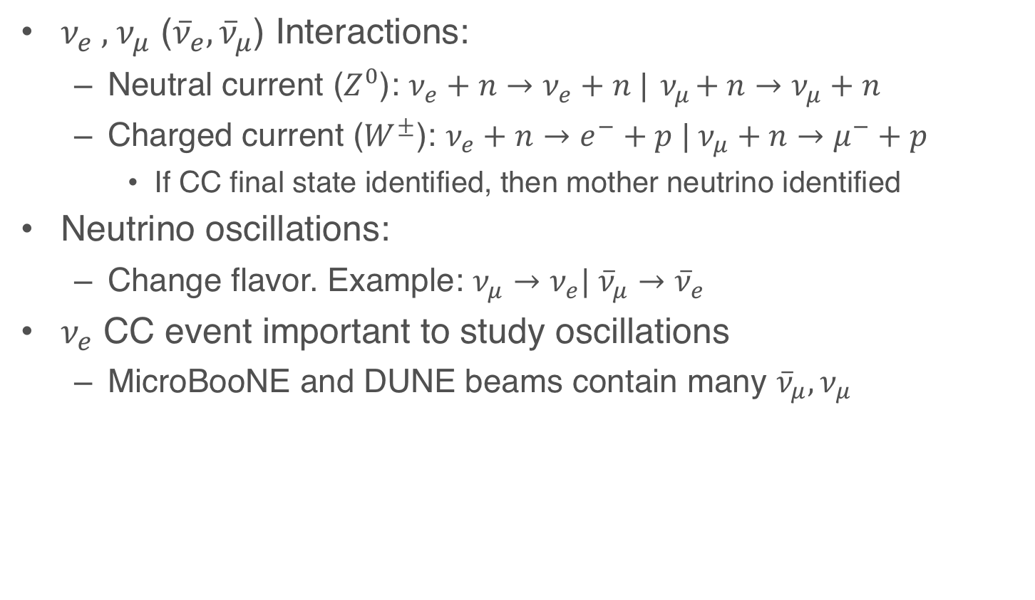
What is a Charged Current Neutrino Interaction?
$ν_{e} ,{ ν}_{μ}$ (${\overline{ν}}_{e}, {\overline{ν}}_{μ}$) Interactions:
  Neutral current ($Z^{0}$): $ν_{e}+n→ν_{e}+n |{ ν}_{μ}+n→ν_{μ}+n$
  Charged current ($W^{±}$): $ν_{e}+n→e^{−}+p | ν_{μ}+n→μ^{−}+p$
    If CC final state identified, then mother neutrino identified
Neutrino oscillations:
  Change flavor. Example: $ν_{μ}→ν_{e}| {\overline{ν}}_{μ}→{\overline{ν}}_{e}$
$ν_{e}$ CC event important to study oscillations
  MicroBooNE and DUNE beams contain many ${\overline{ν}}_{μ}{,ν}_{μ}$

Slide 7


Showers and Event Displays
$γ$ shower
$e^{−}$ shower

Slide 8
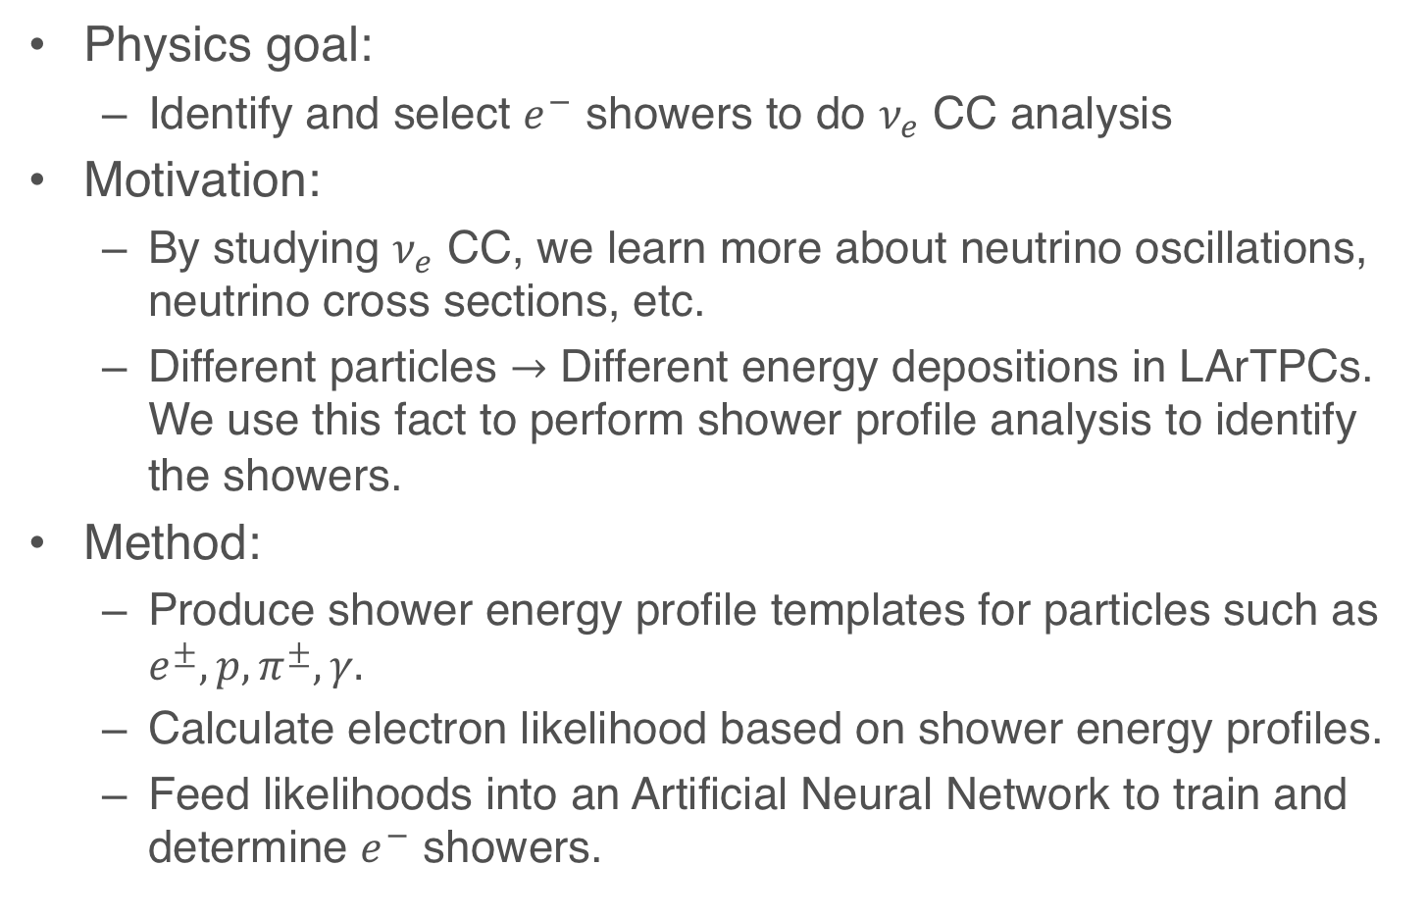
Electron Identification Using Shower Energy Profiles
Physics goal:
  Identify and select $e^{−}$ showers to do $ν_{e}$ CC analysis
Motivation:
  By studying $ν_{e}$ CC, we learn more about neutrino oscillations, neutrino cross sections, etc.
  Different particles $→$ Different energy depositions in LArTPCs. We use this fact to perform shower profile analysis to identify the showers.
Method:
  Produce shower energy profile templates for particles such as $e^{±}, p, π^{±}, γ.$
  Calculate electron likelihood based on shower energy profiles.
  Feed likelihoods into an Artificial Neural Network to train and determine $e^{−}$ showers.

Slide 9




Shower Profile Templates
We use DUNE Far Detector simulations of reconstructed showers to produce our shower templates.
For each shower, we calculate the longitudinal and transverse profiles.
We store the shower profiles from different particles as templates.
Longitudinal Profile
$$e^{±}$$
$$p$$
Simulations
$$π^{±}$$
Transverse Profile
$$γ$$

Slide 10
Shower Profiles
From simulation information, we get shower’s vertex and direction.
We use these to calculate longitudinal and transverse distances:
  Longitudinal: along shower’s direction
  Transverse: perpendicular to shower’s direction.
From hits, we calculate charge.
We save charge vs. distance information in different longitudinal and transverse plots.
Trans. Dist.
Long. Dist.

Slide 11




Longitudinal Shower Profile
$$e^{±}$$
$$γ$$
$$π^{±}$$
$$p$$

Slide 12




Transverse Shower Profile
$$e^{±}$$
$$γ$$
$$π^{±}$$
$$p$$

Slide 13



3D Longitudinal Histogram as Template
$$e^{±}$$
$$γ$$
$$π^{±}$$
$$p$$

Slide 14




3D Transverse Histogram as Template
$$e^{±}$$
$$γ$$
$$π^{±}$$
$$p$$

Slide 15
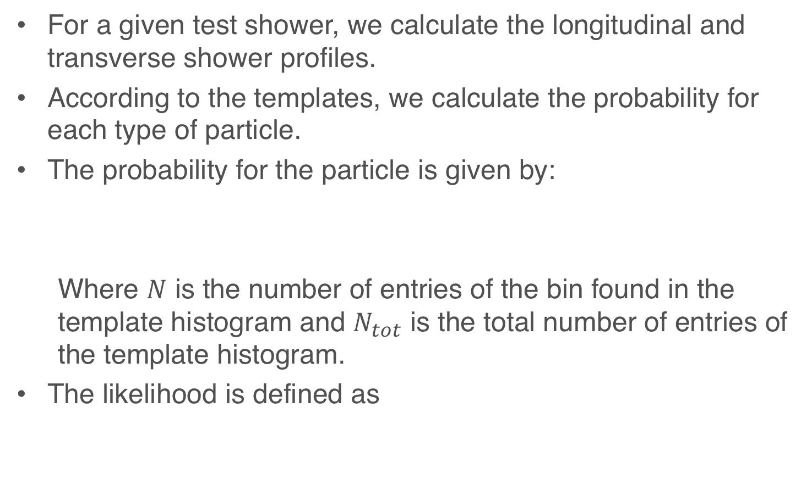
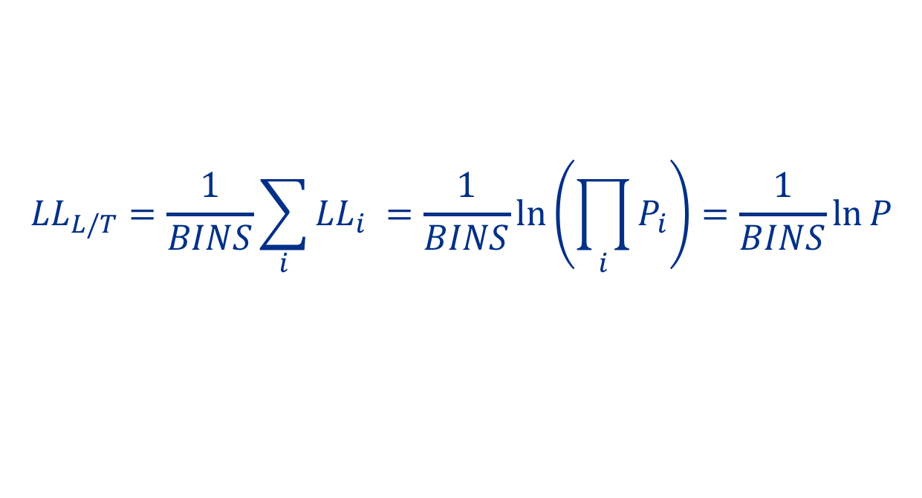
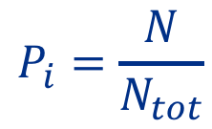
Likelihood Calculation
For a given test shower, we calculate the longitudinal and transverse shower profiles.
According to the templates, we calculate the probability for each type of particle.
The probability for the particle is given by:
Where $N$ is the number of entries of the bin found in the template histogram and $N_{tot}$ is the total number of entries of the template histogram.
The likelihood is defined as
$$P_{i}=\frac{N}{N_{tot}}$$
$$LL_{L/T}=\frac{1}{BINS}\sum_{i}{LL_{i} =\frac{1}{BINS}\ln\left(\prod_{i}{P_{i}}\right)=\frac{1}{BINS}ln{P}}$$

Slide 16
Likelihood Calculation

Slide 17
Conclusion and Future Work
We are able to get shower profiles for different particles.
Using these templates, we are exploring the likelihoods for different showers.
Next steps:
  Feed the likelihoods into an Artificial Neural Network that will determine whether the shower is an electron shower.
  Apply this technique to MicroBooNE, DUNE and other LArTPC experiments.

Slide 18
Acknowledgment
Thank you to Dr. Wanwei Wu and Dr. Tingjun Yang for their encouragement and guidance throughout this summer.
Thank you to Ms. Sandra Charles, Dr. Laura Fields and the SIST committee for giving me the opportunity to work and learn at Fermilab.
Thank you to my mentors Alexander Martinez, Raul Campos and Matthew Alvarez for their assistance throughout my internship here.
And thank you to all my fellow SISTers for their friendship and support during our twelve weeks working here.

