Slide 1
Inferring Convolutional Neural Networks’ accuracy from its architectural characterizations
Duc Hoang – Rhodes College
Supervisor: Dr. Gabriel N. Perdue
SIST – Final Presentation
1 August 2019

Slide 2
Outline
I. MINERvA experiment
Neutrinos and MINERvA detector
Vertex finding and hadron multiplicity problem
II. Deep Learning
Deep Neural Networks
Convolutional Neural Networks (CNNs)
CNN’s design difficulties
III. Inferring CNNs’ accuracy before training time
Architectural characterizations
Predicting CNNs’ accuracy based on characterizations – why is it useful?
IV. Summary & Outlook
Notes:
Depth – height.

Slide 3
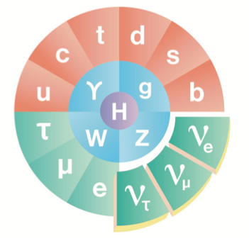
Neutrinos
Neutrinos are fundamental.
They are electrically neutral "partners" of the familiar charged leptons (e.g., electrons).
They are very light,
They very rarely interact with other particles
Proton
U
Quarks
U
D
Protons
Neutrons
Electrons

Slide 4
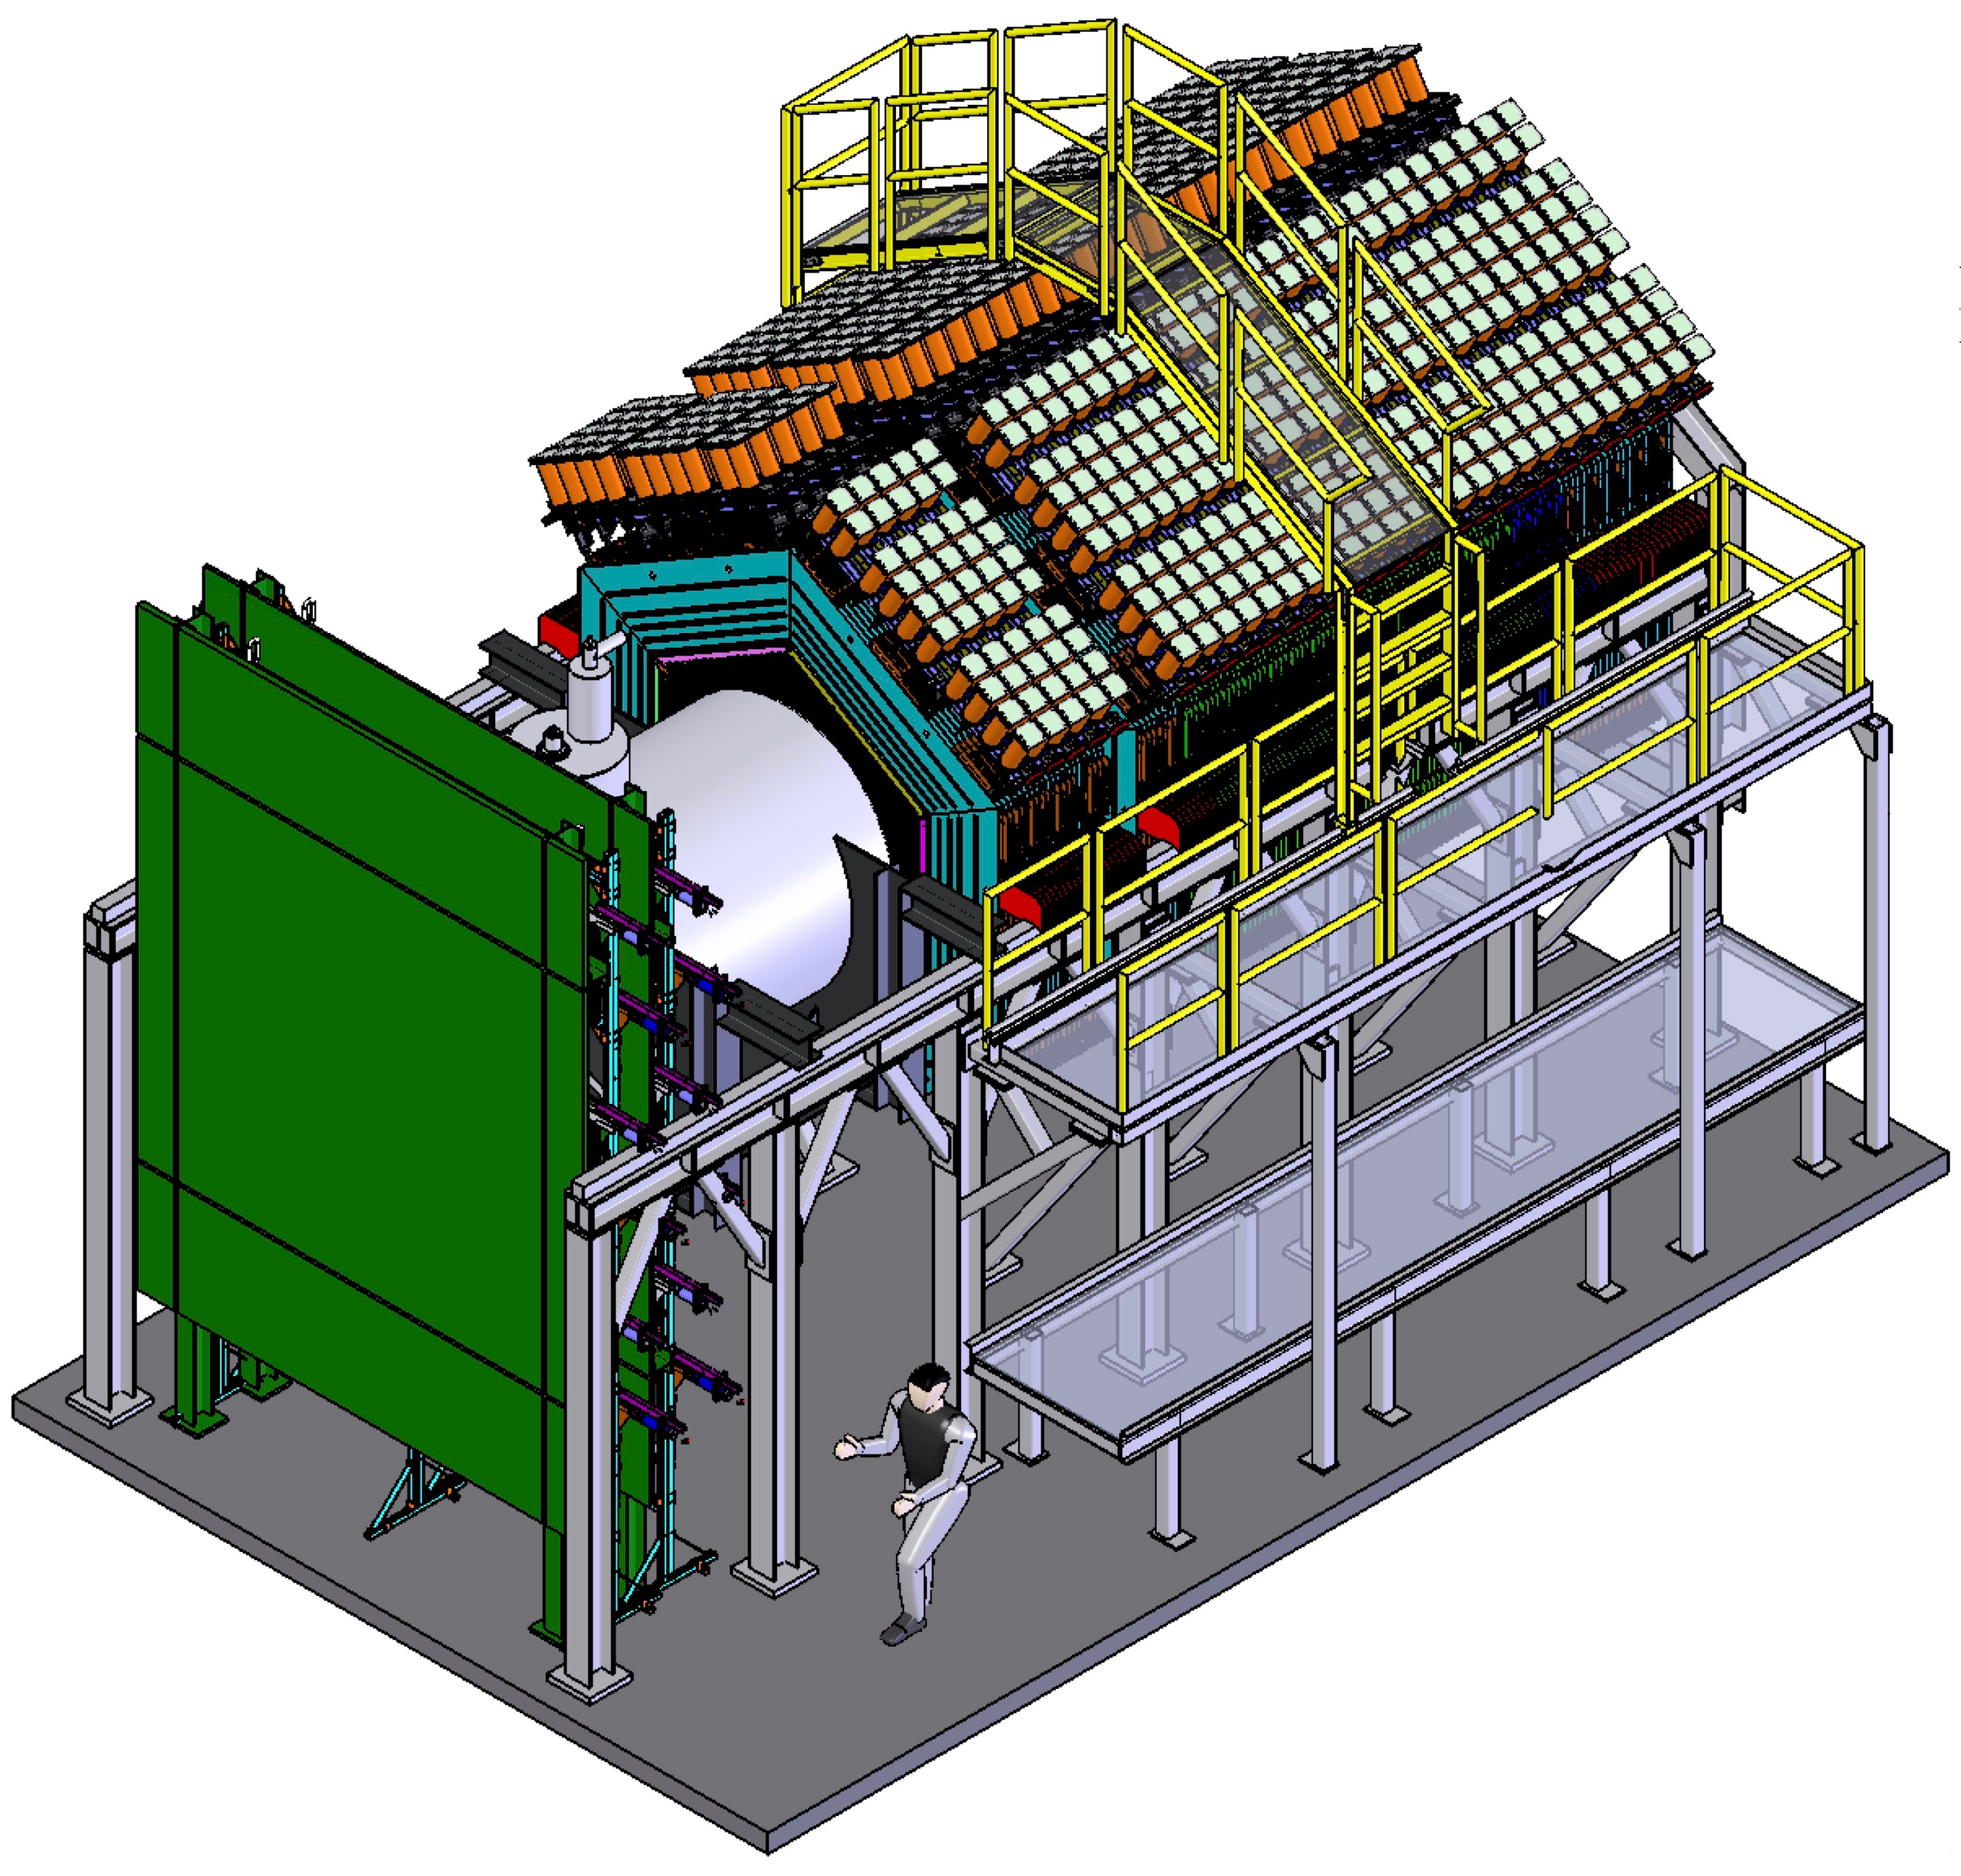
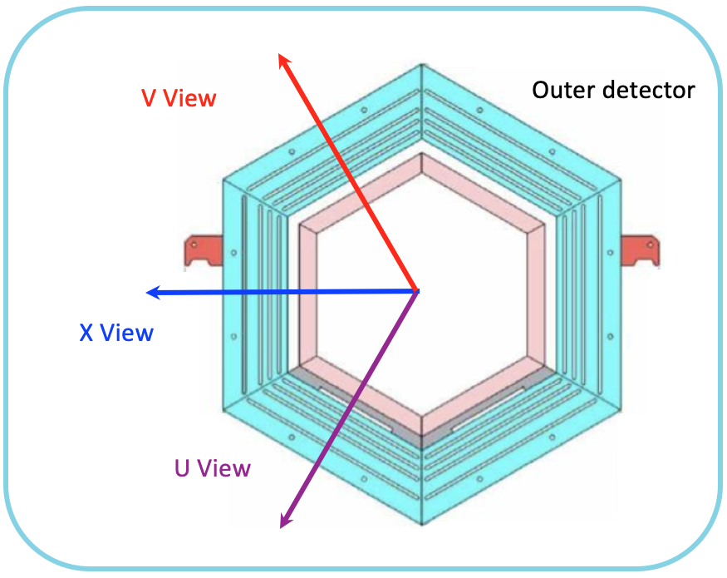
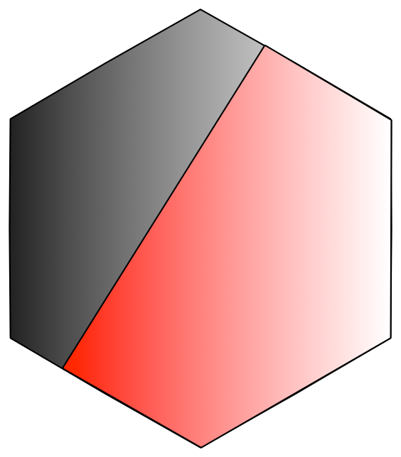
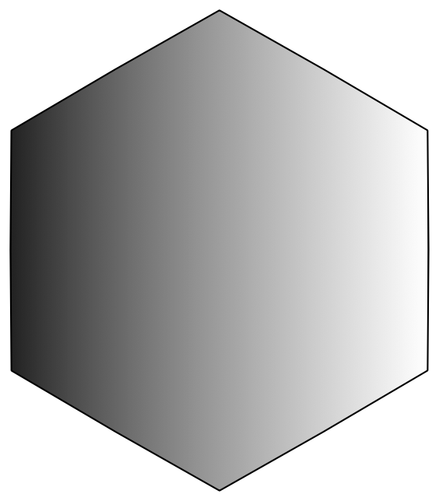
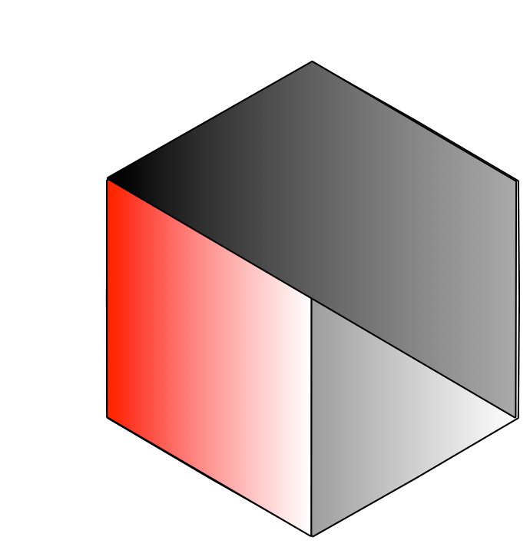
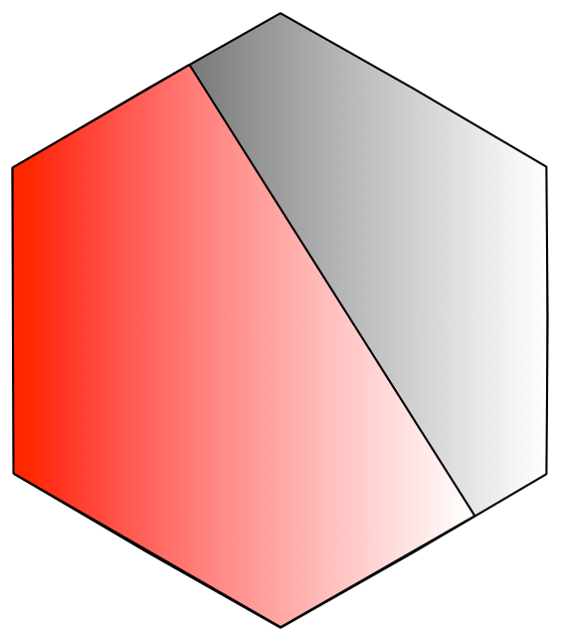
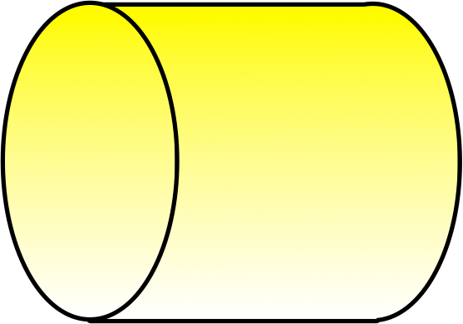
MINERvA
Nuclear effects with a variety of target materials ranging from Helium to Lead.
Fine-grained resolution for excellent kinematic measurements.
Target 5
Target 4
Water Target
Target 3
Target 2
Target 1
Beam Direction (+Z)
He Target
Notes:
Interaction probability, pictures of detectors.

Slide 5
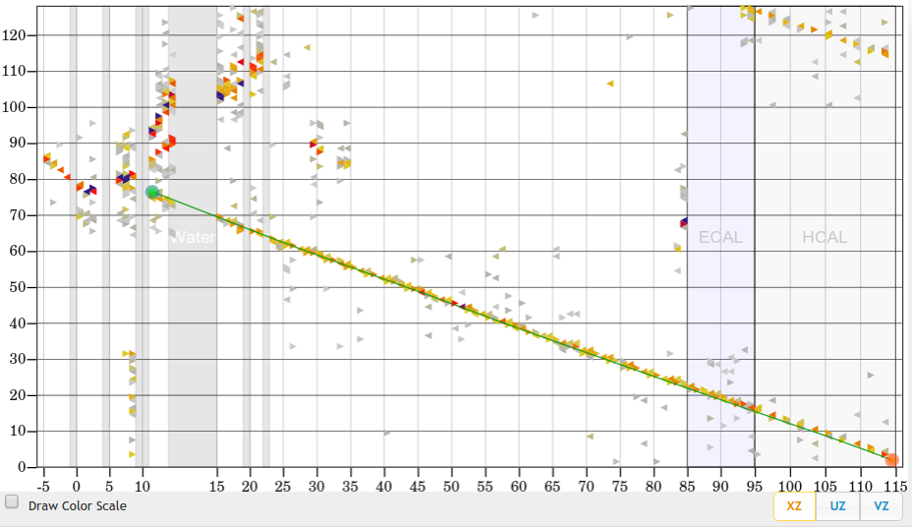
Vertex Finding and Hadron Multiplicity problem
strip number →
Hadron Showers
True vertex
plane number →
5 meters

Slide 6
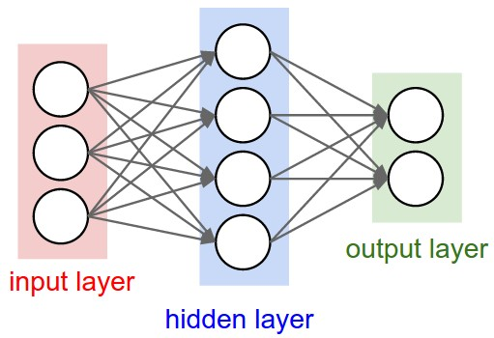
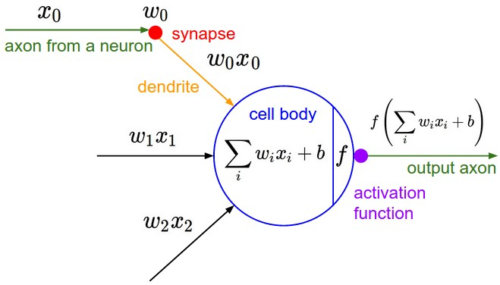
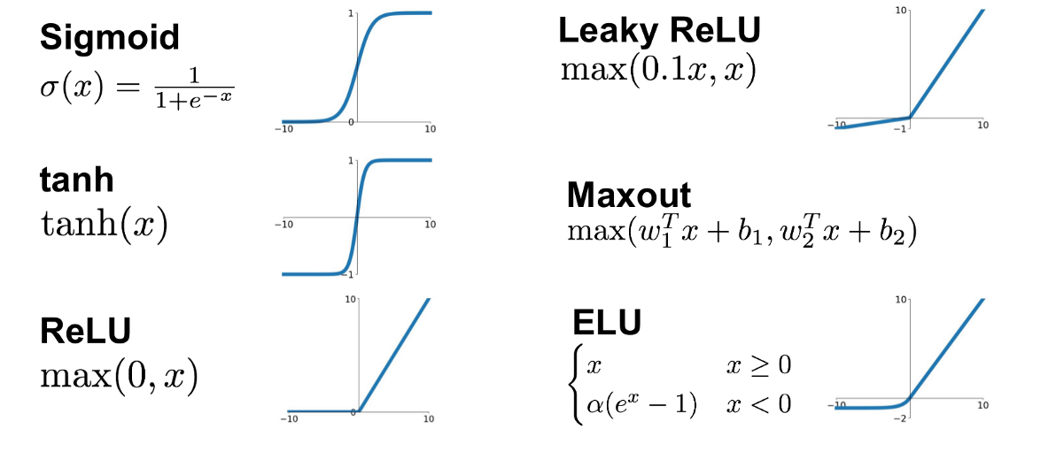
Deep Neural Networks
Fully-connected architecture
Each input multiplied by a weight.
Weighted values are summed, Bias is added.
Non-linear activation function is applied
Trained by varying the parameters to minimize a loss function (quantifies how many mistakes the network makes)

Slide 7
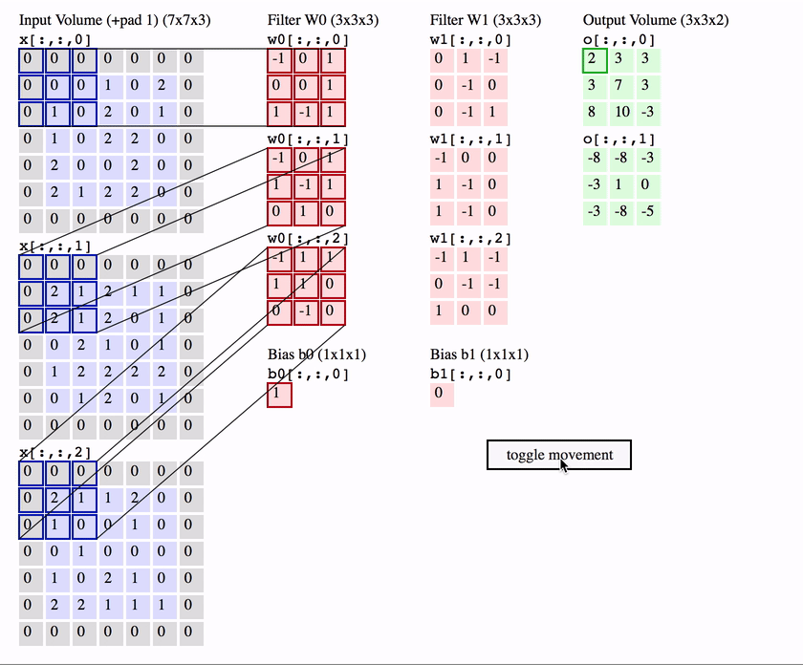
Convolutional Neural Networks (CNNs)
Similar concept to Deep Neural Networks, but highly effective for image inputs, and modern neutrino detectors are imaging detectors.
U
X
V
Notes:
Back-up materials

Slide 8
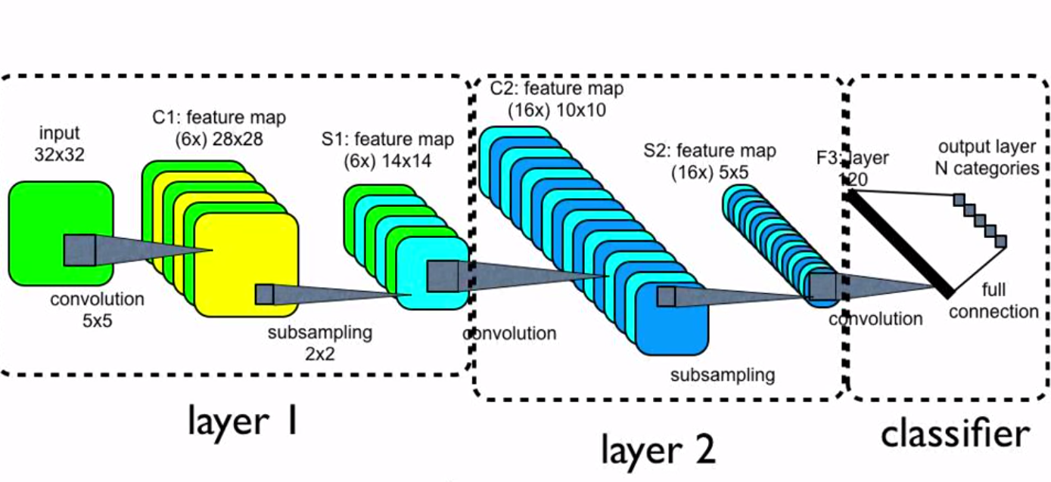
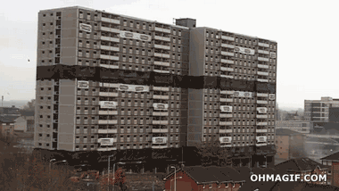
Difficulty
There is no universal CNN design for every tasks.
And designing an appropriate structure/architecture of CNN takes a lot of time and effort even for the experts.
There is no systematic way to design CNNs: mainly rely on human intuition and random/grid search.
Computationally expensive to train a CNN model.

Slide 9
Objectives
Examples of architectural attributes we extracted (32 in total):
Number of convolutional layers.
Number of rectified linear unit (ReLU) activated convolutional layers.
Average depth
Propose a systematic language to characterize CNN’s architecture, and demonstrate that they can be predictive of a CNN’s accuracy.
Suggest architectural changes to CNNs for different physics tasks (vertex finding and hadron multiplicity)

Slide 10
Method
Important architecture of CNN for physics task
Interpret the models
Machine Learning models
(classification and regression)
Architectural characterizations
CNN performance (accuracy)

Slide 11
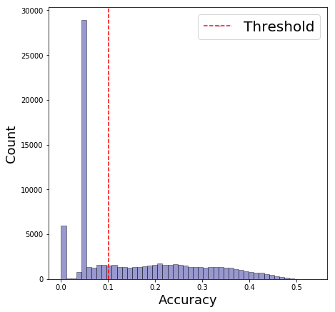
Classification
Divide data set into broken and healthy networks.
Use Random Forest and Extremely Randomized Tree to predict each CNN’s class.
Broken
Healthy

Slide 12
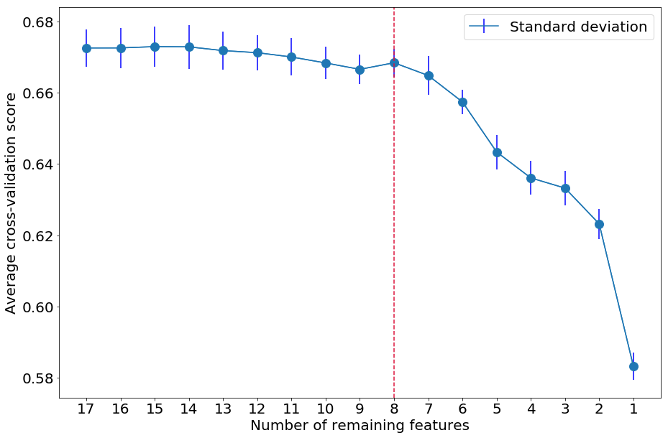
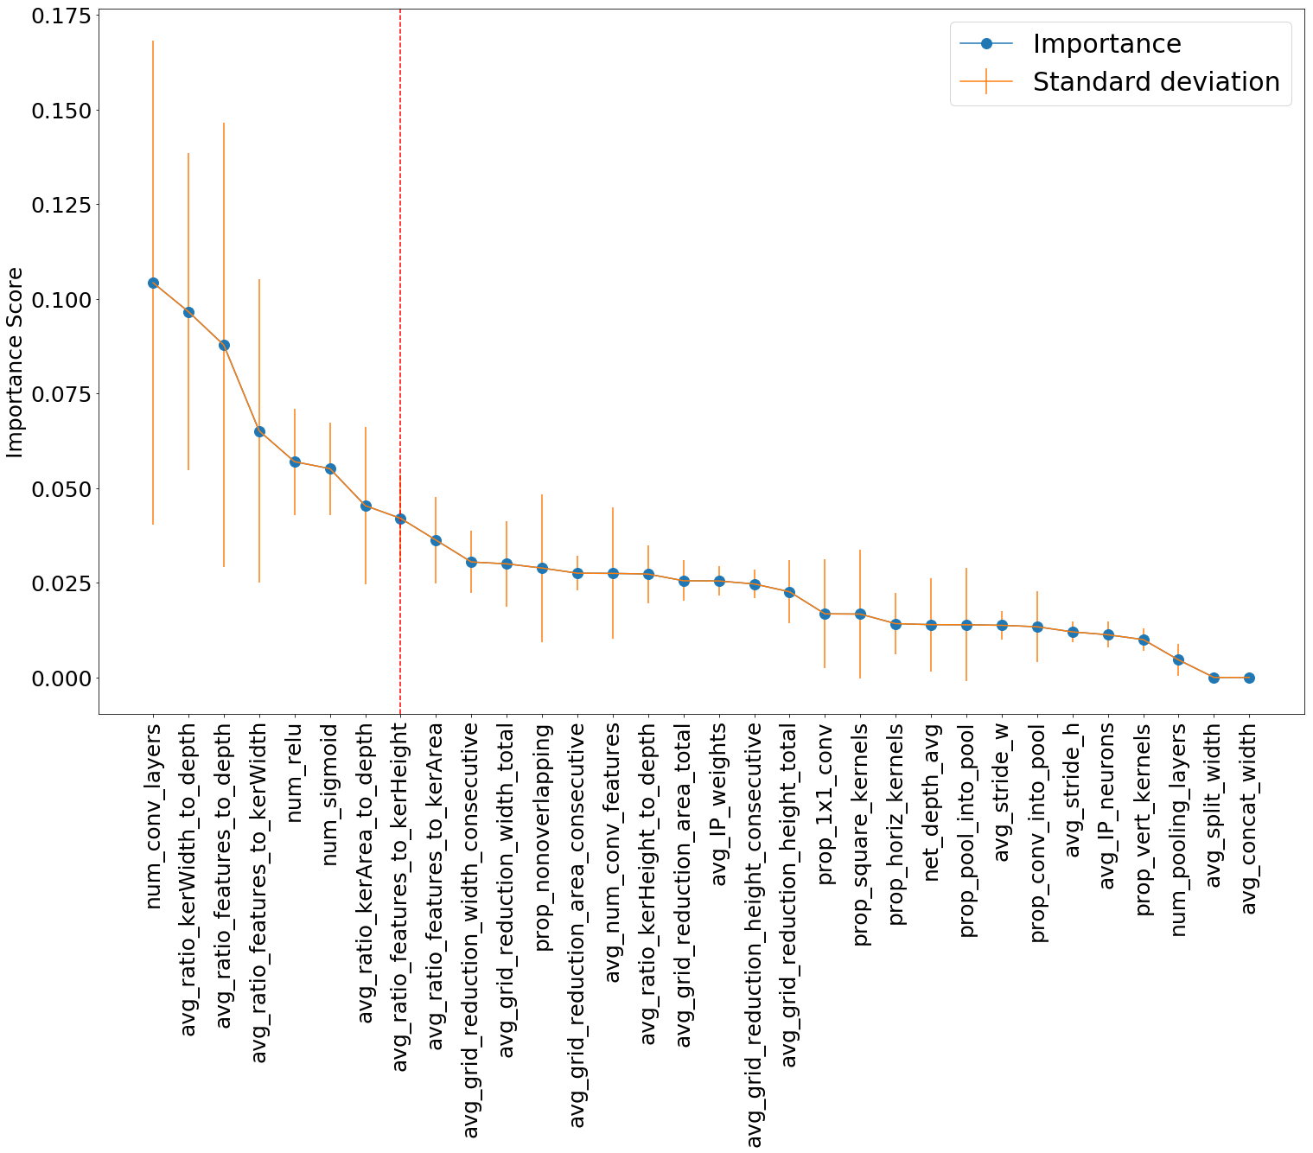
Classification results
Machine Learning models perform significantly better than random guessing (50% when there is no class overflow):
Model | Average 5-fold cross-validation scores | Accuracy on test set
Random Forest | $$70.3 ±0.006 \%$$ | $$70.6 \%$$
Extremely Randomized Tree | $$70.2 ±0.003 \%$$ | $$70.5 \%$$
Were also able to extract important features to suggest architectural changes to CNNs. More details in paper.

Slide 13
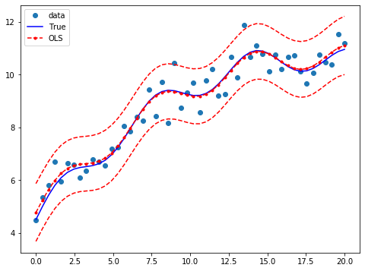
Regression on just healthy networks
Fitted an non-linear Ordinary Least Square model on just the healthy networks.

Slide 14
Regression results
Models fitted on two populations of vertex finding CNNs:
Population | $R^{2}$ of OLS | Number of Healthy CNNs
First | 0.426 | 49276
Second | 0.295 | 21415
Combined | 0.961 | 70691
Limitations: Still not enough parameters to characterize the detailed relationship between CNN’s architecture and its performance. ▶︎ Planning to extend attribute set in the future.

Slide 15
Outlook & Summary
Proposed a systematic language to characterize convolutional neural networks architecture.
Successfully demonstrated that we can use those parameters to predict whether a network is “good”.
There are limitations to predict the exact accuracy, but initial results are promising. Extension of the attributes set might help in the future.
One of the early studies about relationship between CNN’s architecture and its performance.
More details in our up-coming paper.

Slide 16
Acknowledgements
Special thanks to my supervisor, Dr. Gabriel N. Perdue.
To members of MINERvA’s machine learning group for their mentorship and useful conversations:
Anushree
Steven (Oak Ridge)
Nafis
Luis
To members of SIST committee and my mentor group and other awesome interns:
Laura Fields
Sandra Charles
Judy Nunez
Alexander Martinez
Raul Campos
Matthew Alvarez

Slide 17
References
Neural networks and Convolutional Networks visualization: Source
Random Forest: Source

Slide 18
Back-ups

Slide 19
K-folds cross validation

Slide 20
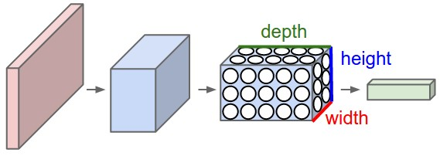
Architectural characterizations of CNNs
Different deep learning problems require different network architecture.
However, selecting an appropriate architecture for CNNs is usually done by human intuition or random search
If we have a way to uniformly characterize a network architecture, then it would be particularly useful.
Good for the task?
?

Slide 21
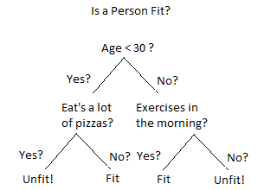
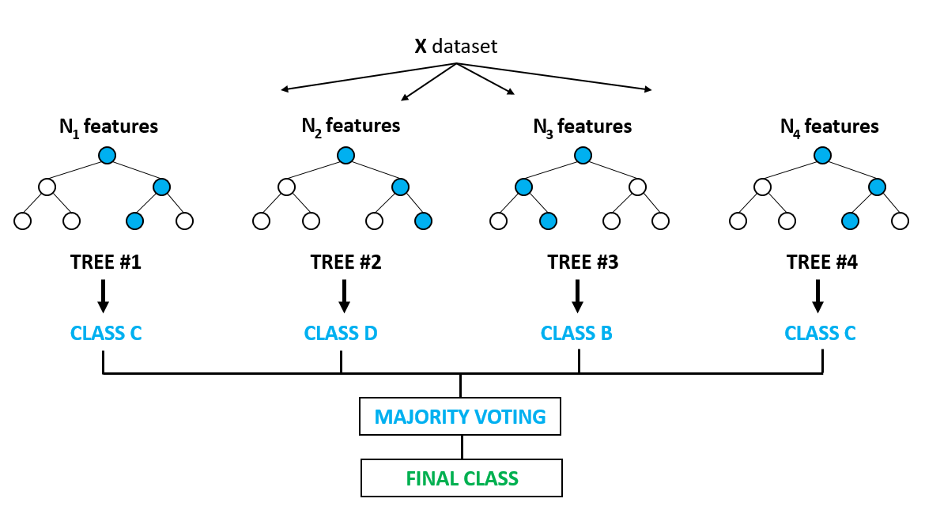
Random Forest and Extremely Randomized Tree

