Slide 1
Industrial Cooling Water Model Update and Analysis Using WaterGEMS
Gustavo Damis Resende
SIST Program - Fermilab
August 5th, 2019

Slide 2
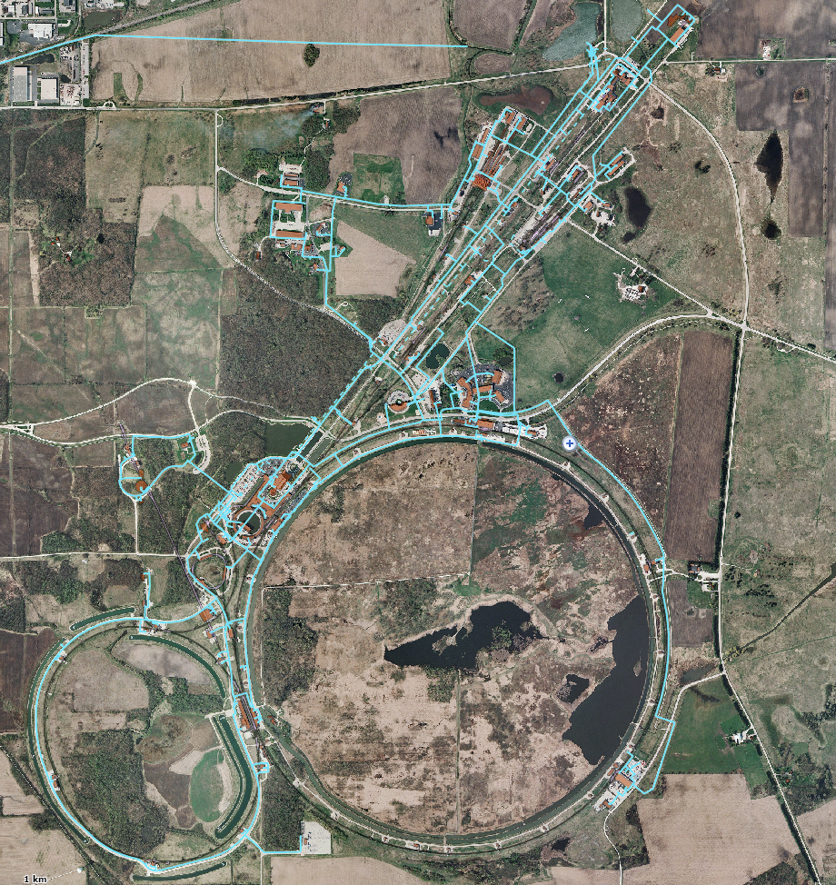
Presentation Summary
Background
The ICW system
WaterGEMS
Previous model
Project Goal
Update the model
Run scenarios of interest
Model Update
Node elevations
Pump house modeling
Demand revision
Scenarios
Normal PIP-II demand
Pipe from PIP-II to CUB
Increased PIP-II demand
Conclusion

Slide 3
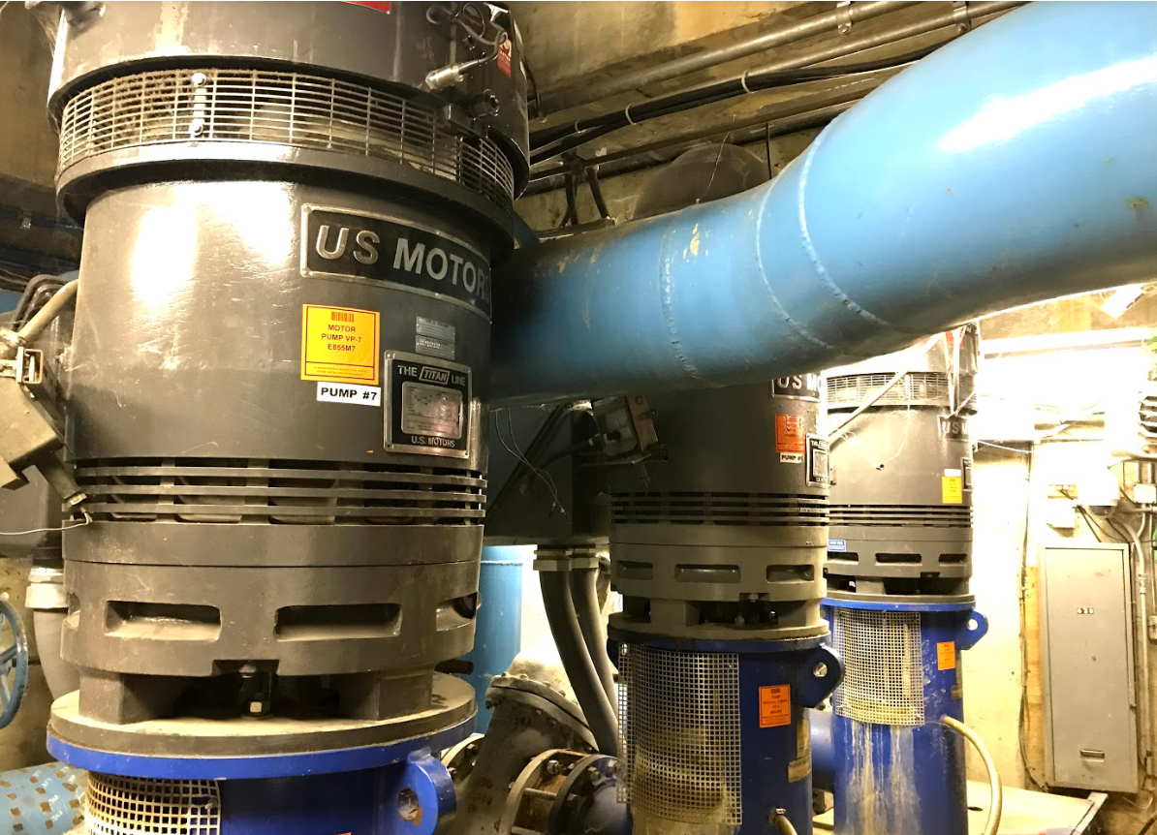
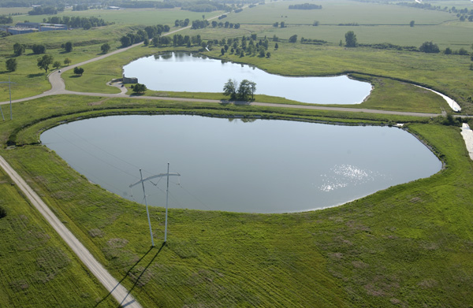
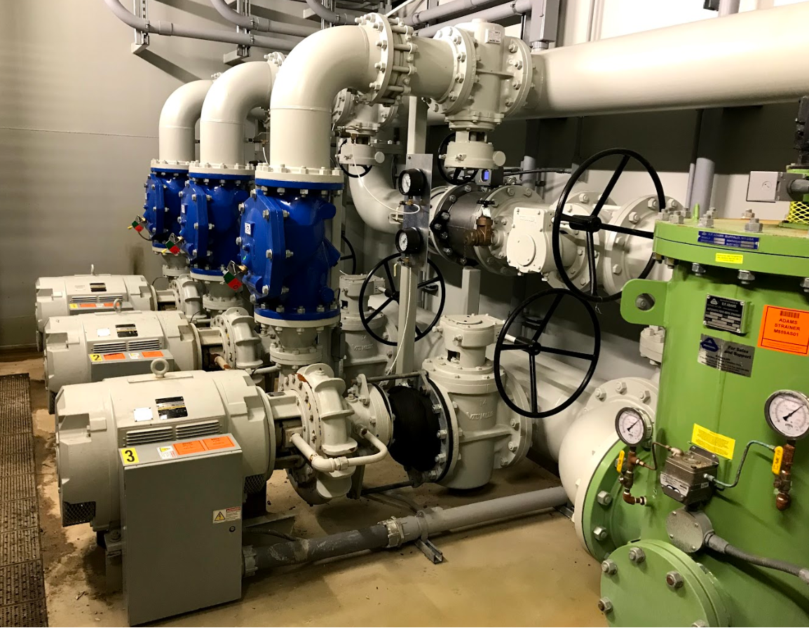
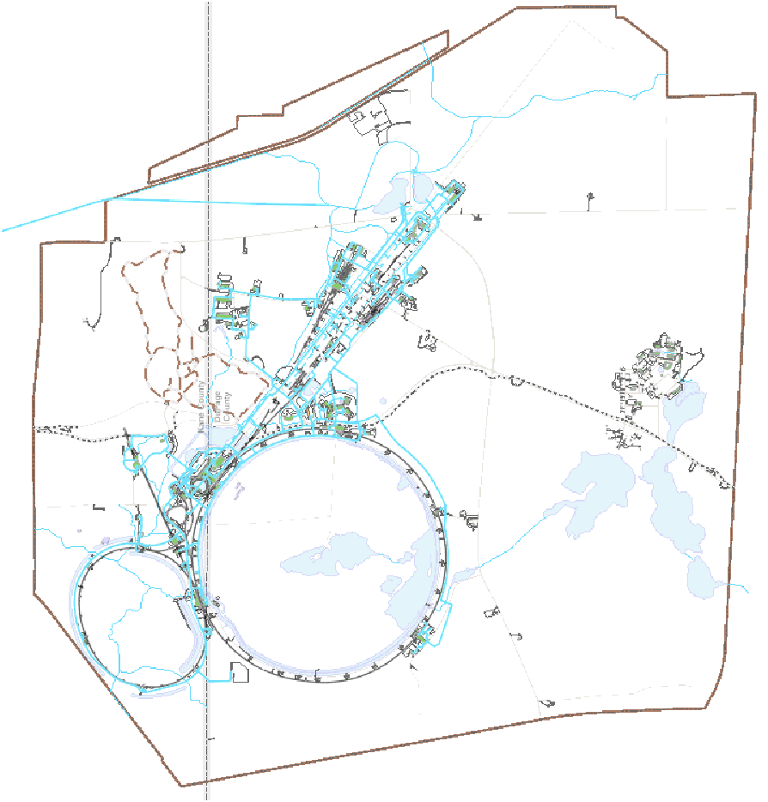
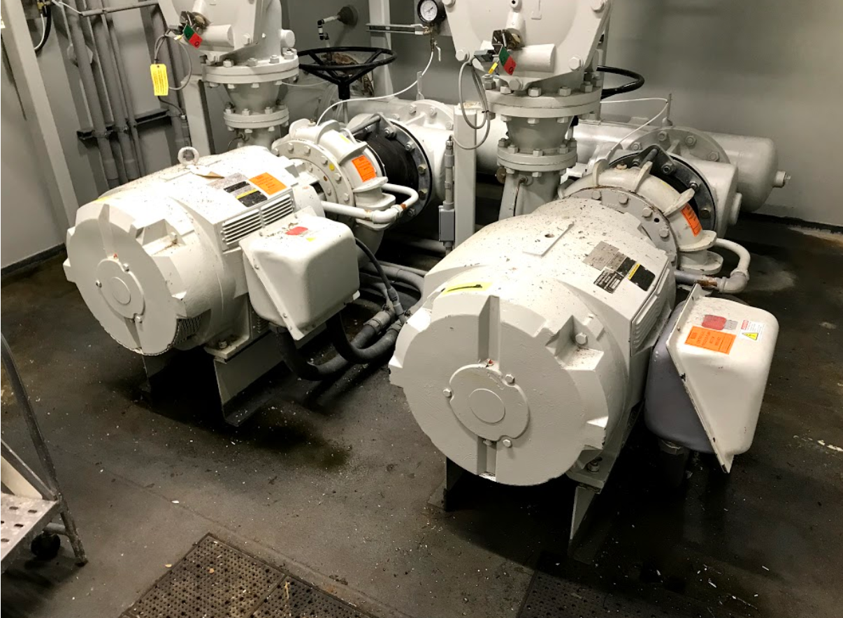
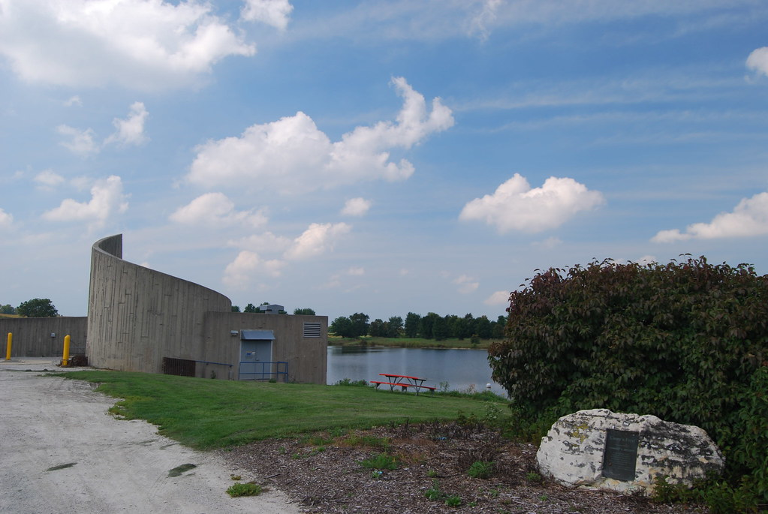
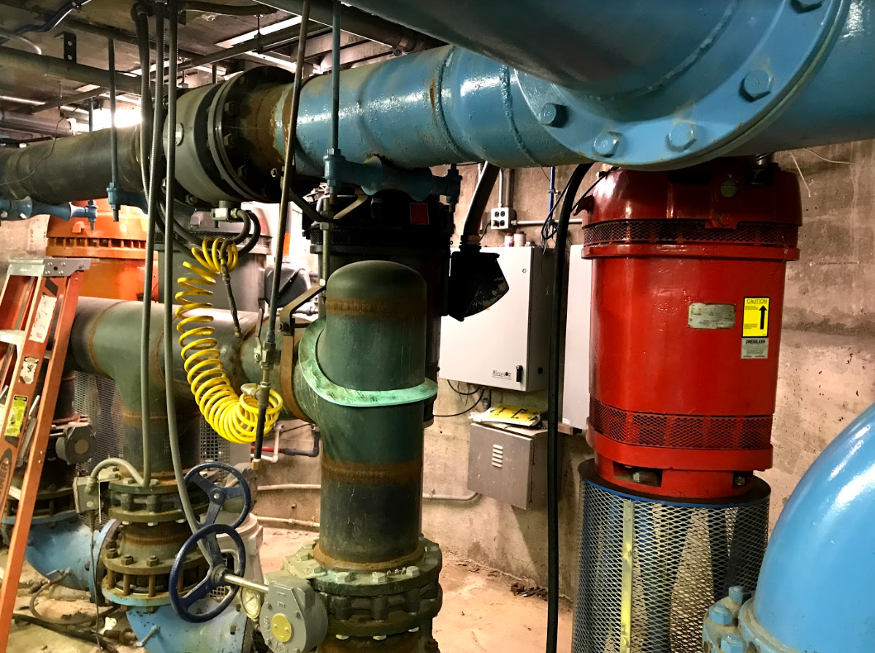
The ICW System
Main Purpose:
Supply cooling water and fire protection.
Infrastructure:
Pump Houses
Reservoirs
Pipes
Fire Hydrants
ICW system is vital for Fermilab’s operation
Notes:
Reservoir numbers: andy’s pond over 9 million, casey’s over 26 million, swan lake over 6 million usable gallons.
Over 110,000 ft, or about 20 miles of pipe, range between 3” and 24” in diameter.
Fox river and rainfall supplies water to Casey’s pond.

Slide 4
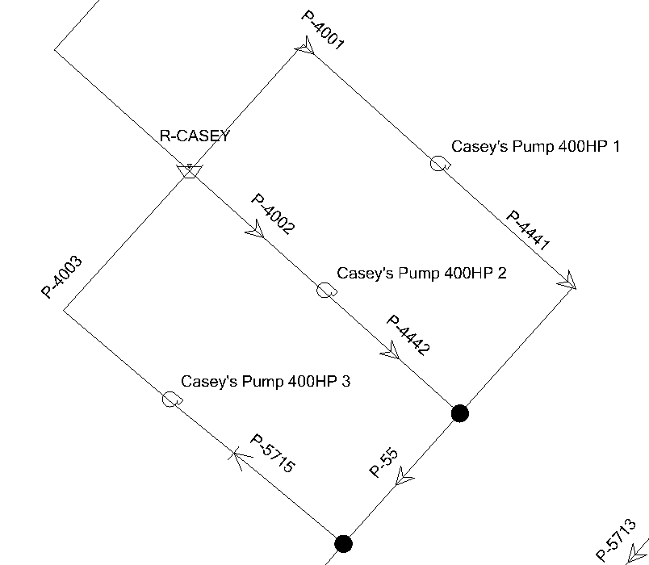
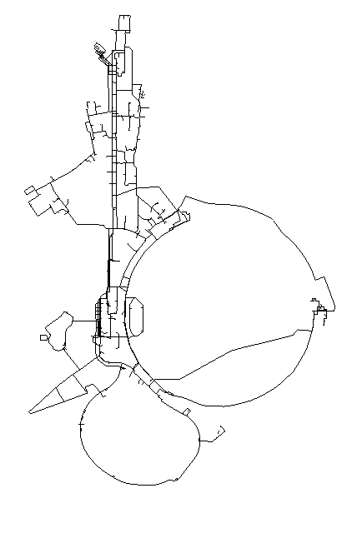
WaterGEMS Software and Previous Model
WaterGEMS is a water distribution and design software.
Software tools:
Steady-state analysis
Automated Fire Flow simulations
Scenario management
Water quality analysis
The ICW model was last updated in 2014. It is a important tool for understanding the system.
Notes:
ICW model is outdated, changes in demand, pump infrastructure and node elevations are necessary.
Explain what water quality analysis.

Slide 5
Project Goals
Update model to reflect current ICW system. Update includes:
Node elevations
Pump house modeling
Demand update
Run scenarios of interest and analyze results. Scenarios include:
Normal PIP-II demand
Pipe from PIP-II to CUB
Increased PIP-II demand

Slide 6
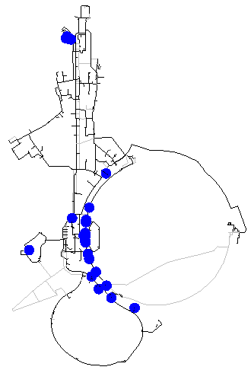
Model Update: Node Elevation
Various nodes had low elevation relative to sea level.
Elevation of those nodes were corrected to reflect their elevation.
Corrections are important for the accuracy of the model.

Slide 7
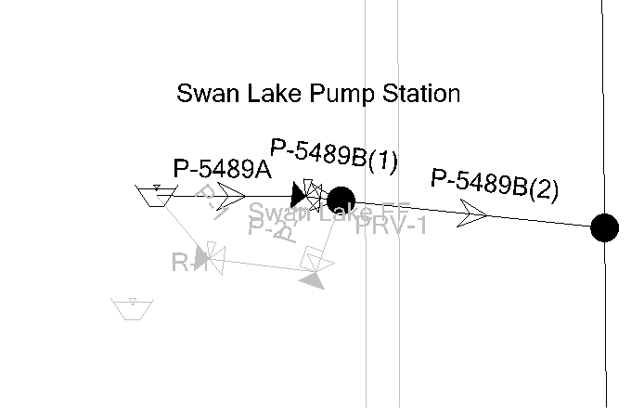
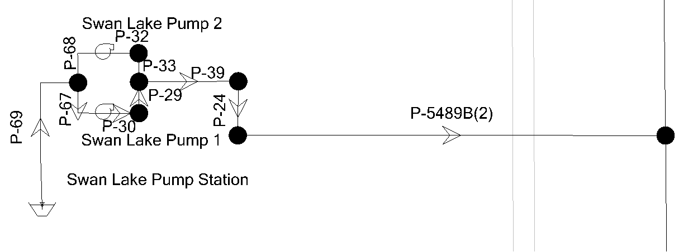
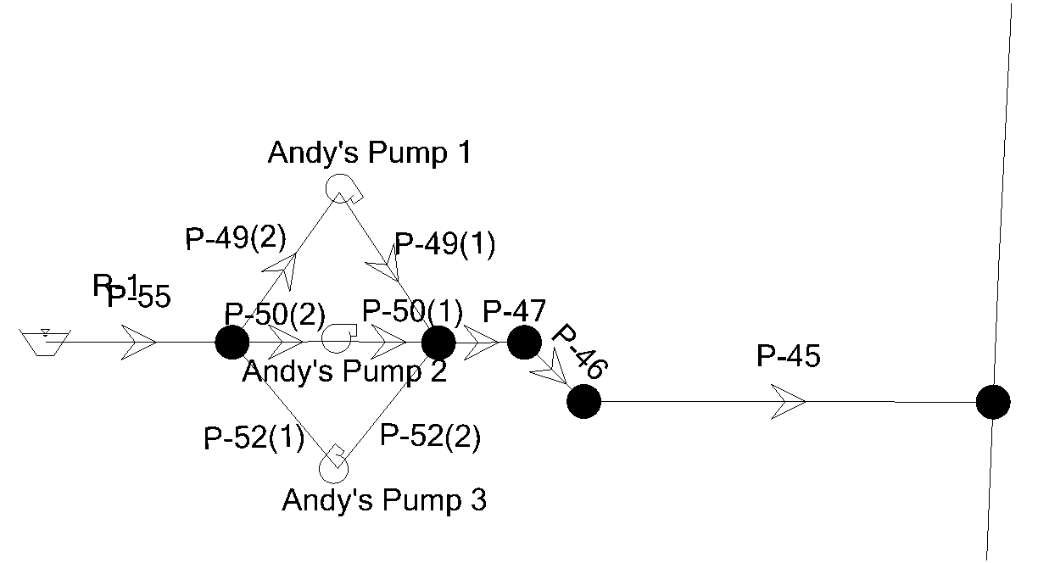
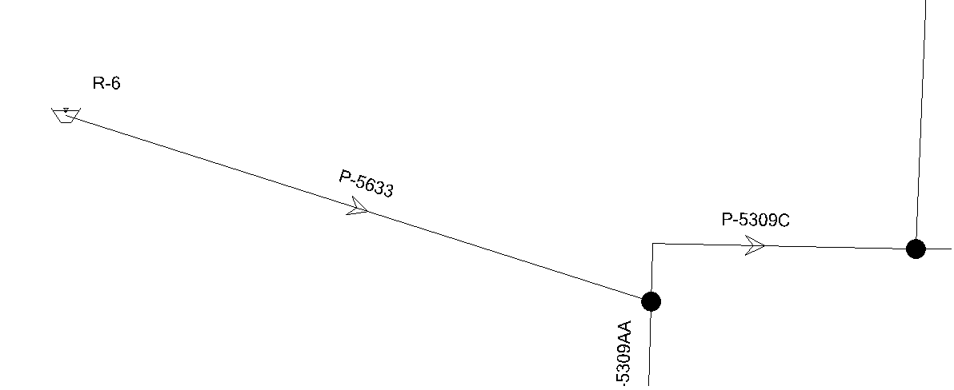
Model Update: Pump House Modeling
Andy’s Pond and Swan Lake pump houses were added to the model.
Pump curves were updated.
Pump settings at Casey’s Pond pump house were correct to reflect current order of operations.

Slide 9
Model Update: Casey’s Order of Operation
Stage | Min Flow (GPM) | Max Flow (GPM) | Pumps Operating
1 | 0 | 4,600 | 1 ‐ 400 hp pump
2 | 4,600 | 5,800 | 1 ‐ 400 hp pump
 |  |  | 1 ‐ 100 hp Ingersoll Dresser Pump
3 | 5,800 | 7,000 | 1 ‐ 400 hp pump
 |  |  | 2 ‐ 100 hp Ingersoll Dresser Pumps
4 | 7,000 | 8,100 | 1 ‐ 400 hp pump
 |  |  | 2 ‐ 100 hp Ingersoll Dresser Pumps
 |  |  | 1 ‐ 100 hp Flowserve pump
5 | 8,100 | 10,500 | 2 ‐ 400 hp pumps
 |  |  | 1 ‐ 100 hp Ingersoll Dresser Pump
6 | 10,500 | 12,000 | 2 ‐ 400 hp pumps
 |  |  | 2 ‐ 100 hp Ingersoll Dresser Pumps
7 | 12,000 | 13,000 | 2 ‐ 400 hp pumps
 |  |  | 2 ‐ 100 hp Ingersoll Dresser Pumps
 |  |  | 1 ‐ 100 hp Flowserve pump
8 | 13,000 | 14,200 | 2 ‐ 400 hp pumps
 |  |  | 2 ‐ 100 hp Ingersoll Dresser Pumps
 |  |  | 2 ‐ 100 hp Flowserve pumps
9 | 14,200 | 17,400 | 3 ‐ 400 hp pumps
 |  |  | 2 ‐ 100 hp Ingersoll Dresser Pumps
 |  |  | 1 ‐ 100 hp Flowserve pump
10 | 17,400 | 20,800 | 3 ‐ 400 hp pumps
 |  |  | 2 ‐ 100 hp Ingersoll Dresser Pumps
 |  |  | 2 ‐ 100 hp Flowserve pumps

Slide 10
Model Update: Demand Revision
Building | Consultant Model (GPM) | Updated Model (GPM)
Cryo Module Test Facility (CMTF) | 1,600 | 1,140
Industrial Compressor Building | 1,490 | 1,800
Feynman Computing Center | 990 | 960
HAB | 624 | 0
Meson Central Cryogenics | 500 | 818
Meson Service #6 and Meson Test Worm | 400 | 715
Industrial Center Building | 325 | 554
Central Helium Liquefier | 300 | 0
MuCool Service Building | 250 | 0
Central Utility Building | 225 | 225
Meson Detector Building | 220 | 133
High Intensity Laboratory | 160 | 11
Liquid Argon Test Facility | 0 | 0
Building | Consultant Model (GPM) | Updated Model (GPM)
PIP-II | 1,400 | 1,400
A-0 Lab | 713 | 800
NML | 680 | 721
Neutrino Lab B | 410 | 700
FH at MI-20 | 350 | 0
PIP-II | 202 | 0
B-0 Main Ring | 179 | 217
Meson West Lab | 170 | 11
Training Center | 102 | 0
Polarized Proton Lab | 91 | 120
Neutrino Lab Nwa | 85 | 0
Neutrino Lab A | 64 | 0
Industrial Building #1 | 60 | 0
Industrial Building #4 | 60 | 76
Linac North Access | 58 | 21
Neutrino Lab B | 50 | 0
Neutrino Lab G | 43 | 0
Neutrino Lab C | 39 | 6
Meson Service #4 | 30 | 0
Neutrino Lab E | 24 | 0
Proton Assembly | 8 | 12
Neutrino Service #1 | 0 | 218
Meson Service #3 | 0 | 19
Service Building | 0 | 42
Over the last 5 years, flow rate demanded by each building has changed.
Using the Metasys system, maximum demand was determined to each building.
These demands were assigned to their respective nodes.
Notes:
Note that study was mainly made for the summer.
Metasys building automation system to monitor pressure and flow of utilities.

Slide 11
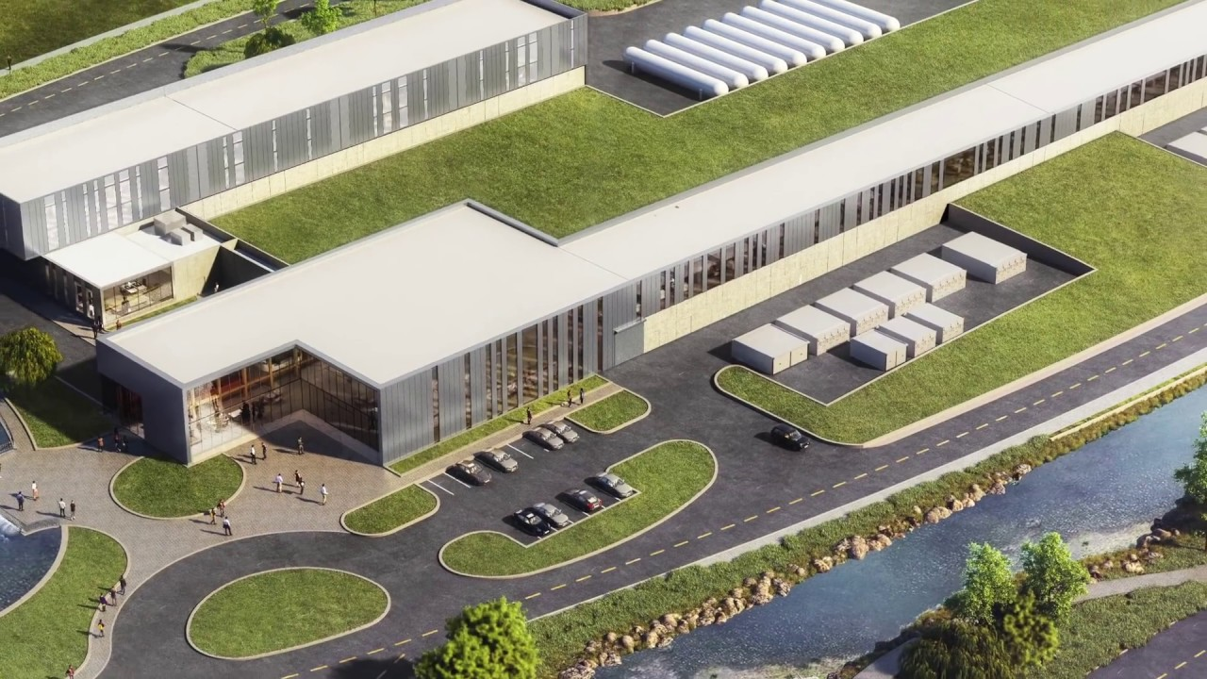
Scenario Analysis
After update, various scenarios were analyzed.
Purpose was to understand how ICW system would behave with different configurations.
Main focus in effect of PIP-II load on system.
Notes:
PIP-II cryo building

Slide 12
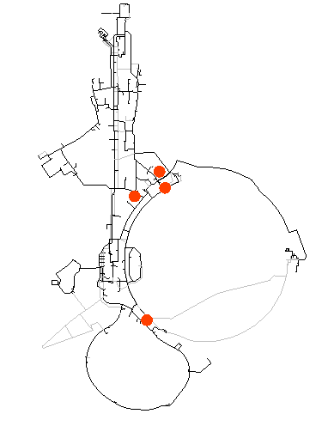
Scenario Analysis: PIP II with 1,400 GPM
First scenario day-to-day usual load of 6,400 GPM, all fire flow constraints were met.
Second scenario with maximum load at each building.
PIP-II flow rate of 1,400 GPM.
Outlet pressure set point of 90 PSI.
Four buildings failed the fire flow constraints.
Building | Fire Flow Needed (GPM) | Fire Flow Available (GPM) | Does it Satisfy Fire Flow Constraints?
B-0 Main Ring | 717 | 486 | FALSE
Feynman Computer Center | 893 | 865 | FALSE
Industrial Building #4 | 516 | 209 | FALSE
F-17 Service Building | 723 | 674 | FALSE

Slide 13
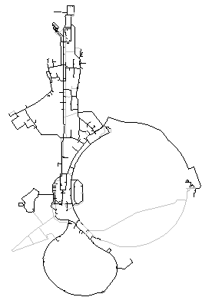
Scenario Analysis: PIP II with 1,400 GPM
Possible solution: Raise the outlet pressure setpoint of Casey’s Pond to 103 PSI.
Flow rate available to each building increase.
All fire flow constraints are met.
Increase in pressure needs to be further studied.
Building | Fire Flow Needed (GPM) | Fire Flow Available (GPM) | Does it Satisfy Fire Flow Constraints?
B-0 Main Ring | 717 | 830 | TRUE
Feynman Computer Center | 893 | 2,283 | TRUE
Industrial Building #4 | 516 | 521 | TRUE
F-17 Service Building | 723 | 935 | TRUE

Slide 14
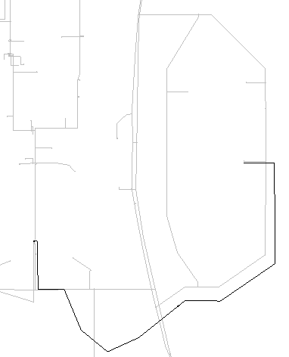
Scenario Analysis: Pipe From CUB To PIP-II
Wilson Hall
Addition of pipe from CUB to PIP-II to provide make up water.
Nodes that failed this scenario are the same nodes that failed previous scenario.
Addition of pipe does not affect overall supply of ICW.
PIP-II
CUB
PIPE

Slide 15
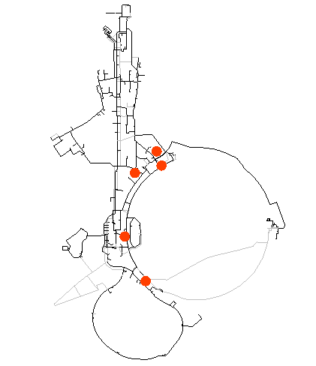
Scenario Analysis: PIP II with 1,900 GPM
Possibility of increasing demand at PIP-II was also analyzed.
PIP-II flow rate at 1,900 GPM
Casey’s outlet pressure set point of 90 PSI.
Five buildings to not meet the fire flow constraints.
Building | Fire Flow Needed (GPM) | Fire Flow Available (GPM) | Does it Satisfy Fire Flow Constraints?
A-0 Lab | 561 | 544 | FALSE
B-0 Main Ring | 717 | 437 | FALSE
Feynman Computer Center | 893 | 655 | FALSE
Industrial Building #4 | 516 | 167 | FALSE
F-17 Service Building | 723 | 618 | FALSE
Notes:
In the case of a fire flow to building would no meet the requirements. NFPA national fire protection association

Slide 16
Scenario Analysis: PIP II with 1,900 GPM
Once again, increasing the outlet pressure setpoint is one possible solution.
With setpoint at 105 PSI, ICW is able to meet all fire protection requirements.
Increase in pressure needs to be further studied.
Building | Fire Flow Needed (GPM) | Fire Flow Available (GPM) | Does it Satisfy Fire Flow Constraints?
A-0 Lab | 561 | 1,021 | TRUE
B-0 Main Ring | 717 | 838 | TRUE
Feynman Computer Center | 893 | 2,298 | TRUE
Industrial Building #4 | 516 | 531 | TRUE
F-17 Service Building | 723 | 926 | TRUE

Slide 17
Conclusion
With proper management and operation setpoint changes, ICW system can handle near future demands.
WaterGEMS model is up to date with ICW system.
ICW model provide overview of the viability of demand increases in the system.
Important to note that the model does not account for all factors.
It facilitates studying how layout and demand changes will affect the ICW system.
Notes:
Model does not account for return water systems and additional heat loads to the buildings.
Making it easier for engineers at FESS to analyze many scenarios of interest in a efficient manner.
Acknowledge: sist committee, my supervisor, mentor, fess engineering, lee, emil.

