Slide 1
Beamline Extension for the Accelerator Applications Development and Demonstration
Jose Manuel Marquez
SIST Internship
Michael I Geelhoed
5 August 2019

Slide 2
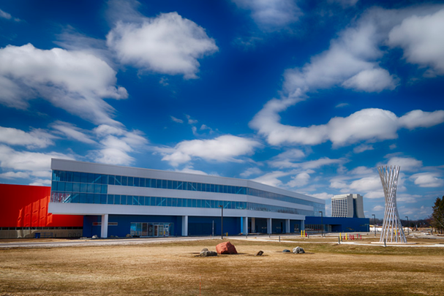
Project Purpose
At Fermilab, IARC…
Located in the Illinois Accelerator Research Center (IARC)
With the purpose to make the particle accelerator more mobile and to expand its purposes into industry.
Specific to the project, the particle accelerator is emitting electrons from a vacuum window onto a target 1.3 meters down.
Electron emission can be used to purify water of contaminants as well as to harden pavement into a very durable material
The project is essentially to improve the number of electron beams reaching a target per cubic centimeter
2 objectives:
Task 1: Sealed Pipe, Focus Spot Size to 4 in of diameter
Task 2: Target Box, Focus Spot Size to less than 1 cm of diameter, as close to 1 mm as possible.

Slide 3
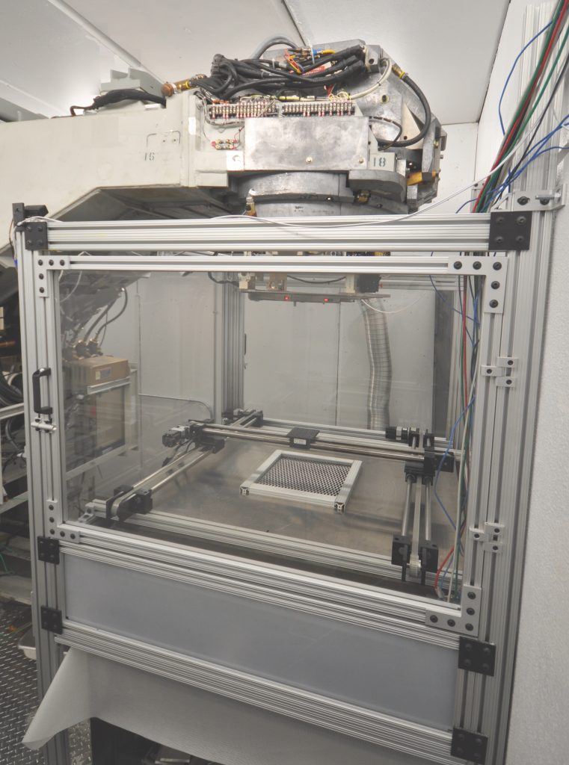
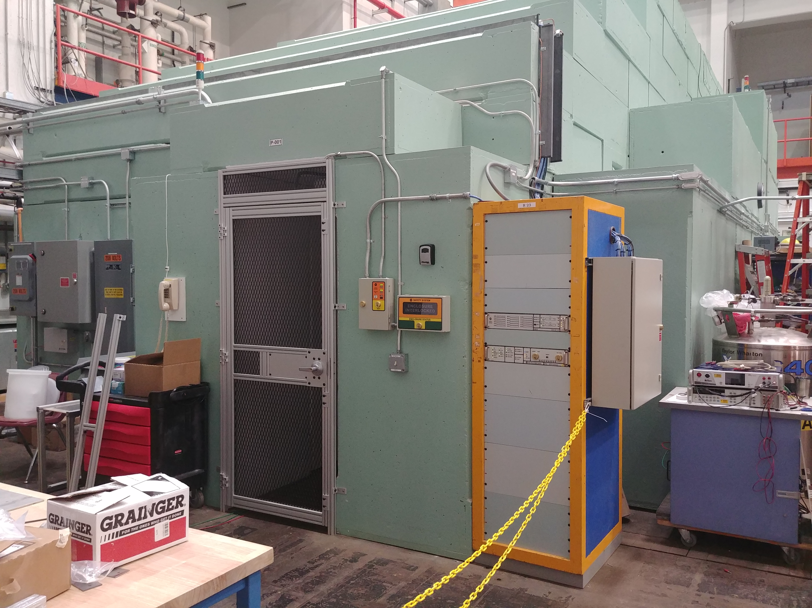
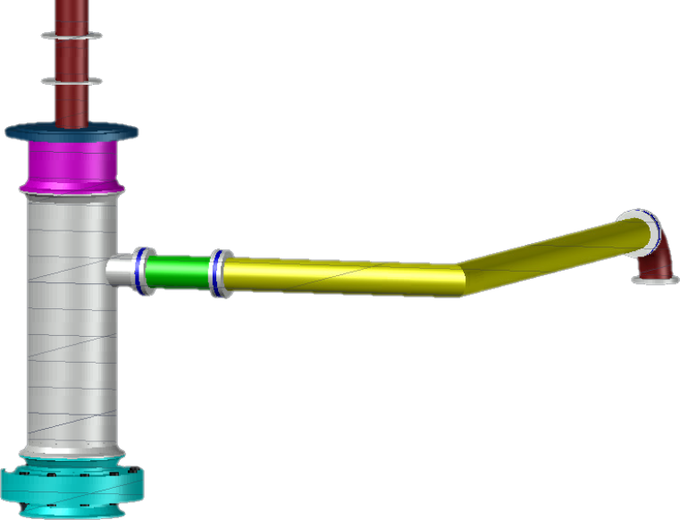
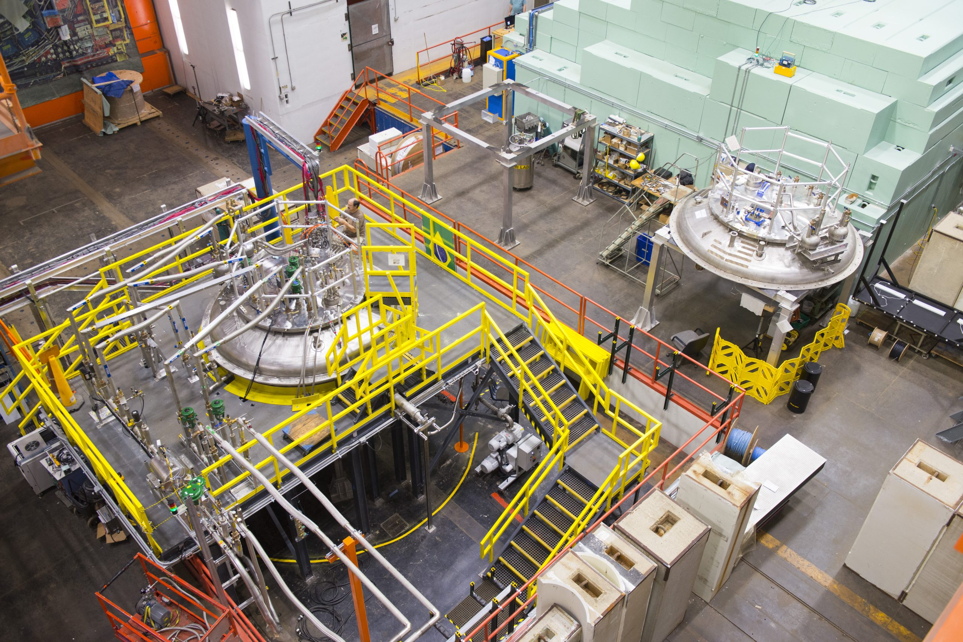
A2D2

Slide 4
Software Learned
AutoCAD
Used to model and design pipe, flanges, and support for the extension.
Used to make complex 3D shapes, make measurements, and to present design.
Was used to help make the notes to take to the fabrication shop to mill, cut, or weld certain components.
Also used to accommodate the extension’s geometry to the particle accelerator dimensions.
G4 Beamline
Used to simulate…
The interaction of particles with matter and electromagnetic fields.
This where we implement our knowledge of the impacts due matter, vacuum, and electromagnetic fields that result in changes in the electron beam (spread and radiation).
Python was used in conjunction.

Slide 5
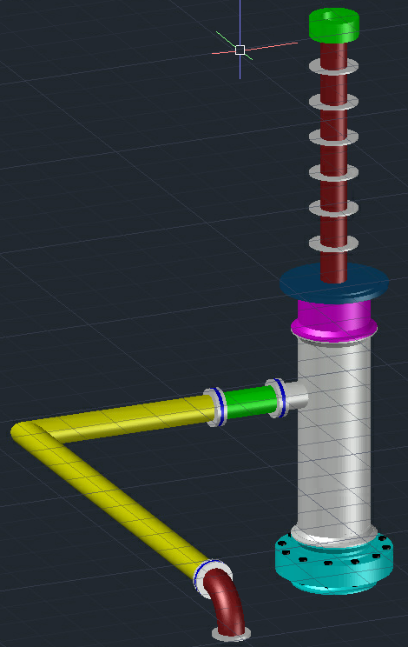
Beam Line Extension Design
Green component is 2 conflat flanges with a 3 mills thick titanium window.
Red component is a 1.5” stainless steel tube.
Grey disks are washers that are placed 5cm from each other to space the solenoids.
Blue component is an adapter plate that joins a 1.5” tube and a 4” tube.
Pink component is a 4” stainless steel tube that joins a 4” aluminum tube (grey component) with a V-Band clamp.
Light blue component is the final 2 flanges with a 8 mills thick titanium window that is attached to the aluminum pipe with a V-clamp.
The 4” aluminum pipe has a KF40 port that 1.5” and goes to a bellow that attaches to a 1.5” tube that extends to the outside of the cabin. This spout is the vacuum port to extract all air.

Slide 6
G4 Beamline Program
Simulations are used to distinguish whether or not the placement or the use of certain materials or components is favorable.
First Stage was to get a baseline readout of how many electrons actually make it to the target while travelling through air alone.
Second Stage was to set the vacuum pressure to 0.01 torr and to place the tubes and windows into the simulation.
Third Stage was to find an ideal location to place a certain kind of solenoid to further focus the beam.
Fourth Stage was to further focus the beam using a pair of quadrupoles at certain locations.

Slide 7
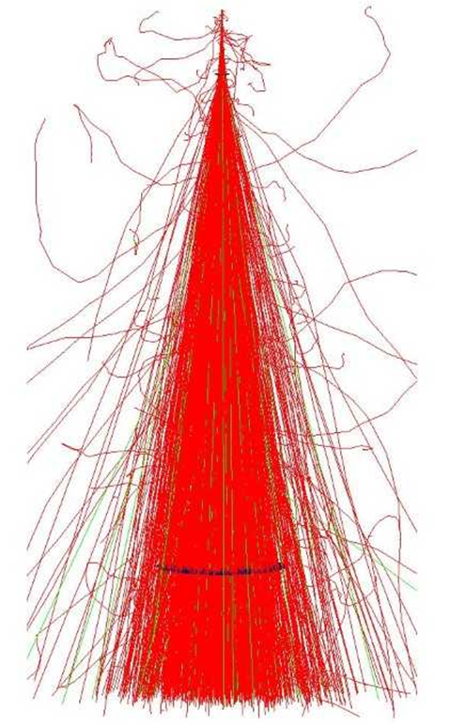
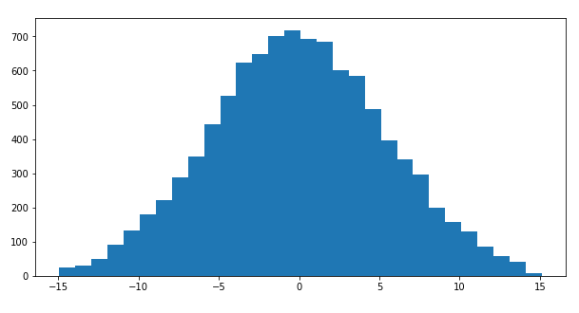
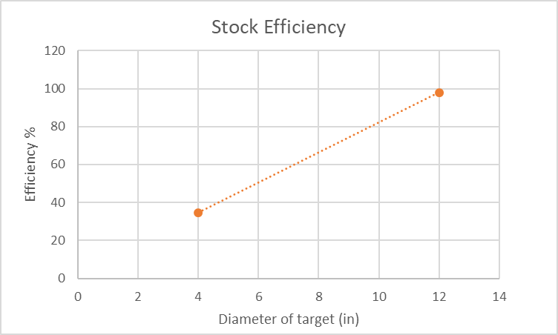
Efficiencies, Stage 1: Baseline
Baseline
Without any modifications or additions to the beam path.
Running through air at 9MeV
Simulation executes 10,000 electron beams in every of the following simulations.
Number of Particles
Bins (cm)
diameter(in) | survived
4 | 3479
12 | 9789

Slide 8
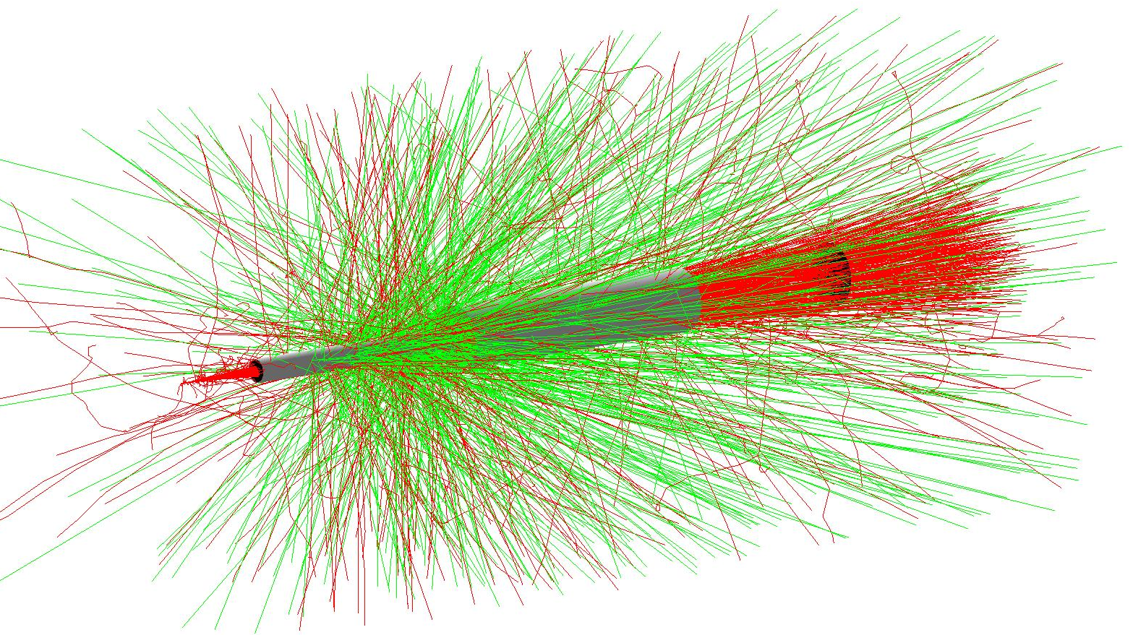
Efficiencies Stage 2: Pipeline Extension
Adjusting vacuum to see how it plays a role from 1000 to 0.01 Torr.
This simulation does not include the titanium windows, that is for the later simulation.
Torr | survived
1000 | 1985
100 | 9327
10 | 9987
1 | 10000
0.1 | 10000
0.01 | 10000
(5mm)

Slide 9
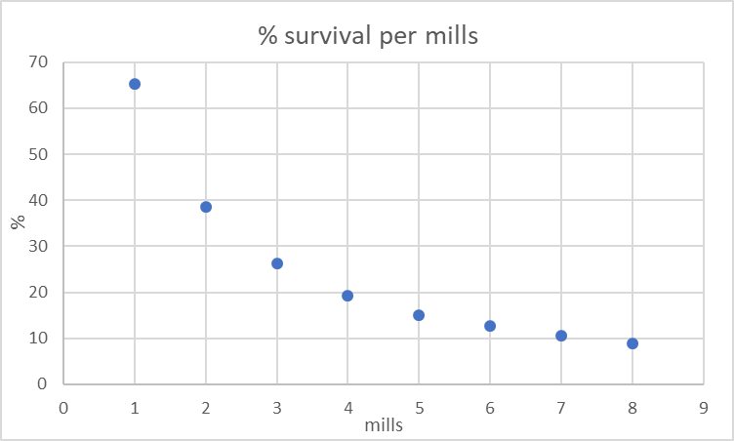
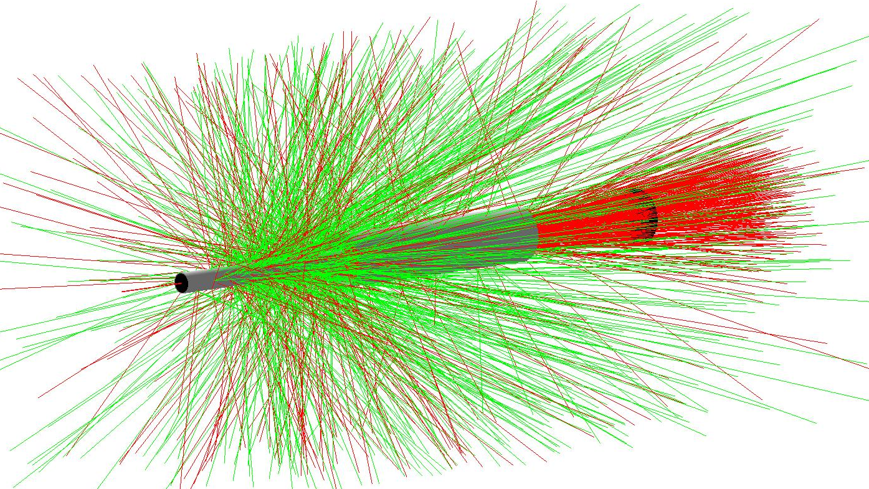
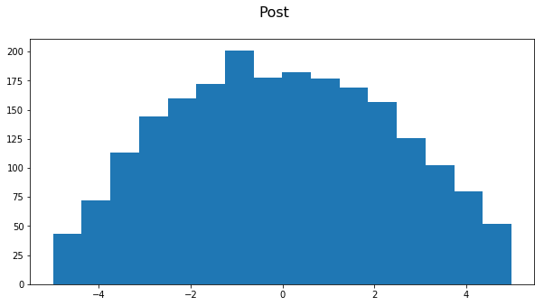
Efficiencies Stage 2: Pipeline Extension cont.
Target in this stage is a 4” diameter target, torr = 0.01
The actual thickness of Ti will be of a 3 mills top and an 8 mills bottom resulting in and efficiency of 21.30%.
Using Grade 5 Titanium
mills | survived
1 | 6525
2 | 3862
3 | 2628
4 | 1936
5 | 1500
6 | 1263
7 | 1055
8 | 897

Slide 10
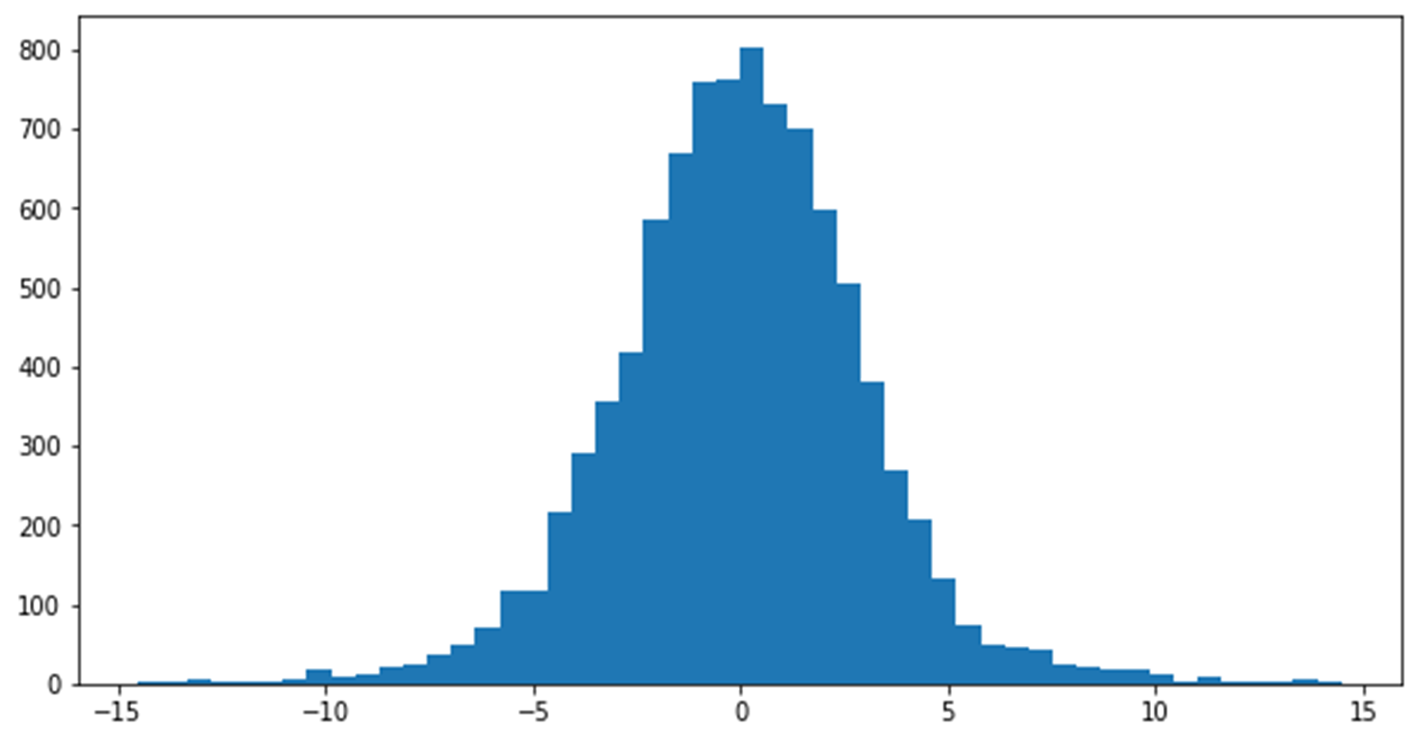
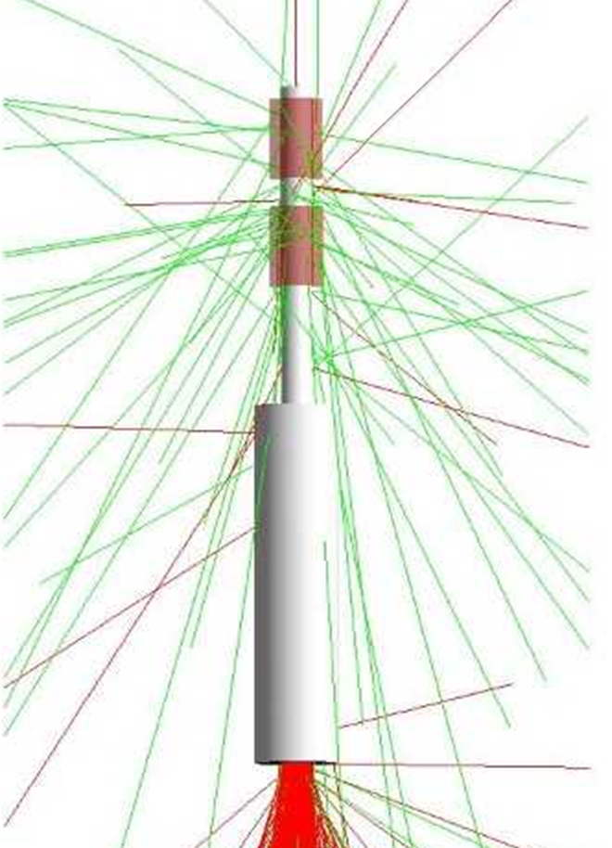
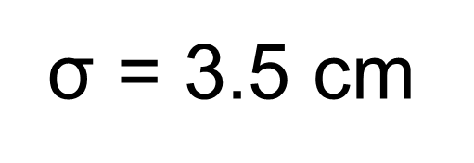
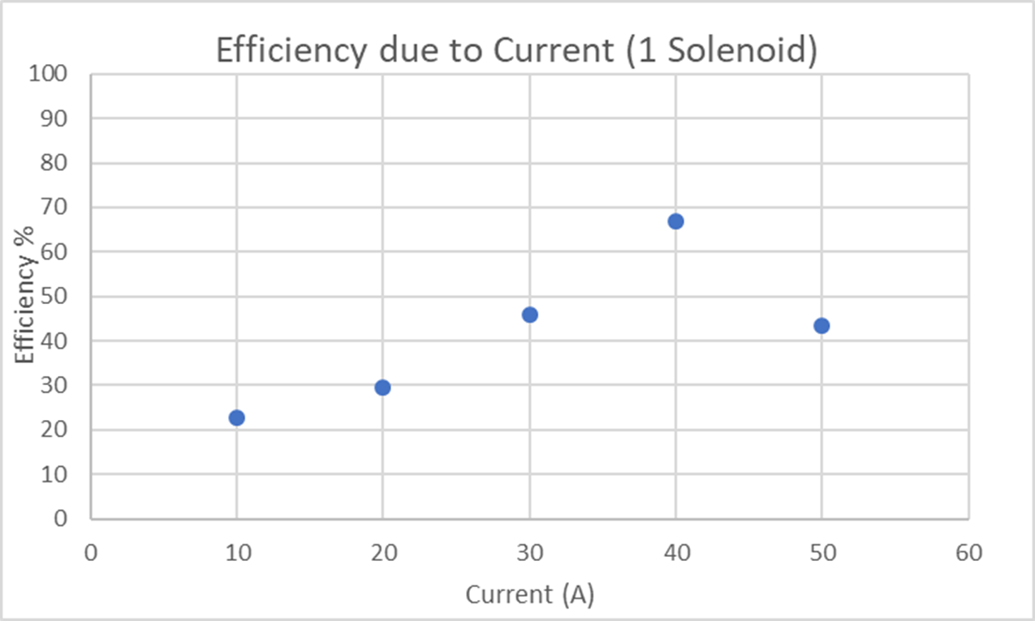
Efficiencies Stage 3: Solenoid
Implemented a solenoid into the design in hopes that the electron spread could be focused.
Started off by finding the ideal current that the solenoid must have to induce a magnetic field strong enough to focus the electrons.
Found that best efficiency to be at 34 amps using 2 identical solenoids. 10 cm long, 12mm thickness, 1.5 inch inner diameter.
The first one is placed 30mm below the top of the Ti window and the second solenoid is 35mm from the first solenoid. With this combination of 2 solenoids a 74.53% efficiency was achieved.
Current (A) | survived
50 | 4336
40 | 6699
30 | 4593
20 | 2968
10 | 2280

Slide 11
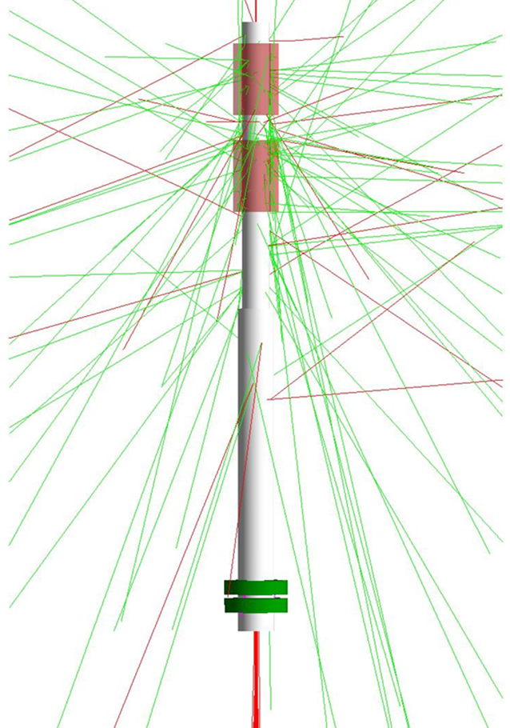
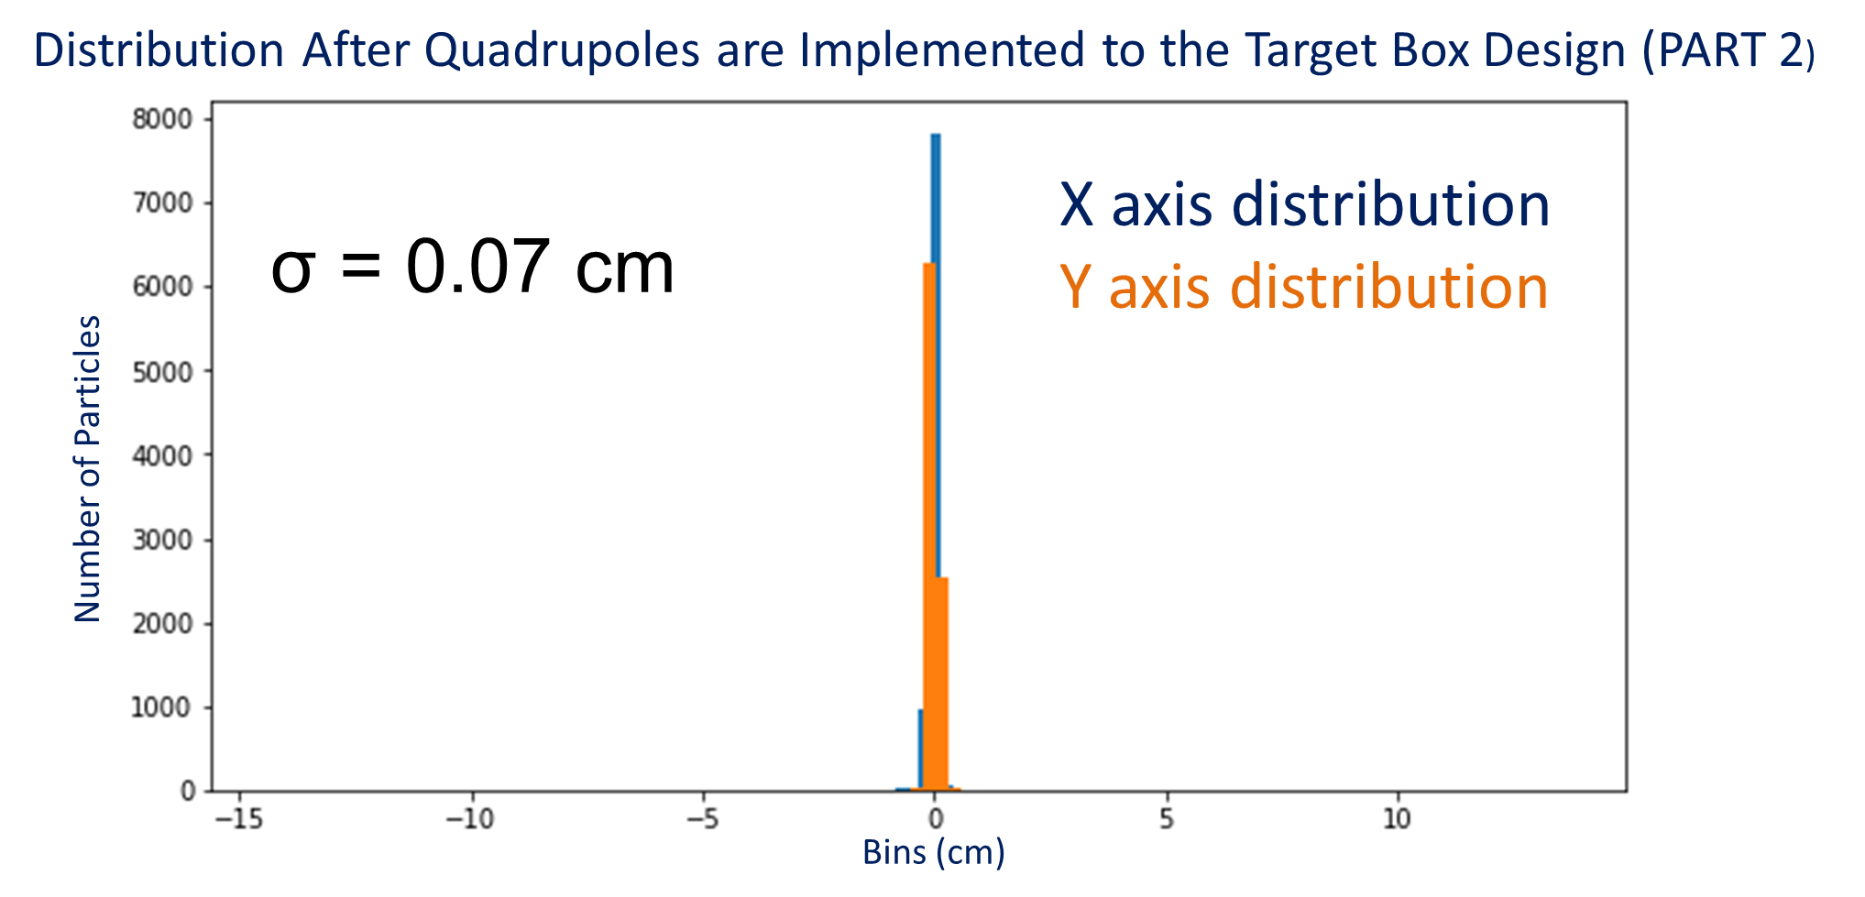
Efficiencies Stage 4: Quadrupoles, for Target Box Project
Pair of Quadrupoles are implemented.
4” diameter Al tube is reduced to a 2” diameter.
Quadrupoles are 2cm thick, bottom quad is placed 26mm above the end of the Beamline Extension and the top quad is 10mm from the bottom quad.
One quadrupole will focus in one plane and defocus in the other, that is where the second quadrupole comes into play by refocusing the defocused components.
Brought efficiency to 82.77% for a 4mm spot size.

Slide 12
Takeaways
Limitations due to high temperature dissipation in the titanium windows resulted in having to have all the tubes made of the same material, no rubber gaskets will survive the heat, metals must be welded together.
Solenoid implementation is being introduced with my presentation, actual design for this will be for future iterations of the improvement.
We may not even run a vacuum tube in the future, we may just use electric-magnetic manipulation.

Slide 13
Thank you, Gracias
To conclude I would like to thank Fermilab and the SIST program for the opportunity to be working at such a prestigious establishment along with brilliant minds.
Special thanks:
To Sandra Charles, Laura Felds, and Judy Nunez for running such an inclusive program and environment.
To supervisor Michael Geelhoed for always being an available, open, and genuine supervisor.
To my mentors and advisors: Camille Ginsburg, Alexander Martinez, Donovan Tooke, Mathew Alvarez, Arden Warner, and Raul Campos for their guidance.
To Adam Watts and Thomas Kroc for their knowledge, time, and experience.
And to all the SIST and GEM members for their friendship and mutual support.

Slide 14
Resources
“A2D2.” Concrete Applications for Accelerator Science,
news.fnal.gov/2017/09/concrete
applications accelerator-science/.
“IARC.” Illinois Accelerator Research Center, iarc.fnal.gov/.
“INTENSE Exchange Program Draws International Group of
Scientists to Fermilab.” INTENSE
Exchange Program Draws International Group of Scientists
to Fermilab,news.fnal.gov/2018/07/intense-exchange
program-draws-international-group-ofscientists-to
fermilab/.

