Slide 1
ArCube Access Platform- Design Discussion
Sai Manohari Kancharla
Mechanical Engineer
05-08-2019

Slide 2
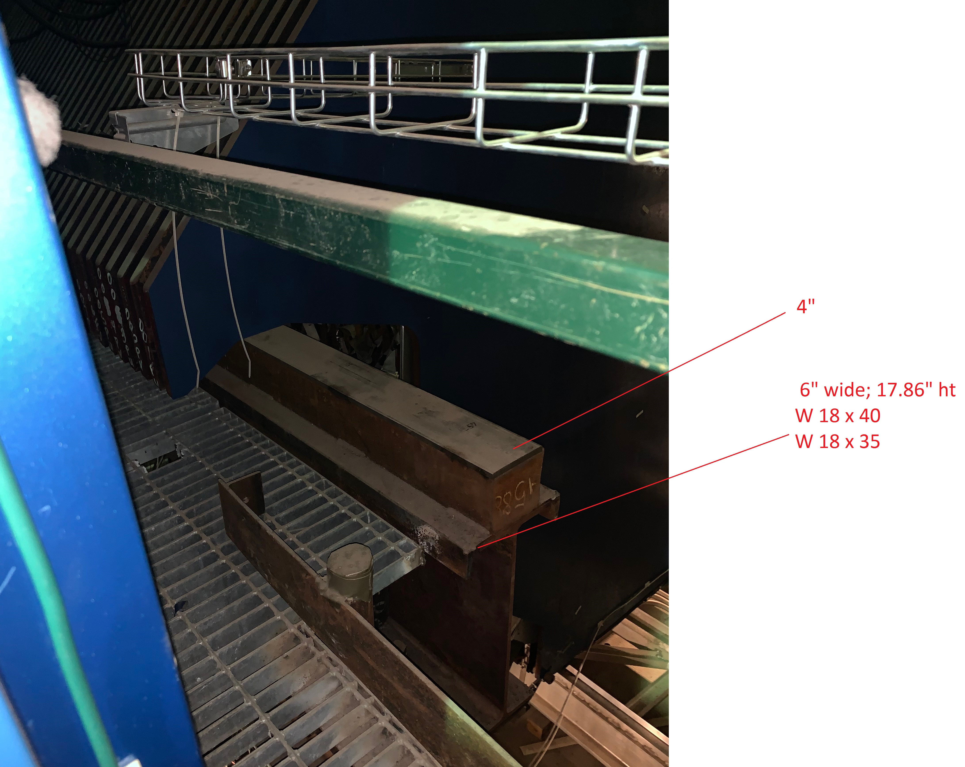
Details from Drawing SS2 (NuMi)
Confirm size of W beam: W18x35
4” x 4” STL. Bar A36
Connection of catwalk support beams to W beam: bolted; 3/8” Stiff plate
Column W8x35
Distance btw columns: 7’

Slide 3
Platform Design Requirements
LL: 4 persons
DL: 100 lbs
Single support frame structure connecting East and West Catwalk
No columns

Slide 4
Design Procedure
Select beam
Check bearing load
Check if west and east bottom supports are at same level
Check NuMi Drawings

