Slide 1
Accelerating discovery in the era of ‘Big Data’ Science
Inder Monga
Executive Director, Energy Sciences Network
Division Director, Scientific Networking
Lawrence Berkeley National Lab
OSG Council Meeting,
October 10th, 2019

Slide 2




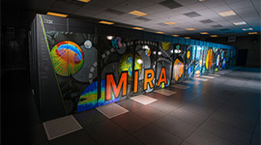
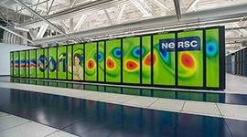

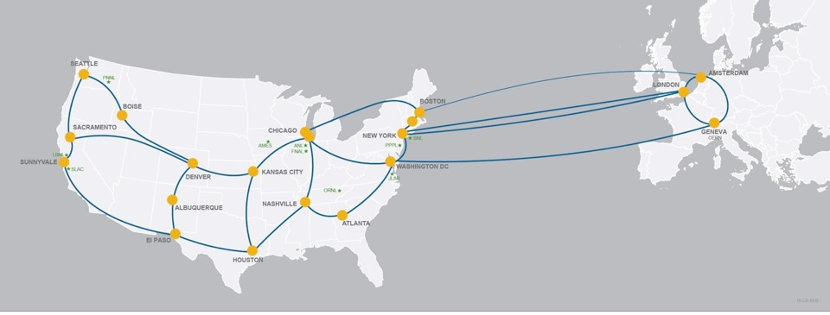
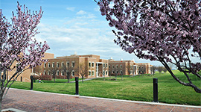
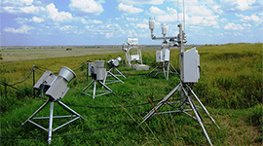
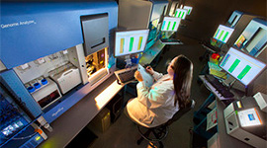
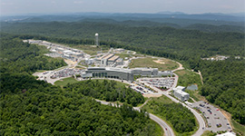






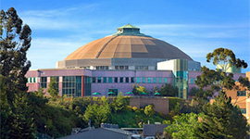
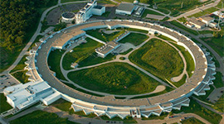
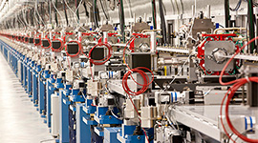
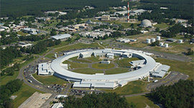
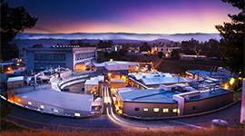


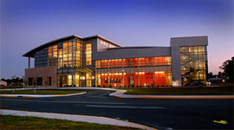
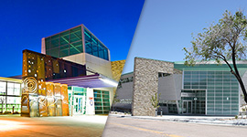
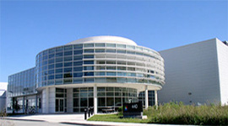
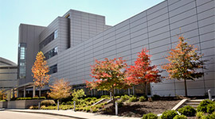
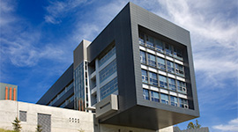



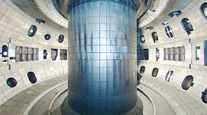
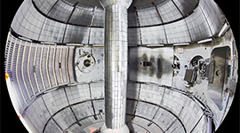
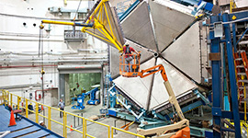

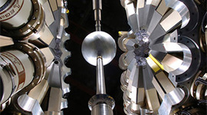
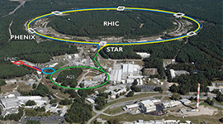



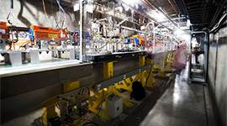
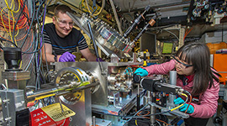
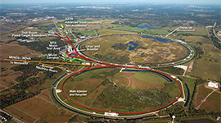

DOE’s high-performance network (HPN) user facility optimized for enabling big-data science
26
user facilities
OLCF
ALCF
NERSC
EMSL
ARM
JGI
SNS
HFIR
ALS
APS
LCLS
NSLS-II
SSRL
CFN
CINT
CNM
CNMS
TMF
DIII-D
NSTX-U
CEBAF
ATLAS
RHIC
FACET
ATF
Fermilab AC
Provides connectivity to all of the DOE labs, experiment sites, & user facilities (> 34417 users)
Notes:
While the user facility serves the connectivity needs of all DOE labs, from experiments to supercomputers, the special sauce is optimization to meet the every growing needs of big-data science
Advanced Scientific Computing Research (ASCR) National Energy Research Scientific Computing Center (NERSC) LBNL Argonne Leadership Computing Facility (ALCF) ANL Oak Ridge Leadership Computing Facility (OLCF) ORNL Energy Sciences Network (ESnet) LBNL Basic Energy Sciences (BES) Light Sources Advanced Light Source (ALS) LBNL Advanced Photon Source (APS) ANL Linac Coherent Light Source (LCLS) SLAC National Synchrotron Light Source II (NSLS-II) BNL Stanford Synchrotron Radiation Light Source (SSRL) SLAC Neutron Sources High Flux Isotope Reactor (HFIR) ORNL Spallation Neutron Source (SNS) ORNL Nanoscale Science Research Centers Center for Functional Nanomaterials (CFN) BNL Center for Integrated Nanotechnologies (CINT) Sandia/LANL Center for Nanophase Materials Sciences (CNMS) ORNL Center for Nanoscale Materials (CNM) ANL The Molecular Foundry (TMF) LBNL Biological and Environmental Research (BER) Environmental Molecular Sciences Laboratory (EMSL) PNNL Atmospheric Radiation Measurement Climate Research Facility (ARM) Global network Joint Genome Institute (JGI) LBNL Fusion Energy Sciences (FES) DIII-D General Atomics National Spherical Torus Experiment Upgrade (NSTX-U) PPPL High Energy Physics (HEP) Accelerator Test Facility (ATF) BNL Fermilab Accelerator Complex FNAL Facility for Advanced Accelerator Experimental Tests (FACET) SLAC Nuclear Physics (NP) Continuous Electron Beam Accelerator Facility (CEBAF) TJNAF Relativistic Heavy Ion Collider (RHIC) BNL Argonne Tandem Linac Accelerator System (ATLAS)

Slide 3
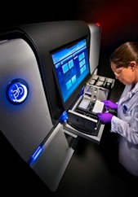
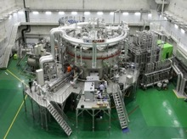
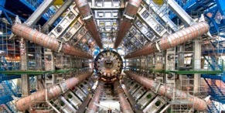
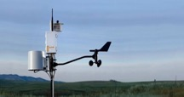
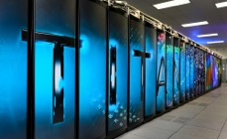
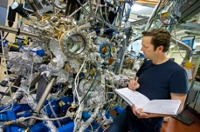
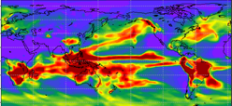
Our vision:
    Scientific progress will be completely unconstrained by the physical location of instruments, people, computational resources, or data.

Slide 4
Even though ESnet builds and operates a network,
it’s focus is on data…
... offering unique capabilities aka “services”, and optimizing the network for
data acquisition, data placement, data sharing, data mobility
Notes:
How does ESnet accelerate science? It provides unique services or capabilities like the OSCARS reservation service and is optimized for handling data - from acquisition, placement, sharing as well as high-speed data transfers aka mobility.

Slide 5
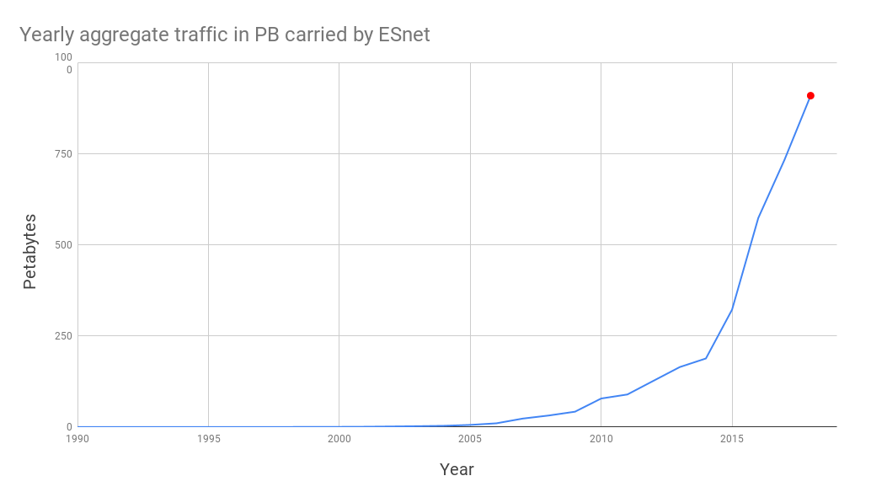
An ~exabyte network today
1078 PB in
FY 2019
~10x growth every 4 years
exponential traffic growth over past 28 years
measures ingress or egress only, not traffic per link
Notes:
Consistent exponential increase in traffic over the past 28 years. We have seen the slope slow down a little the past few years and Chin will talk about how we are taking it into account for our capacity projections.

Slide 6
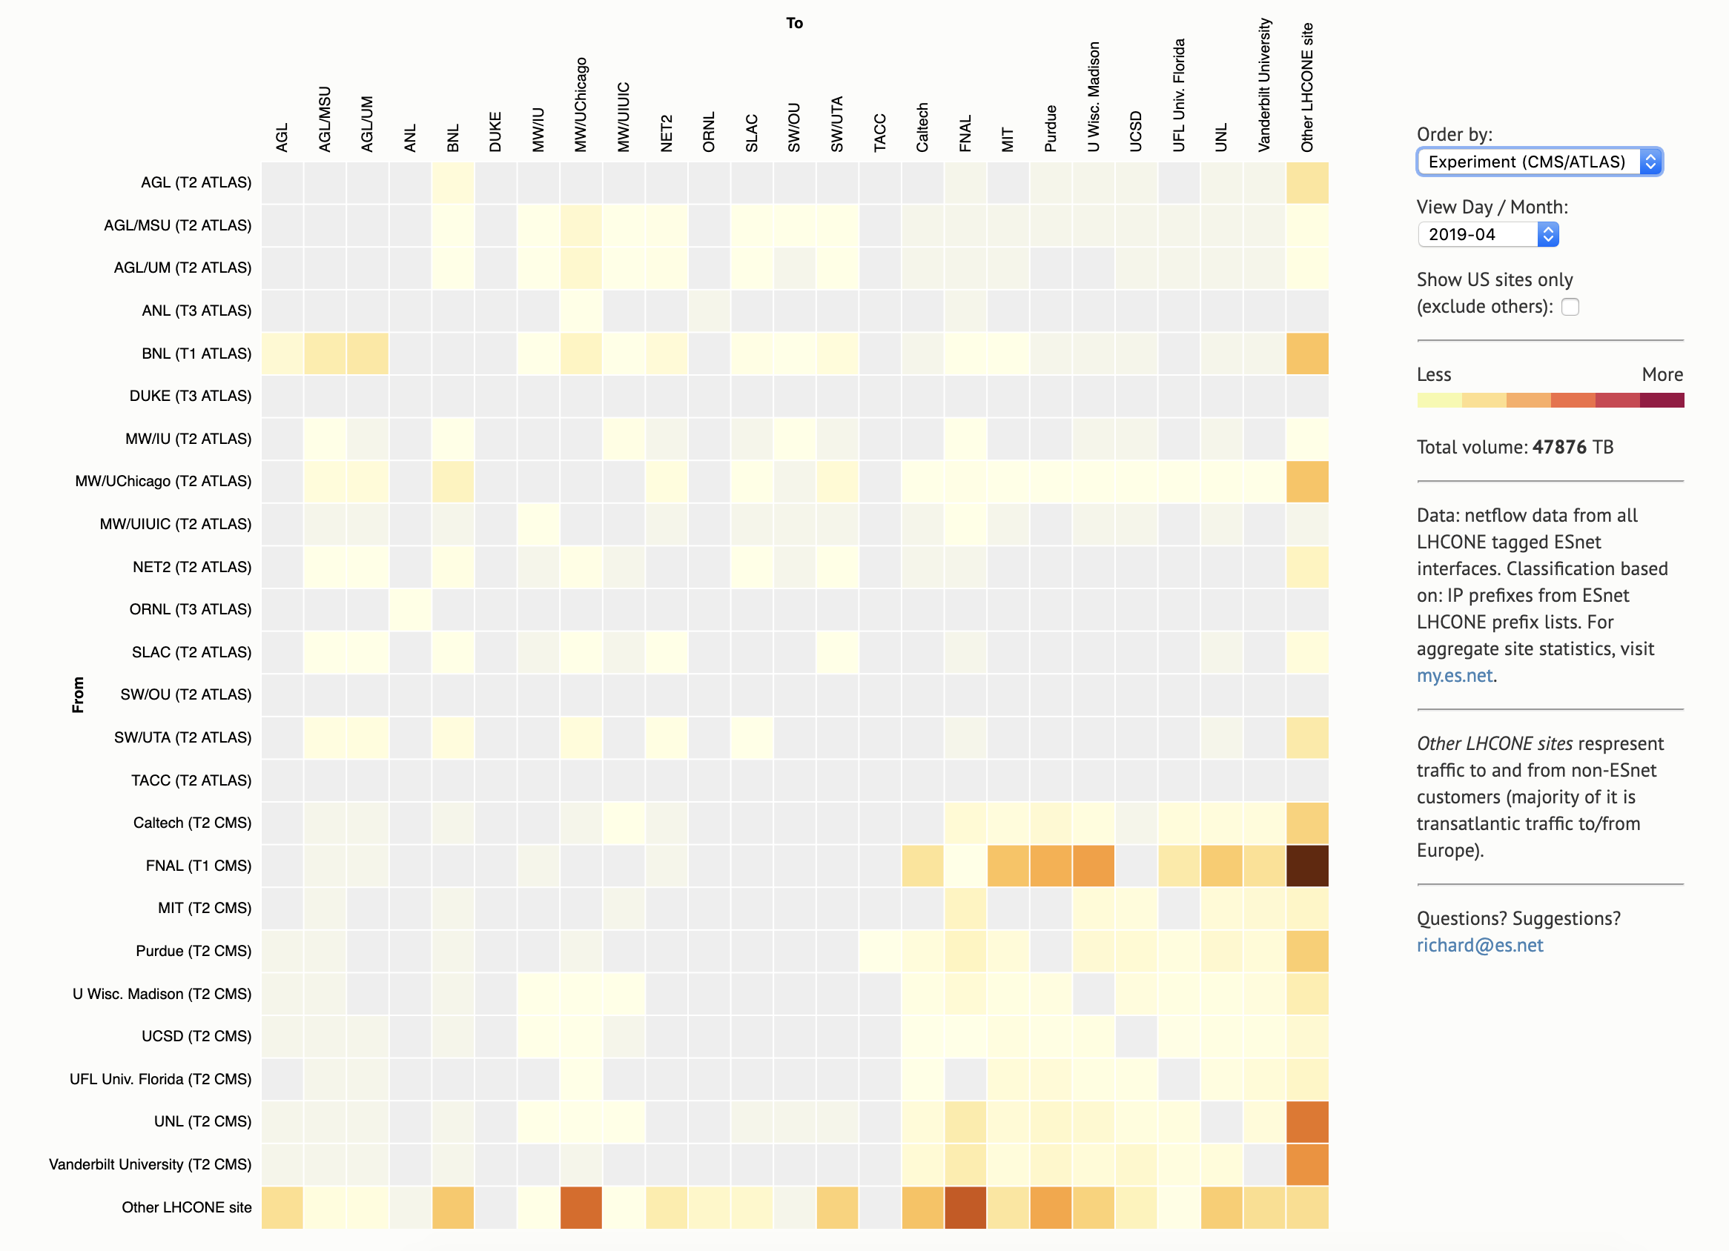
LHCONE ESnet Traffic Matrix - Dynamic Heatmap
Month: April 2019
LHCONE traffic from our peers (e.g., between Compute Canada to CERN via our Canet peering in pnwg-cr5)
Online at: https://downloads.es.net/public/richard/

Slide 7
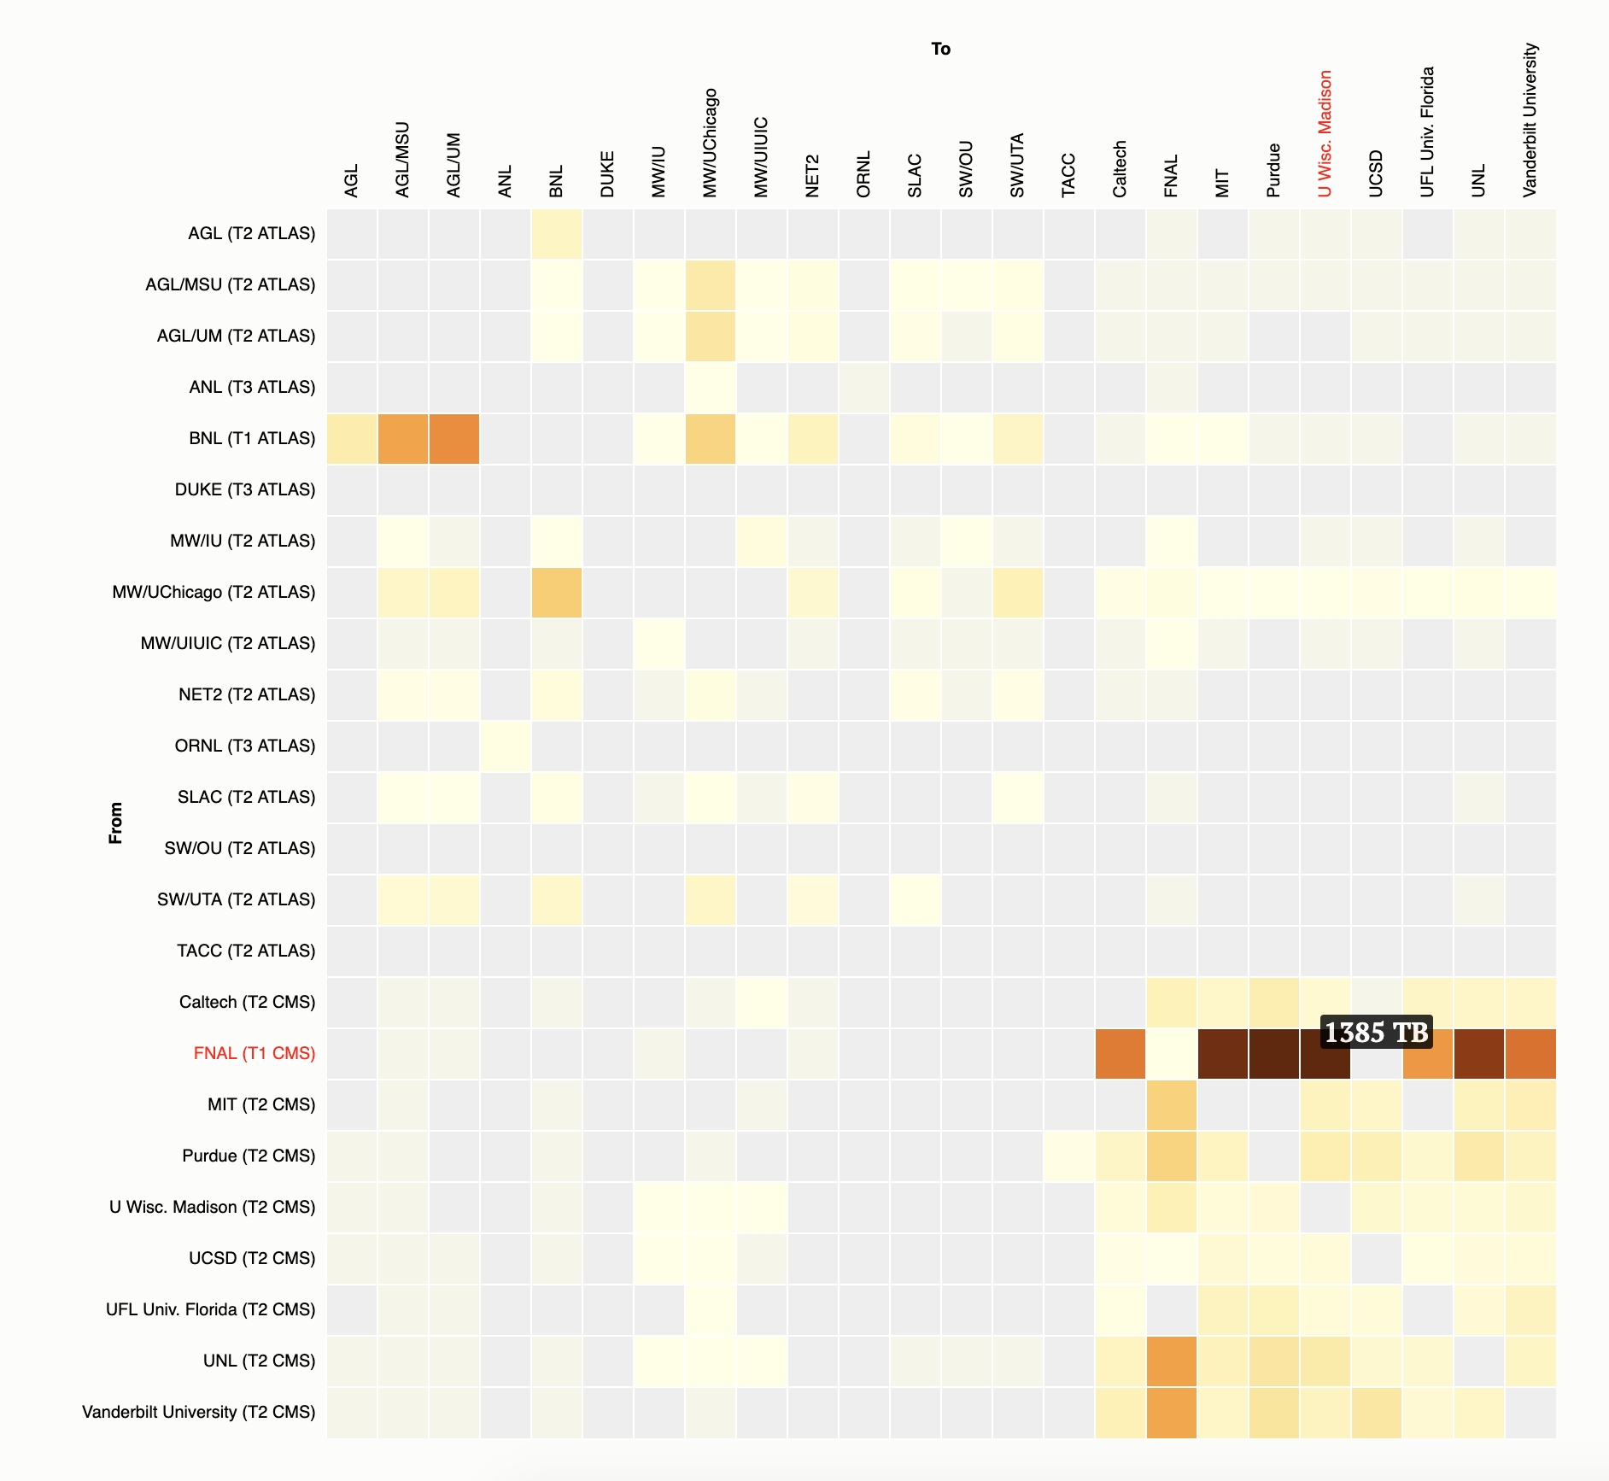
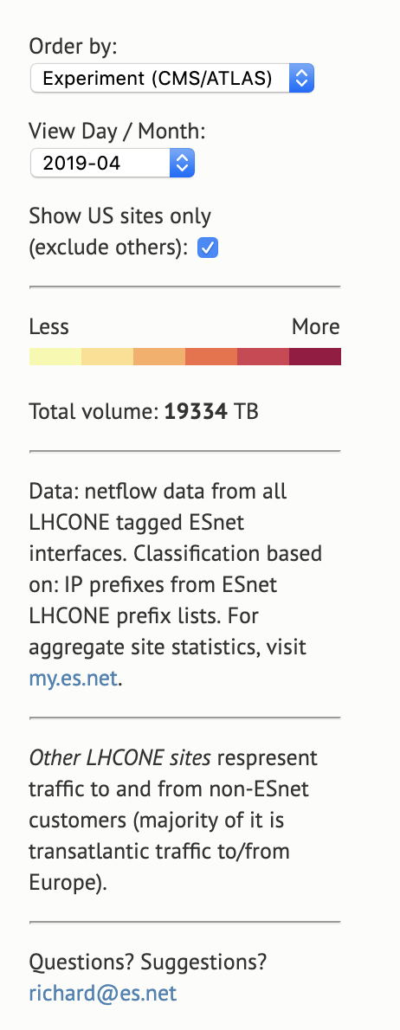
LHCONE US Only Traffic Matrix - Dynamic Heatmap
Month: April 2019
ATLAS
CMS
Online at: https://downloads.es.net/public/richard/

Slide 8
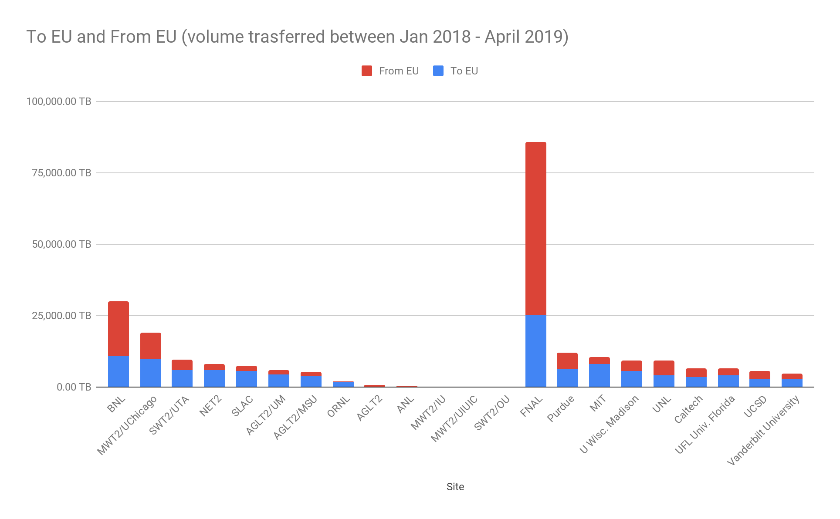
Transatlantic - LHCONE TA
FNAL T1 EU->US
BNL T1 EU->US
ATLAS
CMS
Tier model in operation: most traffic from EU comes to BNL and FNAL.

Slide 9
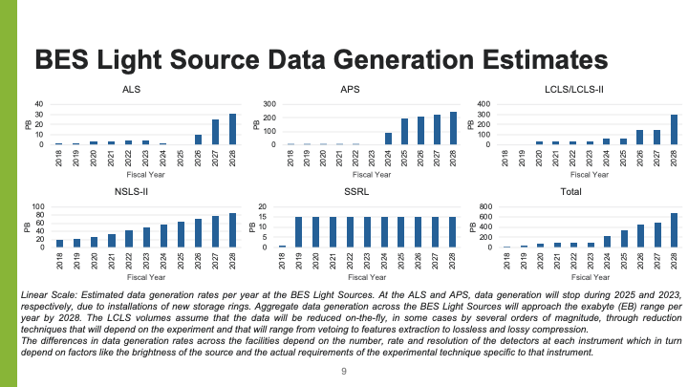
Instrument upgrades will generate ~10x data
Year | Facility
 | ALS | APS | LCLS/LCLS-II | NSLS-II | SSRL
2021 | 3 PB | 7 PB | 30 PB | 42 PB | 15 PB
2028 | 31 PB | 243 PB | 300 PB | 85 PB | 15 PB

Slide 10
Big Data
Data Generation
Data Logistics
Data Analysis and Storage
Science Instruments
like LHC, Telescopes, Light Sources.
Data Transfer Nodes at user facilities, Networks, Caching,
Data streaming, Orchestration etc.
Algorithms (CAMERA++), HPC Systems, Analytics Software Stack, HPSS etc.

Slide 11
Data ‘Tsunami’ is driving network transformation
Network Performance
(End-to-End) Data Workflow
Human manageable
Automation
Experience (gut)
Driven
Analytics
Driven
Fixed/
Scheduled
Flexible/
Interactive
Notes:
Talk about how the current initiatives have been impactful on DOE science and the larger research community

Slide 12
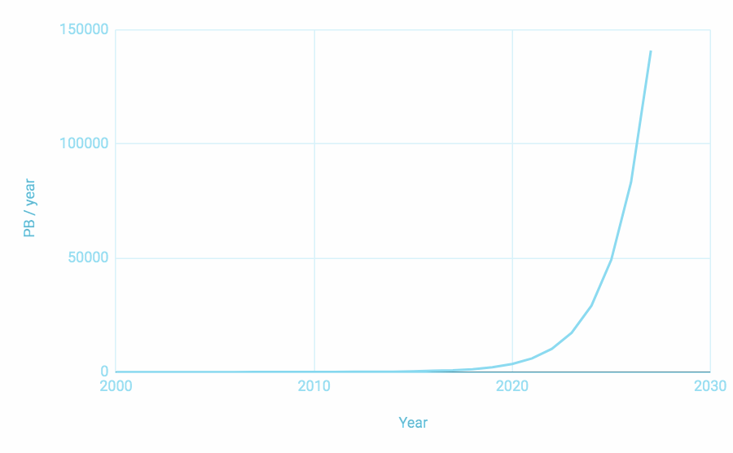
Each major upgrade transforms the facility with innovative, cutting edge technologies
2014:
Transatlantic network
2027
2021
ESnet (Gen 6)
2011
Innovative architecture with capability to meet capacity, reliability, and flexibility mission need
ESnet (Gen 5)
2005
Shared optical substrate (New) with traditional IP routing. Acquisition of Dark Fiber resource
ESnet (Gen 4)
Traditional IP Routing with ESnet innovation OSCARS (new) to build Science Data Network (SDN)
ESnet (Gen 3)
Asynchronous Transfer Mode technology (new, now obsolete), provided by Carrier Sprint
Notes:
Before we talk about ESnet6, I would like to give you a sense of the multiple upgrades the facility has gone through. Our success in upgrades is when the users don’t even know that the upgrade happened. For each upgrade we have transformed the technology base to the most innovative to meet the science needs of that decade. For example, ESnet3, the third generation, was using a technology called ATM (asynchronous Transfer mode), now obsolete. Gen4 saw the birth of OSCARS, our virtual circuit service, and Gen5 is where we delved into the optical layer in addition to the packet layer. In all previous generations, the optical network was provided by a commercial carrier.

Slide 13
ESnet6 architecture components (Layered View)
Code / Software
Data
“Above the Net” Services
(Virtual Network Functions)
“High-Touch Path”
Service Edge
Compute
Storage
“Low-Touch Path”
Service Edge
Services Edge
Layer 3 (IP Routing)
Mission Needs:
Capacity, Resiliency, Flexibility
Mission Needs:
Flexibility
Layer 2.5 (MPLS)
Layer 2 (Ethernet Switching)
Network
Packet Core
Mission Needs:
Capacity, Resiliency
Optical Core
“Hollow” Core
Layer 1 (Optical)
Layer 0
(Transmission Medium)
Mission Needs:
Capacity

Slide 14
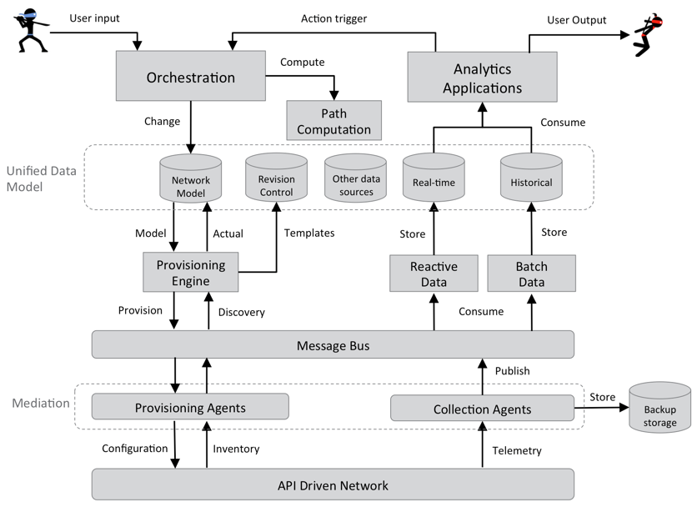
ESnet6: software automation architecture
orchestration
analytics & ML
provisioning
telemetry
Notes:
Animation on slide. The software architecture integrates orchestration, provisioning, telemetry and analytics

Slide 15
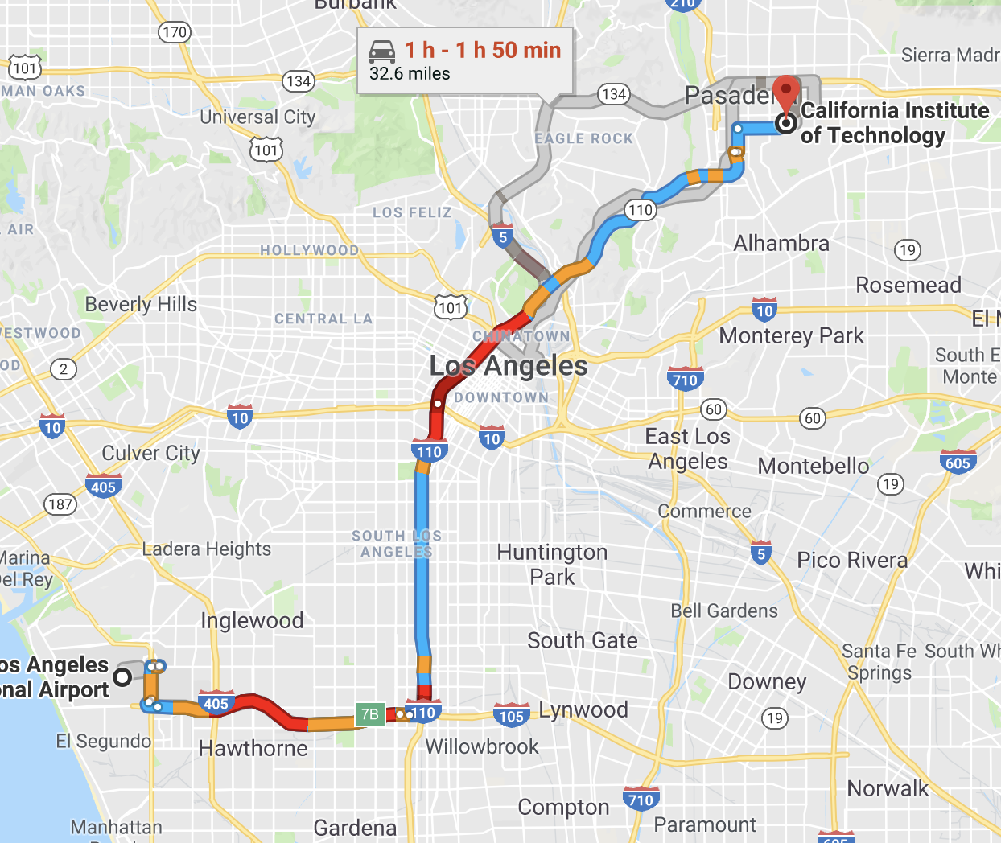
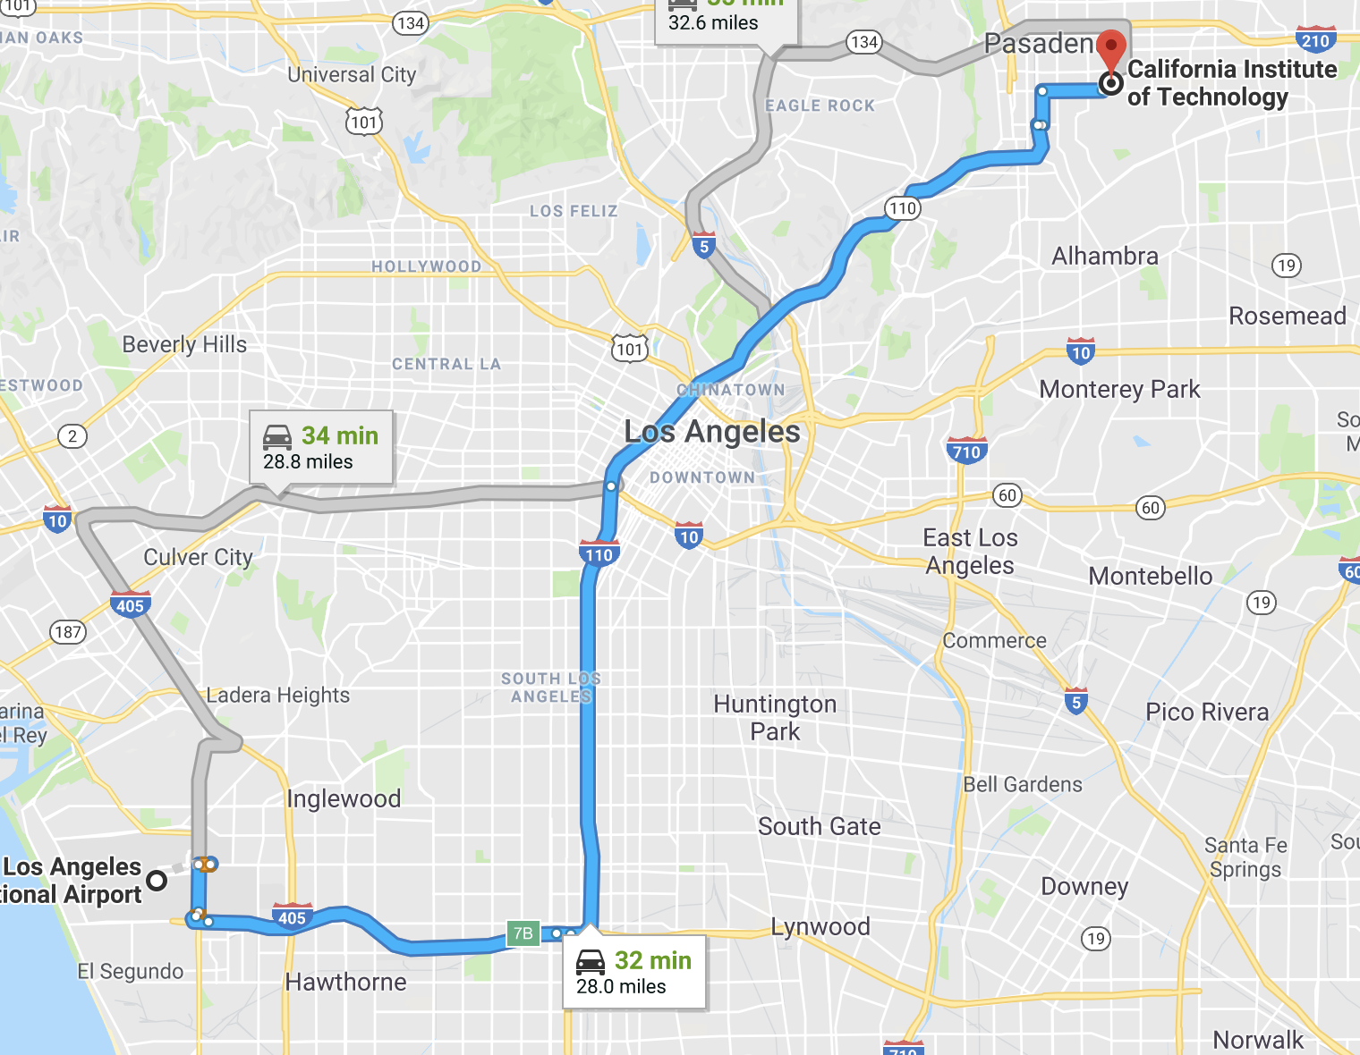
When will I get home?
LAX– Caltech, 6 pm:
1 hr – 1hr 50 min
LAX– Caltech, 11 pm:
32 min

Slide 16
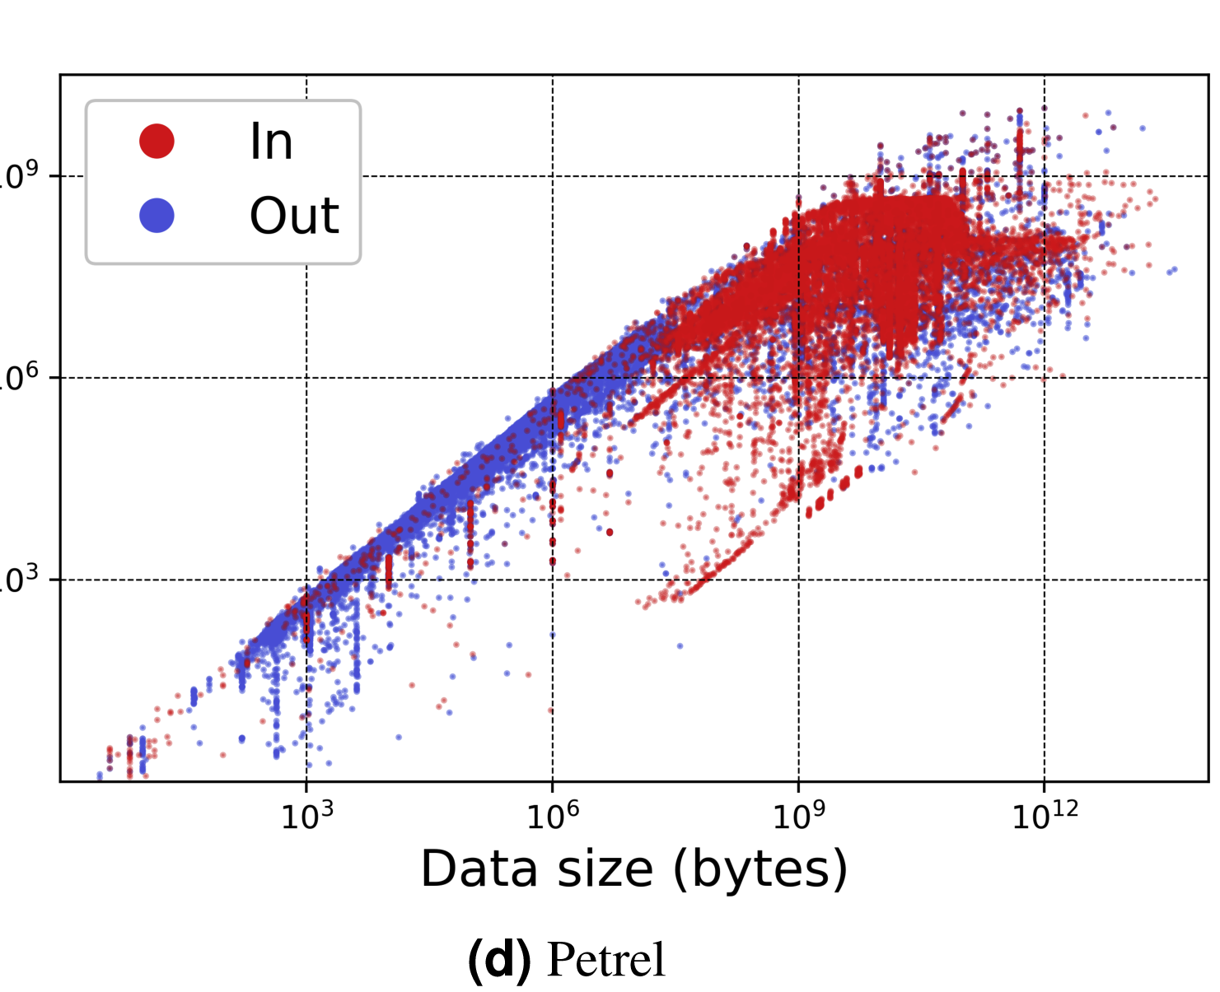
Even well tuned infrastructure does not get consistent service
Nine orders of
variability
Chard K, Dart E, Foster I, Shifflett D, Tuecke S, Williams J. (2018) The Modern Research Data Portal: a design pattern for networked, data-intensive science. PeerJ Computer Science4:e144 https://doi.org/10.7717/peerj-cs.144

Slide 17
How to ‘crack open the network black box’ without destroying the power of the abstraction?
High-precision telemetry
Scalable analytics infrastructure
Model-based approach to request network services
Network prediction using machine learning techniques

Slide 18
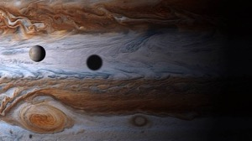
1. High-precision telemetry: deep insight into flows
Jupiter with the naked eye
Jupiter Close Up
Use high-fidelity data to get better insights and analytics:
Packet Microbursts
Path deviations ( RTT and Delay )
Security / anomaly detection
Head of Queue Blocking
Many others…
  Per flow, high-precision telemetry
  Per packet-metadata tracking (e.g. timestamp, ingress location, etc)
  10 ns precision in timing
Notes:
Telemtry

Slide 19
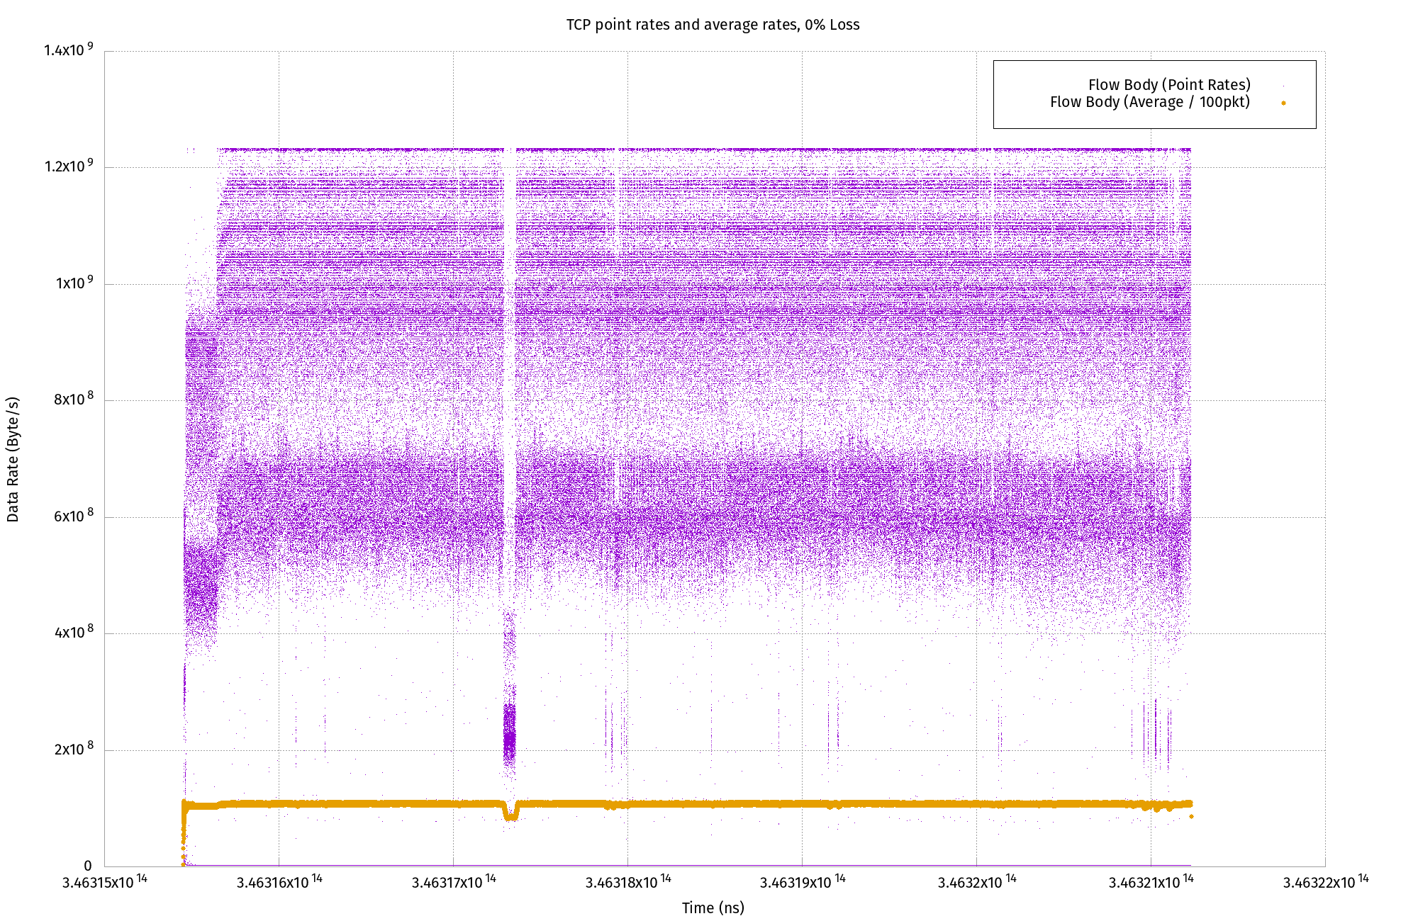
1 Gbps iPerf flow - 600,000 packets
Per-packet rates reaching 10 Gbit/s (line rate of the sender)
1 Gbp/s average flow rate (100 pkt window)
Note: Average rate is calculated using a time-weighted average of per-packet rates.

Slide 20
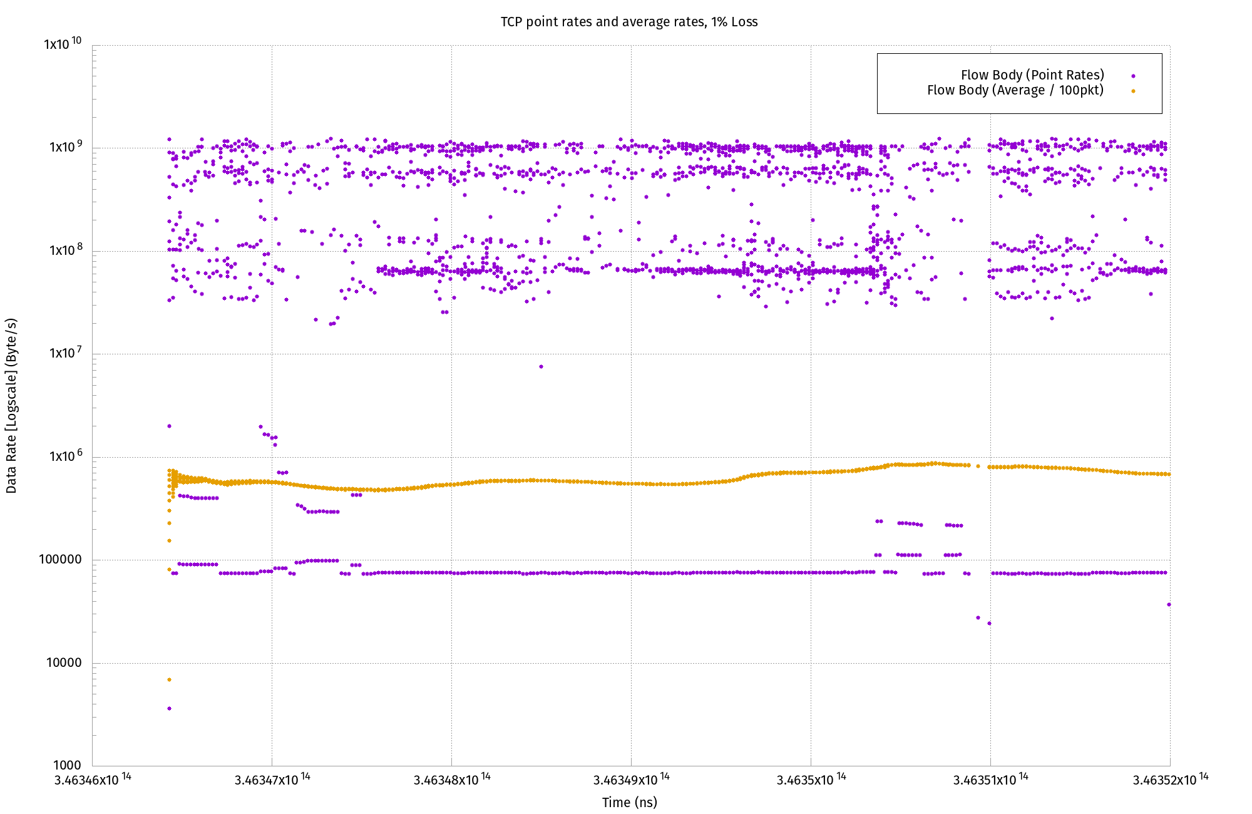
1 Gbps iPerf flow - 1% packet drop
Per-packet rates maximum: 1 Gb/s
5 Mb/s average flow rate (100 pkt window)
Note: only 23 packets were dropped all together, taking bandwidth down to 5 Mb/s from 1 Gb/s.

Slide 21
Usually alert when something is broken…
Why is this so?
…and then get expert help
Notes:
Why is this so? Answer is simple:
Doctors and Nurses don’t have time evaluate your daily data
They do not know what the data means in many cases (the small variations per day)

Slide 22
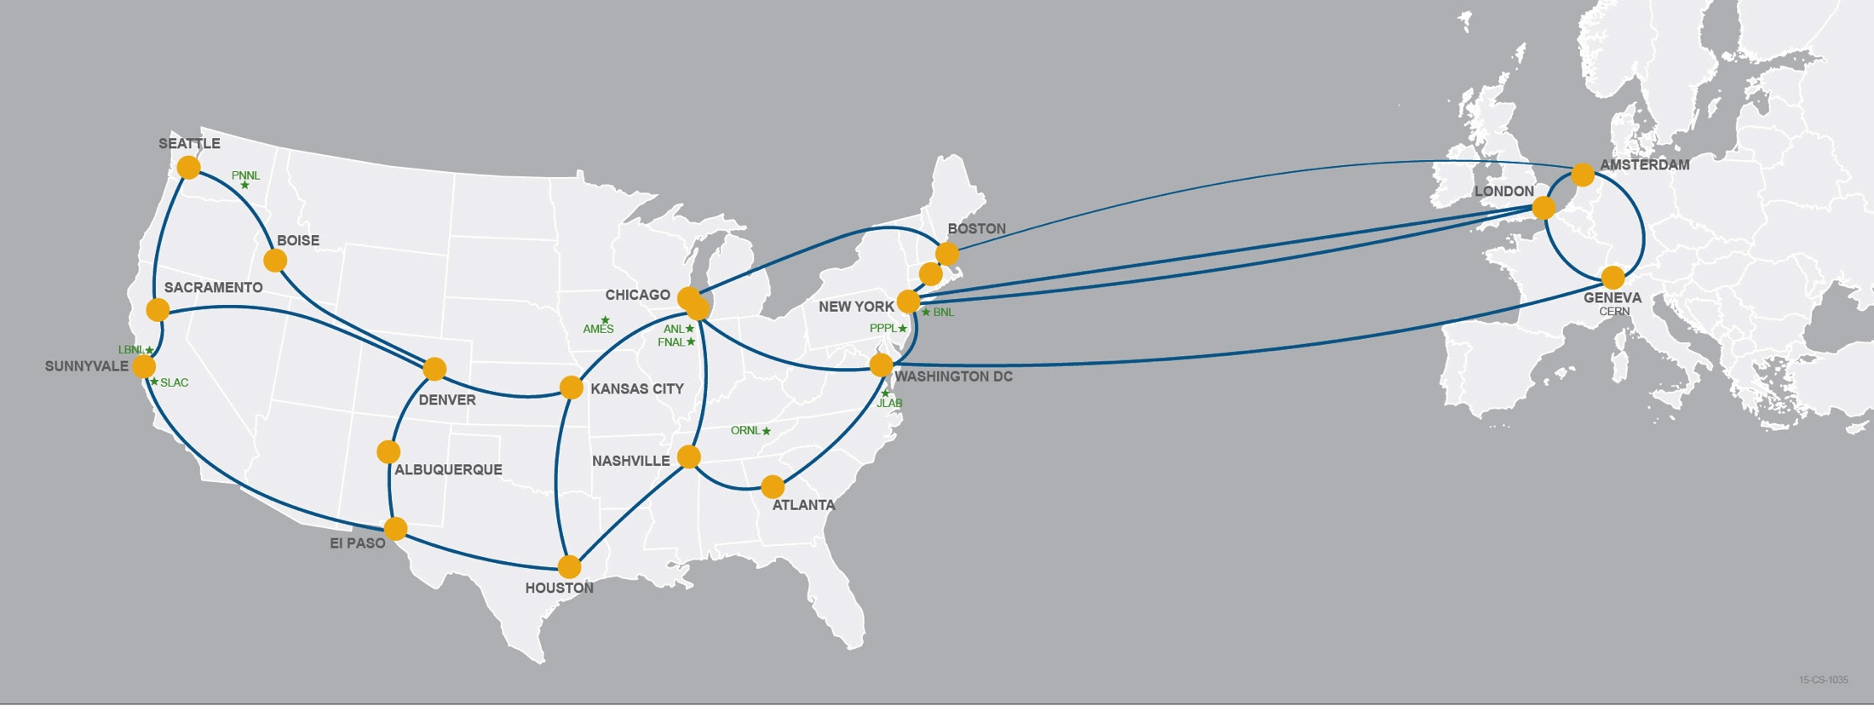
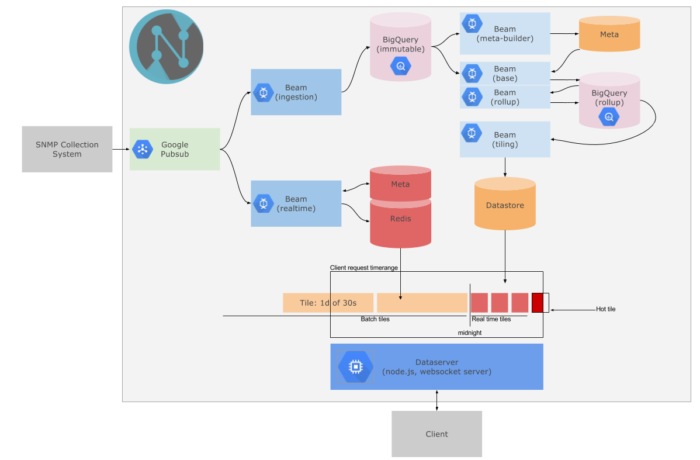
2. Scalable analytics infrastructure
On-demand analytics infrastructure
Streams telemetry
Real-time telemetry from
the network
netbeam platform: Using Apache BEAM and Google Cloud Platform
Both Batch and Stream
processing in parallel
In production for ESnet SNMP data

Slide 23
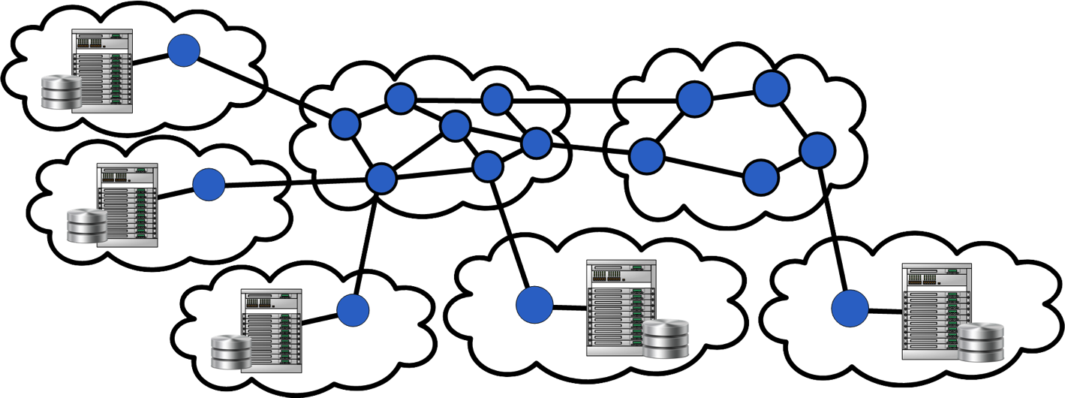
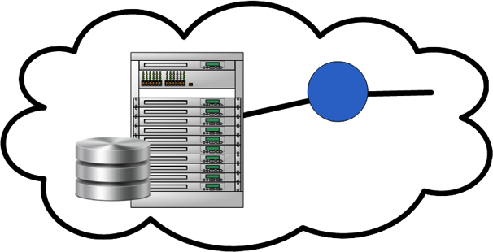










3. Model based approach to request network services
Application Workflow Agent
SENSE Orchestrator
SENSE End-to-End Model
Multi-resource models
abstracts the network
specifics away and allows for higher-level service request
RM
RM
RM
DTN
DTN
DTN
RM
SENSE project is a research project funded by ASCR, DOE, US
UMD
RM
RM
RM
ESnet
MAX
DTN
DTN
RM
SENSE Resource Manager
Realtime system based on Resource Manager developed infrastructure and service models

Slide 24
3. Enables an end-to-end service model that includes compute, storage, instrument and the network
Experiment Resource
Manager
CMS
Compute / Storage Resource Manager
Network Resource Manager
ALICE
LHC-B
Resource Orchestrator
ATLAS
Network of Facilities
Application Workflow
Notes:
Resource Types - Compute (e.g. HPC, local cluster, edge compute), Storage (e.g. HPS, local storage, DTNs), Network (e.g. WAN, LAN, exchanges), Experiment (e.g. colliders, light sources, tokamaks).
Resource Managers - Manages local resources within the domain and communicates with Resource Orchestrator(s).
Resource Orchestrator - Interacts with application workflow and coordinates end-to-end resource provisioning with Resource Managers.
Network of Facilities - Represents a specific set of resources that have been committed as per the request of an application workflow.

Slide 25
3. Enables an end-to-end service model that includes compute, storage, instrument and the network
Experiment Resource
Manager
CMS
Compute / Storage Resource Manager
Network Resource Manager
Capabilities, Availability,
Confirmation, Status
ALICE
LHC-B
Resource Orchestrator
ATLAS
Requests, Credentials
Network of Facilities
Requests, Credentials
Confirmation, Status, telemetry
Interconnected Facilities
Application Workflow
Compute
Storage
Network
Instrument
CMS
Notes:
Resource Types - Compute (e.g. HPC, local cluster, edge compute), Storage (e.g. HPS, local storage, DTNs), Network (e.g. WAN, LAN, exchanges), Experiment (e.g. colliders, light sources, tokamaks).
Resource Managers - Manages local resources within the domain and communicates with Resource Orchestrator(s).
Resource Orchestrator - Interacts with application workflow and coordinates end-to-end resource provisioning with Resource Managers.
Network of Facilities - Represents a specific set of resources that have been committed as per the request of an application workflow.

Slide 26

ExaFEL: A science example for streaming data end-to-end
SDN for End-to-End Networking @ Exascale (SENSE)
LCLS Data Transfer Workflow
SENSE Orchestrator
SENSE Network-RM
SENSE DTN-RM
Aggregate detector data, EPICS data, beamline data -
selection and compression
Exascale HPC
LCLS
LCLS
Software ETH Routers
Burst Buffer nVRAM: Streaming Analysis
Timing
Compressor Nodes
Event builder nodes
PGP
FFB Layer (nVRAM)
PGP
Exascale
HSN
IB
ESNET
NERSC
Router
PGP
DTNs
DTNs
PGP
IB
ESNET
Eth
Beam Line
Data
Online Monitoring & FFB Nodes
10 GB/s - 1Tb/s
NGF / Lustre: Offline from HDF/XTC files.
EPICS
Data
1 TB/s
ExaFEL Data Flow

Slide 27



4. Network prediction using Machine Learning techniques
Understanding which sites are busiest at different times
High-Speed classifying of big and small flows to redirect packet routes
Prevent congestion and links failures by anticipating traffic 24 hours in advance
Network traffic prediction will help us bring route and re-route flows appropriately and on-the-fly

Slide 28

ESnet6 with distributed compute and storage – aligned with OSG’s approach
SmartNIC
Compute Cluster
Storage
SmartNIC
Compute Cluster
SmartNIC
Compute Cluster
Storage
West
East
Open Line System
Open Line System
Centralized
Compute and Storage
Edge Switch Router
Edge Switch Router
Edge Switch Router

Slide 29
Why FABRIC?
The mantra of the last 20 years – ‘Internet is showing its age.’
  Applications designed around discrete points in the solution space
  Inability to program the core of the network
What changed?
  Cheap compute/storage that can be put directly in the network
  Multiple established methods of programmability (OpenFlow, P4, eBPF, DPDK, BGP flowspec)
  Advances in Machine Learning/AI
  Emergence of 5G, IoT, various flavors of cloud technologies
Opportunity for the community to push the boundaries of distributed, stateful, ‘everywhere’ programmable infrastructure
  More control or dataplane state, or some combination? Multiple architectures (co)exist in this space.
  Network as a big-data instrument? Autonomous network control?
  New protocols and applications that program the network?
  Security as an integral component?
Notes:
when showing this slide say that a) we take no position as to which architecture is ‘correct’ and b) the list of possible ideas is non-exhaustive and we want the community to tell what else they might use it for.

Slide 30

FABRIC Core
Notes:
Only Esnet footprint shown. Additional core nodes to be located in several regionals (TBD)

Slide 31

































FABRIC Edge
Notes:
Metcalfe’s law

Slide 32
What is a FABRIC node?
Core and edge nodes have compute, storage and programmable networking capabilities
  Network programming at the level of OpenFlow, P4, eBPF, DPDK
  GPUs to support ML applications
  Ability to interpose compute, memory and storage into the path of fast packet flows
  Processing speeds at 25Gbps, 40Gbps, 100Gbps, Nx100Gbps
  Experimenters access hardware directly (programmable network cards, GPUs, FPGA cards)
The key is node placement
  13 core nodes located in telco locations at the intersection of multiple high-capacity dedicated optical links. Provide sliceable, programmable switching, hierarchical storage and in-network compute
  16 initial edge nodes (also known as ‘hanks’) located on campuses, in lab datacenters to provide base load, serve as gateways for facilities to connect to FABRIC
Notes:
13 core = 9 in Esnet footprint, 4 additional in regionals (TBD)

Slide 33
Four year Construction Timeline
Year 1
Year 2
Year 3
Year 4
Planning
Prototyping
Software development
Community building
Begin phase 1 deployment
Testing, commissioning
Design driver on-boarding
Complete Phase 1
Design driver experiments and early users
Begin Phase 2 deployment
Complete Phase 2 deployment
Prepare for operations

Slide 34
Why ESnet?
Compute, storage and network are converging in interesting ways and are creating new opportunities
  End-to-end orchestration, resource allocation, caching, edge-computing, etc.
With the advent of exascale, AI/ML, extreme heterogeneity – the computing model, and the use of network is bound to change
  Opportunity rather than a problem
FABRIC is a potential strategic platform to test some of the new workflow ideas for science
Larger effort by ESnet to understand how storage can integrate into network to enable more efficient use of the network (e.g., resource scheduling, load-balancing, proactive resiliency, intelligent feedback)
  OSG has similar objectives, and can leverage the change in the network to optimize the data placement for better distributed computing, edge computing, etc.
Leveraging the cloud for cores-on-demand for science applications will require scale and connectivity that ESnet can provide

Slide 35
The Data Circulatory System for DOE Collaborative Science
ESnet 100G
ESnet 2*100G
ESnet
100G
ESnet
100G
ESnet 100G/10G
ESnet 100G
ESnet
100G
Networking tailored to meeting science demands
  Bandwidth reservations, performance monitoring, Science “DMZ” model for the last mile,..
An effective network design and application interaction is extremely important to meet the needs of next-generation of data science
Notes:
ESnet is one of the oldest, fastest parts of the internet

Slide 36
Thank you.
imonga@es.net

Slide 37
GRETA dataflow architecture – in-instrument integration of data, compute and network [Data Management and workflow tools]

