Slide 1
FRIB Recent Developments and Potential Contributions to the Electron Ion Collider
Jie Wei
On Behalf of FRIB Accelerator Team
EIC Workshop, Argonne, October 9 – 11, 2019

Slide 2
Outline
FRIB: the project that must finish before EIC happens
Project status and developments
  Major technology developments and lessons learned
  Infrastructure buildup
  Resources buildup
Relevance to EIC and future accelerator projects

Slide 3
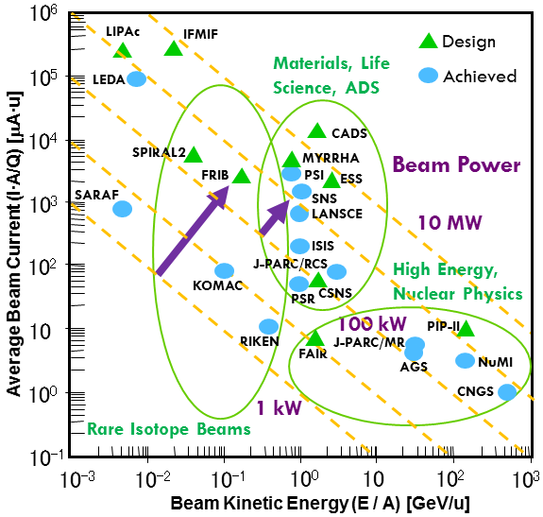
FRIB at Accelerator Power Frontier among Three Major Frontiers: Energy, Power, Brightness
FRIB will provide more beam power by two-to-three orders of magnitude over existing heavy-ion facilities
Past experience for less-complex proton machines, SNS and J-PARC, indicates steep learning curves
Beam losses will limit power ramp-up, mitigation takes time and experience

Slide 4
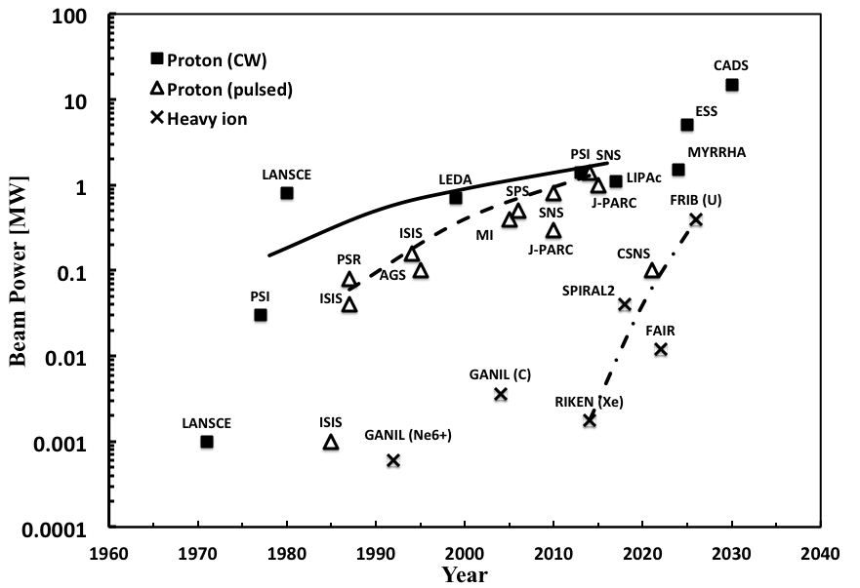
FRIB Physical and Engineering Challenges
Raising Heavy-ion Power Frontier by Two Order-of-magnitudes
SNS raised pulsed proton power frontier by one order-of-magnitude
  Physical challenges: electron cloud mitigation; beam loss control
  Engineering challenges: 1st full-scale superconducting RF proton linac; high-power target
FRIB will raise heavy-ion power frontier by two order-of-magnitudes
Physical challenges
  Machine protection for high-power, low-energy heavy ions
  Simultaneous acceleration of multiple charge-state beams
Engineering challenges
  Full-scale low-β SRF linac
  Liquid lithium charge stripper

Slide 5
FRIB at Michigan State University
DOE/NP Construction Project of $730M; $1B Establishment
2008-12: DOE selects MSU to establish FRIB
2009-6: DOE and MSU sign corresponding cooperative agreement
2010-9 CD-1: conceptual design complete & preferred alternatives decided
2013-8 CD-2/CD-3a: performance baseline, start of civil construction & long lead procurement
2014-8 CD-3b: start of technical construction
2022-6 CD-4: construction completion

Slide 6
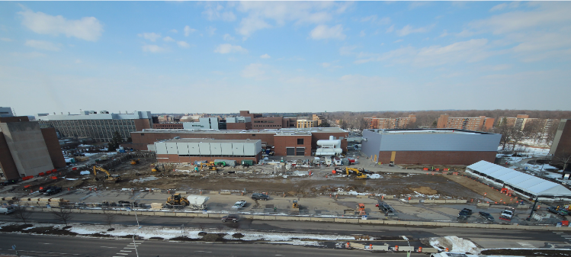
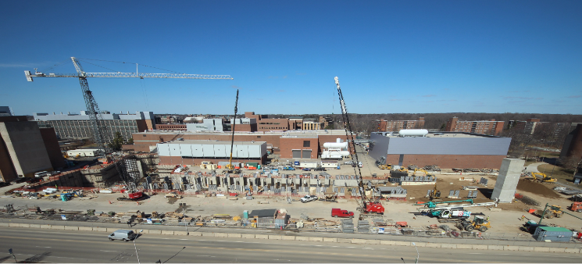
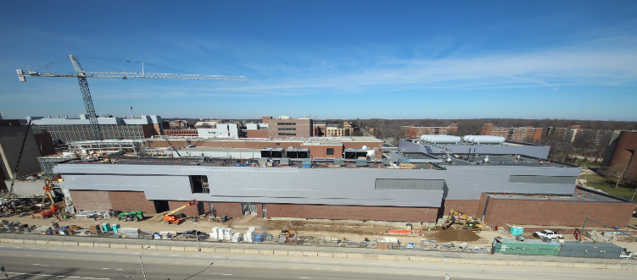
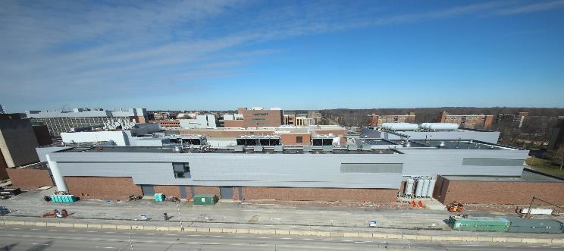
FRIB Technical Construction Started in 2014
CD-3a in 2012 (Long Lead Procurements); CD-3b in 2014 (All)
Groundbreaking – March 2014
March 2015
March 2016
Beneficial Occupancy – 2017
Notes:
Updated image and date on the bottom of the slide - 7/26/17 CB
Updated with September 2017 photo and date – 10/9/17 CB
Updated Images and layout – 10/30/17 CB
No updates – 12/20/17 CB
No Updates 1/24/18 – CB

Slide 7
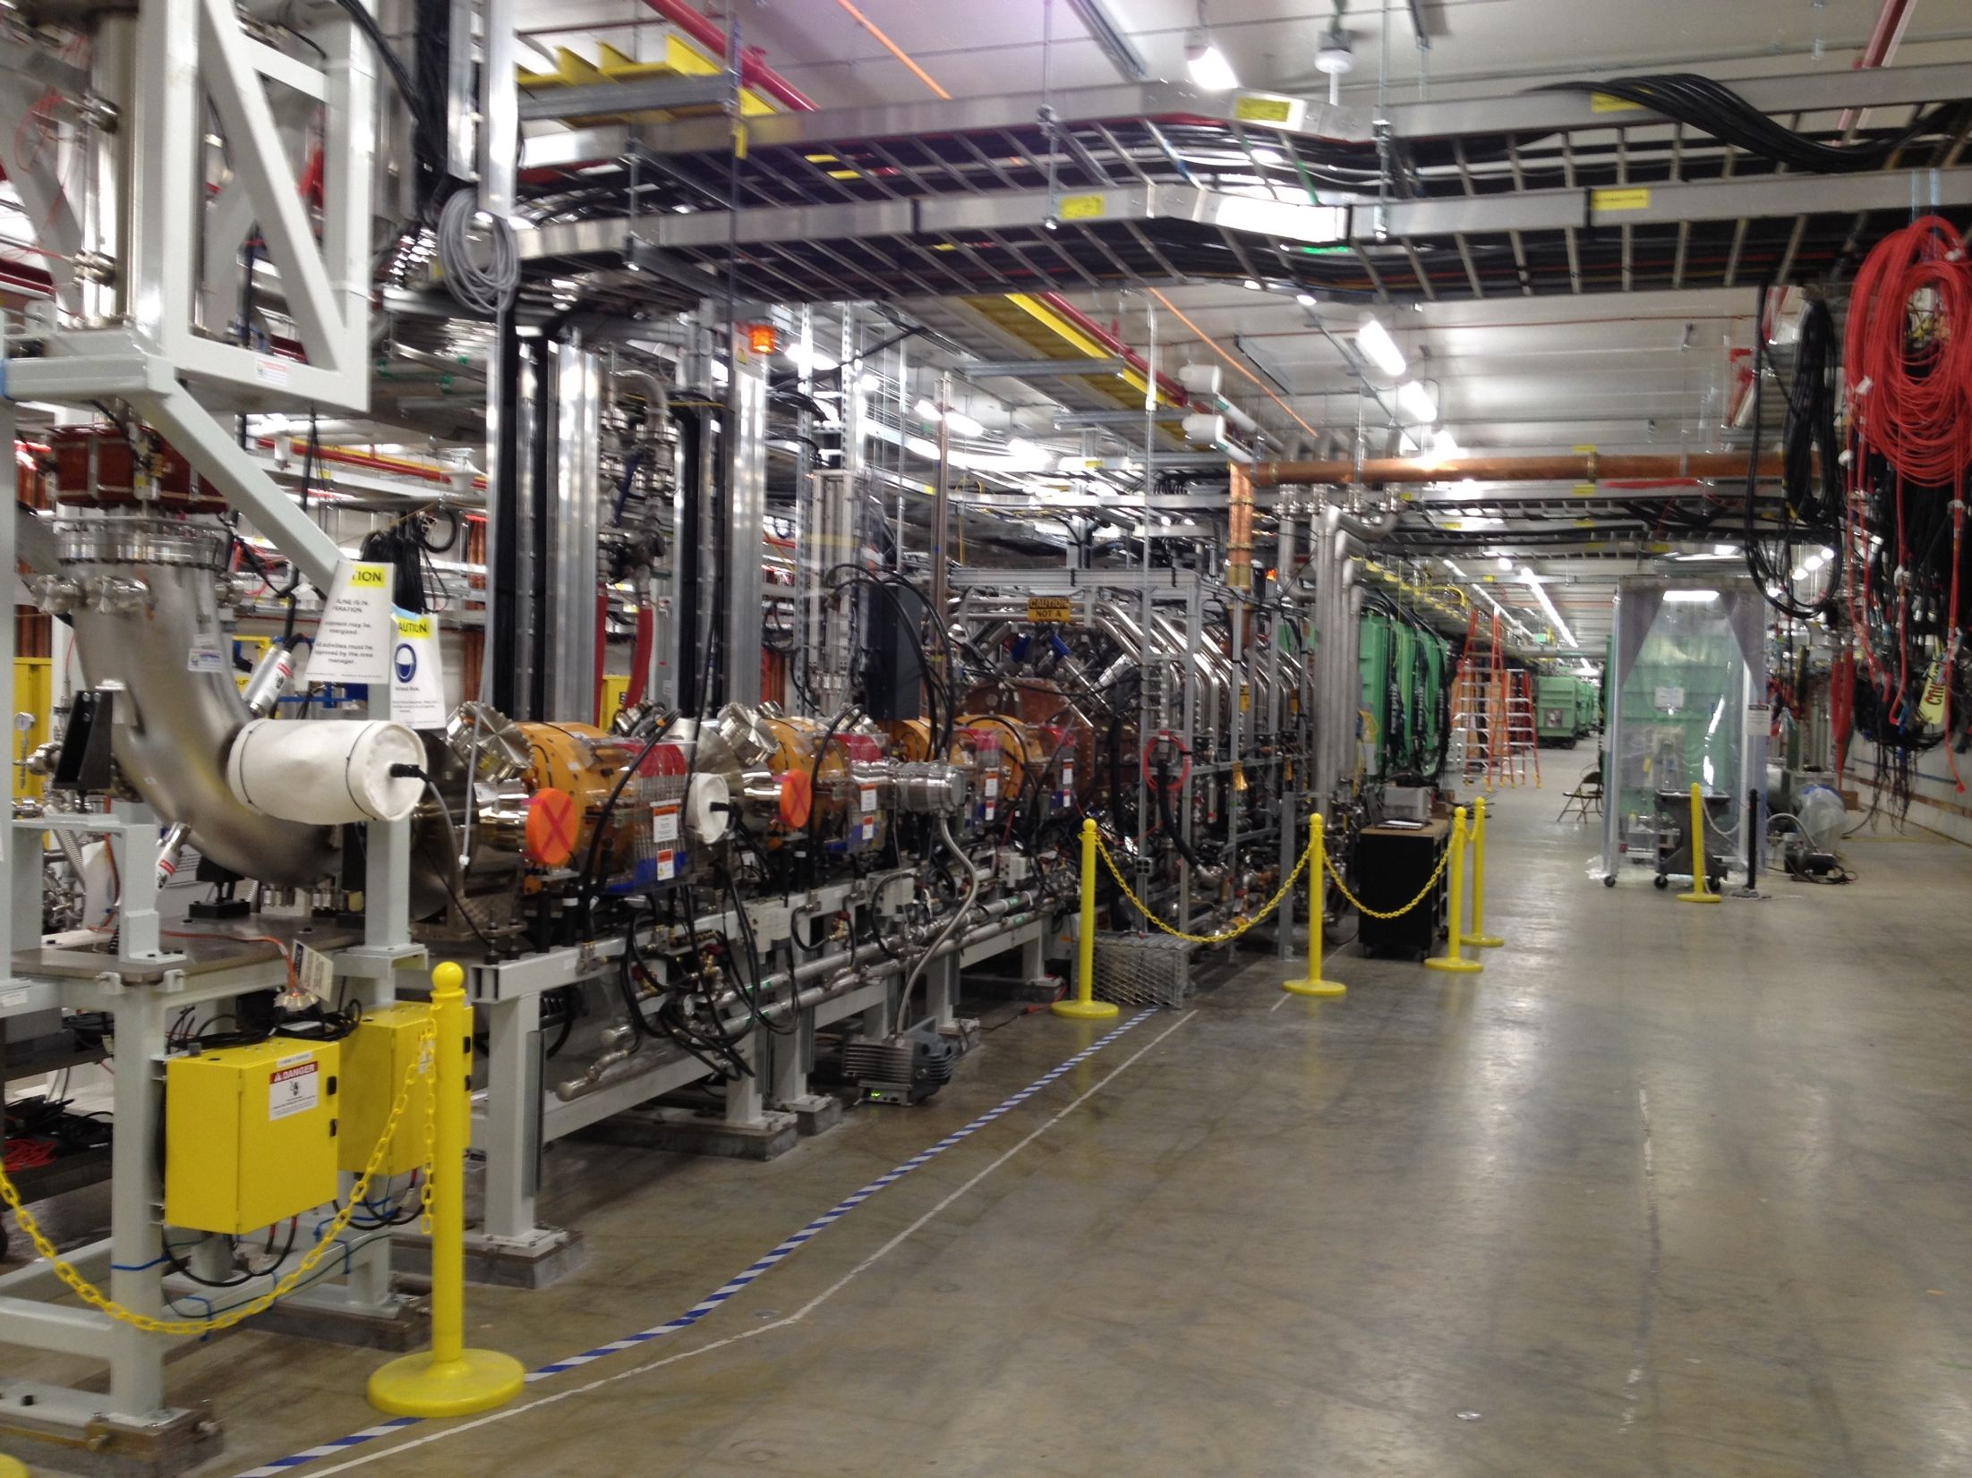
Started Beam Commissioning in 2017 While Installation Proceeds
RFQ assembled and tuned in FRIB tunnel
FRIB Lower LEBT, RFQ, MEBT, and the three β=0.041 cryomodules being installed
FRIB Lower LEBT, RFQ, MEBT, and β=0.041, 0.085, 0.29 and 0.53 cryomodules installed
, Slide 7

Slide 8
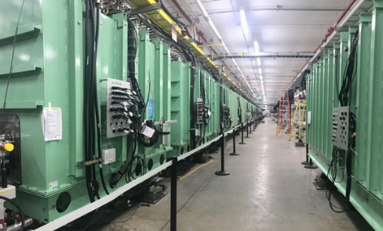
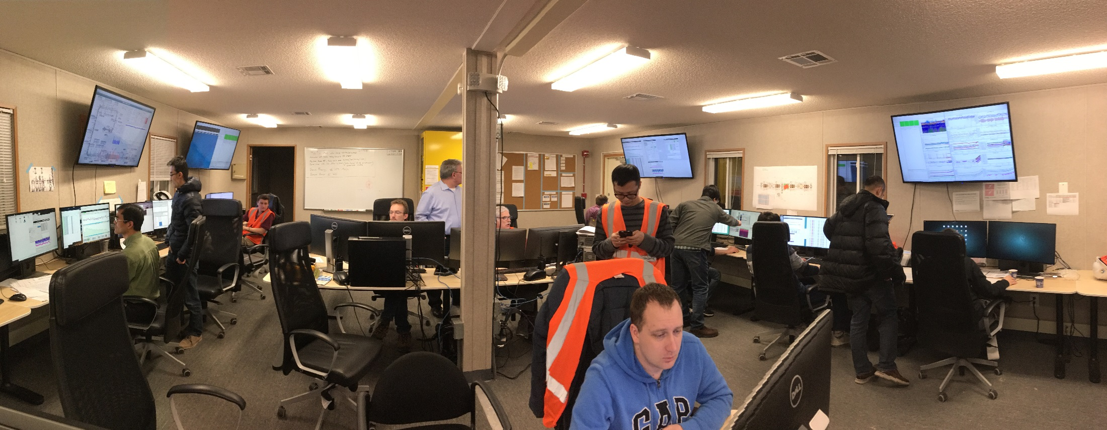
2019: Accelerate Beams > 20 MeV/u
FRIB Became World’s Highest Energy CW Hadron Linac
Time of flight measurement using
beam position monitors
FRIB Linac Segment 1 containing 15 SRF cryomodules
Feb 14, 2019, Ar⁹⁺ beam accelerated by cryomodule 1 – 14 above 20 MeV/u

Slide 9
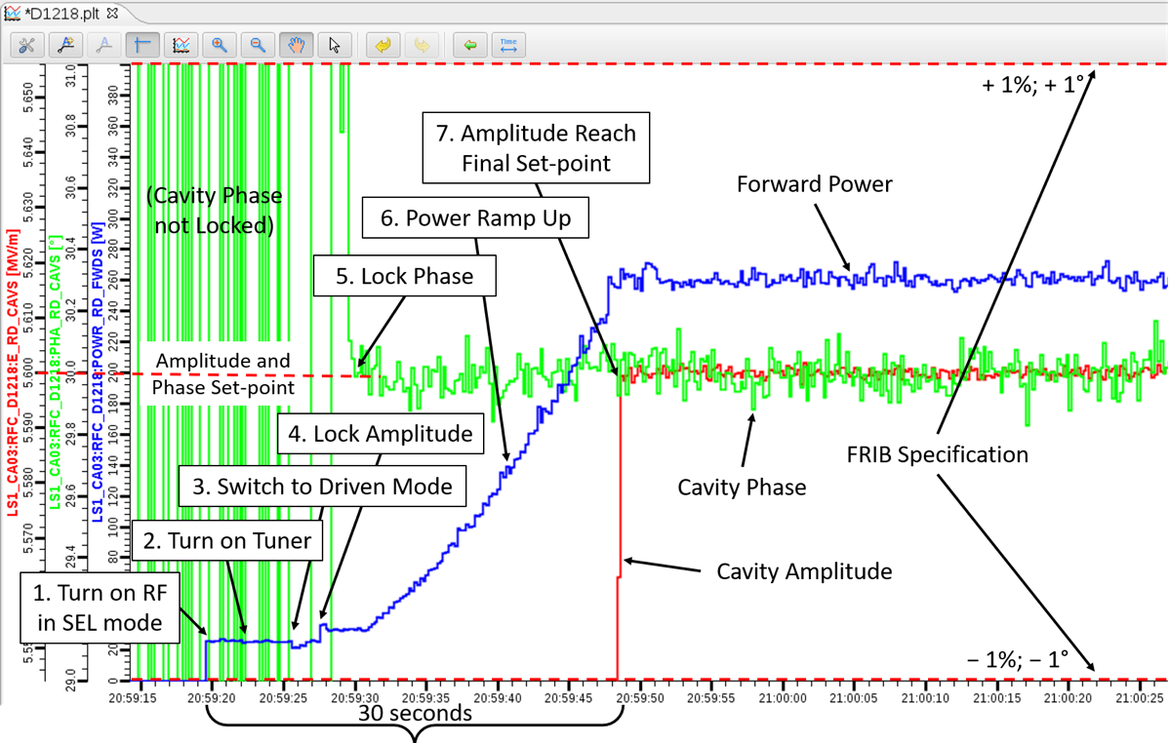
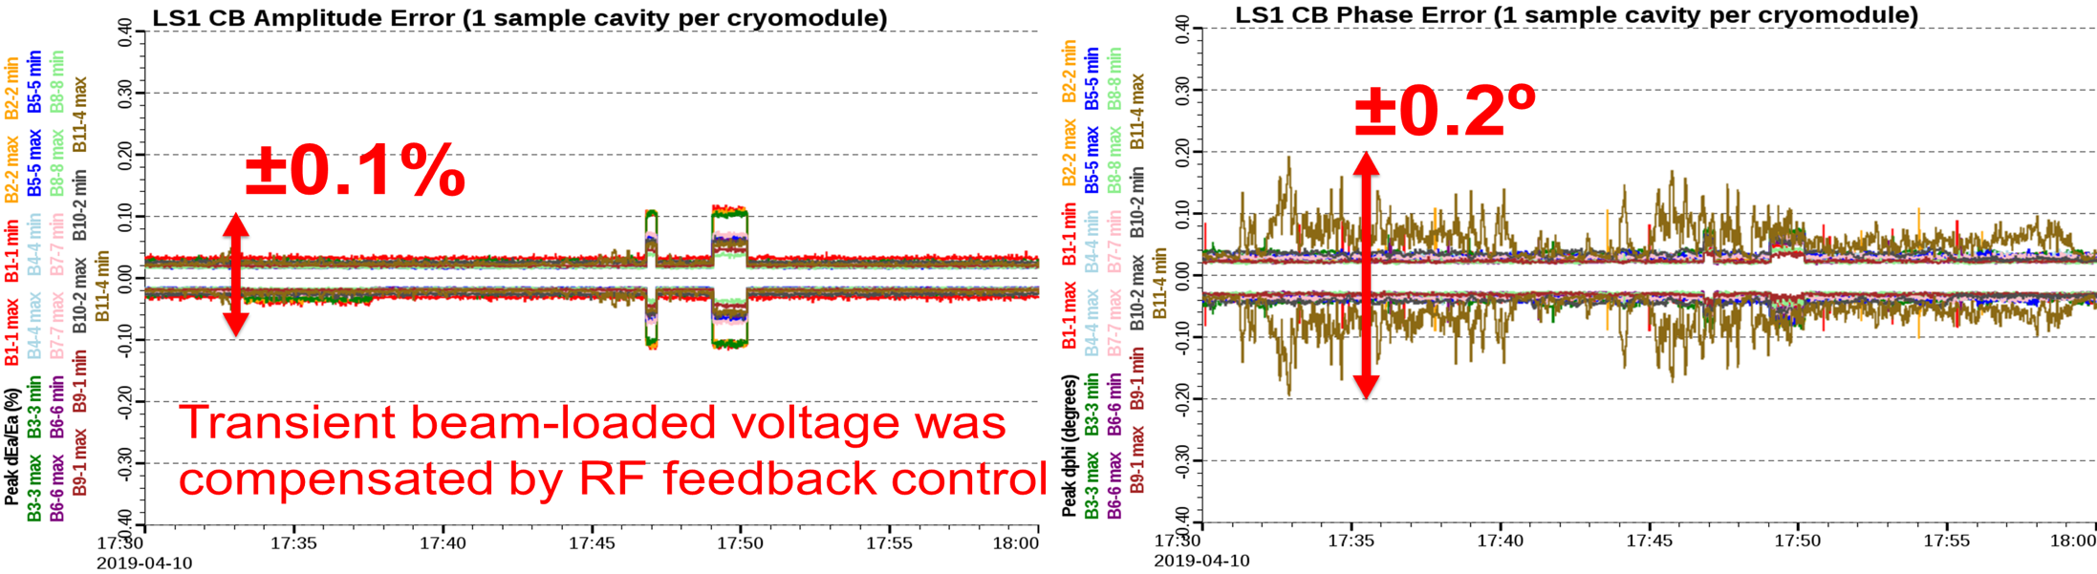
Low-level RF Controls and Automation
Automated Turn-on of 104 SRF Cavities in 2 Minutes
Amplitude and phase errors:
  Achieved < ±0.1%_{pk-pk} < ±0.2º_{pk-pk}
  Specifications: <1%_{pk-pk}, < ±1º_{pk-pk}
Automated turn-on of resonators
  Turn on all 104 QWR cavities in ~ 2 min. for routine operations
No issue with frequency locking

Slide 10
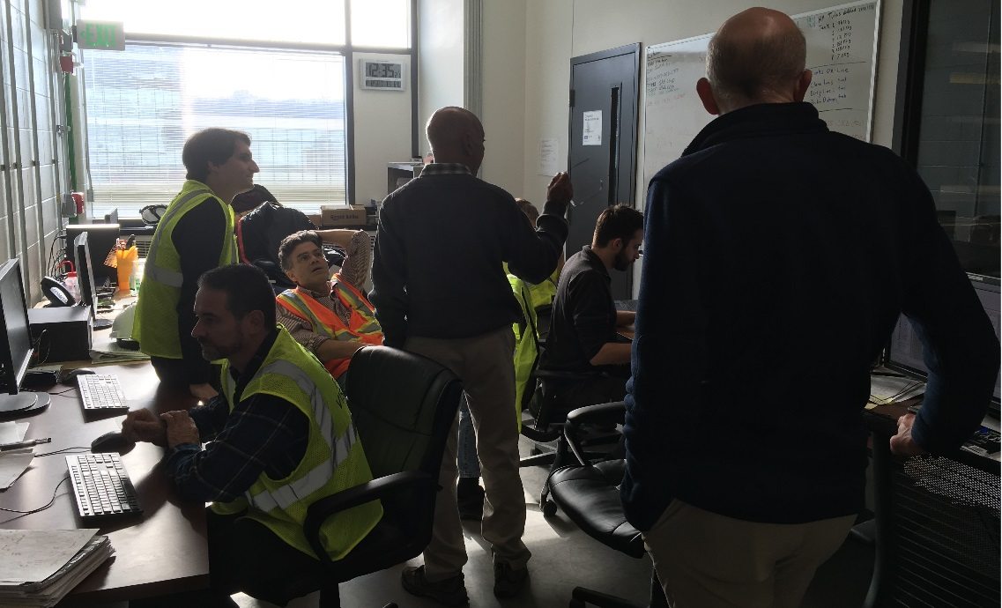
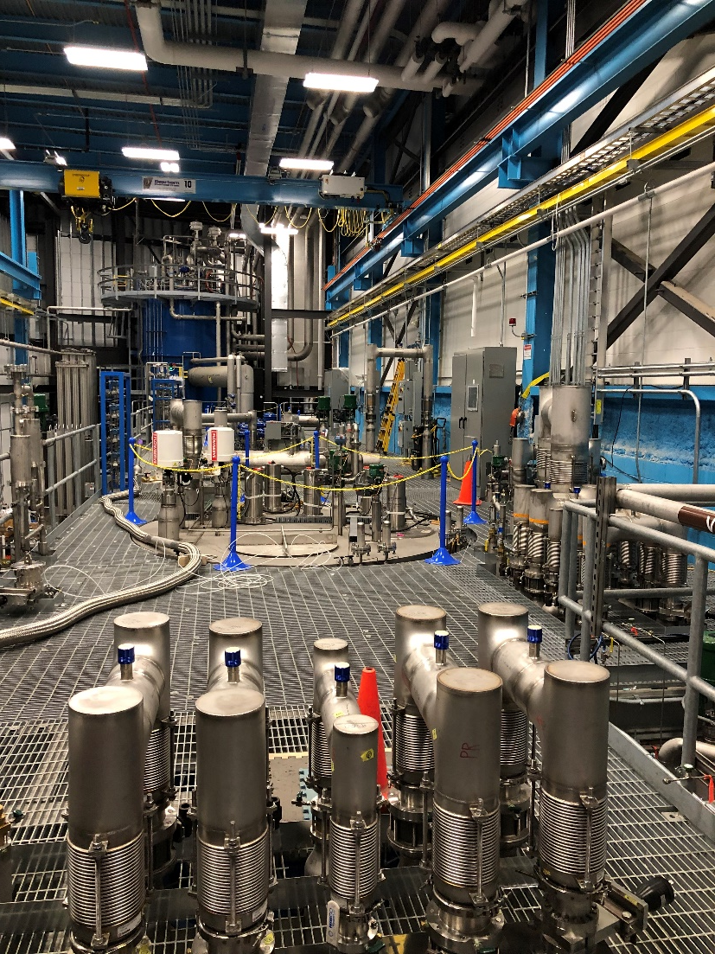
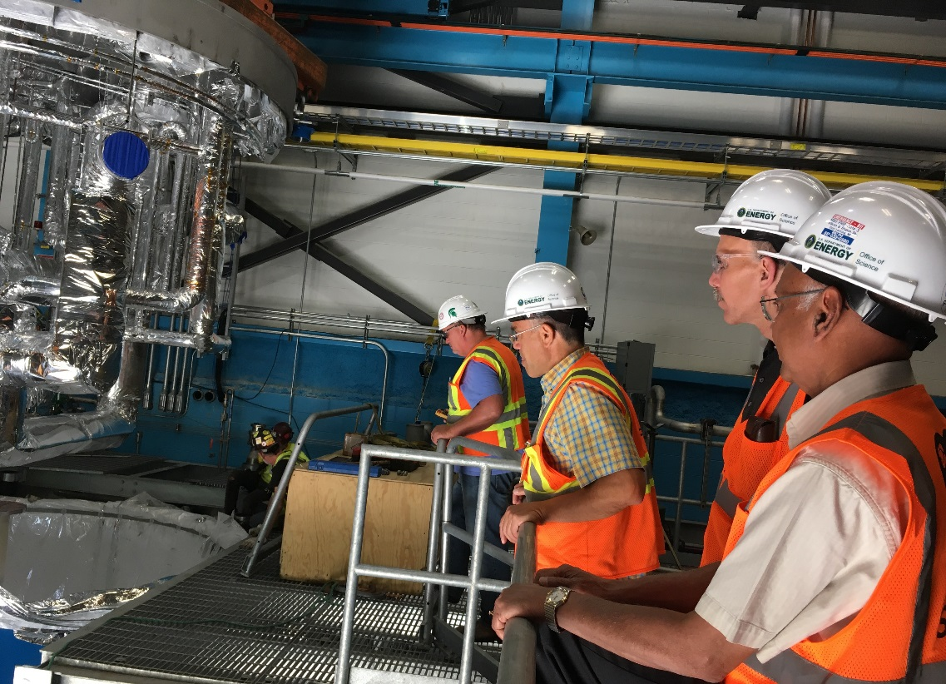
Helium Refrigeration System Fully Operational
28 Out of 46 Cryomodules Cooled Down to 2 K Temperature
2 K cold box commission on December 2018
Both Linac Segment 1 and 2 cryo-lines cool down since March 2019
2 K cold box installation August 2018

Slide 11
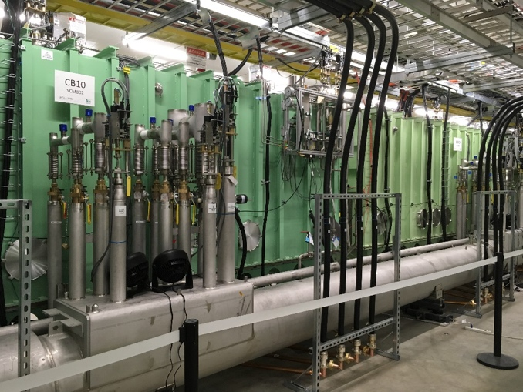
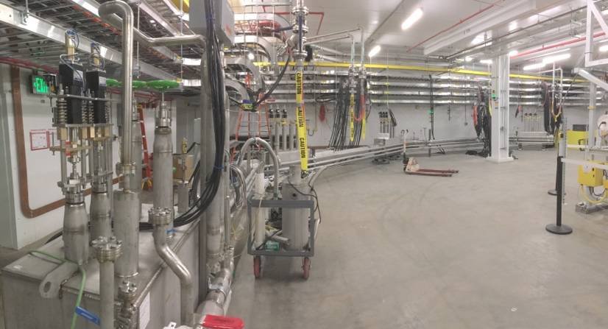
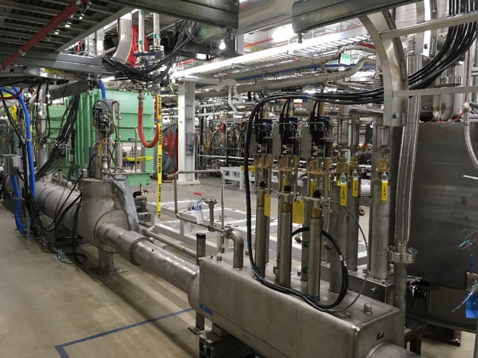
Strategy Facilitating Phased Commissioning
Allowing Each Area at Totally Different Project Phase
LS1: operations; LS2: commissioning; LS3: construction; ESD: design

Slide 12
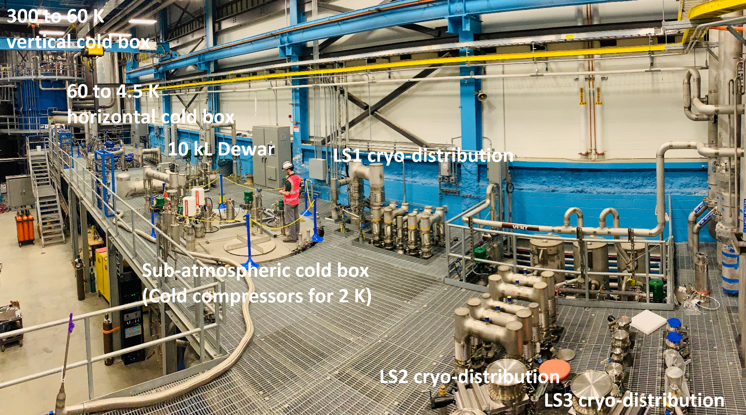
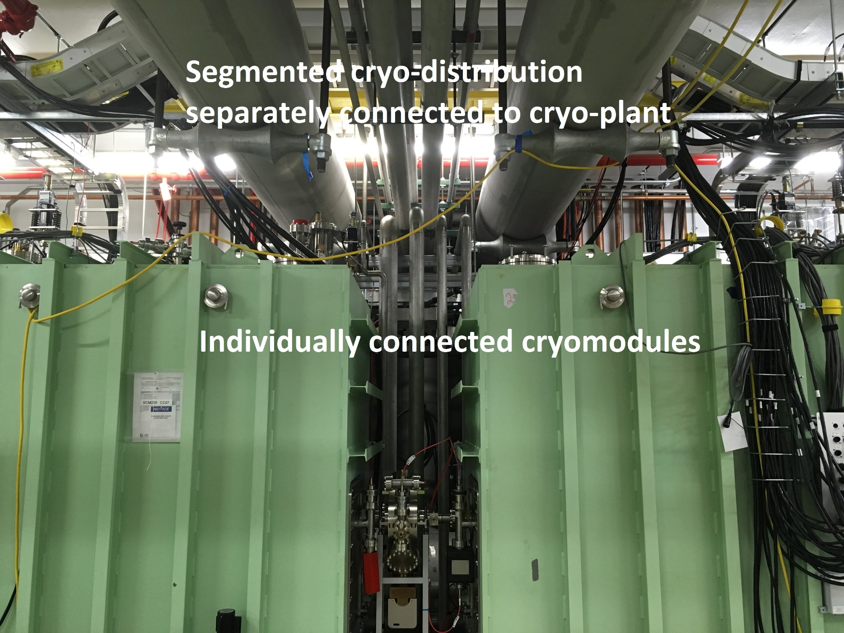
Development [1]: Integrated Cryogenics
Dramatic recovery over early setback in the attempt to procure a turn-key system
An integrated design of the cryogenic refrigeration, distribution, and cryomodule systems is key to efficient SRF operations
  Ganni cycle: floating pressure process
  Distribution lines segmented
  Cryomodules connected with U-tubes: maintenance
  4-2 K heat exchangers housed inside cryomodules
A JLab – FRIB Collaboration

Slide 13
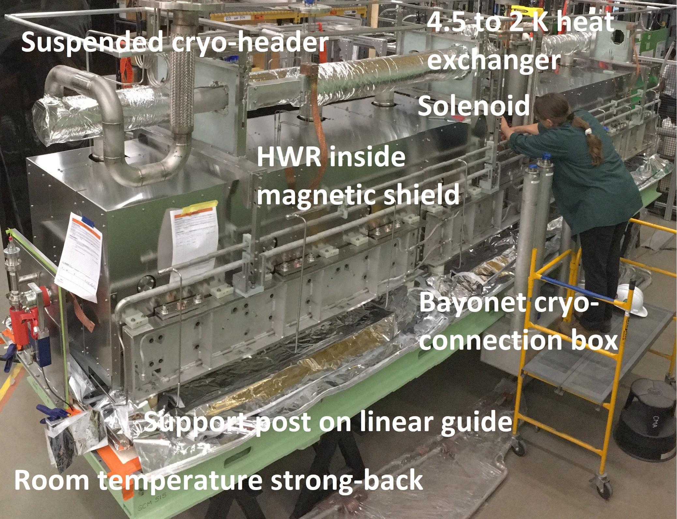
Development [2]: Bottom Up Cryomodule
Facilitate assembly efficiency; simplify alignment; and allow U-tube cryogenic connections for maintainability
  Resonators and solenoids supported from the bottom
  Cryogenic headers are suspended from the top for vibration isolation
All resonators operate at 2 K
All solenoids operate at 4.5 K
Local magnetic shielding for 1.5 μT remnant field

Slide 14
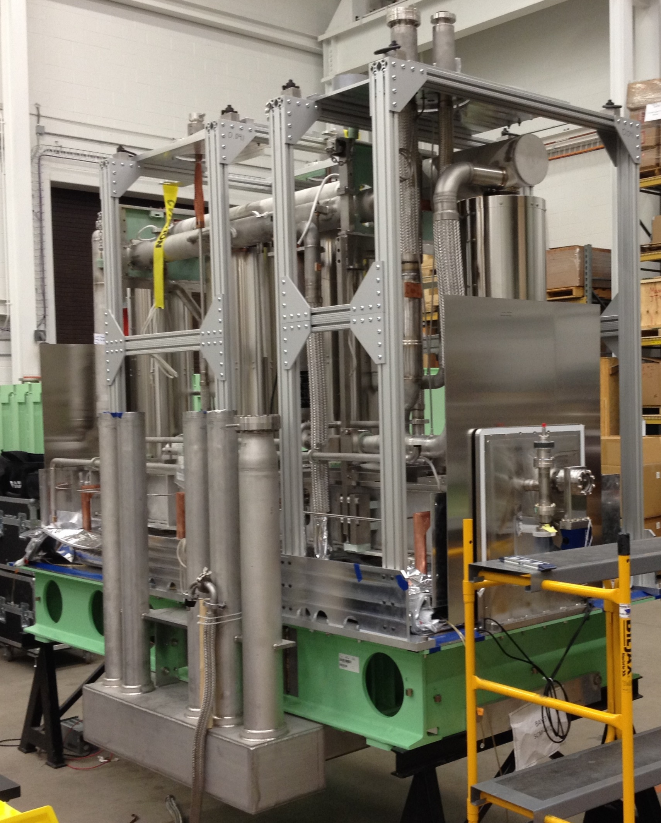
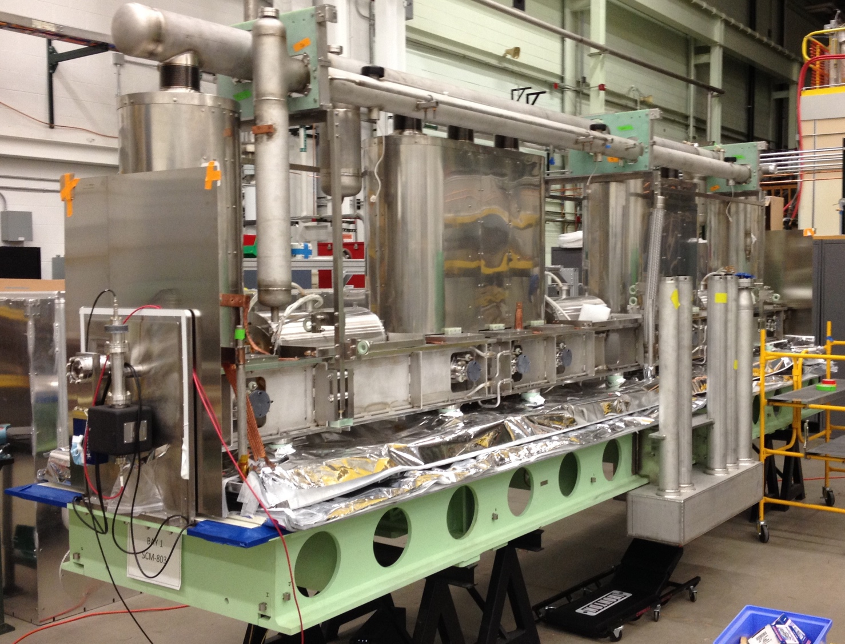
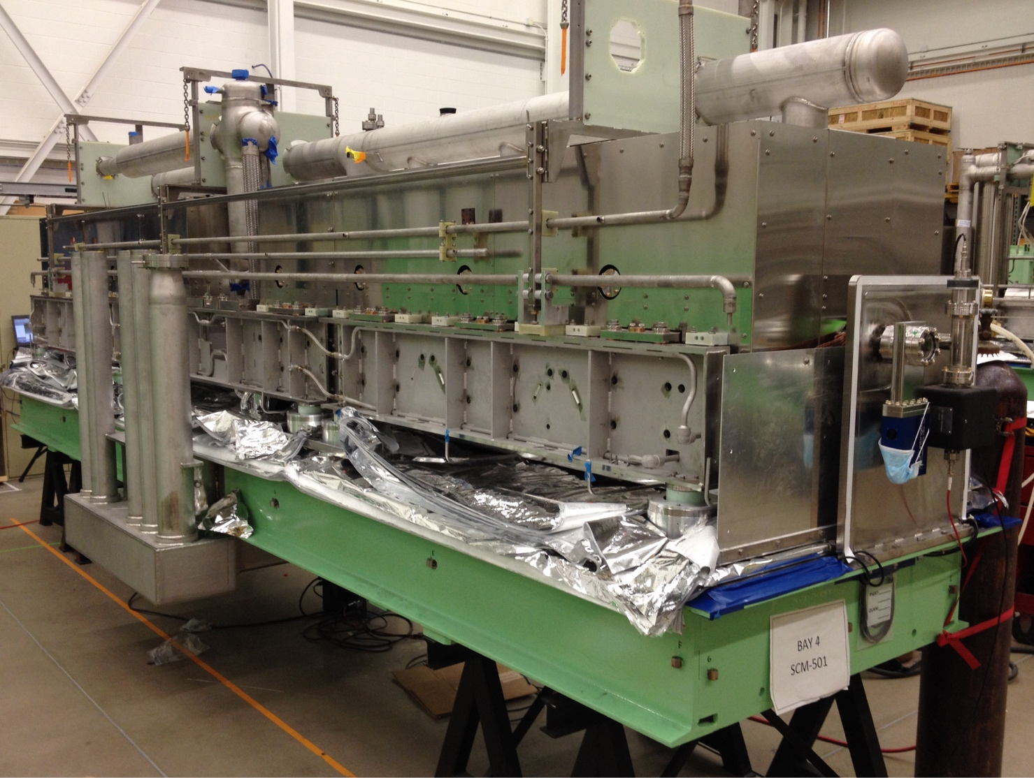
Six Types of Cryomodules Being Assembled β=0.041, 0.085, 0.29, 0.53 for Baseline; β=0.65 for Upgrade
β=0.085 cryomodule #3 being assembled at MSU
β=0.041 cryomodule #1 being assembled at MSU
β=0.53 cryomodule #1 being assembled at MSU

Slide 15
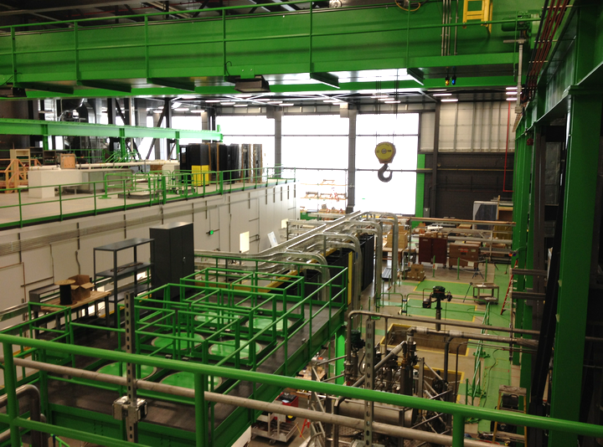
“SRF High Bay” Constructed at MSU
Infrastructure Investment for FRIB Construction & SRF Research
Objective Measures | Date
Ready-for-equip. | 01/2014
Beneficial occu. | 05/2014
Clean 1st cavity | 07/2014
Coord. measure. | 09/2014
Degassing furnace | 10/2014
Etch 1st Cavity | 12/2014
Cryogenics system | 09/2015
RF test 1st cavity | 11/2015
Vertical test area | 01/2016
Cryomodule test | 09/2016
xx
Production throughput:
  5 cavity per week
  ~ 1.5 coldmass per month

Slide 16
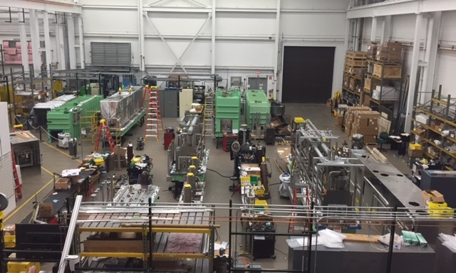
Six Cryomodule Assembly Bays in Parallel
Producing ~ 1.5 Cryomodules Per Month at MSU

Slide 17
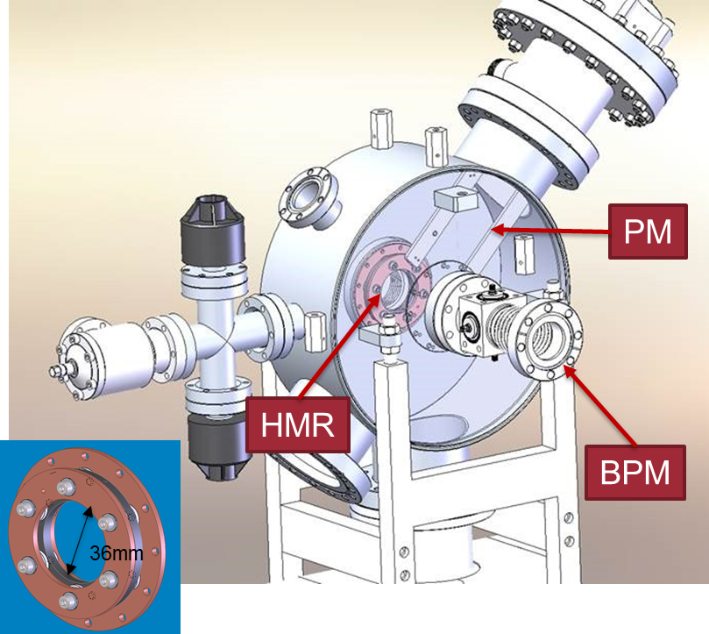
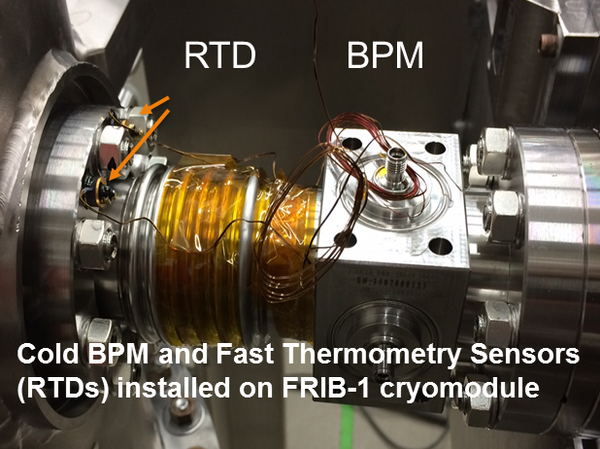
Development [3]: Machine Protection System
Low Sensitivity & Short Range of Intense Heavy-ion Beams
Uranium ion stopping range is about 30 times shorter than proton’s
  Uranium ion energy deposition density in material is more severe than protons
Uranium beam is about 30 times more difficult to detect than protons
  Further complicated by signal interference in the folded layout
MPS of multi time scale is needed to mitigate both acute & chronicle beam loss
  Both prompt damage and long-term degradation of SRF resonators
Innovative detection techniques developed
  Halo monitor ring and thermometry sensors for high-sensitivity loss detection
  Current monitoring modules for critical magnet power supply inhibition

Slide 18
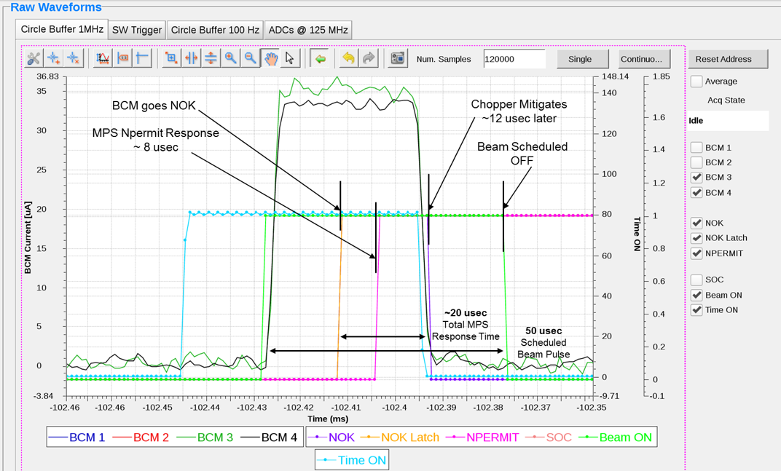
Fast Machine Protection Validated
Differential BPM Readings Inhibits Beam within 35 μs
Validated chopper and chopper monitoring system to limit beam power
Commissioned differential BPM system for fast (< 35 μs) MPS
Halo monitor ring ring provided rich signal for both ion and electrons
Thermometry sensors responded to beam loss with 0.1 K sensitivity
Run permit system under commissioning

Slide 19
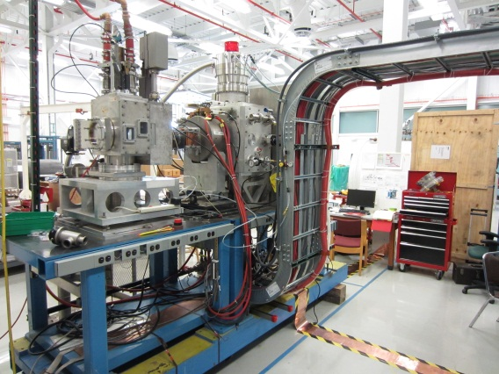
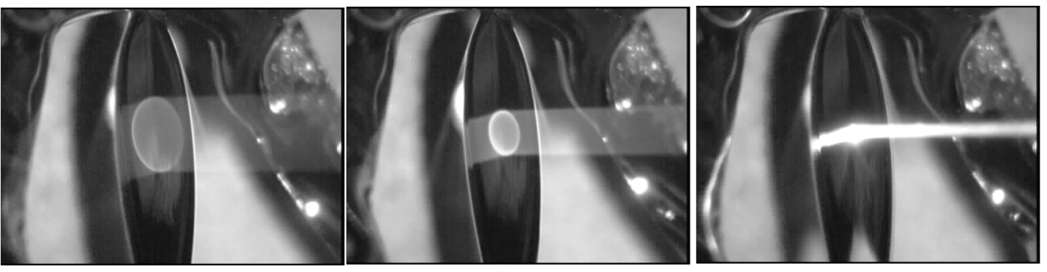
Development [4]: Liquid Li Charge Stripper
Liquid Lithium Film Tested with LEDA Source at ANL
  Liquid lithium film established with controllable thickness and uniformity
    Liquid lithium film moving at ~50 m/s speed to remove deposited heat
    Controlling uniformity to ~10% within beam spot area
Beam power tests on liquid lithium film successfully performed at ANL
  The film sustained ~200% of FRIB maximum power density deposition
Liquid lithium film flowing at high speed (~ 50 m/s) intercepting a proton beam of about 60 kV at ANL. The test produced power deposition densities similar to the FRIB uranium beams.
LANL LEDA ion source restored at MSU

Slide 20
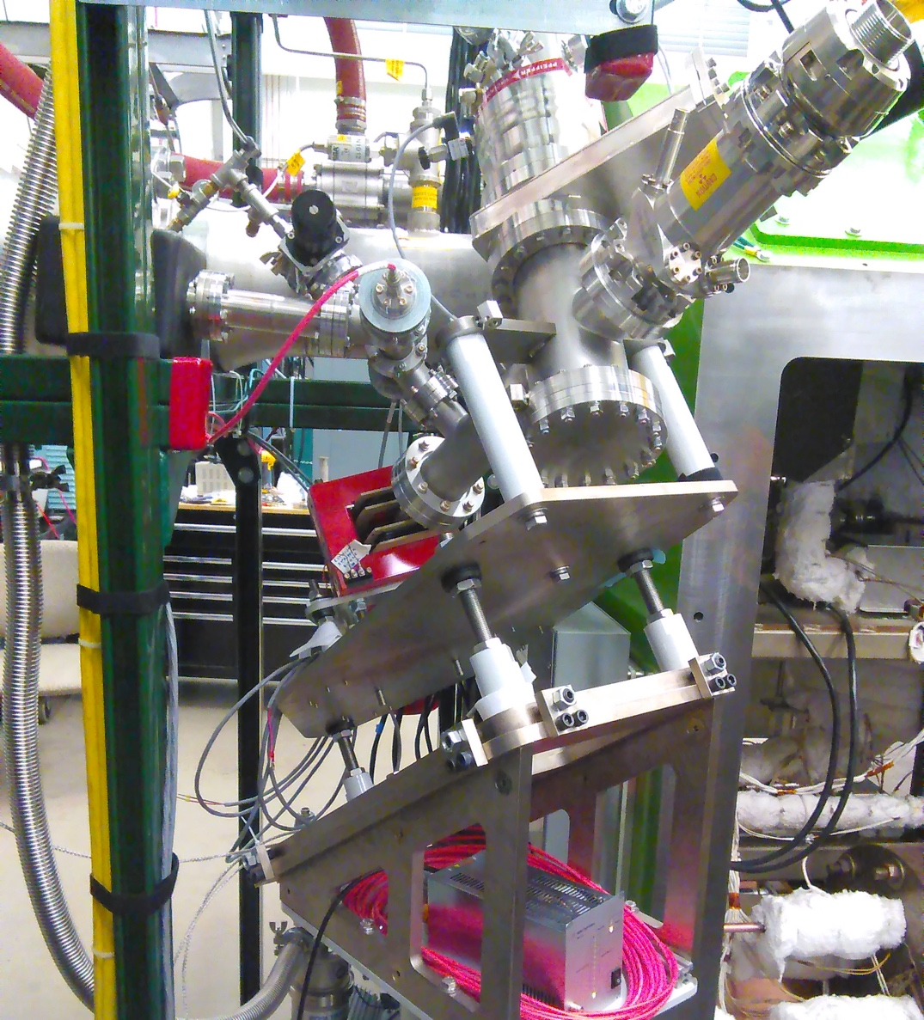
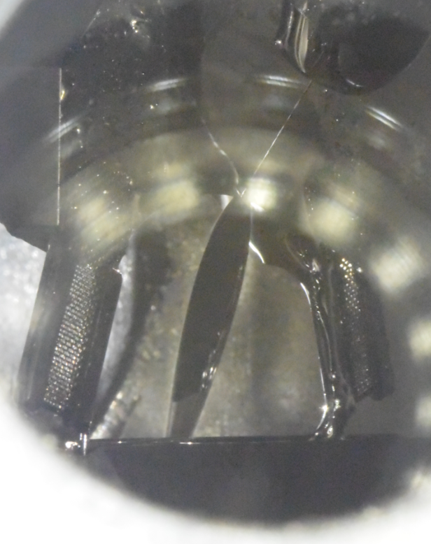
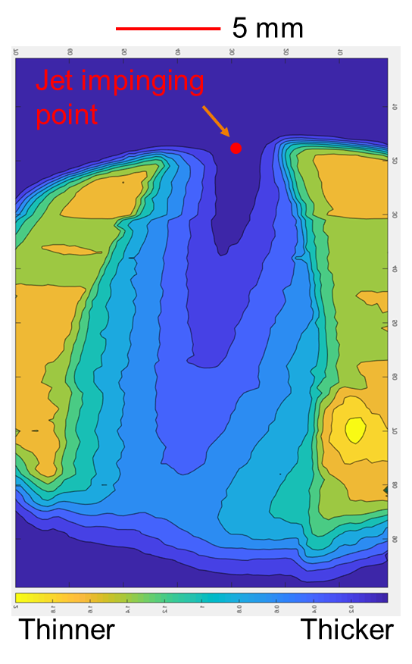
Lithium Film Measurement with e-beam
Study in Progress for Time Stability and Spatial Uniformity
Lithium film measurement with electron beam
e-gun installed to the lithium charge stripper
Lithium film
15-Kanemura
Objective measures | Date
10-day continuous, unattended operations | Mar. 2018
e-gun off-line construction and commissioning | Apr. 2019
e-gun commissioning with Li charge stripper | Jul. 2019
Lithium film thickness measurement with e-beam | Sep. 2019
Lithium charge stripping operation with beam | Nov. 2020
✔
✔
✔
✔

Slide 21
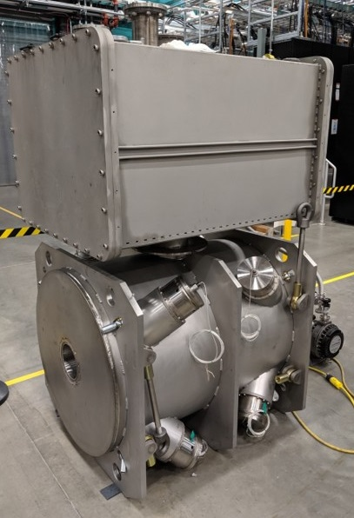
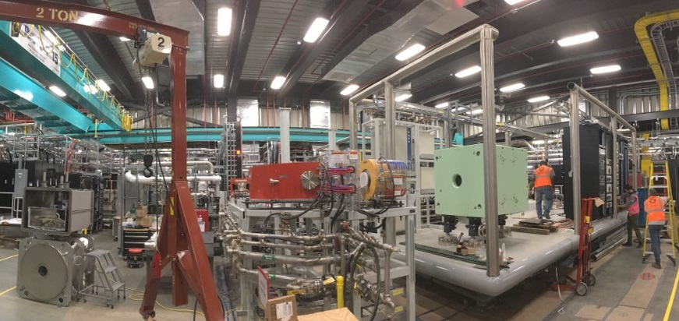
Superconducting ECR Ion Source
Assembling LBNL-built Magnets to Cryostat for Integration
Cryostat coldmass and vacuum vessel assembly completed
Integration of HV platform in process
  Water system installed and pressure tested ready to be filled up
  Isolation transformer and HV platform tested to 100kV successfully
  Electrical panel ready to be energized
Objective measures | Date
Sextupole/solenoid built/tested at LBNL | Oct. 2017
Coldmass assembled | Sep. 2019
System assembled on HV platform | Dec. 2019
Integrated System tested on HV platform | Oct. 2020
HP ECR produces beam | Dec. 2020
✔
✔
SC ECR ion source cryostat assembly
SC ECR ion source high voltage platform and beam line

Slide 22
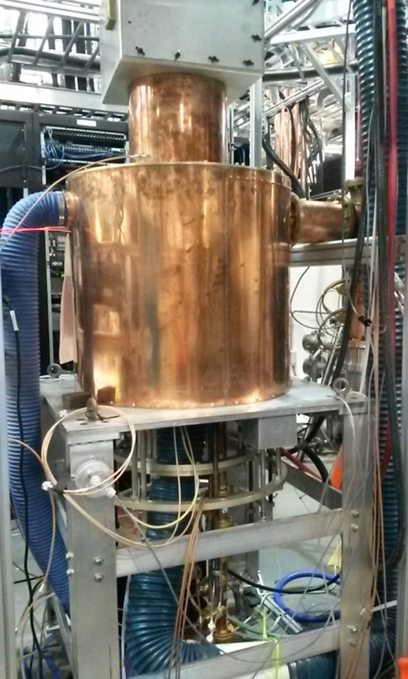
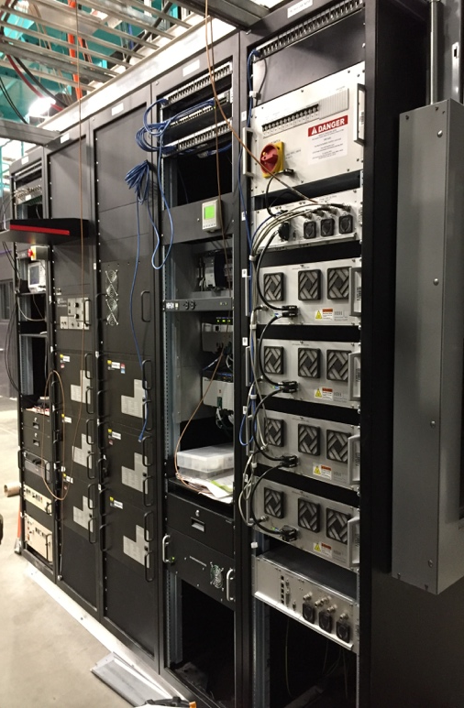
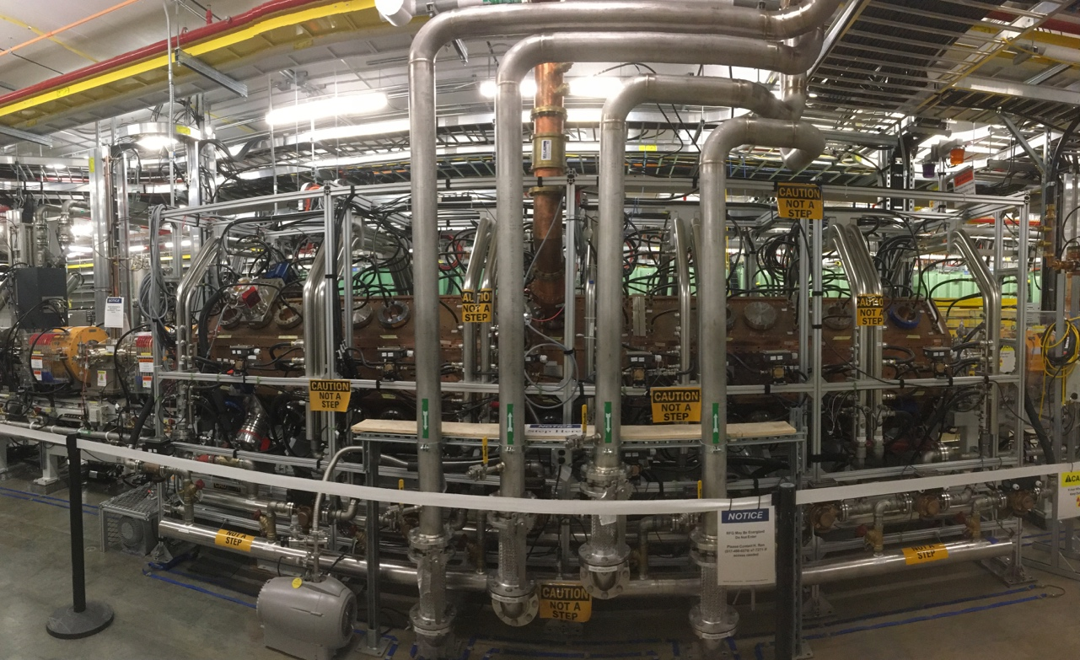
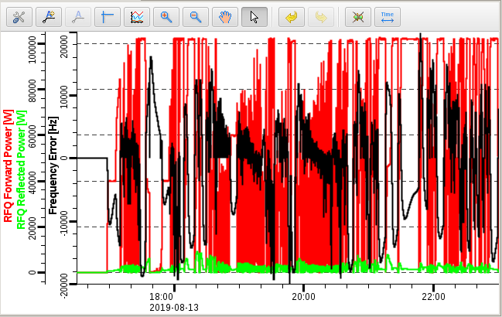
80 MHz RFQ Commissioned for Full Power
> 100 kW CW Power for Uranium Operations
Objective measures | Date
RFQ conditioned above 50 kW CW | Aug. 2017
Accelerating argon beam through RFQ | Oct. 2017
RFQ amplifier tested offline above 100 kW | Jun. 2019
RFQ conditioned above 100 kW | Aug. 2019
Accelerating uranium-like beam through RFQ | Dec. 2020
✔
✔
✔
✔
Analog RFQ power amplifier
FRIB radio frequency quadrupole RFQ

Slide 23







We Cannot Build FRIB Alone and Are Working with the Best in US and Worldwide
Argonne National Laboratory
  Liquid lithium charge stripper;
  stopping of ions in gas; fragment
  separator design; beam dynamics; SRF
Brookhaven National
Laboratory
  Radiation-resistant magnets;
  plasma charge stripper
Fermilab
  Diagnostics
Jefferson Laboratory
  Cryogenics; SRF
Lawrence Berkeley
National Laboratory
  ECR ion source; beam dynamics
Oak Ridge National Laboratory
  Target facility; beam dump R&D;
  cryogenic controls
Stanford National Accelerator Lab
  Cryogenics
Sandia
  Production target
Budker Inst. of Nuclear Physics (Russia)
  Production target
GANIL (France)
  Production target
GSI (Germany)
  Production target
INFN Legnaro (Italy)
  SRF
KEK (Japan)
  SRF technology; SC solenoid magnets
RIKEN (Japan)
  Charge strippers
Soreq (Israel)
  Production target
IMP, CAS (China)
  Room temperature magnet
Tsinghua University (China)
  RFQ
TRIUMF (Canada)
  SRF; beam dynamics

Slide 24
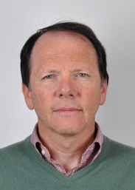
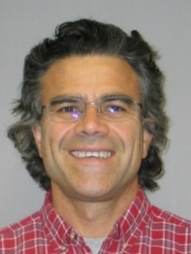
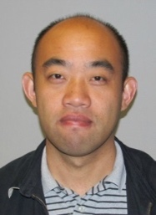
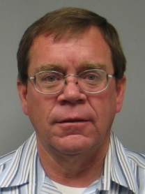
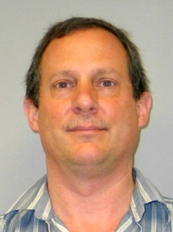
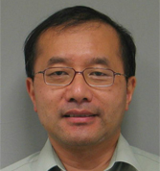
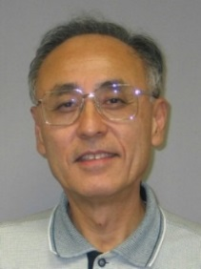
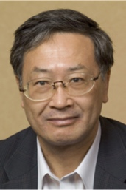
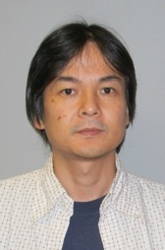
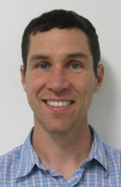

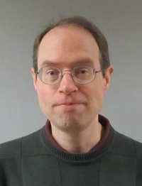















Attracted World Experts in Key Areas
With Culture Background from ~ 30 Countries
Attracted seasoned leaders in accelerator physics and engineering
  H. Ao (J-PARC), N. Bultman (LANL), F. Casagrande (ORNL), J. Chen (PPPL), D. Chabot (BNL), L. Dalesio (BNL), A. Facco (INFN), K. Fukushima (U. Hiroshima), V. Ganni (JLab), A. Ganshyn (Cornell), P. Gibson (ORNL), W. Hartung (Cornell), S.H. Kim (ANL), P. Knudsen (JLab), Y. Hao (BNL), H.-C. Hseuh (BNL), A. Hussain (BNL), M. Ikegami (J-PARC), T. Kanemura (JAEA), S. Kim (ANL), R.E. Laxdal (TRIUMF), S. Lidia (LBNL), S. Lund (LLNL), G. Machicoane, F. Martin, Y. Momozaki (ANL), A.C. Morton (TRIUMF), J. Nolen (ANL), D. Omitto (BNL), P. Ostroumov (ANL), T. Russo (BNL), H. Ren (PKU), K. Saito (KEK), M. Shehab (SESAME), J. Wei (BNL/THU), T. Xu (ORNL), M. Wright (JLab), Y. Yamazaki (KEK), T. Yoshimoto (TIT/KEK)

Slide 25


Sharing Knowledge Gained & Lessons Learned
Benefiting from / Rewarding back the Accelerator Community
Session “Large Scale Refrigeration and Liquefaction – FRIB” at CEC/ICMC 2019
Ganni was awarded S. Colins award for life time achievement in cryogenics
Dedicated session at Cryogenic Engineering Conference with six invited talks by FRIB faculty and staff at the 2019 conference
Ganni awarded the S. Collins award for life time achievement in cryogenics
MSU won competition to host SRF 2021 conference, following the hosting of HB2014, Linac2016, IBIC2017, and NAPAC2019

Slide 26

Cryogenic Initiative Focuses:
Education, R&D, Facility Support
Education
  University courses
  US Particle Accelerator School courses
  Conference tutorial class
Research & development
  Main compressor efficiency improvements
  Low level impurity removal
  Small 2 K system for laboratory use
Facility support
  FRIB Cryoplant, cryo-distribution, cryomodule and superconducting magnets
  National needs in major projects: LCLS-II, PIP-II, electron ion collider
  World wide demands in cryogenics for large accelerator projects

Slide 27
Relevance to EIC / Future Accelerator Projects
A project oriented team seasoned with most recent accelerator project design, construction, and commissioning
Infrastructure growth during the FRIB establishment
  Large scale cryogenic refrigeration and distribution
  A wide-spectrum to SRF developments with mass production capabilities
  Hadron linac establishment
Favorable overhead rates than national laboratories
  The cost difference can be a factor of 2 or more
Specifically developed technologies
  Machine and personnel protection, diagnostics and instrumentation, charge stripping, high-power target and beam dump
Perfect timing with EIC
We are looking forward to contributing to EIC and DOE/NP programs

Slide 28

Thank You!

Slide 29
Acknowledgements
The FRIB accelerator design is executed by a dedicated team of the FRIB Accelerator Systems Division with close collaboration with the Experimental Systems Division headed by G. Bollen, the Conventional Facility Division headed by B. Bull, the Chief Engineer’s team headed by D. Stout, and supported by the project controls, procurements, ES&H of the FRIB Project, by NSCL, and by MSU.
Work supported by the U.S. Department of Energy Office of Science under Cooperative Agreement DE-SC0000661 and the National Science Foundation under Cooperative Agreement PHY-1102511.

Slide 30

Commissioning Preparation: Linac Segment 2
Installation, Cool Down, Energization, and Commissioning
Phase | Area with beam | ARR
ARR01 | Ion source, Low Energy Beam Transport (LEBT), RFQ, Medium Energy Beam Transport (MEBT) | 07/2017 | ✔
ARR02 | Linac Segment (LS) 1 (β=0.041 cryomodules) | 05/2018 | ✔
ARR03 | Rest of LS1 and first dipole of Folding Segment (FS) 1 | 02/2019 | ✔
ARR04 | Rest of FS1, LS2, and part of FS2 to straight dump | 03/2020
KPP | Reach Linac Key Performance Parameters (KPP) | 06/2020
Li stripper | Re-commission with lithium charge stripper | 11/2020
ARR05 | FS2, LS3, part of Beam Delivery System (BDS) to straight dump | 12/2020
ARR06 | BDS, target hall pre-separator | 09/2021
ARR Final | Prior post-start Items, vertical pre-separator (outside target hall), reconfigured A1900, entire facility | 12/2021

Slide 31
FRIB Project Started in June 2009 and
Will Be Complete before 2022
FRIB Project is about 90% complete, on budget, and being managed to early completion in 2021, CD-4 is in June 2022
Beam commissioning is proceeding in parallel with installation
  Frontend is complete – accelerated argon and krypton beams
  Cryoplant operational and making liquid helium
  38 of needed 46 cryomodules are completed and installed
  Beams are accelerated through first 15 cryomodules in 2019
FRIB increases heavy-ion beam power by 2-3 orders of magnitude over existing heavy-ion machines
  Proton machines (SNS and J-PARC) taught us that such an increase is hard
Transition from NSF-funded NSCL user facility to DOE-funded FRIB user facility on track and planned for 2021
1,400 users engaged in working groups, performing successful experiments at NSCL, and getting ready for FRIB science

