Slide 1
IOTA and Opportunities for the EIC
Aleksandr Romanov
Electron-Ion Collider (EIC) Accelerator Collaboration Meeting
10 October 2019

Slide 2
Presentation overview
IOTA for intense beams
IOTA capabilities
EIC related experiments and proposals
Future plans

Slide 3
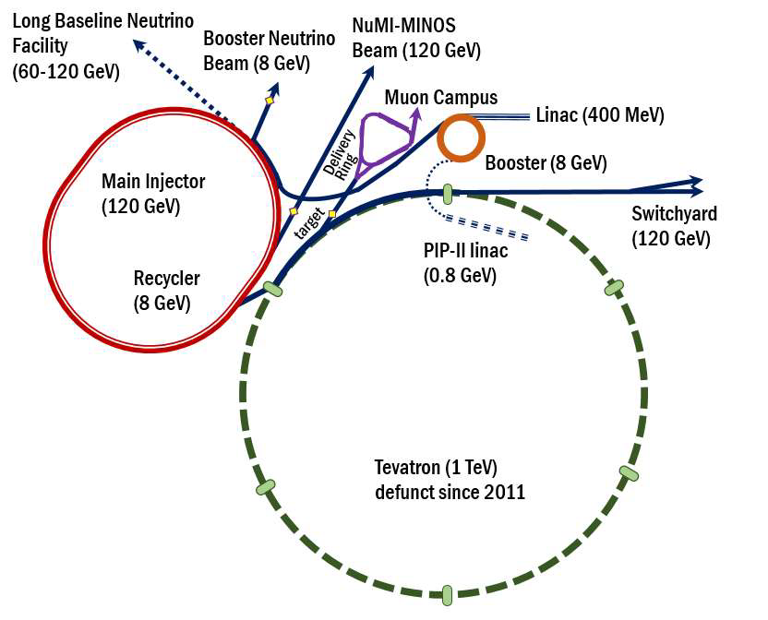
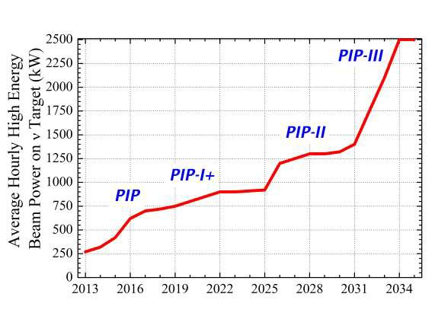
Accelerator and beam physics at Fermilab
Of particular interest to us:
Mitigation of beam losses at high-intensity:
  Booster, Recycler and MI are intensity-limited by losses (~1 W/m).
Mitigation of instabilities in high-brightness beams:
  Fast instabilities which can not be suppressed by external dampers, e.g. an “electron cloud” instability (observed in the Recycler)
Beam cooling
  Future colliders
  Quantum limits/properties of beams
System integration and optimization
IOTA->RCS

Slide 4
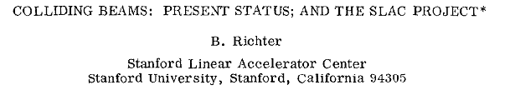
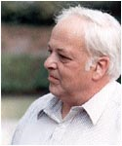
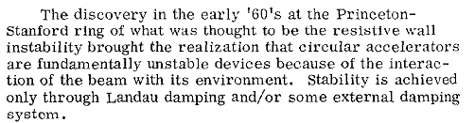
Instability mitigation – Landau damping with nonlinear magnets
Report at HEAC 1971
Landau damping – the beam’s “immune system”. It is related to the spread of betatron oscillation frequencies. The larger the spread, the more stable the beam is against collective instabilities.
  The spread is presently achieved by adding special magnets -- octupoles
External damping (feed-back) system – presently the most commonly used mechanism to keep the beam stable.

Slide 5
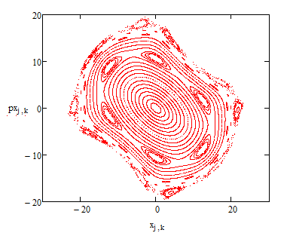
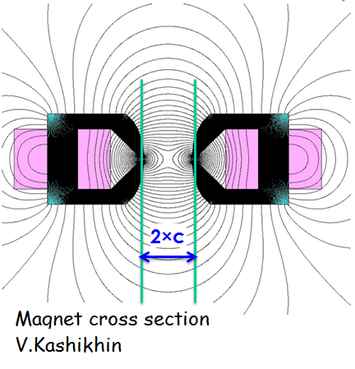
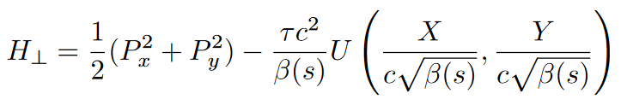
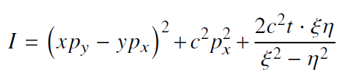

Are there “magic” nonlinearities with zero resonance strength?
Yes, we call them “integrable”
Chaotic motion
Integrable motion
Nonlinear beam dynamics:
A new concept for nonlinear
focusing in rings
Two integrals of motion :
There are several examples suitable for accelerators

Slide 6
Accelerator Science at IOTA/FAST
IOTA Ring – priority research focused on high-intensity proton rings, driven mostly by Fermilab
  Nonlinear Integrable Optics
  Optical Stochastic Cooling
  Space-charge compensation
  Suppression of coherent instabilities
FAST e- Linac and IOTA – opportunities concurrent with main IOTA program, driven mostly by external partners
  Radiation generation
  High average current experiments (ILC-like electron beams)
  Collaboration with the FACET-II team
  EIC R&D
  Quantum science: single and few-electron experiments

Slide 7
Presentation overview
IOTA for intense beams
IOTA capabilities
EIC related experiments and proposals
Future plans

Slide 8
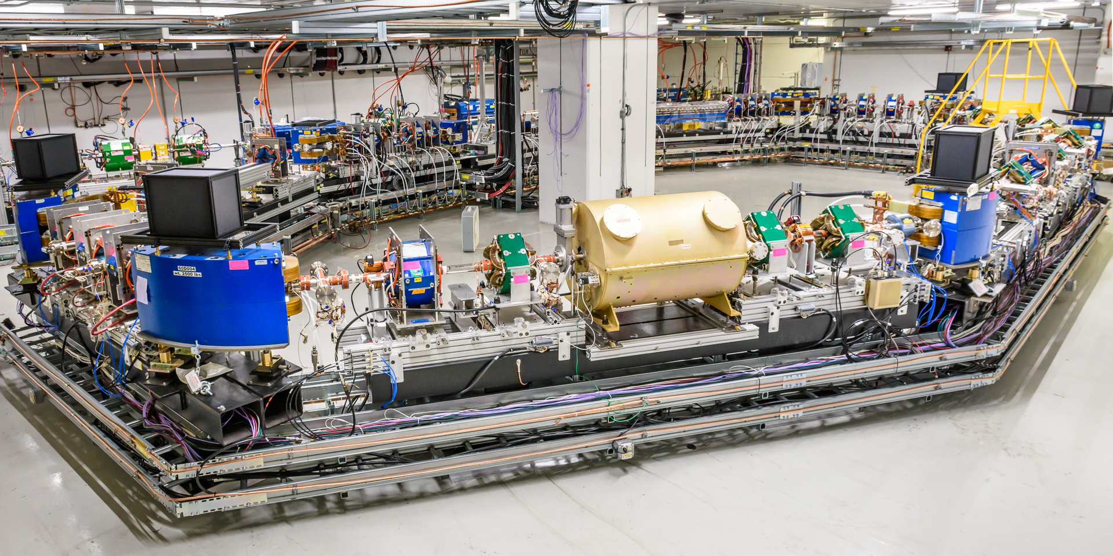
IOTA Assembly Completed 7/29/2018

Slide 9
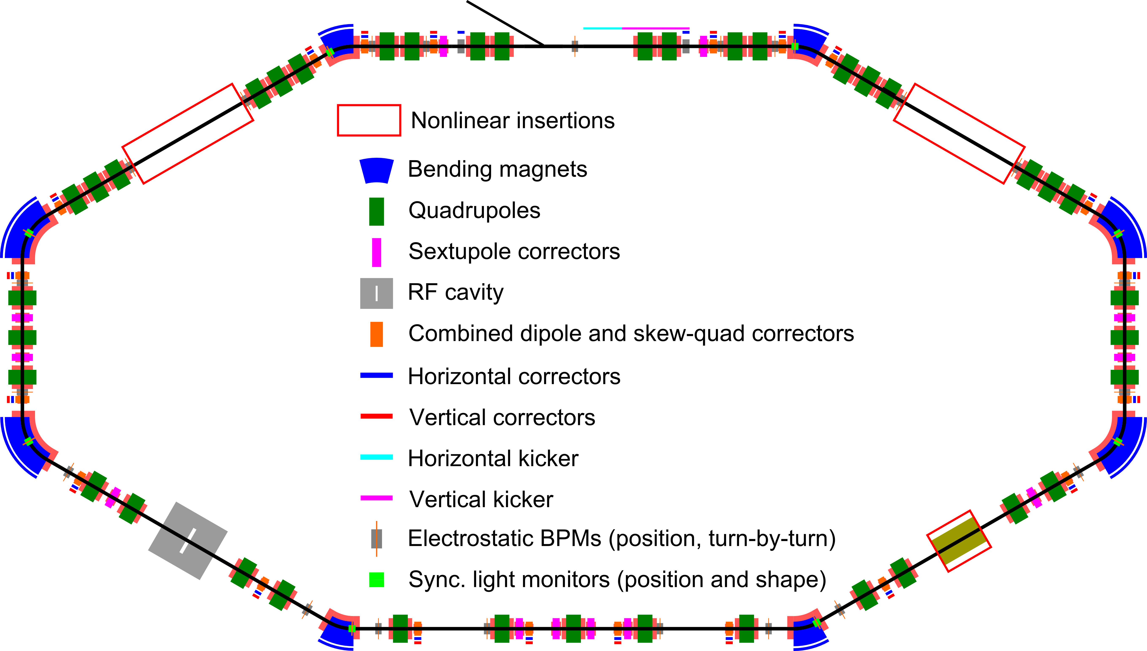
IOTA is…
Integrable Optics Test Accelerator
  Highly reconfigurable storage ring for electrons and protons

Slide 10
IOTA paramteres
Momentum | < 200 MeV
Perimeter | 40 m
RF voltage | <1 kV
RF frequency | 30 MHz & 2.18 MHz
3 Experimental straights | 2x180 cm, 1x150 cm
Main vacuum chamber aperture (R) | 25 mm
Lambertson and kickers aperture (R) | 20 mm
Electrons | 10⁹ e, 1.2 mA
Protons | 10¹¹ p, 9 mA
Vacuum | 6x10⁻¹⁰ torr

Slide 11
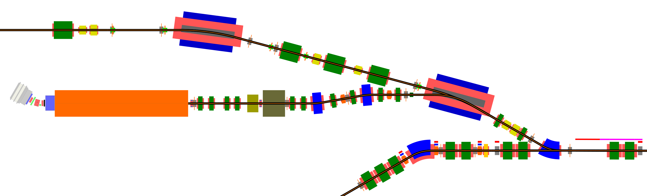
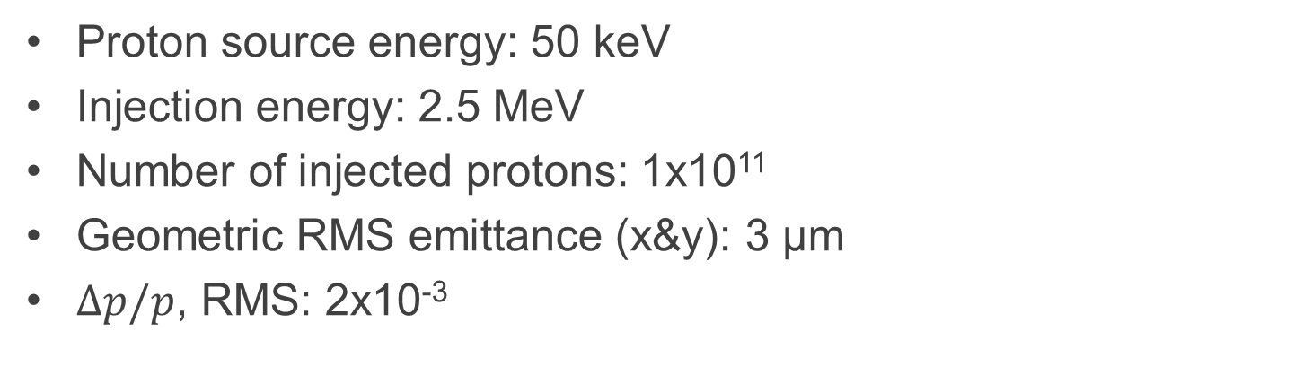
Coming soon: Protons program
Proton source energy: 50 keV
Injection energy: 2.5 MeV
Number of injected protons: 1x10¹¹
Geometric RMS emittance (x&y): 3 µm
$Δp/p$, RMS: 2x10⁻³
Commissioning in 2020
Electrons from FAST
To the HE absorber
Protons line (coming soon)
IOTA ring

Slide 12
Presentation overview
IOTA for intense beams
IOTA capabilities
EIC related experiments
Future plans and proposals

Slide 13
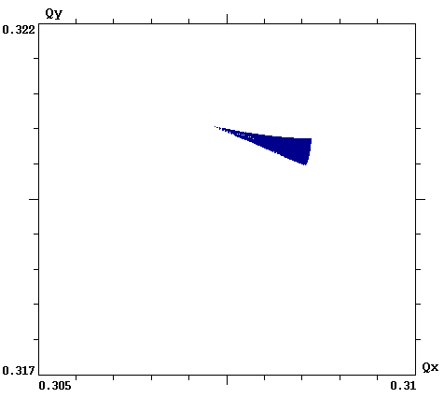
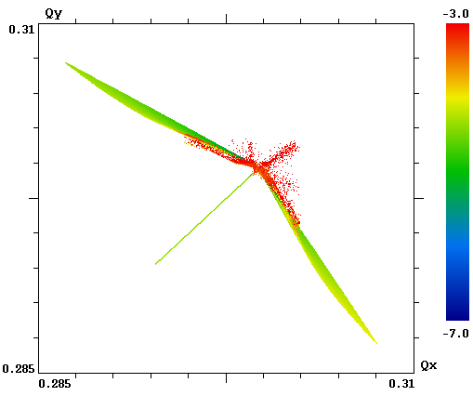
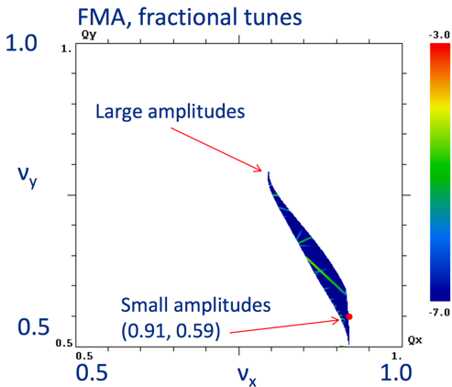
NIO could yield important benefits for future HEP machines
  Reduced chaos in single-particle motion: e.g helpful for space-charge suppression
  Strong immunity to collective instabilities via Landau damping: provides for higher beam current and brightness
  Low cost: brighter beams produce a cascade of cost savings throughout the design, engineering and construction of accelerators
LHC
IOTA w/ Oct.
IOTA w/ NL mag.
ΔQ = 0.001
ΔQ = 0.025
ΔQ = 0.25

Slide 14
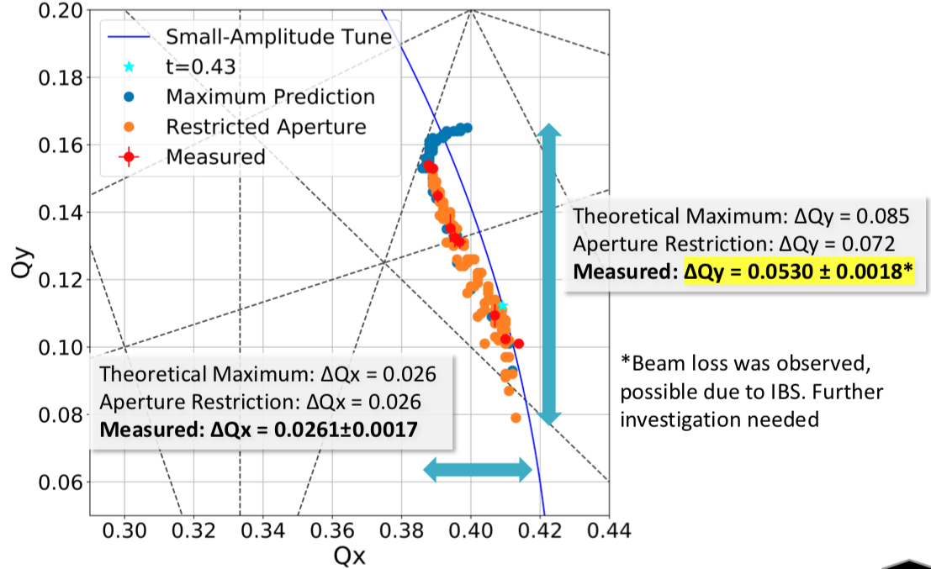
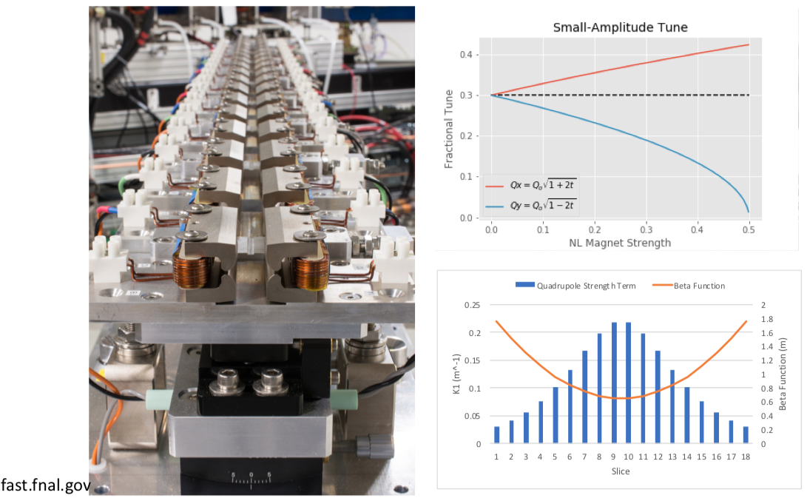
NIO with 2 Invariants of Motion – Special Magnet
(S.Szustkowski, NIU)
60% of prediction
Limited by physical
aperture
made by Radiabeam

Slide 15
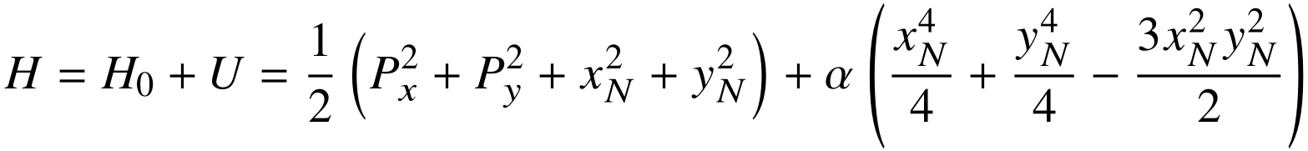
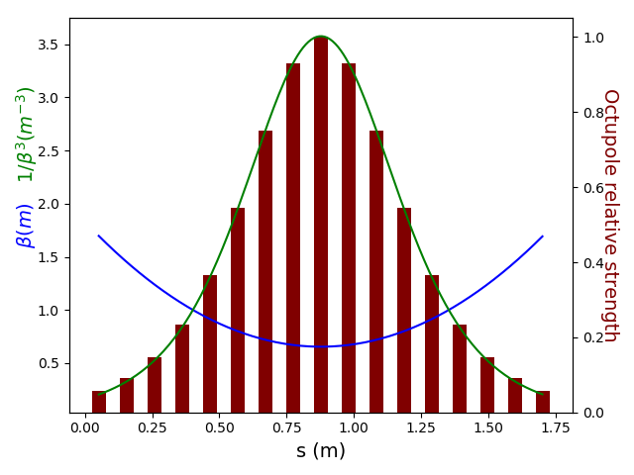
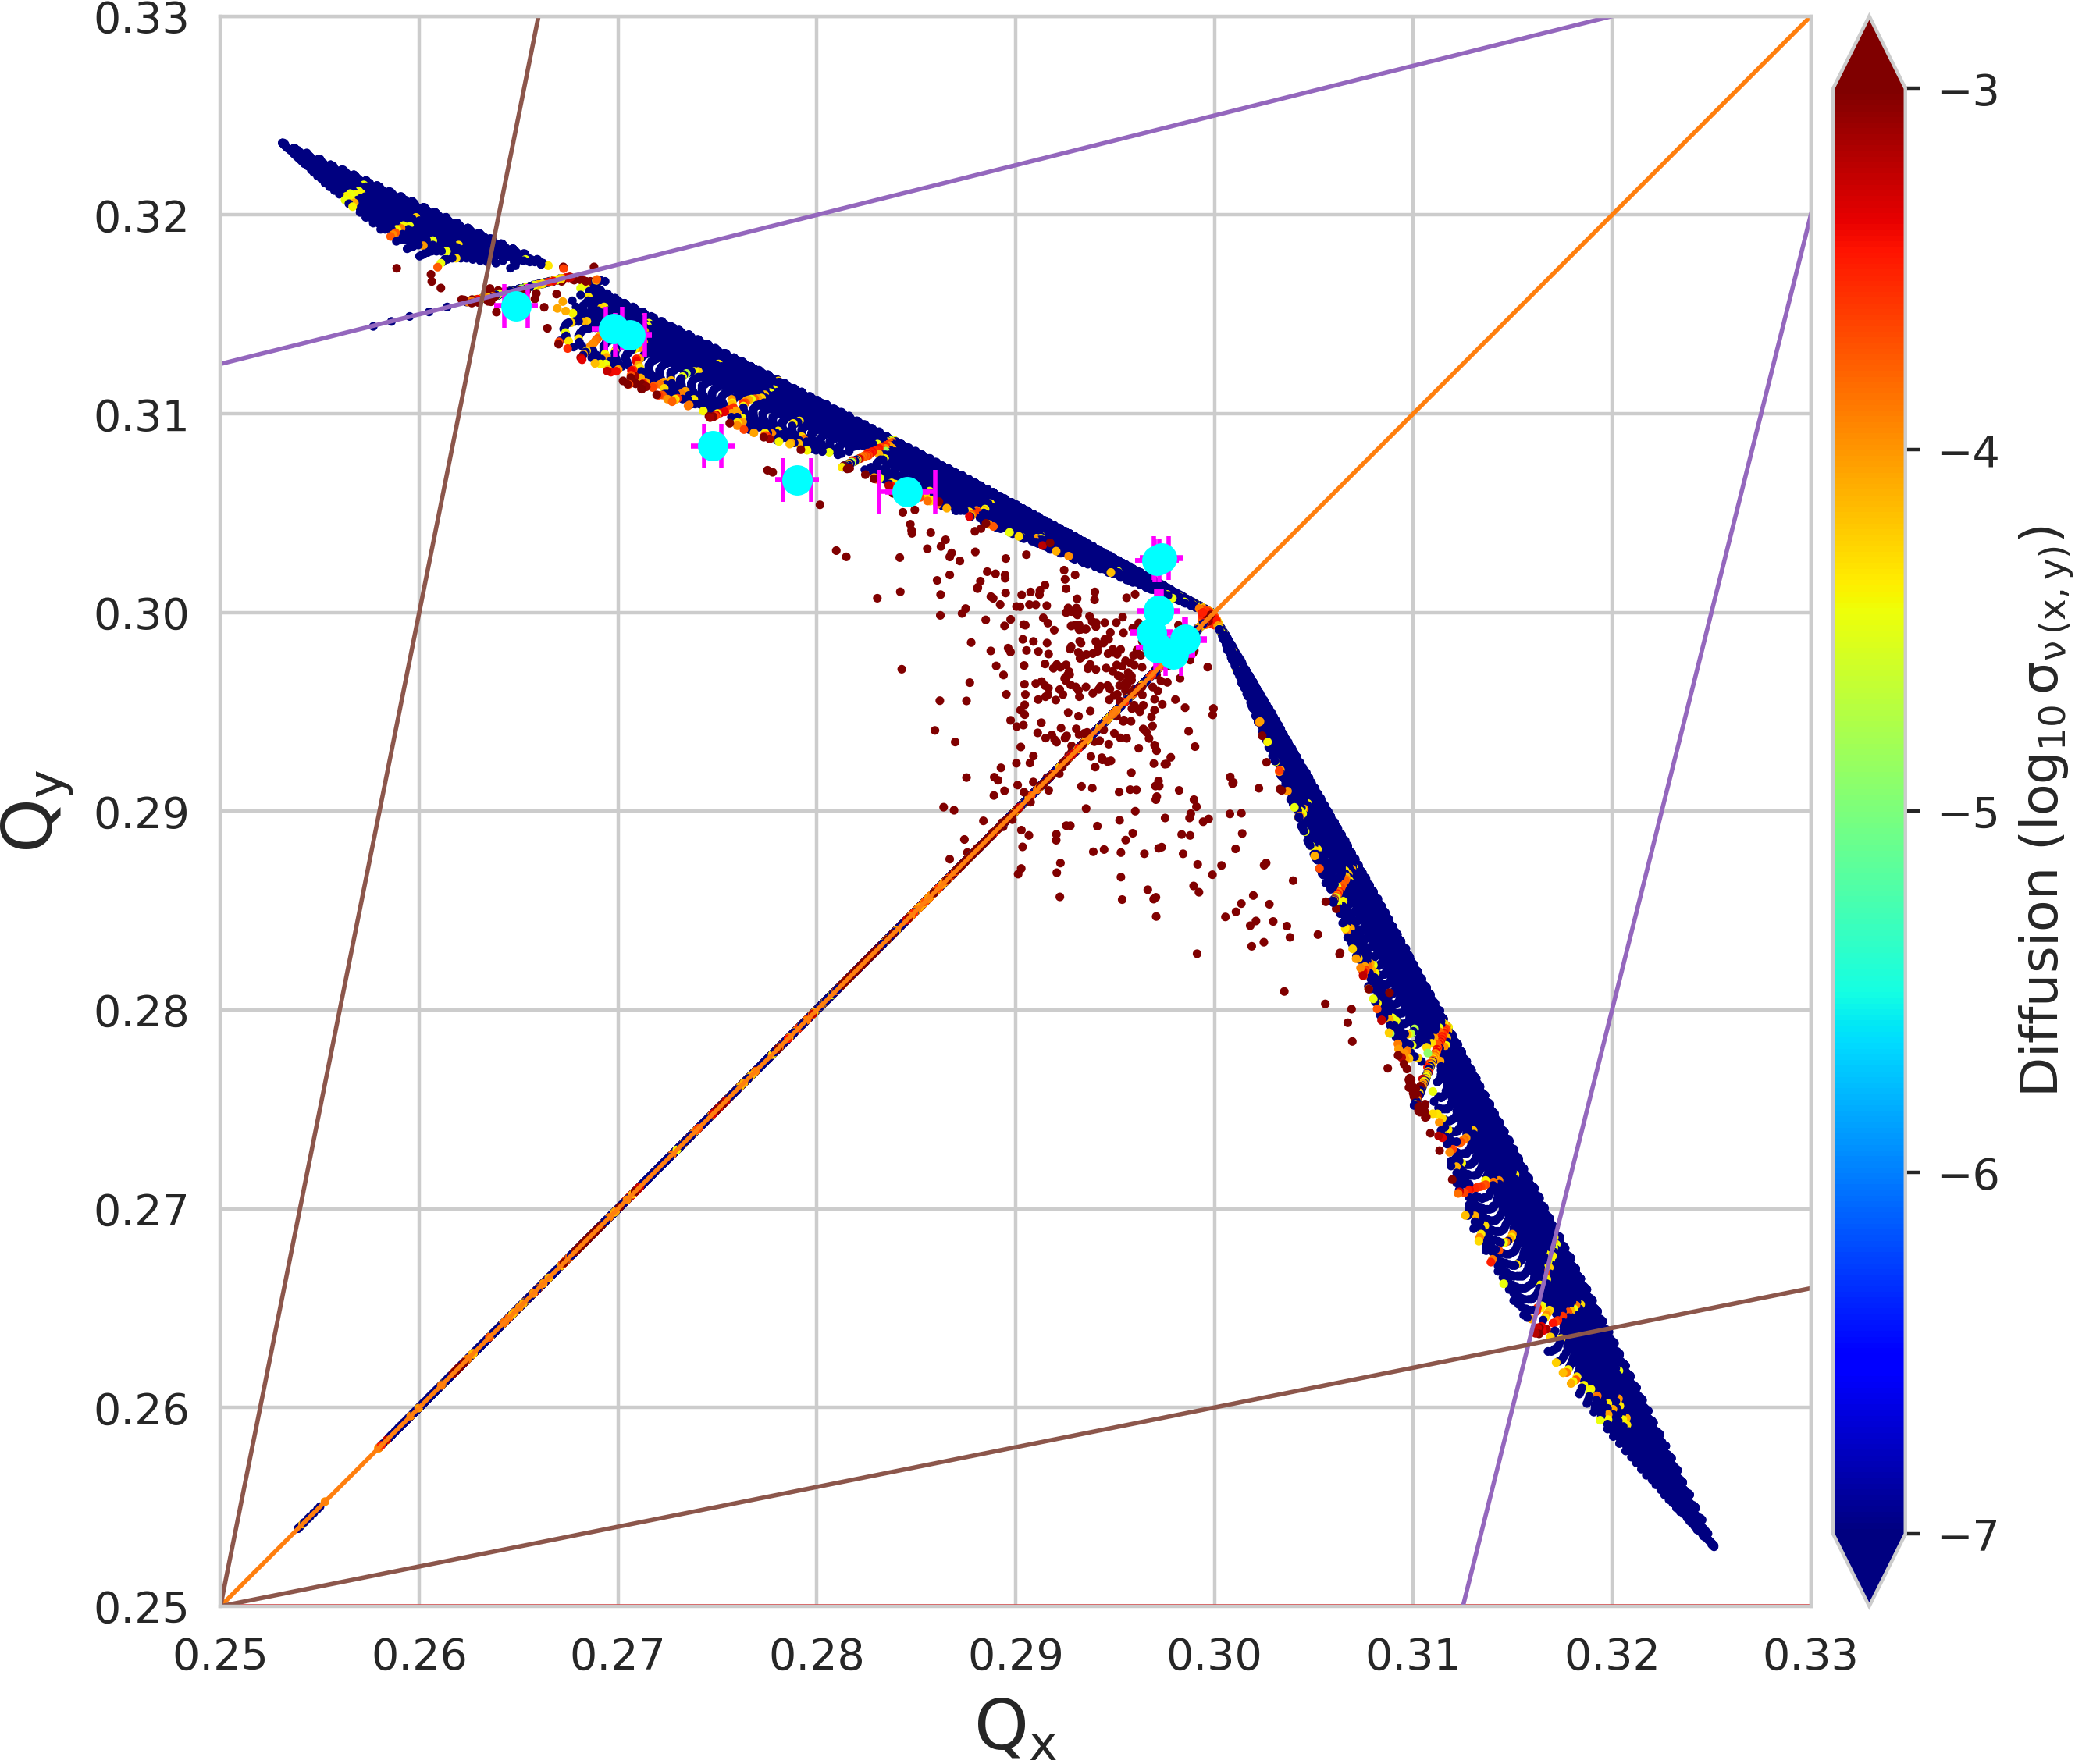
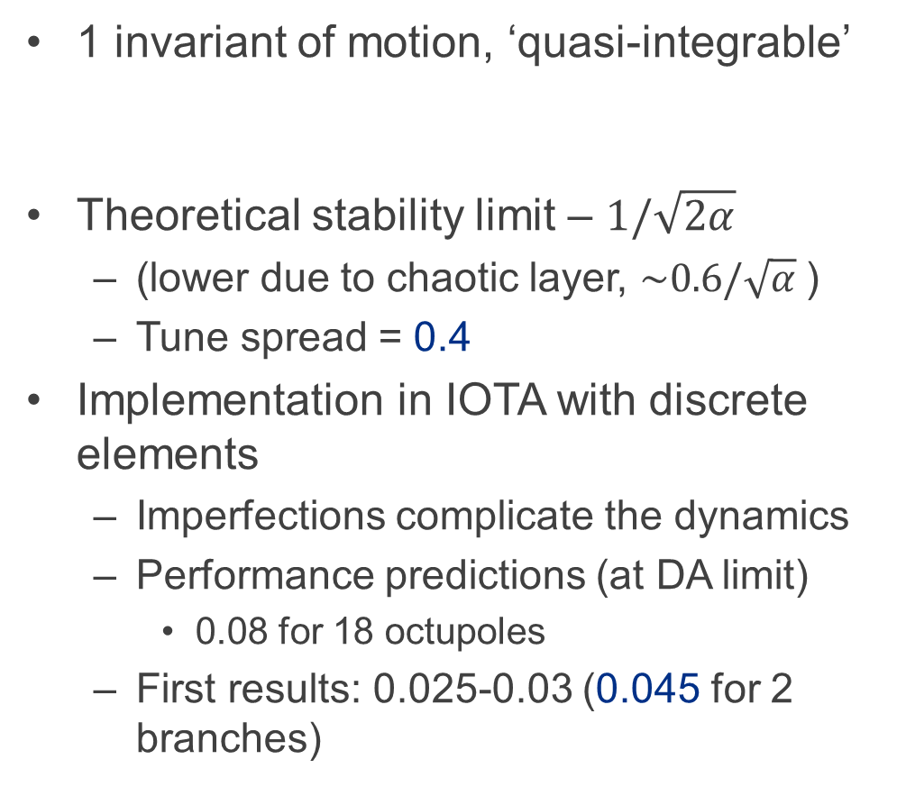
Henon-Heiles Type System with Octupoles
(N.Kuklev, U.Chicago)
1 invariant of motion, ‘quasi-integrable’
Theoretical stability limit – $1/\sqrt{2α}$
  (lower due to chaotic layer, $\sim 0.6/\sqrt{α}$)
  Tune spread = 0.4
Implementation in IOTA with discrete elements
  Imperfections complicate the dynamics
  Performance predictions (at DA limit)
    0.08 for 18 octupoles
  First results: 0.025-0.03 (0.045 for 2 branches)
0.75 Vkick
1A octupoles
ICA+NAFF

Slide 16
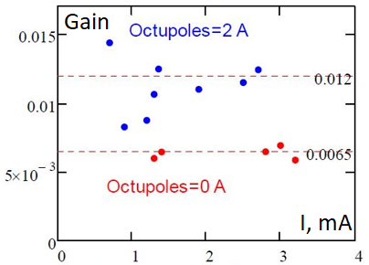
Antidamper experiment: setup
(N. Eddy, Fermilab)
Use a transverse damper to excite controlled instability
Demonstrate instability threshold change when powering quasi-integrable nonlinear optics with octupoles
E2L Button
BPM
~800ps
32db
Horizontal
Kicker
A,B
~20ns
BPM
Analog
Module
A
B
~Position
55db
Diff
Amp
Diff
Amp
Phase
Delay
Att
~20ns
20db
1 Turn
Delay
Demonstrated approximately factor of 2 increase in the instability threshold with octupoles at 2A as compared with 0A

Slide 17
Presentation overview
IOTA for intense beams
IOTA capabilities
EIC related experiments
Future plans and proposals

Slide 18
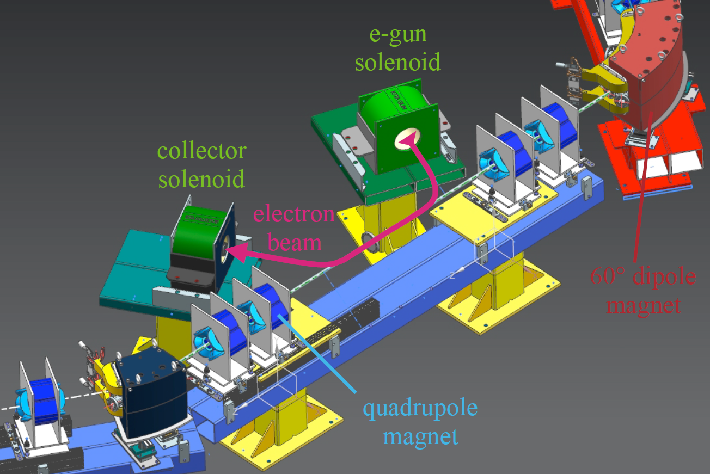
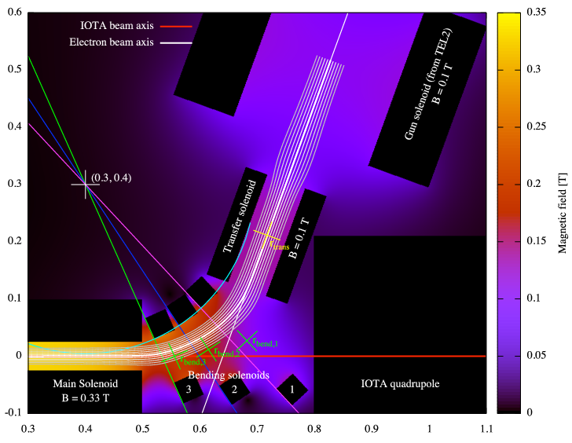
Coming soon: Electron lens
Research with stored electrons:
Novel nonlinear element for integrable optics (using space charge)
Research with stored protons:
Space-charge compensation and Landau damping
Electron cooling: extending performance of IOTA for space-charge studies; cooling studies in a NIO lattice
main solenoid

Slide 19
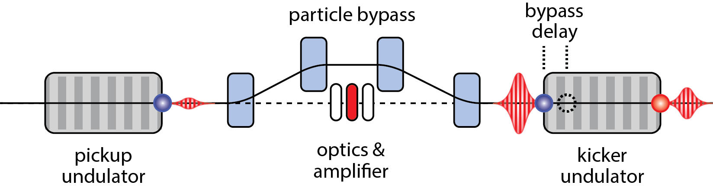
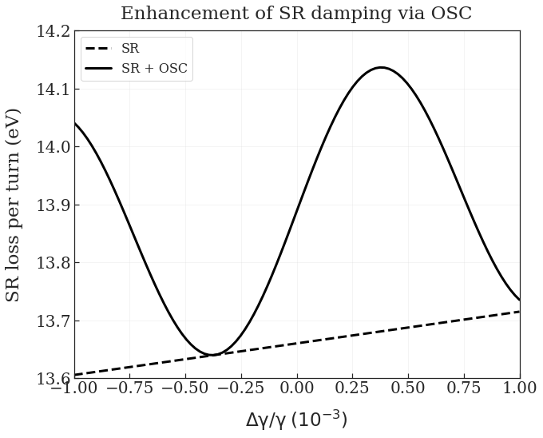
Coming soon: Optical Stochastic Cooling
2
Wavepacket generated
Particle delayed in bypass
Wavepacket amplified and focused
Corrective kick applied
Cooling accumulates over many passes
1
4
5
3
10³ – 10⁴ increase in cooling rate over SC and extension into an energy range where no operational cooling solutions exist
IOTA’s OSC dominates sync. rad. damping by ~20-40x without any optical amplification

Slide 20
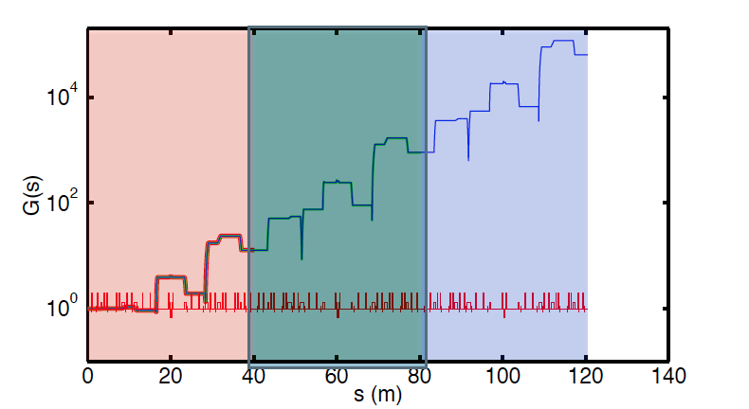
CSR studies
by Rui Li
Microbunching instability occurs when the density modulation in the bunch, as a result of either initial laser profile modulation
Experimental evidence of microbunching instability has been manifested in many accelerators at photocathode gun or shot noise in the bunch
IOTA is a unique circulator ring that can provide transport of electron beams of ultra-high brightness, with a wide range of flexibility of beam parameters and optics in the ring
Initial calculation with free-space CSR impedance has shown that for certain optics and incoming beam parameters the CSR-induced microbunching at IOTA could have a pronounced gain
Gain development along IOTA ring for CSR-induced microbunching instability (for initial modulation wavelength of 2 cm).

Slide 21
Summary
Fermilab has a rich tradition of a world-class accelerator science program, established by R. Wilson and H. Edwards, with its emphasis on operational HEP machines.
  IOTA pushes exploration of new physics beyond HEP boundaries by addressing universal accelerator physics grand challenges.
IOTA/FAST is a unique R&D facility dedicated to the future of intensity-frontier research:
  Electrons and protons, linacs and rings -- concurrently
IOTA also constitutes an excellent platform for technological developments that may be vital for realizing next-gen. facilities.

