Slide 1
Non-Linear Effects and Dynamic Aperture for the EIC
Yuri Nosochkov
Yunhai Cai (SLAC), Fanglei Lin, Vasiliy Morozov (Jlab),
Christoph Montag, Steven Tepikian, Yongjun Li (BNL)
EIC Collaboration Meeting, ANL, October 9–11, 2019

Slide 2
Topics
Correction of non-linear chromaticity for a large momentum range
Off-momentum dynamic aperture (DA)
Misalignment, corrections and DA
Non-linear field errors, tolerances and DA

Slide 3
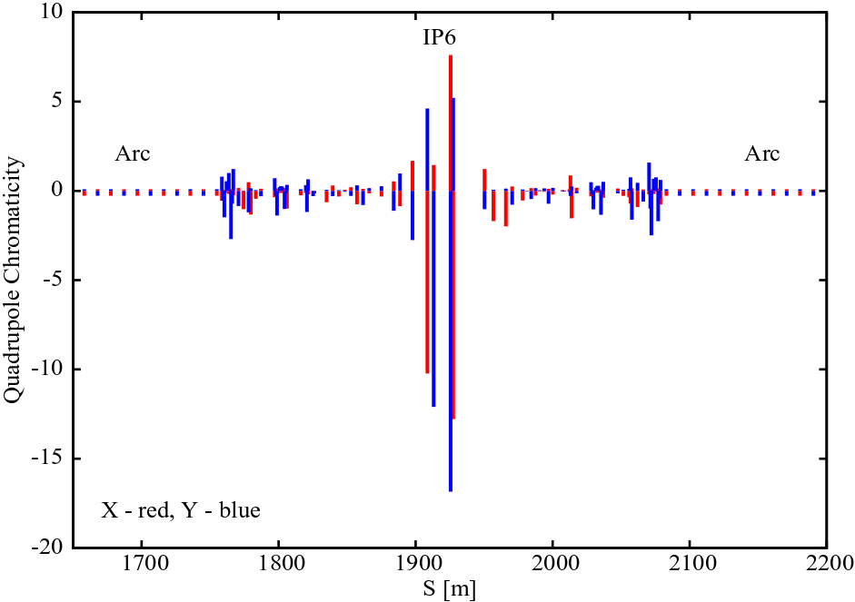
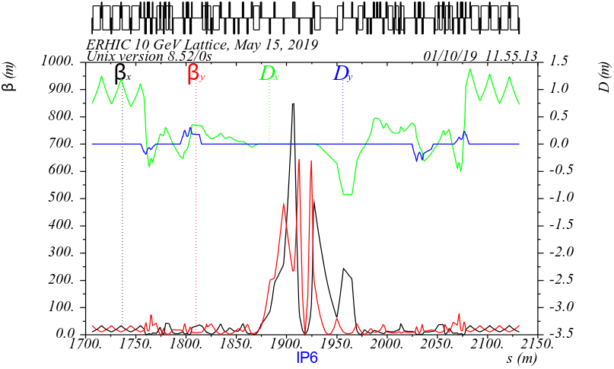
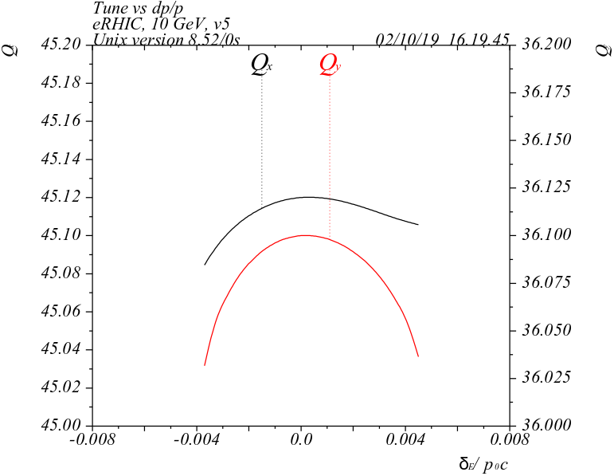
Non-linear chromaticity
Main source of non-linear chromaticity: strong Final Focus Quads (FFQ), where β-function is very large
FFQ create large momentum distortion of β-function causing strong non-linearity of tune with momentum → enlarged momentum tune footprint exposes particles to additional resonances limiting dynamic aperture
Non-linearity increases for tunes near half-integer due to stronger β perturbation near the resonance
Linear chromaticity from quads near IP
eRHIC
First order Δβ₁(δ) from the FFQ creates strong 2nd order (~δ²) momentum tune dependence
2 sextupole families
e-beam
eRHIC

Slide 4
Local correction
Cancel the large Δβ(δ) (W-function) from FFQ by creating an equal but opposite Δβ(δ) wave using dedicated sextupoles placed nπ in phase (in the correction plane) from the FFQ
Independently correct FFQ on each side of IP to cancel Δβ(δ) at the IP and outside of the IR
-I sext
Δβ/β (δ)
FFQ
FFQ
Δβ/β (δ)
-I sext
IP
$$\frac{∆β}{β} \sim −β_{s}{η_{s}K}_{2}lδ$$
$$\frac{∆β}{β} \sim β_{q}K_{1}lδ$$
μ = nπ
Design optics for the sextupoles with:
Large β_{s}η_{s} and large β_{x}/β_{y} (or β_{y}/β_{x}) ratio at the X (Y) sextupoles for acceptable sextupole strength and efficient X & Y correction
Non-interleaved –I sextupole pairs to compensate the sextupole non-linear geometric effects
Low contribution to emittance
The 1st order Δβ/β(δ) and the 2nd order tune shift are corrected with the proper sextupole strengths; the 3rd order tune shift can be reduced by fine tuning of the sextupole phase advance
Two (X & Y) local sextupole families per FFQ and two global families in the rest of the ring for linear chromaticity
Limitations:
Correction is limited to the lower order non-linear tune shift (higher order would require more sextupole families)
The efficiency depends on how close the sextupoles are to the FFQ due to effects of other quads affecting chromatic phase advance between the FFQ and the sextupoles; the presently designed EIC IR straights are relatively long but are filled with other dedicated optics, therefore the closest locations for this scheme are in the arcs (optics changes required)

Slide 5
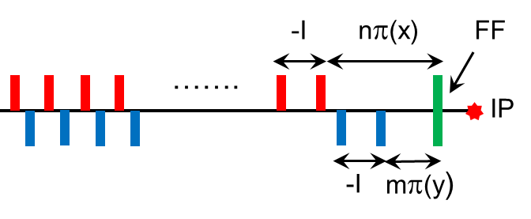
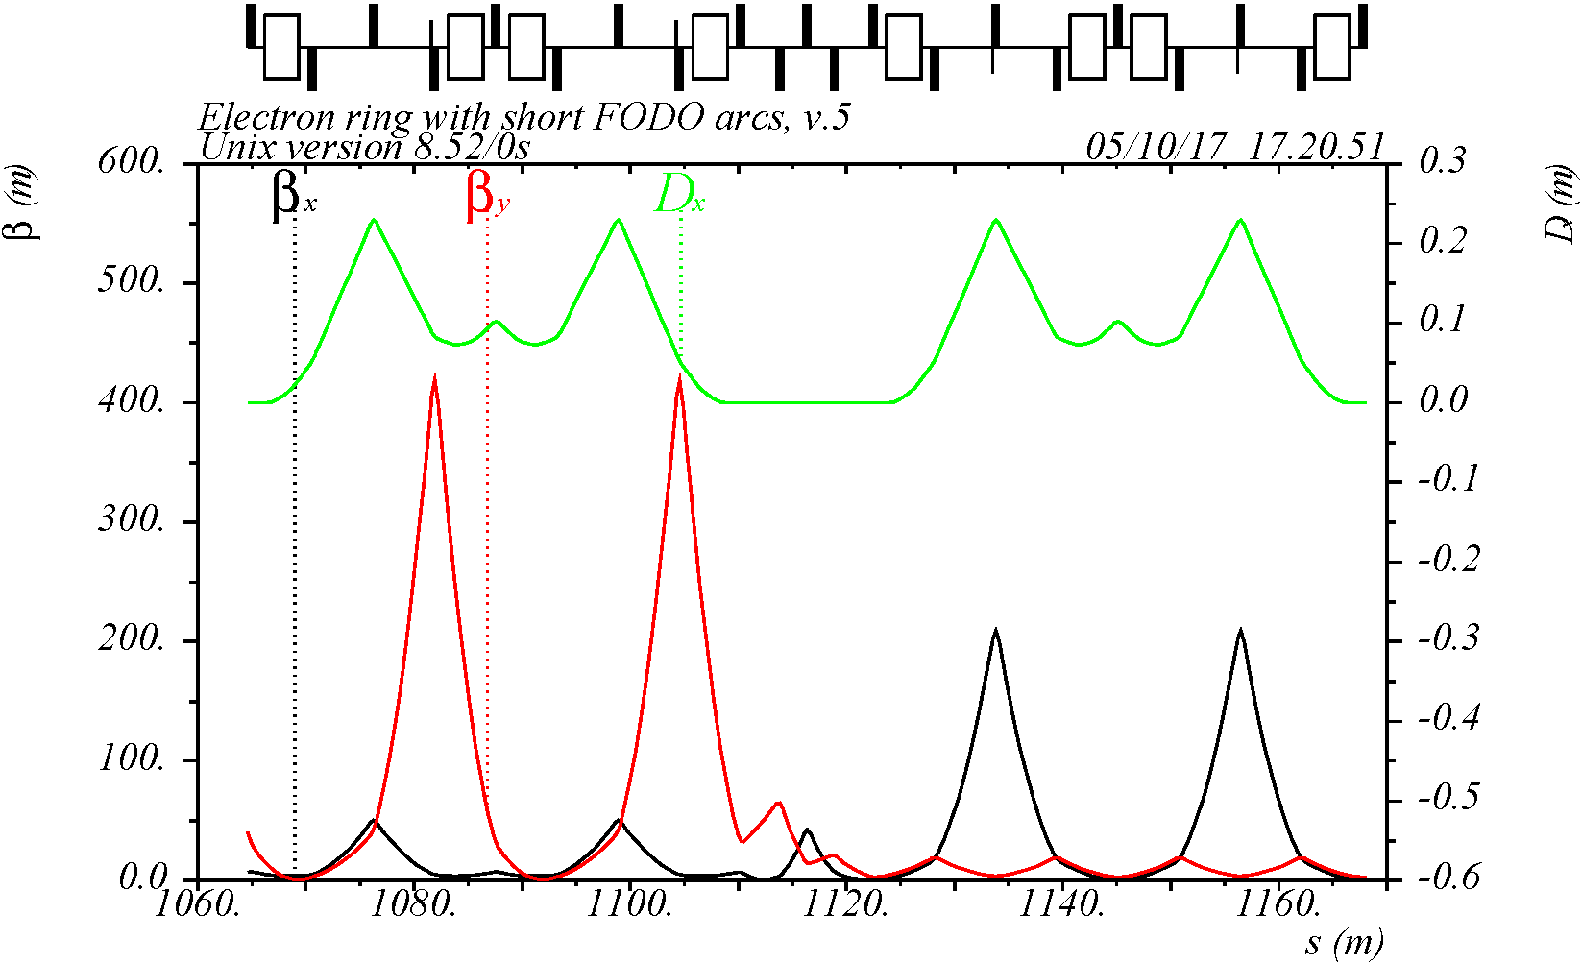
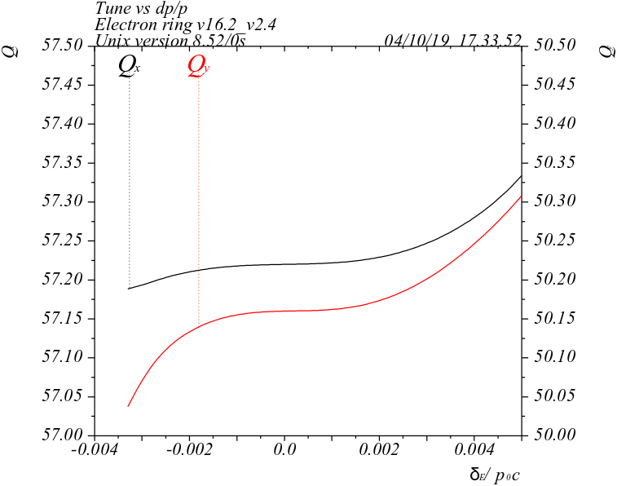
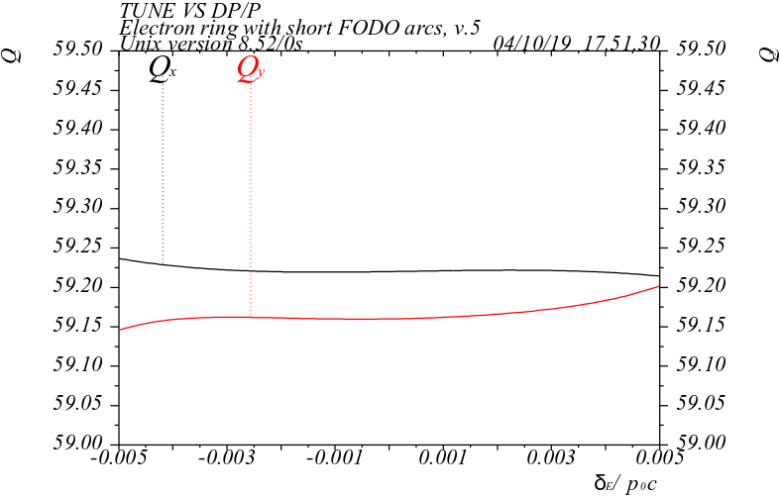
Low emittance chromaticity correction block (CCB)
FF sext
Low emittance CCB with non-interleaved –I sextupole pairs and missing bends based on Super-B scheme
Bends are removed from cells where horizontal beta and dispersion are high to minimize contribution to emittance
Bend strengths are further adjusted for desired emittance
Two CCBs in the arc cells nearest to IP
Linear chromaticity is corrected with conventional 2-family sextupoles arranged in –I interleaved pairs over 2πn phase advance to cancel sextupole resonance driving terms
Linear-ξ sext
Arc cells
Low-emittance CCB with missing bends
w/o local correction
with local correction
JLEIC
JLEIC
-I
S2
S2
S1
-I
S1
8σ_{p}
>11σ_{p}

Slide 6
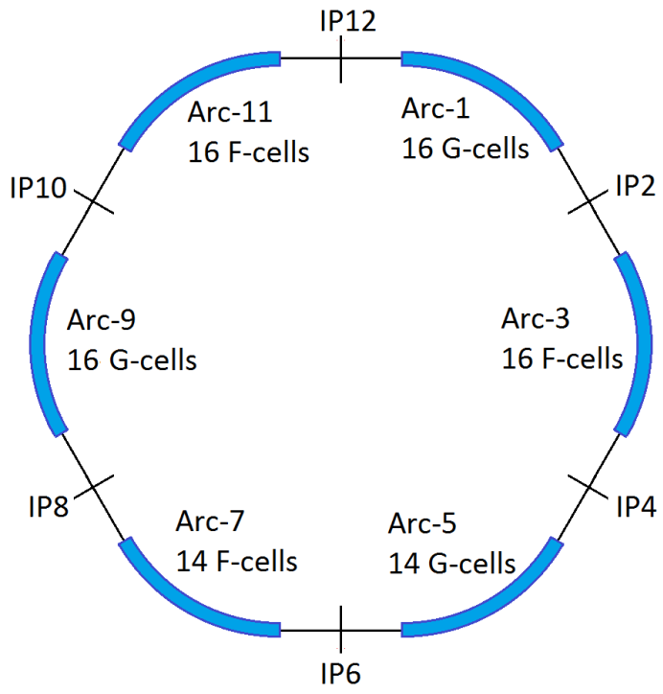
Multi sextupole family chromaticity correction
Chromaticity correction using a large number of sextupole families has been tried in some projects (e.g. for FCC by K. Oide, et al, JACoW-eeFACT2018-MOYAA01)
It uses many sextupole families to minimize high order chromatic terms for maximum momentum range and momentum DA
Relies heavily on numeric optimization of many sextupole strengths
Does not necessarily require special optics and/or special phase advance
Instead it uses the existing different phases of sextupoles to affect the high order chromatic terms
A large number of arcs naturally provides different sextupole phases for the correction
A global multi-family correction scheme is tried for 10 GeV eRHIC with six 60º arcs, also motivated by the BNL team
For this correction, numeric minimization of high order tune shift terms is implemented in LEGO code (Yunhai Cai)
eRHIC

Slide 7
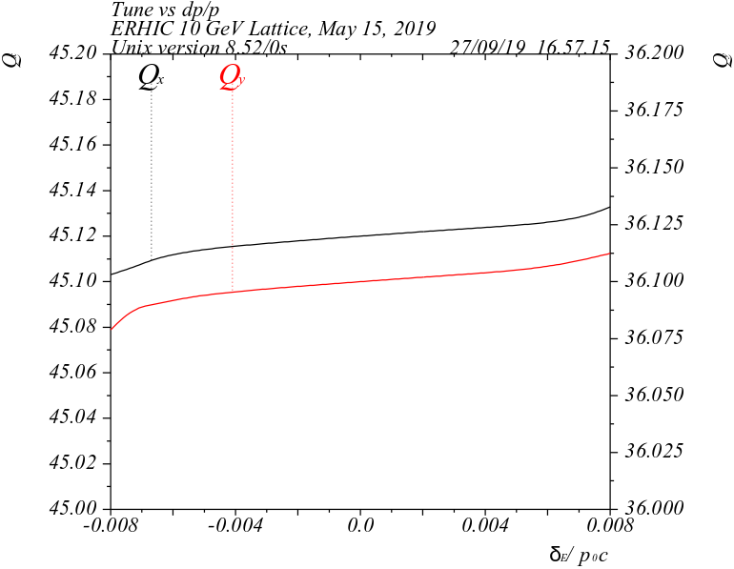
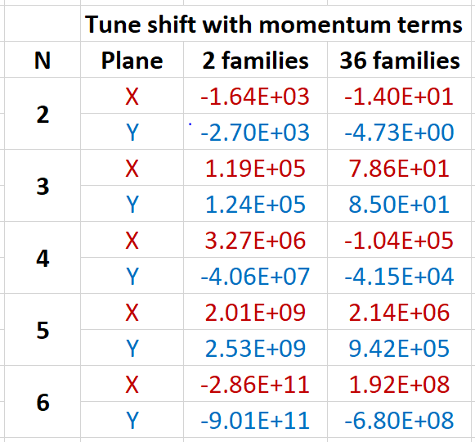
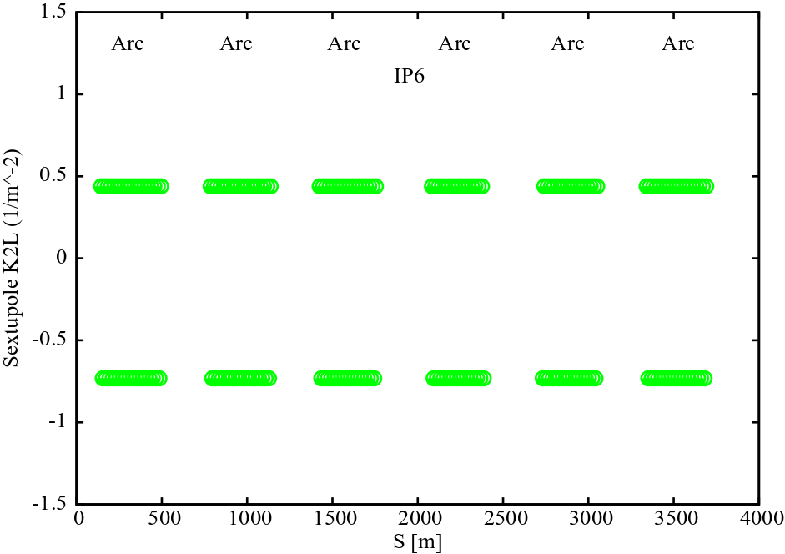
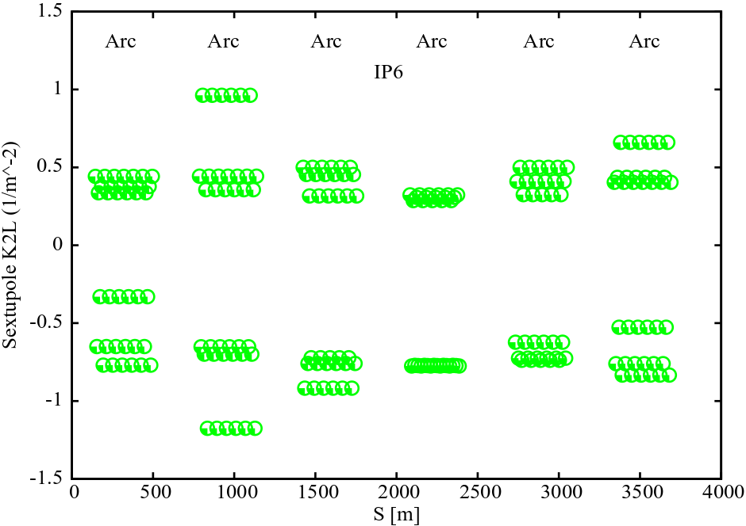
Global correction with 36 sextupole families in six 60º arcs
eRHIC target is a ±1% momentum range at tune of 45.12, 36.10
Correction using 36 sextupole families (6 per arc) arranged in –I pairs has been studied
Obtained optical momentum range is ±0.8%, more than a factor of two compared to 2-family correction
Sextupole strengths are reasonable
No changes to optics
2 families
36 families
eRHIC
eRHIC

Slide 8
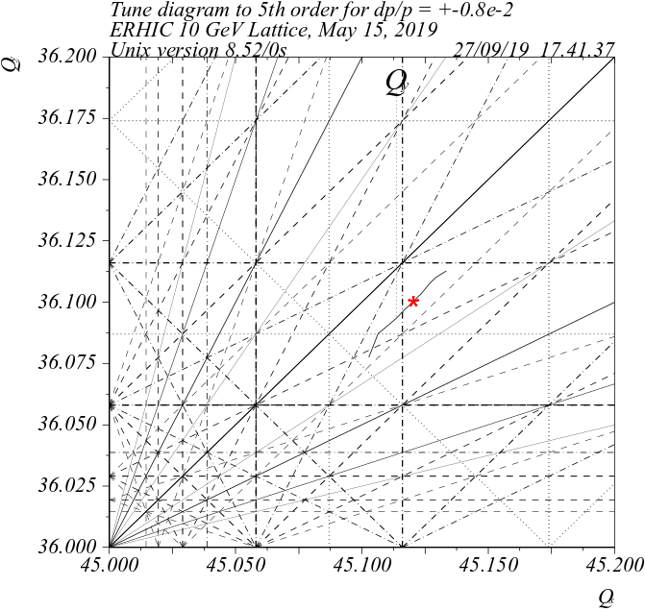
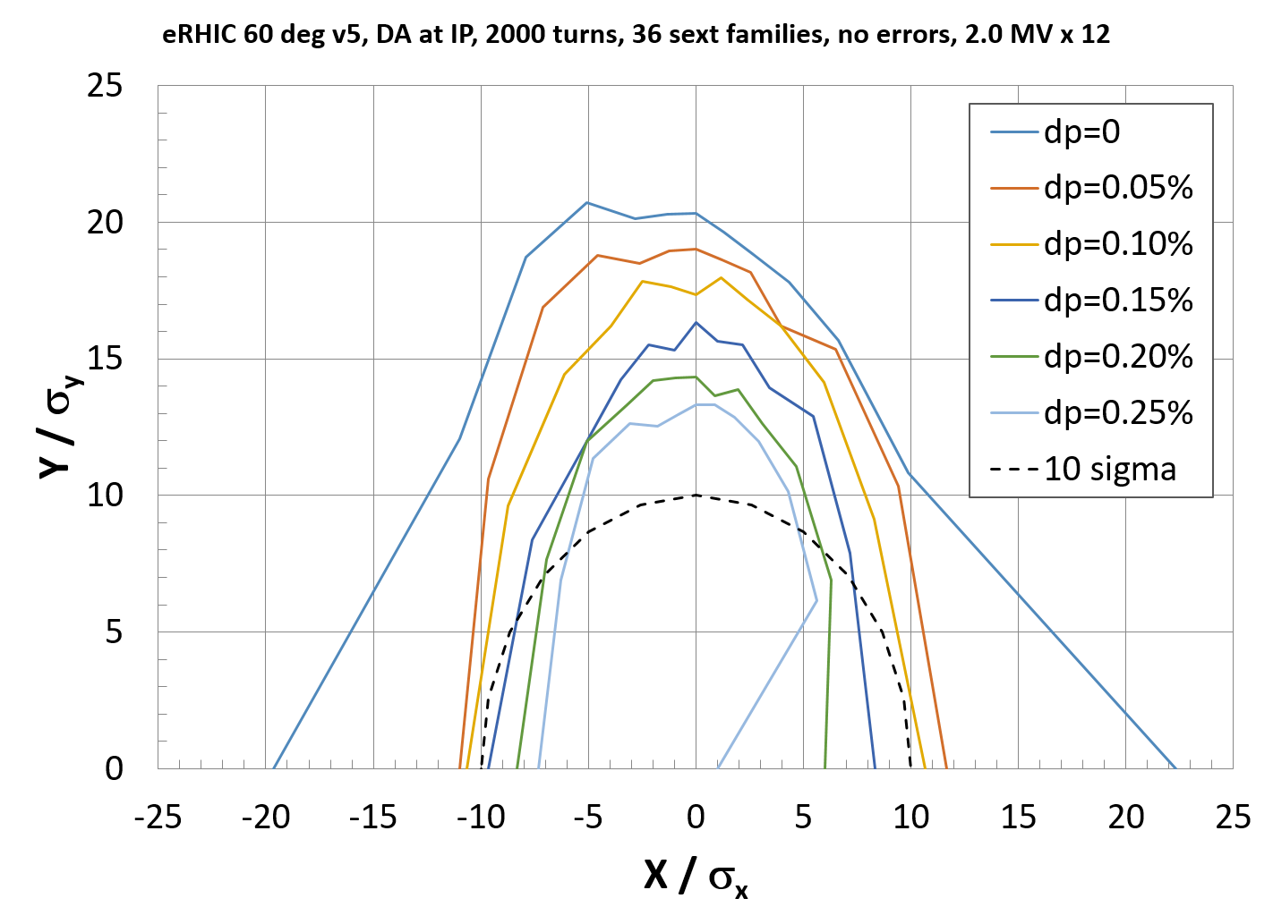
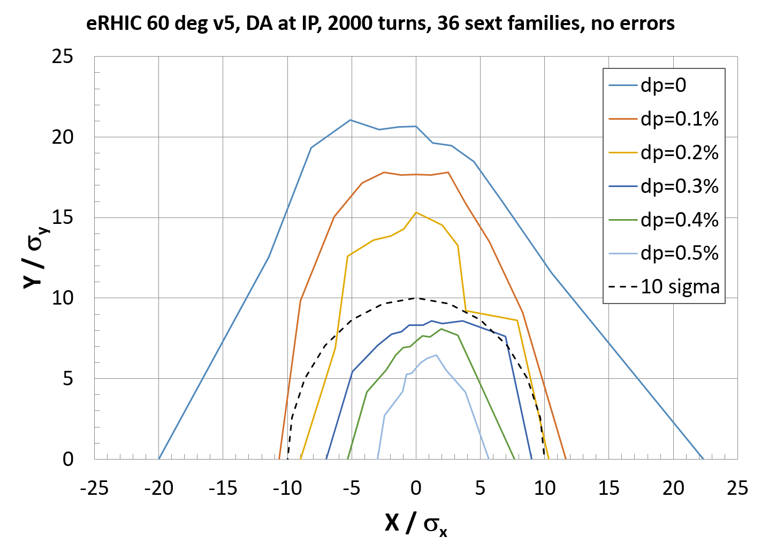
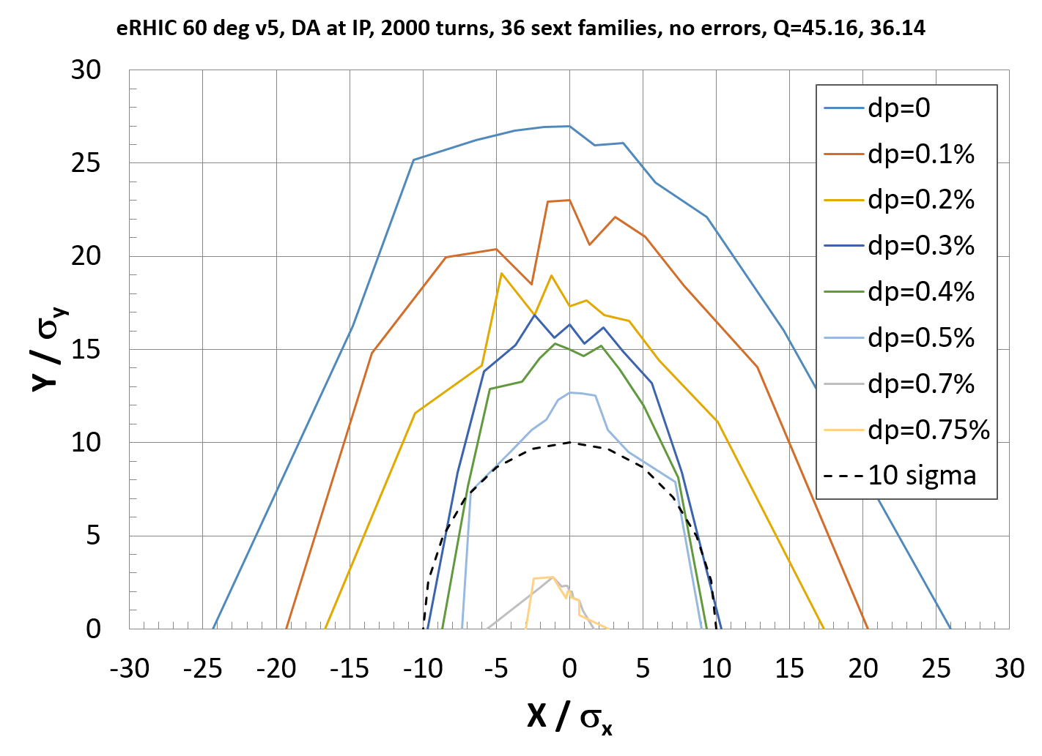
Global correction and momentum DA issues
Without synchrotron oscillations the DA momentum range with 36 sextupoles families agrees with the momentum range from the optics
With synchrotron oscillations the DA momentum range is reduced to ~0.3%
The issue is identified as the synchrotron tune of Qs = 0.0609 close to resonance condition of Qx – 2Qs = 45, where Qx = 45.12, Qy = 36.10
Reducing the voltage by 10% for smaller Qs = 0.0578 increases the range to 0.5%, but still below the optical range
Trying a different tune of 45.16, 36.14 shows stable DA at 0.75%, but instability occurs at about 0.6%
More detailed tune scan and cancellation of 2nd order dispersion at RF cavities are planned to be studied – work in progress
V = 24 MV, Qs = 0.0609
V = 21.6 MV, Qs = 0.0578
V = 21.6 MV, Qxy = 45.16, 36.14
Qx – 2Qs = 45
for Qs = 0.0578
eRHIC
eRHIC
eRHIC
Beam sigma is based on “fully coupled emittance”
ε_{x} = 24 nm,
ε_{y} = ε_{x}/2 @ 10 GeV

Slide 9
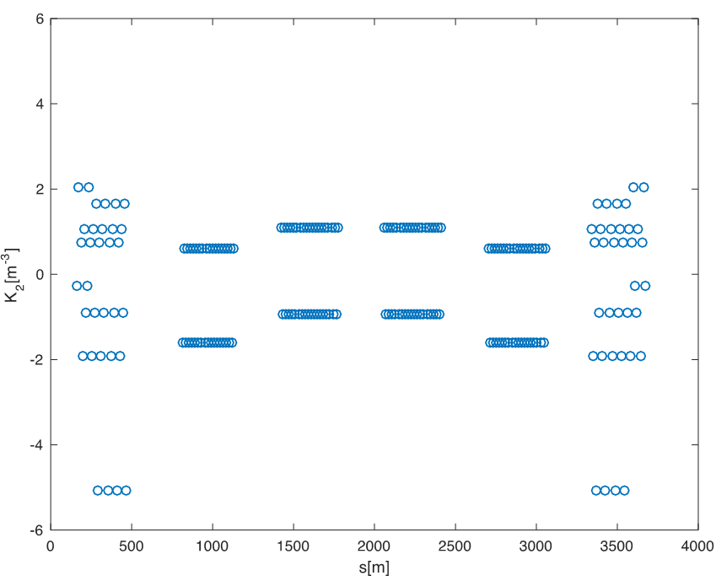
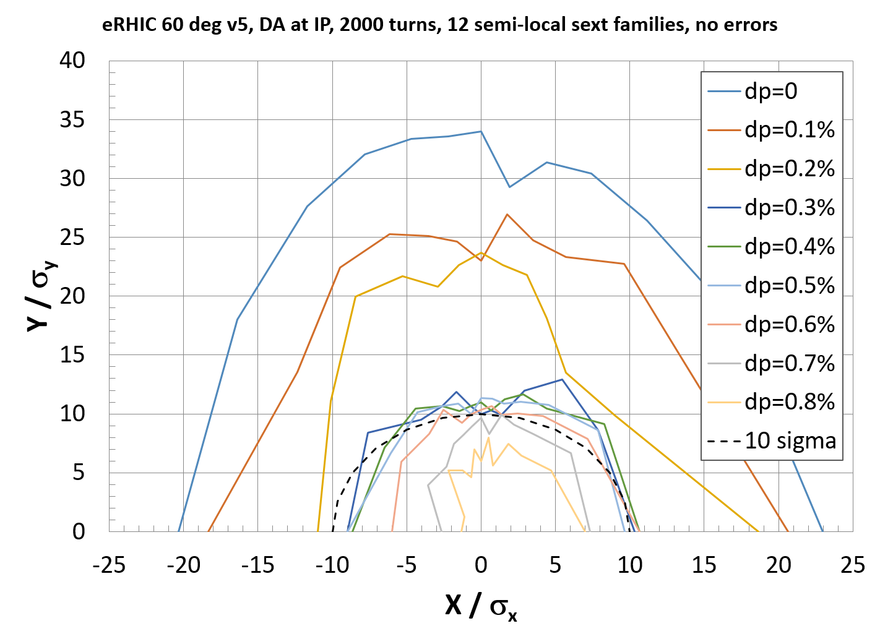
Semi-local scheme with 12 sextupole families and the DA
The DA momentum range improves to 0.8% with another correction scheme using 12 sextupoles families arranged in –I pairs symmetrically relative to the low-beta IP
This scheme is called semi-local since most of the non-linear correction is done using families in the two arcs adjacent to the IP, while sextupoles in the other arcs primarily correct linear chromaticity
In this scheme, in addition to the sextupole strength optimization, phase advance of the straight sections is also optimized using thin-lens trombones
Sextupole K-values, where IP6 is at S = 0
V = 21.6 MV, Qs = 0.0578, Qxy = 45.16, 36.14
eRHIC
For “fully coupled emittance”
ε_{x} = 24 nm,
ε_{y} = ε_{x}/2 @ 10 GeV
DA calculation using LEGO tracking with 2000 turns
eRHIC

Slide 10
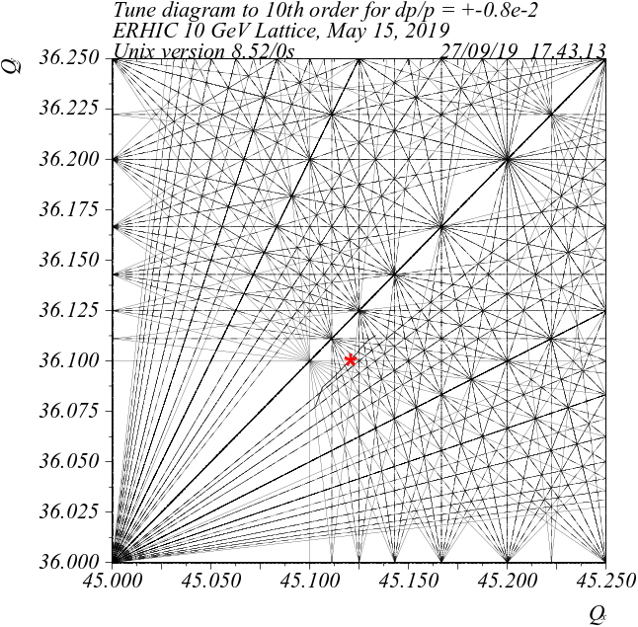
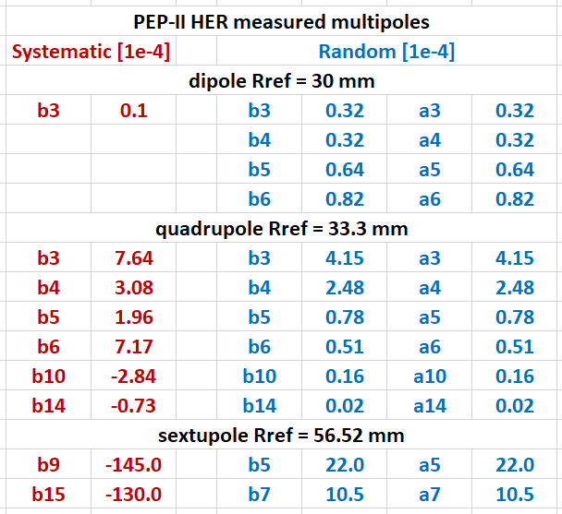
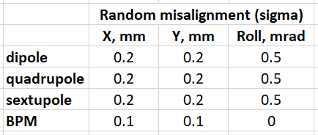
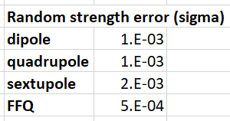
Non-linear field imperfections and other errors
High order magnet field errors (b_{n}, a_{n} multipoles) create non-linear kicks ~b_{n}β^{n/2} and excite high-order resonances limiting the DA
The DA is most sensitive to FFQ multipoles due to the FFQ high β functions
Other studied errors include misalignment and magnet strength errors
DA is obtained in LEGO tracking, typically for 2000 turns, including corrections of tune, linear chromaticity, orbit, coupling, β functions and vertical dispersion
Studied multipoles are based on PEP-II magnets and other available data
Misalignment and strength error tolerances are estimated
Resonance diagram to 10th order
*
* Present design working points:
.12, .10 and .22, .16

Slide 11
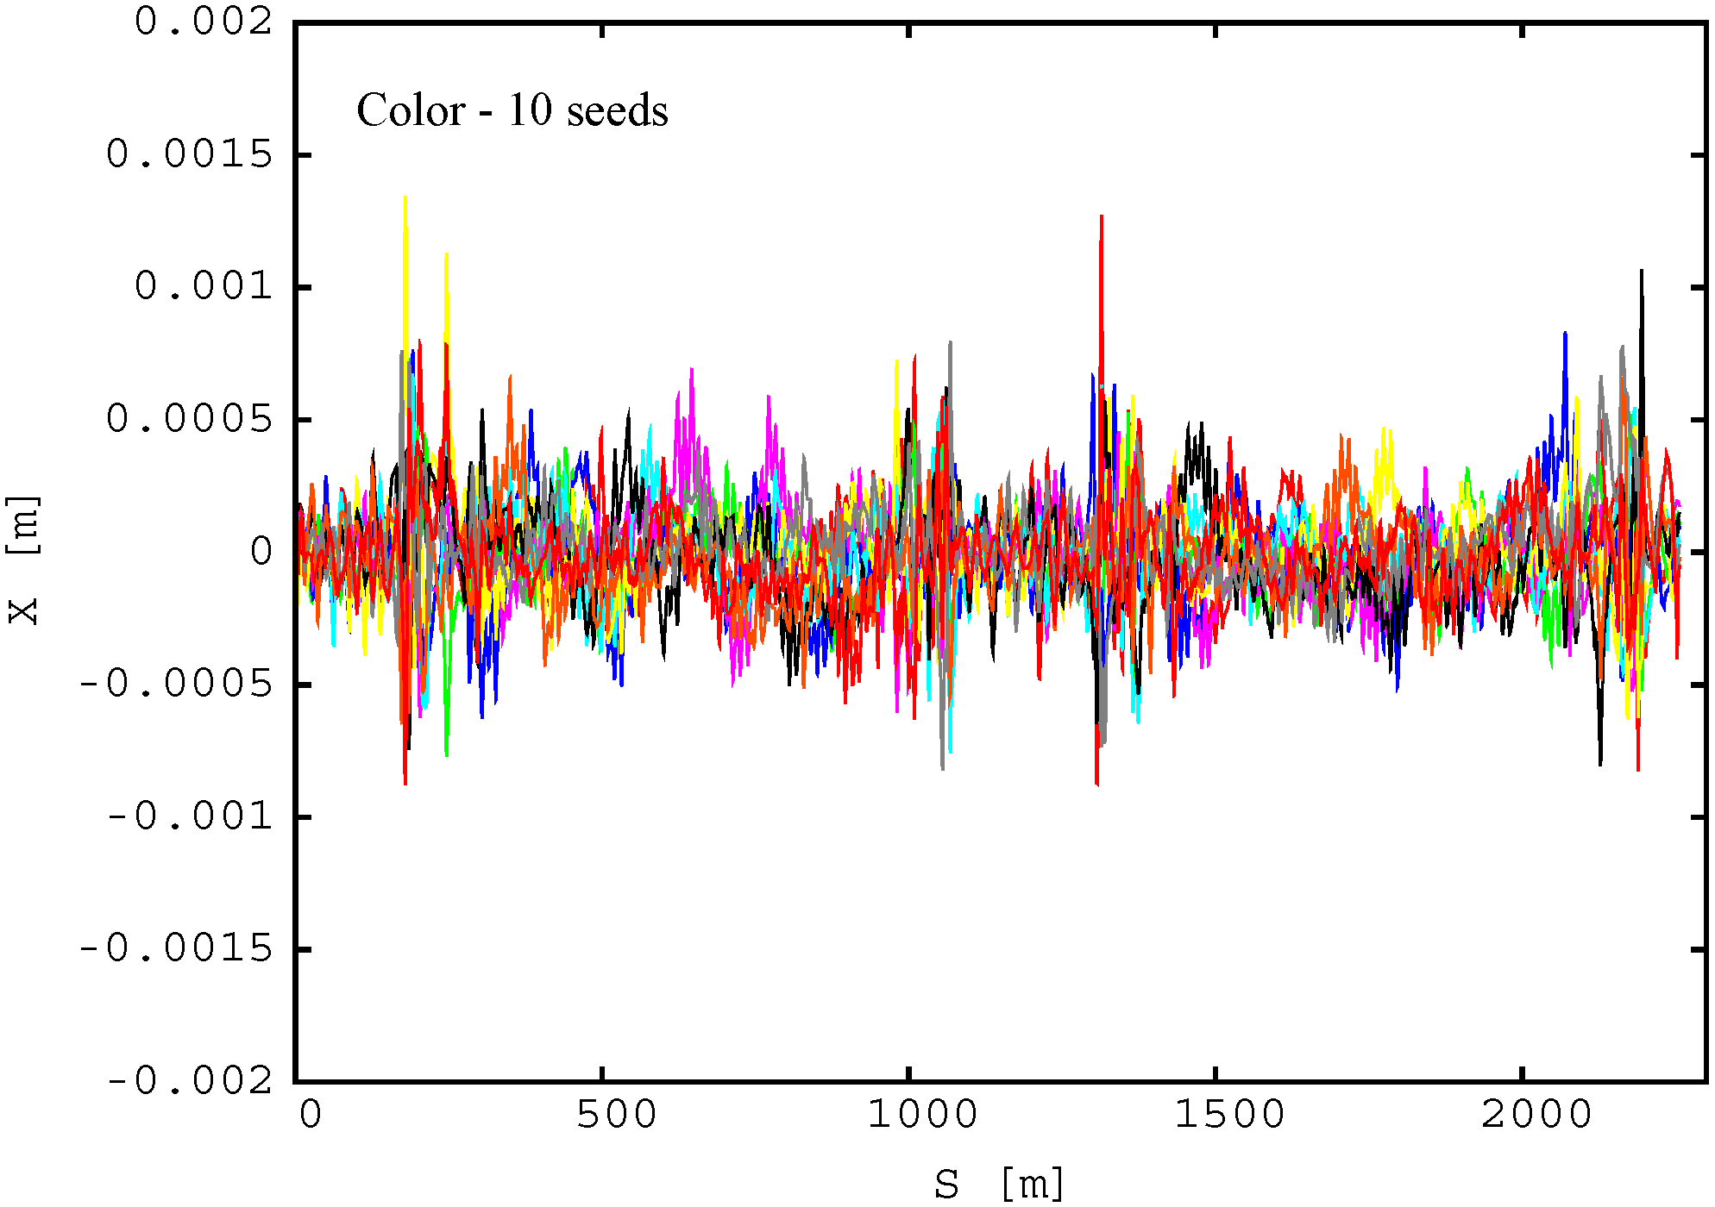
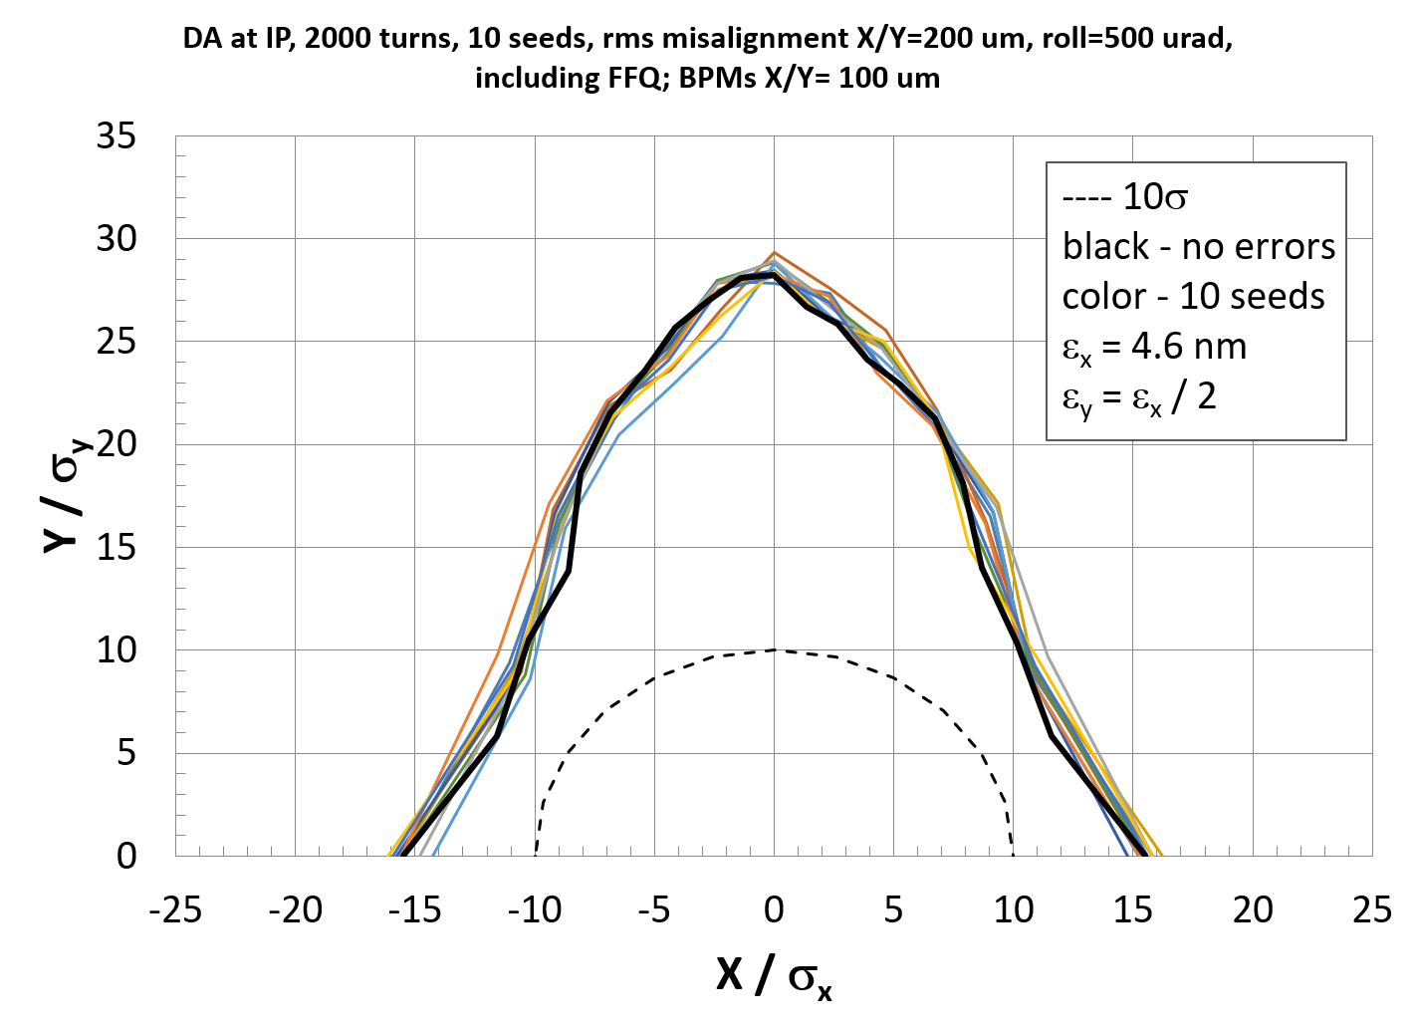
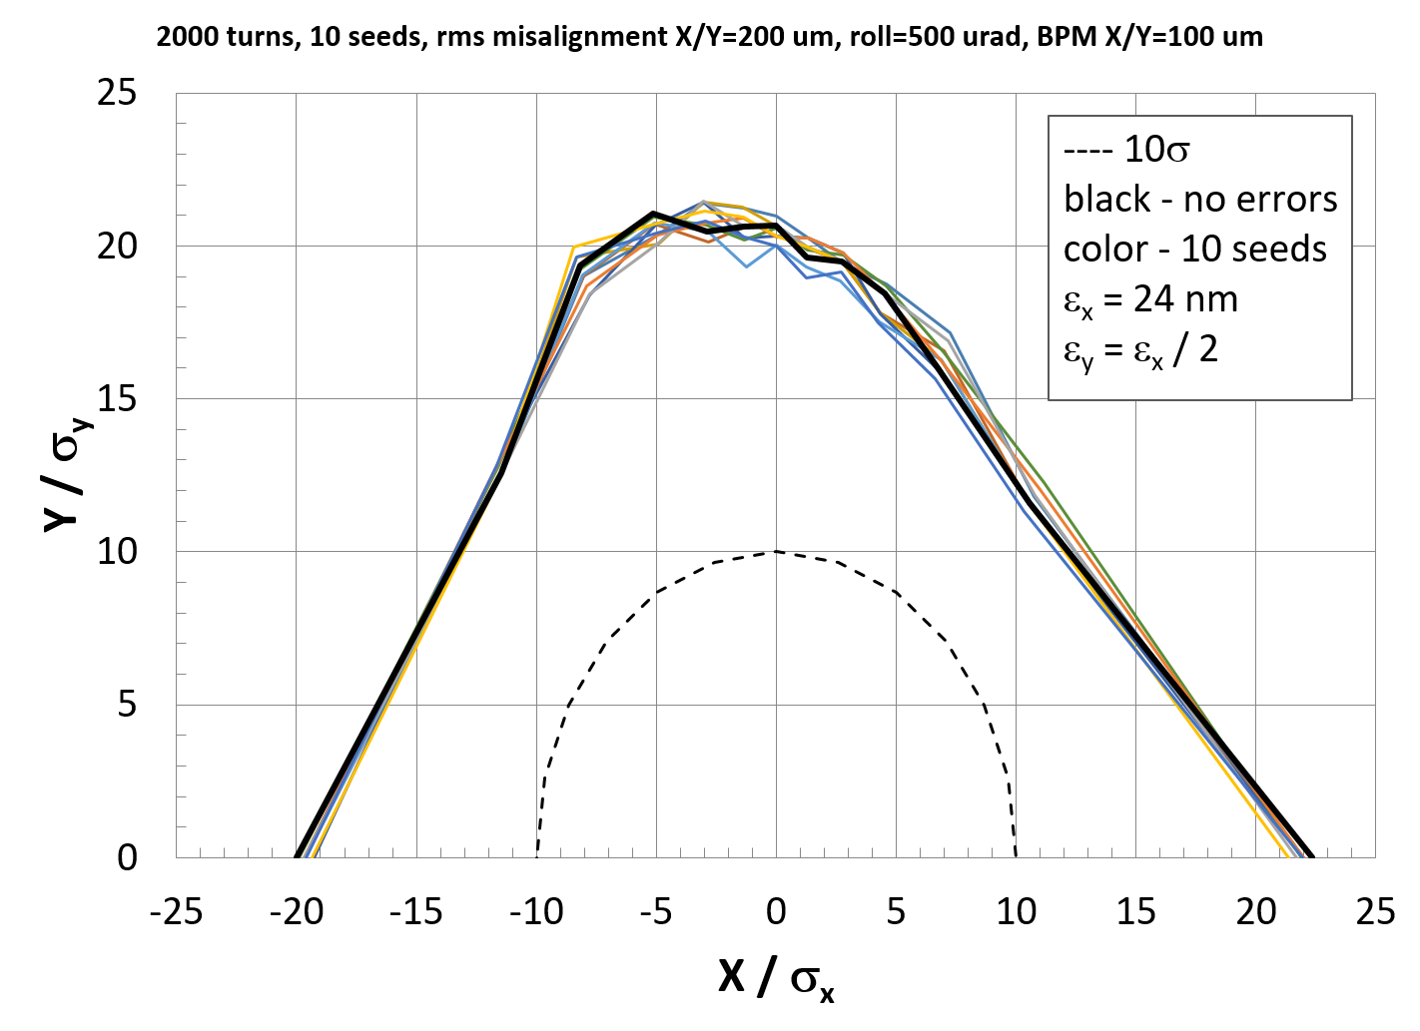
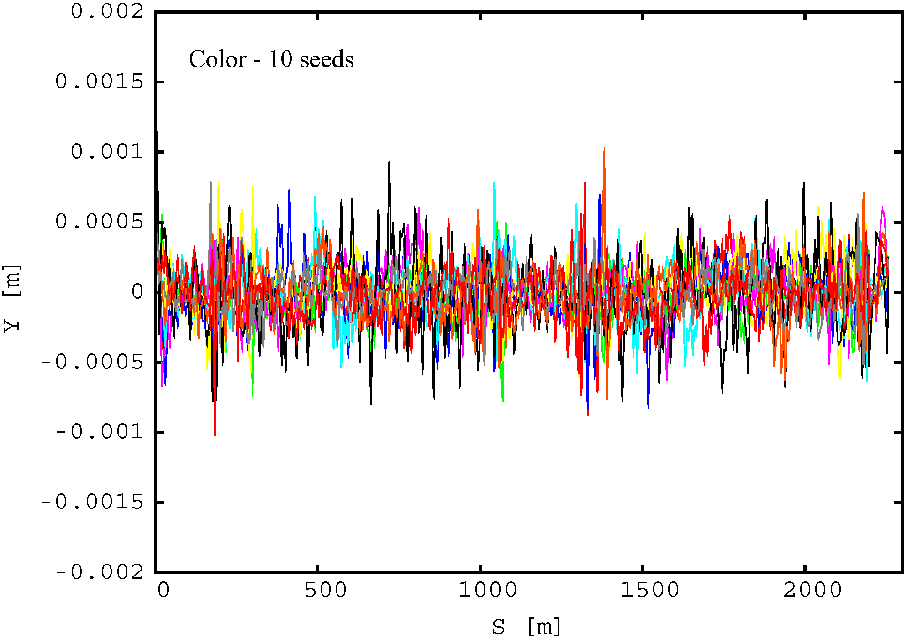
Misalignment, correction and DA
X
Magnet offsets and roll errors create orbit, dispersion, coupling and focusing effects
In the simulations, these effects are compensated using corrections
Typical rms orbit after correction is in the range of 200 – 300 μm
After the corrections, the effect of misalignment on the DA is small
JLEIC
Y
JLEIC
5 GeV
eRHIC
10 GeV
JLEIC

Slide 12
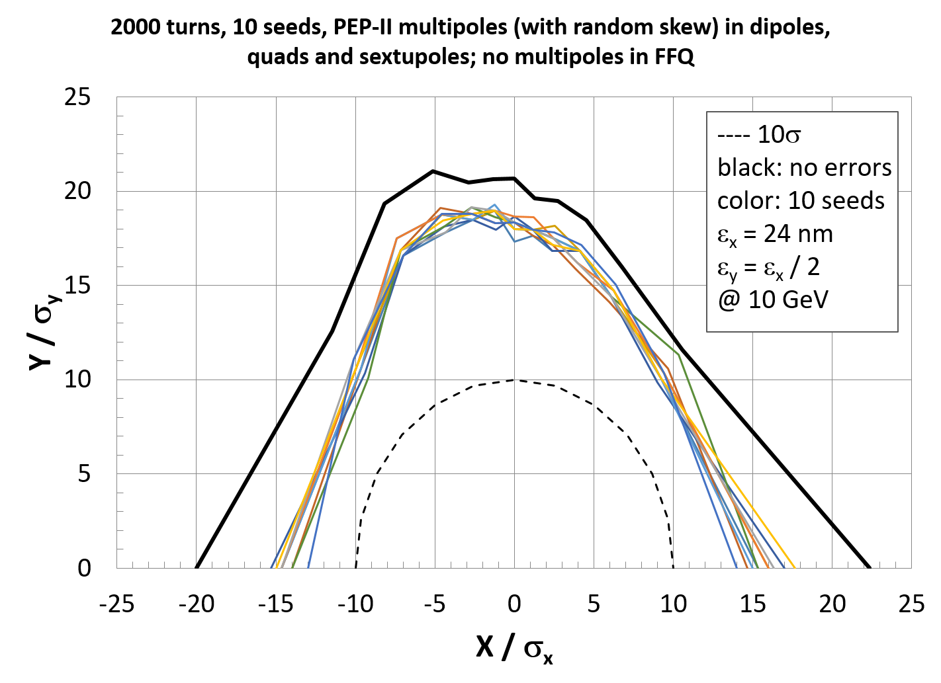
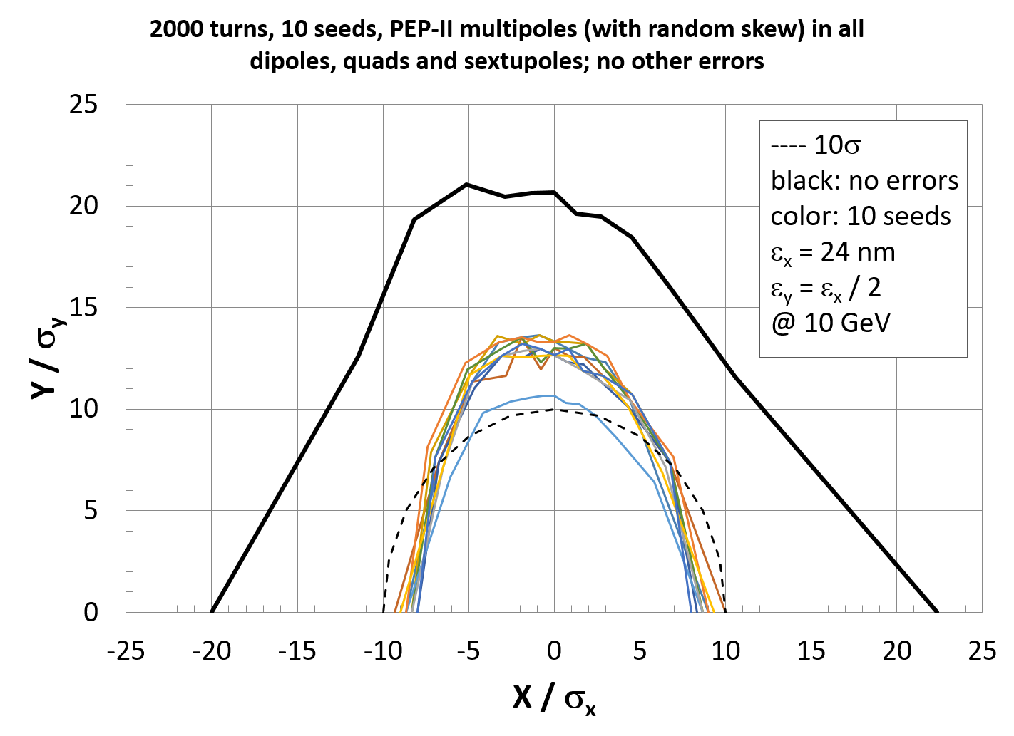
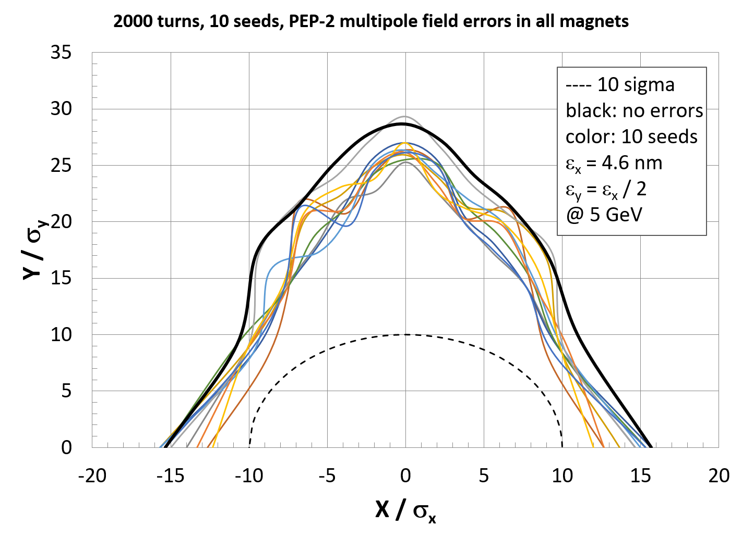
PEP-II multipoles and DA
With PEP-II multipoles in all magnets except FFQ, the DA is comfortably above 10σ
With PEP-II multipoles in all magnets (including FFQ), the DA is above 10σ at 5 GeV, but below 10σ at 10 GeV due to larger beam sigma (emittance ~E²)
For DA > 10σ at higher energy, better FFQ field quality is needed, if optics is the same
The DA w/o errors is larger for 60º arc optics (eRHIC) compared to 108º optics (JLEIC), but the effect of multipoles dominates the DA and makes it comparable for both optics (at the same energy)
No multipoles in FFQ, 10GeV, ε=24nm
With multipoles in FFQ, 10GeV, ε=24nm
With multipoles in FFQ, 5GeV, ε=4.6nm
eRHIC
60 deg
eRHIC
60 deg
JLEIC
108 deg

Slide 13
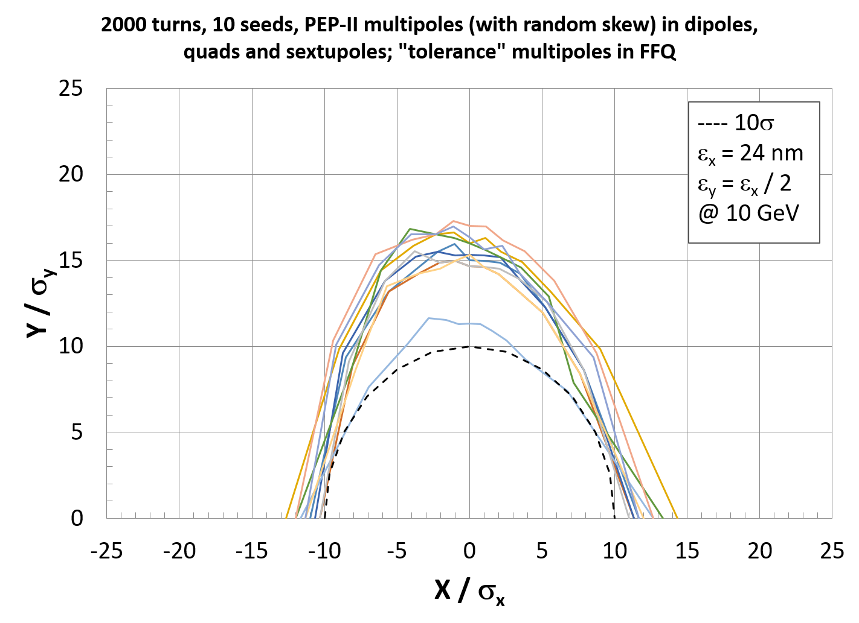
DA sensitivity to multipoles and tolerances
Preliminary DA study identified n = 10 & 14 multipoles as most critical at tune of .12, .10 (eRHIC)
DA at tune of .22, .16 (JLEIC) shows sensitivity to b4 & b5 multipoles, likely due to the nearby 4th and 5th order resonance lines
DA calculations are also done with other available multipole data from HL-LHC, SuperKEKB and the JLEIC FFQ design by G. Sabbi – the DA is comparable or somewhat better than with PEP-II multipoles
More detailed FFQ tolerance study is still needed – work is in progress
Preliminary tolerance
@10 GeV (eRHIC)
eRHIC with tolerances
DA ~ 10σ @ 10 GeV
FFQ multipoles | Tolerance at R = 33.3 mm (10⁻⁴ units)
b6 (S) | 2.5
b10 (S) | 0.07
b14 (S) | 0.01
a10, b10 (R) | 0.05
a14, b14 (R) | 0.01

Slide 14
Summary
Chromaticity correction for a large momentum range has been studied
2-family scheme is limited to linear chromaticity correction and ~0.3-0.35% range
Local scheme with –I pairs and dedicated sextupole optics compensates low order non-linear tune shift for ~0.5% range
Global scheme with many families can compensate higher order terms for 0.8% range – further improvement is under study
Impact of non-linear field and other errors on DA is evaluated using multipole data from PEP-II and other machines and designs
Misalignments after correction do not significantly affect the DA
DA with the studied FFQ multipoles is above 10σ at lower energy (5 GeV) but reduces below 10σ at > 7-8 GeV, assuming the same optics
Estimated multipole tolerances for 10σ DA at 10 GeV look tight – further study is needed

Slide 15
Thank you for your attention!

Slide 16
Back-up slides

Slide 17
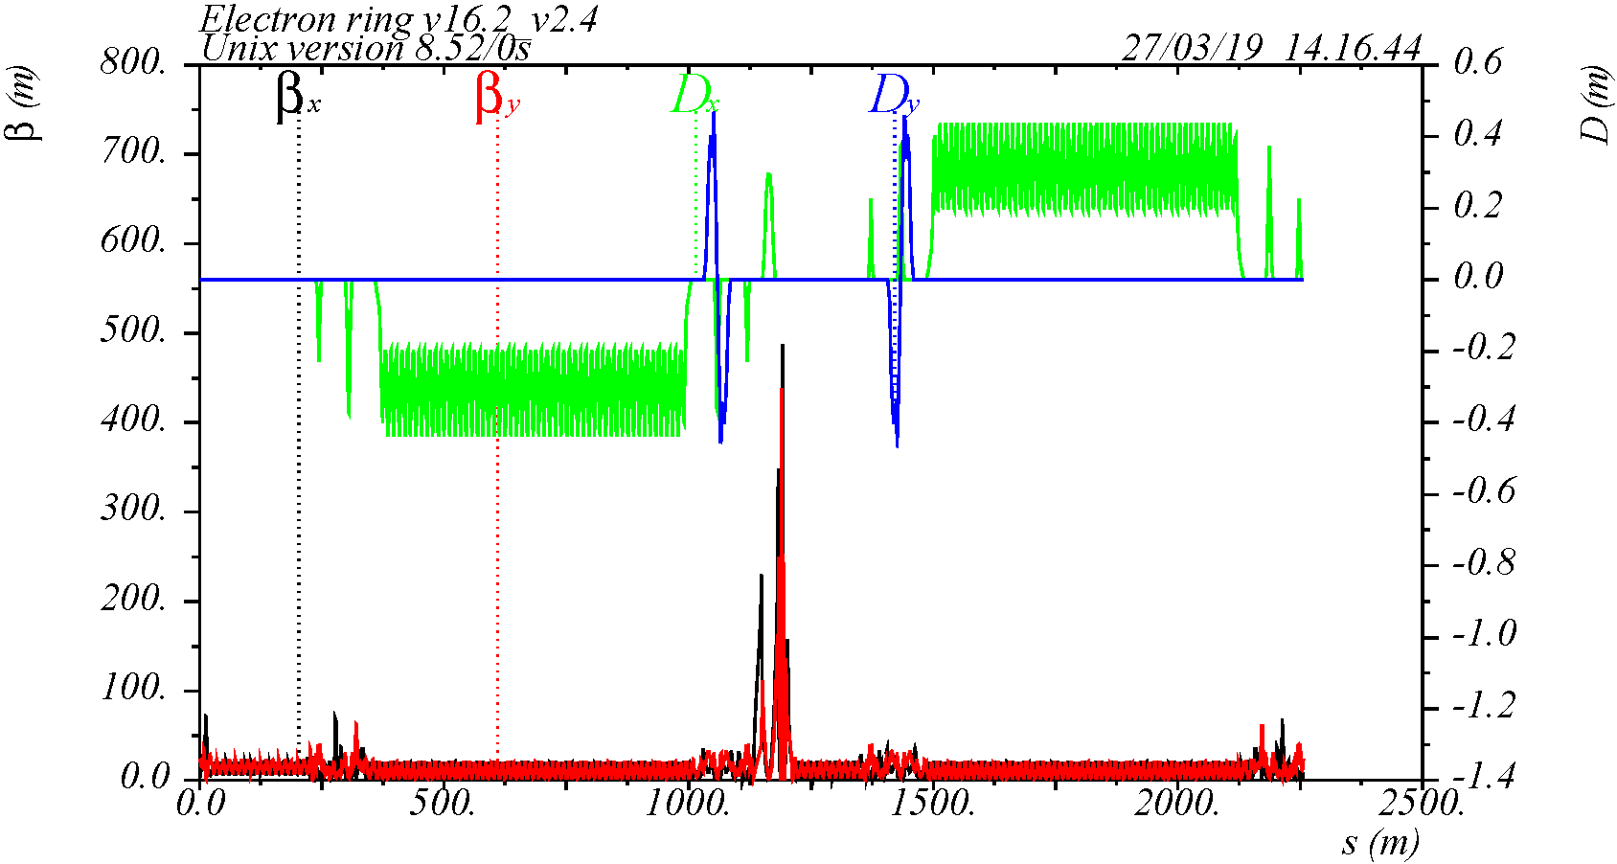
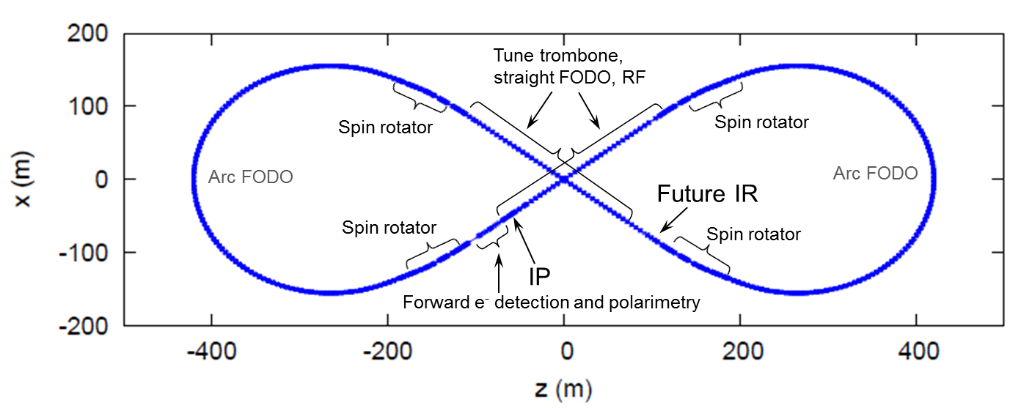
JLEIC electron collider ring optics
Lattice version V16.2_V2.4, includes spin rotators and vertical dogleg, detector solenoid is not included
C = 2256.6145 m, Q_{xy} = 57.22 / 50.16, 108º arcs, β* = 10 / 2 cm, β_{max} = 487 / 438 m, ξ = -124.7 / -128.6, ε_{x} = 4.6 nm-rad @ 5 GeV
IP

Slide 18
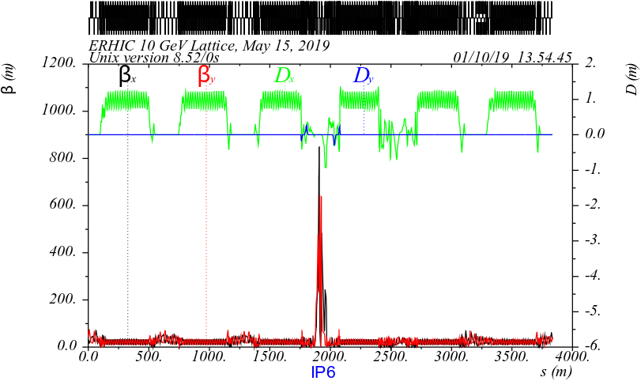
eRHIC electron collider ring optics
Lattice version V5, includes spin rotators, detector solenoid is not included
C = 3833.9400 m, Q_{xy} = 45.12 / 36.10, 60º arcs, β* = 42 / 5 cm, β_{max} = 848 / 645 m, ξ = -83.5 / -90.9, ε_{x} = 24 nm-rad @ 10 GeV

Slide 19
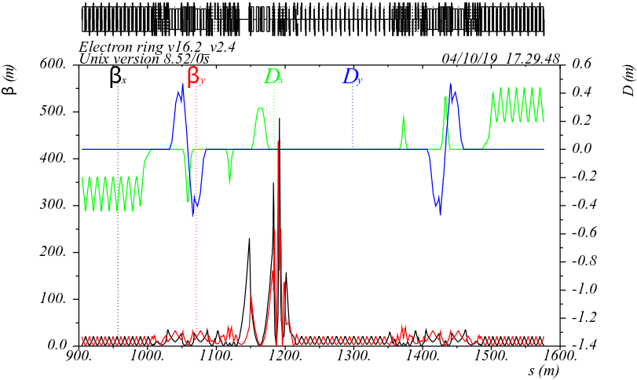
IR optics
Long IR, includes spin rotators with solenoids on both sides
Optics designed to accommodate polarimeter, luminosity monitor; minimize SR at the detector
The IR optics is not designed for local chromaticity correction
e-beam
e-beam
JLEIC
eRHIC
IP

Slide 20
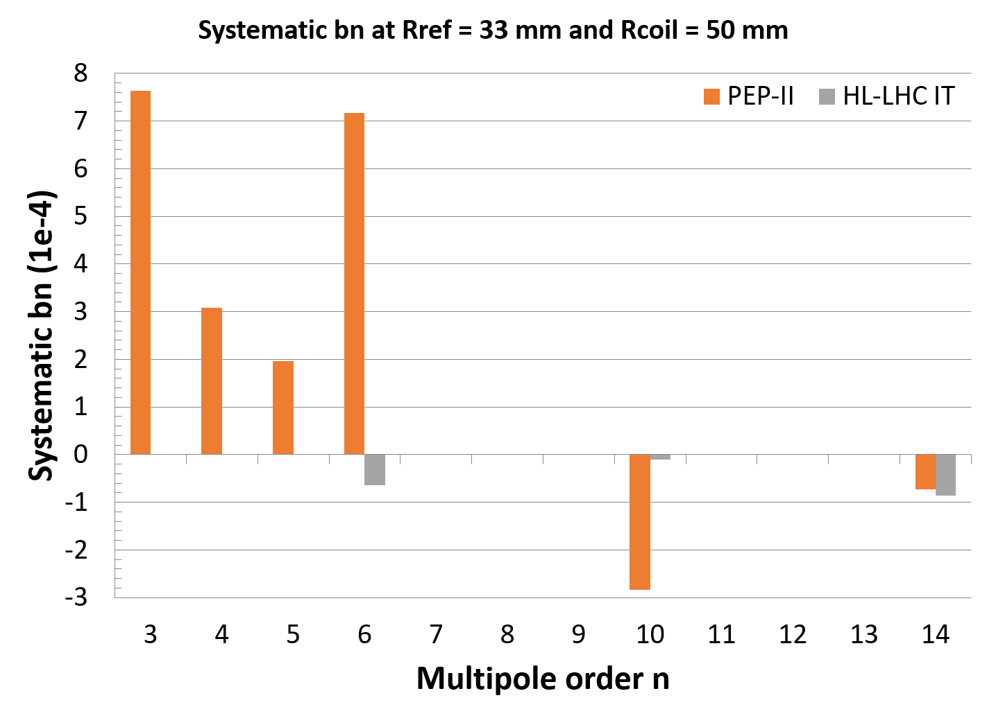
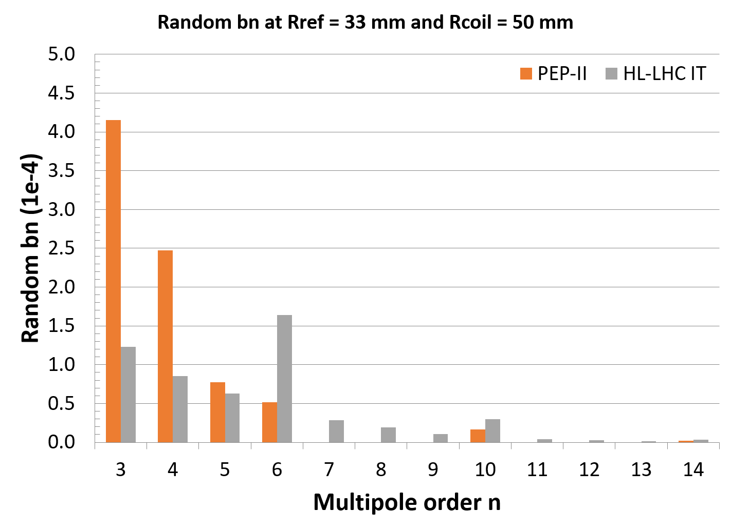
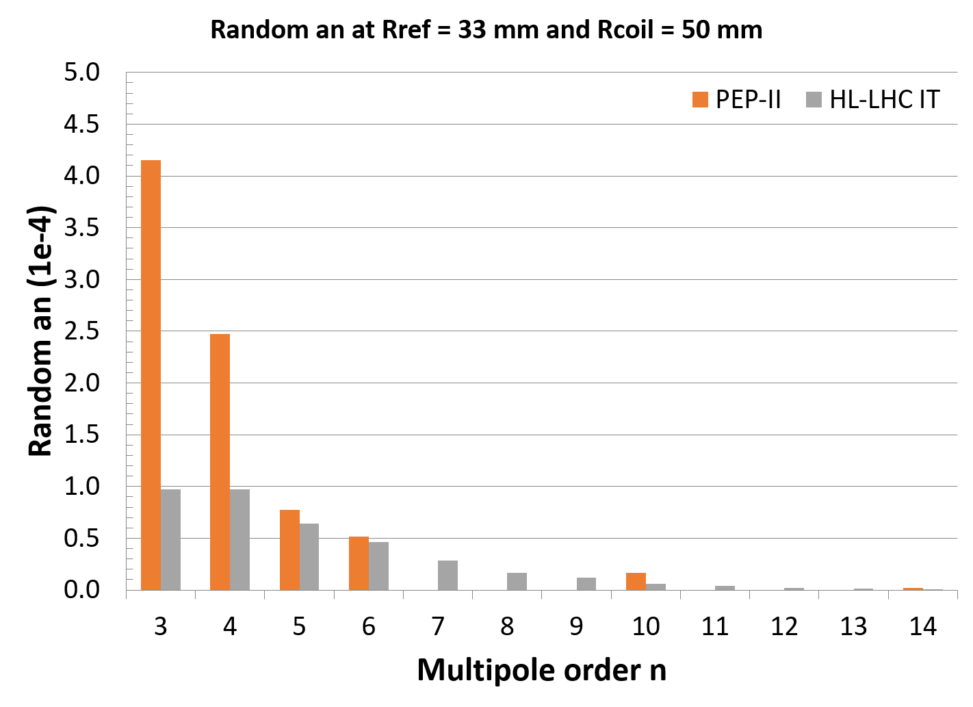
HL-LHC FFQ multipoles vs PEP-II measured multipoles
Multipoles are scaled to Rref = 33.3 mm and Rcoil = 50 mm

