Slide 1
EIC Accelerator Collaboration Meeting 2019 RF Systems for EIC at BNL
K.Smith

Slide 2
Outline
RF Systems Overview
RF Parameters and Pre-Conceptual Designs
Current R&D Efforts
Summary

Slide 3
Overview of RF for EIC at BNL
IR10: SRF Systems
RCS RF Systems
Electron Storage Ring RF Systems
Hadron Ring Storage-2 RF
IR2: Strong Hadron Cooling
Energy Recovery Linac (ERL)
IR4: Hadron Warm RF Systems
IR6: Crab Cavity RF Systems
Crab Cavity Systems
Hadron RF Systems (excluding SRF, IR-10)

Slide 4
Overview of RF for EIC at BNL
RCS: Rapid Cycling Synchrotron
eSR: electron Storage Ring
400 MeV – 18 GeV Full Energy e- Injector
1 Hz Repetition Rate
100 ms ramp
10 nC per bunch
5 GeV – 18 GeV
2.5 A maximum beam current (10 GeV)
1160 bunches, 27.5 nC per bunch
Up to 10 MW synchrotron radiation power
Up to 38 MeV loss per turn (18 GeV)
Strong Hadron Cooling
ERL, Single Pass Up/Down
150 MeV, 100 mA
IR Crab Cavities
Hadron Ring
25 mrad crossing angle
6x Hadron Crab Cavities
2x electron Crab Cavities
Up to 275 GeV Proton Store Energy
1 A maximum beam current
1160 bunches, 11 nC per bunch

Slide 5
Overview of RF for EIC at BNL
RF System | Sub System | Freq [MHz] | Type | Location | #
Electron Storage Ring | Fundamental | 591 | SRF, 2-cell | IR-10 | 14
 | Third Harmonic | 1773 | SRF, 1-cell | IR-10 | 5
Rapid Cycling Synchrotron | Fundamental | 591 | SRF, 5-cell | IR-10 | 3
Pre-Injection LINAC | Buncher 1 | 114 | Copper, ¼ Wave | IR-2 | 1
 | Buncher 2 | 571 | Copper, 1-cell | IR-2 | 1
 | 400 MHz LINAC | 2856 | SLAC type LINAC | IR-2 | 8 x 3m
Hadron Ring | Capture / Accel | 24.6 | Copper, Quarter Wave | IR-4 | 2
 | Bunch Split 1 | 49.2 | Copper, Quarter Wave | IR-4 | 2
 | Bunch Split 2 | 98.5 | Copper, Quarter Wave | IR-4 | 2
 | Bunch Comp. 1 | 197 | Copper, 1-cell | IR-4 | 12
 | Bunch Comp. 2 | 591 | SRF, 5-cell | IR-10 | 2
Crab Cavity | Hadron | 394 | SRF, DQW | IR-6 | 8
 | Electron | 394 | SRF, DQW | IR-6 | 2
Hadron Cooling | SRF Booster | 118 | SRF, Quarter Wave | IR-2 | 2
 | Bunch Comp. | 591 | Copper, 1-cell | IR-2 | 1
 | Fundamental | 591 | SRF, 5-cell | IR-2 | 9
 | Third Harmonic | 1773 | SRF, 5-cell | IR-2 | 2

Slide 6
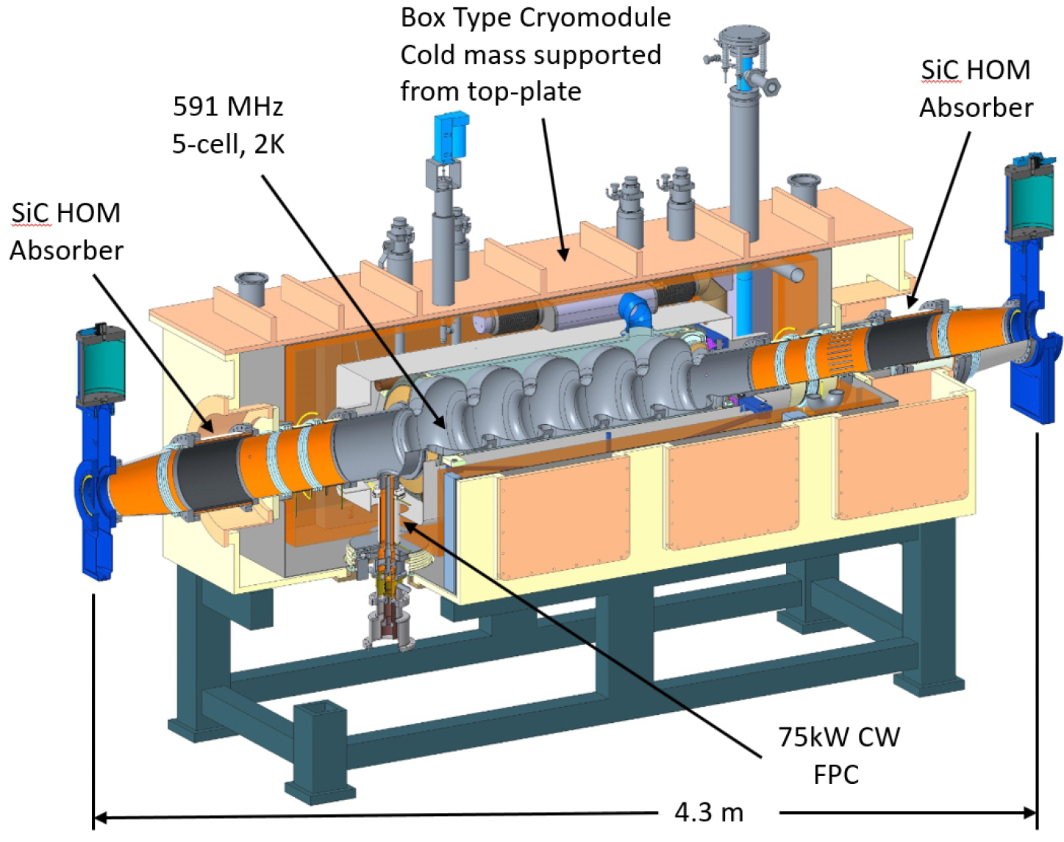
RCS RF System Parameters and Concept
Cryomodules
3x 591 MHz, 5-cell elliptical, 2K
Single cavity per cryomodule
Warm beamline SiC HOM absorbers
Maximum 60 MV installed voltage
E_{acc}: 15.8 MV/m
E_{pk}: 35.8 MV/m
B_{pk}: 69.7 mT
P_{dyn}: 32 W
U_{sync} = 36 MeV / turn (18 GeV)
Δf_{acc} = 500 Hz from 400 MeV – 18 GeV.
RF Power Amplifiers
3x 591 MHz, 65 kW CW, IOT
Commercial transmitter units
Beam Parameters
10 nC per bunch
1 bunch per cycle
100 ms acceleration ramp
1 Hz repetition rate
Note: HOM power is negligible, but strong damping is needed for long range wakes.

Slide 7
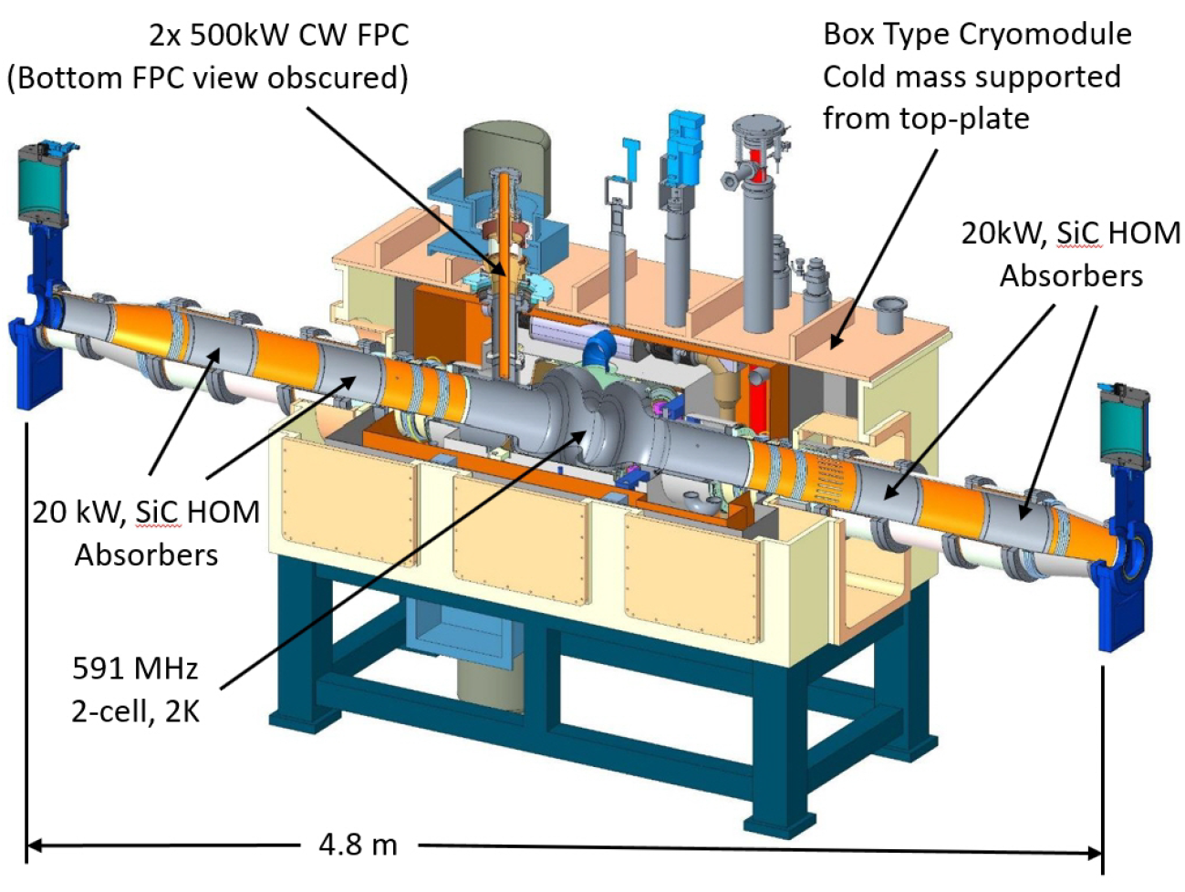
eSR RF System Parameters and Concept
Cryomodules
14x 591 MHz, 2-cell elliptical, 2K
Single cavity per cryomodule
Warm beamline SiC HOM absorbers
Designed for 16 MV/m.
Maximum 68 MV required total voltage for 1.2E-2 bucket height.
E_{acc}: 11.2 MV/m
E_{pk}: 30.8 MV/m
B_{pk}: 58.3 mT
P_{dyn}: 9 W
U_{sync} = 38 MeV / turn (18 GeV)
Up to 10MW sync rad + HOM power
2x 500 kW CW FPCs per cryomodule
Maximum 425 kW operating.
RF Power Amplifiers
14 (7x2) 591 MHz, 65 kW CW, IOT per cryomodule.
Commercial transmitter units.
Hybrid combiner networks.
Exploring options for Solid State as cost continues to decrease.
Beam Parameters
Not all maximum parameters occur under same operating conditions.
Up to 50nC per bunch
Up to 2.5 A
Up to 38 MV synchronous voltage
Up to 68 MV peak voltage => 1.2E-2 dE/E for off momentum injection
Up to 80 kW total HOM power to beamline absorbers (20 kW ea.)

Slide 8
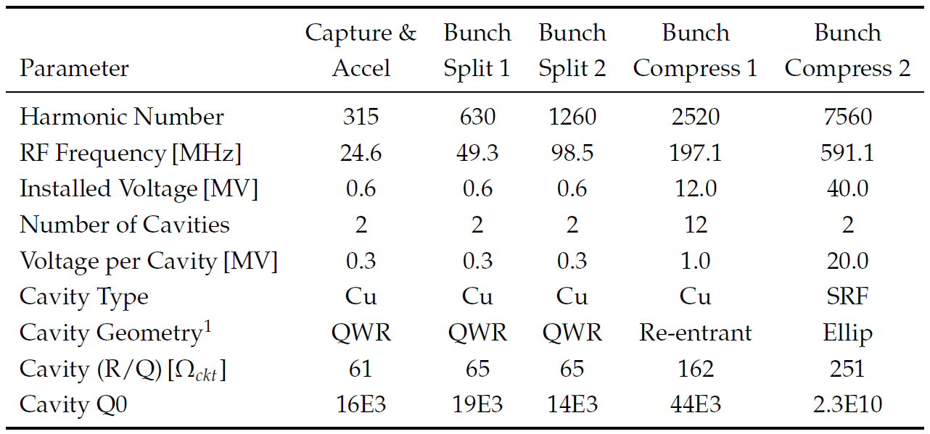
Hadron Ring RF System Parameters and Concept
Cavities & Cryomodules
2x 24.6 MHz Cu (Reuse and modify 28 MHz)
Capture and Acceleration
2x 49.3 MHz Cu (New system)
Bunch Split 1
2x 98.5 MHz Cu (New system)
Bunch Split 2
12x 197 MHz Cu (Reuse existing 197 MHz)
Bunch Compression 1
2x 591 MHz SRF, 5-cell elliptical
Bunch Compression 2
Same as RCS cryomodules
RF Power Amplifiers
24.6 MHz and 197 MHz reuse existing power amplifiers (close coupled tetrodes).
2x 49.3 MHz, 70 kW Solid State
2x 98.5 MHz, 80 kW, Solid State
2x 591 MHz, 65 kW, IOT
Beam Parameters
Up to 1A circulating current
Up to 1160 bunches
290 injected, 580 and 1160 via 1:2 symmetric splits.
Hadron Store 2 RF system uses the RCS 5-cell cavity cryomodule design.

Slide 9
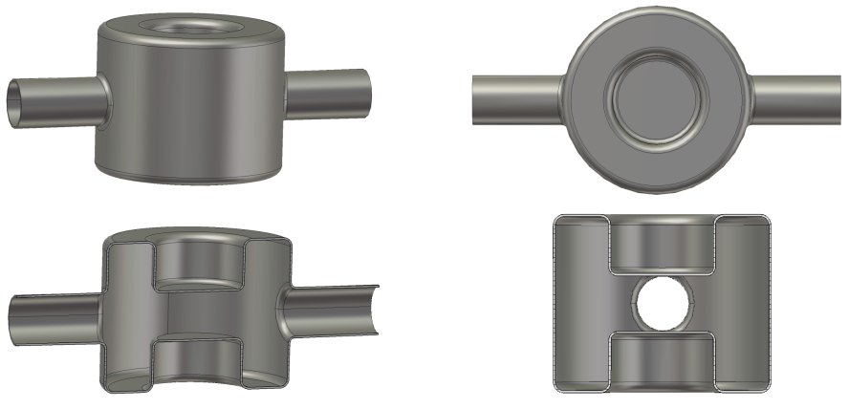
Hadron and eSR Crab RF System Parameters and Concept
 | LHC - HL | Ring - Ring eRHIC (with cooling)
 | p-p | proton | electron
Full Crossing Angle (mrad) | 0.59 | 25 | 25
Energy (GeV) | 7000 | 275 | 18
rms Bunch length (cm) | 7 | 6 | 0.9
Ave. Current (A) | 1.09 | 0.81 | 0.26
Frequency (MHz) | 400 | 394 | 394
Scheme | Vertical/Local | Horizontal/Local
beta function @ IP (m) | 0.15 | 0.90 | 0.6
beta function @ crab cavity (m) | 2616 | 1300 | 200
Horizontal beam size (um) | 7 | 119 | 119
Piwinski angle (rad) | 2.95 | 10.4 | 0.89
Voltage(MV) | 12.4 | 12.0 | 2.5
Number of cavities per side per IP | 4 | 3 | 1
Voltage per cavity (MV) | 3.1 | 4.0 | 2.5
R/Q (Ohm) | 426 | 373 | 373
Power (kW) | 50 | 40 | 5
Cavity horizontal width (m) | 0.33 | 0.16 | 0.16
Cavity vertical width (m) | 0.29 | 0.20 | 0.20
Cavity length (m) | 0.35 | 0.20 | 0.20
Simple symmetric design for easy fabrication, effective cleaning and minimum dimensions.
DQW crab cavity development for HiLumi LHC started in 2006 at BNL.
DQW crab cavities and couplers demonstrated successful beam commissioning in SPS
BNL supported through DOE NP R&D FOA funding for participation in 4 out of 7 SPS crab cavity beam experiments, and further analysis of crab cavity cryomodule in RHIC.
Courtesy: Qiong Wu, Silvia Verdú-Andrés, Doug Holmes

Slide 10
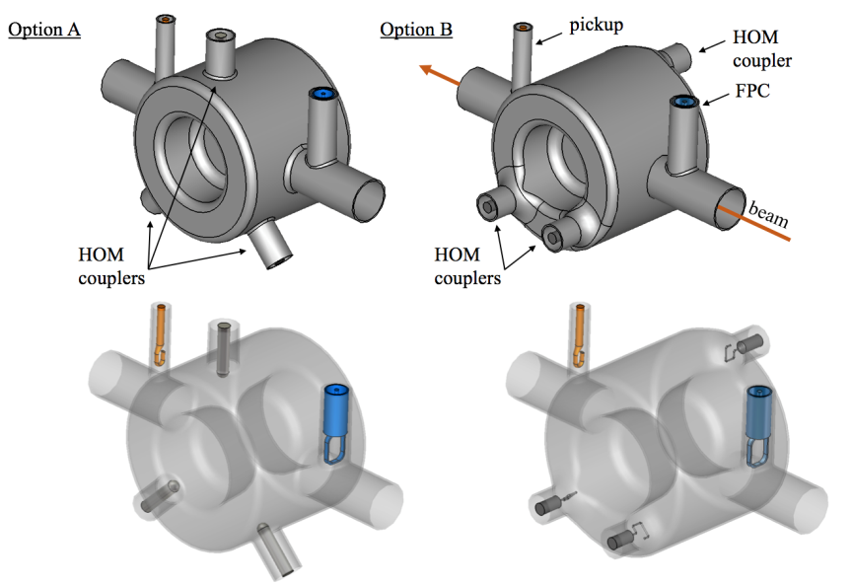
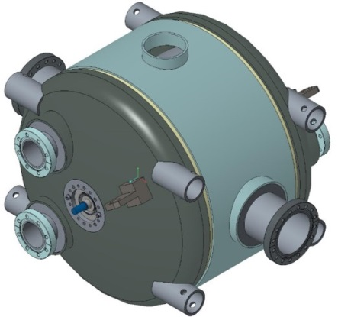
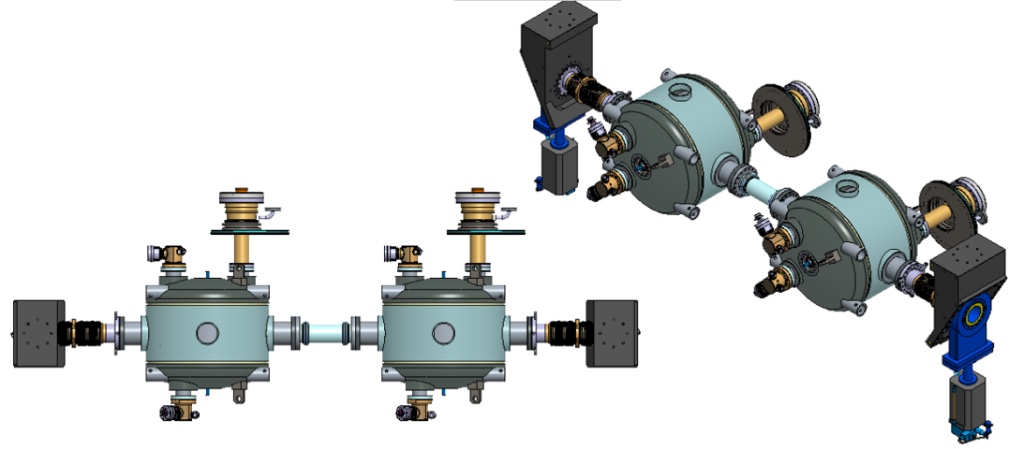
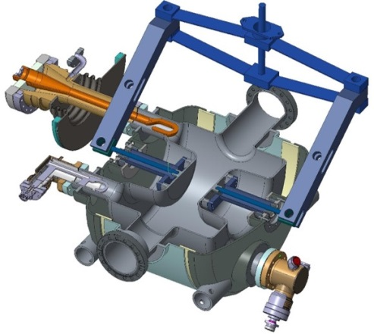
Hadron and eSR Crab RF System Parameters and Concept
The higher order mode damping for crab cavity has two options under investigation: electric and magnetic coupling.
The HOM coupler high pass filter will adopt similar concept to HiLumi LHC crab cavity.
Power required for eRHIC crab cavity is less than HiLumi LHC.
Tuner, helium vessel, cryomodule can all be adopted and benefit from CERN experience.
eRHIC crab cavity with helium vessel
eRHIC crab cavity tuning system
Two cavity string assembly in cryomodule
Courtesy: Qiong Wu, Silvia Verdú-Andrés, Doug Holmes

Slide 11
Strong Hadron Cooling RF System Parameters and Concept
Cryomodules
9x 591 MHz, 5-cell elliptical, 2K (ERL)
Single cavity per cryomodule
Warm beamline SiC HOM absorbers
Maximum 180 MV installed voltage
E_{acc}: 15.8 MV/m
E_{pk}: 35.8 MV/m
B_{pk}: 69.7 mT
P_{dyn}: 32 W
Reusing the same design as the RCS 5-cell single cavity cryomodules.
RF Power Amplifiers
9x 591 MHz, 65 kW CW, IOT
Commercial transmitter units
Beam Parameters
Single Pass 150 MeV ERL (1 up, 1 down)
Maximizes beam breakup threshold current
1 nC per bunch
100 mA single pass current
98.5 MHz bunch frequency
HOM power well below the 20 kW per absorber rating.

Slide 12
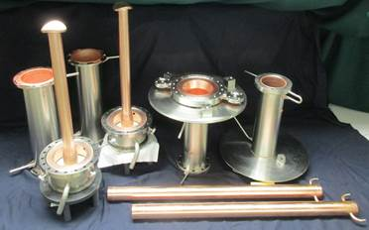
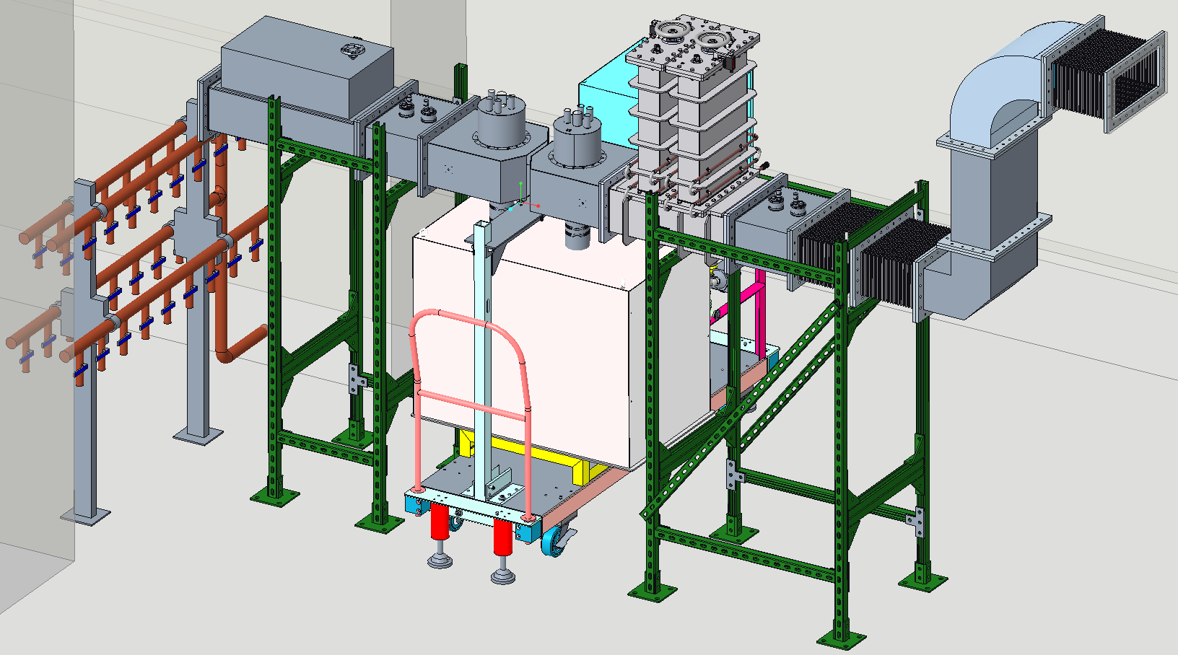
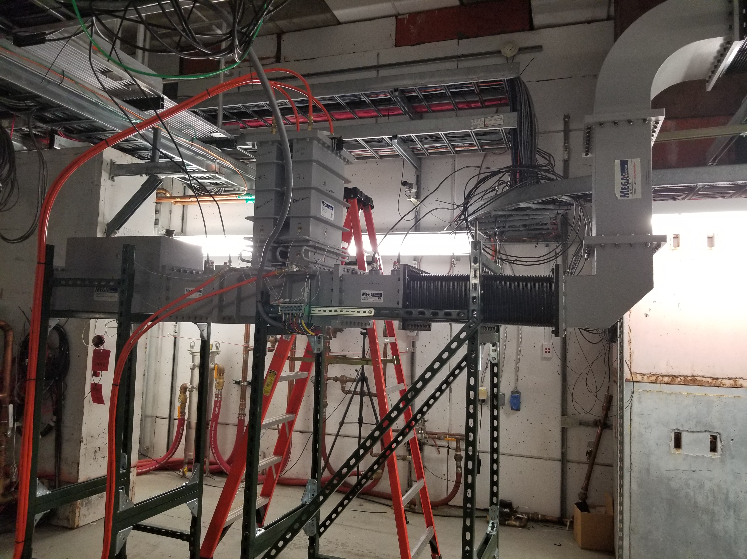
Current R&D Efforts: 500 kW CW, Variable Q_{ext} Couplers
Use existing fixed 500 kW CW coupler design.
Vary Q_{ext} using adjustable waveguide tuner section.
Funded by BNL LDRD.
Testing of waveguide tuner sections is currently underway.
Testing of full setup with two FPCs and waveguide tuner will begin near end of October.

Slide 13
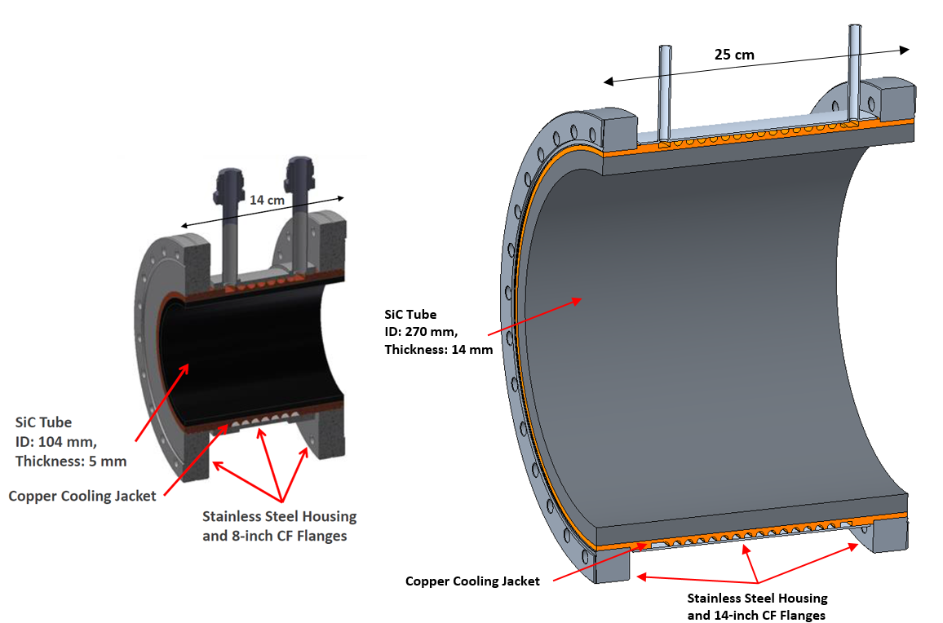
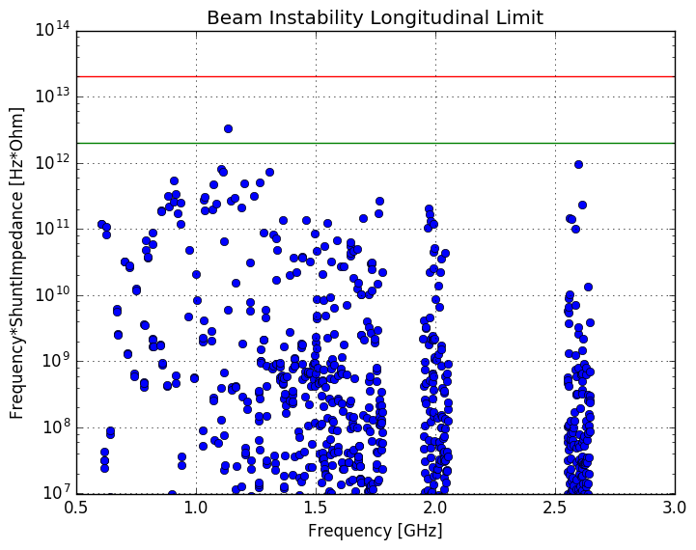
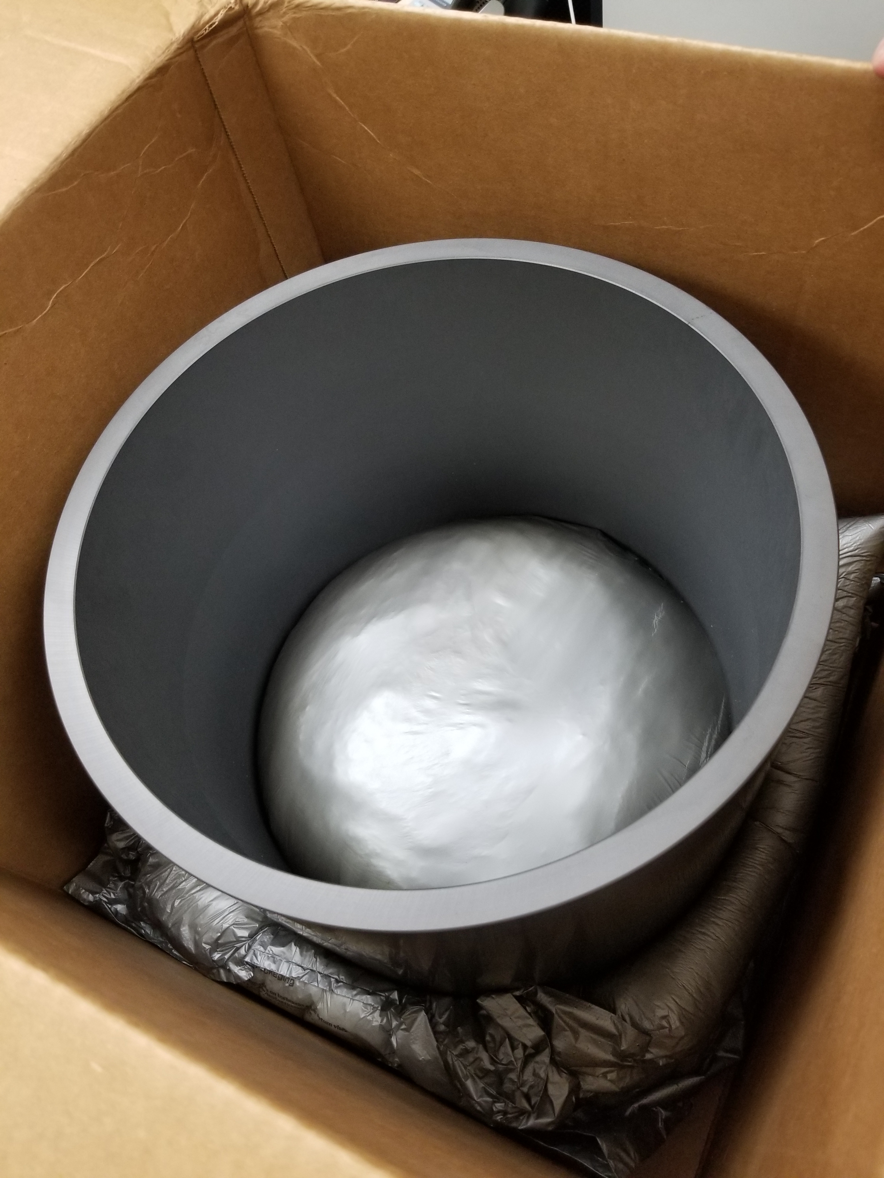
Current R&D Efforts: Warm Beampipe SiC HOM Absorbers
Funded by BNL LDRD.
Simulations show the absorber design meets required damping for beam stability.
Up to 80 kW per cavity in the eSR.
Two sets of absorbers optimized to cover the HOM spectrum.
Absorber SiC cylinders fabricated.
Absorber assemblies being fabricated.
FPCs
BLA1
BLA2

Slide 14
Summary
Pre-Conceptual Designs were done for all RF systems.
Substantial analysis and simulation performed to validate HOM damping and power handling for all systems.
Reuse of the 5-cell, single cavity cryomodule design across several systems reduces number of unique RF systems.
Reuse of the 65 kW CW IOT amplifier unit across numerous systems reduces complexity and improves reliability.
R&D ongoing to validate the most challenging elements.
Thank You for Your Attention and Interest!

