Slide 1
Hidden Sector SEARCHES with REDTOP
Rare Eta Decays with a
Tpc for Optical Photons
Corrado Gatto
INFN Napoli and Northern Illinois University
For the REDTOP Collaboration

Slide 2
REDTOP Quest for BSM Physics
  As LHC found no hint of new physics at high energy so far
    New physics could be at much lower energy
    Colliders have insufficient luminosity (O(10⁴¹) cm⁻² vs O(10⁴⁴) cm⁻² for 1–mm fixed target )
  An η /η’ factory with 10⁴x world statistics would search for discrepancies in the Standard Model at the 1 GeV energy regime with couplings at the level of 10⁻⁸
    Newest theoretical models prefer gauge bosons in MeV-GeV mass range as “…many of the more severe astrophysical and cosmological constraints that apply to lighter states are weakened or eliminated, while those from high energy colliders are often inapplicable” (B. Batell , M. Pospelov, A. Ritz – 2009)
  Main Physics Goals of REDTOP:
  CP Violation via Dalitz plot mirror asymmetry: η → π^{ο} π⁺π⁻
  Search for asymmetries in the Dalitz plot.
  Test of CP invariance via γ∗ polarization studies:η → π⁺π –e⁺e – and η → π⁺π –μ⁺μ –
  Measure the angular asymmetries between the l⁺l– and π⁺π – planes
  Dark photon searches: η → γ Α’ with Α’ → l⁺l⁻
  Scalar meson searches (charged channel): η → π^{ο} Η with H→e⁺e⁻ and H→μ⁺μ⁻

Slide 3
Why the η meson is special?
It is a Goldstone boson
It is an eigenstate of the C, P, CP and G operators (very rare in nature): I^{G} J^{PC} =0⁺ 0⁻⁺
All its additive quantum numbers are zero
Q = I = j = S = B = L = 0
All its possible strong decays are forbidden in lowest order by P and CP invariance, G-parity conservation and isospin and charge symmetry invariance.
EM decays are forbidden in lowest order by C invariance and angular momentum conservation
The η decays are flavor-conserving reactions
Symmetry constrains its QCD dynamics
It can be used to test C and CP invariance.
Its decays are not influenced by a change of flavor (as in K decays) and violations are “pure”
It is a very narrow state (Γ_{η}=1.3 KeV vs Γ_{ρ}=149 MeV)
Contributions from higher orders are enhanced by a factor of ~100,000
Excellent for testing invariances
Decays are free of SM backgrounds for new physics search
η is an excellent laboratory to search for physics Beyond Standard Model

Slide 4
Detecting BSM Physics with REDTOP (η/η’ factory)
  Assume a yield ~10¹³ η mesons/yr and ~10¹¹η’ mesons/yr
  C, T, CP-violation
  CP Violation via Dalitz plot mirror asymmetry: η → π^{ο} π⁺π⁻
  CP Violation (Type I – P and T odd , C even): η−> 4π^{ο} → 8γ
  CP Violation (Type II - C and T odd , P even): η → π^{ο} l⁺l and η → 3γ
  Test of CP invariance via μ longitudinal polarization: η → μ⁺μ –
  Test of CP invariance via γ∗ polarization studies:η → π⁺π –e⁺e – and η → π⁺π –μ⁺μ –
  Test of CP invariance in angular correlation studies:η → μ⁺μ – e⁺e –
  Test of T invariance via μ transverse polarization: η → πºμ⁺μ – and η → γ μ⁺μ –
  CPT violation: μ polariz. in η → π⁺μ⁻ν vs η → π⁻μ⁺ν and γ polarization in η → γ γ
  New particles and forces searches
  Scalar meson searches (charged channel): η → π^{ο} Η with H→e⁺e⁻ and H→μ⁺μ⁻
  Dark photon searches: η → γ Α’ with Α’ → l⁺l⁻
  Protophobic fifth force searches : η → γ X₁₇ with X₁₇ → e⁺e⁻
  New leptophobic baryonic force searches : η → γ B with B→ e⁺e⁻ or B→ γ π^{ο}
  Indirect searches for dark photons new gauge bosons and leptoquark: η → μ⁺μ⁻ and η → e⁺e⁻
  Search for true muonium: η → γ (μ⁺μ – )|_{2Mμ} → γ e⁺e –
  Other discrete symmetry violations
  Lepton Flavor Violation: η → μ⁺e – + c.c.
  Double lepton Flavor Violation: η → μ⁺μ⁺e – e – + c.c.
  Lepton NumberViolation: η → π– π–e/μ⁺ e/μ ⁺ + c.c.
  Other Precision Physics measurements
  Proton radius anomaly: η → γ μ⁺μ – vs η → γ e⁺e⁻
  All unseen leptonic decay mode of η / η ‘ (SM predicts 10⁻⁶ -10⁻⁹)
  Non-η/η’ based BSM Physics
  Dark photon and ALP searches in Drell-Yan processes: qqbar → A’/a → l⁺l–
  ALP’s searches in Primakoff processes: p Z → p Z a → l⁺l– (F. Kahlhoefer)
  Charged pion and kaon decays: π+ → μ⁺ν Α’ → μ⁺ν e⁺e– and Κ+ → μ⁺ν Α’ → μ⁺ν e⁺e–
  Neutral pion decay: πº → γA’ → γe⁺e–
  Nuclear models
  Chiral perturbation theory
  Non-perturbative QCD
  Isospin breaking due to the u-d quark mass difference
  Octet-singlet mixing angle
  Electromagnetic transition form-factors (important input for g-2)
  High precision studies on medium energy physics

Slide 5
Physics Beyond Collider Program
  Instituted by CERN’s Director in 2016 to exploit physics BSM at smaller experiments
  Exploratory study aimed at exploiting the scientific potential of its accelerator complex projects complementary to the LHC
  Study provide input for the future of CERN’s scientific diversity Programme and ESPP
  Three committees coordinating accelerator, experimental, and theoretical particle physics
  Four portals and twelve benchmark processes under consideration: Vector – Scalar– Heavy Neutrino – Axions and ALPs
  21 participating experiments: mostly beam-dump or aimed at invisible searches
  REDTOP unique in terms of experimental technique – sensitive to:
    Vector portal with visible η/η’ decays
    Scalar porta with visible η/η’ decays
    ALPs portal with visible η/η’ decays and beam ALPsstrahlung

Slide 6
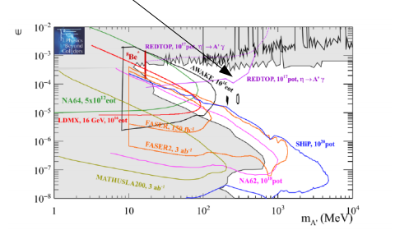
Dark photon searches:
  η → γ Α’ with A’→ μ⁺ μ⁻ and e⁺ e⁻
  Studied within the “Physics Beyond Collider” program at CERN for 10¹⁷ POT
  FNAL and BNL can provide 10x more POT
  Only “bump hunt analysis”. Studies in progress add vertexing+timing to improve the sensitivity to physics BSM.
REDTOP@CERN
6

Slide 7
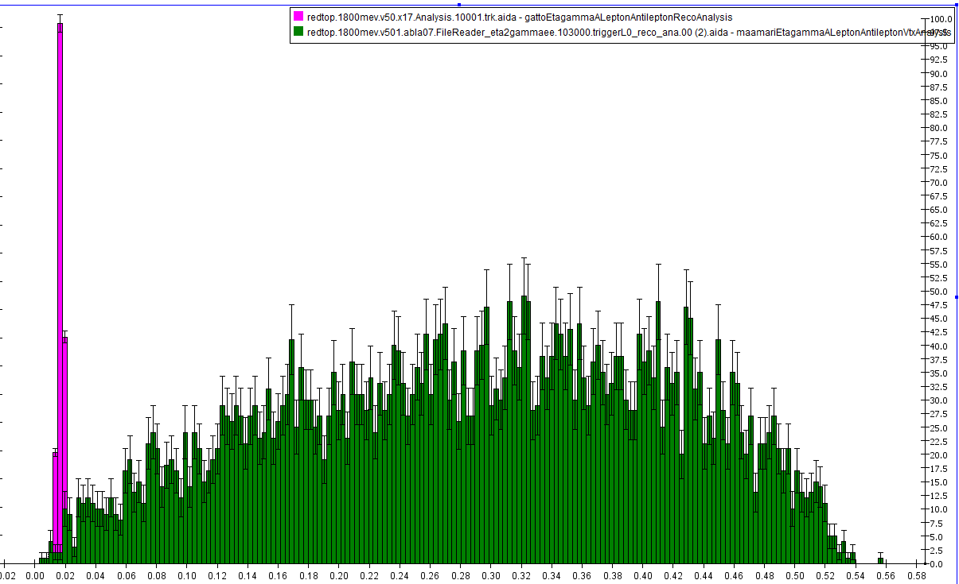
  Special case: protophobic gauge boson X with M_{x}=17 MeV: η → γ X with X→ e⁺e⁻
  Recently postulated to explain a 6.8σ anomaly in the invariant mass distributions of e⁺e⁻ pairs produced in ⁸Be nuclear transitions – J. Feng et al (2016) - arXiv:1608.03591
  Will also explain the 3.6σ discrepancy between the predicted and measured values of the muon’s anomalous magnetic
  Below WASA (and all other η-producing experiments) sensitivity
  Boost from η helps to increase sensitivity to 17 MeV invariant masses
X
η → γ e⁺e⁻
7

Slide 8
Searches for light scalar mesons
  η → π^{ο} S with S→ γγ, π⁺ π⁻, μ⁺ μ⁻ and e⁺ e⁻
  Two categories of theoretical models
  Minimal SM Higgs extension
  Viable DM candidate (in certain circumstances) coupling to Higgs portal - D. O’Connell, M. J. Ramsey-Musolf and M. B. Wise, Phys. Rev. D75 (2007) 037701 and , G. Krnjaic, Phys. Rev.D94 (2016)
  S − H mixing in the Higgs potential via a mixing angle
  It couples mostly to top quark and gluons
  Favorite experimental technique: B factories (LHCb)
  Disvavorite at REDTOP
  Hadrophilic Scalar Mediator
  (or Spontaneous Flavor Violation )
  B. Batell, A. Freitas, A. Ismail, and D. McKeen - arXiv:1812.05103
  D. Egana-Ugrinovic, S. Homiller, P. Meade - arXiv:1908.11376
  Much less constrained by cosmological and EDM bounds
  It couples mostly to up and down quarks
  Favorite experimental technique: η/η‘ factories
  Disvavorite at LHCb and Belle
  Moderate discovery potential with K beams

Slide 9
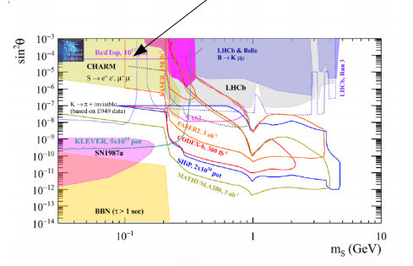
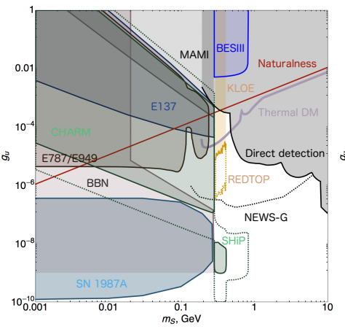
Searches for light scalar mesons
  Minimal SM Higgs extension
  Studied within the “Physics Beyond Collider” program at CERN for 10¹⁷ POT
  FNAL and BNL can provide 10x more POT
  Only “bump hunt analysis”. Vertexing add 10x more sensitivity
  Hadrophilic Scalar Mediator
  Studied in arXiv:1812.05103
  Only bump hunt - no vertexing
REDTOP@CERN
REDTOP@Fermilab
  arXiv:1812.05103

Slide 10
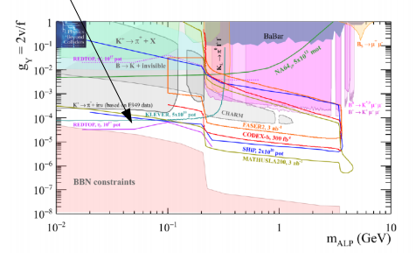
Searches for ALPs with fermion coupling
  η → π^{ο} π^{ο} a and η → π⁺ π⁻ a with a→ μ⁺ μ⁻ and e⁺ e⁻
  Studied within the “Physics Beyond Collider” program at CERN for 10¹⁷ POT
  FNAL and BNL can provide 10x more POT
  Only “bump hunt analysis”. Will add vertexing to the analysis.
REDTOP@CERN

Slide 11
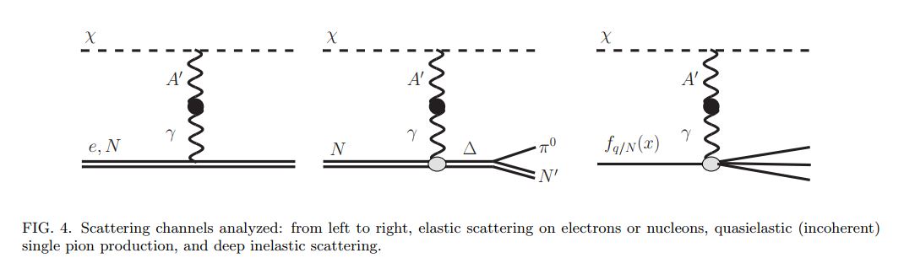
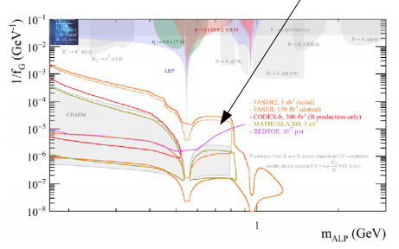
Searches for ALPs with gluon coupling
  Beam emitted ALP’s from the following processes:
    Drell-Yan processes: qqbar → A’/a → l⁺l–
    Proton bremsstrahlung processes: p N → p N A’/a with A’/a → l⁺l– (J. Blümlein and J. Brunner)
    Primakoff processes: p Z → p Z a → l⁺l– – (F. Kahlhoefer, et. Al.)
  Studied within the “Physics Beyond Collider” program at CERN for 10¹⁷ POT
  Redtop@PIP-II will provide x100 sensitivity (ALPACA study).
REDTOP@CERN

Slide 12
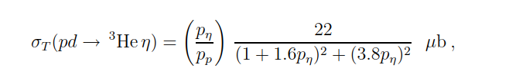
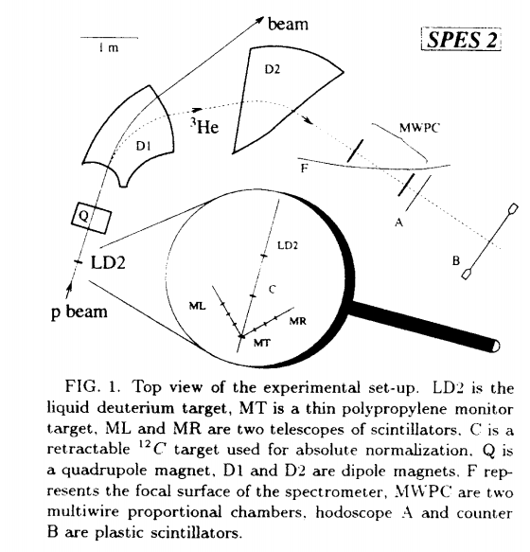
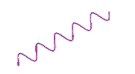
Missing 4-P Searches: tREDTOP (@ PIP-II)
η production already a puzzle of his own
  Fully constrained kinematics
  Unique experimental apparatus to explore visible and invisible decays of LDM
  Tagging expected to lower the background by >100x
  Requires 800 MeV p-beam, De target and 3He⁺ detector
  No η’ production (need about 1.4 GeV beam)
ADRIANO2 Calorimeter
Undetected
De target
Proton beam
η
γ
OTPC
γ
He₃⁺
ADRIANO2 Calorimeter
B. Mayer et al., Phys. Rev. C53, 2068 (1996);

Slide 13
Experimental Techniques- η/η’ production+detection
  Incident proton energy ~1.8 GeV (3.5 GeV for η’)
  CW beam, 10¹⁷-10¹⁸ POT/yr (depending on the host laboratory)
  η/η‘ hadro-production from inelastic scattering of protons on Li or Be targets
  Use multiple thin targets to minimize combinatorics background
  η yield: 2.5 x 10⁶ η /sec (2.5 x 10⁴ η ’/sec) or 2.5 x 10¹³ η /yr (2.5 x 10¹¹ η ’ /yr)
  charged tracks detection
  Use Cerenkov effect for tracking charged particles
  Baryons and most pions are below Č threshold
  Electrons and most muons are detected and reconstructed in an Optical-TPC
  γ detection
  Use ADRIANO2 calorimeter (Calice+T1015) for reconstructing EM showers
  σ_{E}/E < 5%/√E
  PID from dual-readout to disentangle showers from γ/μ/hadrons
  96.5% coverage
  Fiber tracker (LHCB style) for rejection of background from γ-conversion and reconstruction of secondary vertices (~70μm resolution)

Slide 14
REDTOP Requirements
Medium energy proton beam 1.5 – 4 GeV
Proton economics:
  Min: 10¹⁷ POT/yr - CERN
  Optimal: 10¹⁸ POT/yr - FNAL or BNL
  Produce ~10¹³ η mesons/yr – reco eff > 10%
  Produce ~10¹¹ η’ mesons/yr– reco eff > 10%
Efficient detection of the leptonic decays of the η
Blind to protons and low energy charged pions.
Neutron rejection (via dual-readout)
near 4π detector acceptance.

Slide 15
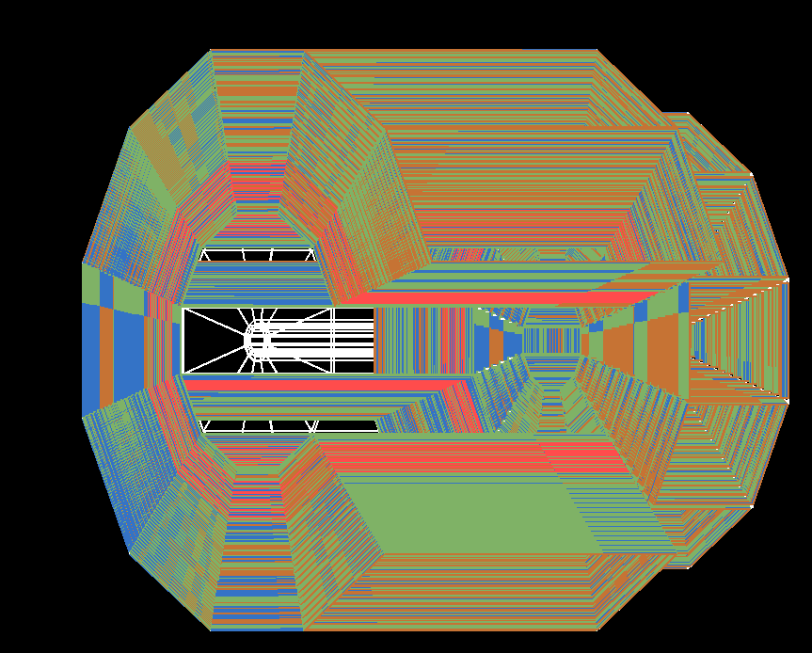
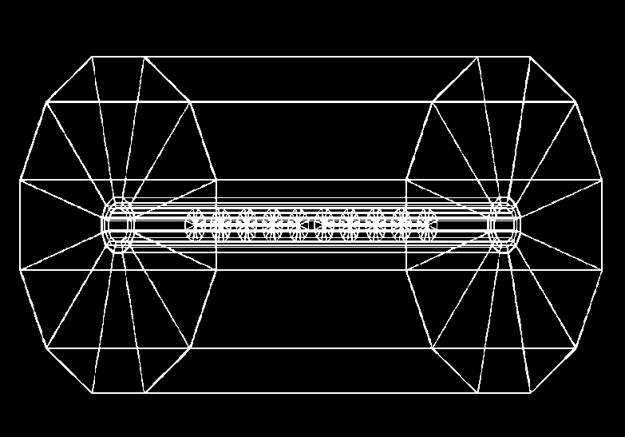
REDTOP detector
(from simulation)
Optical TPC
~ 1m x 1.5 m
CH₄ @ 1 Atm
5x10⁵ Sipm/Lappd
98% coverage
ADRIANO2 Calorimeter (tiles)
Scint. + heavy glass sandwich
20 X ₀ ( ~ 64 cm deep)
Triple-readout +PFA
96% coverage
μ-polarizer
Active version (from TREK exp.) - optional
2.4 m
10x Be or Li targets
0.33 mm thin
Spaced 10 cm
1.5 m
2.7 m
Fiber tracker
for rejection of g-conversion and vertexing
1 m
Aerogel
Dual refractive
index system
OTPC

Slide 16
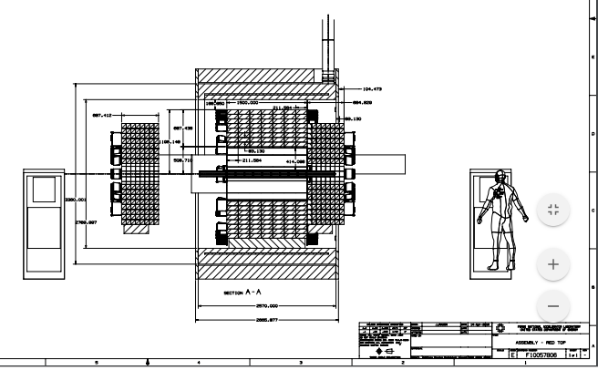
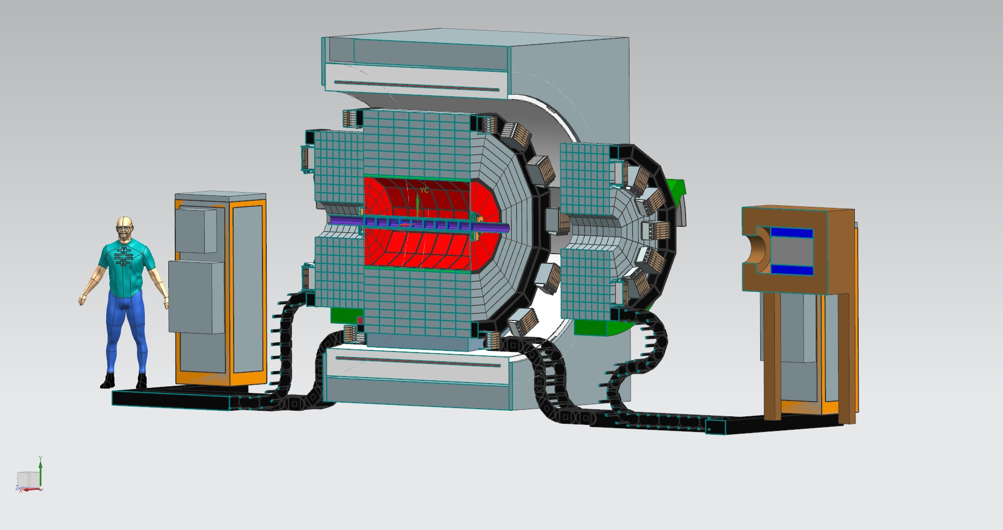
REDTOP Detector + Finuda Magnet
J. Kilmer – J. Rauch

Slide 17
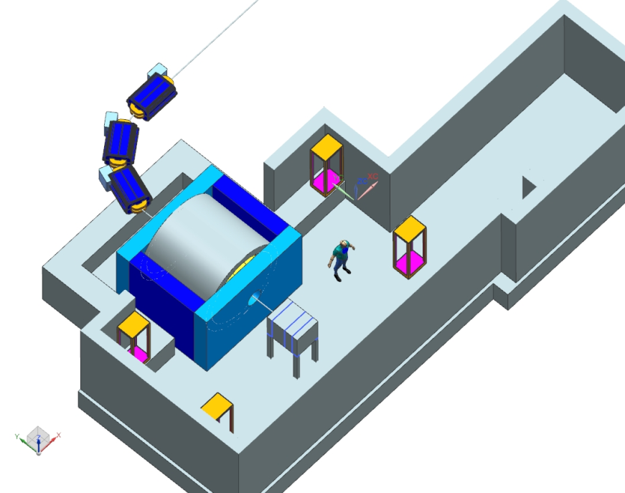
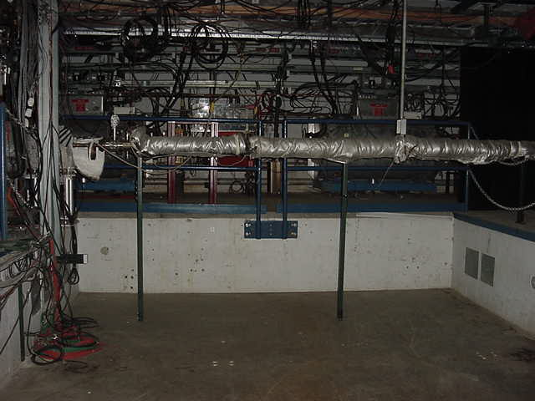
Acceleration Scheme (M. Syphers)
Single p pulse from booster (≤4x10¹² p) injected in the DR (former debuncher in anti-p production at Tevatron) at fixed energy (8 GeV)
Energy is removed by adding 1-2 RF cavities identical to the one already planned (~5 seconds)
Slow extraction to REDTOP over ~40 seconds.
The 270º of betatron phase advance between the Mu2e Electrostatic Septum and REDTOP Lambertson is ideal for AP50 extraction to the inside of the ring.
Total time to decelerate-debunch-extract: 51 sec: duty cycle ~80%
REDTOP

Slide 18
Timeline & Costing
Once approved and funded, REDTOP needs:
  2 years detector R&D
  1 year detector design
  2 years construction
Accelerator mods requires:
  BNL: <1yr (only requiring a new electronics for the extraction line (C4)
  CERN: need further studies
  FNAL: ~1yr (add a SC cavity to the DR and build an extraction line
Total cost (for ESPP): ~50 M$ (including 50% contingency)
  Solenoid and ¾ of Pb-Glass for ADRIANO in-kind contributions from INFN (Finuda and NA64 experiments)
  Construction at participating institutions
  Assembly at hosting laboratory

Slide 19
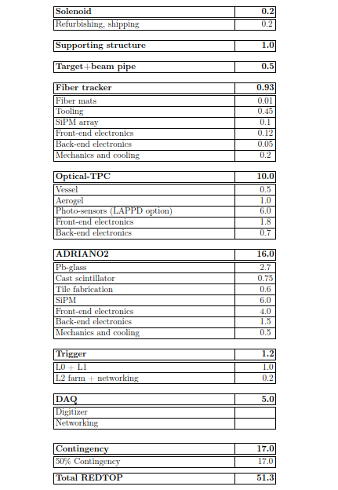
Cost (estimate for ESPP)
  In kind contribution from INFN
    Solenoid (from Finuda experiment at Frascati)
    ¾ of Pb-glass (from NA62)
  For Fermilab
    Add labor and accelerator (R.F.cavities and EM septum are available at Fermilab)
    Adjust contingency from 50% to 25%

Slide 20
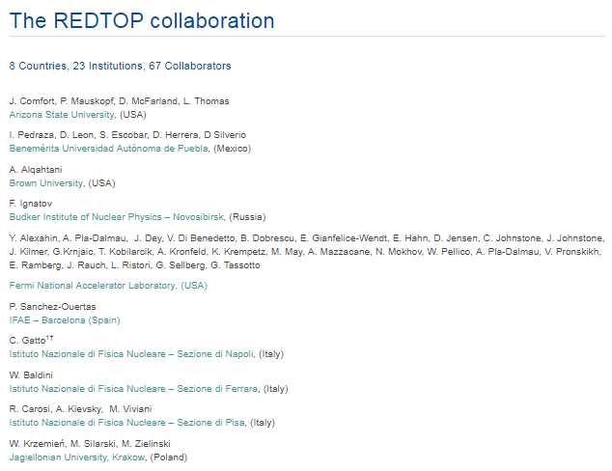
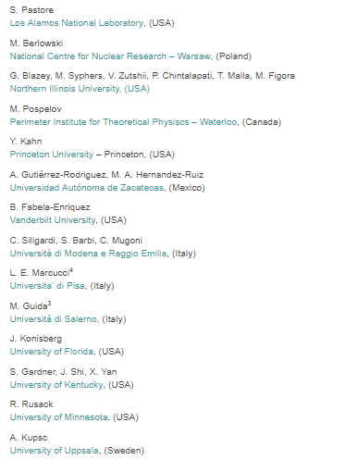
Status of the collaboration
  Potential hosting laboratories: BNL, CERN, FNAL (either Delivery Ring and/or PIP-II)

Slide 21
Summary
The η /η’ meson is a excellent laboratory for studying rare processes and physics BSM (especially, LDM)
Existing world sample not sufficient for breaching into decays violating conservation laws or searching for new particles
REDTOP goal is to produce ~10¹³ η mesons/yr in phase I and ~ 10 ¹¹ η’ /year in phase II
More running phases could use different beam species:
  PIP-II for a tagged-η experiment
Several labs could host the experiment (FNAL is the most optimal)
New detector techniques would set the stage for next generation High Intensity experiments
Moderate cost (50-60 M$)
More details: https://redtop.fnal.gov

Slide 22
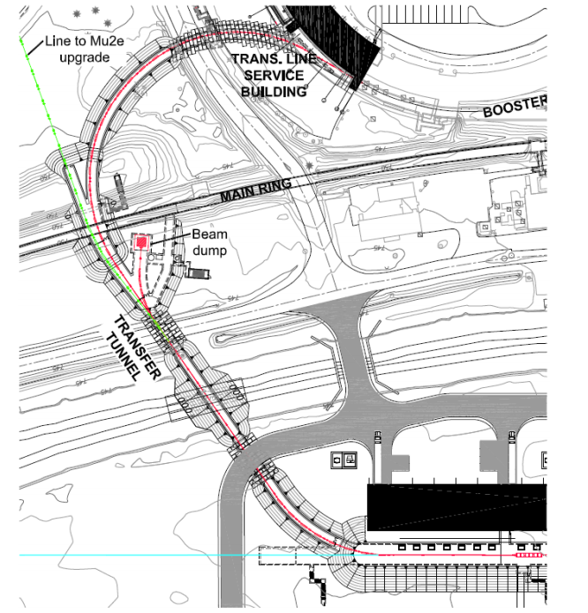
Tagged REDTOP at PIP-II
The ultimate eta factory
tREDTOP

Slide 23
Backup slides

Slide 24
Future Prospects
The Collaboration is currently engaged in the ESPP process and preparing for the P5-Snowmass process
Endorsement by the community and/or laboratories is needed to fund detector R&D activities
Current activities aim at the preparation of a full proposal in a timeframe consistent with the ESPP and Snowmass-P5
  Detector optimization and sensitivity studies are well established and ongoing. Goal is maximize S/ √B
  Detector R&D is minimal (ADRIANO2 only, at present)
Competition from several other experiments (LHCB, et. Al.)
  But, REDTOP experimental techniques is substantially different
More details: https://redtop.fnal.gov

Slide 25
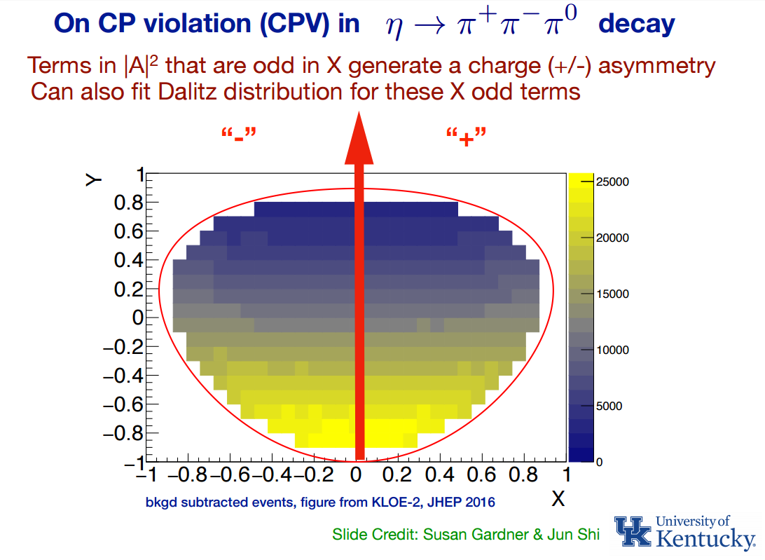
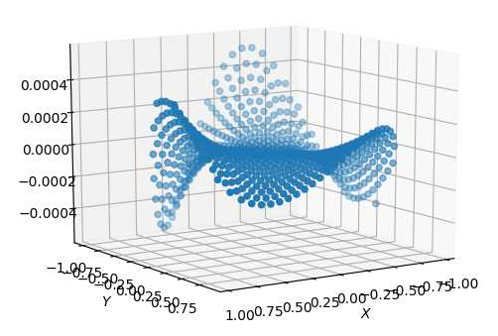
  CP Violation from Dalitz plot mirror asymmetry in η−> π⁺π⁻π^{ο}
  CP-violation from this process is not bounded by EDM as is the case for the η→4π process.
  Complementary to EDM searches even in the case of T and P odd observables, since the flavor structure of the eta is different from the nucleus
  Current PDG limits consistent with no asymmetry
  REDTOP will collect 4x10¹¹ decays (100x in stat. err.) in B-field insensitive detector
  New model in GenieHad (collaboration with S. Gardner & J. Shi – UK) based on https://arxiv.org/abs/1903.11617

Slide 26
History of the Project
  Dec. 2014
    Born at FTBF (A. M., C. G. , H. F.)
  Sept. 2017
    LOI submitted to Fermilab’s PAC in Sept. 2017
    PAC did not at this time
    Fermilab’s Director recommended a two-year waiting period (still ongoing).
  Jan. 2018
    REDTOP admitted into the “Physics Beyond Colliders” program to explore a possible implementation at CERN
    Near full simulations studies indicate very good sensitivity studies to physics BSM for 3 out of 4 “portals”
    Final report from PBC indicate that the experiment is feasible at CERN, but with lower (1/10x) beam luminosity and larger impact on existing physics program cfr. FNAL
  Dec. 2018
    EOI submitted to European Strategy for Particle Physics
  Apr. 2019
    Fermilab SAC’s considered REDTOP among the projects of interest for Snowmass-P5

Slide 27
Timeline & Costing
Once approved and funded, REDTOP needs:
  2 years detector R&D (could be done before formal approval)
  1 year detector design
  2-3 years construction+commissioning
Accelerator mods required:
  BNL: <1yr (only requiring a new electronics for the extraction line (C4)
  CERN: need further studies
  FNAL: ~1yr (add a SC cavity to the DR and build an extraction line
Total cost (for ESPP): ~50 M$ (including 50% contingency)
  Solenoid and ¾ of Pb-Glass for ADRIANO in-kind contributions from INFN (Finuda and NA64 experiments)
  Construction at participating institutions
  Assembly at hosting laboratory

Slide 28
Future Prospects
The Collaboration is currently engaged in the ESPP process and preparing for the P5-Snowmass process
Endorsement by the community and/or laboratories is needed to fund detector R&D activities
Current activities aim at the preparation of a full proposal in a timeframe consistent with the ESPP and Snowmass-P5
  Detector optimization and sensitivity studies are well established and ongoing. Goal is maximize S/ √B
  Detector R&D is minimal (ADRIANO2 only, at present)
Competition from several other experiments (LHCB, et. Al.)
  But, REDTOP experimental techniques is substantially different
More details: https://redtop.fnal.gov

Slide 29
Present & Future η Samples
 | Technique |  | η → 3πº | η → e⁺e⁻γ | Total η
CB@AGS | π⁻⁻p→η n |  | 9×10⁵ |  | 10⁷
CB@MAMI-B | γ⁻p→η p |  | 1.8×10⁶ | 5000 | 2×10⁷
CB@MAMI-C | γ⁻p→η p |  | 6×10⁶ |  | 6×10⁷
KLOE | e+e-→Φ→ηγ |  | 6.5×10⁵ |  | 5×10⁷
WASA@COSY | pp→η pp pd→η ³He |  |  |  | >10⁹ (untagged) 3×10⁷ (tagged)
CB@MAMI 10 wk (proposed 2014) | γ⁻p→η p |  | 3×10⁷ | 1.5×10⁵ | 3×10⁸
Phenix | d Au→η X |  |  |  | 5×10⁹
Hades | pp→η pp p Au→η X |  |  |  | 4.5×10⁸
Near future samples
GlueX@JLAB (just started) |  | γ_{12 GeV}p → η X → neutrals |  |  | 5.5×10⁷/yr
JEF@JLAB (recently approved) |  | γ_{12 GeV}p → η X → neutrals |  |  | 3.9×10⁵/day
REDTOP@FNAL (proposing) |  | p_{1.8 GeV}Be → η X |  |  | 2.5×10¹³/yr

Slide 30
Cost (estimate for ESPP)
  In kind contribution from INFN
    Solenoid (from Finuda experiment at Frascati)
    ¾ of Pb-glass (from NA62)
  For Fermilab
    Add labor and accelerator (R.F.cavities and EM septum are available at Fermilab)
    Adjust contingency from 50% to 25%

Slide 31
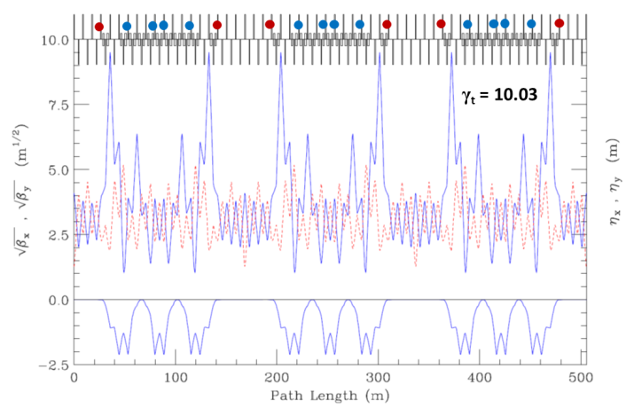
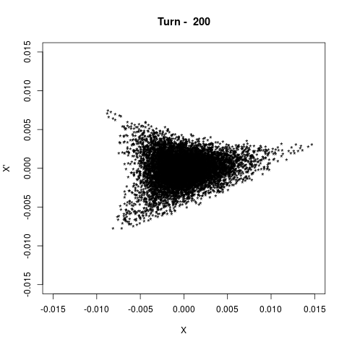
Accelerator Physics Issues
  Transition Energy
    𝛾_{t} is where 𝛥f/f = 1/𝛾2 - <D/𝜌> = 0; synchrotron motion stops momentarily, can often lead to beam loss
    beam decelerates from 𝛾 = 9.5 to 𝛾 = 3.1
    original Delivery Ring 𝛾_{t} = 7.6
    a re-powering of 18 quadrupole magnets can create a 𝛾_{t} = 10, thus avoiding passing through this condition
      Johnstone and Syphers, Proc. NA-PAC 2016, Chicago (2016).
  Resonant Extraction
    Mu2e will use 1/3-integer resonant extraction
    REDTOP can use same system, with use of the spare Mu2e magnetic septum
    initial calculations indicate sufficient phase space, even with the larger beam at the lower energies
  Vacuum
    REDTOP spill time is much longer than for Mu2e
    though beam-gas scattering emittance growth rate 3 times higher at lower energy, still tolerable level

Slide 32

Ring Optics through Deceleration
(J. Johnstone)
Transition is avoided by using select quad triplets to boost γt above beam γ by 0.5 units throughout deceleration until γ_{t} = 7.64 and beam γ = 7.14 (5.76 GeV kinetic).
Below 5.76 GeV the DR lattice reverts to the nominal design configuration
8 GeV injection energy (top) and <5.8 GeV (bottom)
Blue & red circles indicate sites of the γ_{t} quad triplets.
Variation of $γ_{t}$, β_{max}, and the 15π 99% beam envelope through deceleration
"J.Johnstone, M.Syphers, NA-PAC, Chicago (2016)"

Slide 33
The REDTOP Detector
Optical TPC
~ 1m x 1.5 m
CH₄ @ 1 Atm
5x10⁵ Sipm
98% coverage
  Beam & Target
Aerogel
Dual refractive
index system
10x Li/Be targets
0.33 mm thin
Spaced 10 cm
μ-polarizer (optional)
Active version (from TREK exp.)
ADRIANO2 Calorimeter
Scint. + heavy glass sandwich
20 X ₀ ( ~ 64 cm deep)
Triple-readout mode
96% coverage
Solenoid
0.6-0.8 T
Fiber tracker

Slide 34
The ADRIANO2 Calorimeter
  Sandwich of Pb-glass and scintillating plastic tiles with direct SiPM reading
    Evolution of ADRIANO dual-readout calorimeter (A Dual-Readiut Integrally Active Non-segmented Option)
  Triple-readout obtained from waveform analysis
  Rationale for multiple readout calorimetry at η -factory
    Particle identification (see next)
    Integrally active (no sampling)
    Prompt Cerenkov light fed to L) trigger
    Good granularity helps disentangling overlapping showers

Slide 35
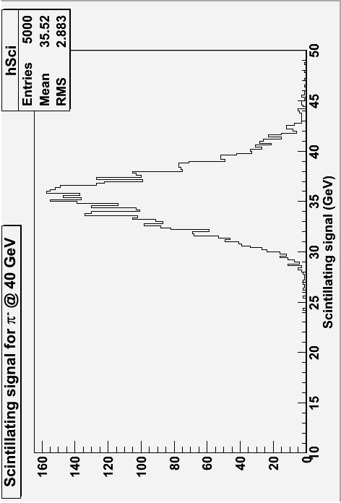
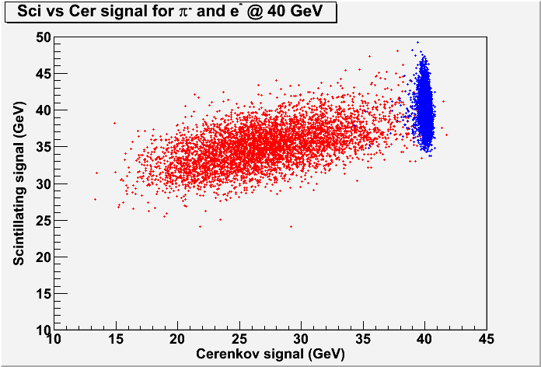
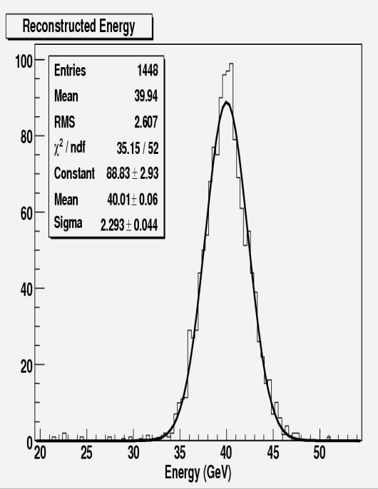
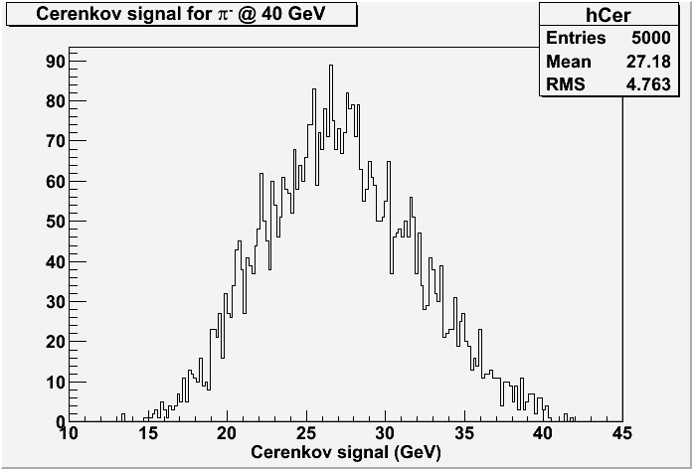
Dual Readout Calorimetry from a Different Perspective
40 GeV π
pions
electrons
gaussian
Triple-readout adds the measurement of the neutron component improving the energy resolution even further
Notes:
35

Slide 36
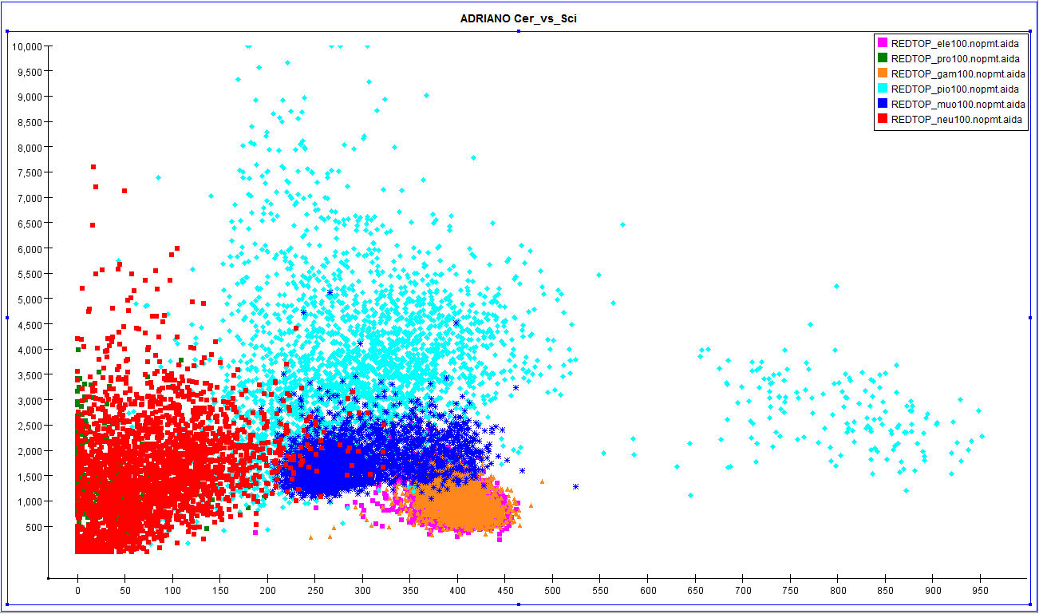
ADRIANO PID @ 100MeV
pions
p/n
muon
e/γ

Slide 37
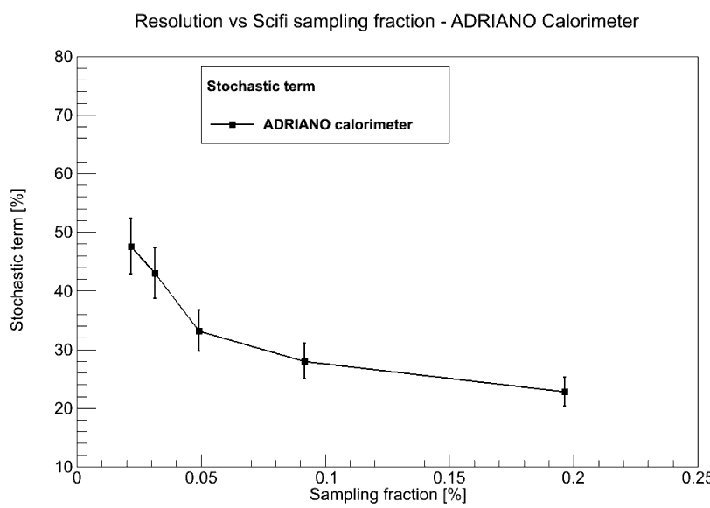
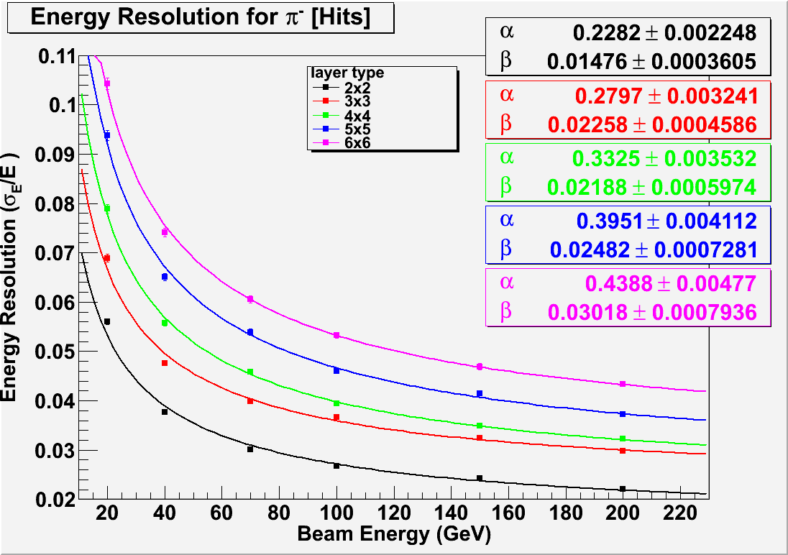
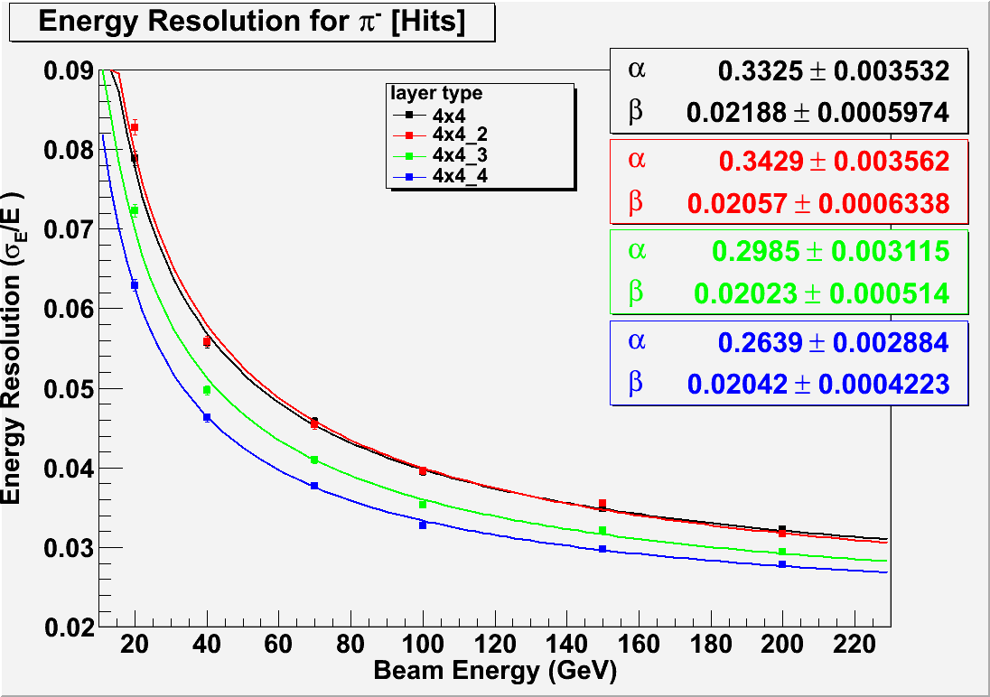
ADRIANO Light Yield and Resolution
Integrally Active with Double side readout (ADRIANO)
Sampling
Pitch [mm²] Diameter | 2x2 1mm | 3x3 1mm | 4x4 1mm | 5x5 1mm | 6x6 1mm | 4x4 1.4mm | 4x4 2mm | 4x4 capillry | Sampling
<pe_{S}/GeV> | 1053 | 430 | 254 | 163 | 124 | 500 | 110 | 250 | 200
<pe_{C}/GeV> | 340 | 360 | 360 | 355 | 355 | 355 | 350 | 350 | 7.5
Baseline
configuration
1-side
readout
ILCroot simulations
Fiber pitches: 2mmx2mm through 6mmx6mm
fiber diameter: 1mm – 1.4mm – 2 mm
C. Gatto - INFN
All numbers include the effect of photodetector QE

Slide 38
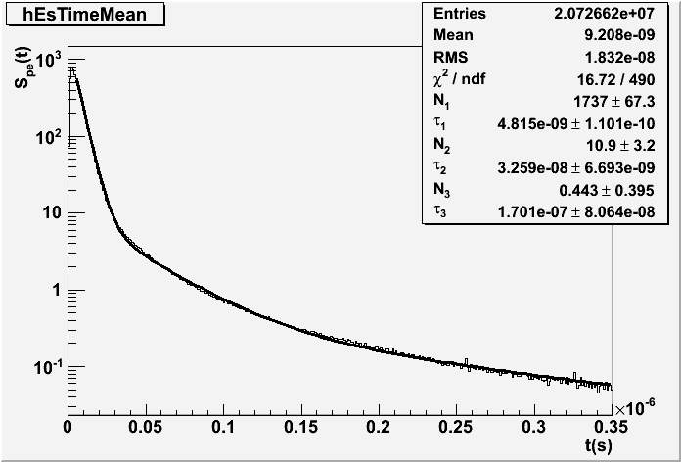
From Dual to Triple Readout
Disentangling neutron component from waveform
Time history of the Scint pe
ILCroot simulations
Time history of the scintillation signal in ADRIANO for π⁻@40 GeV.
The contribution after 35 ns is from neutrons only. The distribution has been fitted with a triple exponential function .
40 Gev pions
Neutron contribution
Triple Readout aka Dual Readout with time history readout

Slide 39
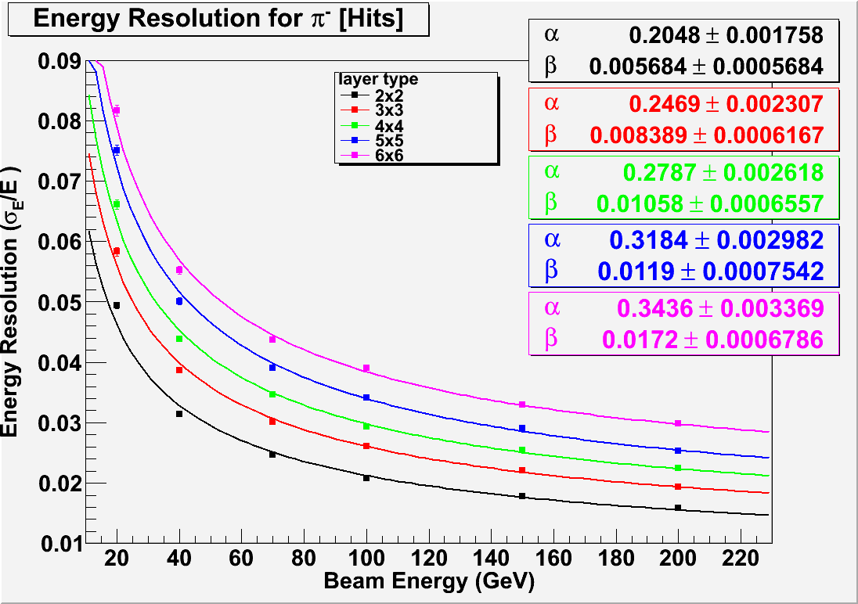
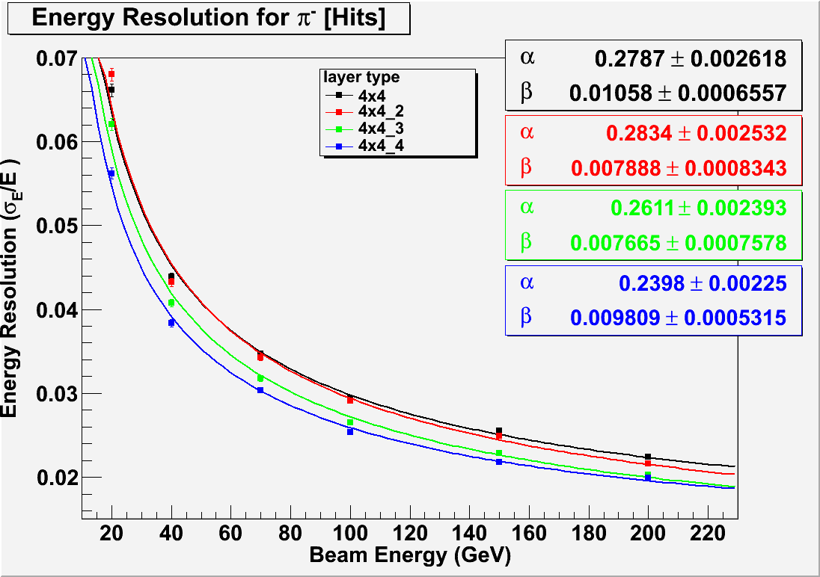
ADRIANO in Triple Readout configuration
Fiber pitches: 2mmx2mm through 6mmx6mm
Baseline configuration
Baseline configuration
Pion beams
fiber diameter: 1mm – 1.4mm – 2 mm
ILCroot simulations
Compare to ADRIANO in Double Readout configuration
39

Slide 40
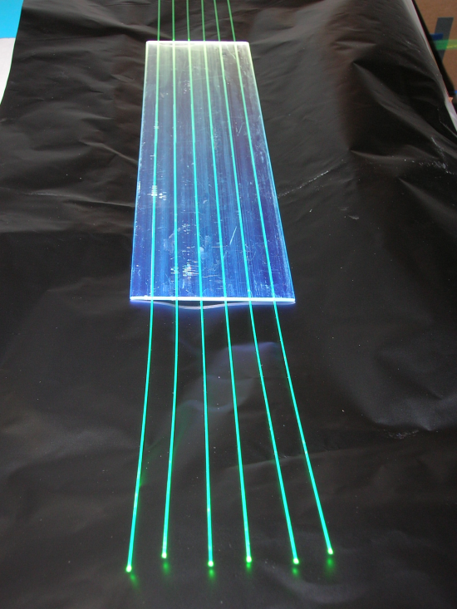
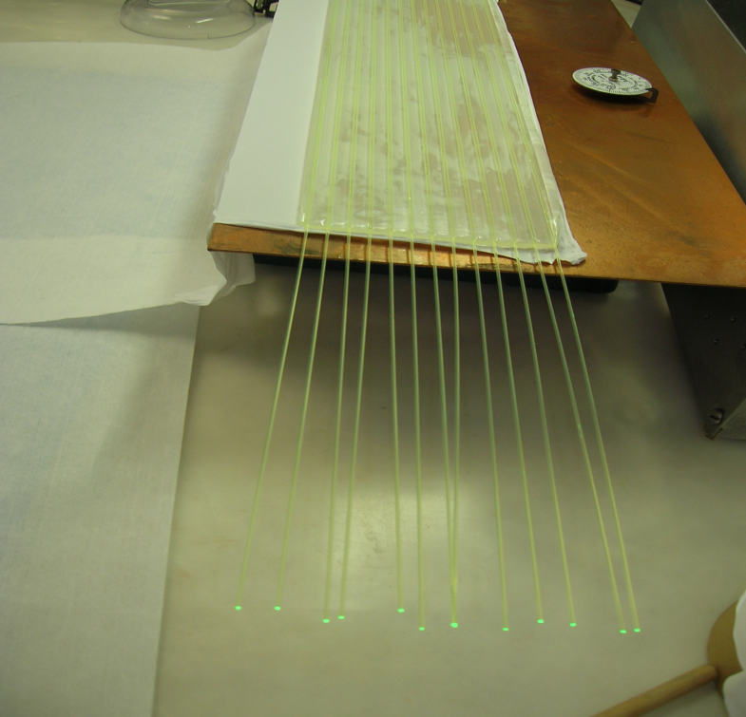
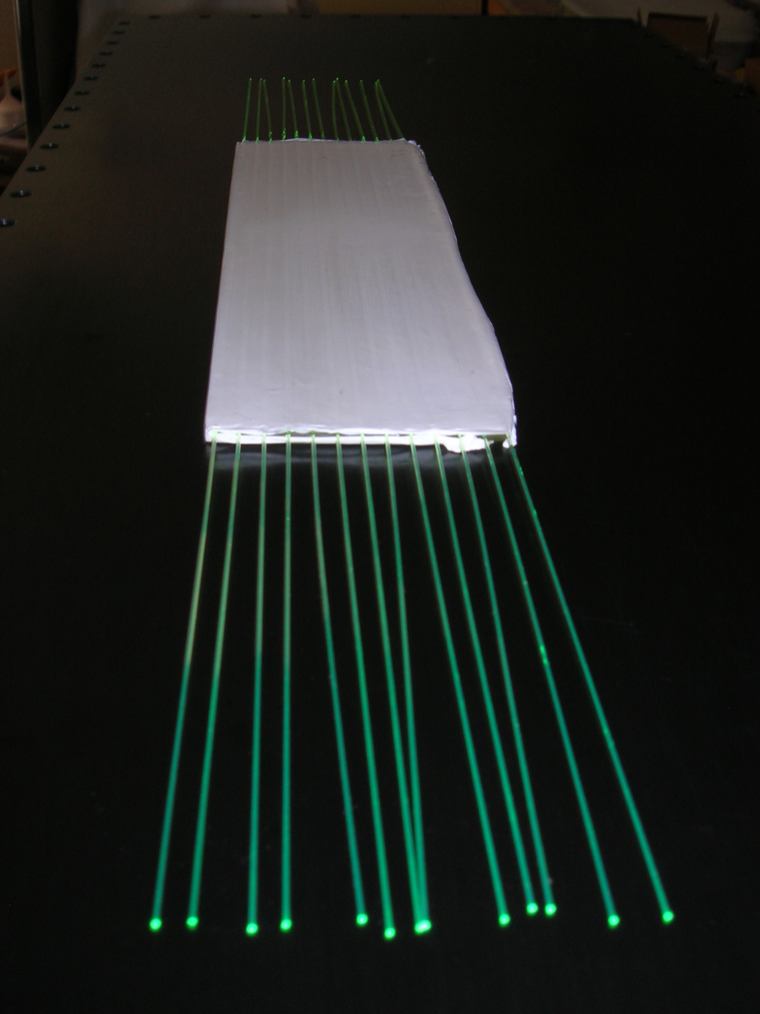
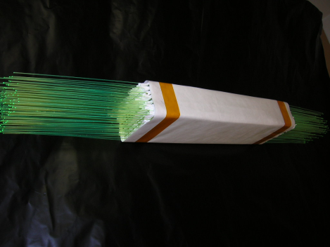
ADRIANO for ORKA Construction
WLS + scintillator
WLS + glass
Teflon wrapping
Final detector

Slide 41
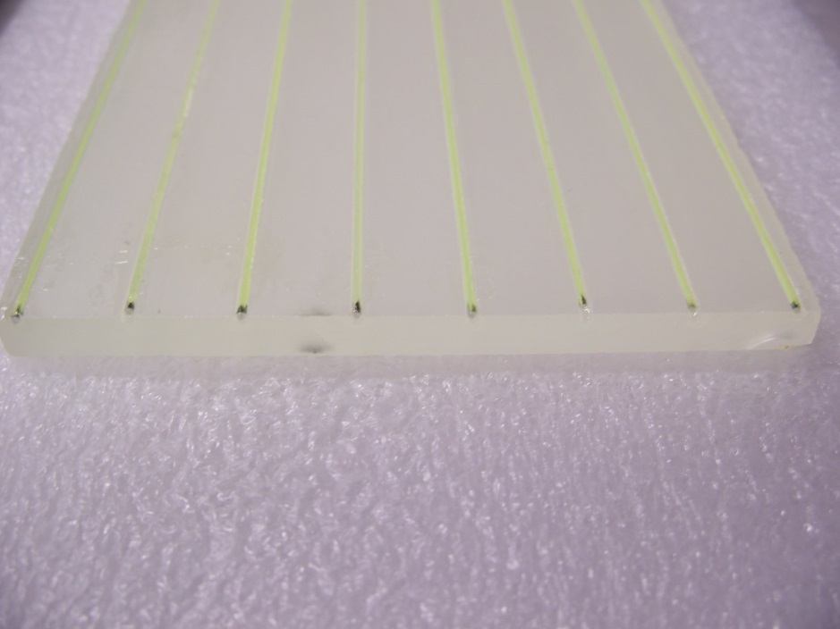
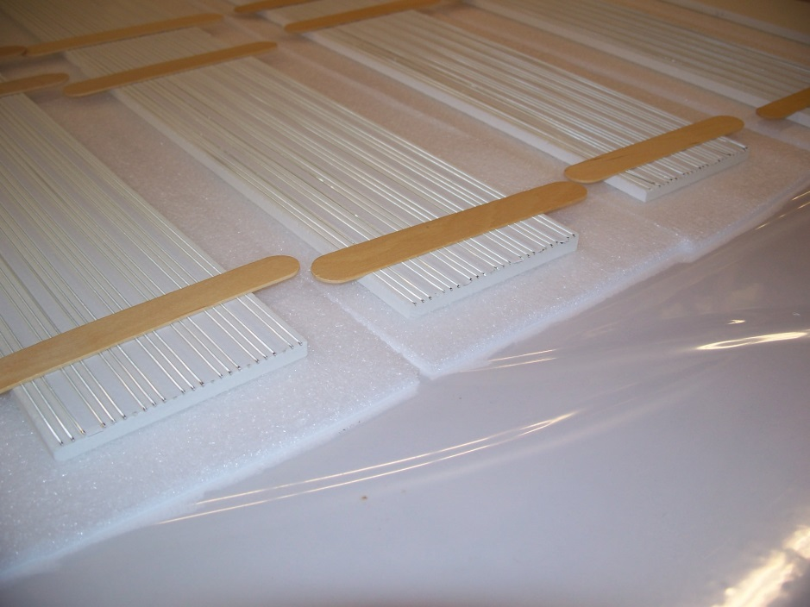
ADRIANO-2014
Two versions built: scifi and scintillating plates
10 x 8 x105 cm3 long prototypes, about 50 Kg each
4 cells total, front and back readout
Hopefully , we will be able to test the dual-readout concept with integrally active detectors
ADRIANO 2014A: 8 grooves
ADRIANO 2014B: 23 grooves

Slide 42
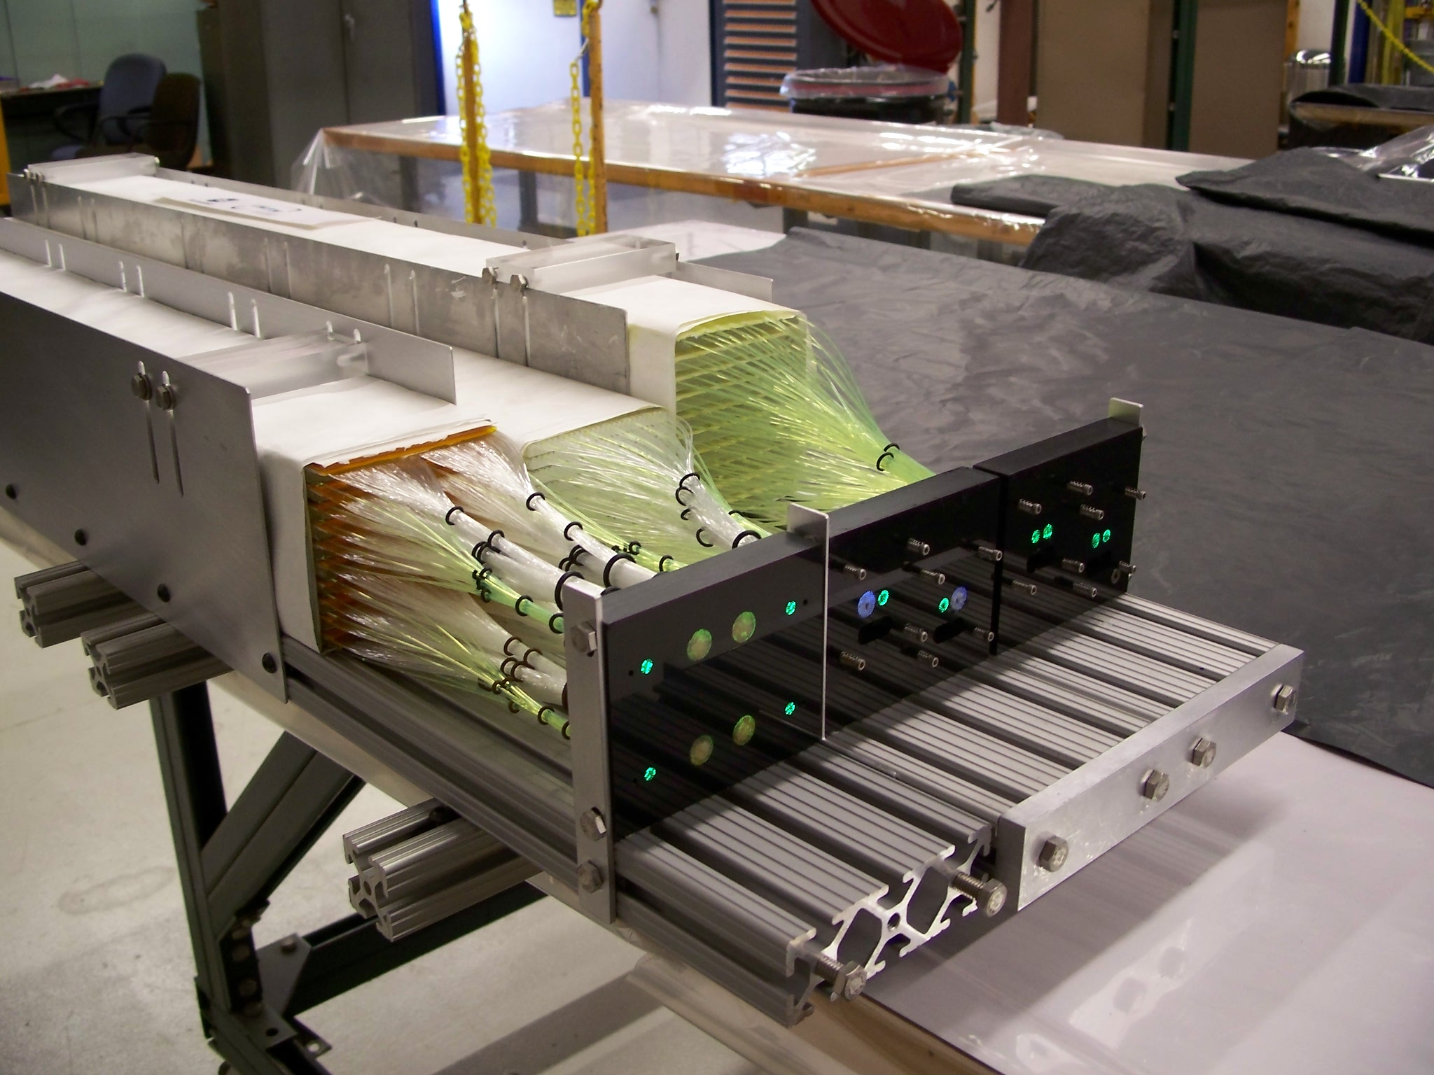
Nov. 2015 test Beam at Fermilab

Slide 43
ADRIANO2 R&D
Evolution of ADRIANO: log layout->tiles
Sandwich of 3mm scintillating plastics and 10 mm Pb-glass (10cm x 10cm transverse size)
WLS light capture -> SiPM directly coupled to glass and plastic
Prompt Cerenkov signal used in L0 trigger
Granularity can be made extremely fine
16 layers – prototype (64 ch) under construction at NIU
Will be tested in Fall 2019 at FTBF
At present, Fermilab-INFN-NIU-UMN Collaboration

Slide 44
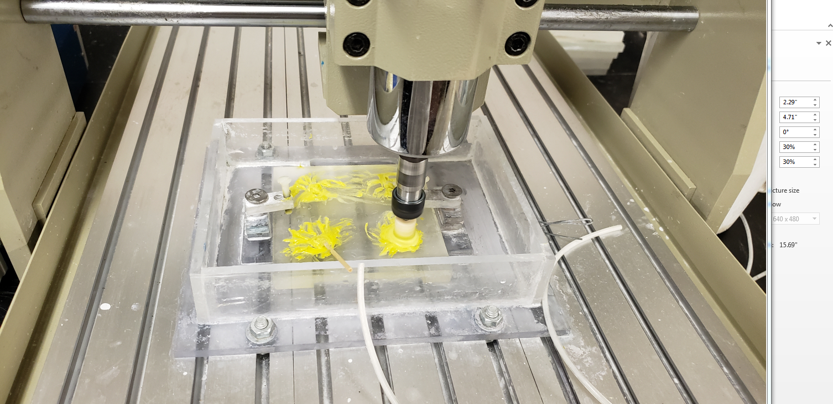
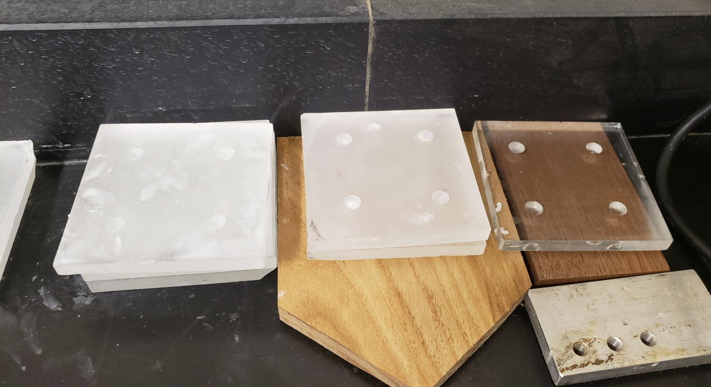
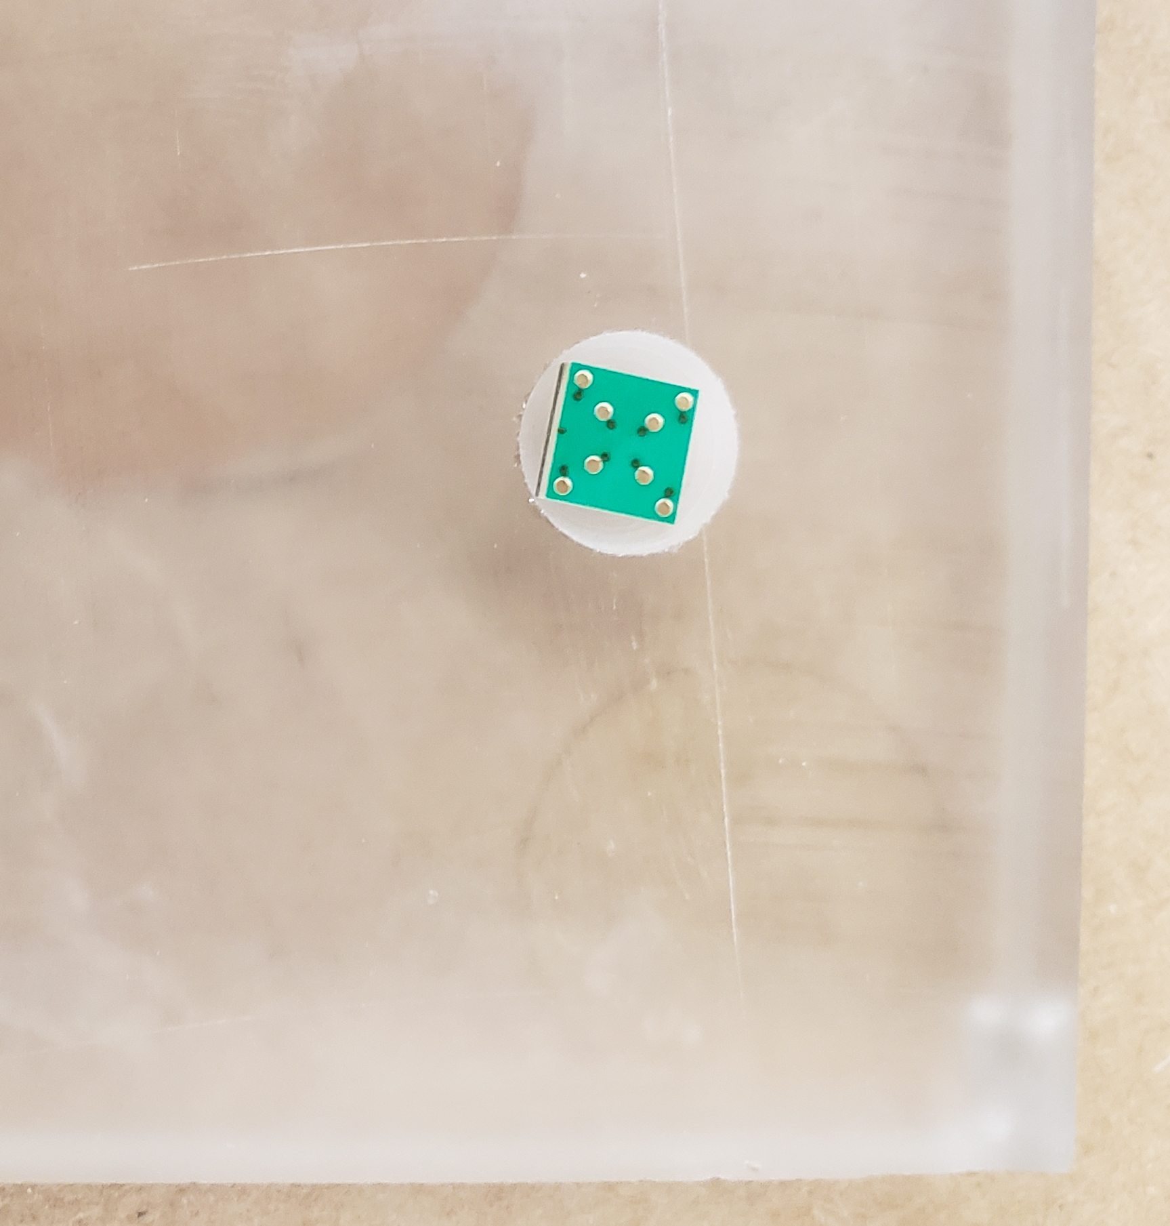
Polishing

Slide 45
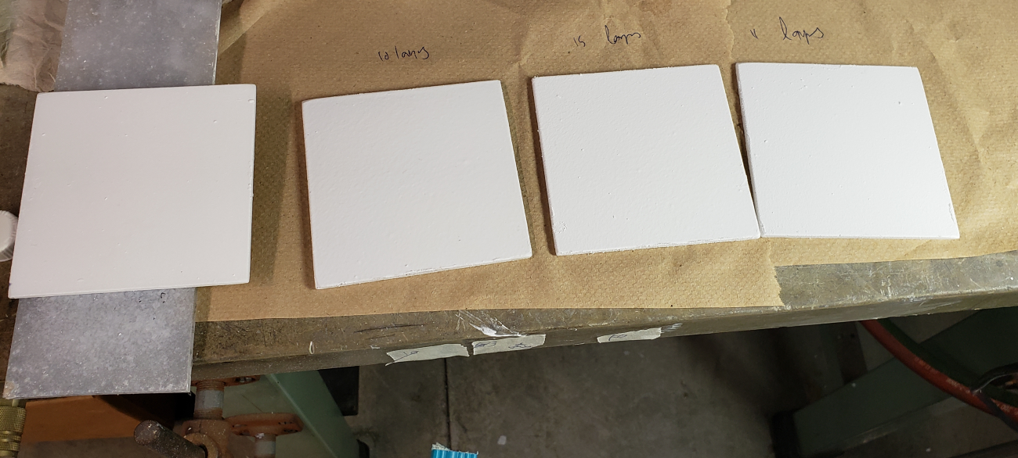
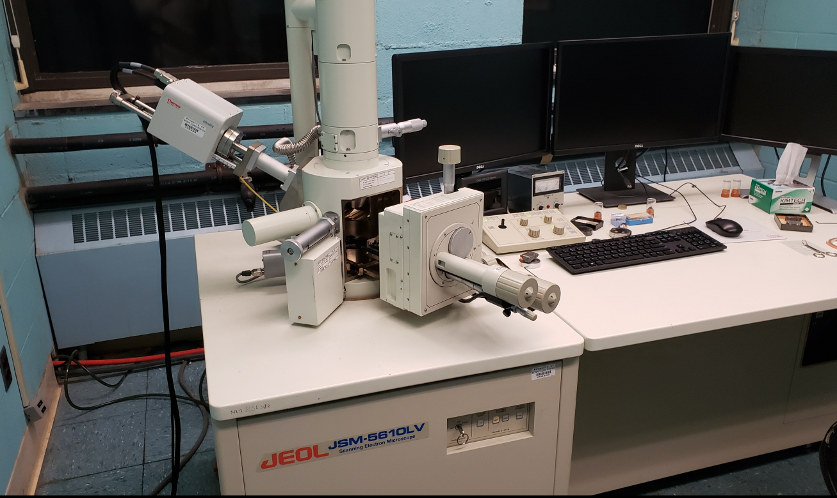
Coating and testing

Slide 46
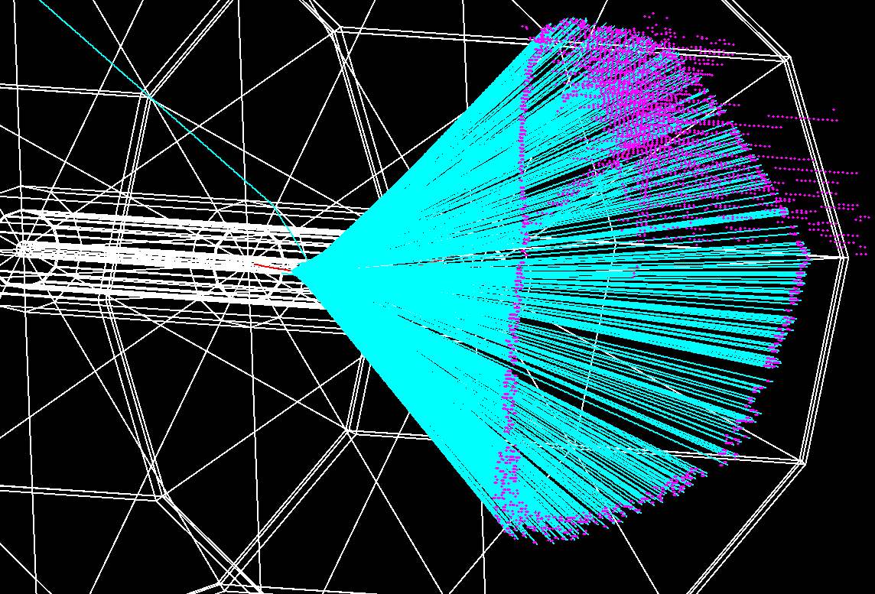
The Optical TPC Concept
  Rationale for an Optical- TPC
  At 1 GHz inelastic interaction rate, a conventional, gas detector is suboptimal
  Hadronic particles (p, ion remnants, slow pions, etc.) will clutter the tracker
  Use the Cerenkov effect to detect the fast (leptons and fast pions) tracks
  Prompt signal is also fed to the L0 trigger for fast selection of event with leptons

Slide 47
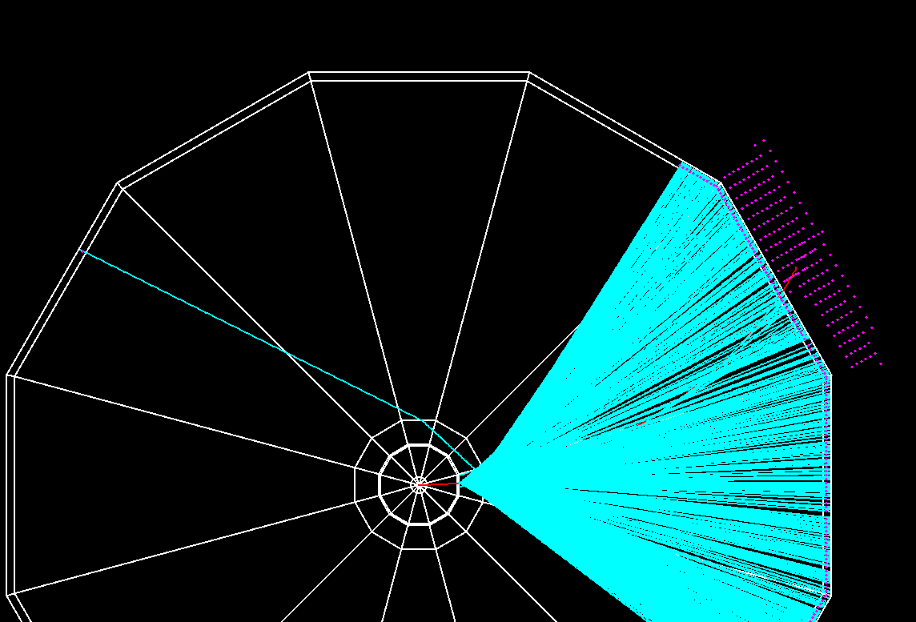
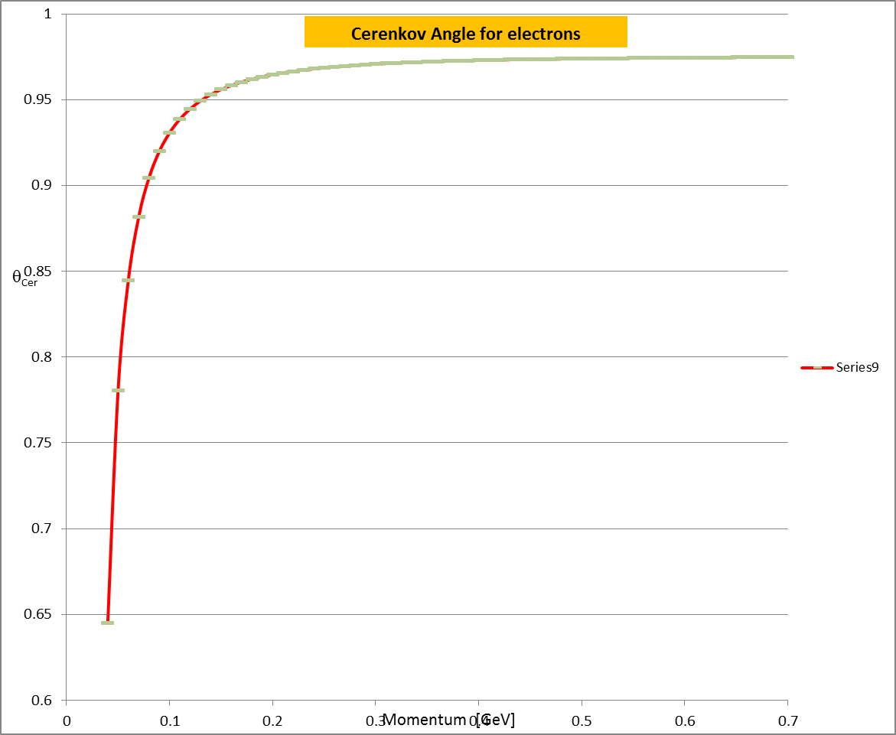
Electron Detection
100 MeV electron
100 MeV electron
n_{D}(N₂@2.7psi)=1.000145
Č threshold for e- in N₂: P=40 mev
n_{D}(aerogel1)=1.12
n_{D}(aerogel2)=1.22

Slide 48


Electron Momentum Reconstruction
200 MeV electron
50 MeV electron
15 cm
5 cm
Electrons are recognized by:
  a large (>30 cm dia) circle of photons generated in the aerogel
  A sweep of photons circles with dia < 1cm and several cm long (depends on P_{t})
  An EM shower in ADRIANO (identified by Č vs S)

Slide 49




Muon/pion Detection
n_{D}(aerogel)=1.22/1.12
Č threshold for muons: P=160 mev
Č threshold for pions: P=200 mev
95 MeV muon
120 MeV muon
Dual-readout: Č vs S for μ and π with P=500 MeV

Slide 50

  η−> π⁺π⁻π^{ο}
Ilcroot simulation

Slide 51


Detector R&D: OTPC
  Fnal –T1059 (H. Frisch, E. Oberla)
  Successful proof of principle in 2015 at FTBF
  Instrumented with an MCP photo-detector, three boards each with thirty channels of 10 GSPS waveform digitizing readout
  http://ppd.fnal.gov/ftbf/TSW/PDF/T1059_tsw.pdf
It requires a robust and dedicated R&D (LDRD)

Slide 52



The Fiber Tracker – LHCb design

Slide 53


Layout for LHCb vs REDTOP
1.5 m
  Input parameters
  ~ 360 m² vs 0.24m²
  1152 mats vs 36 mats
  524,000 vs 18,000 channels
1 m
REDTOP
LHCb

Slide 54





Results from LHCb Test Beam

Slide 55

Fiber Tracker Radiation Hardness
  Expected irradiation at REDTOP
  Worst case (forward detector): ~10¹³ n/cm²
  Average: ~10¹² n/cm²

Slide 56
REDTOP Possible Running Phases
Phase I: η-factory. Goal is ~10¹³ η /yr
  T_{beam}: 1.8-2.1 GeV
  Power: 30 W
  Target: 10 x 0.33 mm Be
Phase II: η ’-factory. Goal is ~10¹¹ η’ /yr
  T_{beam}: 3.5-4.5 GeV (to be optimized)
  Power: 60 W
  Target: 10 x 0.33 mm Be
Phase III: Dark photons radiating form muons. Goal is > 1.0 ×10¹³ μ/yr
  (G. Krnjaic and Y. Kahn)
  T_{beam}: 1< <3 GeV (to be optimized)
  Target: H₂ gas
Phase IV: Muon Scattering Experiment. Goal is > 2.0 ×10¹² μ/yr
  T_{beam}: 0.2< <0.8 GeV (to be optimized)
  Muon yield: >1.6 ×10⁻⁸ μ/p
  Target: 1 x 100 mm graphite
Phase V: tagged REDTOP. Goal is > 2.0 ×10¹³ η/yr
  T_{beam}: 1.2 GeV at PIP-II
  Muon muon yield: >1.6 ×10⁻⁸ μ/p
  Target: ³H
Phase VI: Rare Kaon Decays: K⁺ → π ⁺ ν ν Goal is > 1×10¹⁴ ΚΟΤ/yr
  T_{beam}: K⁺ from 8 GeV protons
  K⁺/π yield: 1 /13 (neglecting very soft pions – factor 1.8 better than p@92 GeV)
  Target: primary (PT: for K production) + secondary (active: scintillating plastics)
It could be made unnecessary by NA62+ and JPARC

Slide 57
Ongoing activities - simulations
Event generation
  GenieHad (Genie add-on) event generator interfaces to: Urqmd, Gibuu, Phsd, Abla, Gemini, SMM, G4EM processes, Incl++, IAEA tables, LELAPS
  New interfaces to JAM (JPARC) and ALPS (for PIP-II simulations) in preparation
Simulation, digitization, reconstruction and analysis
  Based on ILC frameworks (slic, lcsim and ilcroot)
  Full simulation in place (except for OTPC-reco and vertexing)
Detector optimization and sensitivity studies are ongoing
  Improvement on BSM physics from detached vertices

Slide 58
Ongoing activities – detector R&D
ADRIANO – dual readout calorimeter
  ADRIANO2 prototype under construction at NIU (INFN-NIU-UMN collaboration). FNAL probably joining (J. Freeman)
  Inherits from 10+ years R&D by T1015
O-TPC
  UC (H. Frish) only existing prorotype
  Requires a more structured collaboration
Fiber tracker
  No R&D needed: technology is exact copy of LHCB’s new tracker
  In talk with Aachen-RWTH for joining
  Otherwise, technology&tools transfer to REDTOP

Slide 59
Transitionless Deceleration in the Delivery Ring (J. Johnstone)
Large beam losses will occur if beam is decelerated from injection @ 8 GeV (γ = 9.53) to 2 GeV (γ = 3.13) through the DR natural transition energy γ_{t} = 7.64.
Transition is avoided by using select quad triplets to boost γt above beam γ by 0.5 units throughout deceleration until γ_{t} = 7.64 and beam γ = 7.14 (5.76 GeV kinetic).
Below 5.76 GeV the DR lattice reverts to the nominal design configuration
Optical perturbations are localized within each triplet
Straight sections are unaffected thereby keeping the nominal M3 injection beamline tune valid.

Slide 60

The major source of fluctuations: fem
40 Gev π⁻
total
π±,p,n
e±,πº,γ,η

Slide 61
Dual Readout Calorimetry from a Different Perspective
Dual Readout is nothing but a rotation in
E_{S} - E_{C} plane
ILCroot simulations
pions
electrons
If η_{s}≠η_{c} then the system can be solved for E_{HCAL}
Notes:
61

Slide 62



Figures of Merit for Dual-Readout Calorimeter
Large pe/GeV: must be much greater than 45 pe/GeV (corresponding to 15% (teoretical limit) contrubution to stochastic term
System is solvable only when η_{S} ≠ η_{C}. The larger the compensation asymmetry the better. Aka, tg(θ_{S/Q}) much diferent from 1
Small Γ = photodetector area/calorimeter area. Γ_{DREAM} = 24%. Γ_{4th} = 21%. Goal is Γ < 10%.
Small mixing of S and C components
ILCroot simulations
η_{S} = η_{C}

Slide 63


ADRIANO for ORKA Final Prototypes

Slide 64


High Energy vs High Intensity Layouts
High Energy
High Intensity
Detection of Hadronic and EM showers with large S and Č light production
Optimized for maximum shower containment (i.e. max detector density)
Detection of EM showers only with small S and Č light production
Optimized for high sensitivity in the 10 MeV range (i.e. max detector granularity)
Thicker glass
Thin scintillating fibers or ribbons
Fewer WLS fibers
Thinner glass
Thicker scintillator plates
More WLS fibers

Slide 65
Expected η/η’ Yield
  Assume: 1x10¹¹ POT/sec – CW
    Beam power @ 3 GeV: 10¹¹ p/sec × 1.9 GeV × 1.6 × 10⁻¹⁰ J/GeV = 30 Watts (48 W for η ’)
  Target system : 10 x 0.33mm Be or 0.5 mm Li foils, spaced 10 cm apart
    Be is thinner (better vertex resolution) but makes more primary hadrons (final state hadron multiplicity ≈ A^{1/3})
    Prob(p + target → X) ~ 0.5% or 5× 10⁸ p-Be inelastic collisions per second
  p-inelastic production: 5 x 10⁸ evt/sec (1 interaction/2 nsec in any of the 10 targets)
  Probability of 2 events in the same target in 2 nsec: 7%
  η production: 2.5 x 10⁶ η /sec (2.5 x 10⁴ η ’/sec) or 2.5 x 10¹³ η /yr (2.5 x 10¹¹ η ’ /yr)
  Preliminary di-lepton reconstruction efficiency (no-vertexing/timing): 30-50%
  Preliminary background rejection (no-vertexing/timing): < 10⁻⁸ (from QCD) or ≈ 0.1% from η (need to improve 100x with vertexin+timing)

Slide 66


Slide 67

Old method

Slide 68


Slide 69


REDTOP detector in AP50
J. Kilmer
J. Rauch
E. Barzi (Solenoid and yoke)
(Many thanks to K. Krempetz, as well)

Slide 70

BNL hadron complex
REDTOP
Notes:
Add more red boxes

Slide 71

Building 912 AGS Experimental Area (1998)
In use for SRF and ATF-II
REDTOP

