Slide 1
ICARUS Status and Plans
C. Montanari
FNAL – INFN
ICARUS Collaboration Meeting – September 11, 2019

Slide 2
Outline
Present Status of Installation Activities
Collection of Photos and schemes
Cryogenics And detector commissioning
Conclusions

Slide 3
Present Status of Installation Activities (I)
The two cold vessels are completely sealed and under vacuum since the beginning of June.
Vacuum level on the West module is ≈ 10⁻⁵ mbar and the one on the East module is ≈ 5 x 10⁻⁵ mbar
The readout electronics of the wires and the relative power supplies are installed and tested.
The readout electronics and the power supplies of the fototubes are being installed and tested. All the fototubes have been turned on under vacuum and only 2 out of 360 are not working. The laser for the PMTs calibration is also being installed.
The internal probes (temperature and level sensors) are tested, connected to their readout electronics and wired to the cryogenic controls cabinets.
The HV power supply for the drift is being tested in an outside laboratory; it will be positioned and connected to the detector and wired to the slow control system in a couple of weeks.
Cables for the distribution of the HV bias on the wires and for the distribution of the trigger and timing are in production at Fermilab. They are expected to be delivered and installed during the remainder of this month of September.

Slide 4
Present Status of Installation Activities (II)
The external cabling of PMTs and DAQ fibers has just started. Almost all the cable/Fibers trays are in position, the optical fibers have been delivered, 25% of the PMTs cables are onsite while 75% is still on transit (delivered by ship, expected arrival at the beginning of October).
The bottom and North parts of the CRT are installed and tested. The remaining parts can be installed only after the filling of the detector with LAr.
The detector slow controls are being completed (hardware is in place, software is being completed).
The power distribution on top of the detector has been completed.

Slide 5
Present Status of Installation Activities (III)
All the cryogenic equipment and the transfer lines have been installed, welded, pressure and leak tested, with the exception of the collector lines from the chimneys to the gas recirculation units that are being installed.
The argon vent lines from the magnetic safety valves and from the overpressure automatic regulation valves have been installed.
The strain gauges located on the sides of the cold vessels have been connected and the readout system has been installed and operated.
All the argon filters have been activated with the exception of the external filter for the LAr filling that is almost ready for the regeneration.
The gas analysis system (used during the filling to check the quality of the argon and the status of the filling filter) is in position.
The warm vessel is completely sealed and ready to be flushed with dry air to remove moisture.

Slide 6
Present Status of Installation Activities (IV)
External wiring of the cryogenic equipment to the cryogenic control cabinets is almost complete.
Tests of the cryogenic controls are in progress.
The contract for the delivery of LAr is in place. The start of the systematic delivery of LAr has to be notified with a minimum advance of three weeks. The delivery will proceed with six trucks per week: one every working day and two on Fridays; 34 to 36 deliveries are needed to complete the filling (6 weeks).

Slide 7
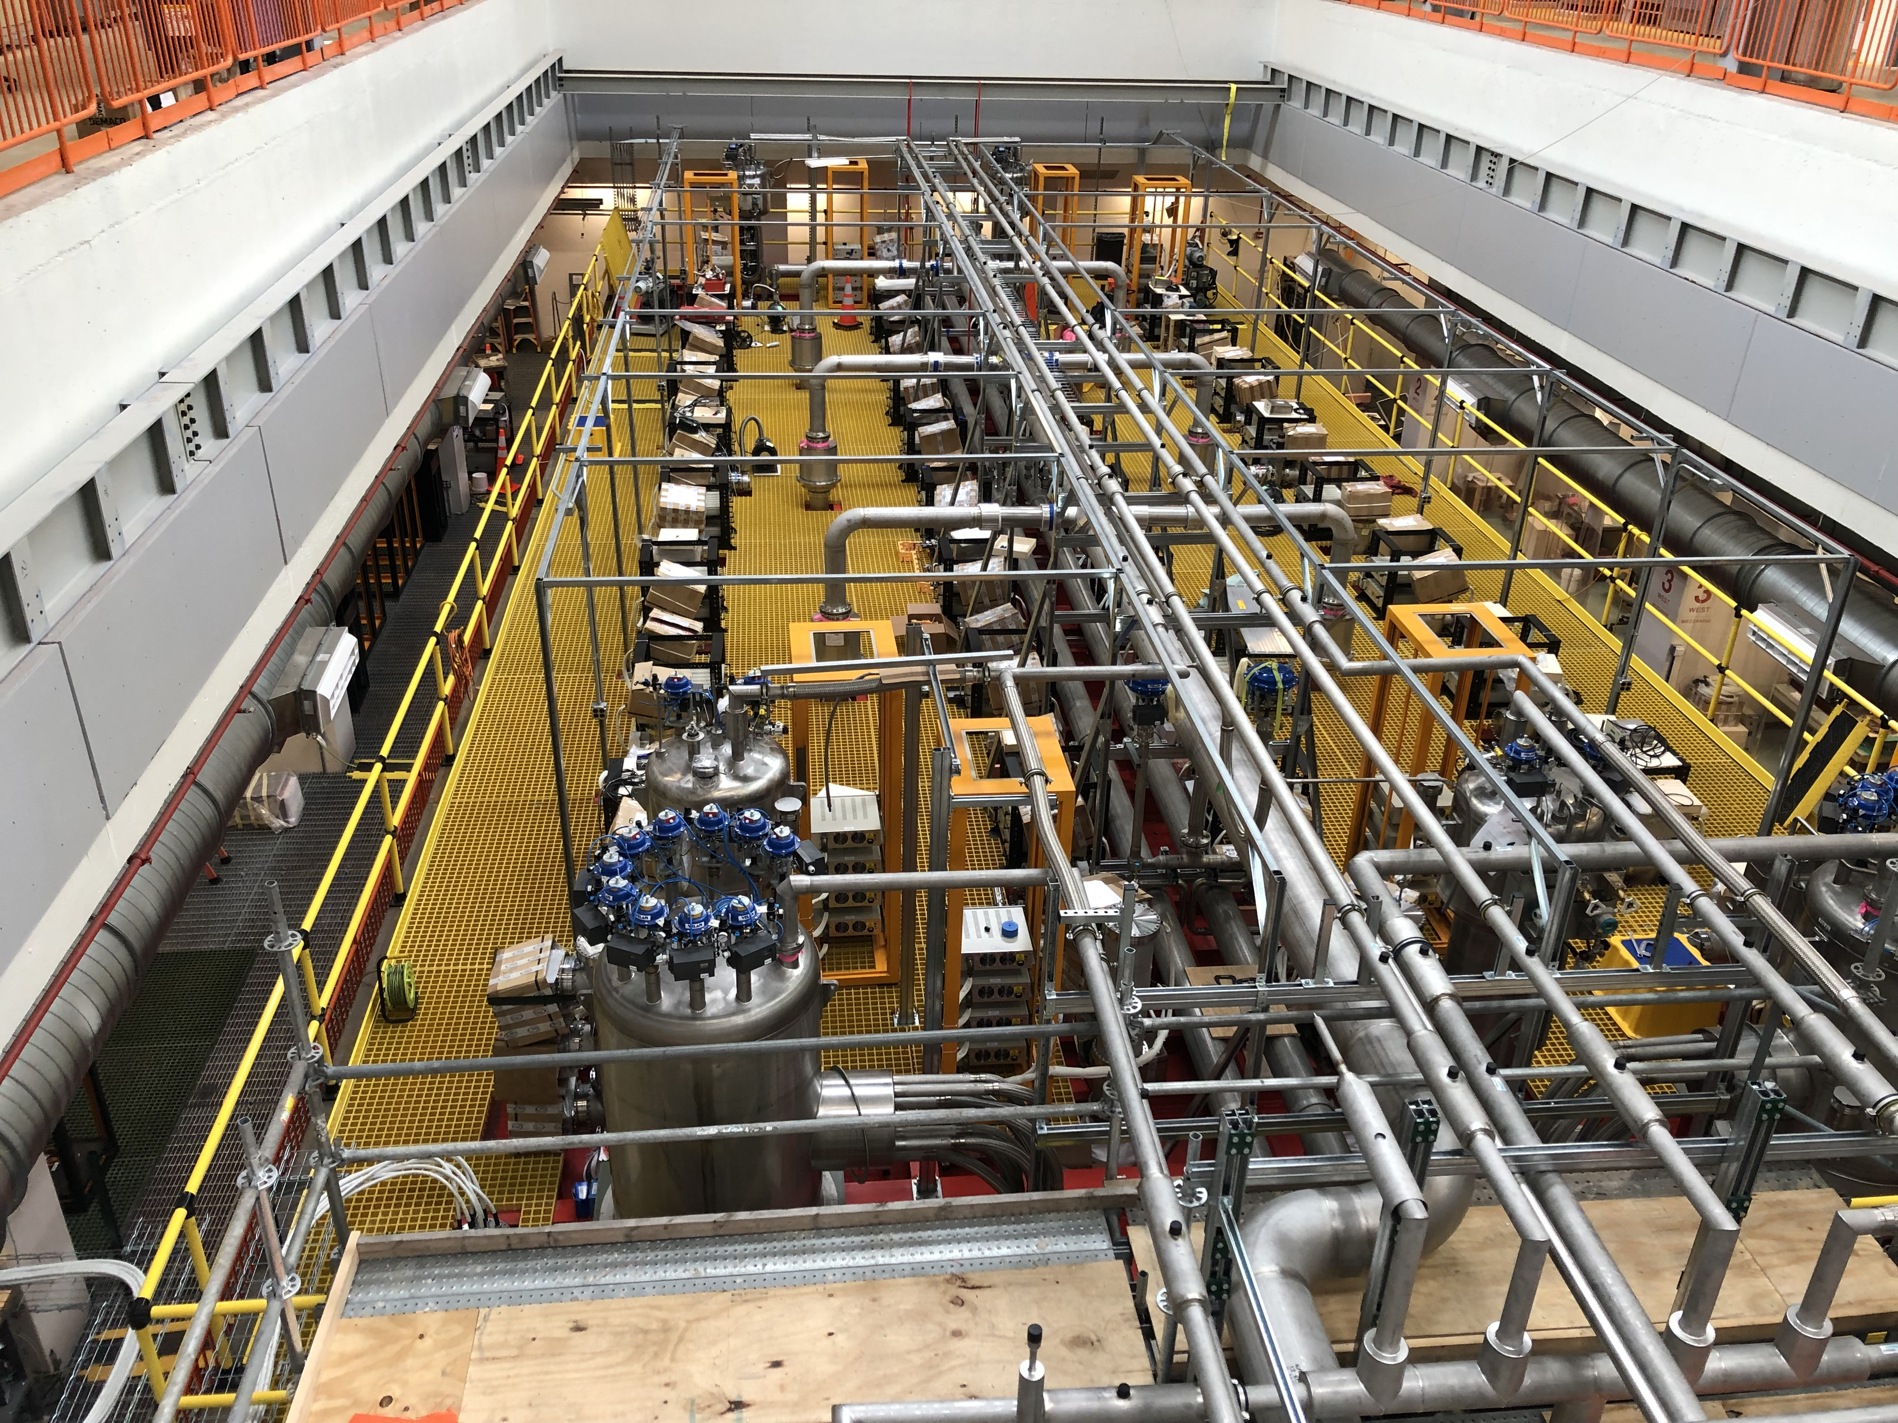
Detector Top
South
Standard crosses
Safety valves
Argon exhaust piping
Decking
Cold shields valve boxes
Picture taken on July 2019
North

Slide 8
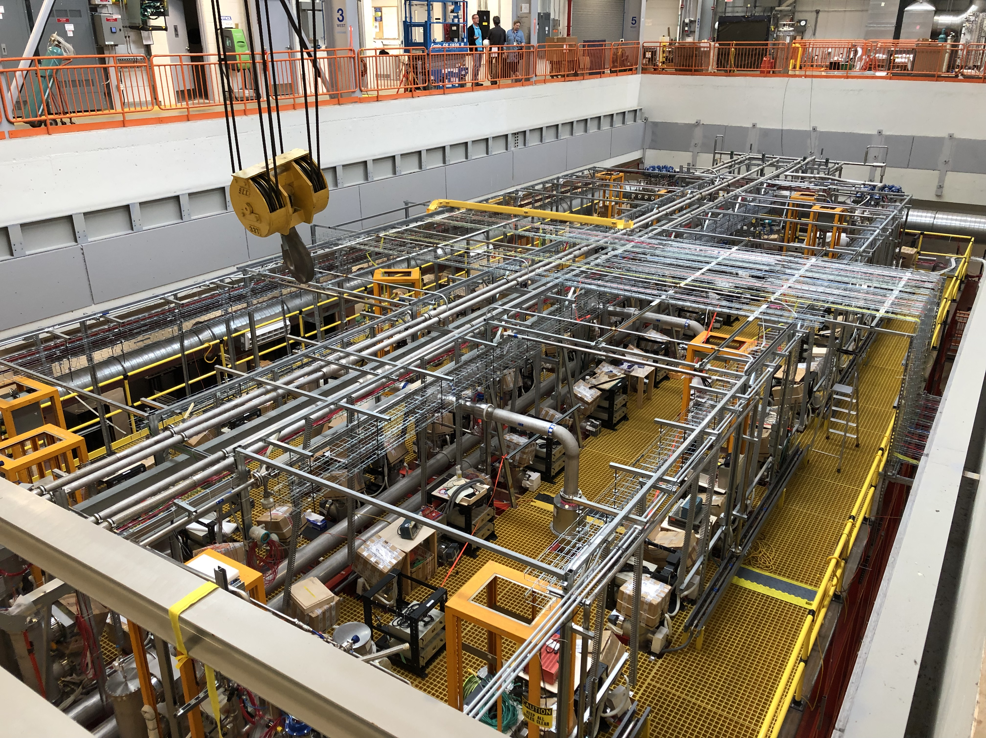
Detector Top
North
Cable trays
Power distribution
Picture taken on September 2019
South

Slide 9
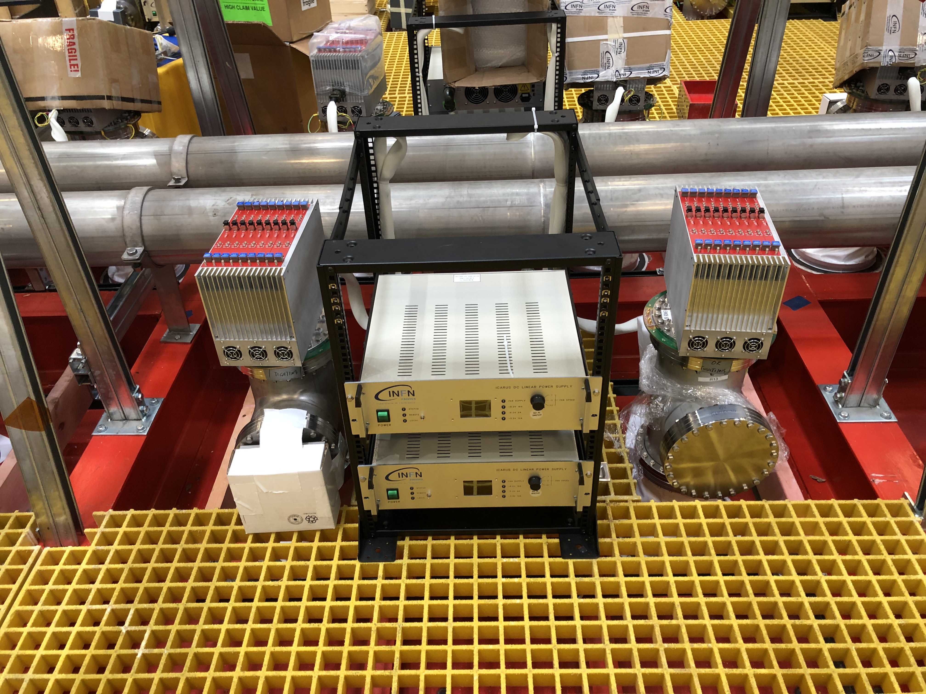
Wires Frontend Electronics
Minicrates with readout boards
Power supplies
Power supplies
Optical fibers feedthrough (covered for protection)
Standard crosses
HV and signal feedthroughs for the PMTs are on the back side of the crosses

Slide 10
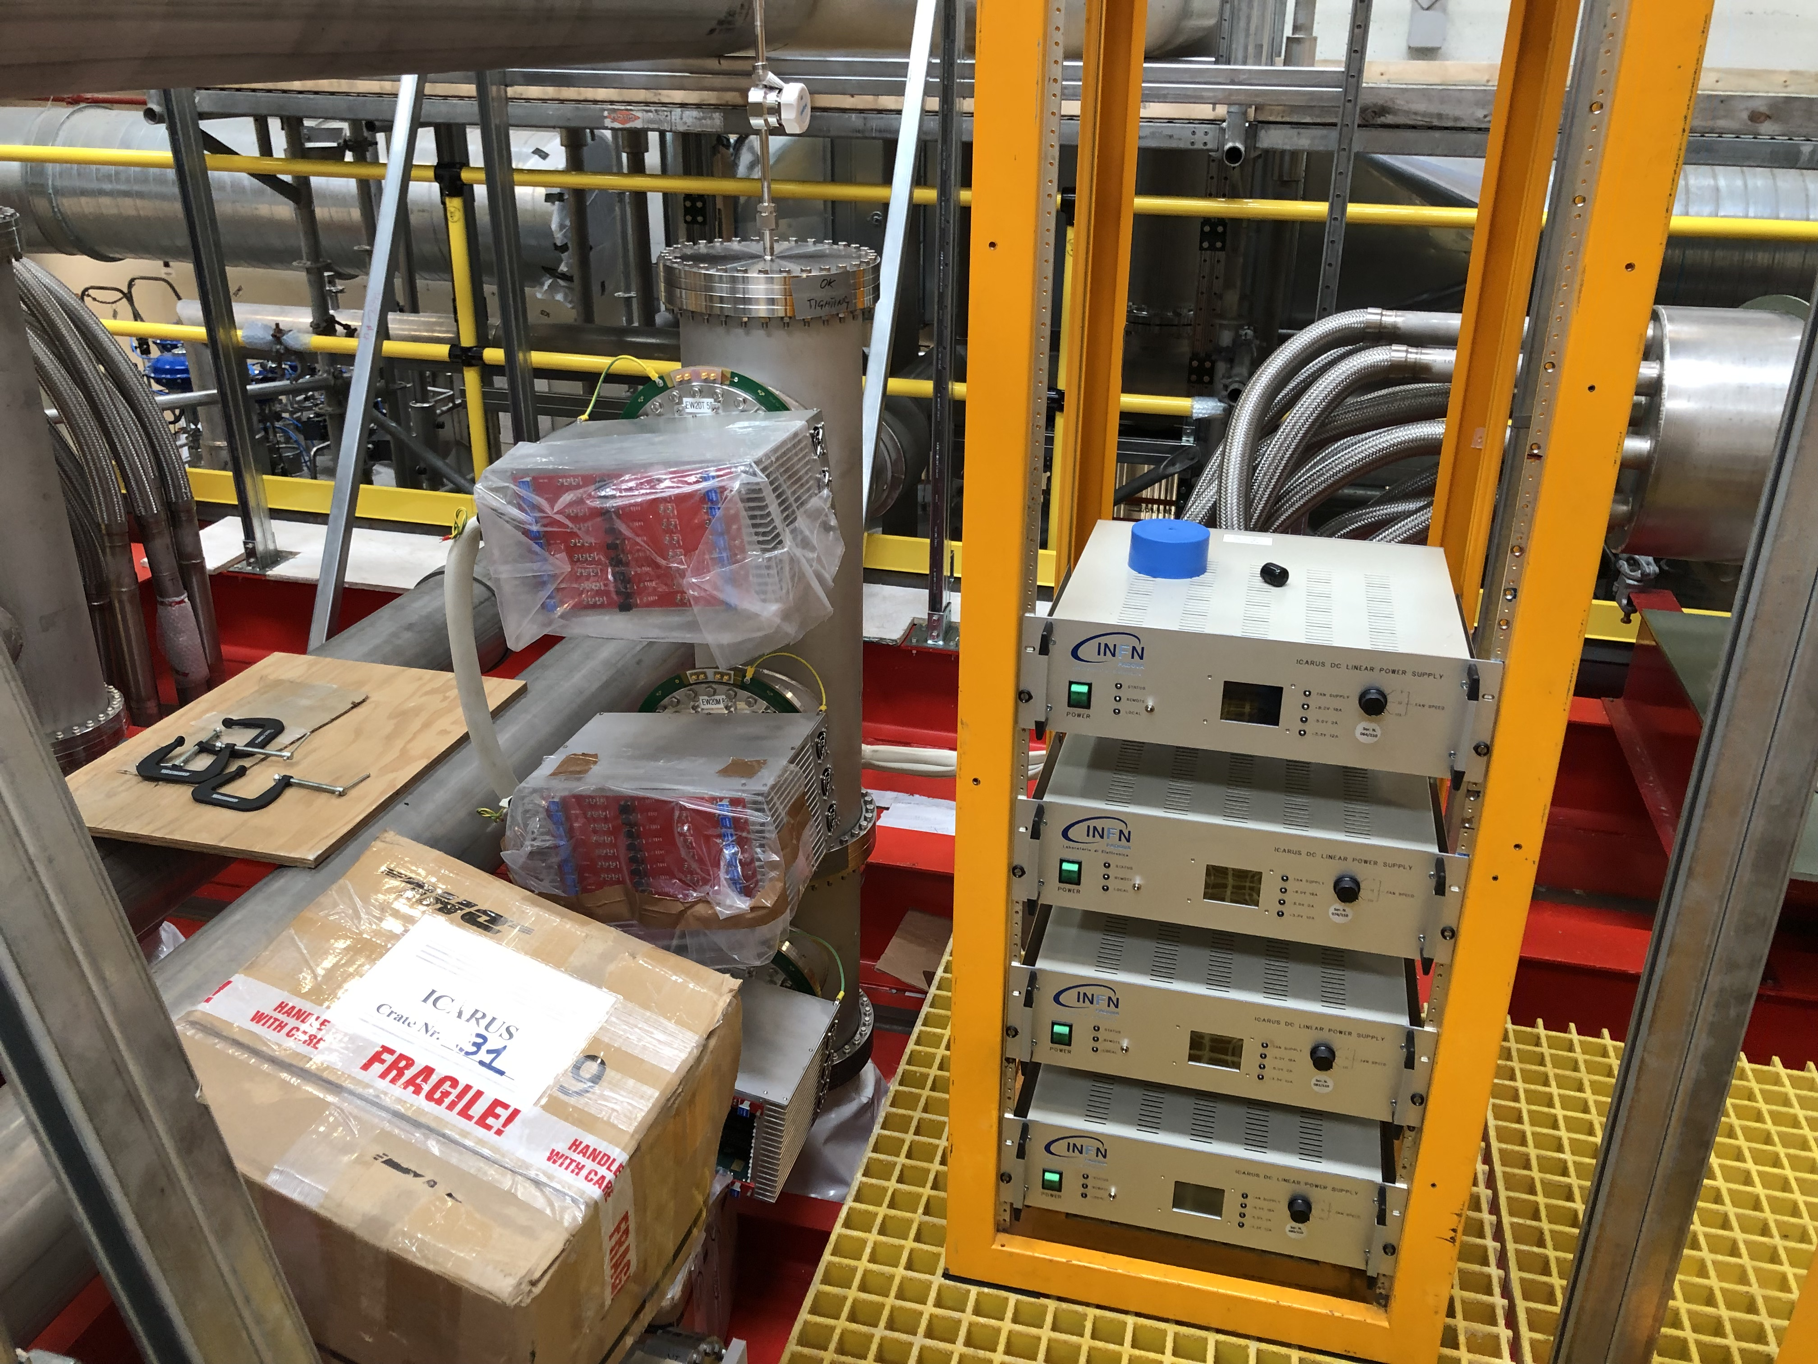
Corner Chimneys
Three minicrates: two for the horizontal wires, one for the «triangle»
Four power supplies: 3 for the corner chimney and one for the last standard cross.

Slide 11
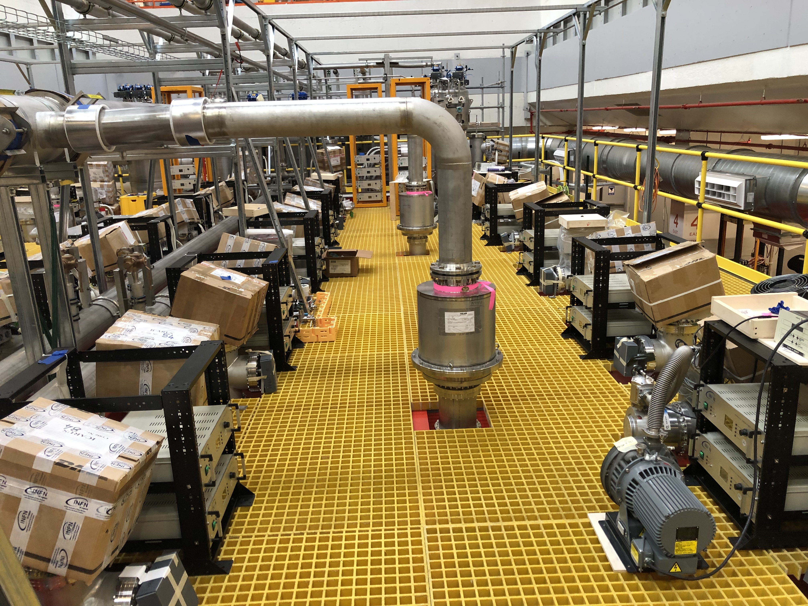
Argon venting
Venting pipe
Magnetic safety relief valve (3 per cold vessel)
Roughing + Turbo vacuum pump (3 per cold vessel)

Slide 12
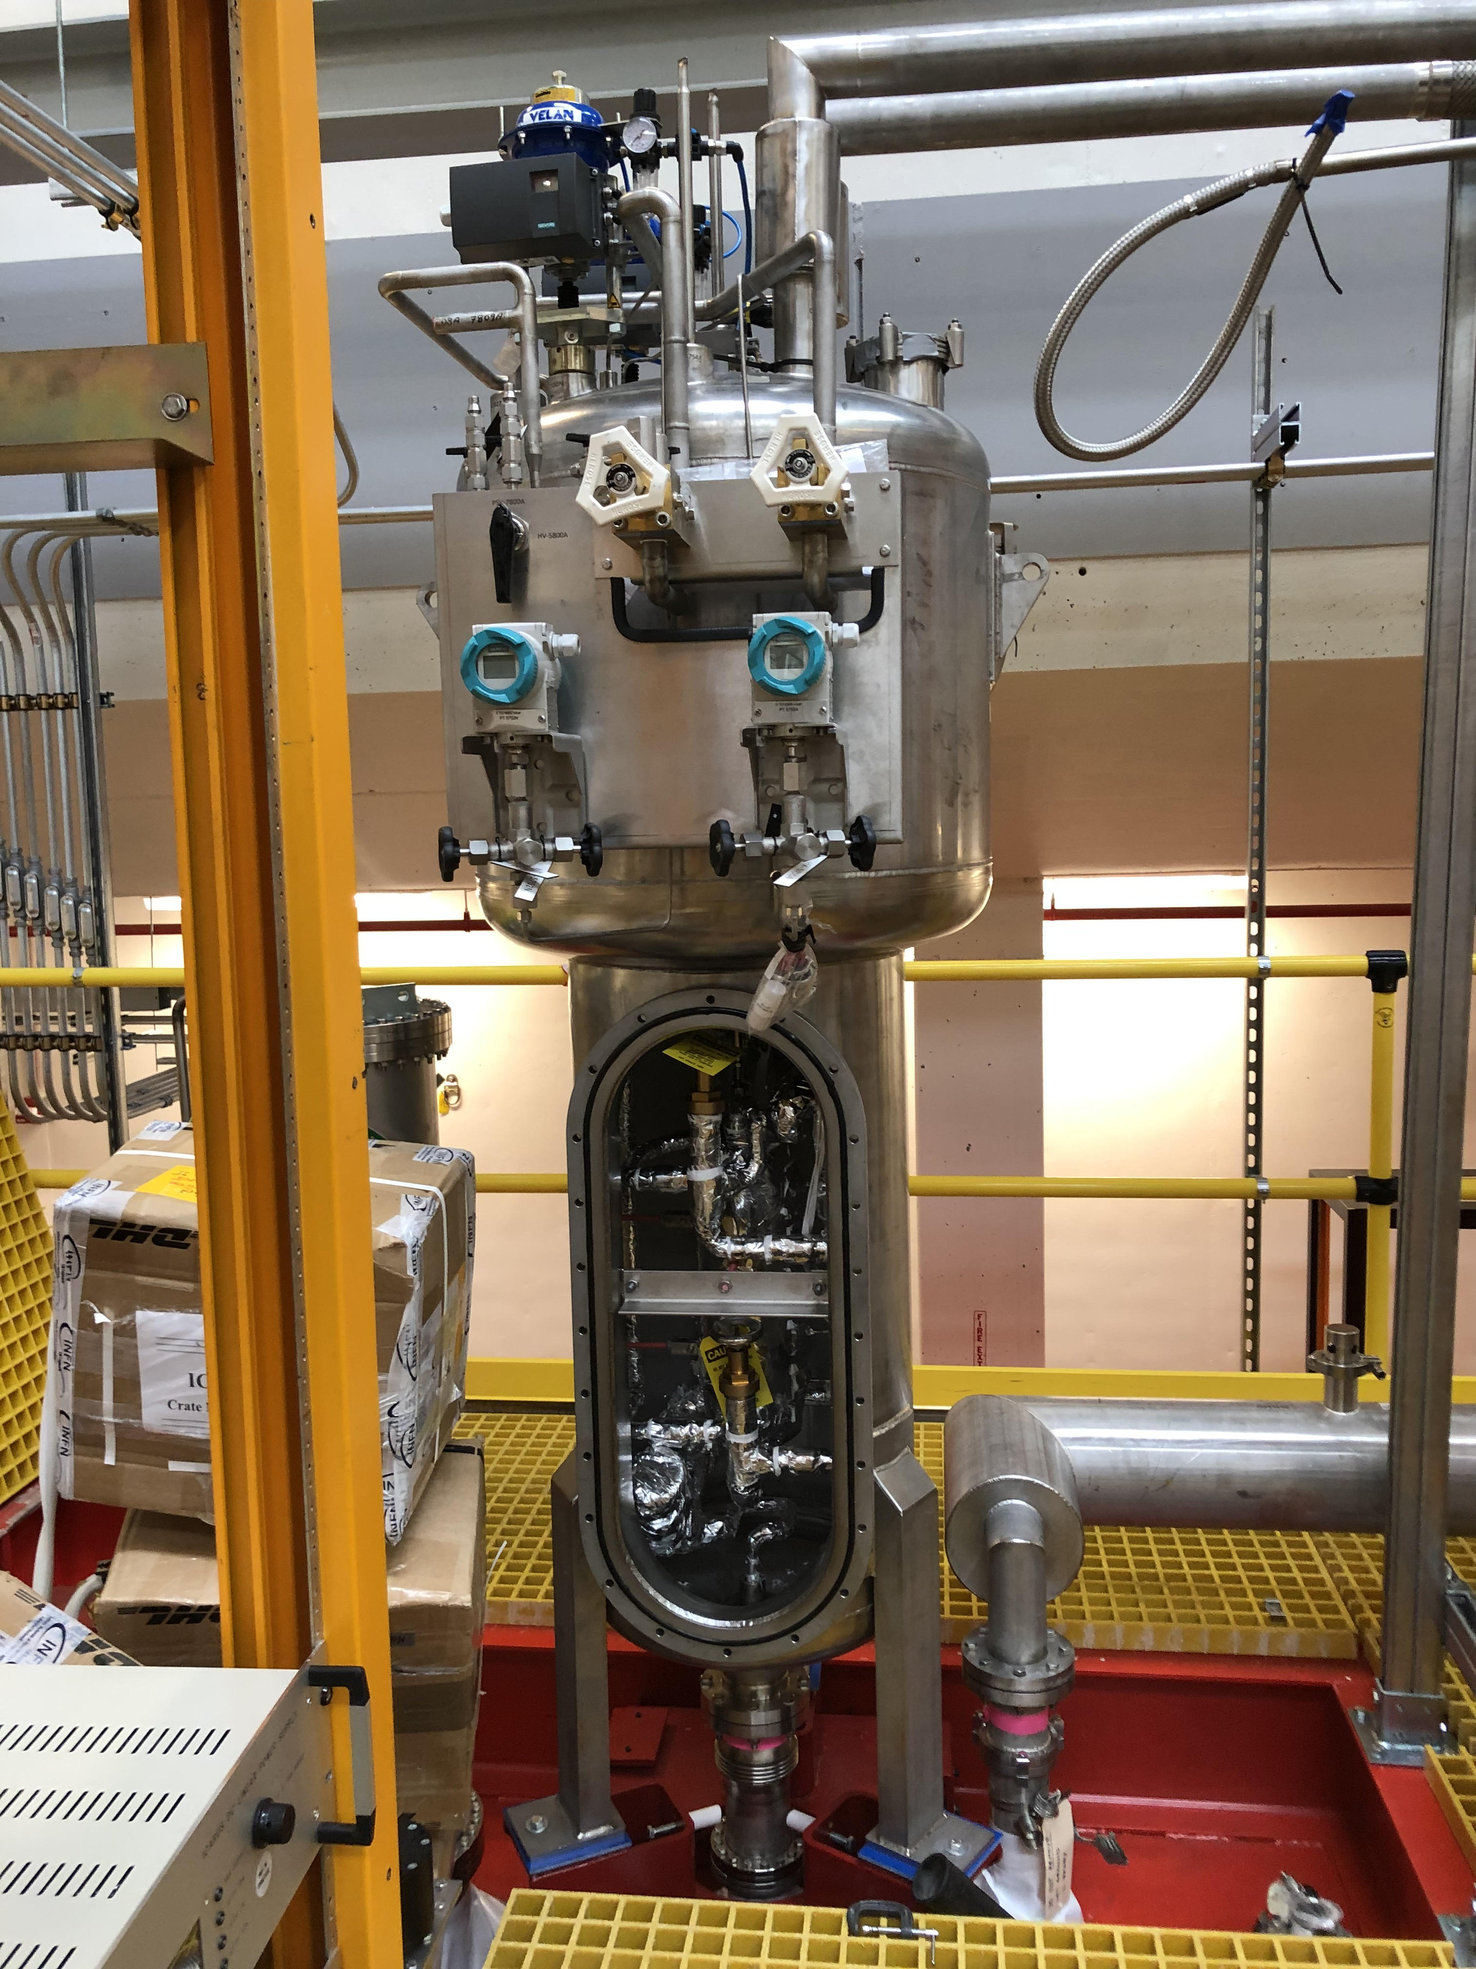
GAr recirculation unit (x4)
Argon re-condenser
Purification filter (copper only)
Output
Sliding support (to allow displacement due to thermal contraction of the cold vessel)

Slide 13
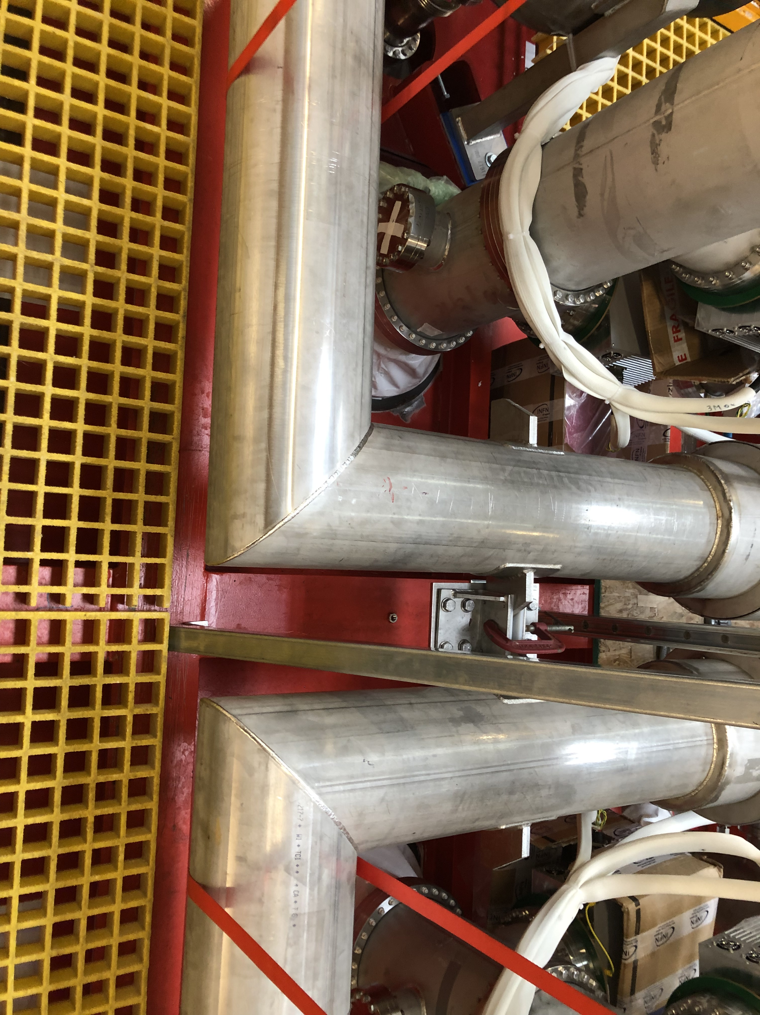
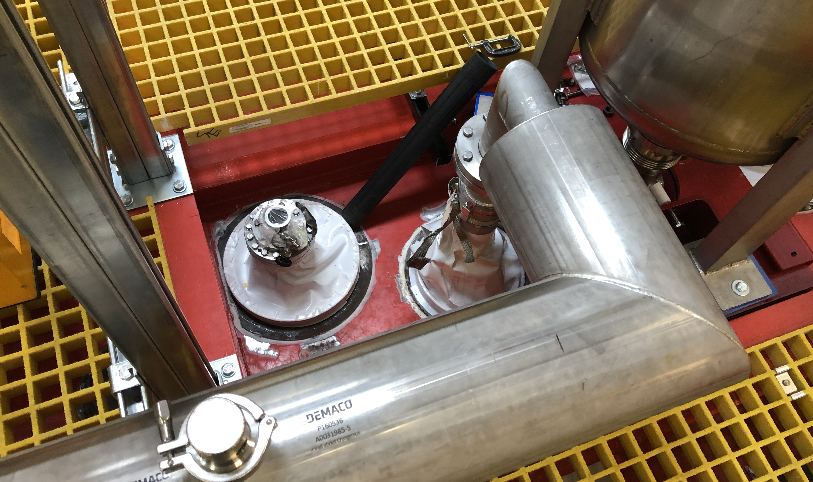
LAr input lines
Vacuum superinsulated, with LN2 cooling circuit (to avoid gas formation)
Boots
HV feedthrough

Slide 14
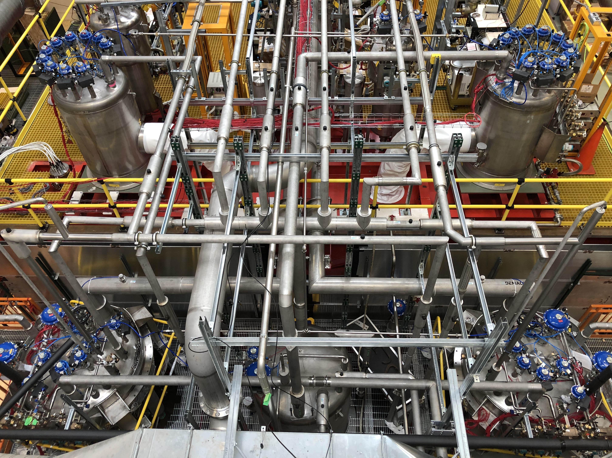
Cryogenic components
GAr recirculation units
Cold shields valve boxes
Venting pipe
LAr filters
Nitrogen phase separator

Slide 15
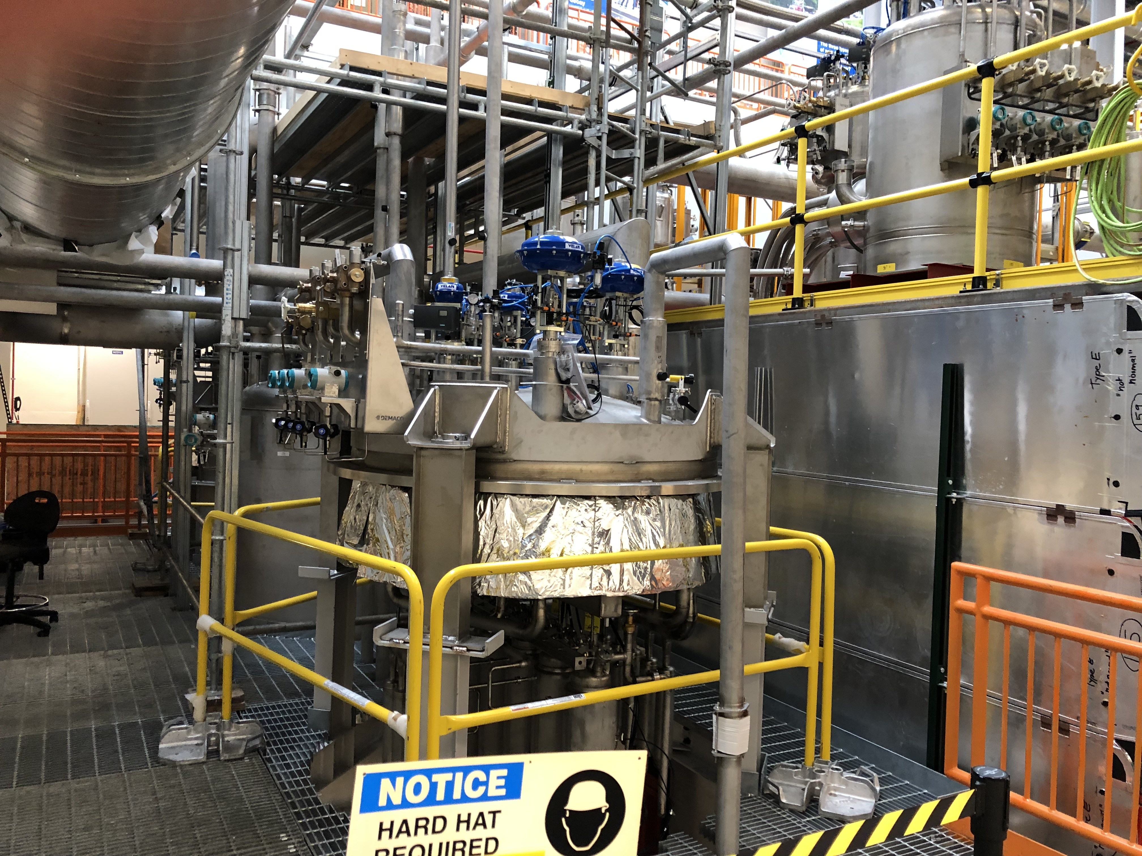
North Side – Mezzanine level
Nitrogen phase separator
Lar purification unit (x2)
Side CRT modules

Slide 16
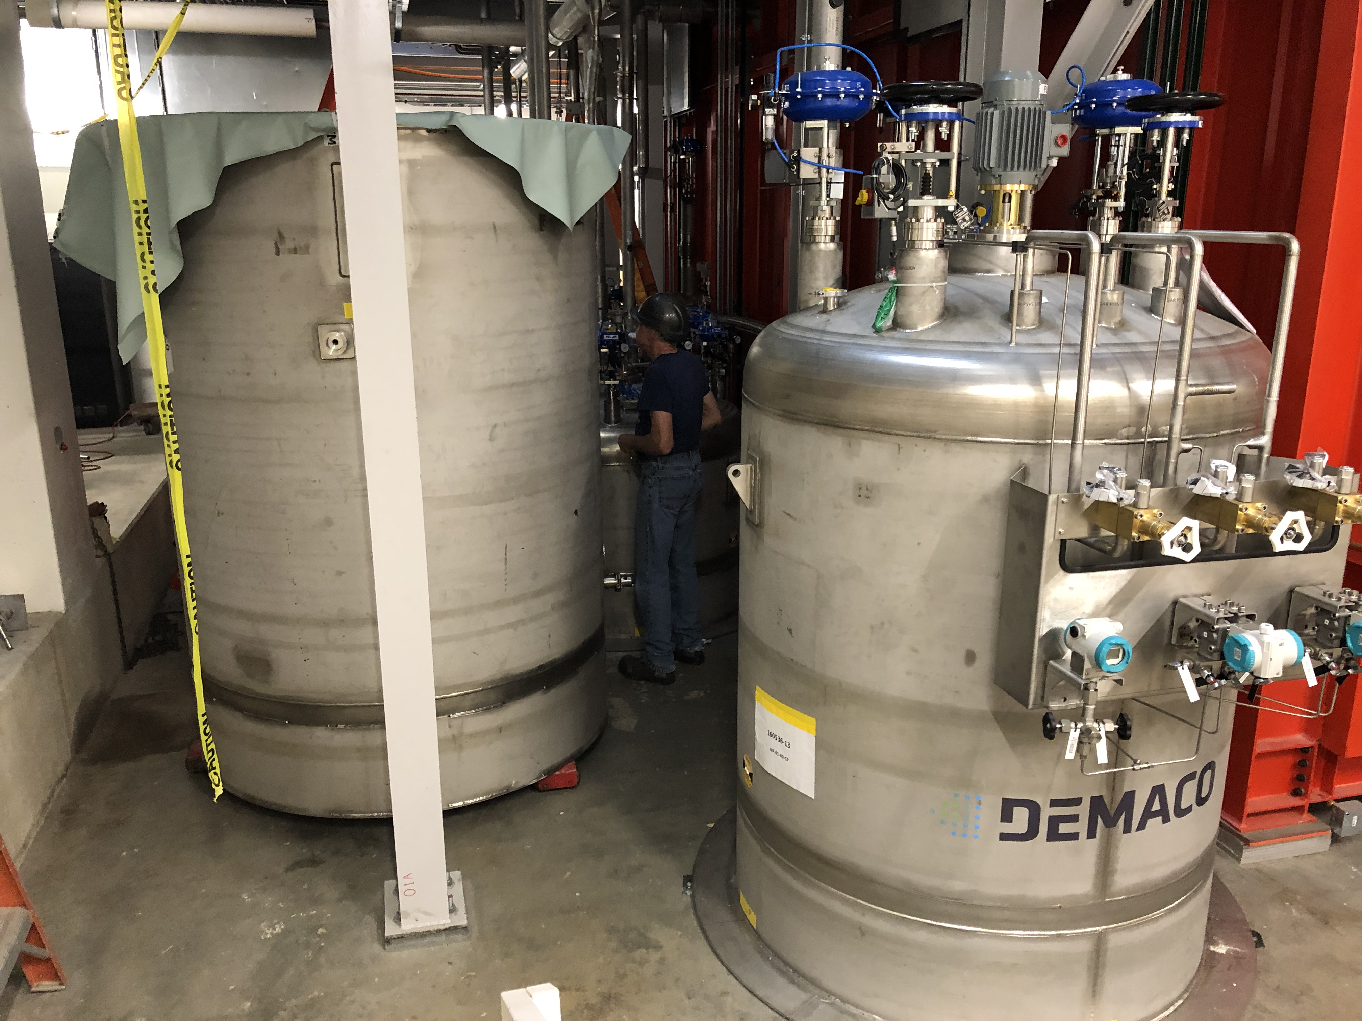
North Side – Bottom Level
LAr purifier vacuum casing (lowered)
LN2 circulation pumps (x3)
LAr recirculation pump (x2)

Slide 17
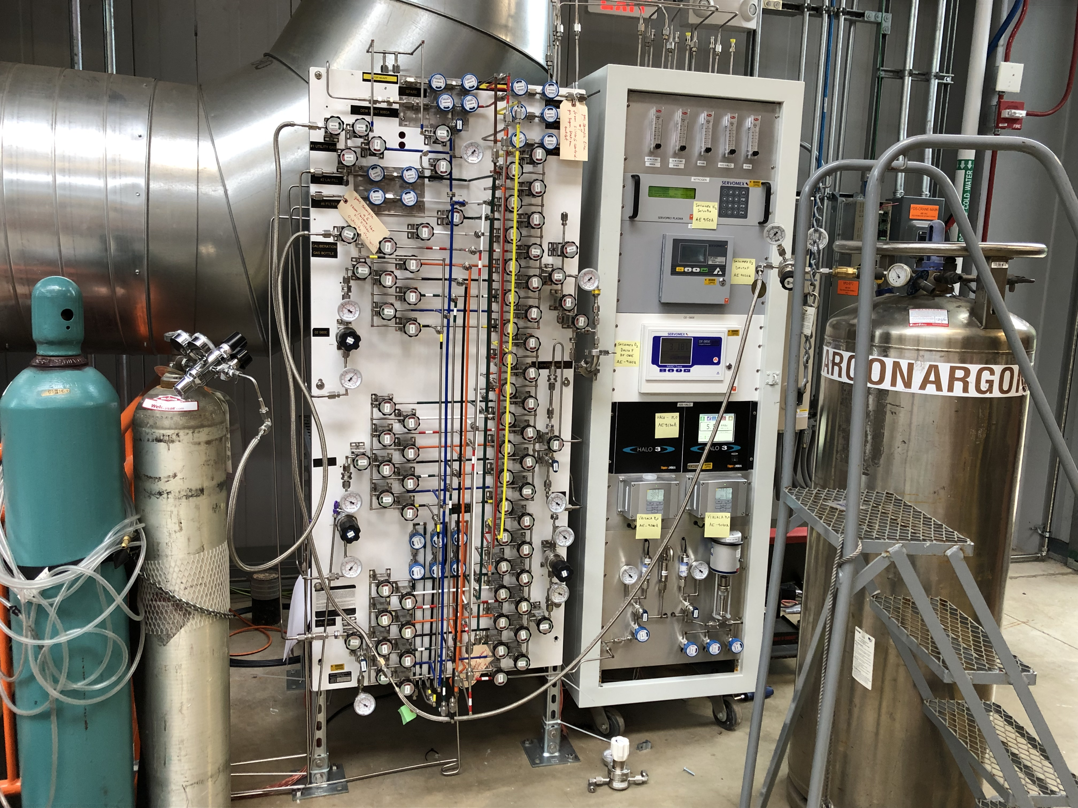
Argon analysis system
Distribution manifold
Analysers

Slide 18
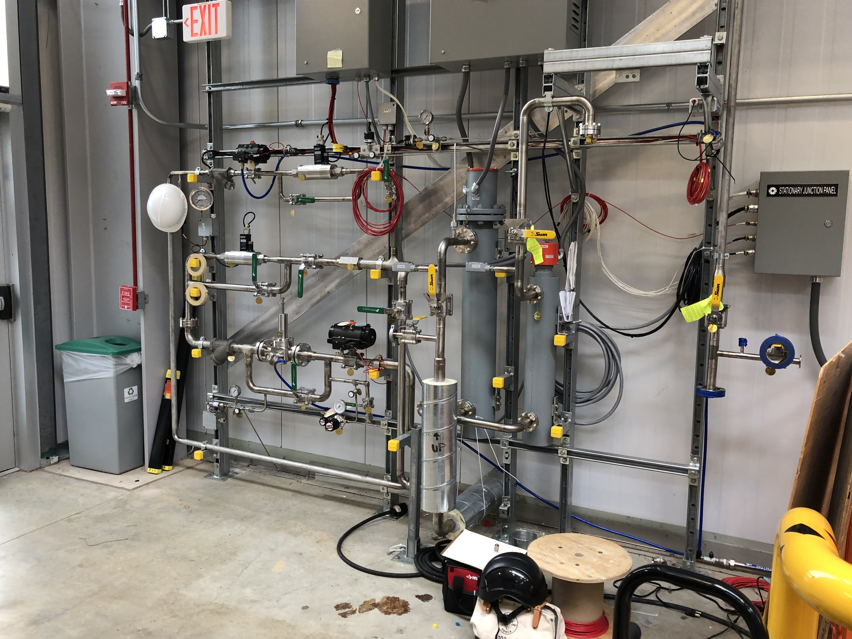
Gas distribution manifold

Slide 19
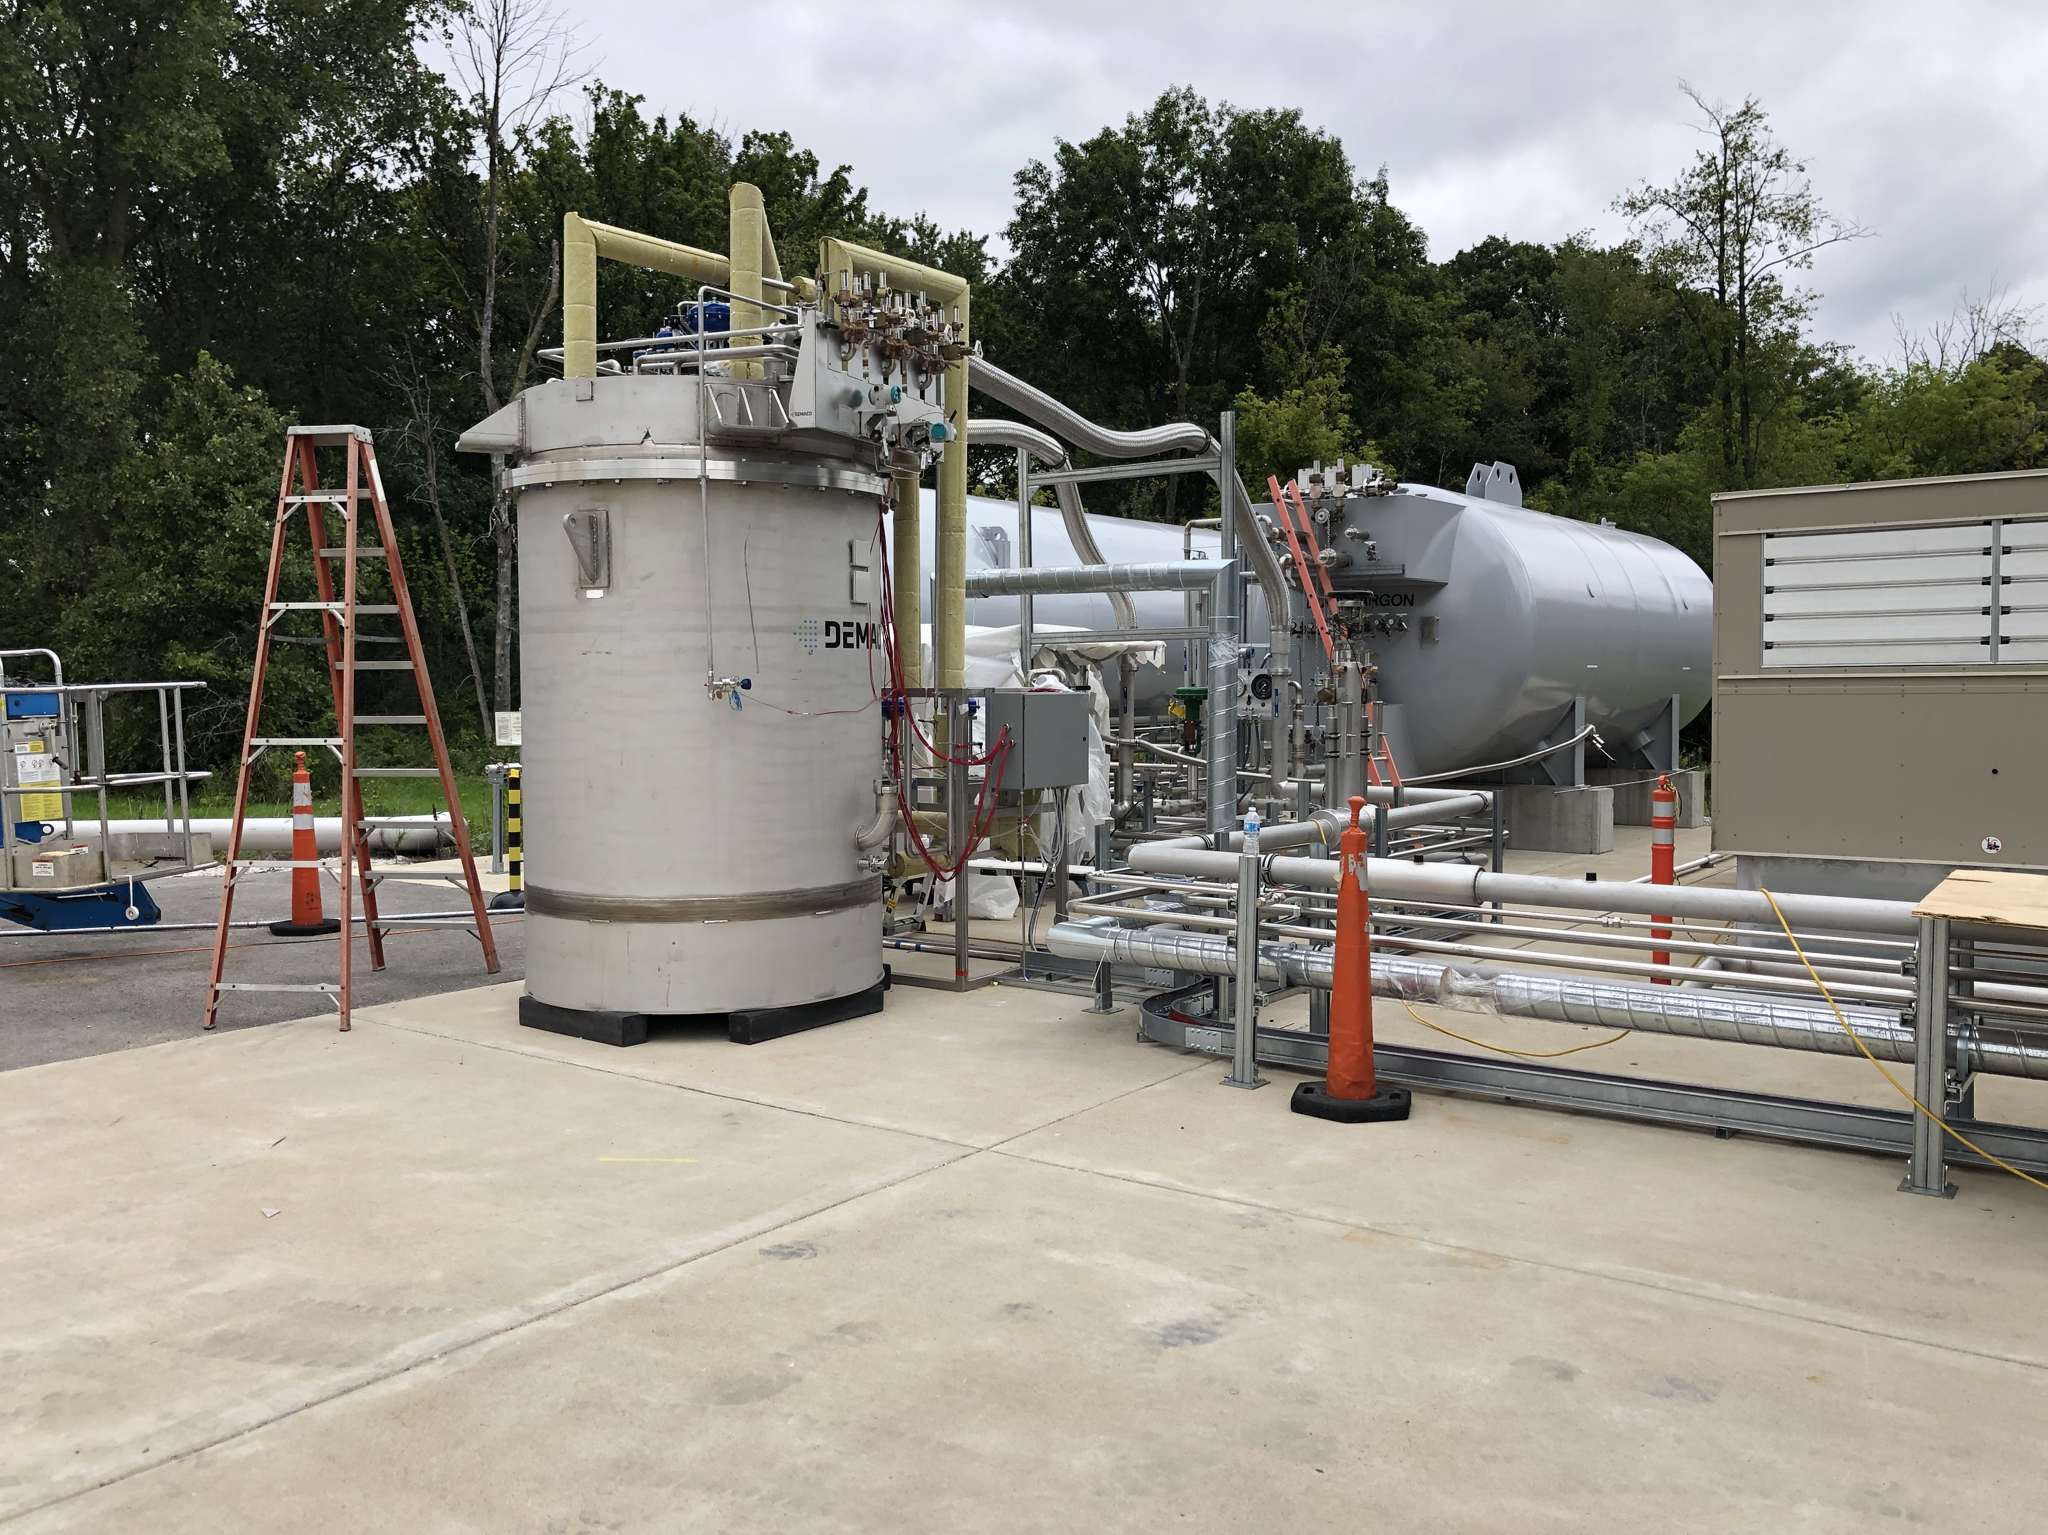
External filter for the LAr filling
Filling filter
Argon and Nitrogen transfer lines (liquid and gas)

Slide 20
Cryogenic commissioning
If we want to complete the filling of the detector before Christmas, the latest date to start the detector cooldown is the 20th of October.
About 10 days are required to complete the cooldown and to start filling with LAr.
A minimum of 6 weeks of continuous filling are required to complete the filling (end on December 15).
To anticipate by one week is highly preferable to account for a possible stop during the filling to regenerate the filling filter and for other unpredictable issues.
The start of the LAr delivery has to be notified to the supplier not less than 3 weeks in advance (October 7).
This requires a sign off of the Laboratory to start the cryogenic commissioning of the detector.

Slide 21
Pre-requisites for Cryogenic commissioning (cryo)
Cryogenic system installation completed. Still few items have to be finalized:
GAr collectors installed, leak tested and opened to the main vacuum;
GAr external lines completed;
Filling filter activated;
Complete the wiring of the cryogenic equipment (some sensors and valves) to the cryogenic controls cabinets.
Cryogenic system pre-commissioning complete:
Complete the programming and testing of the cryogenic controls;
Warm test of sensors, valves and pumps;
Purge all liquid and gas transfer lines that are not yet under vacuum;
Open the liquid filters and close the respective isolation boxes.
Oxygen Deficiency Hazard (ODH) alarms connected and tested.
Clearance for cryogenic operation received (ORC).
Delivery of LAr established.

Slide 22
Pre-requisites for Cryogenic commissioning (detector)
The detector can be operated with at least a fraction of the readout (functional to the measurement of the LAr purity):
HV for the drift completely connected: Power supply for the cathode connected and tested for continuity and bias for the wires completely wired and tested for continuity.
At least 20% of the minicrates on both modules connected and ready for DAQ (networking ready).
The PMTs corresponding to the active minicrates connected and ready for DAQ (networking ready).
Slow controls for the above items operational.
At least two monitors in the control room in Wilson Hall operational to display the status of the internal sensors (temperatures and levels), of the high voltage and of the connected PMTs and minicrates.
24hr shifts organized starting from the beginning of the cooldown (October 20).

Slide 23
Re-arranging the cables on the East Module
There is a request to open two of the corner chimneys on the East module to cut, re-connectorized and re-arrange the readout cables of the horizontal wires.
This operation will require to break the vacuum and can be performed on the 23rd and 24th of September.
The vacuum will be then re-started on the 25th of September and the present vacuum level should be re-stored in some days.
Another leak check will be performed on the flanges that have been opened.
This operation requires the endorsement of the Collaboration and the agreement with Cern and Fermilab.

Slide 24
Important notice!
With the beginning of the cryogenic commissioning the detector building will become an ODH1 area (Oxygen Deficiency Hazard type 1 area).
Access to the building will be restricted to people that have taken the required ODH training and the relative medical exam.
Additional restrictions will be in place during the cryogenic commissioning so that severe limitations will be imposed to any activity inside the building.
Installation activities will be therefore suspended during the detector cooldown and filling.
According to the present schedule no installation activity can take place between October 20 and the beginning (5th) of January.

Slide 25
Detector Commissioning and CRT installation
After the completion of the cryogenic commissioning the detector will be progressively activated starting with the turning on the HV on the cathode and the wires bias.
First aim is to start the detector calibration and the monitoring of the LAr purity.
The unfinished external cabling has to be completed and the optimization of the electronic noise will be started. The aim is to have the detector completely operational by the end of January 2020.
The installation of the side CRT will take from 4 to 6 weeks (until the end of February) followed by the installation of the top CRT.
The beams summer shutdown in 2020 should start between the end of May and the beginning of June.
Run coordination should begin to operate at the beginning of 2020 in parallel with the Commissioning coordination and it should be fully instated by not later than April 2020.

Slide 26
Conclusions
The cold commissioning of the detector could start during October 2019, to be completed before Christmas provided that:
1) The cryogenic installation and pre-commissioning is successfully completed;
2) The detector installation (external cabling) has been completed to the extent that allows for detector operation for LAr purity measurements;
3) The cryogenic operation is signed off by Fermilab.
4) The Collaboration agrees on the start of operation
The first part of 2020 would be then dedicated to the detector commissioning.
Data taking with the complete CRT could start before the summer shutdown
The overburden will be added during the second half of 2020. Data taking for sterile neutrino search will follow then.

