Slide 1
Updates from the Calibration WG
Purity measurements update
Calibration of the TPC wires
Activities on PMTs
Documentation
Next Steps
C. Farnese, M. Mooney
ICARUS Collaboration Meeting September 12th 2019
Notes:
1

Slide 2
ICARUS Calibration Working Group
Selection of ν_{e} events
The ICARUS Calibration Working Group main activities are related to the preparation of the tools for the calibration of the ICARUS sub-detectors (TPC wires, PMTs, CRT)
  Calibration obtained using directly the collected events
  Focus in particular to the selection and analysis of cosmic muons and of the “standard candles” as for example the Michel electrons, π⁰, stopping muons…
Tri-weekly meetings: Tuesdays at noon (FNAL time) :
  Next meeting on Oct 1st
  Zoom connection: https://fnal.zoom.us/j/3288157593
  On average 6-7 participants
  Strong connections with the other Working Groups (TPC/PMT/CRT/DAQ/Reconstruction)
  Mailing list: ICARUS-CALIBRATION@fnal.gov

Slide 3
Purity measurement in ICARUS
Selection of ν_{e} events
The measurement of the free electron lifetime τ_{ele} is a fundamental feature that should be ready for the commissioning of the detector
  for the monitoring of the Liquid Argon condition in the TPCs
  for a precise measurement of the deposited energy in the events
Starting from the automatic procedure used during the Gran Sasso run, two complementary tools have been implemented:
  A fast method, that provides the required monitoring in real time of the LAr condition
    no sophisticated reconstructions, small number of events, few seconds for the full analysis of each event
  An offline and more precise measurement for the final calibration of the detector
    Full event reconstruction and larger number of events required
Both methods should be ready before the LAr filling, in order to be used as soon as the detector is completely filled

Slide 4
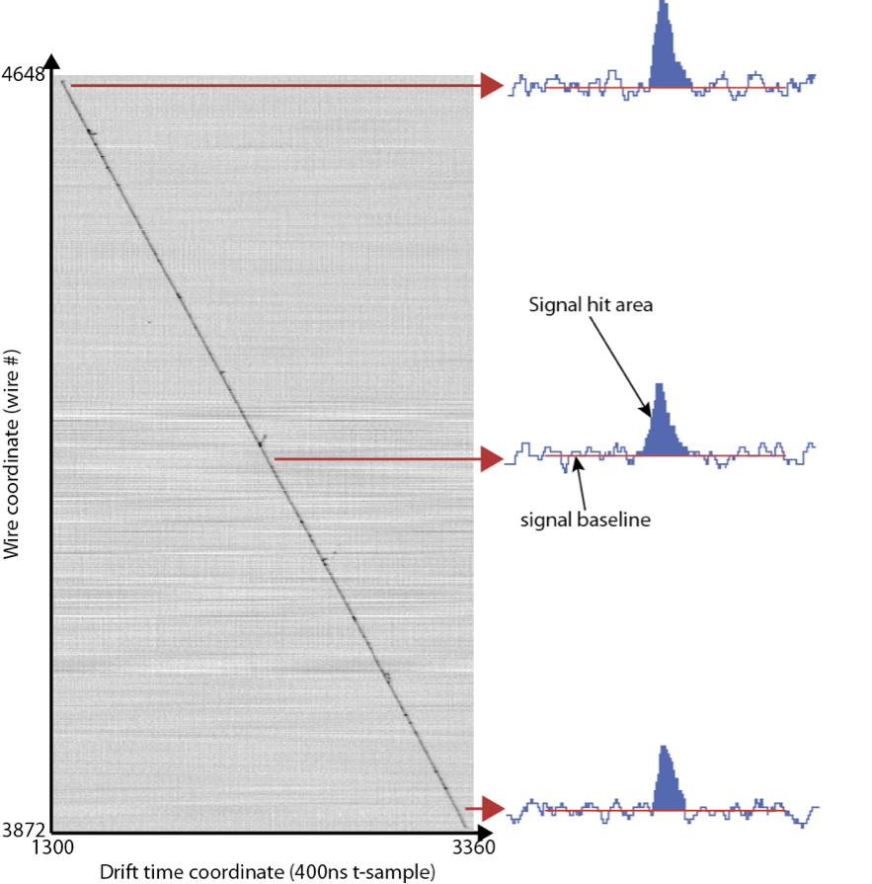
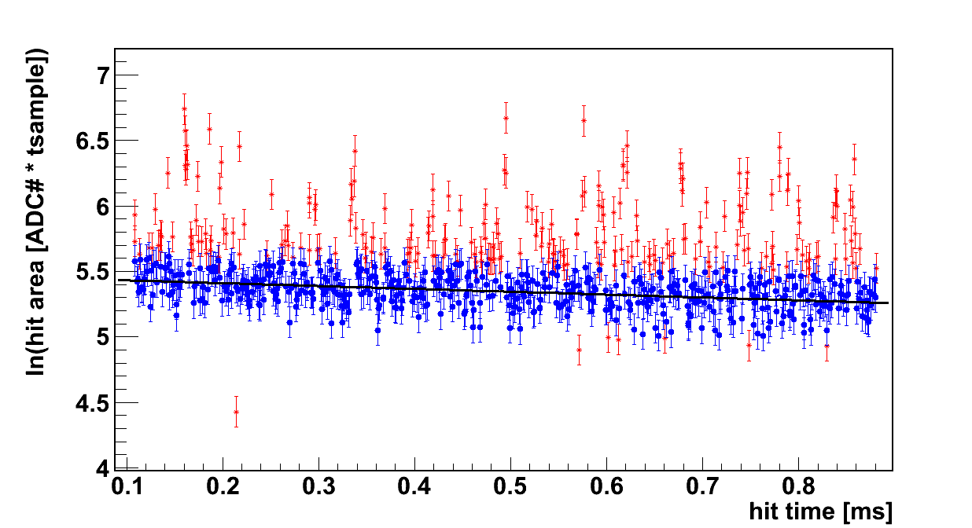
Purity measurement in the T600: methods description
Selection of ν_{e} events
The prepared tools are based on the same steps:
  Automatic selection of through-going cosmic-ray muons with reduced e.m. activity (only Collection used, no 3D reco).
  Rejection of residual δ-rays along the track
  Survived hits Removed hits
  Reduction of the fluctuations along the track due to the asymmetric Landau tail of the dE/dx
  Study of the charge attenuation along each selected tracks
  Final value λ = 1/τ obtained averaging over the identified tracks in a defined number of events;

Slide 5
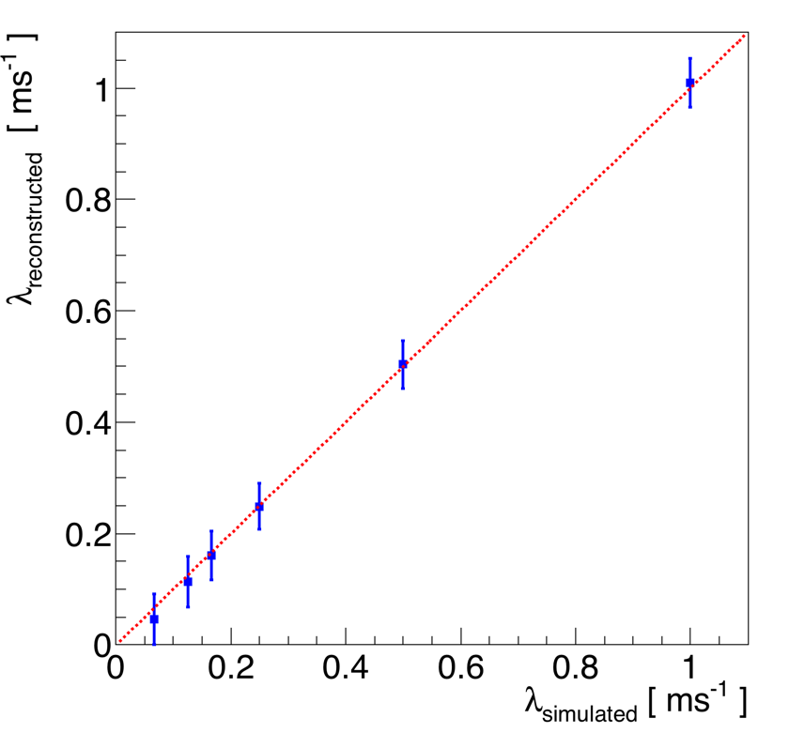
Purity measurement at FNAL: results from the online method
Selection of ν_{e} events
The method is applied on 40 collected events;
  The method has been improved, obtaining a reduction of the bias previously observed for low purity level (still present an overestimation above 6 ms)
  The method is adequate for the required monitoring, providing information on when the purity is too low for the physics run;
  This analysis is performed using “full” events (all collection channels): since tracks are uniformly distributed, if a reduced number of mini-crates are collected, the same precision can be obtained increasing the statistics (for example for 20% mini-crates collected ~200 events are required)
2 ms
1 ms
8 ms
4 ms
6 ms
15 ms
  These measurements can be uploaded on database and displayed in the online monitoring

Slide 6
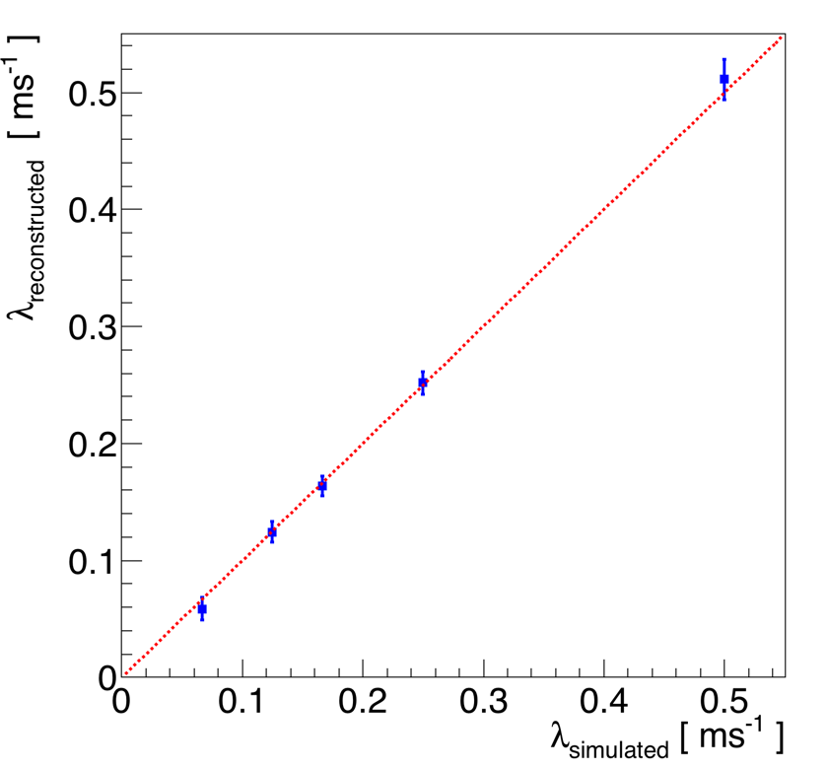
Purity measurement at FNAL: results from the offline method
Selection of ν_{e} events
  The method is applied directly on the reconstructed events (hits/clusters/tracks recognized using the standard reco tools) and based on 200 events;
  The online measurements are used as starting point for this analysis
  Some residual bias still present, introducing
  An underestimation of λ = 1/τ for τ > 8ms introducing a maximum 0.8% underestimation of the deposited energy at high purity level;
  An overestimation of λ = 1/τ for τ < 4ms, introducing a maximum 1.1% overestimation of the deposited energy for low purity level;
2 ms
4 ms
6 ms
8 ms
15 ms

Slide 7
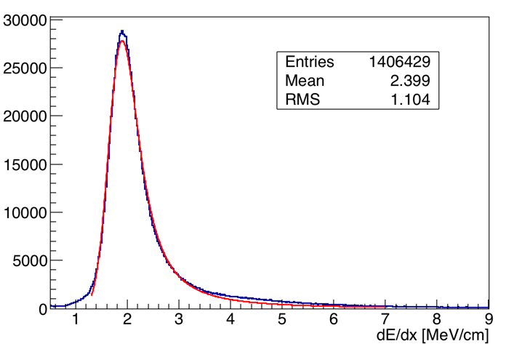
Ongoing Activities - calibration of TPC wires
Selection of ν_{e} events
The evaluation of the calibration constants for the TPC wire channels is required to obtain the deposited energy measurement and to guarantee the equalization of the channel responses;
These calibration constants can be obtained studying the dE/dx along cosmic μ tracks selected on a very large number of cosmic events:
  The muons used for the purity measurement can be a starting point
  First preliminary test performed on 5200 MC cosmic events: on average
    1-2 selected μ tracks per event
    each Collection wire crossed by a selected ~ 250 tracks;
  Accumulating the dE/dx signals in each channel, we can extract the MP value and from this the required calibration constant;
dE/dx MP value: 1,83 MeV/cm
  This analysis requires the knowledge of the t0 time of each used track

Slide 8
Ongoing Activities – PMT studies - 1
Selection of ν_{e} events
A campaign of measurements of the PMTs gain and dark count rates has been recently performed at room temperature
  All the details are summarized in the tech note in docdb https://sbn-docdb.fnal.gov/cgi-bin/private/ShowDocument?docid=14169
  A Summary of the results obtained in these measurements is available at https://www.phy.bnl.gov/icarus/test/database/
The measurements have been performed using the LED and using a Tek scope with high data recording speed and very small noise level
  about half of the PMTs (mainly in west cryostat) tested at room temperature in air with a large input light intensity: mean number of photoelectrons (p.e.) measured by PMTs ~ 10;
  the other PMTs have been tested under vacuum at 2x10⁻⁴ mbar with a low input light intensity, to measure the single p.e. spectrum;
Similar studies will be performed also after the cool down of the detector, in order to compare the results in the warm and cold condition, and with the CAEN digitizers, to take into account of the possible different noise level with respect to the Tek scope

Slide 9
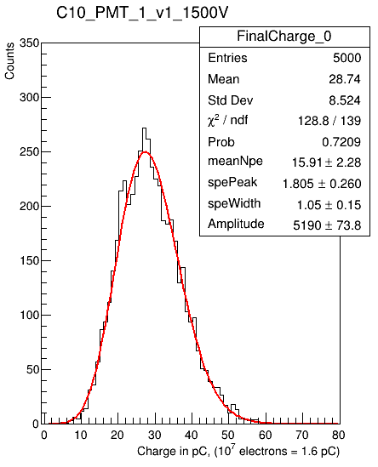
Ongoing Activities – PMT studies - 2
Selection of ν_{e} events
PMT gain measured by fitting the charge distribution of the LED pulses
Charge distribution for a PMT at 1500 V
PMT voltage to have a 10⁷ gain
Gain vs Voltage for a PMT

Slide 10
Ongoing Activities – PMT studies - 3
Selection of ν_{e} events
Dark count rate also measured using random trigger with LED off: an average rate ~1.6 kHz measured, consistent with the previous measurement; it results on average higher in the east module (under investigation)
A dedicated study has been performed to evaluate the possible presence of afterpulses: two broad bumps observed in the time distribution at ~1.8 μs and at ~6.5 μs, with an average probability of ~7%
afterpulses

Slide 11
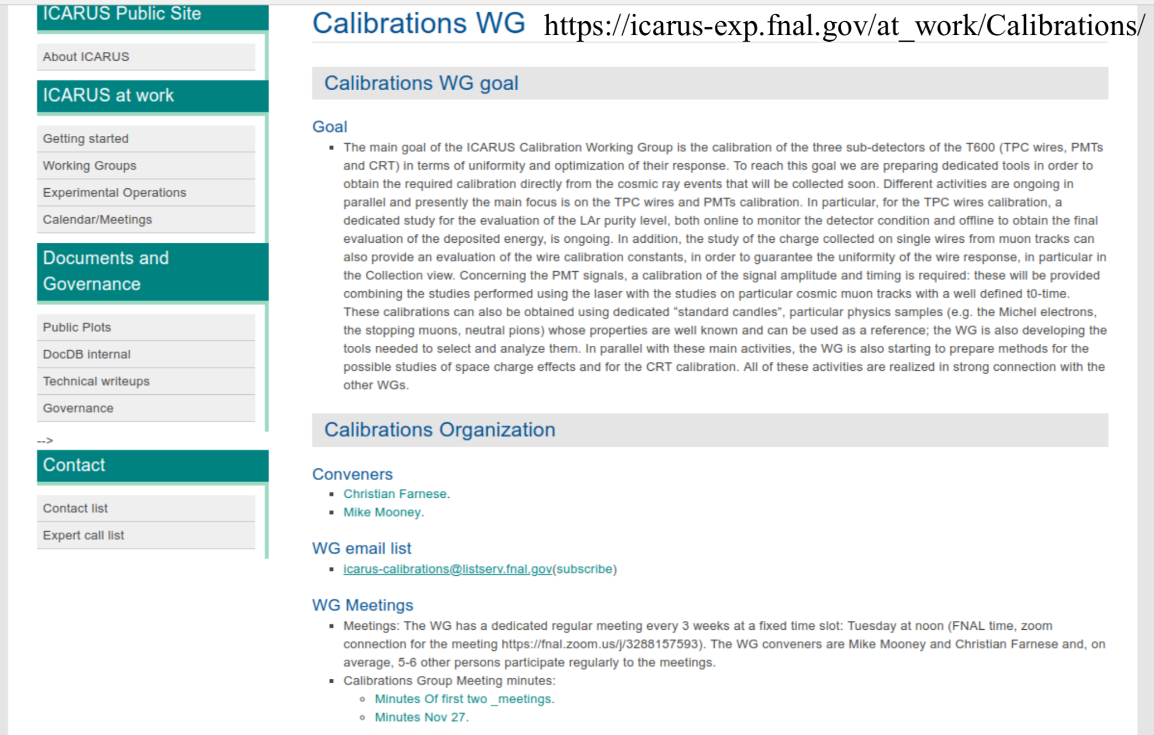
Documentation under preparation
Selection of ν_{e} events
  The documentation related to the activities the working group is doing and needed during the commissioning and data taking will be collected on a dedicated internal web page that is under preparation

Slide 12
Summary and next steps - 1
Selection of ν_{e} events
The ICARUS Calibration WG is working in close connection with the other Working Groups (TPC/PMT/CRT/Documentation/Online monitoring…)
The main goal is the calibration of the ICARUS sub-detectors (TPC wires, PMTs, CRT) based on the collected events
The method for the continuous measurement of the LAr purity, needed before the filling of the detector, is essentially ready to be applied to the collected events
  Additional final tuning/studies can be performed before the commissioning, for example a study of the purity measurement precision with different noise conditions
The selection/analysis tools for the collected cosmic muons to be used for the equalization/calibration of the TPC wire channels are under preparation;
Studies for the PMT calibration are also ongoing

Slide 13
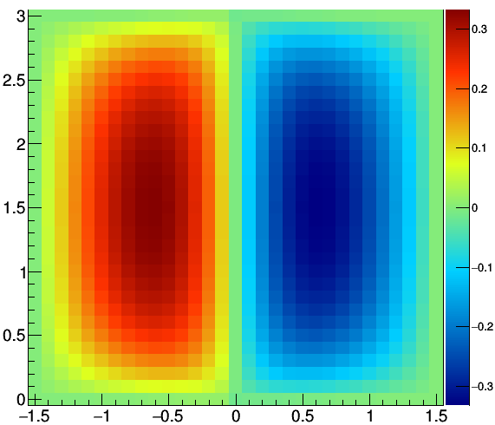
Summary and next steps - 2
Selection of ν_{e} events
The WG is also introducing in the simulation the expected space charge effect (SCE), evaluated starting from the information collected during the previous ICARUS data taking and using a model that provide SCE effect maps: this will allow to evaluate the impact of this effect on the calibration analysis
anode
cathode
Xreco-Xtrue [cm] at Z=9 m
anode
vertical coordinate [m]
drift coordinate [m]
The WG is also developing tools for the selection of stopping muons, Michel electron and t0-tagged through-going muons for calibration purposes. This includes Michel electron reconstruction using machine learning techniques.

